Slide 1

Grade 6
LESSON 1
© FEMM

Slide 2
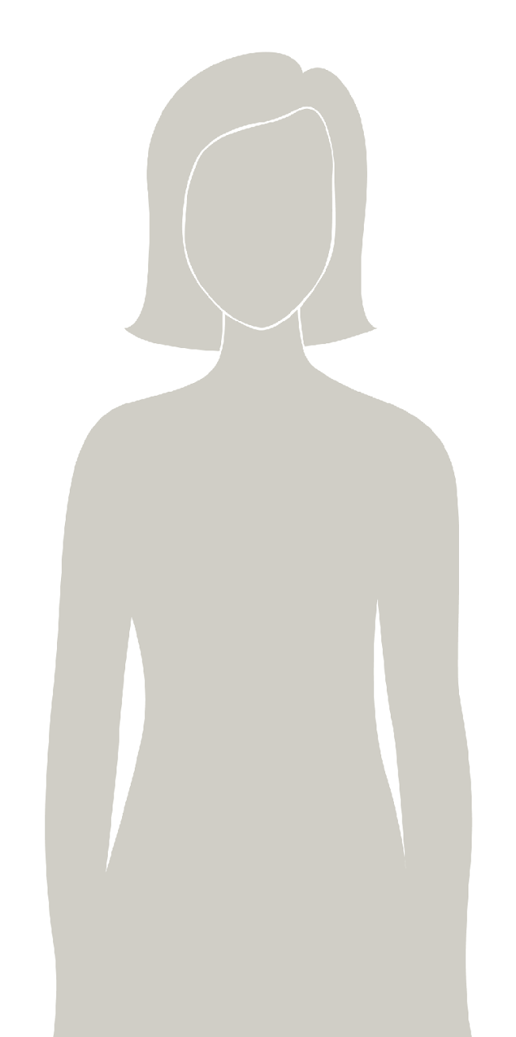
Introducing
a health program
that will help you understand your body & track your health
as you grow to full maturity.
You will learn about hormones, your reproductive system, physical and emotional changes in puberty, and
how daily lifestyle choices affect you!
© FEMM
Notes:
teenFEMM is a health program that will help you understand your body and track your health as you grow to full maturity. You will learn about the reproductive system, the physical and emotional changes of puberty, and how daily lifestyle choices affect health.
You will have 8 teenFEMM classes per year. teenFEMM classes will continue every year through grade 12. By then you will be a health expert!

Slide 3

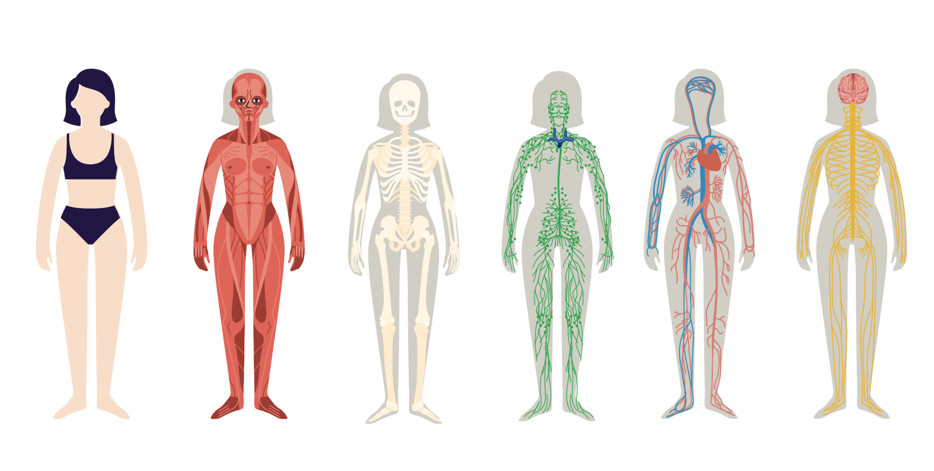
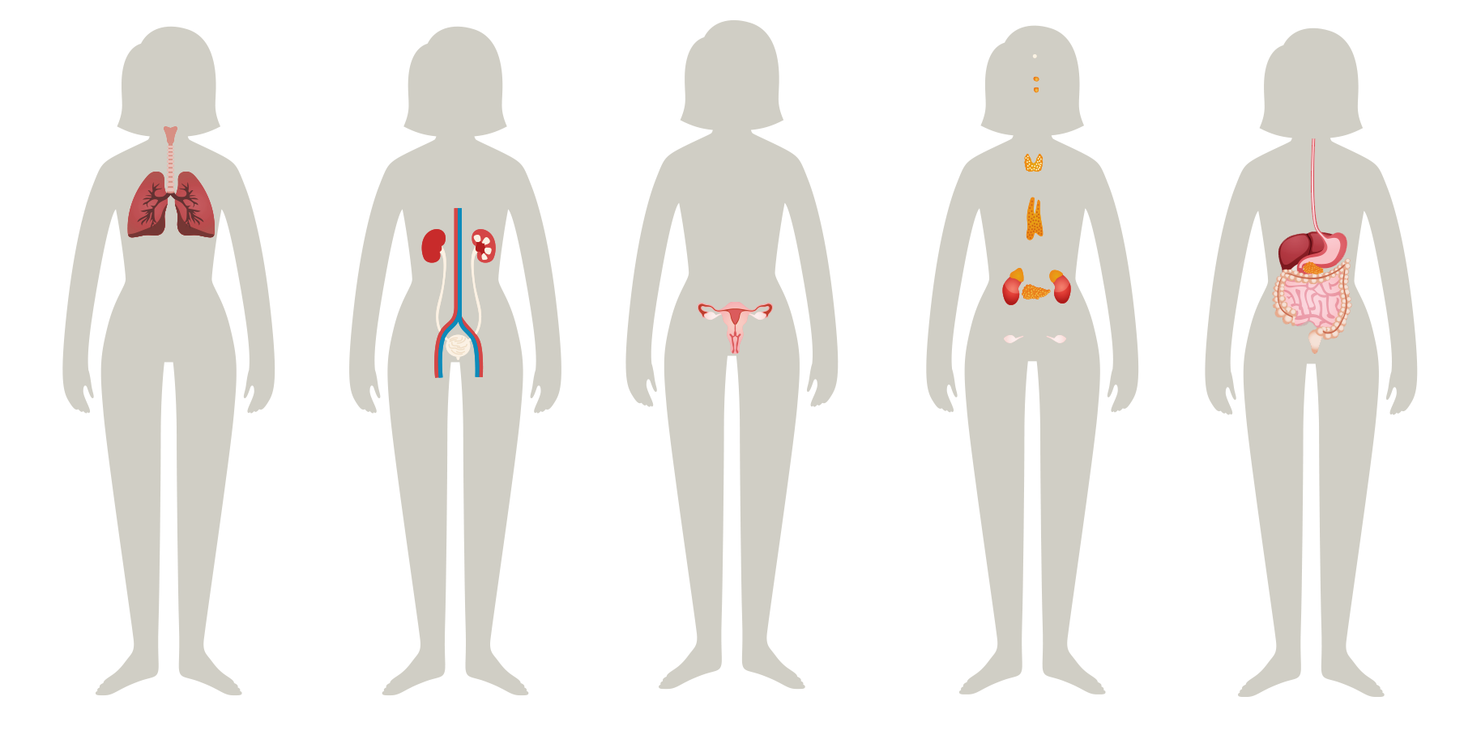
Healthy body
The body is made up of systems.
Every system impacts the health of every other system.
© FEMM
Notes:
Your body is made up of many parts. Each part has a particular and important job to do.
When certain parts work together for a similar purpose, they are called a system. Your body has several systems, all working together to make sure you function well. Can anyone name a system in the body? What about the skeletal and muscular systems?

Slide 4
Muscles and bones!
There are about 600 muscles in the human body!
But without me, you couldn’t stand it!
© FEMM
Notes:
Without these two systems, we literally wouldn’t be able to stand or sit down!
Can you guess the jobs of the skeletal system and the muscular system, which work together to form the musculoskeletal system?
Bones support (so we can stand, sit) and protect (ribs protect lungs and heart).
Muscles move the body.
Let’s look at a few other systems in the body and what they do to keep our bodies healthy and functioning well!

Slide 5
The respiratory system
TO-DO list:
- Pull air into lungs
- Bring oxygen into the body
- Send carbon dioxide out
-Repeat 22,000 times/day
😮‍💨
© FEMM
Notes:
The respiratory system, through the lungs, breathes air and oxygen needed for life.

Slide 6
The nervous system
Of course I’m nervous! Have you SEEN my To-Do list?
TO-DO list:
-heartbeat, breath, etc.
-carry signals between brain and 7 TRILLION nerves
-control reflexes
- taste, hear, see, smell, touch
© FEMM
Notes:
The nervous system sends quick impulses between the brain and body.
(The fire is hot; your muscles yank your hand from the flame.)

Slide 7
The digestive system
TO-DO List:
- The wave!*
-Break down food into nutrients
-Move food to small and then large intestine…
*Muscles in your esophagus act like a giant wave to move food+ drink down into your stomach.
© FEMM
Notes:
The digestive system breaks down the food you eat to make fuel for your body, which is absorbed as nutrients, then eliminates the waste it cannot use.
Did you know: emotions (including stress) affect how your body digests food? Sitting down to eat (not eating on the go) tells your brain and gut: “we’ve got time” and this relaxes the body, resulting in better digestion.

Slide 8
The circulatory system
TO-DO list:
- pump 100 gallons of blood /hour -gather food nutrients in small intestine and deliver them to every cell in the body!
You’re a work of ARTeries!
If all of your arteries, capillaries and veins
were lined up, end to end,
they would extend
60,000 miles long!
That’s enough to circle
the earth 2.5 times!
© FEMM
Notes:
This system pumps blood from the heart through the blood vessels, carrying oxygen from the lungs and nutrients from the food in the small intestine, to every cell of the body. You can think of the word circulate, which means to move around, as that’s what our blood is doing, to help you remember the function of this system.

Slide 9
The reproductive system
TO-DO list:
- send signals to brain
- grow cell (egg) in ovary
-produce hormone estrogen
-ovulate egg in to fallopian tube
-produce hormone progesterone
-thicken uterus lining
-shed uterus lining (period.)
© FEMM
Notes:
The reproductive system is responsible for bringing about a new life. In girls, it includes the ovaries, fallopian tubes, the uterus, and vagina.
In boys it includes the testes, scrotum, penis, and all the tubes through which sperm travels. The reproductive system also produces hormones, which are controlled by your brain. Hormones do amazing things throughout the body and are necessary for your health.

Slide 10
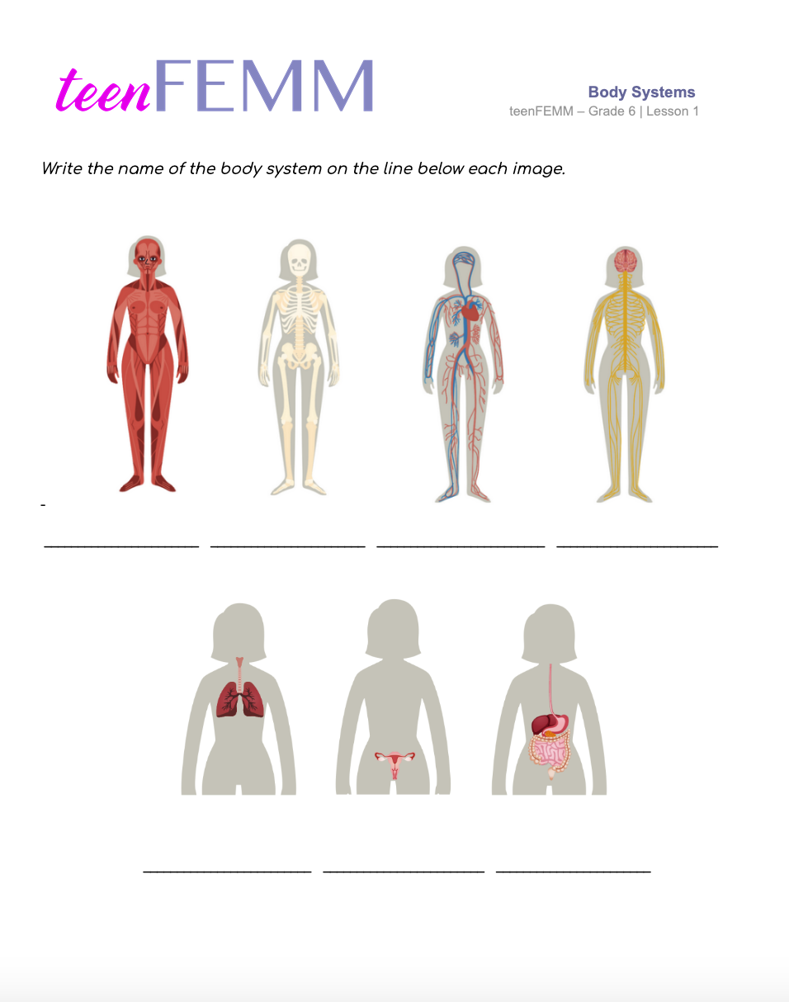
Worksheet | Body Systems
What’s my name?
Notes:
All of your body systems are working together, full-time, to keep you healthy. Each system in the body must function properly for the whole body to be healthy. For example, if the lungs are congested, or the stomach is upset, the body will not feel well.
Hand out the Body Systems Worksheet to each student. Give students a couple of minutes to fill in their worksheet. When finished, review the answers as a class, using the following slide.

Slide 11
Answers | Body Systems
Muscular
Skeletal
Circulatory
Nervous
Respiratory
Reproductive
Digestive
Notes:
Did you remember these systems?

Slide 12

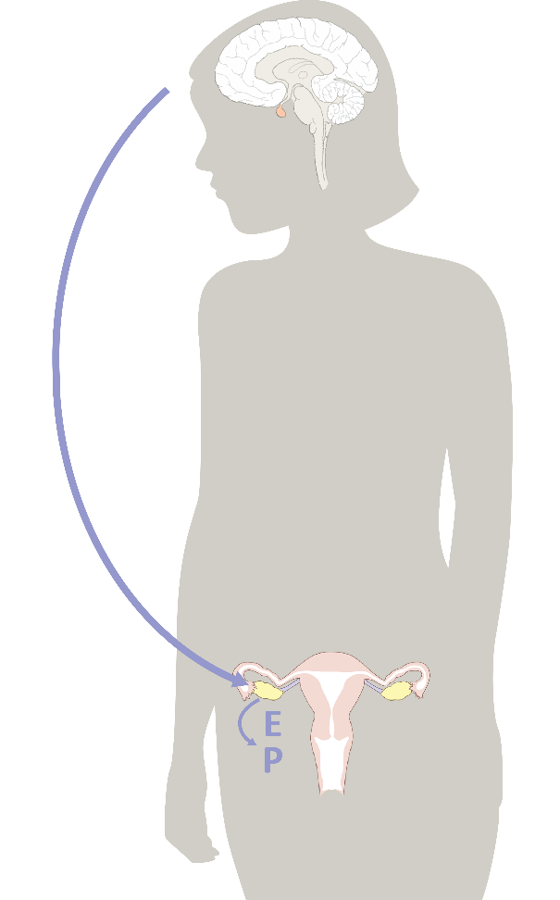
Hormones & You
1.
Hormones direct the activity of every system in the body!
© FEMM
Notes:
Hormones direct the activity of every system of the body!

Slide 13
Hormones & You
Brain
2.
Hey
Hormones are chemical signals or messengers that travel in the bloodstream.
You can think of them like text messages, sent between the brain and the different parts of the body.
Reproductive System
Yea?
© FEMM
Notes:
Hormones are chemical messengers that travel in the bloodstream, directing the activity of every system in the body. You can picture them like text messages, sent from the brain to the different parts of the body.

Slide 14
Hormones & You
3.
Puberty is kickstarted in the brain.
The brain sends hormonal signals throughout the body, when it’s time for a girl’s physical and reproductive characteristics to mature.
This is typically between the ages of 9-14.
© FEMM
Notes:
Hormones are the reason that your arms and legs are the same length, your body turns food into fuel, and your body changes dramatically during puberty.
Puberty is when your body begins the process of maturing towards adulthood. Puberty is a time of rapid growth and development for your body and your brain. This typically begins to happen in girls between the ages of 9-14.

Slide 15
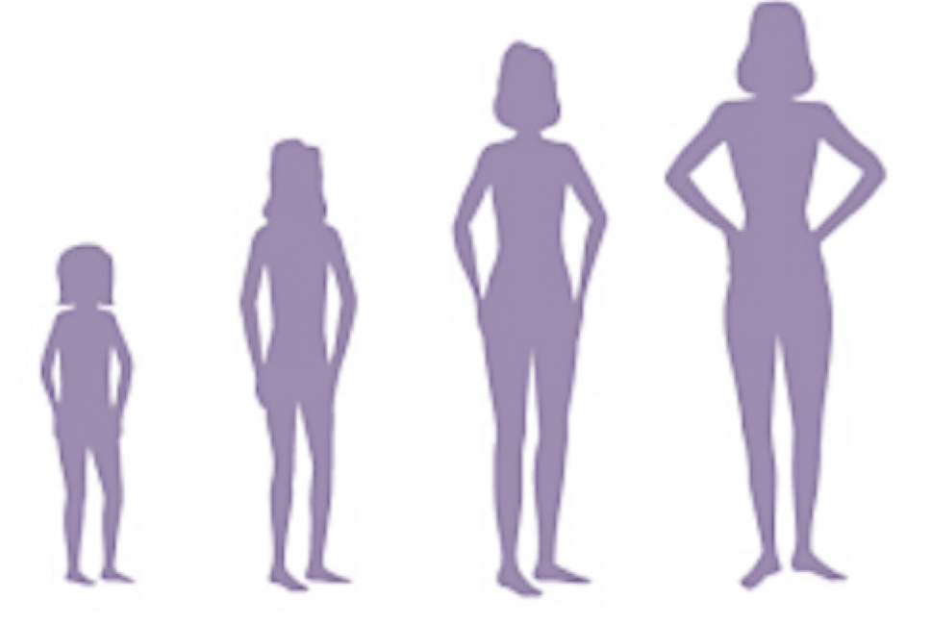
Hormones & You
4.
These hormonal signals trigger all kinds of growth & development:
You grow taller
Your body shape changes
Increased hair growth
Changes in your brain cause changes in moods
© FEMM
Notes:
Initially, you might notice that you are growing taller, or that your body shape is changing: your breasts develop and your hips get wider.

Slide 16
Hormones & You
5.
Your brain controls your hormones. Hormones direct all
of the changes your body goes through during puberty.
Mood
Growth
Bone Development
Maturation
© FEMM
Notes:
Then, you may notice increased hair growth in the armpits and pubic area and changes in body odor. Hormones are responsible for all of the growth and development during puberty, including mood and emotional changes. All of these changes during puberty are signs of a healthy reproductive system! And a healthy reproductive system is an important part of a healthy body!

Slide 17
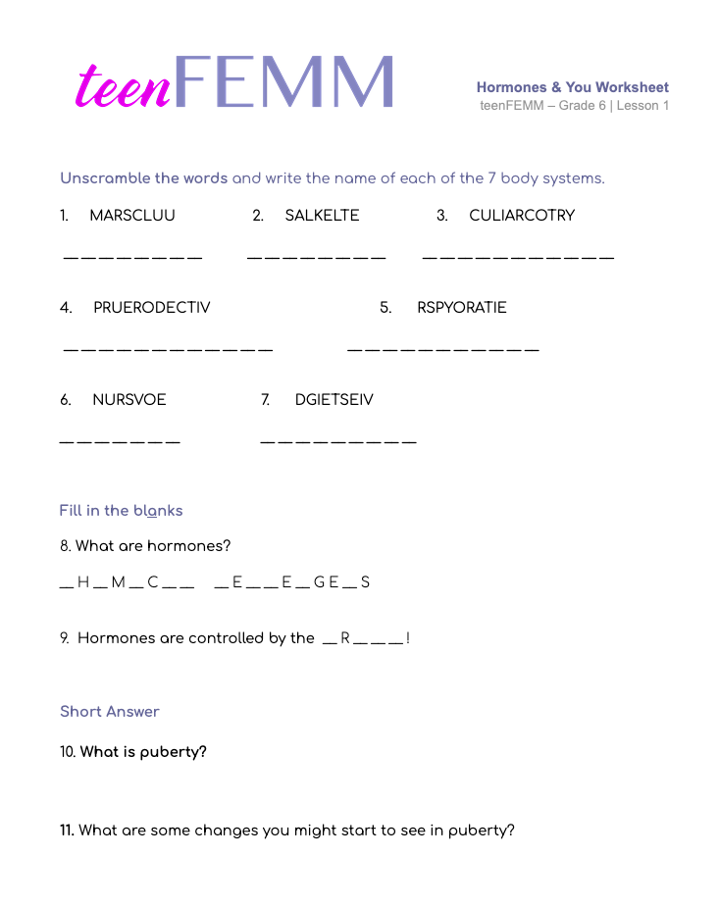
Worksheet
Hormones & You
© FEMM
Notes:
Hand out the Hormones & You Worksheet. Give students a couple of minutes to complete the worksheet, then review answers together using the Teacher’s Answer Key provided in the materials.

Slide 18
Review
1. A healthy reproductive system is an important indicator of your body’s overall health.
2. Your brain and reproductive system are linked by chemical messengers called hormones.
3. Puberty is the time when your body grows to full maturity.
© FEMM
Notes:
All body systems are important for your health. Through teenFEMM, as we learn more about your growth and development during this important time in your life, we will focus on how a healthy reproductive system is an important indicator of your body’s overall health.

Slide 19
Grade 6
LESSON 1
© FEMM

