Slide 1

Grade 6
LESSON 1
Grade 6
© FEMM

Slide 2
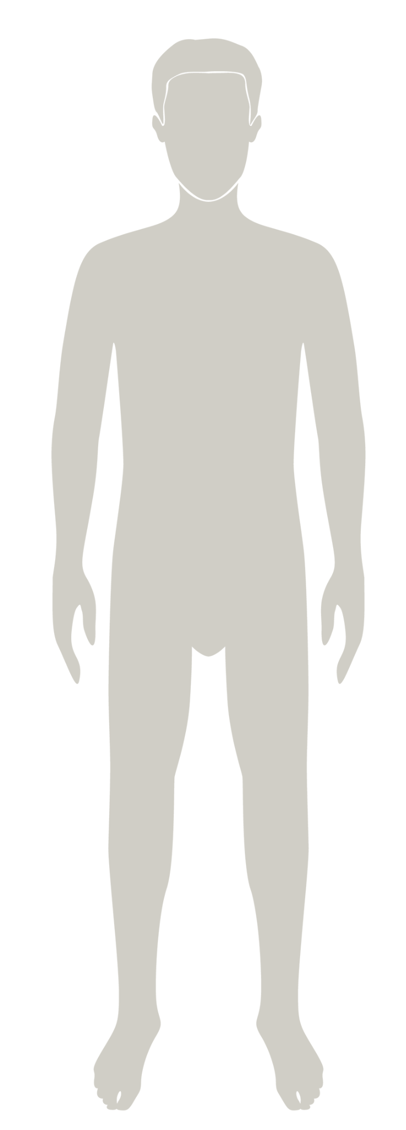
Introducing
a health program to help you
understand your body and track your health
as you grow to full maturity.
TO DO LIST:
LEARN ABOUT:
- The Reproductive System
- Hormones
- Physical Changes of Puberty
- Emotional Changes of Puberty
- Daily Lifestyle Choices
© FEMM
Notes:
teenMEN is a health program that will help you understand your body as you go through puberty and grow to full maturity. Maturity means the growth and development of the body, brain and emotions. Through this course, you will learn about the reproductive system, the physical and emotional changes of puberty, and how your choices have a big impact on your growth and health!

Slide 3
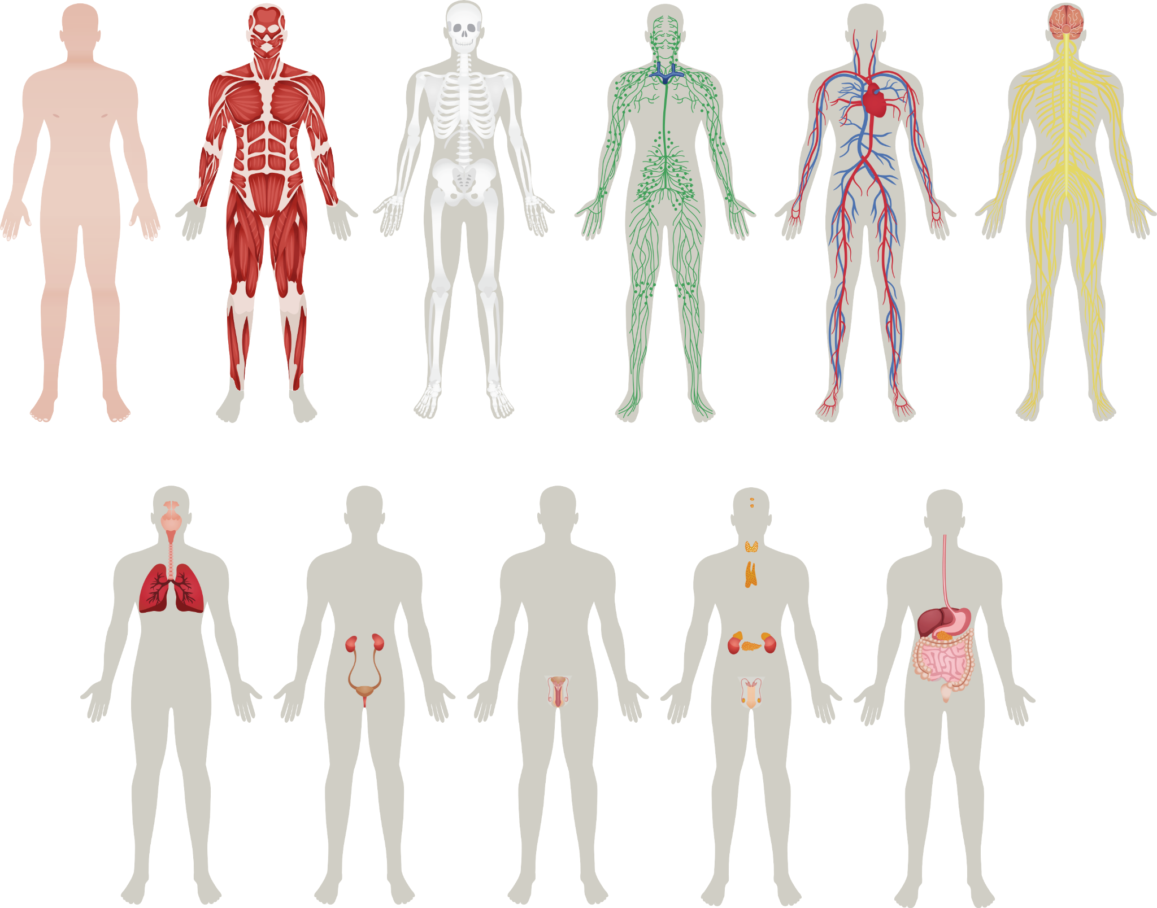
Healthy body
Healthy body
The body is made up of systems.
The health of every system impacts
the health of the whole body.
Notes:
Your whole body is made up of many parts. Each part has its own important job to do. When certain parts work together for a similar purpose, they are called a system.
Your body has several systems, all working together to make sure you function well. Can anyone name a system in the body?

Slide 4
The musculoskeletal system(s)
Nice muscle suit,
Iron Man.
You couldn’t stand a day without me.
Notes:
What about the skeletal system or the muscular system? Since these two systems work together so closely, they are also called the musculoskeletal system.
Without these two systems and the work they do together, we literally wouldn’t be able to stand up or sit down. Let’s look at a few other systems in the body to see what they do to keep our bodies healthy and functioning!

Slide 5
The nervous system
You’ve got a lot of nerve!
7 trillion, to be exact…
TO-DOs:
-Carry signals between the brain and 7 TRILLION nerves!
-Control reflexes
- Manage five senses: touch, hearing, taste, smell, sight
© FEMM
Notes:
The nervous system sends quick impulses between the brain and body. It includes the brain and spinal cord and the nerves.
(The fire is hot; your muscles yank your hand from the flame.)

Slide 6
The respiratory system
TO-DOs:
- Pull air through nose/ mouth into the lungs
- Bring oxygen into the body
- Send carbon dioxide out
-Repeat 22,000 times /day!
😮‍💨
The lungs perform the complex task of breathing and transferring oxygen to the rest of the body.
© FEMM
Notes:
The respiratory system, through the lungs, breathes the air and oxygen needed for life. It includes the airways from the mouth and nose to the lungs, as well as the lungs.

Slide 7
The digestive system
TO-DOs:
- The wave!*
-Break down food into nutrients
-Move food to small
and then large intestine…
*Muscles in your esophagus act like a giant wave to move food+ drink down into your stomach.
© FEMM
Notes:
The digestive system breaks down the food you eat to make fuel for your body then eliminates the waste it cannot use. It includes the mouth, esophagus, stomach, and intestines, up to the anus.

Slide 8
The cardiovascular (or circulatory) system
TO-DOs:
- Pump 100 gallons of blood each HOUR
-Gather nutrients from food
(in small intestine) and deliver
to EVERY CELL in the body!
You’re a work of ARTeries!
If all of your arteries, capillaries and veins
were lined up, end to end,
they would extend
60,000 miles long!
That’s enough to circle
the earth 2.5 times!
© FEMM
Notes:
The cardiovascular system carries blood pumped by the heart through the blood vessels, carrying oxygen from the lungs and fuel from food, to all parts of the body. It includes the heart and the blood vessels. This system is also referred to as the circulatory system.

Slide 9
The male reproductive system
TO DOs:
-Produce testosterone
-Testosterone to regulate:
-bone mass
-fat distribution
-muscle strength,
-red blood cells
The reproductive system is responsible for bringing about a new life.
In boys, it includes the testes, scrotum, penis, and all the tubes through which sperm travels.
The reproductive system plays an important role in men’s overall health.
© FEMM
Notes:
The reproductive system is responsible for bringing about a new life. In boys, it includes the testes, scrotum, penis, and all the tubes through which sperm travels. In girls, it includes the ovaries, fallopian tubes, the uterus, and vagina. The testicles produce testosterone, the main male hormone.

Slide 10
Healthy body
Cells
Organs
Systems
The health of every system impacts the health of the whole body.
© FEMM
Notes:
The body has levels of organization that build on each other. Cells make up tissues, tissues make up organs, and organs make up body systems. Every system of the body must function properly for the whole body to be healthy. For example, if the lungs are congested, or the stomach is upset, or the heart is weak, the body will not feel well.

Slide 11
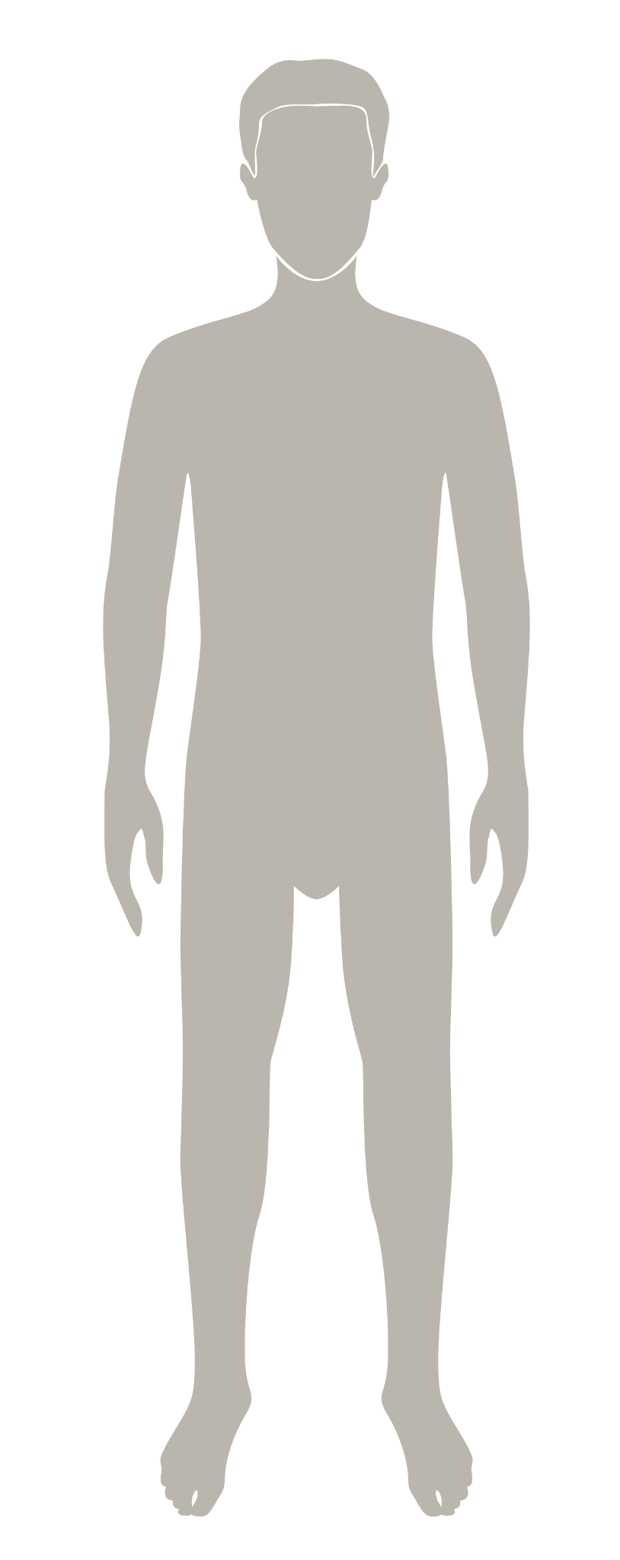
⚡Game Time!⚡
It’s time for…
Name that System!
Notes:
Divide students into two teams. Give each team a “buzzer” or assign a sound for them to make when they know the answer. Teams may consult with their teammates but the first team to sound their buzzer gets to answer first. For each correct answer, the team gets one point. The team with the most points wins.
Note that there are six slides containing the body systems and the next slide shows the answers.

Slide 12
⚡Name that system!⚡
Notes:
Reveal the answer on the next slide!

Slide 13
⚡Answer⚡
Circulatory System

Slide 14
⚡Name that system!⚡
Notes:
Reveal the answer(s) on the next slide!

Slide 15
⚡Answer⚡
+
=
Muscular System
Skeletal System
Musculoskeletal System

Slide 16
⚡Name that system!⚡
Notes:
Reveal the answer on the next slide.

Slide 17
⚡Answer⚡
Respiratory System

Slide 18
⚡Name that system!⚡
Notes:
Reveal the answer on the next slide.

Slide 19
⚡Answer⚡
Nervous System

Slide 20
⚡Name that system!⚡

Slide 21
⚡Answer⚡
Reproductive System
Notes:
Answer!

Slide 22
⚡Name that system!⚡
Notes:
Reveal the answer on the next slide!

Slide 23
⚡Answer⚡
Digestive System
Notes:
Reveal the answer on the next slide!

Slide 24
⚡Answers⚡
Muscular
Skeletal
Circulatory
Nervous
Respiratory
Reproductive
Digestive
Notes:
Answers!

Slide 25
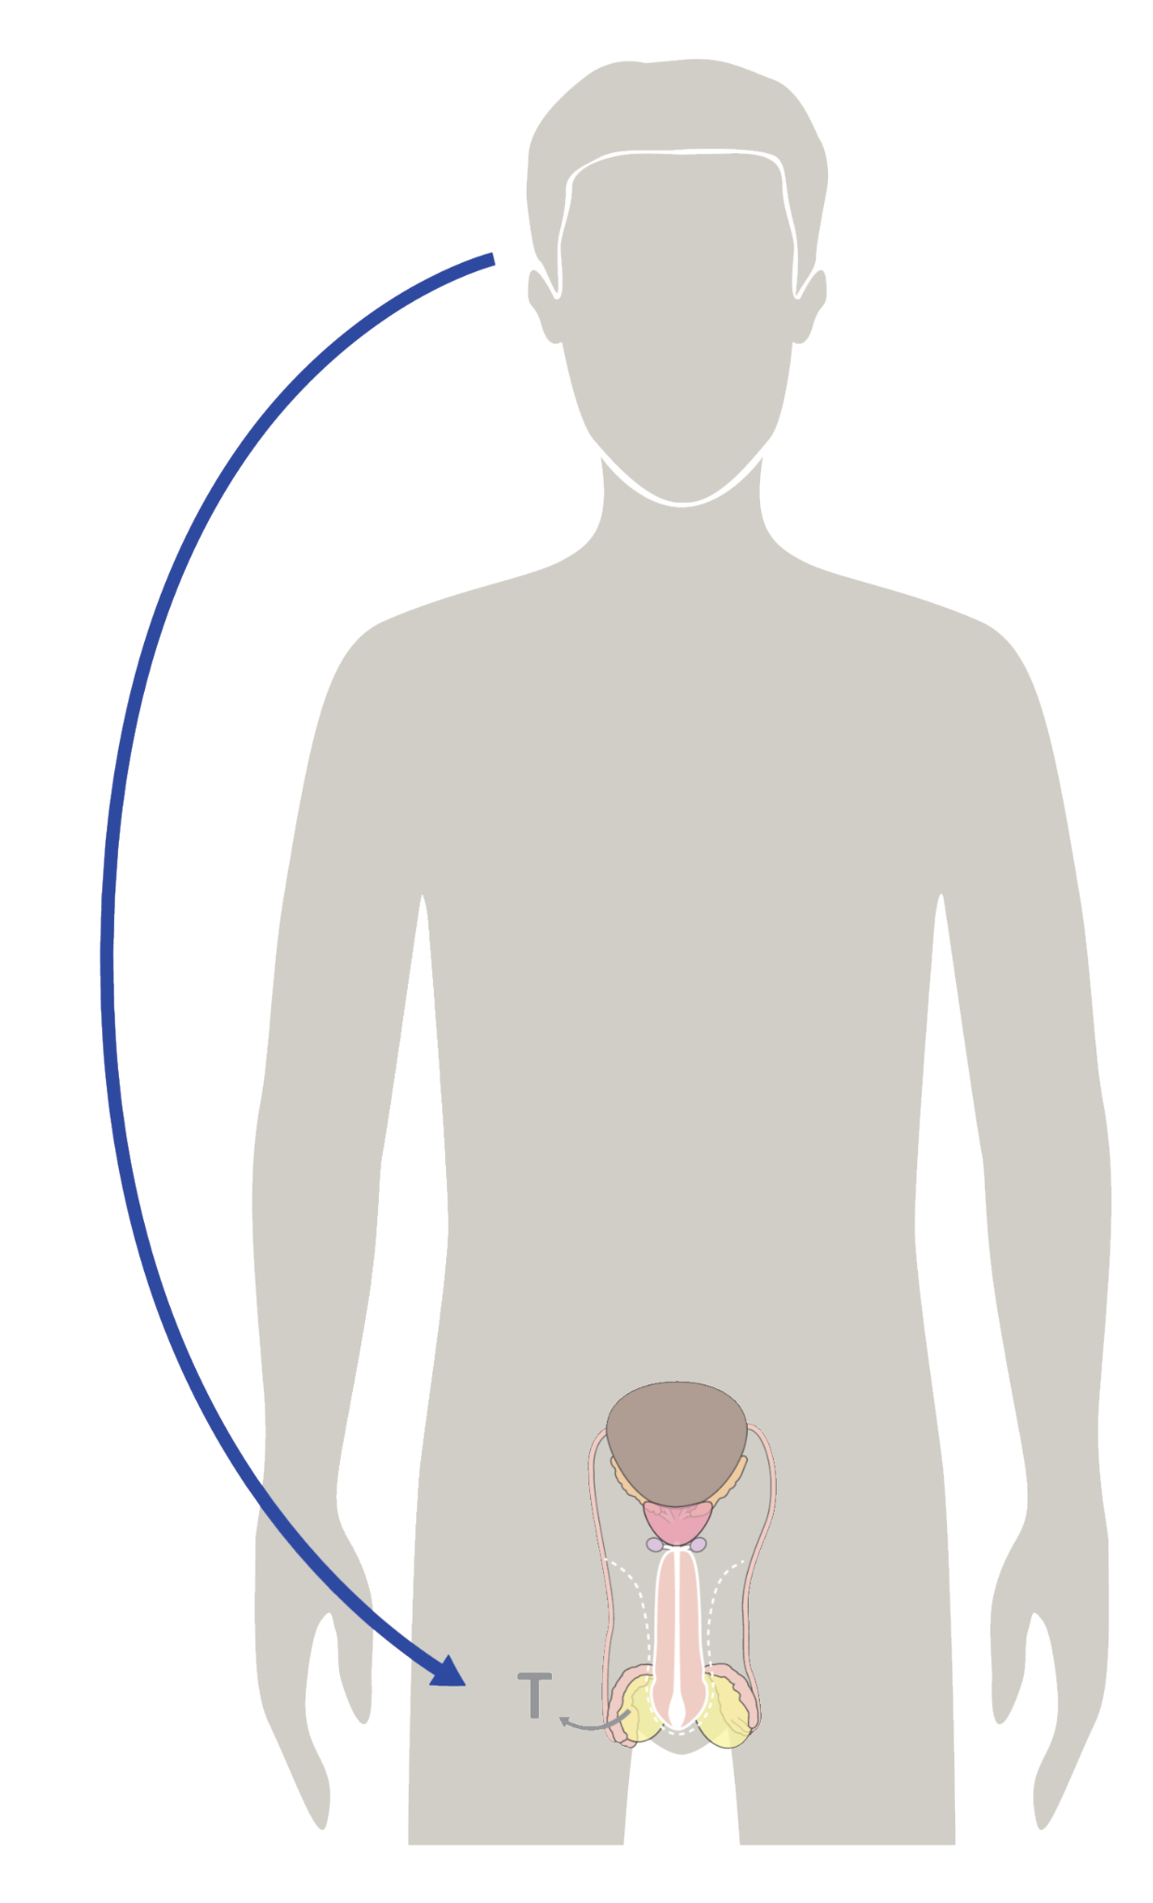
What are hormones?
Hormones are chemical signals, or messengers, that travel in the bloodstream to tissues and organs, directing:
growth & development
mood
reproduction
Hormones direct every system of the body.
© FEMM
Notes:
Hormones are chemical messengers that travel in the bloodstream and direct the activity of every system in the body.

Slide 26
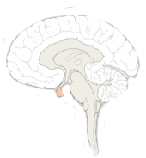
Hormones: chemical messengers
Brain
Reproductive System,
hello, come in,
do you read me?
Repro S.
Roger that, Brian.
Lol BRAIN
Release testosterone.
Notes:
You can think of them like text messages sent from your brain to communicate with every part of your body.

Slide 27
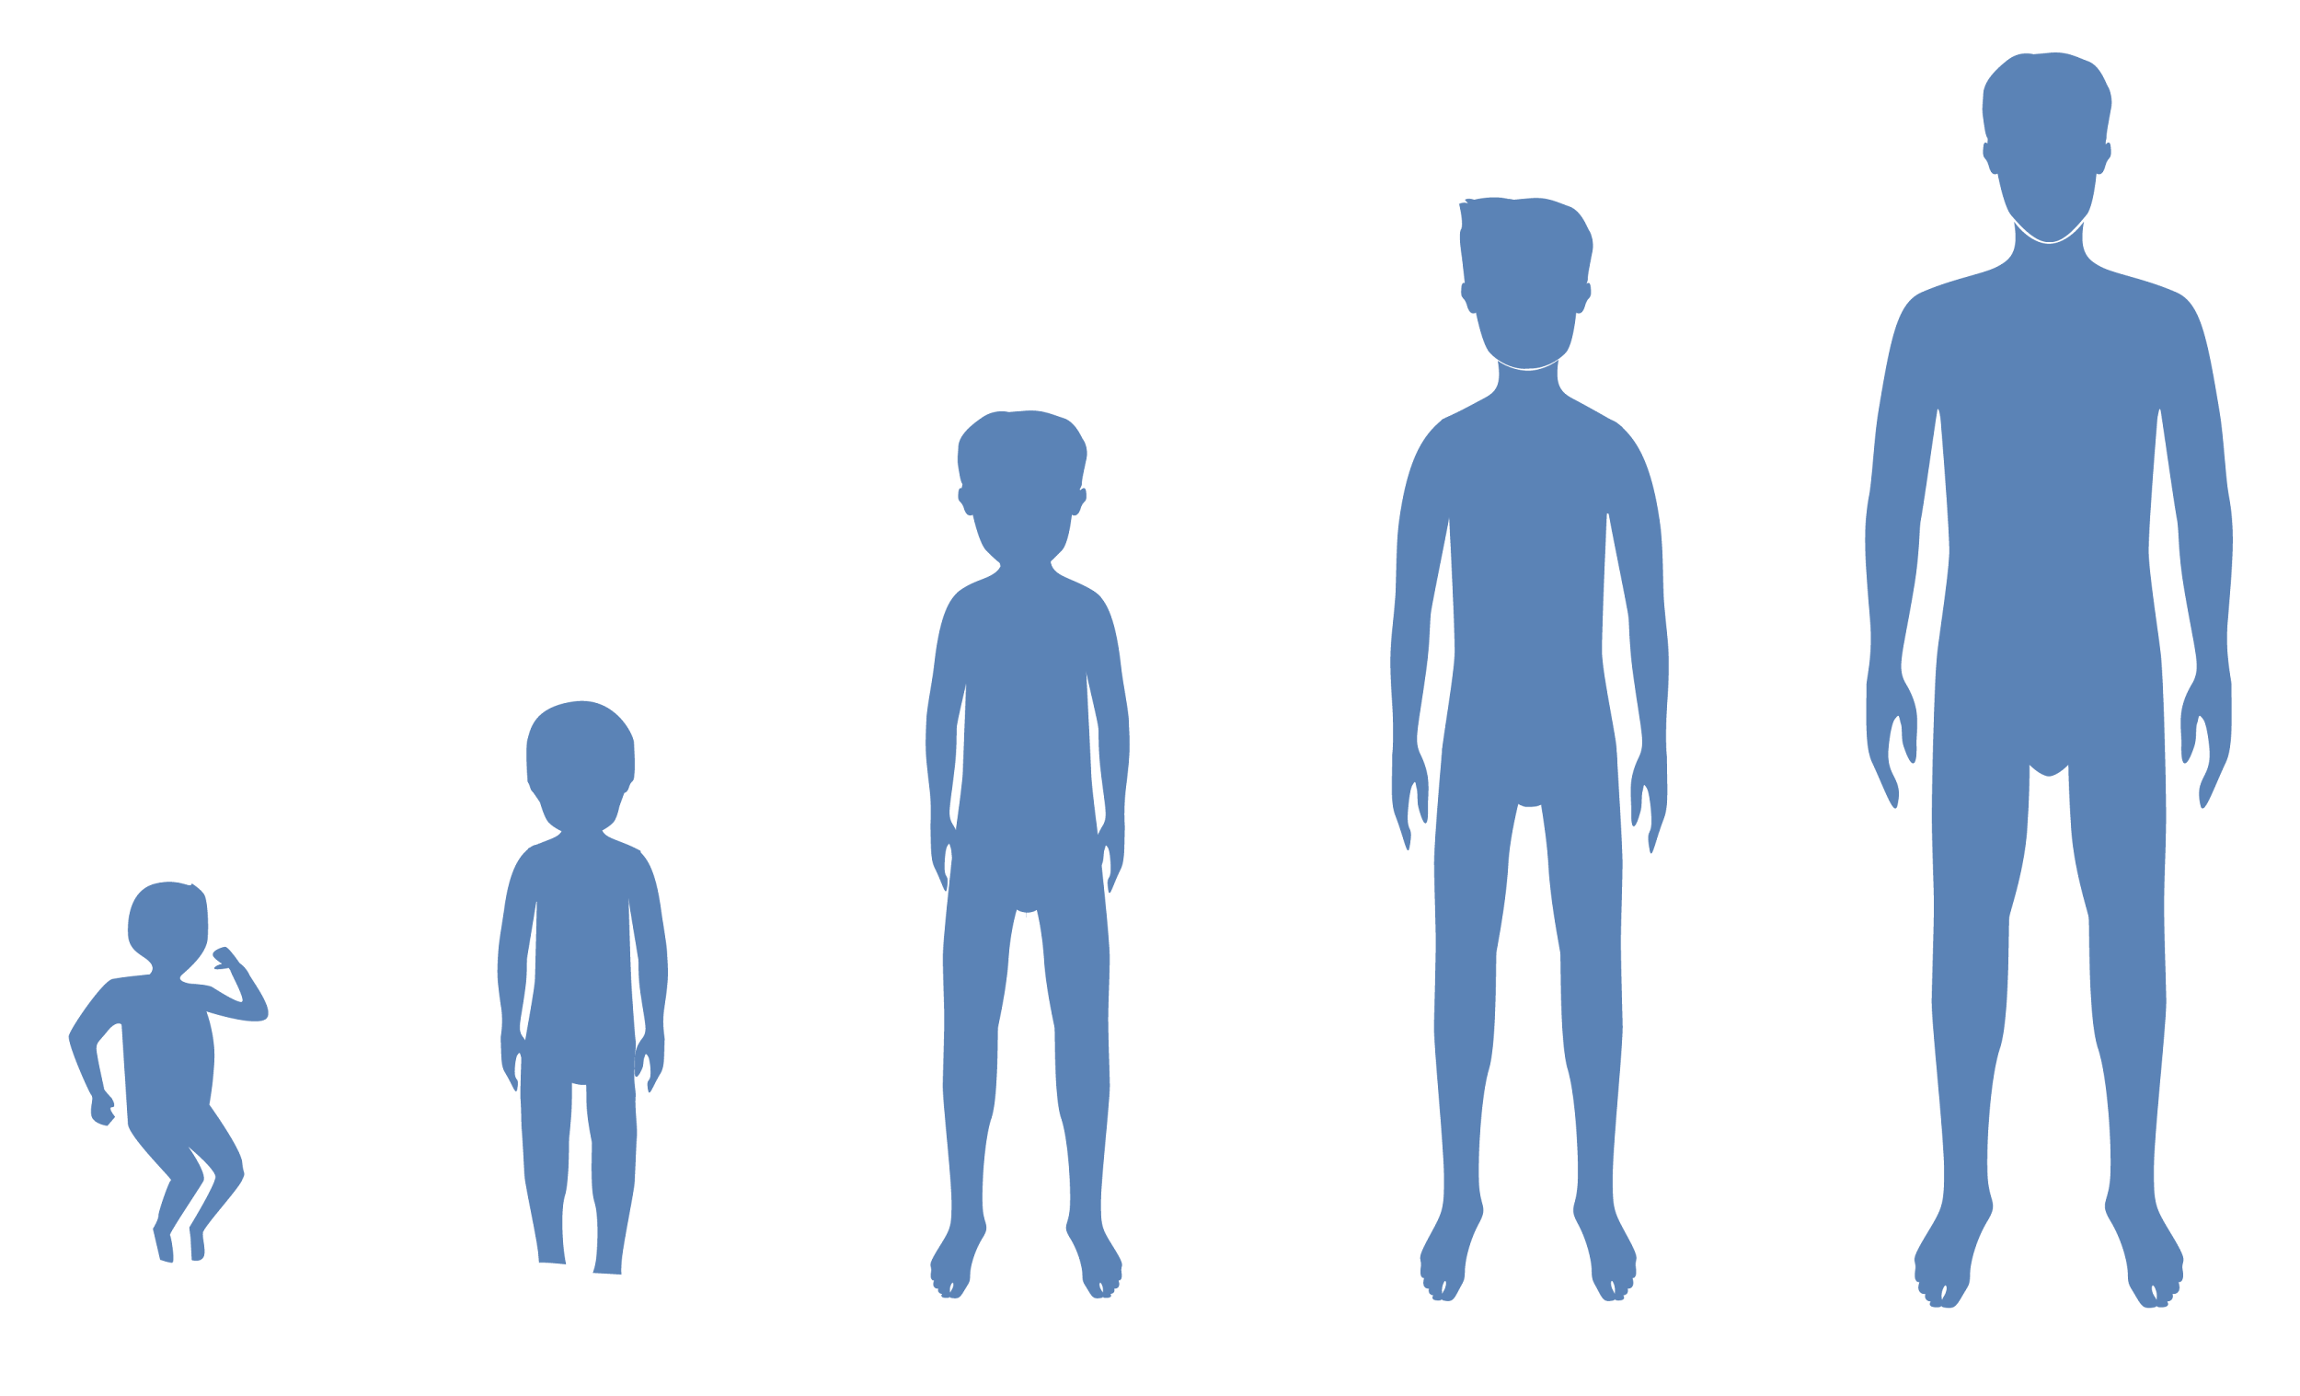
What is puberty?
Puberty is the time when a child's physical and sexual characteristics mature (starting around age 10 until 17) due to hormonal changes.
© FEMM
Notes:
Hormones in the brain kick start puberty. Hormones located in the pituitary gland, a tiny part of the brain, signals to the testes to produce the main male hormone, testosterone.Puberty is the time when your physical and sexual characteristics mature, due to hormones. For boys, puberty usually happens between the ages of 10-17 years and between the ages 9-14 years for girls. Puberty is a time of rapid growth and development as a result of hormonal changes.
Hormones cause all of the growing and changing that your body undergoes during puberty.

Slide 28
Puberty & your growth
Hormones cause all the growing & changing that your body undergoes during puberty.
Your brain starts the process, sending hormonal signals throughout your body to trigger growth & development.
Hormones control the health of the entire body, including reproductive health.
© FEMM
Notes:
You may notice body odor, increased sweating, hair growth, especially in your armpits and pubic area, your voice will start to deepen and you’ll grow taller. Your body shape will also change as your shoulders and muscles develop. You may also experience more oily skin, fatigue, and moodiness.
28

Slide 29
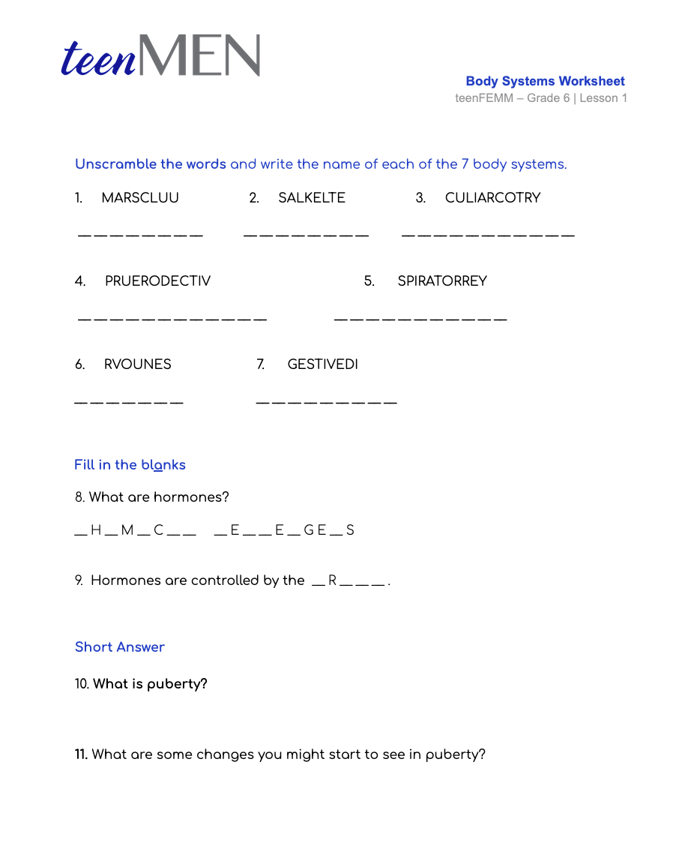
Worksheet
Body Systems
© FEMM
Notes:
Provide students with the Body Systems Worksheet. Give students a few minutes to fill in their answers. When finished, review together as a class using the Teacher’s Answer Key provided in the materials.

Slide 30
Review
All body systems are important for overall health.
A healthy reproductive system is an important indicator of your body’s overall health.
Your brain and reproductive system are linked by chemical messengers called hormones.
Puberty is the time when your body grows to full maturity.
© FEMM
Notes:
All body systems are important to overall health. Through teenMEN, as we learn more about your growth and development, we will focus on how healthy reproductive and endocrine systems is an especially important indicator of overall health. In the next lesson, we will learn about the parts of the reproductive system.

Slide 31
Grade 6
LESSON 1
Grade 6
© FEMM

