Slide 1

Grade 6
LESSON 2
© FEMM

Slide 2
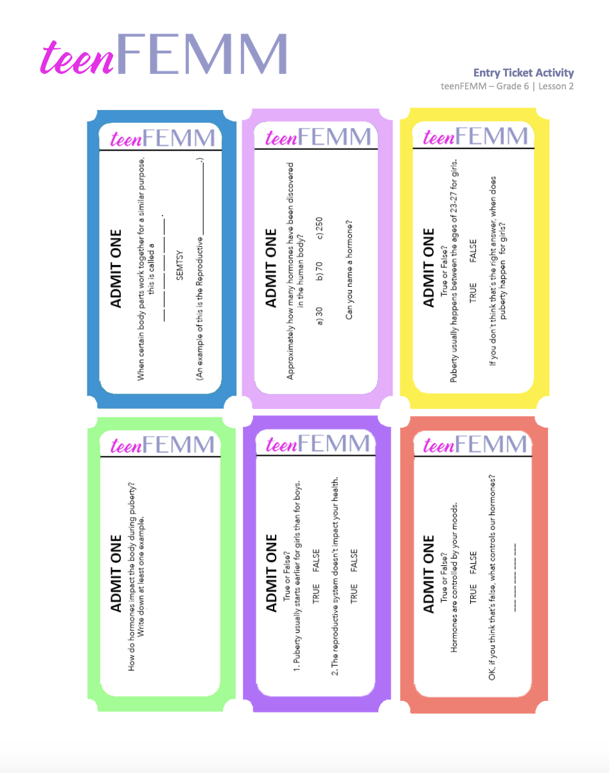
Entry Ticket Activity
© FEMM
Notes:
Provide students with worksheet to fill in the blanks.
Review, using the slides (image with blank spaces, then with answers).

Slide 3
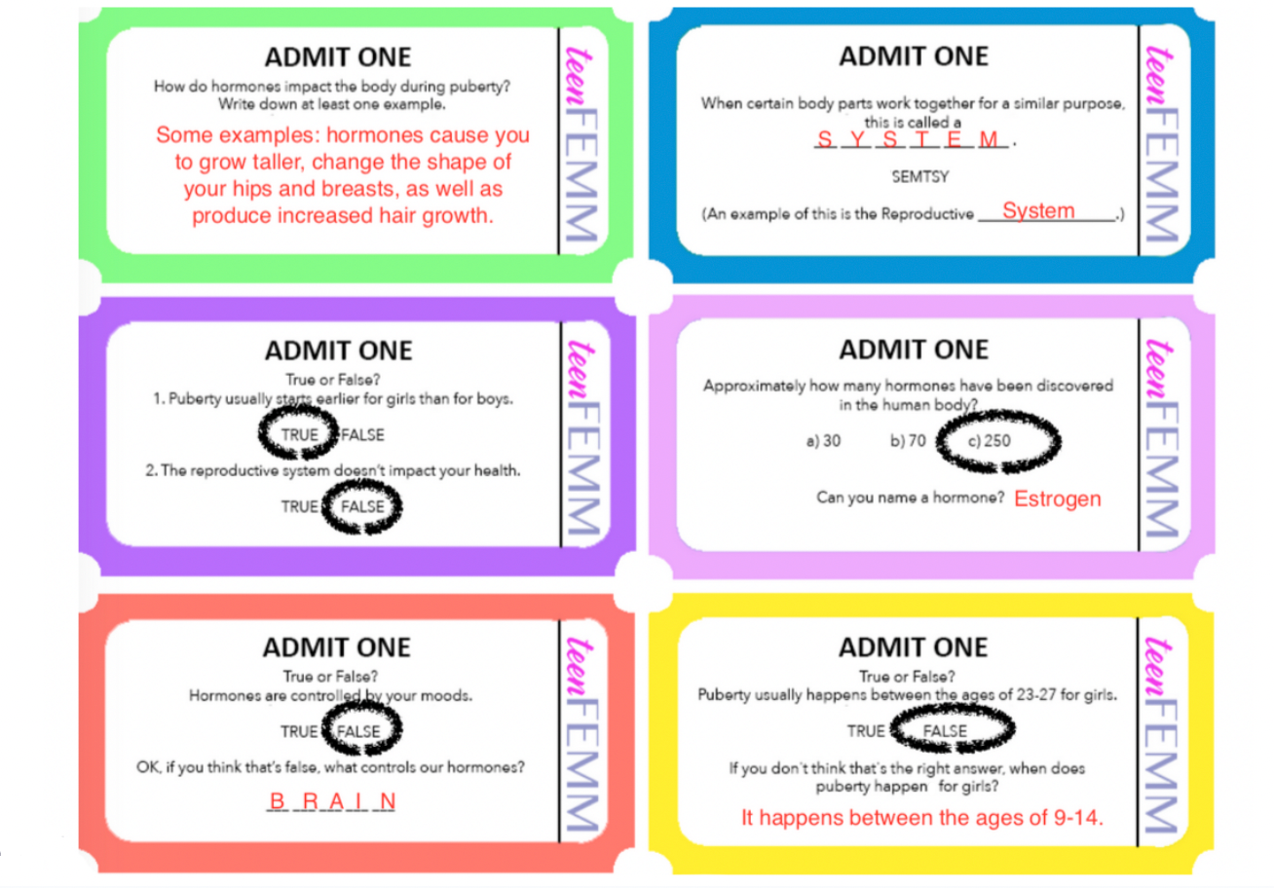
Answers | Entry Ticket Activity
© FEMM

Slide 4
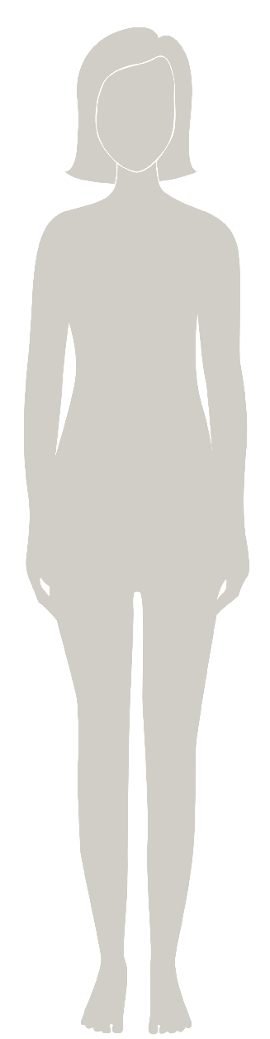
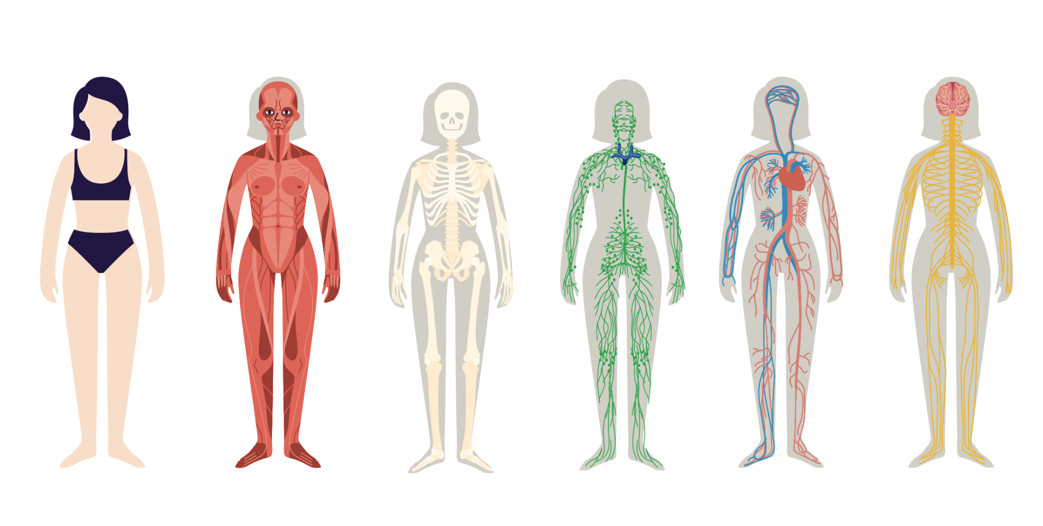
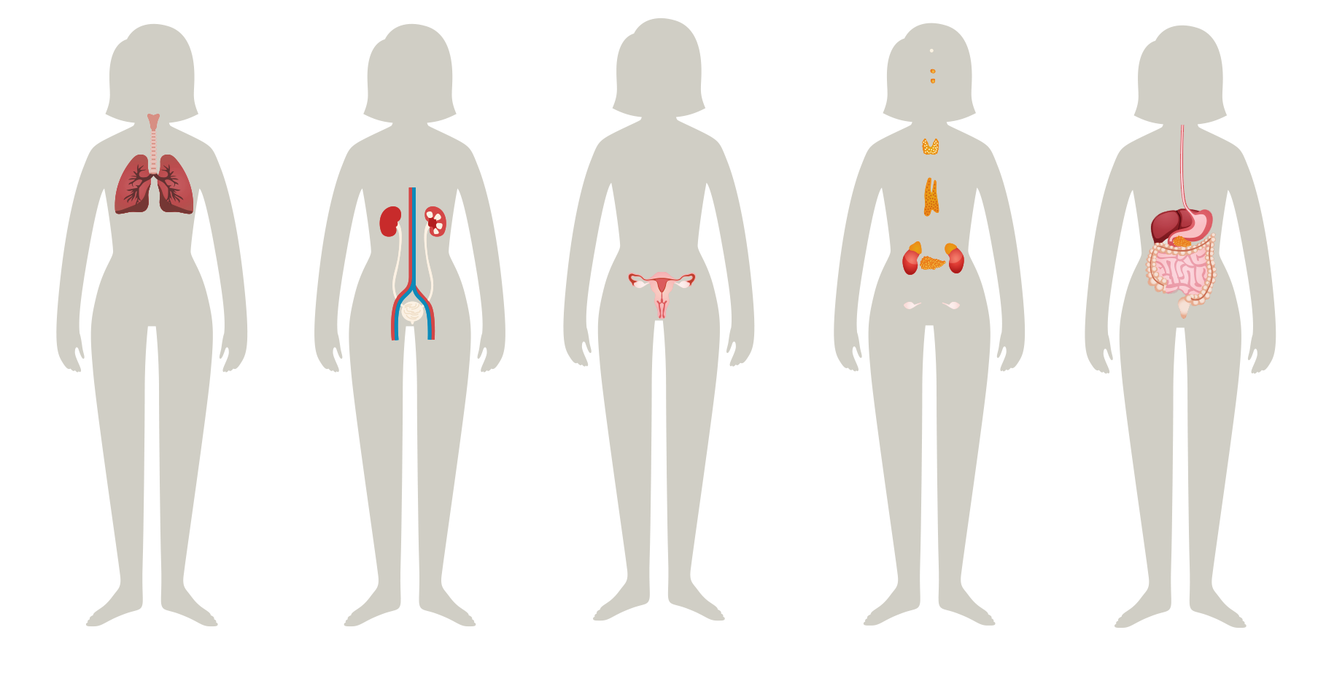
Health & You
The body is made up of systems
The health of every system affects the health of the whole body.
© FEMM
Notes:
Your body is made up of many parts. Each part has a particular and important job to do.
When certain parts work together for a similar purpose, they are called a system.
Your body has several systems, all working together to make sure you function well.

Slide 5
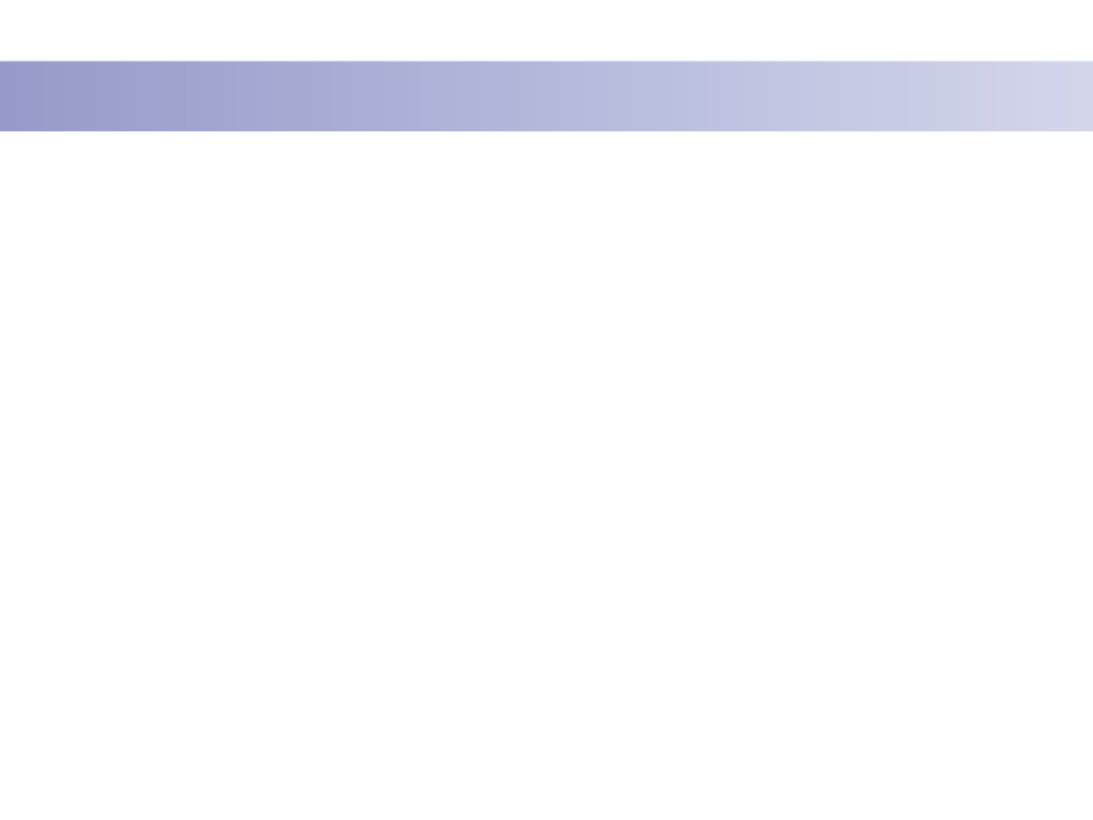
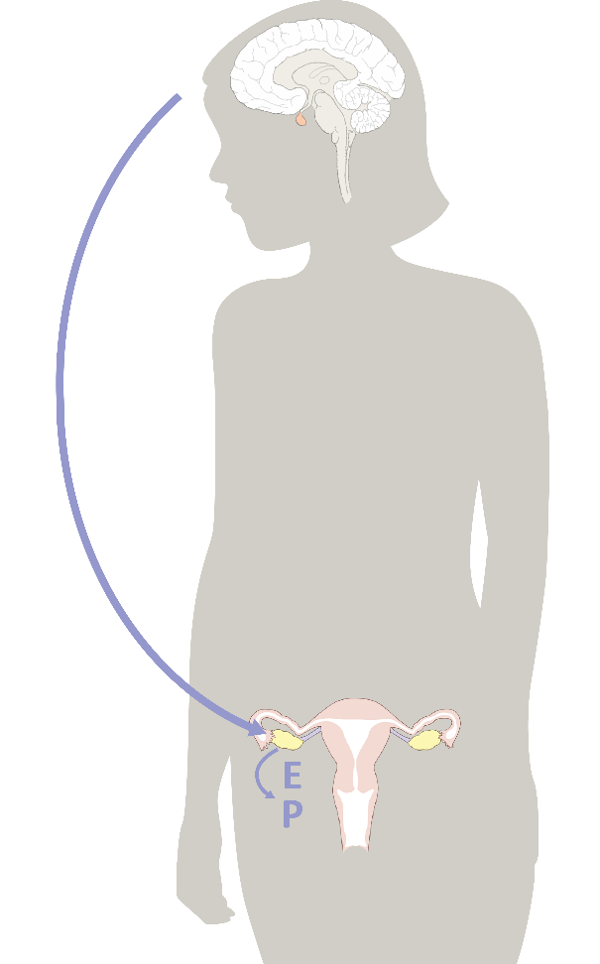
Hormones & You
1.
Hormones direct the activity of every system in the body!
© FEMM
Notes:
A healthy reproductive system is an important part of a healthy body.
Hormones control the health of the reproductive system and the entire body.

Slide 6
Hormones & You
Director (Brain)
2.
Hello
Hormones are chemical signals that travel in the bloodstream.
Hormones direct growth and development, mood, energy, reproduction and more!
Reproductive System
Yea?
Lights, camera,
ACTION! 🎬
© FEMM
Notes:
A healthy reproductive system is an important part of a healthy body.
Hormones control the health of the reproductive system and the entire body.

Slide 7
Hormones & You
3.
Puberty begins in the brain.
The brain sends hormonal signals throughout the body.
Hormones are the reason for all the growing and changing your body does during puberty.
© FEMM
Notes:
A healthy reproductive system is an important part of a healthy body.
Hormones control the health of the reproductive system and the entire body.

Slide 8
Get to know YOUR….
Female
Reproductive Anatomy!
© FEMM
Notes:
The reproductive organs are the group of organs in the lower belly/pelvis that work together in women to mature an egg (female cell of reproduction) and develop a growing baby.

Slide 9
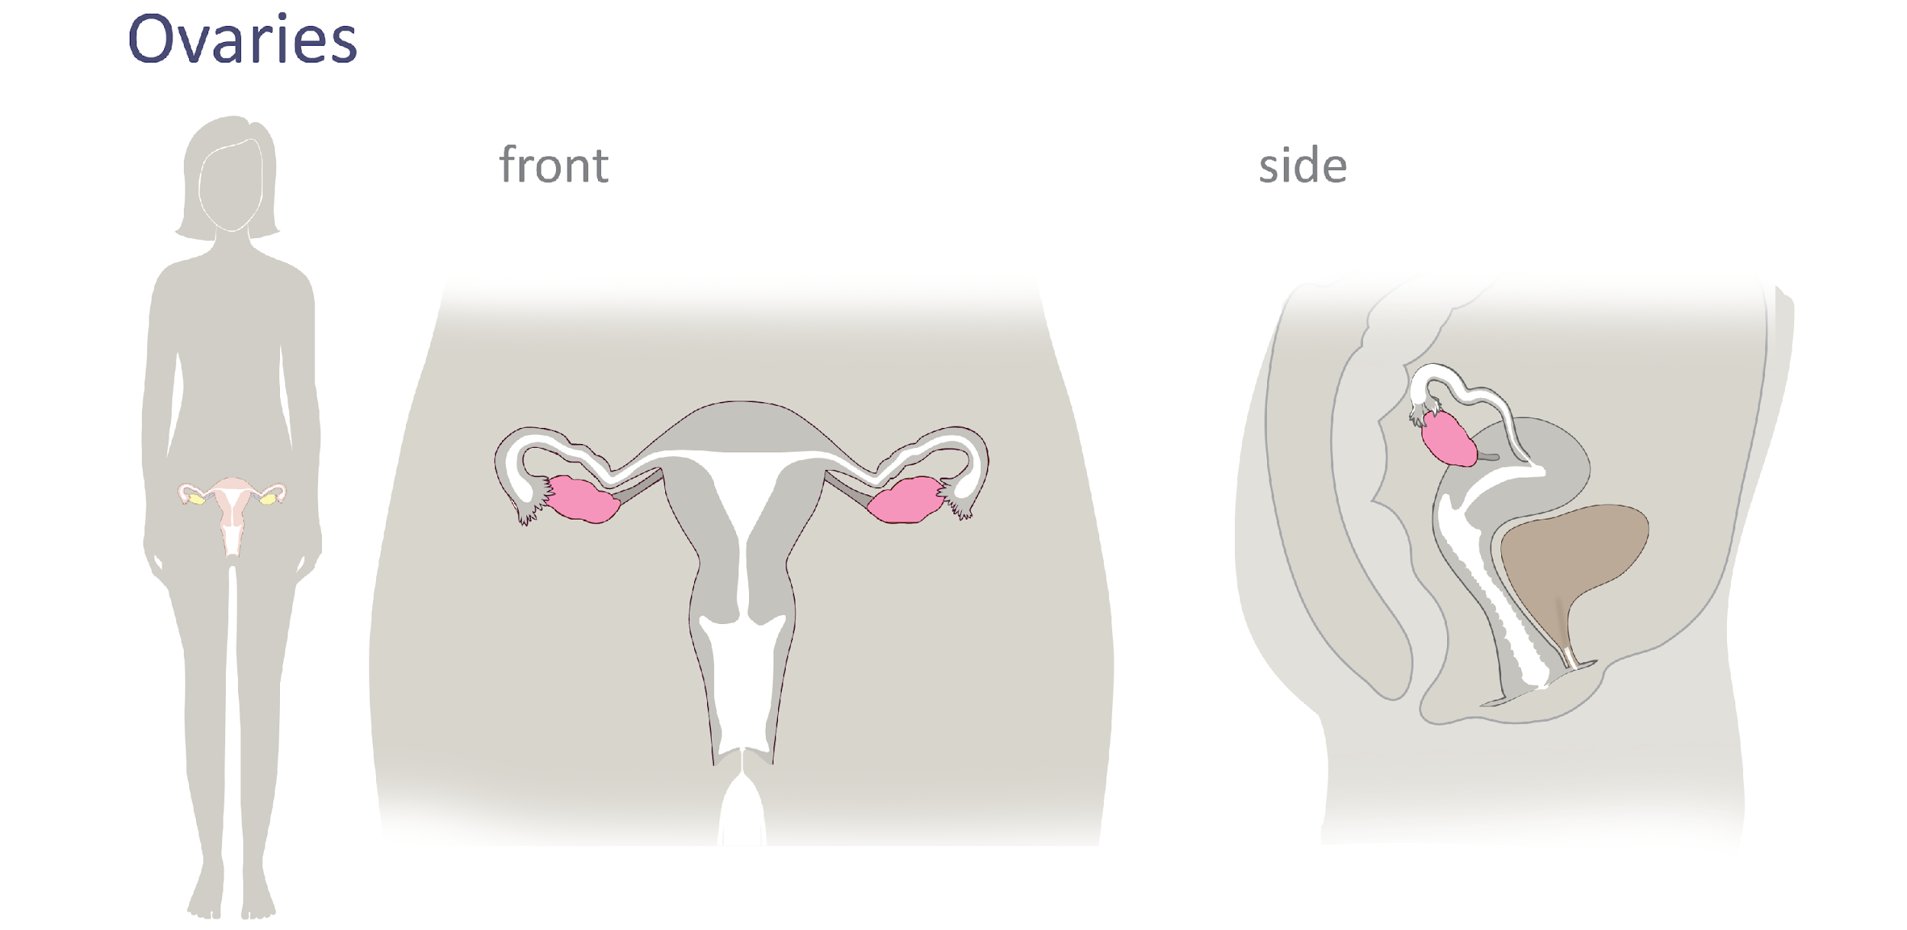
Female Reproductive Anatomy
© FEMM
Notes:
The ovaries are two small organs on either side of the uterus that contain a woman’s eggs. The ovary is responsible for developing and releasing an egg, approximately once a month.

Slide 10
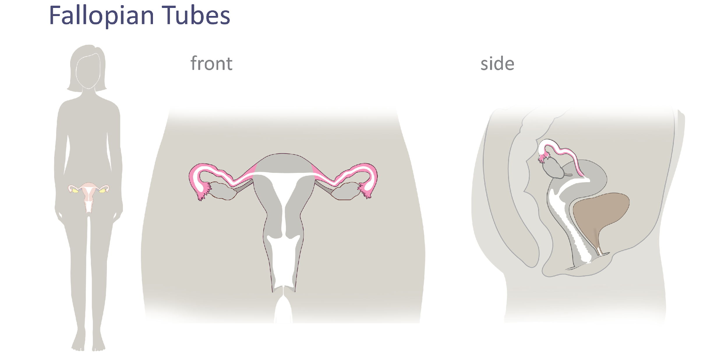
Female Reproductive Anatomy
© FEMM
Notes:
The Fallopian tubes are two thin tubes, attached to either side of the uterus, where the egg travels after ovulation.

Slide 11
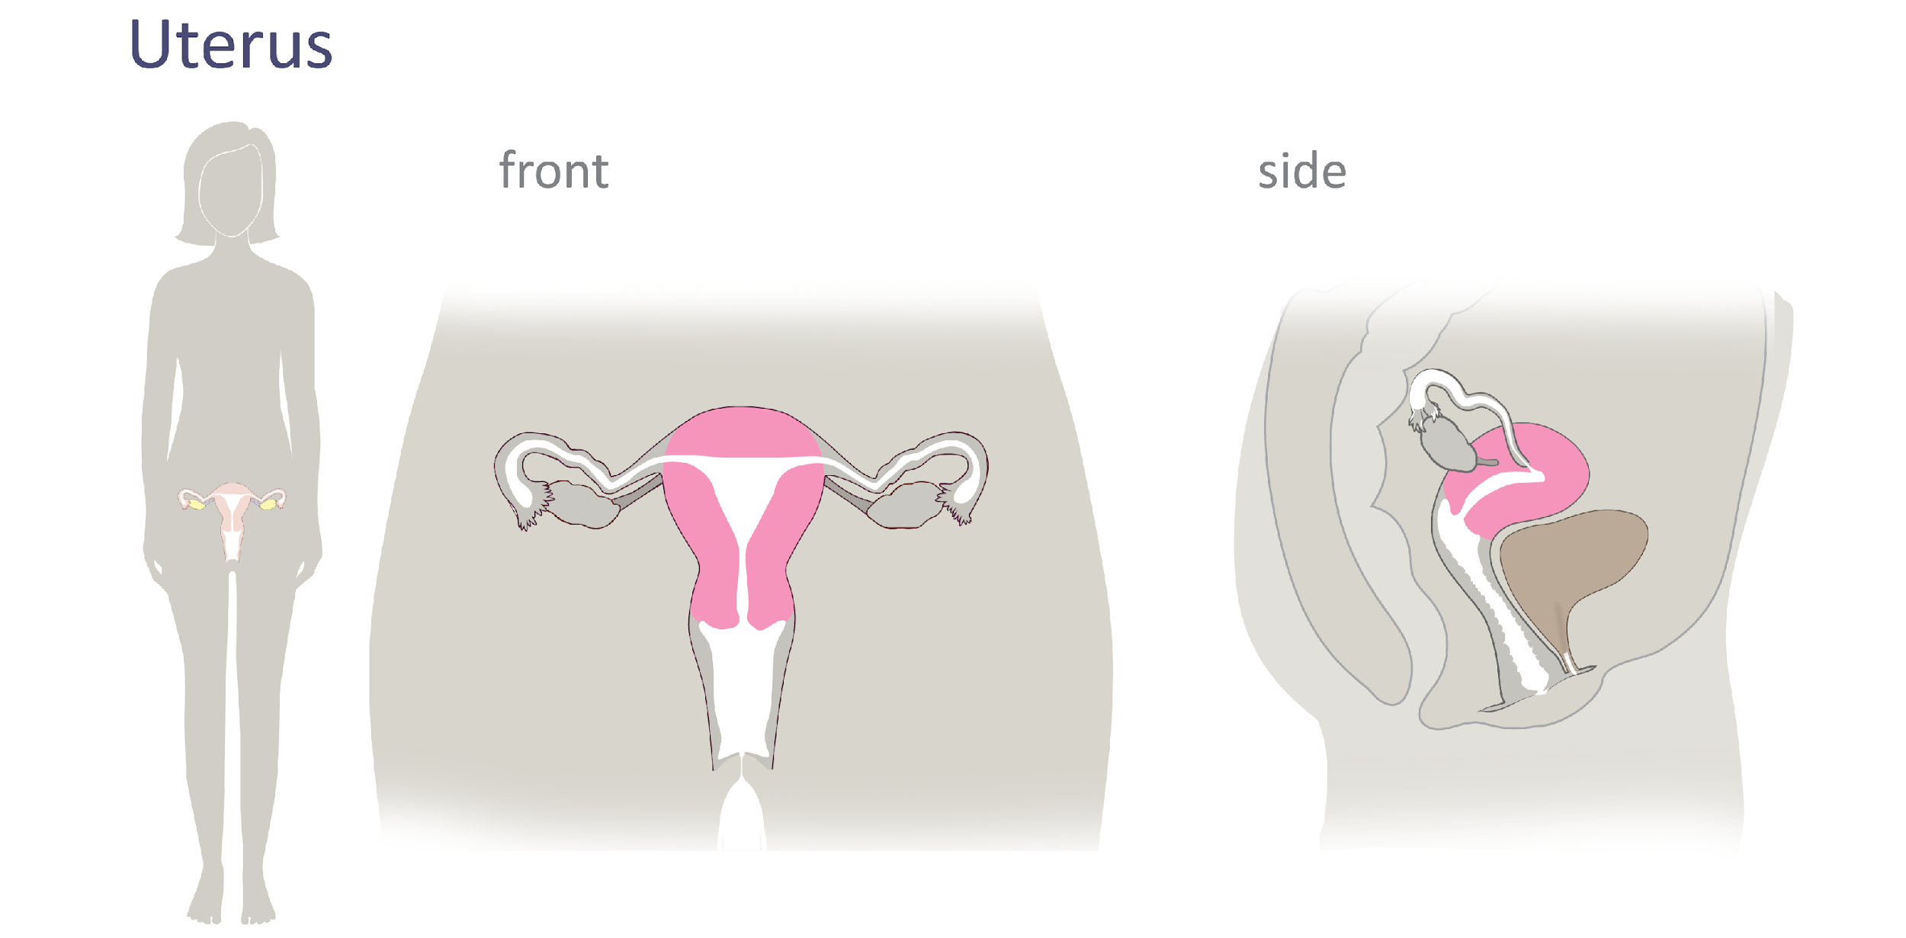
Female Reproductive Anatomy
© FEMM
Notes:
The uterus, also called the womb, is where all of us begin to grow. It’s a hollow organ that expands during pregnancy. The lining of the uterus thickens during every cycle to provide a “nest” in case pregnancy occurs. If pregnancy doesn’t occur, the lining of the uterus sheds in menstruation. This is what is known as a “period.”

Slide 12
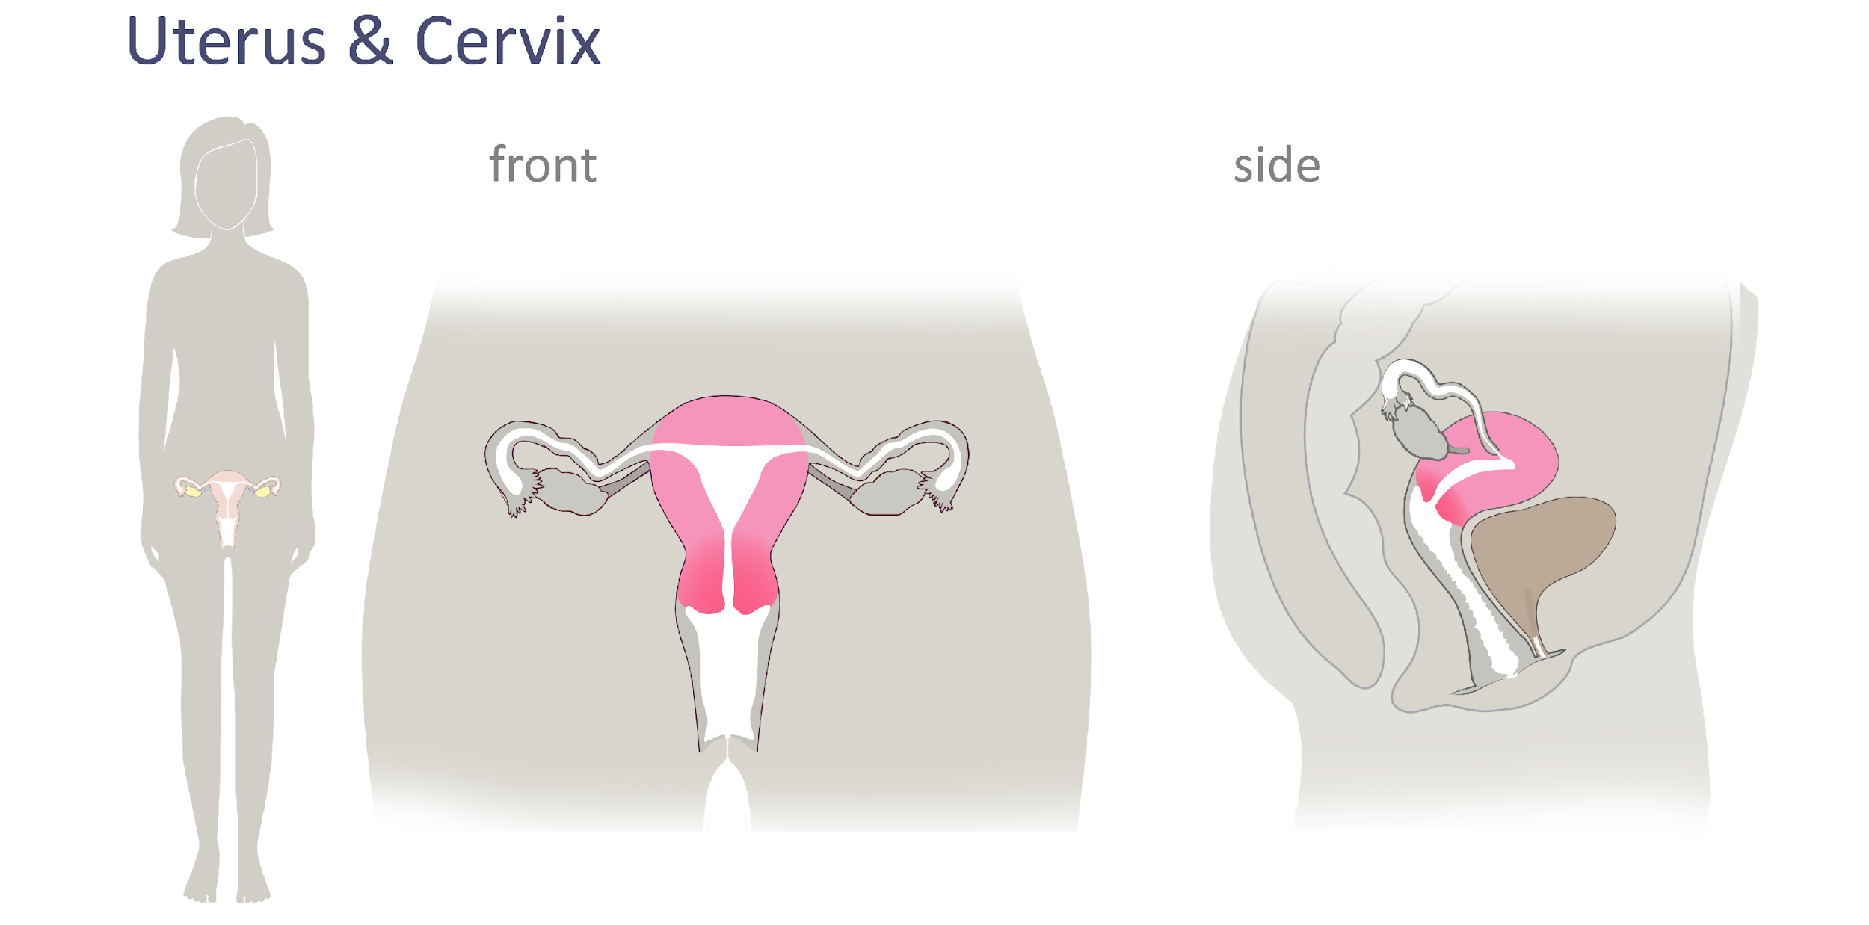
Female Reproductive Anatomy
© FEMM
Notes:
The cervix is the lower portion of the uterus, a narrow canal opening into the vagina

Slide 13
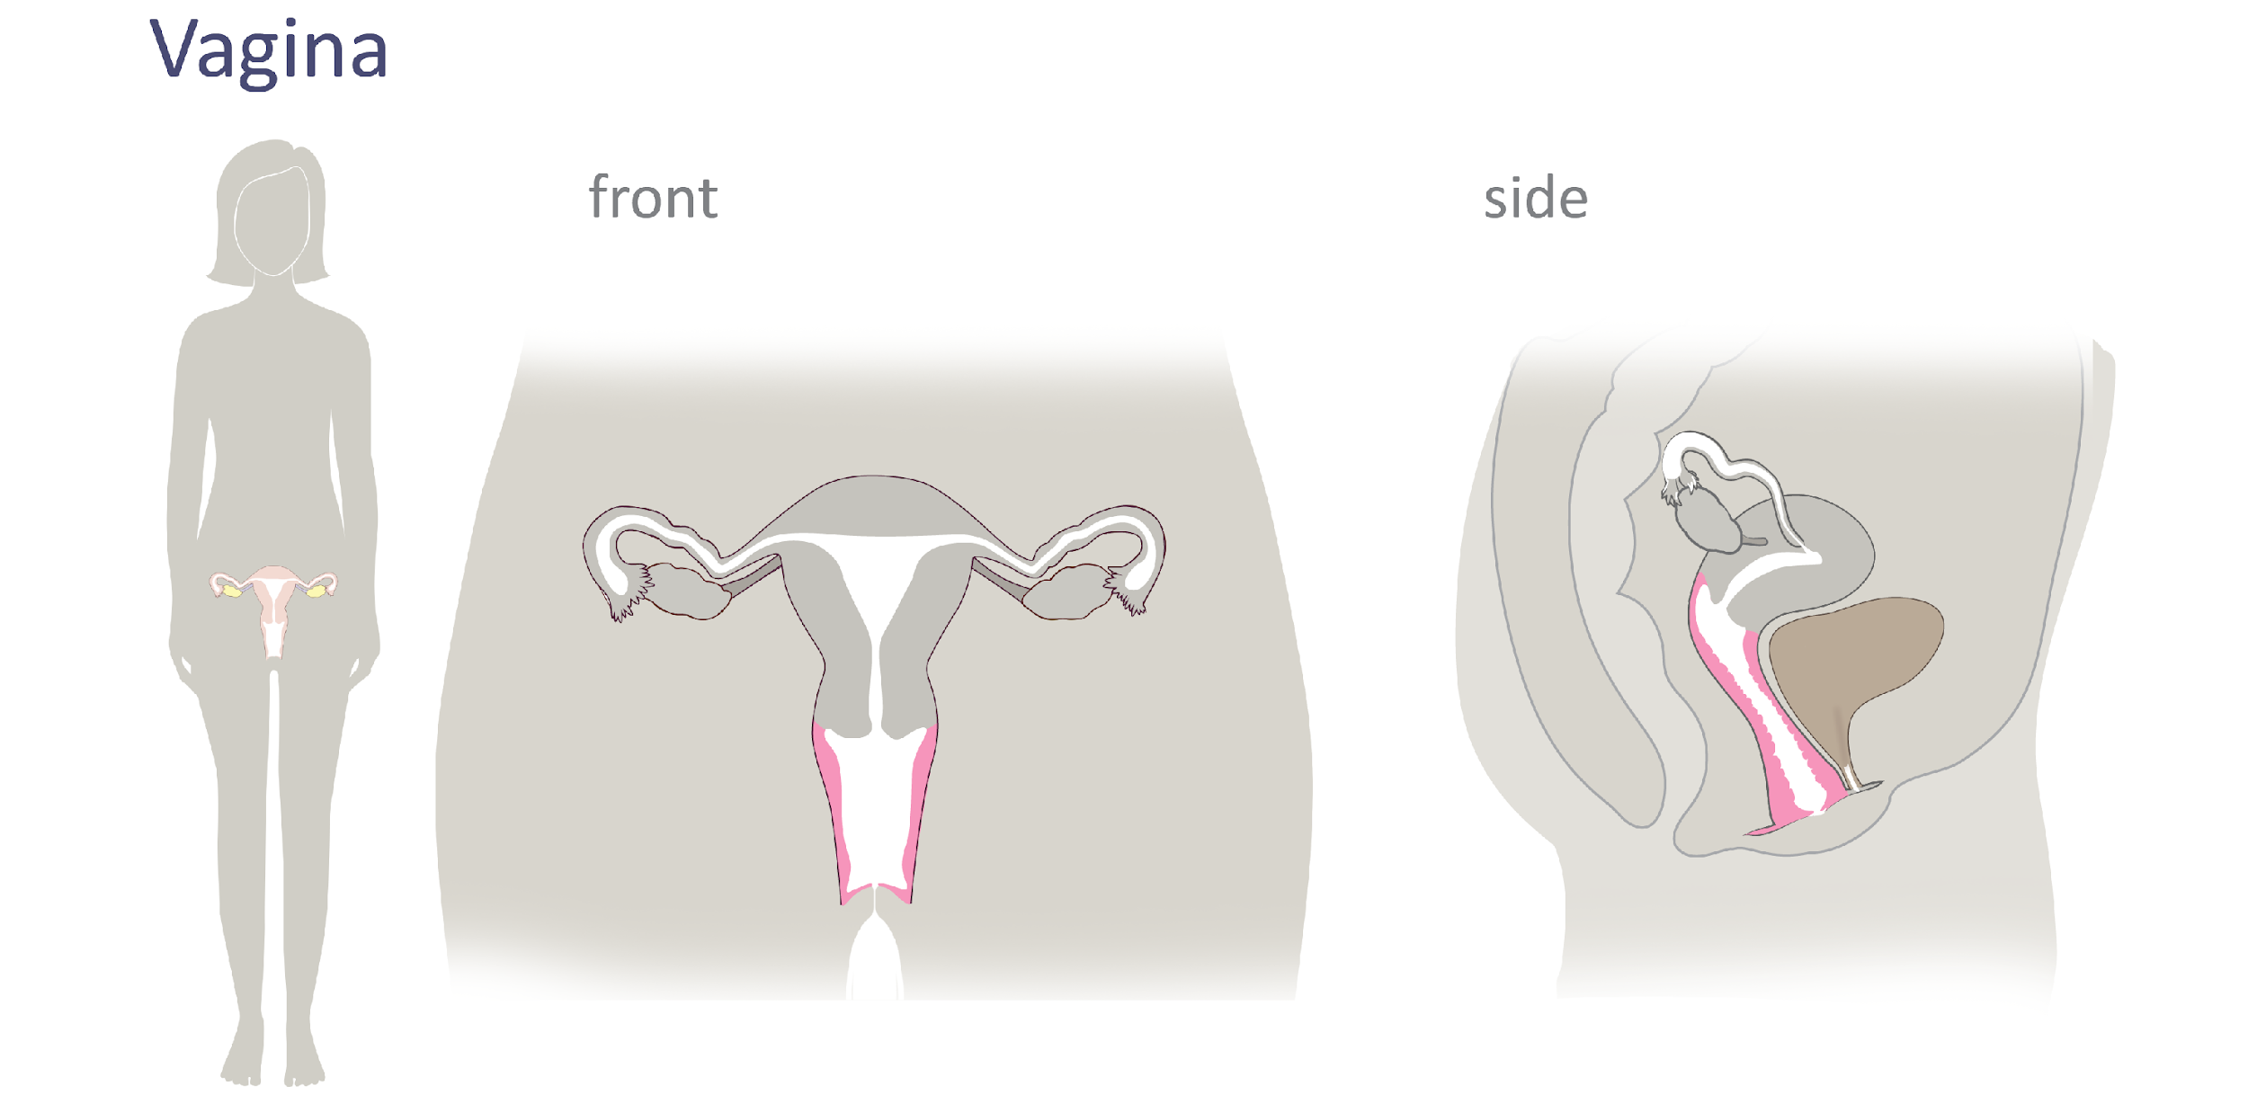
Female Reproductive Anatomy
© FEMM
Notes:
The vagina is the canal that connects the uterus to the outside of the body. It’s the entrance to the reproductive organs and exit for menstrual bleeding and the delivery of a baby.

Slide 14
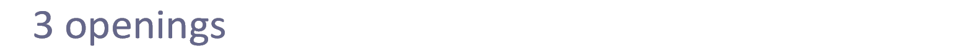
Female Reproductive Anatomy
Urethra
Vagina
Anus
Vagina
© FEMM
Notes:
Teacher: point out the 3 openings/exits from the body: vagina, urethra, anus.
Vagina: The canal that connects the uterus to the outside of the body. It’s the entrance to the reproductive organs and exit for menstrual bleeding and the delivery of a baby.
Urethra: The tube that carries urine from the bladder to the outside of the body.
Anus: The exit for waste matter from the digestive system to the outside of the body.

Slide 15
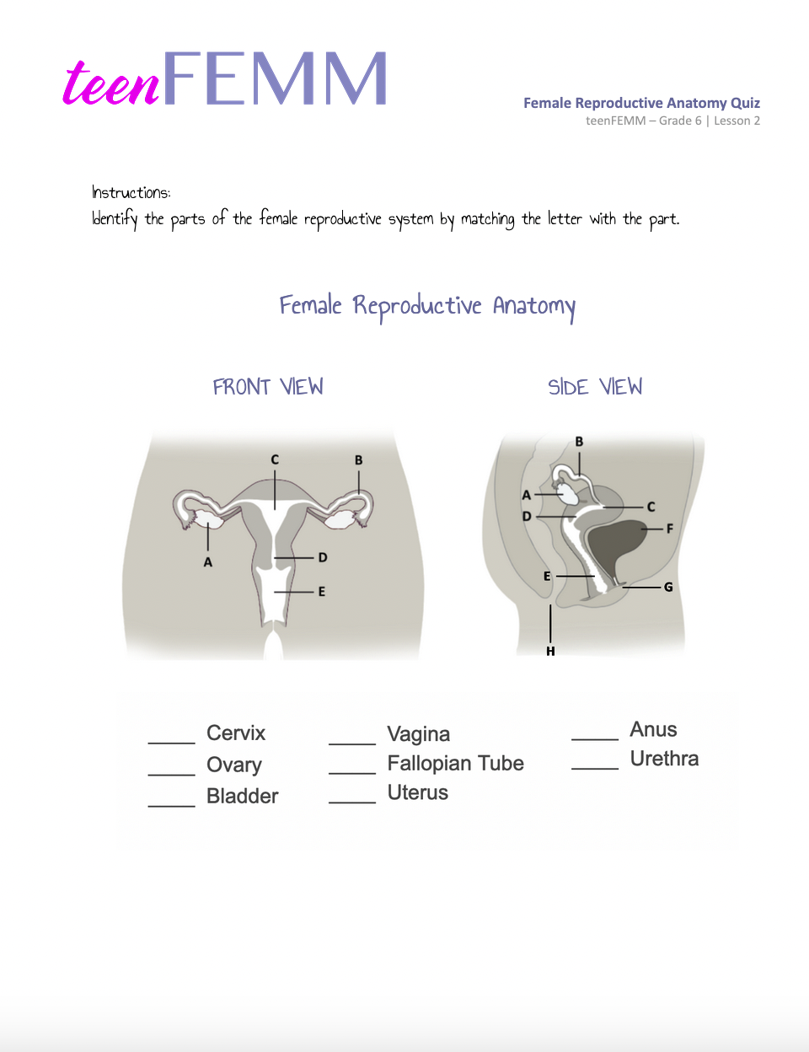
Pop Quiz!
Female
Reproductive
Anatomy Quiz!
© FEMM
Notes:
Provide students with worksheet to fill in the blanks.
Review, using the slides (image with blank spaces, then with answers).

Slide 16
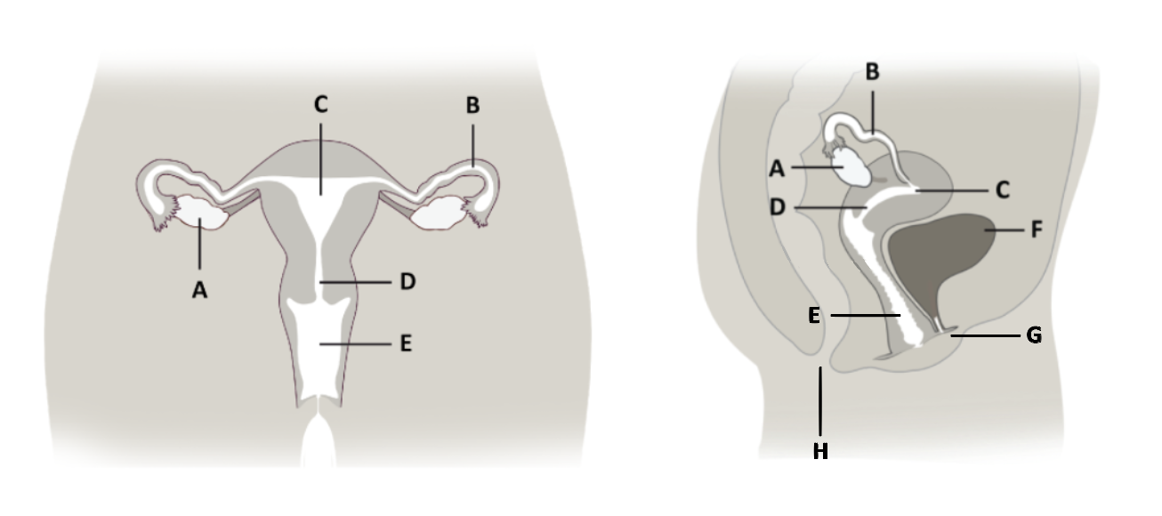
____ Cervix
____ Ovary
____ Bladder
____ Vagina
____ Fallopian Tube
____ Uterus
____ Anus
____ Urethra

Slide 17
Answers!
____ Cervix
____ Ovary
____ Bladder
____ Anus
____ Urethra
D
A
F
E
B
C
H
G
____ Vagina
____ Fallopian Tube
____ Uterus
Notes:
Ovary: Two small organs on either side of the uterus that contain a woman’s eggs - develop and releasing an egg, each month.
Fallopian Tube: 2 tubes, on either side of the uterus, where the egg travels after ovulation.
Uterus: also called the ‘womb’, is where babies begin to grow.
Cervix: A canal at the base of the uterus, that opens into the vagina.
Vagina: canal that connects the uterus to the outside of the body. entrance to the reproductive organs and exit for the delivery of a baby.
Urethra: The tube that carries urine from the bladder to the outside of the body.
Anus: The opening for waste matter from the digestive system to exit the body.

Slide 18
Grade 6
LESSON 2
© FEMM

