Slide 1

Grade 6
LESSON 2
Grade 6
© FEMM

Slide 2
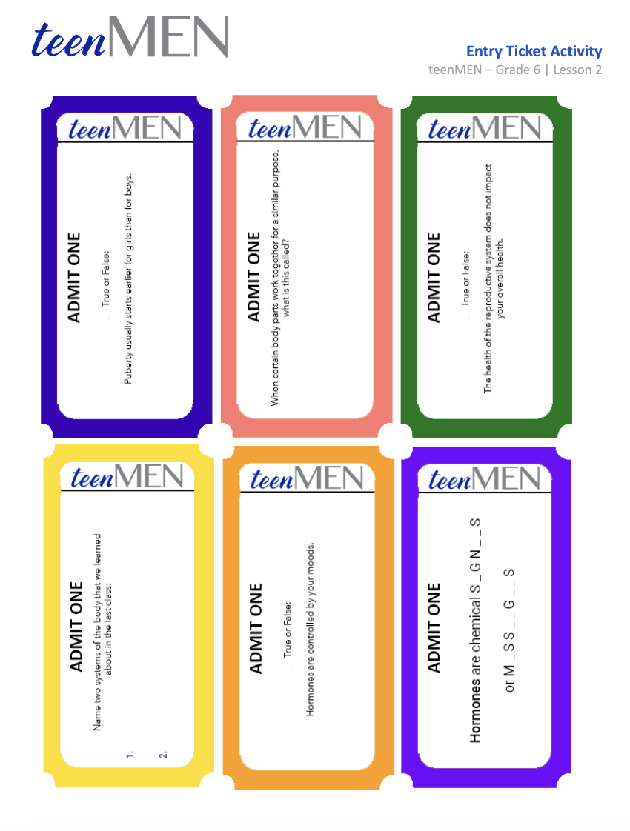
Entry Ticket Activity
© FEMM
Notes:
Print and cut out an “Entry Ticket” per student. Greet students at the door as they enter the classroom and give each student an “Entry Ticket”. Have students write their answers down on the back of the ticket and review questions and answers as a class:
1. When certain body parts work together for a similar purpose, what is this called? Give an example.
This is called a system. The student can name any body system (reproductive, respiratory, cardiovascular, etc.)
2. Are hormones more like text messages or are they more like putting in a password? Why?
They are more like text messages, because they transmit information from one body part to another.
3. Approximately how many hormones have been discovered in the human body? 30, 70, or 250? Can you name one?
70. Some examples are: estrogen, progesterone, testosterone, growth hormone, insulin.
4. True or False? Puberty usually happens between the ages of 23-27 for boys. If you don't think that's the right answer, write the correct answer on the back!
False. It happens between the ages of 10-17 for boys.
5. How do hormones affect puberty? Give at least one example.
Hormones affect puberty by starting it and continuing it. Some examples: making you taller, increasing muscle growth, deepening your voice, and increasing hair growth.
6. True or False: Puberty usually starts earlier for girls than for boys.
True!

Slide 3
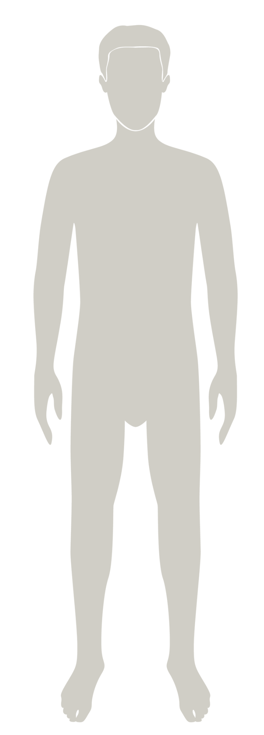
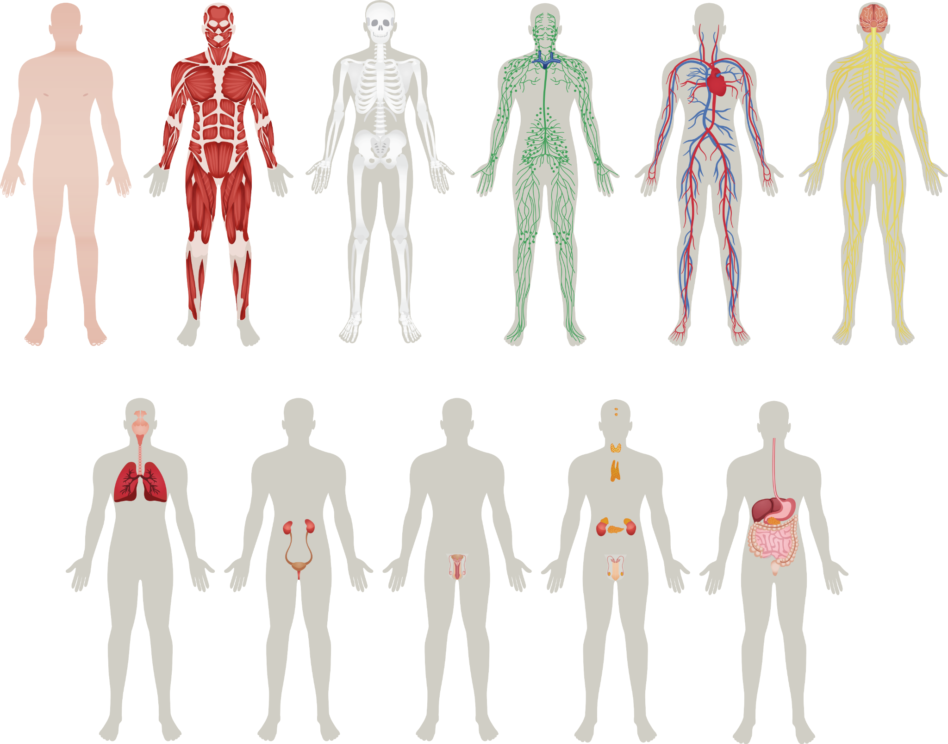
Healthy body
Healthy body
The body is made up of systems.
The health of each system affects the whole body.
Notes:
The body is made up of systems, all working together to make sure the body functions well. We looked at seven body systems in the last class.

Slide 4
Can you name some of your body’s systems?
Notes:
Can you name them all?

Slide 5
⚡Answers⚡
Muscular
Skeletal
Circulatory
Nervous
Respiratory
Reproductive
Digestive
Notes:
Answers!

Slide 6
What’s so great about hormones?
Hormones manage the activity of every system in the body.
Hormones are chemical signals that travel in the bloodstream to tissues and organs, directing:
growth & development
mood
reproduction
© FEMM
Notes:
Just as we need air to breathe, what does every body system need in order to do its job well, and to work together as a whole? Every body system needs clear signals from the brain. What are these signals called? Hormones.

Slide 7
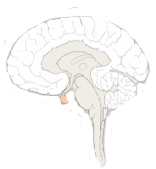
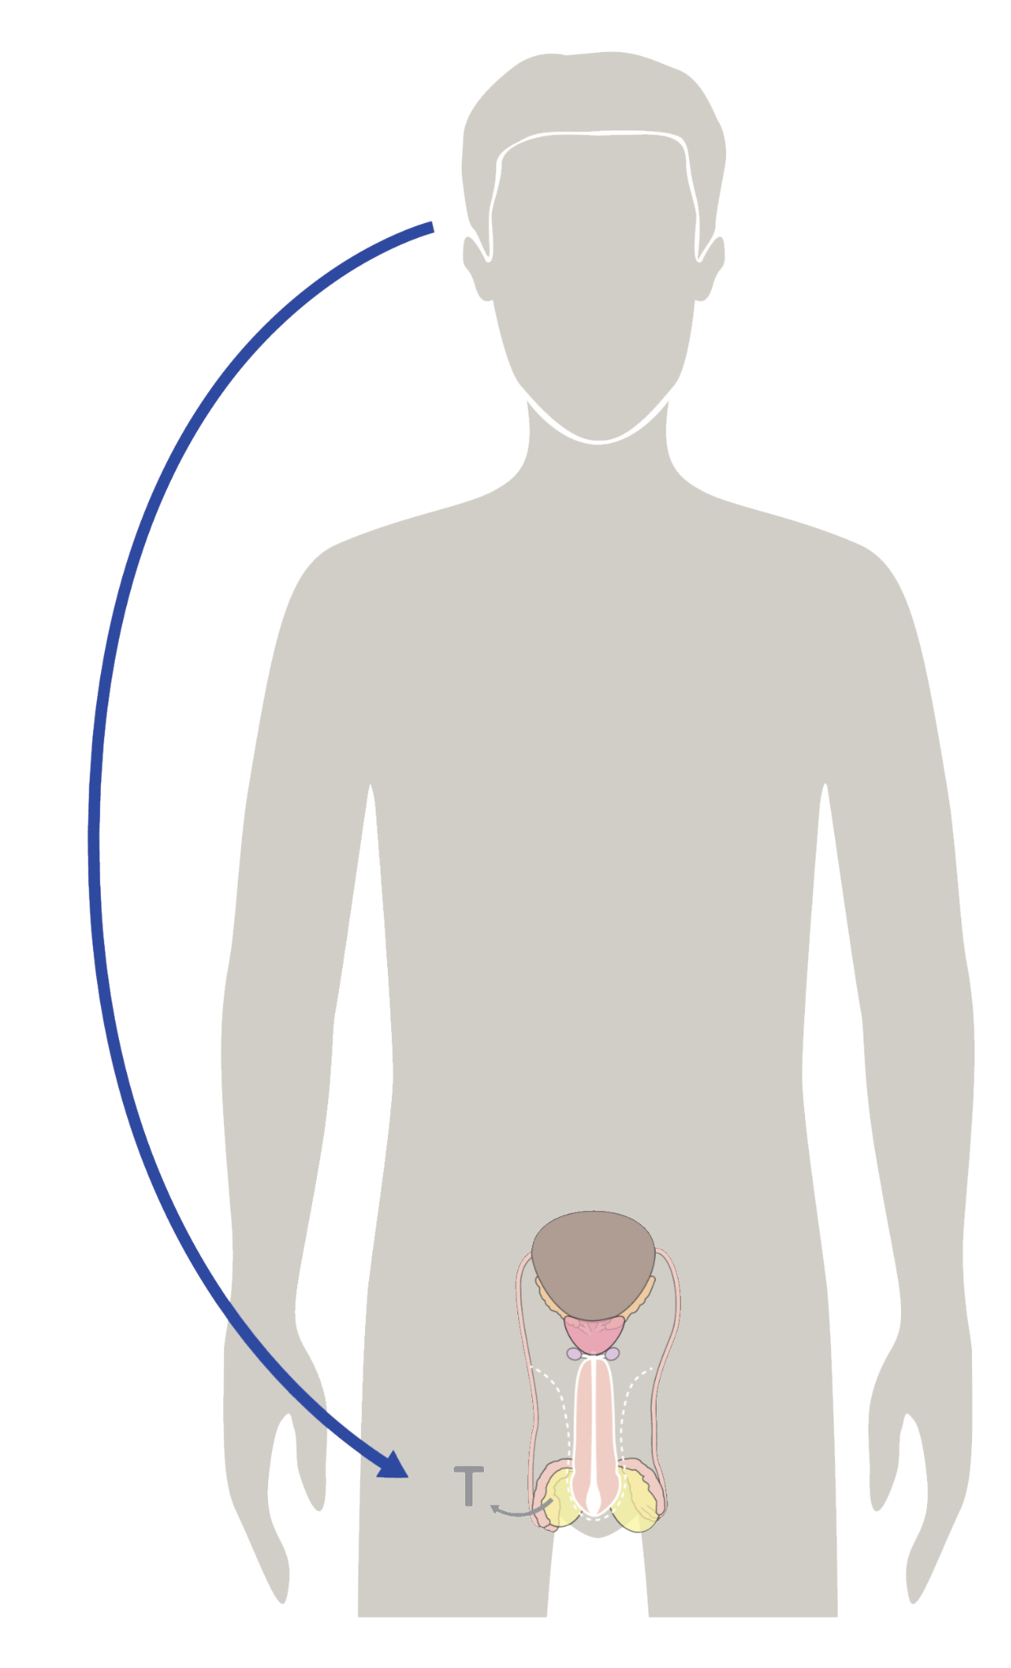
Hormones: chemical text messages
Brain
Reproductive System,
hello, come in,
do you read me?
Repro S.
Roger that, Brian.
Lol BRAIN
Release testosterone.
Notes:
Hormones manage the activity of every system in the body. Hormones are chemical signals that travel in the bloodstream, directing your growth and development, your mood, and in the future, reproduction.
You can think of them like the body’s text messages: chemical messages that your brain and other parts of your body send back and forth, telling them what to do, how to do it, and when to do it.

Slide 8
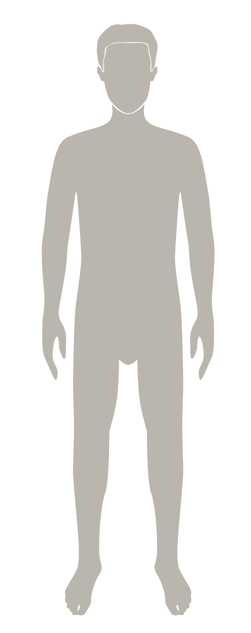
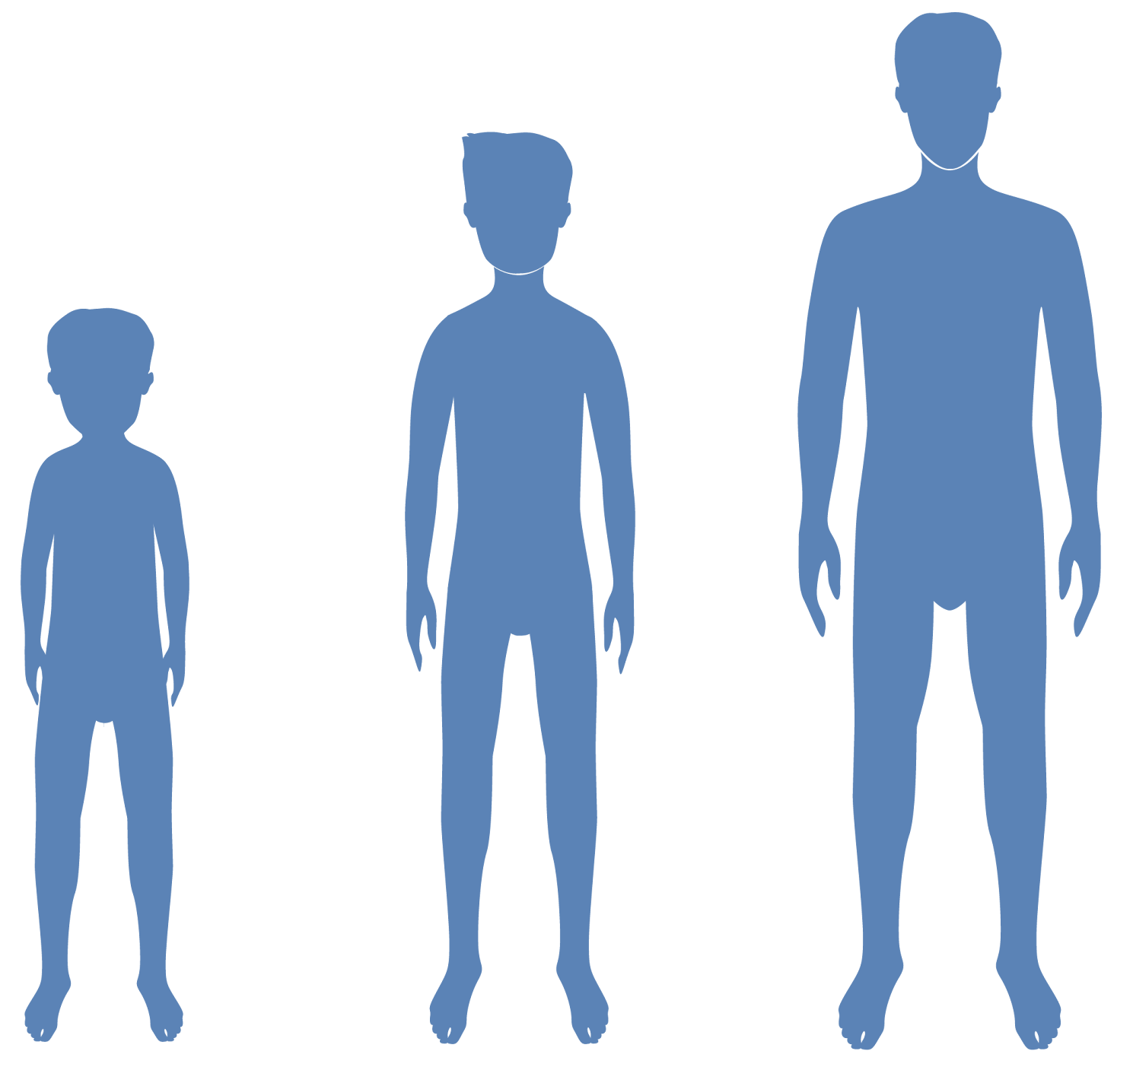
Hormones & your growth
Hormones cause all of the growing & changing that your body does during puberty.
Your brain starts the process, sending hormonal signals throughout your body to trigger growth & development.
© FEMM
Notes:
How do hormones impact puberty?
Hormones cause all of the growing and changing your body undergoes during puberty.
A healthy reproductive system is an important part of this process. To know what a healthy reproductive system is, we first need to know the parts of this system.
8

Slide 9
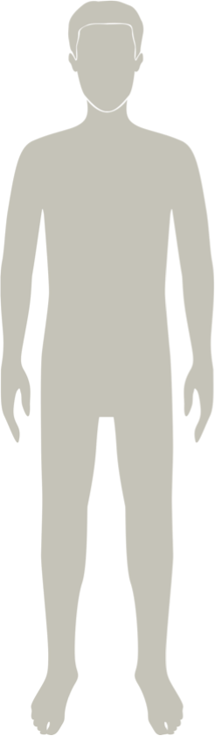
Male
Reproductive Anatomy
© FEMM
Notes:
The reproductive organs are the group of organs in the lower belly/pelvis that work together in men to produce sperm, the male cell of reproduction, and testosterone, the main male hormone.

Slide 10
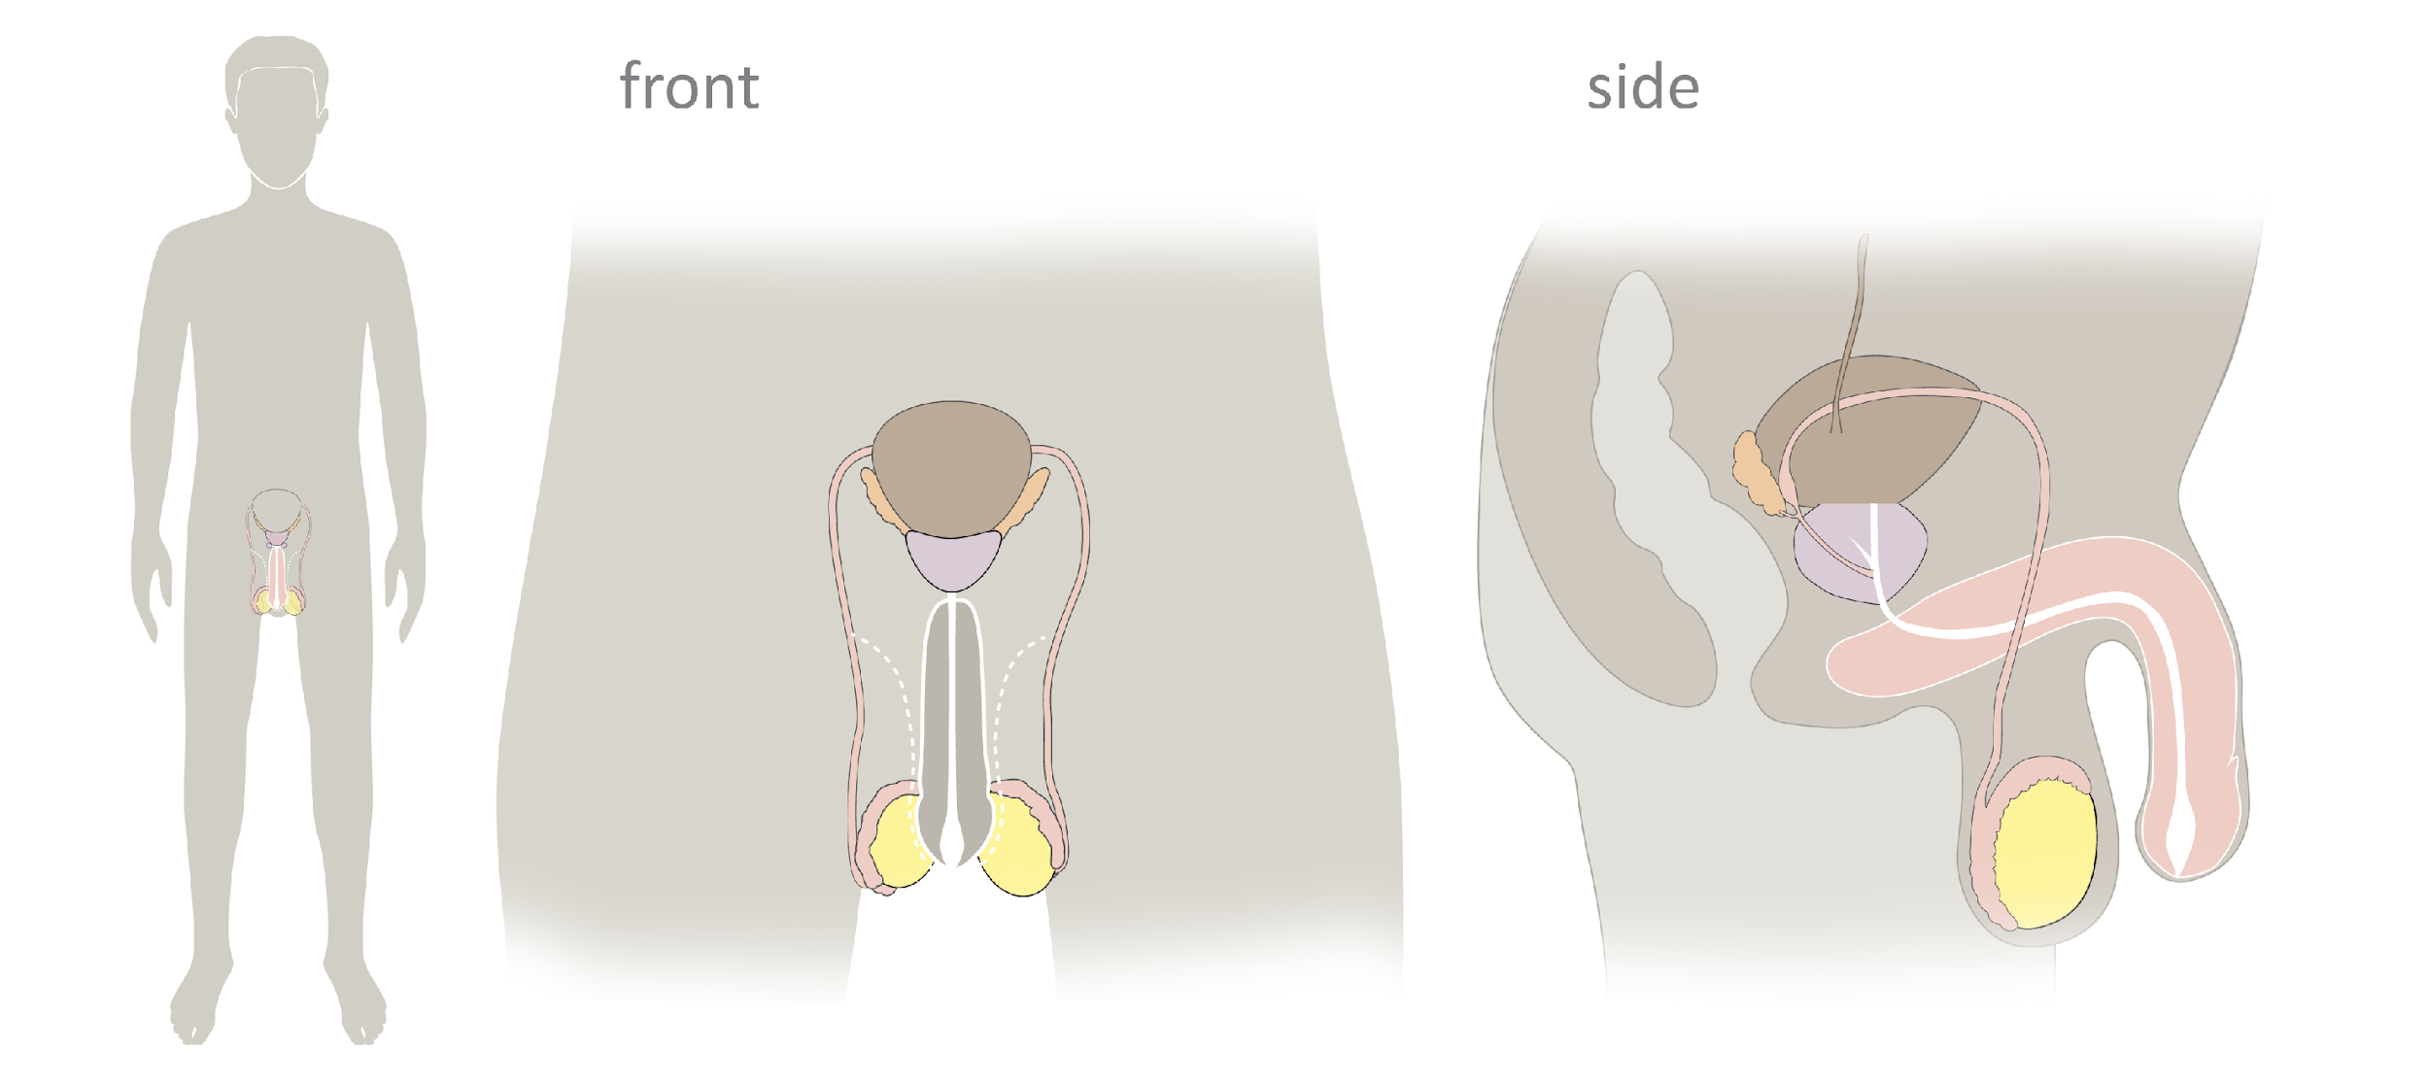
Male Reproductive Anatomy
© FEMM
Notes:
Here is a diagram of the male reproductive anatomy from both the front and side view. The brown, football-shaped organ is the bladder - where urine is stored. This is not part of the reproductive anatomy, but it is useful to know where it is in relation to the reproductive system.
Now we’ll learn the the male reproductive anatomy beginning with the testes and sperm production, and following its movement through the reproductive tract. -testes, vas deferens, urethra, penis.

Slide 11
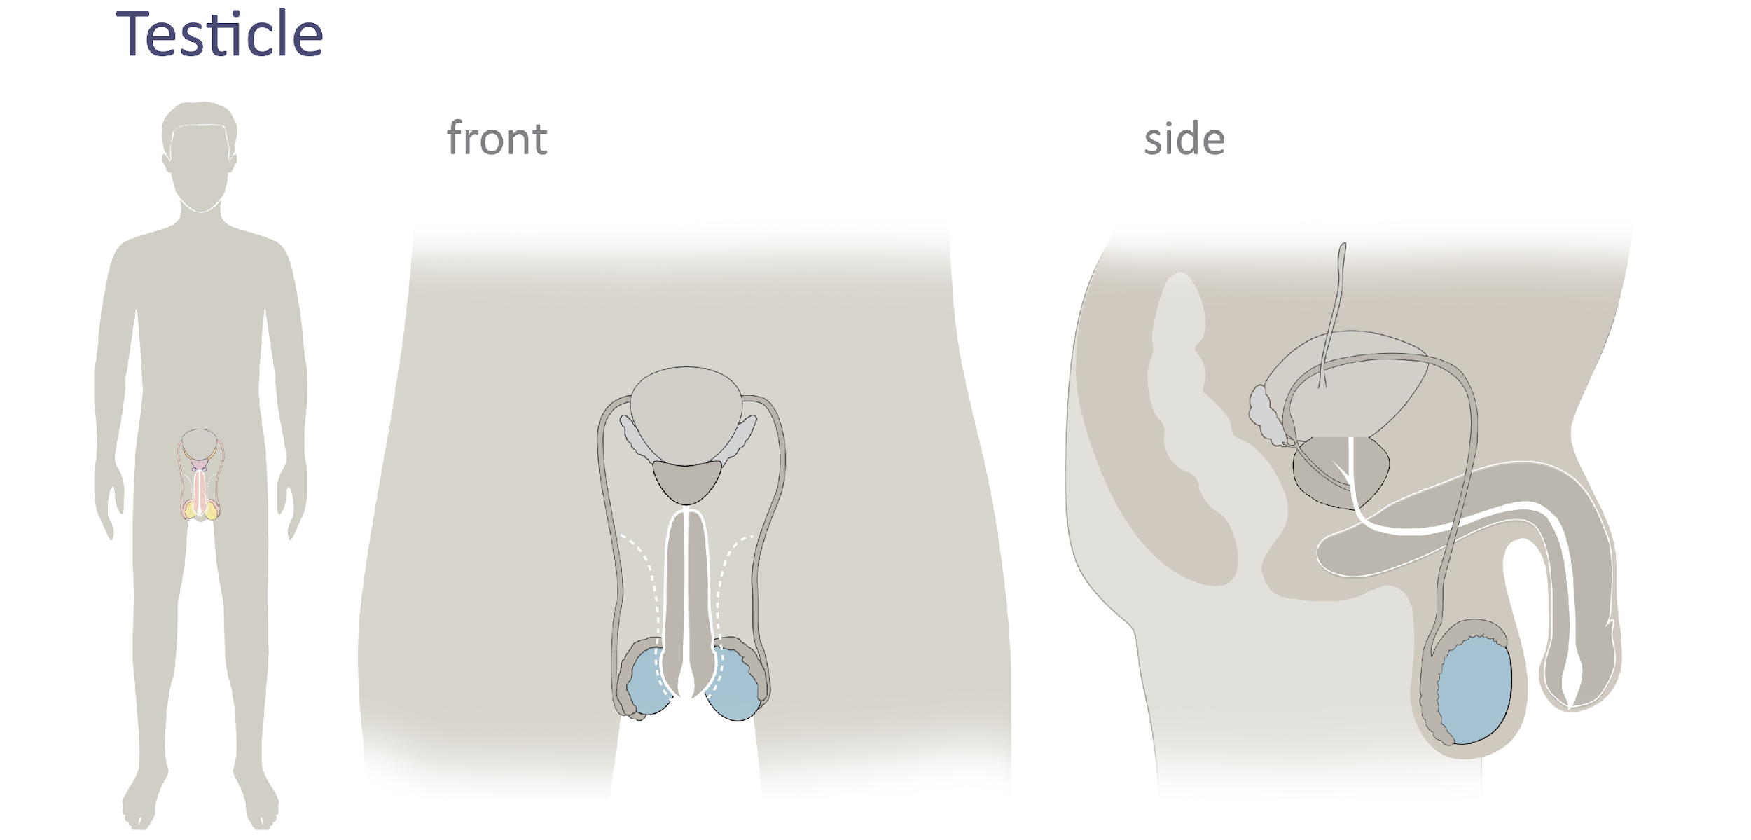
Male Reproductive Anatomy
Testicles
© FEMM
Notes:
Testicles: These are two small organs that produce sperm, the male cell of reproduction. Men/boys have 2 testicles and they are located outside the body, in the scrotum. The testicles also produce the main male reproductive hormone, testosterone.

Slide 12
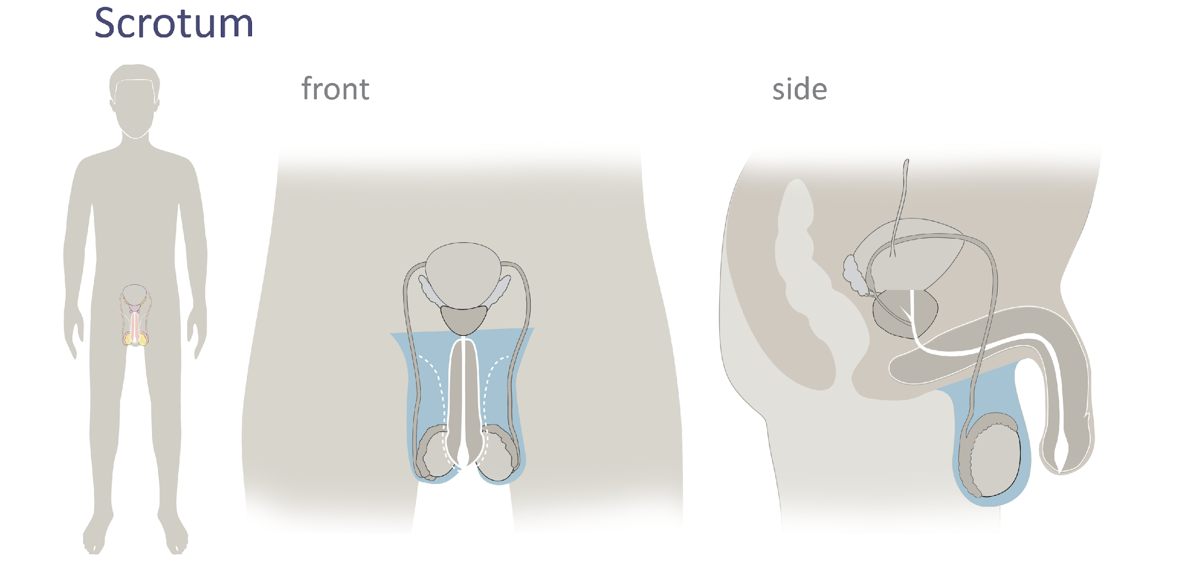
Male Reproductive Anatomy
© FEMM
Notes:
Scrotum: The scrotum is a protective sac of skin, located outside the body, containing the testicles and part of the vas deferens.

Slide 13
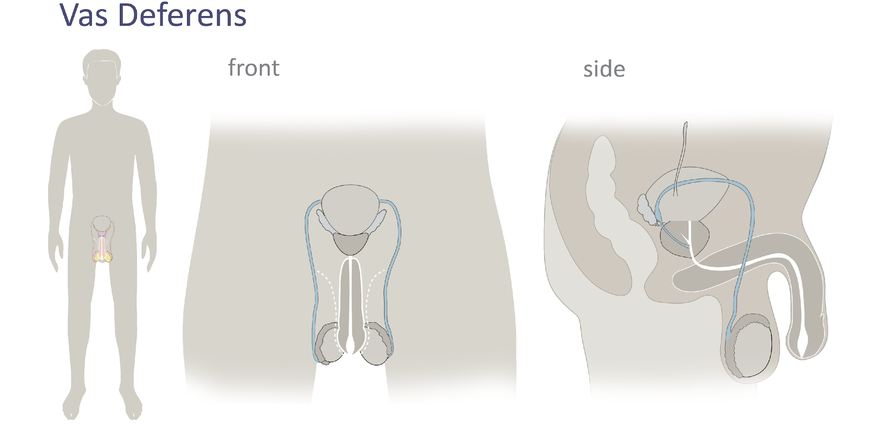
Male Reproductive Anatomy
© FEMM
Notes:
Vas deferens: this is a long tube that transports sperm from the testicles to the urethra. There are 2 vas deferens, one for each testicle.

Slide 14
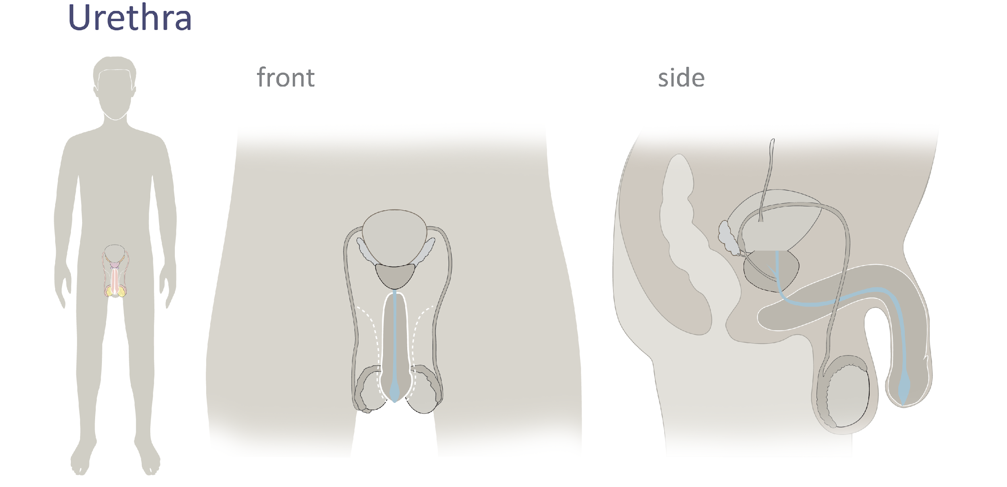
Male Reproductive Anatomy
© FEMM
Notes:
Urethra: this is a tube that begins at the bladder (organ that holds urine) and ends at the tip of the penis. The urethra is the tube that allows urine and seminal fluid to pass out of the body. *Note that urine and seminal fluid cannot be released at the same time.

Slide 15
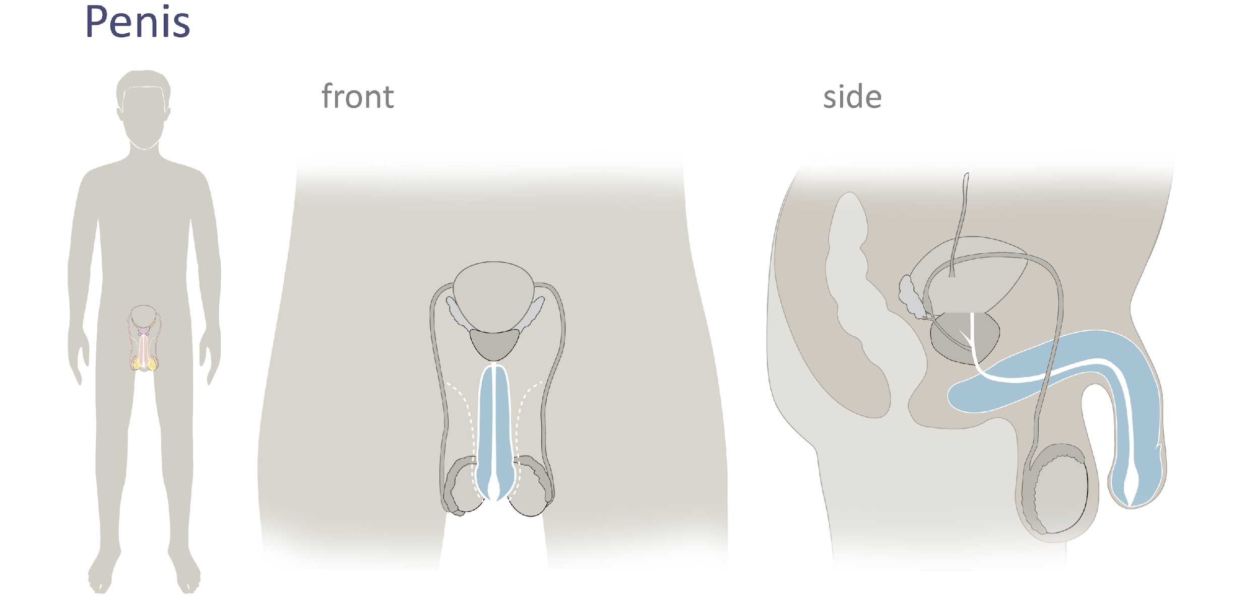
Male Reproductive Anatomy
© FEMM
Notes:
Penis: The penis is an organ used for both urination and sexual intercourse, though never at the same time.

Slide 16
Male Reproductive Anatomy
2 openings
Urethra
Anus
© FEMM
Notes:
In this final anatomy slide, point out the 2 openings to the body in the side image:
urethra: tube that travels through the penis, carrying
a. either urine from the bladder,
b. or semen from the reproductive system
anus: opening for waste to exit from the digestive system
It is important to be mature enough to understand that the reproductive system can be an uncomfortable part of the body to learn about and discuss - but, it’s essential to do so, since it is an important part of a healthy body and is capable of bringing about a new life.

Slide 17
Male Reproductive Anatomy Quiz
© FEMM
Notes:
Provide students with worksheet to fill in the blanks.
Review, using the slides (image with blank spaces, then with answers).

Slide 18
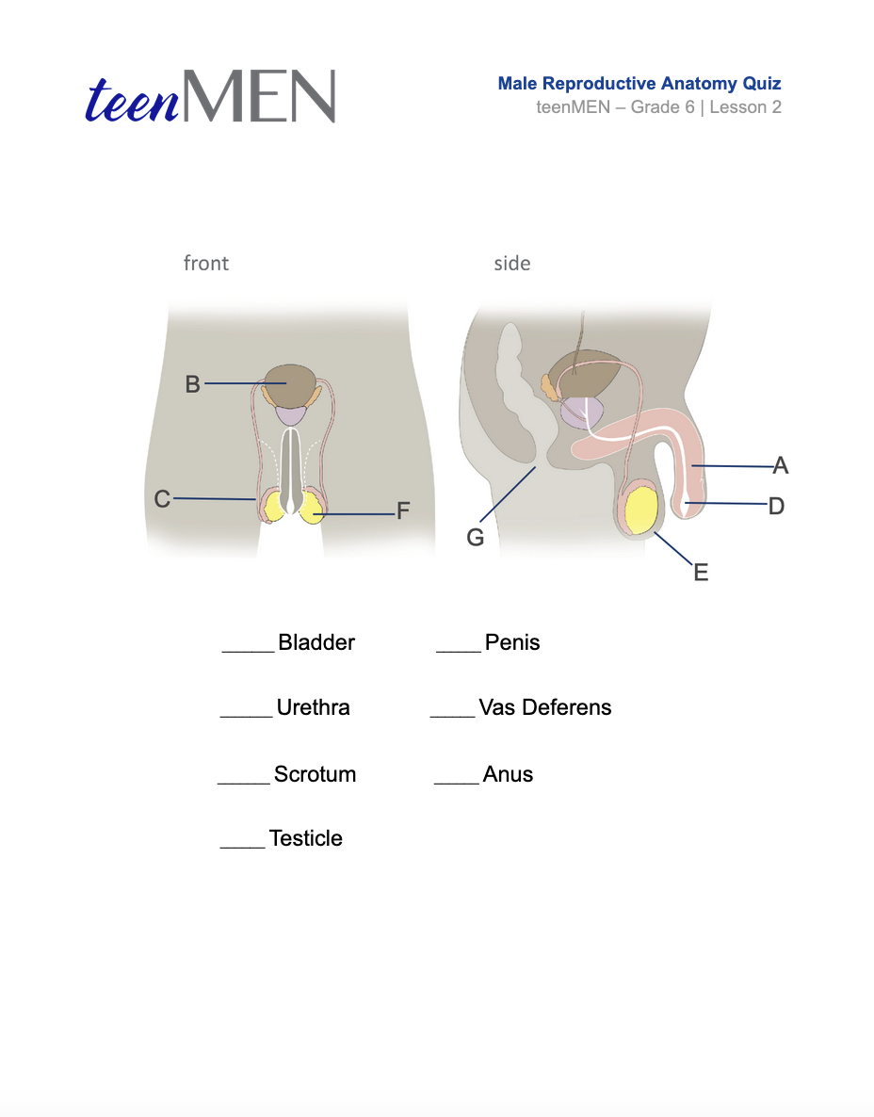
How well do you know your body?
Male Anatomy Quiz
© FEMM

Slide 19
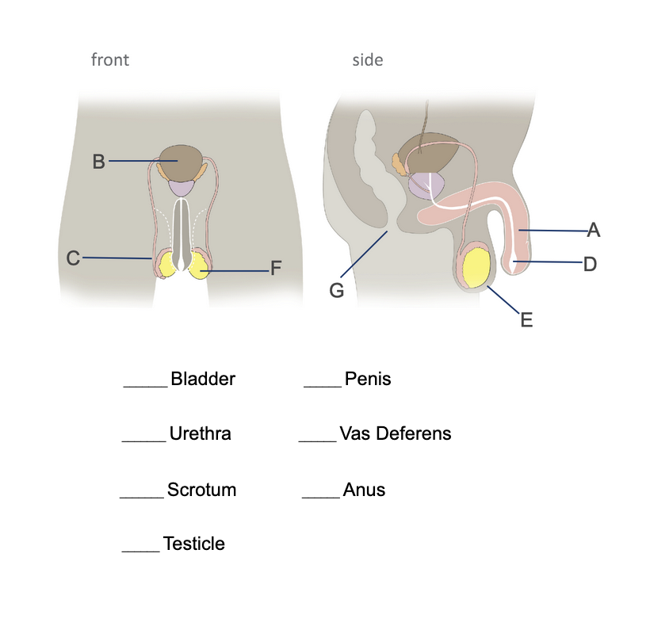
Male Anatomy Quiz
© FEMM
Notes:
Bladder: where urine is stored. This is not part of the reproductive anatomy, but it is useful to know where it is in relation to the reproductive system.
Testicles: These are two small organs that produce sperm, the male cell of reproduction. Men/boys have 2 testicles and they are located outside the body, in the scrotum. The testicles also produce the main male reproductive hormone, testosterone.
Scrotum: The scrotum is a protective sac of skin, located outside the body, containing the testicles and part of the vas deferens.
Vas deferens: this is a long tube that transports sperm from the testicles to the urethra. There are 2 vas deferens, one for each testicle.
Urethra: this is a tube that begins at the bladder (organ that holds urine) and ends at the tip of the penis. The urethra is the tube that allows urine and seminal fluid to pass out of the body. *Note that urine and seminal fluid cannot be released at the same time.
Penis: The penis is an organ used for both urination and sexual intercourse, though never at the same time.
In this final anatomy slide, point out the 2 openings to the body in the side image:
urethra: tube that travels through the penis, carrying
a. either urine from the bladder,
b. or semen from the reproductive system
anus: opening for waste to exit from the digestive system

Slide 20
Male Anatomy Quiz | Answers
B
A
D
C
E
G
F
© FEMM
Notes:
Bladder: where urine is stored. This is not part of the reproductive anatomy, but it is useful to know where it is in relation to the reproductive system.
Testicles: These are two small organs that produce sperm, the male cell of reproduction. Men/boys have 2 testicles and they are located outside the body, in the scrotum. The testicles also produce the main male reproductive hormone, testosterone.
Scrotum: The scrotum is a protective sac of skin, located outside the body, containing the testicles and part of the vas deferens.
Vas deferens: this is a long tube that transports sperm from the testicles to the urethra. There are 2 vas deferens, one for each testicle.
Urethra: this is a tube that begins at the bladder (organ that holds urine) and ends at the tip of the penis. The urethra is the tube that allows urine and seminal fluid to pass out of the body. *Note that urine and seminal fluid cannot be released at the same time.
Penis: The penis is an organ used for both urination and sexual intercourse, though never at the same time.
In this final anatomy slide, point out the 2 openings to the body in the side image:
urethra: tube that travels through the penis, carrying
a. either urine from the bladder,
b. or semen from the reproductive system
anus: opening for waste to exit from the digestive system

Slide 21
Grade 6
LESSON 2
Grade 6
© FEMM
Notes:
This lesson, we reviewed the body systems and learned about the anatomy of the male reproductive system. Healthy levels of hormones are required to be able to produce sperm and for the health of your entire body. Every part of the male reproductive system supports the health of the whole system and the body’s overall health. Next lesson we’ll take a closer look at how all of these parts work together and what drives their activities to keep a healthy body: hormones!

