Slide 1

Grade 6
LESSON 3
© FEMM
Notes:
Step 1 (5 minutes): Activity: Two Truths & A Lie
Print and cut out the What Am I? Two Truths and A Lie activity cards. Hand out the cards for students to read aloud to the class. The rest of the class will guess: first, which body system or part of the body the statements are talking about, and second, which of the three statements is false.
Check answers using the Answer Key provided in the materials.

Slide 2
Understand Your Health
To understand your health,
it’s important to know the basic parts
of your reproductive system.
© FEMM
Notes:
Last class, we went over the female reproductive system parts and how they work together. Let’s review these important parts of the body!

Slide 3
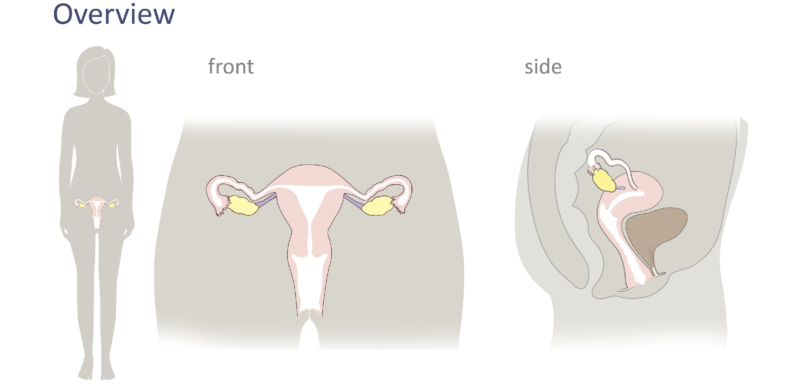
Female Reproductive System
© FEMM
Notes:
The ovaries are the two small organs on either side of the uterus that contain a woman’s eggs. They are shown here in yellow. They are each about the size of an almond. They are small but mighty! In the ovary, an egg (a cell about the size of a pinhead) develops and is released from the ovary into the fallopian tube. This process is called ovulation. This process is not just necessary for reproduction, but it’s also a sign of hormonal health. We’ll learn about this in the coming lessons.
The fallopian tubes are the two thin tubes attached to either side of the uterus. Fun fact: as we learned in the previous activity, the fallopian tubes are about the size (diameter) of a piece of spaghetti!
The uterus, also called the womb, is where all of us begin and grow. It’s an organ that can expand for pregnancy from the size of a lemon to the size of a watermelon. The lining of the uterus thickens during each cycle to prepare the body so that someday it can support a pregnancy. Without a pregnancy, the lining sheds in menstruation. This is what is known as a “period.” This process is normal and healthy for your body.
The cervix is the lower portion of the uterus, a narrow canal opening into the vagina.
The vagina is the canal that connects the uterus to the outside of the body. It’s the entrance to the reproductive organs and exit for menstrual bleeding and the delivery of a baby.

Slide 4
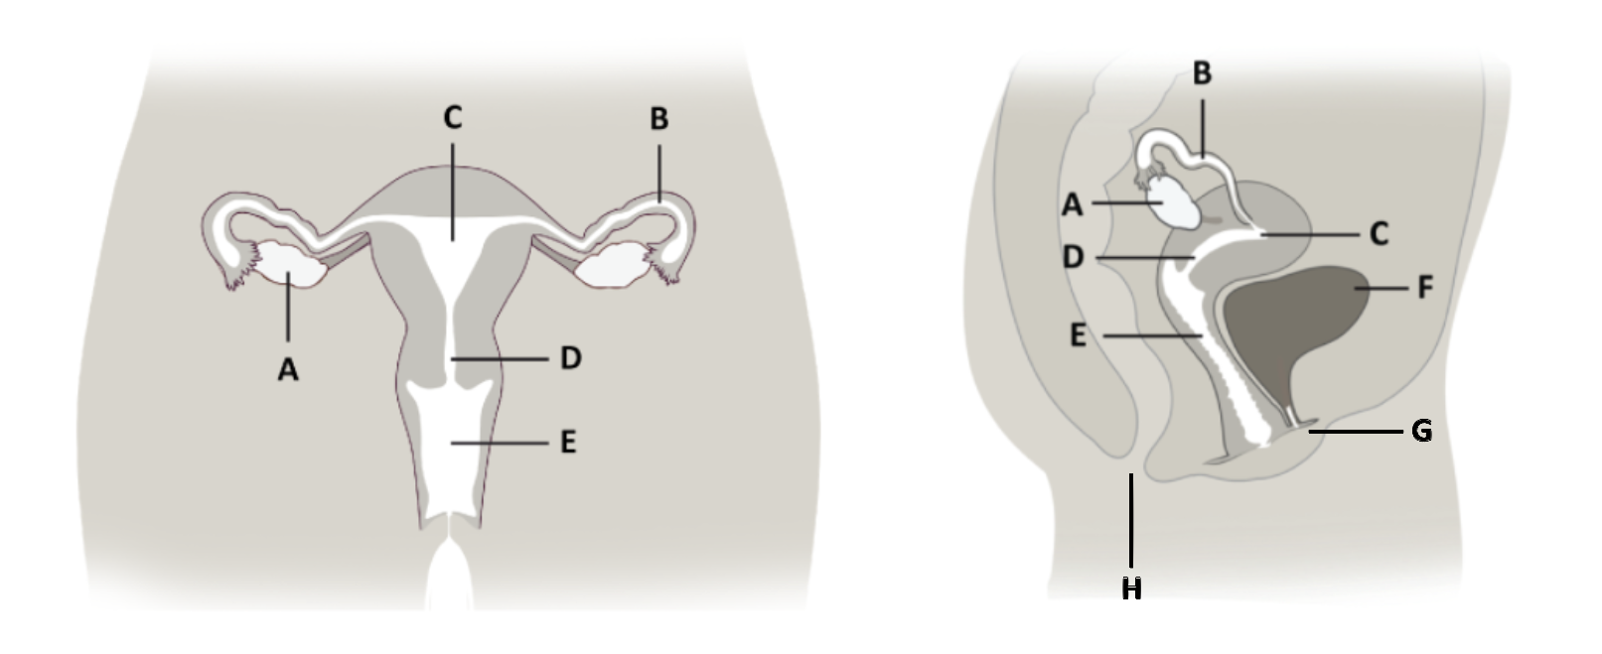
Female Anatomy Quiz
____ Cervix
____ Ovary
____ Bladder
____ Vagina
____ Fallopian Tube
____ Uterus
____ Anus
____ Urethra
Notes:
Have students identify the labeled anatomy on the Female Anatomy Quiz slide, by answering aloud in class. Then show the Answers slide once students have had a chance to respond.

Slide 5
Female Anatomy Quiz Answers
____ Cervix
____ Ovary
____ Bladder
____ Anus
____ Urethra
D
A
F
E
B
C
H
G
____ Vagina
____ Fallopian Tube
____ Uterus
Notes:
Ovary: Two small organs on either side of the uterus that contain a woman’s eggs - develop and release an egg, each month.
Fallopian Tube: Two tubes, on either side of the uterus, where the egg travels after ovulation.
Uterus: Also called the ‘womb’, is where babies begin to grow.
Cervix: A canal at the base of the uterus, that opens into the vagina.
Vagina: Canal that connects the uterus to the outside of the body. Entrance to the reproductive organs and exit for the delivery of a baby.
Urethra: The tube that carries urine from the bladder to the outside of the body.
Anus: The opening for waste matter from the digestive system to exit the body.

Slide 6
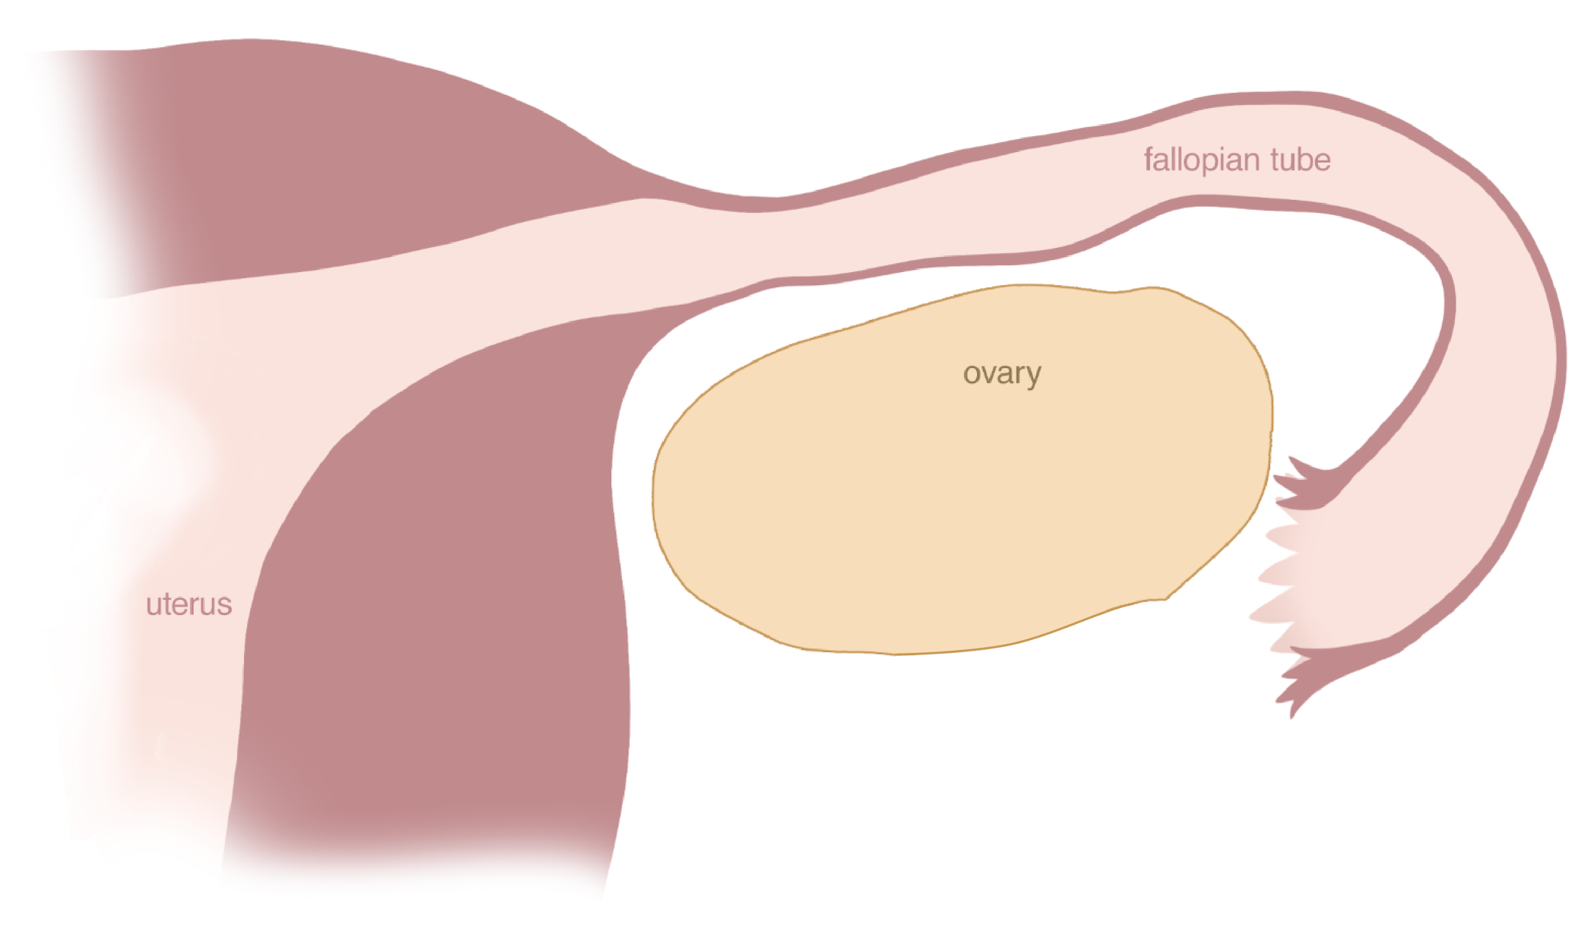
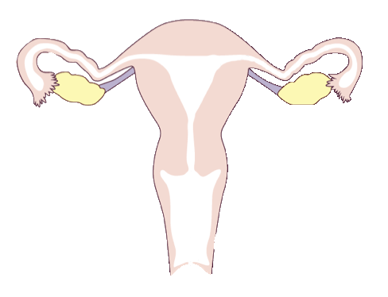
What happens in the ovary?
© FEMM
Notes:
All of the activity of the female reproductive system begins in the ovary.
The ovary is responsible for developing and releasing an egg. An egg is the female cell of reproduction. An egg is no bigger than the point of a pin, but every egg in your ovary contains all of your DNA! That’s a lot of amazing information in one tiny egg!

Slide 7
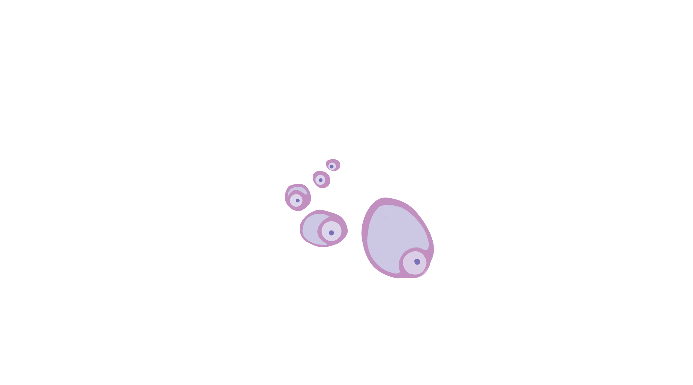
Ovulation
© FEMM
Notes:
As of the onset of puberty, every month, an egg starts to grow and develop in the ovary.
This egg is surrounded by a special, protective tissue, called a follicle (point out the small egg and the follicle, in the image). The egg and the follicle grow together (point out the egg and follicle mid-size).

Slide 8
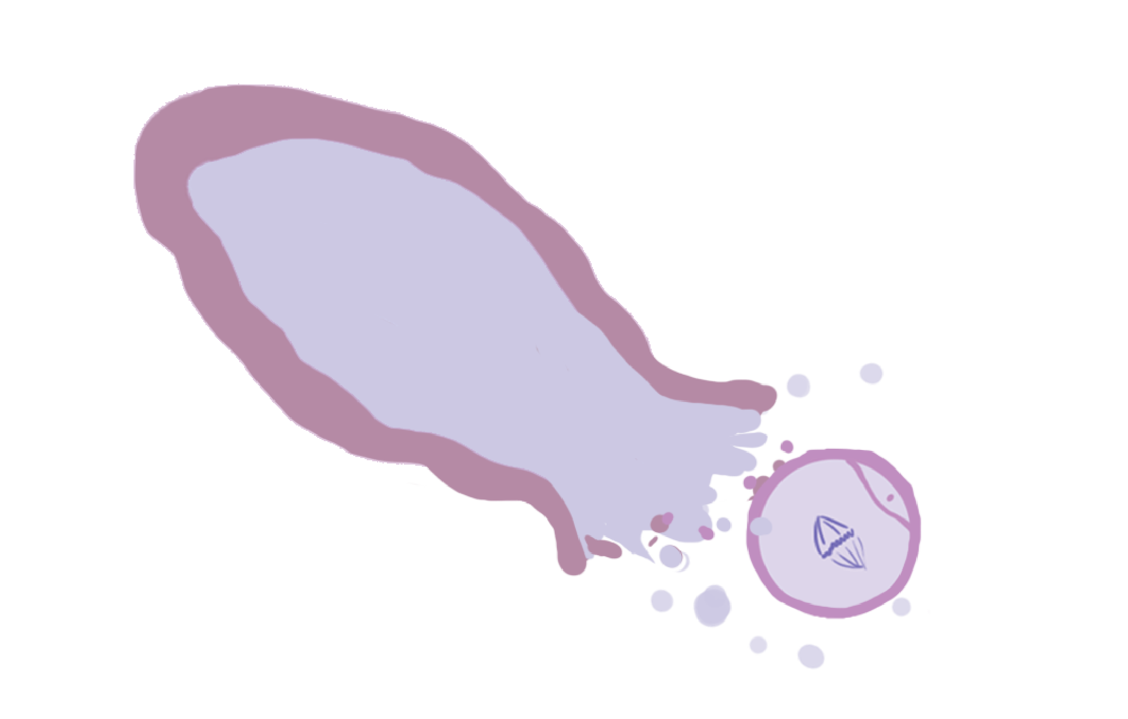
Ovulation
© FEMM
Notes:
When the egg is ready, it is released from its follicle -- this is called OVULATION (point out the empty follicle) -- into the fallopian tube, to begin its journey. (We will talk more about this journey in the next lesson.)
Ovulation takes place in the ovary every month. Something else happens …
Ovulation makes the 2 main female hormones: estrogen and progesterone.

Slide 9
Ovulation + Estrogen
E
© FEMM
Notes:
The growing egg and follicle produce the hormone estrogen. The bigger and more mature the egg and follicle get, the more estrogen they make (point out the growing egg/follicle). This seemingly small event in the ovary releases estrogen to every part of your body: brain, bones, skin, etc!

Slide 10
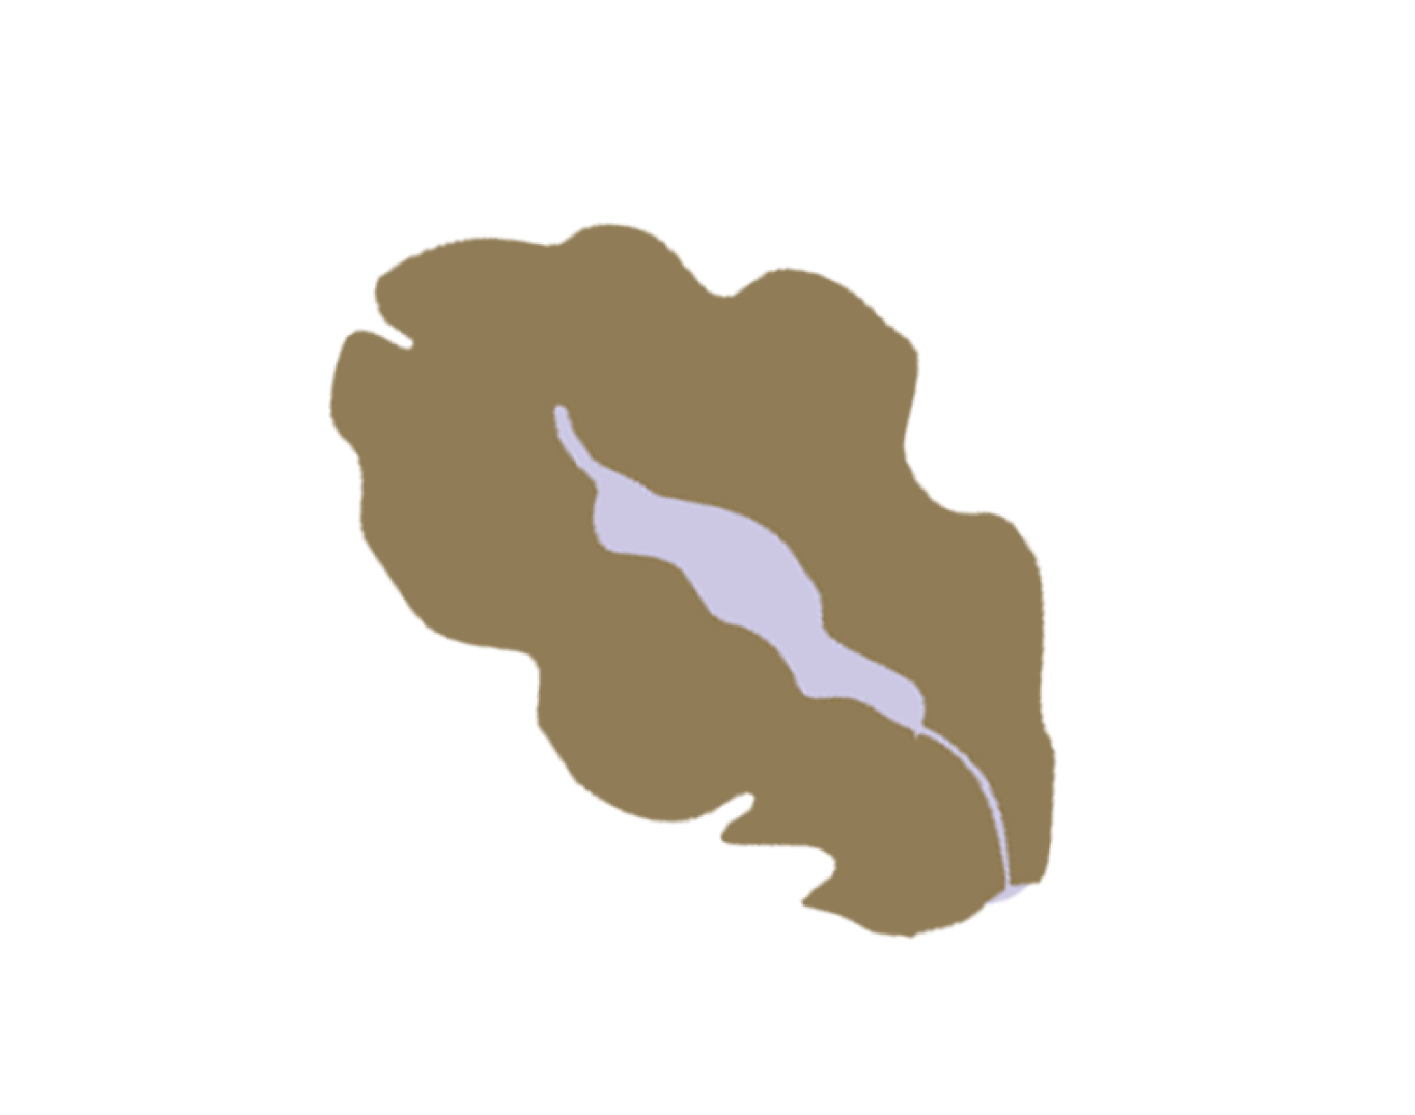
Ovulation + Progesterone
P
© FEMM
Notes:
When the egg is ready, it is released from its follicle -- this is called OVULATION (point out the empty follicle) -- into the fallopian tube.
After ovulation, the empty follicle in the ovary is turned into a new tissue that now makes the hormone progesterone. This tissue is called the corpus luteum.
Fun facts: corpus is the Latin word for ‘body’ and luteum comes from the word ‘lutum’ which is a plant that was used to dye cloth yellow. Under the microscope the corpus luteum tissue is yellowish in color. Hence the name, “yellow body”.

Slide 11
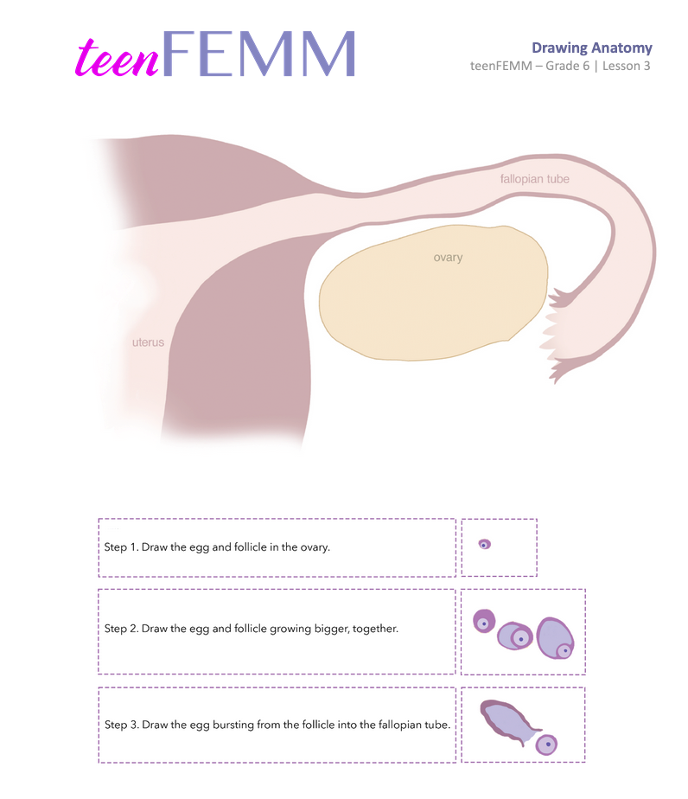
Your turn!
© FEMM
Notes:
Now it’s your turn to describe what happens in the ovary each month.
Hand out the Drawing Anatomy worksheet for students to complete.
Give students a few minutes to complete, then, click through the following four slides to illustrate both the growth of the egg and follicle in the ovary and how estrogen and then progesterone are produced.

Slide 12
Review
© FEMM
Notes:
1. Now it’s your turn to describe what happens in the ovary each month.
What happens to the egg? What happens to the follicle?
Have the students describe the ovulation cycle to the best of their ability. Other students can add or correct statements. Prompt what has not been addressed by the students.

Slide 13
Review
© FEMM
Notes:
2. What is OVULATION and where in the body does it happen?
Ovulation is the bursting of the mature egg from the follicle; it happens in the ovary.

Slide 14
Review
Estrogen
© FEMM
Notes:
3. What are the 2 main jobs of the ovary that happen together?
Develop and ovulate an egg.
b) Produce the 2 main female hormones.

Slide 15
Review
Progesterone
© FEMM
Notes:
4. What are 2 main female hormones made by the ovary?
Estrogen and Progesterone.

Slide 16
Grade 6
LESSON 3
© FEMM

