Slide 1

Grade 6
LESSON 3
Grade 6
© FEMM

Slide 2
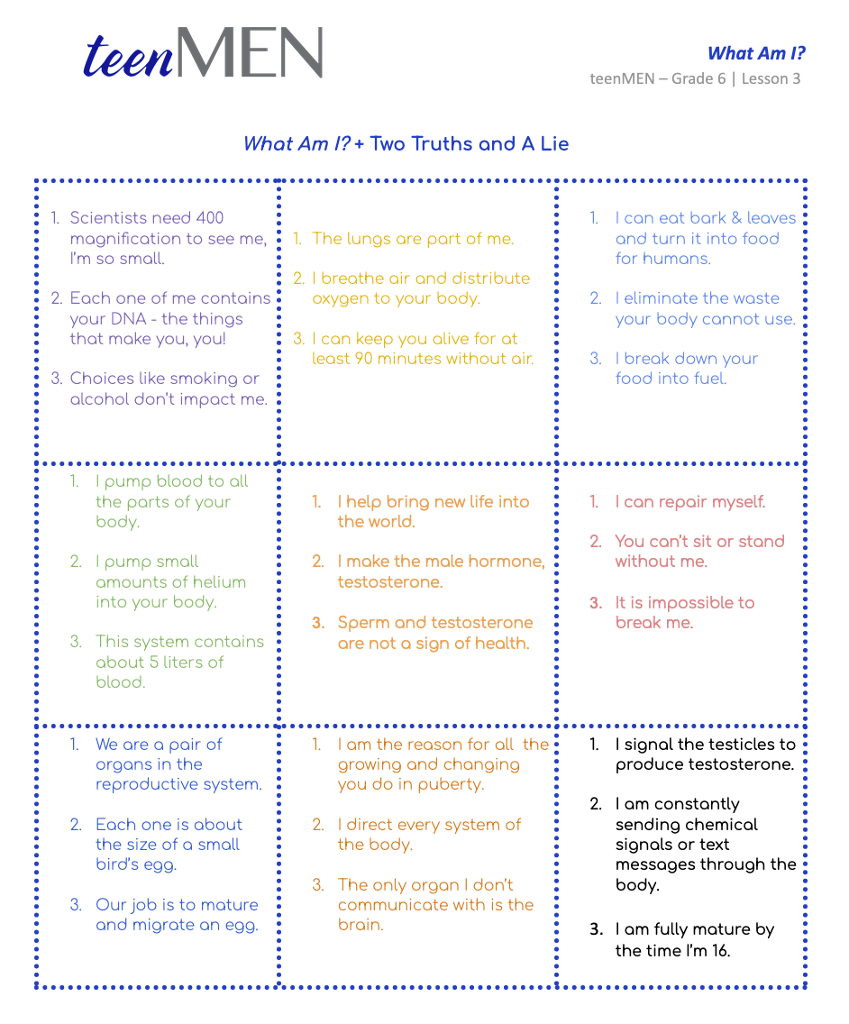
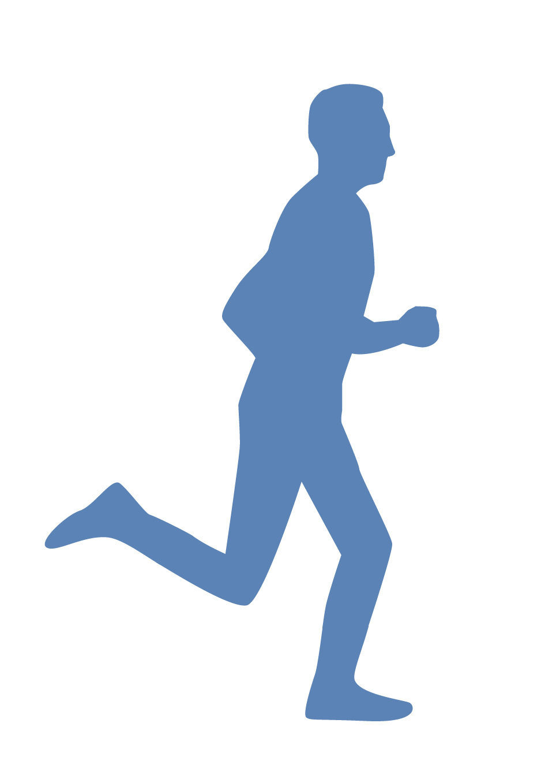
Entry Ticket Activity: What Am I?
WHAT AM I?
A body system or a body part?
Two statements are true
but one is a false start!
© FEMM
Notes:
Print and cut out the What Am I? Two Truths and A Lie activity cards. Hand out the cards one at a time to a student to read aloud to the class. The rest of the class will guess: which body system or part of the body the statements refer to, and which two statements are true and which one is false. Complete as many riddles as time permits.
Check answers using the Teacher’s Answer Key provided in the materials.

Slide 3
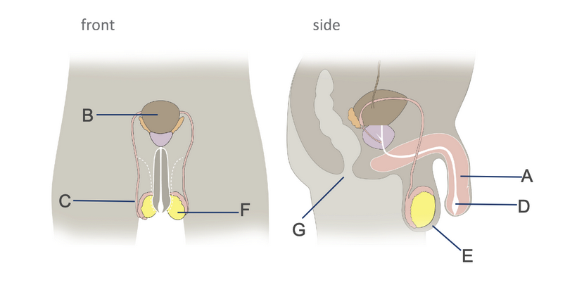
Male Anatomy Quiz
A
Penis
B
Bladder
C
Vas Deferens
D
Urethra
E
Scrotum
F
Testicle
G
Anus
© FEMM
Notes:
Bladder: where urine is stored. This is not part of the reproductive anatomy, but it is useful to know where it is in relation to the reproductive system.
Testicles: These are two small organs that produce sperm, the male cell of reproduction. Men/boys have 2 testicles and they are located outside the body, in the scrotum. The testicles also produce the main male reproductive hormone, testosterone.
Scrotum: The scrotum is a protective sac of skin, located outside the body, containing the testicles and part of the vas deferens.
Vas deferens: this is a long tube that transports sperm from the testicles to the urethra. There are 2 vas deferens, one for each testicle.
Urethra: this is a tube that begins at the bladder (organ that holds urine) and ends at the tip of the penis. The urethra is the tube that allows urine and seminal fluid to pass out of the body. *Note that urine and seminal fluid cannot be released at the same time.
Penis: The penis is an organ used for both urination and sexual intercourse, though never at the same time.
In this final anatomy slide, point out the 2 openings to the body in the side image:
urethra: tube that travels through the penis, carrying
a. either urine from the bladder,
b. or semen from the reproductive system
anus: opening for waste to exit from the digestive system

Slide 4
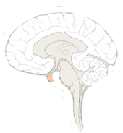
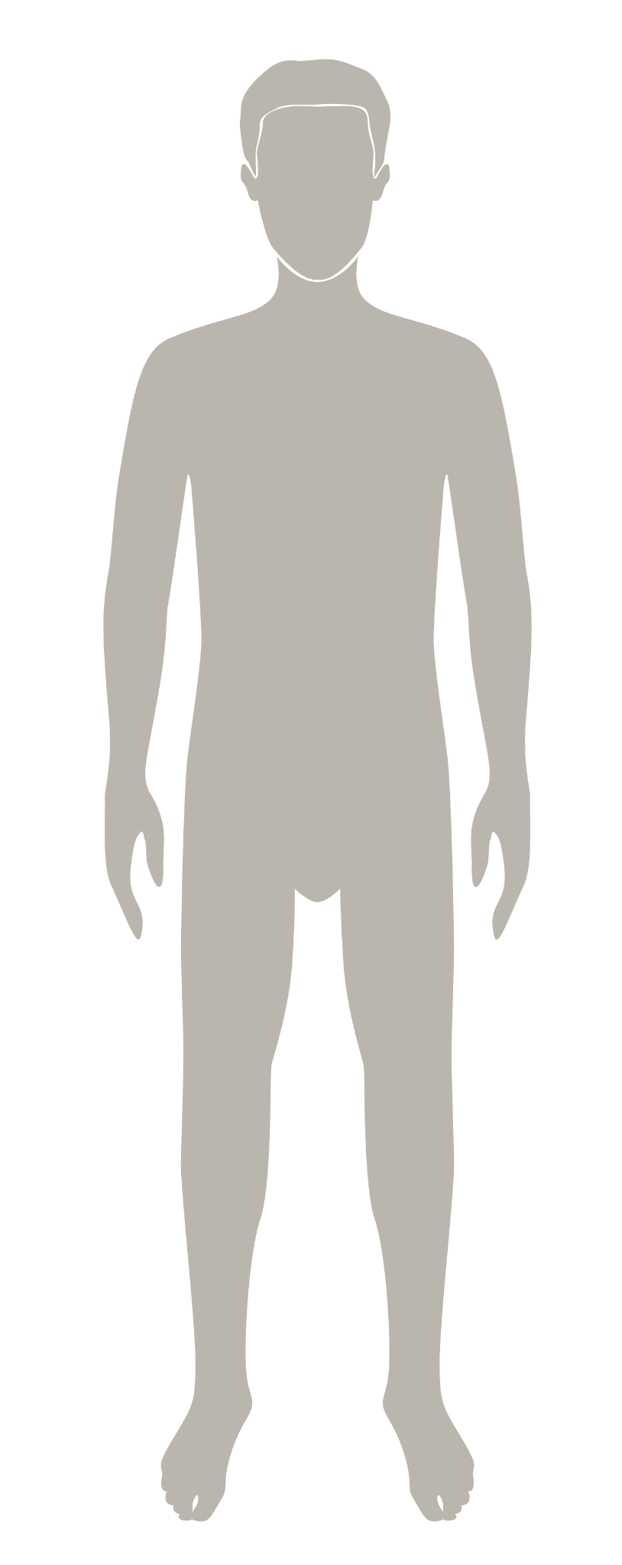
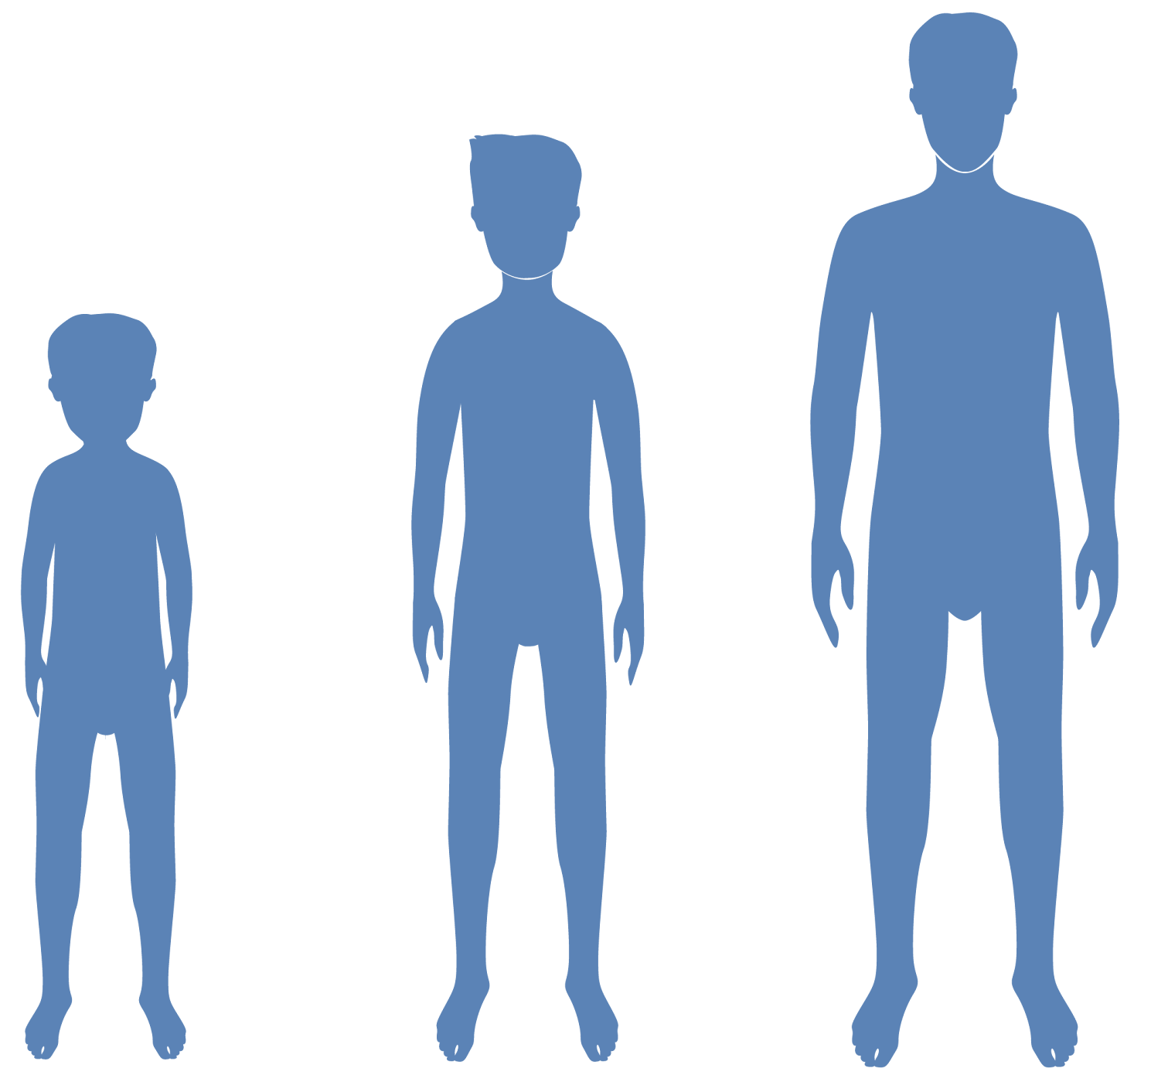
Hormones & your growth
All male reproductive activity starts in the brain.
© FEMM
Notes:
All the activity of the male reproductive system begins in the brain.
4

Slide 5
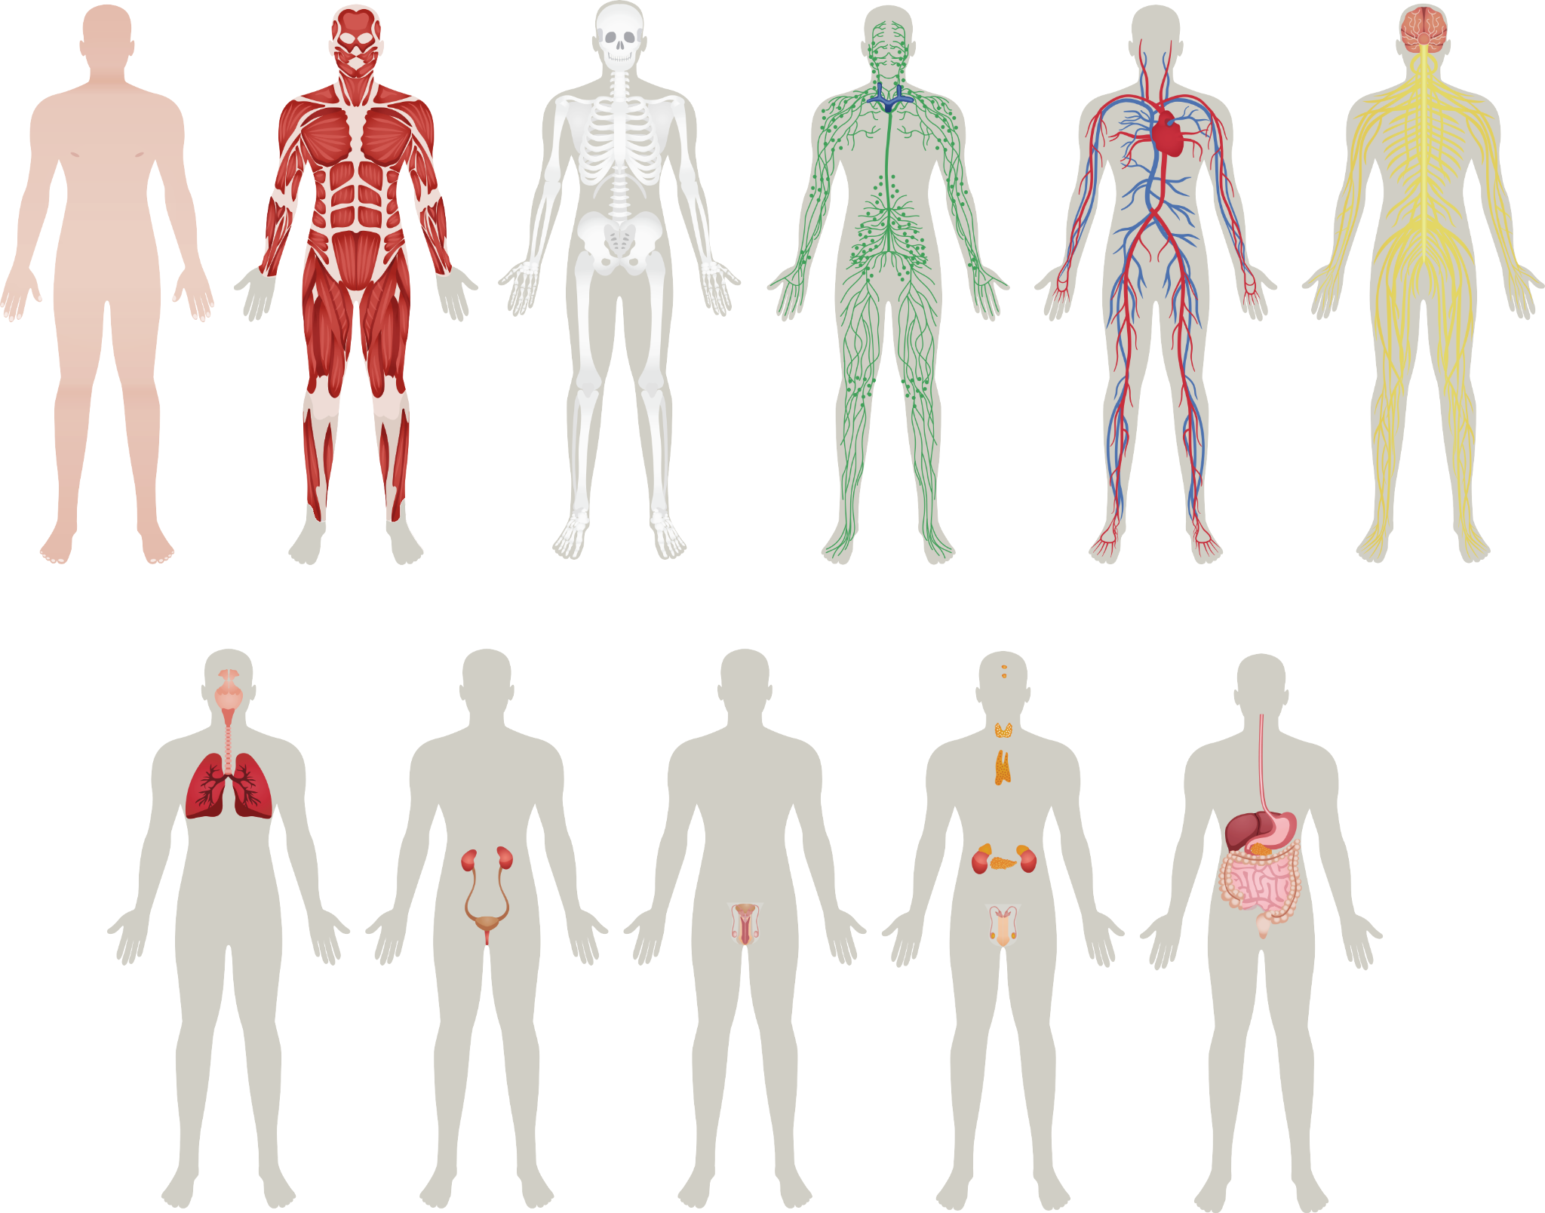
Healthy body
Hormones & your body
Hormones are chemical signals controlled by the brain
that travel in the bloodstream and direct the activity of every system of the body.
Notes:
Who can tell me what a hormone is? Hormones are chemical signals that travel in the bloodstream directing the activity of every system in the body. The body has many different hormones, produced in different parts of the body.
In puberty, the brain tells the reproductive system to produce sperm and testosterone. How?

Slide 6
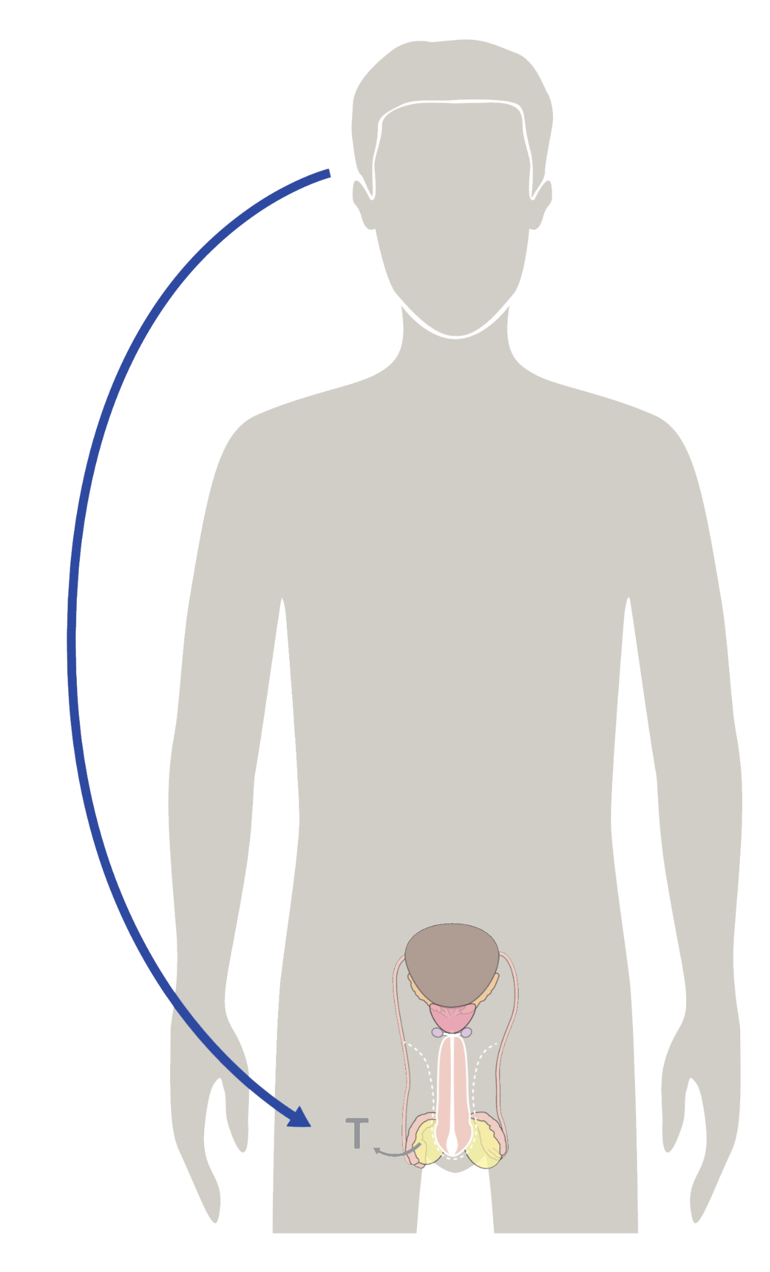
Hormones & your body
1.
This tiny part in the brain is called the
pituitary gland. It’s about the size of a kidney bean and it controls most of the hormones
in your whole body.
2.
The pituitary gland signals the cells in your testicles to produce sperm and testosterone.
3.
This whole process is an important sign of health!
It means that your body is working properly.
Notes:
This tiny part of the brain, colored in orange on the slide, is called the pituitary gland. It’s about the size of a kidney bean. It controls most of the hormones in your body. The pituitary gland sends a signal to the testes, to produce the male cell of reproduction, sperm, and the male hormone, testosterone.
This starts in puberty, as the reproductive system matures to adulthood.

Slide 7
Hormones & your body
This starts in puberty, when the brain signals the testes to start producing:
Sperm & Testosterone
Sperm:
male cell of reproduction
Testosterone:
main male hormone
Notes:
When you were born, you had all of the parts of your reproductive system in place. But it isn’t until a boy reaches puberty that all of his reproductive organs start to function in a fully mature way. Your body didn’t produce sperm when you were a young boy. Boys do have testosterone but not as much as a fully grown man.

Slide 8
Sperm production in the testicles
Sperm are the male cell of reproduction.
They are made in the testicles.
They are one of the smallest cells in your body.
Each sperm (0.05 millimeters!) contains your DNA.
© FEMM
Notes:
The testicles actually make millions of sperm. In fact, by the time your body is done making sperm when you are much older, you will have made about 525 billion sperm. Sperm are one of the smallest cells in your body, measuring about 0.05 millimeters! An individual sperm can only be seen under the microscope.

Slide 9
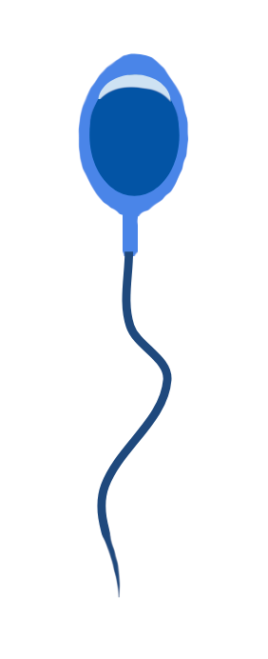
Sperm production in the testicles
Sperm have a head, a midpiece, and a tail.
It takes 75 days for sperm
to become fully mature.
Sperm move through the different parts of the reproductive system during this time.
Sperm must be made at a temperature that is lower than the body’s temperature.
The head is where
genetic material
is carried
The midpiece supplies
the energy the tail
needs to move
The tail propels the
sperm and helps
breach the
egg
Notes:
Under a microscope you can see that sperm have a few distinct parts. Sperm have a head, a midpiece, and a tail. Each part serves a special function in human reproduction, to enter the female egg and join together to create a new life.
It takes about 75 days on average for sperm to grow and mature through the male reproductive system. Each part of the reproductive system contributes something unique to the development of sperm, and in a mature man, this process of sperm development is constantly happening. After sperm are made, they remain in the testicles for about two weeks before the cells die and are reabsorbed by the body. In the case of human reproduction, sperm enter the woman’s reproductive system and when the sperm and egg join together, they create a new human being.
Sperms are delicate and must be made at a temperature that is about 3-5 degrees lower than body temperature. This is why the testicles hang outside the body in the scrotum. The scrotum contains small muscles, and just like any other muscle in the body they have the ability to contract and move. When the body is cold, for instance, muscles raise the testes to bring them closer to the warmer groin region.

Slide 10
Testosterone production in the testicles
Testosterone is the main male reproductive hormone.
Special cells (Leydig cells) produce testosterone inside of your testicles.
Testosterone helps with sperm production, but it also does many other important jobs in your body.
© FEMM
Notes:
The two main jobs of the testicles is to produce sperm and testosterone. Special cells in the testes produce the hormone testosterone. Testosterone then enters the bloodstream and impacts the health of your whole body.

Slide 11
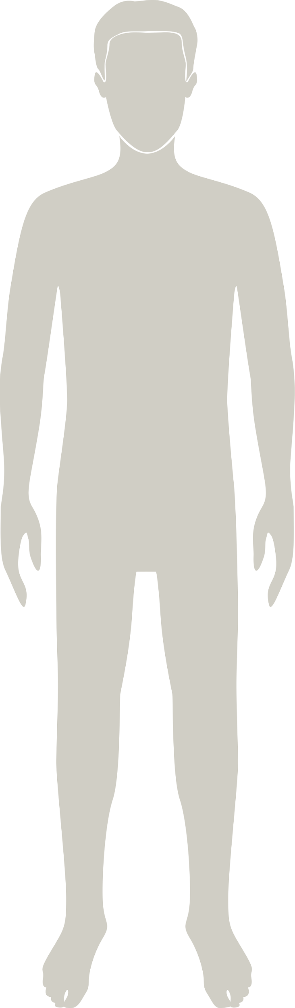
Testosterone & growth
Testosterone has these effects:
strengthens bones, muscles, heart
deepens voice
increases hair growth
increases oil & sweat production
These changes begin during puberty (typically ages 10-17)
© FEMM
Notes:
In puberty, the increased production of testosterone in the cells of the testicles, triggers growth and development in every part of your body. Some of the noticeable effects of testosterone on the body are: increased muscle development, strength, deeper voice, increased hair growth and sweat production.
All of the growth that you will do in the next several years, as your body grows from a boy’s body to a man’s body, will be impacted by the hormone testosterone.

Slide 12

Relay Race to Review!
© FEMM
Notes:
Print two copies (each team will need a copy) of the Relay Race to Review and cut along the dotted lines.
Explain that the general idea of a relay race is a team of athletes who work together to each complete their portion of the race, passing the baton to the next person when their part of the race is complete.
In the teenMEN Relay Race to Review there are three skill testing sections, each with three questions to complete. These questions are to be answered by the individual for the team but not with help from the rest of the team (depending on class size, students may complete their section as a pair.) There is a final Team Bonus question that can be answered by the whole team, for the finish. In the end, the team with the most points wins.
Divide students into two teams. Arrange the two teams at one end of the room, while the teacher will stand at the other end of the room with the questions. Students will race to the teacher to receive their section, fill out the answers to the questions at the front of the room, then return to their team. The next student will follow, racing to the front of the room to receive their questions, and so forth until the Bonus round when students can work as a team to submit their answers.

Slide 13
Review
Your brain directs the activity of your reproductive system.
Sperm is the male cell of reproduction. Sperm is made in the testicles.
Healthy levels of hormones are required in order to be able to produce sperm and for the health of your entire body.
© FEMM
Notes:
All male reproductive activity is controlled by the brain. The brain lets your reproductive system know that it’s time to mature and grow towards becoming a man. Sperm is the male cell of reproduction. Testosterone is the main male hormone. Testosterone has many important effects on the healthy growth of your body and we’ll learn more about these in the next lesson.

Slide 14
Grade 6
LESSON 3
Grade 6
© FEMM

