Slide 1

Grade 6
LESSON 4
© FEMM

Slide 2
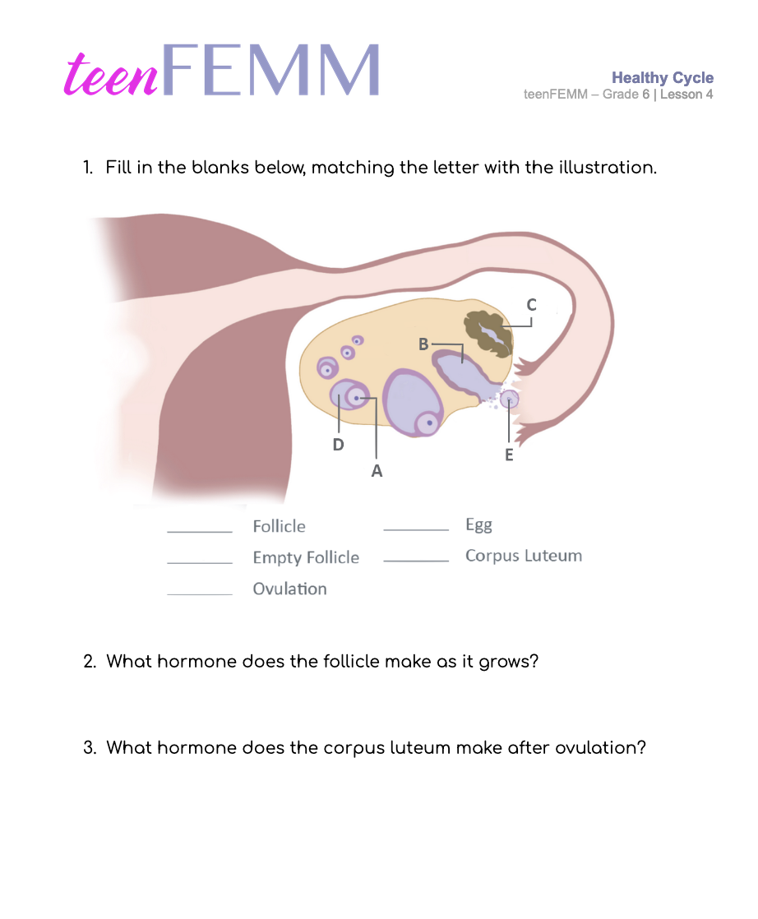
Healthy Cycle | Worksheet
Check Your Knowledge!
Notes:
Hand out worksheets. Have students identify the labels showing the activity of the ovary. Once a few minutes have elapsed, reveal the slide with answers.

Slide 3
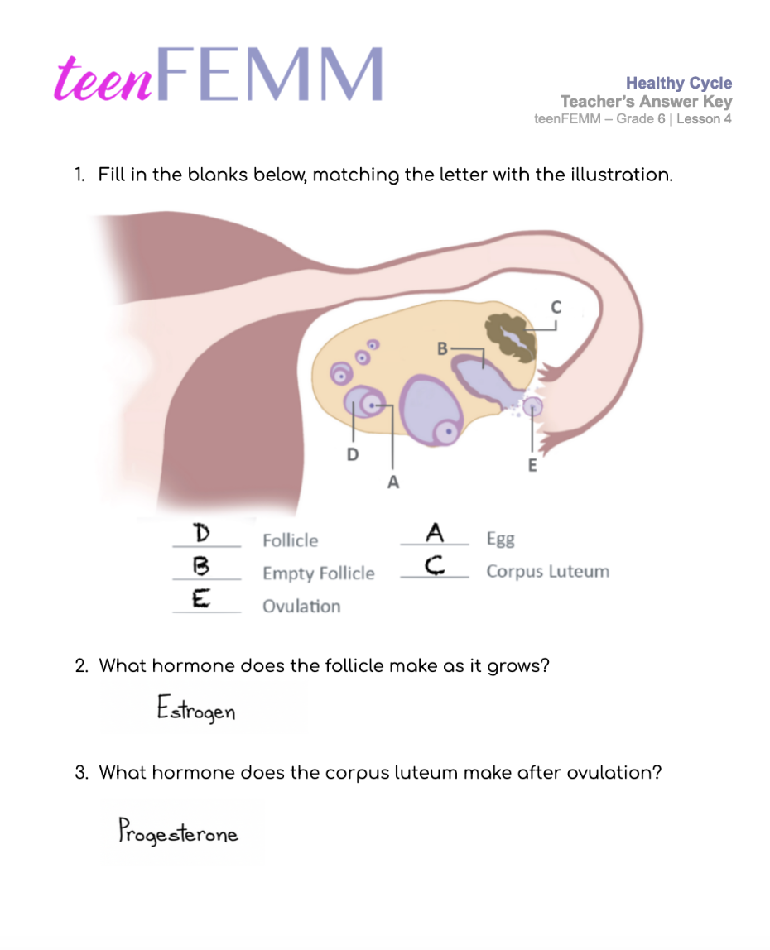
Worksheet | Answer Key
Look at how much you’re learning!
Notes:
Task a few students to explain what is happening in the ovulation cycle.

Slide 4
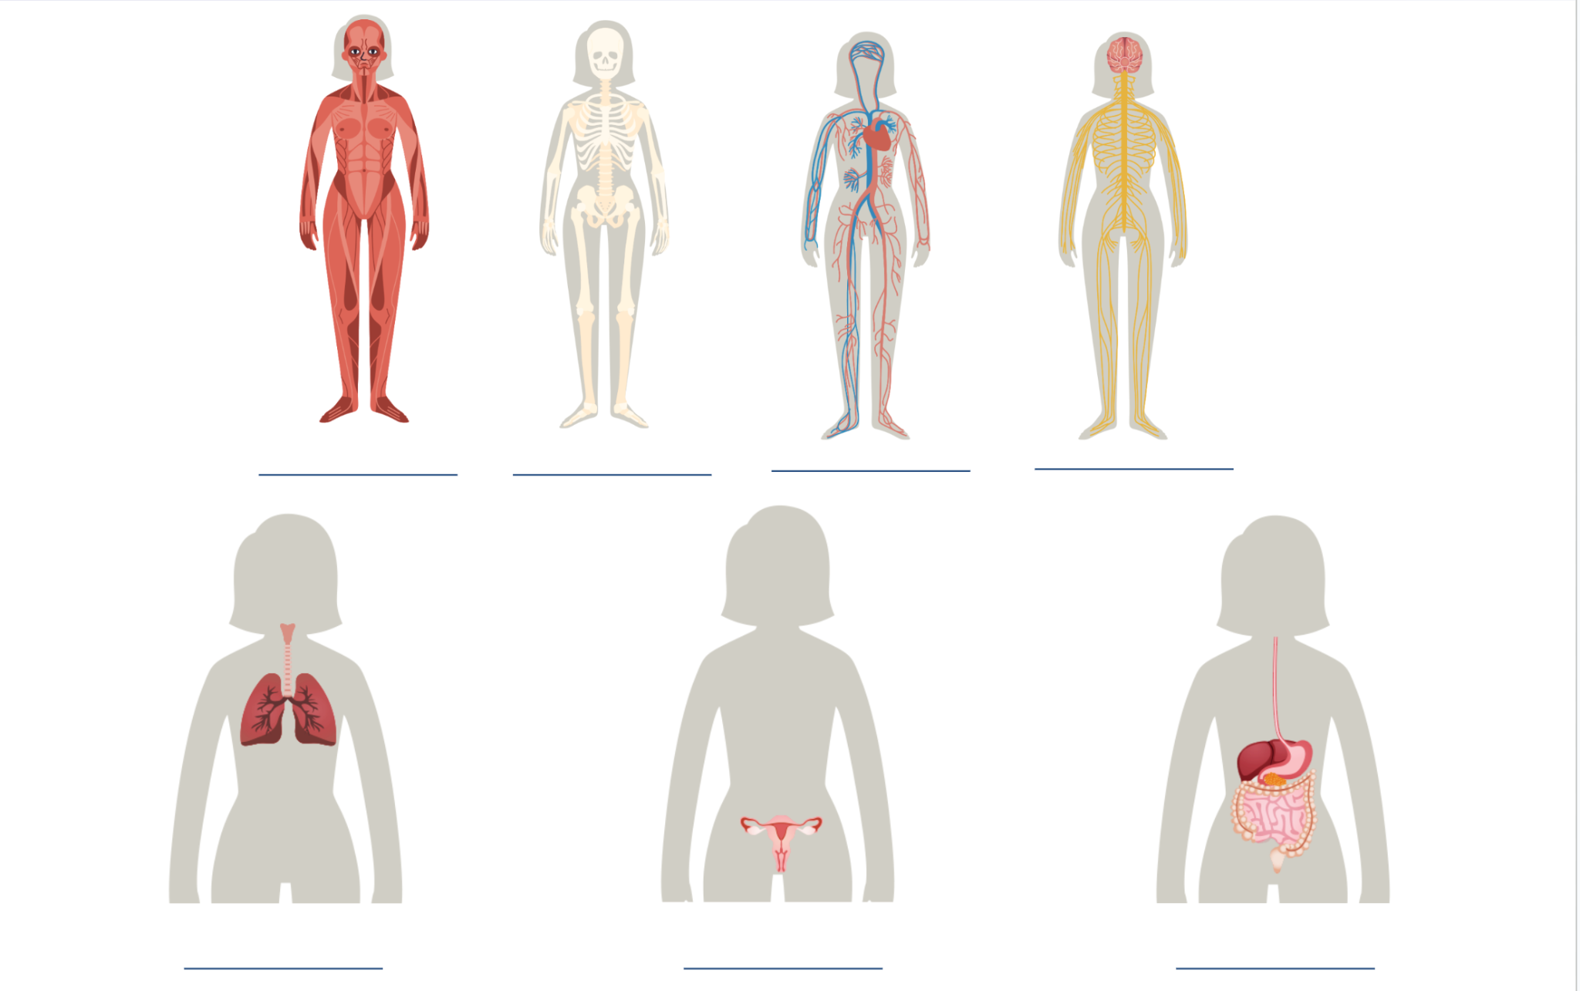
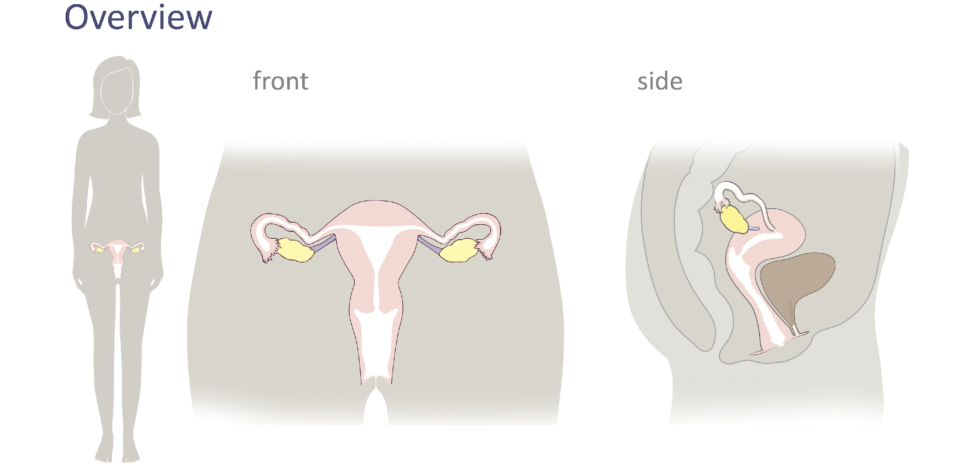
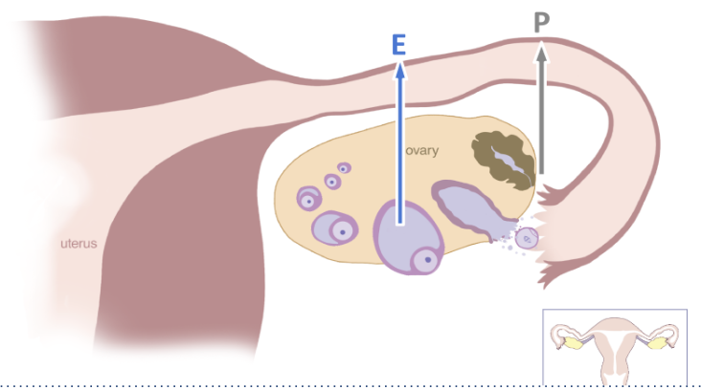
Review
Lesson 2
Lesson 1
You are here!
Lesson 4
Lesson 3
Notes:
We began teenFEMM Lesson 1 by learning about the body systems and how every system needs to be healthy for the whole body to be healthy. In Lesson 2, we zoomed in on the female reproductive system and the different parts of the system. In Lesson 3, we looked at the process of ovulation, and the two main female reproductive hormones produced in the ovary: estrogen and progesterone. Today, in Lesson 4, we will talk more about why the ovulatory cycle is so important to your overall health and the specific effects of estrogen and progesterone in the body.

Slide 5
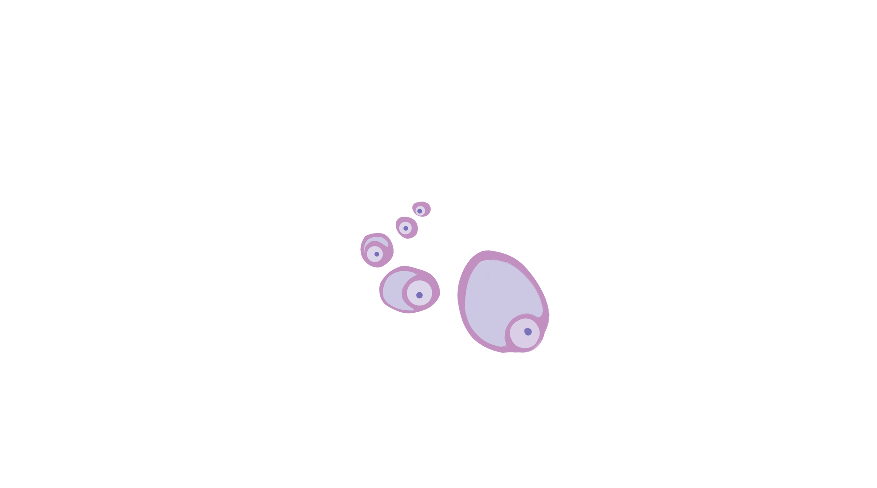
Your turn
What are the ✌🏻 main jobs
of the ovaries?
To grow follicles and release an egg
1
2
Produce estrogen + progesterone
Notes:
Hormones are controlled by the brain. The brain produces its own hormones (chemical messengers), which direct the ovaries, to produce other hormones (like estrogen).
Do you remember the 2 jobs of the ovaries?
To grow follicles and release an egg (ovulation).
To make the hormones estrogen and progesterone.

Slide 6
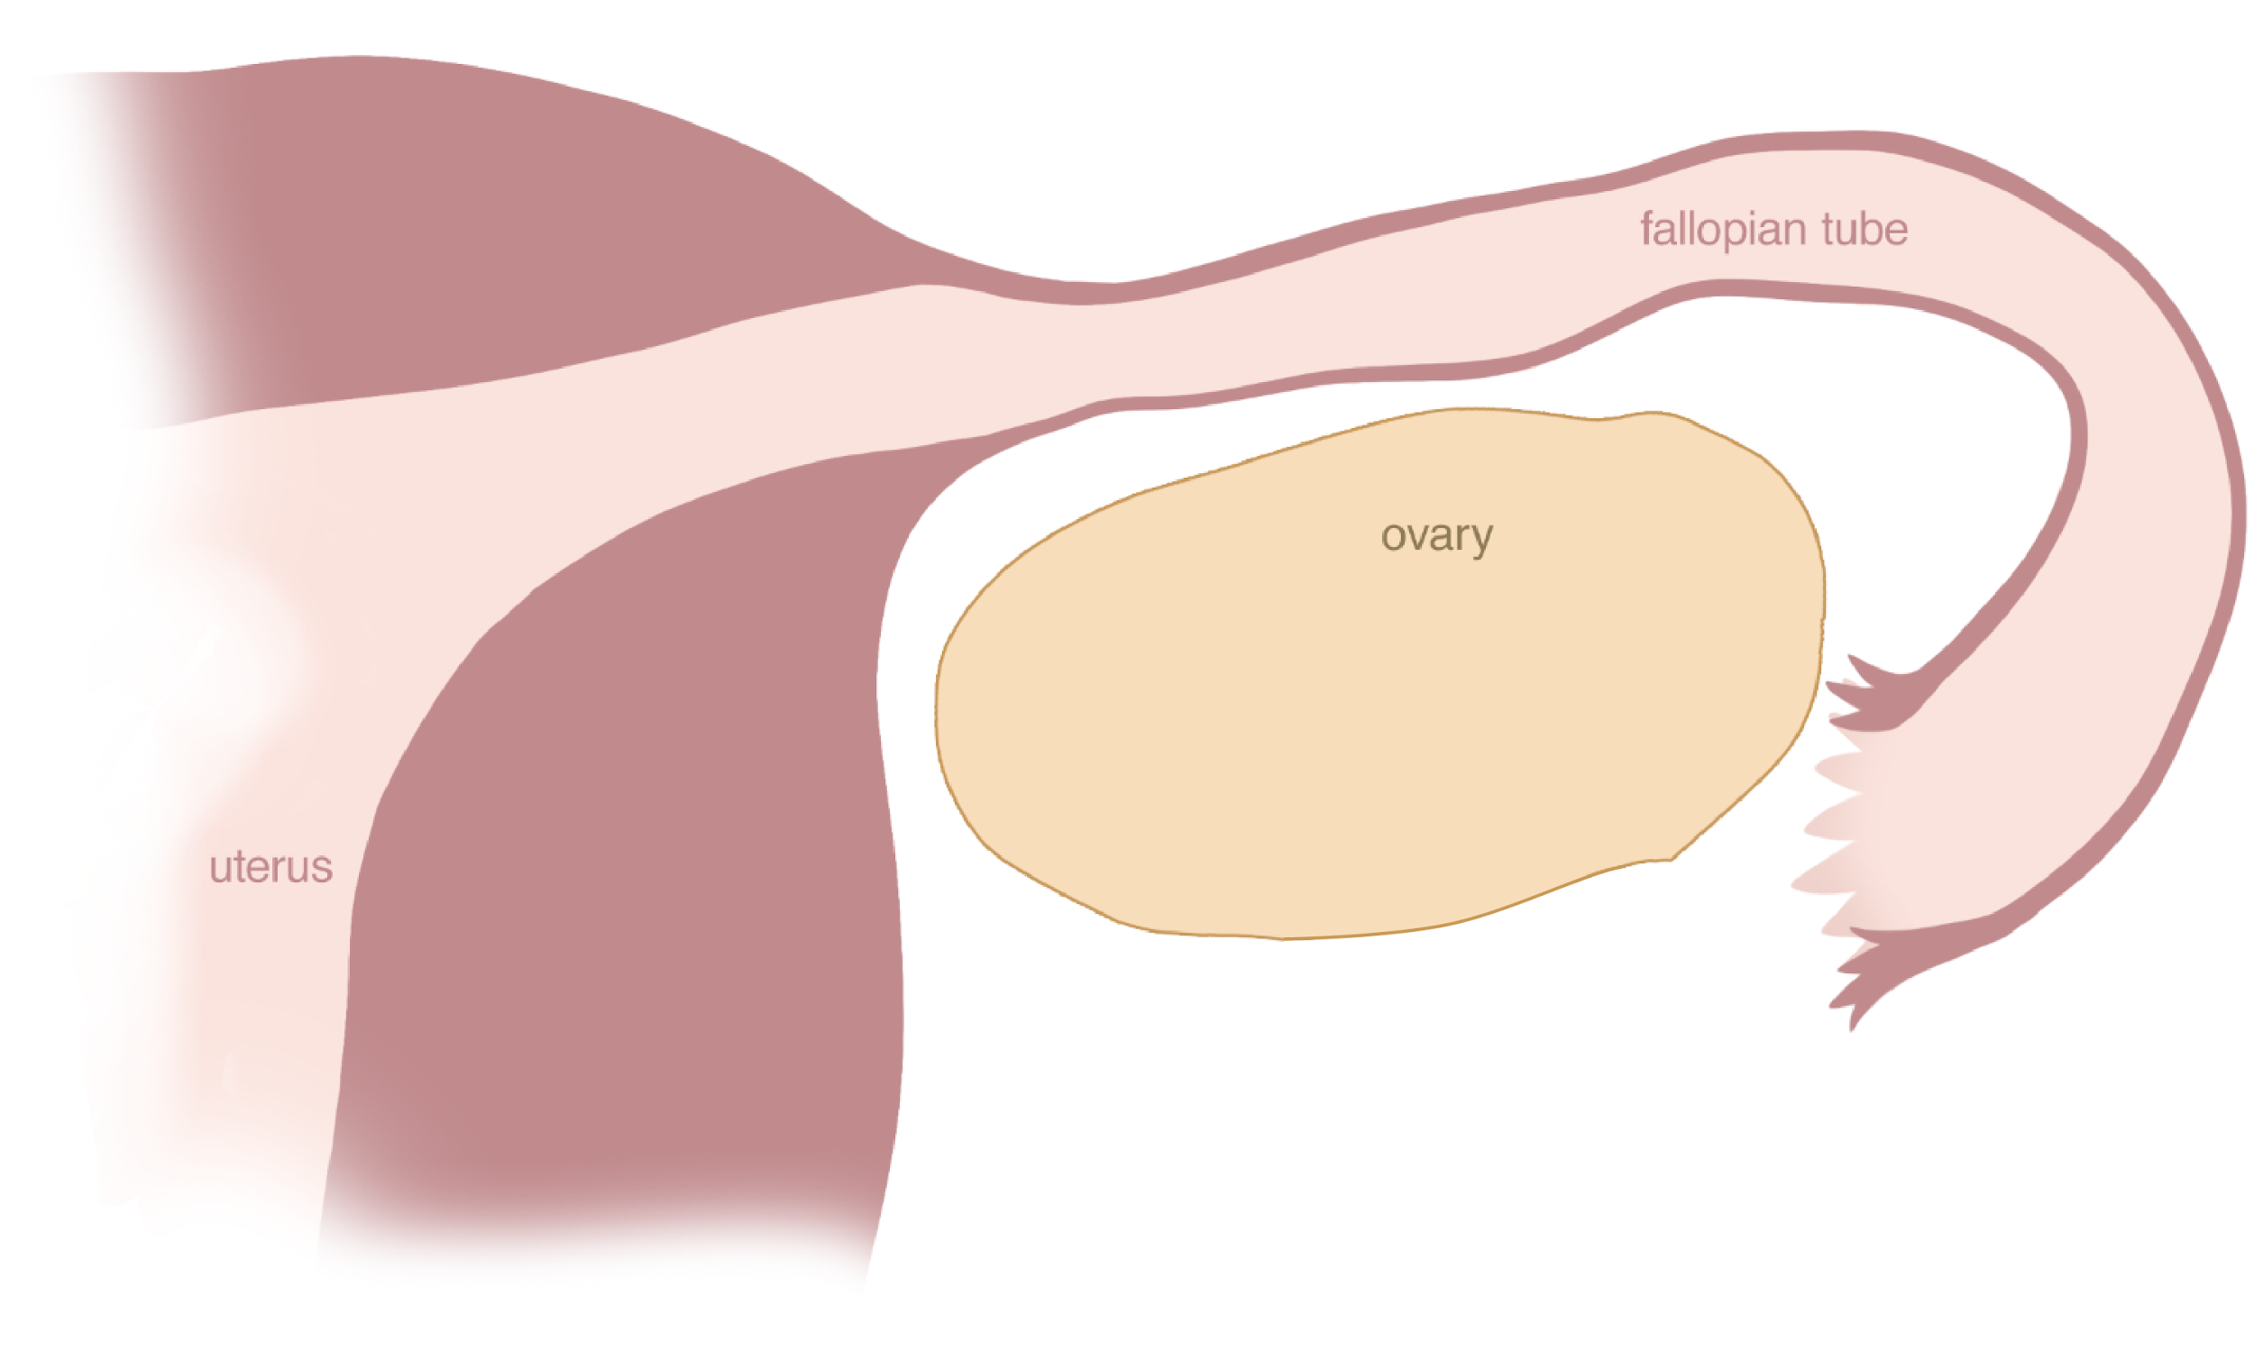
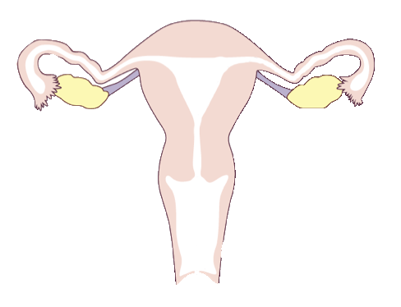
Ovulation
© FEMM
Notes:
This process is called a ‘cycle’ because it repeats over and over again. Sort of like how a bike wheel doesn’t have a “start” and an “end” - it’s a continuum. At the “end” of one cycle is the period (the shedding of the uterine lining). This leads directly to the growth of a new follicle in the ovary and the cycle continues.
Teacher: Ask the students to explain again, in their own words, the ovulation cycle.
Can you describe what happens in the ovary each cycle?
Have students take turns explaining the ovulatory cycle with the following slides, to consolidate their learning.

Slide 7
Ovulation
© FEMM

Slide 8
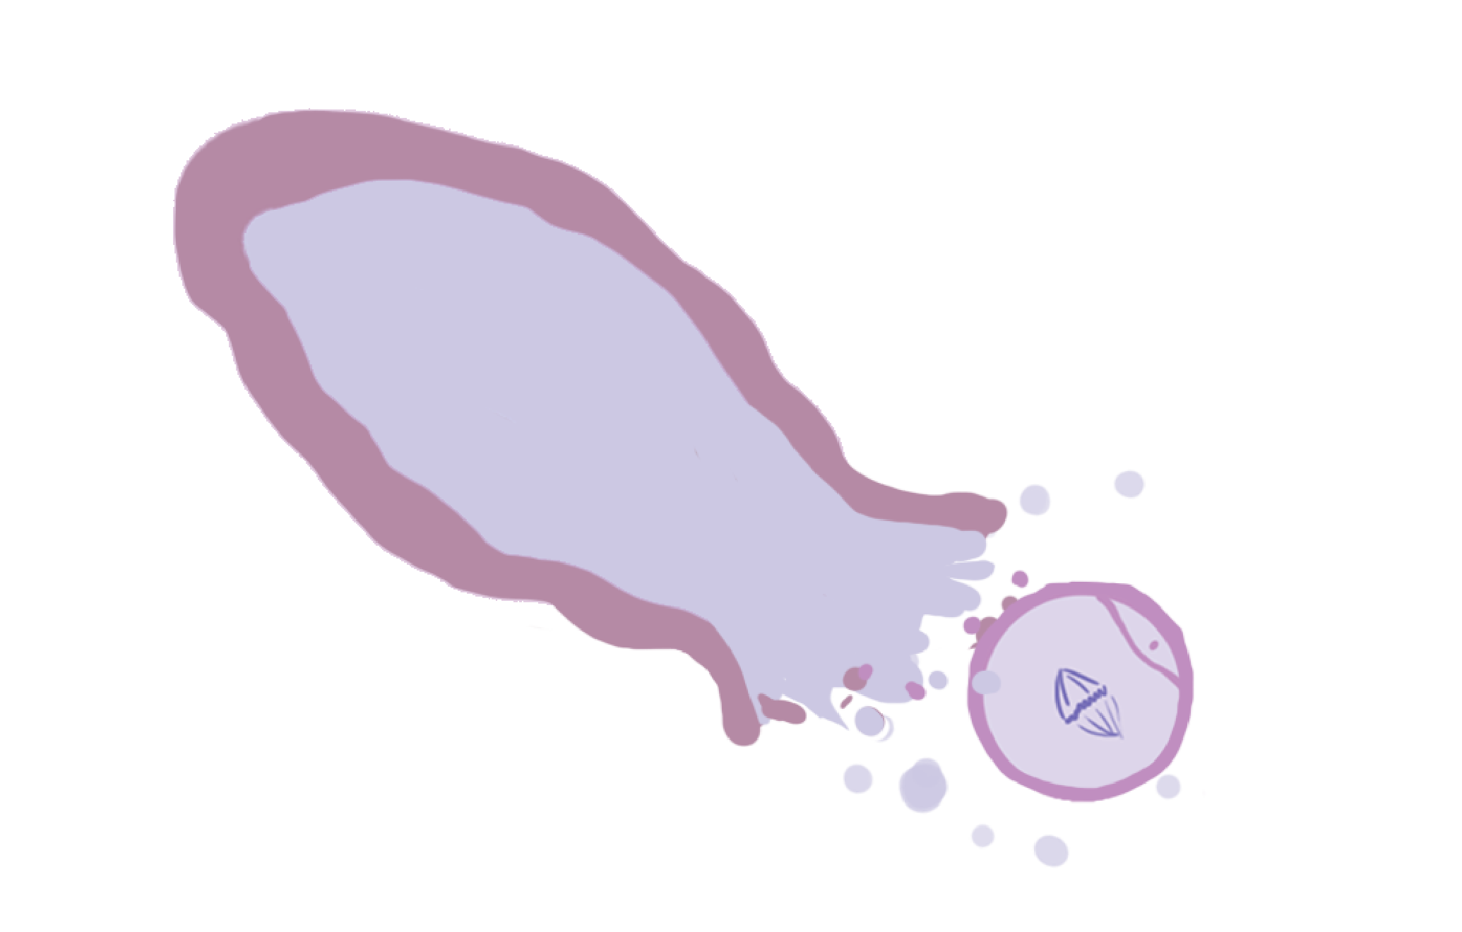
Ovulation
© FEMM

Slide 9

Ovulation
© FEMM
Notes:
You did a great job explaining the process. Ovulation is a sign of a healthy body, because it means that your hormones are working well and making all parts of the cycle happen properly.

Slide 10
Ovulation + Hormones
P
E
© FEMM
Notes:
Ask: The growing egg/follicle in the ovary makes ________? Estrogen! After ovulation, the follicle is turned into the corpus luteum and makes which other hormone? Progesterone!
What happens to the egg after it is released from the ovary? It goes into the fallopian tube. Then, on its own, the egg will simply dissolve in a few hours. If the egg joins with the male cell of reproduction, sperm, through intercourse, the egg and sperm join together and a new life is created that will implant and grow in the uterus for 9 months.

Slide 11
A sign of health… for your whole body!
The purpose of a woman’s cycle
is to develop & ovulate an egg…
…and produce the two main female hormones, estrogen and progesterone
1
2
4
Your brain and body need these hormones, month to month, to be healthy and happy.
This is why ovulation is a POWERFUL sign of your body’s health!
3
© FEMM
Notes:
But it’s important to know that ovulation is not just necessary for pregnancy; month to month, it’s a sign of health for you and your whole body. Your body needs all of your hormones to be healthy and work together, to impact every system of your body.

Slide 12
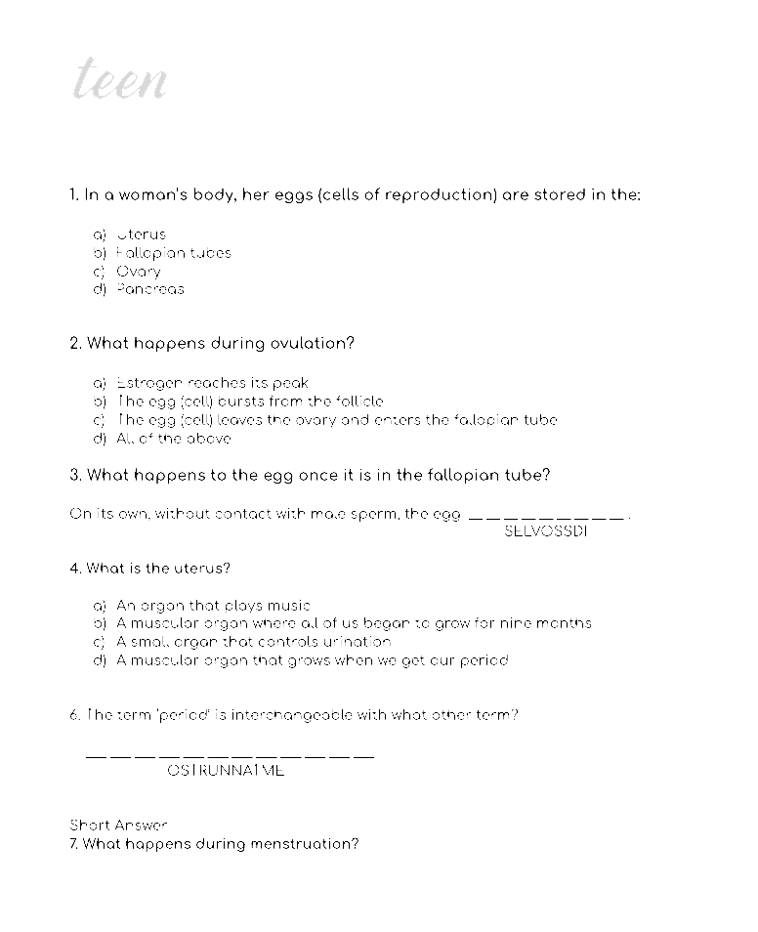

Seven Cycle Skill-Testing Questions
Bet you can’t say that 10x fast!
CHALLENGE!
© FEMM
Notes:
Arrange students in two groups. Provide each group with the Seven Cycle Skill-Testing Questions worksheet, face down.
Explain to students that they have two minutes to complete the questions. For every question they get right, their team will get one point. For every question they get wrong, the other team will get a point. In the end, the team with the most points wins the challenge! Ready? Set? Go!
Review the answers together using the Answer Key provided in the materials.

Slide 13

Effects of estrogen & progesterone
 | estrogen | progesterone
uterus | tones, contracts | relaxes
uterine lining | grows | maintains
breasts | grows | normalizes
bones | forms | maintains
blood vessels | dilates, increases flow | relaxes, normalizes clotting
brain cells | stimulates | maintains and heals
well-being | normal levels promote well-being; high levels increase anxiety | promotes sleep and relaxation; decreases anxiety
© FEMM
Notes:
Step 5 (10 minutes): Estrogen, Progesterone and menstruation
To better understand why ovulation is a sign of health, let’s look at the effects of estrogen and progesterone (produced through the ovulatory cycle) and how these hormones impact every part of your body.

Slide 14
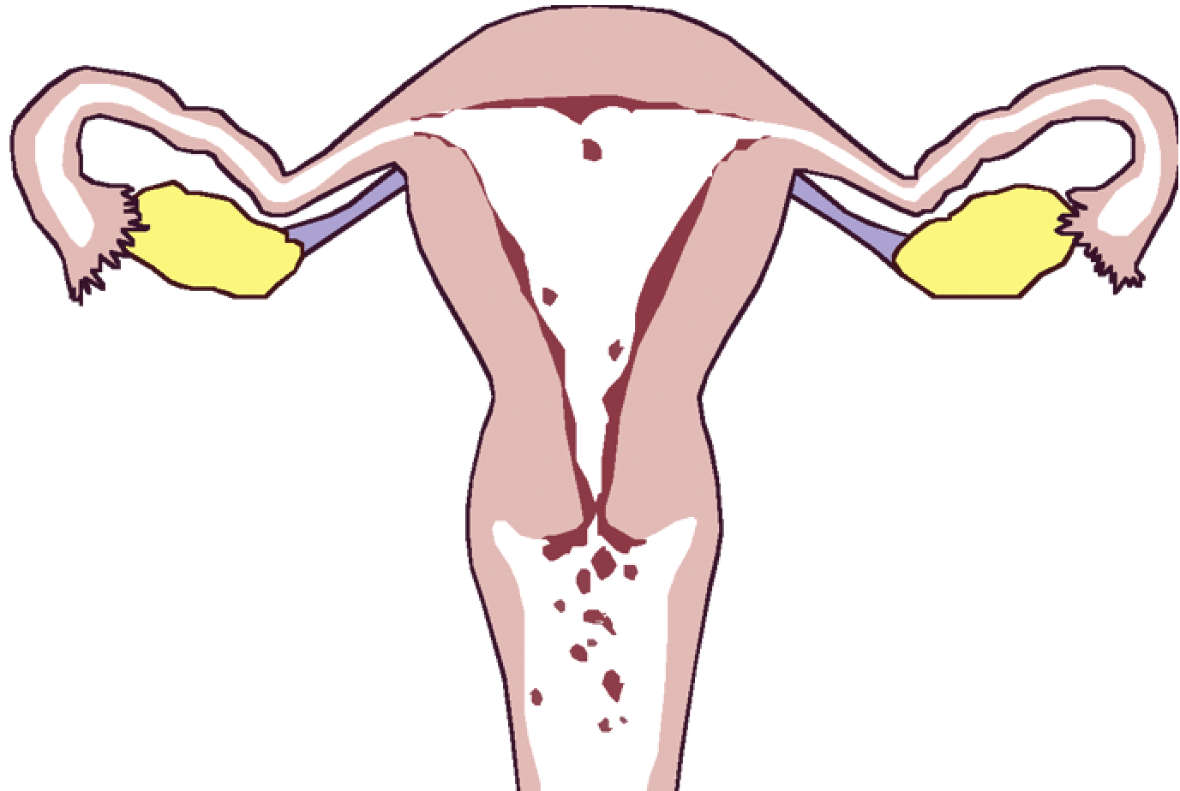
Menstruation is normal and healthy. Period.
During the cycle, estrogen & progesterone build up the lining of the uterus. At the end of a cycle, the lining falls away.
Notes:
During the cycle, estrogen and progesterone build up and maintain the lining of the uterus. The lining of the uterus thickens during the cycle, to be able to provide a snug environment in case of pregnancy. But, without pregnancy, the corpus luteum (that produces progesterone in the ovary) breaks down and as a result, the lining in the uterus breaks down and sheds. This causes a few days of bleeding, and is called menses, which comes from the Latin word that means ‘month’.

Slide 15
Grade 6
LESSON 4
© FEMM
Notes:
Ovulation is a sign that a body is growing to full maturity. Ovulation is the release of the female cell of reproduction: the egg, from the ovary. Ovulation is a sign that your body is healthy. Now that we’ve learned what a healthy cycle is, next lesson we’ll learn how we can record specific characteristics of our ovulation cycle in order to know about our hormones and our health.

