Slide 1

Grade 6
LESSON 5
© FEMM
Notes:
Start by placing three chairs in the front of the classroom. Choose three students to be the ‘experts’ sitting in the chairs. Give each expert a piece of paper and a marker, to write down their answer.
Explain that the teacher will ask a question, and the experts will write down their answer, but hold their paper to their chest so no one else can see. When asked, the experts will reveal their answer. If the expert is correct, they can remain in their chair for the next round. If an expert is incorrect, any student in the class can raise their hand to give the correct answer and start a new panel of experts.
NOTE: Clicking on the slide will reveal the answer(s).

Slide 2
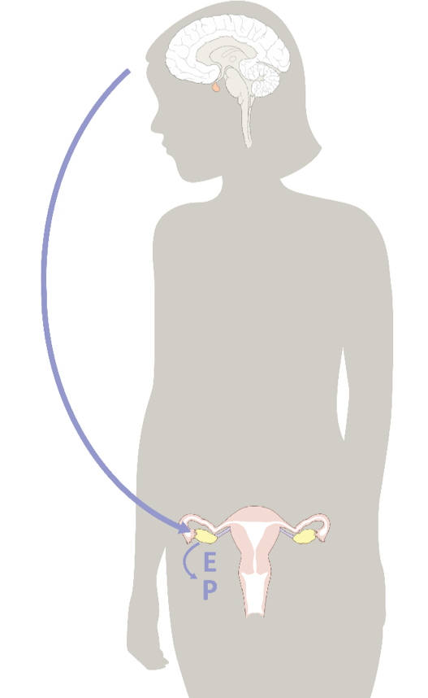
Fill in the ______!
________ direct all of the physical changes of puberty.
Hormones
© FEMM

Slide 3
Review | Fill in the ______!
Hormones are controlled by the
_____
Brain
© FEMM

Slide 4
Review | Fill in the ______!
As the egg and follicle grow
in the ovary, they produce
this hormone:
________
Estrogen
© FEMM

Slide 5
Review | Fill in the ______!
After ovulation, the
empty follicle produces
____________
Progesterone
© FEMM

Slide 6
Review | Fill in the ______!
At the end of a cycle, the
lining of the ______ sheds.
This is called: ____________
uterus
menstruation
© FEMM

Slide 7

Estrogen & Progesterone
 | estrogen | progesterone
uterus | tones, contracts | relaxes
uterine lining | grows | maintains
breasts | grows | normalizes
bones | forms | maintains
blood vessels | dilates, increases flow | relaxes, normalizes clotting
brain cells | stimulates | maintains and heals
well-being | normal levels promote well-being; high levels increase anxiety | promotes sleep and relaxation; decreases anxiety
Estrogen & Progesterone have a HUGE impact on the whole body!
© FEMM
Notes:
Hormones influence the development of your brain, bones, body systems and more!

Slide 8
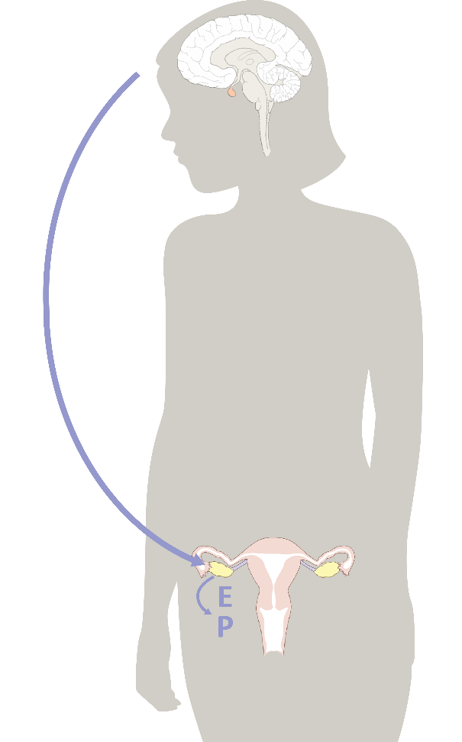
Hormones & your brain
Estrogen + Progesterone
help brain functioning such as memory, attention, and language!
🧠
Can I get a fist bump,
you brainiac, you?!
Notes:
Hormones are controlled by the brain.
Your brain and your hormones are constantly in communication. The hormones estrogen and progesterone shape your brain. Together, they help with memory, attention and language!

Slide 9

Hormones & your emotions
Estrogen (energizing) + Progesterone (peaceful/relaxed)
are so important for our
mental health.
Drops in
Estrogen + Progesterone
can make us feel
irritable or anxious
Notes:
It is very common to experience mood changes as you go through puberty. After all, we have learned a lot about how much hormones influence your brain! Even minor drops in estrogen can make us feel irritable or anxious. Progesterone, which is produced after ovulation, calms us down and can help us sleep better. But you don’t want only progesterone as you need estrogen, too! Remember: estrogen and progesterone balance each other out, through the different points in the cycle.

Slide 10
Hormones & Biomarkers
Estrogen & Progesterone
produce certain effects in your body.
These effects are
called biomarkers
‘bio’ = life
‘marker’ = sign
Biomarkers provide
health information
Notes:
Now, you may be thinking, if only there was a way that you could see what your hormones were doing inside your body?
Estrogen and progesterone produce different effects on the body. These ‘effects’ are called biomarkers (bio = life, markers = signs) and they can help you understand the hormonal activity taking place inside your body. It’s kind of like a superpower that you have as a woman!

Slide 11
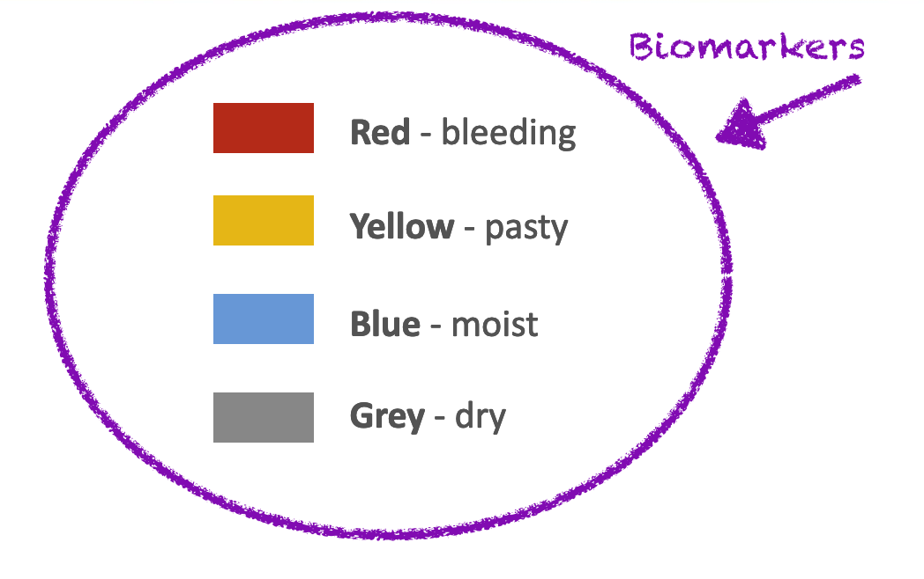
Charting hormonal changes
Red - bleeding
Yellow - pasty
Blue - moist
Grey - dry
Notes:
These are the four colors we use to track the hormonal changes occurring in our bodies: red, yellow, blue and gray. Each color represents a different biomarker: bleeding, pasty, moist and dry. These four biomarkers tell us what our hormones are doing in our body.

Slide 12
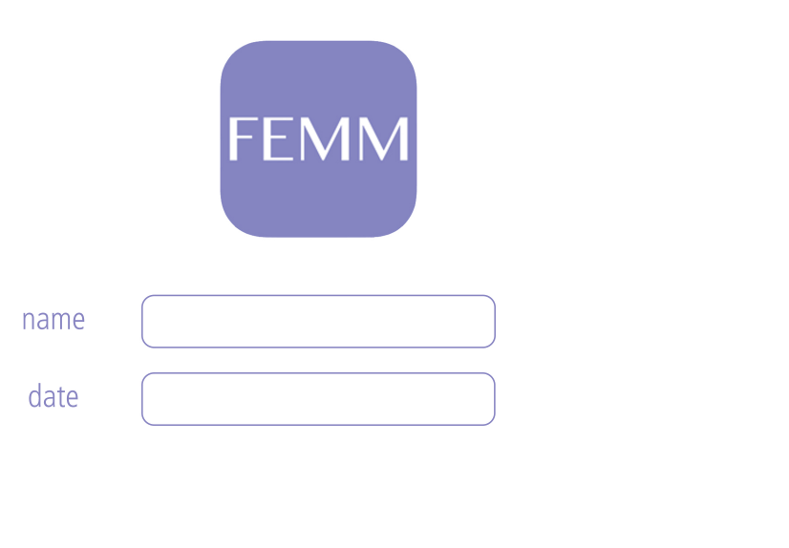
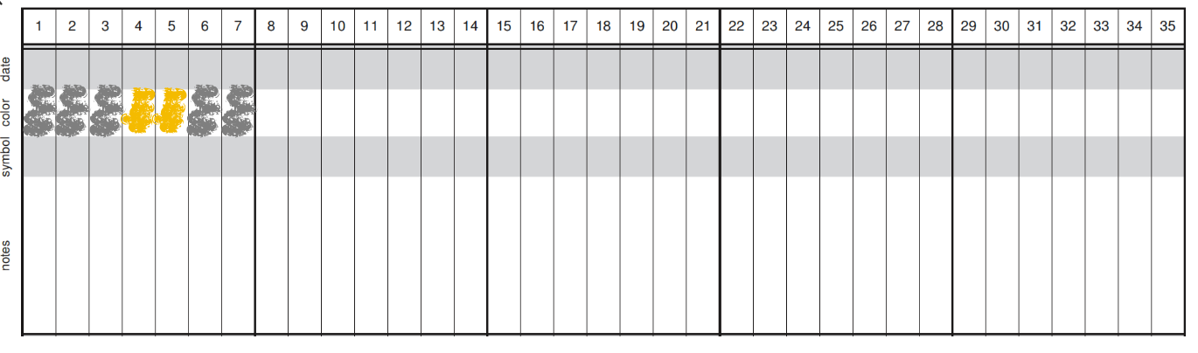
Charting hormonal changes
Kyla
April
5th 6 7 8 9 10 11
Notes:
This is called a chart. Charting is a way to write down hormonal health observations. A chart can be as simple as a piece of paper with your name, the date and the different biomarkers and their colors. In this example, Kyla started charting her biomarkers on April 5th, so she wrote down her first observation under day 1.

Slide 13
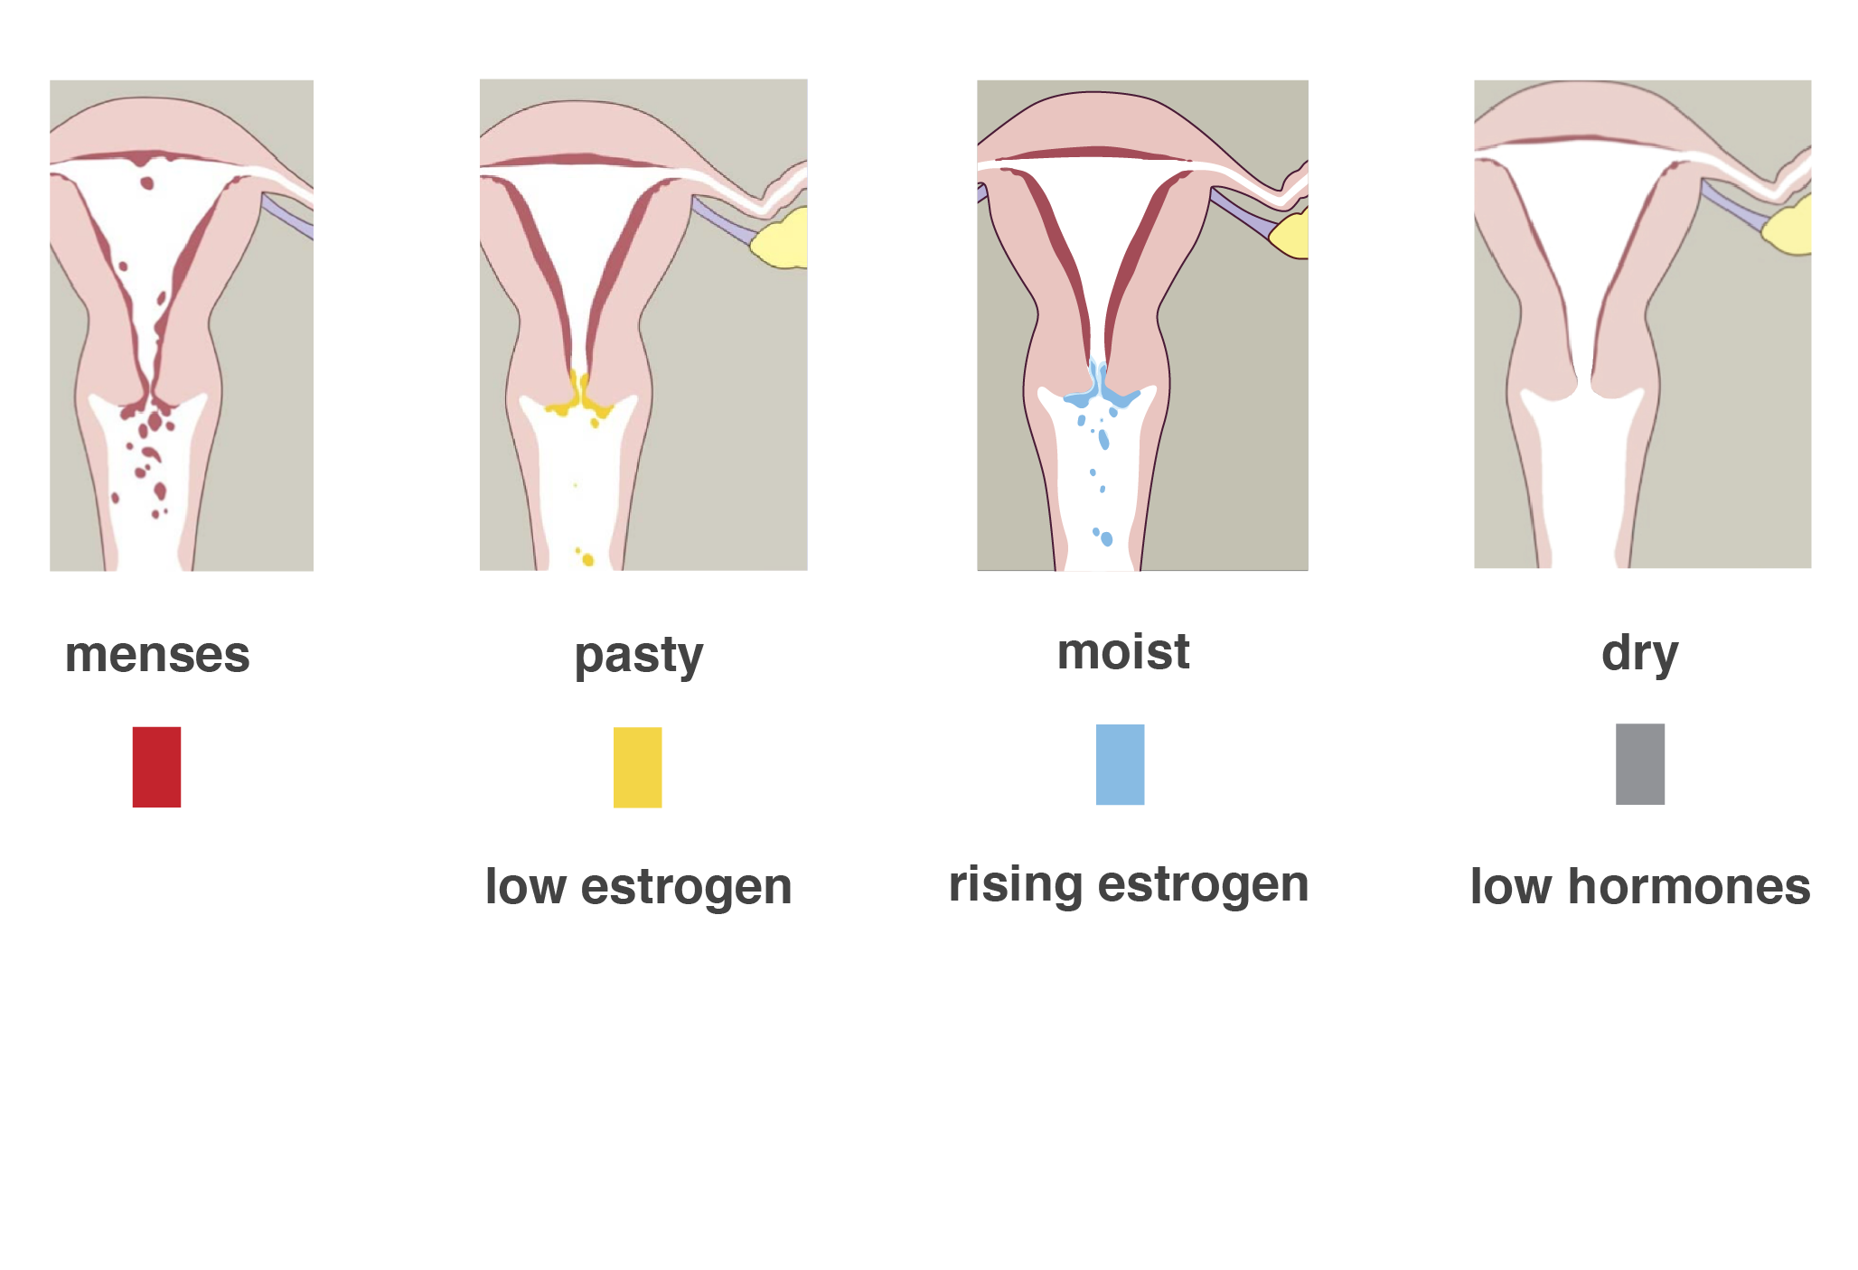
Charting hormonal changes
Notes:
The most obvious biomarker to see is bleeding. Bleeding tells us that the uterine lining has built up and is now shedding. On the chart, we mark this with red. Tracking your bleeding pattern will be easy and obvious and is something that every woman does to understand and manage her body.
Estrogen and progesterone also have signs that you can see in your body. Estrogen causes the cervix, the small canal at the base of the uterus, to produce a cervical fluid. Low levels of estrogen produce low levels of cervical fluid. As this fluid travels down the vaginal canal it can mix with the normal, slight shedding of tissue in the body. You might notice this as a pasty or crumbly observation on the inside of your underwear. To chart this, we would mark this low level of estrogen in the body with the color yellow.
As estrogen levels get higher, you might feel a sensation of moistness when you wipe after using the bathroom. Higher levels of estrogen in the ovary produce higher levels of cervical fluid. To chart this, we would mark this higher level of estrogen, with the color blue.
On other days, when you are not on your period and you do not feel a moist sensation from estrogen, you will feel the sensation you might feel most of the time right now: dry. We chart that with the color gray.
As you get older, and your hormone levels are higher, with ovulation, dryness will represent the hormone progesterone. But for now, if you have not yet begun to menstruate, you have likely not yet begun to ovulate. The dryness you feel is healthy for early puberty as your hormones are just starting to “wake up” in your body.

Slide 14
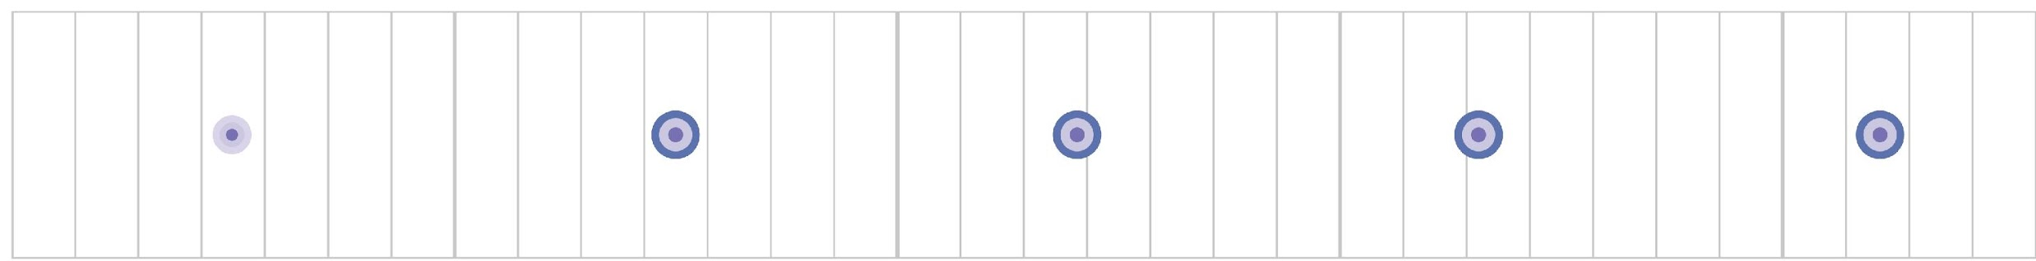
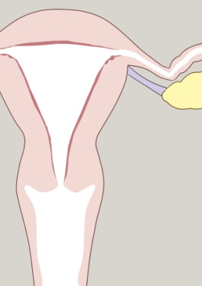
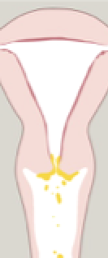
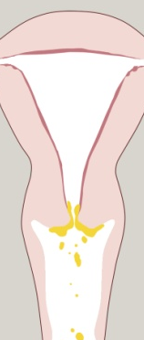
Making sense of your cycle in puberty
1.
In puberty, the brain & ovaries are just beginning to communicate.
The egg + follicle inside the ovary (grow a little - but not enough to ovulate)
2.
You might think not much is happening
Low estrogen in the ovary (as seen above) produces little cervical mucus.
Charting would look like this.
Notes:
You can see how the anatomy of the reproductive system and hormones fit together. At the beginning of puberty, the brain and ovaries are just starting to communicate. On the slide, you can see the egg in the top level -- still small, but growing a little. This little bit of growing produces only low levels of estrogen. Even if you think not much is happening, charting will help you to anticipate changes in your body as your hormonal cycle matures.

Slide 15
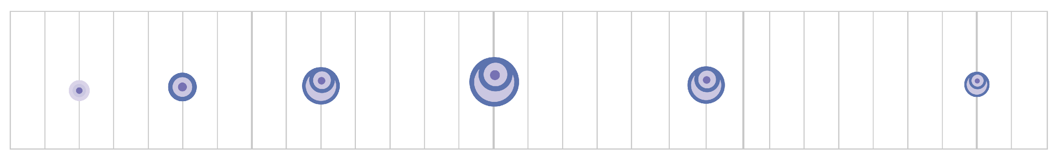
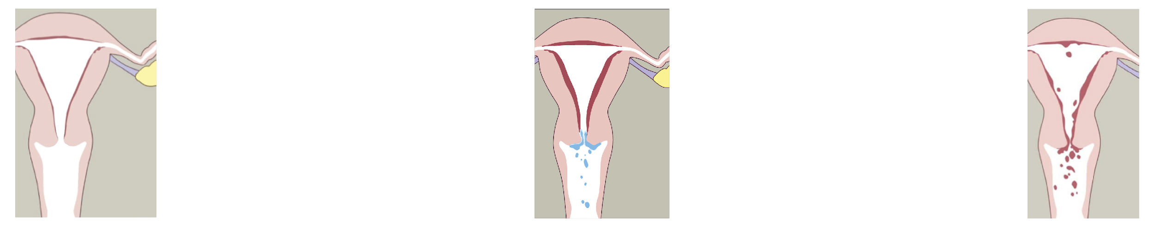
Making sense of your cycle in puberty
3.
As you mature, your brain & ovaries communicate better.
4.
More estrogen produces more cervical mucus.
5.
You get your period for the first time – it will likely be short/light.
Notes:
Cycle by cycle, as your body matures, the communication between the brain and the ovaries strengthens. The egg and follicle start to grow and produce more estrogen. This increased estrogen acts on the cervix producing moist cervical mucus. This is charted with the color blue.

Slide 16
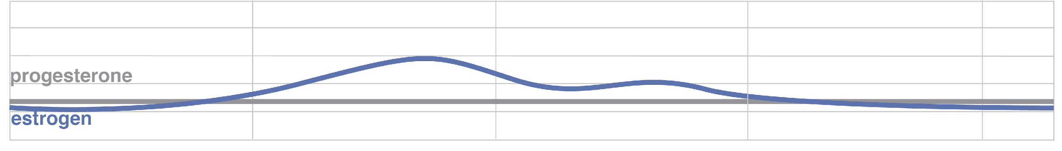
Making sense of your cycle in puberty
Notes:
Eventually, you will bleed for the first time. During your first period, it will most likely be short and light. You will chart this with the color red.
This slide shows different hormonal activity. In the top row, we see an illustration of the egg growing larger in the ovary. The second row shows a graph of estrogen (blue line) and progesterone (gray line). In the third image, we see the impact of estrogen on the level of the uterus (thickening the lining of the uterus). Lastly, the chart shows us how these hormonal changes would be observed in the body’s biomarkers.

Slide 17
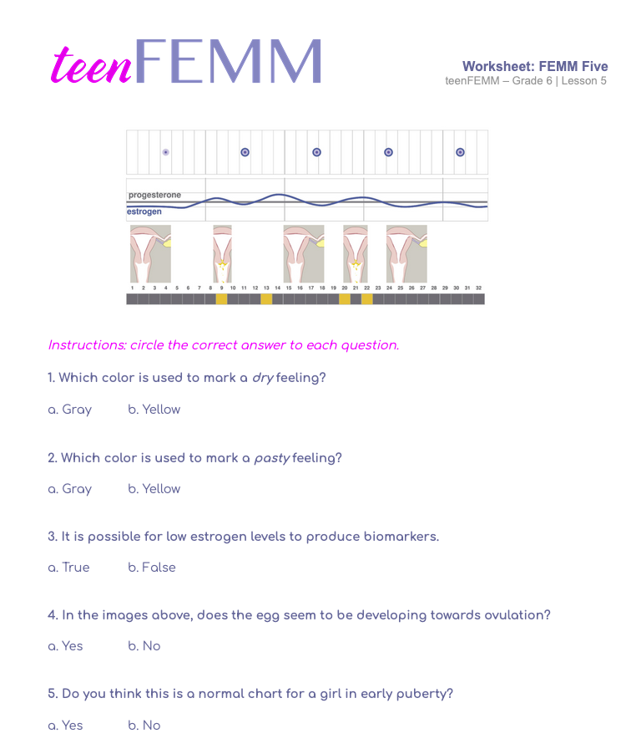
Worksheet
© FEMM
Notes:
Learning to chart your hormonal activity is a powerful way to understand the changes you are experiencing, both physically and emotionally.
Hand out the FEMM Five Worksheet to students. Give students a couple of minutes to complete the five questions.
Review using the slide. Click on the slide to reveal the answers.

Slide 18
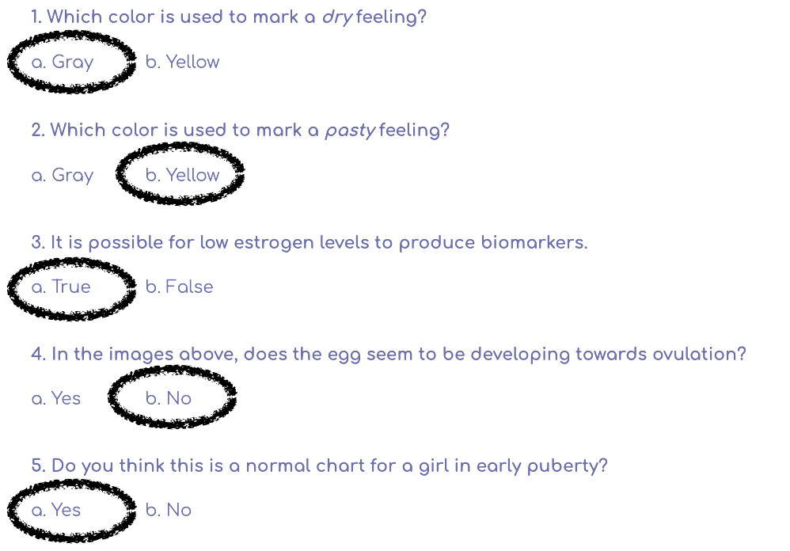
Worksheet | Answers!
?

Slide 19
Review
Ovulation is a sign
of a healthy body
growing to full maturity
Our body gives us
biomarkers
Biomarkers provide health information about our body
© FEMM
Notes:
Our hormones are an important part of the health of our entire body. Our body gives us biomarkers: these can help us tell what is happening in our body and whether it is normal and healthy. Charting our biomarkers helps us to know and feel confident about our body.

Slide 20
Grade 6
LESSON 5
© FEMM

