Slide 1

Grade 6
LESSON 5
© FEMM

Slide 2

Entry Ticket Activity
© FEMM
Notes:
Print and cut out the Entry Ticket Activity, so that there is one ticket per student.
As students enter the class, hand one ticket to each student to fill out.
Give students a couple of minutes to answer the questions and then have volunteers share their responses with the class. Discuss.

Slide 3
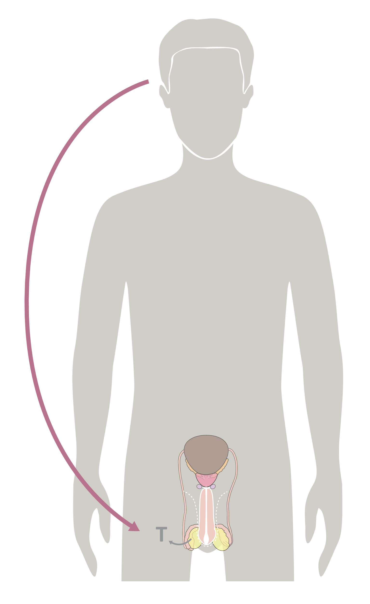
Hormones & your growth
Hormones cause all the growing & changing that your body does during puberty.
Your brain sends hormonal signals throughout your body to trigger growth & development.
© FEMM
Notes:
Do you remember what controls the activity of every system in the body?
Yes, hormones! Hormones are directed by your brain!
All of our growth in puberty starts with the brain. The brain acts like the control center for everything that is happening and changing in the body.

Slide 4
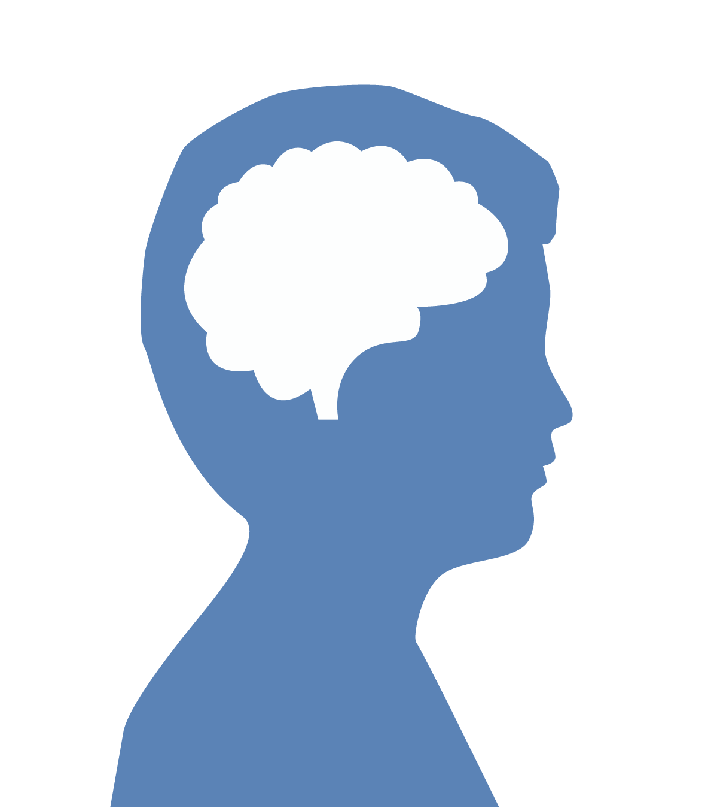
What influences the brain?
Because the brain is the organizing center …
Things that affect your brain
will affect your physical &
emotional health.
© FEMM
Notes:
Because the brain is the organizing center for all this activity, things that affect your brain will also affect your physical and emotional health. Everything you do, whether it’s eating junk food or healthy food, playing video games or playing a sport, has an impact on your brain. Taking care of your body with good hygiene is an important part of growing in maturity.
Worksheet: Hand out to students at beginning of this section for their use.
Brainstorm ideas related to the healthy choices presented in this slide series; write ideas on the board and have students fill in the different answers on their worksheets.
Your choices about what you eat and how much you exercise and sleep are important; they impact your hormones and your whole body. Hormones play a big role in how you feel.

Slide 5





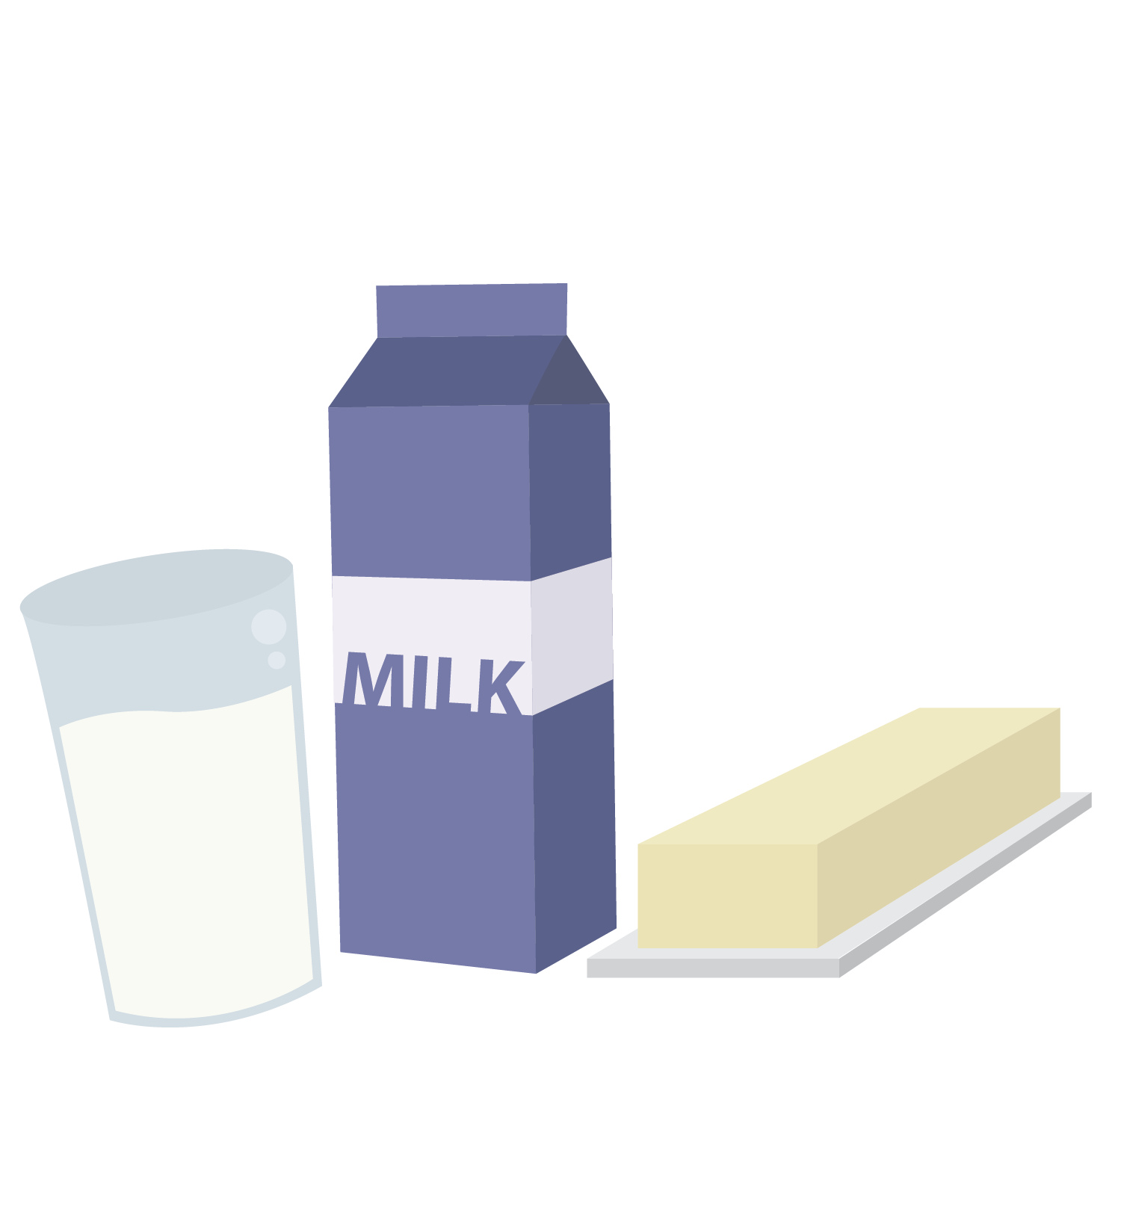


The Three Pillars of Health
Nutrition
Exercise
Sleep
© FEMM
Notes:
They are called the three “pillars” because they are the foundation for your health. The first pillar we’ll learn about is nutrition.

Slide 6
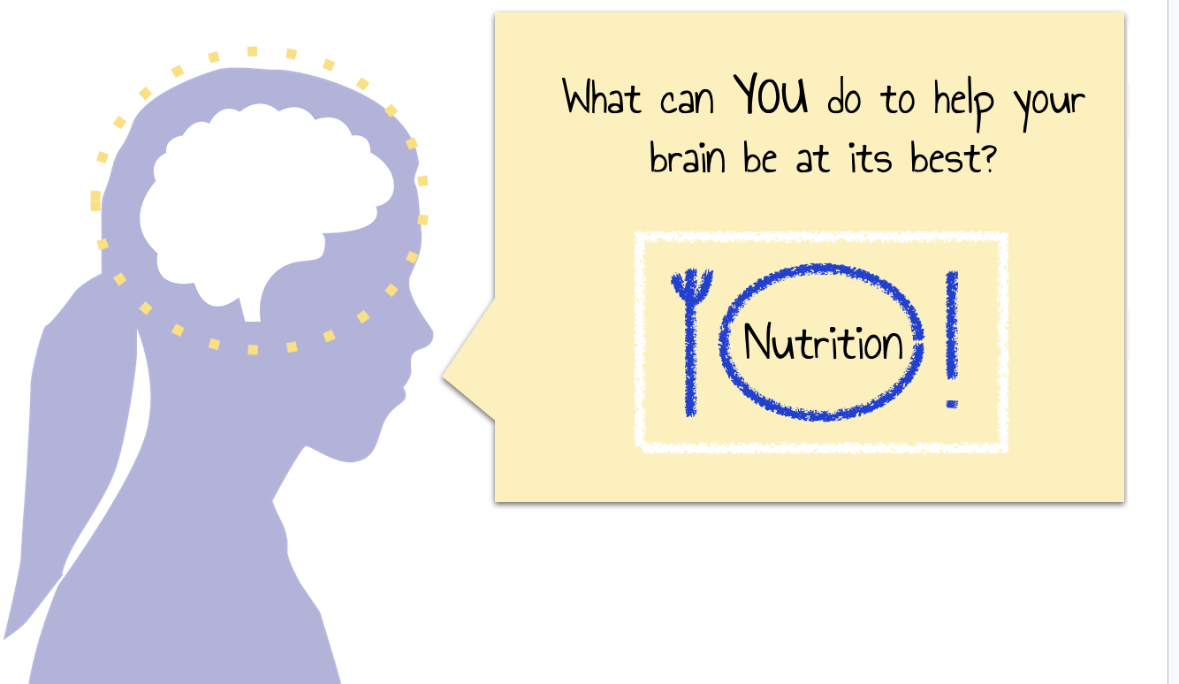
The Three Pillars of Health
Pillar 1.
You are here.
Nutrition
© FEMM
Notes:
Nutrition is the nourishment that your body needs to get from the food you eat.

Slide 7
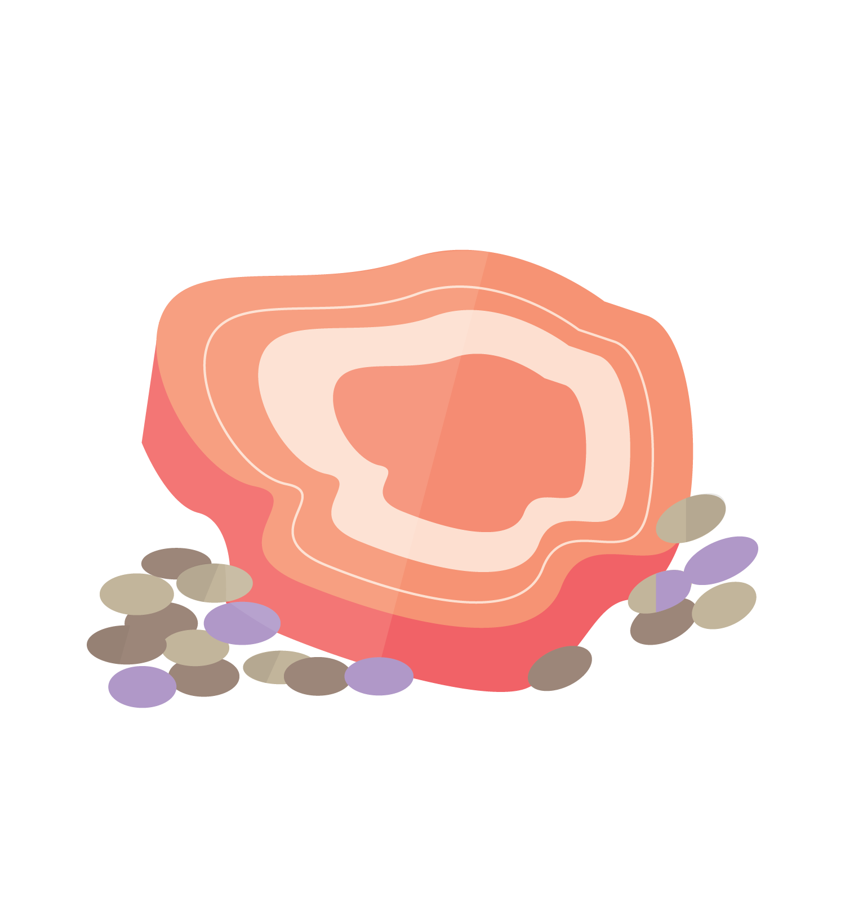
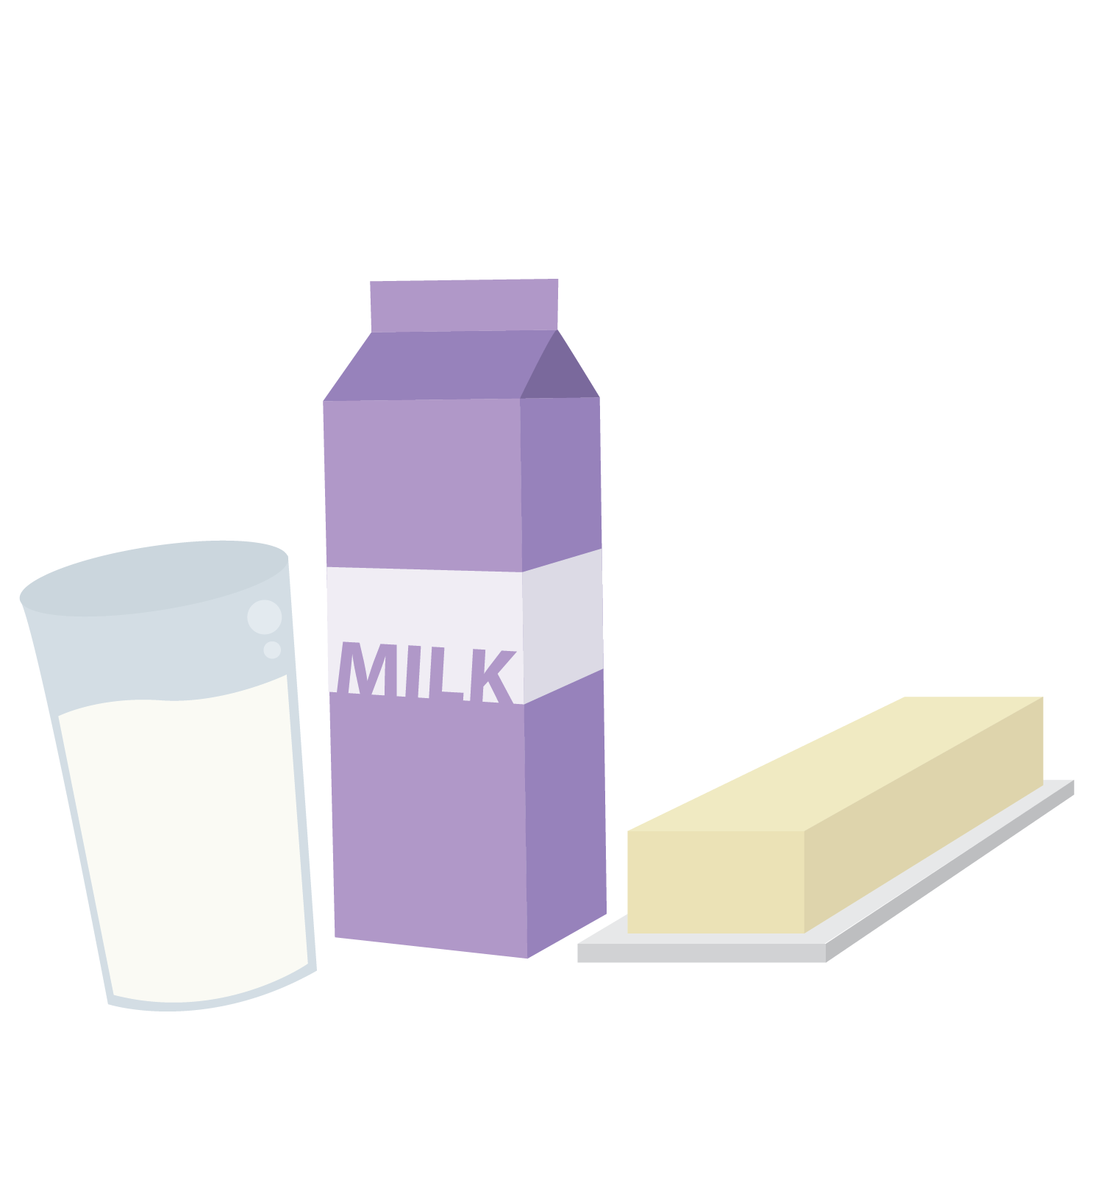



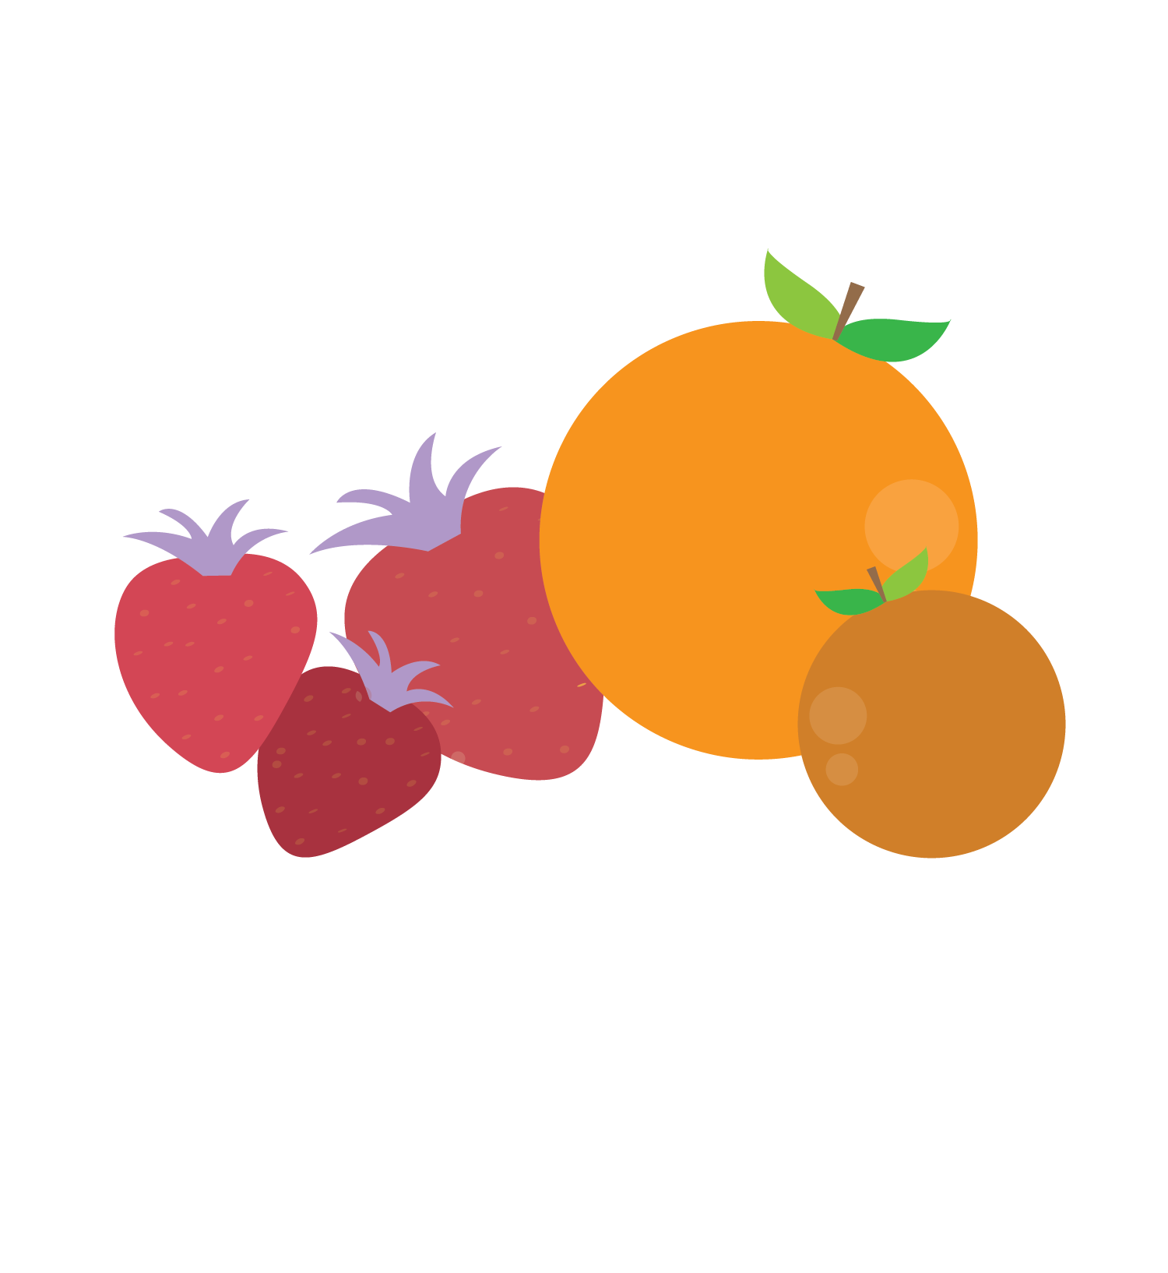
To-Eat:
Proteins
build & maintain body & make hormones
Carbohydrates & fats:
provide energy & make hormones
Vitamins & minerals:
build & maintain body & balance hormones
Water: carries nutrients; energizes muscle; clears waste & balances hormones
©FEMM
Notes:
Good nutrition supports your brain and your body. The different types of nutrients we need to get from food are:
Proteins: build and maintain cells, help make hormones.
Carbohydrates & fats: provide energy, balance hormones.
Vitamins & minerals: build and maintain cells, balance hormones.
Water: carries nutrients, energizes muscle, clears waste.

Slide 8
To-Eat:
Proteins: nuts, eggs, greek yogurt, beans, fish, chicken, beef, etc.!
Carbohydrates: whole wheat bread, pasta, rice, quinoa
Fats: nuts, olive oil, butter, milk, cheese
Vitamins & minerals: fruits & vegetables
(think of eating foods of different colors: orange, yellow, red,, green…)
Water: just water! - not soda or other sugary drinks
©FEMM
Notes:
When we eat, our body breaks down the food and uses the different nutrients in that food to fuel our energy, hormones and health. Sometimes, when a body does not have enough nutrients, disease can result. For instance, back in the day when sailors went on long sea voyages, they weren’t getting enough Vitamin C because they were basically only eating crackers and salted meat. This lack of vitamins and nutrients causes a disease called scurvy, which makes you weak, gives you pain in your legs, bleeding gums and causes your teeth to fall out. On future sea voyages, they were able to fix this by packing lots of citrus fruits on board.
Every meal you eat should contain some protein, carbohydrates, good fats and vitamins and minerals. There are lots of foods that fit into each of the different categories, but here are a few examples:
Proteins: nuts, eggs, beans, fish, meat
Carbohydrates: whole wheat bread, pasta, rice, quinoa
Fats: nuts, olive oil, butter, milk, cheese, yogurt (nuts and dairy products contain a lot of healthy fats our body needs.)
Vitamins & minerals: fruits and vegetables!
You can think of this in terms of targeting different colors:
Yellow: lemons, melons, yellow squash
Orange: oranges, butternut squash, sweet potatoes, carrots
Red: apples, strawberries, beets, tomatoes
Blue/Purple: blueberries, grapes, eggplant, plums
Green: Lettuce, Spinach, zucchini, green peppers
There are so many foods that aren’t listed here, so the menu is endless! Staying hydrated is also a key component of good health. Water is involved in almost every process in the human body.
Making good choices about what you eat impacts your health, growth and hormones.
Protein is the building block for our cells. All hormones are made from protein and fats. Carbohydrates help to keep your hormones in healthy balance. Minerals and vitamins help your body to produce and balance hormones, too. That means that if you are deficient in one of these groups, it will be pretty tough for your body to make the right amount of hormones that it needs. What you choose to eat every day is important!

Slide 9
To-Eat:
Proteins: nuts, eggs, greek yogurt, beans, fish, chicken, beef, etc.!
Carbohydrates: whole wheat bread, pasta, rice, quinoa
Fats: nuts, olive oil, butter, milk, cheese
Vitamins & minerals: fruits & vegetables
(think of eating foods of different colors: orange, yellow, red,, green…)
Water: just water! - not soda or other sugary drinks
©FEMM
Notes:
When we eat, our body breaks down the food and uses the different nutrients in that food to fuel our energy, hormones and health. Sometimes, when a body does not have enough nutrients, disease can result. For instance, back in the day when sailors went on long sea voyages, they weren’t getting enough Vitamin C because they were basically only eating crackers and salted meat. This lack of vitamins and nutrients causes a disease called scurvy, which makes you weak, gives you pain in your legs, bleeding gums and causes your teeth to fall out. On future sea voyages, they were able to fix this by packing lots of citrus fruits on board.
Every meal you eat should contain some protein, carbohydrates, good fats and vitamins and minerals. There are lots of foods that fit into each of the different categories, but here are a few examples:
Proteins: nuts, eggs, beans, fish, meat
Carbohydrates: whole wheat bread, pasta, rice, quinoa
Fats: nuts, olive oil, butter, milk, cheese, yogurt (nuts and dairy products contain a lot of healthy fats our body needs.)
Vitamins & minerals: fruits and vegetables!
You can think of this in terms of targeting different colors:
Yellow: lemons, melons, yellow squash
Orange: oranges, butternut squash, sweet potatoes, carrots
Red: apples, strawberries, beets, tomatoes
Blue/Purple: blueberries, grapes, eggplant, plums
Green: Lettuce, Spinach, zucchini, green peppers
There are so many foods that aren’t listed here, so the menu is endless! Staying hydrated is also a key component of good health. Water is involved in almost every process in the human body.
Making good choices about what you eat impacts your health, growth and hormones.
Protein is the building block for our cells. All hormones are made from protein and fats. Carbohydrates help to keep your hormones in healthy balance. Minerals and vitamins help your body to produce and balance hormones, too. That means that if you are deficient in one of these groups, it will be pretty tough for your body to make the right amount of hormones that it needs. What you choose to eat every day is important!

Slide 10

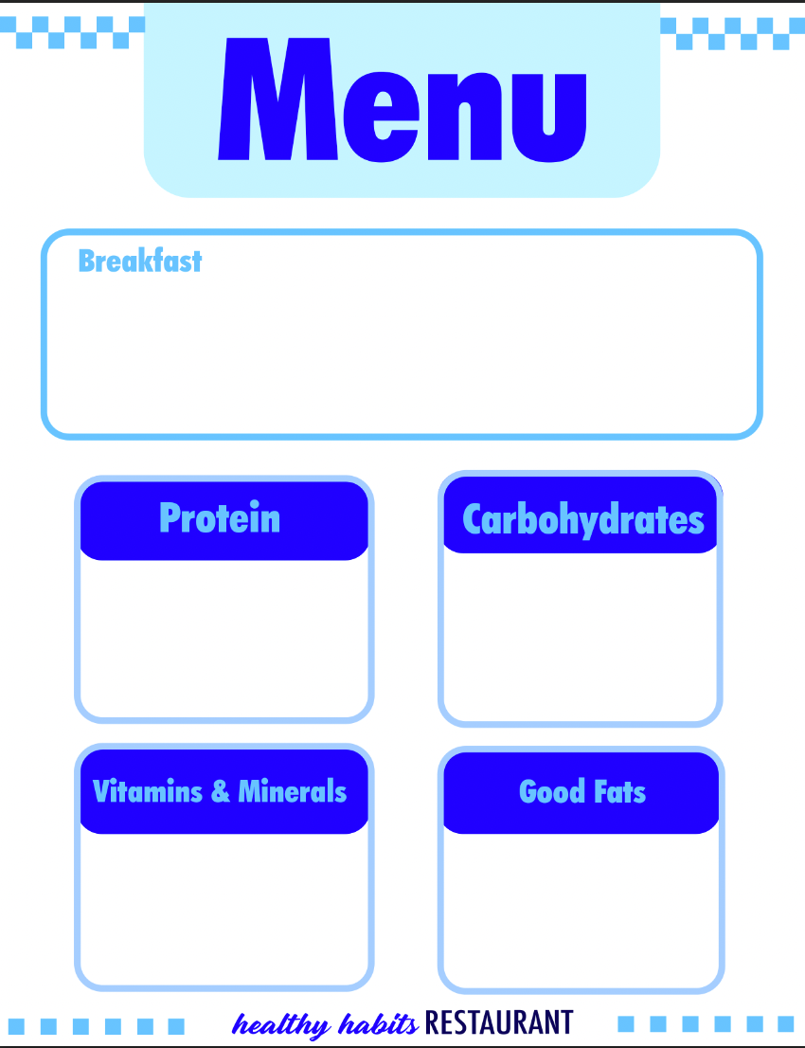
What’s on the menu at
Instructions
In your group, decide your meal.
Write a description of the meal, making it sound as delicious as possible!
Write down the foods your meal contains in the 4 categories.
Almond butter on a lightly toasted slice of our finest whole wheat bread, with a drizzle of honey. A bowl of greek yogurt topped with fresh berries.
Whole wheat toast
Greek Yogurt
Fresh berries
Almond butter
© FEMM
Notes:
Nutrition is the nourishment that your body gets from the food you eat. Good nutrition supports a healthy body. Let’s look at the different types of nutrients our body needs.
These are the main types of nutrients we receive from our food.
Proteins are complex substances that consist of amino acids. Different types of proteins have different combinations of amino acids. We need different types of proteins to give us all of the building blocks we need for a healthy body.
Carbohydrates are made up of three components: fiber, starch, and sugar. Just like there are different types of proteins, there are also different types of carbohydrates. One of the main differences between carbohydrates are simple carbohydrates and complex carbohydrates. Simple carbohydrates are mainly made up of sugars. Complex carbohydrates have more fiber and starch. Simple carbohydrates are okay to eat sometimes, but complex carbohydrates are the ones that we should eat more.
Fats are an important source of energy. They are made of fatty acids. These dietary fats can enter the bloodstream so that your body can use them in the most appropriate way. Even though we sometimes think that fat is a bad thing to eat, it is absolutely important for every human to have some sources of good fat in their diet.
Together, proteins, carbohydrates and fats are the three macronutrients that make up the majority of the foods you eat.
Vitamins & minerals are micronutrients required by the body to carry out a variety of functions. They are not produced in our bodies, so we must get them from a variety of different food sources. Sometimes, when a body does not have enough of one of the vitamins or minerals, diseases can result. An example of this is when sailors on long sea voyages weren’t getting enough Vitamin C because they were only eating what was basically crackers and salted meat. They got a disease called rickets, which meant their legs started to bow out to the sides, among other things. On future sea voyages, they were able to fix this by packing lots of citrus fruits on board. Citrus fruits, like oranges and lemons, are able to keep for a long period of time and also contain Vitamin C.
Water is an essential nutrient at every stage of life. Optimal hydration is a key component of good health. The sensation of thirst is our body’s signal that lets us know it is time to re-hydrate. Water is involved in almost every process in the human body.
When we eat, our bodies break down the food and use the different nutrients to keep us healthy and growing.

Slide 11
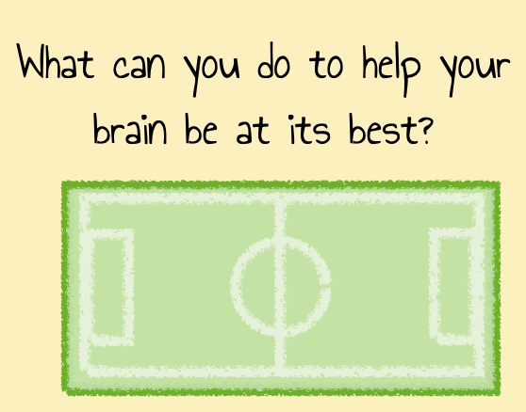
The Three Pillars of Health
Nutrition
Exercise
Pillar 2.
You are here.
Exercise! Play on!
© FEMM
Notes:
The second pillar of health is exercise.
Exercise is really important for your brain and body. You’ve probably heard that exercise is good for your muscles and your lungs. It is! But it’s also so much more! Did you know that exercise also increases your energy, improves your mood, and reduces anxiety? How? Exercise releases endorphins, dopamine, and adrenaline. These are names of hormones that make you feel happier, more confident, and less stressed!
Finding an exercise you like to do is important at every age, whether it’s biking, swimming, badminton, pickleball, or basketball!
Guys who are physically active tend to have better grades in school, because exercise improves your concentration and memory.

Slide 12
Exercise 1 hr
To Do:
Boosts your BRAIN 🧠
increases energy
improves mood
reduces anxiety
⚽️🏀🏈⚾️🎾⛷️⛹🏻🏌🏾‍♂️🏄🏻‍♂️🚴🏻‍♂️
2. Strengthens your HEART ❤️
3. Strengthens your LUNGS 🥵
(So you don’t look like this emoji when you run.)
4. Strengthens MUSCLES and BONES
© FEMM
Notes:
Finding an exercise you like to do and that brings you joy is important at every age, whether it’s hiking, mountain biking, swimming, badminton, pickleball, or just walking!
Guys who are physically active tend to have better grades, are healthier and have better concentration and memory.
12

Slide 13

The Three Pillars of Health
Nutrition
Exercise
Pillar 3.
What can you do to help your brain be at its best?
You are here.
Sleep
8-10 hrs.
© FEMM
Notes:
The third pillar of health is sleep. Maybe sleep doesn’t sound very interesting to you; maybe you actually try to stay up as late as possible….
But do you know how much happens for your brain and your body when you sleep?!
Did you know that your body does most of its growth during sleep?

Slide 14
Sleep 8-10 hours: just do it
To Do:
Boosts your BRAIN 🧠
helps you learn new things
leads to more creativity
makes you happier
😴
Builds and repairs MUSCLE 💪
Regulates your appetite hormones
(you crave more sugar when you’re tired)
Regulates your reproductive hormones
and MORE!
© FEMM
Notes:
That’s because most of your hormones are produced while you sleep. Your body needs 8-10 hours of sleep each night. Making the choice to go to bed on time is one of the most important things you can do for yourself and your health.
You can help yourself to have a good sleep by putting your phone or screen away an hour before bed.
14

Slide 15
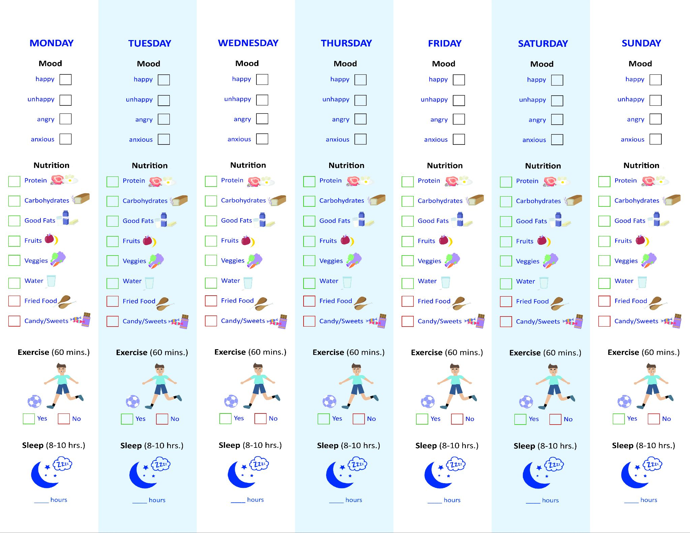
Health Checklist Challenge!
✔️ Your:
Mood
Food
Exercise
Sleep
for 1 week!
© FEMM
Notes:
This week, we’re going to do the Health Checklist Challenge.
The point of the challenge is to pay attention to your daily habits for one week. A habit is something you do so often that you don’t even think about it. So this week, we’re going to try to notice our habits: what do you eat during the day, do you exercise for 60 minutes and how many hours of sleep do you get each night? What impact does this seem to have on your mood and how you feel the next day? This will be a great tool to pay attention to your mood, physical symptoms, nutrition, exercise, and sleep.
Hand out a Health Checklist to each student. You may want to incentivize completing the Health Checklist challenge by offering a prize next week or making it a challenge of students against teachers.

Slide 16
Grade 6
LESSON 5
© FEMM
Notes:
Our brains control our hormones and hormones make puberty possible. Keeping our brains and our bodies as healthy as possible through good nutrition, an adequate amount of exercise and sleep can help us to grow and be as healthy as we can be.

