Slide 1

Grade 6
LESSON 6
© FEMM

Slide 2
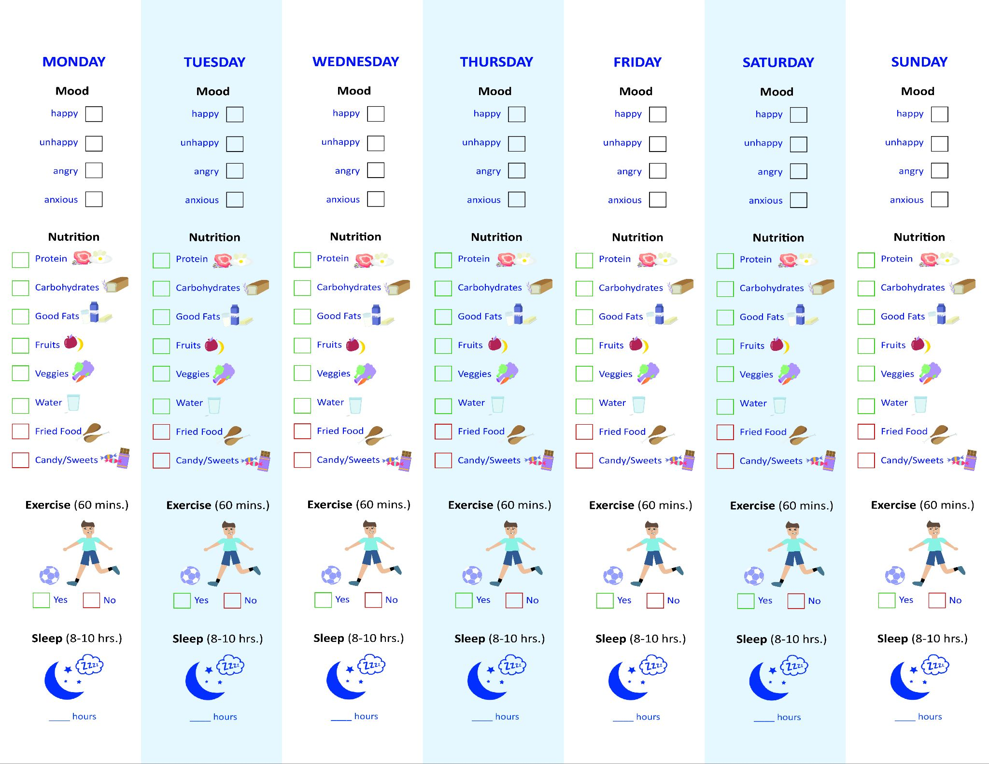
Health Checklist: How did it go?
✔️ Your:
Mood
Food
Exercise
Sleep
for 1 week!
© FEMM
Notes:
Step 1 (10 minutes): Health Challenge: Sports Interview Recap
Print and hand out the Health Challenge: Sports Interview Recap to each student. Instruct students to write their names on the blanks. Then, answer the interview questions in their own words.
When finished, pair students off and ask them to perform their interview in front of the class, with one person playing the role of interviewer and the other person being interviewed, like a sports journalist interviewing an athlete.

Slide 3
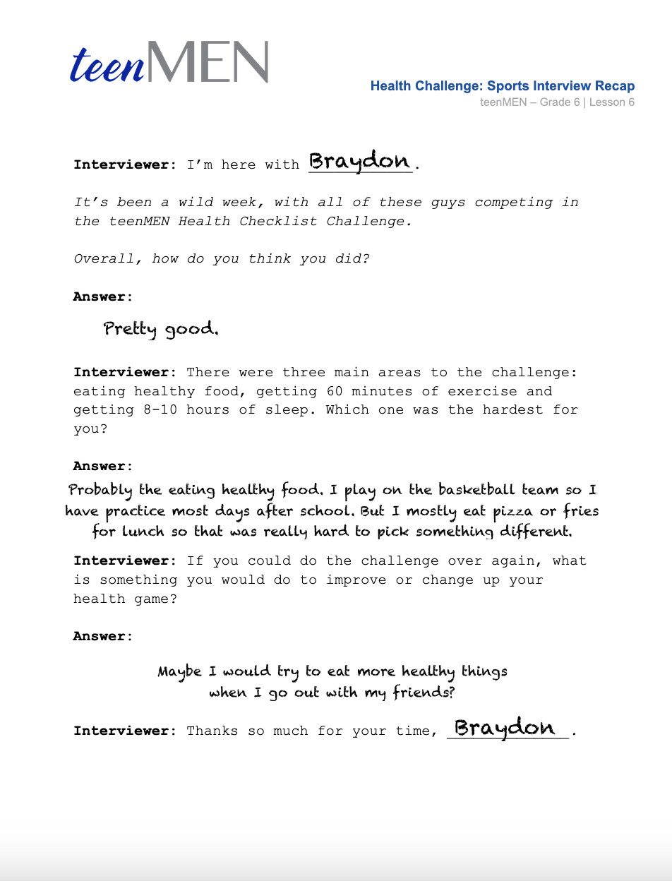
Health Checklist: Sports Interview Recap
🎤
To Do:
Fill in the worksheet, writing your name on the blanks and answering the questions.
In pairs, select one interview to use, and decide who will play the role of sports journalist and who will play the role of the athlete.
Perform your interview for the class.
🎤
🎤
© FEMM
Notes:
Step 1 (10 minutes): Health Challenge: Sports Interview Recap
Print and hand out the Health Challenge: Sports Interview Recap to each student. Instruct students to write their names on the blanks. Then, answer the interview questions in their own words.
When finished, pair students off and ask them to perform their interview in front of the class, with one person playing the role of interviewer and the other person being interviewed, like a sports journalist interviewing an athlete.

Slide 4

What influences the brain?
Because the brain is the organizing center …
Things that affect your brain
will affect your physical &
emotional health.
30x !
© FEMM
Notes:
Do you remember what controls the activity of every system in the body? Yes, hormones! Hormones are directed by your brain. Hormones cause all of the growing and changing that your body does during puberty.
Because the brain is the organizing center for your whole body, things that affect your brain will affect your physical and emotional health! During puberty, the level of testosterone in your body increases by up to 30 times the amount from when you were a boy. With that increase comes a lot of changes!

Slide 5

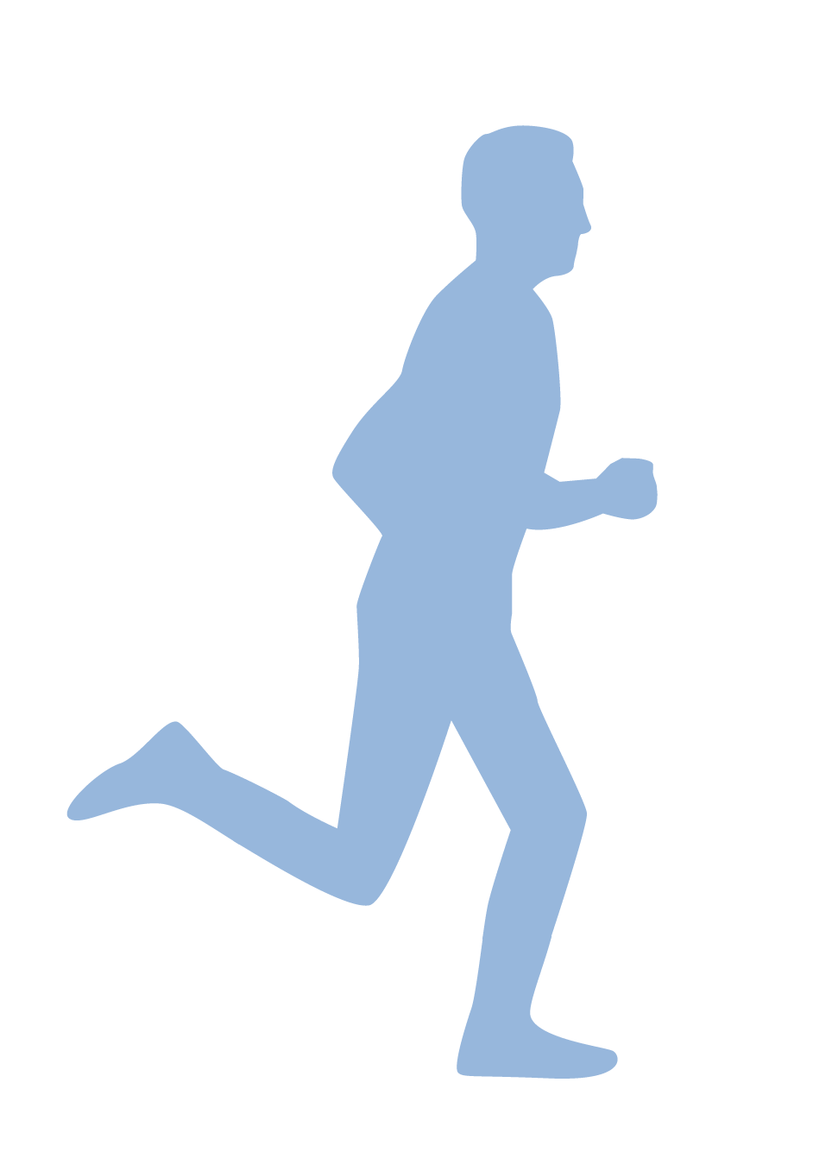
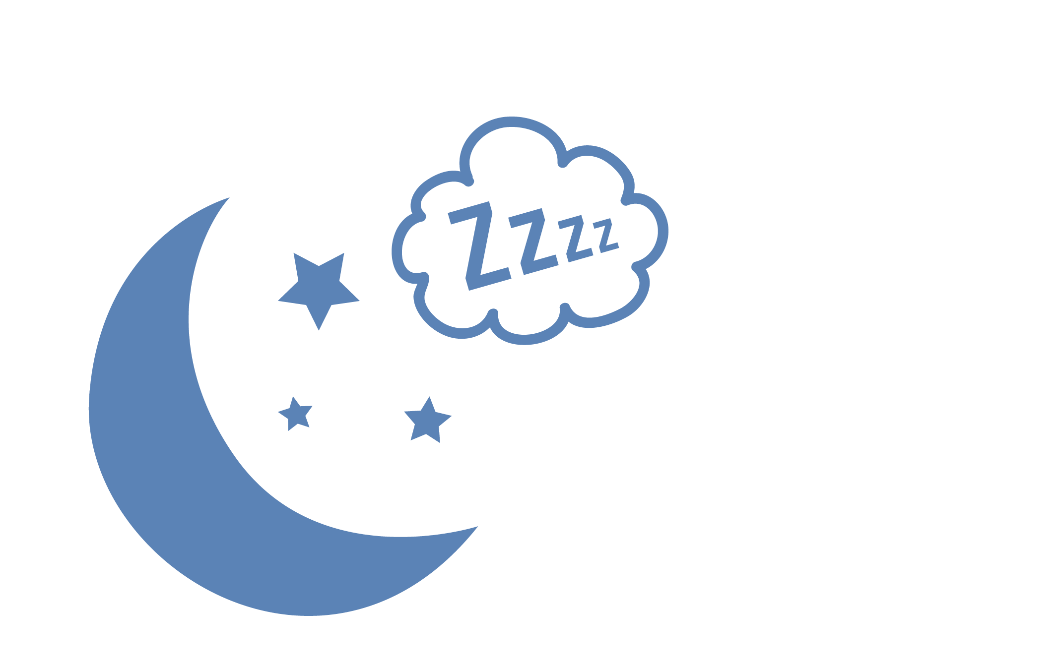

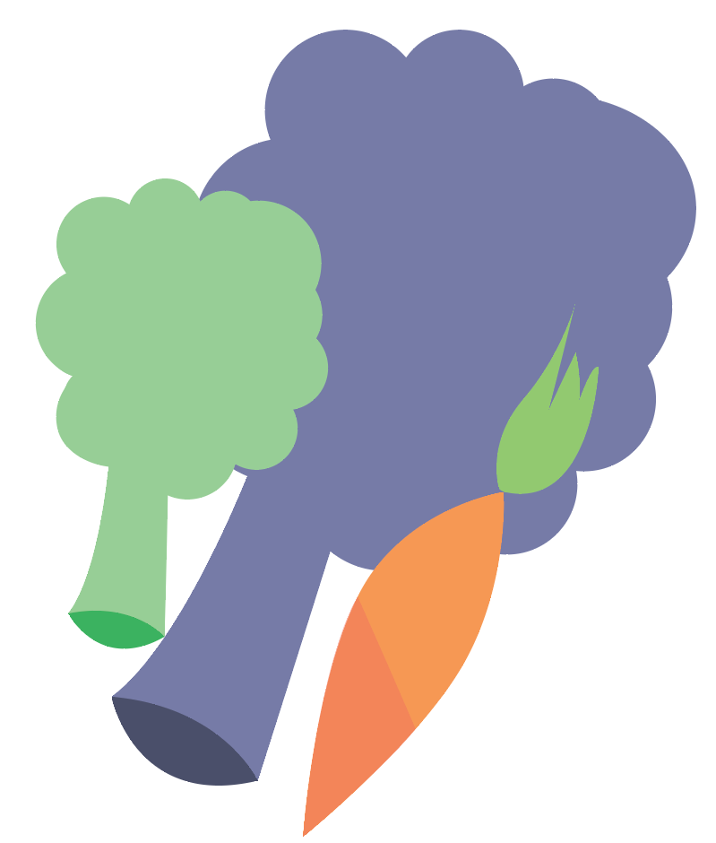

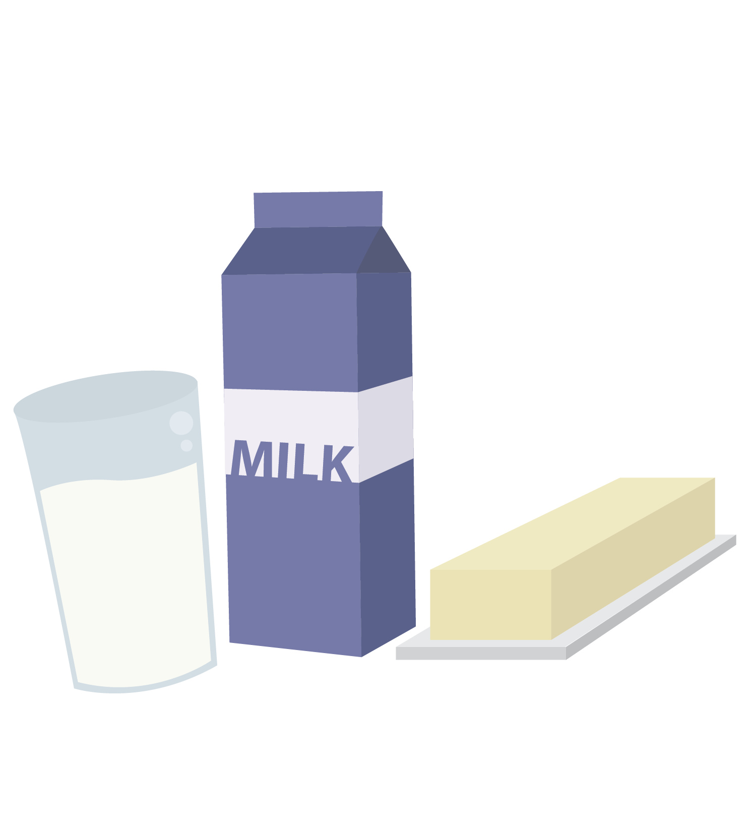
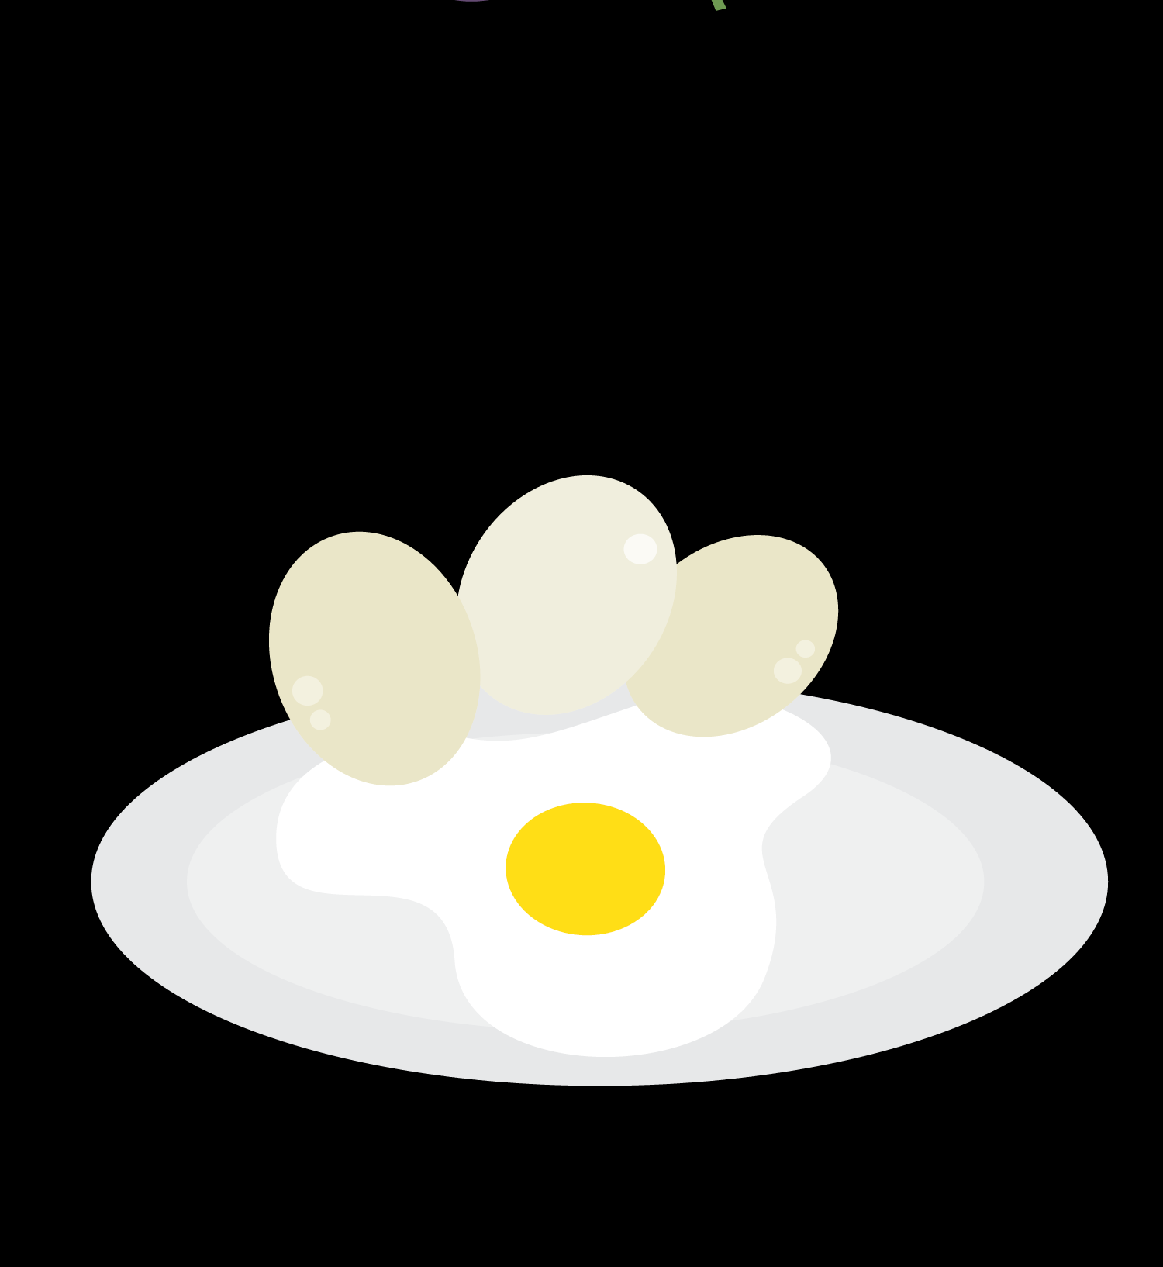
The Three Pillars of Health
Nutrition
Exercise
Sleep
© FEMM
© FEMM
Notes:
The best way to support the brain and the body to grow in a healthy way through puberty is to focus on the three pillars of health: good nutrition, exercise for 60 minutes a day and 8-10 hours of sleep each night. Sleep is when our body produces most of our hormones and exercise helps to balance our hormones.

Slide 6
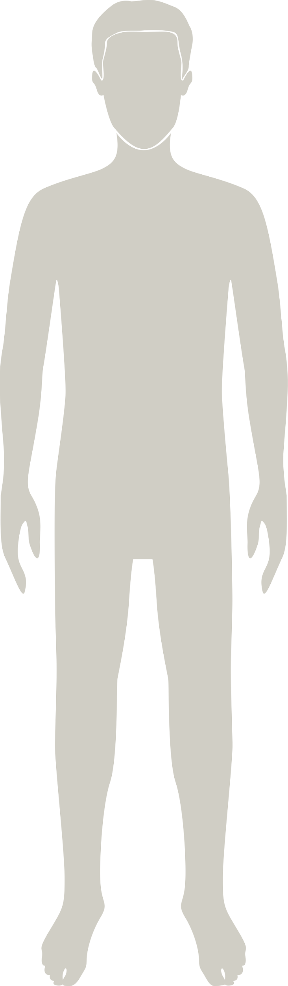
Your hormones & emotions
The hormones in puberty cause:
1. physical development
2. changing emotions
3. brain development.
The changes in puberty are a sign of health.
© FEMM
Notes:
Testosterone is sometimes thought of as the hormone that contributes only to rage or aggression, like the Incredible Hulk, but this is not the case. Testosterone has actually been linked to many different types of emotions. Not having enough testosterone at certain points in our development has been linked to depression later in life. Allowing testosterone to do what it is supposed to do during adolescence has been shown to be linked to better management of emotions overall, especially when faced with challenges.

Slide 7
Emotions during puberty
Hormones don't just affect the body,
they affect the brain, too.
During puberty, guys can experience
different & changing emotions.
What are some emotions that guys experience?
© FEMM
Notes:
During adolescence, it can sometimes feel like your emotions are getting the best of you. There will probably be times when we feel like it is hard to control our emotions, or even that we don’t know why we are feeling or saying certain things.
Boys can experience emotional ups and downs during puberty. These feelings are a normal part of growing up.
Ask: Can you name some emotions that guys can experience? Do you notice any change in your emotions since puberty began?
Write the boys’ answers on one side of the board. You’ll go back to these at the end of the lesson.

Slide 8
Emotions during puberty
🙂😡😟
Boys can experience emotional ups + downs during puberty:
You might feel sad or angry
You might worry about what others think of you.
You might feel more embarrassed or self-conscious
These feelings are a normal part of growing up.
© FEMM
Notes:
Boys can experience emotional ups and downs during puberty. These feelings are a normal part of growing up.

Slide 9
Understanding your changing emotions
Understanding your changing emotions will help you to manage them.
Knowledge of ourselves helps us to use our brain to choose to make good decisions – regardless of how we feel.
This is part of the process of maturing & growing.
© FEMM
Notes:
Knowledge of ourselves helps us to use our brain - and the ability to choose - to make good decisions about how to act, regardless of how we feel.

Slide 10
Emotions during puberty
We always have the power to choose how we react.
Emotions are one part of us.
2. We also need to also apply our intelligence & reasoning to our decision-making process.
© FEMM
Notes:
Your hormones play a big role in your changing body and emotions. There are many hormones besides testosterone that also affect how we feel. But no matter what emotions we experience, we always have the ability to choose how we react.
Think about when you were a boy. It was very easy to knock down a tower of blocks that you had made. It was much more difficult to build or create that tower. The decisions that you make affect you and the people around you. You can choose how to respond to your changing emotions. Choosing to have a more mature response to your emotions is more challenging, but remember: you are creating something. You are creating the mature man that you will someday be. Emotions are only one part of us. We need to also apply our intelligence to our decision-making as well as our feelings.

Slide 11
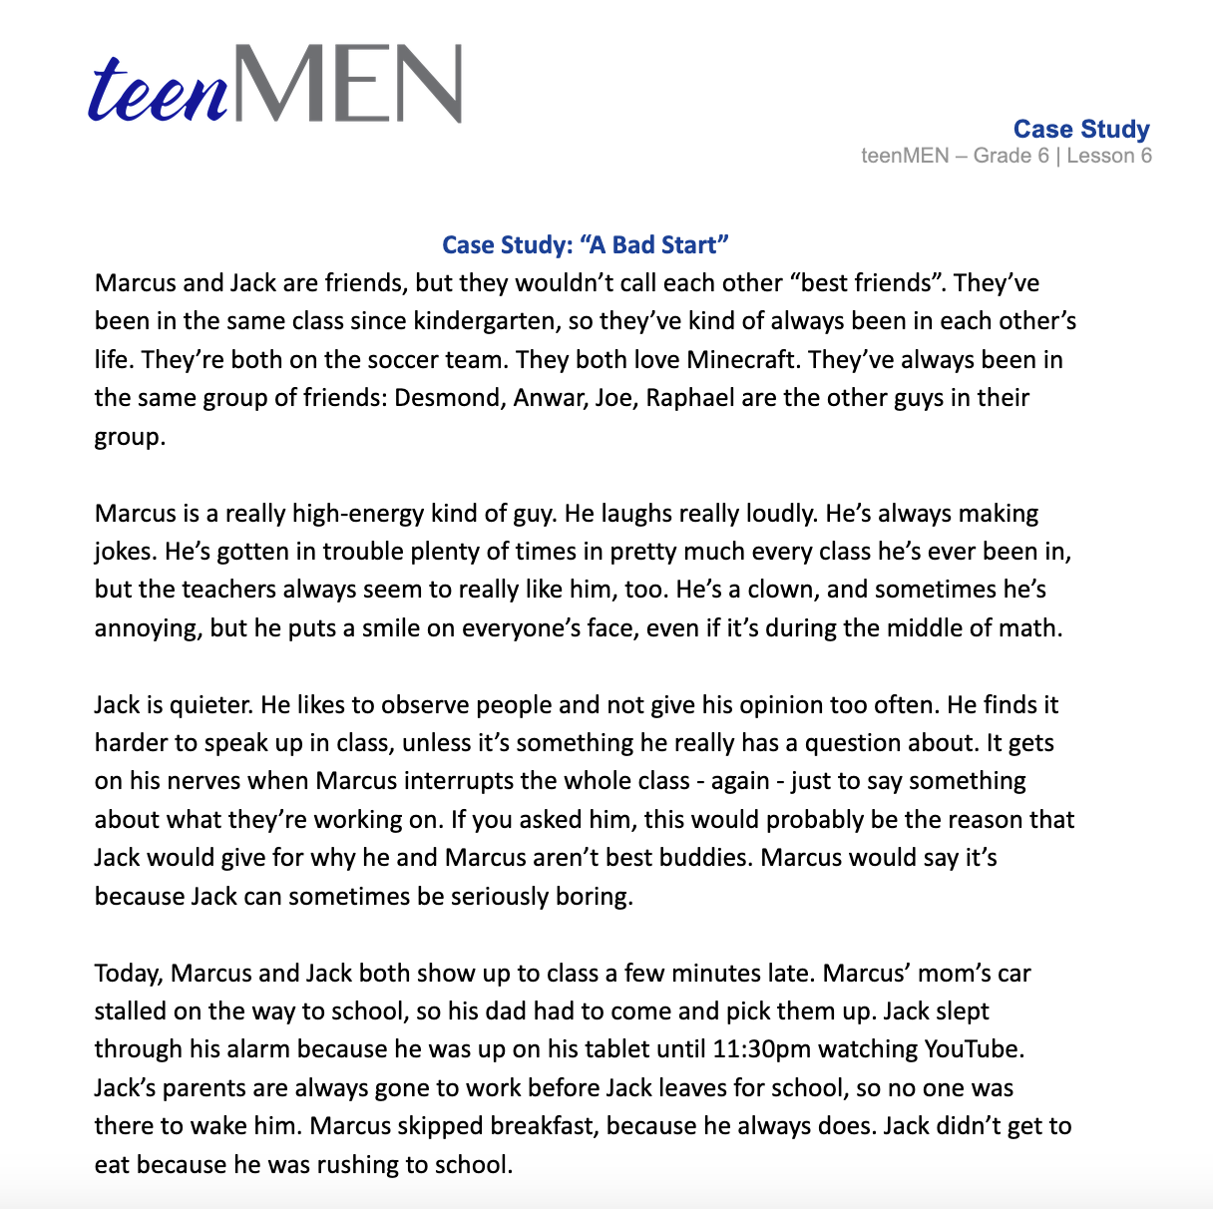
What would you do?
YOU CAN CHOOSE:
How will you choose to respond to your emotions?
© FEMM
Notes:
Read the Case Study: “A Bad Start” aloud to the class. Lead students through the Discussion Questions to possible solutions, with the Teacher’s Answer Key provided in the materials.

Slide 12
Health Checklist
✔️ Your:
Mood
Food
Exercise
Sleep
for 1 week!
© FEMM
Notes:
Hand out the Health Checklist to each student. We’re going to keep using the Health Checklist as a tool to check in on our health habits. This week, try to ask yourself at the end of each day which emotions you experienced over the course of the day. Think about your morning, during class, and at home in the evening. What did you choose to do with the feelings that you had? See if you see any connections between your emotions and the amount of sleep you had the night before? What is your mood like before an hour of exercise and afterwards? Make any notes on the back of the checklist for that day. Remember, you can always ask a trusted adult how to help you deal with emotions that sometimes feel like a lot for you.

Slide 13
Review
Testosterone is important for our healthy development.
We have the ability to make our own health choices.
Sometimes, our emotions might feel like a rollercoaster ride.
We can always make a good choice when it comes to how we react to our emotions.
© FEMM
Notes:
We have the ability to make our own health choices so that we do not let negative influences make our choices for us. During puberty, we will notice that sometimes our emotions are like a rollercoaster. We can always make a good choice when it comes to how we react to our emotions. Our emotions are neither good nor bad. It’s what we choose to do with them that makes the difference.

Slide 14
Grade 6
LESSON 6
© FEMM

