Slide 1

Grade 6
LESSON 6
© FEMM

Slide 2
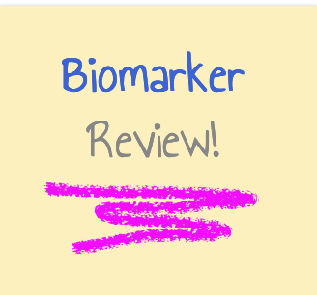
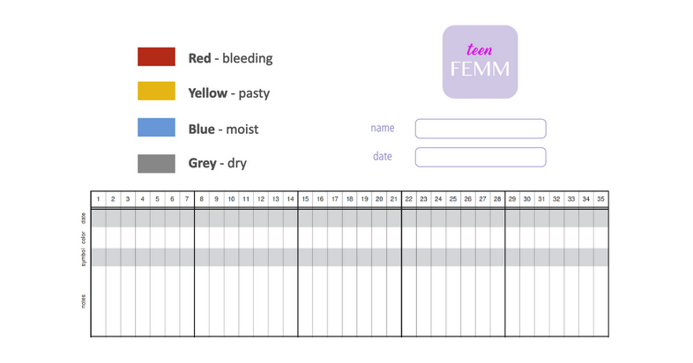
Notes:
Hand out a Charting Worksheet to each student.

Slide 3
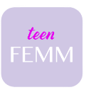
Meet Mira!
Is at the end of sixth grade.
Lives with her two brothers, mom, and dad. (And her cat!)
Loves horses, but has never ridden one!
Plays on her school’s badminton team!
Go birdies!
Just started teenFEMM at school.
💁🏻‍♀️
🐈
🐎
🏸
Notes:
Meet Mira!
Is at the end of sixth grade at an all-girls school.
Lives with her two brothers, mom, and dad. (And her cat!)
Loves horses, but has never ridden one!
Plays on her school’s badminton team.
Just did teenFEMM with her classmates at school.

Slide 4
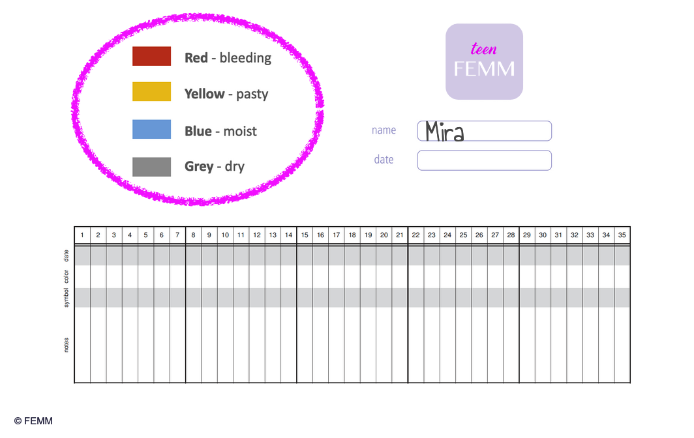
Help Mira chart
Mira
© FEMM
Notes:
Use the biomarker key on your Charting Worksheet, to help Mira fill in her chart as we go over her observations. (go to next slide)

Slide 5
Help Mira chart
Mira wrote down the following observations during her last cycle.
Based on these observations, what would her chart look like?
Felt dry, with nothing to observe - 6 days
Noticed she was feeling moisture - 3 days
Back to dryness - 3 days
Moist again - 2 days
Back to dryness - 2 days
Three days of moisture in a row when wiping
Dry for 5 more days
She noticed a few splotches of blood on one day
The next day she was lightly bleeding
© FEMM
Notes:
Felt dry, nothing to observe - 6 days
Noticed she was feeling moisture, especially when wiping - 3 days
Had a day where she saw mucus on the toilet paper when she wiped and it was clear and stretchy - 1 day
Back to dryness - 2 days
Moist again - 2 days
Back to dryness - 2 days
Now, three days of moisture in a row when wiping!
Dryness for 5 more days
She noticed a few splotches of blood on one day
The next day she was lightly bleeding

Slide 6
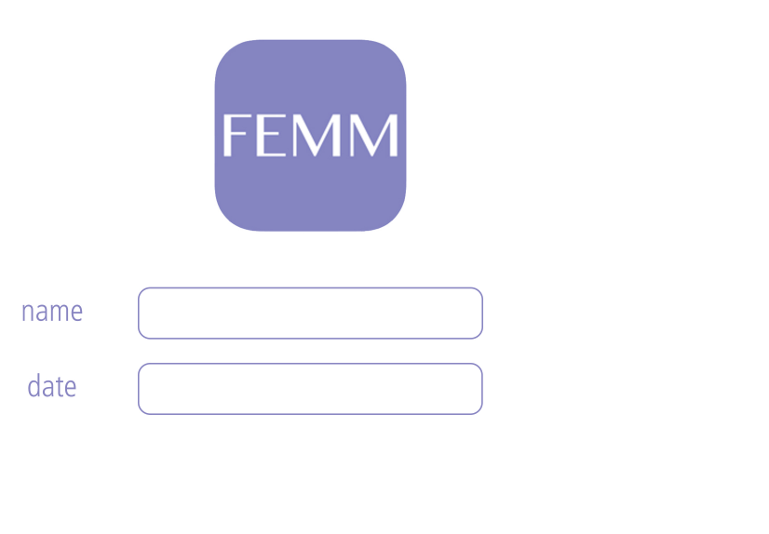
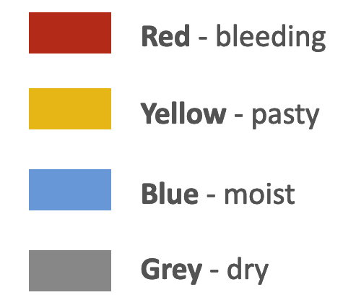
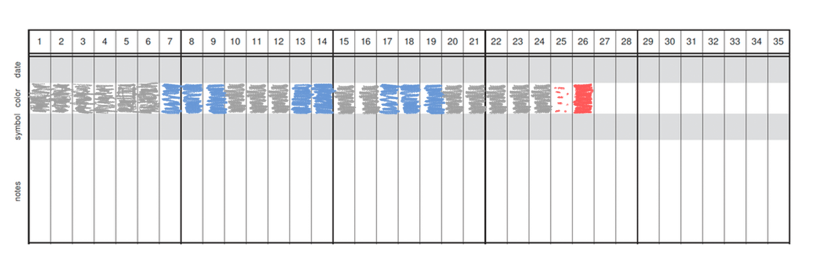
Mira’s chart
Mira
© FEMM
Notes:
What does your chart for Mira look like? Ask students if their chart matches the chart on the slide? Discuss any questions with the class.

Slide 7
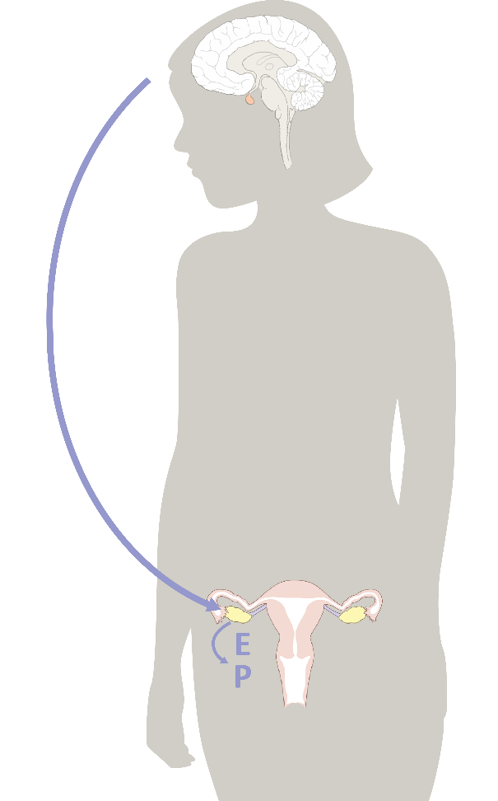
_ _ _ _ _ _ _ _ & your growth
_ _ _ _ _ _ _ _ cause all the growing & changing that your body does during puberty.
Your _ _ _ _ _ sends hormonal signals throughout your body to trigger growth & development.
H
O
R
M
O
N
E
S
B
R
A
I
N
© FEMM Foundation, Inc. All rights reserved.
Notes:
You’ve filled in Mira’s chart and you’re more than half way through your teenFEMM course. Can you solve the sentences?
Click on the slide to reveal letter by letter, as students guess the answer to fill in the blanks.
1. _________ cause all of the growing and changing that your body does during puberty. HORMONES
2. Your _____ sends hormonal signals throughout your body to trigger growth and development. BRAIN

Slide 8

What influences the brain?
Because the brain is the organizing center for all this activity…
Things that affect your brain
affect your physical & emotional
health.
Notes:
Because the brain is the organizing center for all this activity, things that affect your brain will also affect your physical and emotional health. Can you think of 3 things that have a BIG impact on your physical and emotional health? Click on the following slide to reveal each answer.

Slide 9
What influences the brain?
3 things that have a BIG impact on your physical & emotional health?
Nutrition
Exercise
Sleep
© FEMM
Notes:
Eating lots of healthy foods, moving your body, and getting eight to ten hours of sleep each night are so important that they are actually called the three pillars of health.

Slide 10
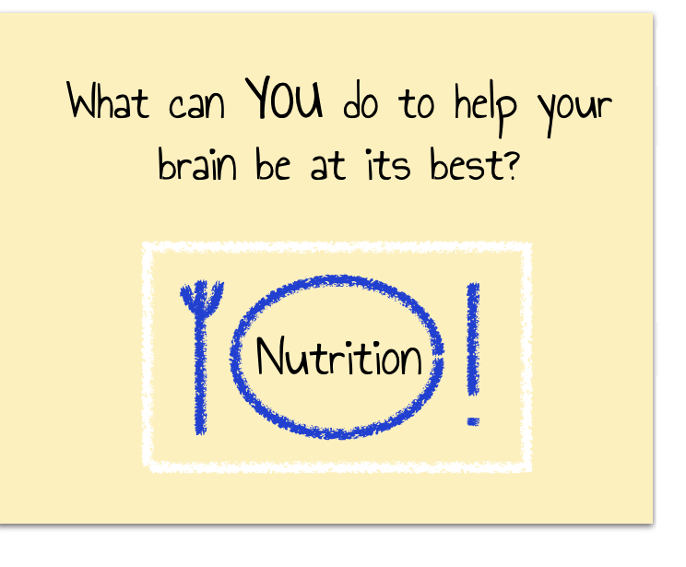
Help!
© FEMM Foundation, Inc. All rights reserved.
Notes:
The first pillar of health is nutrition. Nutrition is the nourishment that your body gets from the food you eat.

Slide 11
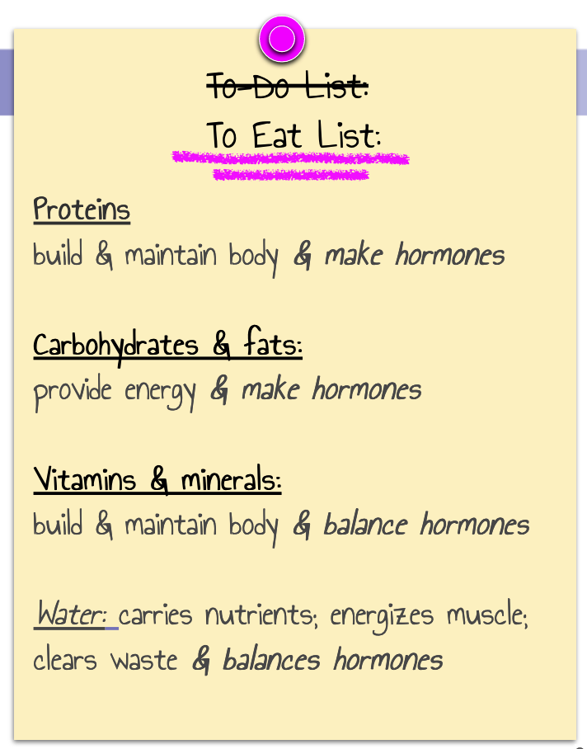

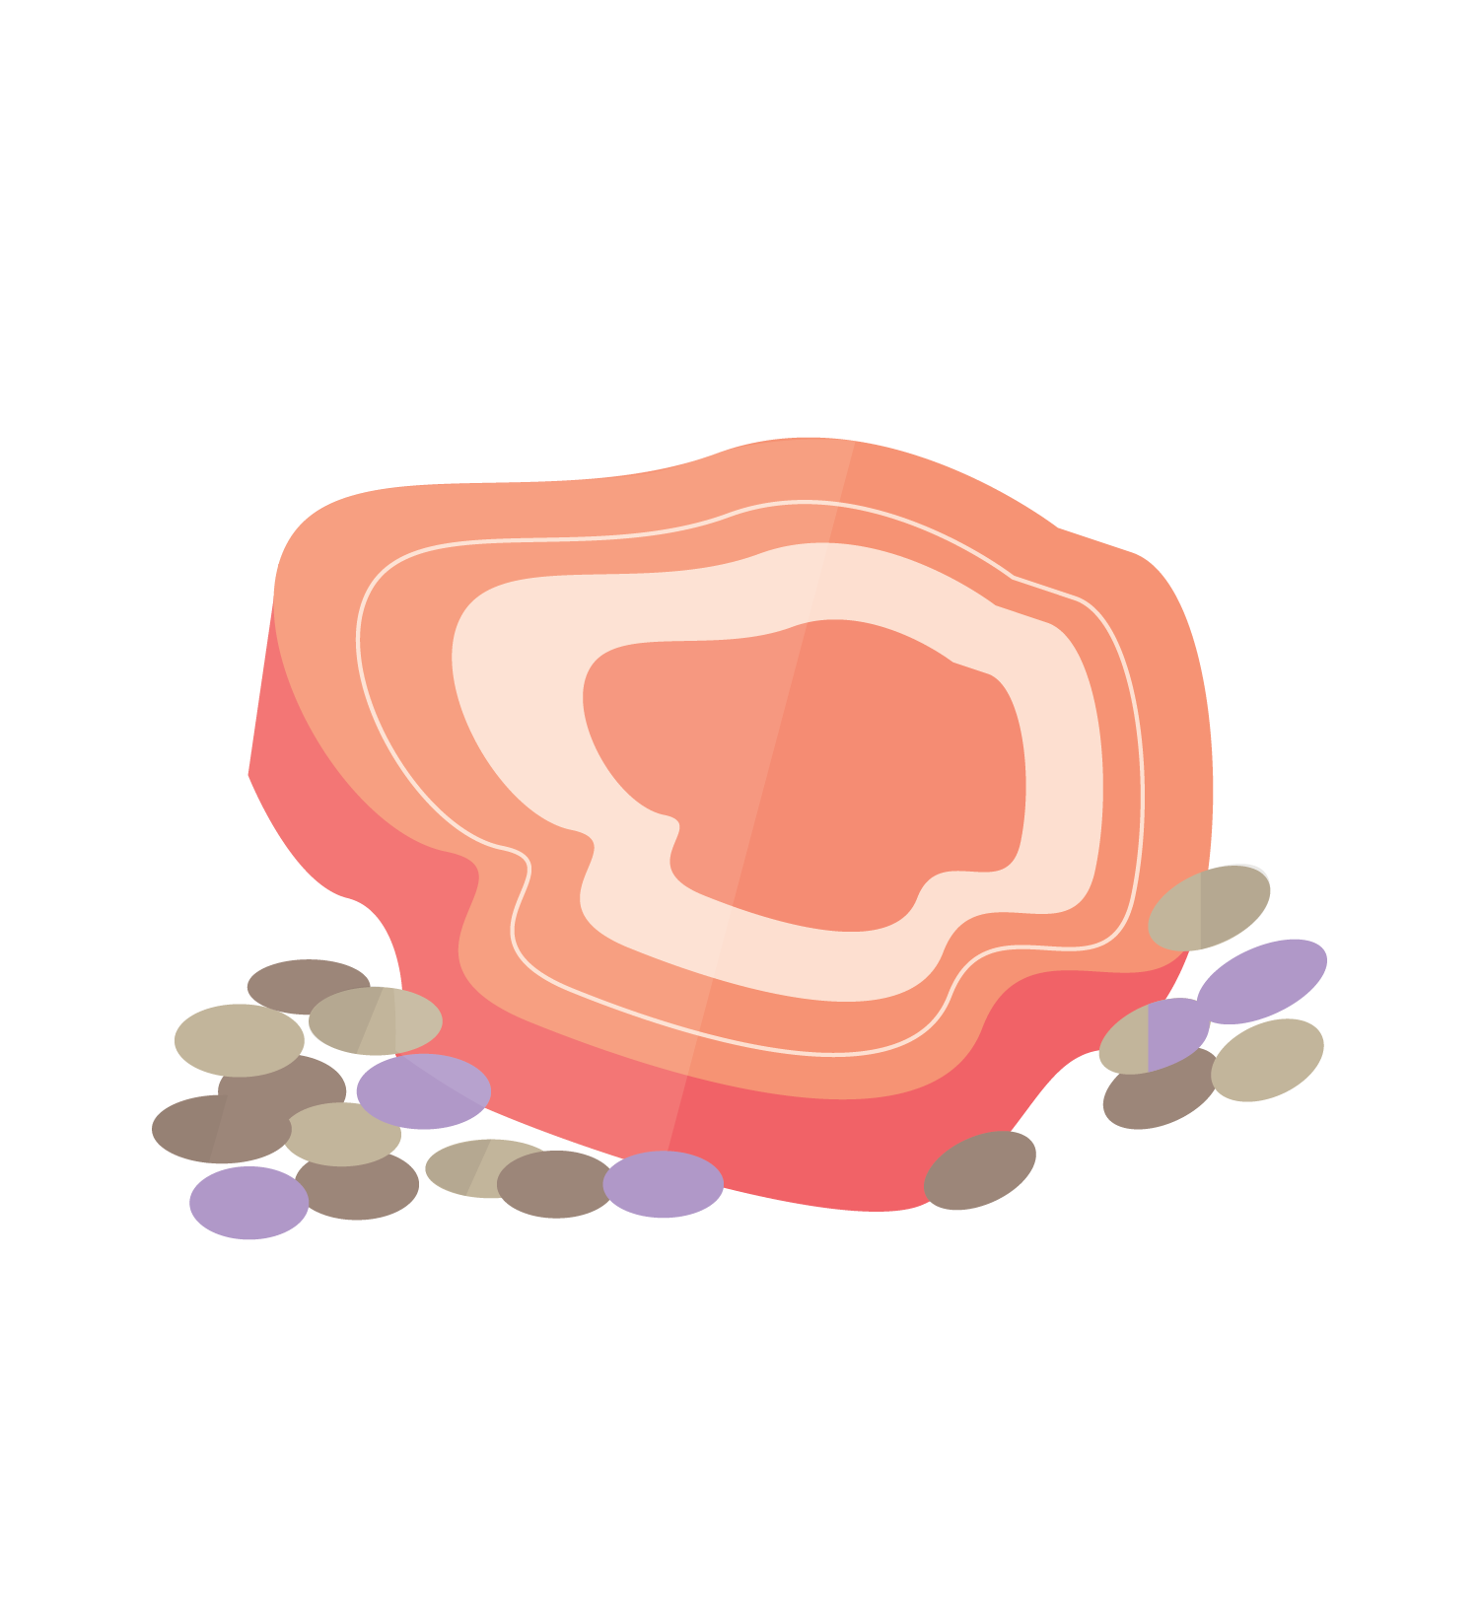
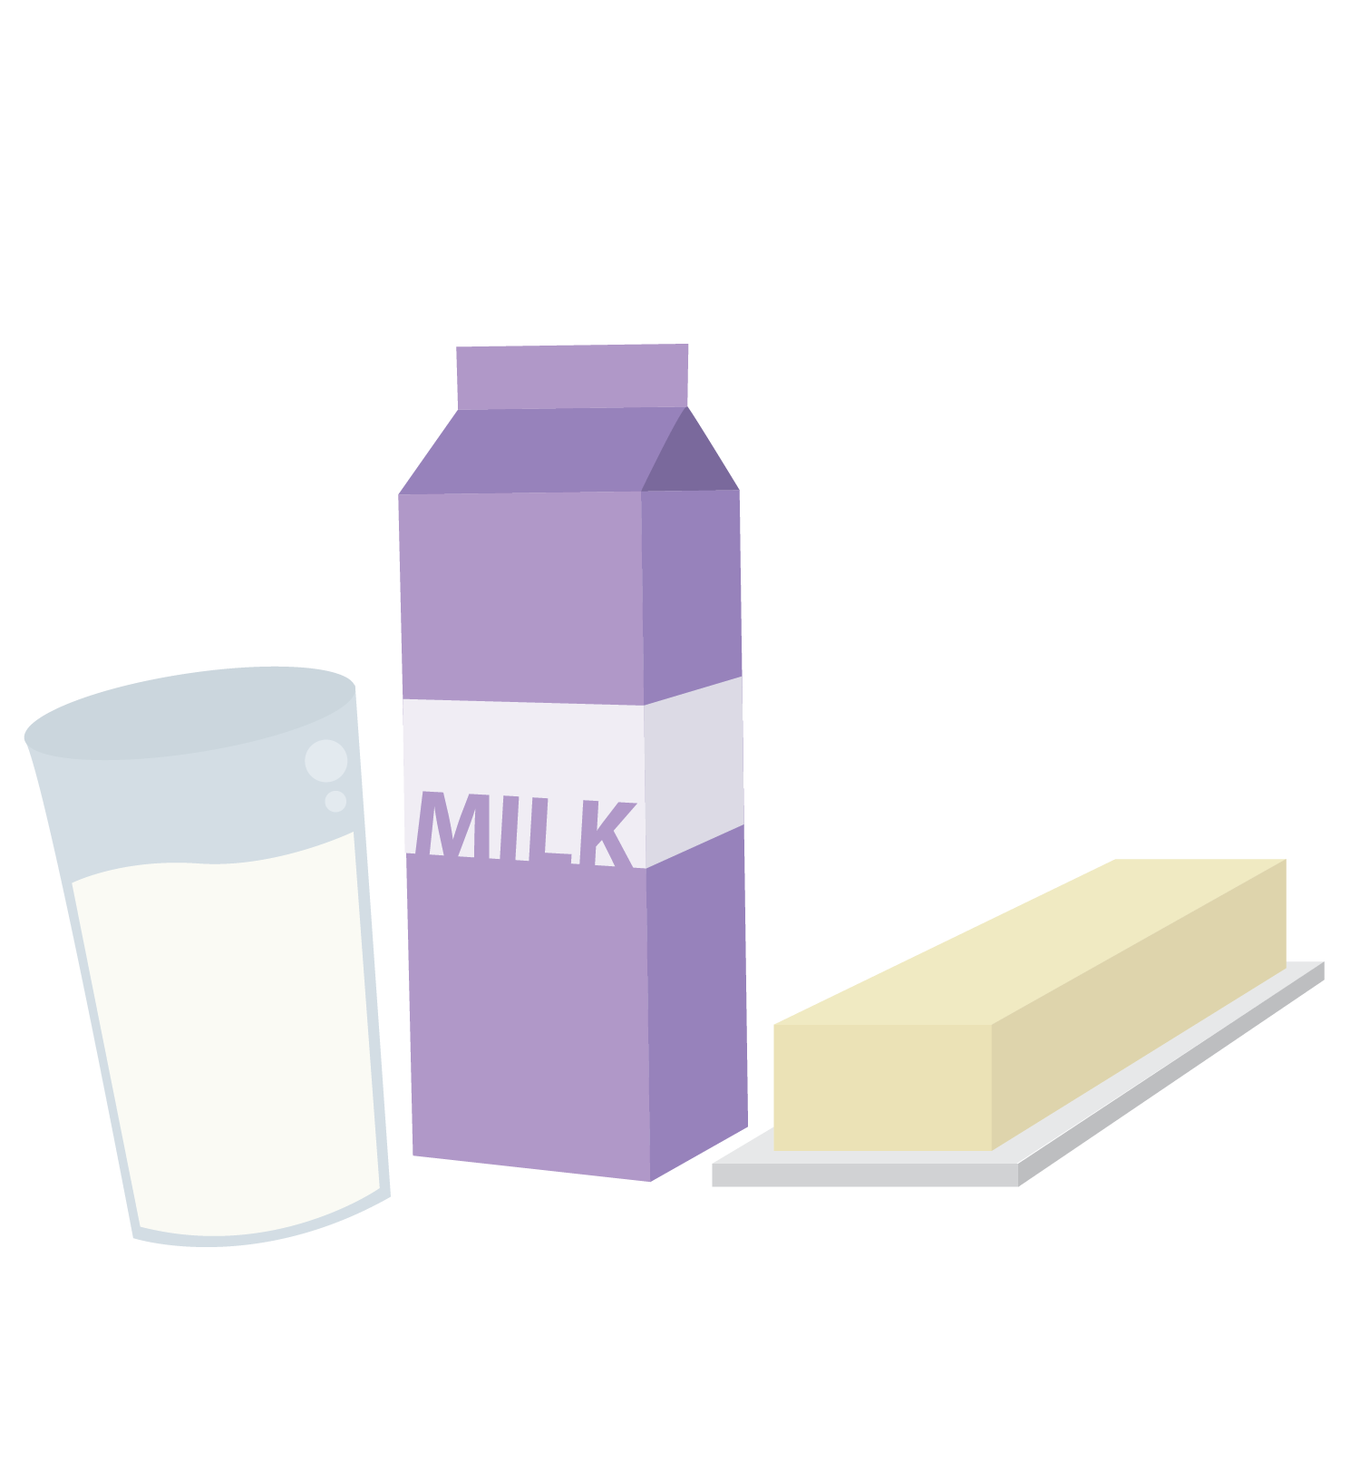




To-Do List:
To Eat List:
Proteins
build & maintain body & make hormones
Carbohydrates & fats:
provide energy & make hormones
Vitamins & minerals:
build & maintain body & balance hormones
Water: carries nutrients; energizes muscle; clears waste & balances hormones
©FEMM
Notes:
Good nutrition supports your brain and your body. The different types of nutrients we need to get from food are:
Proteins: build and maintain cells, help make hormones.
Carbohydrates & fats: provide energy, balance hormones.
Vitamins & minerals: build and maintain cells, balance hormones.
Water: carries nutrients, energizes muscle, clears waste.
When we eat, our body breaks down the food and uses the different nutrients in that food to support our health.

Slide 12
Protein: nuts, eggs, greek yogurt, beans, fish, chicken, beef, etc.!
Carbohydrates: whole wheat bread, pasta, rice, quinoa
Fats: nuts, olive oil, butter, milk, cheese
Vitamins & minerals: fruits & vegetables
(think of eating all the colors of the rainbow)
Water: just water! - not sugary drinks
©FEMM
Notes:
There are lots of foods that fit into each of the different categories, but here are a few examples:
Proteins: nuts, eggs, beans, fish, meat
Carbohydrates: whole wheat bread, pasta, rice, quinoa
Fats: nuts, olive oil, butter, milk, cheese, yogurt (nuts and dairy products contain a lot of healthy fats our body needs.)
Vitamins & minerals: fruits and vegetables!
Think of this like eating the colors of the rainbow:
Yellow: lemons, melons, yellow squash
Orange: oranges, butternut squash, sweet potatoes, carrots
Red: apples, strawberries, beets, tomatoes
Blue/Purple: blueberries, grapes, eggplant, plums
Green: Lettuce, Spinach, zucchini, green peppers
Every meal you eat should contain all of the different types of nutrients. There are so many foods that aren’t listed here, so food combinations are endless!

Slide 13

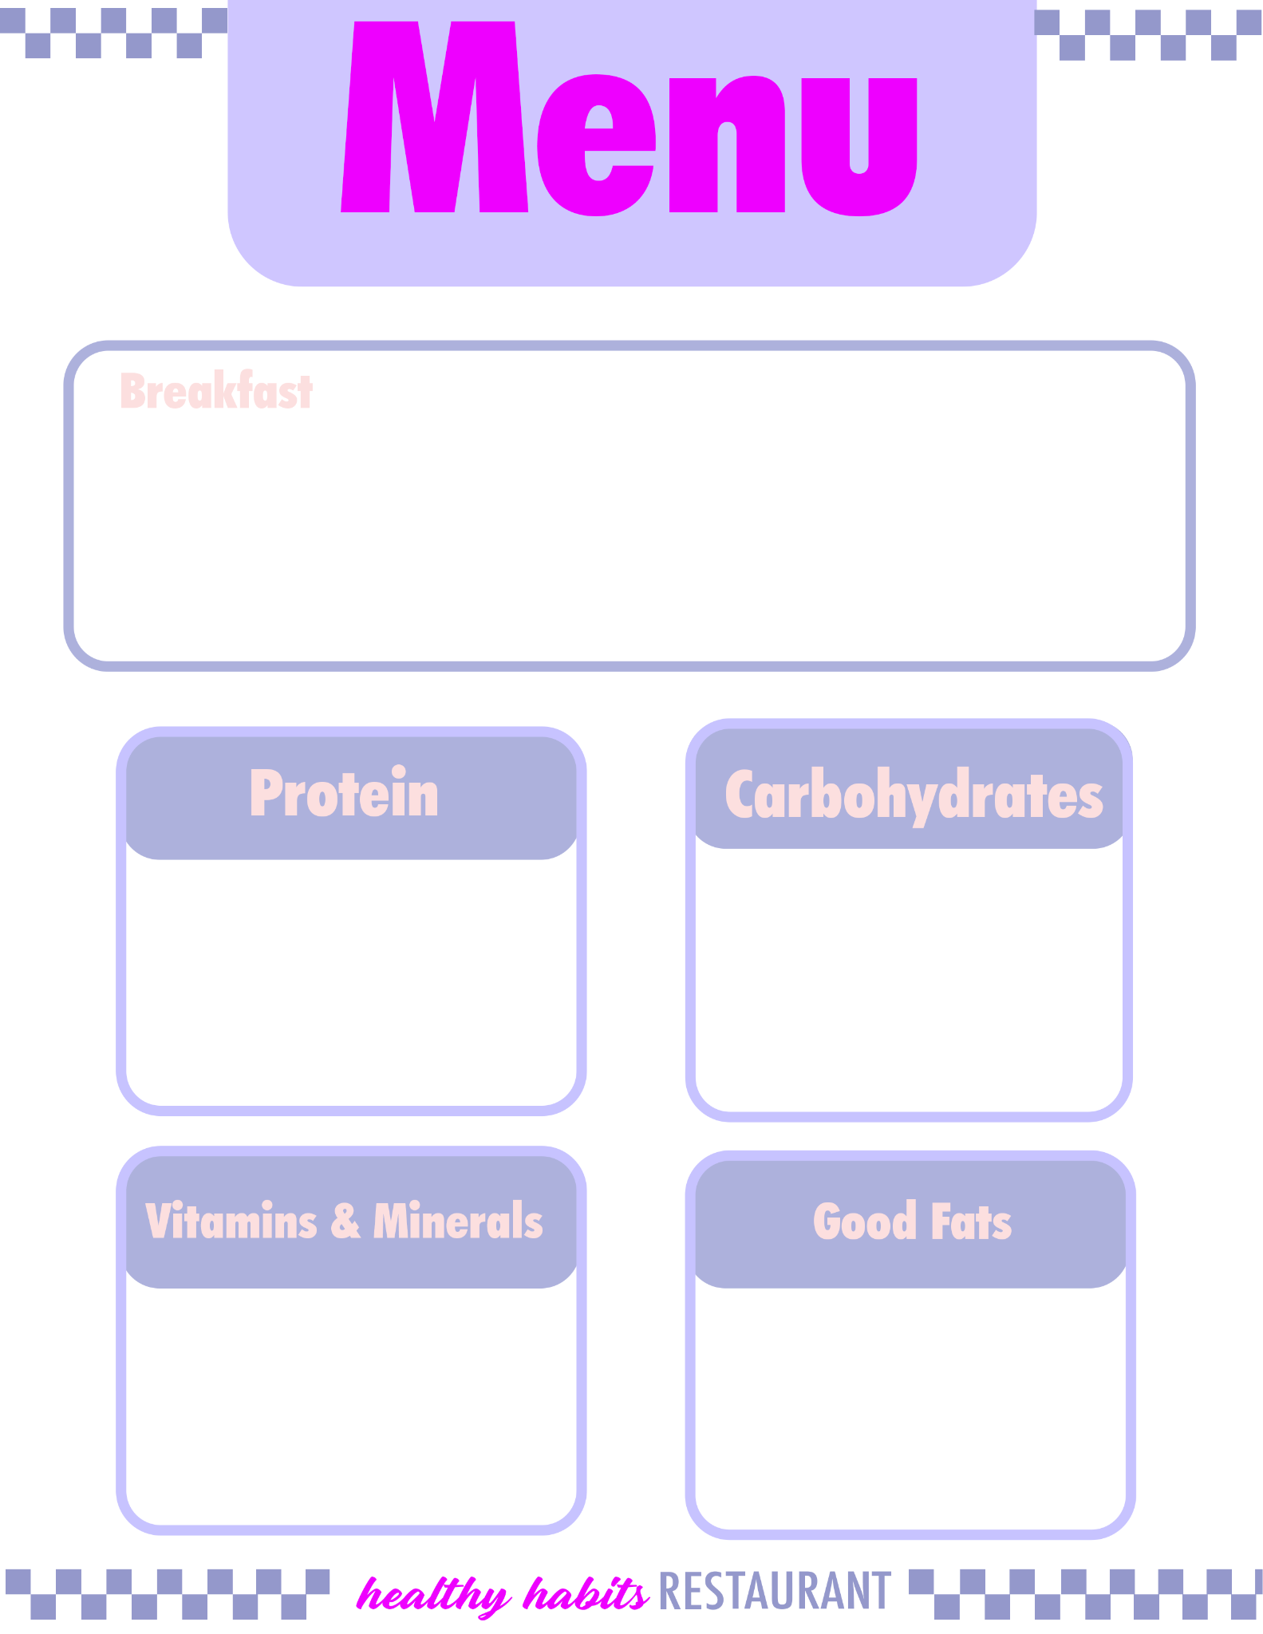
What’s on the menu at
Instructions
In your group, decide your meal.
Write a description of the meal, making it sound as delicious as possible!
Write down the foods your meal contains in the 4 categories.
Almond butter on a lightly toasted slice of our finest whole wheat bread, with a trickle of honey. A bowl of greek yogurt topped with berries.
Greek Yogurt
whole wheat toast
fresh berries
Almond butter
©FEMM
Notes:
Divide students into three groups. Handout one of the Healthy Habits Restaurant Menus to each group (ex: group 1: breakfast, group 2: lunch, group 3: dinner).
Healthy Habits Restaurant has asked for your help with their breakfast, lunch and dinner menu. As you can see from their sample breakfast menu on the slide, you are to:
Come up with a nutritious meal that contains: protein, carbohydrates, vitamins and minerals and good fats.
Write a description of the meal. Describe it in the most delicious way possible!
List the parts of the meal in the different nutrient categories, so that customers know what nutrients they’re getting from the meal.
Present your menu to the class. Groups can choose to present their menu acting as the restaurant owner, chef, waiter, etc.
Give groups a couple of minutes to work on their menu. You may want to display the previous slide containing food examples, to provide ideas. Then, invite groups to present.

Slide 14
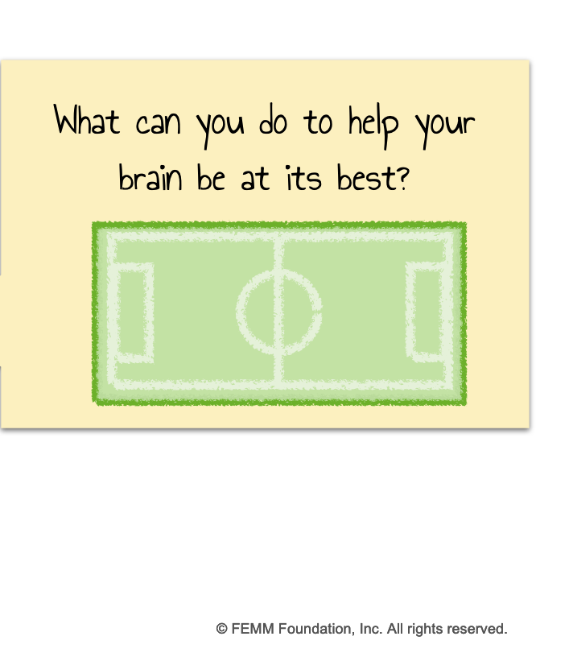
Help!
Exercise!
Play on!
Notes:
The second pillar of health is exercise.
You may think exercise is for your muscles or your lungs. It is. But it’s so much more!
Did you know that exercise also increases your energy, improves your mood, and reduces anxiety? How? Exercise releases endorphins, dopamine, and adrenaline. These are names of hormones that make you feel happier, more confident, and less stressed!

Slide 15
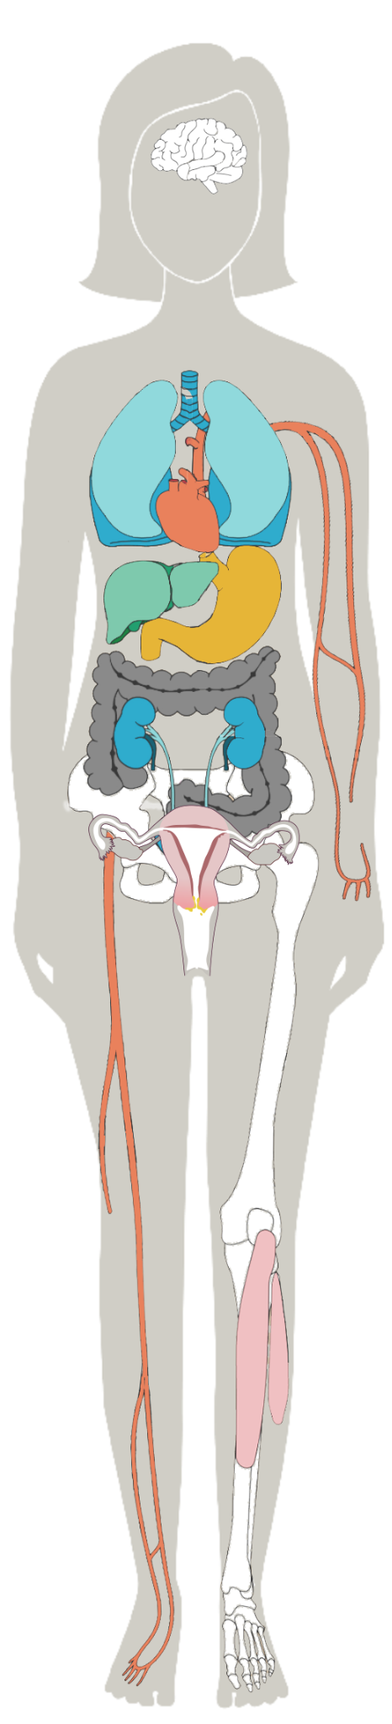
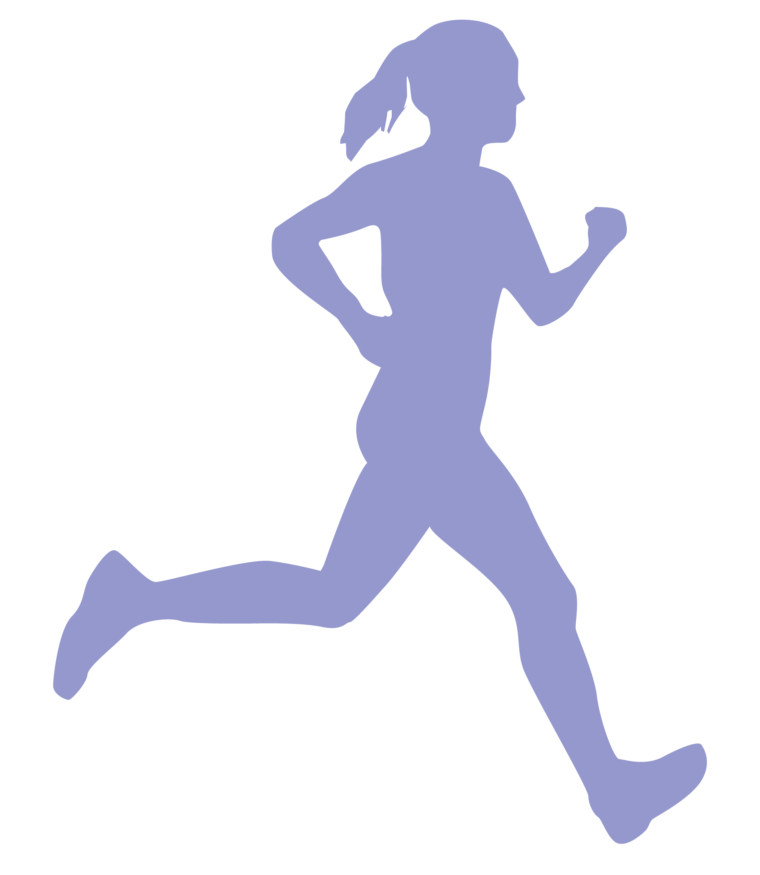

Exercise is for every part of your body
Boosts your BRAIN 🧠
Increases energy
improves mood
reduces anxiety
2. Strengthens your HEART ❤️
3. Strengthens your LUNGS 🥵
(So you don’t look like this emoji when you run.)
4. Strengthens MUSCLES and BONES🕺
(You need muscles to groove too, you know.)
© FEMM
Notes:
Exercise is for your brain, mood, energy, heart, lungs, muscles, bones, HORMONES… and too many more things to list!

Slide 16
Exercise is for every part of your body
To Do:
-Try to get 60 minutes
of exercise a day
© FEMM
Notes:
Exercise is about moving your body. Exercising is for EVERY body and it can be as simple as taking a walk outside, playing tag with a group of friends, going for a bike ride, enjoying a dance class, playing on a sports team, etc.

Slide 17

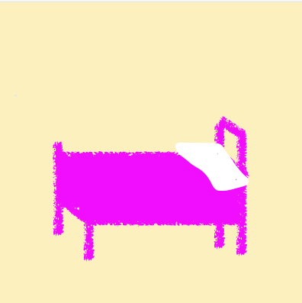
Help!
What can you do to help your brain be at its best?
Sleep! 8-10 hrs.
Notes:
The third pillar of health is sleep. Maybe sleep doesn’t sound very interesting to you; maybe you try to stay up as late as possible….
Do you know how much happens for your brain and your body when you sleep?!

Slide 18
Sleep is for every part of your body
To Do:
-
Boosts your BRAIN 🧠
helps you learn new things
leads to more creativity
makes you happier
😴
Builds and repairs MUSCLE 💪
Regulates your appetite hormones
(you crave more sugar when you’re tired)
Regulates your reproductive hormones
and MORE!
Notes:
Your body does most of its growth during sleep. Most of your reproductive hormones are produced while you sleep. Your brain even does a kind of “house cleaning” during sleep, clearing out toxins and improving your memory and creativity.
18

Slide 19
Sleep is for every part of your body
To Do:
-Go to sleep!
Get at least 8 hours of sleep a night.
© FEMM
Notes:
Your body needs 8-10 hours of sleep each night. Making the choice to go to bed on time is one of the most important things you can do for your brain, your health, AND your mood. Getting 8-10 hours of sleep each night makes you happier.

Slide 20
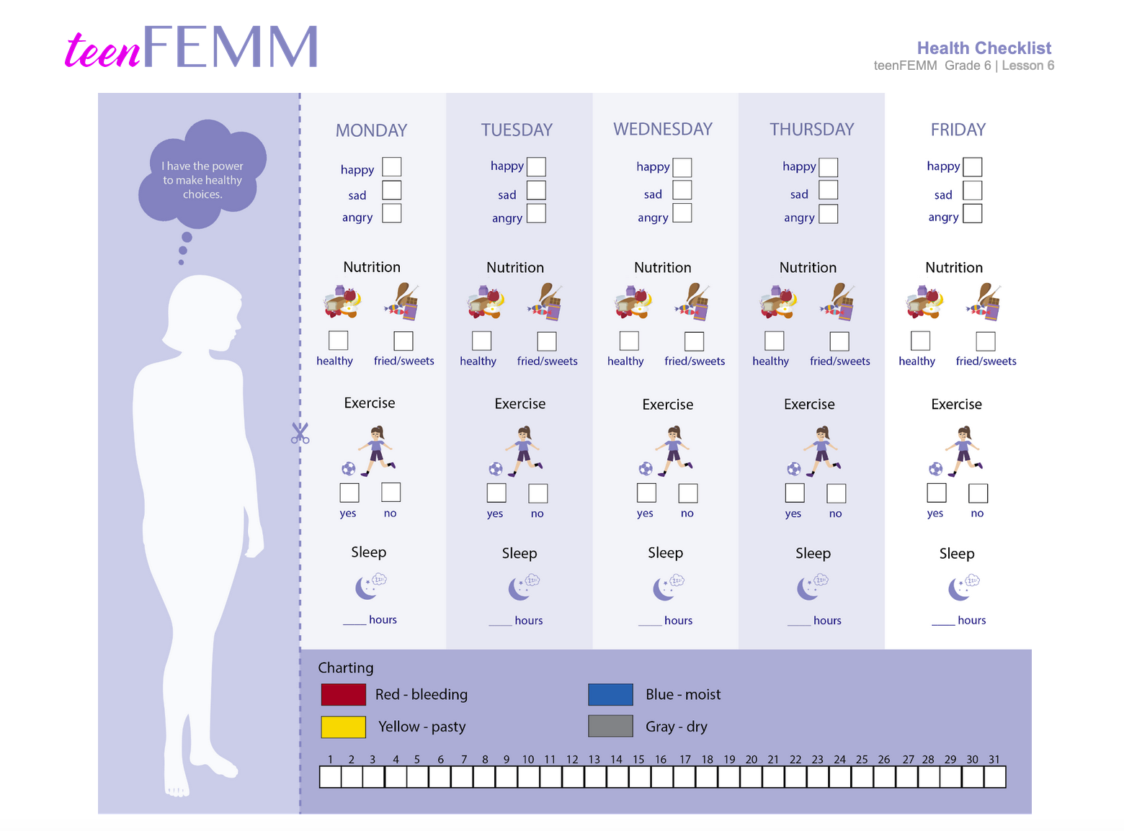
Health checklist challenge!
Notes:
This week, we’re going to do the five-day Health Checklist challenge. The purpose of the checklist is to pay attention to our daily habits for five days. Does getting 8-10 hours of sleep improve your mood the next day? Does eating healthy food impact your energy? Check it out. Make any notes on the back.

Slide 21
Review
Hormones are directed by our brain.
Our brain is affected by the foods we eat, the exercise we do, and the sleep we get.
We can help our hormones be at their best by practicing the
3 Pillars of Health!
Nutrition, exercise, and sleep are key to giving us a good foundation for our health!
Notes:
In this lesson, we reviewed what biomarkers will look like when we eventually start charting. We’ll learn more about this next year! We also revisited how important it is to make healthy food, exercise and sleep choices, because what we eat, how we move, and how much we sleep impacts our brain and body health and how these hormonal messages are sent and received. Please try to chart what you are eating and how you are feeling on your healthy choices worksheet. This helps us get ready for when we start charting our biomarkers next year!

Slide 22
Grade 6
LESSON 6
© FEMM

