Slide 1

Grade 6
LESSON 7
© FEMM

Slide 2
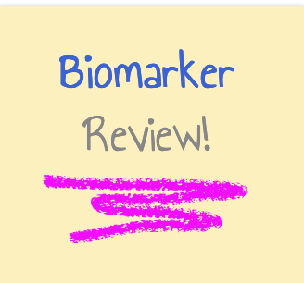
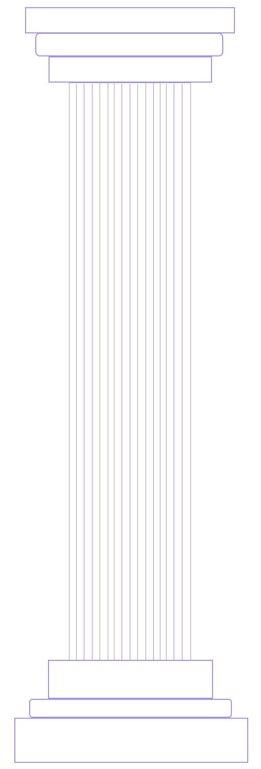
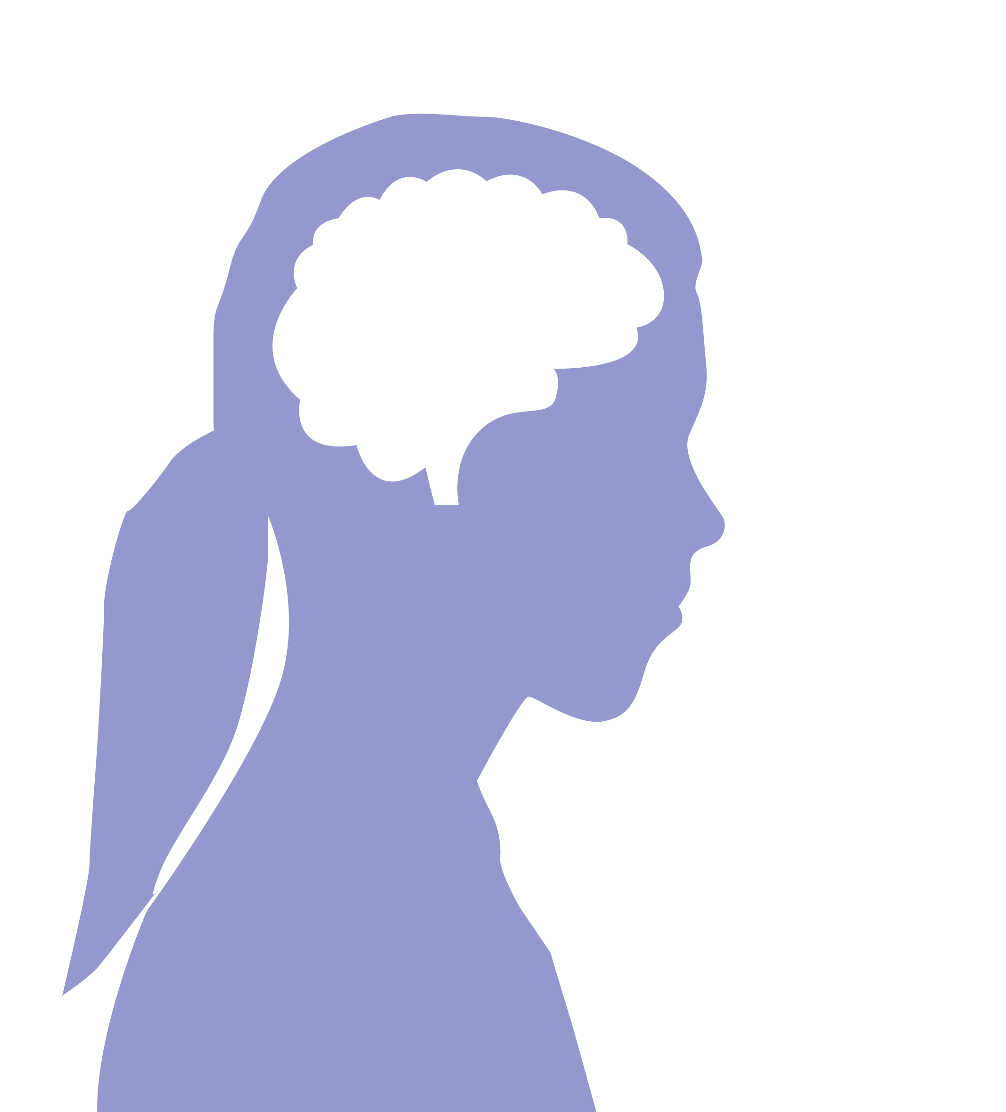
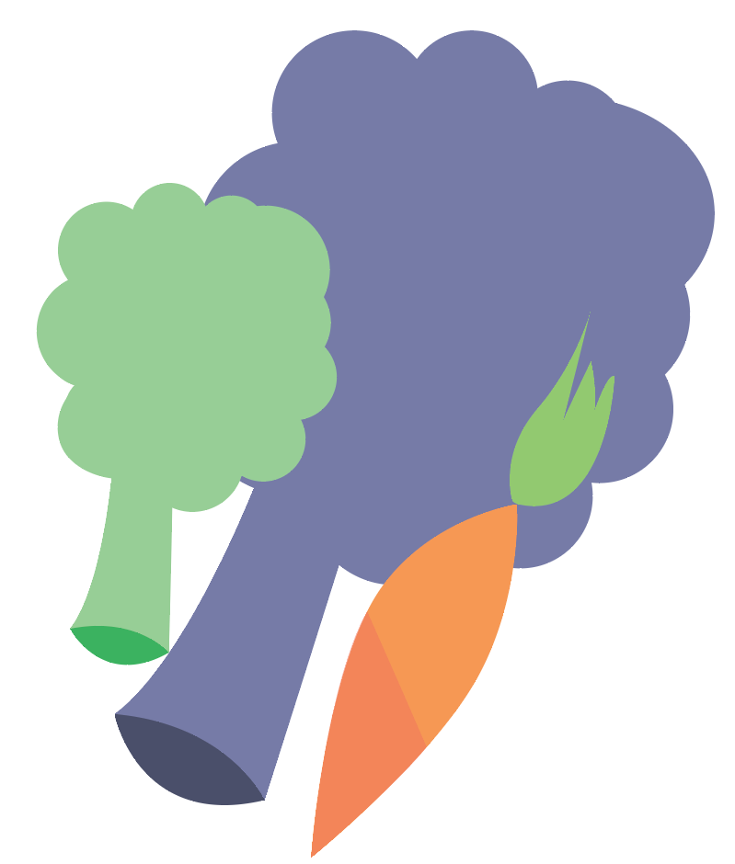
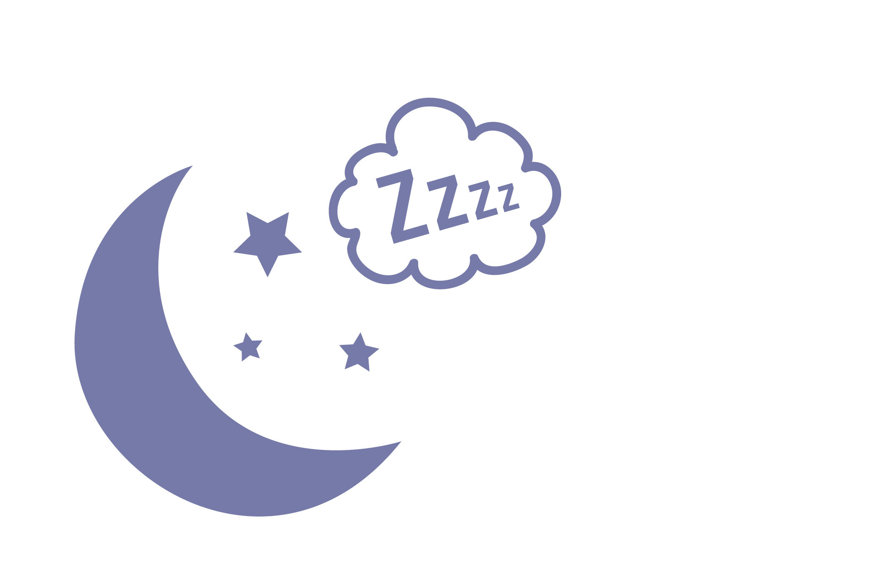

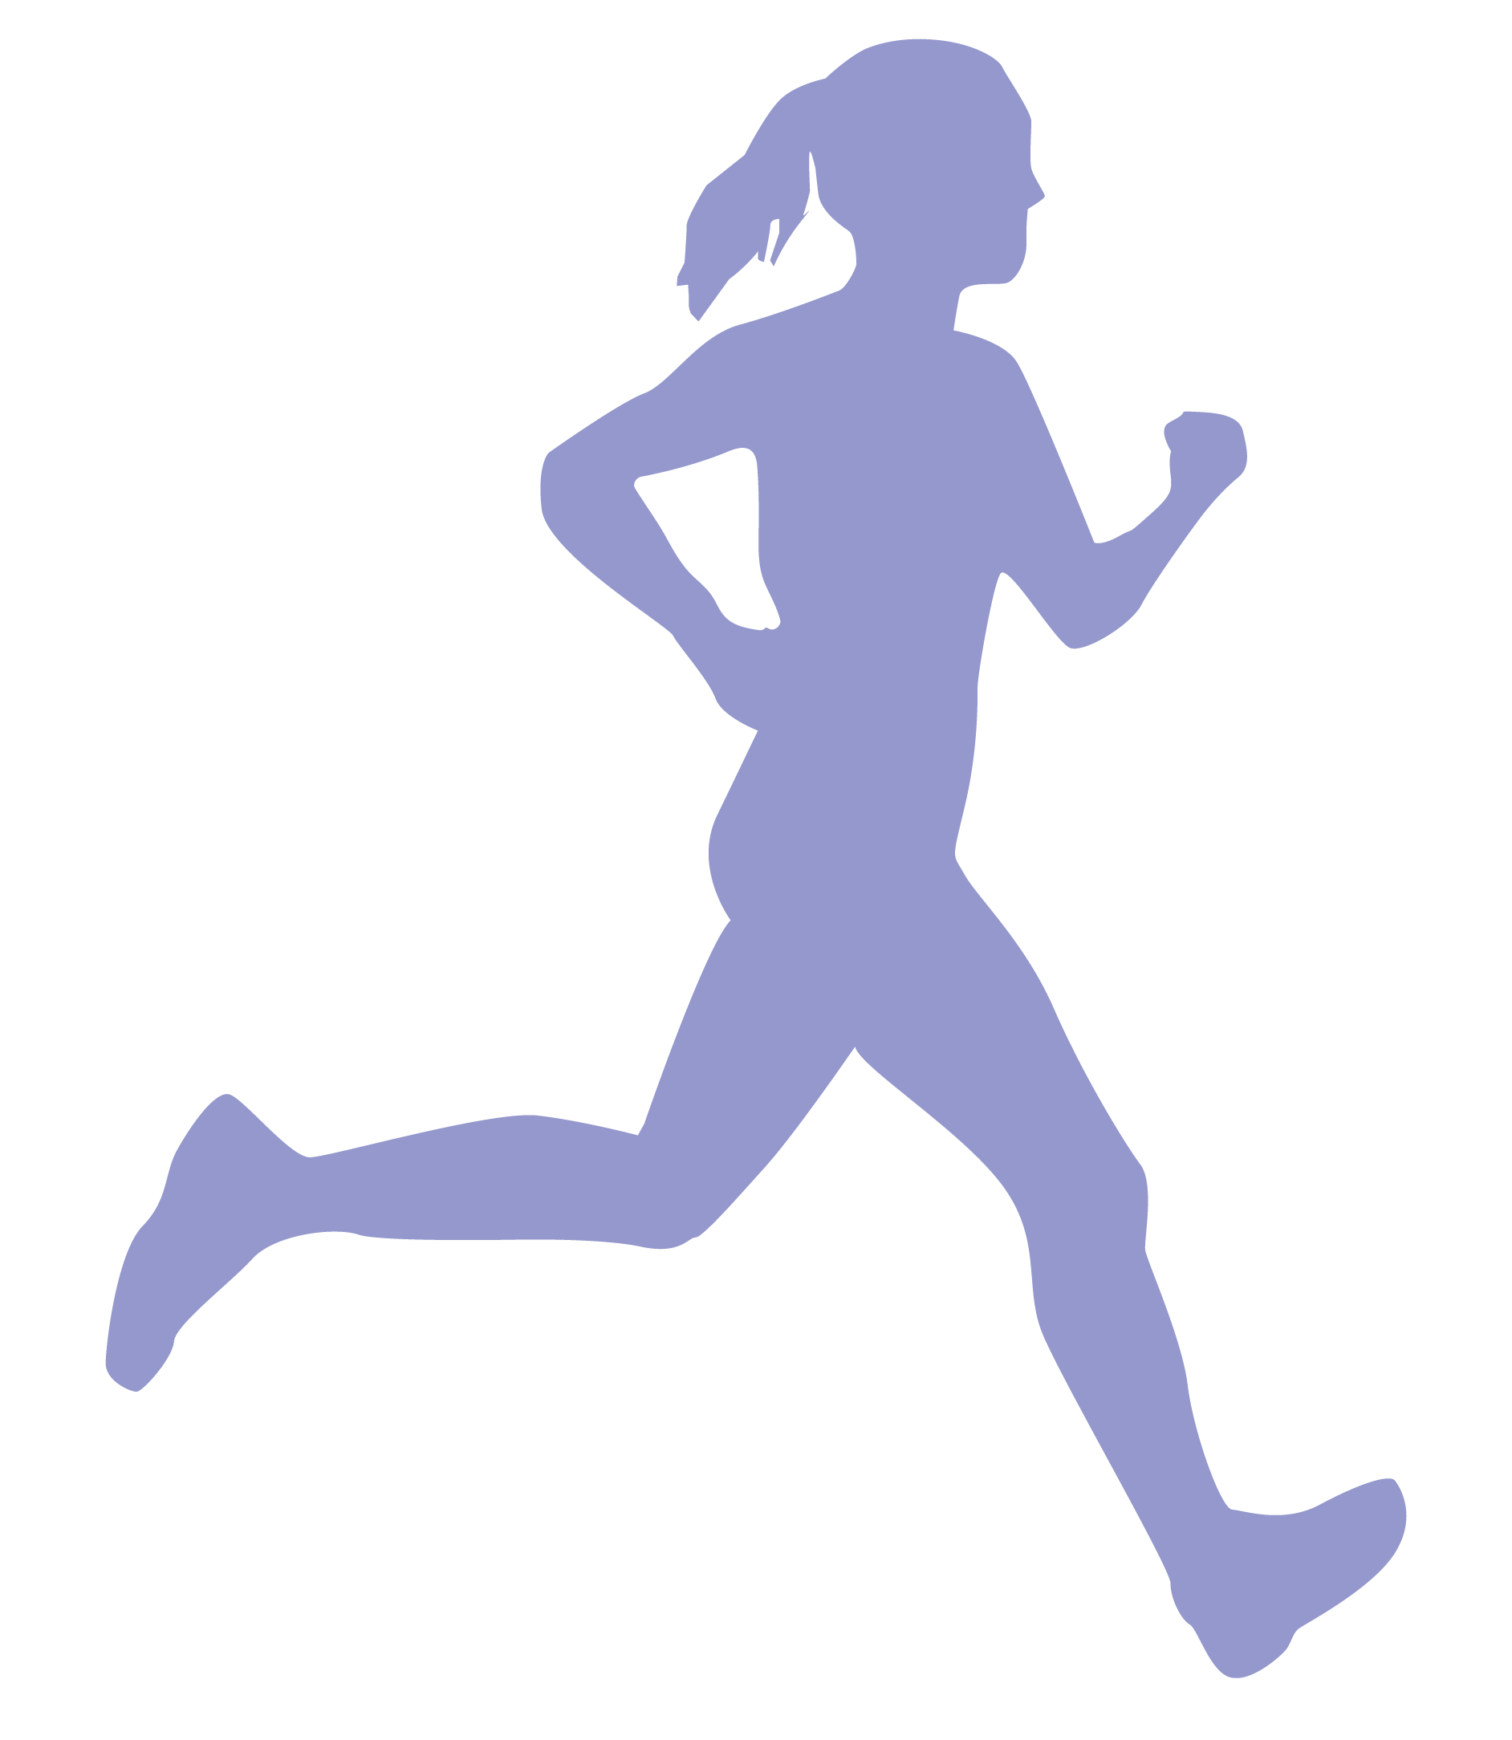
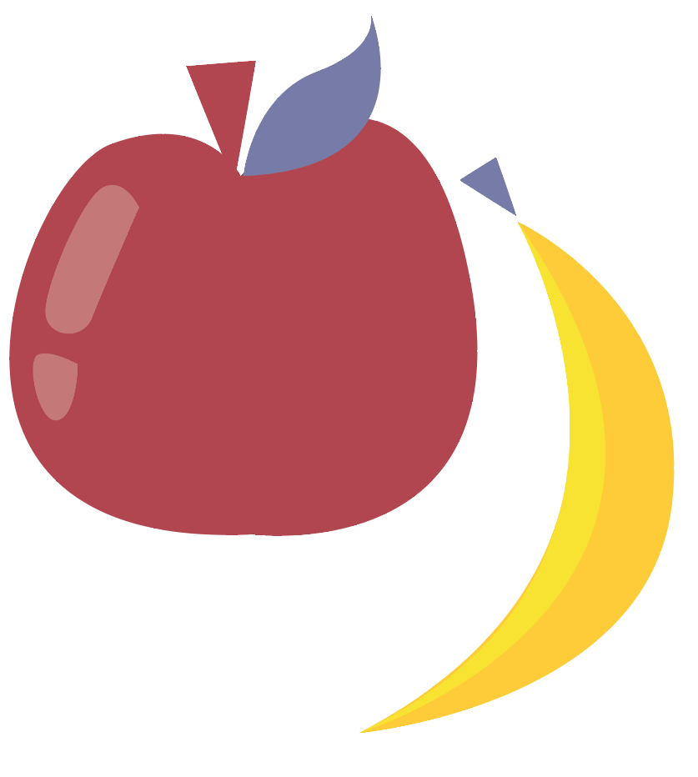
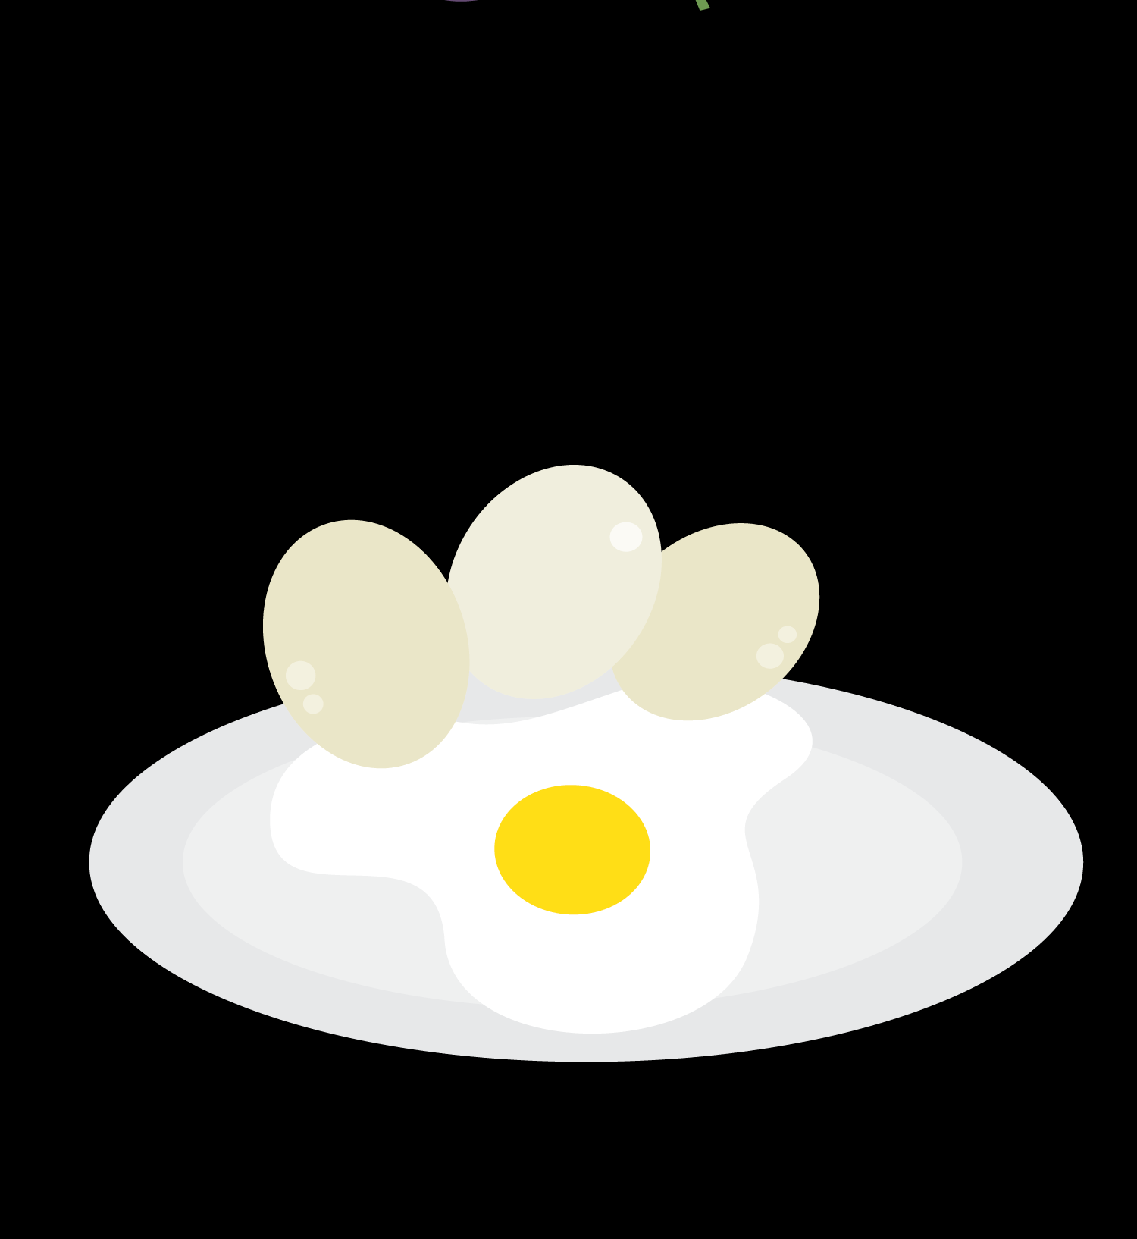
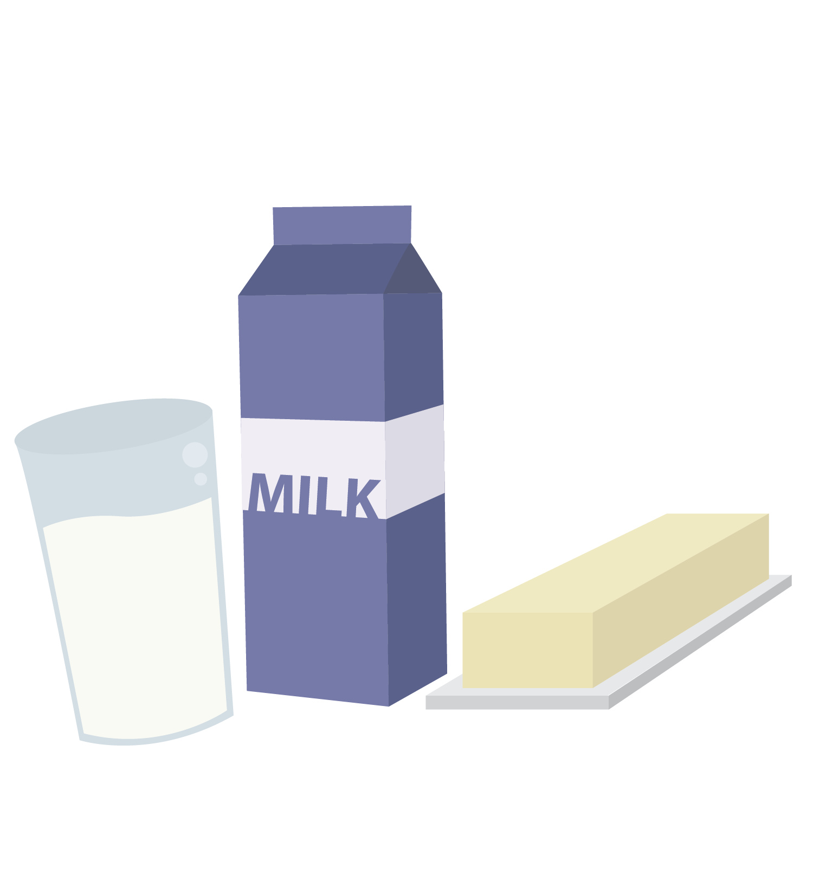
Nutrition
Exercise
Sleep
© FEMM
Notes:
Do you remember what controls the activity of every system in the body?
Yes, hormones. Hormones are directed by your brain. We learned in the last few classes that there is a lot that we can do to help our hormones stay in balance, such as eating a variety of healthy foods, exercising, and getting adequate sleep. When we don’t do these things we make it hard for our bodies to stay healthy and to grow and develop as they should, especially during this important time of puberty. Today, we will talk about how technology fits into this picture, especially when it comes to sleep and body image.

Slide 3
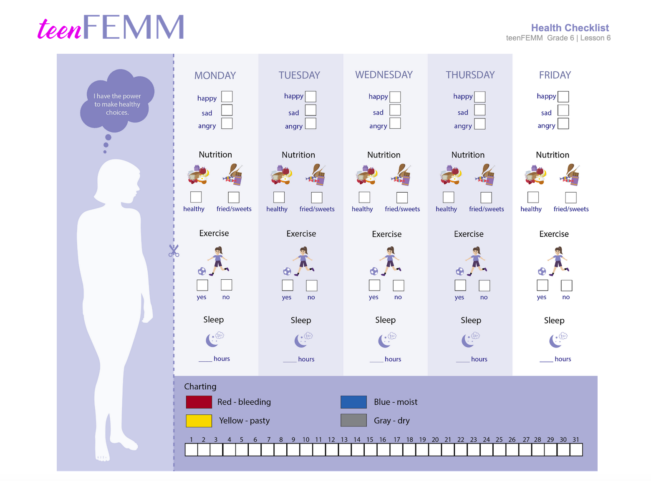
Health checklist challenge!
Notes:
Ask the class: What did you notice about your habits this week? How did the pillars of health affect your mood, sleep, habits, etc.?

Slide 4
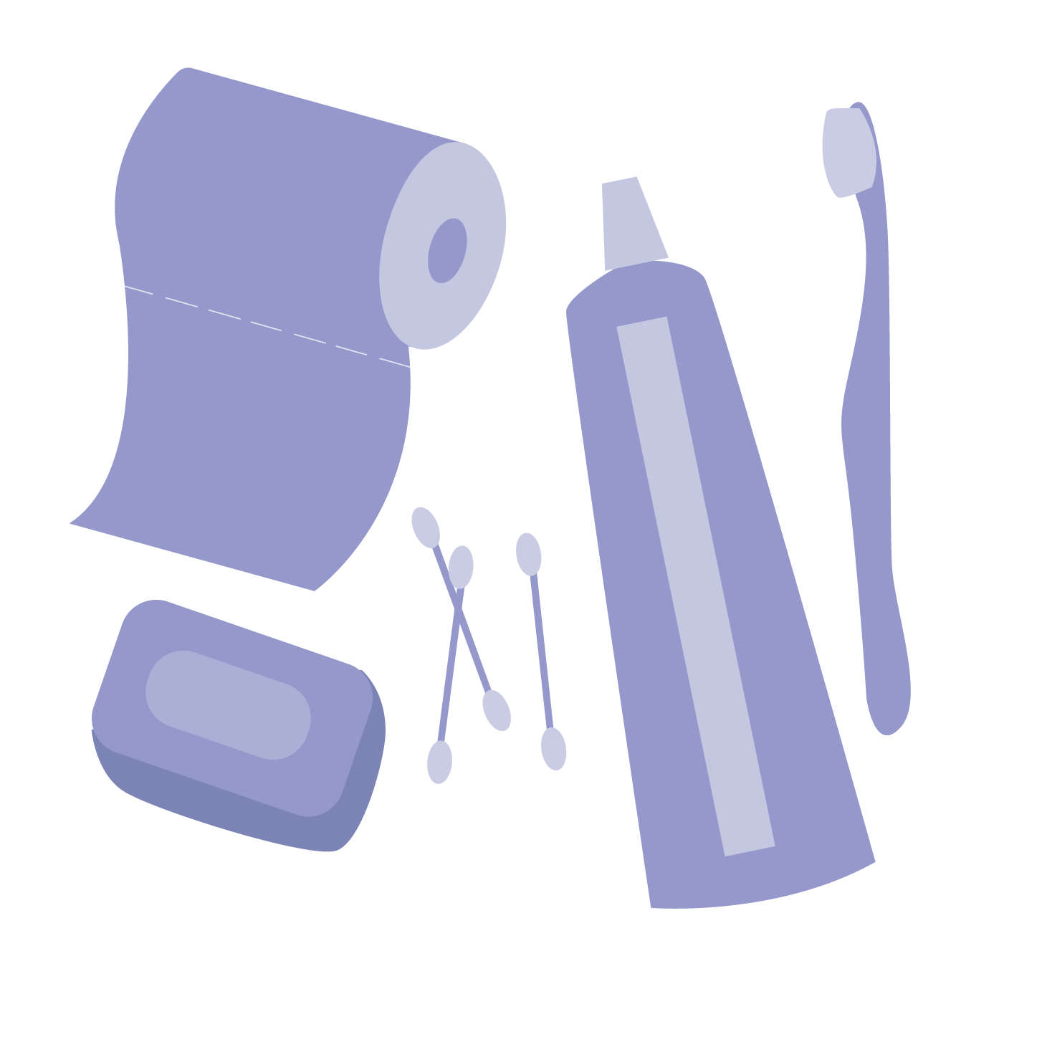
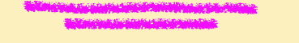
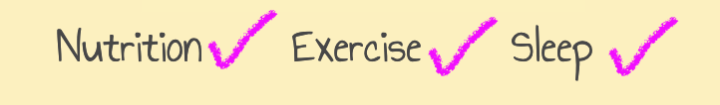

Hygiene: taking care of your body
Healthy Habits
Bathe or shower daily
Use deodorant to eliminate body odor
Brush your teeth 2x each day
Brush your hair each day
Cut your nails once a week
Wash your hands before eating
(or preparing food)
Wash your hands after the bathroom
Don’t forget
to use soap!
And to clean your ears!
Morning
& before bed at night
Notes:
Another area where it is important to develop healthy habits is your personal hygiene. As you grow and mature, you become responsible for keeping your body clean and healthy. (Parents wash and change their young children, keeping them clean and healthy. When you are bigger, you wash yourself). The things you do to keep yourself clean are your hygiene habits. Your hygiene is important for your health.
Maintaining healthy habits in each of these areas is important for your entire life, but especially in puberty when your body is growing into a mature adult, and many changes are happening quickly. As a result, you need good nutrition and lots of exercise and sleep.
Making good choices in these areas now will help you to develop a strong and healthy brain, healthy hormones, healthy body systems, ultimately leading to a healthier you.
4

Slide 5
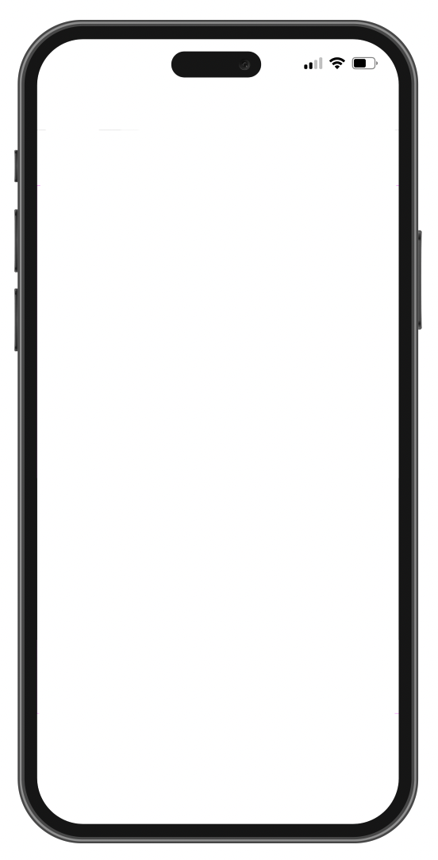

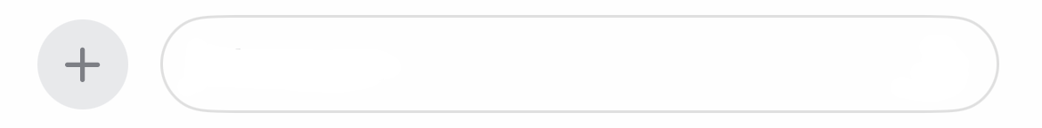
Technology & your health
Technology lets us connect and have fun 👌
Pros ✔️ Cons X
connect distraction
fun lose time
learn things ignore people
What else?
you can FaceTime family who live far away!
and learn new things
. . .
what?
teenFEMM Message
© FEMM
Notes:
As you know: because the brain is the organizing center for all this activity, things that affect your brain will also affect your physical and emotional health. One thing that impacts your brain? Technology use!
Technology gives us lots of opportunities to connect and have fun.
Maybe your grandparents live far away and you FaceTime them from your family’s iPad or iPhone. It’s great to be able to do this! Technology can also help us learn many new things or see things in a way that we would never have been able to do 50 years ago.
Technology also carries risks, such as distraction from what’s happening around us (have you ever seen someone almost walk into something because they’re too busy texting to look where they’re going?) Technology also distracts us from relationships as we lose quality family time or are not fully present to friends or others if we’re together, but on our phones.

Slide 6
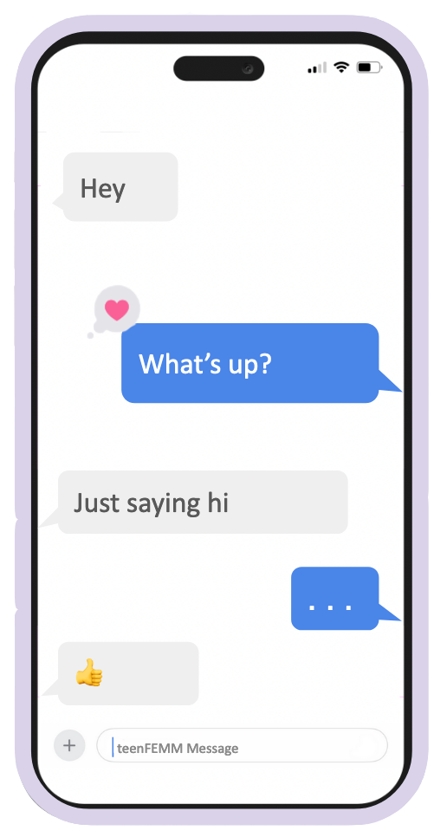
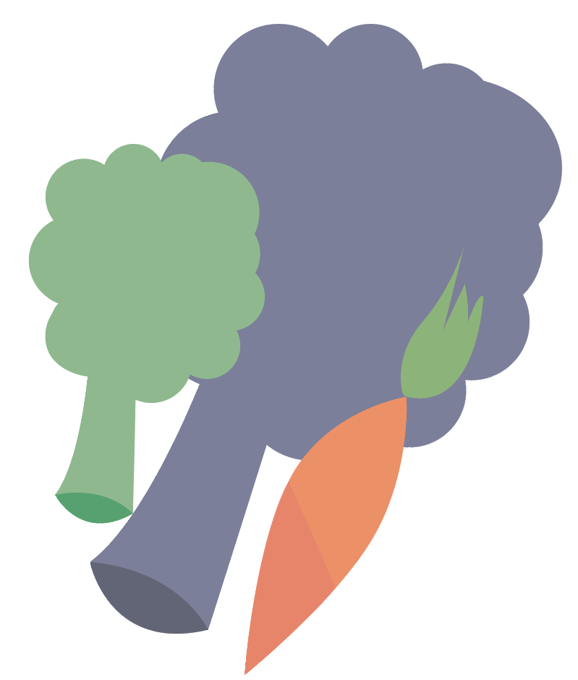
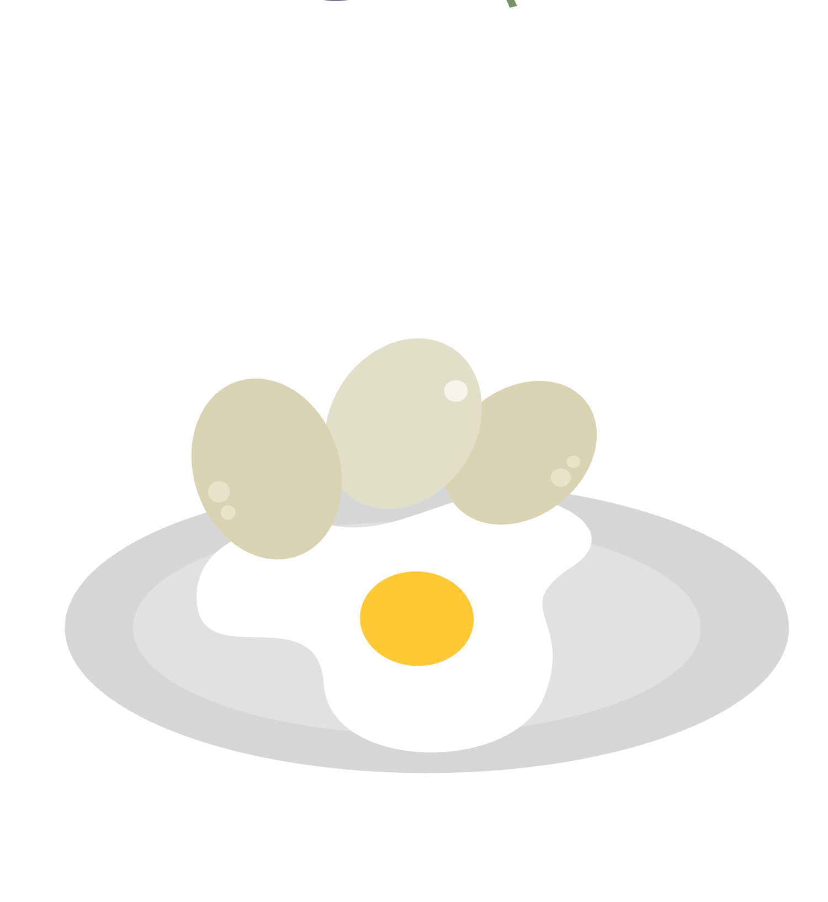

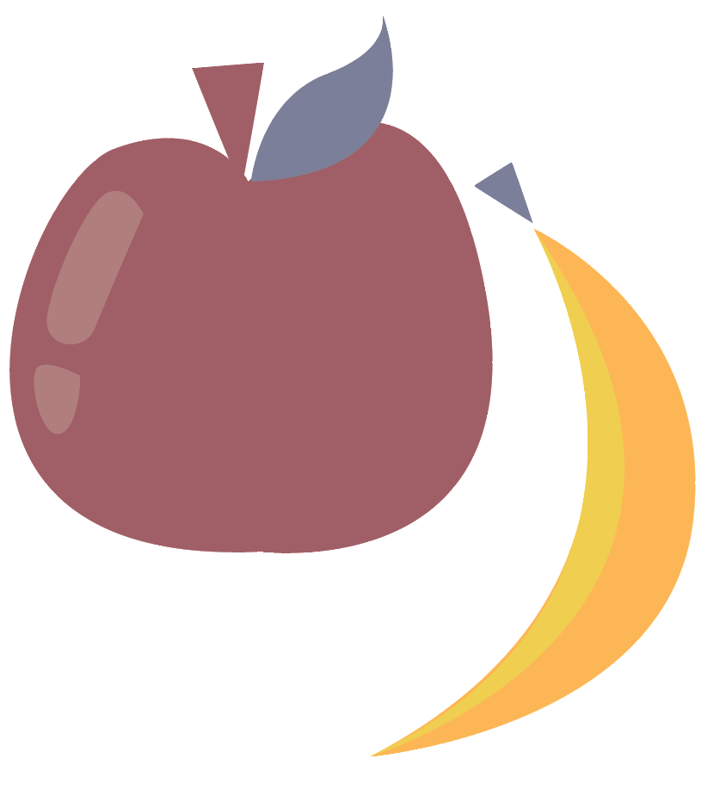
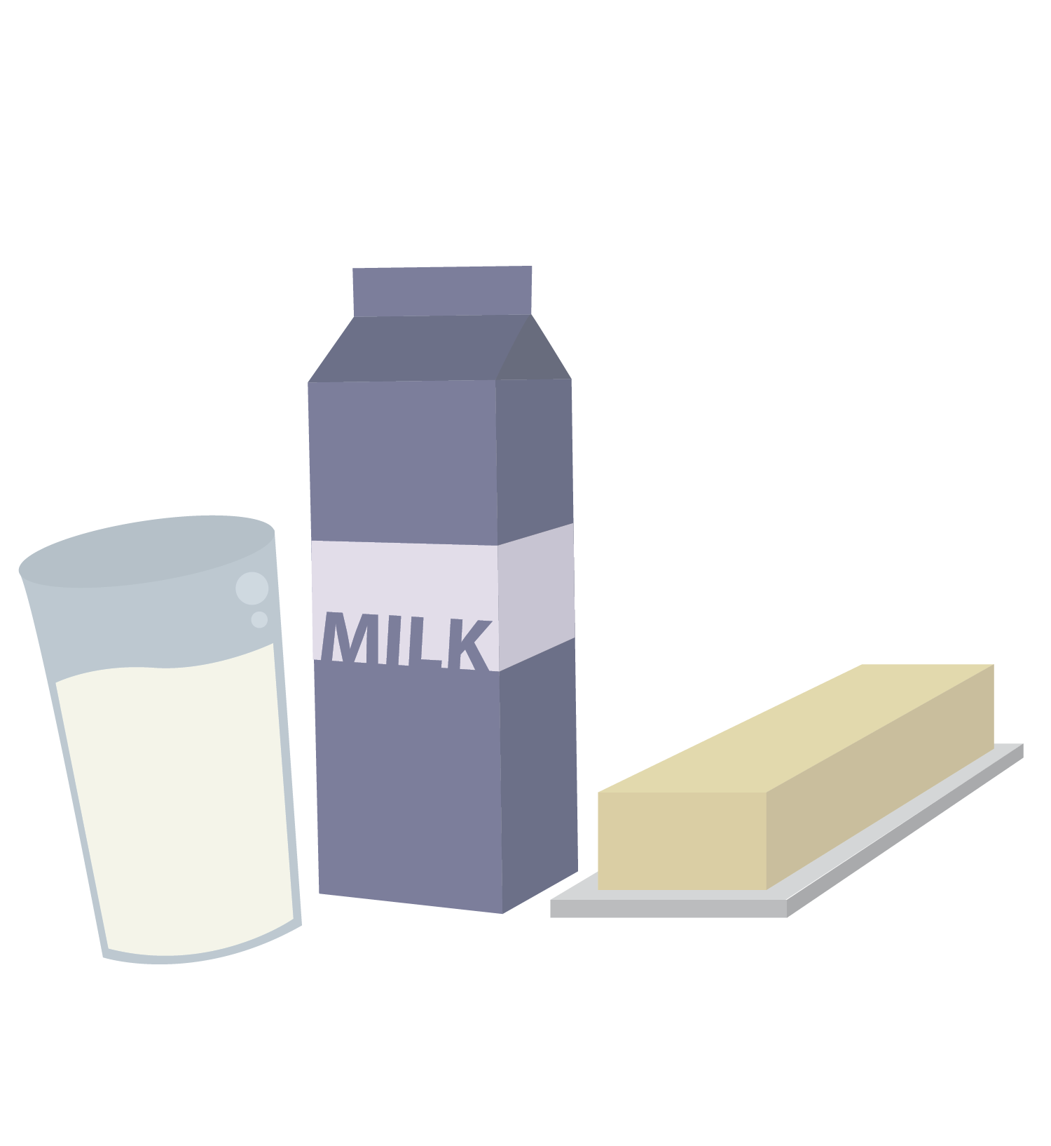
Technology & your health: nutrition
Skipping meals signals to your body:
”Where’s the food?!
It’s an emergency!
Produce stress hormones!!”
© FEMM
Notes:
Technology impacts brain development and health! How so?
You might skip a meal to keep scrolling on Instagram or watching Tiktok videos.
Do you know that when you skip a meal, your body sees this as a mini-emergency?
It starts to produce stress hormones. This might not be such a big deal once in a while, but if we do it a lot, it can cause us to not feel very well. It also affects our blood sugar levels, which means that we can get cranky and irritable. Regularly skipping meals can also affect your metabolism, because your body thinks you are in a state of famine! This can signal your body to gain weight unnecessarily, if you do this a lot.

Slide 7
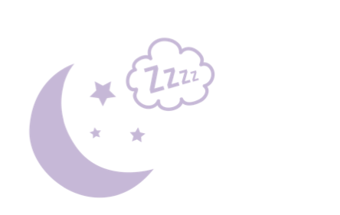
Technology & your health: sleep
Staying up late on screens
is bad for your brain.
It makes it harder to pay attention, learn and remember things in school.
© FEMM
Notes:
You might stay up really late at night to watch YouTube when you should have been asleep three hours ago! This has very real effects on our body and brain.
When tech use affects sleep, this has negative effects on our ability to pay attention, learn, and remember things in school. It can also make you feel more worried or sad.

Slide 8
Technology & your health: sleep
Staying up late on screens can also make you feel more worried and sad.
It causes your body to release a stress hormone called cortisol.
© FEMM
Notes:
Sleep regulates our hormones. When we don’t get enough sleep, this triggers the release of the stress hormone cortisol, which makes us feel annoyed, anxious and moody.

Slide 9
Technology & your health: sleep
Our body produces a hormone called melatonin to help us sleep.
The light from screens prevents melatonin from being made. This is why it’s important to put screens away.
© FEMM
Notes:
Did you know: our bodies produce a hormone called melatonin to help us rest.
The light from phones and other devices prevents the body from producing proper amounts of melatonin. So, the solution is really simple: put screens completely away before bedtime.

Slide 10
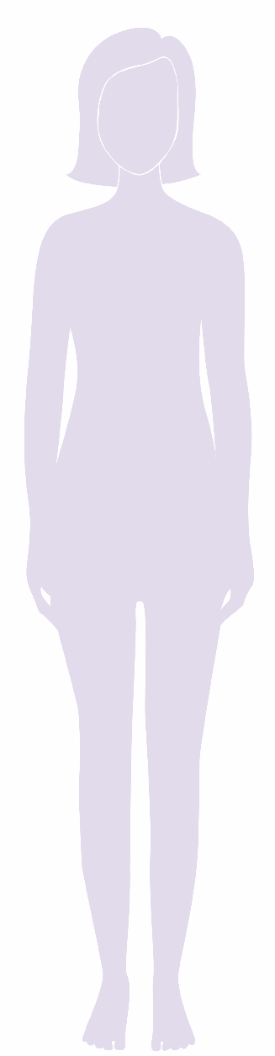

Body image:
How an individual sees their body and the feelings that accompany this
I’m not perfect, but nobody is
Bad hair day,
so what? 🤷‍♀️
I feel confident.
Be less? No way!
Don’t give into
peer pressure!
LIKE yourself!
Work harder
to be a good friend to yourself.
© FEMM
Notes:
What is body image? Body image is how an individual girl sees her own body, and the feelings that go along with this viewpoint. This is a very normal time in your life to be thinking more about your body as it grows and changes. But, instead of comparing your body to the girls around you, or to the girls or women on social media or in shows, talk with a trusted grown up to learn and focus on what is healthy and best for you.
You know yourself better than anyone else! Each girl will grow at her own pace. And depending on her genetics and the health choices that she makes, each girl will grow into a unique, strong, beautiful woman.

Slide 11
Body image:
How an individual sees their body and the feelings that accompany this
I’m not perfect
Bad
Good
Be less like yourself
Work harder
Be more like that
© FEMM
Notes:
It is so important not to spend a lot of time comparing ourselves to girls and women on social media. Spending time on Instagram seeing what other girls are wearing and what their bodies look like, can make you feel like your body doesn’t measure up. Have you ever felt this before? Did you know that a lot of girls feel this way? Did you know that almost everyone has felt this way at one point or another?

Slide 12
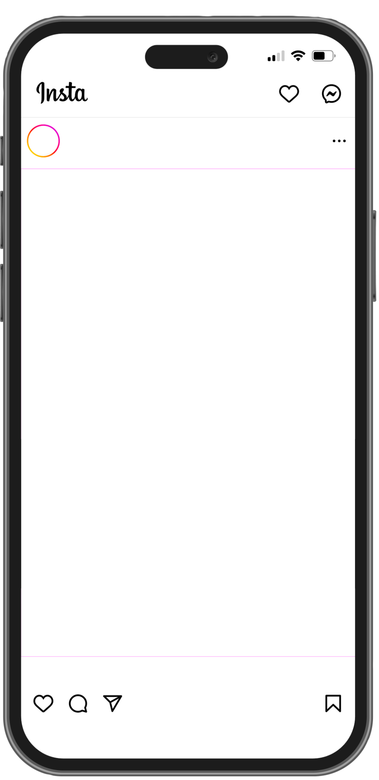
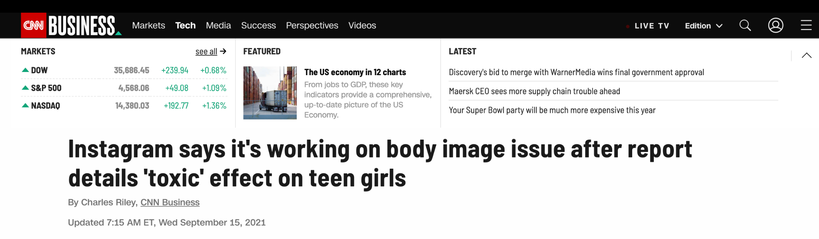
Body image
You don’t have the right look
Be more like this
If only you had…
© FEMM
Notes:
The people who created Instagram have admitted that using their app causes young women to view themselves more negatively. As many as 1 out of 3 teen girls feel worse about their bodies as a result of time spent on social media! This is not OK.
Comparing ourselves to the lives of others on social media is not good for body image, our health or our happiness. Negative body image increases our stress and anxiety, which harms our hormones and our health.

Slide 13
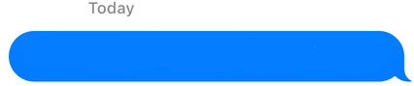

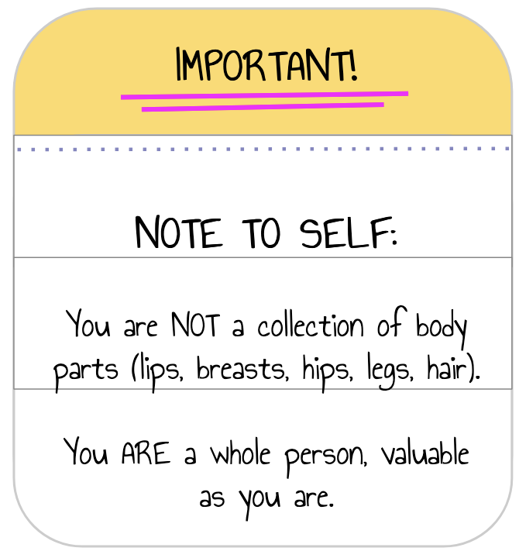
ALERT!
IMPORTANT!
NOTE TO SELF:
You are NOT a collection of body parts (lips, breasts, hips, legs, hair).
You ARE a whole person, valuable as you are.
You are valuable just as you are
© FEMM
Notes:
Instead of feeling like a collection of body parts (lips, breasts, hips, legs, hair), we need to remember that we are a whole person, valuable as we are.
Make an effort to think and say nice things about yourself, your abilities, and your looks. Negative self-talk is a habit, just like any other habit. If you find yourself thinking negatively about yourself after time online, that’s the moment to put the phone down and do something you enjoy. Your physical health and mood will improve!

Slide 14
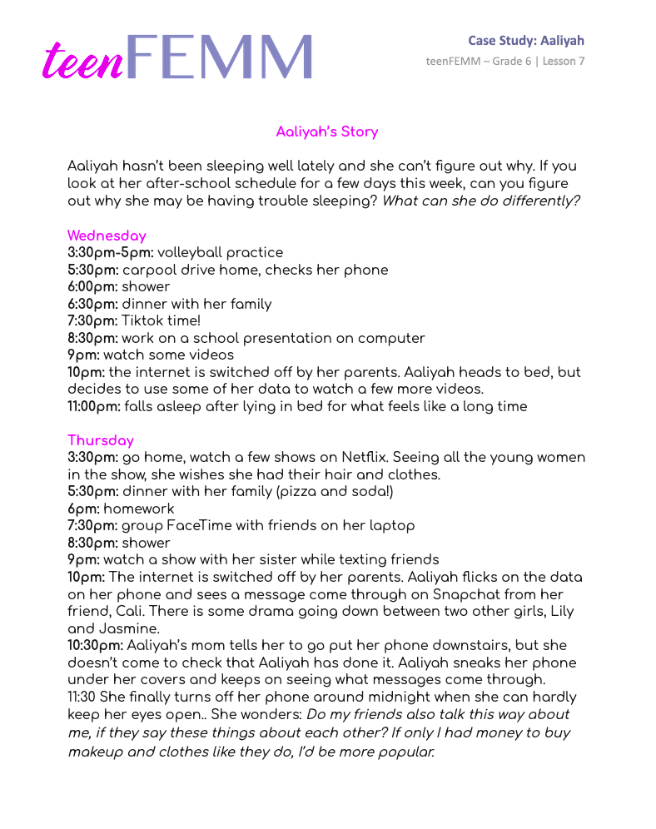
Case Study: Aaliyah
Aaliyah hasn’t been sleeping well lately
and she can’t figure out why…
© FEMM
Notes:
Divide students into small groups, and pass out the Case Study: Aaliyah worksheet.
Give groups a few minutes to read and fill in the answers on their worksheet as a group. Then, bring the class back together to go over their answers.

Slide 15
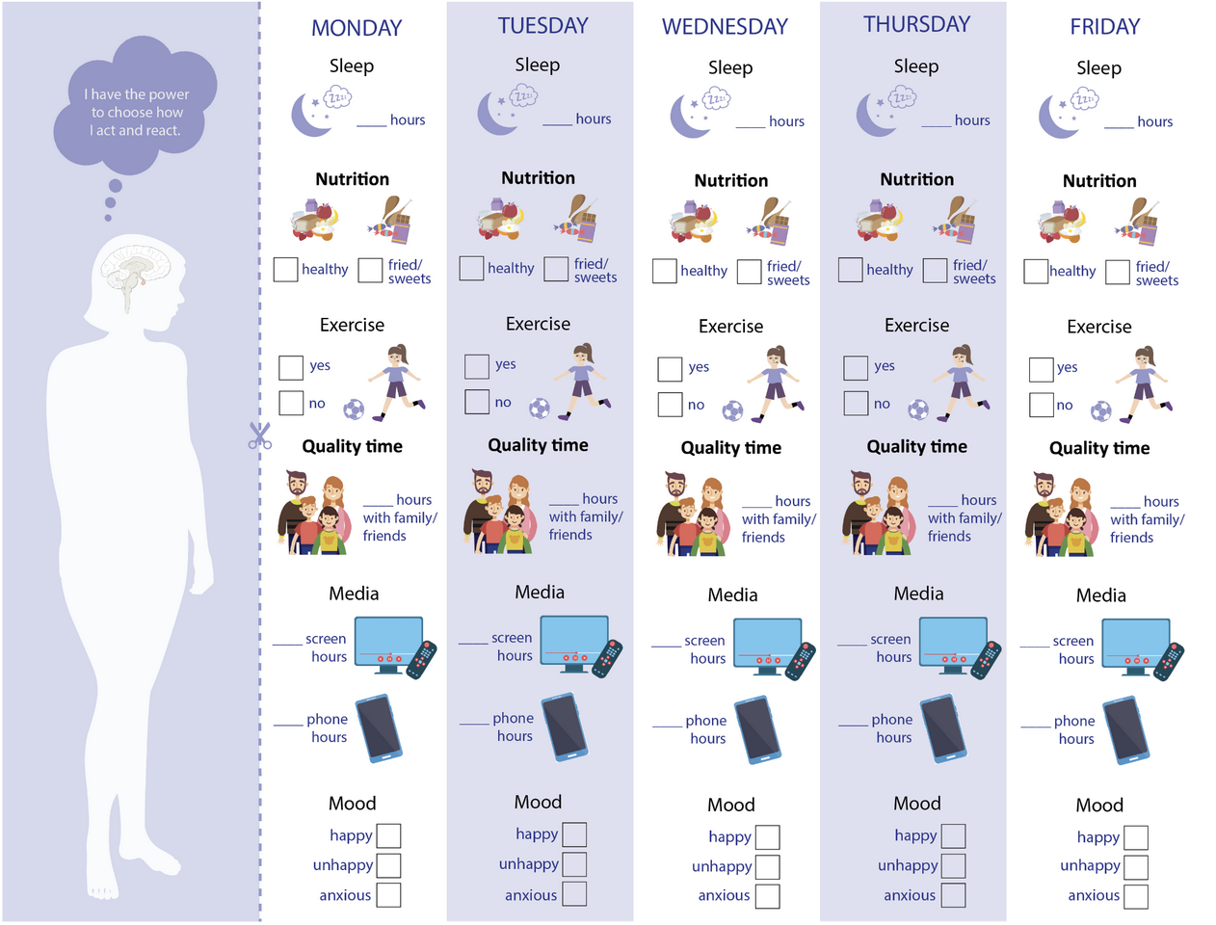
Health Checklist Challenge: Media
Health Checklist Challenge!
media use edition
© FEMM
Notes:
Handout the Health Checklist: Media edition to all students.
Given what you now know about how your brain responds to social media, TV and time on screens, this week we’ll take the Health Checklist: Media edition challenge!
In addition to the three pillars of health: nutrition, exercise and sleep, this checklist includes quality time versus time on media and asks you to reflect on how you feel after time online.

Slide 16
Maturity means making excellent choices
Check in with yourself:
Do I feel 👍 or 👎 after I use social media?
Do I feel 👍 or 👎 confident about myself, my abilities and my interests after I use social media?
Do I feel 👍 or 👎 grateful for the things that I have in my life after I use social media?
© FEMM
Notes:
The next time you use a device, think about the following:
Do I feel more or less positive after I use social media?
Do I feel more or less confident in my choices, abilities, and interests after I use social media?
Do I feel more or less grateful for the things that I have in my life after I use social media?

Slide 17
Re: You
The media we consume impacts our body image.
Media can be a force for good or bad, but it’s up to us to make healthy choices.
Part of growing to maturity involves making excellent choices about how we use media and tech.
YOU are in charge of your devices… they are not in charge of you!
Notes:
Today we learned more about how nutrition, exercise and sleep affect our body and mind. We also learned that the media, images and content we consume affects our body image and our health. Part of growing to maturity means making excellent choices. Let’s practice healthy habits this week!

Slide 18
Grade 6
LESSON 7
© FEMM

