Slide 1

Grade 6
LESSON 7
© FEMM

Slide 2
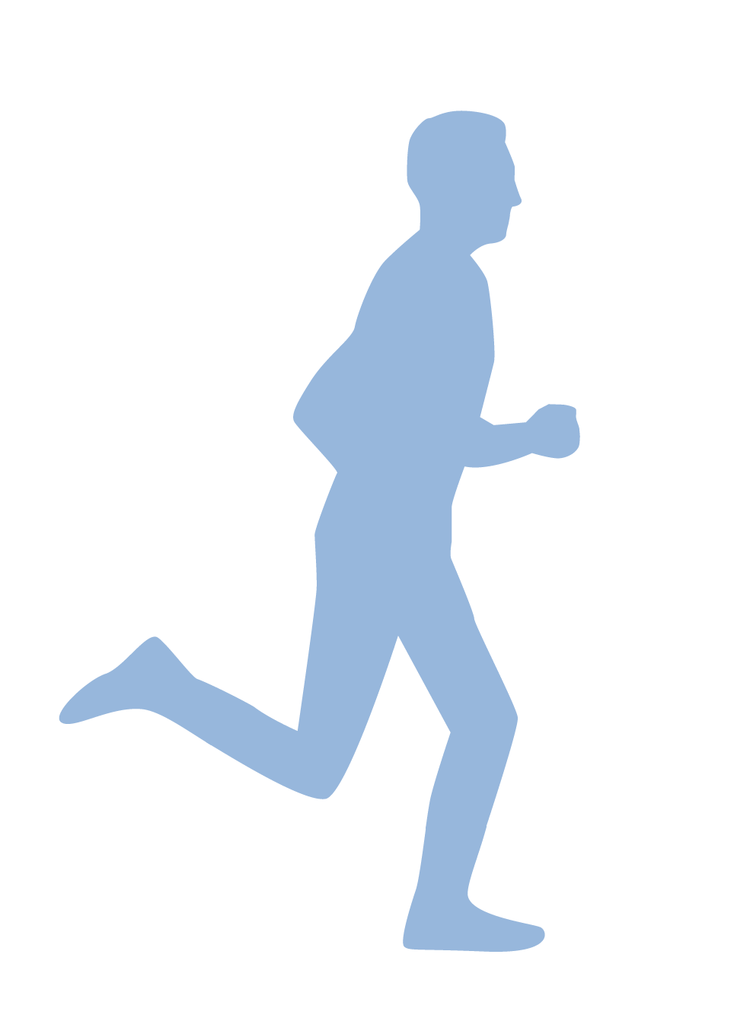

Game Time
Review Rush!
© FEMM
Notes:
Divide students into teams of two or more, depending on the class size. Give each team the Review Rush! Worksheet, face down. When the teacher says “go” students can flip over the worksheet and try to answer all of the questions as quickly as possible.
The first team to complete all questions in the shortest amount of time and to get the most answers correct, wins! Once the activity is complete, review answers as a class using the Teacher’s Answer Key.

Slide 3
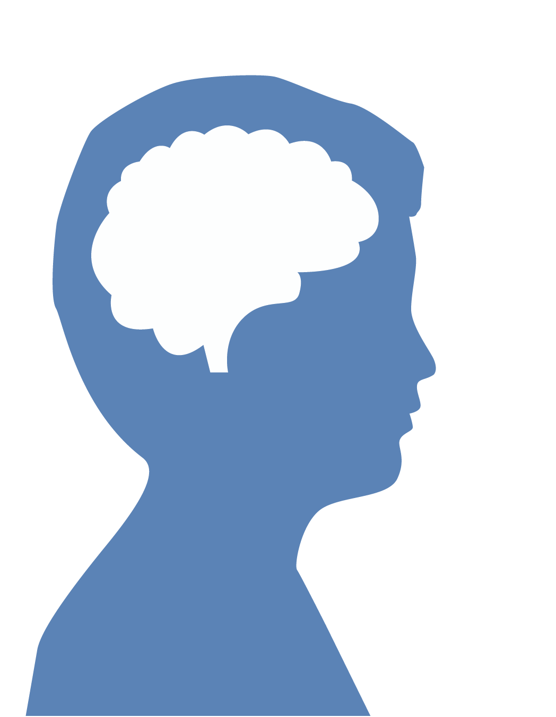
Body image
How an individual sees their own body and the feelings that accompany this.
© FEMM
Notes:
Do you remember what controls the activity of every system in the body? Yes, hormones. Hormones are directed by your brain. We learned in the last few classes that there is a lot that we can do to help our hormones stay in balance, such as eating a variety of healthy foods, exercising, and getting adequate sleep. When we don’t do these things we make it hard for our bodies to stay healthy and to grow and develop as they should, especially during this important time of puberty. Today, we will talk about how technology fits into this picture, especially when it comes to sleep and body image.
What is body image? Body image is how an individual boy sees his own body, and the feelings that go along with this viewpoint. This is a very normal time in your life to be thinking more about your body as it grows and changes. But, instead of comparing yourself to the boys around you, or guys on social media, talk with a trusted adult to focus on what is healthy and best for you. Each boy will grow at his own pace. And depending on his genetics and the health choices that he makes, each boy will grow into a unique man.

Slide 4
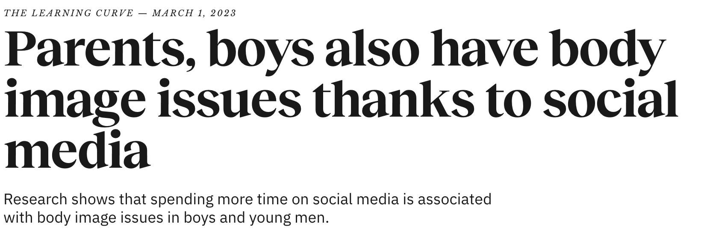
Body image
© FEMM
Notes:
Research has shown that boys who spend more time online than their peers tend to struggle more with thoughts that their body is not good enough and that they are not healthy (even if they are). It’s so important to focus on what we can do to become the person we want to be.

Slide 5
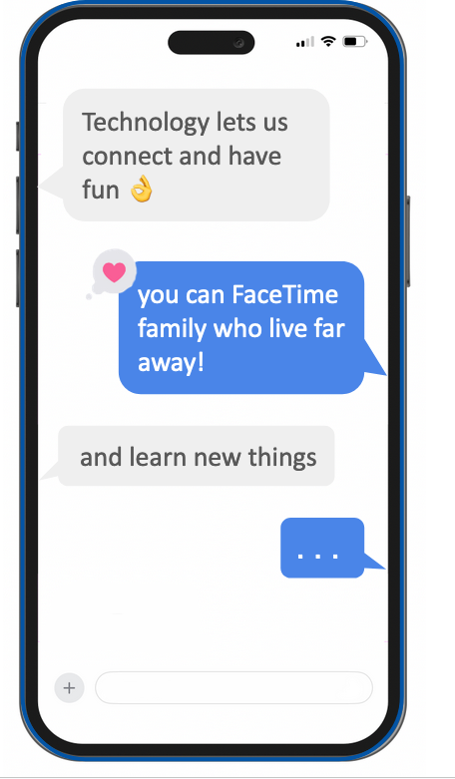
Technology: Pros and Cons
Pros ✔️ Cons X
connect distraction
fun learn things
What else?
Notes:
Technology gives us lots of opportunities to connect and have fun. Maybe your grandparents live far away and you FaceTime them from your family’s iPad or iPhone. It’s great to be able to do this! Technology can also help us learn many new things or see things in a way that we would never have been able to do 50 years ago.
Technology also carries risks, such as distraction from what’s happening around us (have you ever seen a video of someone walking into a pole on the street because they were staring at their smartphone?); distractions from other relationships (has one of your parents ever not answered your question because they were on their phone?); too much screen time and even technology addiction.

Slide 6
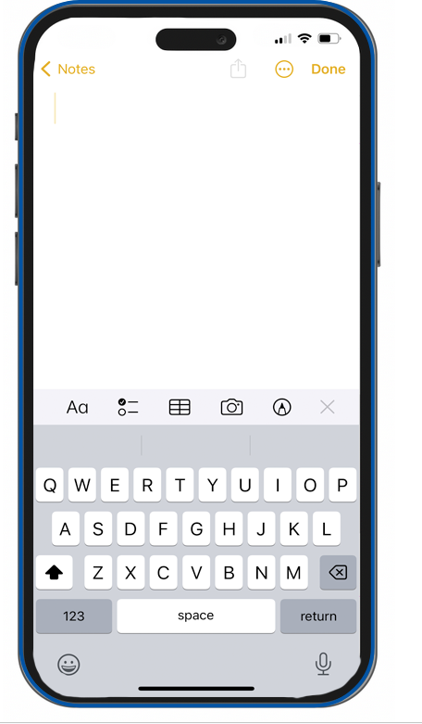
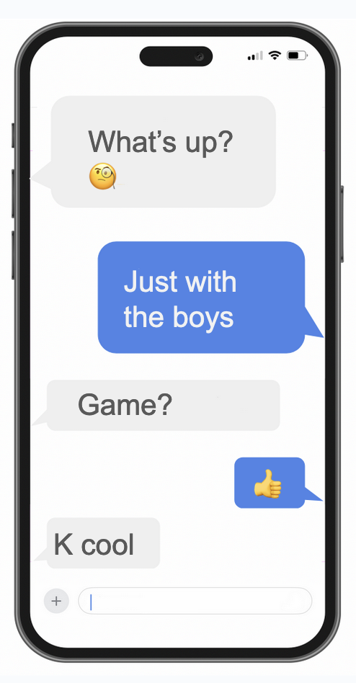




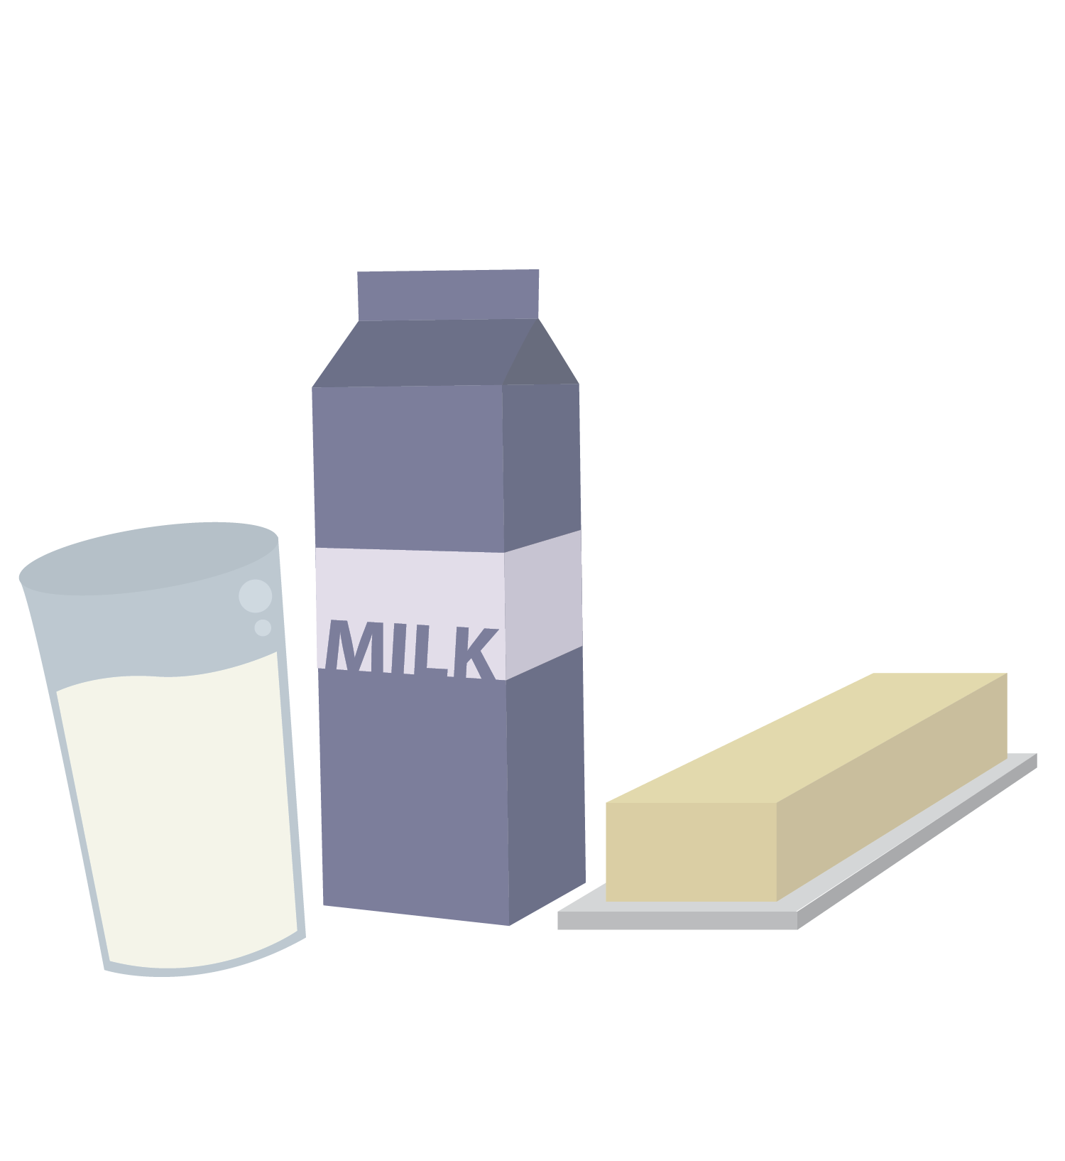
Technology & your health: nutrition
Skipping meals tells your body: ALERT!
Where’s the food?
It’s an emergency!
Produce
STRESS hormones!
Notes:
Sometimes, when you’re having a really good time doing something on a screen, it can be hard to notice how much time is being used. Eventually, you might even start to feel like you “need” the device to feel good and that when it isn’t in your hand, you are looking for it all the time. Technology also gets in the way of the three pillars of health.
You might skip a meal to keep scrolling on Instagram or watching videos on Tiktok. Do you know that when you skip a meal, your body sees this as a mini-emergency? It starts to produce stress hormones. This might not be such a big deal once in a while, but if we do it a lot, it can cause us to not feel very well. It also affects our blood sugar levels, which means that we can get cranky and irritable. Regularly skipping meals can also affect your metabolism, because your body thinks you are in a state of famine! This can signal your body to gain weight unnecessarily or make it hard to lose weight.

Slide 7
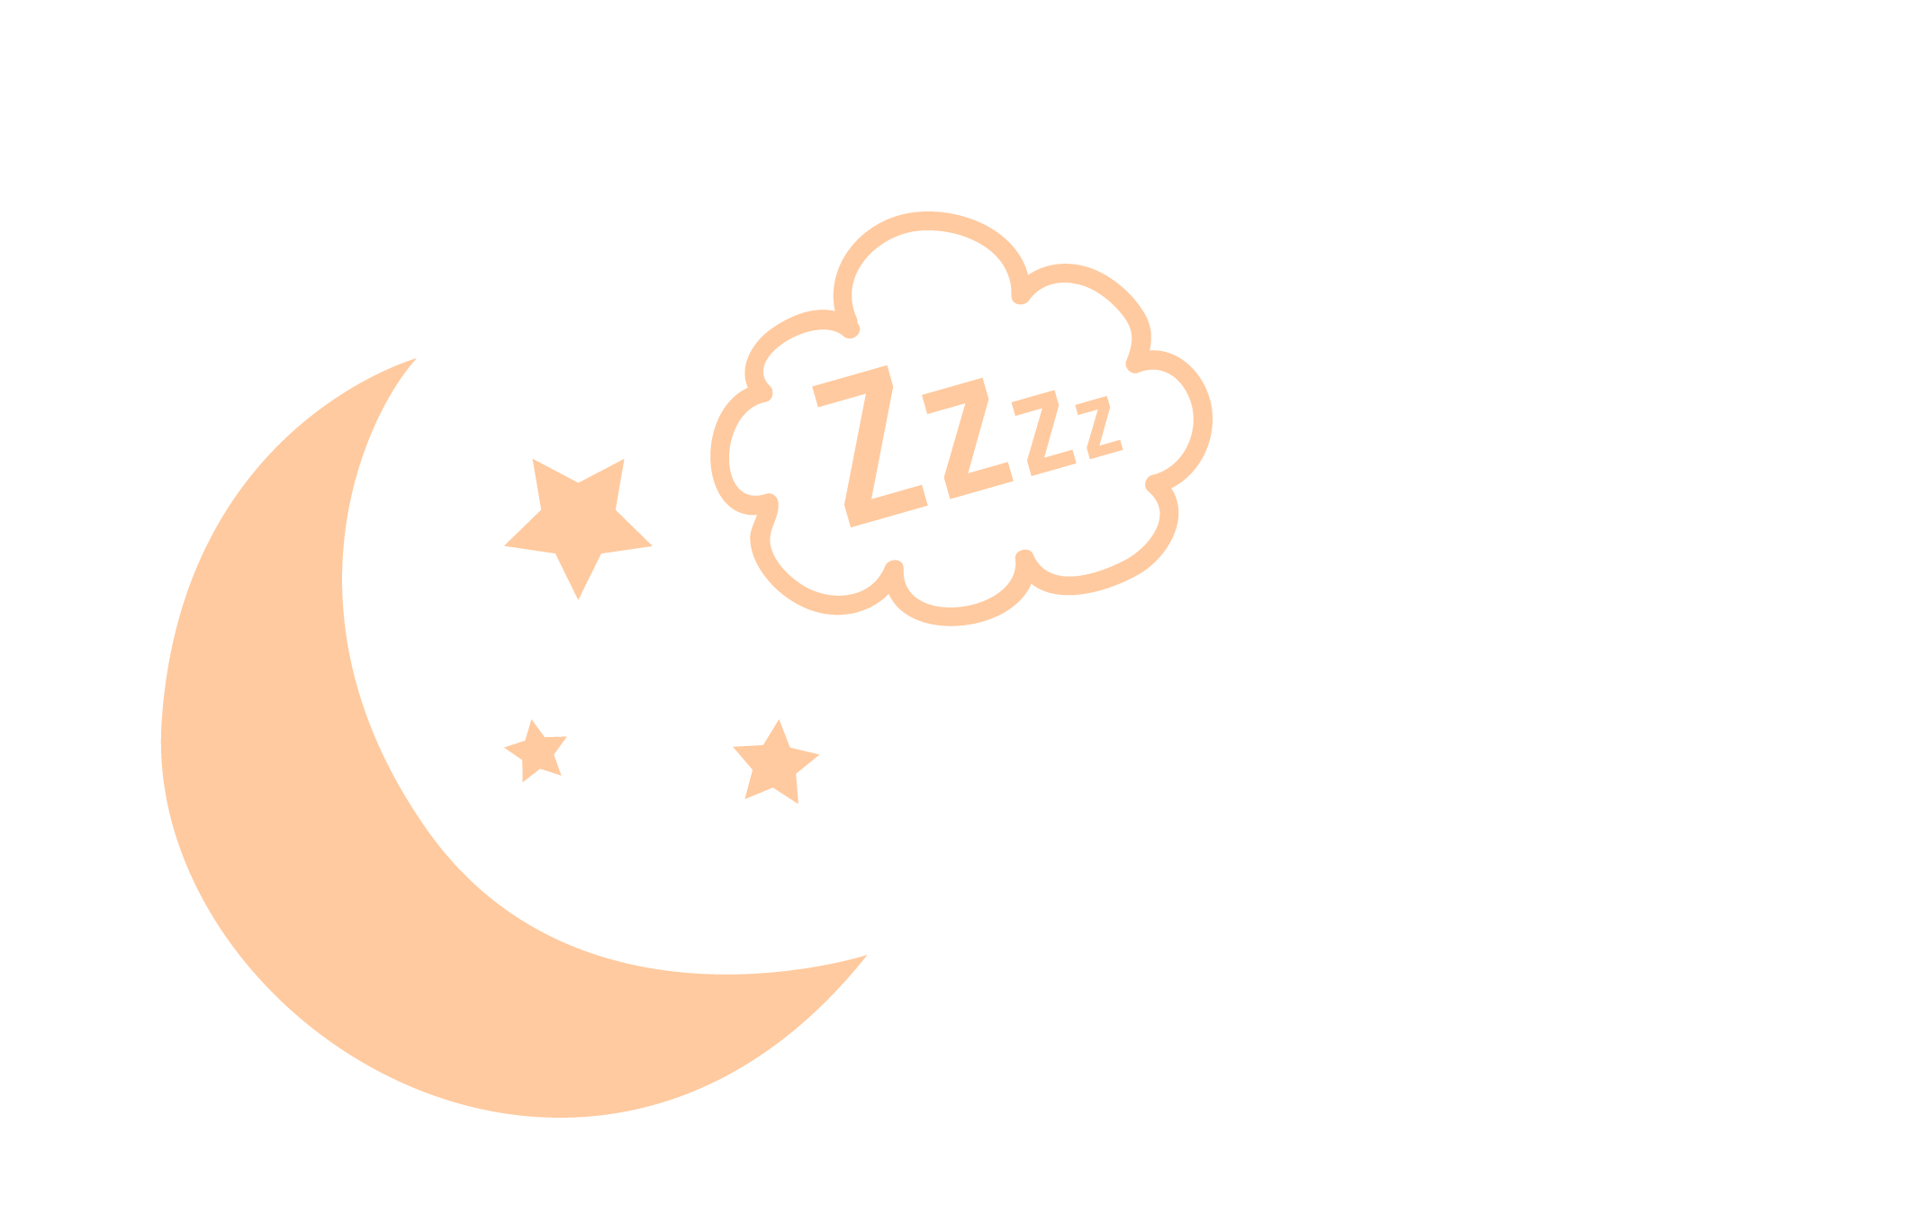
Technology & your health: sleep
Staying up late causes the body to produce the stress hormone, cortisol.
Stress hormones
increase anxiety
Notes:
You might stay up really late at night to watch YouTube when you should have been asleep three hours ago! This can have very real effects on our body and brain. When tech usage affects sleep, this can have negative effects on our ability to pay attention, learn, and remember things in school the next day. It can also make you feel worried or sad. Our bodies produce a hormone called melatonin at night to help us rest, and our bodies need a certain amount of darkness to produce it. Did you know that using screens during the hour before bedtime can prevent our bodies from producing enough melatonin, leading to worse sleep?

Slide 8
Technology & your health: exercise
🏃🏼🏈⚽️🏀🎾⛳️🏸🏒
-Exercise for 60 minutes. 👍
-Play a sport YOU enjoy. Maybe it’s a team sport? Or, maybe you like the individual challenge!
Notes:
You might spend so much time on Instagram seeing what other guys are wearing and what their bodies look like, that you might start to feel like your body doesn’t measure up. Have you ever felt this before? Did you know that high rates of social media use cause poor body image? This can lead to unhealthy eating habits, even for young men. It can be fun to see what other friends or even celebrities are up to, or to learn more about professional athletes and what they do to train, but it’s important to remember to focus on the real people and activities in your life. You are not a collection of body parts (chest, legs, back, abs). You are a whole person, valuable as you are.

Slide 9
Technology and YOU
Do I feel 👍 or 👎 positive after I’m on social media?
Do I feel 👍 or 👎 confident in my choices, abilities, and interests after I use social media?
Do I feel 👍 or 👎 grateful for the things that I have in my life after I use social media?
Put your phone down and go outside, play a game with a sibling or do something nice for someone else.
© FEMM
Notes:
The next time you use a device, ask yourself the following:
Do I feel more or less positive after I use social media?
Do I feel more or less confident in my choices, abilities, and interests after I use social media?
Do I feel more or less grateful for the things that I have in my life after I use social media?

Slide 10
Take control!
YOU are in charge of your devices… they are not in charge of you!
🏡 Talk with your parents about setting expectations in your house.
🗓 Think about a schedule that allows you to maintain control of your time.
© FEMM
Notes:
One main thing to remember is that you are in charge of your devices; they are not in charge of you!
It’s important to talk to your parents about what the expectations are in your house about tech usage. Given what you now know about how your brain responds to social media, computer games, online videos, and other forms of digital media, think about an after-school and weekend schedule that allows you to maintain control of how you spend your time. Make sure you find out the best ways to protect your online profiles and to turn off auto-play and notifications that are there to keep you watching.
Given what you now know about how your brain responds to social media, computer games, online videos, and other forms of digital media, think about an after-school and weekend schedule that allows you to maintain control of how you spend your time. Leave your phone in another room for meal times and quality time with others.

Slide 11
Leo’s story
💻 How much time does Leo spend looking at a screen from the moment school ends until he goes to bed each day?
💤 Why is Leo having trouble sleeping?
Is his time spent online with friends helping him feel 👍 or 👎 positive afterwards?
👤 How is his tech use affecting his body image?
© FEMM
Notes:
Divide the boys into small groups, and pass out the Case Study Worksheet. Read the case study out loud and go over Leo’s schedule. Allow them to fill out the answers on the worksheet in their small groups for 10 minutes, and then bring the class back together to discuss for 10 minutes.

Slide 12
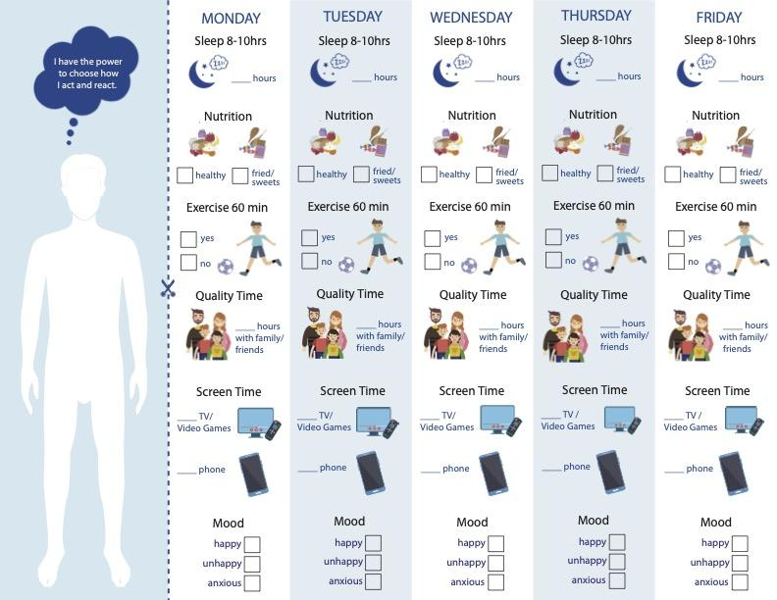
Health Checklist | you are in charge
© FEMM
Notes:
Quick Activity: Screen time expectations versus reality
Ask all of the boys in the class to write down the amount of time they think they spent just on their phones last week. For those with phones, have them check their screen time app on their phones and present both numbers to the class. See how close expectations are to reality.

Slide 13
Review
The media we consume can have an effect on our body image.
Media can be a force for good or bad, but it’s up to us to make healthy choices that are right for us.
Part of growing to maturity involves making good choices about how we use media and tech.
Notes:
Today we learned that what we consume, including media, images and content through technology, needs to support the health of our body and mind. We can help our bodies become as healthy as possible by choosing to practice healthy habits.

Slide 14
Grade 6
LESSON 7
© FEMM

