Slide 1

Grade 6
LESSON 8
© FEMM

Slide 2
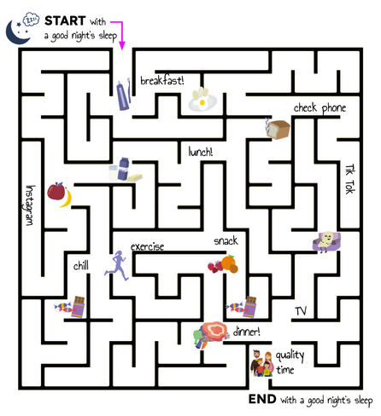
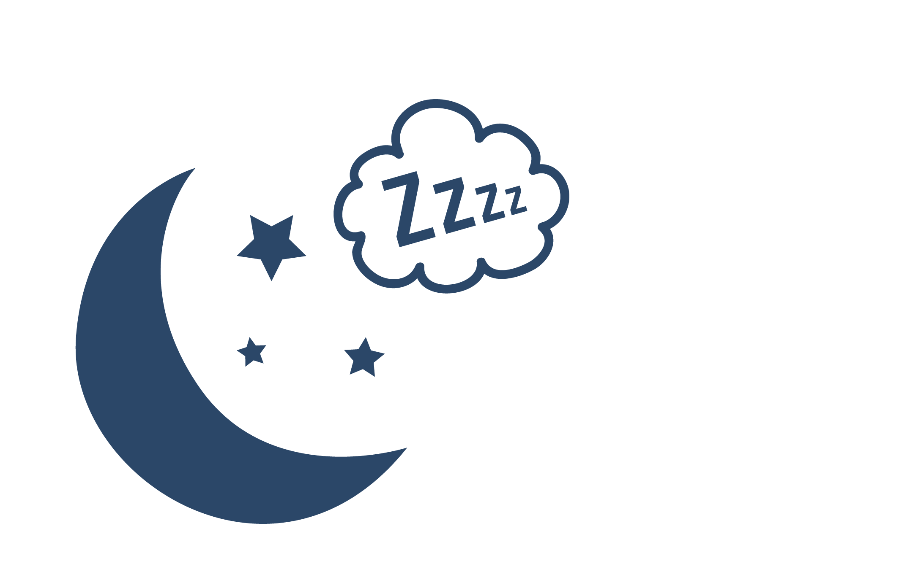

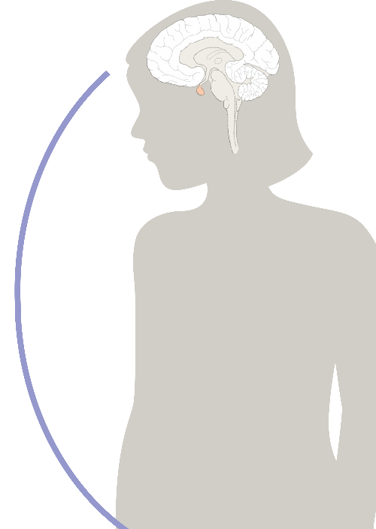
Entry Ticket Activity
START with
a good night’s sleep
© FEMM
Notes:
Daily choices create habits. Whether it’s making a sandwich to bring for lunch instead of buying french fries, going to bed on time instead of staying up late on your device, these choices become habits. Habits train our brain. The brain is like a maze of all of our choices and habits. Do you remember the first time you learned to walk? Probably not! But when you were a toddler, your brain was forming a new habit of walking. Now, you don’t know about it, you just walk. When you make a healthy choice, your brain remembers this. Habits form the brain. It can take time to form a new habit in our brain, but it’s worth it!

Slide 3

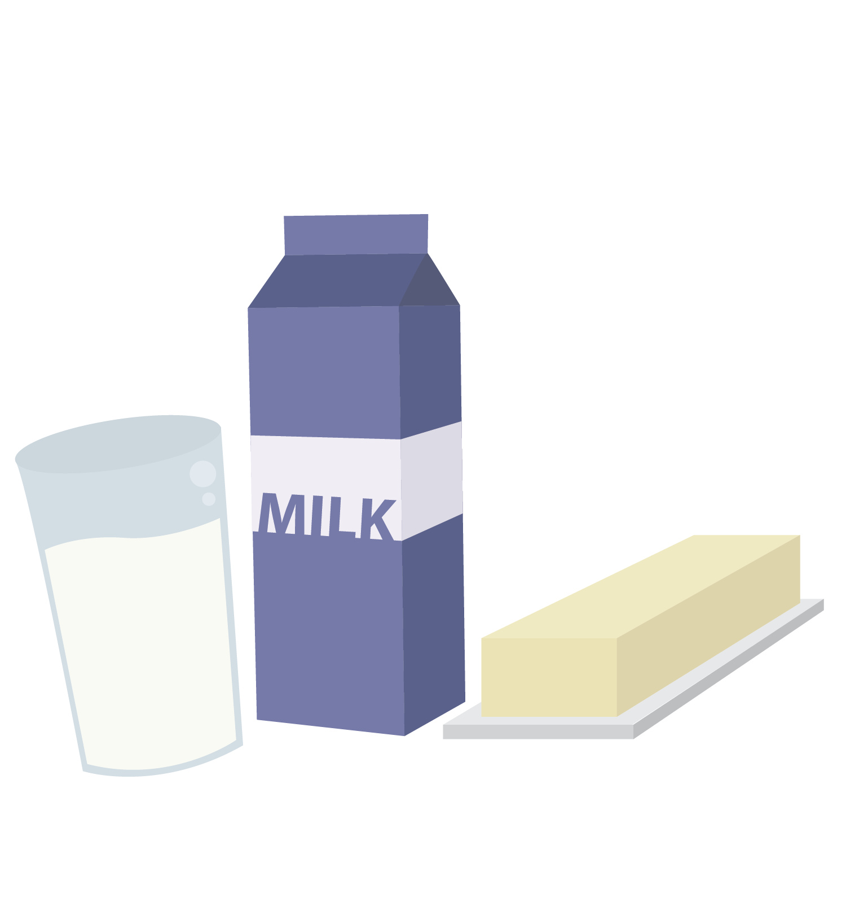

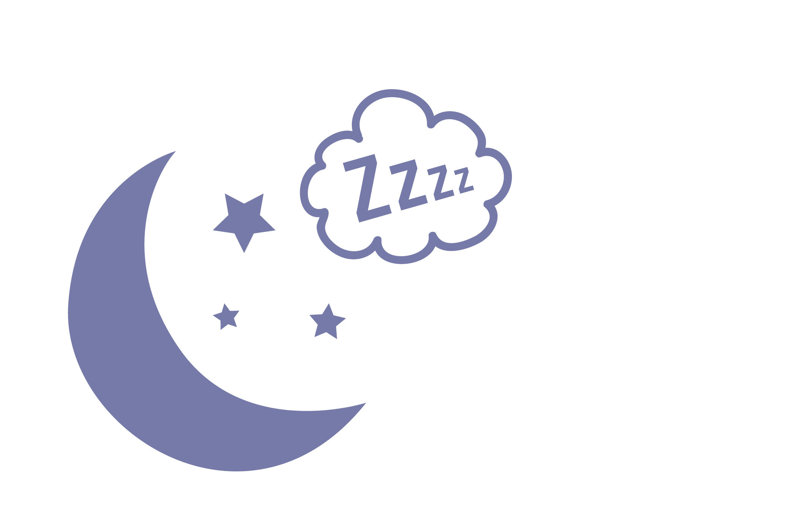
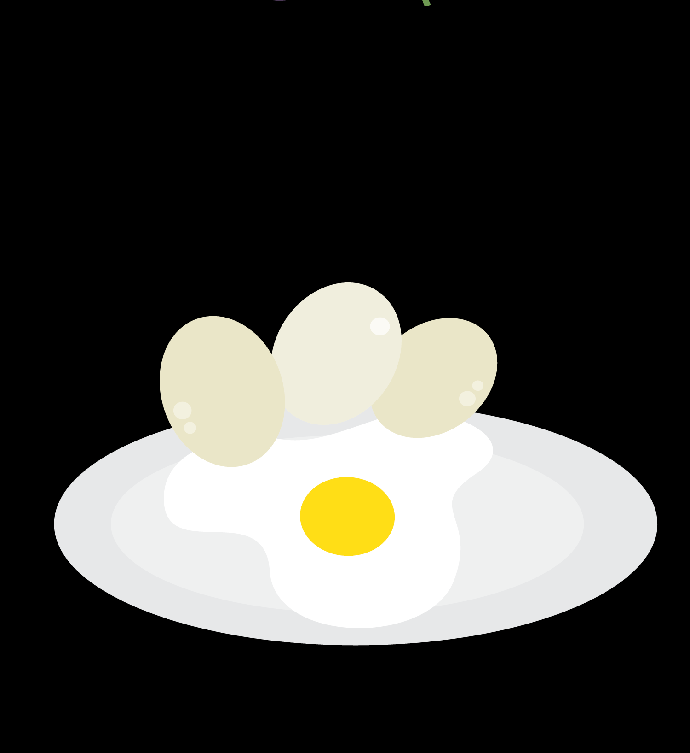
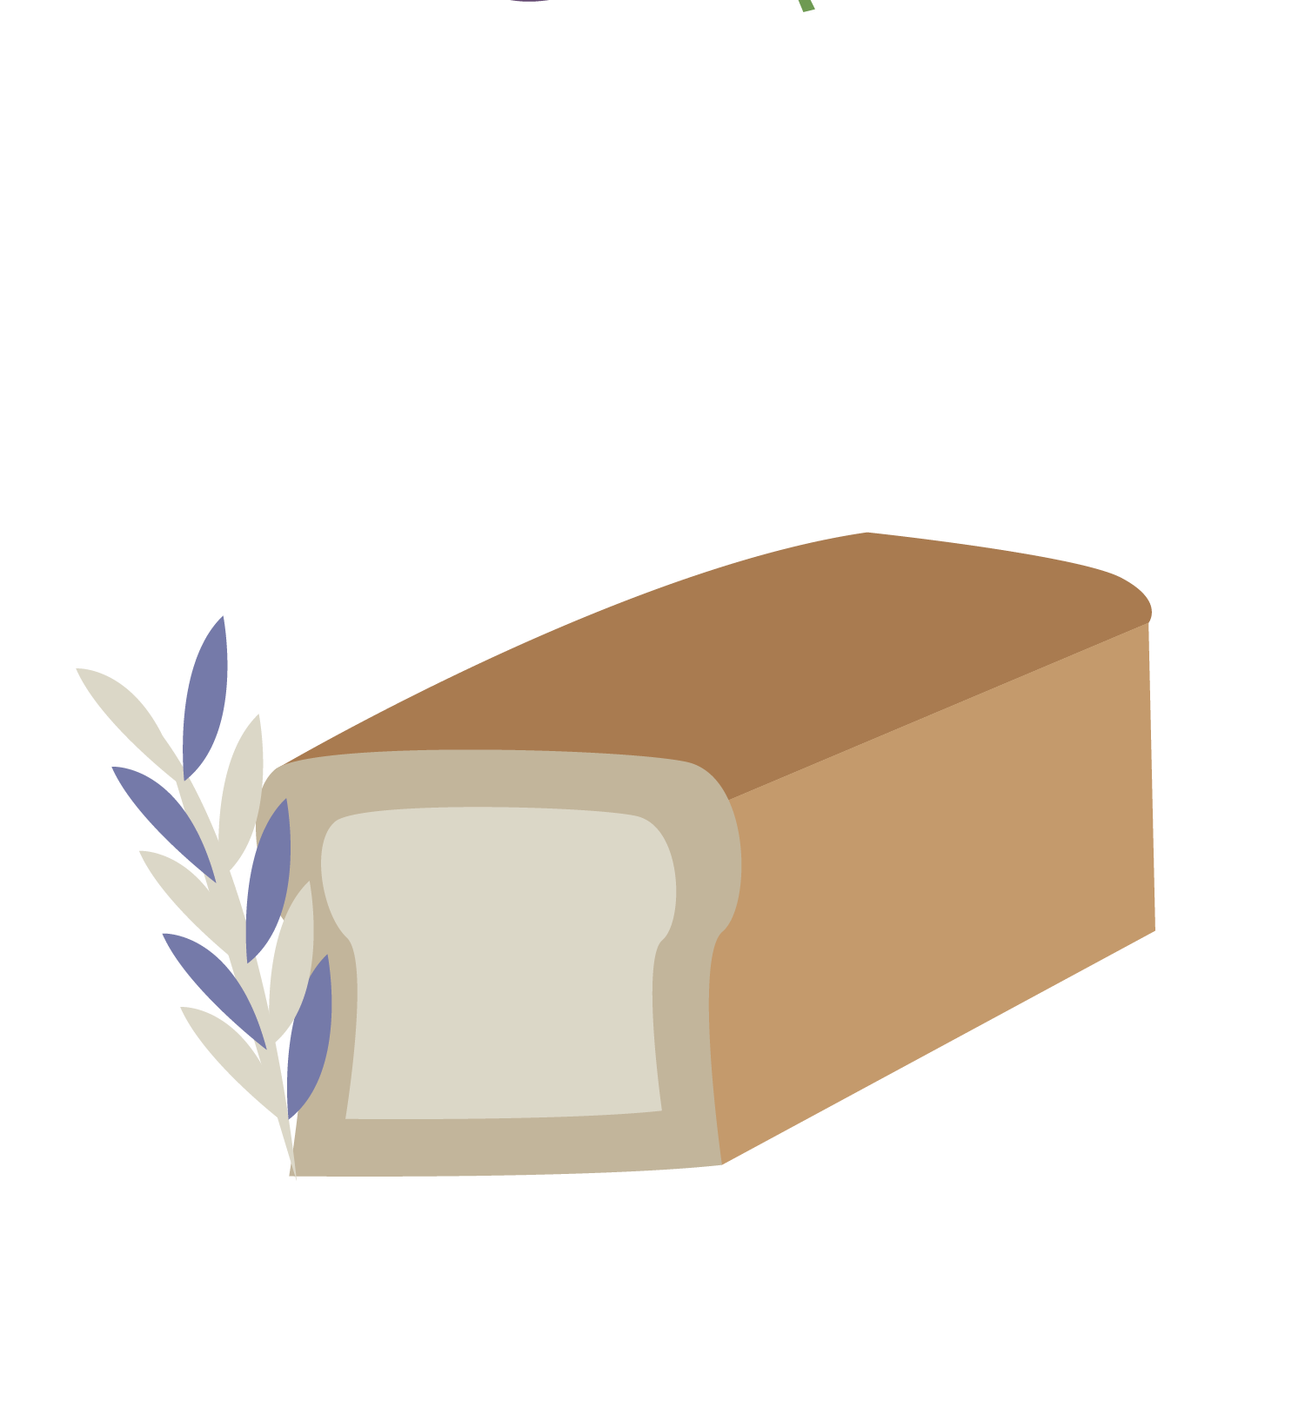


Review:
Healthy Habits + Healthy Cycles
Nutrition
Exercise
Sleep
© FEMM
Notes:
Last class, we learned about the pillars of health. They are what “hold up” your health. What we eat, how much we sleep, and how much we move our body impacts our overall health and helps our hormones stay in balance. When we don’t do these things, we make it hard for our body and brain to function at their best.

Slide 4
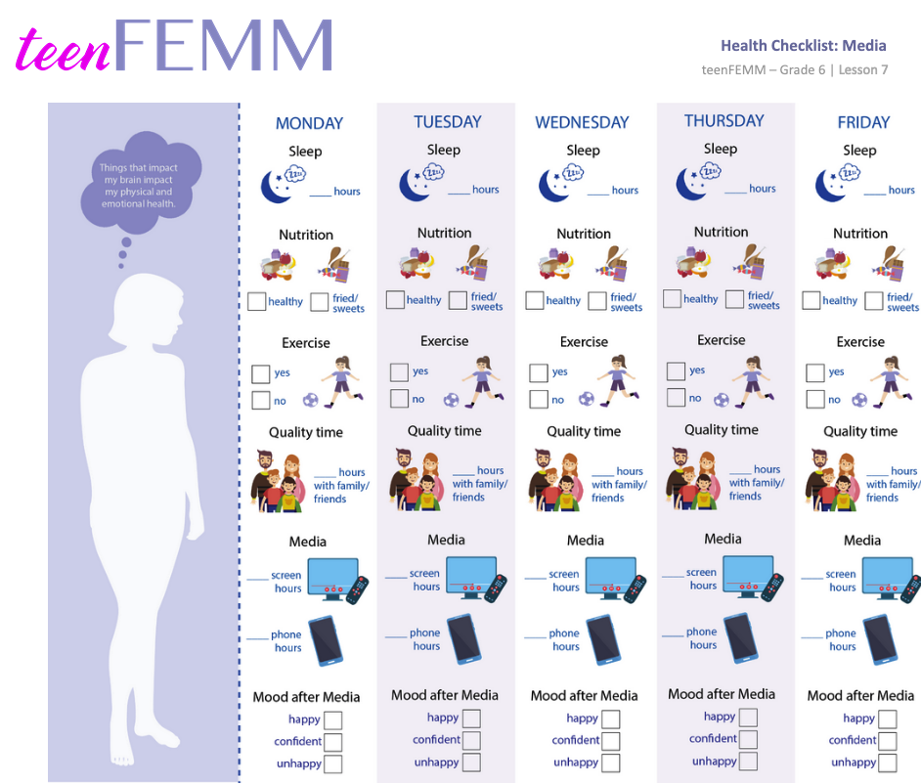
Review: Health Checklist Challenge
Health Checklist Challenge!
media use edition
© FEMM
Notes:
Scientists say that it takes about 21 days to create a new habit in the brain. If you filled in your Health Checklist: Media edition last week, you’re five days closer to a new habit!
What did you learn about yourself? What are some of your social media habits? Give students a couple of minutes to discuss.

Slide 5
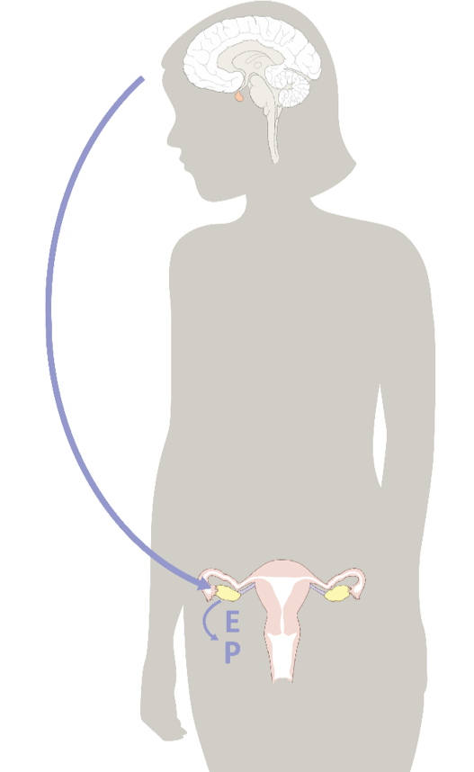
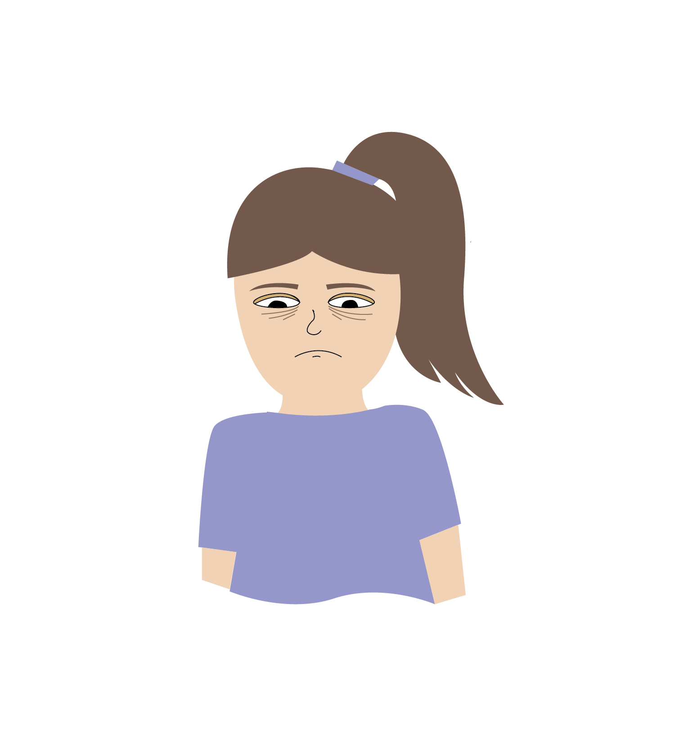
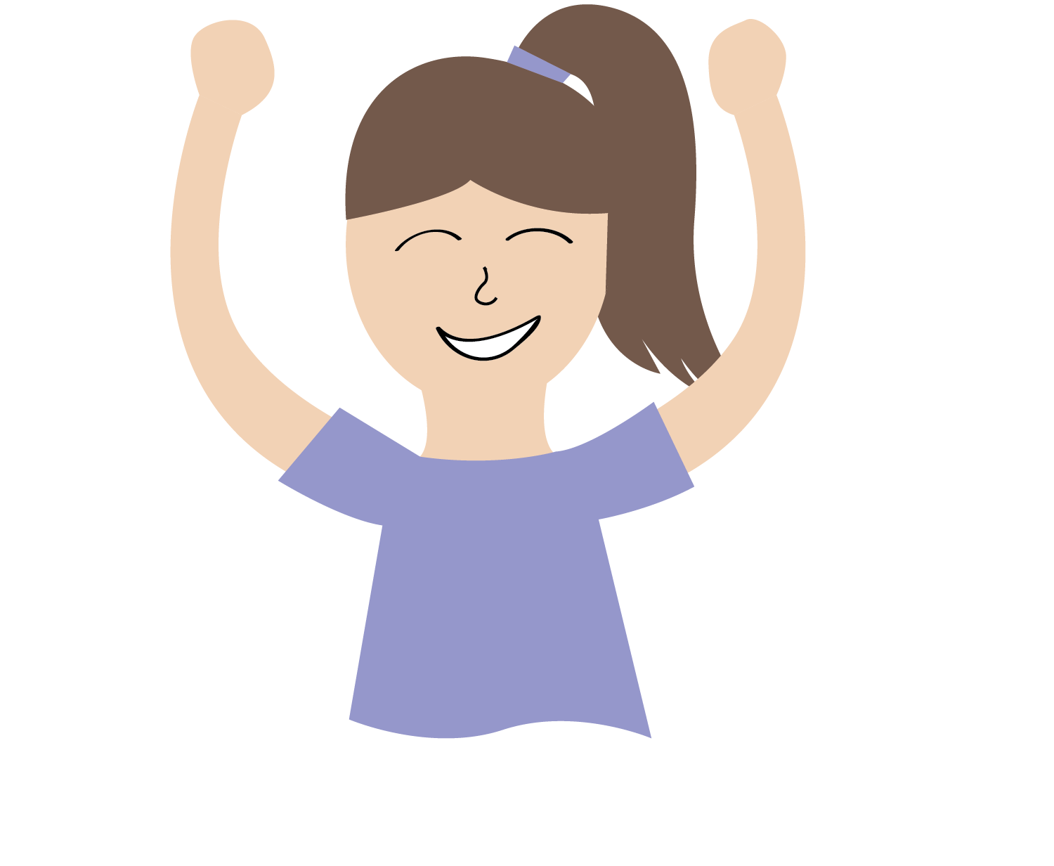
Hormones & Emotions
Estrogen and Progesterone
impact the brain, along with our feelings and emotions!
© FEMM
Notes:
We know that estrogen and progesterone do a lot of very important things in our body! The hormones estrogen and progesterone also impact our emotions and feelings.
One day we might feel like we’re on top of the world: we could give a great presentation to the whole class and feel amazing doing it! Another day, we feel like hiding in our room, or yelling at anyone who gets in our way!

Slide 6
Emotions and Conflict
Sometimes, our feelings can lead to conflict with the
people around us.
Conflict is a normal part of life, but it’s how we handle it that’s important.
© FEMM
Notes:
Sometimes, the way we are feeling can lead to more or less conflict with the people around us. Conflict basically means that you disagree with someone about something. Dealing with conflict is something that happens to all of us. It’s a natural part of human relationships, but it isn’t necessarily something to be viewed negatively. Conflict can lead to positive change, but we must handle it with care.
Conflict resolution is an important skill to build. Being honest and communicating directly is a great skill! Running away from conflict might seem like the easy way out, but it can often make things worse. To grow in maturity we need to practice working through disagreement in a positive way.

Slide 7
Tips for Resolving Conflict
#1
#2
#3
Recognize your emotions.
Try to name how you are feeling. Is it sad, angry or disappointed? When you know the emotion, you can better communicate your needs.
Listen well.
Really try to understand their perspective on the issue. Use your power of imagination to picture things from their view.
Stick to the facts!
Be specific about what is bothering you and how it made you feel.
© FEMM
Notes:
Ask: When have you had to deal with conflict before? Can you think of some examples where conflict produced a good outcome? Can you think of some examples of conflict where there was a bad outcome?
Sometimes, we have conflicts with our parents or siblings. Other times, we have conflict with our friends. We may even have found ourselves in the midst of conflict with our teacher or principal. We can expect that there will sometimes be conflict in our life, but what is most important is how we work through this conflict.
Recognize your emotions. Try to name how you are feeling when you are sad, angry, disappointed, or upset. This is a better option than just saying it doesn’t matter. When you’re aware of your emotions, you can communicate your needs without threatening or punishing others.
Listen well. Really try to understand their perspective on the issue. You can ask questions. Really try to use your power of imagination to try and understand things from their view.
Stick to the facts! Don’t bring up old problems that are not relevant to what is going on right now. Remain calm and be respectful when you are addressing the person with whom you are having conflict. Be specific about what is bothering you and how it made you feel. Both parties need to communicate for there to be positive results.
Resolving a conflict doesn’t mean that one person wins and one loses. Instead of thinking of it as “me versus you”, try to think of it as “us versus the problem.”

Slide 8
Conflict Resolution
Resolving a conflict DOESN’T MEAN that one person wins and one person loses.
Resolving a conflict MEANS changing our thinking to “us” versus the problem. Win-win!
The Problem
?
👍 ME vs. YOU 👎
What are going to do to solve it?
© FEMM
Notes:
Resolving a conflict doesn’t mean that one person wins and one loses. Instead of thinking of it as “me versus you”, try to think of it as “us versus the problem.”
Conflict resolution is an important skill to build. Being honest and communicating directly is a great skill! Running away from conflict might seem like the easy way out, but it can often make things worse. To grow in maturity we need to practice working through disagreement in a positive way.

Slide 9
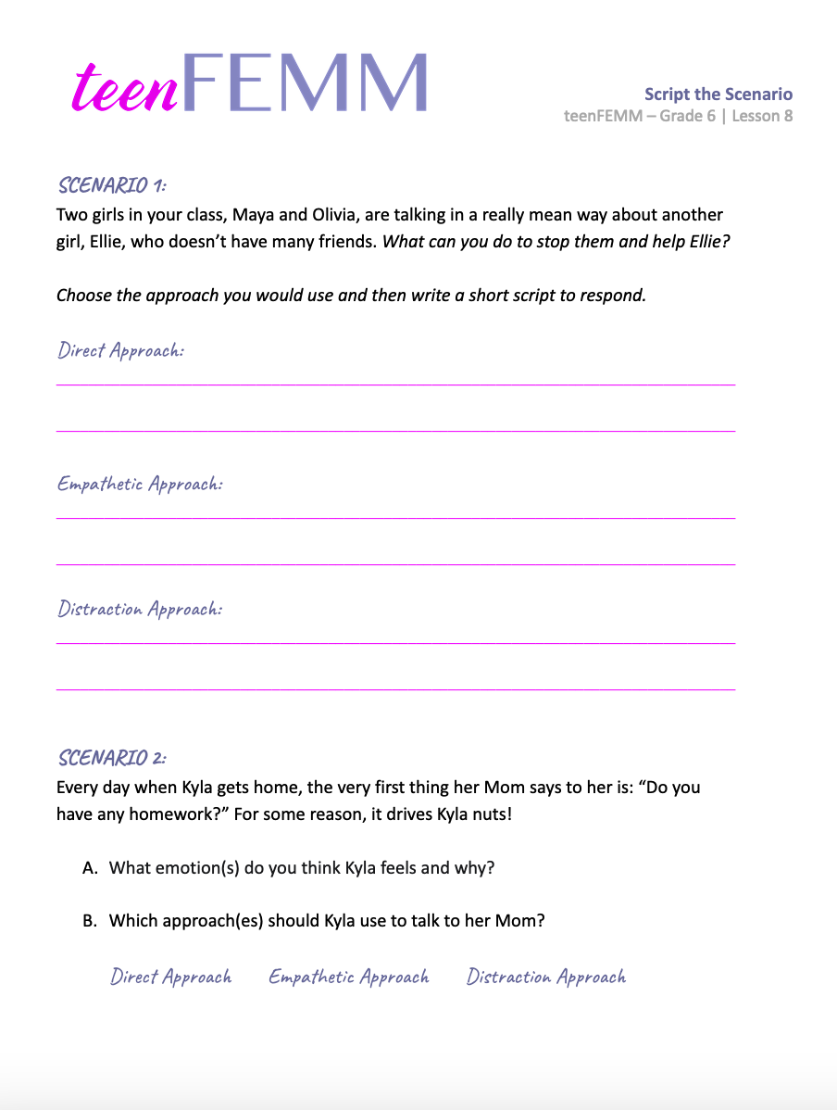
Script the Scenario
💡
You might find it easier to deal with conflict if you have practiced some ways to resolve conflict before a situation arises!
Scripts are phrases that you have thought about in advance, so that you know what to say in the situation.
© FEMM
Notes:
You might find it’s easier to deal with tricky situations if you have practiced some ways to resolve conflict before the conflict actually begins. Scripts are phrases that you have practiced in advance, that can help you remain calm or get out of a difficult situation.
Hand out the Script the Scenario worksheet to each student. Read the questions aloud with the class. You may use the Teacher’s Answer Key for guidance, to help students brainstorm and script solutions to the questions.
Having tools to manage conflict means that you will be someone who helps friends and others in a positive way. Conflicts will happen, but learning to deal with them in a calm and mature way takes practice.

Slide 10
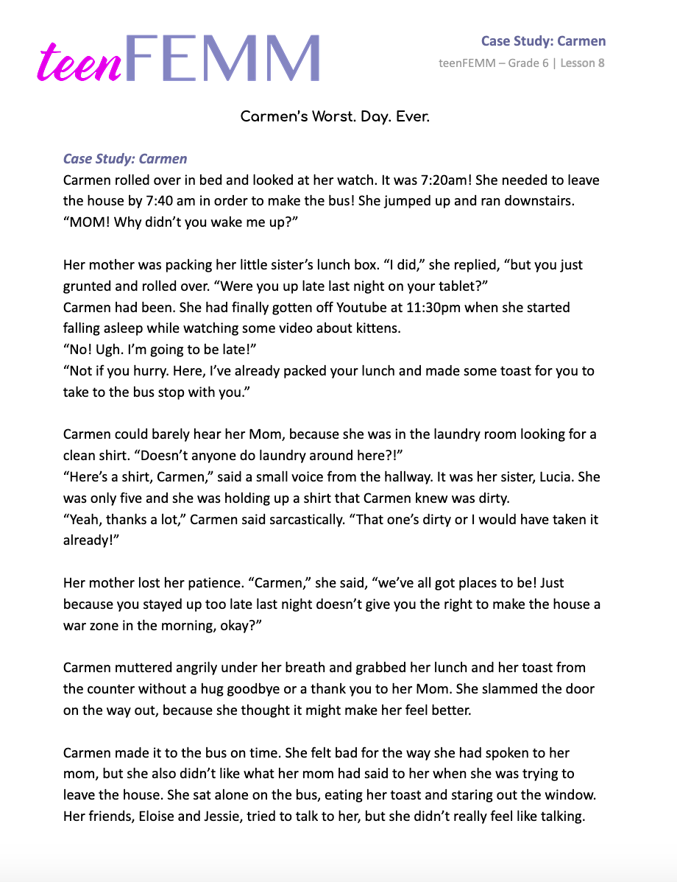
Case Study: Carmen’s Worst. Day. Ever.
To do:
🗣️ Describe the conflict
🕵🏻 Facts of the case
🔍 Find the issues
🧠 Brainstorm solutions
© FEMM
© FEMM
Notes:
Ask students to volunteer to read the story aloud. Work through the Discussion Questions as a class. It’s important to describe the conflicts, name the facts (these need to be agreed upon by all students and the teacher), then move to issues and solutions.
—
Discussion Questions (teacher reads and discusses with the class):
Describe the conflict(s) in this case study. (Carmen vs. mom; Carmen vs. sister; Carmen vs. guys in her class, especially Ben; Carmen vs. Mr. Collis.)
How are the characters handling the conflict? Stick to the facts! (Carmen’s mom raised her voice; Carmen stomped and shouted in her house; Carmen yelled at Ben; Mr. Collis spoke very loudly, etc.)
What are some of the issues that led to the conflict? (Carmen waking up late, Carmen staying up too late the night before, Carmen not having organized laundry/laundry issues in the house, Carmen rushing and forgetting to wash her face and pack her homework, guys in class teasing Carmen, etc.)
What are some solutions that could be used to help Carmen, her mom, and Ben in this case? How could Carmen have been a better sister to Lucy? Why is it important for Carmen to recognize her behavior last night affected her ability to deal with conflict today? How could Carmen have stood up for herself more effectively in front of Ben and the other guys and girls that were laughing at her?

Slide 11
Conclusion
Our emotions are affected by our hormones.
Conflict is a normal part of life.
We can learn skills to make us better at conflict resolution.
Part of growing to maturity involves making good choices about what we do when conflict arises.
Notes:
Our emotions are affected by our hormones. This is normal. Sometimes, we will find ourselves in conflict with others. Part of growing up and becoming a mature person is taking responsibility for ourselves. We can use certain skills to become excellent at conflict resolution. This helps us, our family, our friends, and our community. Conflict resolution may also mean practicing the habit of going to bed on time or preparing our clothes the night before. Maturity is about making choices that lead to good health, habits and relationships in life.

Slide 12
Grade 6
SUMMARY
© FEMM

Slide 13
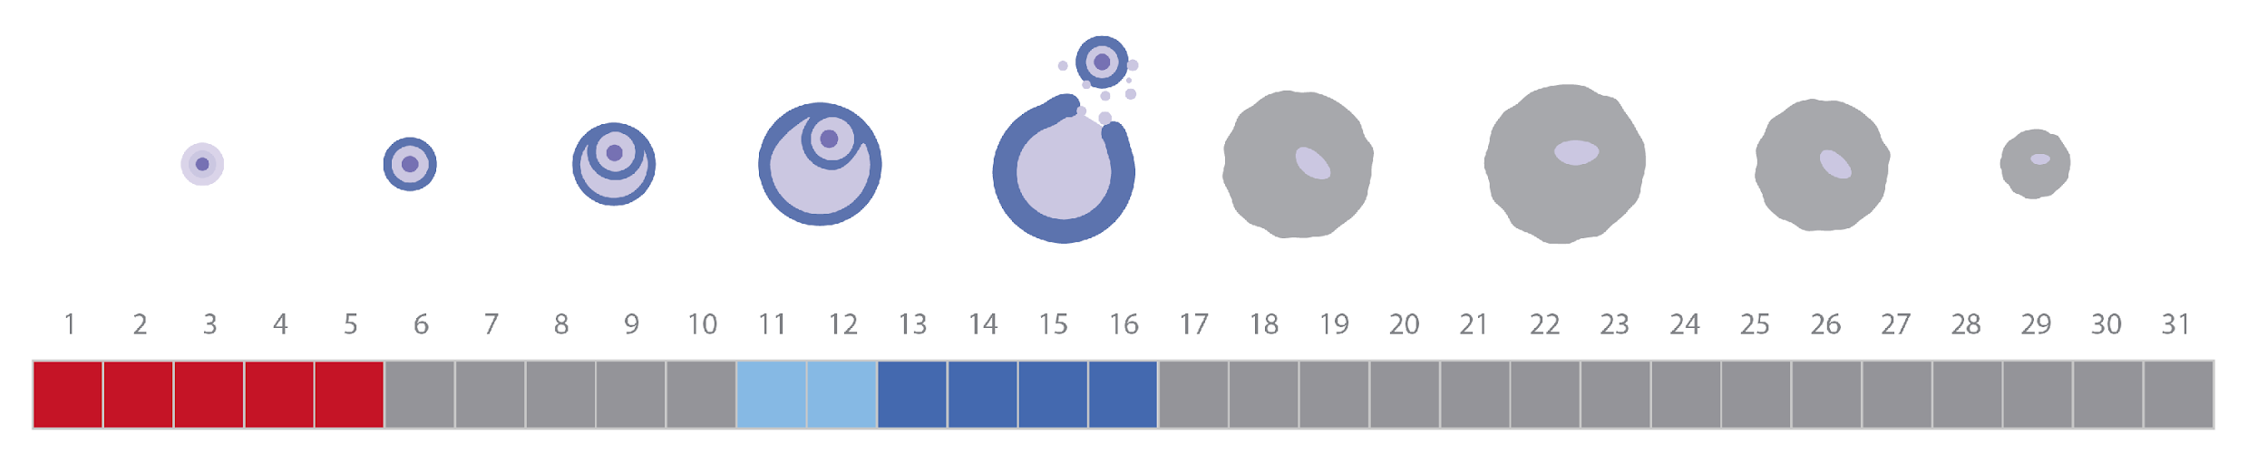
A healthy cycle
Remember: Ovulation is a sign of health!
Keep charting & keep noticing what is
happening to your body.
Notes:
The boys in your grade have completed their grade 6 teenMEN course as you have been working through this course. Although their changes are different from yours, many of the same hormones are also playing a major role in the boys’ body and brain development during puberty. It is important to remember that all kids go through puberty, and hopefully you all will have a little bit more understanding for each other as you navigate these changes. The boys won’t have a monthly hormonal cycle, like you, but rather a much more gradual daily hormonal “cycle.” Through puberty, the pathways in their brains will continue to develop, they will grow taller and stronger, their voices will deepen, they will grow more body hair, and their reproductive organs will mature. You are both going through these incredible changes, and with a little bit of extra focus on making good choices to support your bodies and minds through this process, you will all grow into amazing men and women!

Slide 14
Summary
Practice excellent habits for your brain and health!
  Remember the 3 Pillars of Health.
  Limit screen time, especially before bed!
Pay attention to your chart, as your hormones will change as you go through puberty.
Becoming aware of the language of your body helps you to better equip yourself for all of the exciting adventures that still await you!
Notes:
This brings us to the end of our teenFEMM grade 6 course. I hope that you have learned some new things about your cycle and your health, and are feeling excited to be going through this amazing stage of growth in your lives. It is a great idea to keep charting- on paper or in the FEMM app if your parents are ok with it- so that you have a unique health record for yourself as you become the woman you are meant to be. I hope you continue to consider the impacts of sleep, nutrition, and exercise on your developing mind and body, and remember that your ovulation cycle is an amazing window into your own health and strength as a young woman.

Slide 15
Grade 6
LESSON 8
© FEMM

