Slide 1

Grade 6
LESSON 8
© FEMM

Slide 2
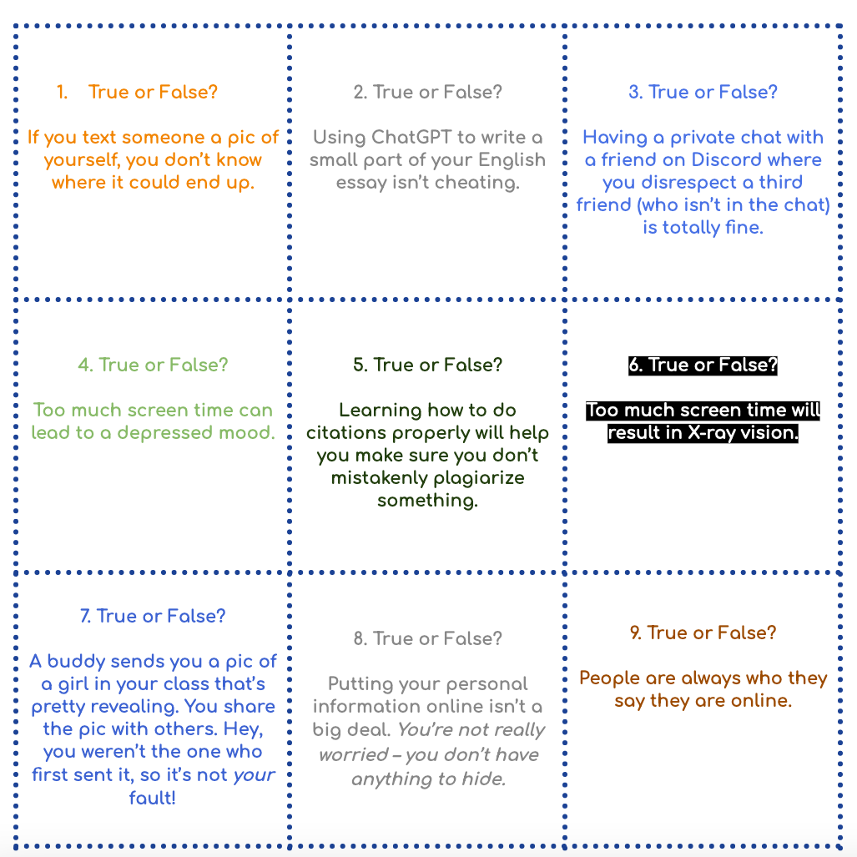
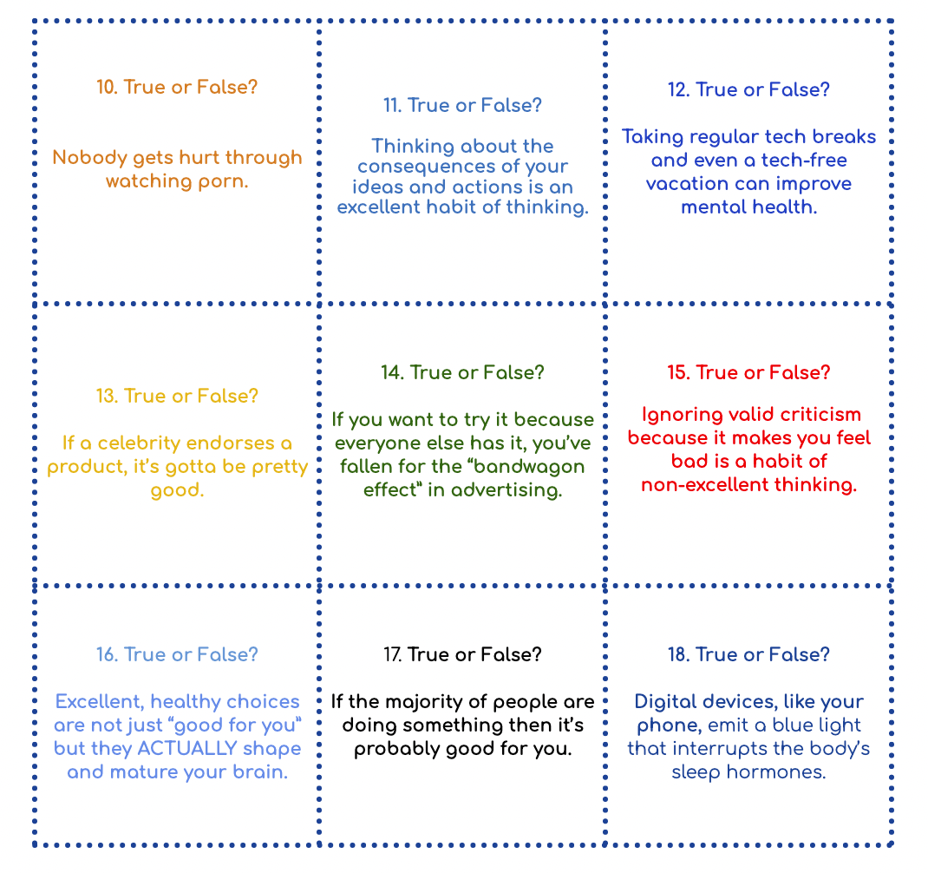
Entry Ticket Activity
Is it true or false ?
© FEMM
Notes:
(Before class, cut out the Entry Ticket Activity squares into 18 cards.) As students enter the classroom, hand out one or two cards per student, depending on the number of students in the class. Once students have answered the question on their card, have them read the question aloud for the class to answer. Check answers using the short answer key provided at the bottom of the document or, for more in-depth answers, use the Teacher’s Answer Key provided in the materials.

Slide 3
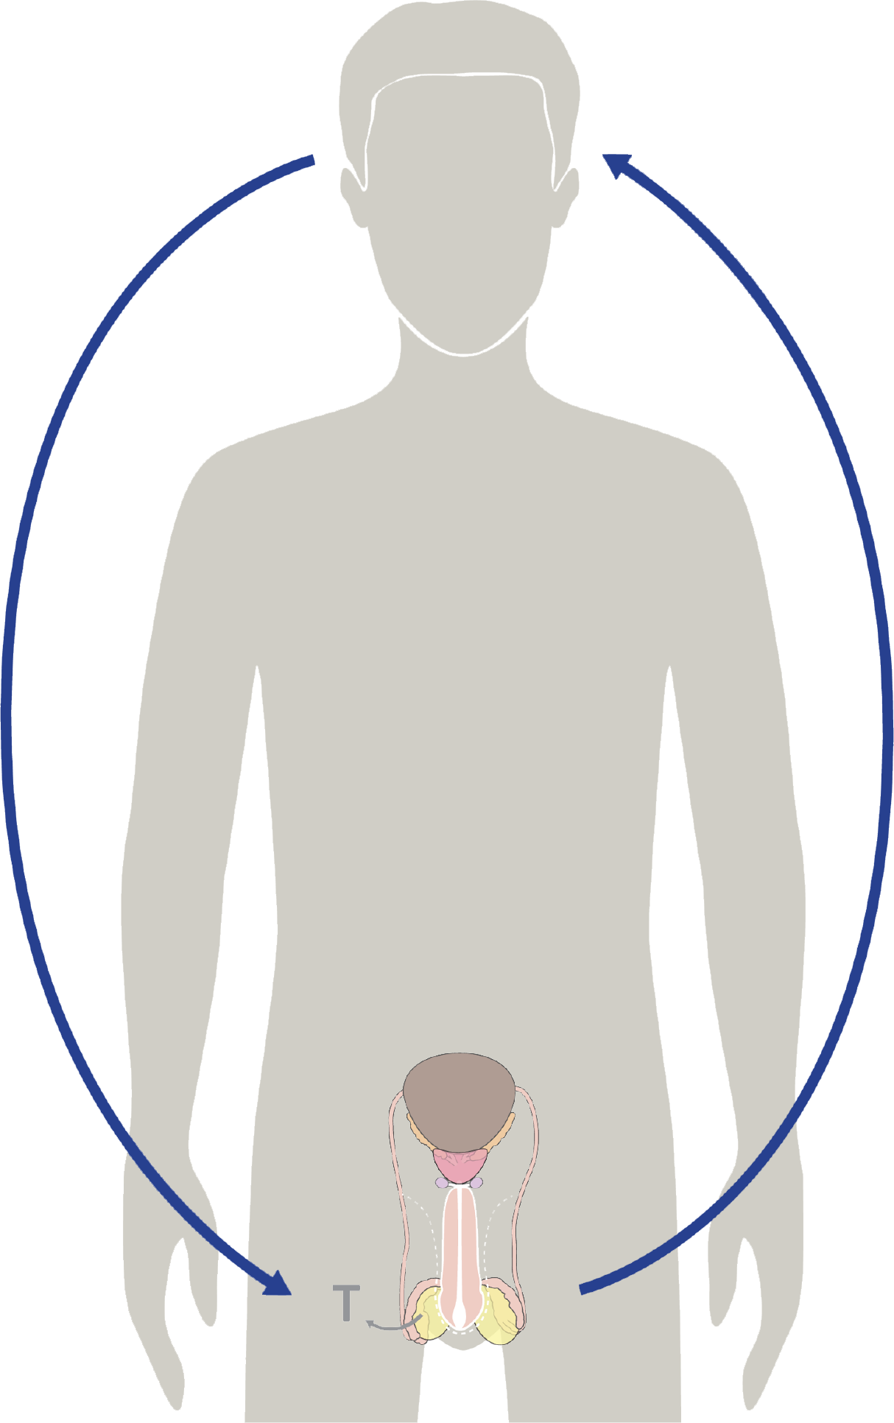
Hormones & your growth
Hormones cause all the growing & changing that your body does during puberty.
Testosterone is the main male hormone.
© FEMM
Notes:
Do you remember what controls the activity of every system in the body?
Yes, hormones! Hormones are directed by your brain. They cause all of the growth and development that your body does during puberty.
Testosterone and all of your other hormones are affected by what you eat, how much sleep you get, whether you exercise, etc.

Slide 4
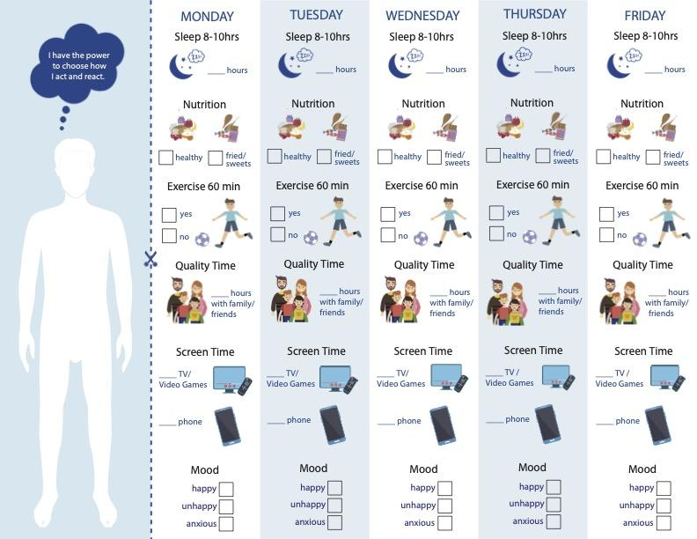
Health Checklist: Media Edition
How did it go?
What did you notice?
Any habits you could change to be healthier?
© FEMM
Notes:
Something else that impacts hormones is stress. We learned last class that not getting to bed on time, not eating well or exercising can all stress the body. Briefly discuss the Health Checklist: Media Edition. What did you notice? Did anything surprise you about your technology use? Did you spend more time online than maybe you thought? Are there any habits you’d like to change to be healthier?

Slide 5
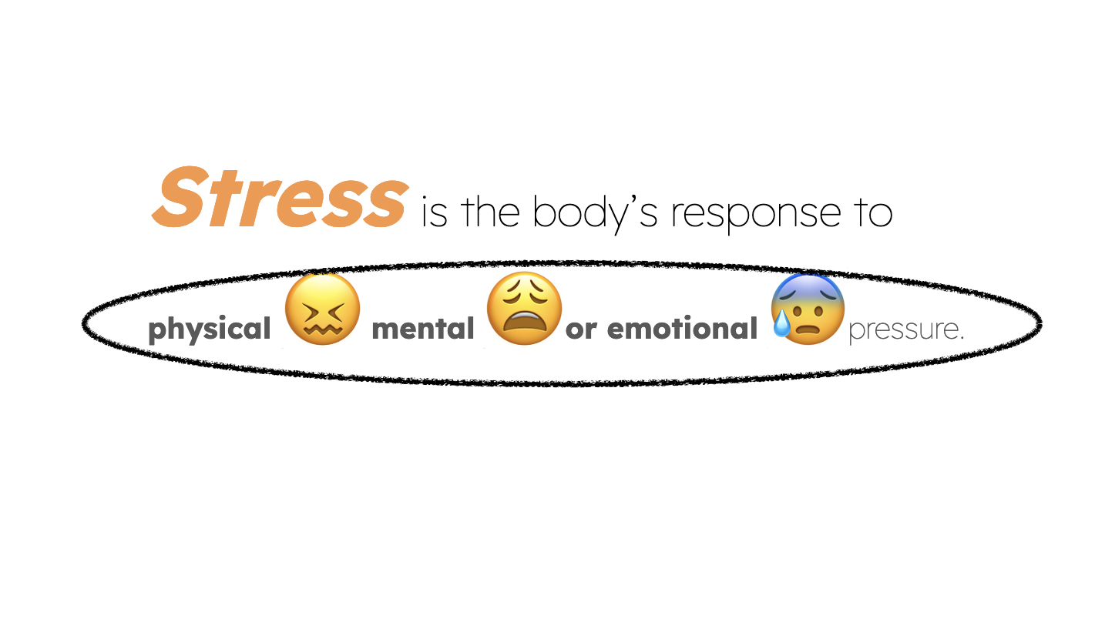
What do you think of when you hear the word “stress”?
© FEMM
Notes:
Stress is the body’s response to physical, mental, or emotional pressure. When our body is under stress, it can start to react in a variety of ways. It’s important to know that stress is something that happens to everyone and at all stages of life.
Also, not all stress is bad! If there’s a test coming up and we feel stressed about it, that can spur us on to study for the test. However, if we get too overwhelmed by our stress, we might put off studying for the test and then stay up way too late studying the night before, which ends up negatively impacting our sleep and performance on the test. In this scenario, we made our stress worse, with avoidance. So, it’s not necessarily the stress that is the problem; it’s what we do when we are feeling stressed. So, what we do when we are feeling stressed is an important life skill.

Slide 6
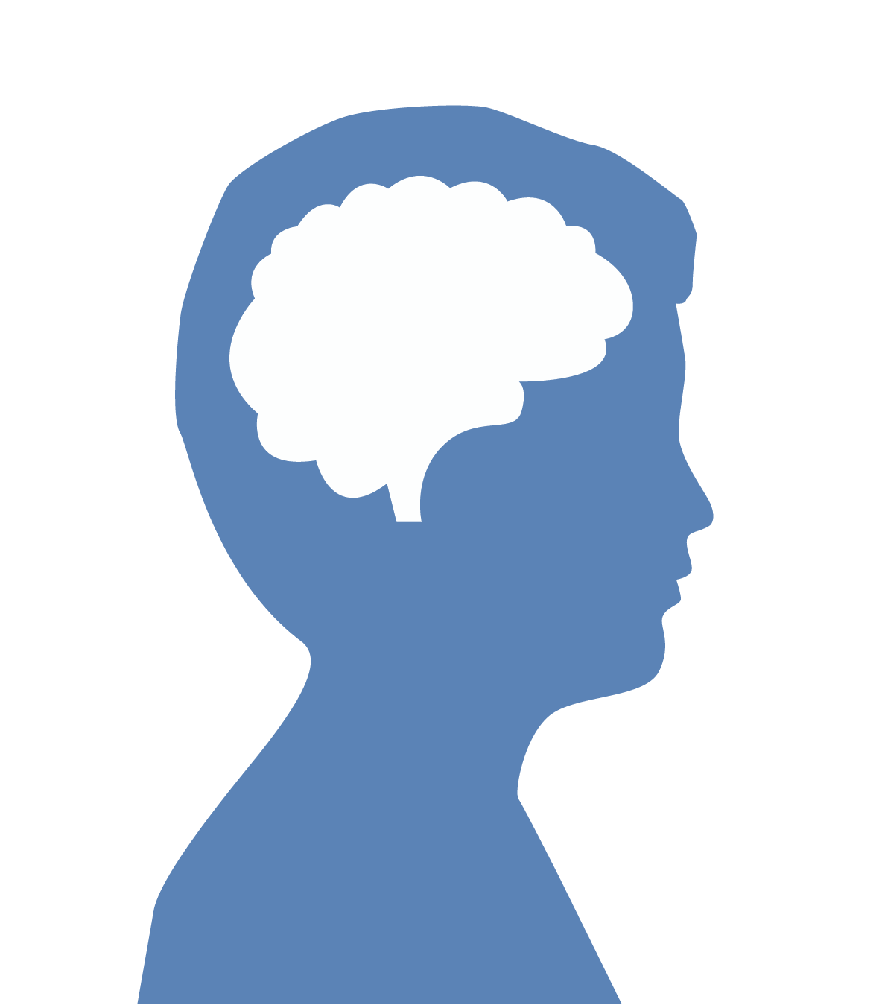
Recognizing stress
There are two kinds of Stress.
I’m a failure.
Because I’m not good at this one thing, it means I’ll never be good at ANYTHING.
Exhibit A.
When our mindset or expectation is “all or nothing,” this can cause us stress
INTERNAL STRESSORS
© FEMM
Notes:
So, how can we help ourselves to manage stress?
The first thing to do is recognize the stress.
Internal stressors are stressors that come from within ourselves. When our mindset or expectation is “all or nothing,” this can cause us stress. If we think we either have to be perfect at public speaking or else we’re a failure at public speaking, we are going to stress ourselves out when the teacher announces that everyone in the class has to give a presentation. Internal stressors are usually driven by our thoughts or behaviors.
External stressors are stressors that we have little or no control over. These can include major life events, like the death of a grandparent or a parent losing their job. These kinds of stressors come from outside of ourselves, which is why they are called external. We can’t control external stressors; but we CAN choose how we respond.

Slide 7
Recognizing stress
There are two kinds of Stress.
Exhibit B.
These can include major life
events, like the death of a
grandparent or a parent
losing their job.
I can’t control EXTERNAL stressors...
I can only control how I react.
EXTERNAL STRESSORS
© FEMM
© FEMM
Notes:
So, how can we help ourselves to manage stress?
The first thing to do is recognize the stress.
Internal stressors are stressors that come from within ourselves. When our mindset or expectation is “all or nothing,” this can cause us stress. If we think we either have to be perfect at public speaking or else we’re a failure at public speaking, we are going to stress ourselves out when the teacher announces that everyone in the class has to give a presentation. Internal stressors are usually driven by our thoughts or behaviors.
External stressors are stressors that we have little or no control over. These can include major life events, like the death of a grandparent or a parent losing their job. These kinds of stressors come from outside of ourselves, which is why they are called external. We can’t control external stressors; but we CAN choose how we respond.

Slide 8

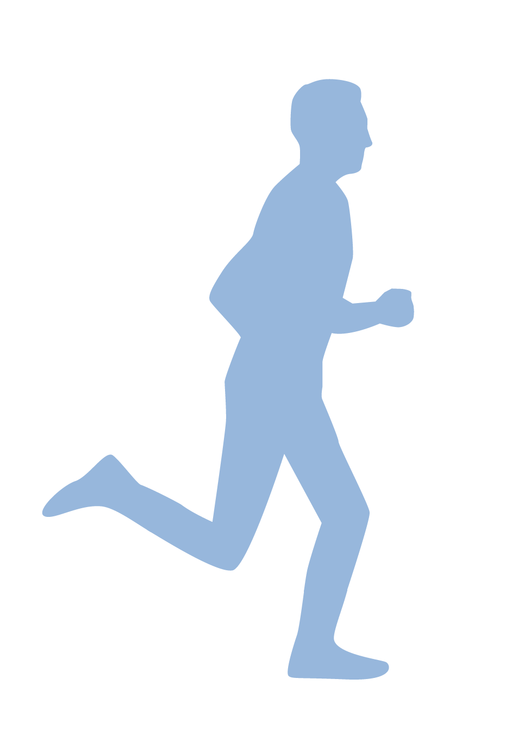
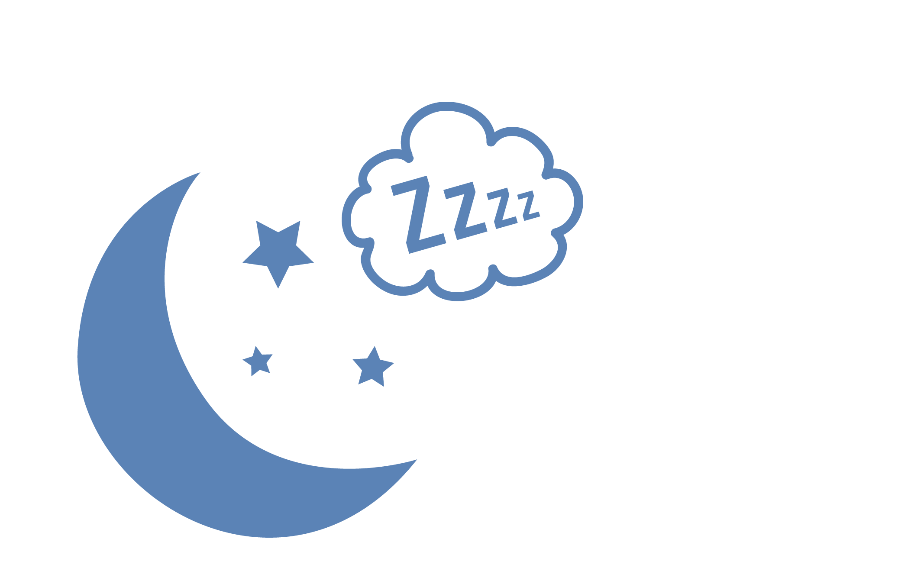

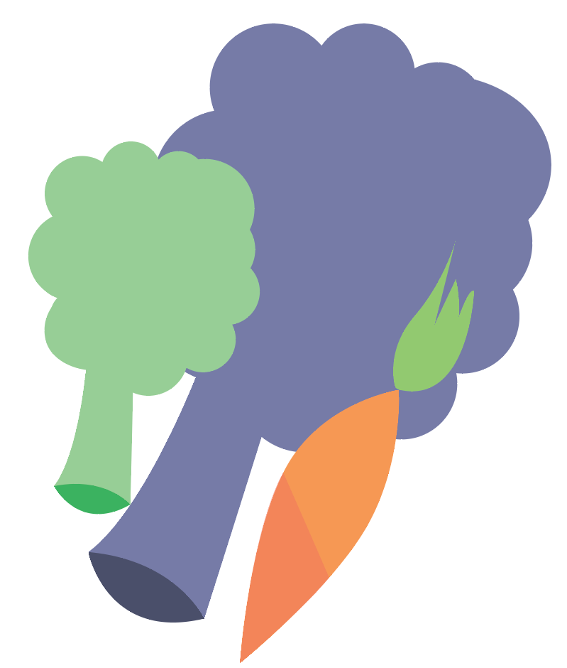

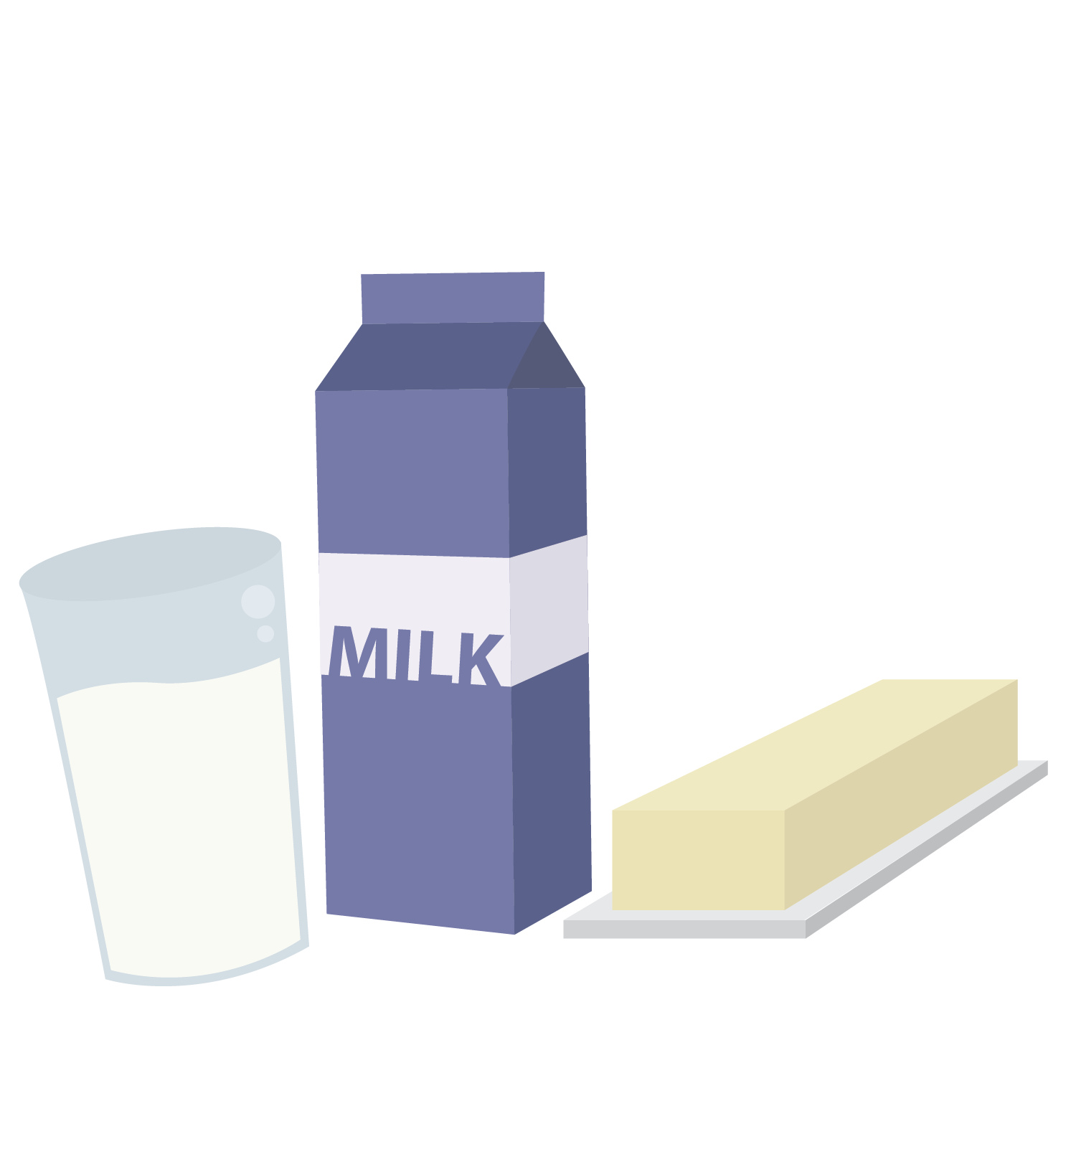
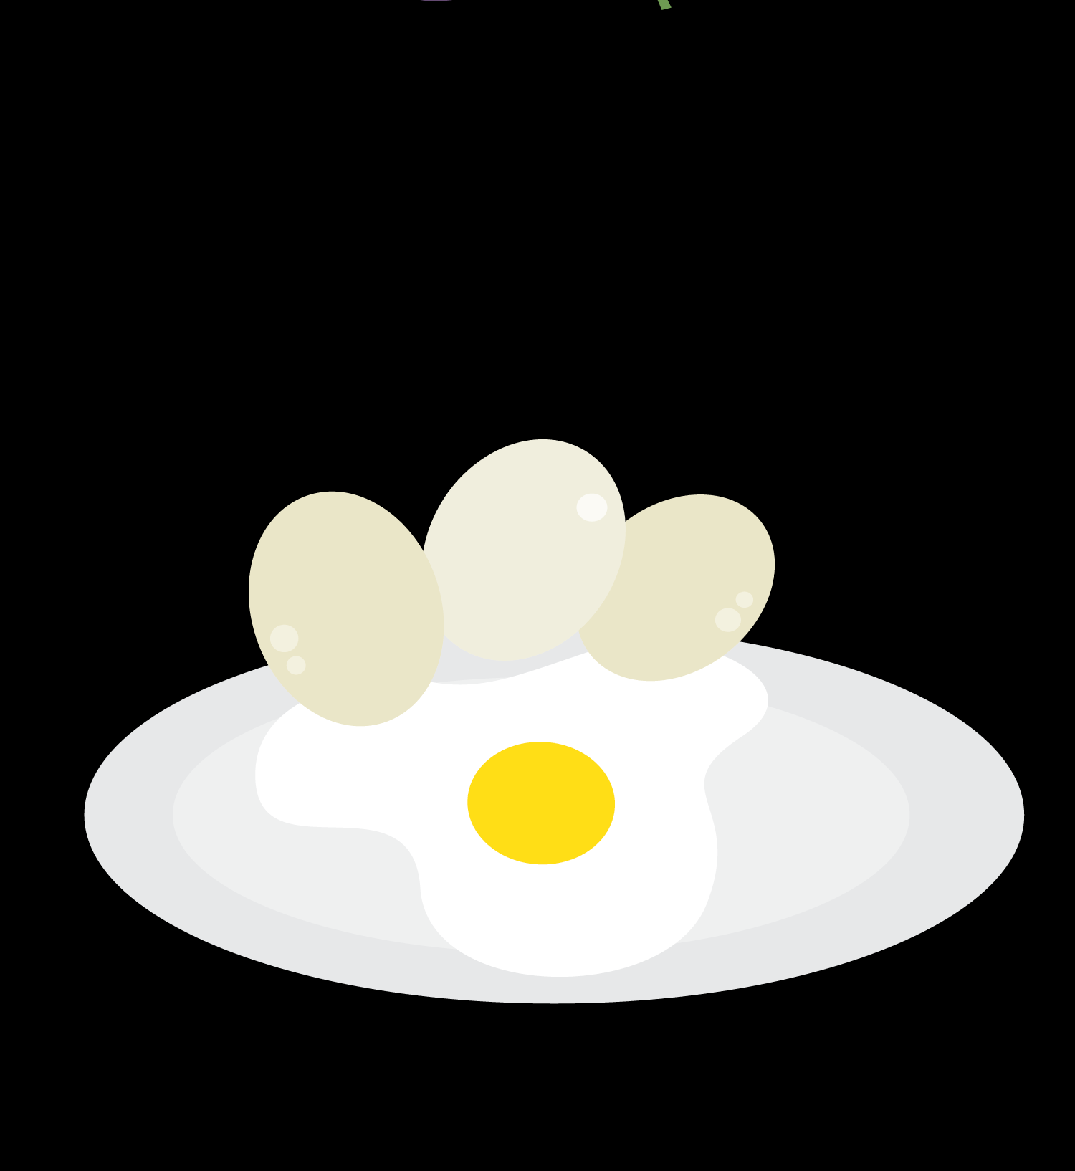
Healthy Choices Help with Stress
Healthy Choices help with Stress
Nutrition
Exercise
Sleep
When you’re stressed, it can be easy to think, “I don’t have time for exercise or 8-10 hrs of sleep!” WRONG. That’s when you need it most!
© FEMM
Notes:
Stress is a part of life. We are all going to have times where we are very stressed. We will have other times where we are less stressed. It’s important to remember when we are going through a difficult time that it won’t last forever!
Especially in times of stress, don’t forget what YOU can do:
Exercise and eat nutritious food. This helps keep our body more resilient to stress.
Get enough sleep: especially when you feel stressed!
Look out for that negative self-talk and try to replace it with more positive statements. This helps us work on our mindset and those internal stressors.
Listen to upbeat music, write, draw or be outside in nature.
Make sure you have friends, and most importantly, a trusted adult, that you can talk to when things are hardest.

Slide 9
Healthy Choices Help with Stress
Maturity doesn’t mean going it alone. 👎
Maturity does mean 👉 communicating what you’re feeling and talking with a trusted adult when things are hard.
NOBODY gets there alone. EVERYBODY needs support and encouragement.
© FEMM
Notes:
Remember: NOBODY gets there alone. EVERYBODY needs support, encouragement and help.

Slide 10
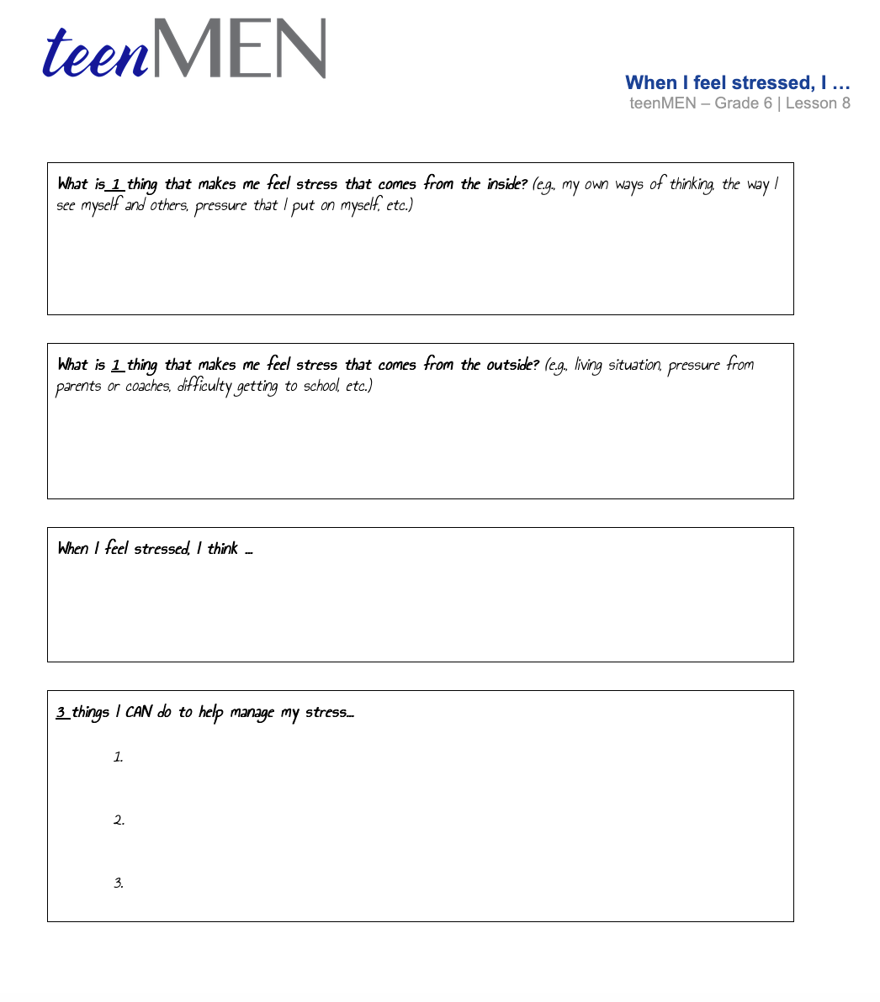
Worksheet:
When I feel stressed, I ….
© FEMM
Notes:
Hand out the Worksheet: When I Feel Stressed to each student.
Give students time to write down their responses. Discuss as a class, asking students if they’d like to volunteer to share their answers aloud.

Slide 11
Emotions & Conflict
To know:
Emotions and stress can lead to conflict.
Conflict is normal and is a part of human relationships.
What is important is how conflict is approached and dealt with.
© FEMM
Notes:
Stress can have an effect on our emotions. Sometimes, our emotions and our stress can lead to conflict.
Conflict basically means that you disagree with someone about something. Dealing with conflict is something that happens to all of us. It’s a natural part of human relationships, but it isn’t necessarily something to be viewed negatively. Conflict can lead to positive change, but we must handle it with care.

Slide 12
Conflict Resolution
#1
#2
#3
😡😰😩
Name your emotion.
When you can name the emotion you feel, you can better communicate your needs.
Listen well.
Use your power of imagination to picture things from their view.
Stick to the facts!
Be specific about what is bothering you and how it made you feel.
© FEMM
Notes:
Conflict resolution is an important skill to build. Conflict resolution is when two or more individuals find a solution to their issue. Here are three steps in trying to resolve conflict:
Recognize (name) your emotions.
Try to name the emotion (s) you are feeling. When you can name the emotion: sad, angry, disappointed, hurt, etc. you can better communicate your needs without threatening or punishing others.
Listen well. Really try to understand their perspective on the issue. Ask questions. Really try to use your power of imagination to try and understand things from their view.
Stick to the facts! Don’t bring up old problems that are not relevant to what is going on right now. Remain calm and be respectful when you are addressing the person with whom you are having conflict. Be specific about what is bothering you and how it made you feel.
Remember that resolving a conflict doesn’t mean that one person wins and one loses. Instead of thinking of it as “me versus you”, try to think of it as “us versus the problem.” That way, when you come up with a solution, you are both on the winning side.

Slide 13
Scripts for conflicts with friends
Where: back of the school bus
Scene: Raph snatches Mateo’s sunglasses off his head. Mateo tries to snatch them back, but Raph has a firm grip and won’t give them to Mateo. Mateo says he’s going to post something that “everyone will be very interested in seeing” about Raph…
What could you say to your friends to help resolve this conflict?
© FEMM
Notes:
It’s easier to practice resolving conflicts before you are in the middle of one that’s gotten out of hand. Scripts are phrases that you have practiced before a real-life situation comes up, so that you know what to say or do. Let’s see if we can brainstorm some scripts for dealing with conflict in different situations:
Scenario #1:
You’re on the bus with two friends. Raph snatches Mateo’s sunglasses off his head. Mateo tries to snatch them back, but Raph has a firm grip and won’t give them to Mateo. Mateo says he’s going to post something that “everyone will be very interested in seeing” about Raph. This is getting bad… fast!
What can you do to help your two friends?
“Raph, just give them back.” (Direct approach.)
“Mateo, don’t do something you’ll regret doing to Raph later.” (Empathetic approach.) “You guys, come on, I want to show you my new Rubik's cube!” (Distraction approach.)

Slide 14
Scripts for conflicts with friends
Where: Classroom
Scene: Two guys in your class, Mikey and Omar, are beside you, talking in a really mean way about another guy, Julian, who doesn’t have many friends…
What could you say to stop them and help
Julian?
© FEMM
Notes:
Scenario #2:
You’re in your classroom. Two guys in your class, Mikey and Omar, are beside you, talking in a really mean way about another guy, Julian, who doesn’t have many friends.
What can you say to stop them and help Julian?
“Knock it off. Leave Julian alone.” (Direct approach.)
“Hey guys, Julian would probably feel pretty bad if he heard you.” (Empathetic approach.)
“Do you guys want to come shoot hoops with me?” (Distraction approach.)

Slide 15
Scripts for conflicts with family
If there are certain things around the house that you often get in conflicts with your parents or siblings about, what are they?
What scripts could help you to find a solution that works for you and your parents?
Don’t forget:
1. know your emotions
2. listen well
3. stick to the facts
© FEMM
Notes:
Scenario #3:
If there are certain things around the house that you often get in conflicts with your parents or siblings about, what are they?
What scripts could help you to find a solution that works for you and your parents?
Remember:
Know your emotions.
Listen well.
Stick to the facts.

Slide 16
Grade 6
LESSON 8
© FEMM
Notes:
Part 3: Conclusion of Lesson 8
Our emotions are affected by our hormones. Sometimes, we will find ourselves in conflict with others. This is normal. We can use certain skills to become excellent at conflict resolution. This helps us, our family, our friends, and our community. Part of growing up and becoming a mature person is taking responsibility for ourselves. This may mean practicing the habit of going to bed on time or preparing our clothes the night before. Maturity is about making choices that lead to good health, habits and relationships in life.
This brings us to the end of our teenMEN grade 6 course. I hope that you have learned some new things about your health, and are feeling excited to be going through this amazing stage of growth in your lives. I hope you continue to consider the impacts of sleep, nutrition, and exercise on your developing mind and body, and remember that your hormone health will impact the rest of your body’s health.

