Slide 1

Grade 7
LESSON 1
© FEMM

Slide 2
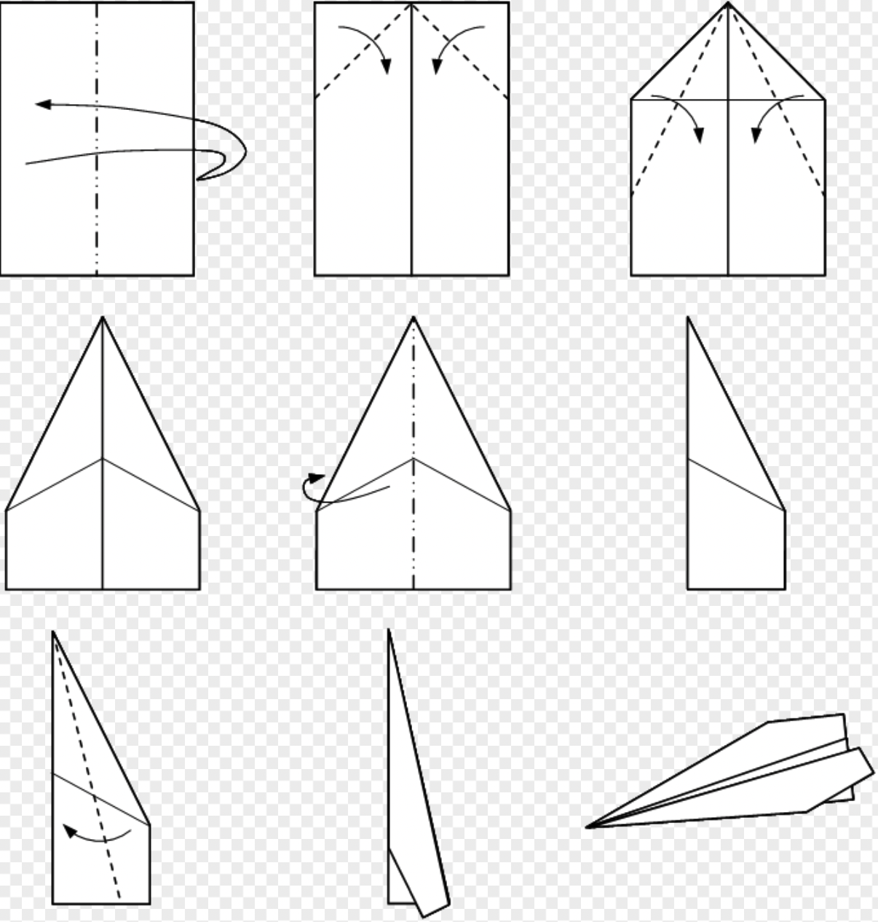
Icebreaker Activity
1: Get out a piece of paper.
2: On your paper, write down an important quality that you admire in a person.
3: Follow the instructions and fold your paper into an airplane!
Notes:
Step 1 (10 minutes): Icebreaker Activity + Introduce teenMEN as a health program
Have students get out a piece of paper.
On their paper, instruct students to write down a characteristic or quality in a friend, classmate, family member, etc. that they admire/that they’d like to develop in themselves. For example: “they try really hard in school”, “they encourage me when I’m feeling down”, “they always put others before themselves,” etc.
Give students a minute to write down their response on the paper.
Next, follow the diagram on the slide and walk students through the process, step by step, to fold their paper into a paper airplane.
Once students have completed their airplane, have them try to throw it across the room to another student. Each student should send and receive an airplane. Have students share what is written on the airplane they have received.

Slide 3
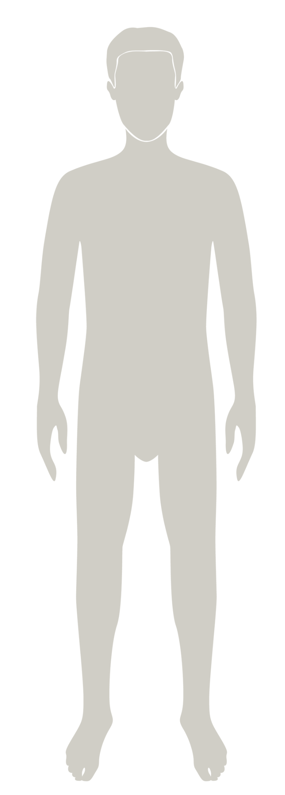

Introducing teenMEN
is a health program that will help you understand your body & your health as you grow to full maturity.
You will learn about:
✔️the reproductive system
✔️the physical and emotional changes
of puberty
✔️ the importance of your choices now and for your future.
Notes:
Maturity means the growth and full development of the body, brain, and emotions. In other words, it’s a time when your life takes off and you start to mature towards adulthood. We are going to learn in this class what this looks like for your body and for your health. Most of this growth and development you don’t control. But maturity also means taking responsibility for the things you can control: your choices and how you respond to situations in your life. With this icebreaker, you actually all grew in maturity! You used your body, brain and emotions to think about the kind of qualities or habits that you admire in another person. This kind of mature thinking is the first stopover on the path to becoming an excellent person, yourself.
teenMEN is a health program that will help you learn about your body and also yourself. In this class you will learn about your hormones, your reproductive system, the physical and emotional changes of puberty, and how the choices you make now will impact your life as you grow to full maturity.

Slide 4
Puberty
Puberty is a time when your body is maturing.
You will notice:
shoulders and muscles develop
you get taller
your voice deepens
increased body hair growth
You may also notice acne, fatigue, body odour and mood changes.
© FEMM
Notes:
Puberty is a time of rapid physical growth, brain development and maturation. Puberty usually happens between ages 10 and 17 years (between ages 9 and 14 years for a girl). Initially, you may notice that you are getting taller, your voice is deepening, there is increased body hair growth and changing of your body shape as your shoulders and muscles develop. You may also experience acne, fatigue, increased sweat and odor, and moodiness.

Slide 5
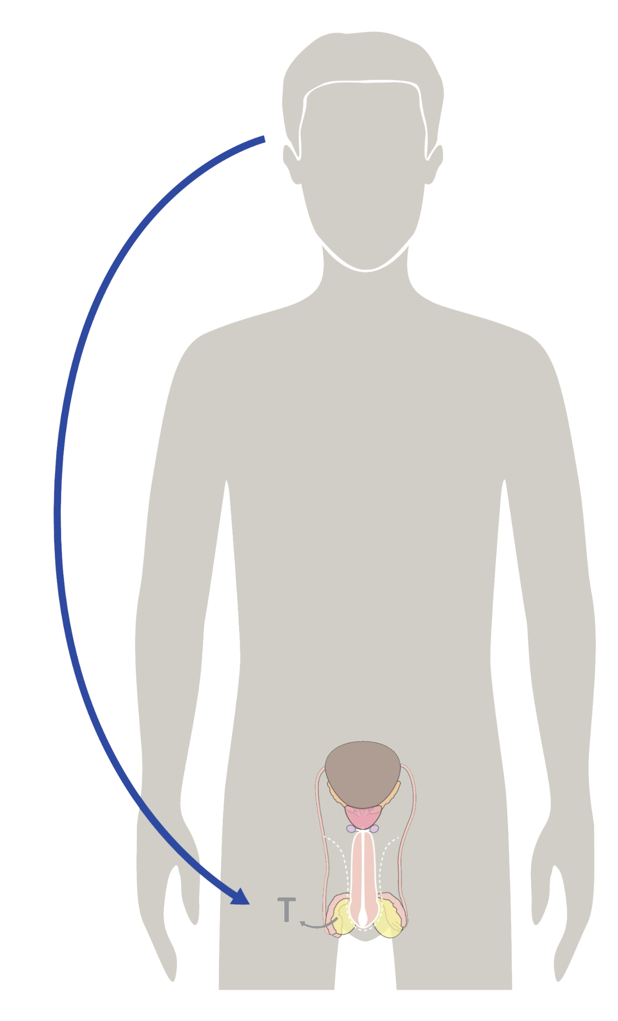
Puberty & Hormones
Hormones have a BIG role to play in puberty.
Hormones keep our body functioning at its best.
© FEMM
Notes:
During puberty, multiple organ systems and major changes in the central nervous system impact your emotional behavior as well. Hormones are powerful and they play a big role in puberty. Next to infancy, puberty is the second most rapid period of growth in the life of a human being.
5

Slide 6
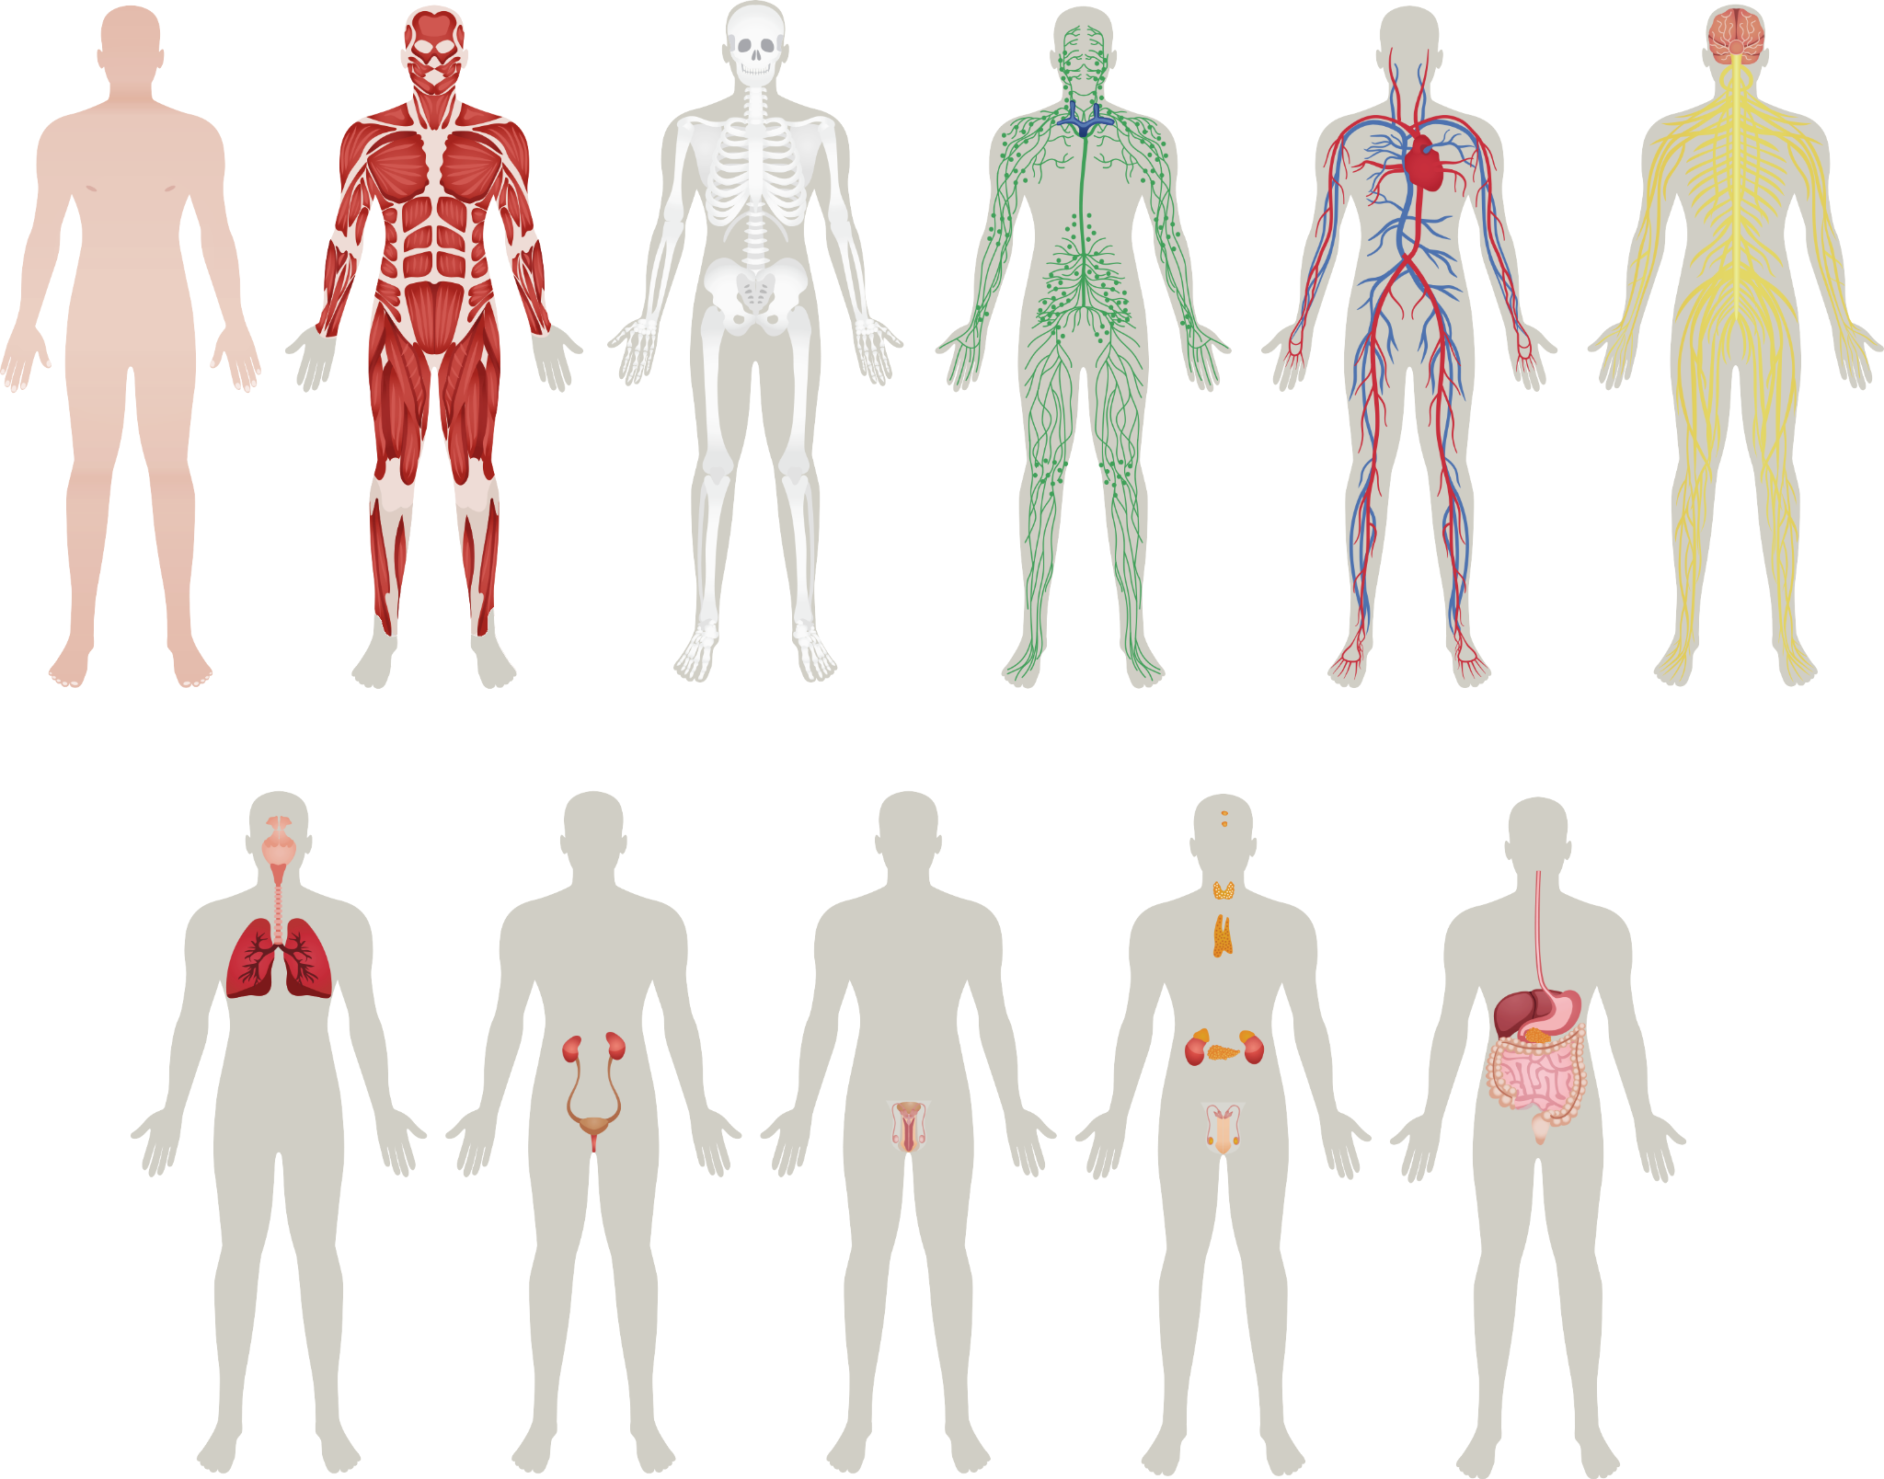
Body Systems
When organs work together for a similar purpose, this is called a system.
Your body has many systems, all working together to make sure you are at peak health!
© FEMM
Notes:
Step 2 (15 minutes): The reproductive system + other body systems
The human body is amazing. Let’s talk about some of the basics of the body’s systems.
Your body is composed of cells that are organized into tissues, organs, and organ systems.
When many organs work together for a similar purpose, we call this a body system. Today we will look at nine of the body’s systems:

Slide 7
The Musculoskeletal System(s)
Look
at all of
these muscles you have in your body!
muscular system
skeletal system
© FEMM
Notes:
The muscular system and the skeletal system are sometimes called the musculoskeletal system. We sometimes put them into one system because they are so closely linked! Muscles, bones, and joints are attached to each other by different tissues. Ligaments are found at your joints, and their job is to hold bones together. Tendons are found at the ends of muscles, and their job is to connect muscles to bones. When you tighten a muscle, your tendon pulls the bone to which it’s attached. So, when you kick a soccer ball, the tendons in your legs have to do a lot of work to make that one motion!

Slide 8
The Nervous System
There are over
SEVEN TRILLION nerves in your body!
… Technically, that makes you a Trillionaire!
nervous system
© FEMM
Notes:
The nervous system controls everything you do, including breathing, walking, thinking, and feeling. This system is made up of your brain, spinal cord, and all of the nerves of your body. The brain is the control center and the spinal cord is the major highway to and from the brain. The nerves carry the messages to and from the body, so the brain can interpret them and take action. At your age, your nervous system is still maturing. That’s why you’re not yet allowed to do all of the things that you will one day be able to do, like drive a car.

Slide 9
The Respiratory System
Our brain controls how fast our lungs draw in air.
When we exercise, our brain tells our lungs to work faster.
When we’re sleeping or
resting, our lungs slow down
for their rest.
😮‍💨
respiratory system
© FEMM
Notes:
The respiratory system consists of the airways, the lungs and the respiratory muscles that move air into and out of the body. For example, if you do a lot of running for your sport or are on the cross-country team, you will actually get better at breathing! Your body adapts and gives you more of the things you need to transport oxygen around your body and to your muscles.

Slide 10
The Digestive System
Food is moved through the body by a series of muscle contractions.
Food goes down the esophagus
into the stomach
then the small intestine (nutrients in the food are absorbed into the blood here)
then the large intestine
where waste is produced, before exiting the body
🍊🍌🍇🥝🍅🥑🥦🌽🍞🍳🧀🥩🍗🍝🍱🍚🥛🍲
🍰🍛🍕🥨🥪🥘
Being a couch potato negatively impacts your digestion!
digestive system
© FEMM
Notes:
The digestive system consists of a group of connected organs—the mouth, pharynx, esophagus, stomach, small and large intestines, and anus. Through these structures, food is processed via mechanical and chemical action into usable nutrients and expendable waste. It is important to eat enough fiber to keep everything moving along well in your digestive system. Fiber is found in things like fruits and vegetables. Movement helps your body to use the food you eat for energy and growth. Drinking lots of water is also important to keep things moving in your digestive system!

Slide 11
The Cardiovascular System
From Greek kardia ‘heart’
Now you know a word in Greek!
I drop around 10,000 beats per day and my surround Circulatory System pumps about five litres of blood.
cardiovascular system
© FEMM
Notes:
The circulatory system is made up of blood vessels that carry blood away from and towards the heart. Arteries carry blood away from the heart and veins carry blood back to the heart. The circulatory system carries oxygen, nutrients, and hormones to cells, and removes waste products, like carbon dioxide. When you weight train or do cardio exercise (like running) you also improve the way your cardiovascular system works, by training your heart and blood vessels to work more effectively.

Slide 12
The Urinary System
Did you know?
The bladder can store up to 500 ml of urine in women and 700 ml in men.
For men, that’s two full bottles of Gatorade in there!
urinary system
© FEMM
Notes:
The various activities of the body create waste by-products that must be expelled in order to maintain health. To excrete certain fluid wastes, the body has a specialized filtering and recycling system known as the urinary system.

Slide 13
The Reproductive System
Testosterone is the hormone that causes boys to develop deeper voices, bigger muscles, and body and facial hair.
Testosterone is produced
in the testicles.
Your Reproductive System
is important for your hormonal
and overall health!
reproductive system
© FEMM
Notes:
The reproductive system is responsible for bringing about a new life. In boys it includes the testes, scrotum, penis, and all the tubes through which sperm travels. In girls, it includes the ovaries, fallopian tubes, the uterus, and vagina. The reproductive system is also in charge of producing testosterone and other hormones responsible for all of the growth and changes during puberty.

Slide 14
The Endocrine System
HORMONES!
Hormones control lots of body functions, such as: growth, development, metabolism,
mood … and more!
hypothalamus
+ pituitary
thyroid
endocrine glands send out hormones into the blood
adrenals
testes
endocrine system
© FEMM
Notes:
The endocrine system: controls and regulates body processes by means of chemical messengers called hormones. The system is composed of a group of ductless glands located throughout the body that produce hormones in response to the body’s needs. Once released, hormones may act on nearby structures, or they may travel in the blood to distant target organs. Hormones act like text messages in the body. So, your brain might send a text to your thyroid gland to let it know that it’s time to do its thing. “Hey, thyroid, can you get moving?”

Slide 15
Healthy body
Healthy body
The body is made up of systems.
The health of every system impacts
the health of the whole body.
Notes:
Your whole body is made up of many parts. Each part has its own important job to do. When certain parts work together for a similar purpose, they are called a system.
Your body has several systems, all working together to make sure you function well. Can anyone name a system in the body?

Slide 16
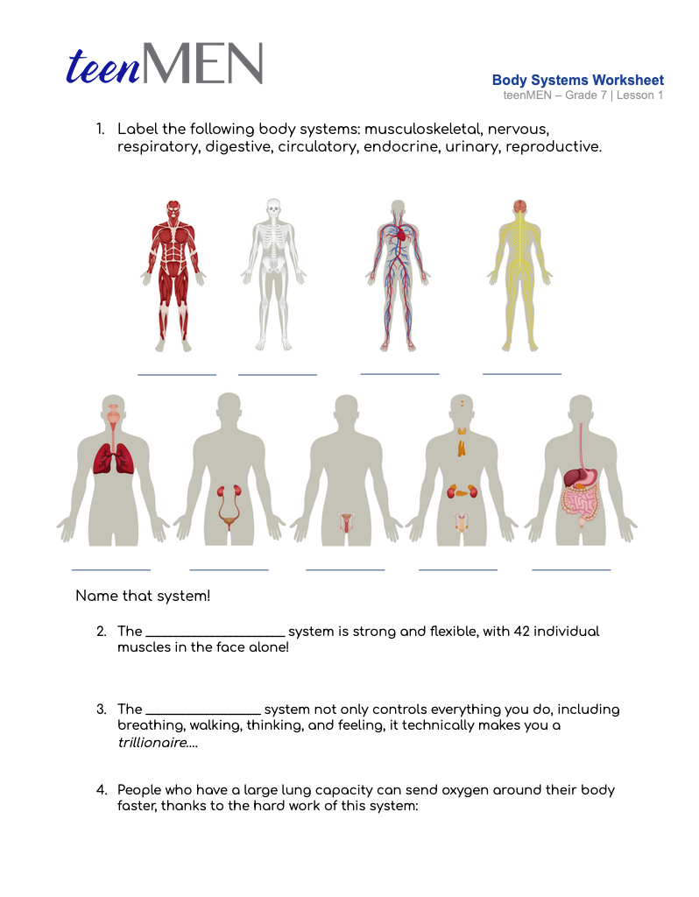
Body Systems Worksheet
Notes:
Hand out the Worksheet: Body Systems to students to complete. When students are finished, review the answers together with the following slides or the Teacher’s Answer Key provided in the materials.

Slide 17
Answers | Body Systems Worksheet
Muscular
Skeletal
Circulatory
Nervous
Respiratory
Urinary
Reproductive
Endocrine
Digestive

Slide 18
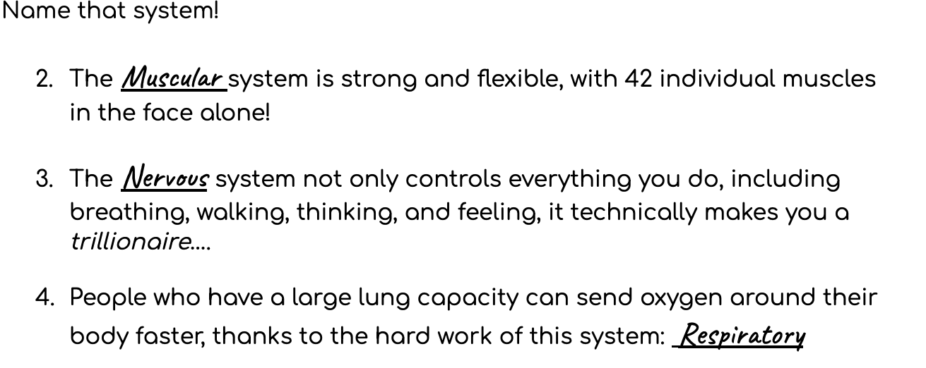
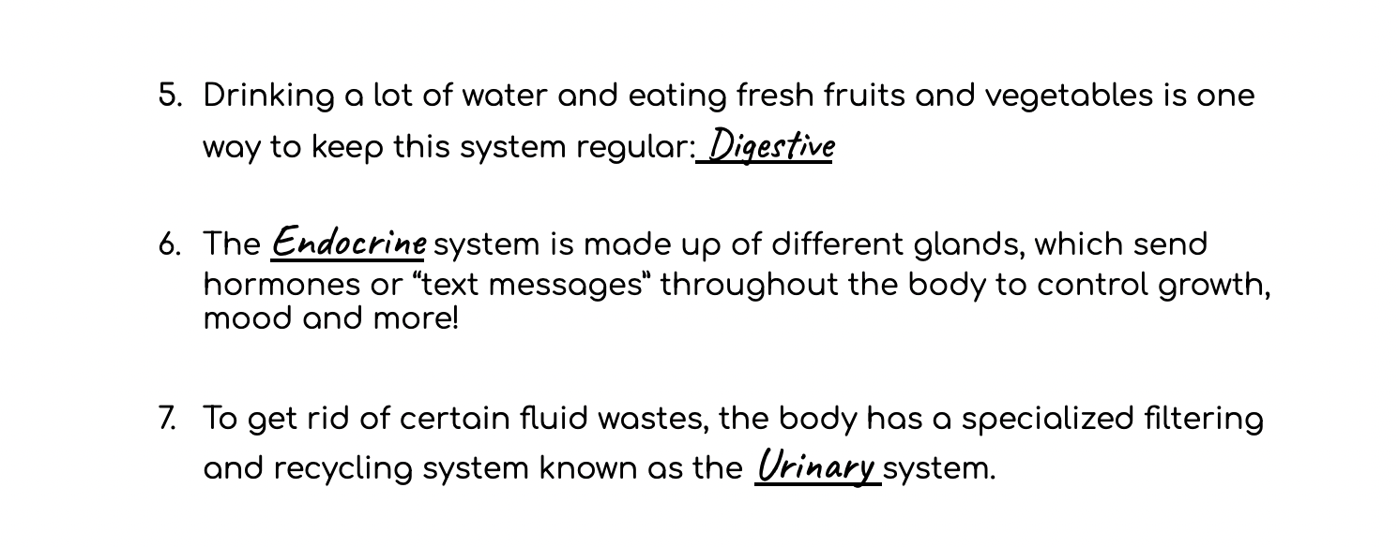
Answers | Body Systems Worksheet

Slide 19
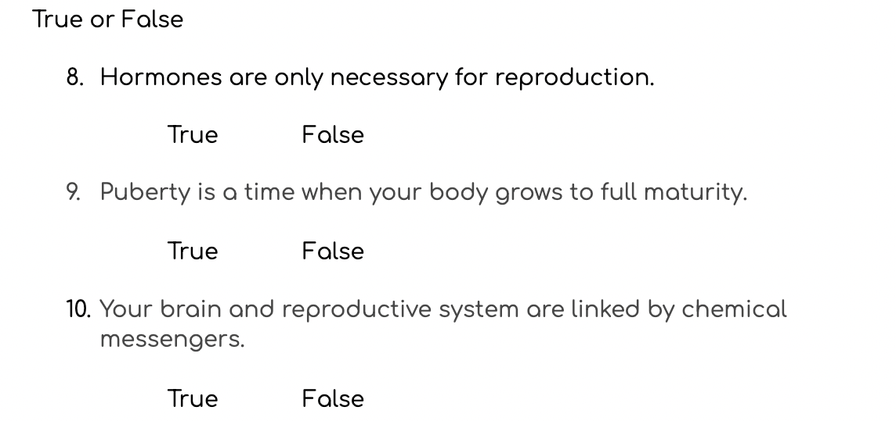
Answers | Body Systems Worksheet

Slide 20
Review
All body systems are important for your overall growth and health.
Your brain and reproductive system are linked by chemical messengers called hormones.
Puberty is a time of rapid growth when your body grows towards full maturity.
© FEMM
Notes:
CONCLUSION
Puberty is a time of rapid development, when your body grows towards full maturity. The proper functioning of all of your body systems is important, including your reproductive system. The maturation of the reproductive system is especially important during puberty as that’s where the main male hormone, testosterone is produced. We’ll learn more about the reproductive system in the next lesson.

Slide 21
Grade 7
LESSON 1
© FEMM

