Slide 1

Grade 7
LESSON 2
© FEMM

Slide 2
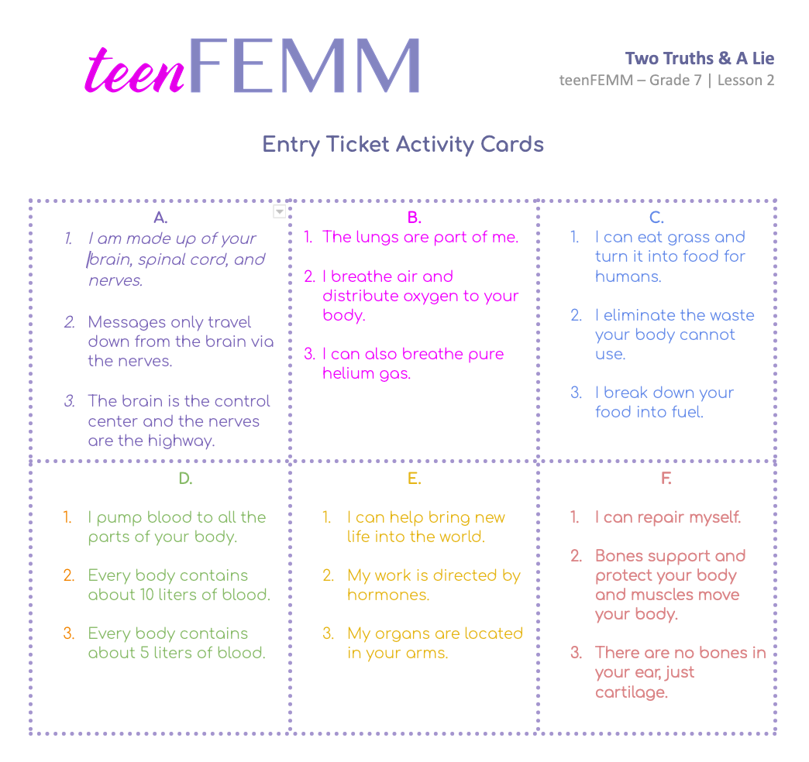
Two Truths & A Lie!
Entry Ticket Activity
Notes:
PROCEDURE
Cut out the Entry Ticket Activity cards before class.
Step 1 (5 minutes): Entry Ticket Activity - Two Truths and a Lie
Hand out the 9 Entry Ticket Activity cards to different students. Have students read the statements on their card aloud, while the rest of the students guess: 1) which body system the card refers to and 2) which two statements are true and which statement is the lie. Review answers as you go, using the Teacher’s Answer Key provided in the materials.

Slide 3
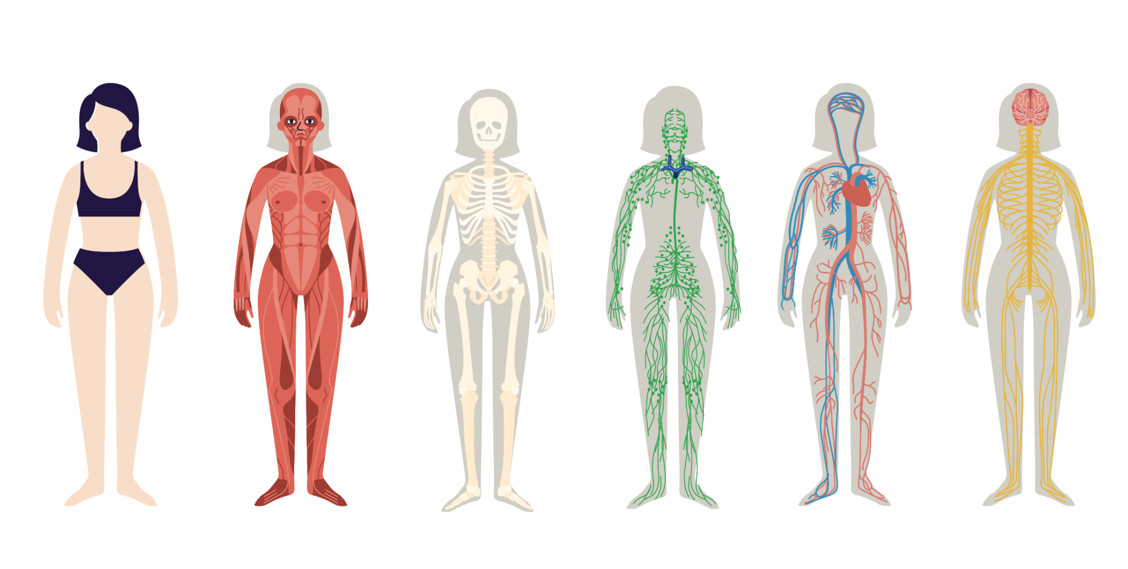
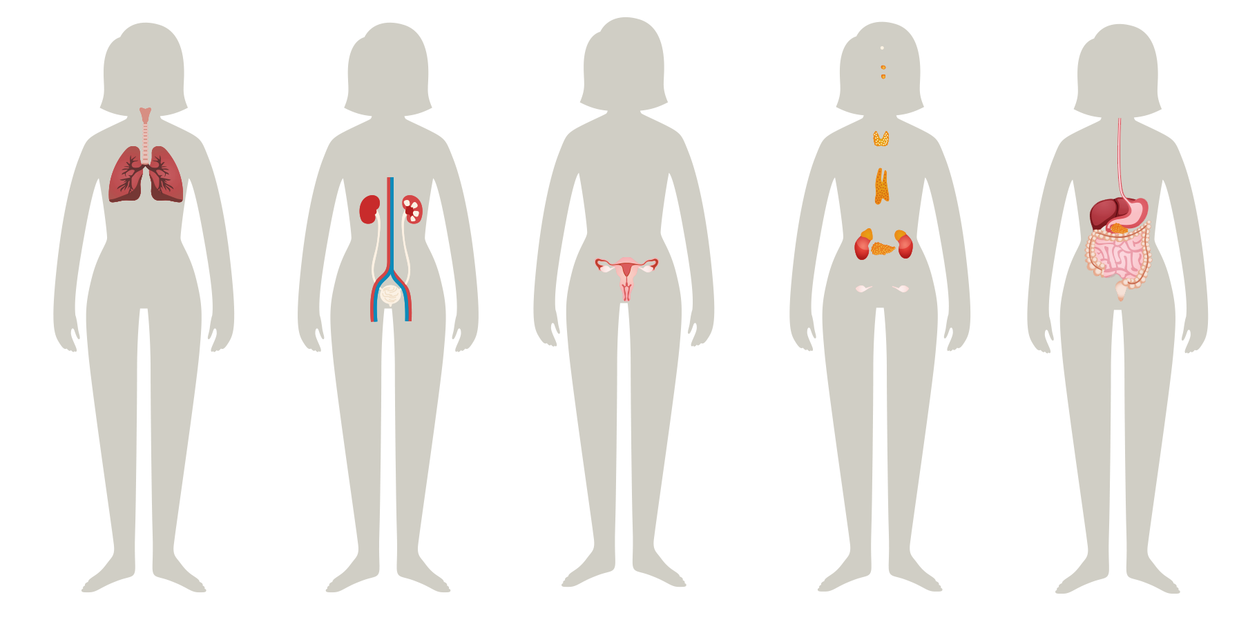
Body Systems
Muscular
Skeletal
Circulatory
Nervous
Respiratory
Urinary
Reproductive
Endocrine
Digestive
Notes:
Step 2 (10 minutes): Review Nine Body Systems, Hormones and Puberty
The body is made up of several systems, all working together to make sure the body functions well.
Do you remember the names of the different body systems we learned about last class? Ask students if they can name the 9 body systems covered in the previous lesson. (On the slide, click the blank line under each image for the answer to appear.)
Who can describe the job of these three systems:
Respiratory system: provides breath to keep us alive.
Digestive system: processes the food we eat and helps us to absorb nutrients so our body can grow. The digestive system expels waste through the anus.
Circulatory system: sends oxygen from the lungs, and nutrients from food, to all parts of the body.

Slide 4
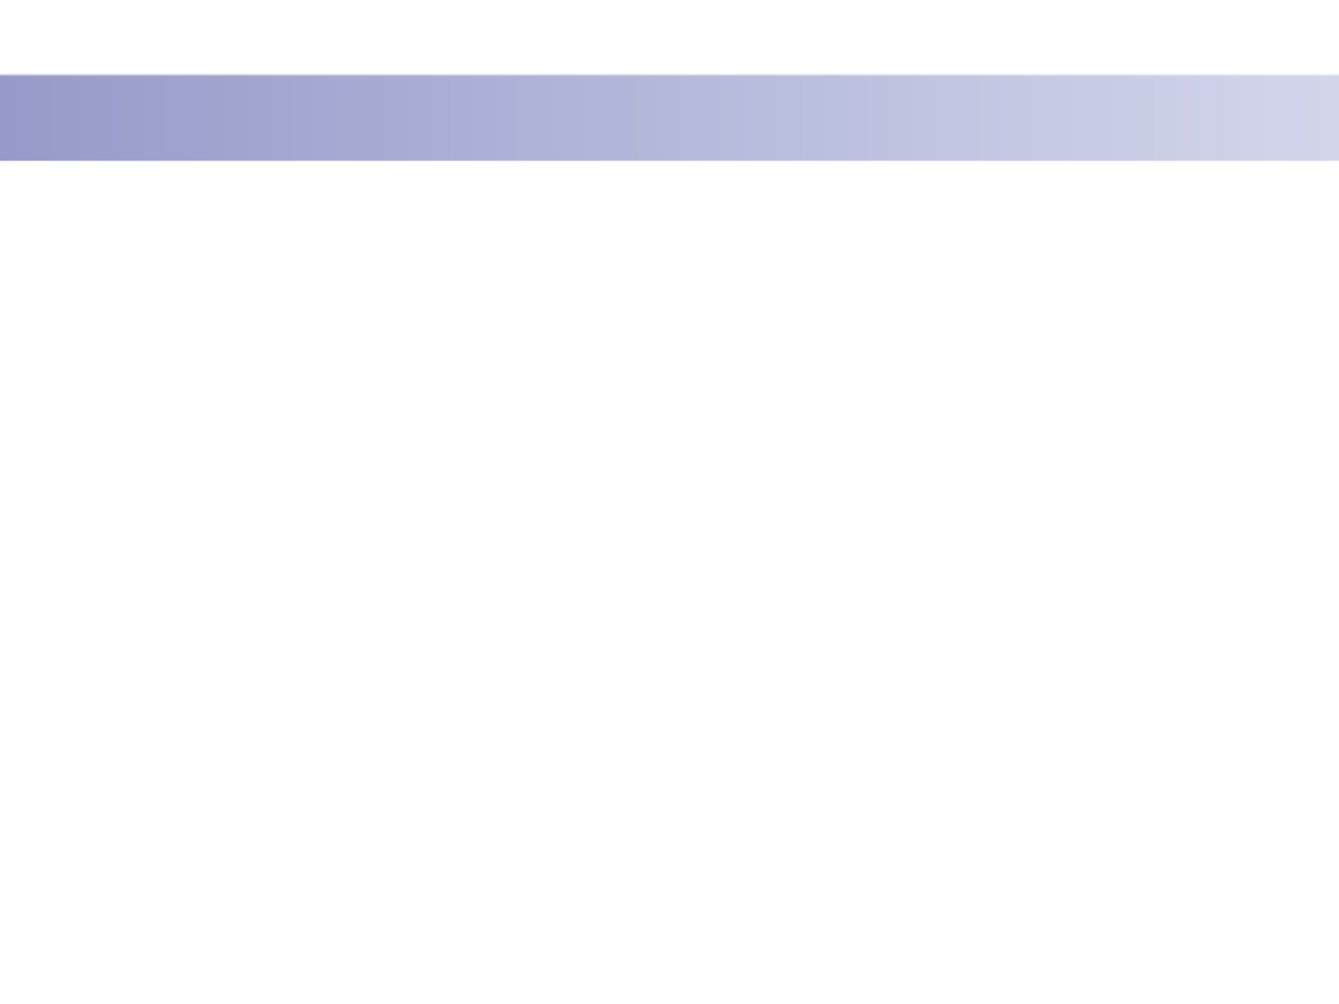
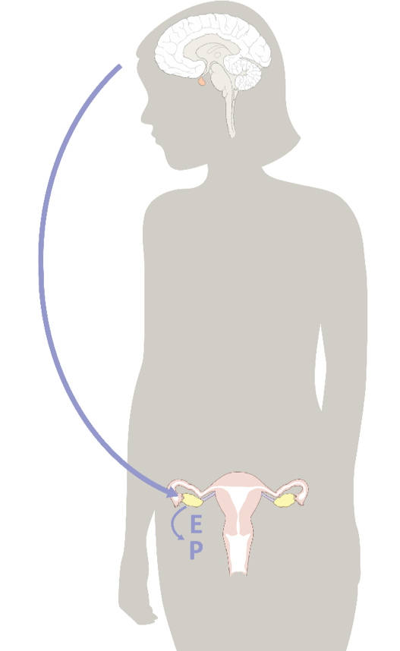
What do all body systems need?
Signals from the brain
Hormones!
© FEMM
Notes:
What do all these body systems need in order to do their own particular jobs well, and to work together properly? They need clear signals from the brain. What are these signals called? (Allow the students to answer “hormones.”)
The endocrine system is responsible for releasing hormones into your bloodstream so they can travel to the different systems in your body. The endocrine system is intricate, managing when and how much of each hormone to release. The endocrine system works together with the nervous system to control almost all of your body’s processes.
As you grow and mature, your brain sends hormonal signals to the different systems and parts of the body to direct all of the changes your body needs to undergo in puberty. It is very normal for girls your age to be feeling a lot of feelings and experience more intense emotions as a result of the many hormonal changes your body is going through in puberty. It’s important to remember that puberty is a normal, healthy and hugely important stage of development for you as your brain and body are doing amazing things!

Slide 5
Reproductive Anatomy
Reproductive
Anatomy
Female
© FEMM
Notes:
Step 3 (15 minutes): Female Reproductive Anatomy + Coloring Worksheet
Let’s take a look at the different parts of the reproductive system, so that we can learn about the fascinating link between the brain, hormones and overall health.

Slide 6
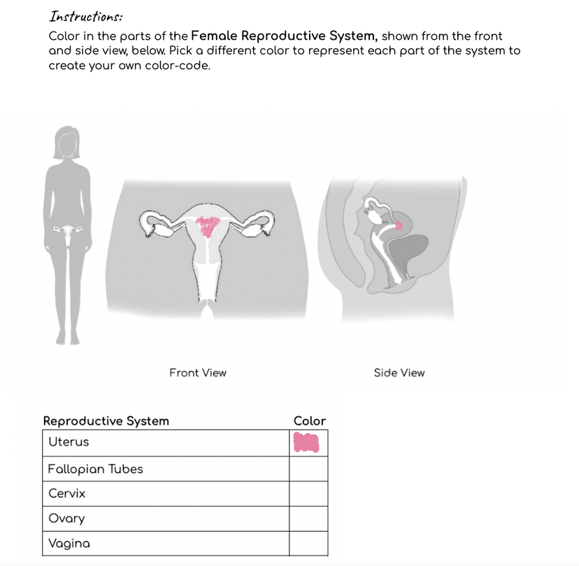
Worksheet
Female Reproductive System Anatomy
Coloring
Notes:
Hand out the Anatomy Coloring Worksheet to students. As you review the parts of the female reproductive system aloud with the class, have students color in the parts of the reproductive system on the Anatomy Coloring Worksheet.

Slide 7
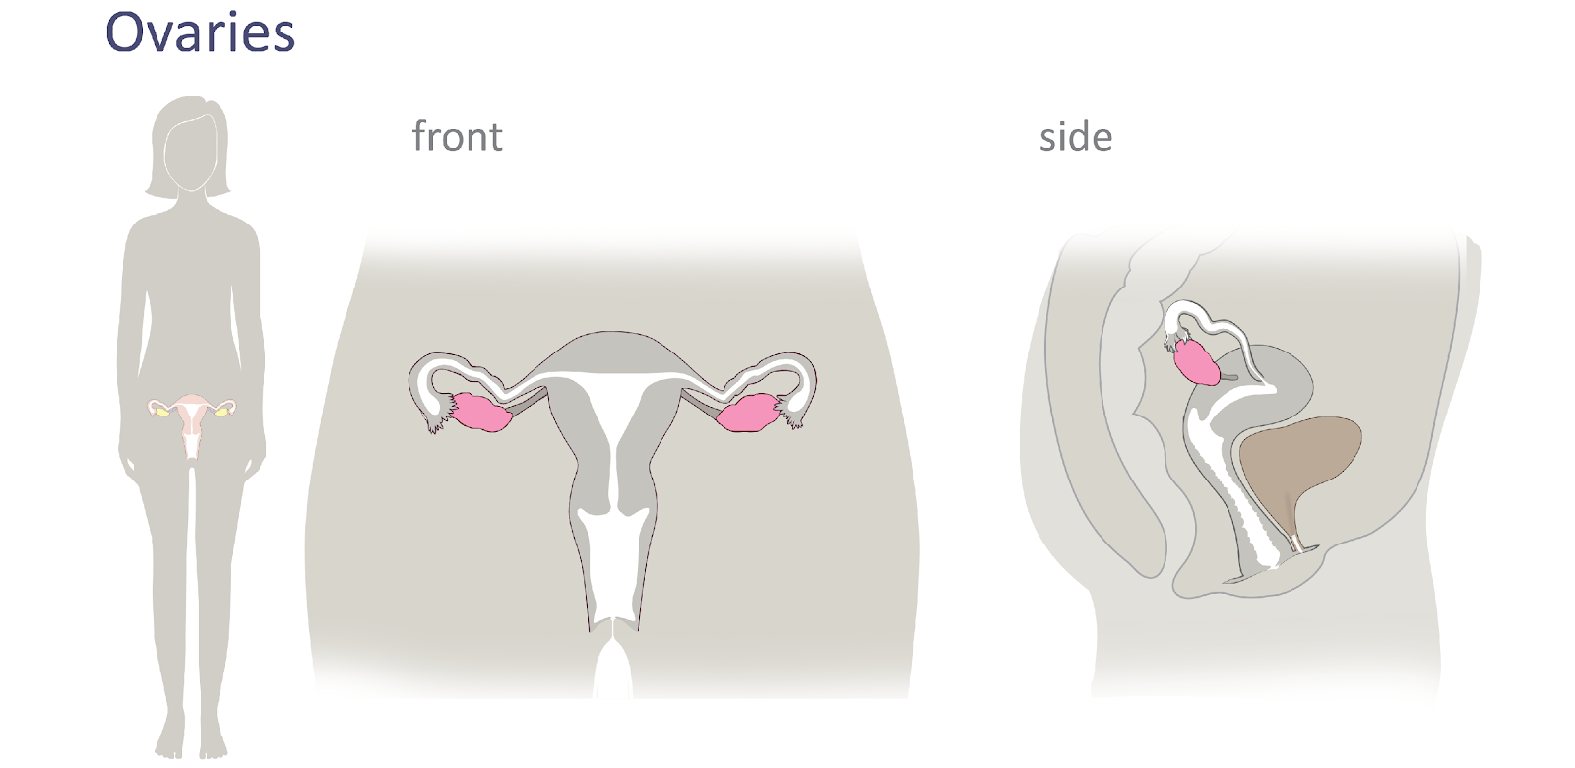
Female Reproductive Anatomy
© FEMM
Notes:
In this first slide, you can see where the reproductive organs are located in the body, around the pelvis area.
The ovaries are two small organs that sit on either side of the uterus and they are about the size of almonds. They are highlighted in pink on the slide. The ovaries take turns; each month one is responsible for developing and releasing an egg. The egg is the female cell of reproduction. The woman’s ovaries store her eggs from birth. As of puberty, each month, inside an ovary, an egg matures to the size of a pinhead and is eventually released from the ovary in a hormonal health process called ovulation. Ovulation is very important for a woman’s health as it indicates that all of the female hormones are working together and functioning properly. We will learn more about this in the next lessons.

Slide 8
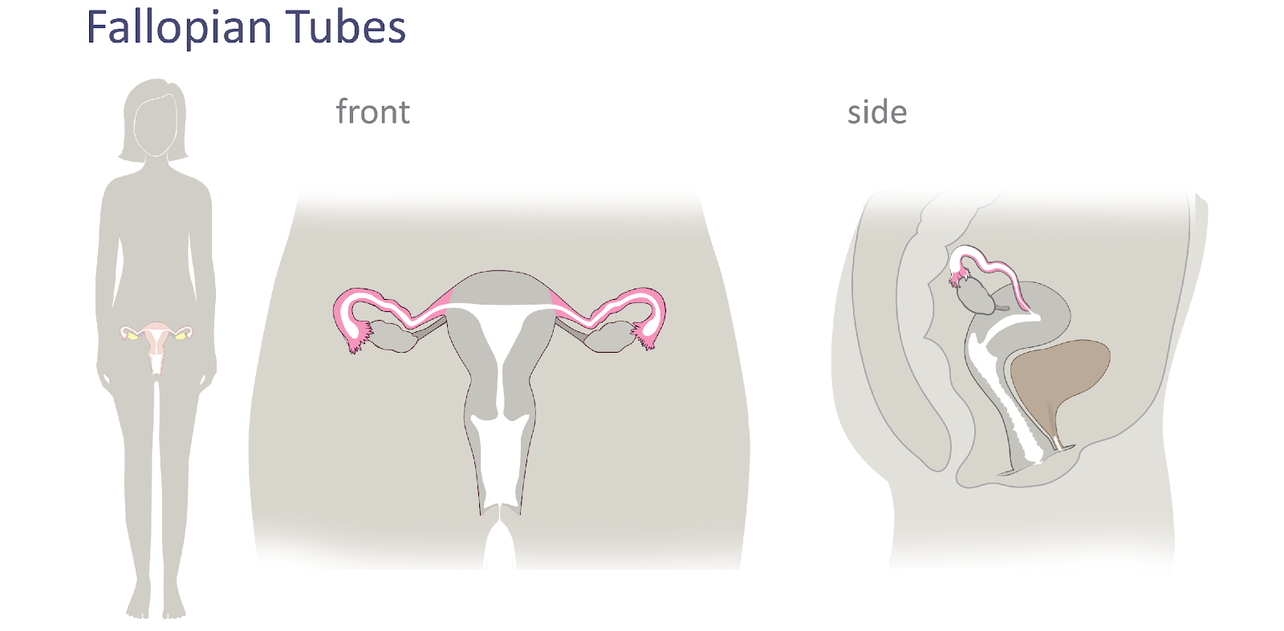
Female Reproductive Anatomy
© FEMM
Notes:
The fallopian tubes are the long thin tubes that are connected to either side of the ovary, providing a way for the egg to travel from the ovary into the uterus. They are about the width of a spaghetti noodle.

Slide 9
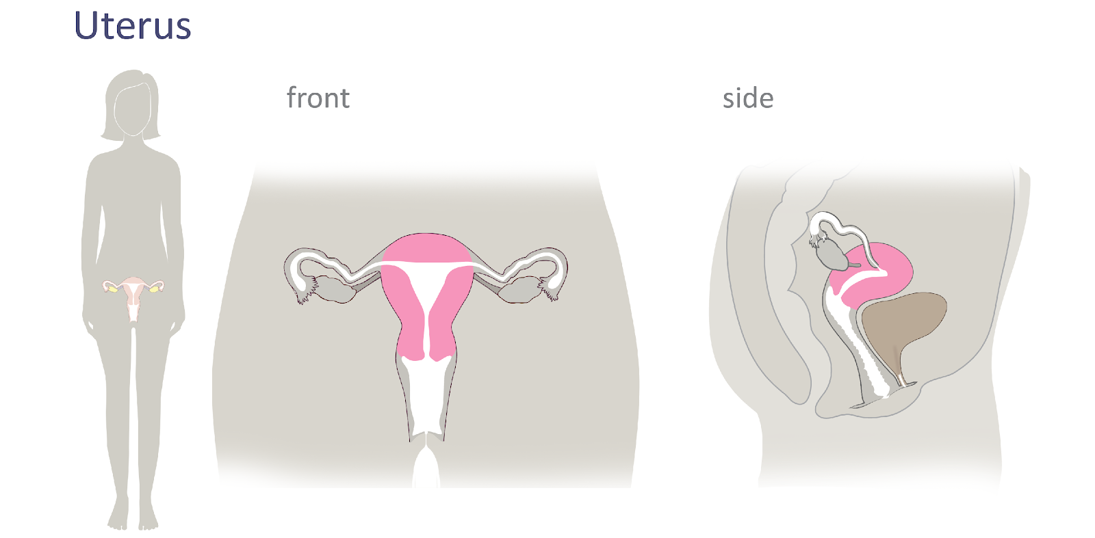
Female Reproductive Anatomy
© FEMM
Notes:
In the front view, you can see the uterus in the center. Without the uterus, none of us would be here! The uterus is the hollow, pear shaped organ in which a baby can grow and develop. By weight, the uterus is the strongest muscle in your body! It can also increase in size to accommodate a baby in pregnancy.
The lining of the uterus is called the endometrium. This mucus membrane lining responds to your hormones each month to thicken in preparation for a possible future pregnancy. When a woman becomes pregnant, the baby attaches to this lining to receive the nourishment it needs to grow. The endometrium (the lining of the uterus) breaks down at the end of each cycle and sheds, in a woman’s period or menstruation.

Slide 10
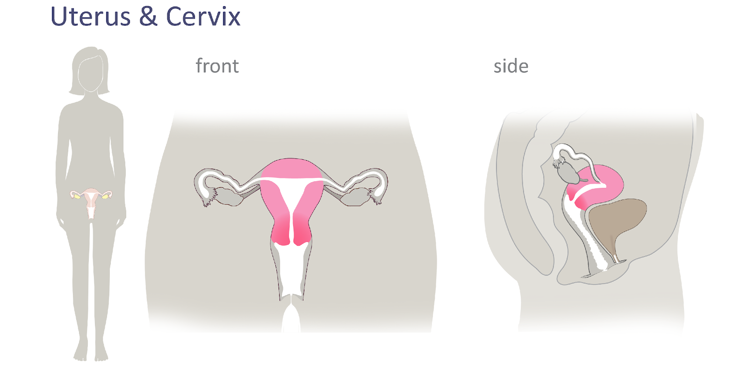
Female Reproductive Anatomy
© FEMM
Notes:
The cervix is the canal or opening at the base of the uterus that connects to the vagina.

Slide 11
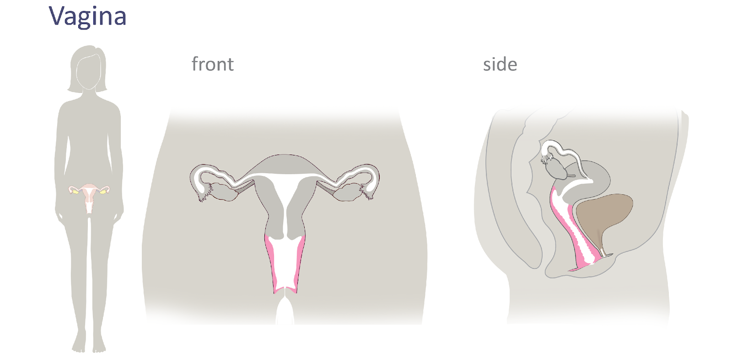
Female Reproductive Anatomy
© FEMM
Notes:
The vagina is the canal that connects the uterus to the outside of the body. It is the entrance to the reproductive organs and the exit for the delivery of a baby. It is also sometimes referred to as the birth canal.
The organ in brown is the bladder. The bladder is not part of the reproductive system, which is why you didn’t color it in, but rather part of the urinary system. The urethra is the tube that carries the urine from the bladder to the outside of the body as we go to the bathroom. The urethra is easy to remember as being part of the urinary system because both deal with urine.

Slide 12
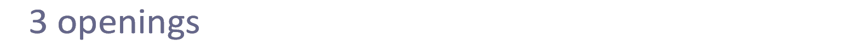
Female Reproductive Anatomy
Urethra
Vagina
Anus
Vagina
© FEMM
Notes:
The opening behind the vagina is the anus. The anus is part of the digestive system. It is the opening for waste to exit the digestive tract.
The proximity of these three openings is significant for women as it increases the risk of bacteria transfer. When using the bathroom, it is important to always wipe from front (urethra) to back to avoid introducing bacteria from the digestive system into the vagina and/or urethra.
In the final anatomy slide, point out the 3 openings to the body in the side image:
vagina: opens to the reproductive system
urethra: opens to the tube carrying urine from the bladder
anus: opens for waste to exit from the digestive system

Slide 13
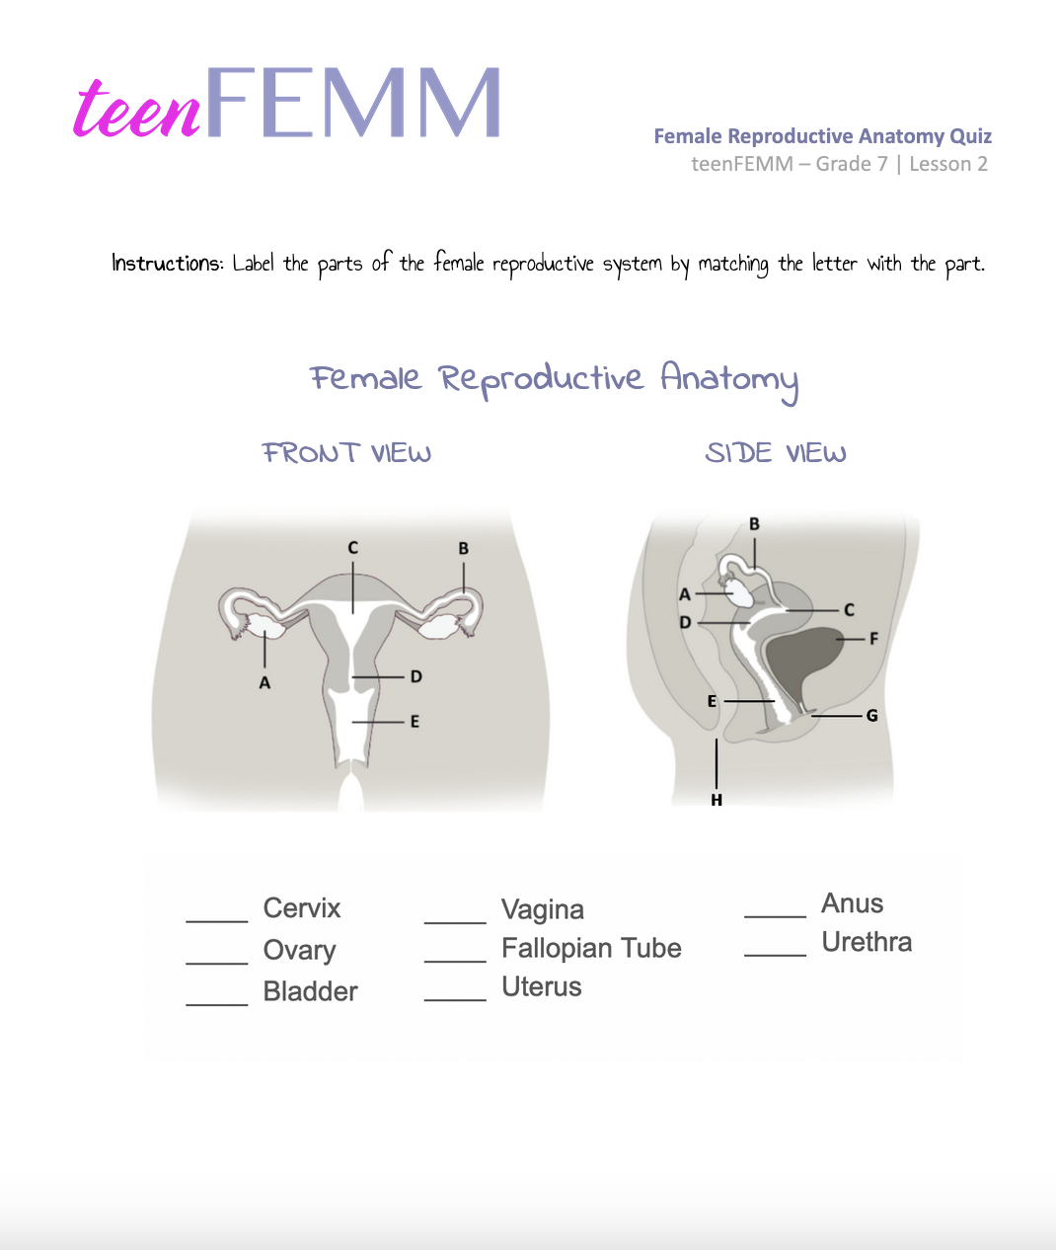
Female Reproductive Anatomy Quiz
How well do you know your body?
Quiz!
Notes:
Step 4 (5 minutes): Anatomy Quiz
Hand out the Female Reproductive Anatomy Quiz to students. Give students a few minutes to identify the parts of the female reproductive system, matching the letter to the part.

Slide 14
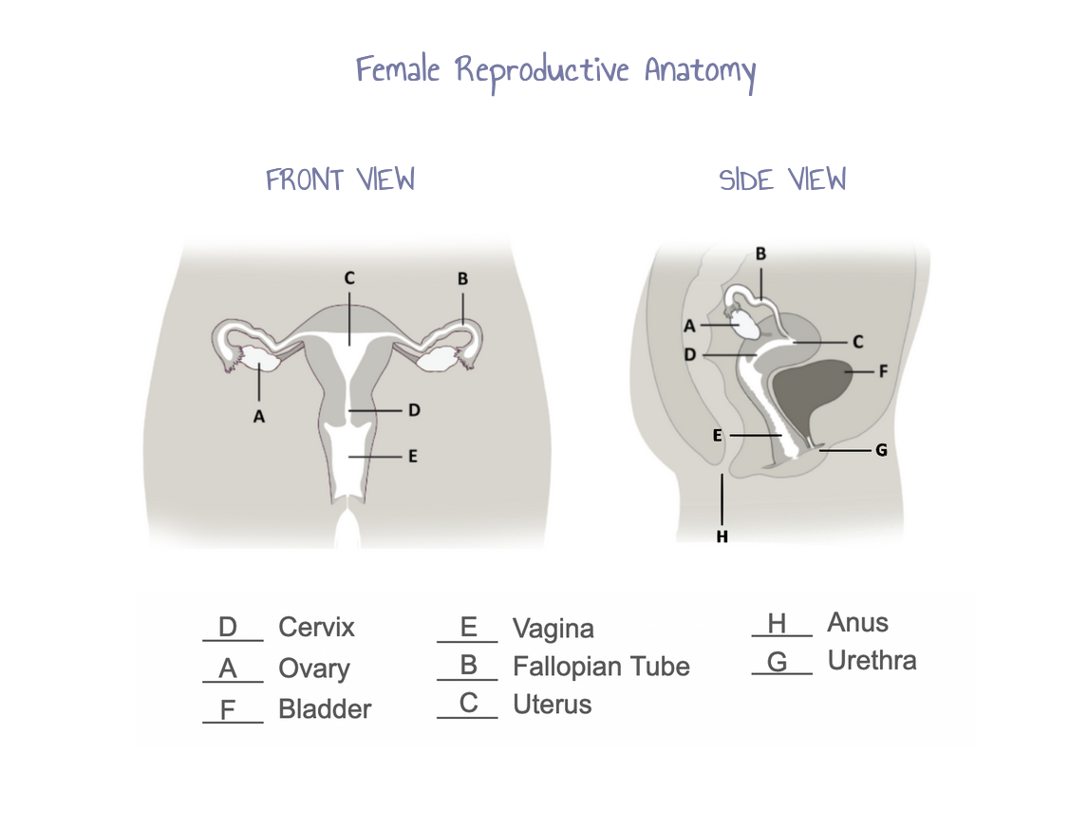
Answers | Female Reproductive Anatomy Quiz
Check your answers!
How did YOU do?
© FEMM
Notes:
After students have completed the anatomy quiz, check answers with the following slide or with the Answer Key provided in the materials.

Slide 15
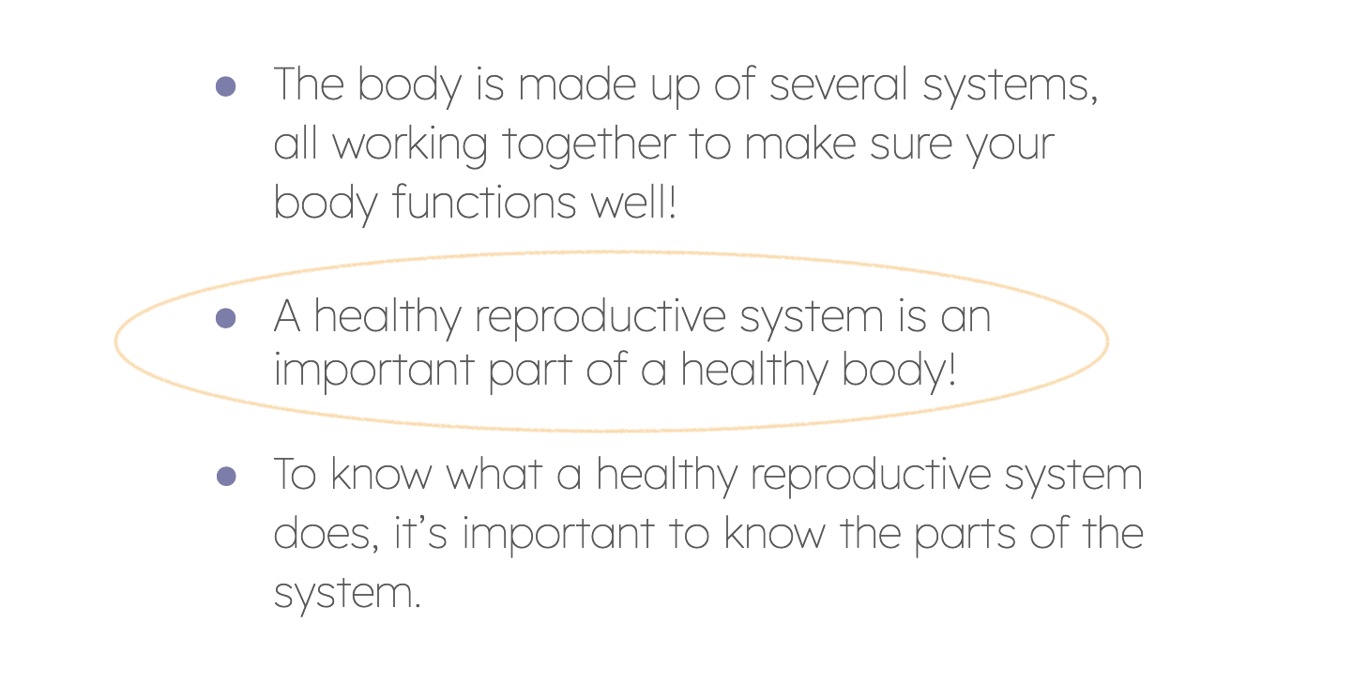
Review!
© FEMM
Notes:
CONCLUSION
Next lesson we’ll talk more about the processes that occur each month in the female reproductive system, and the hormones that direct this process. To conclude the lesson, give students the Written Response Worksheet to complete as homework.

Slide 16
Grade 7
LESSON 2
© FEMM

