Slide 1

Grade 7
LESSON 2
© FEMM

Slide 2
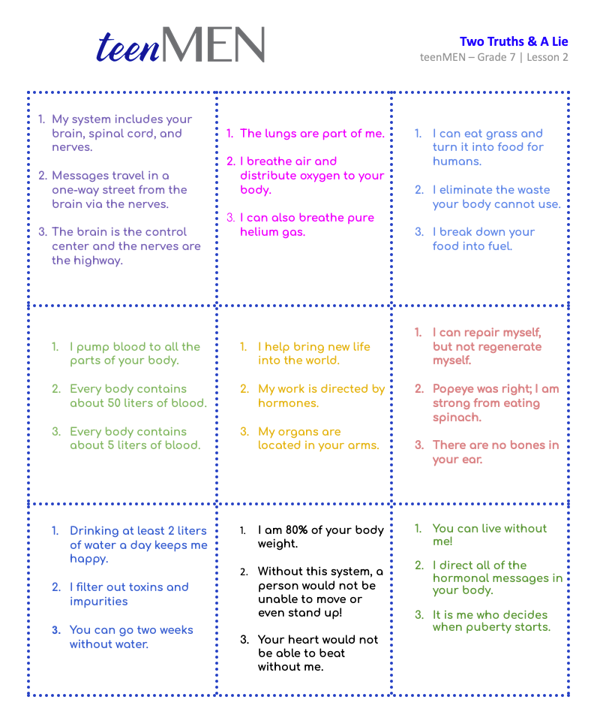
Two Truths & A Lie
Entry Ticket Activity
Notes:
PROCEDURE
Print and cut out the Entry Ticket Activity cards, before class.
Step 1 (5 minutes): Entry Activity: Two Truths & A Lie
Hand out each of the nine cards to students. Have each student read the statements on the card aloud, while the rest of the class must guess which body system the statements refer to and of the three statements, which is the lie. Use the Teacher’s Answer Key provided in the materials.

Slide 3
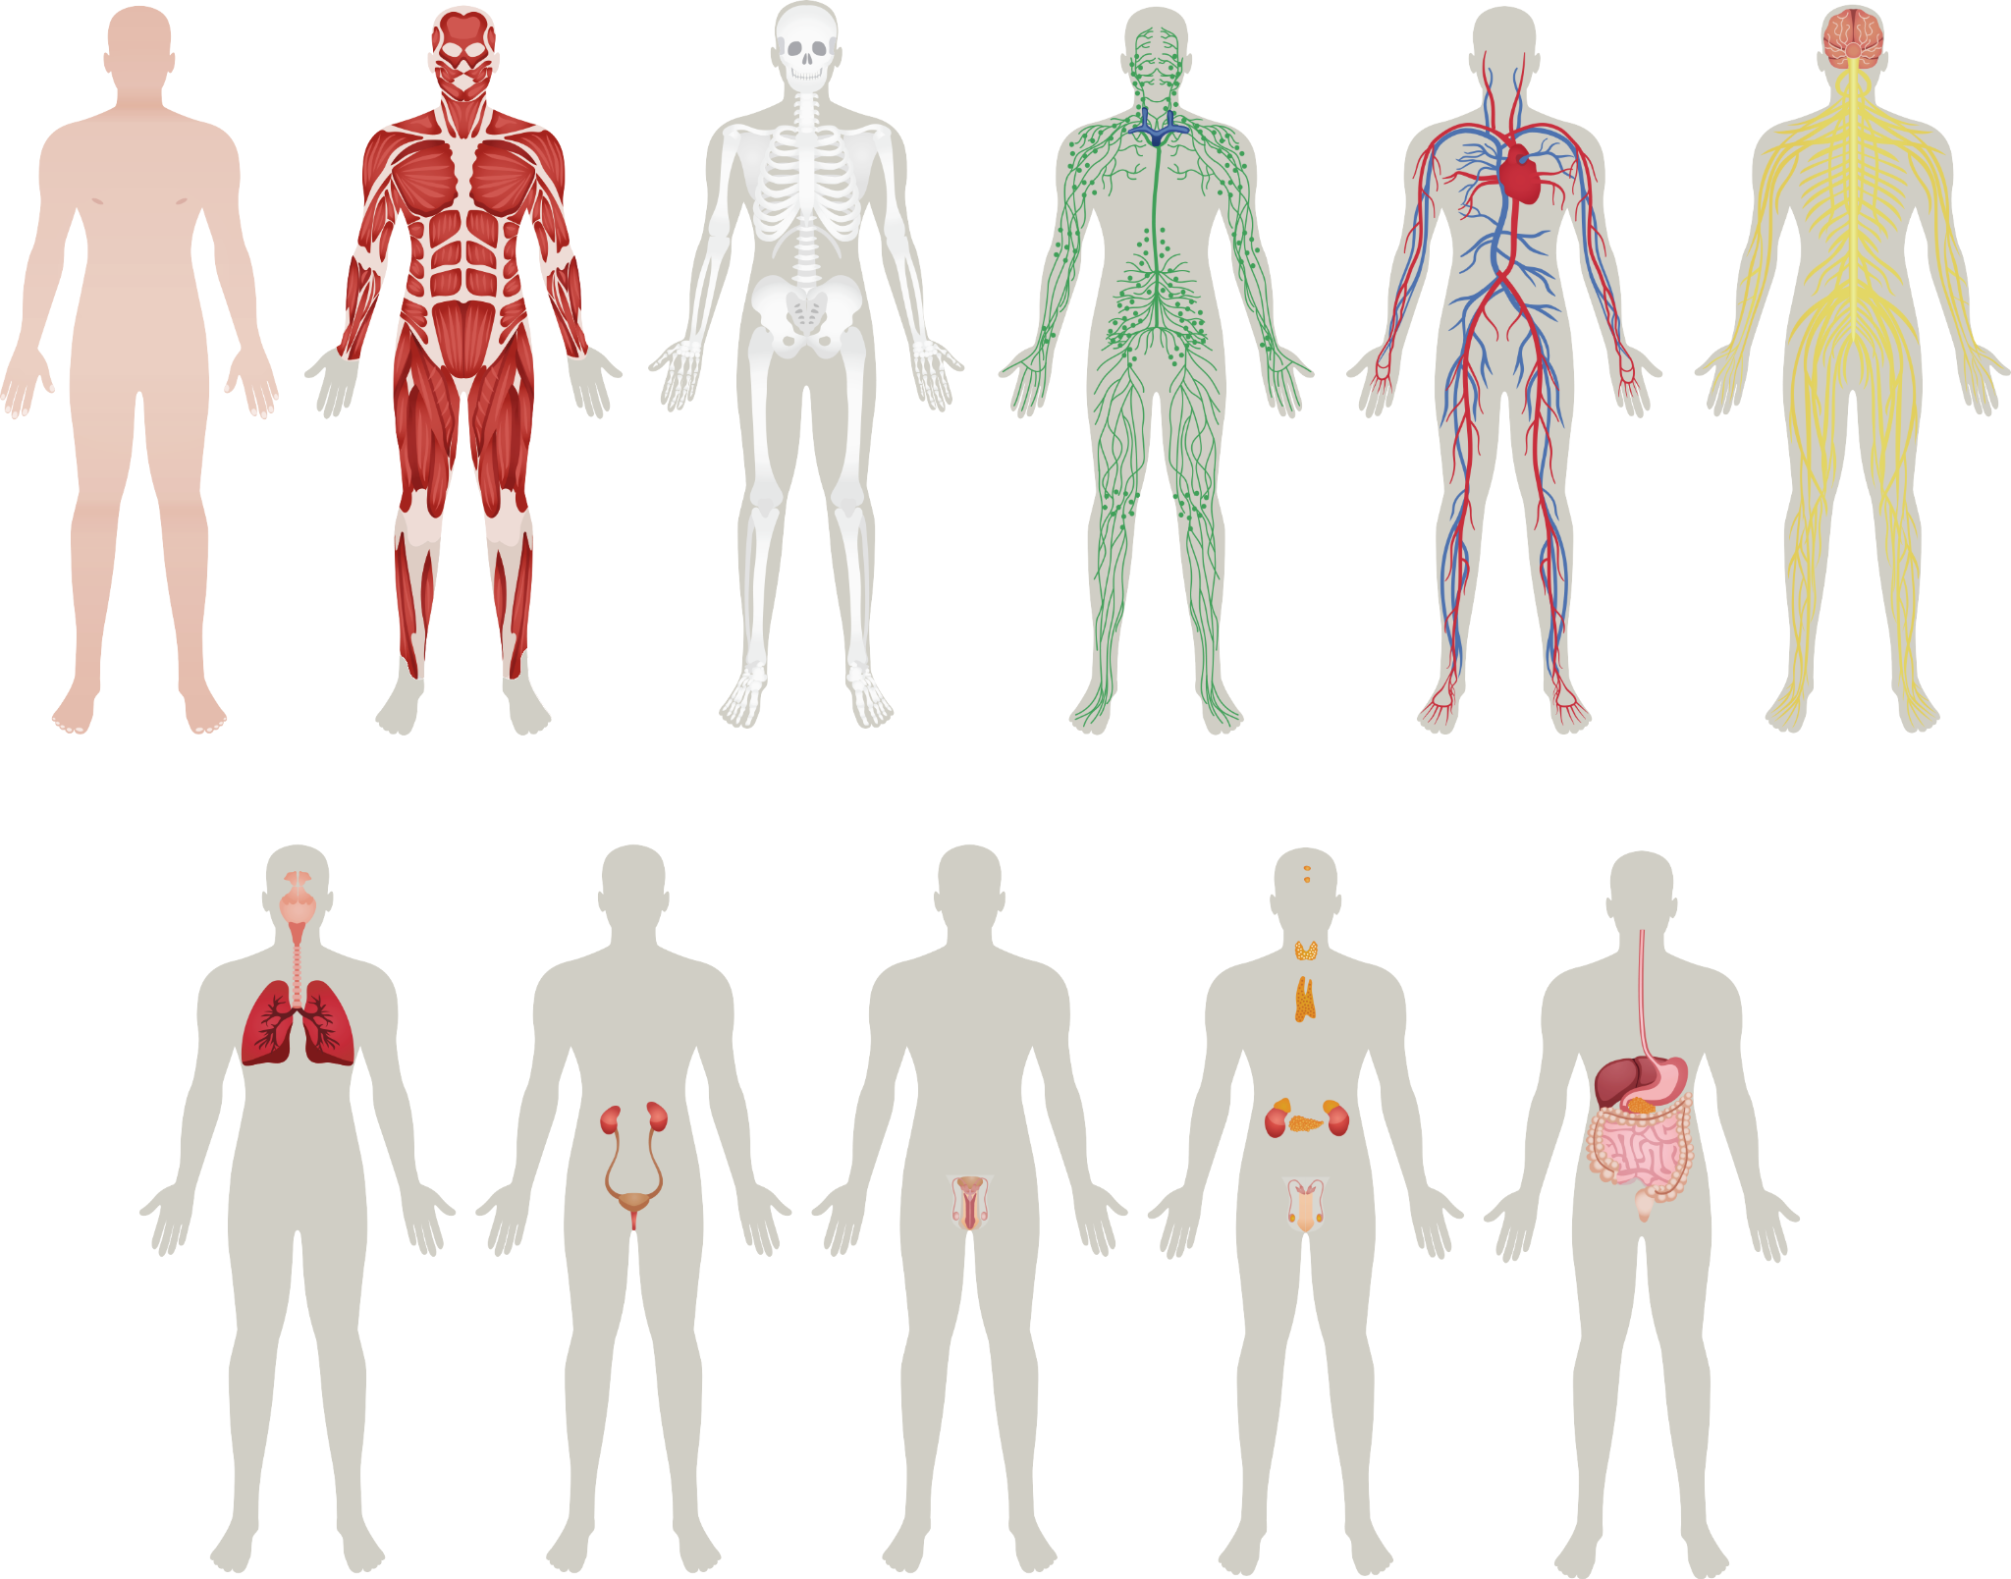
Body Systems
Notes:
Step 2 (5 minutes): Review body systems and the reproductive system
In our last lesson, we learned about how the body is made up of several systems, all working together to make sure of the health of the whole. Let’s see how quickly you can name the nine body systems we discussed.
Inform students that the rule is they have to raise their hand for their answer to count. Otherwise, a minute will be added to the clock. Set a stopwatch and see what time it takes the students to correctly identify all nine of the body systems displayed on the slide.

Slide 4
Answers | Body Systems
Muscular
Skeletal
Circulatory
Nervous
Respiratory
Urinary
Reproductive
Endocrine
Digestive
Notes:
As we learned in the Entry Ticket Activity game, we wouldn’t even be able to stand up without the muscular system! And the nervous system controls everything, including breathing and walking! Today we’re going to look at the male reproductive system and learn all of the names for the different organs that make up this system.

Slide 5
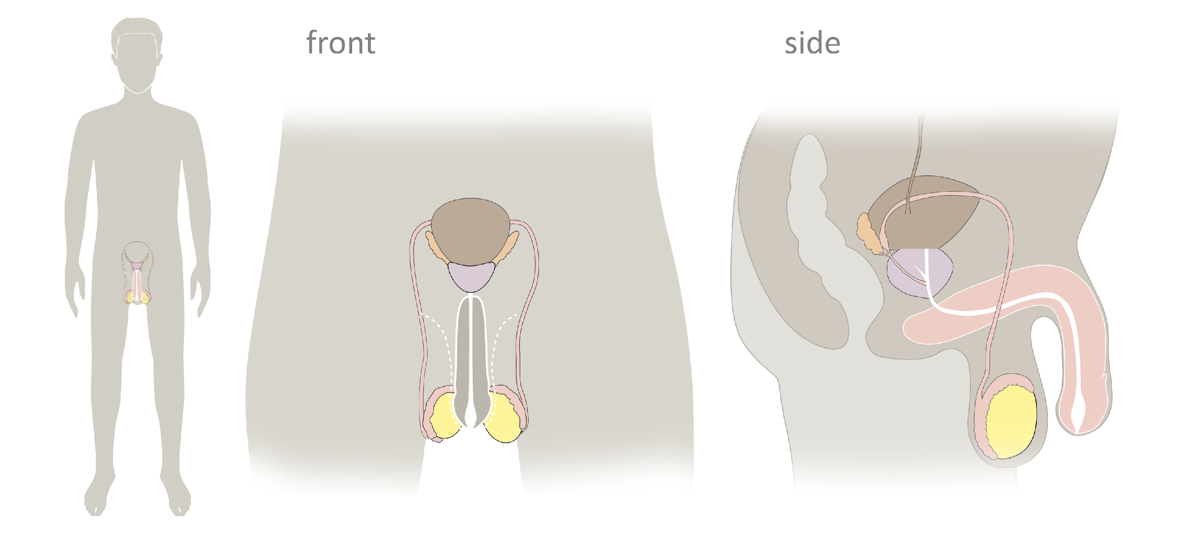
Male Reproductive Anatomy
© FEMM
Notes:
Step 3 (15 minutes): Introduce Male Reproductive Anatomy
In this slide, you can see the male reproductive system.

Slide 6
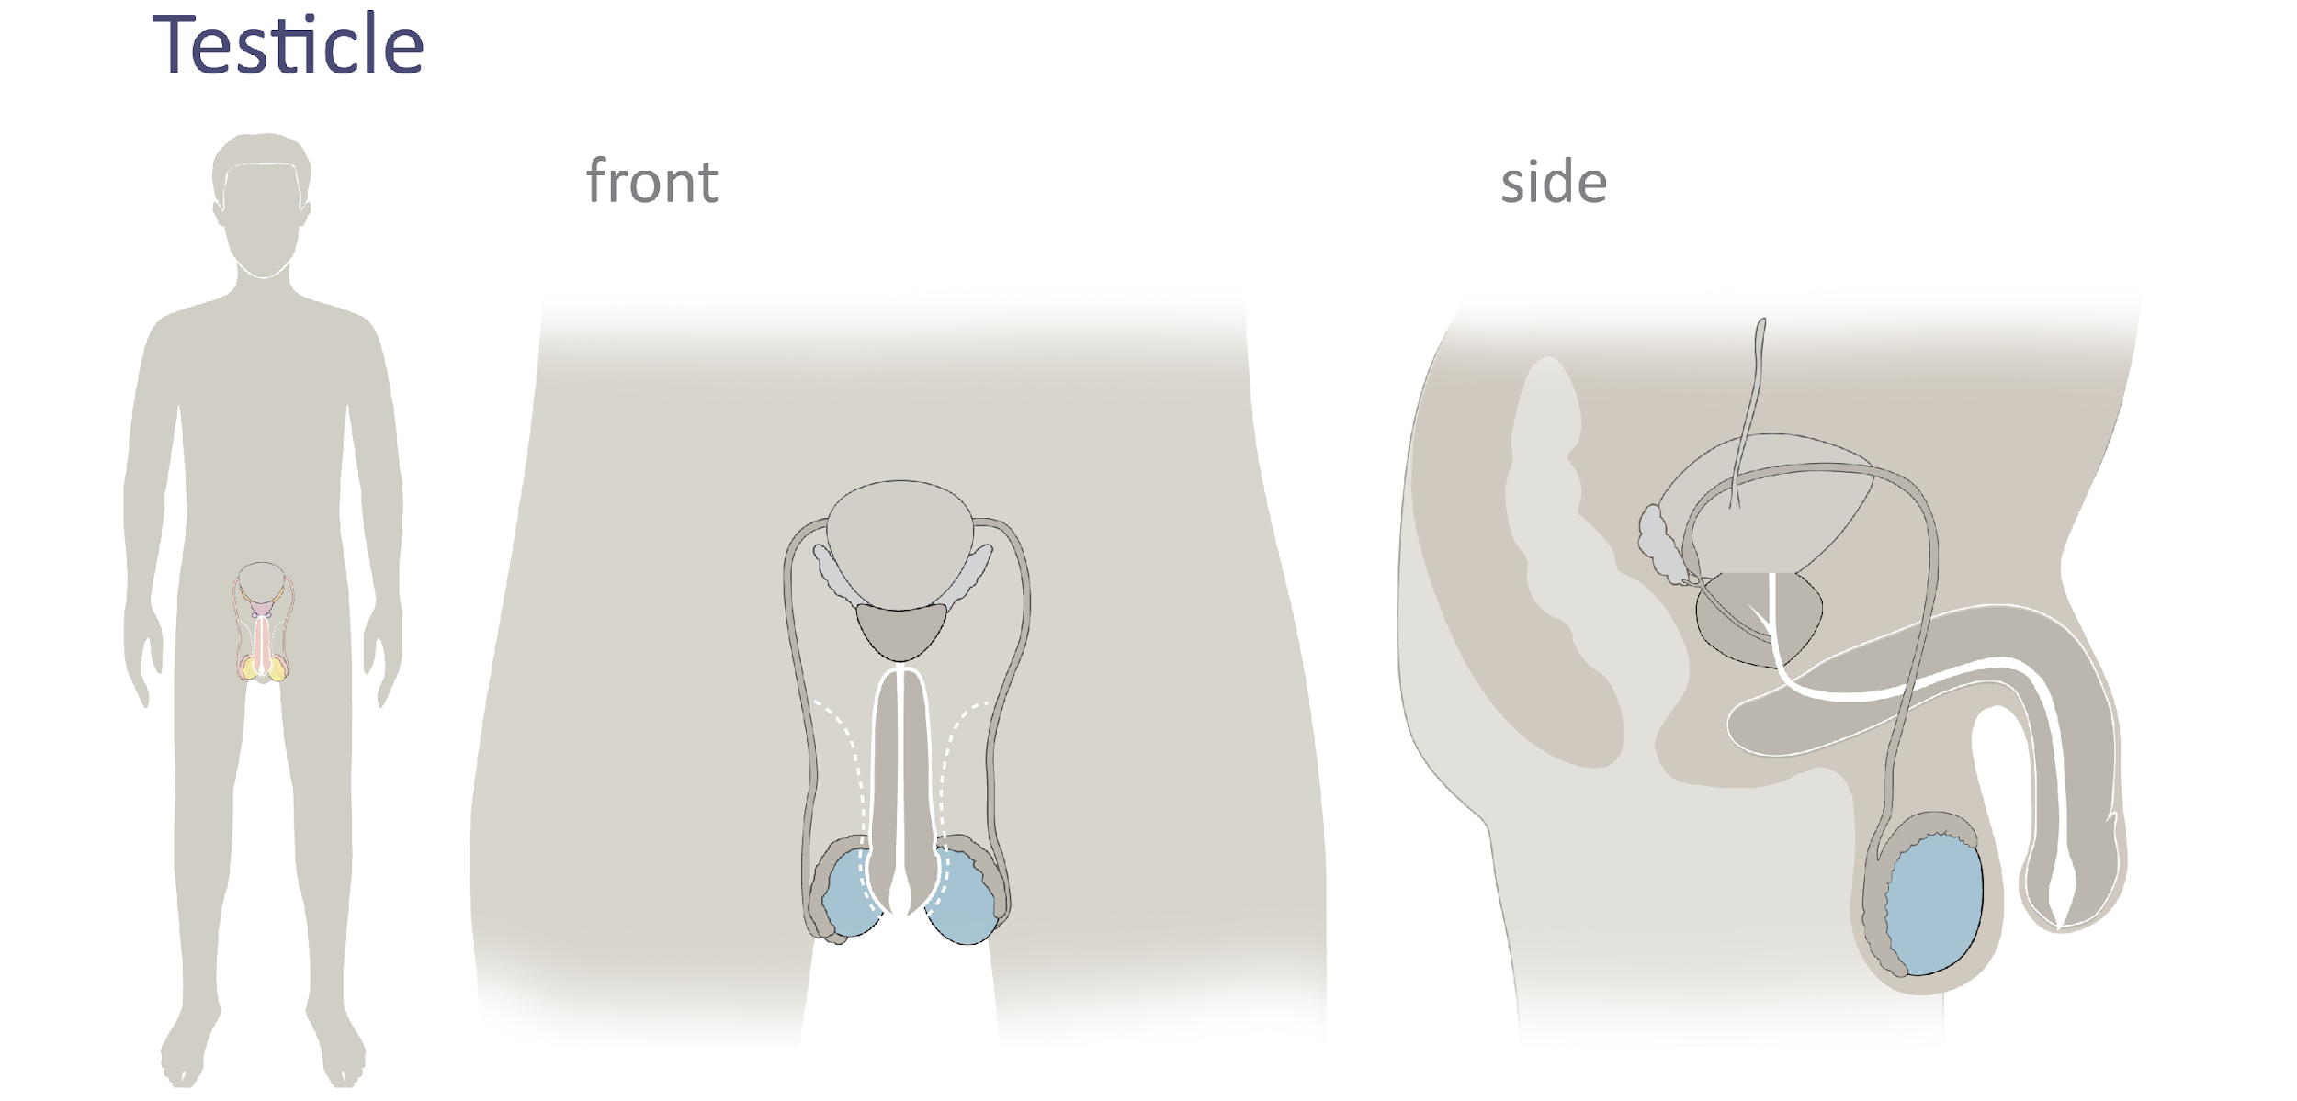
Male Reproductive Anatomy
Testicles
© FEMM
Notes:
How well do you know your body? Let’s find out. We’ll go over the name and function of each of the parts in order to understand their role in the body.
The testicles or testes are two small organs, highlighted on the slide in blue, located in the scrotum. The testicles produce sperm, the male cell of reproduction and the male hormone, testosterone.

Slide 7
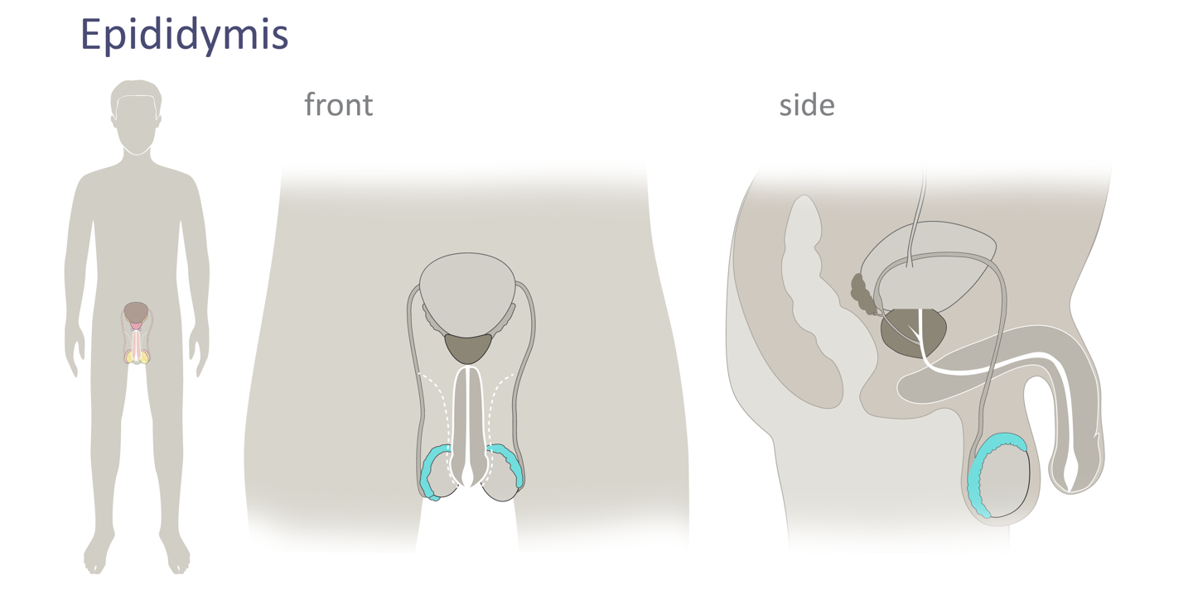
Male Reproductive Anatomy
Epididymis
Notes:
The epididymis is a tightly coiled tube, attached to each testicle. Sperm mature and are stored here.
(May help students to visualize it like a slinky toy, but teeny tiny, for sperm to travel through the wire.) If the epididymis was uncoiled, it would be about twenty feet long! So, sperm also have a long way to go to mature!

Slide 8
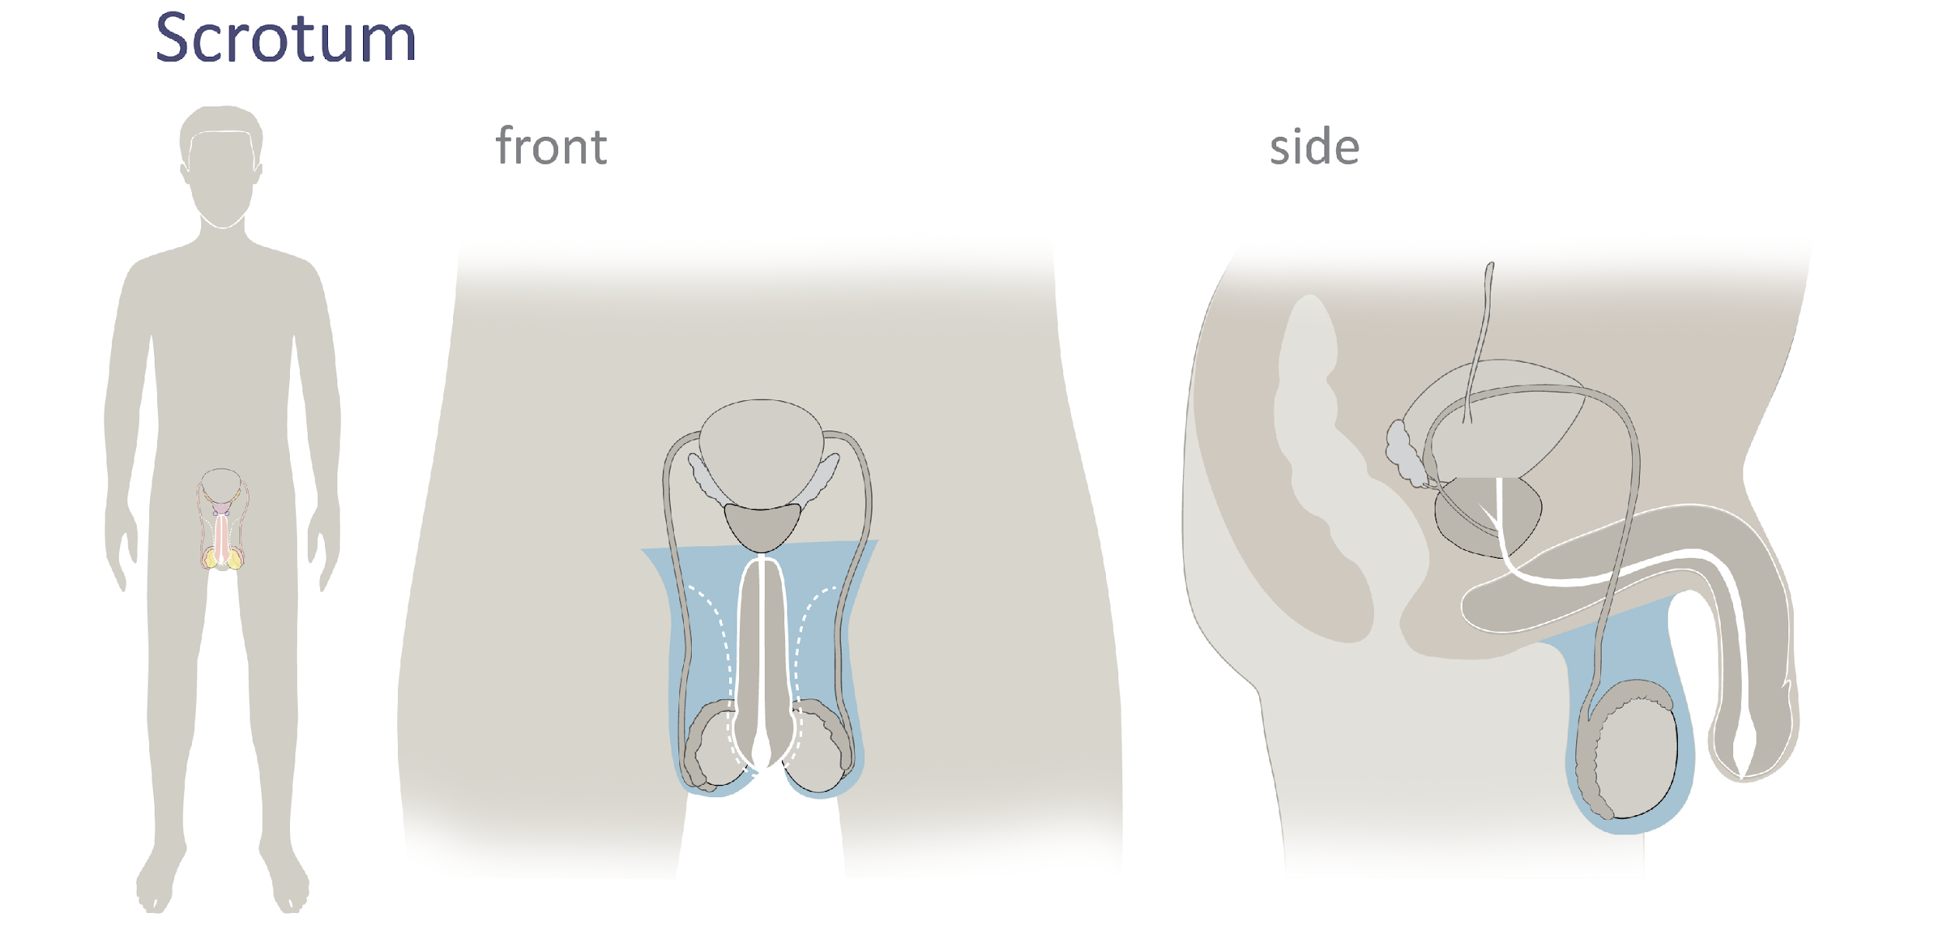
Male Reproductive Anatomy
Male Reproductive Anatomy
Scrotum
© FEMM
Notes:
The scrotum is the protective sac that encloses both testicles and epididymis. The scrotum draws them toward or away from the body in order to regulate temperature as needed.

Slide 9
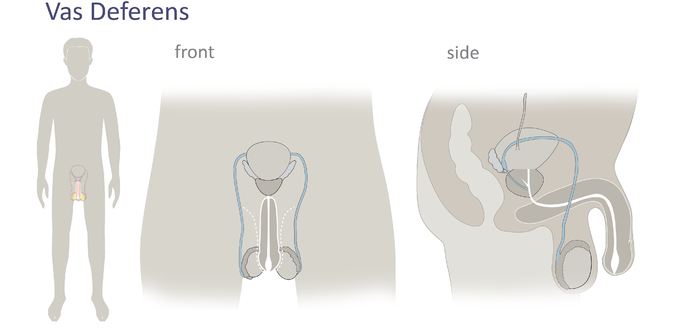
Male Reproductive Anatomy
Vas deferens
© FEMM
Notes:
Vas deferens: The vas deferens are the two long tubes that transport sperm from the epididymis to the urethra.

Slide 10
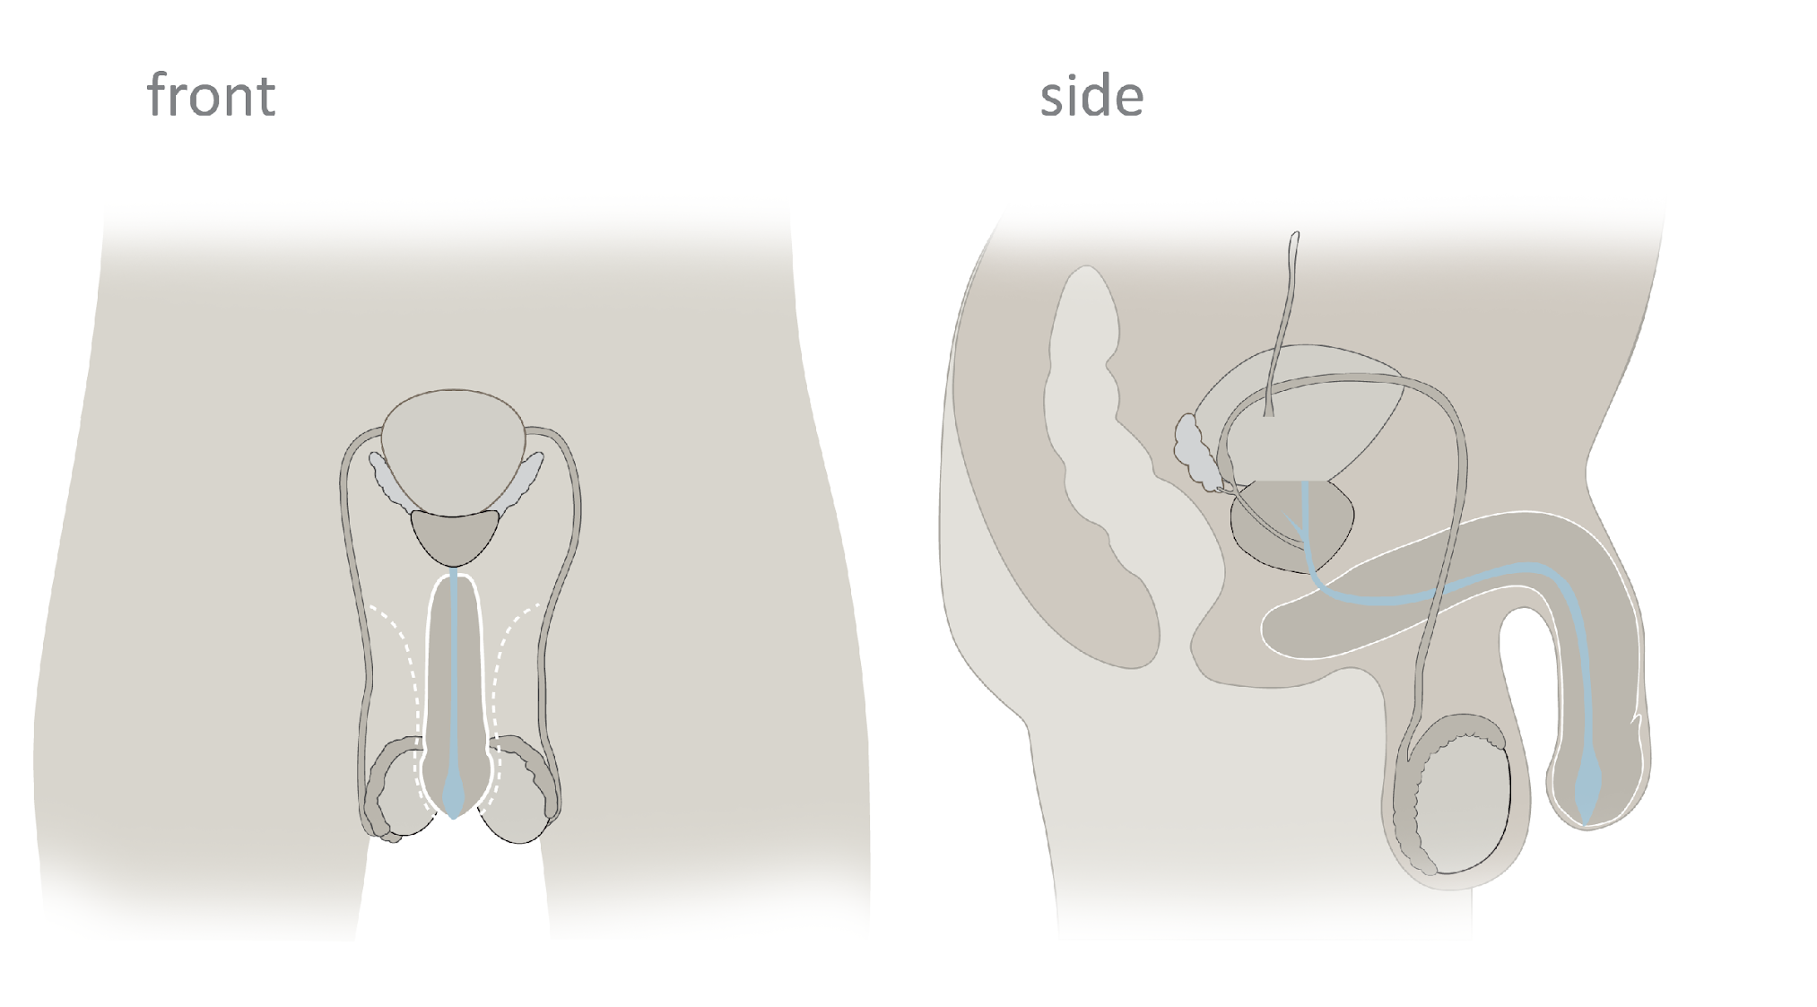
Male Reproductive Anatomy
Urethra
© FEMM
Notes:
The urethra is the tube that travels through the penis, carrying either urine from the bladder, or semen from the reproductive system; never at the same time.

Slide 11
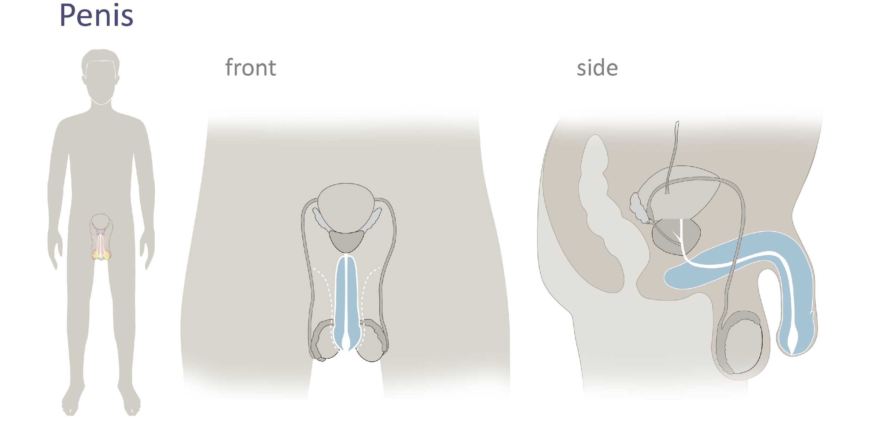
Male Reproductive Anatomy
Penis
© FEMM
Notes:
The Penis is the organ used for sexual intercourse. It contains the urethra, which carries either sperm or urine out of the body; never at the same time.

Slide 12
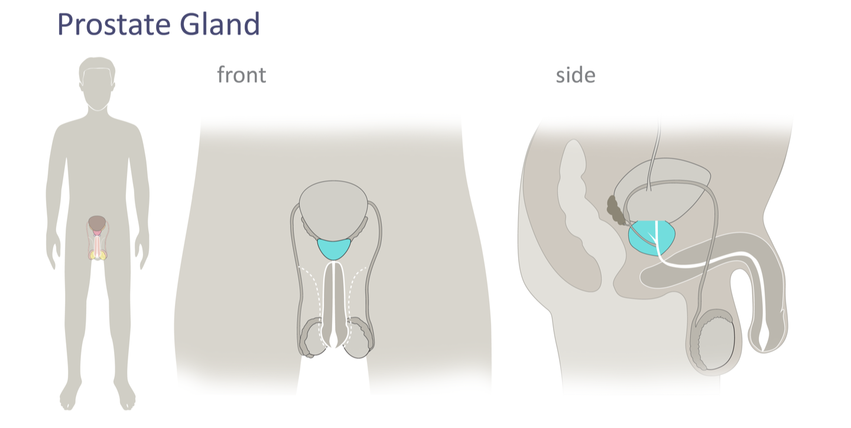
Male Reproductive Anatomy
Prostate Gland
Notes:
The prostate is a gland located just below the bladder. It is approximately the size of a walnut. It produces fluid that helps make up part of seminal fluid.

Slide 13
Male Reproductive Anatomy
Bladder
The bladder is technically a part of the urinary system, but works closely with the reproductive system. The anus, also in close proximity, is part of the digestive system.
© FEMM
Notes:
The bladder is not technically part of the reproductive system but is close to and works with the organs of the reproductive system. The bladder is a hollow muscular organ that holds urine. The urethra carries urine from the bladder out of the body.
Let’s review the process of the male cell of reproduction!
Sperm is made in the _________ (testes), matures in the __________ (epididymis) and both the testes and epididymis are enclosed in the _________ (scrotum). Sperm travels up the vas deferens leading to the urethra. The urethra is the tube within the penis which is the final passageway of the sperm before it exits the body.
Sperm is the male cell of reproduction, but it is also an important sign of hormonal and reproductive health. Sperm production is related to the production of the important hormone that your body needs: testosterone. We’ll talk more about this in the following lessons as we learn about the hormone testosterone and its impact on the brain and body.
For now, let’s see if you can identify the parts of your body!

Slide 14
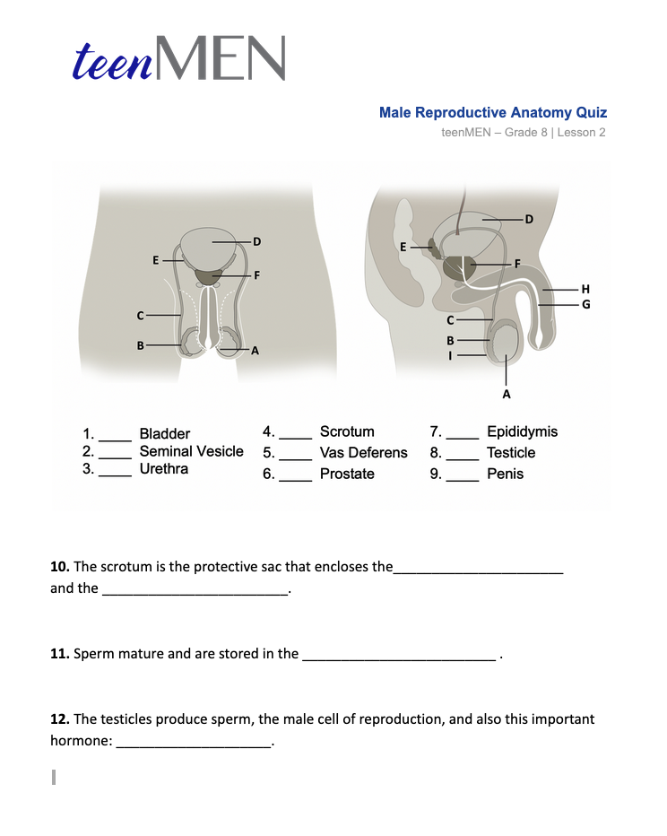
Male Anatomy Quiz
How much do you really know?
© FEMM
Notes:
Step 4 (10 minutes): Male Anatomy Worksheet
Provide students with the Male Anatomy Worksheet from the materials. Give students a few minutes to complete the worksheet.

Slide 15
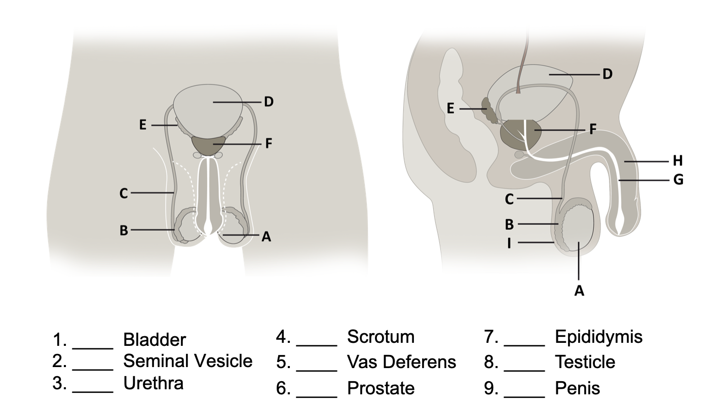
Male Anatomy Quiz
Notes:
After students have finished, review the answers using the following slides.

Slide 16

Answers | Male Anatomy Quiz

Slide 17
Answers | Male Anatomy Quiz
10. The scrotum is the protective sac that encloses the testicles and epididymis.
11. Sperm mature and are stored in the epididymis.
12. The testicles produce sperm, the male cell of reproduction, and also this important hormone: Testosterone.
Answers | Male Anatomy Quiz

Slide 18
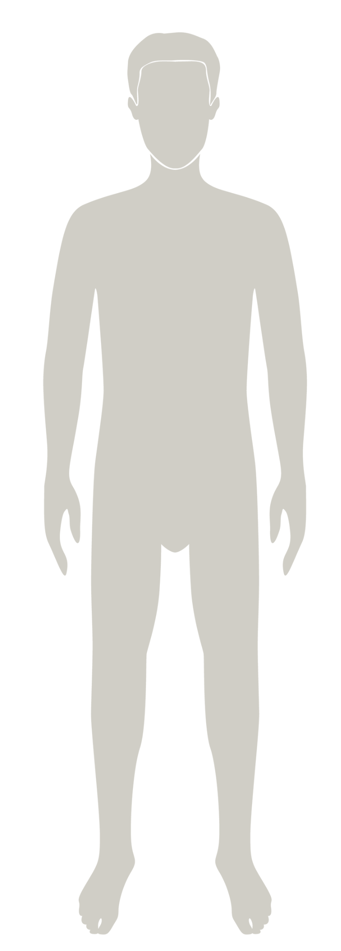
Review
Hormones cause all of the growing & changing
that your body does during puberty.
The male reproductive system is responsible
for making the male cell of reproduction
(sperm) and testosterone.
For your body to be healthy, you need your
reproductive system and your hormones
to be working well!
© FEMM
Notes:
The male reproductive system is responsible for developing the male cell of reproduction (sperm) and producing testosterone. For your body to be healthy, you need your reproductive system and your hormones to be working well. Next lesson we’ll take a closer look at the endocrine system, which helps all of these parts work together and what drives their activities to keep your body healthy.

Slide 19
Grade 7
LESSON 2
© FEMM

