Slide 1

Grade 7
LESSON 3
© FEMM

Slide 2
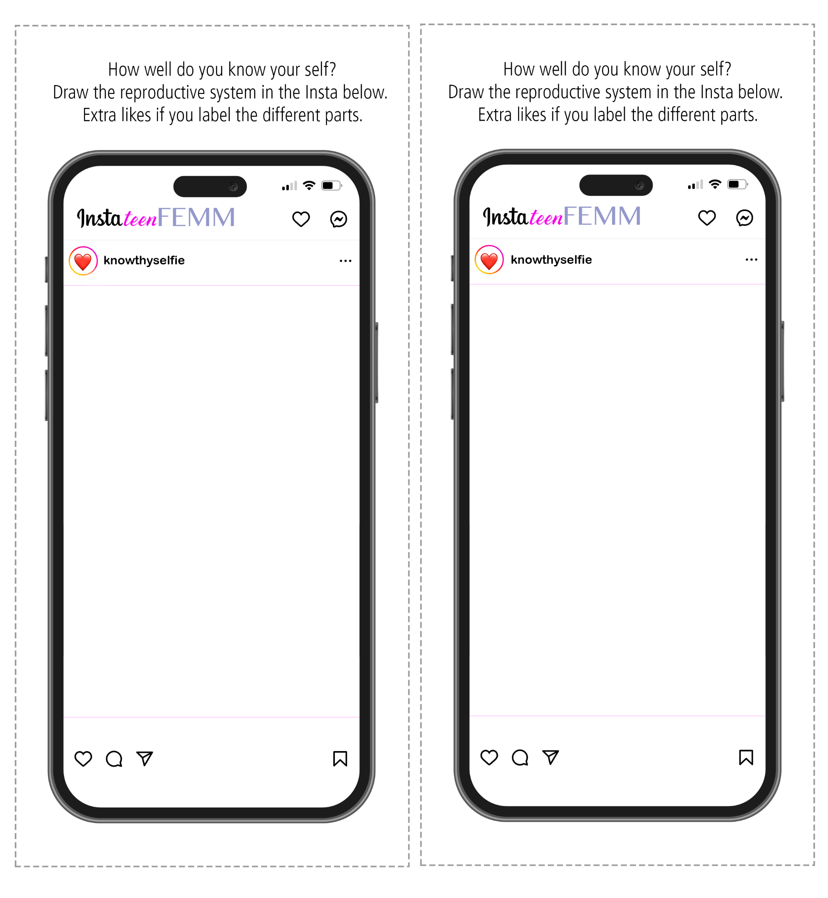
Entry Ticket Activity: #knowthyselfie
Notes:
PREPARATION
For the Entry Ticket Activity: before class, print and cut out one cell phone image per student, from the Entry Ticket Activity page provided.
Materials needed For Step 3: salt, plastic spoons and water. To illustrate the size of an ova or egg, pouring a few grains of salt into the hand of each student can help them to visualize the size. Spoons and water can be used to show that the egg simply dissolves at the end of each cycle.
PROCEDURE
Step 1 (5 min): Entry Ticket Activity: #knowthyselfie
Hand out one cell phone image to each student at the beginning of the class. Have students draw the reproductive system as they remember it, based on the illustrations on the slides from the previous lesson.
Note that knowing about the reproductive system is an integral part of knowing about themselves and how their body works. However, many people don’t actually know how all of these parts work together, or that hormones are directed by the brain, and that our reproductive health impacts our overall health, energy, mood, metabolism, skin… and so much more! This lesson we’re going to look at the ovaries and the production of the two main female hormones: estrogen and progesterone.

Slide 3
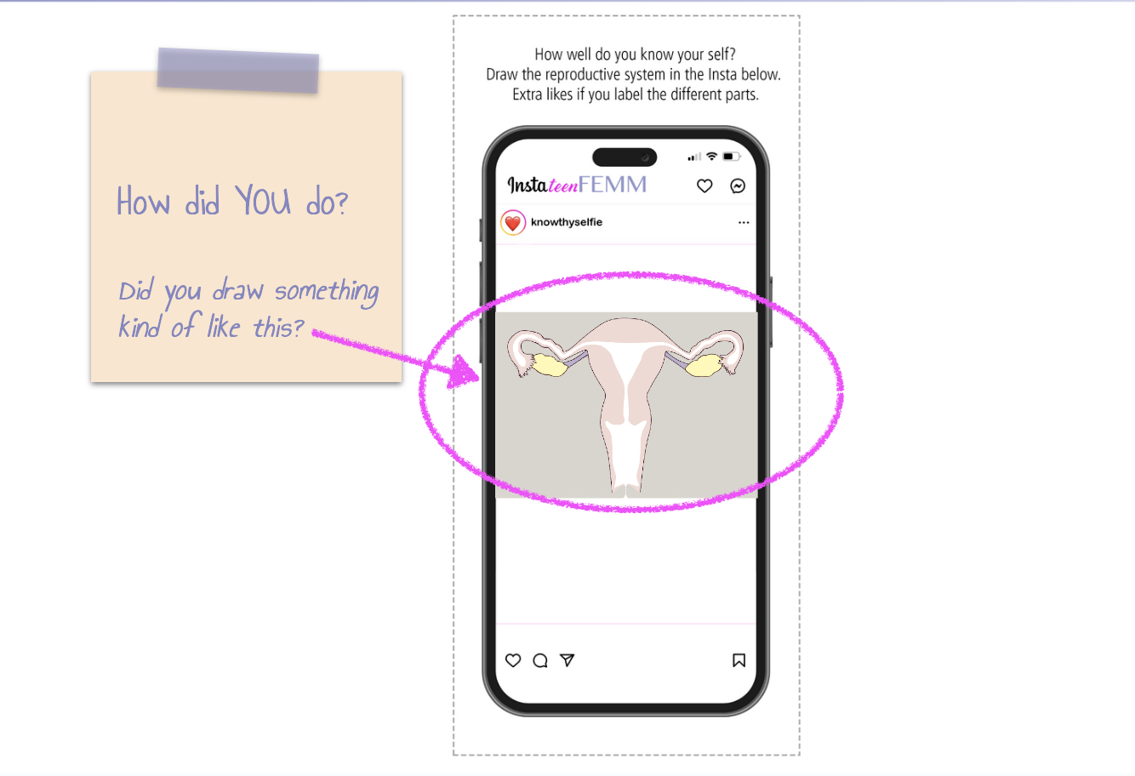
Entry Ticket Activity: #knowthyselfie
Notes:
PREPARATION
For the Entry Ticket Activity: before class, print and cut out one cell phone image per student, from the Entry Ticket Activity page provided.
Materials needed For Step 3: salt, plastic spoons and water. To illustrate the size of an ova or egg, pouring a few grains of salt into the hand of each student can help them to visualize the size. Spoons and water can be used to show that the egg simply dissolves at the end of each cycle.
PROCEDURE
Step 1 (5 min): Entry Ticket Activity: #knowthyselfie
Hand out one cell phone image to each student at the beginning of the class. Have students draw the reproductive system as they remember it, based on the illustrations on the slides from the previous lesson.
Note that knowing about the reproductive system is an integral part of knowing about themselves and how their body works. However, many people don’t actually know how all of these parts work together, or that hormones are directed by the brain, and that our reproductive health impacts our overall health, energy, mood, metabolism, skin… and so much more! This lesson we’re going to look at the ovaries and the production of the two main female hormones: estrogen and progesterone.

Slide 4
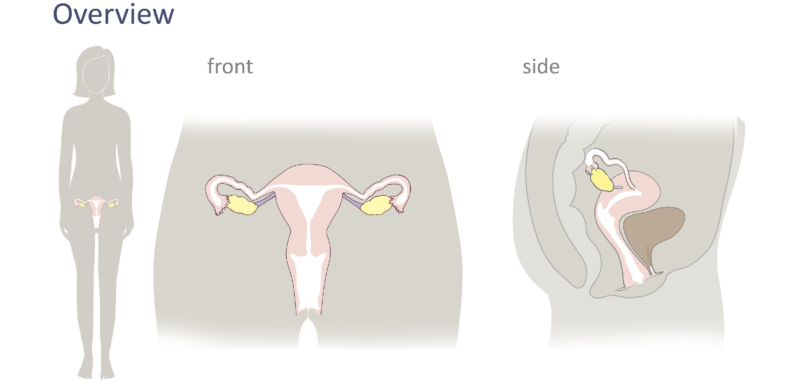
Review
© FEMM
Notes:
Step 2 (5 minutes): Review Female Reproductive Anatomy
First, let’s briefly review the anatomy parts, before we explore more in-depth the female reproductive cycle and how ovulation is an important sign of health.
Reference the slide with blank spaces, then on the following slide, click to reveal answers.

Slide 5
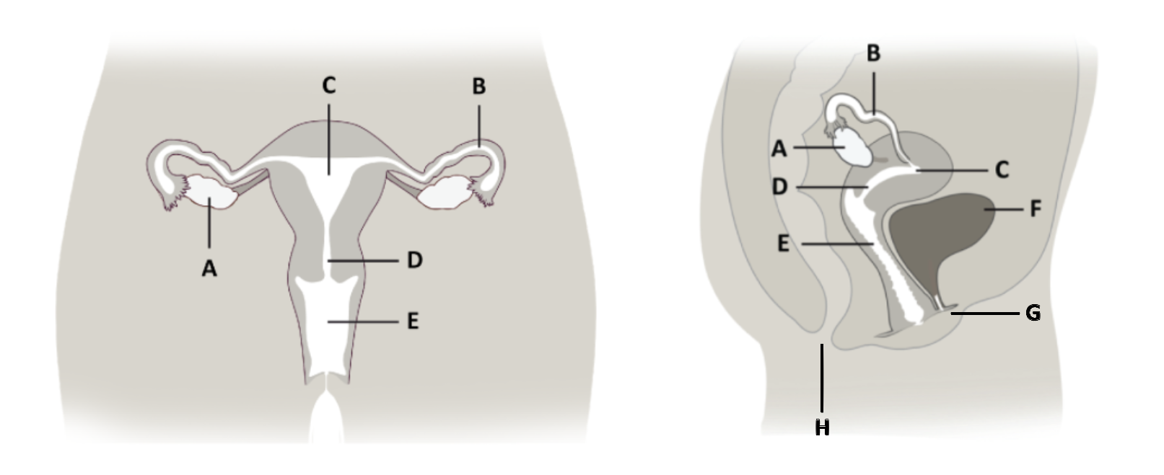
Female Anatomy Review
____ Cervix
____ Ovary
____ Bladder
____ Vagina
____ Fallopian Tube
____ Uterus
____ Anus
____ Urethra
Notes:
Review the students’ worksheets from lesson 2, using the slides (image with blank spaces, then with answers).

Slide 6
Female Anatomy Answers
____ Cervix
____ Ovary
____ Bladder
____ Anus
____ Urethra
D
A
F
E
B
C
H
G
____ Vagina
____ Fallopian Tube
____ Uterus
Notes:
Ovary: Two small organs on either side of the uterus that contain a woman’s eggs; develop and release an egg, each month.
Fallopian Tube: 2 tubes, on either side of the uterus, where the egg travels after ovulation.
Uterus: also called the ‘womb’, is where babies begin to grow.
Cervix: A canal at the base of the uterus, that opens into the vagina.
Teacher: point out the 3 openings/exits from the body: vagina, urethra, anus.
Vagina: canal that connects the uterus to the outside of the body. entrance to the reproductive organs and exit for the delivery of a baby.
Urethra: The tube that carries urine from the bladder to the outside of the body.
Anus: The opening for waste matter from the digestive system to exit the body.

Slide 7
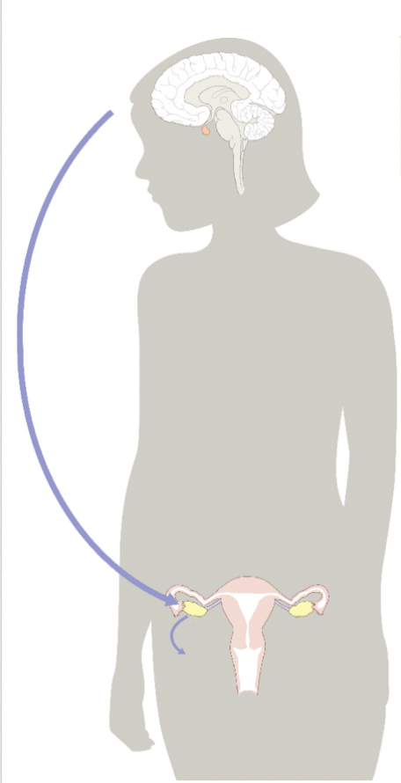
Puberty and the Hormonal Axis
Your brain and ovaries talk,
sending hormonal messages back and forth through your body.
FSH
LH
The health of your hormones now, during puberty, shapes your body and your brain for the rest of your life!
Ovulation is a sign of a woman’s health, because it means that all your reproductive hormones are working.
E
P
Notes:
Step 3 (20 minutes): Puberty, the Hormonal Axis and the Ovulatory Cycle
As you begin puberty, hormonal messages are sent from the brain to the reproductive system to start the physical changes that you notice on the outside: hair growth, breast growth, increased sweating, changes in body shape and even emotional changes. What you can’t necessarily see is that your brain and your ovaries (point out the ovaries on the slide) are linked in a “Hormonal Axis”.
The Hormonal Axis is a description of the important connection that develops as of puberty, between the brain and the ovaries, as the many parts of your body work together to mature and prepare your body for ovulation.
What is ovulation? Approximately once a month, an egg or “ova” (think oval, like the shape of an egg) is released from the ovary. Because this process starts, ends and begins again, it is called a cycle. You may have heard it called the menstrual cycle or some people talk about getting your period, menses, menarche, etc. In fact, the more precise term for the menstrual cycle is the ovulatory cycle, because ovulation is really the main event.

Slide 8
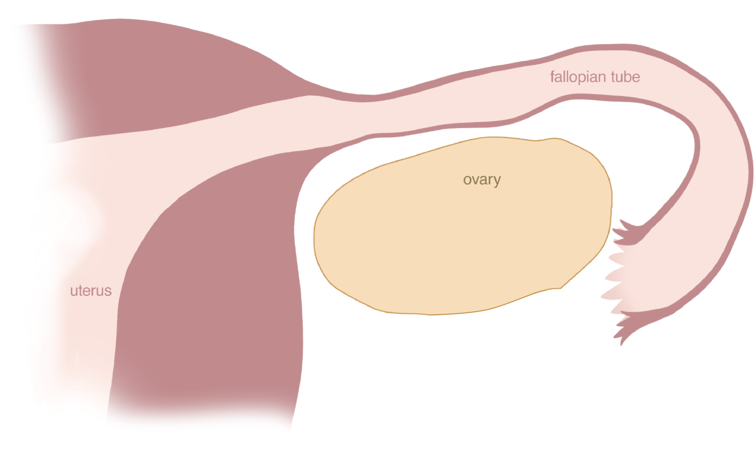
Ovulation: a sign of health
Notes:
Let’s go through the process of ovulation, step by step.
The human female body has two ovaries, one on each side of the uterus. On this slide, we have zoomed in on one ovary - the right side - so that we can get a better look at what happens inside.

Slide 9
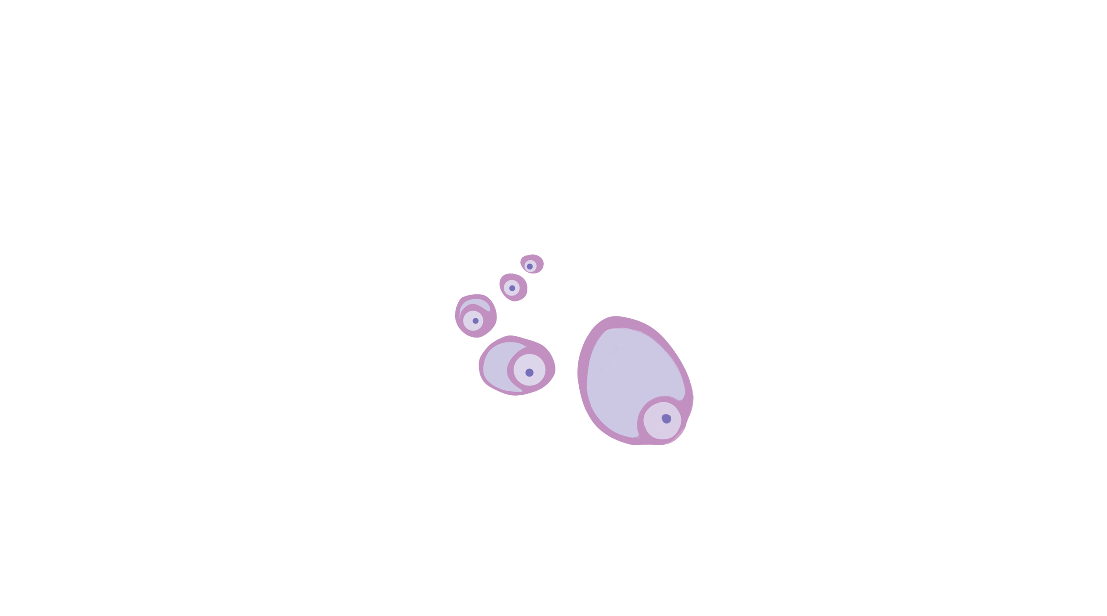
Ovulation: a sign of health
At puberty, you have about 400,000 eggs.
Each egg is about ¼ the size of a grain of salt!
Notes:
Inside each ovary, the female cells of reproduction: the ova or “eggs”, are stored. They are tiny cells, about ¼ the size of a grain of salt!
Give each student a small teaspoon of salt in their hand, for them to examine a single grain and imagine the egg ¼ of that size.
Each one of these eggs contains a copy of all of your DNA. That’s 23 chromosomes containing everything that makes you, you! In something even smaller than a grain of salt! Amazing, right?

Slide 10
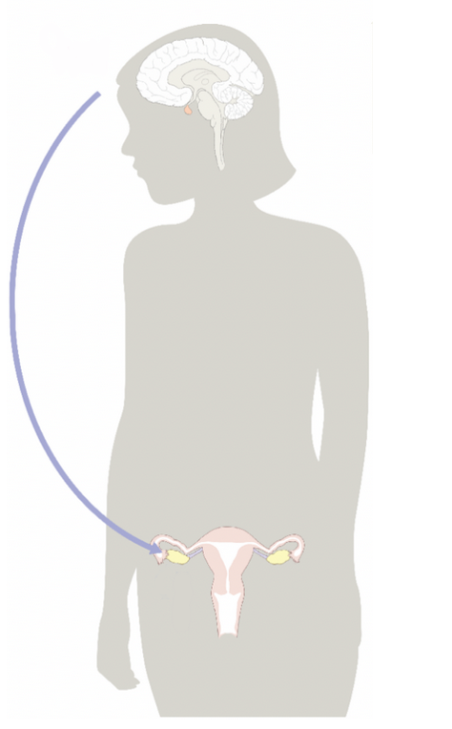
Ovulation: a sign of health
follicle stimulating hormone
(FSH)
follicles in the ovary
© FEMM
Notes:
To kickstart the ovulatory cycle, the brain releases a hormone called FSH which stands for “Follicle Stimulating Hormone”. This hormone “stimulates” (causes to grow) one egg each month. The ovaries “take turns” each month. The hormone FSH comes from the brain and acts on the ovary, to grow an egg. Click on the slide to show the egg increasing in size.

Slide 11
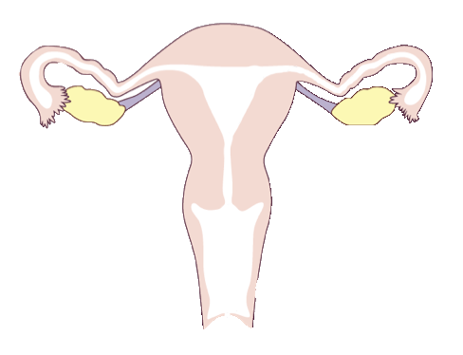
Ovulation: a sign of health
egg
follicle “protective tissue”
© FEMM
Notes:
The egg is inside a special, protective tissue that acts like a sac around it called a follicle (point out the small egg and the follicle surrounding the egg, in the image). Both the egg and follicle grow together. The egg and follicle inside the ovary produce one of the main female hormones: estrogen.

Slide 12
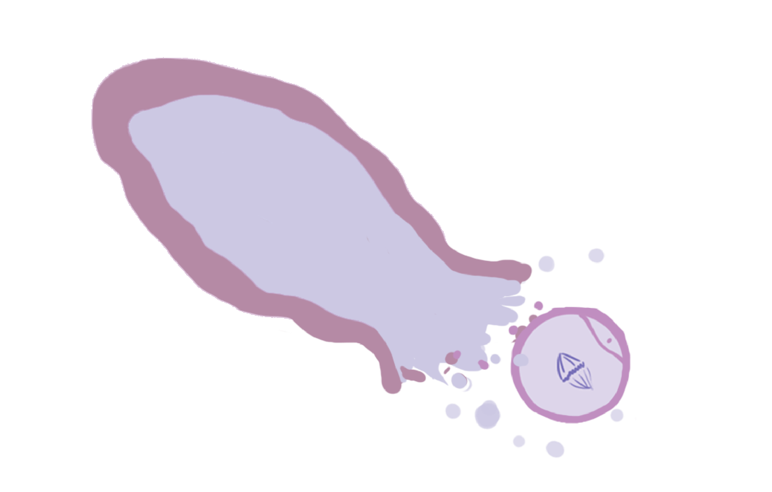
Ova (egg) released = Ovulation
ovulation
© FEMM
Notes:
When the egg and follicle have grown and matured to the correct size, and when estrogen is at its peak, the egg bursts from its follicle into the fallopian tube. This event is called ovulation.

Slide 13
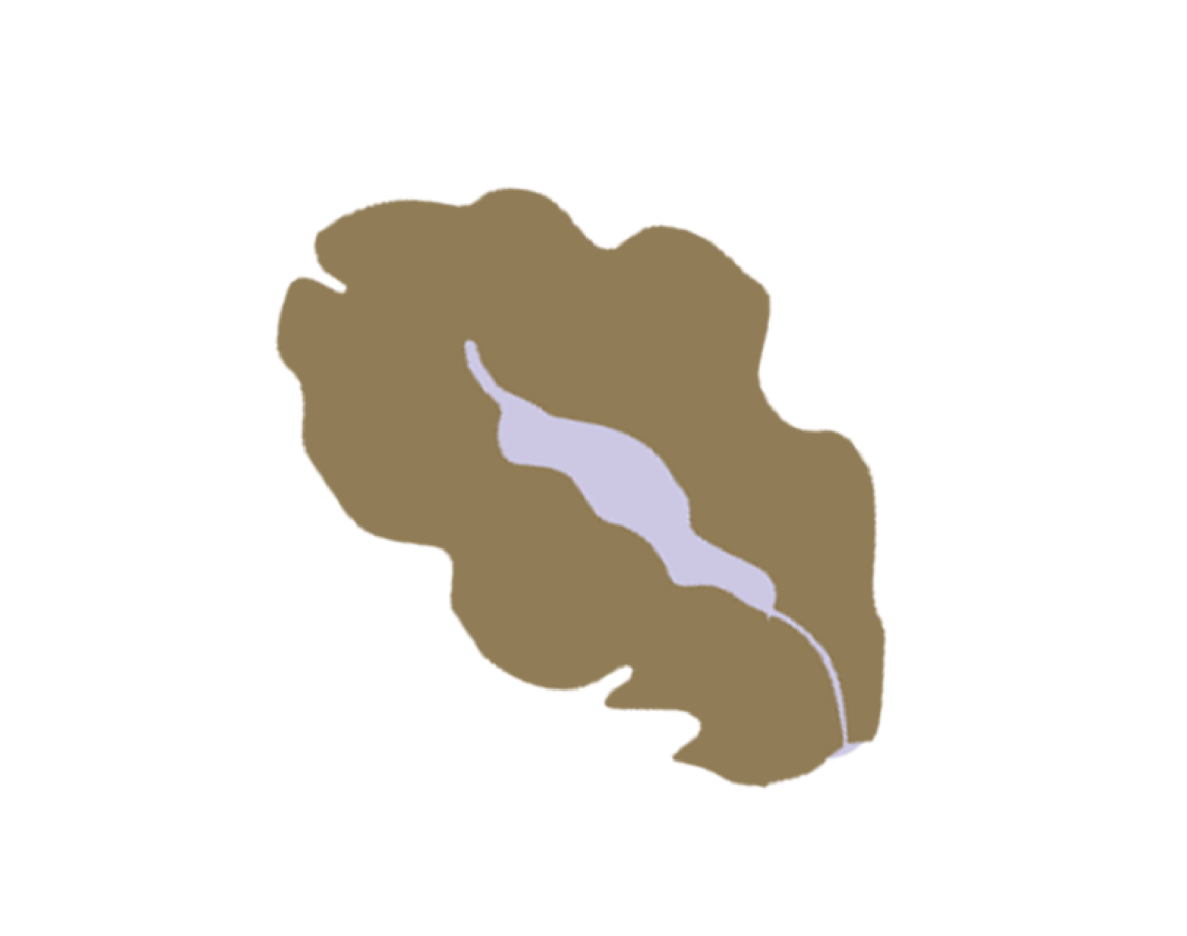
The ovary makes estrogen and progesterone
Estrogen
Progesterone
© FEMM
Notes:
As we said, the growing egg and follicle leading up to ovulation produce estrogen. The bigger the egg and follicle get, the more and more estrogen they produce in the body.
After ovulation, the empty follicle (shown here in brown) becomes a new tissue that produces the second main female hormone: progesterone.
Estrogen and Progesterone do a lot of amazing things for your mind and body that we’ll look at in the next lesson.
Wait, what happens to the egg? The egg enters the fallopian tube and if it comes into contact with the male cell of reproduction, sperm, then the sperm fertilizes the egg and a new human life is formed. But, on its own, what happens to the egg each cycle? Give each student a plastic spoon and a little bit of water in the spoon. Instruct students to put their grains of salt in the water.
Ask: What happens to the grains of salt? They dissolve. The same is true for the unfertilized egg each cycle. It simply dissolves in the fallopian tube and a few days later. The lining of the uterus sheds as a woman gets her period, and the next cycle starts.

Slide 14
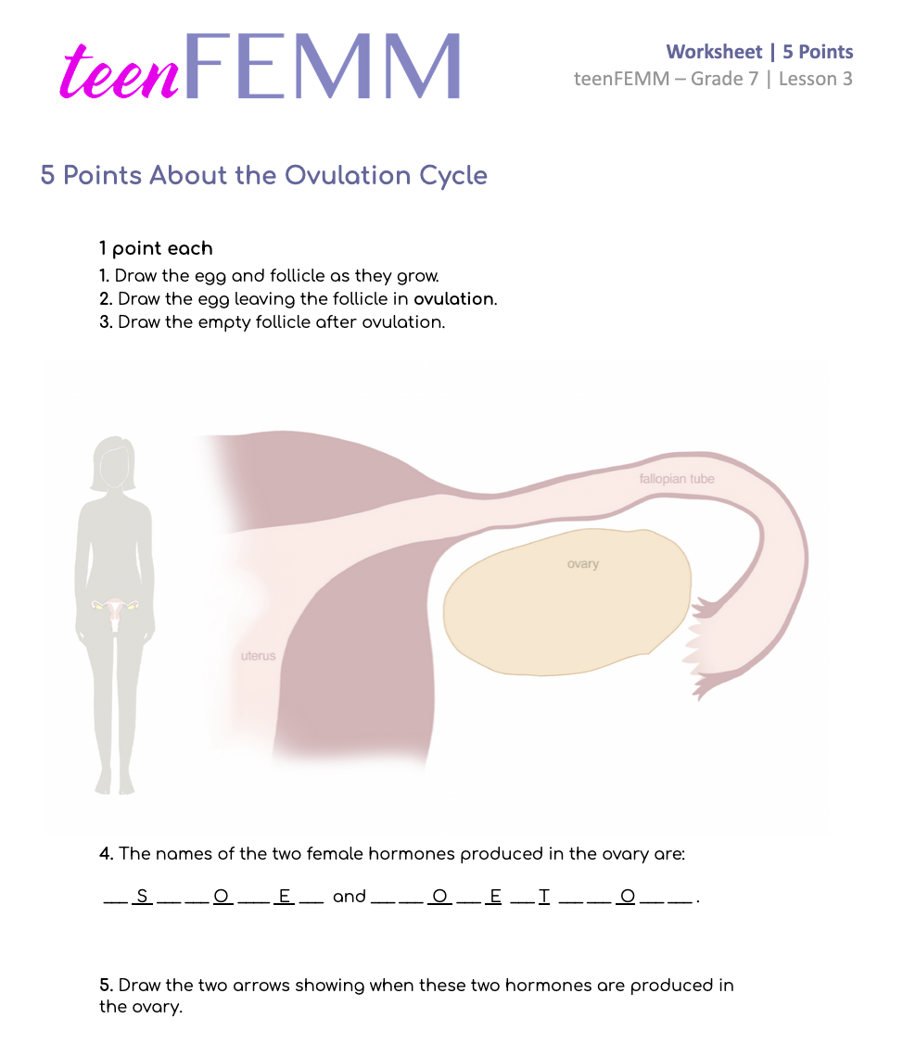
Five Points | Worksheet
Five Points Worksheet
Illustrate Your Knowledge!
Notes:
Step 4 (5 minutes): Five Points Worksheet
Hand out the worksheet Five Points Worksheet for students to complete. See if students can get all five points about the ovulation cycle.

Slide 15
Five Points Worksheet | Answers
Estrogen
Progesterone
© FEMM
Notes:
Review the answers with the class by clicking through the animations one by one on the next slide.

Slide 16
True or False?
1. In puberty, your hormonal axis is still developing.
TRUE FALSE
2. Ovulation is the bursting of the mature egg from the follicle.
TRUE FALSE
3. The hormones Estrogen and Progesterone are not important to your health.
TRUE FALSE
4. A healthy period comes at the end of a healthy ovulatory cycle.
TRUE FALSE
5. The egg travels to the bladder after ovulation
TRUE FALSE
Notes:
Step 5 (5 minutes): Review: True or False
Let’s do a final review of the things we learned today about the reproductive system and the ovulatory cycle.
True or False:
1. As you go through puberty, your hormonal axis is still developing (T)
2. Ovulation is the bursting of the mature egg from the follicle (T)
3. The hormones Estrogen and Progesterone are not important to your health. (F)
4. A healthy period comes at the end of a healthy ovulatory cycle (T)
5. The egg travels to the bladder after ovulation (F) The fallopian tubes!

Slide 17
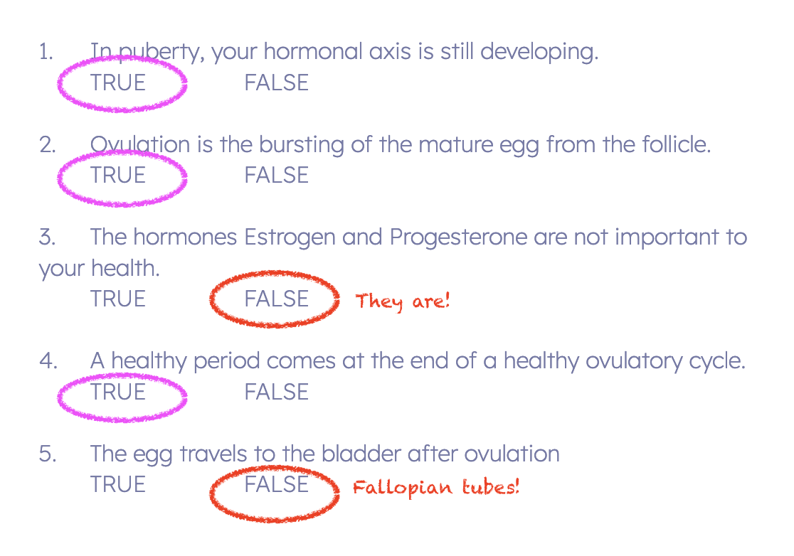
ANSWERS | True or False?
?
Notes:
Step 5 (5 minutes): Review: True or False
Let’s do a final review of the things we learned today about the reproductive system and the ovulatory cycle.
True or False:
1. As you go through puberty, your hormonal axis is still developing (T)
2. Ovulation is the bursting of the mature egg from the follicle (T)
3. The hormones Estrogen and Progesterone are not important to your health. (F)
4. A healthy period comes at the end of a healthy ovulatory cycle (T)
5. The egg travels to the bladder after ovulation (F) The fallopian tubes!

Slide 18
Review
Ovulation is a marker for health and hormone levels.
The ovary makes the hormones: estrogen and progesterone.
When we go through puberty, our hormonal axis “wakes up” and starts to function.
Notes:
CONCLUSION
Next lesson, we will learn more about hormones and why they are so important to overall health, especially right now during your development in puberty. We will also learn about menstruation and what a healthy cycle looks like for teens your age.

Slide 19
Grade 7
LESSON 3
© FEMM

