Slide 1

Grade 7
LESSON 3
© FEMM

Slide 2
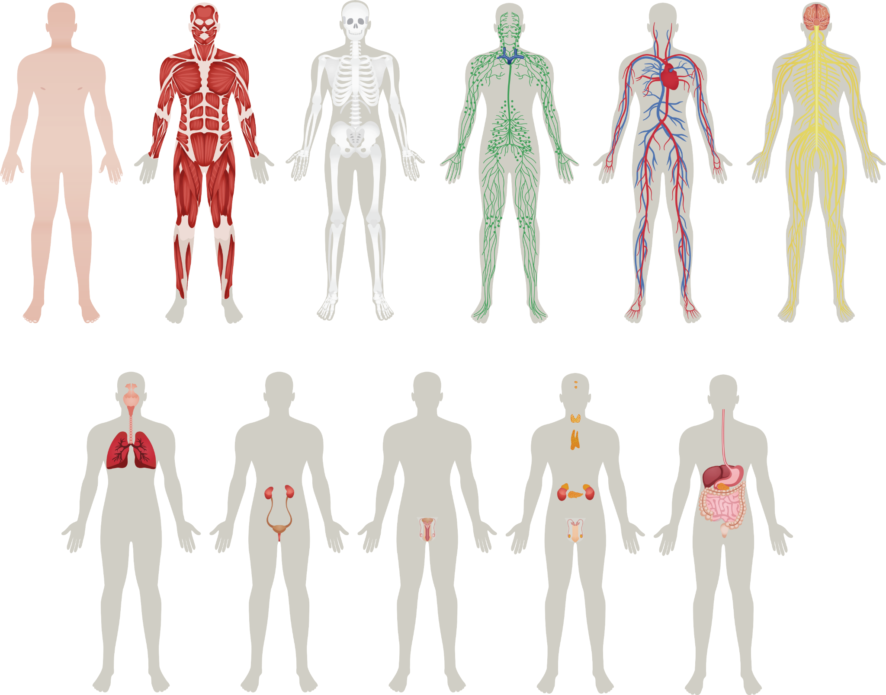
WHO WANTS TO BE A TRILLIONAIRE?
teenMEN edition
Notes:
Step 1 (10 minutes): Who wants to be a Trillionaire: teenMEN edition
1. Divide students into two teams. Each time will select one person to be the group leader. The leader will represent the team in giving the answers.
2. On each slide is a question and a multiple choice answer. Once the slide with the question is shown, the first team leader to raise their hand gets to answer. However, they must have their final answer ready - they cannot consult their group after their hand is raised. So, make sure you discuss the question with your group first, once the slide is shown, and then raise your hand to give the group’s final answer.
3. If a team gets the answer wrong, then the other team has a chance to guess. Each team will receive one trillion points per correct answer. In the end, the team with the most points wins.
The Teacher’s Answer Key is provided in the materials. For the Powerpoint, clicking on the slide will reveal the answer.

Slide 3
WHO WANTS TO BE A TRILLIONAIRE
teenMEN edition
Hormones are important because they make you:
Moody and difficult
b) Self-conscious
c) Grow and develop
d) Tall
© FEMM

Slide 4
WHO WANTS TO BE A TRILLIONAIRE
teenMEN edition
Exercise is good for:
Exercise is good for:
Digestion + Hormones
b) Circulation
c) Metabolism
d) All of the above
© FEMM

Slide 5
WHO WANTS TO BE A TRILLIONAIRE
This system is made up of glands that send “text messages” to different parts of the body:
teenMEN edition
Exercise is good for:
iPhone 15 System
b) Communication System
c) Endocrine System
d) Indoctrination System
© FEMM

Slide 6
WHO WANTS TO BE A TRILLIONAIRE
Without this, you would not be able to “pump iron” nor would your heart be able to pump blood.
teenMEN edition
TikTok
b) Muscular System
c) Muscle Milk
d) Cardiovascular
© FEMM

Slide 7
WHO WANTS TO BE A TRILLIONAIRE
teenMEN edition
Testosterone is the hormone that causes boys to develop deeper voices, bigger muscles and more body hair. It is produced in the:
Testicles
b) Hypochondria
c) Hypothalamus
d) Vesicles
© FEMM

Slide 8
WHO WANTS TO BE A TRILLIONAIRE
A protective sac encloses which two parts of the male reproductive system:
teenMEN edition
Testes and Exams
b) Testes and Scrotum
c) Testes and Vas Deferens
d) Testes and Epididymis
© FEMM

Slide 9
WHO WANTS TO BE A TRILLIONAIRE
teenMEN edition
These two organs are not part of the reproductive system:
Anus and Penis
b) Urethra and Bladder
c) Bladder and Prostate
d) Prostate and Anus
© FEMM

Slide 10
WHO WANTS TO BE A TRILLIONAIRE
teenMEN edition
Your brain and reproductive system are linked by:
Hormones
b) Microbiomes
c) DNA
d) The Nervous System
© FEMM

Slide 11
WHO WANTS TO BE A TRILLIONAIRE
teenMEN edition
The Nervous System is made up of how many Trillions of nerves?
6.5 Trillion
b) Over 7 Trillion
c) Over 8 Trillion
d) 5.6 Trillion
© FEMM

Slide 12
CONGRATULATIONS!
YOU ARE ALL TRILLIONAIRES!
teenMEN edition

Slide 13
How well do you know your…
Reproductive System
Anatomy?
© FEMM
© 2023 FEMM Foundation, Inc. All rights reserved.
Notes:
Step 2 (5 minutes): Review Male Reproductive Anatomy
Review male reproductive anatomy, using the Powerpoint slide. Ask students to identify the labeled anatomy.

Slide 14
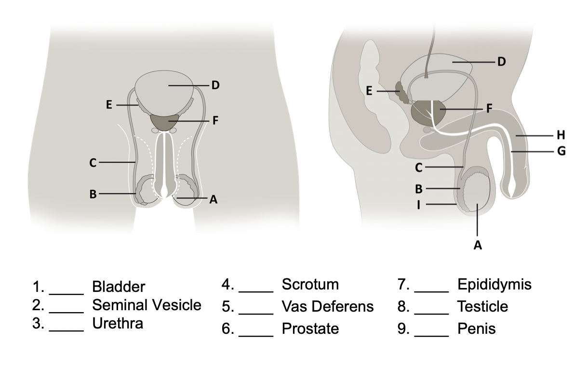
Review | Male Reproductive Anatomy
Notes:
Then, show the following slide with the answers.

Slide 15
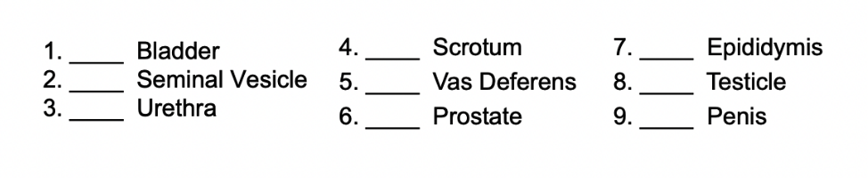
Answers | Male Reproductive Anatomy
D
I
B
E
C
A
G
F
H

Slide 16
What are hormones?
Hormones manage the activity of every system in the body.
Hormones are chemical signals that travel in the bloodstream to tissues and organs, directing:
Growth & development!
Mood!
Reproduction!
That’s a lot to direct!
© FEMM
Notes:
Step 3 (10 minutes): The brain and sperm production
Let’s talk about the power of hormones. Hormones manage the activity of every system in the body.
Hormones are chemical messengers that travel in the bloodstream. Different hormones give different signals to direct growth and development, mood, and reproduction. But it’s important to remember: hormones and puberty aren't random. Despite what you may have heard about puberty or becoming a man, all of the activity of the male reproductive system is controlled by the brain.

Slide 17
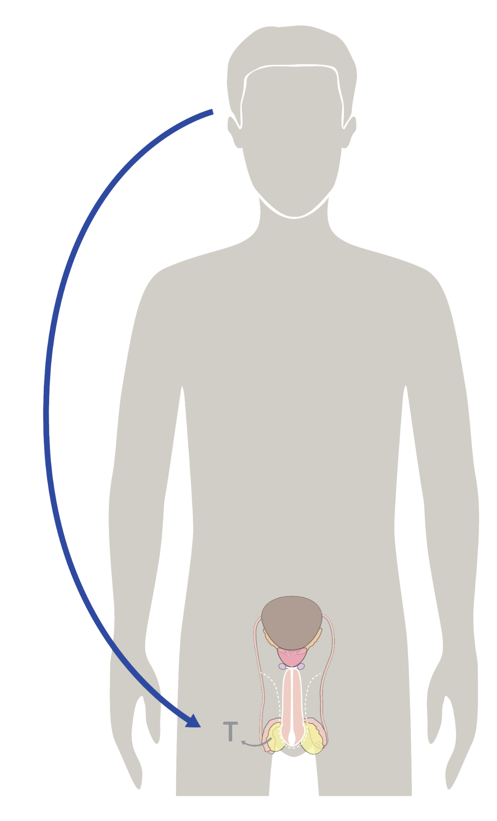
The Brain & Hormones
The brain sends hormonal signals to your reproductive organs to help them mature and function.
The testicles receive these hormonal signals.
Sperm and testosterone are both produced in the testicles.
© FEMM
Notes:
The brain sends signals to your reproductive system to mature in their function. During puberty the pituitary gland begins to function like that of an adult.
‹#›

Slide 18

The Brain & the Powerful Pituitary Gland
This little bean-shaped pituitary gland is the “master gland” for your body.
The pituitary gland signals the cells in your testes to produce sperm.
This is an important sign of health!
It means that your body and your hormones are working properly.
Did you know: the health of your hormones now, during puberty, shapes your brain and your body for the rest of your life?
Notes:
The pituitary gland is located in the brain. It’s a small but powerful part!
The pituitary gland is often called the "master gland" because it controls the release of most of the hormones in the body.
Fun fact: a normal pituitary gland weighs less than 1 gram, which is the weight of a raisin or a paper clip and is about the size and shape of a kidney bean!
In the male body, this tiny gland releases the hormones that tell the testicles to produce sperm and testosterone. (Powerful, for something the size of a kidney bean!) Sperm is the male cell of reproduction, and testosterone, the main male hormone.

Slide 19
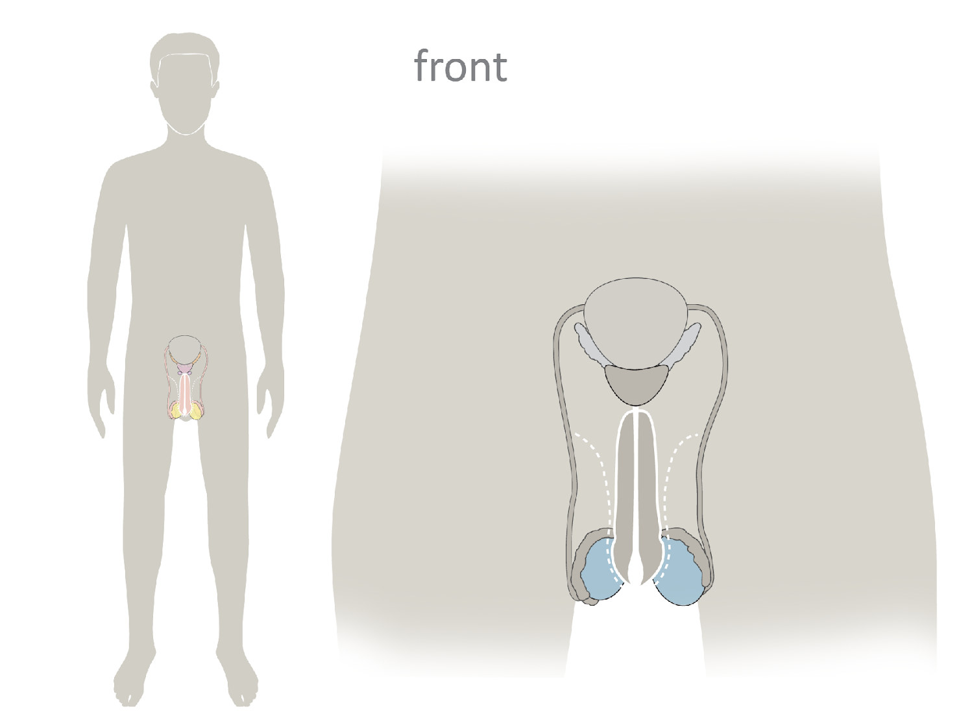
Sperm
Sperm are the male cell of reproduction. Each sperm carries your DNA!
They are made in the testicles.
You will make about 525 billion sperm in your entire lifetime.
© FEMM
Notes:
The testes actually make millions of sperm. In fact, by the time your body is done making sperm when you are much older, you will have made about 525 billion sperm. To make new sperm, it takes your body about 75 days, but this is a process that is happening every day in your body, so sperm is constantly being generated. All of the other parts of your reproductive system help to move the sperm through the body to the outside. But all of this happens in the testes because of your brain.
The sperm cell is approximately 55 micrometers long, which is roughly the same size as a pollen grain. In contrast to the egg cell, the female cell of reproduction, the sperm cell is one of the smallest cells of the human body!

Slide 20

Sperm production in the testicles
Sperm have a head, a midpiece, and a tail.
It takes 75 days for sperm
to become fully mature.
Sperm move through the different parts of the reproductive system during this time.
Sperm must be made at a temperature that is lower than the body’s temperature.
The head is where
genetic material
is carried
The midpiece supplies
the energy the tail
needs to move
The tail propels the
sperm and helps
breach the
egg
Notes:
To make new sperm, it takes your body about 75 days, but this is a process that is happening every day in your body, so sperm is constantly being generated. All of the other parts of your reproductive system help to move the sperm through the body to the outside. But all of this happens in the testes because of your brain.
The sperm cell is approximately 55 micrometers long, which is very tiny. In contrast to the egg cell, the female cell of reproduction, the sperm cell is one of the smallest cells of the human body!
Under a microscope you can see that sperm have a few distinct parts. Sperm have a head, a midpiece, and a tail. Each part serves a special function in human reproduction, to enter the female egg and join together to create a new life.
It takes about 75 days on average for sperm to grow and mature through the male reproductive system. Each part of the reproductive system contributes something unique to the development of sperm, and in a mature man, this process of sperm development is constantly happening. After sperm are made, they remain in the testicles for about two weeks before the cells die and are reabsorbed by the body. In the case of human reproduction, sperm enter the woman’s reproductive system and when the sperm and egg join together, they create a new human being.
A boy begins to produce sperm in puberty and continues to produce sperm every day throughout his life.

Slide 21
Testosterone: messages from the brain
Brain
Reproductive System, hello, come in, do you read me?
Repro S.
Roger that, brian.
Lol Brain
Increase testosterone.
© FEMM
Notes:
Step 4 (10 minutes): The brain and testosterone production
Something else happens in the testes... The testes also make the main male hormone testosterone.
When the pituitary gland sends those hormonal signals to the testicles, special cells in the testes called Leydig cells produce the hormone testosterone. You can think of the hormonal messages between the brain and the testes like a series of text messages, back and forth. It’s a constant feedback loop between the brain and the reproductive system.
On average, a man produces about 5mg of testosterone a day. This is less than a drop of water on a teaspoon. But hormones have a big impact! Testosterone in the testes helps with sperm production. And the testosterone that is released into the bloodstream communicates with the other parts of the body to impact growth and health. In puberty, all growth is impacted by the body’s production of the hormone testosterone.

Slide 22
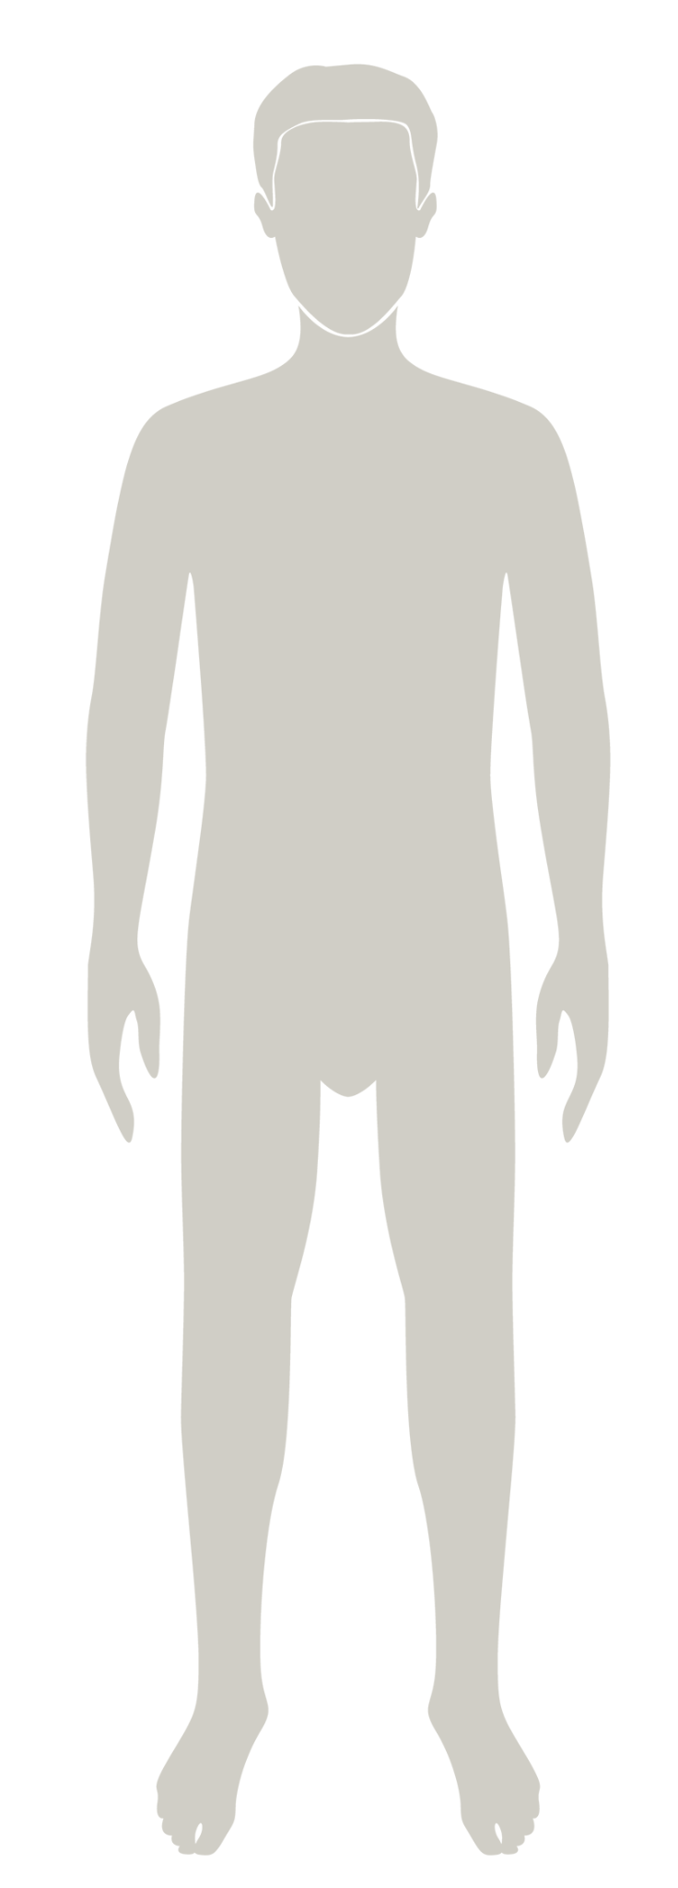
Hormones & your voice
hello? Ahem.
HELLO!
Testosterone has a big impact on your voice: it deepens it and lowers it.
This is called voice mutation.
This can start around age 12.
© FEMM
Notes:
For example, when your voice starts to get deeper, this is because testosterone has an effect on your larynx and vocal cords. This is actually called voice mutation. (But you are not a mutant!) Girls’ voices also change during puberty, but not even close to the same way that boys’ voices change.

Slide 23
Hormones & your hair
🥸
Testosterone has a big impact on your hair: it gets thicker and coarser.
Testosterone acts on different parts of your body (armpits, chest, mustache/beard, pubic area), but not all. Your eyelashes will not get thicker and coarser!
This will continue as you mature.
Testosterone probably won’t make you look like ‘disguised face’ emoji, though.
© FEMM
Notes:
Testosterone acts on different parts of your body, like your armpits, chest, pubic area, mustache/beard area, to make the hair there grow in more thickly and, usually, darker. But testosterone won’t act on all of your hair: your eyelashes are not going to get out of control!
If your body didn’t eventually start going through puberty, this could have health effects for you. Going through puberty is a sign of health. The changes that you observe in puberty are signs that your brain and your hormones are working in order to make you into the mature man that you are supposed to be.

Slide 24
Grade 7
LESSON 3
© FEMM
Notes:
CONCLUSION
Next lesson, we will learn more about what happens to your body when testosterone is acting on different parts of your body during puberty,
Exit Activity - True or False?
Read each statement aloud to the class and then choose one student to answer. Each student in the class must get one correct answer before the class is dismissed.
Testosterone is only produced after the age of 25 (F).
During puberty, your eyelashes will start to grow very thickly and you’ll have to trim them (F).
Hair will start to grow in your armpits (T).
Semen is the male cell of reproduction (F).
Sperm is the male cell of reproduction (T).
Your body will produce approximately 525 billion sperm in your lifetime (T).
You can see an individual sperm without a microscope (F).
Testosterone is produced in the testicles (T).
The brain must signal the testicles in order to produce sperm (T).
If your body doesn’t go through puberty by the time you’re 18, it’s no big deal (F).
Getting bigger muscles in puberty is a sign of health (T).
Testosterone is the main male hormone (T).
Testosterone acts on your larynx to make your voice deeper (T).
Every guy’s voice has to be the same tone or it means he hasn’t gone through puberty (F).
The change your voice undergoes during puberty is called voice mutation (T).
Both men and women have hormones (T).
Hormones are chemical messengers in the bloodstream of all humans (T).
Hormones act like text messages in the body, sending messages from one part to another (T).
It is normal to be born with two testicles (T).
Men produce sperm only one day per year (F).
Men produce sperm only at night (F).
Sperm and fluids together are what make up semen (T).
Estrogen is the main male hormone (F).
Hormones manage the activity of every system in the body (T).
Men produce sperm only once every three months (F).

