Slide 1

Grade 7
LESSON 4
© FEMM

Slide 2
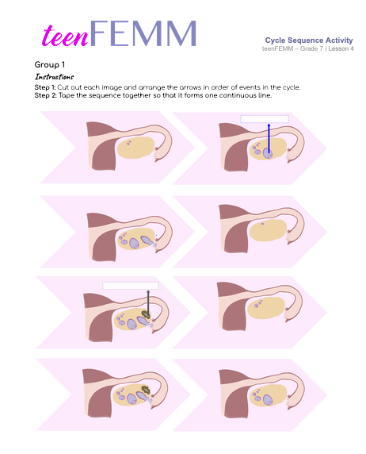
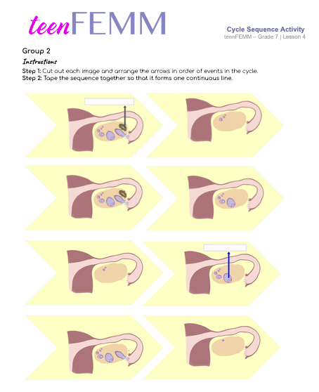
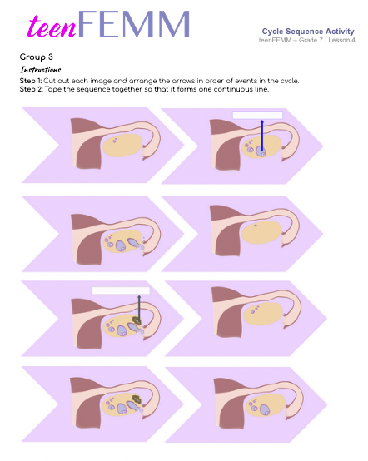
Cycle Sequence
Entry Ticket Activity
© FEMM
Notes:
Pass out sheets of paper. Ask the students to draw for three minutes. They should draw a diagram of the ovulation cycle from memory as best they can. When three minutes are up, have students turn in their papers. Choose the three drawings that look the most complete and have those students each draw part of the cycle on the white board.
To start off today, we’re going to do a drawing activity. This isn’t an activity to see who is the best artist. This is to get you remembering the ovulation cycle and how it works. You’ve got three minutes to draw what you can remember… GO!

Slide 3

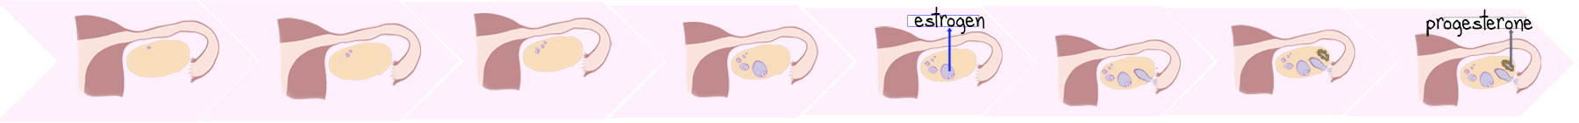
Answers | Cycle Sequence
This
Tape =
… a beautiful cycle sequence!
FSH –> growing egg + follicle -> estrogen -> HIGH estrogen -> Ovulation! -> Corpus Luteum -> Progesterone!
© FEMM
Notes:
For now, set aside the sequences to return to later.

Slide 4
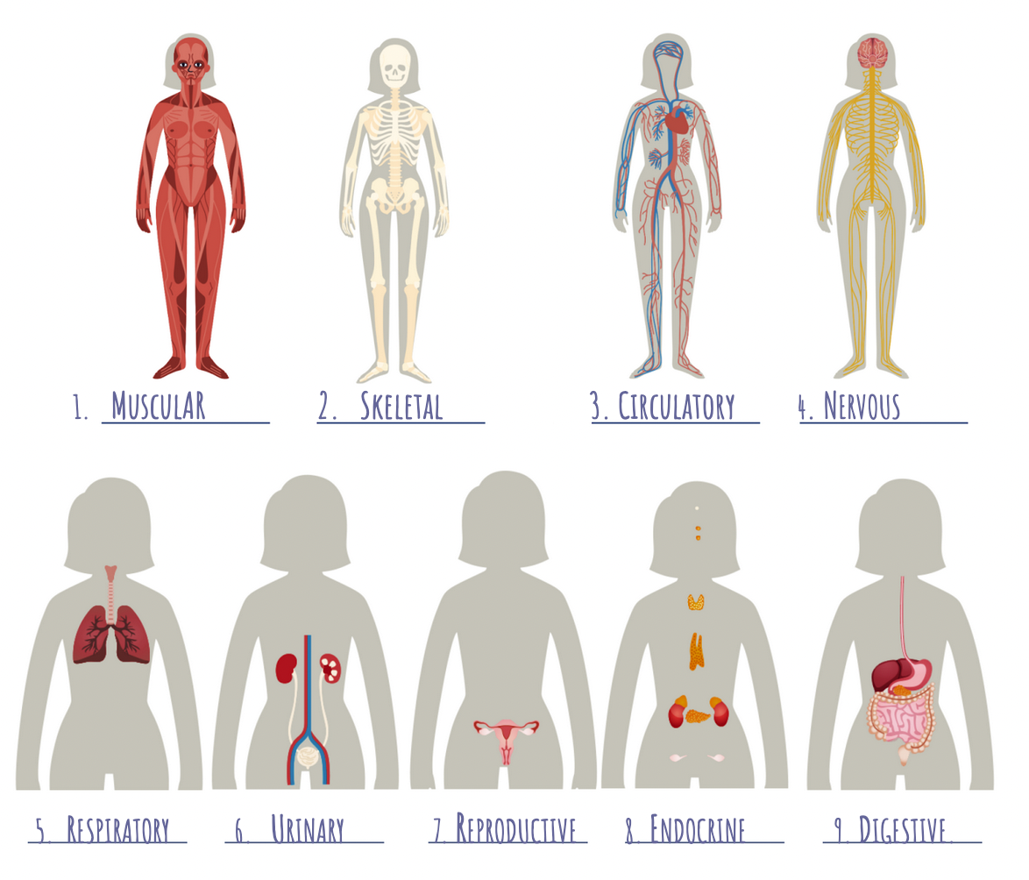
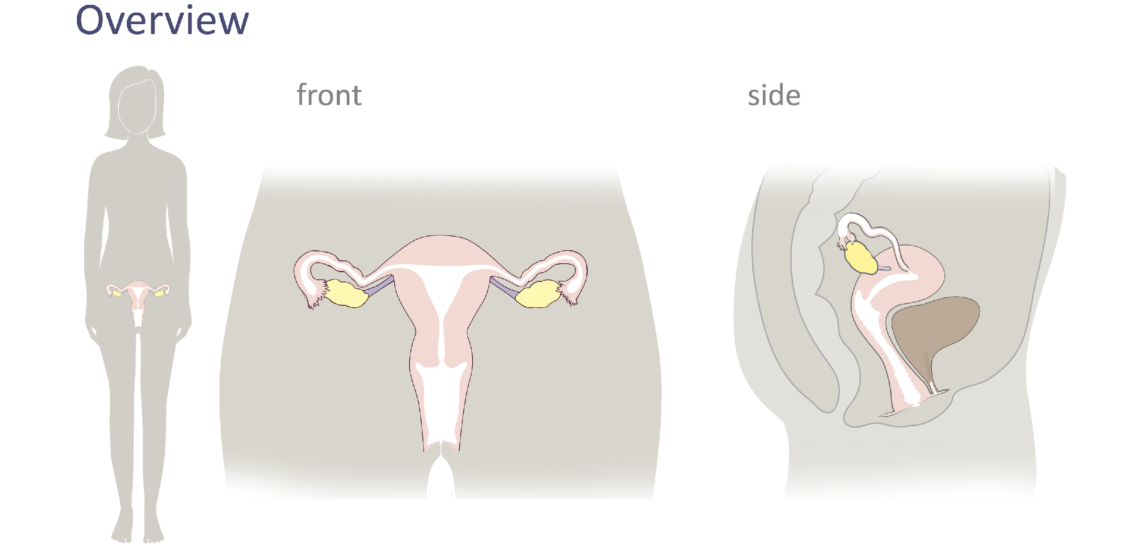
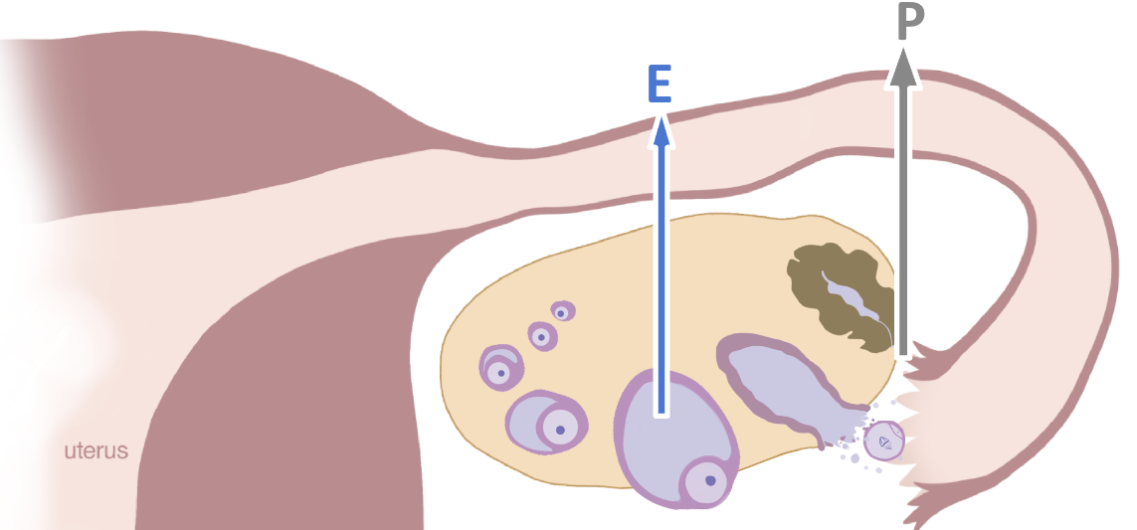
Review
Lesson 1
Lesson 2
Lesson 4
Lesson 3
You are here.
Notes:
Step 2 (5 minutes): Review previous lessons and introduce new concepts for this lesson
In lesson one we learned about 9 of the body’s systems and how they work together. In class two, we zoomed in on your reproductive system and its anatomy and function. In lesson three, we looked closely at the ovaries and the process of ovulation. Today, we will talk about the rest of the ovulatory cycle and menstruation.
Do you remember what controls the activity of every system in the body?
Yes, hormones! Hormones aren’t random: every single hormone is released and directed by your brain. And for you to feel good and healthy in your body, every hormone needs to be released at the correct level and at the correct time. One way to think about the cycle each month is that your hormones go through an intricate sort of dance and the brain is the choreographer: “On your toes FSH, you’re up! Now rise, Estrogen… gradually…”

Slide 5

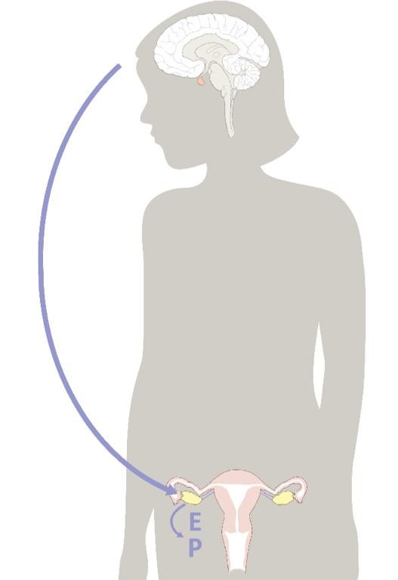

The brain is the command center
Brain
🩰
On your toes
FSH, you’re up!
FSH
On it!
Terrific entrance! That was really “en pointe”
*Bows*
© FEMM
Notes:
Remember the hormonal axis: the brain is the command center but it’s in constant communication with the ovaries. Let’s briefly review the ovulatory cycle as a class.

Slide 6
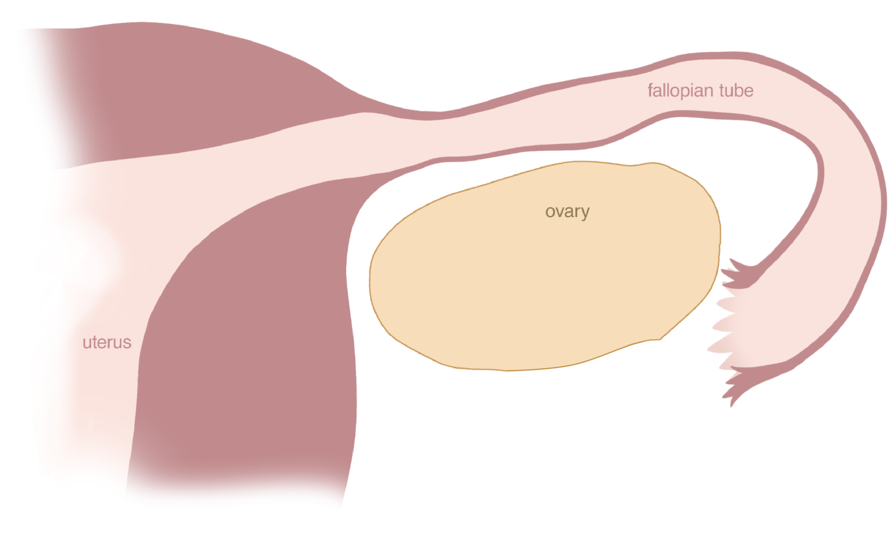
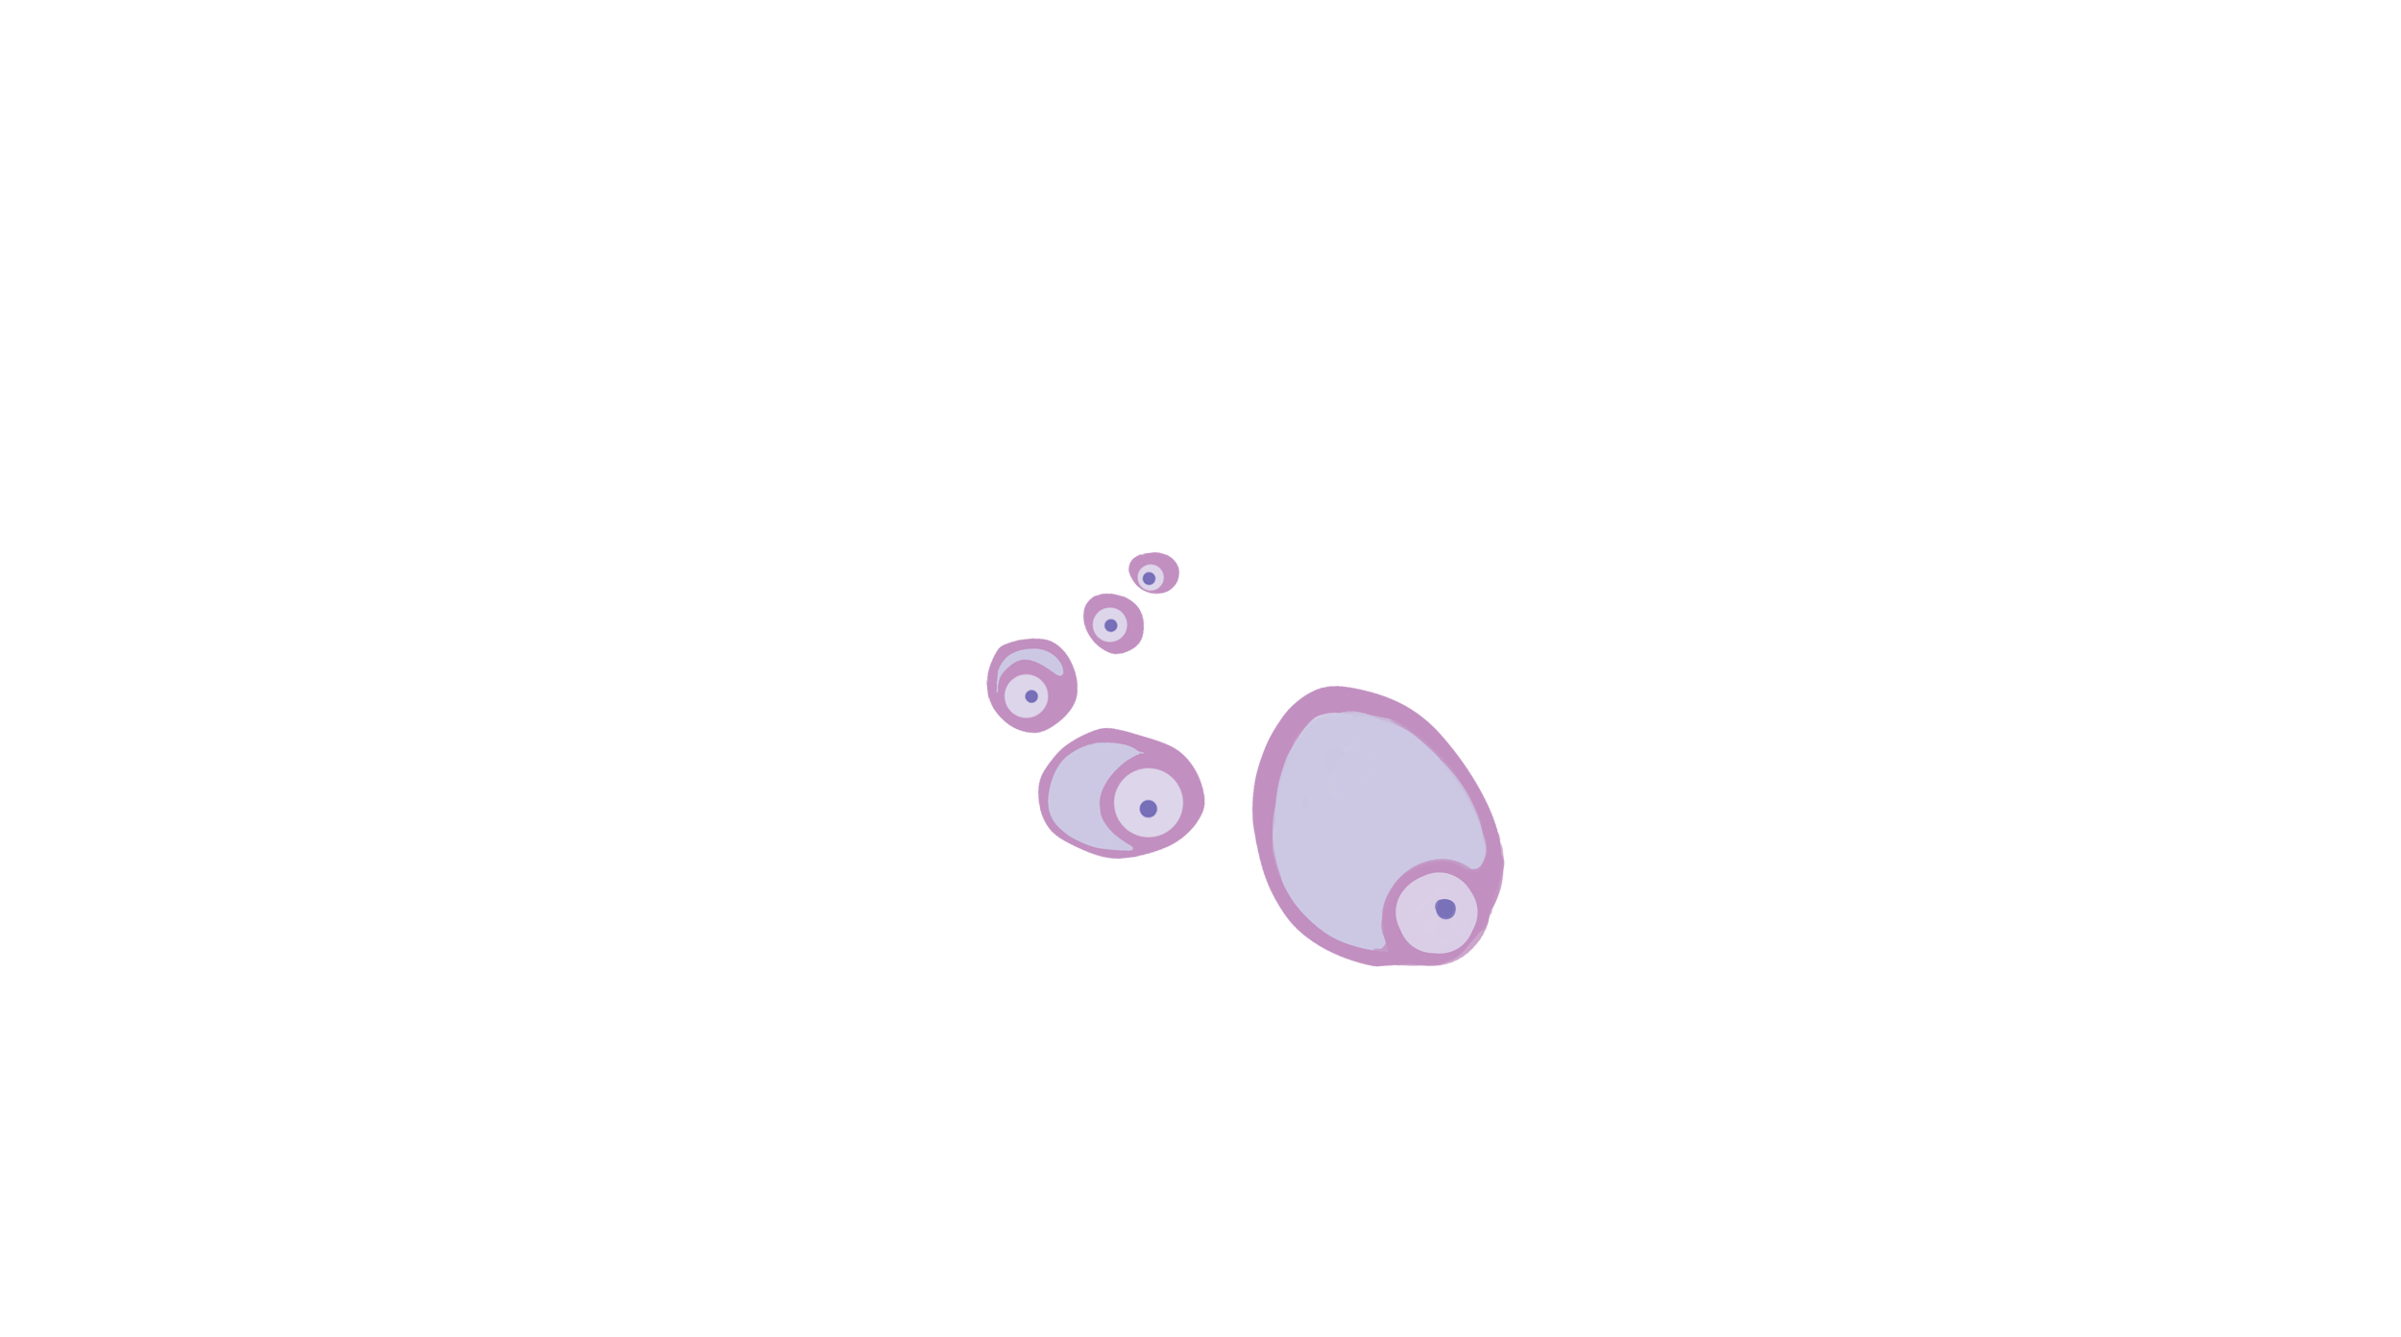
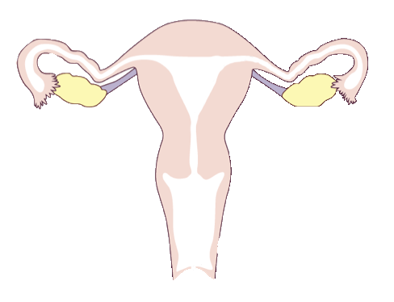
Ovulatory cycle: The follicle begins to grow
© FEMM
Notes:
Every month, in the ovary, an egg, a female cell of reproduction, begins to grow and develop. This egg is surrounded by a special, protective tissue, called a: follicle____ . The egg and follicle grow: together___.

Slide 7
Ovulatory cycle: Estrogen
© FEMM
Notes:
As the egg and follicle grow in size, they produce more and more of the hormone: estrogen__.

Slide 8
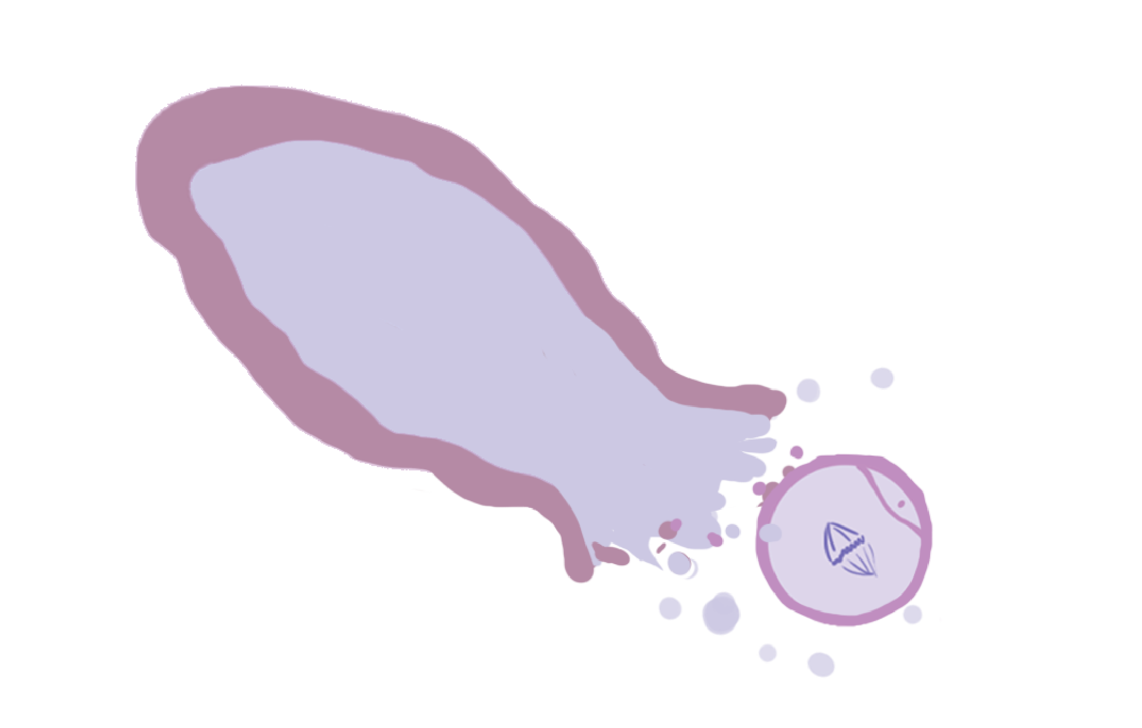
Ovulatory cycle: Ovulation
© FEMM
Notes:
When the egg is big enough, the egg bursts from its follicle and leaves the ovary. This is called: ovulation_.

Slide 9

Ovulatory Cycle: Progesterone
© FEMM
Notes:
After ovulation, the now-empty follicle becomes a new tissue that produces the second main female hormone: _progesterone____. This new tissue that produces progesterone is called the corpus luteum___which in Latin means “yellow body”.

Slide 10
Check your knowledge!
What are the ✌🏻 jobs
of the ovaries?
To grow and release an egg
1
2
Produce estrogen + progesterone
Notes:
What are the 2 jobs of the ovaries? Click on the yellow box to reveal each answer.
1. To grow and release an egg (ovulation).
2. To make the hormones estrogen and progesterone.

Slide 11
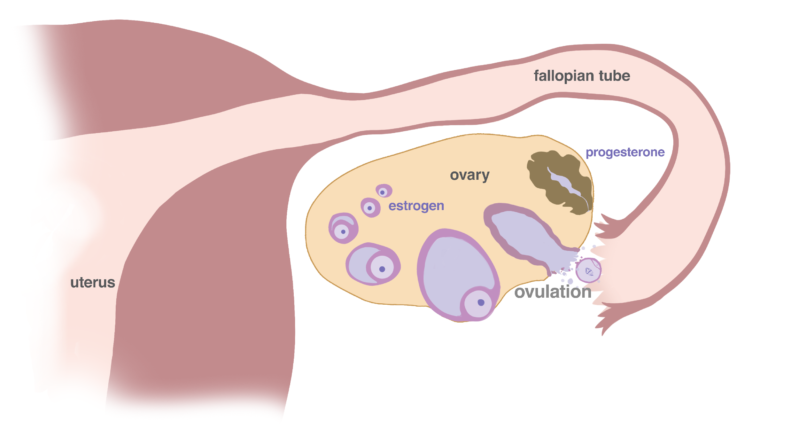

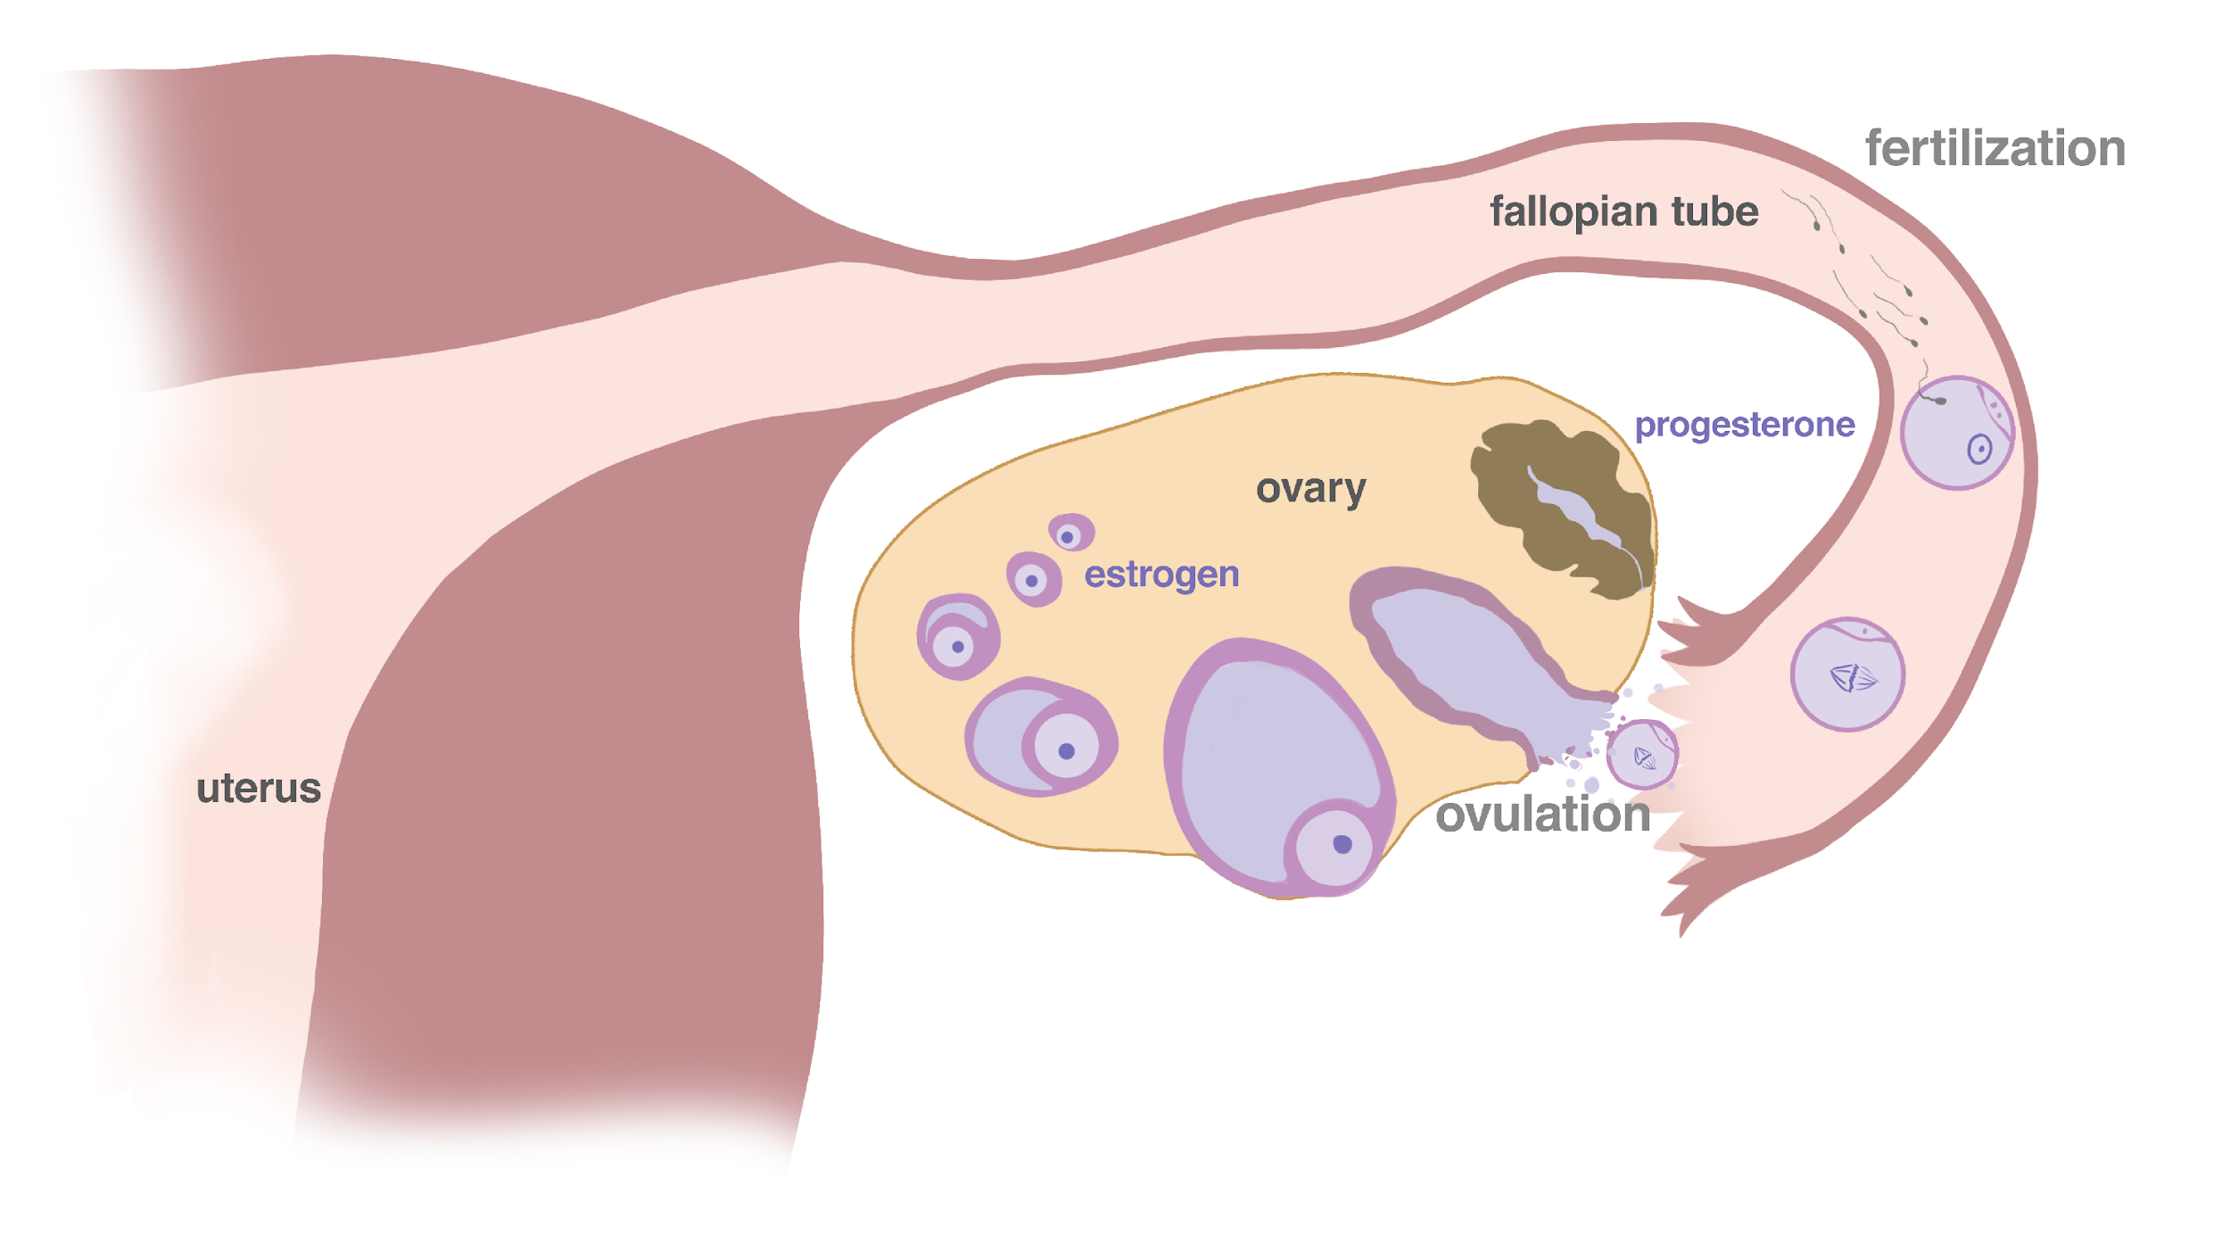
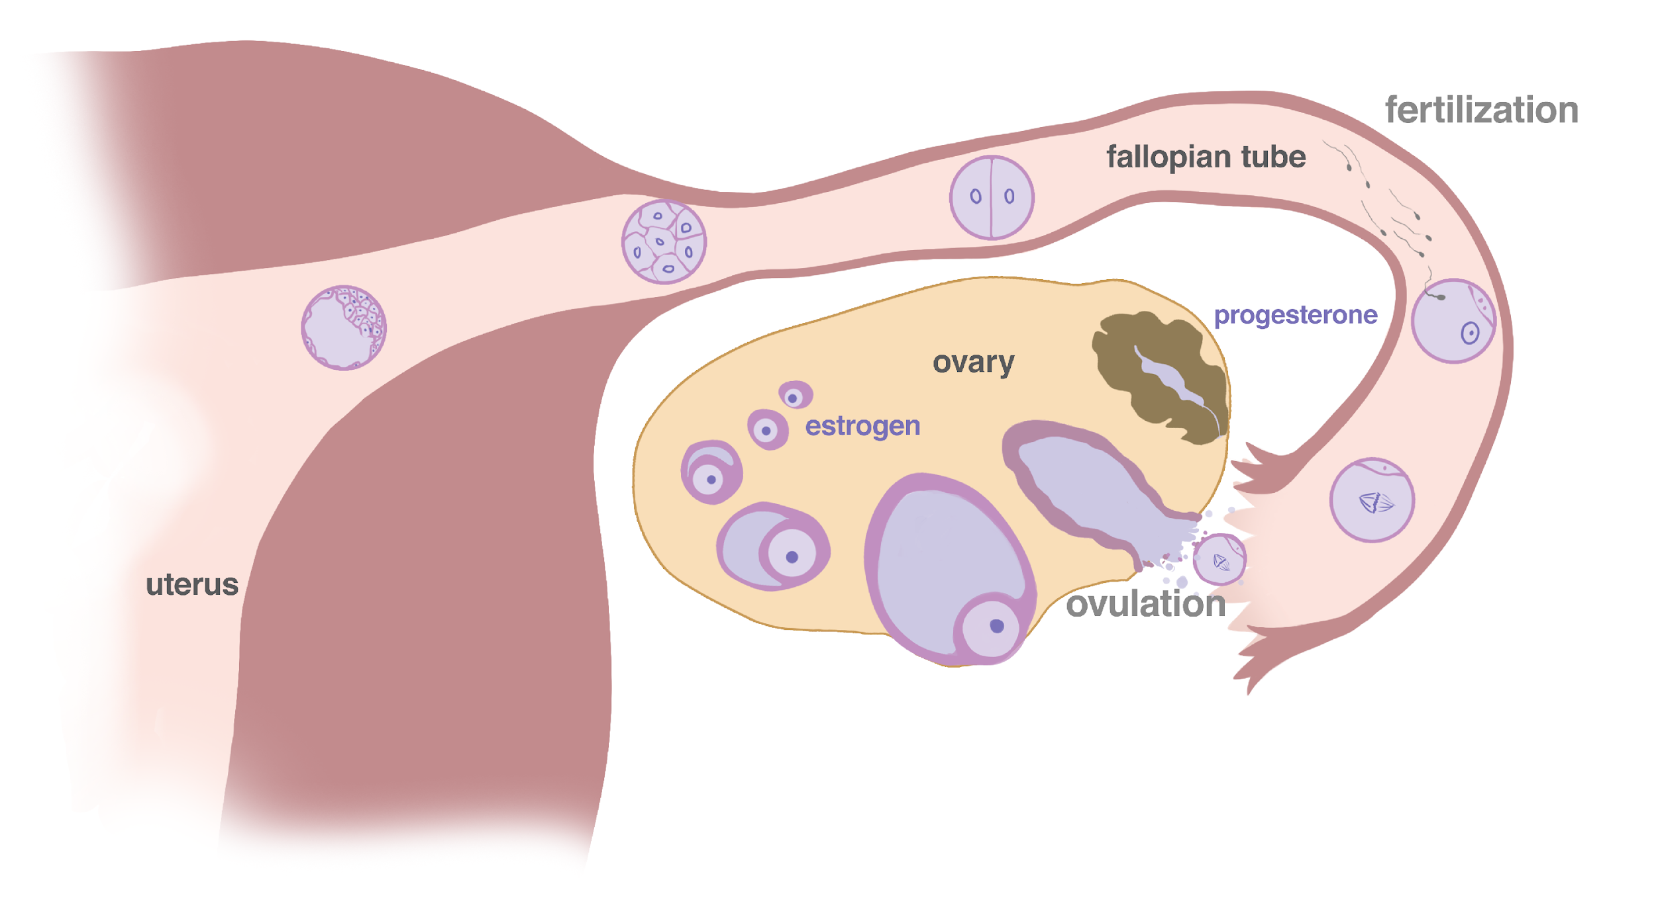
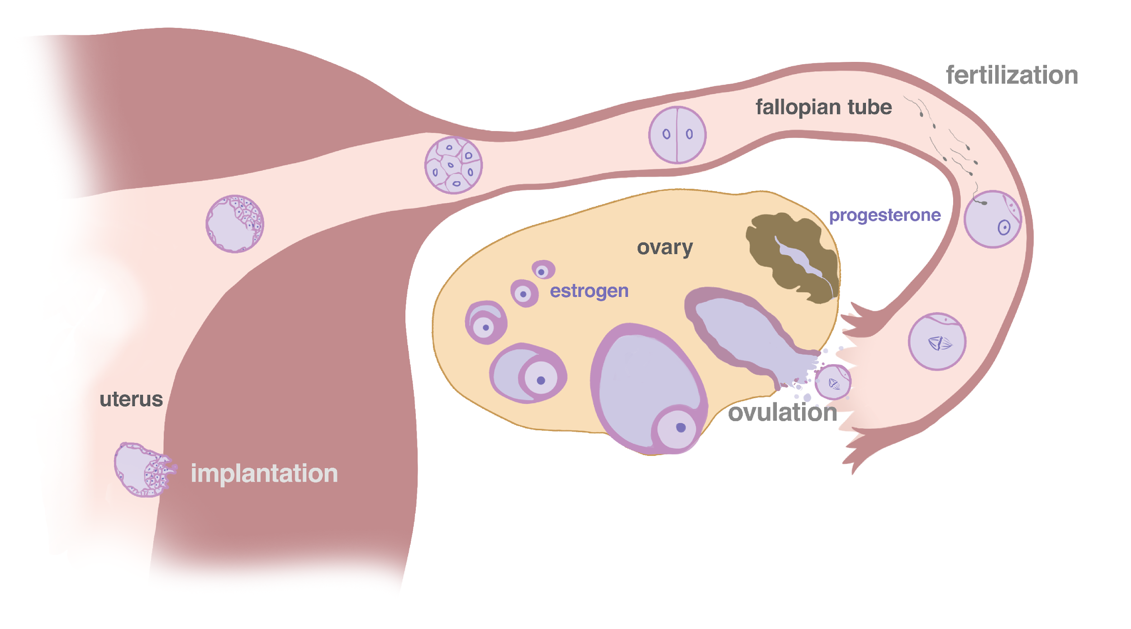
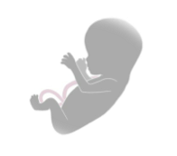
The beginning of life
© FEMM
Notes:
Step 3 (10 minutes): Expand on the rest of the cycle
What happens to the egg after it is released from the ovary into the fallopian tube?
If the egg joins with the male cell of reproduction, sperm, it becomes a fertilized egg, also known as a zygote. This newly formed life contains the genetic material from both the woman’s egg and the man’s sperm: 23 chromosomes from the female cell and the 23 chromosomes from the male cell.
As the fertilized egg, or zygote travels from the fallopian tube to the uterus, hour after hour it divides from one cell into two and then four, until (while still only the size of a pinhead!) Eventually, this new life is composed of hundreds of cells when it embeds into the uterine wall. There it continues to grow and expand the uterus until approximately 9 months later.

Slide 12
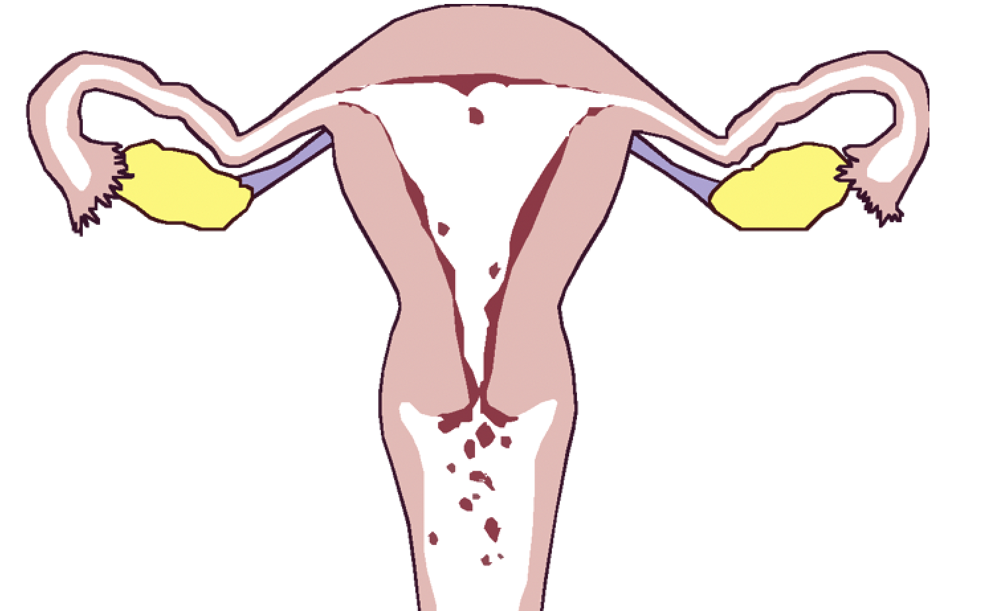
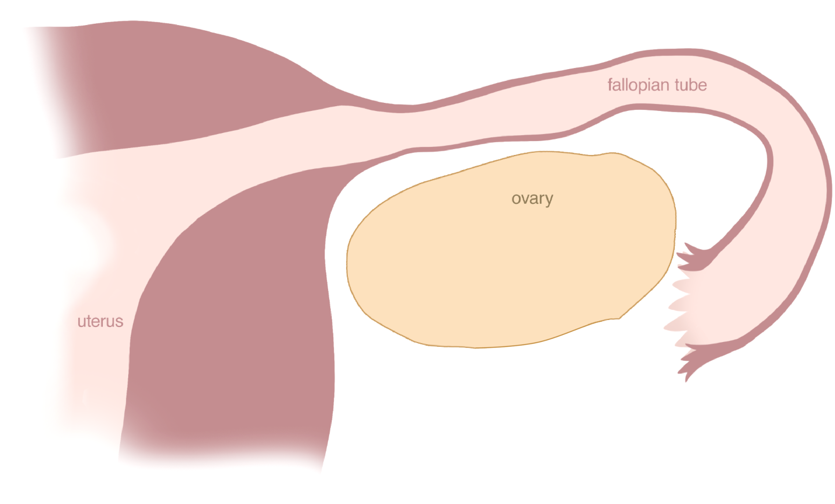
Menstruation
Notes:
On its own, the egg simply dissolves after 12-24 hours (just like the grains of salt in the water did that we observed last class). Days later, the uterine lining sheds during a few days of bleeding at the end of the cycle. This shedding of the uterine lining is called menstruation and it is what is happening inside of you when you get your period. Menstruation typically lasts from 3-7 days.
As we have learned, the growing egg/follicle in the ovary makes estrogen. The estrogen produced in the ovary impacts the uterus by thickening the lining of the uterus. The progesterone produced in the ovary acts on the uterus by nourishing and maintaining the lining of the uterus, in case a baby attaches and grows.
The whole ovulatory cycle: from growing and releasing an egg, producing the hormone estrogen and then progesterone, to menstruation, repeats every 24-36 days. This cycle is a normal and important process that tells us a lot about a woman’s health and the health of her hormones.

Slide 13
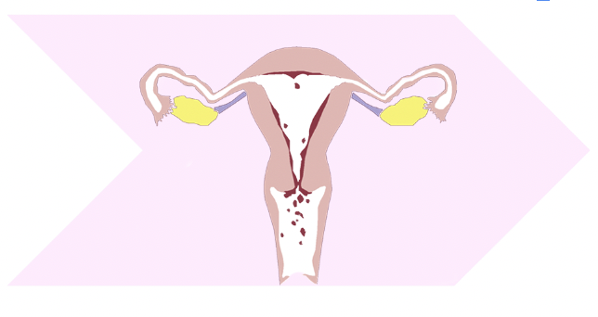
Complete the Cycle Sequence
Growing egg + follicle -> HIGH estrogen -> Ovulation! -> Corpus Luteum -> Progesterone! -> Menstruation
© FEMM
Notes:
Step 4 (5 minutes): Link the ovulatory cycle + menstruation
Cut out the three arrows on the last page of the Cycle Sequence Activity.
Now that we’ve learned that menstruation, the shedding of the uterine lining, marks the end of the ovulatory cycle (like a period comes at the end of a sentence), let’s place the final piece at the end of each sequence. Have students tape the menstruation image to the end of each sequence. Then, connect and tape all three sequences together in a long line. Finally, tape both ends together to make one large circle/loop.
The large loop illustrates how the end of each cycle begins the next. This visual representation will hopefully be helpful as we learn to chart in upcoming lessons.

Slide 14
Effects of estrogen & progesterone
 | estrogen | progesterone
uterus | tones, contracts | relaxes
uterine lining | grows | maintains
breasts | grows | normalizes
bones | forms | maintains
blood vessels | dilates, increases flow | relaxes, normalizes clotting
brain cells | stimulates | maintains and heals
well-being | normal levels promote well-being; high levels increase anxiety | promotes sleep and relaxation; decreases anxiety
© FEMM
Notes:
Step 5 (10 minutes): Estrogen, Progesterone and overall health
To better understand why ovulation is a sign of health, let’s look at the effects of estrogen and progesterone on different parts of the body.

Slide 15
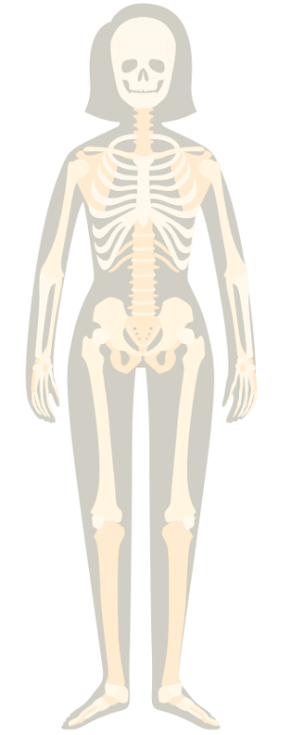
Hormones help your bones!
Estrogen + Progesterone
are really important for bone health and strength!
Too much or too little estrogen or progesterone can contribute to osteoporosis.
Notes:
Bones (height/size and density)
Throughout puberty, your bones are growing rapidly. By the time you have a regular cycle, you will most likely have reached your adult height. This is why hormonal health is so important during puberty, as your body’s estrogen and progesterone levels influence your height and the health of your bones. Proper hormone levels are vital to achieve strong bones so that they are not as susceptible to breaks.

Slide 16
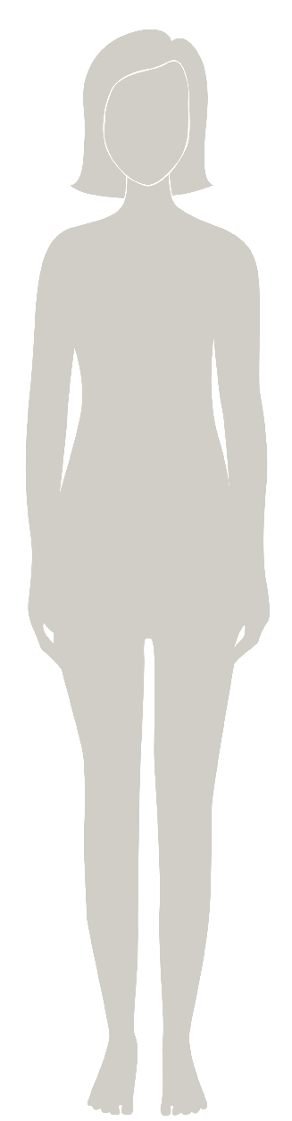
Hormones help your hair!
Estrogen + Progesterone
stimulate hair growth. They can even help your hair grow faster!
Too little estrogen and progesterone can cause hair thinning or hair loss.
Notes:
As estrogen starts to increase in the ovaries during puberty, the impact of this can be seen in the hair. You may find that your hair gets more oily, thick or even changes texture: some people with straight hair start having wavy hair during puberty and vice versa. You will also notice the growth of pubic and underarm hair. You may also find that you sweat more, and are ready to use deodorant. You will also notice the growth of pubic and underarm hair. You may also find that you sweat more, and are ready to use deodorant. Deodorant is usually applied under the arms once in the morning and reapplied if you have a sporting event or another activity that might cause more sweating later in the day.

Slide 17

Hormones help healthy breasts
Estrogen + Progesterone
are necessary for normal breast development through puberty.
Progesterone balances estrogen-ic growth which is especially important with regards to preventing cancer.
Notes:
Increasing hormones promote breast growth, and it takes several years for breasts to fully mature. In the first stage of development, small lumps called breast buds appear. The nipple and area surrounding the nipple (called the areola) begin to expand. Then, the breasts continue to enlarge until they reach their full size. Don’t worry, it is common for one breast to grow faster than the other.

Slide 18
Hormones help your skin!
Estrogen
increases skin hydration, and supports increased skin thickness.
Progesterone balances estrogen and contributes to sebaceous gland (oil production) activity.
Notes:
Hormones are working hard in your body throughout puberty. Sometimes when they work a little too hard, you can end up with acne, which is when there is an overproduction of oil in the glands in your skin. Making healthy choices to support overall hormonal balance can help to keep your skin smooth and clear into the future. We will talk more about this in other lessons.

Slide 19
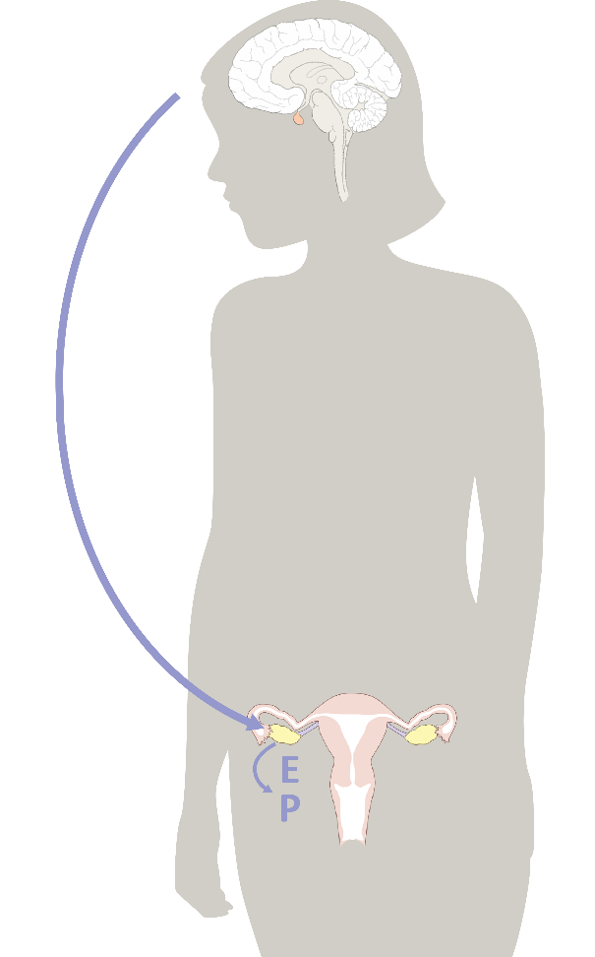
Hormones help your mood!
Estrogen + Progesterone
are so important for our mental health.
Drops in Estrogen can make us feel irritable and anxious.
😨
Notes:
It is very common to experience mood changes as you go through puberty. After all, we have learned a lot about how much hormones influence your brain! Even minor drops in estrogen can make us feel irritable or anxious. Ovulation is a sign of health for our body but also supports our mental health as estrogen boosts mood.

Slide 20
Hormones help your mood!
Estrogen + Progesterone
are so important for our mental health.
Progesterone, produced by
ovulation, calms us down and helps us sleep better.
But that doesn’t mean you want ONLY Progesterone as you need Estrogen, too!
REMEMBER: Estrogen and Progesterone balance each other out during the cycle.
Notes:
Progesterone, which is produced after ovulation, calms us down and can help us sleep better. But you don’t want only progesterone as you need estrogen, too! Remember: estrogen and progesterone balance each other out, through the different points in the cycle.

Slide 21
Hormones help your brain!
Proper amounts of Estrogen + Progesterone facilitate higher order cognitive functioning such as memory, attention, and language!
🧠
can I get a fist bump,
you brainiac, you?!
Notes:
Did you know that both the male and female brain is not fully mature until age 25?
Hormones play a key role in helping all of the essential brain pathways and processes to develop and connect properly.

Slide 22
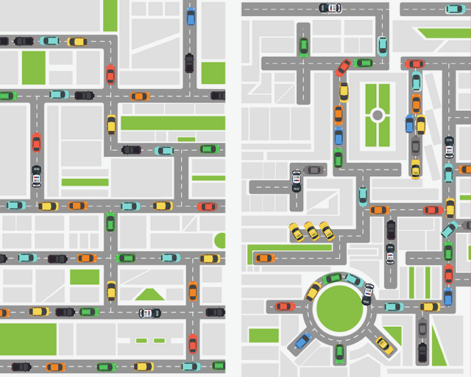
Hormones organize your brain!
Did you know that proper amounts of Estrogen + Progesterone produced through ovulation help to
ORGANIZE the developing teen brain?
That means that your brain looks like this…
Instead of this…
Notes:
Hormones influence how structures of the brain grow and what parts of it are activated in certain situations or environments.
All of this can be a lot to take in. Is there a trusted adult you can talk to about your questions? Maybe they can help you with a personal care routine? For instance, you may feel more confident if you are prepared ahead of time for your period.
CONCLUSION
Now that we’ve learned more about the ovulatory cycle, menstruation and how the hormones progesterone and estrogen develop our bodies and brain, next lesson we will learn how to record specific characteristics of our cycle in order to pay attention to the quality of our hormones and our health.

Slide 23
Grade 7
LESSON 4
© FEMM
Notes:
CONCLUSION
Now that we’ve learned more about the ovulatory cycle, menstruation and how the hormones progesterone and estrogen balance and develop our bodies and brain, next lesson we will learn how to record specific characteristics of our cycle in order to pay attention to the quality of our hormones and our health.

