Slide 1

Grade 7
LESSON 4
© FEMM

Slide 2
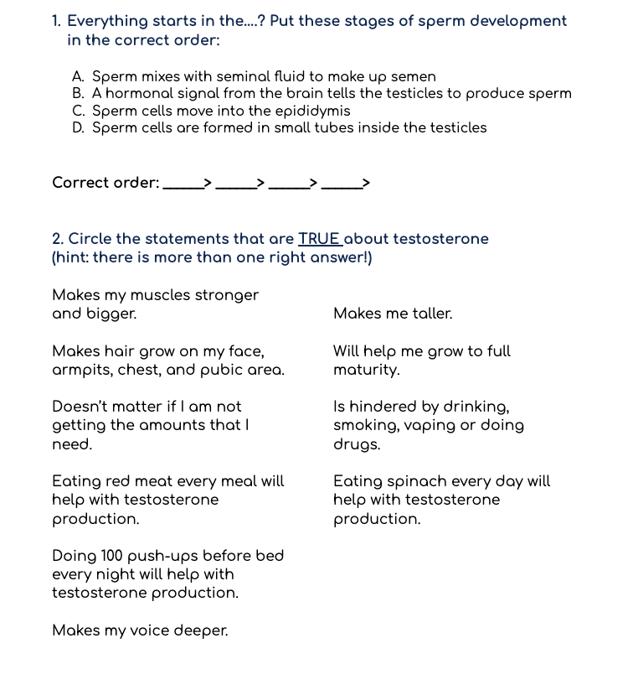
Worksheet
Did You Know That?
© FEMM
Notes:
PROCEDURE
Step 1 (5 minutes): Worksheet: Remember that?
Hand out the Worksheet: Remember That? Allow students a few minutes to complete their worksheet and then review the answers with the class using the Teacher’s Answer Key.

Slide 3
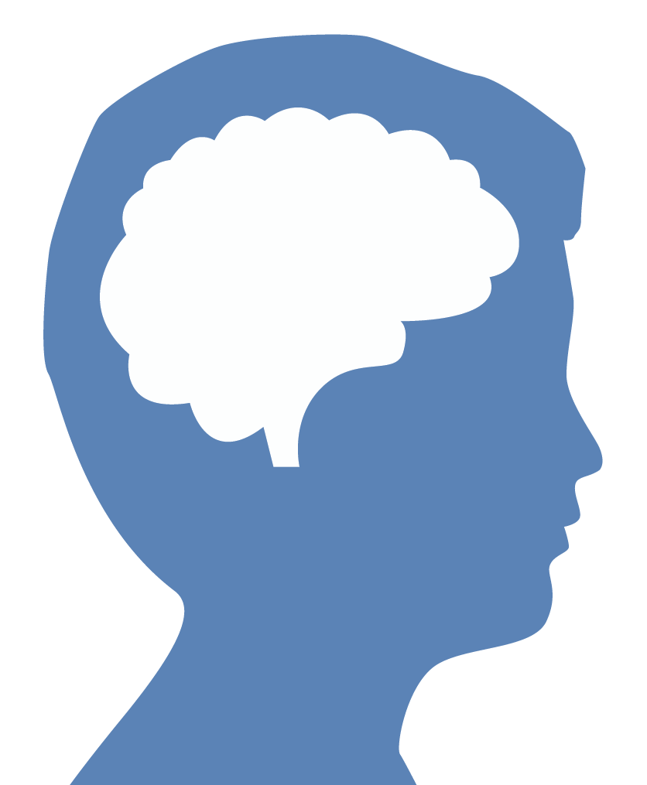
Brain development & testosterone
25
© FEMM
Notes:
Step 2 (5 minutes): Brain and Testosterone
Last class, we talked about the main male hormone…? Testosterone. During puberty, the hormone testosterone works to develop your brain, your bones, and the growth of every part of your body. An amazing thing is that the brain starts to generate testosterone, and this hormone in turn helps to develop your brain.
Did you know that the brain isn’t fully mature until we’re about 25 years old! That’s amazing news for you! This means that your actions, choices and habits right now are shaping and molding your brain for the rest of your adult life. Think of your brain like a ball of soft clay. If you press your fingernail into the clay it leaves a small mark. During puberty, testosterone influences the development of new cells in the amygdala, a powerful part of your brain. Now, during puberty it’s like you put your fingernail into the clay, but thanks to Testosterone, that mark is really deeply ingrained in the clay. So, you want to make sure you’re making the right marks.
Because the brain is the organizing center for all of this activity, things that affect your brain affect your physical and emotional health. The opposite is also true: things that affect your physical health affect your brain. Take exercise, for example. It’s good for your body and muscles and heart and lungs but did you know that it also improves your mood? So when you’re feeling down or have a lot going on in your head, going for a run or playing a sport is actually just what your brain needs to produce feel-good hormones in your body.

Slide 4
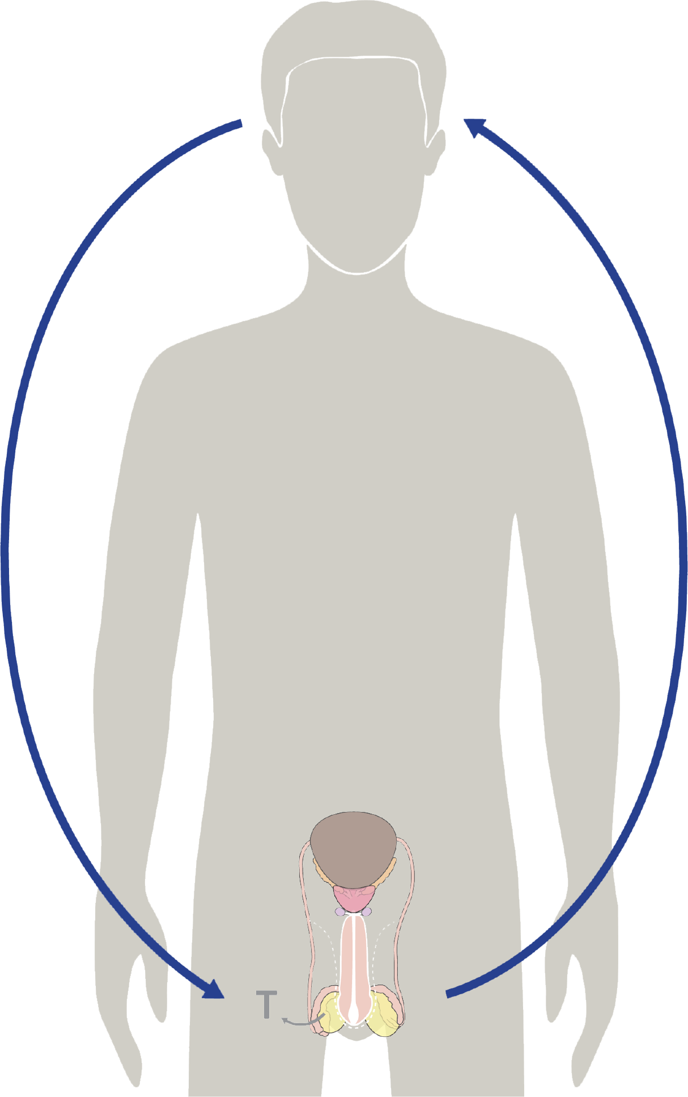
Hormonal feedback
The brain signals the testes to produce testosterone
4. Testosterone changes the body and the brain.
3. The increase in Testosterone signals to different parts of your body to start growing.
2. The hormone testosterone
is produced by cells in the testicles.
© FEMM
Notes:
Step 3 (10 minutes): Hormones are Powerful
Your brain starts the process of puberty by directing hormones.
For some, this usually starts around the age of 10, even if you don’t notice any changes right away. For others, this process can start later because every guy’s body is unique.

Slide 5
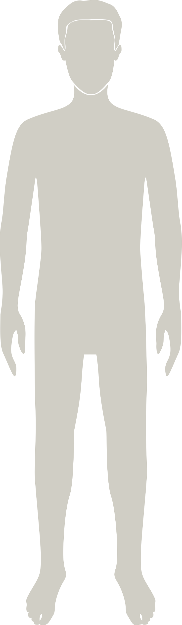
Testosterone & your growth
Testosterone has these effects:
strengthens bones, heart
deepens voice
sharpens mind
increases hair growth
increases oil & sweat production
growth spurt (you get taller)
increased muscle
These changes begin during puberty
(typically ages 10-17)
© FEMM
Notes:
Testosterone strengthens bones, muscles and the heart. It deepens the voice, sharpens your mind, increases hair growth and sweat production. Testosterone impacts every part of your body; the next chart shows the impact of some parts of your body.

Slide 6
Testosterone & your growth
 | testosterone
brain cells | increases ability to learn
bones | strengthens bone formation & density
muscles | increases muscle mass
hair | promotes growth
fat metabolism | promotes fat burning
blood sugar | keeps at a healthy level
overall well-being | normal levels promote confidence and motivation
© FEMM
Notes:
Testosterone is made in your testes or testicles, along with sperm. This is why your reproductive health is so important to your overall health! The testicles produce testosterone which then enters the bloodstream and travels throughout your body. There are a lot of steps in the process, but essentially, in puberty, your body gets the message that it is supposed to increase testosterone levels. The brain controls these levels, communicating with your reproductive system.

Slide 7
Text message testosterone
🧠 improved mood!
❤️feeling sensitive and self-conscious
Increased muscle mass💪🏽
🦴
increased bone density!
© FEMM
Notes:
Testosterone is made in your testes or testicles, along with sperm. This is why your reproductive health is so important to your overall health! The testicles produce testosterone which then enters the bloodstream and travels throughout your body. There are a lot of steps in the process, but essentially, in puberty, your body gets the message that it is supposed to increase testosterone levels. The brain controls these levels, communicating with your reproductive system.
The increasing testosterone levels cause the physical changes that you see such as increase in height, weight and muscle mass or the emotional changes you experience, from feeling sensitive and self-conscious to energetic and competitive.

Slide 8
Hormones are
POWERFUL.
The smallest changes in hormone levels can cause huge changes in your body.
© FEMM
Notes:
Hormones are very powerful. The smallest changes in hormone levels can cause huge changes in your body. Have you ever heard about Olympic athletes who were caught using substances to make them go faster or jump higher or run longer? The substances they take are often a kind of testosterone. Even things found in muscle-building supplements can be very unhealthy for your body. Supplements and drugs to increase muscle and testosterone cause damage to the heart, increase the risk of cancer and they actually decrease or even stop your body’s own production of testosterone.
In puberty, testosterone will help your body to develop and mature. It will help you grow taller and build strong bones and muscles. It will also cause your voice to change, eventually deepening. You will also notice that your body will start to produce more odor and sweat and become more hairy. All of these things will happen when your body is ready. You do not want to interfere with your brain and body development.
The growth that you see and experience during the next several years will give you confidence that you are developing as you should, so you can feel proud rather than self-conscious of these changes.

Slide 9
“Does testosterone
change my brain?”
William, age 12
© FEMM
Notes:
Step 4 (10 minutes):
Let’s talk about some of the changes you might be seeing, and some of the concerns guys have as they enter puberty.
Does testosterone change my brain?
Testosterone changes how your brain is organized. It makes certain parts of your brain bigger. Also, testosterone can influence how your brain gets activated when it responds to a situation or environment. These changes are normal and are meant to happen.

Slide 10
“Will I be tall?”
Jayden, age 12
© FEMM
Notes:
Will I be tall?
There’s no way to know how tall you’ll be exactly (until you stop growing!). Many boys your age are now shorter than the girls. This can be normal, because girls get a head start on puberty (typically ages 9-14 for a girl, and ages 10-17 for a boy). So, you’ll likely catch up and maybe even be taller than the girls, eventually. Some boys have been known to keep growing until college!

Slide 11
“When do my muscles get as big as possible?”
Leo, age 13
© FEMM
Notes:
When do my muscles get as big as possible?
You might be worried about how your body will develop, especially as you watch your friends’ bodies change. Guys can expect their shoulders to broaden and muscles to grow, but remember - all guys grow differently and at different paces. Testosterone makes it easier to build muscle, but exercise is also important. Choosing healthy habits - which we’ll learn about in the next session - are important to keep your whole body healthy, including your muscles.

Slide 12
“Where is all this hair coming from?”
Nick, age 12
© FEMM
Notes:
Where is all this hair coming from?
In puberty, the hair over your body begins to thicken. Boys can begin to see hair growing on the chin and upper lip, chest, armpits, and in the pubic area (around the testicles). This hair growth is a result of all of the hormones, particularly testosterone, that are working hard to develop your body from a boy’s body to a man’s body.

Slide 13
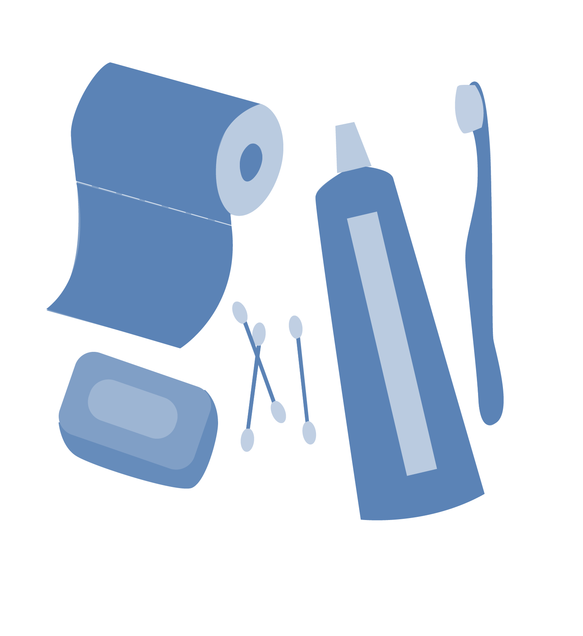
Healthy Hygiene Habits
Hygiene: the habits that help keep you clean and healthy.
• Bathe or shower daily, or more if you’re doing sports, outdoor work, etc.
• Wash your face in the morning and at night.
• Use deodorant, as needed, to help eliminate body odor.
• Brush your teeth at least twice per day.
• Trim your finger and toe nails once a week.
• Wear clean clothes every day.
Bathroom hygiene:
• Wipe well after using the bathroom.
• Wash your hands after using the bathroom.
© FEMM
Notes:
Step 4 (5 minutes): Hormonal Changes and Hygiene + Think and Write Exercise
Because of all of these new changes in your body, it’s important that you start to take care of your body.
The things you do to keep yourself clean are important hygiene habits. Some of the things you can get in the habit of doing each day are:
Taking a bath or shower each day (or more, if you’re doing sweaty activities!): Body odor in your armpits actually comes from bacteria in your armpits. Taking a bath or shower and washing your armpits with a washcloth and soap is really important for the health of your skin and for getting rid of body odor.
A close second for getting rid of body odor is wearing deodorant each day. There are many different types. Ask a parent or trusted adult to help choose the one that’s best for you!
Washing your face in the morning and at night can help with oily skin (you can do this as part of your shower or bath, whenever you take it).
Washing your hands and trimming your nails is important for your overall health. Washing your hands keeps germs away, so we should be doing this especially before eating and after going to the bathroom. Trimming your nails is something you can do every week. Keeping nails short helps to eliminate bacteria and germs since they can’t hide under the nail. Keeping nails on your toes short helps to protect against things like ingrown toenails.
Wipe yourself well after using the bathroom.
Brush your teeth at least twice a day! Keeping bad breath away is nice for you and also nice for the others around you. Don’t forget to brush your tongue and to floss.
Wearing clean clothes is important, too. Some clothing can be worn for more than one day (for example, a sweater), but some clothing needs to be changed every day (like your underwear or t-shirt). If you wear a uniform to school, try to plan ahead so that you have a clean one to wear each day.
Hand out the Think and Write Journaling Exercise for students to complete as homework.
13

Slide 14
Review
When our bodies are working properly, we will see normal changes.
Our brain is in charge of starting and stopping these changes.
Our brain uses testosterone - and other hormones - to do this work.
The way that puberty is progressing for us is a sign of health and a sign that our body is working well.
We can continue to help our bodies become as healthy as possible with how we treat our body and with the healthy choices we make.
© FEMM
Notes:
CONCLUSION
Now that we have learned more about how our body grows, develops and works, we will learn in the next lesson about what we can do in our daily activities to ensure that our bodies remain healthy.

Slide 15
Grade 7
LESSON 4
© FEMM

