Slide 1

Grade 7
LESSON 5
© FEMM

Slide 2

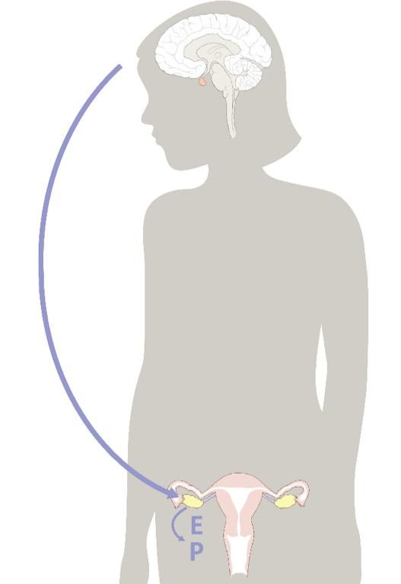
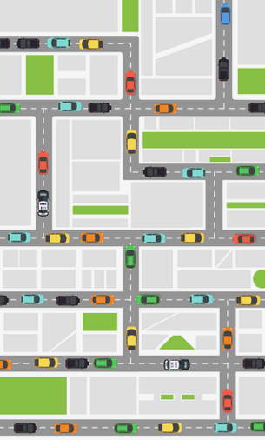
Command Center
© FEMM
Notes:
PROCEDURE
Step 1 (10 minutes): Review the importance of hormones; Worksheet: Fill in the Blanks
As we’ve discussed in the previous lessons, hormones begin and direct all of the physical changes of puberty. The two main female hormones are estrogen and progesterone and like best friends, they need each other!

Slide 3
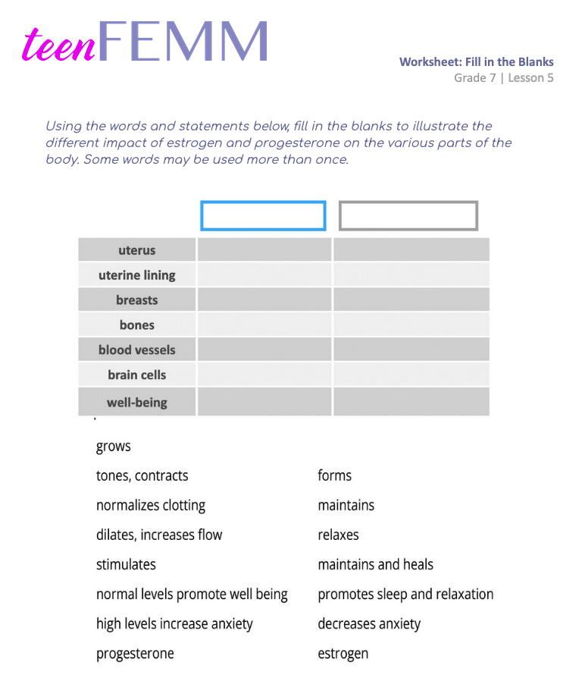
Worksheet |
Fill in the Blanks!
© FEMM
Notes:
Group students into pairs, and hand out the Worksheet: Fill in the Blanks.
When groups are finished, review the answers as a class using the Answer Key slide or with the Teacher’s Answer Key provided in the materials.

Slide 4
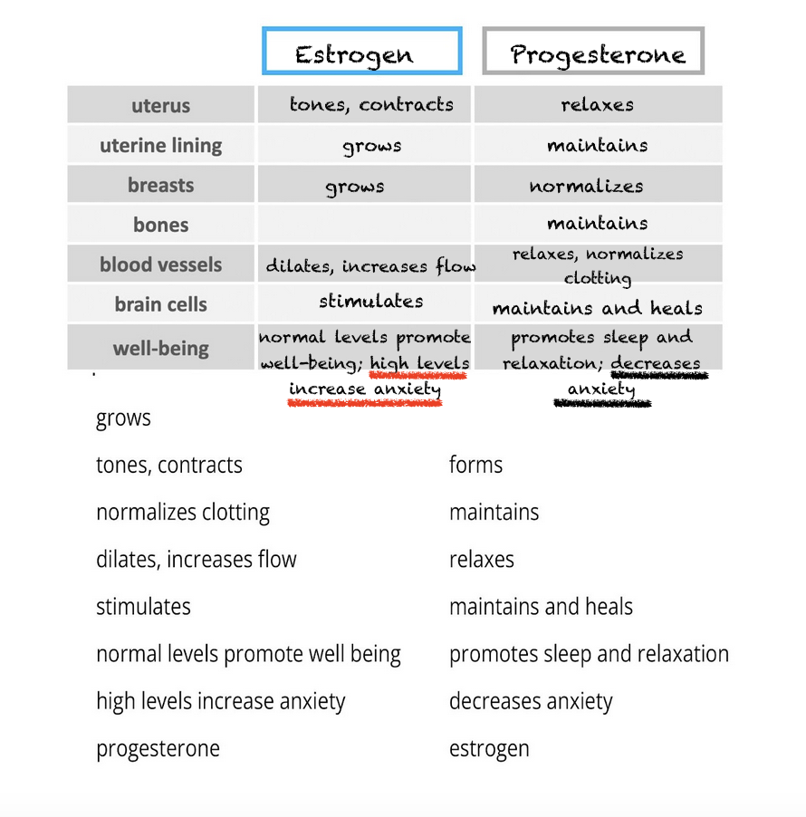
Answers | Fill in the Blanks
© FEMM
Notes:
Estrogen and progesterone don’t just influence parts of the female reproductive system; estrogen and progesterone influence every part of your whole body. The two hormones need each other to balance the effects of the other.

Slide 5
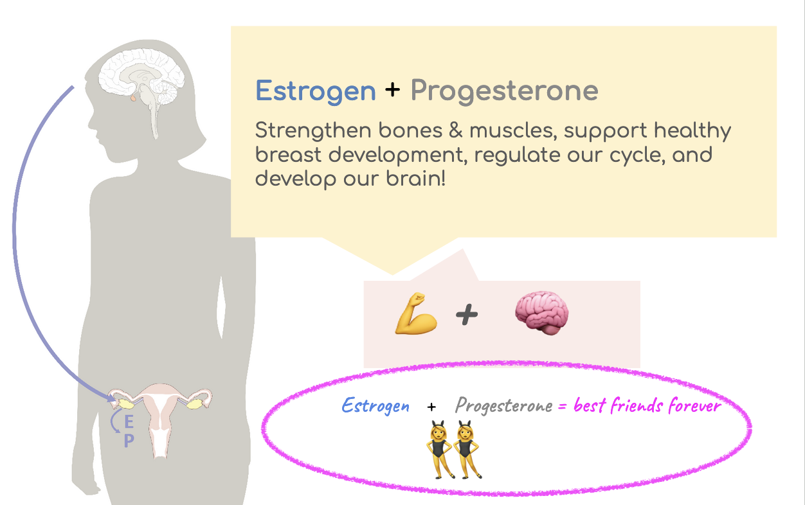
Estrogen and Progesterone help your whole body!
Notes:
This is why we’re learning about these hormones: because your whole body needs both estrogen and progesterone in the right amounts, for you to feel your best.

Slide 6
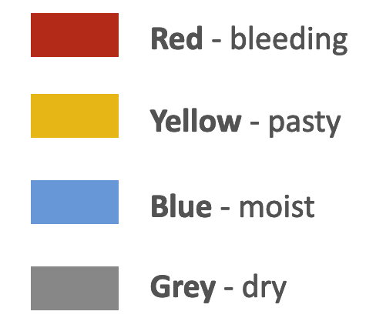
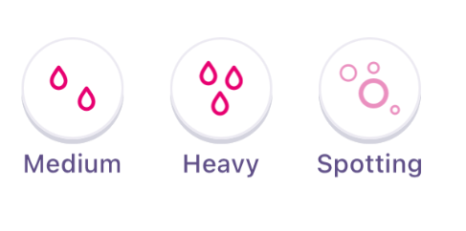
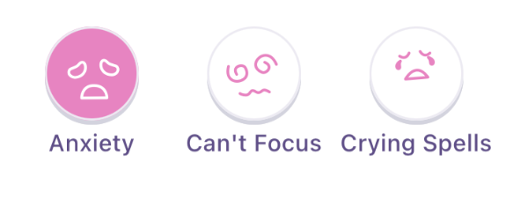
Charting the cycle | Biomarkers
Getting your period is an important biomarker to chart
biomarker = life sign
2. Feeling like this is also an important
biomarker to chart
Notes:
Because Estrogen and Progesterone impact our overall health, it is important to learn to track or “chart” our cycles. What is charting? Charting is simply a way to write down health observations.
Biomarkers are signs that the body gives us, like menstrual bleeding, cervical fluid, and physical or emotional symptoms, to tell us what our hormones are doing inside the body.
Remember: right now, as you enter puberty, some of you will see signs of estrogen and progesterone before other girls do, and that’s completely normal and healthy. If you have not yet begun to menstruate (you have not experienced your first period), your hormones may be rising and falling a little bit but it’s unlikely that you will have high enough hormone levels to be ovulating yet. But, as you grow through your teen years, charting your biomarkers will help you understand your hormones and their impact on your mood and behaviors.

Slide 7
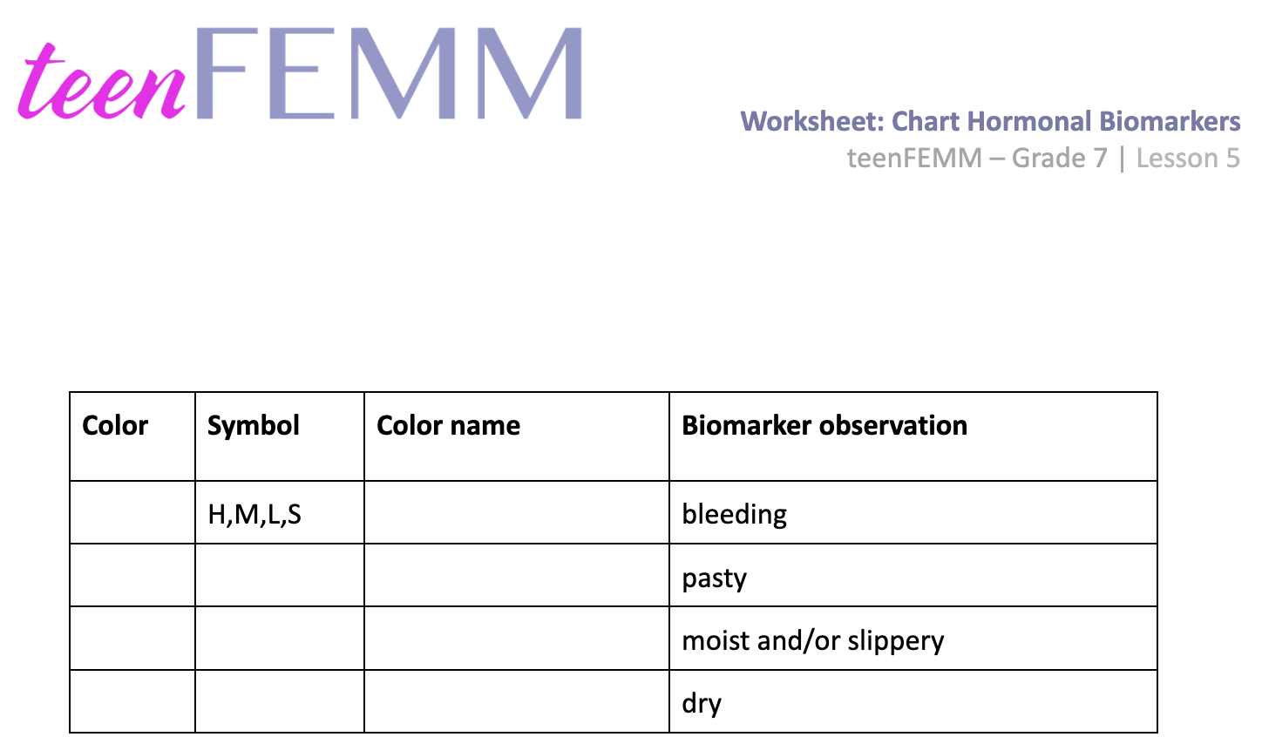
Worksheet | Learning to Chart Hormones
Notes:
Step 2 (15 minutes): Review biomarkers; hand out second worksheet to fill in together
Today, we are going to start to chart (to record on paper) the biomarkers that can be observed in the body. By recording these, we can understand what our hormones are doing and know that they are healthy!
First, we will review the different hormonal changes and the color we use to chart them.
Let’s take a few moments and fill in our worksheet and see if you can remember the different colors that we use for each biomarker.
Hand out the Worksheet: Learning to Chart Hormones from the materials and begin to fill it in together as a class, reviewing the biomarkers and colors.

Slide 8
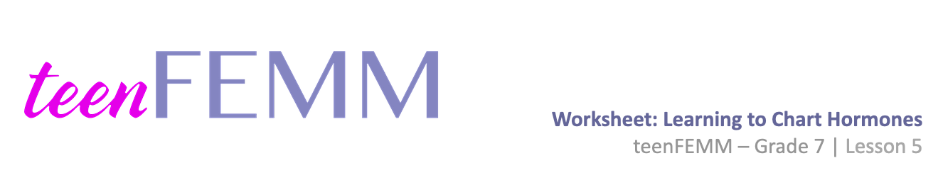
Answers | Learning to Chart Hormones
Color | Symbol | Hormone | Biomarker observation
 | H,M,L,S | very low estrogen + progesterone | bleeding
 |  | Low estrogen | pasty
 |  | Estrogen | moist or slippery
 |  | Progesterone | dry
© FEMM
Notes:
Now that you have this handy chart filled in, you have a great reference sheet to understand the hormones inside your body and how you can observe them. Knowing these hormonal biomarkers is called body literacy. It’s about being able to read the different signs of your body.

Slide 9
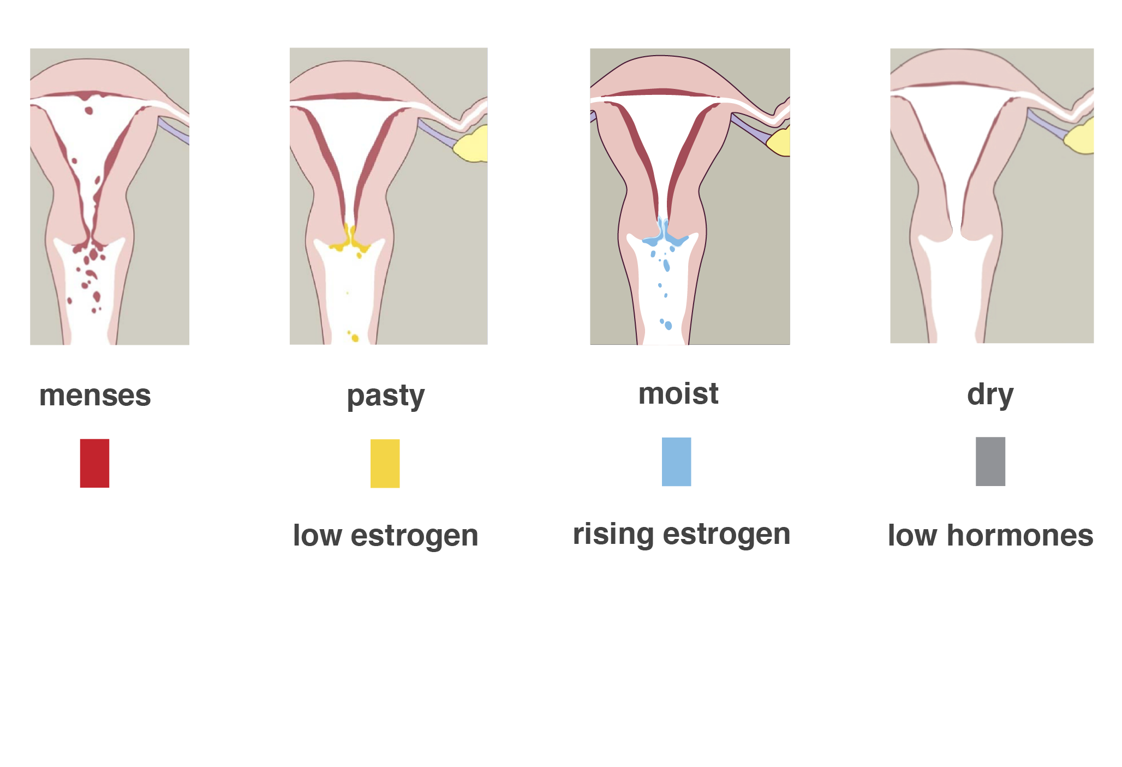
Charting hormonal changes
Notes:
The first observed biomarker on the worksheet is bleeding. This is maybe an obvious sign and easy to chart. Hormonally, bleeding means that the lining of your uterus, called the endometrium, is shedding. You will know and experience this as your period, or menstruation. This is a normal sign of reproductive health. On the chart what color do we use to note bleeding? Students should answer “red” and fill in the appropriate box on their worksheet. Tracking your bleeding pattern will be easy and obvious and is something that every woman can do to understand and manage her body. Each day that you have your period, you simply color in “red” on your chart. If the bleeding is heavy, you can write the letter H on your chart. If it is moderate, you use the letter M. If it is light, use L. If you have bleeding that is very light, irregular, or is outside the time of your normal menstruation, you call that kind of bleeding spotting and write an S on your chart.
If your bleeding is heavy, you might find that sometimes it will get on to your bedsheets or onto your clothes. Sometimes, it’s just a matter of finding the right product for you. Other times, it might be good to talk to your parents or doctor about this, especially if it becomes a problem for you.
The next biomarker (in other words “what you notice” during the day as you use the bathroom or when you change your clothes after playing sports) is listed as “pasty.” The hormone Estrogen is what causes the cervix to produce cervical fluid. Low levels of estrogen produce low levels of cervical fluid. You might notice this as a pasty or crumbly observation on the inside of your underwear. What color do we note on our chart if we see this? Students answer “yellow.” This represents the presence of low estrogen in our body.
As estrogen rises you may feel this fluid/wet sensation when you wipe. Instead of wondering what it is, why it’s there, and if there might be something wrong with you, tracking your cycle will help you recognize that this mucus is very normal and healthy! It’s a sign that estrogen is reaching peak levels and impacting every part of your body. High levels of estrogen, high levels of cervical fluid. Do you remember which color we put on our chart when we feel or see this fluid sensation? Students should answer blue.
Lastly, we see the biomarker observation “dry”. Dry days after ovulation are a sign of progesterone in your body. You may also have dry days before ovulation as your estrogen is not yet rising. What color do we put on our chart when we feel this sensation? Gray.

Slide 10
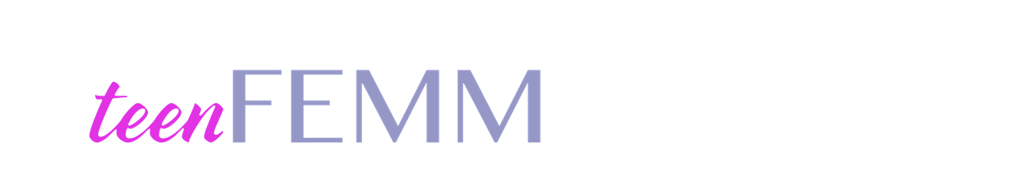
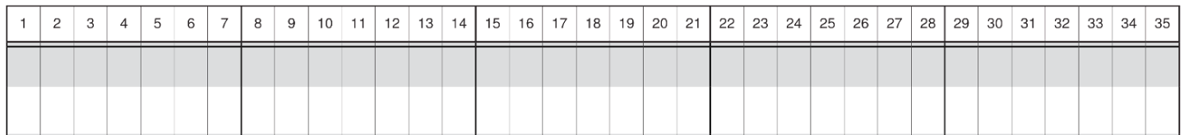
On your mark, get set, chart!
October 30th
© FEMM
Notes:
Step 4 (15 minutes): Charting Worksheet; review chart together.
Did you know that FEMM has a free app to support you in your charting? The app is available for android and apple devices and is easy to use, so you can chart your biomarkers, physical symptoms and emotions. For today, we’ll use a paper chart, but the concept is the same.
Let’s take a look at this practice chart together. The left side is the first day of this girl’s chart and moves from left to right, each square representing one day. In this example, the first day of her period is charted as red, and she also notes the calendar date as October 30th.

Slide 11
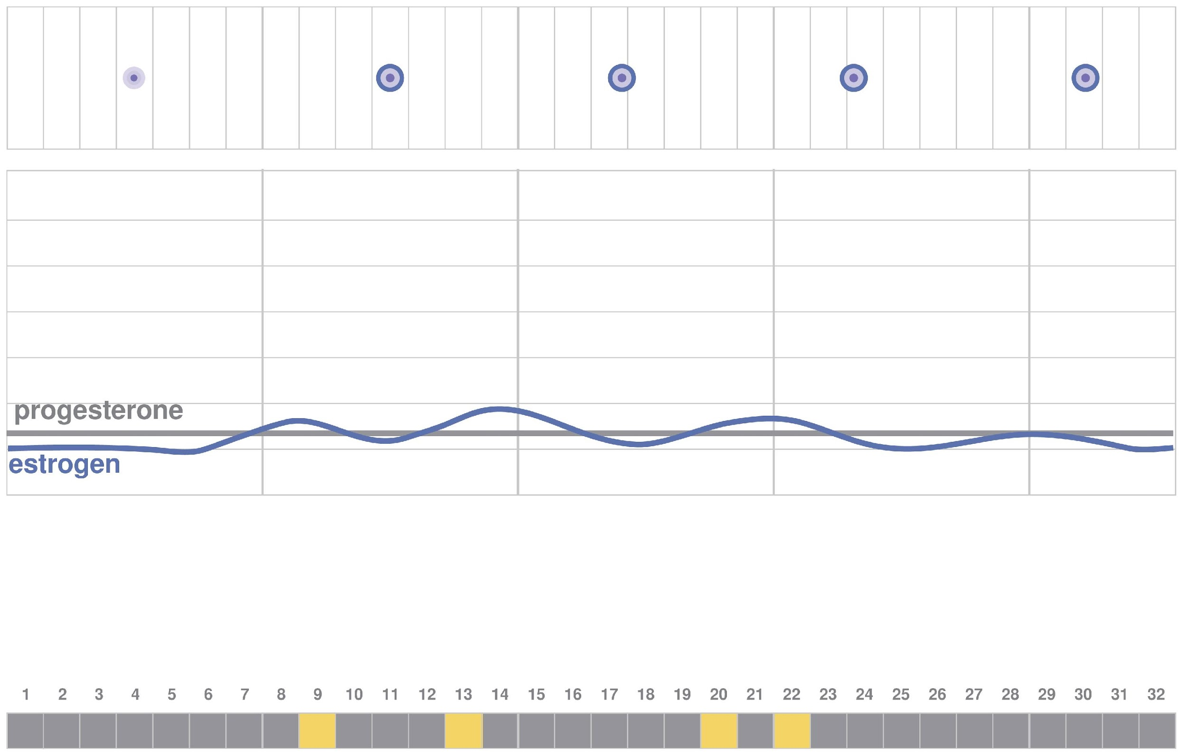
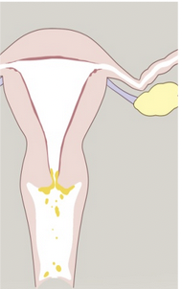
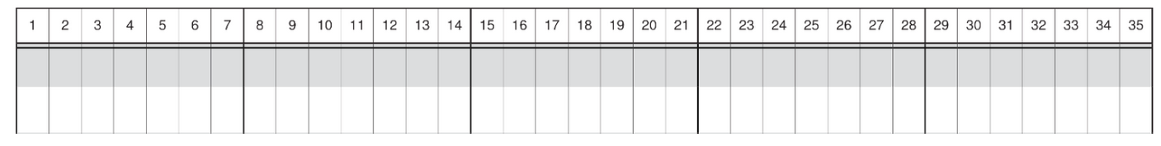
Making sense of your cycle in puberty
What it looks like in the ovary (follicles trying)
Small follicles produce only little rises in Estrogen
Little Estrogen causes cervix to produce little
cervical fluid.
Biomarkers
observed:
Notes:
On the next slide, at the top of the page, you can see the follicle. There is not much happening with it yet! Then, there is a graph of the level of progesterone in gray and estrogen in blue. The graph shows that progesterone stays the same, but the estrogen is just beginning to rise a little and then fall in her body.
Even though estrogen levels are low, these levels are still important to help her body to grow and mature. In the third row, we see the impact of the estrogen rises on the cervix, producing some small amounts of cervical mucus. What biomarkers do you think she would observe?

Slide 12
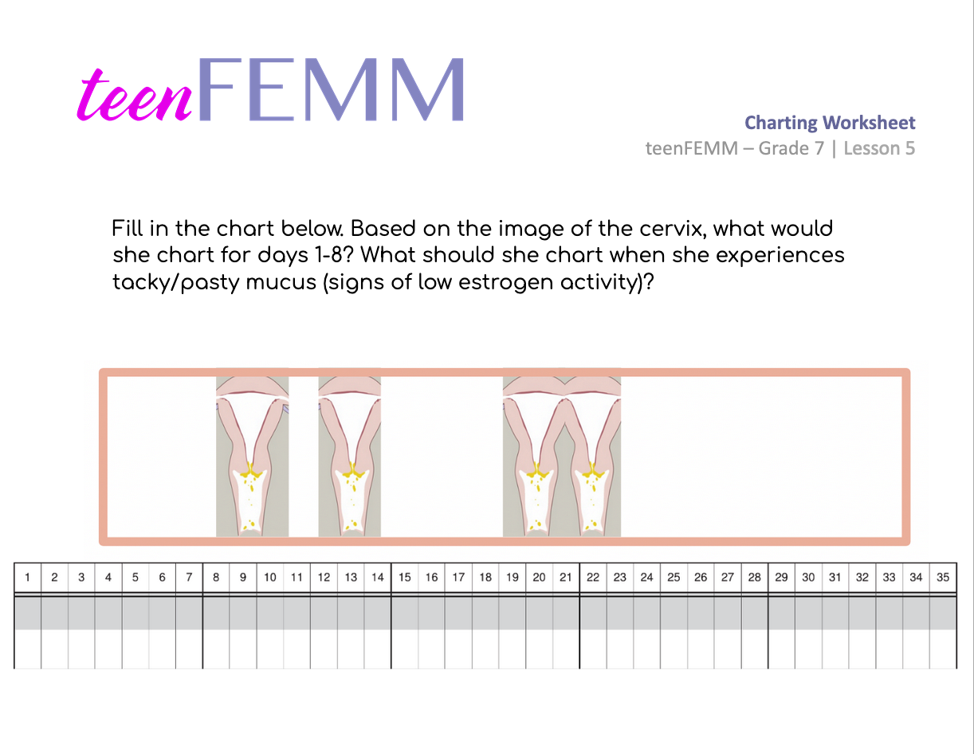
Charting Worksheet
Notes:
Hand out the Charting Worksheet for students to fill in with pencil crayons. If needed, students can use the Worksheet: Learning to Chart Hormones filled in at the beginning of the class for reference.
Give students a few minutes to fill in the practice chart on their own. Once students are finished, show the following slide:

Slide 13
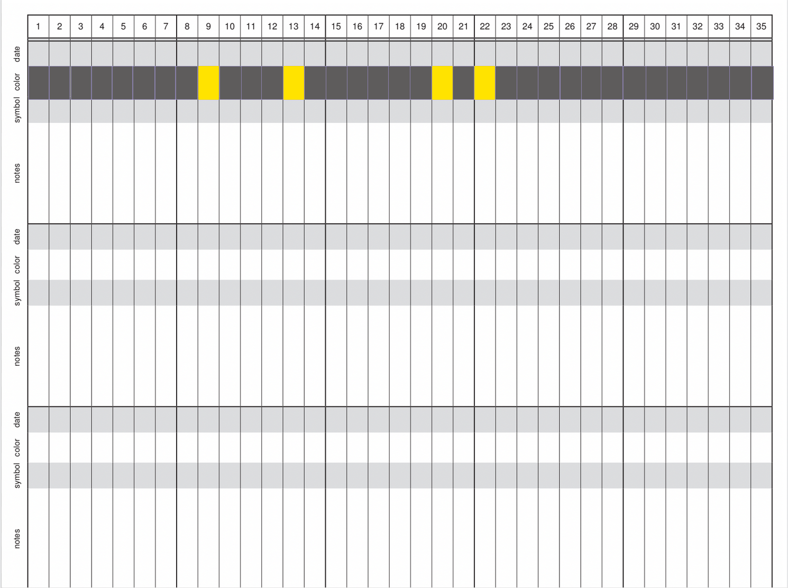
teenFEMM Chart
© FEMM
Notes:
Talk through the answers as a class. You can see from days 1-8 she doesn’t notice anything, and feels dry. What color should you have filled in for those days? Students should answer Gray. On day 9, she notices something sticky in her underwear. What color should she chart that with on day 9? Yellow. Low estrogen. On days 10, 11, and 12, she doesn’t feel anything when she wipes. Dry. What color do we use? Gray. On day 13, she notices something similar to what she saw on day 9. What color? Yellow. On days 14-19, she doesn’t notice anything. Gray. On day 20, she notices a crumbly mucus again. Yellow. On day 21 she feels dry again. Gray. Then, on day 22, she notices something pasty again. Yellow. After that, as you can see, progesterone remains the same and estrogen drops down. What do you think she is feeling/seeing when there is no hormonal activity? Dry. Gray for the rest of this cycle.

Slide 14
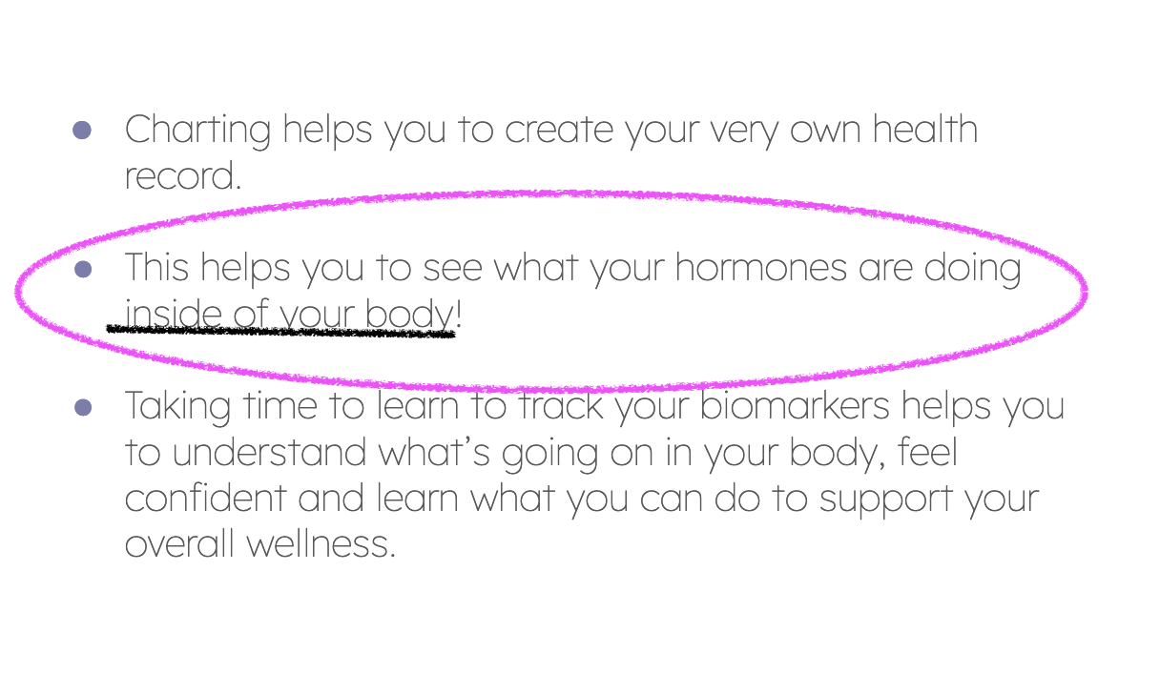
Review
Seriously, you have to admit that’s pretty cool!
© FEMM
Notes:
You did a great job charting today! Charting can be a bit overwhelming at first but once you understand what’s happening in your body it’s an easy habit to track your hormones! Throughout the next few lessons, we will be able to talk about what we can do to help keep our hormones and bodies healthy.

Slide 15
Grade 7
LESSON 5
© FEMM
© FEMM Foundation, Inc. All rights reserved.

