Slide 1

Grade 7
LESSON 5
© FEMM

Slide 2
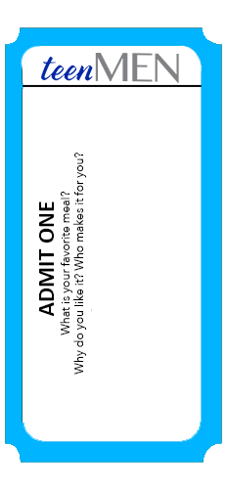
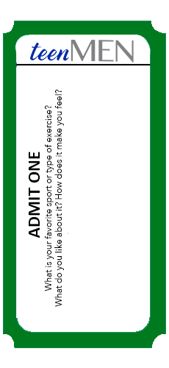
Entry Ticket Activity: Fuel and Mileage
© FEMM
Notes:
Print and cut out “Entry Tickets” to hand out to students as they enter class.
Step 1 (5 minutes): Entry Ticket Activity: Fuel and Mileage
Hand out one Entry Ticket to each student. Give students a minute to write down their responses.
Ask students who received a blue ticket: Is there a meal that you really love that you do not know how to make? If it’s a meal that a family member makes, can they teach you how to make it? What do you like about this meal? Ask a few volunteers to share their answers.
Ask students who received a green ticket: What’s your favorite sport or type of exercise? What do you like about this activity? Is it about being around other people or do you like the challenge of getting better at something? Ask a few volunteers to share their answers.
Food is the fuel your body needs to do all of the physical activities that you enjoy! Good fuel gives your body more mileage, or energy, to live long and be healthy!

Slide 3
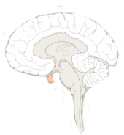
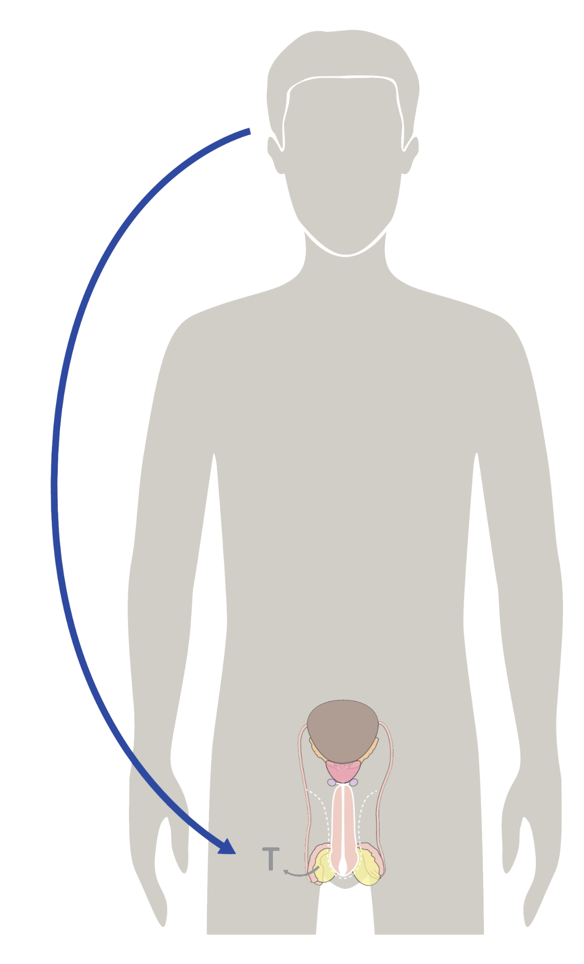
Hormones & your growth
Hormones cause all the growing & changing that your body does during puberty.
Your brain starts the process, sending hormonal signals throughout your body to trigger growth & development.
© FEMM
Notes:
Step 2 (5 minutes): How can you help your body to do its job?
So, we have learned about the body systems and how they all work together to keep our body healthy. We’ve also learned about chemical messengers that help different body systems talk to each other. What are those chemical messengers called? Hormones! Some hormones are produced in the brain and these hormones communicate with other parts of the body to get them to produce different hormones. One example of this is in puberty, when your brain sends hormonal signals to your testicles to get them to produce testosterone.

Slide 4
How can I help my body do its job?
Because the brain directs all of your hormonal activity, things that affect your brain affect your physical & emotional health.
© FEMM
Notes:
The brain is the control center, telling every other part of the body what to do and when. Since your brain is the command center for all of your hormonal activity, things that affect your brain affect your physical and emotional health.

Slide 5


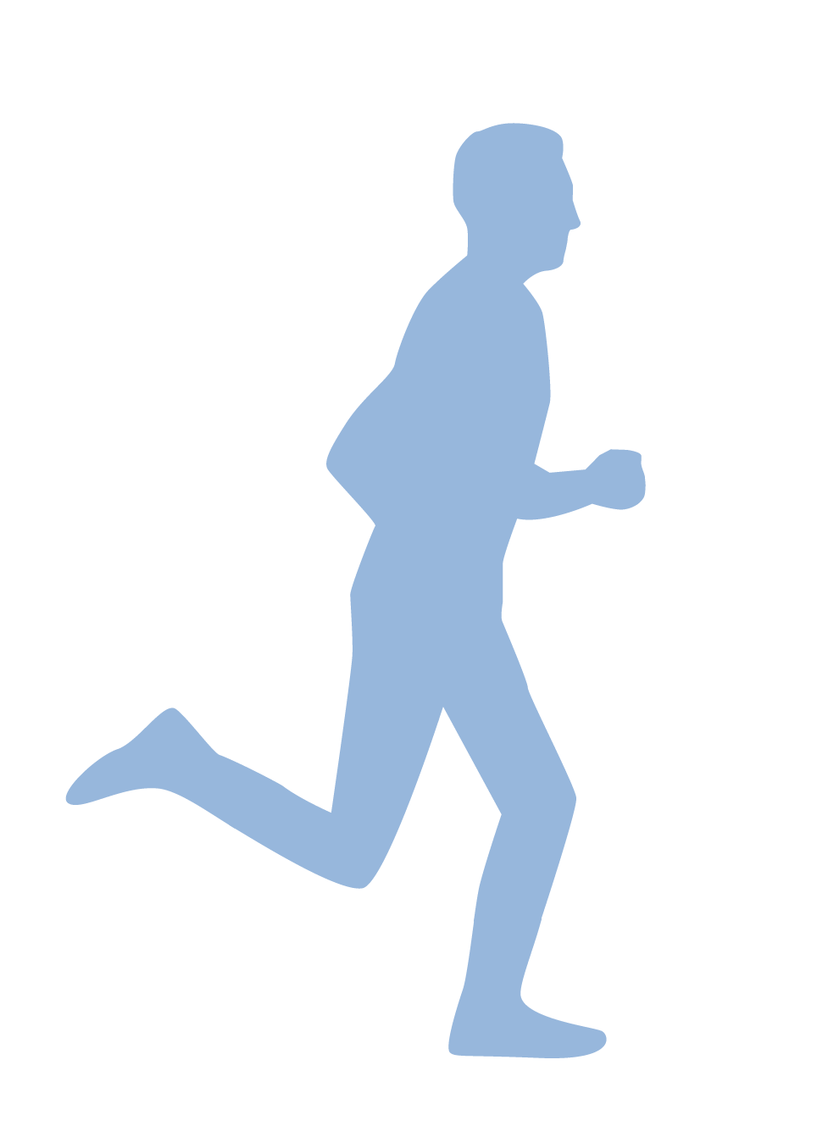



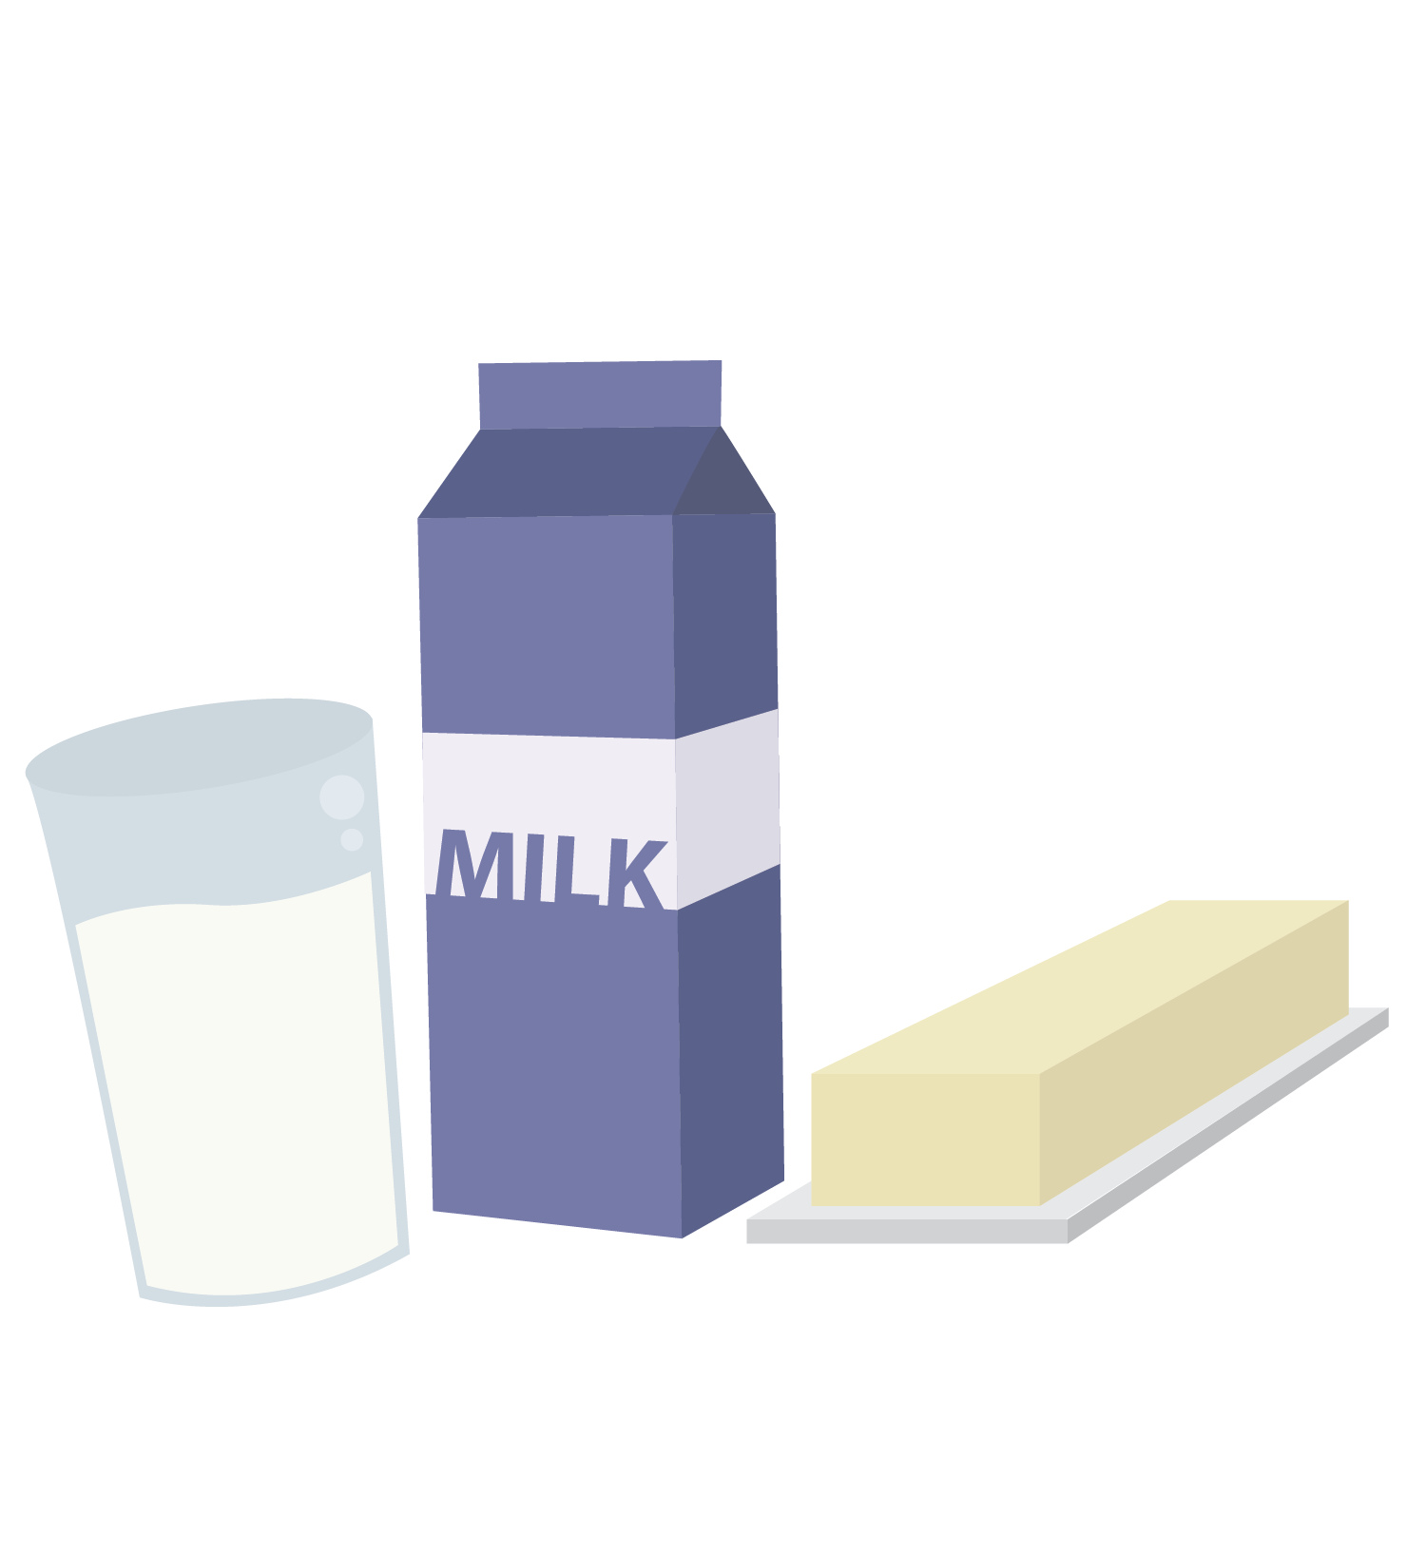

The Three Pillars of Health
Nutrition
Exercise
Sleep
© FEMM
Notes:
What happens if you give a car diesel fuel when it actually runs on gasoline? It will stop on the road and it can be a huge job to fix it after that. The same thing happens with your body. If you don’t give your body the fuel it needs, it will stop working or it will not work very well. A better choice would be to give your body what it needs. How? Through what we call the three pillars of health: nutrition, sleep, and exercise.
They are called the three “pillars” because they are the foundation for your health. The first pillar we’ll learn about is nutrition.

Slide 6
Nutrition
1.
Protein
2.
Carbohydrates
Nutrition
3.
Fats
4.
Vitamins & Minerals
5.
Water
© FEMM
Notes:
Step 3 (15 minutes): Pillars of Health: Nutrition
Your choices are important: food, sleep and exercise impact your hormones and your whole body. Because of our genetics and other things, we will all look and develop differently. But, good nutrition, exercise and sleep give your body the best chance to develop and grow to your full potential.
Let’s start with the first pillar: Nutrition.
Nutrition is the nourishment that your body gets from the food you eat. Good nutrition supports a healthy body. Let’s look at the different types of nutrients our body needs: proteins, carbohydrates, fats, vitamins and minerals and water. When we eat, our bodies break down the food and use the different nutrients in the food to fuel every part of our body. The digestive system breaks the food down, our cardiovascular system helps to transport the nutrients in our blood streams, and then our organs receive these nutrients and make things with them!

Slide 7
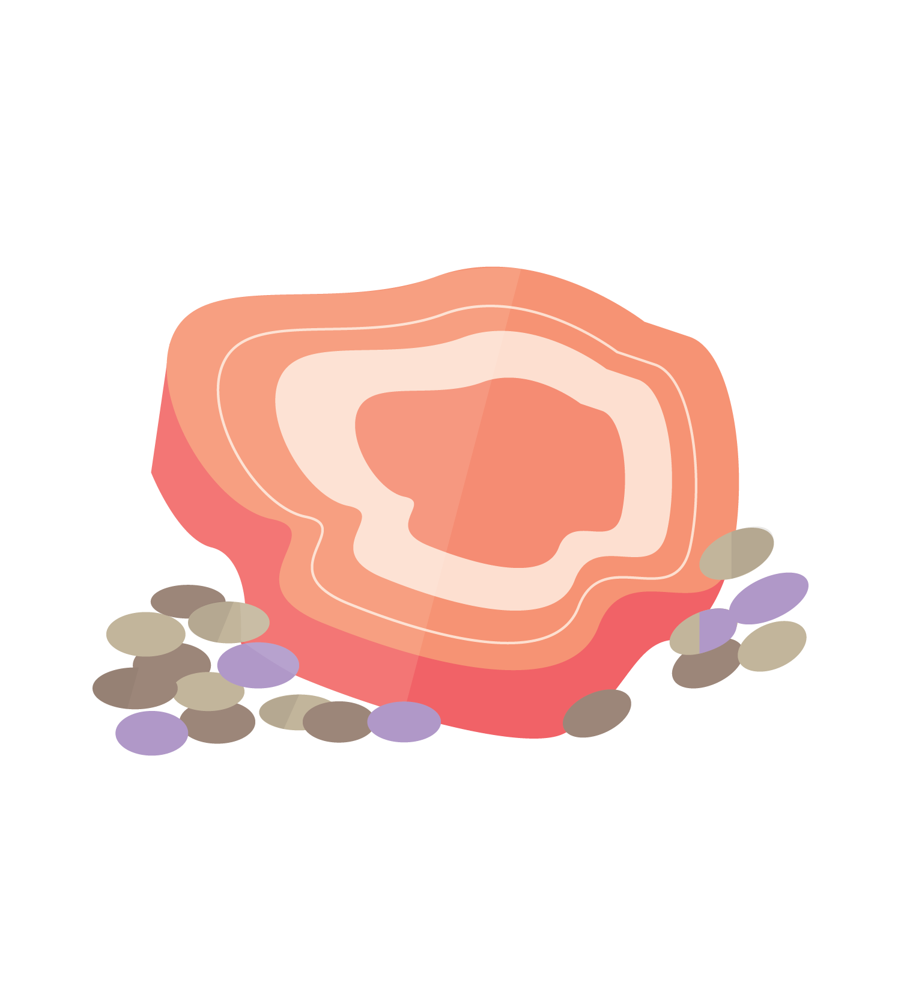
Nutrition
Protein
Found in meat, fish, beans, eggs, nuts
Build & maintain body, especially muscle
Help produce male hormones
Try to eat some at each meal!
Nutrition
© FEMM
Notes:
Proteins: build and maintain cells, help make hormones.
What are some examples of foods you could eat that contain protein? Meat, fish, beans, eggs, nuts, yogurt, etc.

Slide 8
Nutrition
Carbohydrates
Found in whole grains, fruit, vegetables
Provide energy
Help balance hormones
Try to eat some at each meal!
Nutrition
© FEMM
Notes:
Carbohydrates: provide energy, balance hormones.
What are some examples of foods that you eat that are carbohydrates?
Whole wheat bread, pasta, rice, apples, bananas, broccoli and corn all contain carbohydrates.

Slide 9

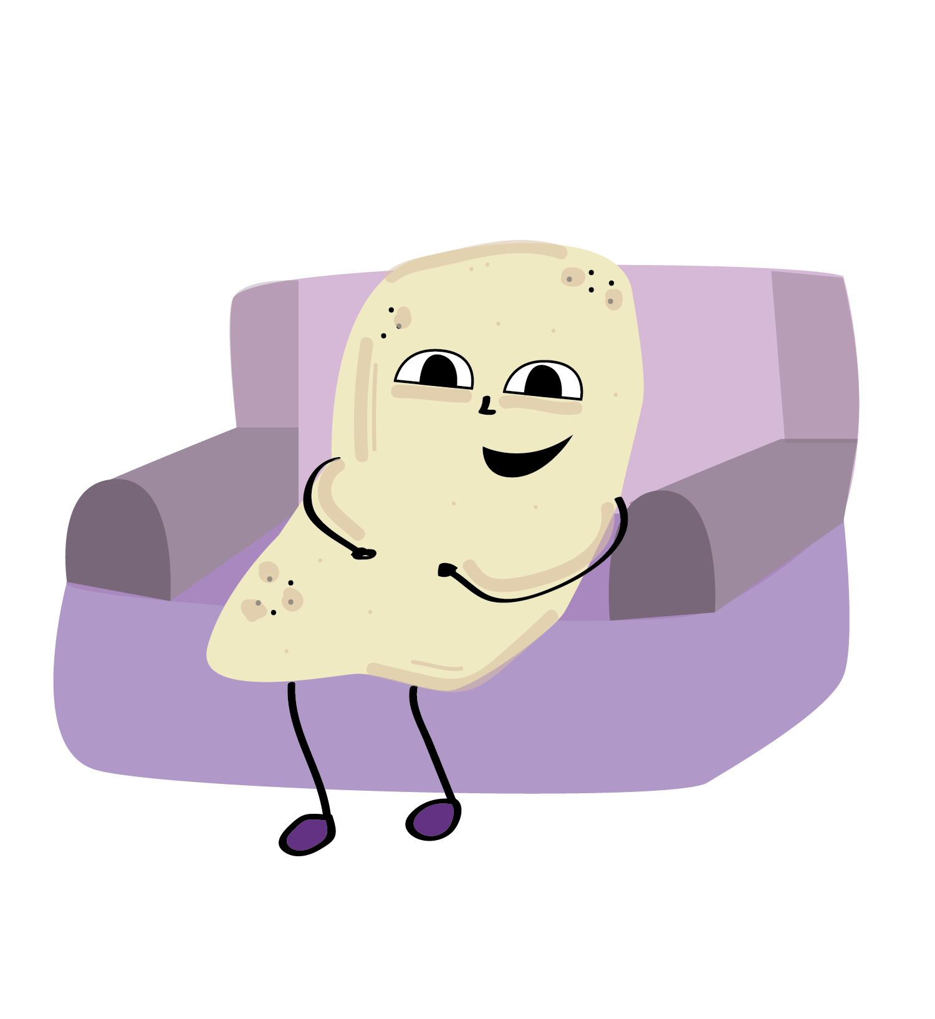
Nutrition
Fats
Found in nuts, oils, butter, milk/cream, yogurt
Provide energy
Help make & balance hormones
Try to eat some at each meal!*
Nutrition
*Mr. Potato Chip doesn’t qualify
© FEMM
Notes:
Fats: provide energy, make and balance hormones.
You need fats like nuts, yogurt, avocados, etc. Your body doesn’t need the kind of fat that’s deep-fried, for example: french fries, potato chips or donuts can be a treat but are not a food group.

Slide 10
Nutrition
Vitamins & Minerals
Found in nuts, fruits, vegetables, eggs, whole grains, etc!
Build & maintain cells
Help balance hormones
Eating a balanced diet ensures you get all the vitamins and minerals you need!
Nutrition
© FEMM
Notes:
Vitamins & minerals: build and maintain cells, balance hormones. Vitamins and minerals are found in all unprocessed foods. Basically, if it comes in its natural state.

Slide 11
Nutrition
Water
Just water! Not juices, sodas, or other drinks
Carries nutrients, energizes muscle
Clears waste from cells
Balances hormones
Nutrition
© FEMM
Notes:
Water: carries nutrients and clears waste.

Slide 12
Nutrition
Protein
+
Fats
Hormones
© FEMM
Notes:
All hormones are made from protein and fats.
Protein is the building block for cells. Carbohydrates help to keep your hormones in balance. Micronutrients like minerals and vitamins help your body to produce hormones, too. If you are deficient in any one of these groups, it will be pretty tough for your body to make the hormones that it needs.

Slide 13

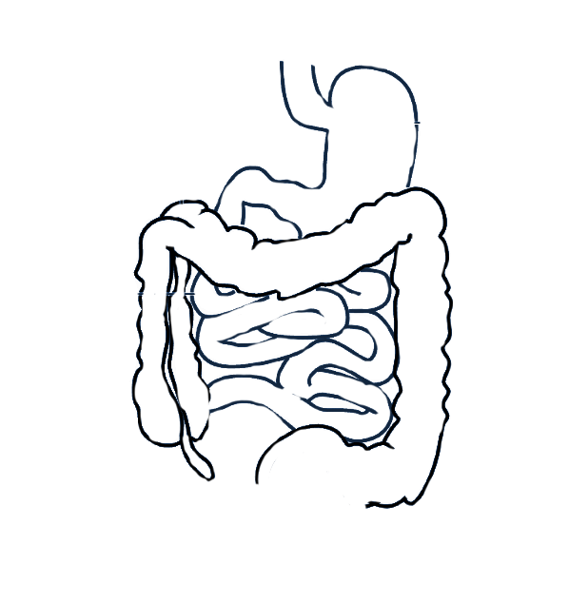
How nutrients pass into the bloodstream
Chomp, chomp, carbohydrates!
Chew
and then down the
Esophagus (tube) in to the
Stomach where enzymes break down the food before it enters
the
Small Intestine where nutrients are absorbed into the blood
and what’s left goes through the
Large Intestine and then
exits the body
© FEMM
Notes:
Step 4 (5 minutes): Digestion Demo
Good nutrition makes for good digestion! Eating foods that your body needs helps your body. Eating foods that your body doesn’t really need or want for fuel, like a diet of potato chips, soda and candy, makes it hard for your body to get the nutrients it needs. It puts your body through all of the work of digestion for no nutritional reward!
Let’s learn about two kinds of digestion: mechanical and chemical.
1. Chewing. Mechanical digestion is mostly what you do as you chew your food as you eat. Chewing your food actually helps your digestion.
2. Esophagus. The food molecules travel down the esophagus tube to the ….
3. Stomach. Here, the second kind of digestion happens: chemical digestion, as stomach enzymes break down the food molecules further.
4. Small intestine. In the small intestine, nutrient absorption happens. As the food molecules work their way through the small intestine, the blood grabs all of the nutrients (the good, useful stuff) and delivers them to where they are needed.
5. Large intestine. This is where waste is produced. Now that all nutrients have been taken out of the food, what’s left exits the body through the anus.
Suggestion: Give each student a snack (something simple like a cookie or wheat thin cracker) for them to eat, as they name the parts and process of digestion: chewing (mechanical), esophagus, stomach (chemical), small intestine, large intestine, out.
As you are learning, what you choose to eat is important for your body and your growth! Your meals should contain all of the different types of nutrients. It’s also important not to skip breakfast or lunch and to eat regular meals to help keep your body fueled.

Slide 14
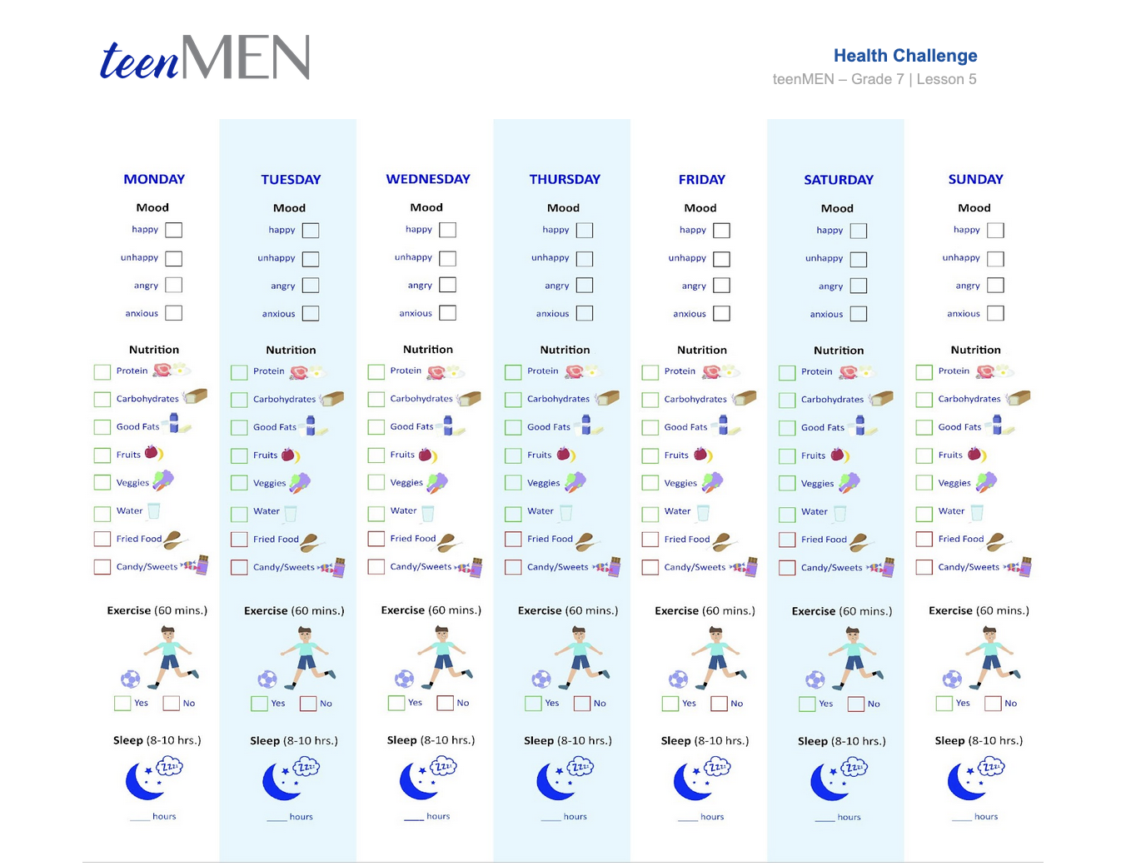
Health Checklist Challenge!
© FEMM
Notes:
CONCLUSION (5 minutes): Health Challenge Checklist
Hand out the Health Challenge Checklist to each student. Encourage students to honestly complete the checklist each day. You can offer a prize if the whole class completes the challenge. Or, you can make it a teacher versus students challenge to see how many days in a row the students can achieve healthy habits.
This health checklist is a personal challenge to pay attention to your nutrition, exercise and sleep habits for one week. At the end of the day, check which mood was dominant that day. Each morning, check the box if you got eight hours of sleep or (yawn) didn’t, the night before. Do you feel any different when you eat nutritious food and exercise? The important thing is to be honest about your habits as you fill in this checklist this week. Don’t forget to bring it to our next class!

Slide 15
Grade 7
LESSON 5
© FEMM

