Slide 1

Grade 7
LESSON 6
© FEMM

Slide 2
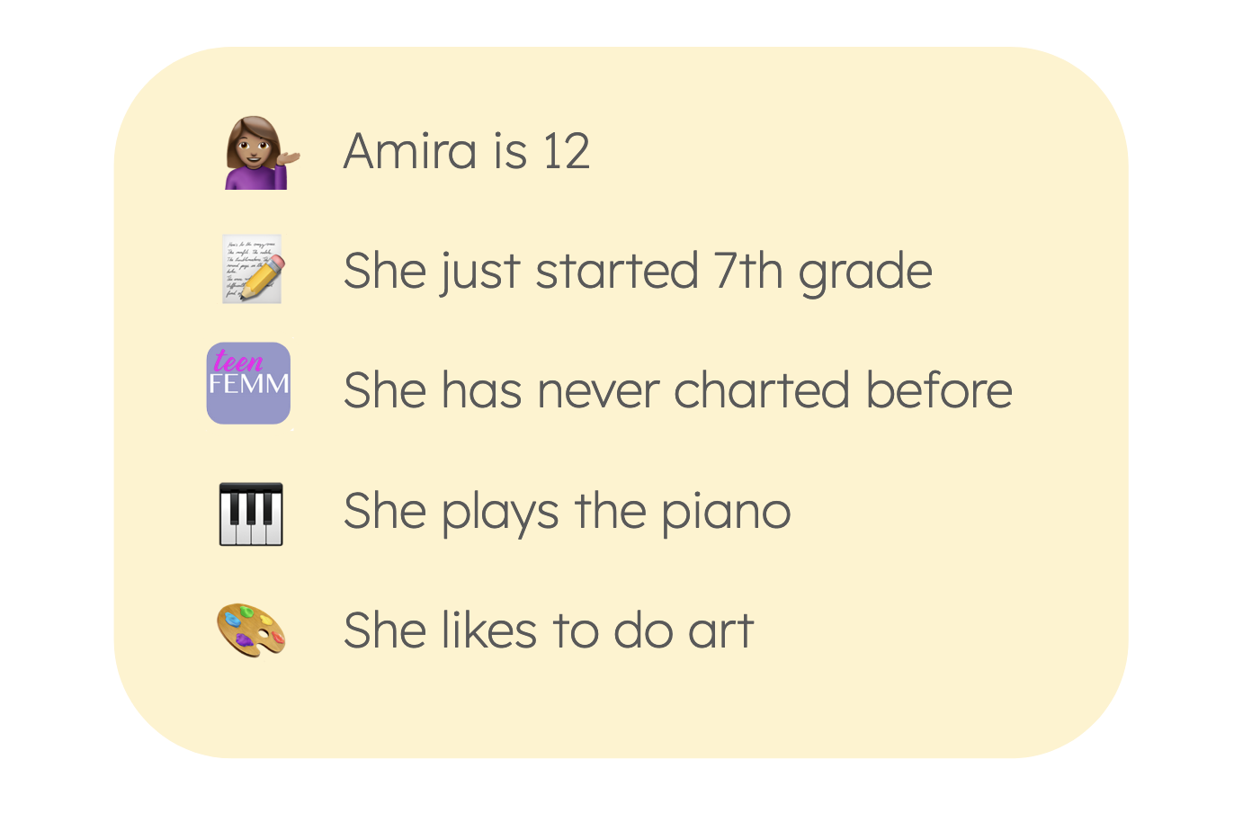
Meet Amira!
© FEMM
Notes:
Step 1 (5 minutes): Meet Amira and Faizah
In this lesson, we are going to look at another chart that would be very normal for a girl during puberty who is closer to menstruating for the first time and we’ll meet a girl named Amira.
Meet Amira and Faizah
Amira is 12 years old and just started 7th grade. She has never charted before. But, one day, she found a chart in the bedroom that she shares with her sister, Faizah. Faizah learned about teenFEMM at school and had already started to chart. Faizah is a year older and has already had her first period. Amira is really close with Faizah (even though they fight… a lot!) and thinks that pretty much everything Faizah does is cool. So, Amira wants to know everything about her body, too, and what all of the changes she is seeing mean.
When Amira asked Faizah about her chart, Faizah explained everything. Their mom came into their room and the three of them had a great chat. Faizah explained that, when she was first learning to chart, there were times where she wondered if it was even worth it to chart! She felt like nothing was changing. Then she started to notice more changes. Faizah told Amira that it’s important not to give up and that it’s worth it to get into the habit of charting to see how everything is developing.

Slide 3
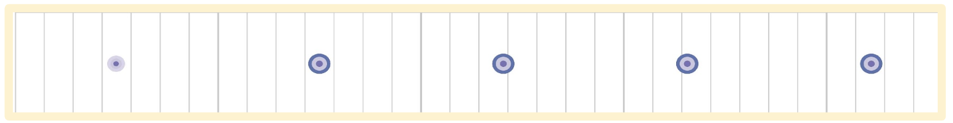
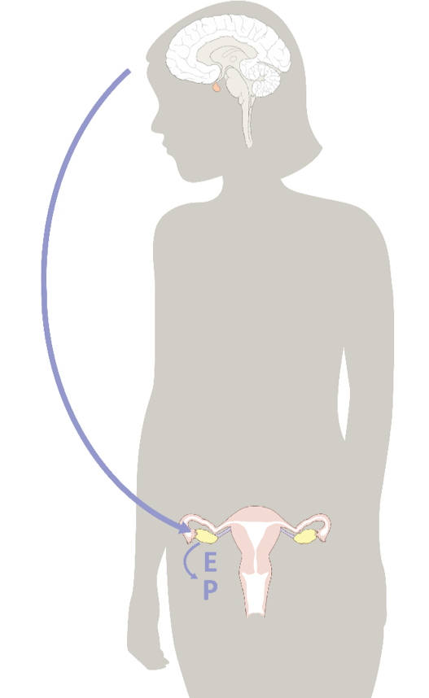
Amira’s chart
How would you graph Amira’s hormones,
estrogen and progesterone?
Hormonal axis
Notes:
Step 2 (10 minutes): Worksheet: Amira and Faizah
Hand out the Worksheet: Amira and Faizah. Let’s try to chart what Amira might be starting to see. On your worksheet, draw the levels of estrogen and progesterone, based on what we see in the ovary. Then, fill in Amira’s chart.
Give students a couple of minutes to complete the first page of their worksheet.
In puberty, as your brain is learning to communicate with your ovaries more, this produces small rises in estrogen, while progesterone stays the same. Remember: progesterone is produced after we ovulate. So, no ovulation, no progesterone. However, these small rises in estrogen happening in the ovary, as the follicle starts to grow are important. It indicates that the body is strengthening its brain-ovary communication, which we call the hormonal axis.

Slide 4
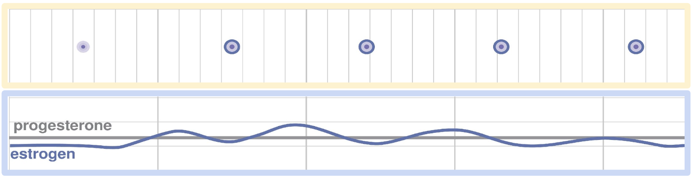
Amira’s chart
Hormonal axis
Notes:
Based on this slight rise of estrogen in her body, what would Amira’s hormones look like? Graph is showing a straight line for progesterone and a slightly wavy line for estrogen.
For Amira, this slight rise in estrogen would mean that she would see or feel crumbly, pasty mucus, which she would chart with the color yellow. Her chart would look something like this:

Slide 5
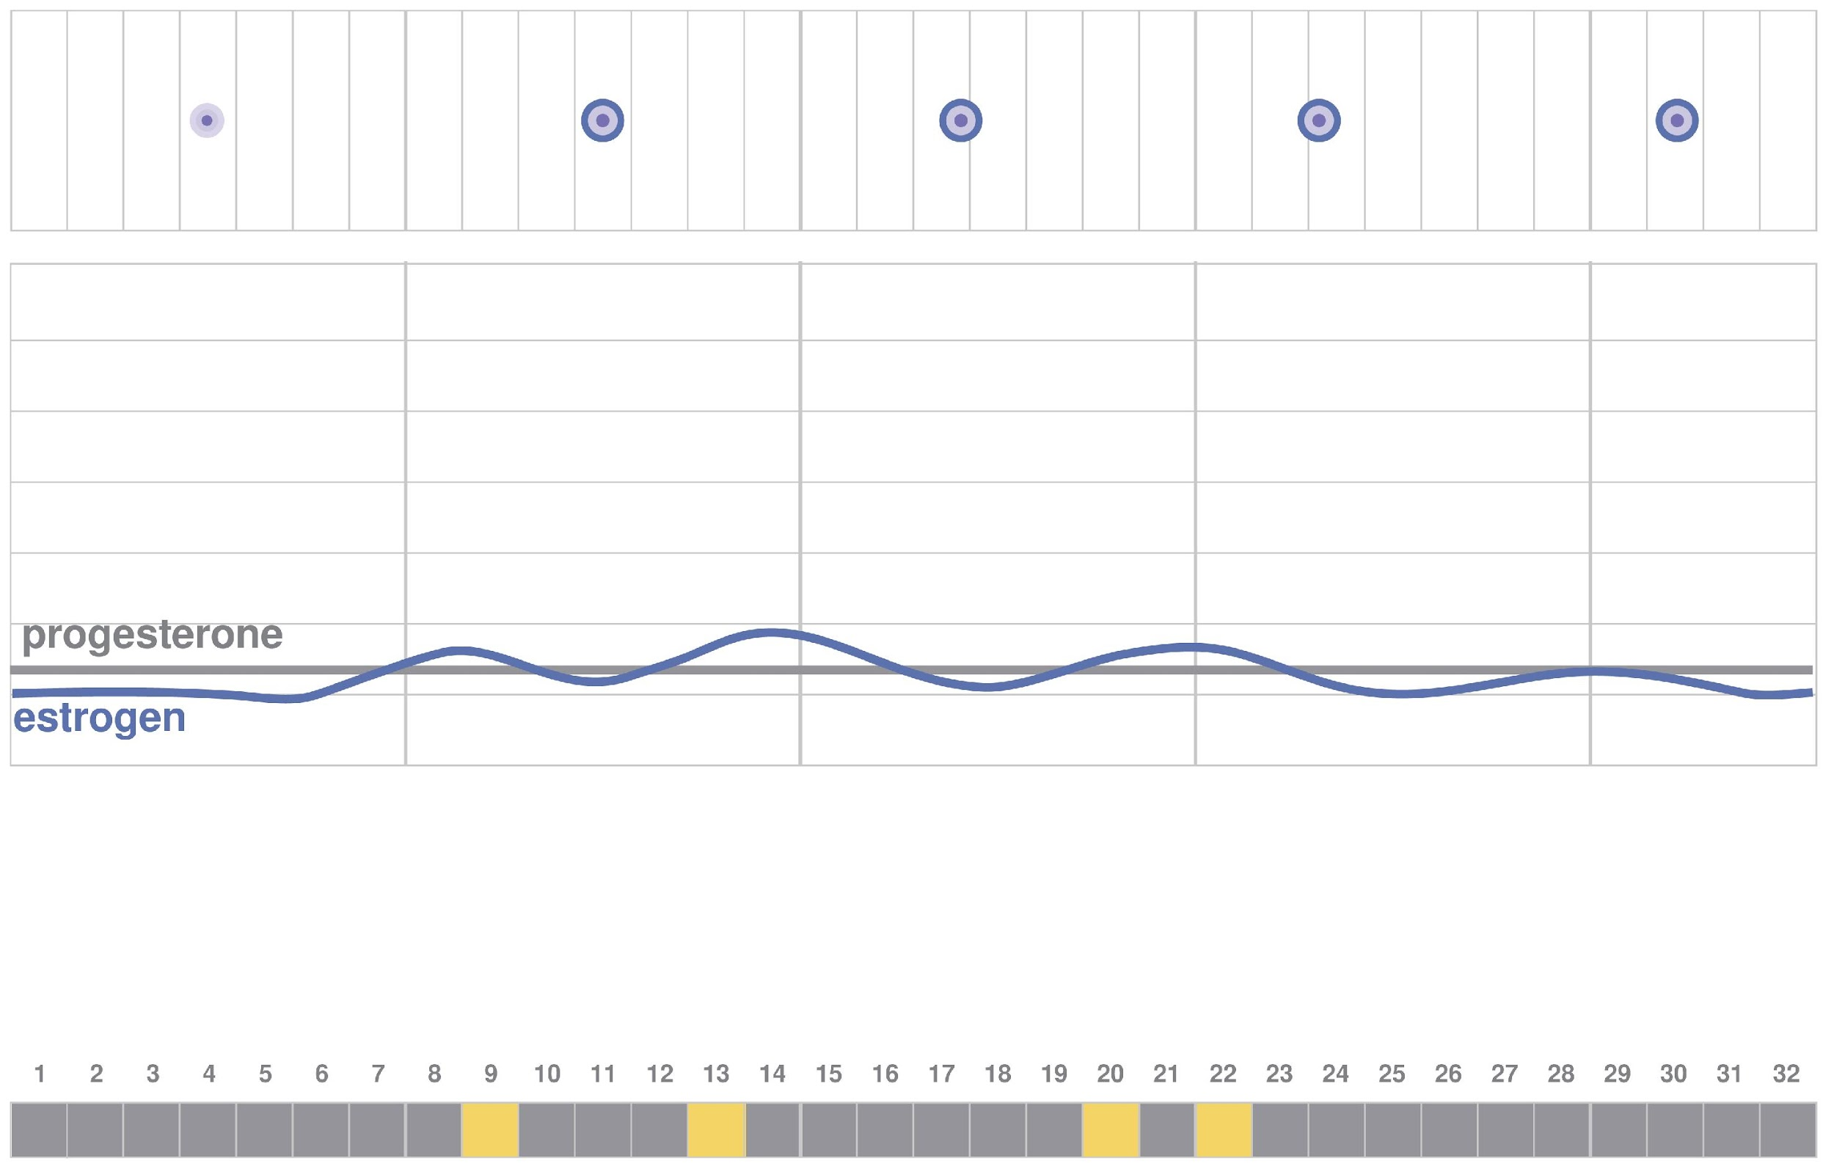
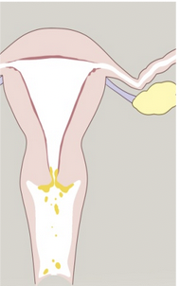
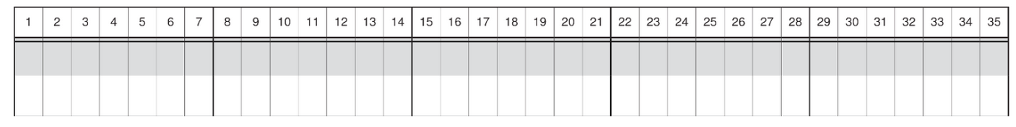
Amira’s chart
At the start of puberty, your brain & ovaries are just beginning to communicate.
Notes:
What will this look like if Amira is charting her observations each day? Well, we can see that her body may be producing pasty/crumbly mucus. What would she chart?

Slide 6
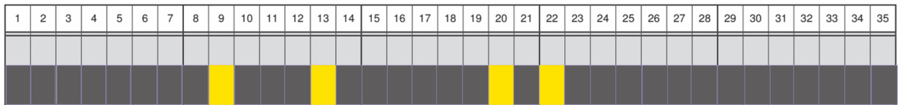
Amira’s chart
At the start of puberty, your brain & ovaries are just beginning to communicate.
Notes:
For Amira, this slight rise in estrogen would mean that she would see or feel crumbly, pasty mucus, which she would chart with the color yellow. Her chart would look something like this.
Now, take a couple of minutes to fill in the second page of the worksheet. Give students a couple of minutes to answer the questions about Faizah.

Slide 7
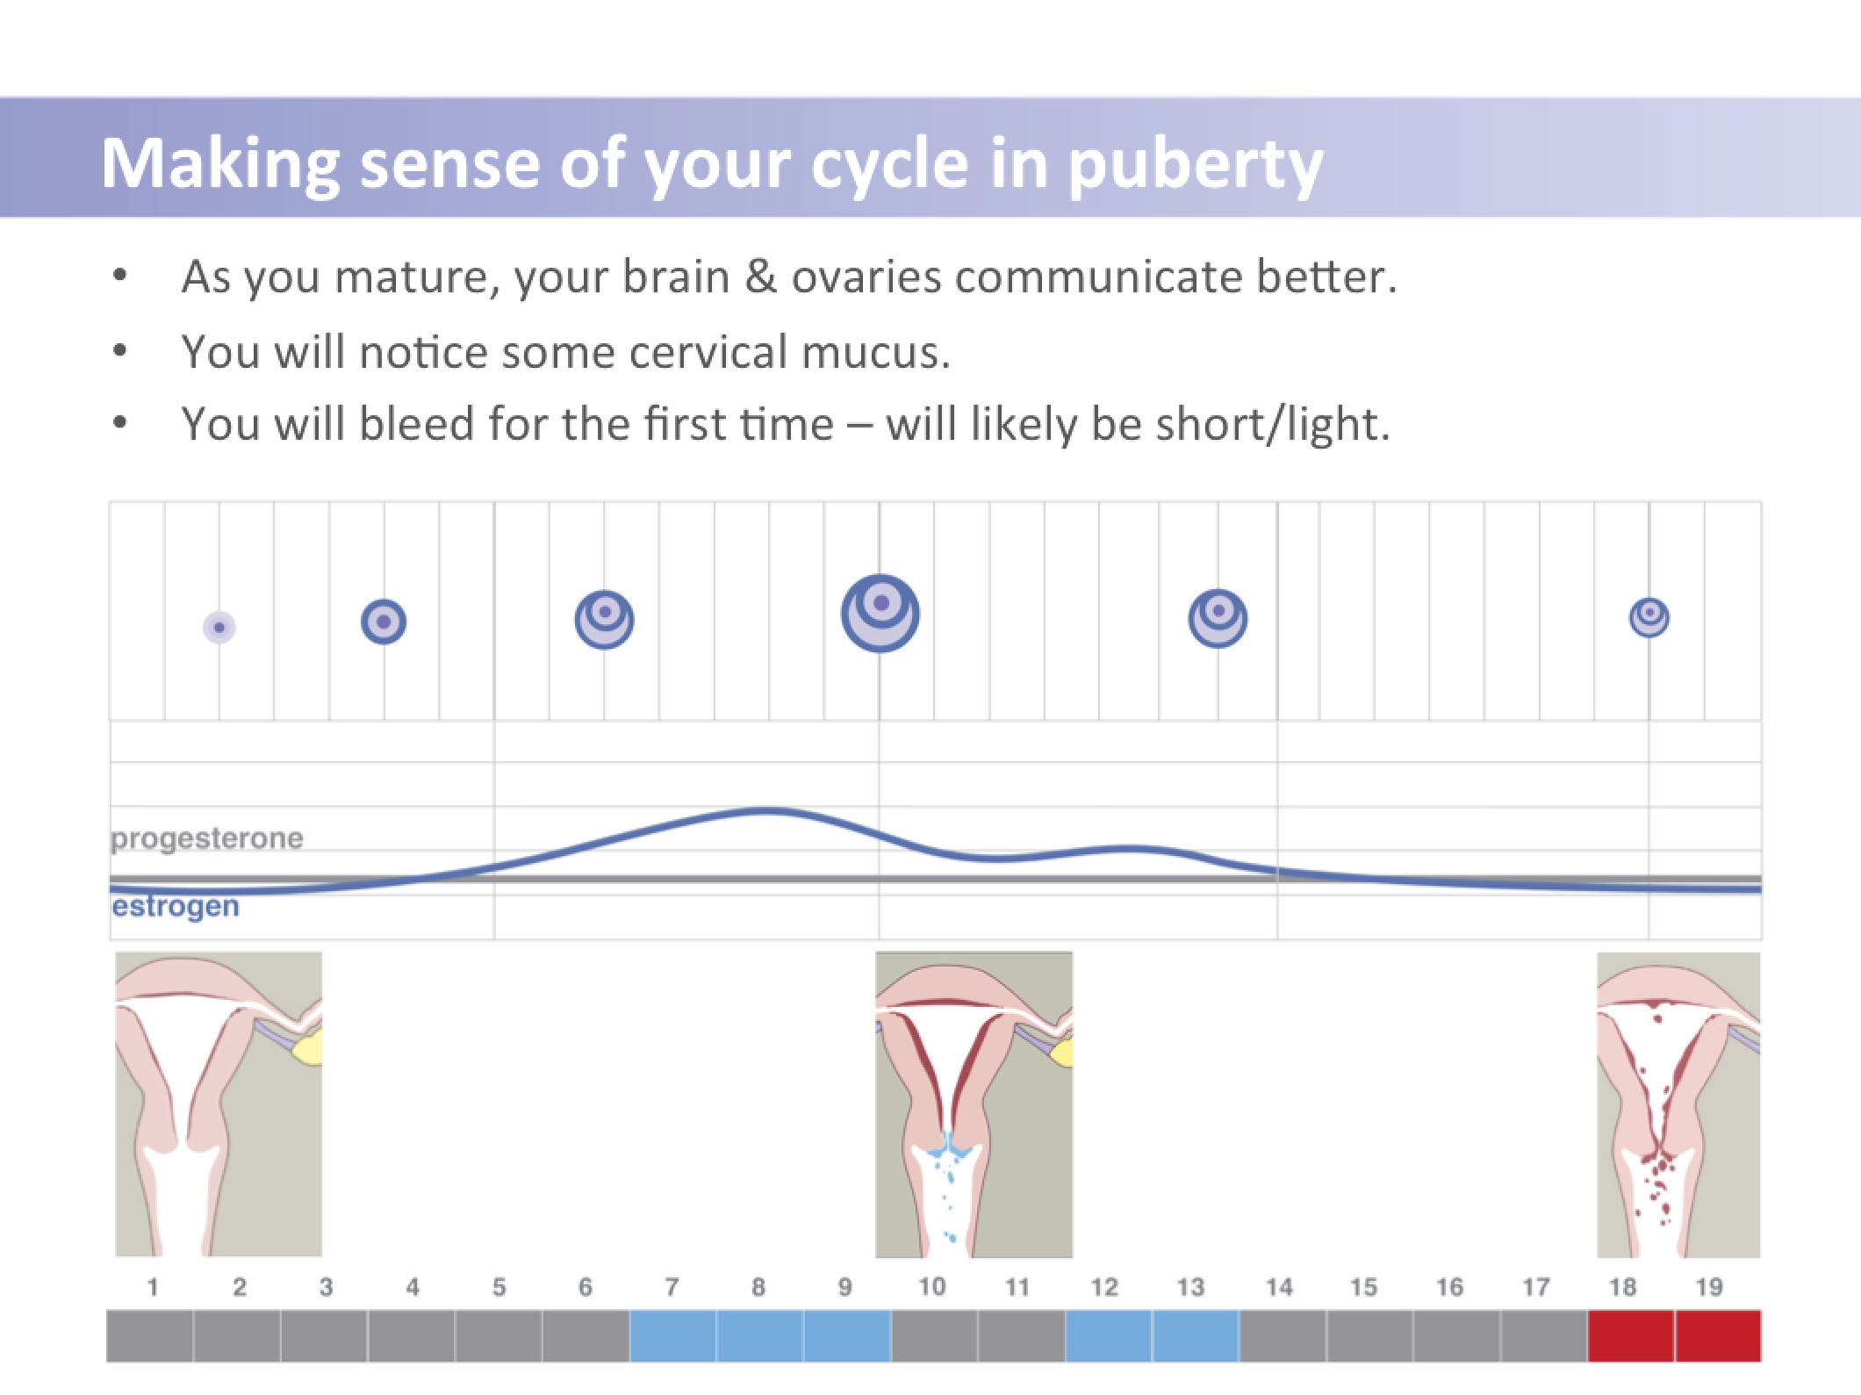
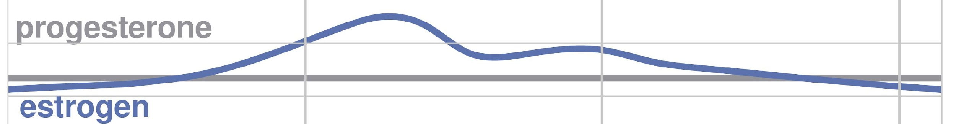
Faizah’s chart
Notes:
As you can see from the activity in the ovary, Faizah’s hormonal axis is a bit more developed, as she’s older. She notices more moisture, and not just a pasty or crumbly feeling or observation.
What would Faizah’s estrogen and progesterone look like?
Her estrogen levels were more steadily rising, but then they declined. Faizah did not ovulate. Since she isn’t ovulating yet, her progesterone levels remain the same and so this would be drawn as a flat gray line.

Slide 8
Faizah’s chart
Notes:
Based on her hormones, what would Faizah be seeing or experiencing? What would her chart look like? It would look something like this:

Slide 9
Notes:
Let’s talk through this chart. Moving from left to right, we can see that Faizah’s hormone levels are low at the beginning of this chart. On her first day of charting she doesn’t notice anything; there is no mucus and so she charts gray for dry. It’s the same for six days. Then on her day 7 of charting, as her estrogen is rising she feels a sensation of moistness and observes this biomarker in her underwear. She knows this indicates a higher level of estrogen. She experiences this on day 7, 8 and 9 and charts blue each day. Then she has two dry days, then another two days of moist. Faizah doesn’t actually ovulate here, but her chart is normal. Her observations indicate that her brain and ovaries are communicating more, which is a sign of her body’s hormonal health.

Slide 10
Ovulation Balances Estrogen and Progesterone
 | estrogen | progesterone
uterus | tones, contracts | relaxes
uterine lining | grows | maintains
breasts | grows | normalizes
bones | forms | maintains
blood vessels | dilates, increases flow | relaxes, normalizes clotting
brain cells | stimulates | maintains and heals
well-being | normal levels promote well-being; high levels increase anxiety | promotes sleep and relaxation; decreases anxiety
“Ovulation is a sign of health” =
if you’re ovulating, it’s a good health indicator that your body is getting
both estrogen and progesterone in the right amount!
© FEMM
Notes:
In the two charts of Amira and Faizah, you can see that estrogen is the main hormonal biomarker. Why does it all start with estrogen? We can think of estrogen as a hormone that proliferates, builds and develops. It helps to build your bone density and is critical to forming the pathways in your brain. It literally affects how you think as you grow!
If you want to have healthy skin, hair, and the body shape that is just right for you depending on your genetic makeup, you will want to chart, to take note of this progression from early cycles where estrogen is the main active hormone, to ovulating cycles where progesterone begins to balance out the effects of estrogen.
Ovulation is a sign of health because it indicates that your body is getting both estrogen and progesterone in the right amount. As you can see from this slide, estrogen and progesterone do very different things in the body, which is why you need both to feel good and be healthy.

Slide 11
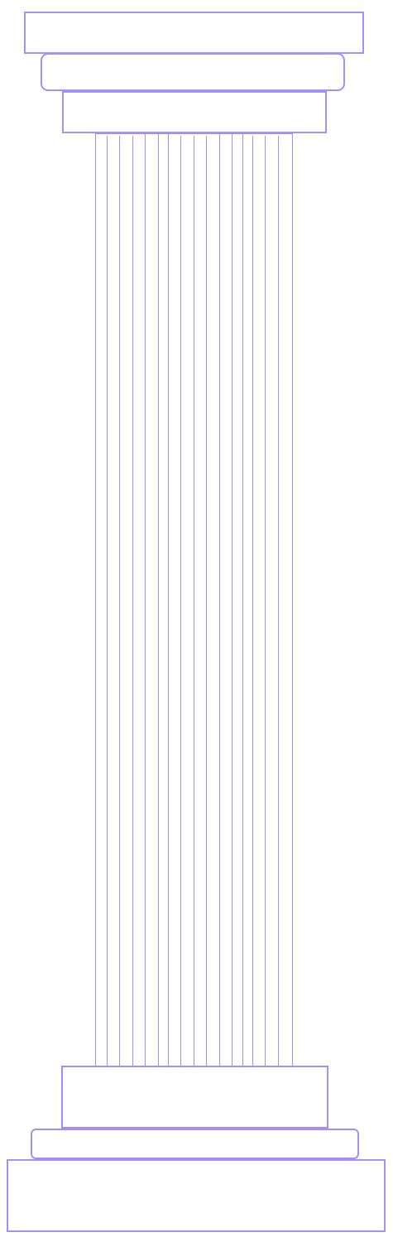
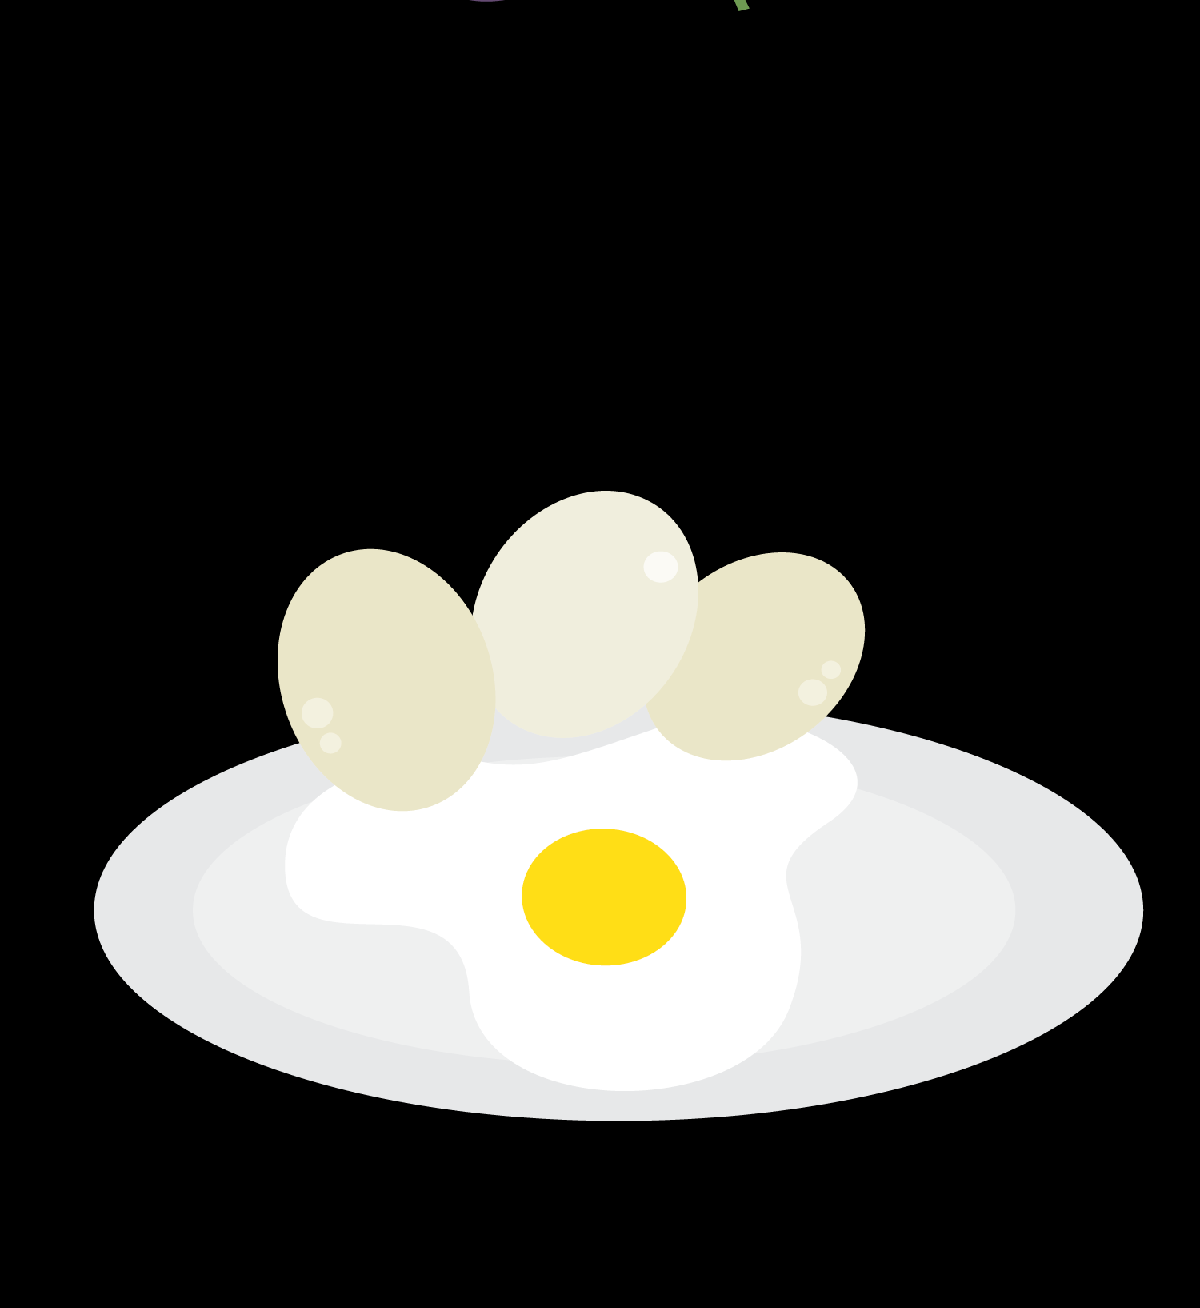

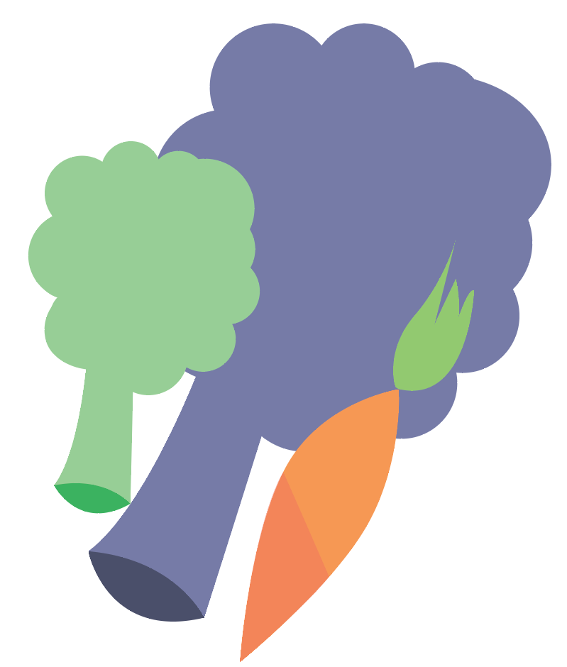
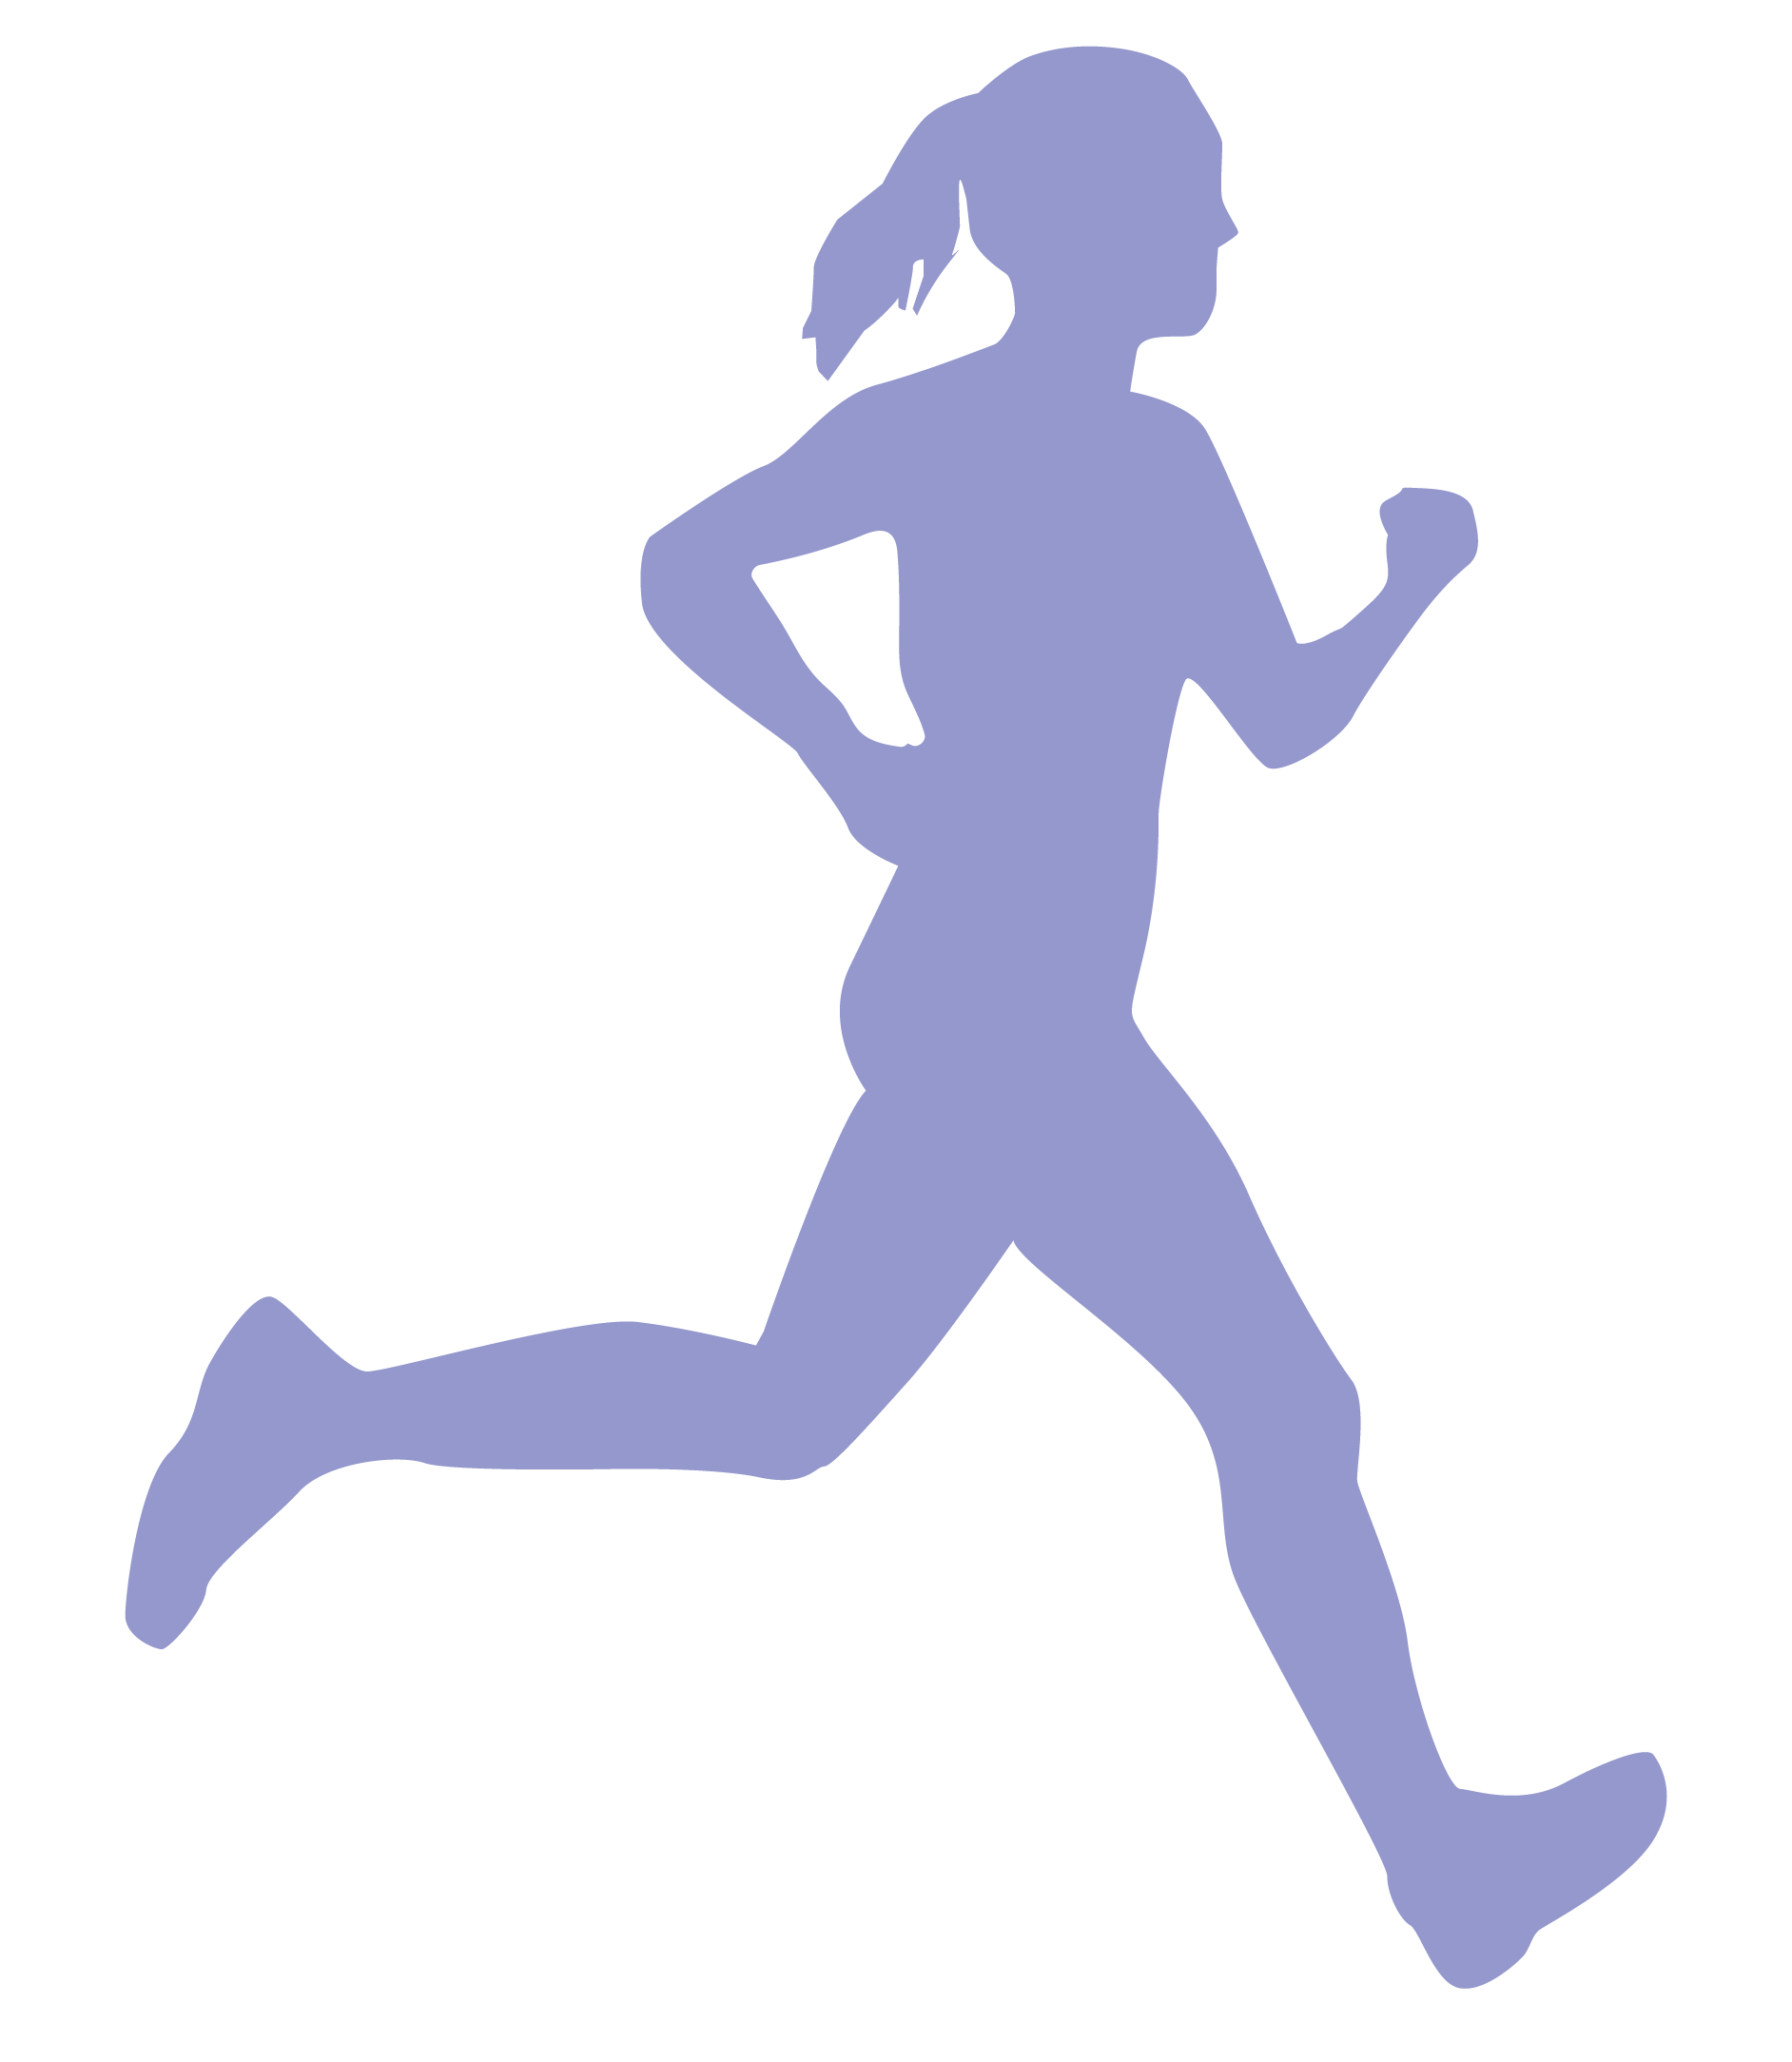
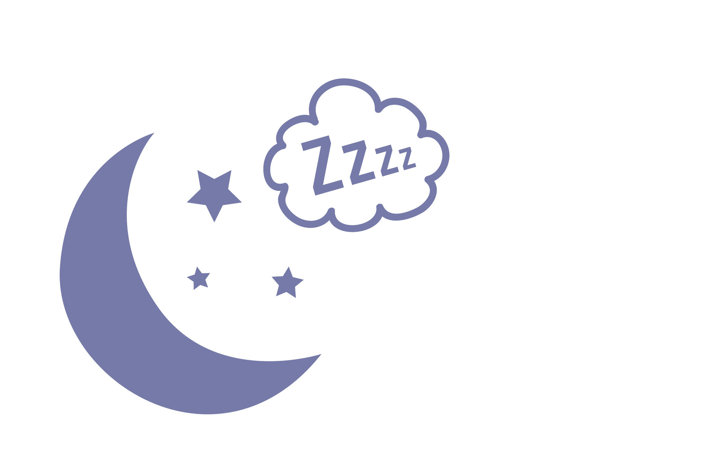

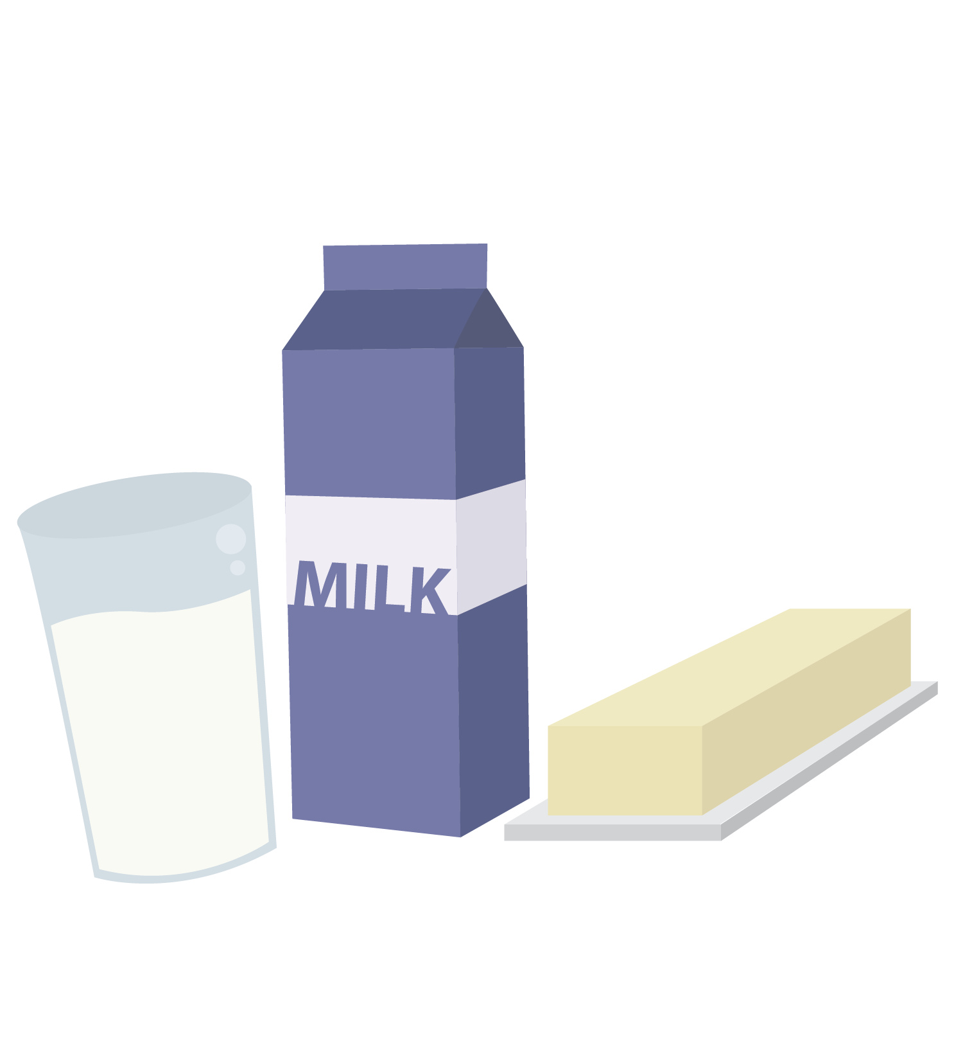
The Three Health Pillars
The Three Pillars Supporting Your Health
1
2
3
Nutrition
Exercise
Sleep
© FEMM
Notes:
Step 3 (15 minutes): Health Pillars; Nutrition and Hormones
To help our bodies, there are three important things we can do. Do you know what they are?
The three health pillars: nutrition, exercise and sleep. Making excellent choices is important because your choices form habits. What is a habit?
Habit: Something you do so often that it becomes natural to you.
When Faizah started to chart, it was hard. She didn’t know if it was worth it as she wasn’t seeing much going on with her hormones. But, in practicing the habit of charting each day, it became natural to her to know what was going on inside her body. Because of this, she was able to easily explain charting to Amira.

Slide 12
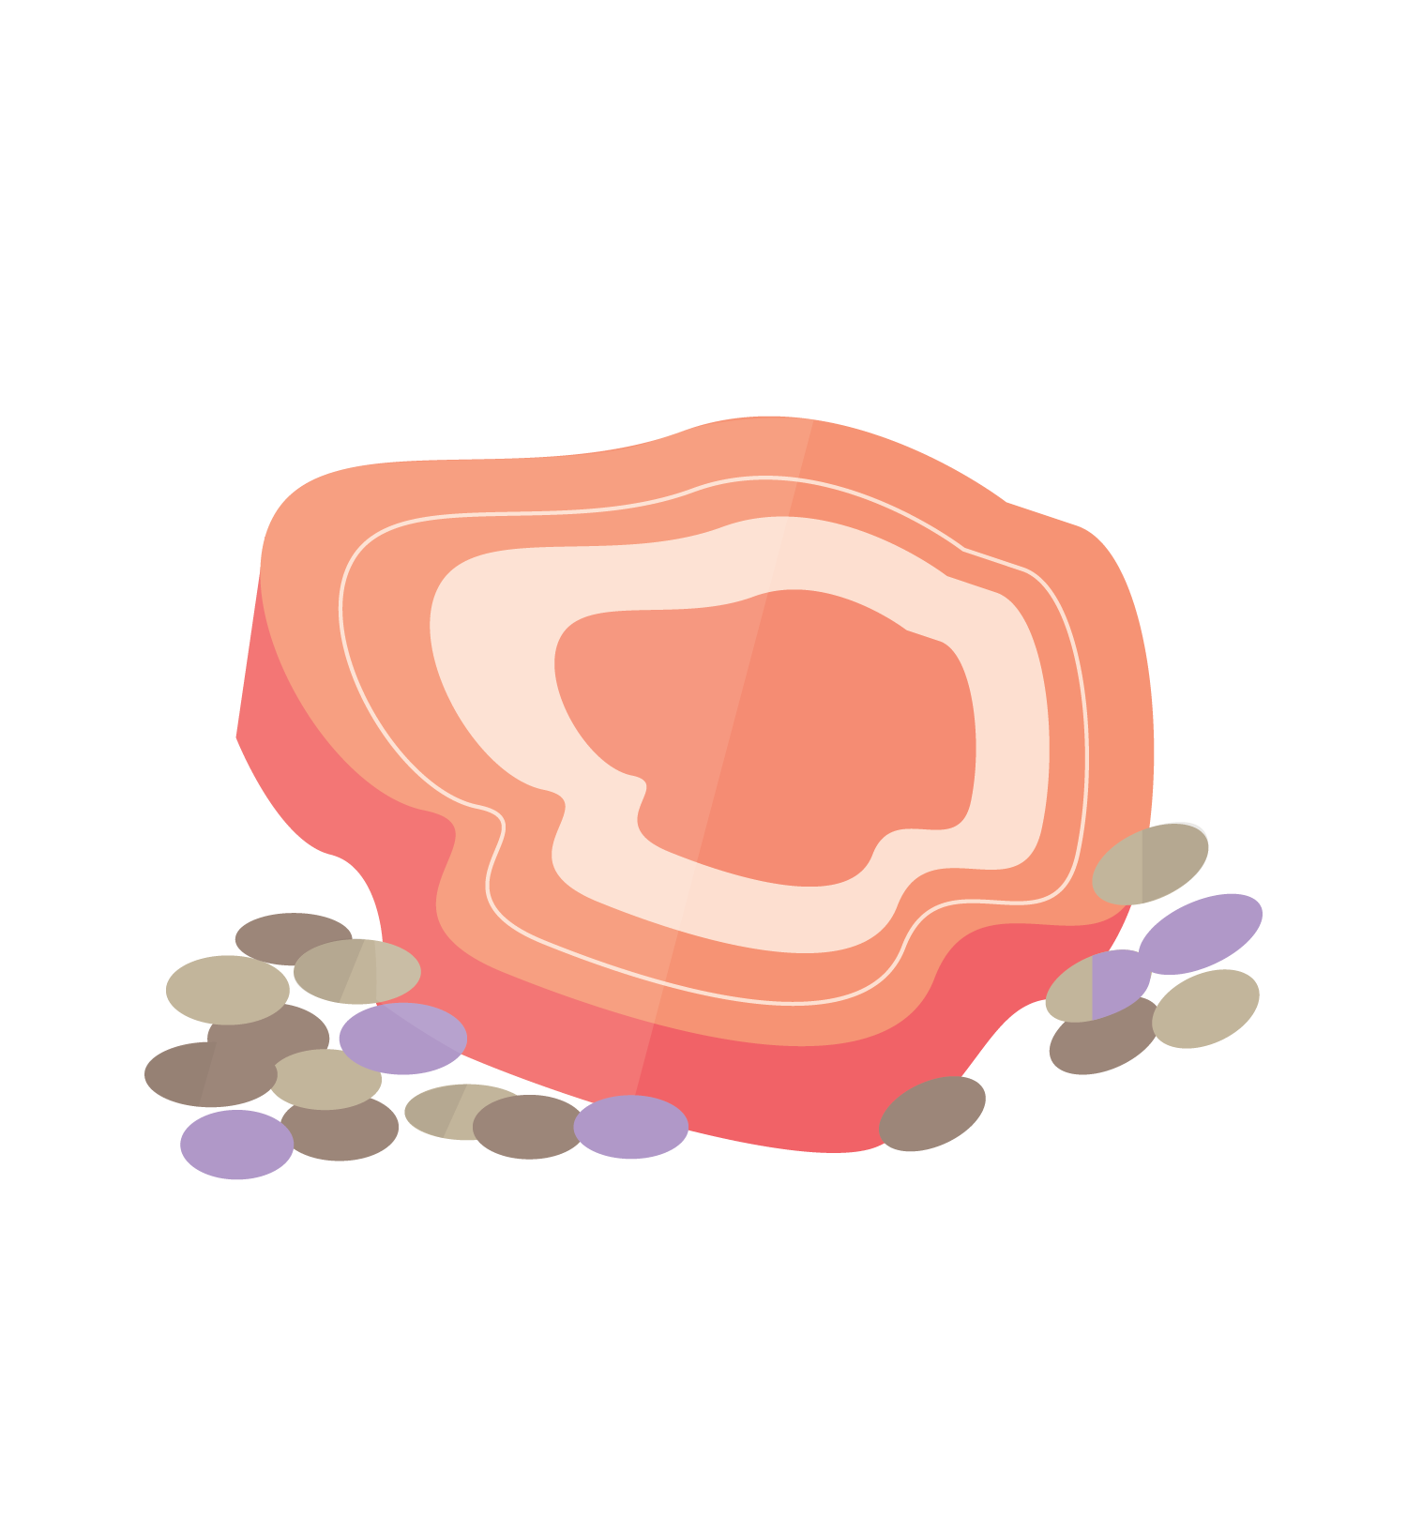
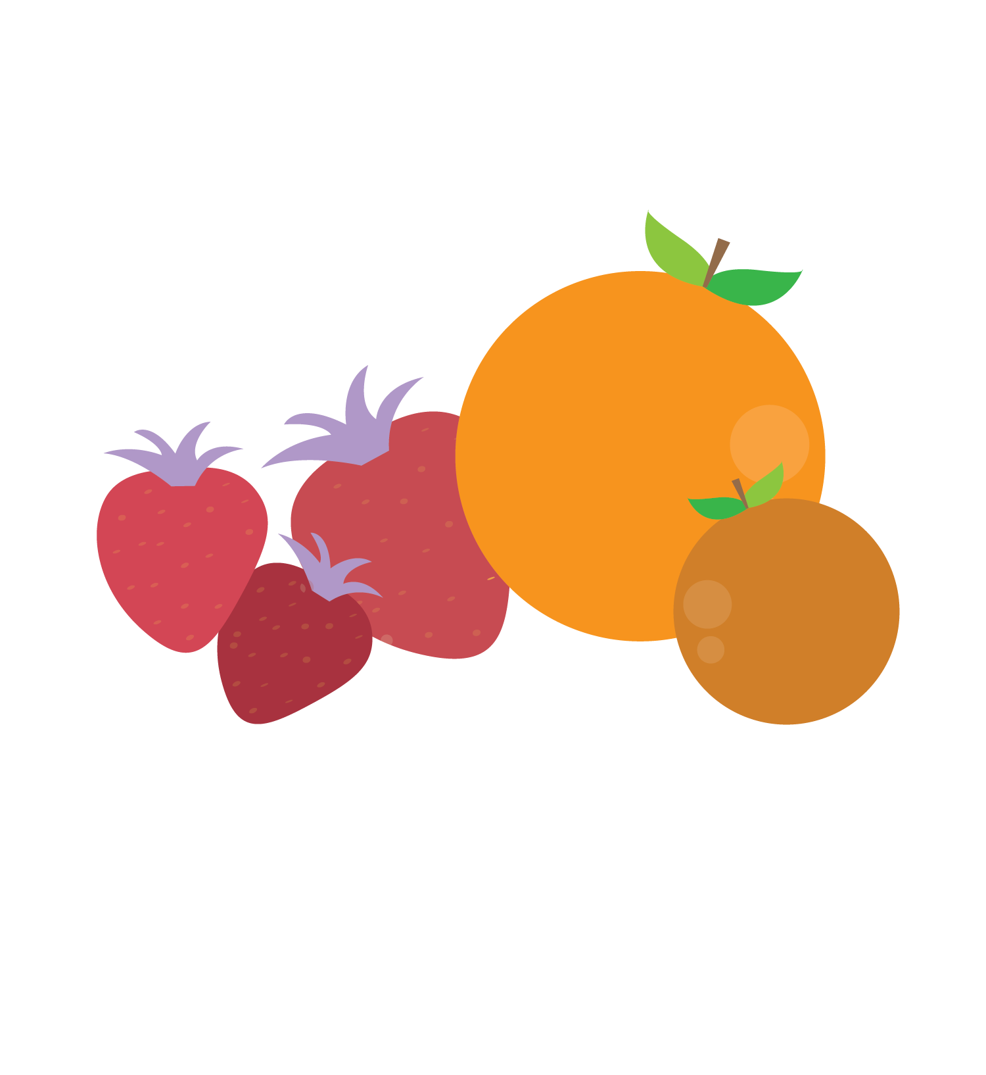
Nutrition & Hormones
Good nutrition feeds your whole body!
Proteins: meat, eggs, fish, nuts, beans
Carbohydrates: whole wheat bread, pasta, rice
Good fats: nut butters, olive oil, yogurt
Vitamins & minerals: fruits, vegetables
Water - don’t forget to hydrate your body!
© FEMM
Notes:
It takes practice to make excellent choices. But, it can start with the three pillars.
Nutrition is the nourishment that your body gets from the food you eat. Good nutrition supports a healthy body and healthy brain. A lack of nutrition doesn’t give our brain or our body the fuel it needs to function and grow properly. Listed here are the food groups that are important to everyone’s health. Take a look and see if you think you’re getting these groups in your meals each day.

Slide 13
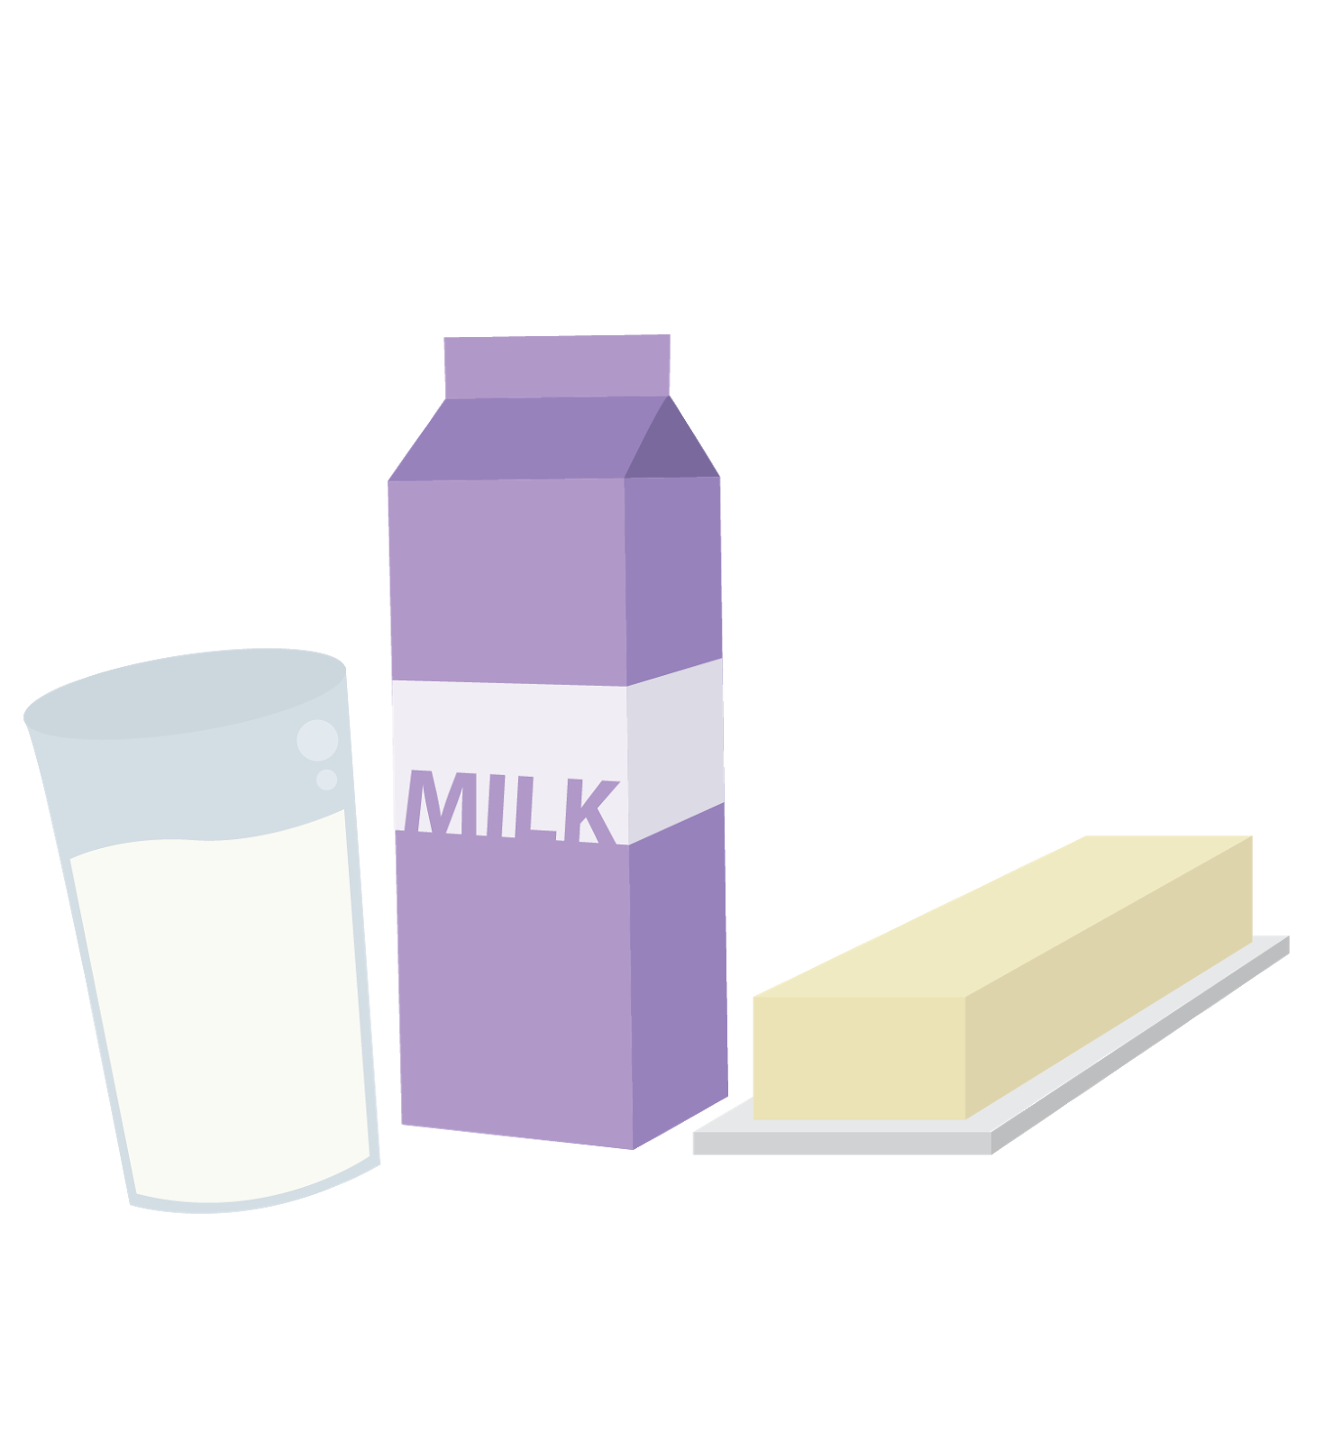
Nutrition & Hormones
Good nutrition supports a healthy body
proteins
carbohydrates & fats
vitamins & minerals
water
Good nutrition supports a healthy body.
proteins: build & maintain cells
carbohydrates & fats: provide energy
vitamins & minerals: build & maintain cells
water: carries nutrients; moistens tissue; lubricates joints; energizes muscle; clears waste
© FEMM
Notes:
Ever heard the phrase, “You are what you eat?” Well, our bodies use the energy from the food we eat to do absolutely everything. So, if you skip breakfast and eat only candy for lunch (or even worse, eat nothing at all!), you aren’t giving your body any of the fuel it needs, such as protein, carbohydrates, good fats or vitamins and minerals. Give your body the food it needs and you’ll have the energy to do more.

Slide 14
Exercise & sleep
Exercise
Sleep
Your mind and body needs
60 minutes
of physical activity a day!
Your mind and body needs
8-10 hours
of sleep each night!
© FEMM
Notes:
What about the other two pillars, exercise and sleep? We’ll talk more about these next time, but here is a bit of information:
Exercise: our bodies were made to move! Physical activity improves your blood circulation, prevents bone loss, boosts energy, reduces anxiety, improves your quality of sleep… and more! Start with an activity that you like: walking, playing a sport, biking, etc. (Some people go jogging just to listen to their favorite music!)
Sleep is so important for your mental and physical health. But did you know that getting eight hours of sleep each night can actually make you smarter, nicer and improve your skin? Studies show that getting eight hours of sleep at night sharpens your thinking and facilitates creativity. Also, when we get enough sleep, we actually read people’s emotions better and are more empathetic, which leads to better relationships at home and at school. Staying up late raises your stress levels. When your stress levels are raised, the body produces more sebaceous oil, which causes breakouts on the skin.

Slide 15
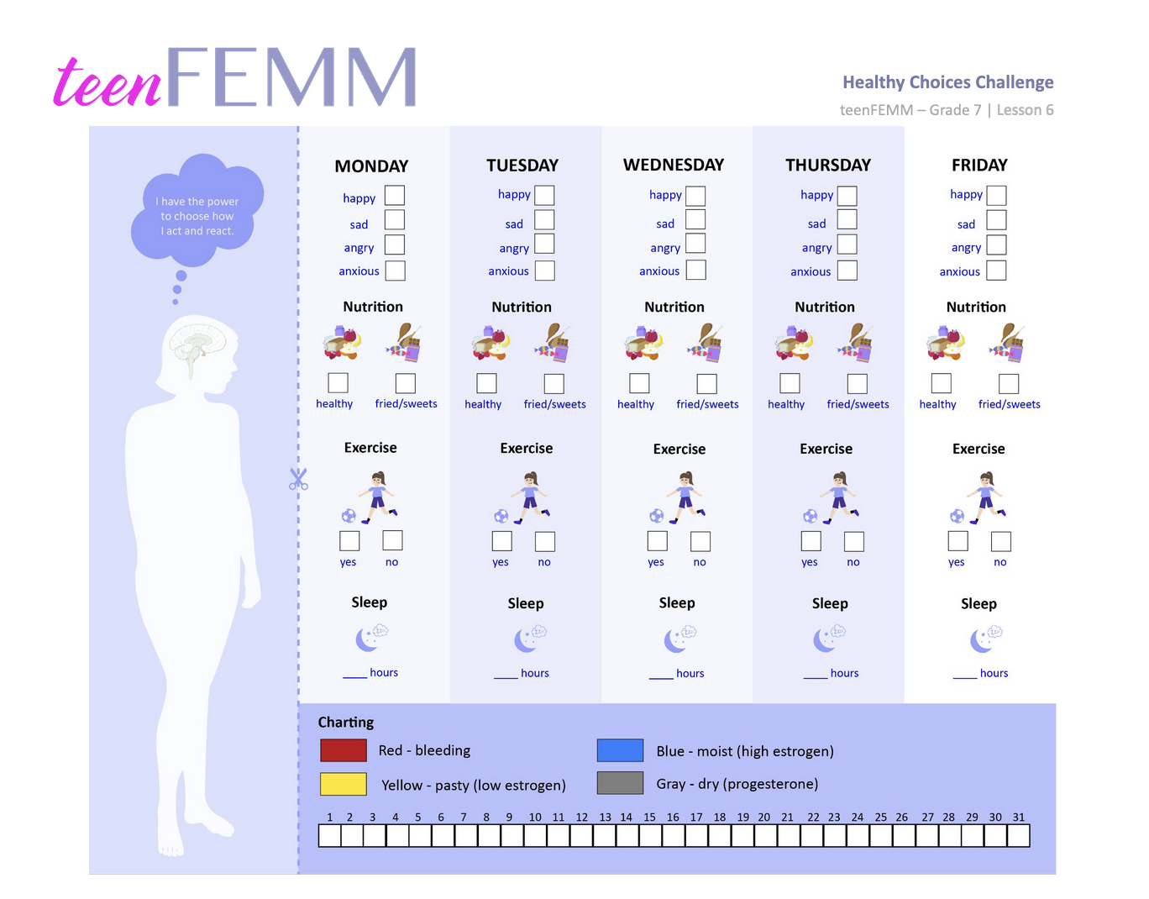
Challenge | Chart your Health!
© FEMM
Notes:
CONCLUSION (5 minutes): Healthy Choices Challenge + teenFEMM Chart
Hand out the Healthy Choices Challenge and a teenFEMM Chart to each student.
On the Healthy Choices Challenge handout, you’ll see that the first box starts with your mood. Each day you’ll check whether you were happy, sad or agitated/often annoyed/angry? The second section asks about your nutrition: did you eat fruits, veggies, meat and dairy? Or, did you eat more fried foods (fries, burgers, pizza, chicken fingers, etc) and sugar/soda/sweets? In the third section you’ll simply check whether you did or did not exercise for 30 minutes that day. Then, (you’ll fill this question in the following morning) did you get eight hours or less than eight hours of sleep the previous night? At the bottom of the page is a teenFEMM chart. You can start charting on this page or you can use the teenFEMM chart to take home with you. You will not be required to show this in class, it is just for you to practice and gain confidence charting. Maybe, just like Faizah, you won’t see much at first and you’ll wonder why you’re charting. There are no right or wrong answers, the purpose of the health challenge is to become aware of your habits and their connection to your overall health.

Slide 16
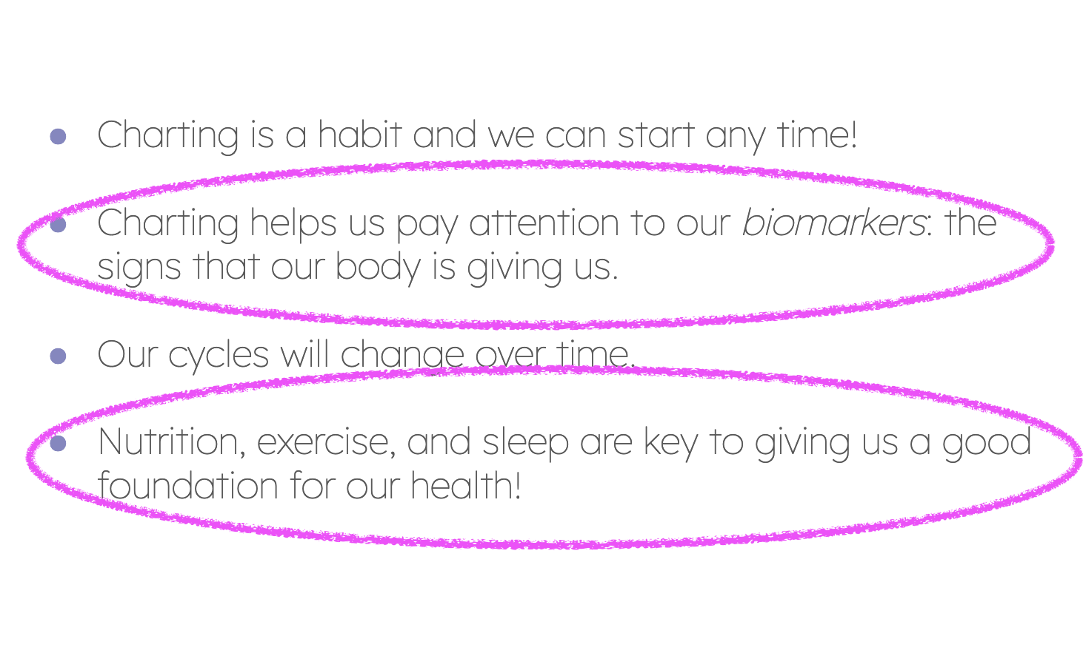
Review
Notes:
In this lesson, we learned more about charting and what healthy hormones look like as you journey through puberty. We also revisited how important it is to make healthy food choices, because what we eat impacts our brain and body health and how these hormonal messages are sent and received. Please continue to chart your biomarkers this week as you also chart what you are eating and how you are feeling on your healthy choices worksheet. You might be able to make some interesting connections between the two charts. Next lesson, we’ll talk a little bit more about exercise and sleep, and how important they are to hormones and therefore our physical and mental well-being.

Slide 17
Grade 7
LESSON 6
© FEMM

