Slide 1

Grade 7
LESSON 6
© FEMM

Slide 2
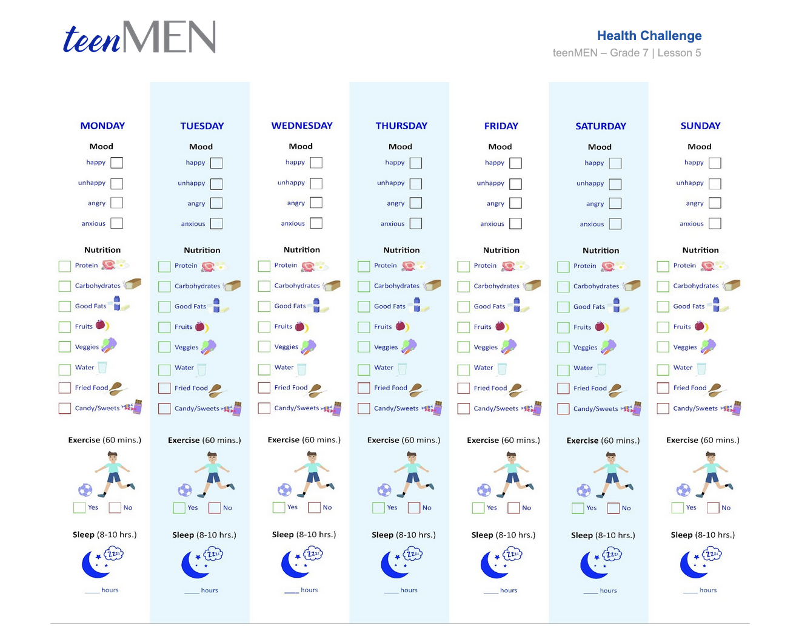
Health Checklist Challenge: how did it go?
© FEMM
Notes:
Step 1 (5 minutes): Discuss Health Checklist
How did it go filling in your Health Checklist last week? What was the hardest part? What was something you learned about yourself? Give students some time to share their answers and discuss.

Slide 3


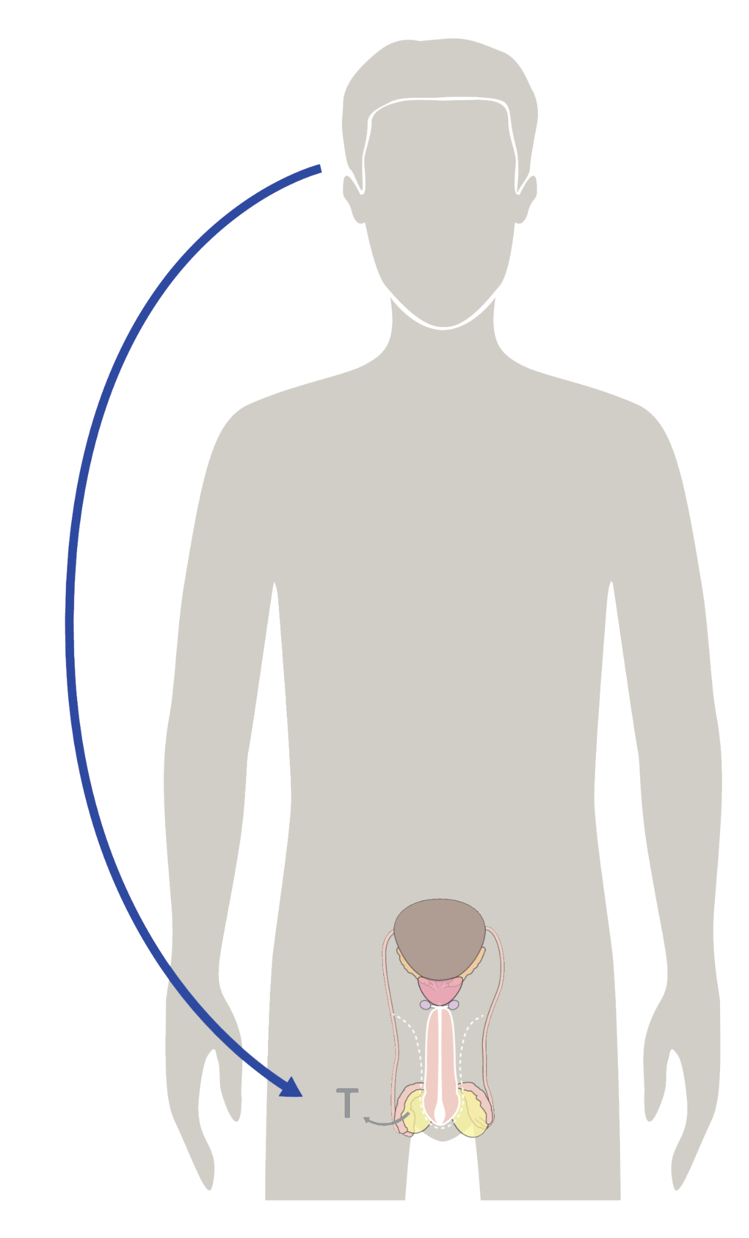

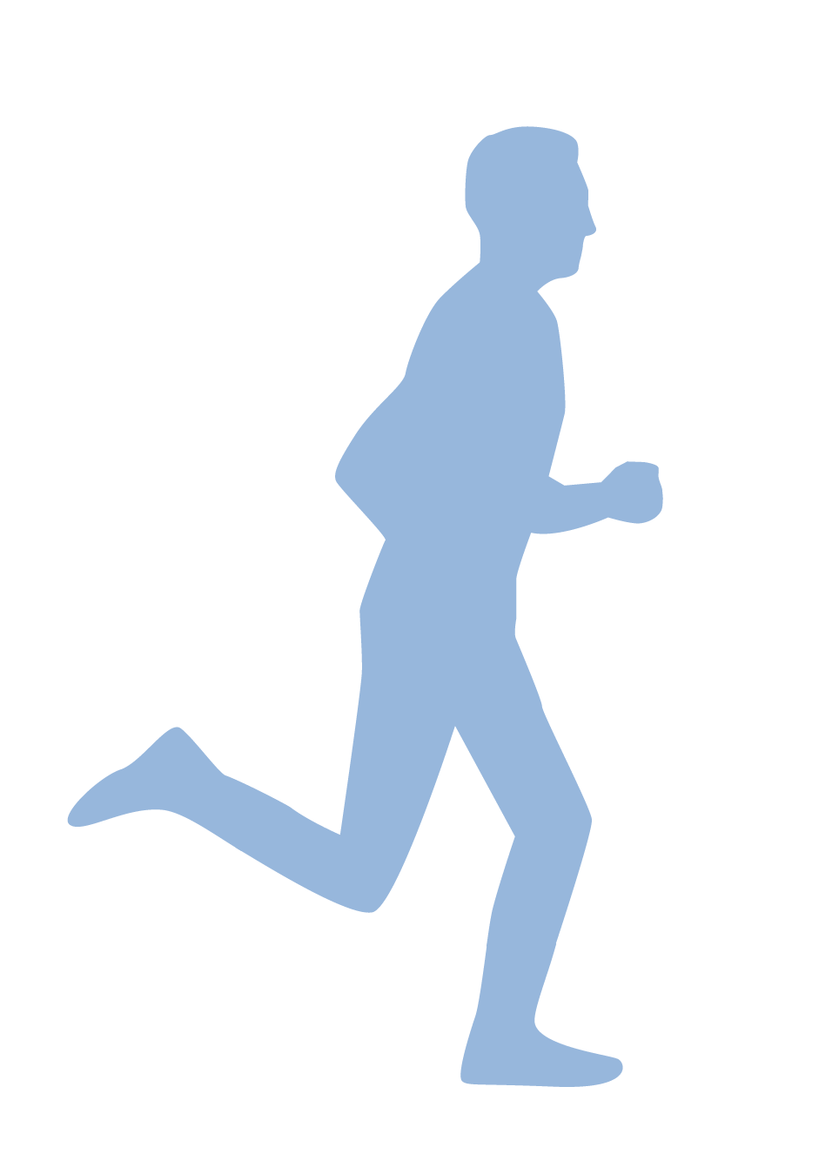
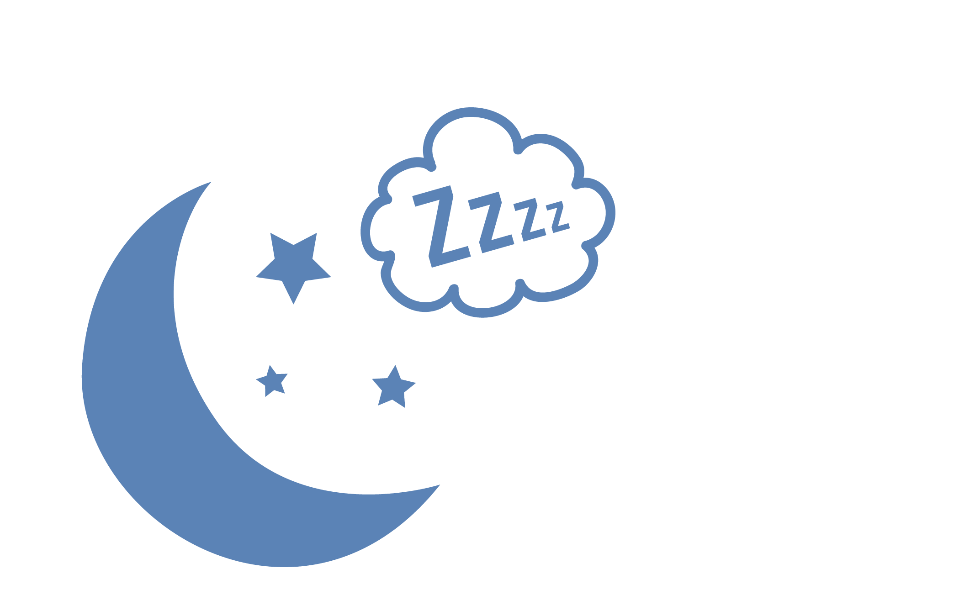




The Three Pillars of Health
Nutrition
Exercise
Sleep
© FEMM
Notes:
Step 2 (15 minutes): Health Pillars: Exercise + Sleep
Do you remember what controls the activity of every system in the body?
Yes, hormones. Hormones are directed by your brain and we also learned last class that there is a lot that we can do to help our hormones stay in balance, such as eating a variety of foods that our body needs.
You might have heard about guys who are taking supplements to try to get stronger. Many supplements promise to do a lot of things: give you bigger muscles, give you more explosive power, give you more stamina or focus. However, using substances such as steroids or other muscle-building supplements, can be dangerous. Did you know that steroids actually are hormones? When steroids are used outside of a doctor’s care, they can really harm your body. They can result in growing breasts and having smaller testicles. They can also raise your risk of developing cancer.
Your body is growing and changing a lot right now and the best way to support your body’s health, strength and stamina is through the health pillars: nutrition, exercise and sleep!

Slide 4

Exercise does what?!
strengthens heart, lungs, muscle + bones
increases energy, improves mood, reduces stress + anxiety!
necessary for good circulation, healthy hormones + proper body function
© FEMM
Notes:
Health Pillar: Exercise
Exercise improves every part of the body: the heart, lungs, brain, testosterone levels, and more!
Remember: every boy’s body is different: some will naturally put on more muscle while others will be leaner. Exercise is for your body’s health, not just to look a certain way. Getting into the habit of exercising daily adds years to your life.

Slide 5
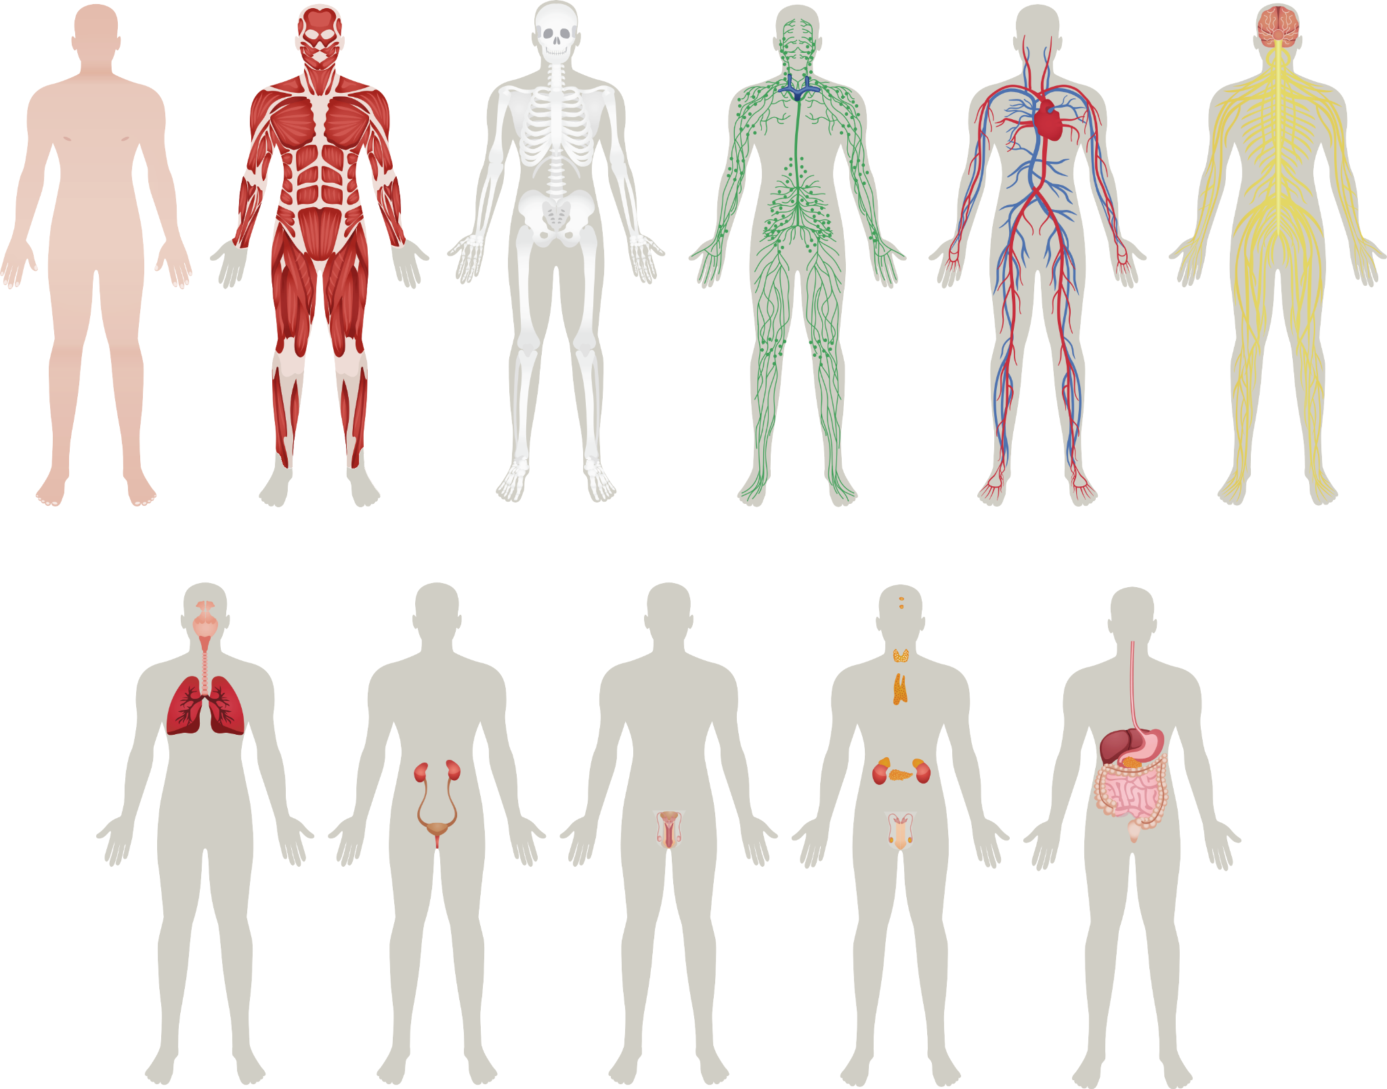
Exercise is for every part of your body
Boosts your brain 🧠
Strengthens your heart
Strengthens your lungs 🥵
(so you don’t look like this emoji when you run.)
Strengthens muscles and bones
Notes:
Did you know that exercise even boosts your brain power? Just 20 minutes of walking increases the oxygen flow to the brain which improves brain function. Stressed after a hard day? 30-60 minutes of moderate exercise relieves stress, boosts your energy levels, helps you sleep better, and improves your self-image.

Slide 6

Your body needs 60 minutes!
Play a sport!
Scuba or Ski
Run, swim or bike!
⚽️🏀🏈🎾🏐🥏🏓🏸🏒🏏 🤿⛷🛼 🪁
🏃🏻 🏊🏼‍♂️ 🚴🏼
Roller skate or kite?
Yes, even cricket!
Notes:
Ask a couple of students to share a sport or activity that they like to do.

Slide 7

Sleep is for every part of the body
Did you know?
1. When you sleep, your brain “house cleans”: it gets rid of toxins and keeps the important stuff.
2. Your body does all of its growing when you’re asleep!
3. Most of your testosterone is produced while you sleep!
© FEMM
Notes:
Health Pillar: Sleep
What do you think is the best way to reset your brain, hormones and body? Sleep!
Your brain does its “house cleaning” during sleep, clearing out toxins. Sleep consolidates all of the learning that you did that day.
You may have thought that nothing happens when you sleep, but sleep is when your body does most of its growing!

Slide 8
Sleep: what is it good for?
Allows your body to grow & repair itself
Enhances your immune system
Promotes attention, memory & learning
Lack of sleep affects mood, energy, strength and concentration.
You need 8-10 hours of sleep each night!
© FEMM
Notes:
And when it comes to hormones, the majority of testosterone is released in the body during sleep. Lack of sleep is associated with lower testosterone levels. Lack of sleep also makes a person more irritable and prone to exaggerated emotional reactions. While the occasional sleepover can be fun, you need to regularly get 8-10 hours of sleep.
Look at the difference on the next slide, when college athletes changed one thing in their routine: they made it a priority to get 10 hours of sleep a night.

Slide 9
Want to be better at sports? Go to bed early!
Sleep-deprived
10 Hours of Sleep
Athletes were slower.
Exhausted faster.
Delayed reaction time in male athletes.
Difficulty learning and decision making.
Research of middle and high school athletes revealed that a lack of sleep is associated with increased injury.
A study of men’s basketball players who extended their sleep to 10 hours a night found several positive outcomes:
The players ran faster in both half-court and full-court sprints.
Their shooting improved by at least 10%.
The athletes reported feeling better physically and mentally.
© FEMM
Notes:
N.B. Cover points on the slide or have students read them out aloud to classmates.

Slide 10
Sleep
YIKES!
According to researchers,
70% of students are not
getting enough sleep
on a regular basis.
© FEMM
Notes:
Getting 10 hours of sleep each night has been shown to promote attention, memory, and critical thinking. And yet, many teens are sleep-deprived. In fact, the Center for Disease Control says that up to 70% of students aren’t getting enough sleep on a regular basis. The main reason? Screentime.
Ask: What can you do to make sure you get enough sleep?
Source: CDC

Slide 11
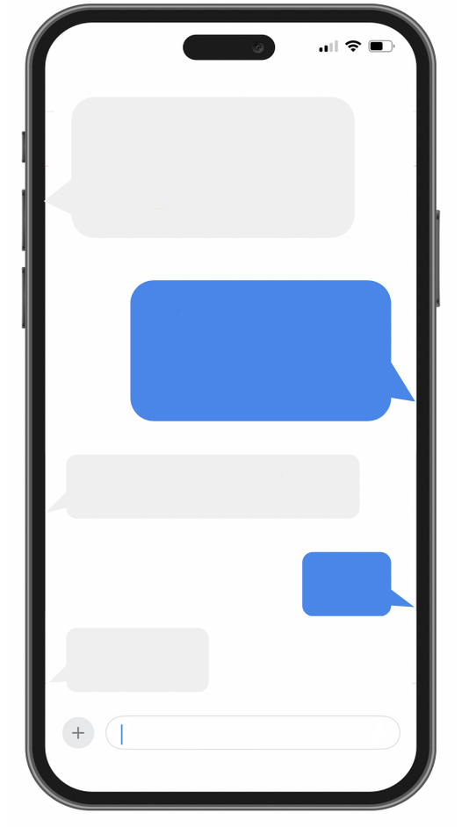
Positives 👍
Pros
Allows us to connect with loved ones.
Allows us to have fun together.
Allows us to reach out for help.
Allows us to learn in a way we wouldn’t have been able to do before.
© FEMM
Notes:
Step 3 (5 minutes): Screen Time and Sleep Hygiene
Technology gives us lots of opportunities to connect and have fun. Technology can also help us learn new things.

Slide 12
Negatives 👎
Cons
Distraction from the world around us
Technology/Gaming addiction
Skipping meals/sleep
Watching porn
!
© FEMM
Notes:
Technology has a downside, too. Technology also carries risks, such as distraction from what’s happening around us (have you ever seen a video of someone walking into a pole on the street because they were staring at their smartphone?); distractions from other relationships (has one of your parents ever not answered your question because they were on their phone?); too much screen time, or having issues with the way you use social media.
Have you ever heard of technology addiction? Sometimes, when you’re having a really good time doing something on a screen, it can be hard to notice how much time is being used. Eventually, you might even start to feel like you “need” the device to feel good and that when it isn’t in your hand, you are looking for it all the time. It can even get in the way of the pillars of health.
You might skip a meal to keep gaming. Do you know that when you skip a meal, your body sees this as a mini-emergency? It starts to produce stress hormones. This might not be such a big deal once in a while, but if we do it a lot, it can cause us to not feel very well. It also affects our blood sugar levels, which means that we can get cranky and irritable. Regularly skipping meals can also affect your metabolism, because your body thinks you are in a state of famine! This can signal your body to gain weight unnecessarily or make it hard to lose weight.
You might stay up really late at night to watch YouTube when you should have been asleep three hours ago! These can have very real effects on our body and brain. When tech usage affects sleep, this can have negative effects on our ability to pay attention, learn, and remember things in school the next day. It can also make you feel worried or sad.
You might start to watch pornography and find it hard to stop. Pornography is material that is designed to arouse sexual feelings by depicting nudity, sexual behavior, or any type of sexual information. Pornography is easier to get than ever today, but that doesn’t mean it’s good for us. Porn can have serious effects on your ability to have a healthy relationship. Over time, with increased usage, it can also have negative physical effects on your body. Porn objectifies both men and women. Research has suggested that exposure to pornography at a young age may be related to poor mental health, sexism and objectification, increased sexual aggression, interpersonal relationship problems, and other negative outcomes.
If you or someone you know is struggling in any of these areas (gaming, Youtube, porn), it’s best to bring it up with a trusted adult and get some help.

Slide 13

Who’s the boss?
Don’t Let Your Devices
Take Charge of You.
TAKE CHARGE OF YOUR DEVICES
by talking to a trusted adult about a plan to limit screen time.
!
© FEMM
Notes:
The thing to remember is that you can take charge of your devices; don’t let them take charge of you! Talk to a parent or trusted adult about a schedule for screen time in your home.

Slide 14

Sleep Hygiene
Practicing good sleep hygiene means:
put away screens/your phone 30-60 minutes before bed
don’t drink beverages with caffeine
keep your bedroom cool, quiet and dark
© FEMM
Notes:
You can start to take charge by practicing good sleep hygiene.
Sleep hygiene, like the hygiene we learned about for our bodies, is really important. Practicing good sleep hygiene means: put away screens and devices for 30-60 minutes before bed; don’t drink anything with caffeine; and keep your bedroom cool, quiet and dark.

Slide 15
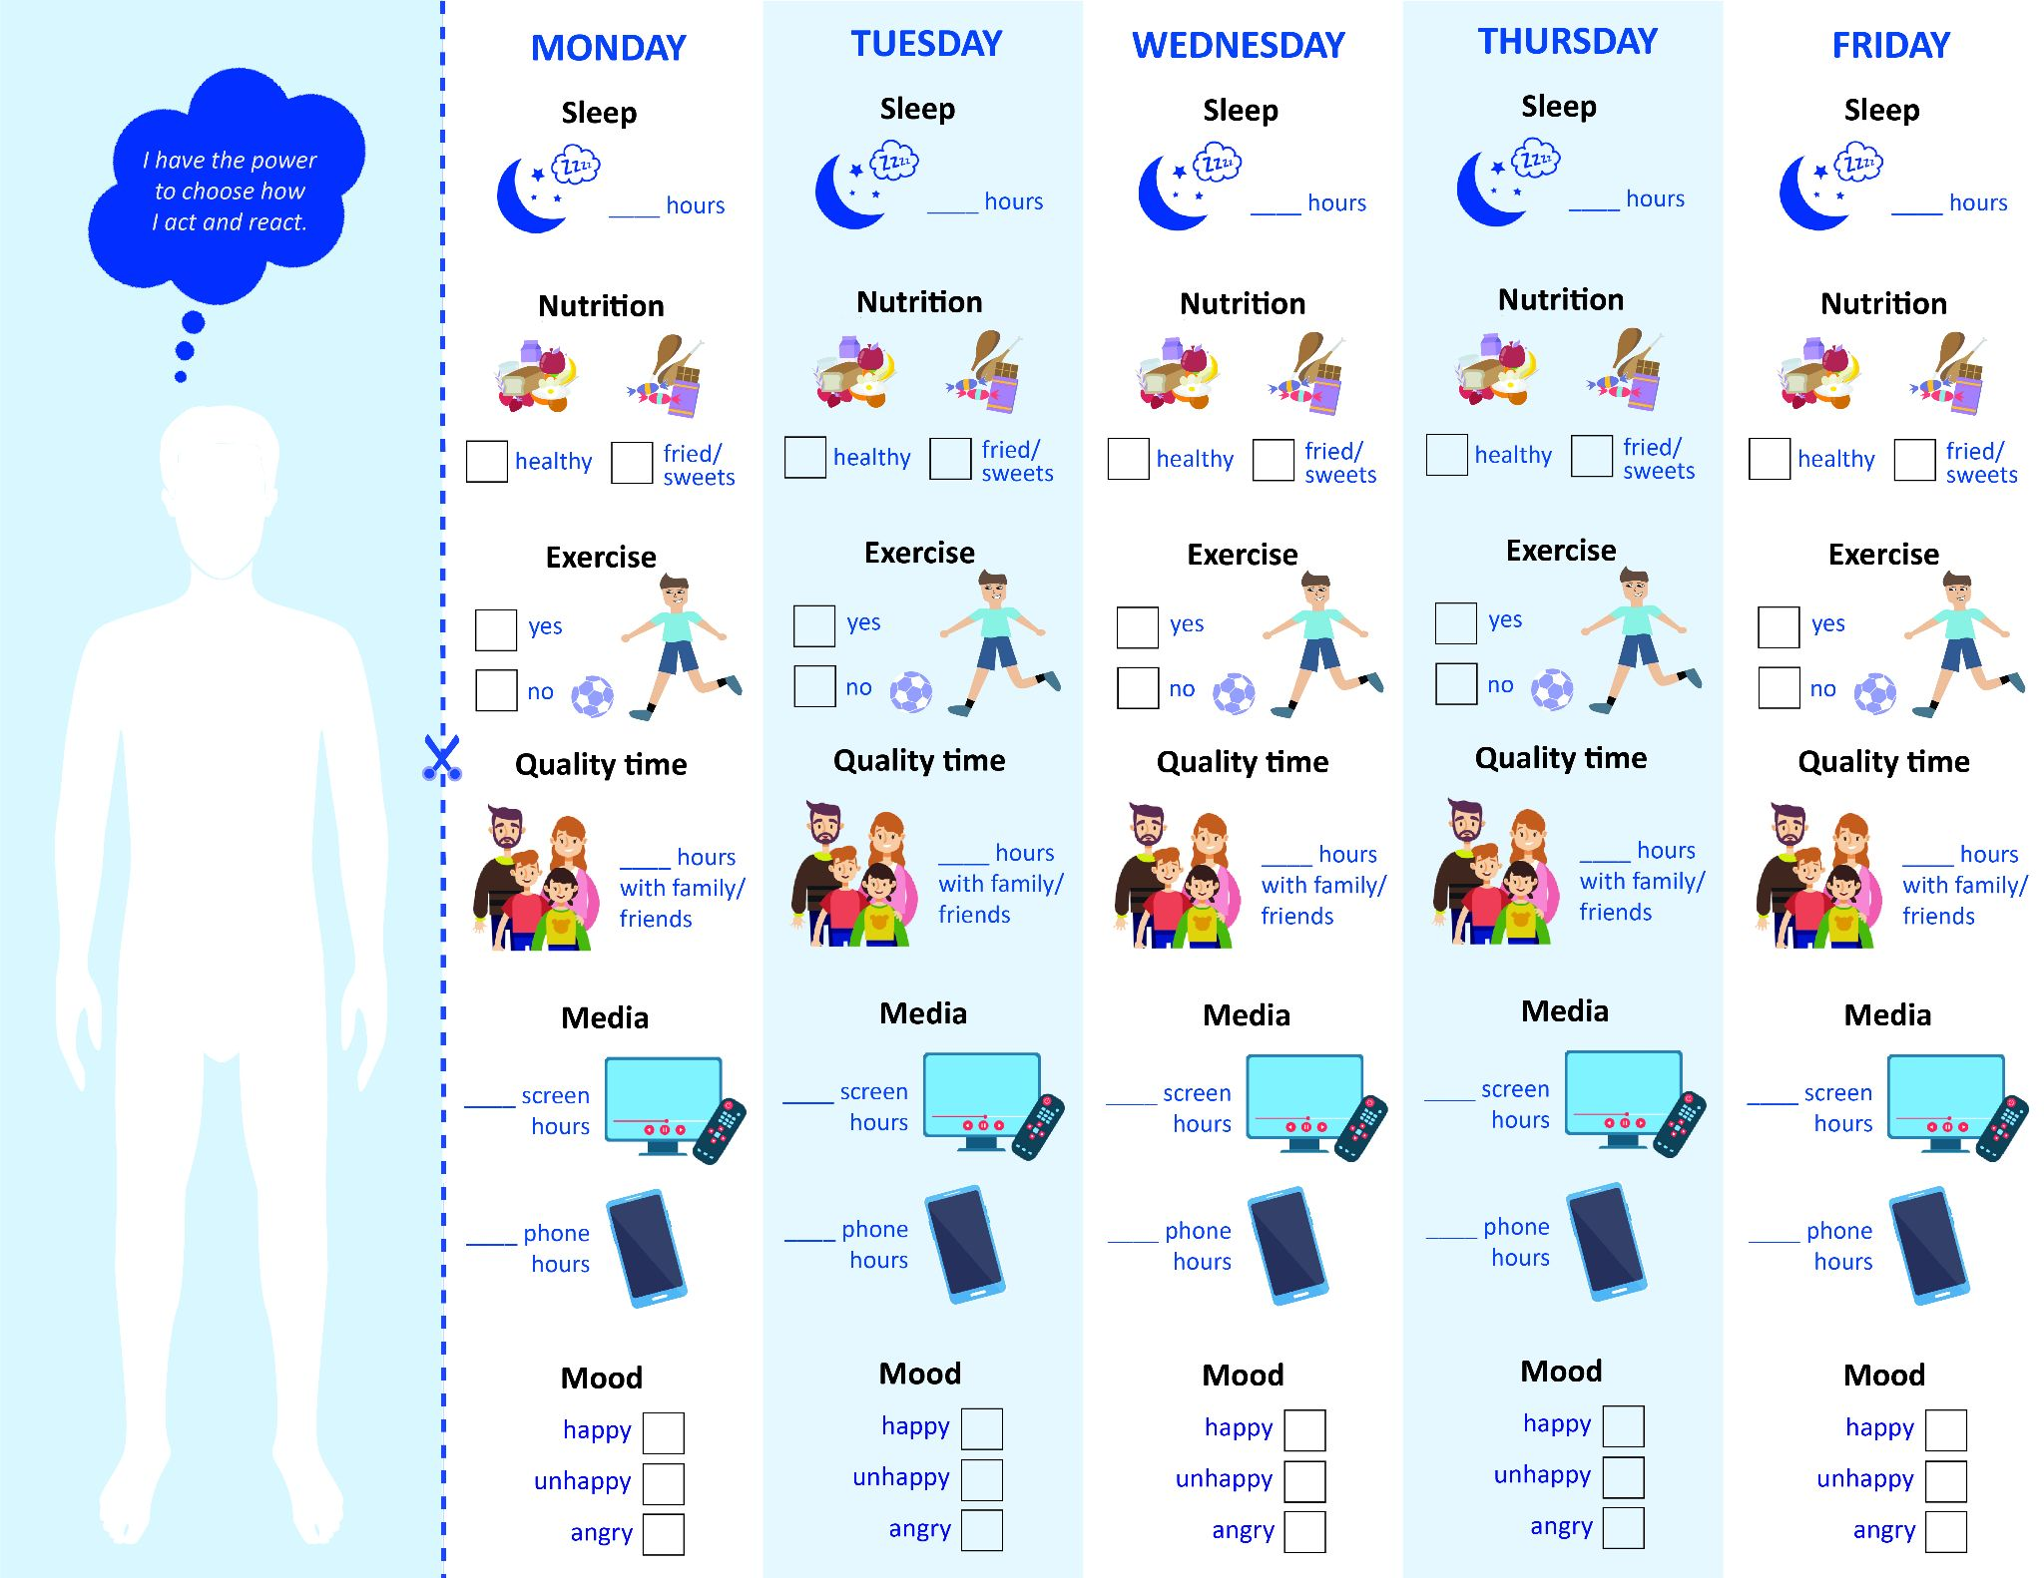
Health and Technology Checklist
© FEMM
Notes:
Step 4 (2 minutes): Tech Tips + Health and Technology Checklist
This week you’re going to continue to track your pillars of health habits and add a focus on technology.
Give students the Tech Tips to read at home and the Health and Technology Checklist to fill in for the week.
Pay attention to how many hours you spend on screens: either a computer or a TV, watching shows, and on your phone. You can check your screen time use on your phone in your settings. Bring your completed Checklist to our next class! You may want to incentivize students by assigning a bonus mark or prize to those who bring it completed.

Slide 16
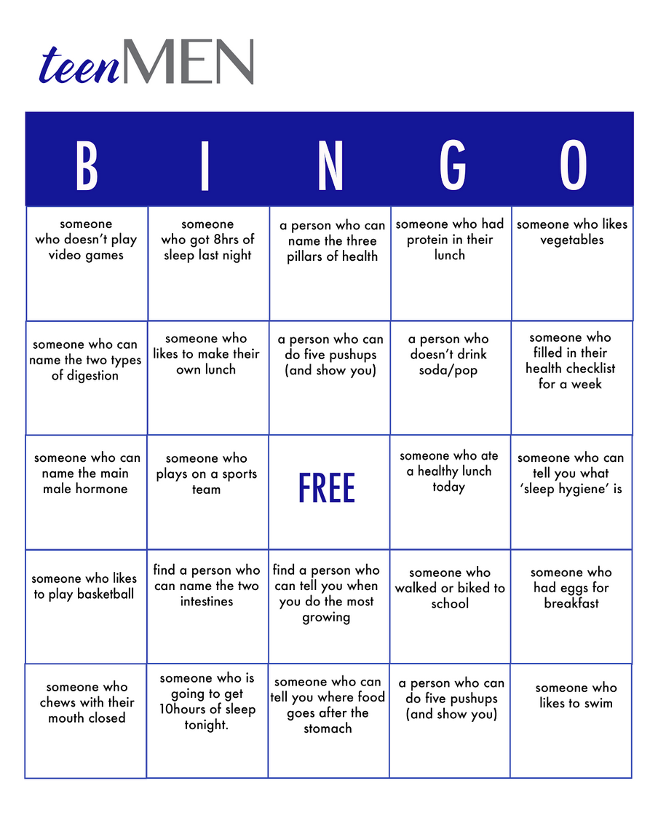
Brain Break!
Walk around the room and ask different people questions as you try to get
five squares in a row on
your bingo card!
© FEMM
Notes:
If time permits, end the class with the teenMEN Bingo game.
CONCLUSION (8 minutes): teenMEN BINGO Game
Instructions: Hand out a bingo card to each student. Have students move around the room, asking each person a question on the bingo card. If one of the squares applies to someone in the room, have them write their name down in the square. When you ask a student one of the skill-testing questions, have them write their name down once they say the answer. When you have five squares in a row, yell “BINGO”! The teacher will check the card to confirm the winner.

Slide 17
Grade 7
LESSON 6
© FEMM

