Slide 1

Grade 7
LESSON 7
© FEMM

Slide 2
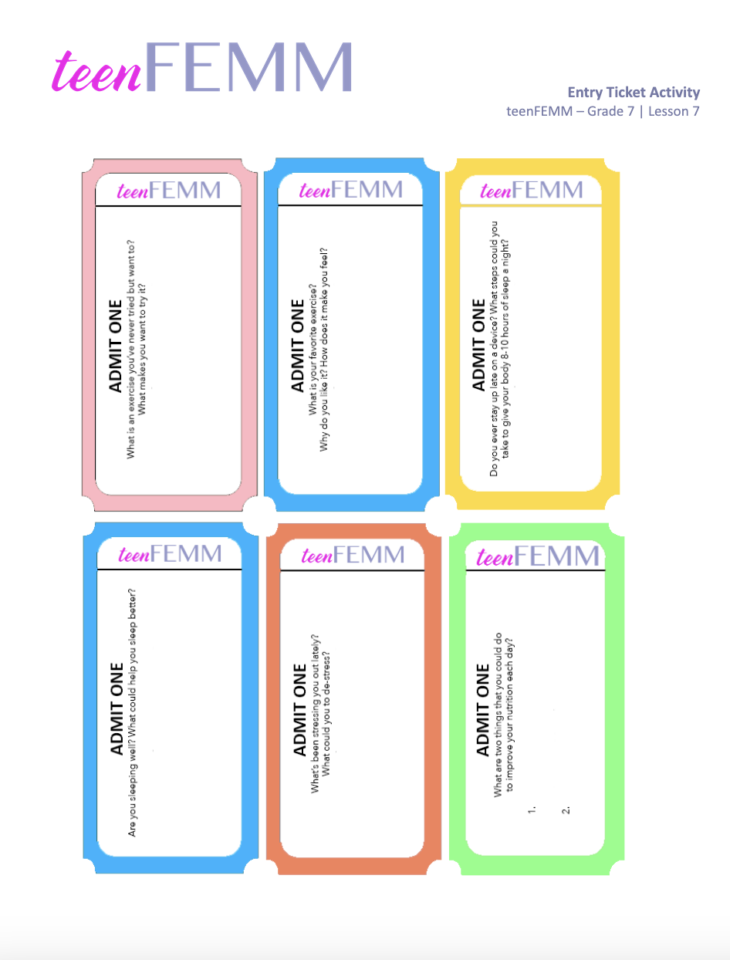
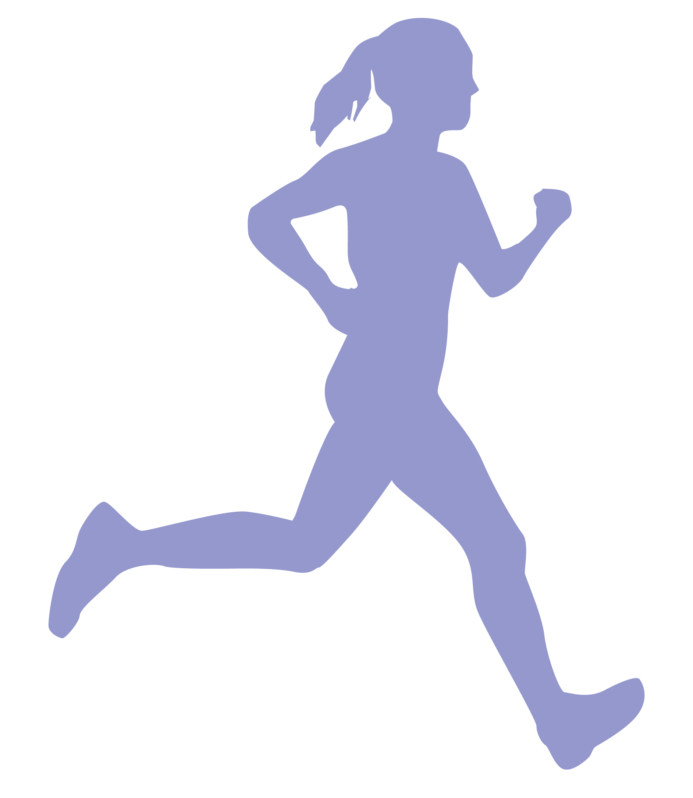
Entry Ticket Activity!
What are your health habits?
© FEMM
Notes:
PROCEDURE
Before class, print and cut out as many entry tickets as needed in order to give one ticket per student.
Step 1 (5 minutes): Entry Ticket Activity
Hand out one Entry Ticket to each student as they enter the class. Give students a couple of minutes to write down their responses to the questions. Ask students to volunteer to share their responses.

Slide 3
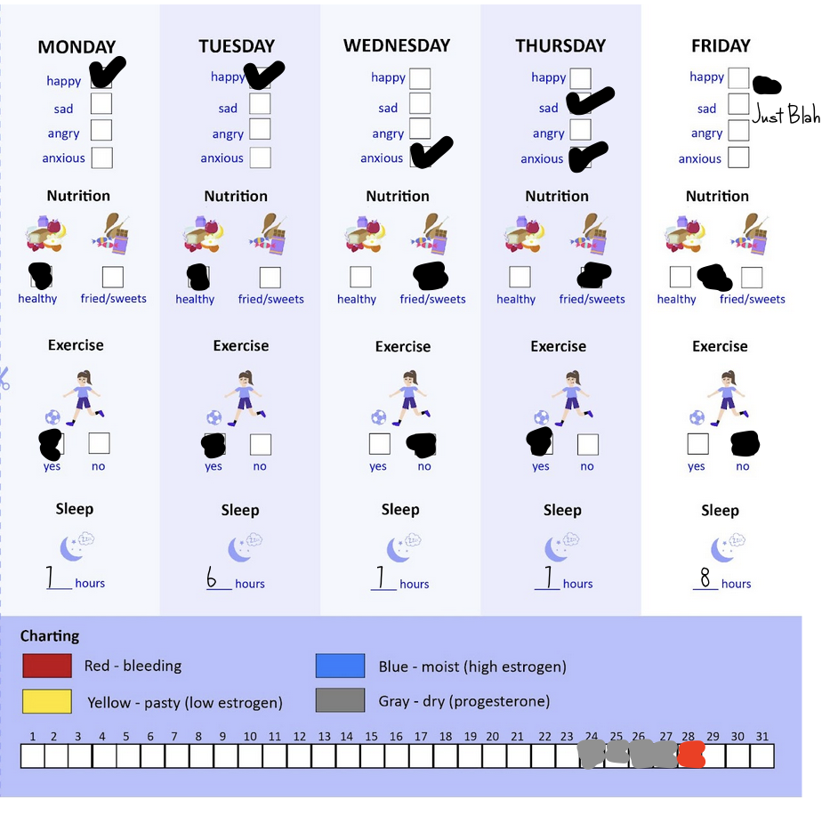
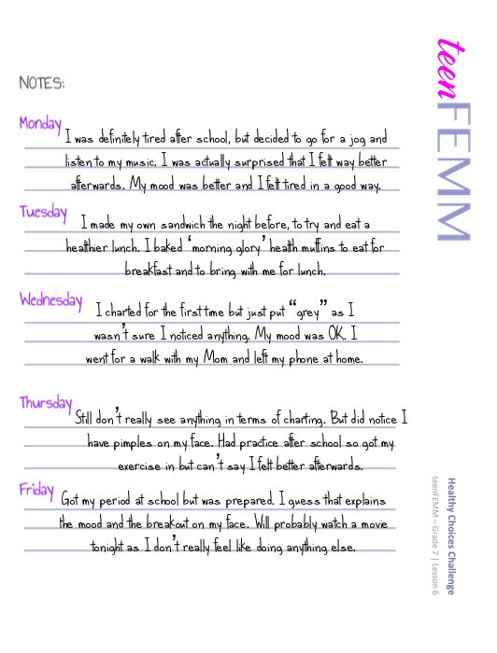
Healthy Choices Challenge!
What did you notice?
© FEMM
Notes:
Step 2 (5 minutes): Class discussion on the Healthy Choices Challenge
How did everyone do with the Healthy Choices Challenge? What did you notice about your nutrition, sleep and exercise habits? Any difference in your mood, after exercise or a good night’s sleep? Did anything surprise you? Give students a chance to provide feedback, based on what they might have noticed from the Healthy Choices Challenge.
What about charting? Did anyone try to chart their cycle? Was it easier or harder than you thought? Remind students that it takes practice to get in the habit of charting biomarkers, mood, and any physical symptoms. In this chart, one teenFEMM participant shared,“Still don’t really see anything… '' but noted that they had a breakout on their face. Then she got her period. So, it’s a good example of how mood or physical symptoms can also be indicators of what’s going on with our hormones.
In this lesson, we will go through a few examples of girls just like you and talk about some of the connections between what they ate, how much sleep and exercise they got, and their emotions and cycles.

Slide 4
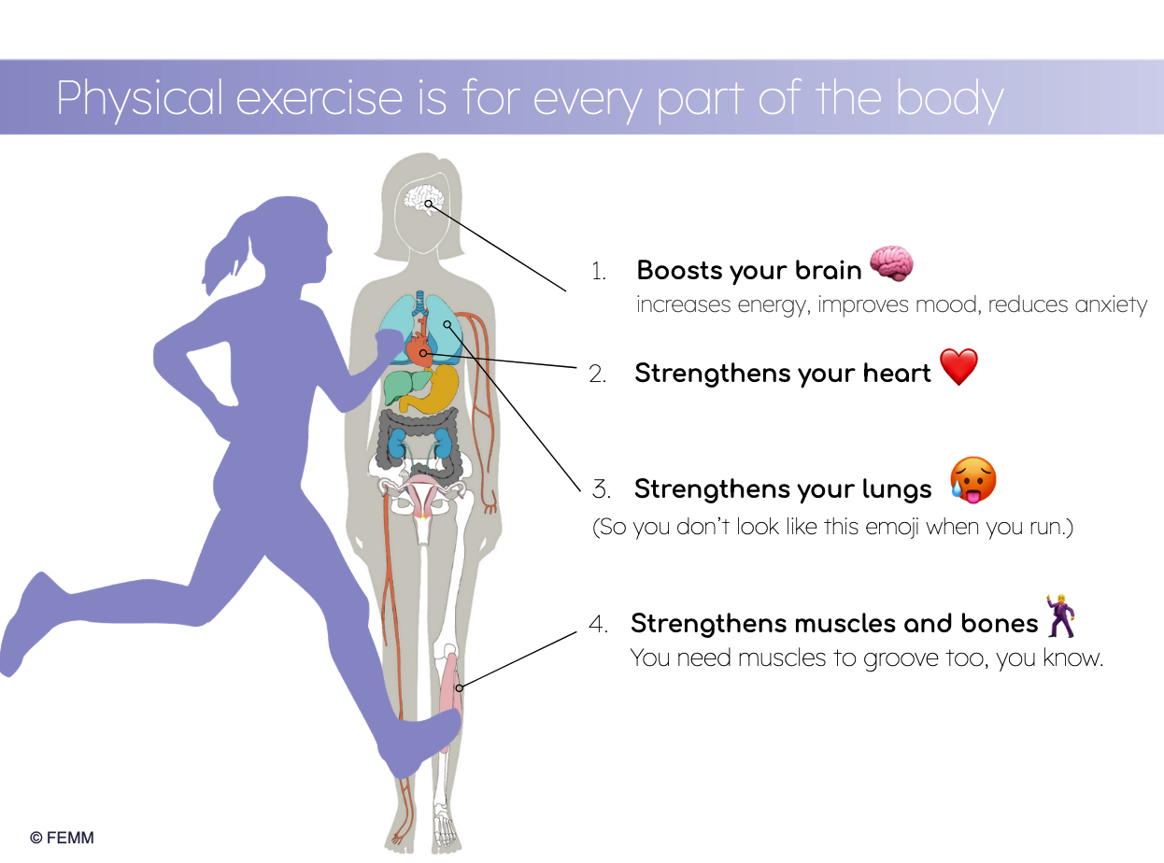
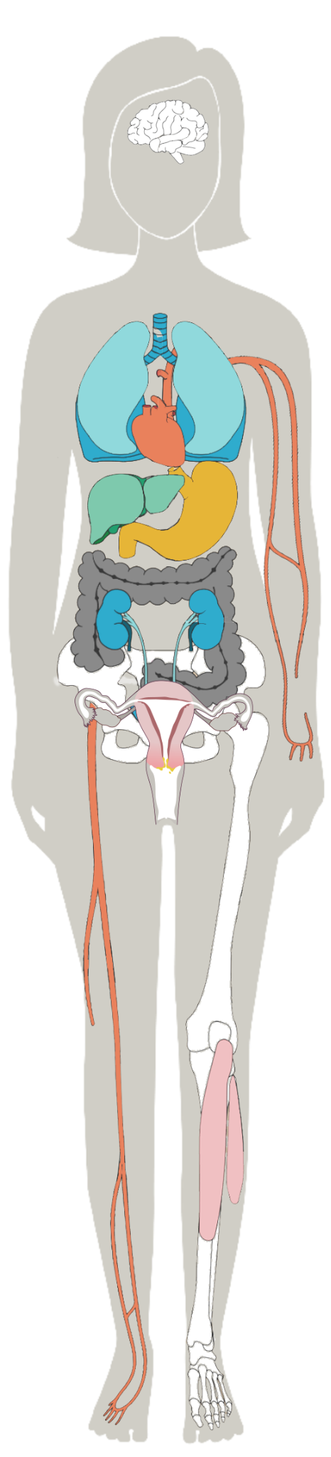
Physical exercise is for every part of the body
Boosts your brain 🧠
2. Strengthens your heart ❤️
3. Strengthens your lungs 🥵
(So you don’t look like this emoji when you run.)
4. Strengthens muscles and bones🕺
(So you can move heavy furniture out of the way… to dance!)
© FEMM
Notes:
Step 3 (10 minutes): Sleep & Exercise
First, let’s review why exercise and sleep are so important.
It boosts your brain. Exercise actually does improve your memory and thinking. So you can remember and retain knowledge. Exercise also reduces anxiety and improves your self-image.
It strengthens your heart. Exercise reduces stress on your heart.
It strengthens your lungs. With exercise, your body brings more oxygen into your body, which increases energy!
It strengthens your muscles and bones. Strong bones and muscles protect against injury and improve balance and coordination.

Slide 5

Physical exercise is for every body
60 minutes
You could play all the sports!
Scuba or Ski
Or dance!
⚽️⛹🏻‍♀️🏈🎾🏐🥏🏓🏸🏒🏏🩰💃🪁🤿⛷🛼🤸🏿‍♀️ 🏃🏽‍♀️🏊🏻‍♀️🚴🏽‍♀️
Run after a kite
Gymnastics
Yes, even cricket!
Notes:
In the Healthy Choices Challenge, how many of you noticed you felt better after exercise? 60 minutes of exercise each day is what doctors prescribe for teens your age! Grab a skipping rope, fly a kite, take a class or join a sports team!

Slide 6
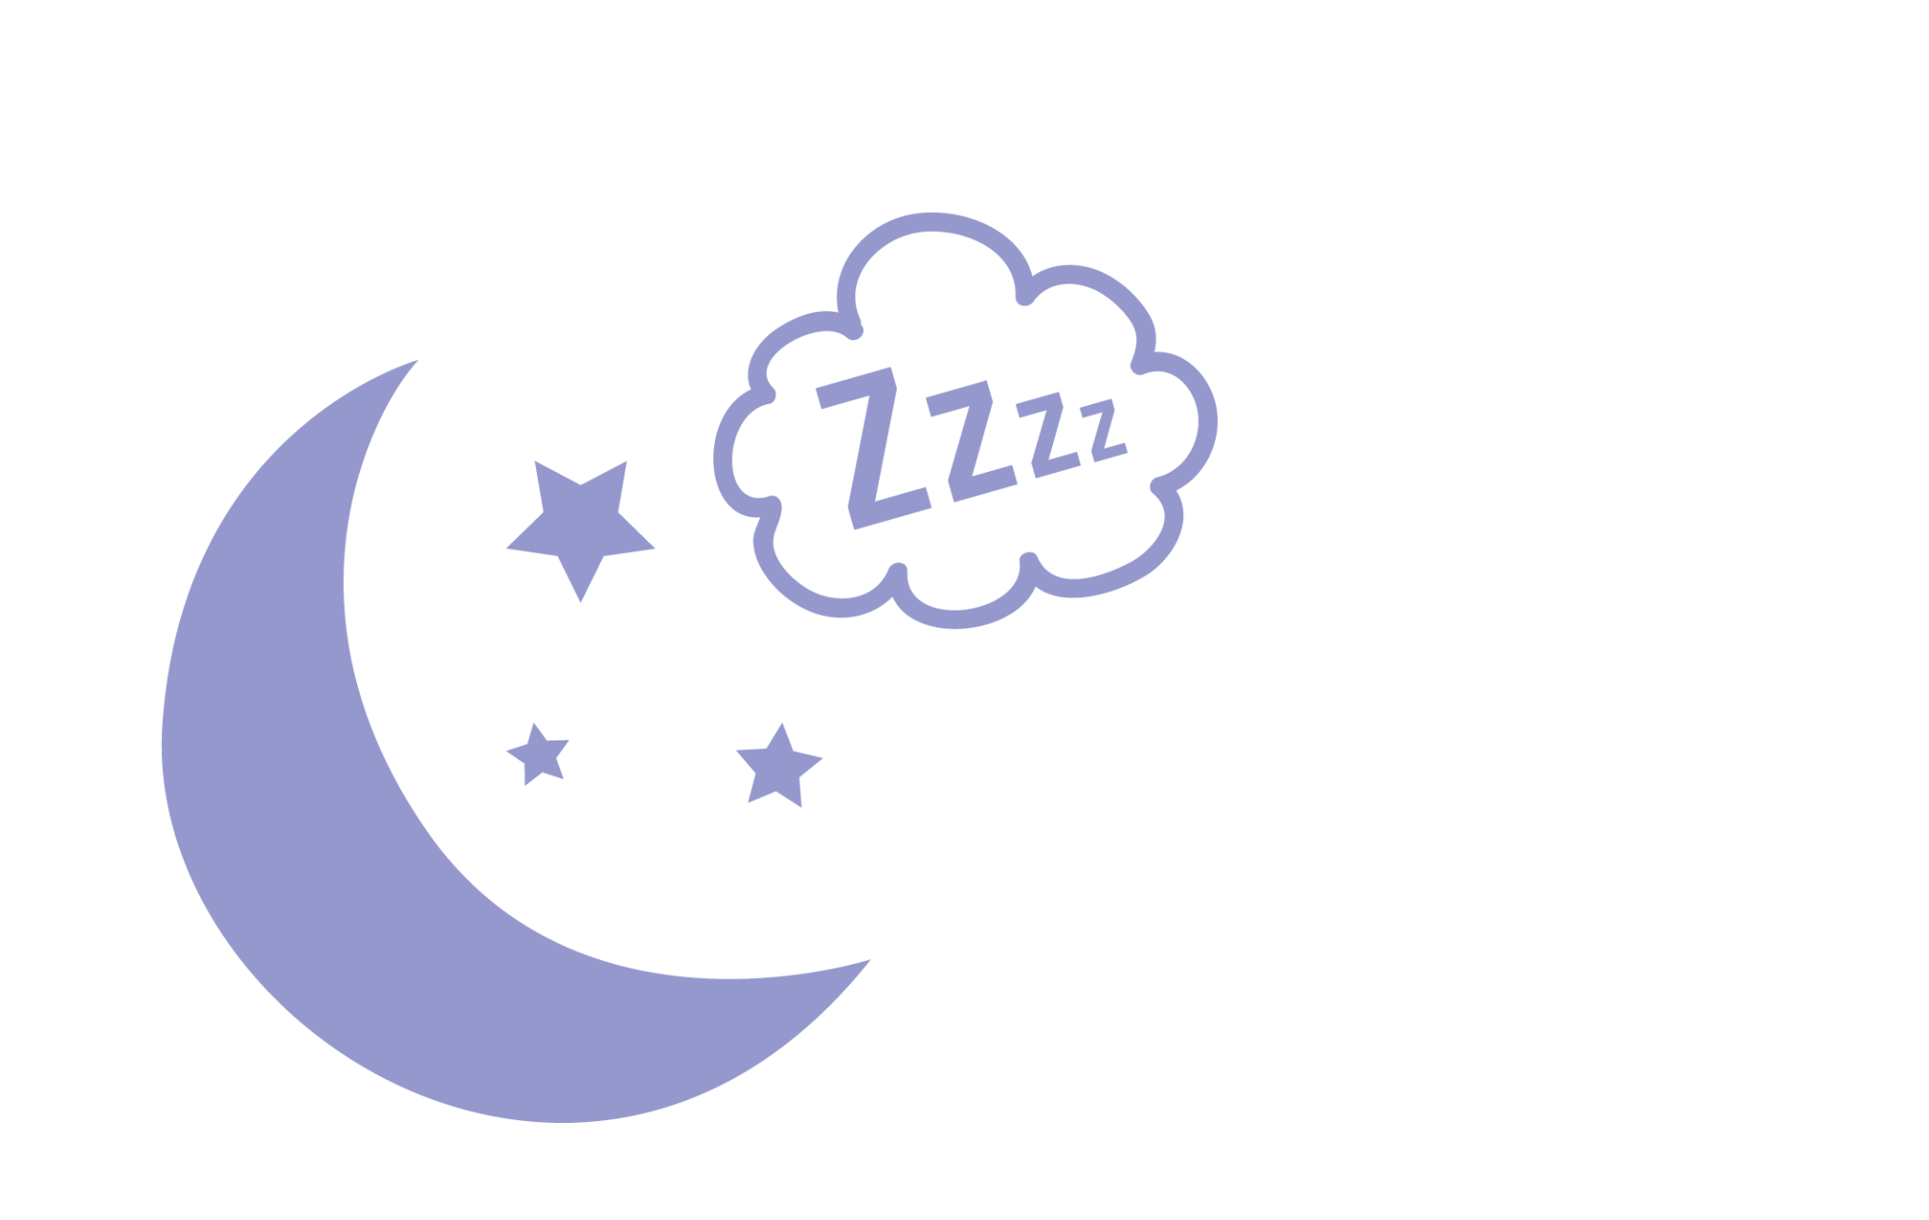

Sleep is for every part of the body
When you sleep, your brain does house cleaning: getting rid of toxins and keeping only the important stuff.
Your body does all of its growing when you sleep!
Most of your reproductive hormones are produced while you sleep!
© FEMM
Notes:
Exercise even helps you get a better sleep.
You may think that nothing is happening when you sleep, so why not skip a few hours to do something more fun? Did you know that your body does all of its growing and repairing when you sleep? It’s amazing how much is happening. Your brain gets rid of toxins and basically cleans house while you are in those deep levels of slumber. Did you know that most of your reproductive hormones are produced while you sleep?
This is why you need to get at least 8 hours of sleep at night: to give your brain and body time to build and repair your bones and muscles, regulate your growth hormones and keep your immune system strong.

Slide 7
Want to be a better athlete? Go to bed early!
Sleep-deprived
10 Hours of Sleep
Athletes were slower.
Exhausted faster.
Decreased accuracy.
Difficulty learning and decision making.
Lower immune resistance to colds
Research of middle and high school athletes revealed that a lack of sleep is associated with increased injury.
Athletes who extended their sleep to 10 hours a night found several positive outcomes:
The players ran faster.
Their shooting improved by at least 10%.
Accuracy improved.
The athletes reported feeling better physically and mentally.
© FEMM
Notes:
However, getting 10 hours of sleep each night can make a big impact. Look at the difference on the next slide, when student athletes extended their sleep to 10 hours a night.
Getting 10 hours of sleep each night will help keep your mind sharp, your mood positive and increase your energy.

Slide 8


Meet Maria!
📚
She is in 7th grade.
She has been charting for a year.
She is on the school soccer team.
Her favorite dessert is carrot cake.
⚽️
© FEMM
Notes:
Step 4 (10 minutes): Maria’s Story: Act It Out + class discussion
Let’s meet Maria. Maria is in the 7th grade. She has been charting for about a year. She loves soccer and plays on the school team. Her favorite dessert is carrot cake.

Slide 9
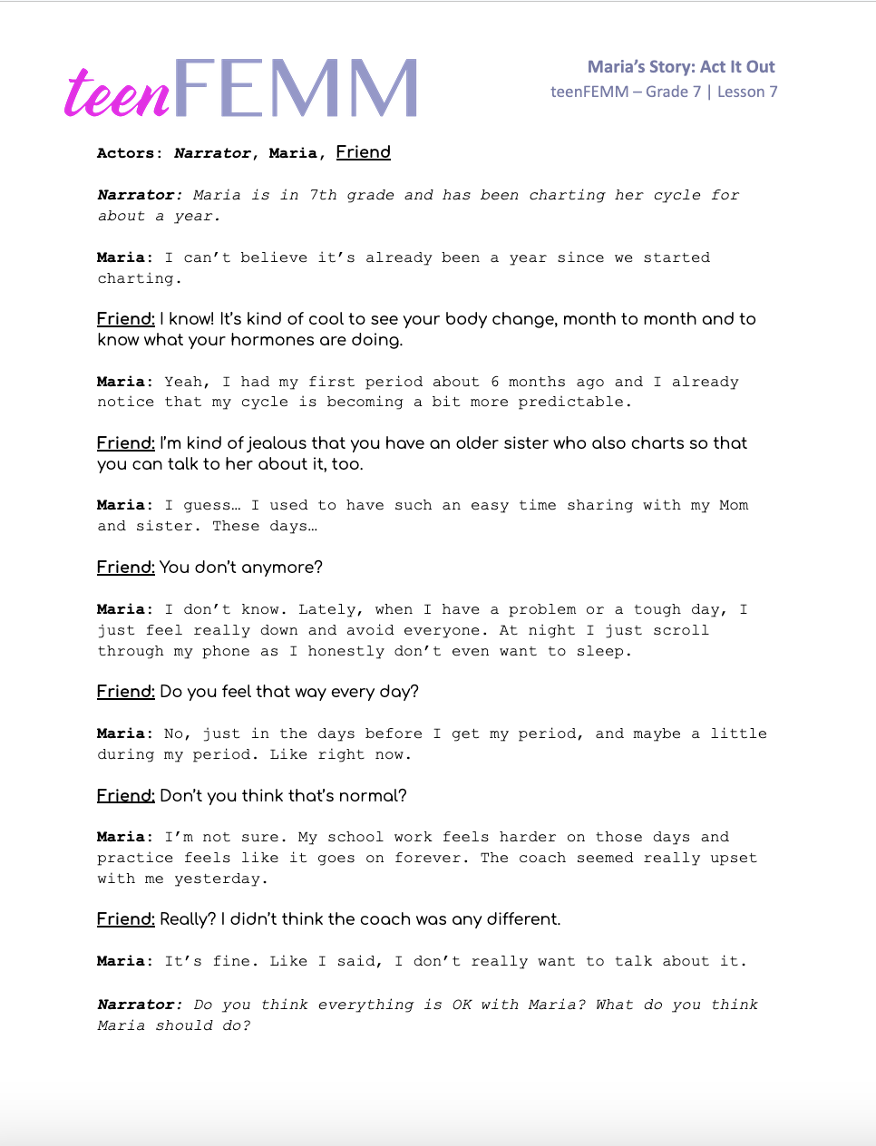
Maria’s Story: Act it Out
NARRATOR
MARIA
FRIEND
© FEMM
Notes:
Ask for three student volunteers to act out a scene. Give each student a printout of the script and have them pick their role: Narrator, Maria and Friend. Have students read/act out the script in front of the class.
At the end of the script, read the following scenarios aloud for the class to select which of the three following options Maria should choose. Discuss.

Slide 10
What should Maria do?
Keep pushing herself and ignore the feelings. It’s just part of being a girl and growing up!
Skip practice and homework, avoid her mom and sister, and just scroll through social media or watch some shows.
Go to practice, but don’t push herself as hard as when she is feeling her best. Take a break when it is offered, and drink lots of water. Try to go to bed a little bit earlier than usual. Ask her mom and sister if they have ever felt anything similar. What did they do about it?
© FEMM
Notes:
Maria should keep pushing herself and ignore the feelings. It’s just part of being a girl and growing up!
Maria should skip practice and homework, avoid her mom and sister, and just scroll through social media or watch some shows. No one cares about how she’s feeling and so she may as well distract herself. Nothing will make a difference to how she’s feeling and so getting to bed on time is the least of her problems.
Maria should go to practice, but not push herself as hard as she is not feeling her best. She should take a break when it is offered, and drink lots of water. She should try to go to bed a little bit earlier than usual as it will make a big difference in how she feels the next day. Things will look brighter in the morning after a good night’s sleep! Also, she should ask her mom or sister if they have ever felt anything similar. And if so, what did they do about it?
Take some time to discuss these answers and clearly highlight that the best answer is number three. It’s important to take care of our body and it’s also important to talk to a parent or trusted adult when you’re feeling down, like Maria mentioned. Sharing her experience will make her feel better and her Mom and sister may have some good recommendations for her. It’s very normal to feel a little down and less motivated the days before your period and when you’re on your period, because your hormones are dropping off. Spend time with people you love and who love you when you’re feeling down, so that you can just be yourself; do something enjoyable and restful.
N.B. Instructor can choose to have a wider discussion regarding why it’s sometimes harder to choose option 3. Most of the girls will know that option 3 is the best option, but may struggle to choose it in practice. Identifying barriers and solutions in advance can help when they face the actual (or similar) issue themselves.

Slide 11
Meet Josie!
She is in 7th grade.
She is a competitive dancer and she loves to move!
Charted for a long time without seeing much, but now is noticing a pattern.
Loves Boba tea!
📚
🥇
🧋
© FEMM
Notes:
Step 5 (5 minutes): Worksheet: Josie
Introduce the class to the second case study. Josie is in 7th grade and has just started to get her cycle. She loves to dance and has been dancing competitively since she was very young. She was charting for so long and just recording a little bit of moisture and constantly shifting mood changes, but now things are starting to seem more regular.

Slide 12
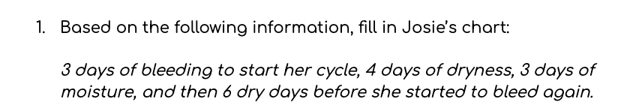
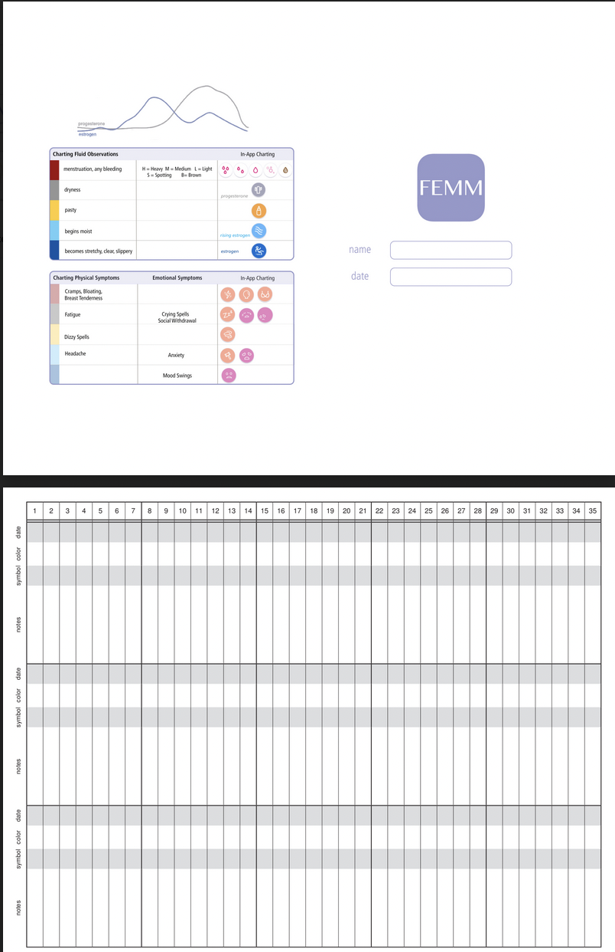
Worksheet | Fill in Josie’s chart
© FEMM
Notes:
Let’s fill in Josie’s chart together.
This month, Josie had 3 days of bleeding to start her cycle, 4 days of dryness, 3 days of moisture, and then 6 dry days before she started to bleed again. Two days before she started to bleed, she wrote in her notes that she was craving sweets, and on her health checklist she ate a lot of ice cream and fast food. Then the next two days, she noted that she felt very full, bloated, and tired. She also noticed that she was way hungrier and had a lot more energy on the moist days!
Give students a couple of minutes to fill in the chart on their worksheet. Then, review answers with the following slide.

Slide 13
Answers | Fill in Josie’s chart
© FEMM
Notes:
Give students a couple of minutes to fill in the chart on their worksheet. Then, review answers with this slide.

Slide 14

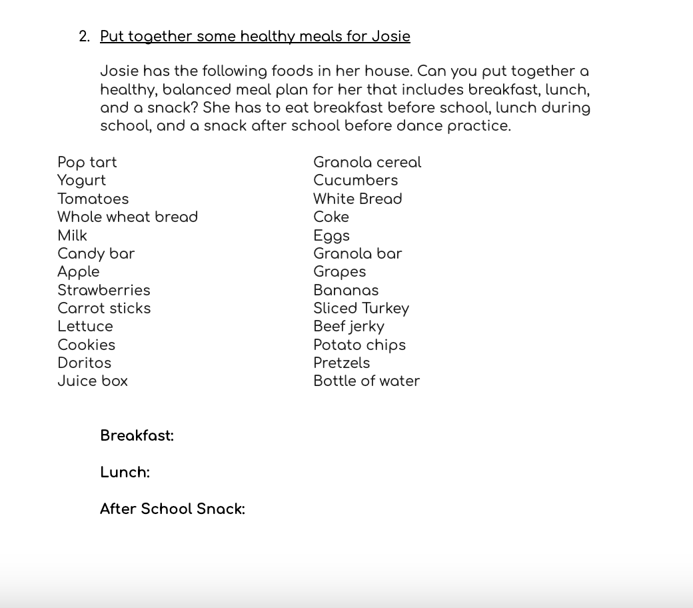



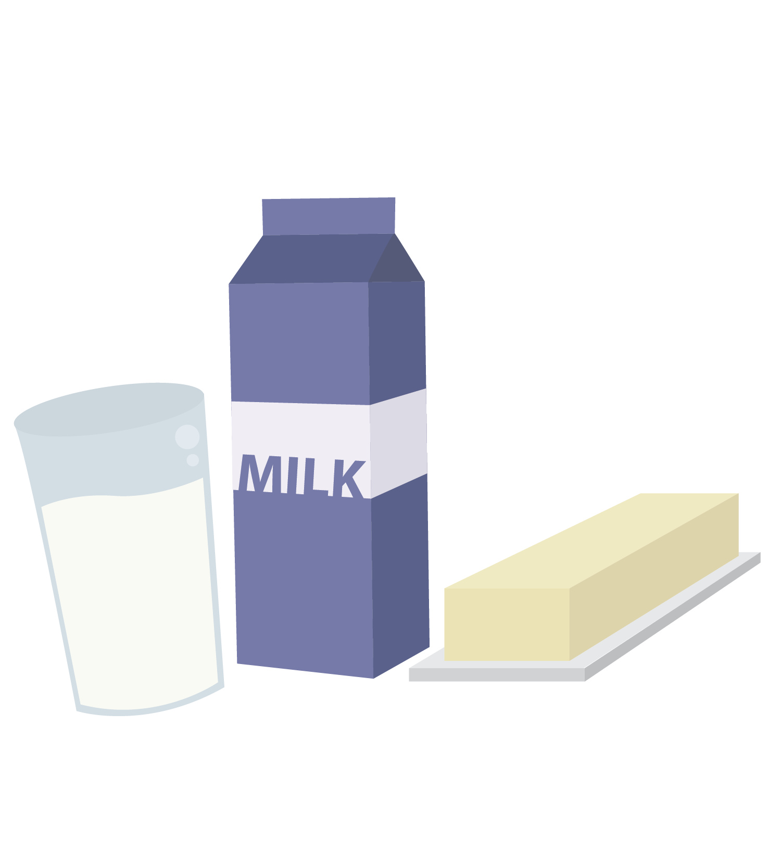

Worksheet | Josie’s Nutrition
Nutrition
Pop tart Granola cereal
Yogurt Cucumbers
Tomatoes White Bread
Whole wheat bread Cola
Milk Eggs
Candy bar Granola bar
Apple Grapes
Strawberries Bananas
Carrot sticks Sliced Turkey
Lettuce Beef jerky
Cookies Potato chips
Doritos Pretzels
Juice box Bottle of water
*Cookies, pop tarts or Cola can be a rare treat
but they’re not the every day nutrition your body needs.
© FEMM
Notes:
The next question on your worksheet asks you to put together a healthy breakfast, lunch and snack for Josie.
What could she eat that would satisfy her cravings for sweet things but that won’t make her feel as bloated and tired as junk food before her period? What about yogurt with strawberries and some honey? Or whole wheat toast with peanut butter and jam? These would be snacking improvements over Cola and pop tarts! Ask students to share other answers for breakfast, lunch and snack suggestions.

Slide 15
Worksheet | Josie’s Nutrition
Nutrition
Example
Breakfast: Eggs on Whole Wheat Toast
Lunch: Sandwich (turkey, lettuce and tomato)
carrot sticks and potato chips
Snack: Yogurt and a banana
© FEMM

Slide 16
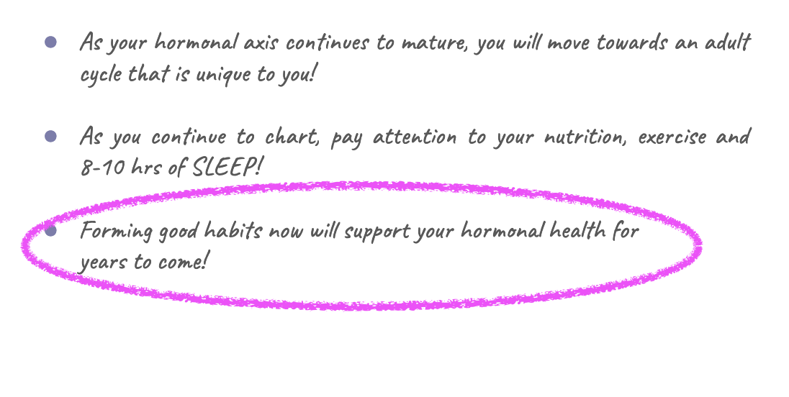
Review
Notes:
This class, we continued to focus on the health pillars and how nutrition, sleep and exercise impact your hormonal health. Next class, we will talk about technology and how it fits into the big picture. This week, continue to chart and listen to your body as you make healthy choices!

Slide 17
Grade 7
LESSON 7
© FEMM

