Slide 1

Grade 7
LESSON 7
© FEMM

Slide 2
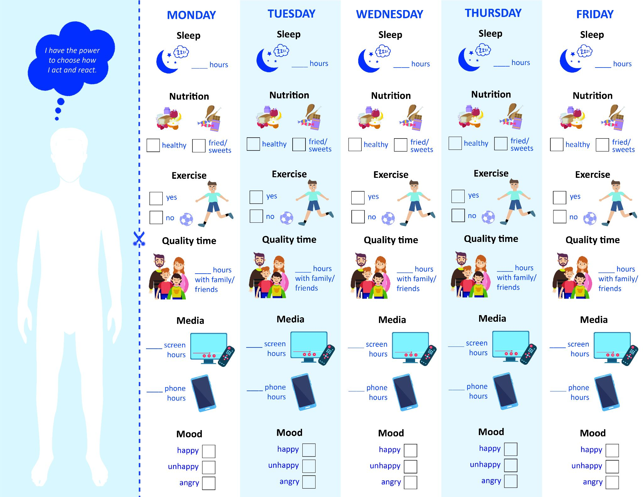
Health+Technology Checklist: what did you discover?
© FEMM
Notes:
Step 1 (5 minutes): Health and Technology Checklist
Talk to the students about what they discovered: do they spend more time on screens than they thought? Do they spend more time on their phone than they do with friends or family? Did they notice any patterns with screen time and mood? Exercise and mood? Have an open discussion with the class.

Slide 3
Technology Review
Better or the BEST?
© FEMM
Notes:
Step 2 (5 minutes): Technology: Better or Best?
Read each of the four scenarios aloud to the class, and have students critically evaluate which option would be better and which option would be the BEST thing to do.

Slide 4
Better or the BEST?
Julian has a big track meet on Thursday.
It’s Tuesday night. His buddies are gaming tonight. They usually stay up until 11:30pm when they play. Should he do it?
Yes! It’s gonna be fun!
No. Track is really important to him and if he wants to do well, he needs to get enough sleep every night and not just the night before his meet.
Maybe he can play with them until 9pm and then still have a decent bed time.
© FEMM

Slide 5
Better or the BEST?
Jay says he’s going to bed around 9:30 pm.
But he’s been staying up in his room watching Tik Tok until almost 2am. He feels sleepy and grumpy a lot. What can he do?
He can still use his phone, but he needs to watch his bedtime.
His bedtime is too late and he might be watching stuff on Tiktok that is affecting his mood.
Nothing. If his parents don’t care when he goes to sleep, it’s fine.
© FEMM

Slide 6
Better or the BEST?
Colton keeps seeing guys on Discord messaging about vapes. He’s never thought about vaping before, but he finds himself wondering if it might feel good. What can he do?
Nothing. Lots of people vape. It’s no big deal.
Mute the Discord channels where he’s seeing a lot of vaping content. It’s getting in his head and he knows it!
Mute the channels and talk to a parent. They want the best for him and will help him figure out why he’s so drawn to trying vaping.
© FEMM

Slide 7
Better or the BEST?
Oscar got a weird message the other day on Snapchat. It was from a girl in another city who asked him for a picture of himself. He didn’t do it, but he keeps thinking that maybe he should. Plus the girl keeps messaging him. What can he do?
Talk to his parents about it.
Delete Snap off of his phone for a while and talk to his parents about it. He knows his parents have talked to him about people pretending to be other people on the internet.
Just go ahead and send it. What can go wrong? Then she’ll stop bugging him.
© FEMM
Notes:
It’s so important to tell your parents about something like this. Even if you think “they’ll freak out” or “they won’t understand”, they love you and want what’s best for you. A stranger asking for pictures of you is not OK. It might seem like a silly joke, but once your photos leave your phone, you don’t know what someone could do with them as they are no longer in your control. So, the best thing to do is to block this person and let a parent know. They will understand and be proud of you for doing the right thing.

Slide 8
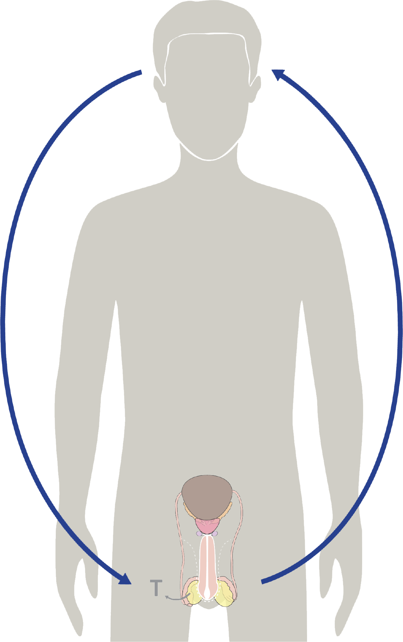
Hormones & your growth
Hormones cause all the growing & changing that your body does during puberty.
Testosterone is the main male hormone.
After testosterone is produced, it acts as a messenger back to your brain = hormonal feedback.
© FEMM
Notes:
Step 3 (10 minutes): Review Testosterone + Think and Write: Positive Peer Influences
Ask: What controls the activity of every system in the body? Yes, hormones! We really know that by now!
Hormones are directed by your brain! There are a lot of different hormones at work in your body. We have already learned about testosterone. After your body produces testosterone in your testes, testosterone acts as a messenger back to your brain. This is called hormonal feedback.

Slide 9

Testosterone, risk & peer influence
Testosterone can have these effects:
strengthens bones, muscles, heart
deepens voice
increases hair growth
Make us want to try risky activities
The influence of friends can also make us more prone to try risky things.
💪
🎙️
🥸
⚠️
© FEMM
Notes:
We already know that testosterone does a lot of very important things in our bodies. It helps us grow muscles, it helps us grow facial hair, it makes our voices deeper. Testosterone can also make us want to try riskier activities. This is not always a bad thing. When we need to help someone, for instance, testosterone, along with other hormones, makes us act quickly and take the risk to pull our friend out of a rushing river.
However, sometimes testosterone makes us want to try risky things that are not good for us or others. Another thing that can make us want to try riskier behaviors is the influence of our friends. There is research to show that, sometimes in the presence of our peers, we choose worse things just because they are around us. If we had been alone, we might have chosen differently.

Slide 10
Testosterone, risk & peer influence
Excellent friends may cause these risks:
Help us become better. They encourage and competitively challenge us to do good things.
They give us the courage to stand up for our convictions and choose what is excellent.
Inspire leadership. They always show respect to others, which is why people respect them.
🧗
💪
🏅
© FEMM
Notes:
Of course, if we choose our friends wisely, they can also be a good influence on us. Friends can help us improve or competitively challenge us. Friends can inspire us to listen to new music, to help out with a good cause, and to meet other people. It’s a gift to have good friends!

Slide 11
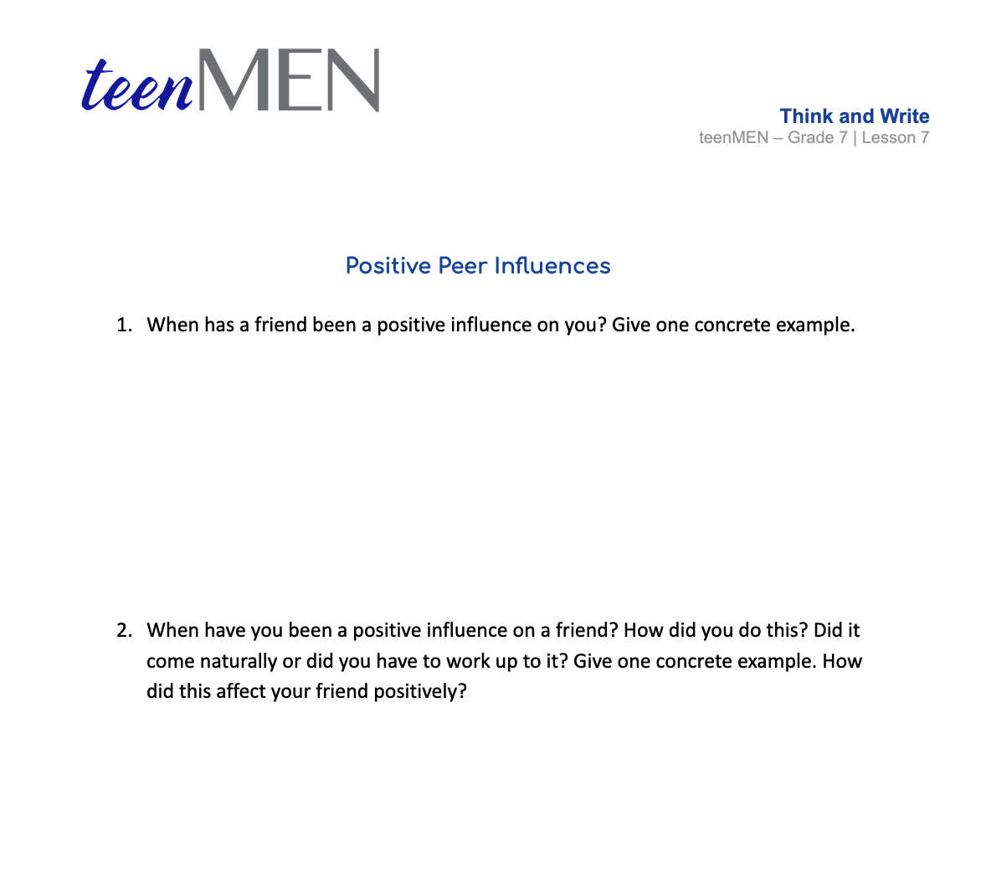
Think and Write
© FEMM
Notes:
Think and Write: Positive Peer Influences
Pass out the Think and Write worksheet. Give students a couple of minutes to journal.

Slide 12

Self-determination
Self-determination is an important skill to build!
It is the ability to do the things you know you should do, even if you do not want to do them.
Notes:
Step 4 (5 minutes): Self-Determination
We can’t blame testosterone or peer pressure for everything! We have to take responsibility for what we are doing. This can give us a lot of hope, because it means we are not robots! We are in control of what we are doing.
Self-determination is being in control of your emotions, habits, and behaviors. It is the ability to make yourself do the things you know you should do, even if you do not want to do them. It is the ability to respond rather than react. The good thing is that it can be learned! Even if we do not have a lot of self-determination now, we can work on it every day to get more of it.

Slide 13
Living self-determination
⚠️
Avoid the situation in the first place:
Stealing chocolate bars?
Change your thinking:
FOMO or a choice towards important goals?
Challenge yourself with healthy choices:
Remember the three pillars of health!
Set a goal and tackle it, step by step:
Start small!
💪
🧗
🏅
Notes:
Some ways that we can help ourselves and our friends to make good choices are to:
Avoid the situation in the first place: for example, if we know that we are always tempted to steal chocolate bars from a certain store when we’re with a certain group of friends, maybe we shouldn’t go to that store or hang with those friends.
Change your thinking: instead of thinking about how you’re missing out on things, remind yourself that you’re making a choice towards important goals.
Challenge yourself with healthy choices: Take care of yourself and your hormones by getting enough sleep and eating delicious, healthy food.
Make a goal and tackle it, step by step: You have to start somewhere! Even if it seems small, GO FOR IT and take the first step! It will feel great and you’ll be closer to your goal!

Slide 14
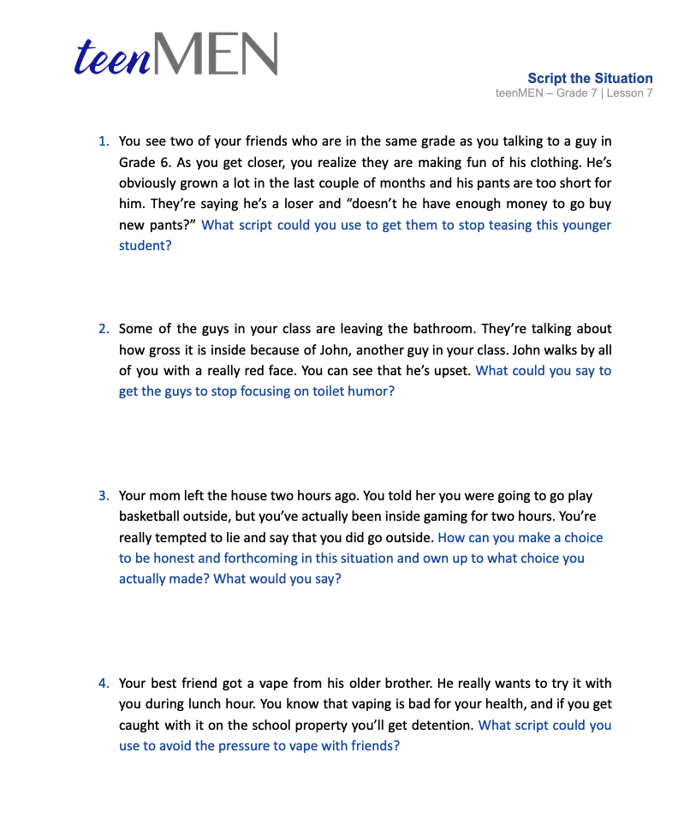
Worksheet | Script the Situation
For example: a friend is trying to get you to try smoking.
Script your response:
No, it’s not really my thing. I don’t like how the smell sticks to your clothes.
© FEMM
Notes:
Step 4 (10 minutes): Script the Situation
You might find it’s easier to say no to things that you know aren’t the best to do, if you have a couple of responses that you’ve already thought through and prepared.
You may also find it easier to say “no” in another kind of way, that makes it hard for your friends to disagree with you. For example, someone is trying to get you to try smoking but instead of saying, “No. It’s bad for my health.” You could say, “it’s not really my thing; I don’t like how the smell sticks to your clothes.”
Arrange students into four groups. Give each group the Script the Situation worksheet and assign each group one of the scenarios. Have each group read and discuss the scenario, then, together, come up with a script (a few sentences that they can write down) in dealing with the situation. Inform groups that they can either read their script aloud or perform their script by acting out the scene in front of the class.

Slide 15
Review
Testosterone is important for our healthy development.
Practicing small steps towards making healthy choices helps us when tricky situations come along.
Friends are important. Remember that we can influence our friends positively.
A true friend is someone who wants what’s best for our health and wellbeing.
© FEMM
Notes:
CONCLUSION
Testosterone is important for our healthy development. We have the ability to make our own healthy choices. We can practice self-determination so that we do not let negative influences from others make our choices for us. A true friend is someone who wants what is excellent for you, your health and wellbeing. We can be this friend and leader for others. Practicing what to say or do in difficult situations can help you prepare for the real situation.

Slide 16
Grade 7
LESSON 7
© FEMM

