Slide 1

Grade 7
LESSON 8
© FEMM

Slide 2



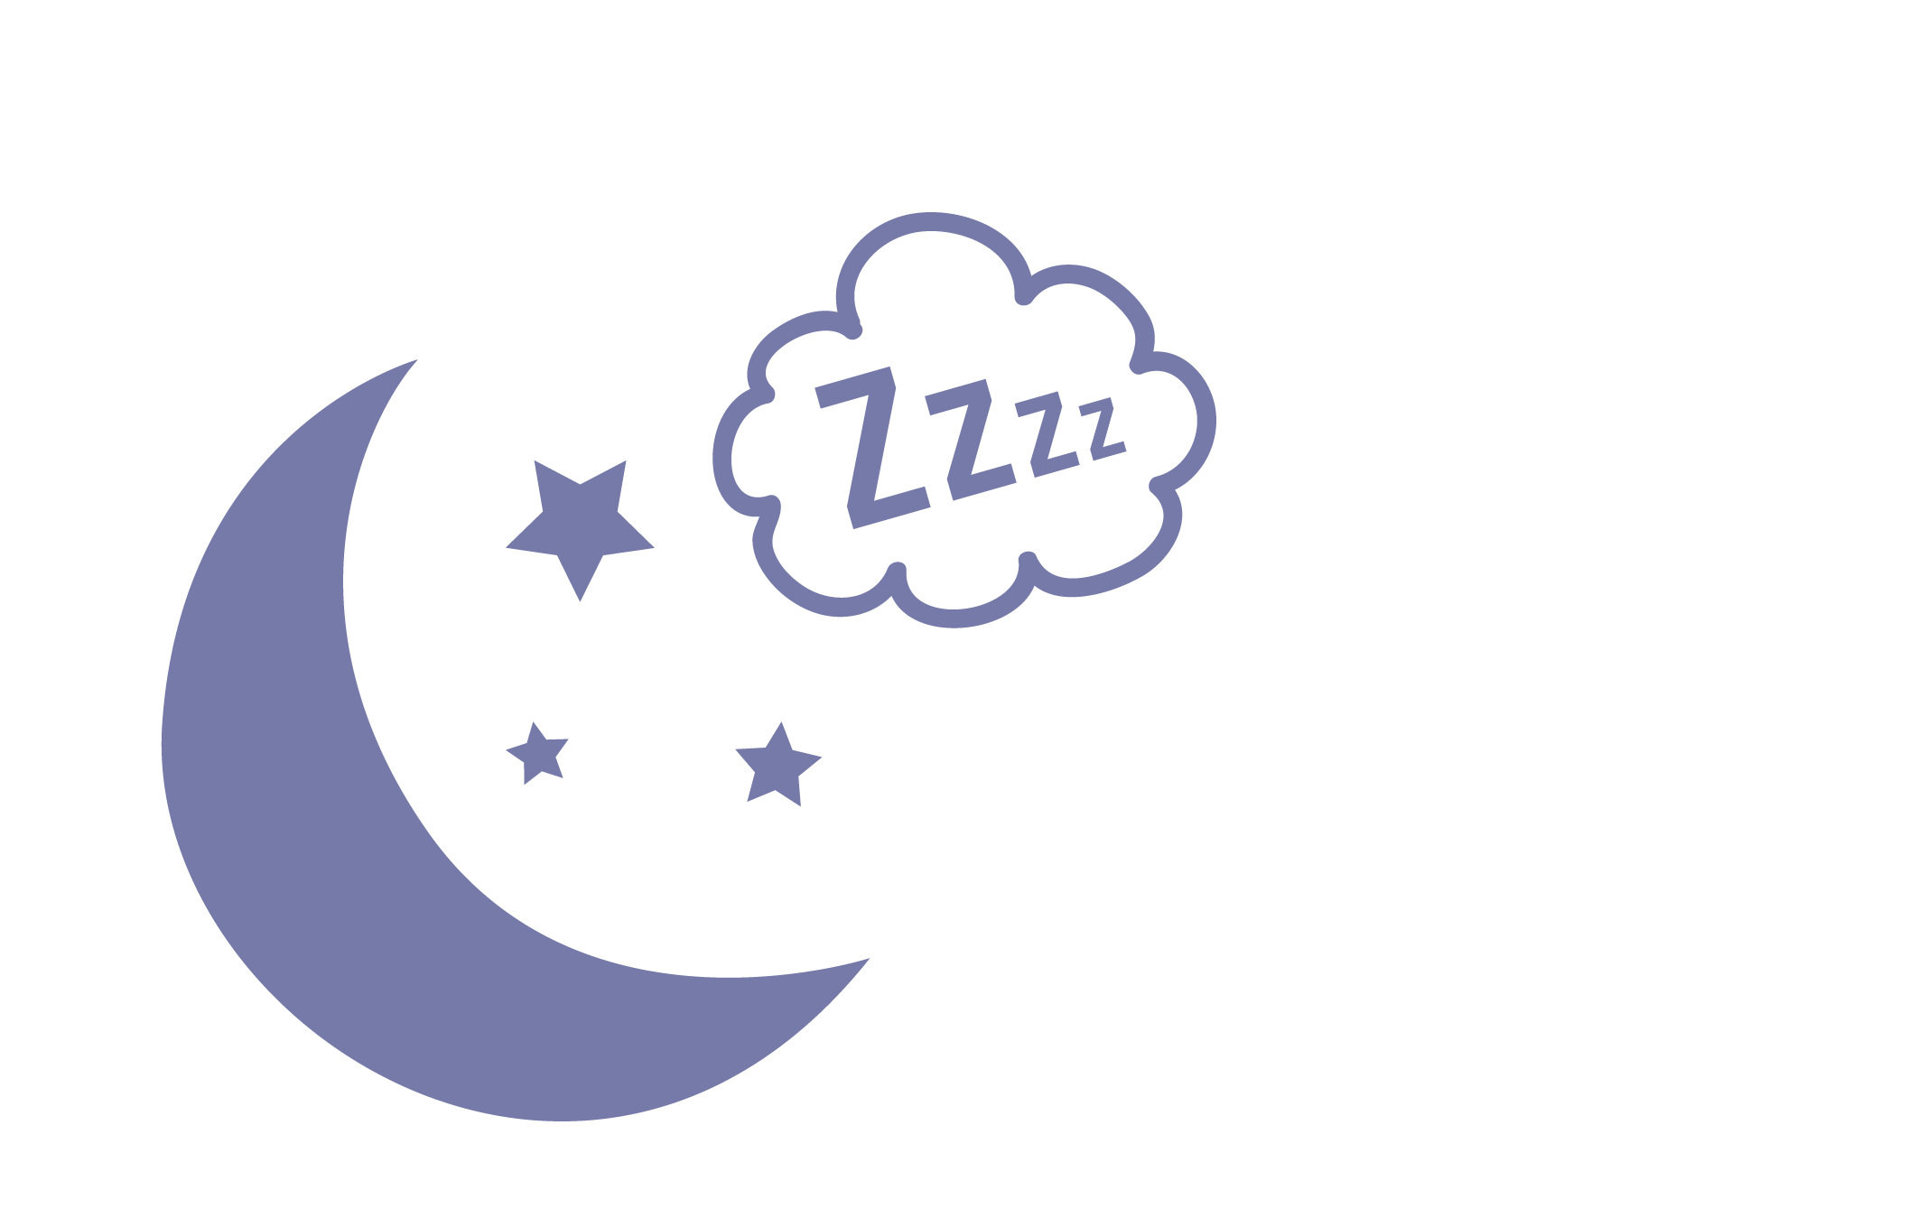

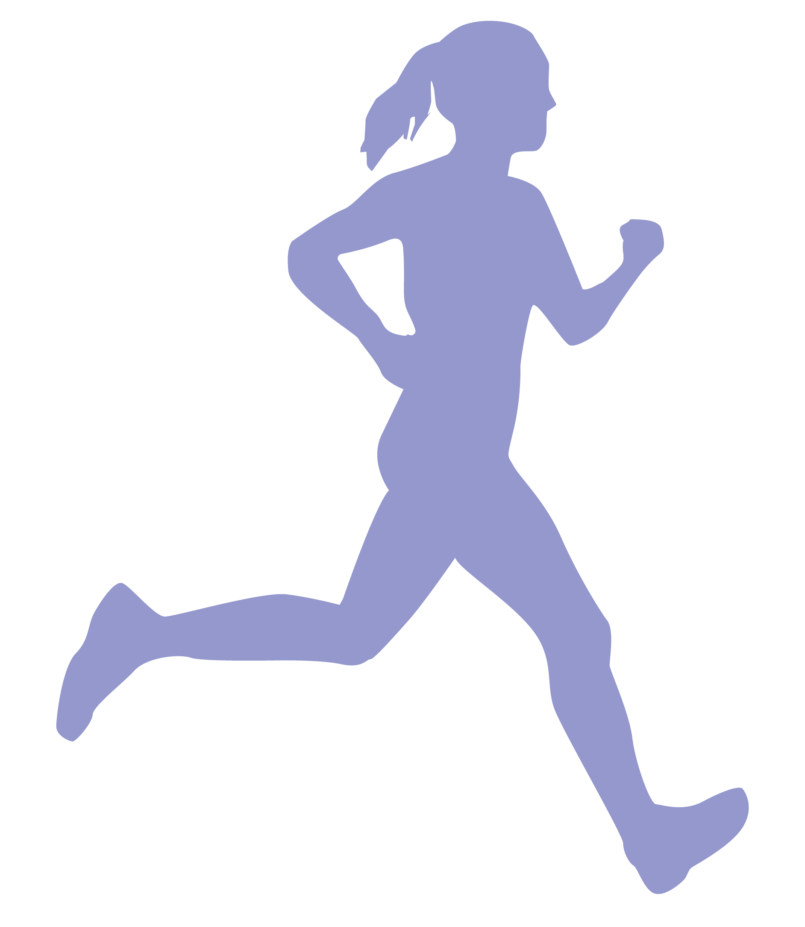

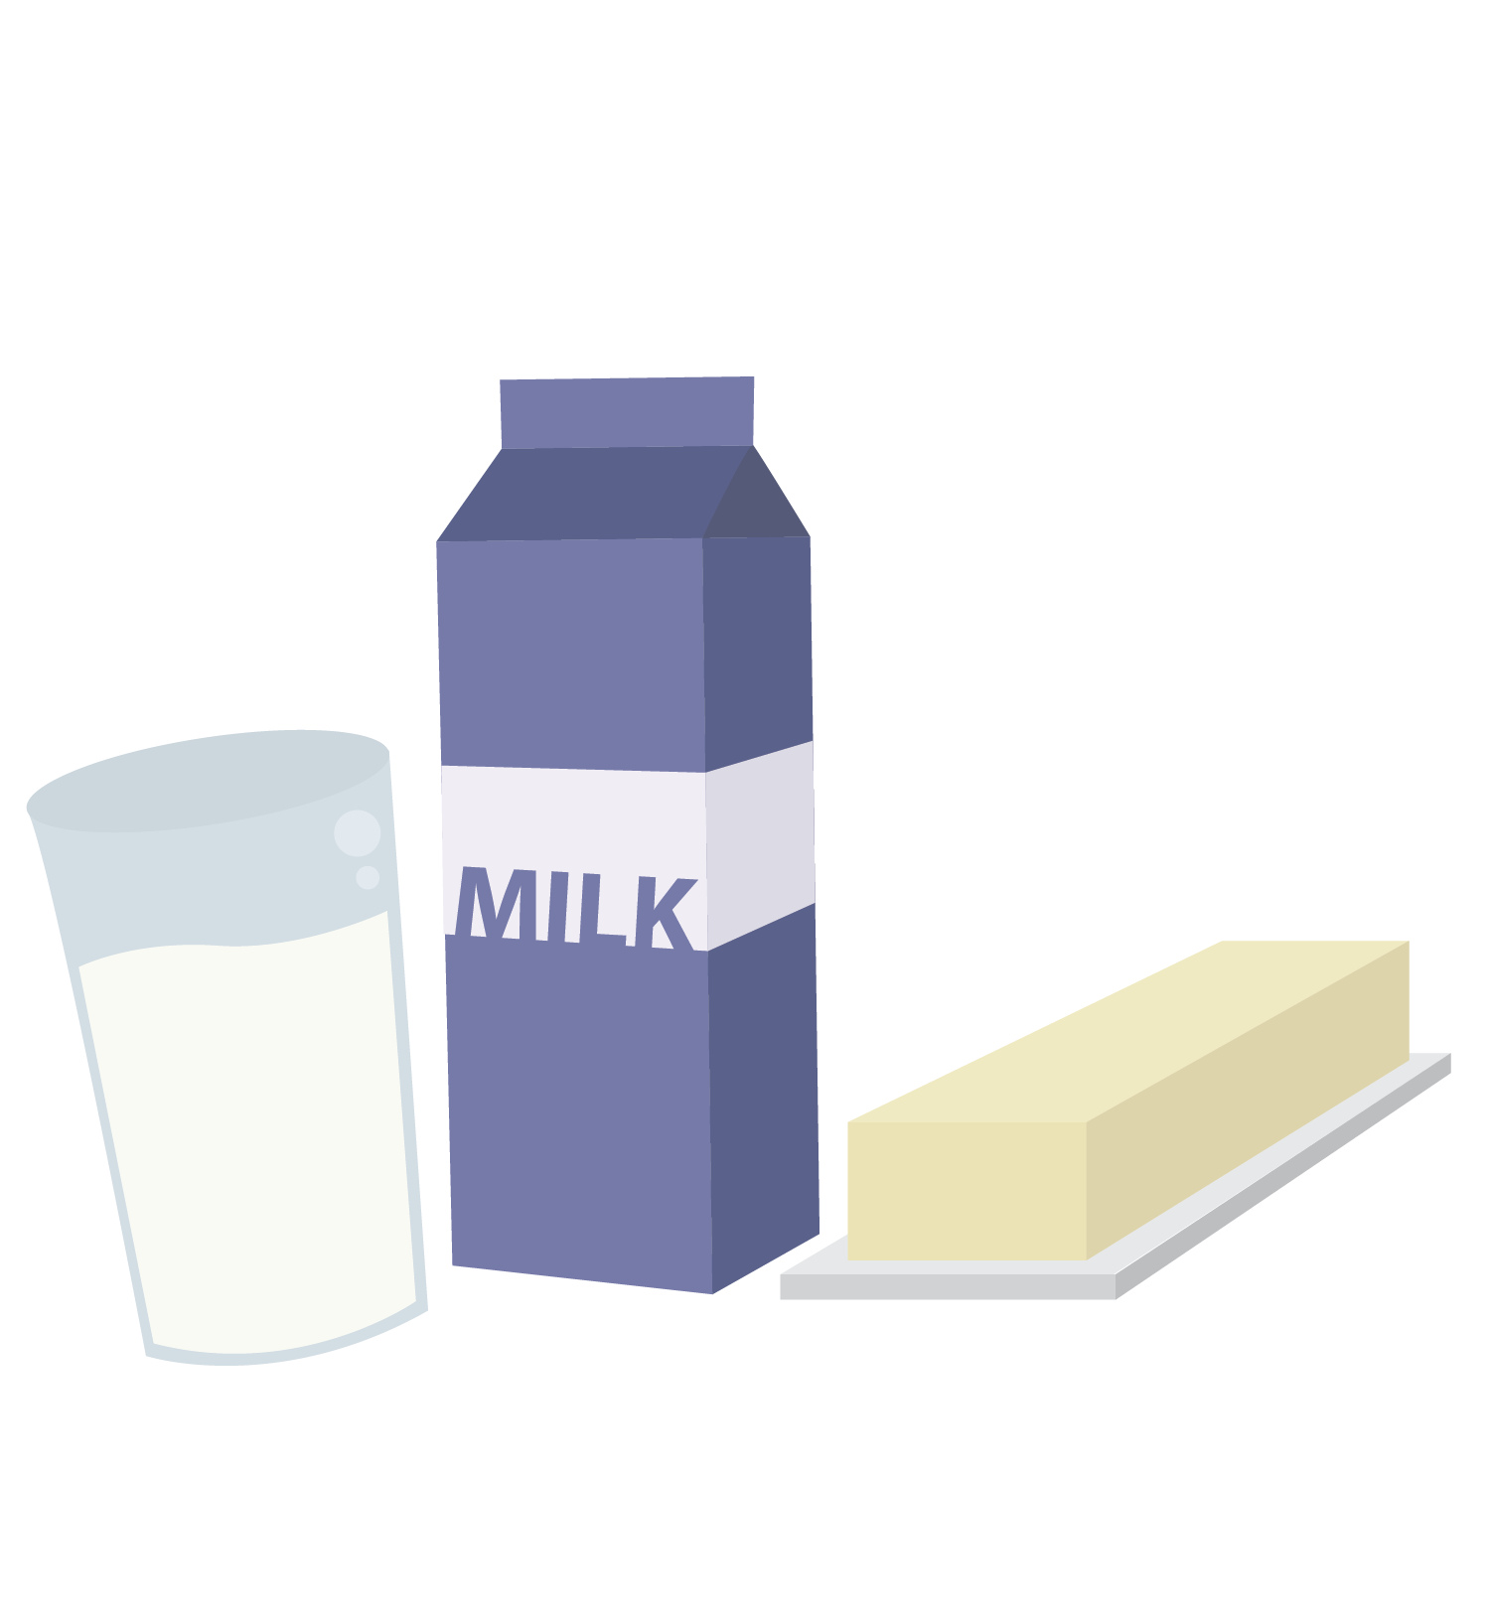
Healthy choices help healthy cycles
The Three Pillars Supporting Your Health
1
2
3
Nutrition
Exercise
Sleep
© FEMM
Notes:
PROCEDURE
Step 1 (5 minutes): Review and introduce the concept of body image
What controls the activity of every system in the body? Hormones. Hormones are directed by your brain. We have learned in the last few classes that our choices not only impact the body but impact the brain.

Slide 3
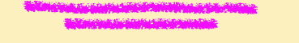
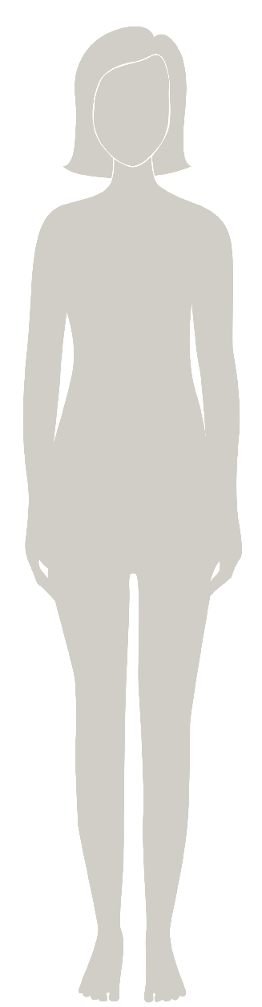

Body image:
How an individual sees their body and the feelings that accompany this
I’m not perfect, but nobody is
Bad hair day,
so what? 🤷‍♀️
I feel confident.
Be less? No way!
Don’t give into
peer pressure!
LIKE yourself!
Work harder
to be a good friend to yourself.
© FEMM
Notes:
What is body image? Body image is how an individual girl sees her own body, and the feelings that go along with this viewpoint. This is a very normal time in your life to be thinking more about your body as it grows and changes. But, instead of comparing your body to the girls around you, or to the girls or women on social media or in shows, talk with a trusted grown up to learn and focus on what is healthy and best for you.
You know yourself better than anyone else! Each girl will grow at her own pace. And depending on her genetics and the health choices that she makes, each girl will grow into a unique, strong, beautiful woman.

Slide 4
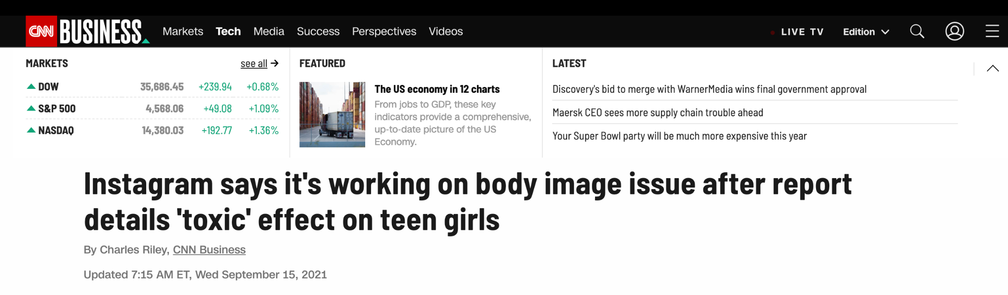
Time online can be toxic for body image
© FEMM
Notes:
54% of girls said that being on social media made them feel worse about their body.
Because the brain is the control center for your whole body, things that affect your brain also affect your physical and emotional health. And things that affect your emotional health impact your physical health, your hormones and your cycle. So, it’s so important to take time away from your phone and not spend your time comparing your body to the girls around you or the people you see online or on TV. You will all grow and mature at a different pace, depending on your genetics and your health choices.

Slide 5
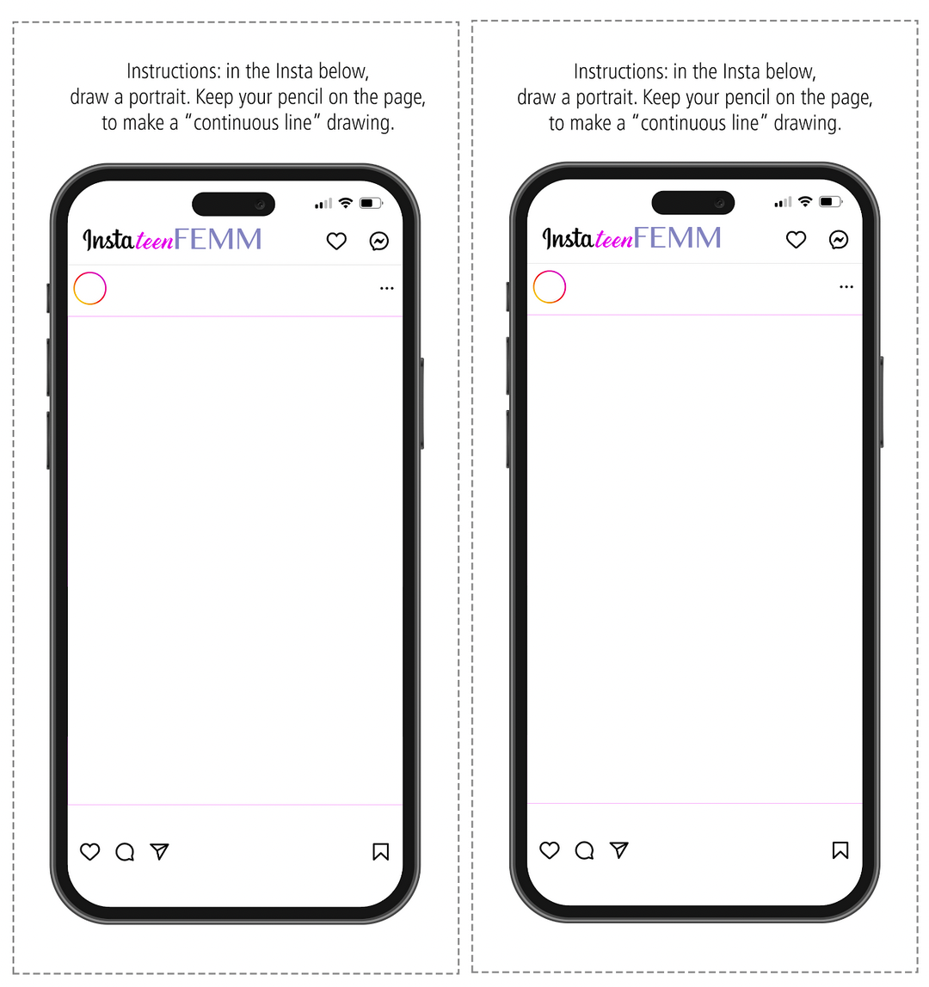
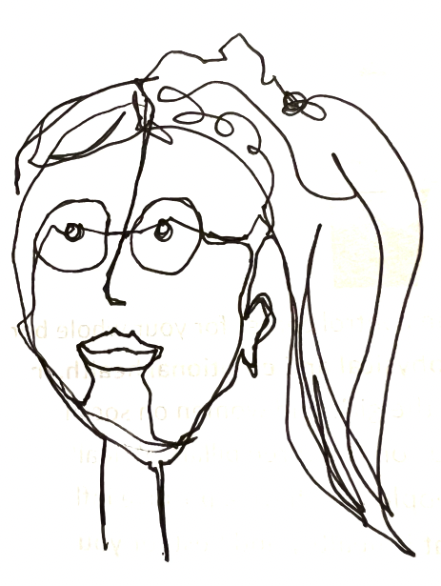
Activity | insta teenFEMM selfie!
Keep your pencil on the page the WHOLE time!
© FEMM
Notes:
Step 2 (10 minutes): InstateenFEMM Portrait
Place students in pairs. Give one InstateenFEMM phone to each student.
Explain: Draw a portrait of yourself, within the instateenFEMM cell phone outline. The only catch is that you have to keep your pencil/pen on the page the whole time - it’s called a “continuous line” drawing. Have fun!
Give students two minutes to draw themselves. Then, have students tape or hang the completed portraits on a wall in the classroom.
Discuss as a class: What did you like about this activity? Was it fun to do? Did you feel a lot of pressure to look the best in your portrait? Ha! No, of course not, right? This drawing is just a fun image. It probably barely even looks like you! That’s what we have to remember about instagram and social media, too: it’s just an image. And if it’s making you feel less confident or more anxious about your appearance, then it’s not even fun.

Slide 6

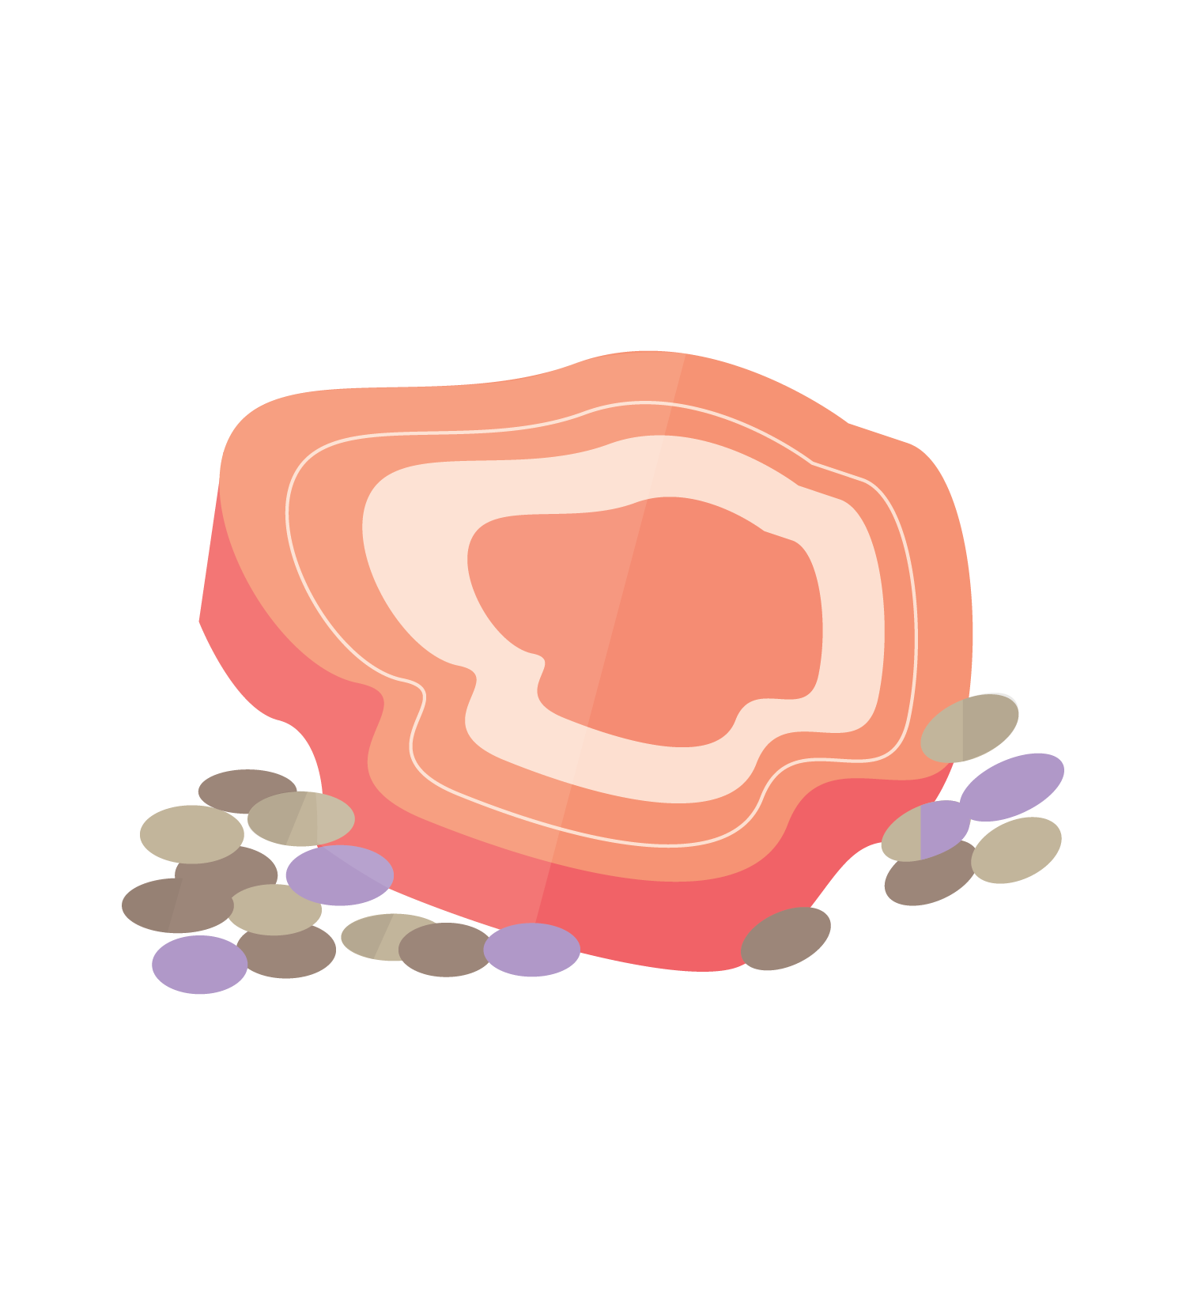
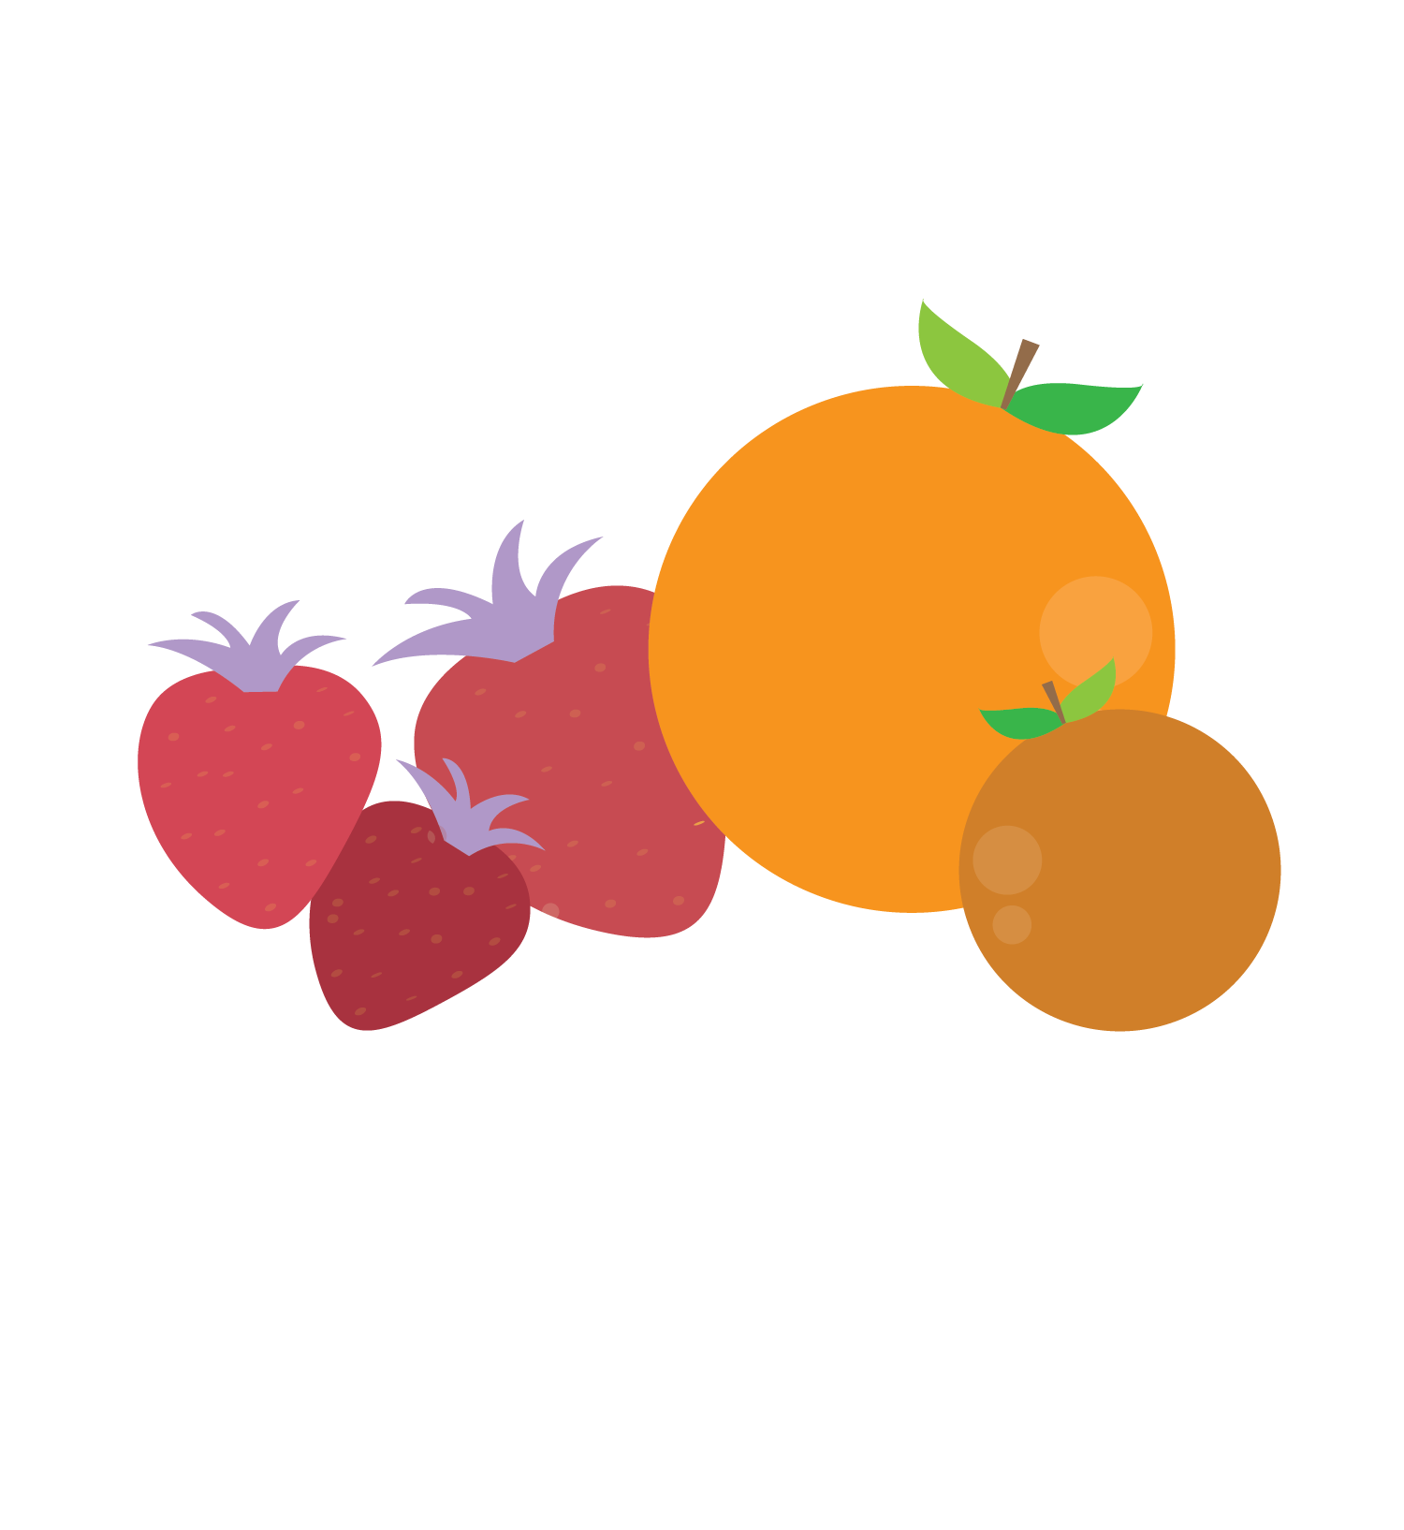
Check in with yourself
DON’Ts of Technology
Skipping meals to keep scrolling
Do you know that when you skip a meal, your body sees this as a mini-emergency?
It starts to produce stress hormones.
This isn’t healthy for your body or your emotional health. Skipping meals can also affect your metabolism, because your body thinks you are in a state of famine! Talk to a trusted adult about this.
!
© FEMM
Notes:
Step 3 (10 minutes): Media and Technology
Technology gives us lots of opportunities to connect. Maybe your grandparents live far away and you FaceTime them from your family’s iPad or iPhone. It’s great to be able to do this! Technology can also help us learn many new things.
Technology can also be a way to disconnect. It can distract us from what’s going on around us. Our body might be in the room but our brain is on our phone or device. This can cause problems in our friendships or our relationships with our family if we’re not really listening or giving our full attention to the person in front of us.
There are other risks of technology, too.
Skipping meals to keep scrolling
Do you know that when you skip a meal, your body sees this as a mini-emergency? It starts to produce stress hormones. This isn’t healthy for your body or your emotional health. Skipping meals can also affect your metabolism, because your body thinks you are in a state of famine! Talk to a trusted adult about this.

Slide 7
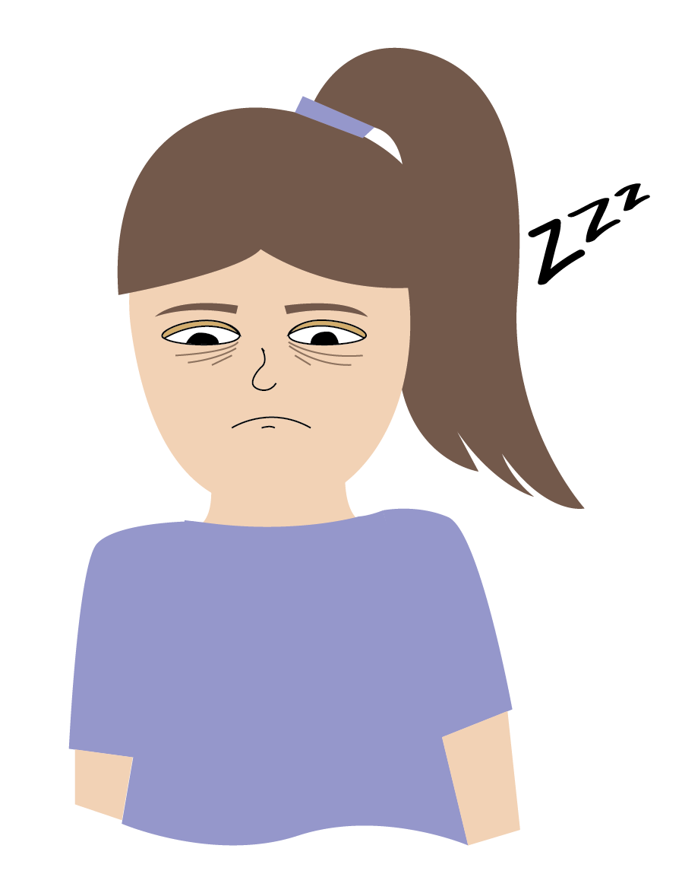
Check in with yourself
DON’Ts of Technology
Staying up late to watch videos when you should have been asleep three hours ago!
This can have very real effects on our body and brain. Lack of sleep affects your ability to pay attention, learn, and remember things. Not getting enough sleep can also make you feel more anxious or sad.
Our bodies produce a hormone called melatonin at night to help us sleep. The light from our screens prevents our bodies from producing enough melatonin, which leads to worse sleep.
!
For best results, turn off screens 1hr before bed.
© FEMM
Notes:
Staying up late watching YouTube when you should have been asleep three hours ago!
This can have very real effects on our body and brain. Lack of sleep affects your ability to pay attention, learn, and remember things in school. It can also make you feel worried or sad. Our bodies produce a sleep hormone called melatonin at night to help us sleep. The light from our screens actually prevents our body from producing melatonin, which makes it harder to fall asleep. To avoid this, put your phone/screen out of reach an hour before bed.

Slide 8
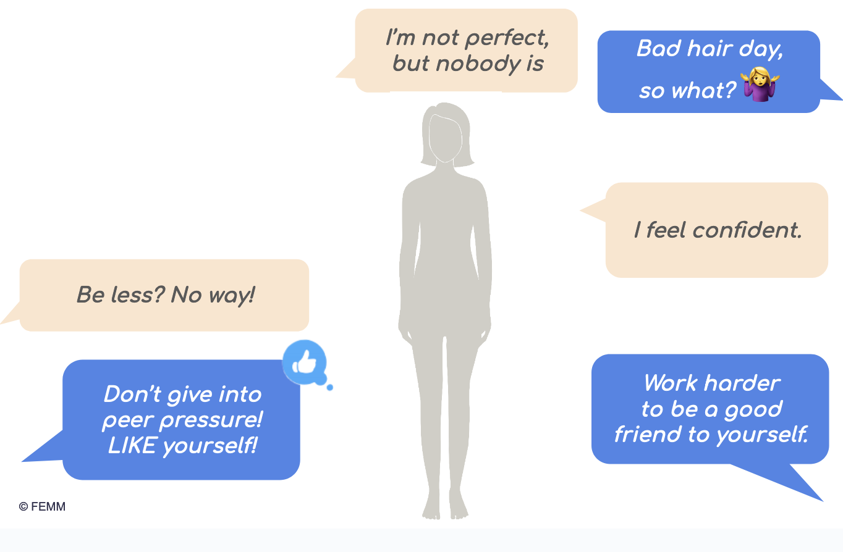
Check in with yourself
DON’Ts of Technology
Spending so much time on Instagram, Tik Tok, etc. that you start to feel like your body doesn’t measure up.
Have you ever felt this before? Did you know that a lot of girls feel this way? 1 out of 3 girls feel worse about their bodies after being online. This is not cool!
Make things, do things, play sports, enjoy music and enjoy your day. You are valuable, just as you are. And you have a lot more to give the world than your measurements.
!
© FEMM
Notes:
3. Spending so much time on instagram that you start to feel like your body doesn’t measure up.
Have you ever felt this before? Did you know that a lot of girls feel this way? 1 out of 3 girls feel worse about their bodies after being online. Instead, practice making things, play sports, enjoy music and learn new things. You are way more important than your body shape or size and you have so much more to give the world.

Slide 9

Check in with yourself
Do I feel 👍 or 👎 after using social media?
Do I feel 👍 or 👎 confident about my choices,
abilities or interests after I’m on social media?
Do I feel 👍 or 👎 grateful for the things that I have in my life after I use social media?
© FEMM
Notes:
Check in with yourself!

Slide 10
Take control!
YOU are in charge of your devices… they are not in charge of you!
Think about a schedule that allows you
to maintain control of your time.
© FEMM
Notes:
Step 4 (10 minutes): Take control + Worksheet: Katya’s Story
One main thing to remember is that you are in charge of your devices; they are not in charge of you!
Given what you now know about how your brain responds to social media, online videos, and other forms of digital media, think about an after-school and weekend schedule that allows you to maintain control over how you spend your time. Make sure you turn off auto-play and notifications that are there to keep you watching.

Slide 11
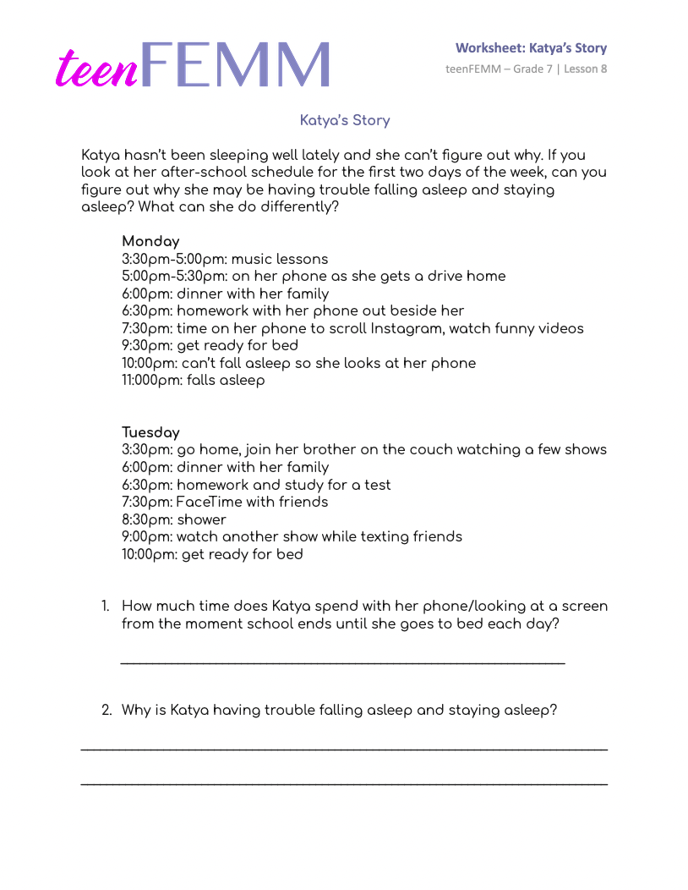
Worksheet | Katya’s Story
© FEMM
Notes:
Hand out Worksheet: Katya’s Story to students. Give students a couple of minutes to answer the questions on the worksheet and then discuss their answers together. Or, you may also use the following questions as a jumping off point for the students, instead.
How many hours of sleep do you usually get each night?
Write down each girl’s answer.
Do you think it is enough? Discuss this together.
What can you do to get more sleep and/or better sleep?

Slide 12
Grade 7
SUMMARY
© FEMM

Slide 13
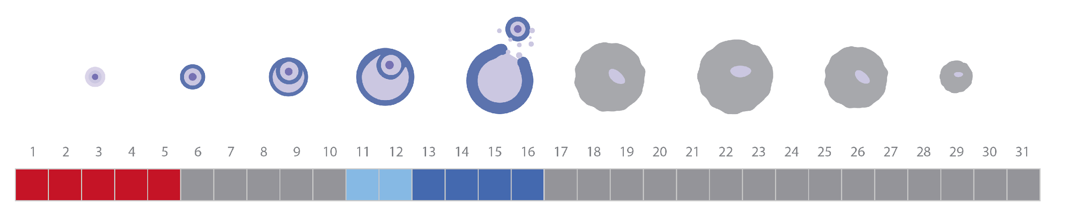
A healthy cycle looks like this
Remember: Ovulation is a sign of health!
Keep charting & keep noticing what is
happening to your body.
Notes:
Conclusion: Everyone goes through puberty!
The boys in your grade have completed their grade 7 teenMEN course as you have been working through this course. Although their changes are different from yours, many of the same hormones also play a major role in the boys’ body and brain development during puberty. It is important to remember that all kids go through puberty, and hopefully you all will have a little bit more understanding for each other as you navigate these changes.
This brings us to the end of our teenFEMM grade 7 course. I hope that you have learned some new things about your cycle and your health. It is a great idea to keep charting- on paper or in the FEMM app if your parents are ok with it- so that you have a unique health record for yourself. I hope you continue to consider the impacts of sleep, nutrition, and exercise on your developing mind and body, and remember that your ovulation cycle is an amazing window into your own health and strength as a young woman.

Slide 14
Grade 7
LESSON 8
© FEMM

