Slide 1

Grade 7
LESSON 8
© FEMM

Slide 2
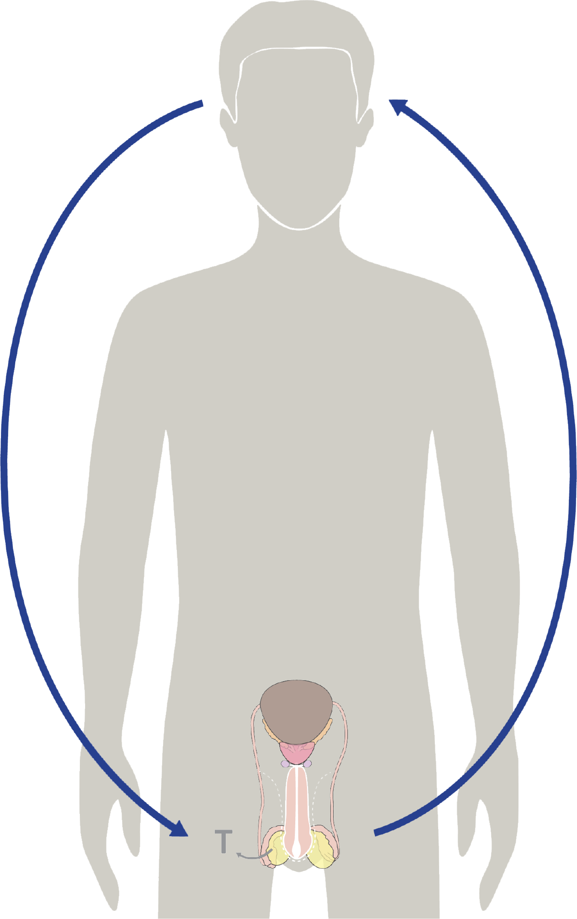
Hormones & your growth
Hormones cause all the growing & changing that your body does during puberty.
Testosterone is the main male hormone.
After testosterone is produced, it acts as a messenger back to your brain = hormonal feedback.
© FEMM
Notes:
Step 1 (5 minutes): Review hormones & the brain. Introduce hormones & emotions.
Do you remember what controls the activity of every system in the body?
Yes, hormones! You’re basically experts now.
Hormones are directed by your brain and, as we learned last class, hormones can actually give feedback to the brain to make it want to act in certain ways, like choosing to do certain things when we are around our peers. This is where we need to practice those habits of self-determination, to make healthy choices for ourselves and others, so that we’re prepared for when we feel peer pressure to do otherwise.

Slide 3
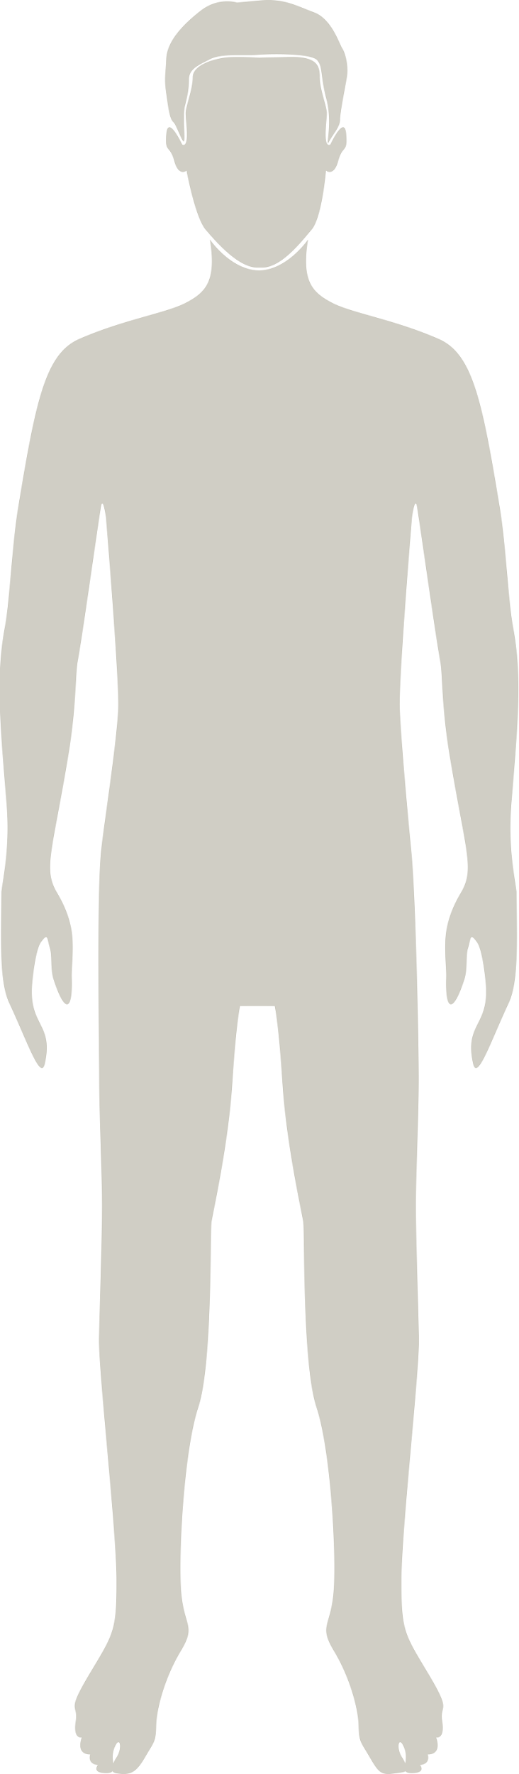

The 3 Pillars are the foundation for emotional wellness
🙂 🫀 🧠
Nutrition
Exercise
Sleep
© FEMM
Notes:
We know that testosterone is an important hormone for us and that it helps us in many different ways. When it comes to emotions, testosterone also plays a role. Testosterone is sometimes thought of as the hormone that contributes only to rage or aggression, like the Incredible Hulk.
But testosterone has actually been linked to many different types of emotions. Not having enough testosterone at certain points in our development has been linked to depression later in life. Supporting healthy testosterone levels by practicing the three pillars of health, will help you better manage your emotions overall, especially when faced with challenges.

Slide 4
Testosterone & emotions
Testosterone has these effects:
can help to decrease the effects of depression
can help to manage emotions
can help organize behaviour when you are faced with challenges
👍
👍
👍
© FEMM
Notes:
During adolescence, there will probably be times when we feel like it is hard to control our emotions. Or, we may not know why we are feeling or saying certain things. This is where recognizing certain things about emotions can be really helpful to us.

Slide 5
Recognizing emotions
😰
Emotions are neither good nor bad. Emotions give us information.
😡
It is how we decide to act when we feel an emotion
that can have a big impact for us
(and for others!)
😔
Do you know how to recognize what emotion you are feeling?
© FEMM
Notes:
It’s important to know that emotions themselves are neither good nor bad. They give us information. It is what we decide to do when we are feeling a certain emotion that can have a lasting impact on us, our friends or family, or the people around us. If we are feeling really mad about something and we punch our fist into our bedroom wall, that is going to have an impact on our family (somebody is going to have to patch that hole!) It will also have an impact on our hand: ouch! If we are mad and our fist finds a person’s head, then that is going to have a big impact on him and you.
So, how can we help ourselves to deal with a lot of emotions that we might be feeling? Recognizing them is the first step.
Tuning into our bodies can be a way to name what emotion we might be feeling. Anger sometimes feels like a hot sensation that spreads up through our torso and into our neck, the back of our throat and maybe even out to the arms and hands. Sadness sometimes feels like a heaviness in our chest or stomach. Joy can make us feel light and airy, like we could bounce up and down. Recognizing what each emotion feels like for us can be an important step in getting to know ourselves better.

Slide 6
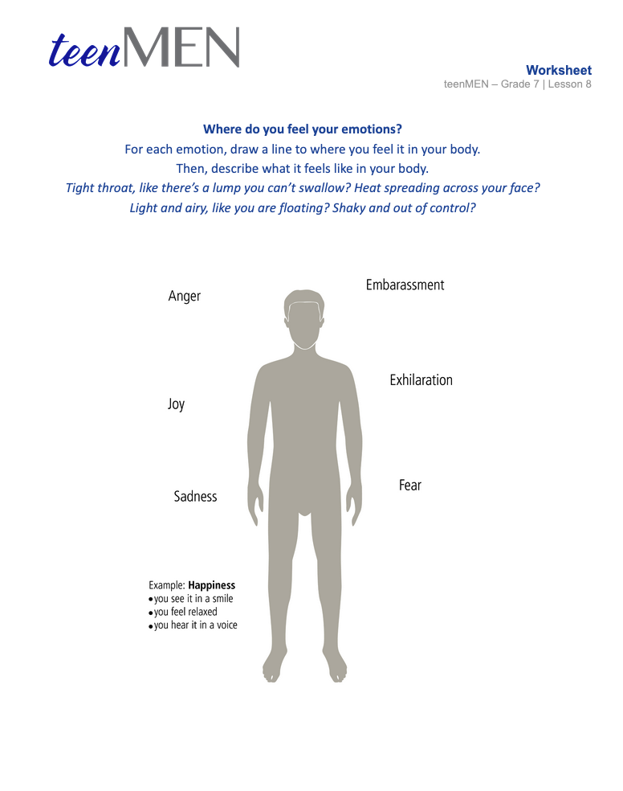
Worksheet
Where do you feel emotions?
© FEMM
Notes:
Pass out the Worksheet: Where do you feel emotions? Give the students a few minutes to try to recognize how they may have felt certain emotions in the past and what they felt like physically.

Slide 7
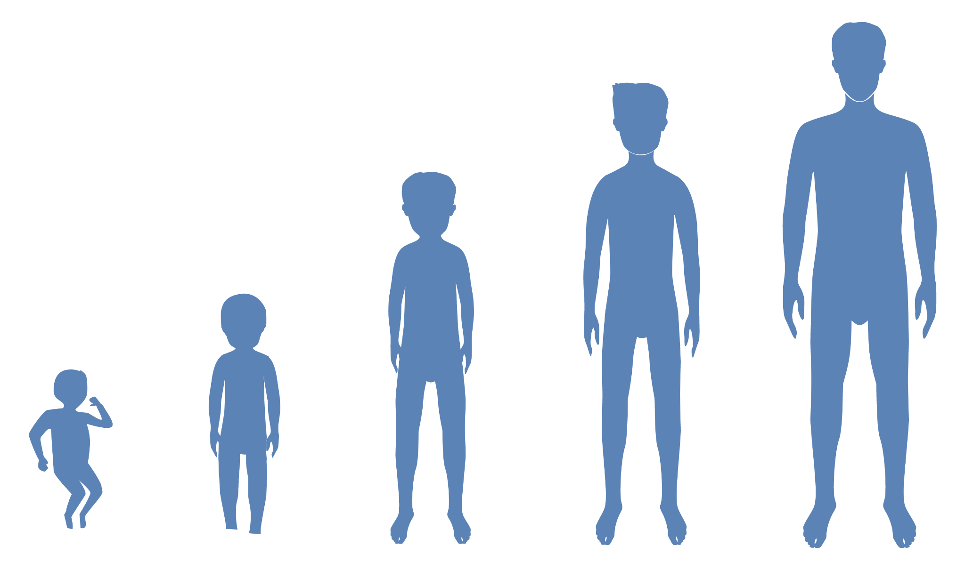
Communicating in a mature way
Emotions are neither good nor bad.
We can become more skilled in understanding and communicating emotions.
This skill is called emotional intelligence.
🗣️
😡
😫
😭
© FEMM
Notes:
Step 3 (10 minutes): Communicating in a healthy way + Case Study
Like we said before, emotions in themselves are neither good nor bad. We can remember that it is the way we react to our emotions, and the way that we let others know how we are feeling, that is important. In fact, becoming more skilled in understanding and communicating our emotions is a sign of maturity; it’s called emotional intelligence. When we were little, we let all of the emotions we were feeling come out right away. Sad, angry, excited, scared… it didn’t matter when we were little guys!
Now that we’re getting older, we are starting to realize that it’s not okay to have temper tantrums anymore. It is important to have emotional awareness. Being able to recognize our emotions - identifying what they are and putting them into words - is an important skill to build as you grow into men. We can get better and better at this skill as we get older and know ourselves better.

Slide 8
Emotional awareness helps us:
build better relationships with those around us
know when to walk away
know when to speak up
know when to help
know when to ask for help
© FEMM
Notes:
Emotional awareness is a type of intelligence. It’s something we can practice and get better at. It can help us to build better relationships with those people around us.
If we are aware of our emotions, we can know when it’s the right time to walk away, the right time to speak up, the right time to help someone, or the right time to talk to someone.
Do you have someone in your life that you can talk to about emotions you are having? Maybe your dad, your mom, your grandpa or grandma? Maybe a coach or an older sibling? Let’s read a case study about Rowan and Daniel.

Slide 9
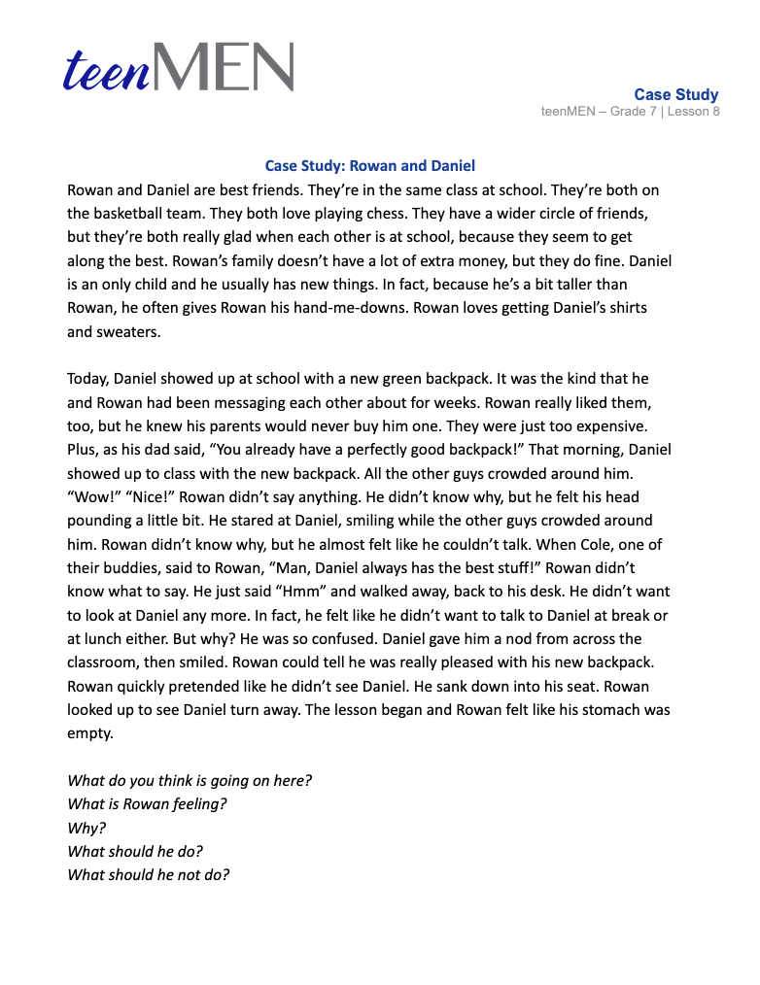
Case Study: Rowan and Daniel
© FEMM
Notes:
Read the following Case Study aloud, or print and hand out the case study for students to take turns reading aloud.
Case Study: Rowan and Daniel
Rowan and Daniel are best friends. They’re in the same class at school. They’re both on the basketball team. They both love playing chess. They have a wider circle of friends, but they’re both really glad when each other is at school, because they seem to get along the best. Rowan’s family doesn’t have a lot of extra money, but they do fine. Daniel is an only child and he usually has new things. In fact, because he’s a bit taller than Rowan, he often gives Rowan his hand-me-downs. Rowan loves getting Daniel’s shirts and sweaters.
Today, Daniel showed up at school with a new green backpack. It was the kind that he and Rowan had been messaging each other about for weeks. Rowan really liked them, too, but he knew his parents would never buy him one. They were just too expensive. Plus, as his dad said, “You already have a perfectly good backpack!” That morning, Daniel showed up to class with the new backpack. All the other guys crowded around him. “Wow!” “Nice!” Rowan didn’t say anything. He didn’t know why, but he felt his head pounding a little bit. He stared at Daniel, smiling while the other guys crowded around him. Rowan didn’t know why, but he almost felt like he couldn’t talk. When Cole, one of their buddies, said to Rowan, “Man, Daniel always has the best stuff!” Rowan didn’t know what to say. He just said “Hmm” and walked away, back to his desk. He didn’t want to look at Daniel any more. In fact, he felt like he didn’t want to talk to Daniel at break or at lunch either. But why? He was so confused. Daniel gave him a nod from across the classroom, then smiled. Rowan could tell he was really pleased with his new backpack. Rowan quickly pretended like he didn’t see Daniel. He sank down into his seat. Rowan looked up to see Daniel turn away. The lesson began and Rowan felt like his stomach was empty.
Note to teacher: After reading the case together as a class, prompt the class to work through some possible issues/problems that arise in the case by asking: What do you think is going on here? What is Rowan feeling? Why?
Write answers that students provide on the board. Make sure to let all students answer. There are no right or wrong answers to the issues/problems that students might bring up, so continue to promote answers, even if some seem unlikely, etc.
Next, come up with a list of solutions together as a class by asking: What should he do?
What should he not do?
Again, no possibilities should be dismissed immediately and can be added to the board. Let the students see the spectrum of possible solutions that might be available for Rowan. The best solutions will be discussed in Step 4.

Slide 10
Case Study Solutions
Rowan could talk to someone he trusts when he realizes he feels jealous.
He could go for a walk or jog to clear his head and cool off.
He could ……. ?
© FEMM
Notes:
Step 4 (10 minutes): Healthy communication benefits us and those around us
One solution is that Rowan could talk to someone he trusts when he realizes he feels jealous. Another solution is that Rowan could talk to Daniel and tell him directly that he was feeling jealous that Daniel got a new backpack and he didn’t.
Some things that Daniel should not do, include: hurting Daniel or stealing his backpack. It also wouldn’t be a great solution to ignore Daniel. After all, Daniel didn’t do anything to intentionally hurt Rowan. Daniel probably doesn’t know how Rowan feels. Rowan needs to identify his feelings and then figure out a way to resolve them. However, this can take a little bit of time. So, maybe Daniel needs to go for a walk on his own to think. Or, exercise is a great way to clear your head of frustrations. Then, he’ll be able to see the situation in a new way.
When we are able to communicate our emotions in the right way to other people, it is a way of showing respect: it demonstrates that we respect ourselves enough to communicate in a mature way, and it demonstrates that we respect the other person enough to explain to them what we’re feeling, why we acted like we did, etc.

Slide 11
Review
Emotions are neither good nor bad.
The way we choose to act on our emotions is what makes the difference!
If we are able to recognize our emotions and communicate them effectively, we help ourselves and those around us.
© FEMM
Notes:
Our emotions are neither good nor bad. It is the way that we choose to act on our emotions that makes the difference. If we are able to recognize our emotions and communicate them effectively, we help ourselves and those around us.

Slide 12
Grade 7
SUMMARY
© FEMM

Slide 13
Course Summary
Hormones play a major role in puberty for both boys and girls.
The physical changes of puberty (growing bigger, getting stronger, growing more hair, your voice changing…etc.) are signs of hormonal health!
The pathways in your brain continue to develop during puberty and aren’t fully mature until age 25!
Keep supporting your body and mind with good nutrition, exercise and sleep, so that you can grow to full maturity!
© FEMM
Notes:
Summary of teenMEN Grade 7
The girls in your grade have completed their grade 7 teenFEMM course as you have been working through this course. Although their changes are different from yours, their hormones are also playing a major role in their body and brain development during puberty. For you, getting bigger, stronger, and growing hair are all signs of hormonal health. It is important to remember that all kids go through puberty. You have daily surges in testosterone. You are both going through these incredible changes, and with a little bit of extra focus on making good choices, you can support your body and mind through this process of maturing and becoming young men!

Slide 14
Grade 7
LESSON 8
© FEMM

