Slide 1

Grade 6
LESSON 4
© FEMM

Slide 2

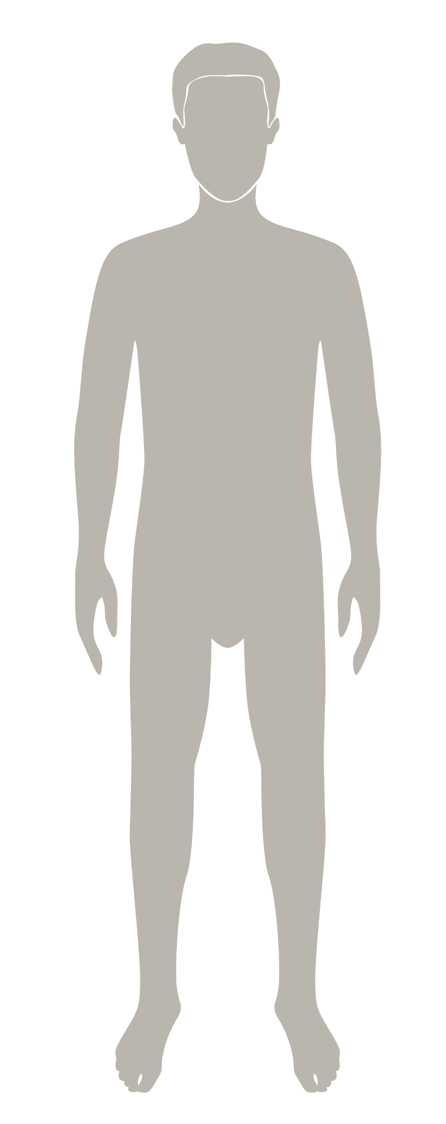
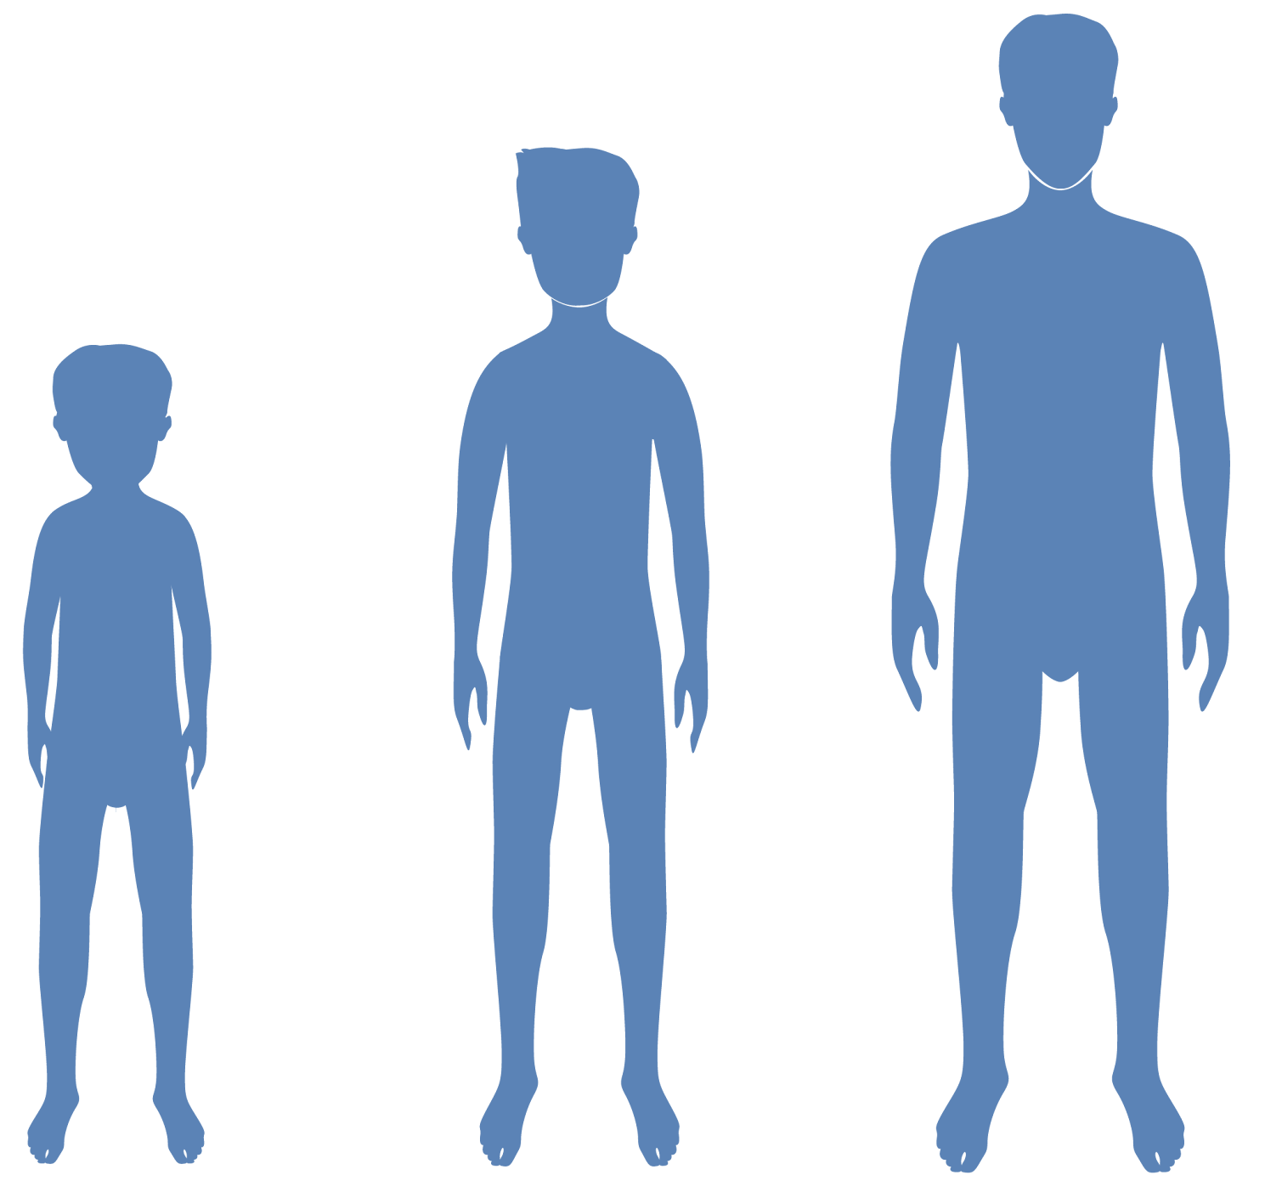
Warm up!
10 True or False
facts about Testosterone!
© FEMM
Notes:
All the activity of the male reproductive system begins in the brain.
2

Slide 3
Warm up!
Testosterone production starts in the brain.
Step 1. Here.
TRUE or FALSE
© FEMM
Notes:
Testosterone production starts in the brain.
True. All hormonal activity is controlled by the brain. Testosterone production is started by another hormone in the pituitary gland (that small kidney-bean-sized part of the brain) that tells the testicles to begin producing testosterone.

Slide 4
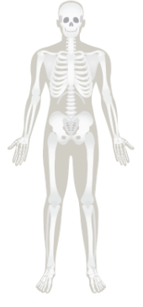
Warm up!
2. Testosterone gives you stronger bones.
TRUE or FALSE
© FEMM
Notes:
Testosterone gives you stronger bones.
True. Testosterone plays a role in bone density and in maintaining bone health.

Slide 5
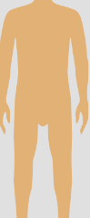
Warm up!
3. Testosterone can give you X-ray vision.
TRUE or FALSE
© FEMM
Notes:
Testosterone can give you x-ray vision.
False! Your vision is dependent on several factors, but testosterone isn’t considered to be one of them. (Plus, x-ray vision only happens in video games!)

Slide 6

Warm up!
4. Red Bull and other energy drinks
increase testosterone.
TRUE or FALSE
© FEMM
Notes:
Red Bull and other energy drinks increase testosterone.
False. Red Bull has not been proven to make testosterone levels better and in fact causes heart problems and nervous system disorders. Yikes!

Slide 7

Warm up!
5. Testosterone affects your mood.
TRUE or FALSE
© FEMM
Notes:
Testosterone affects mental health.
True. Testosterone affects thinking, mood, and memory. Low testosterone can sometimes lead to feelings of depression. In puberty, as testosterone levels change, it’s normal for moods to change as a result.

Slide 8
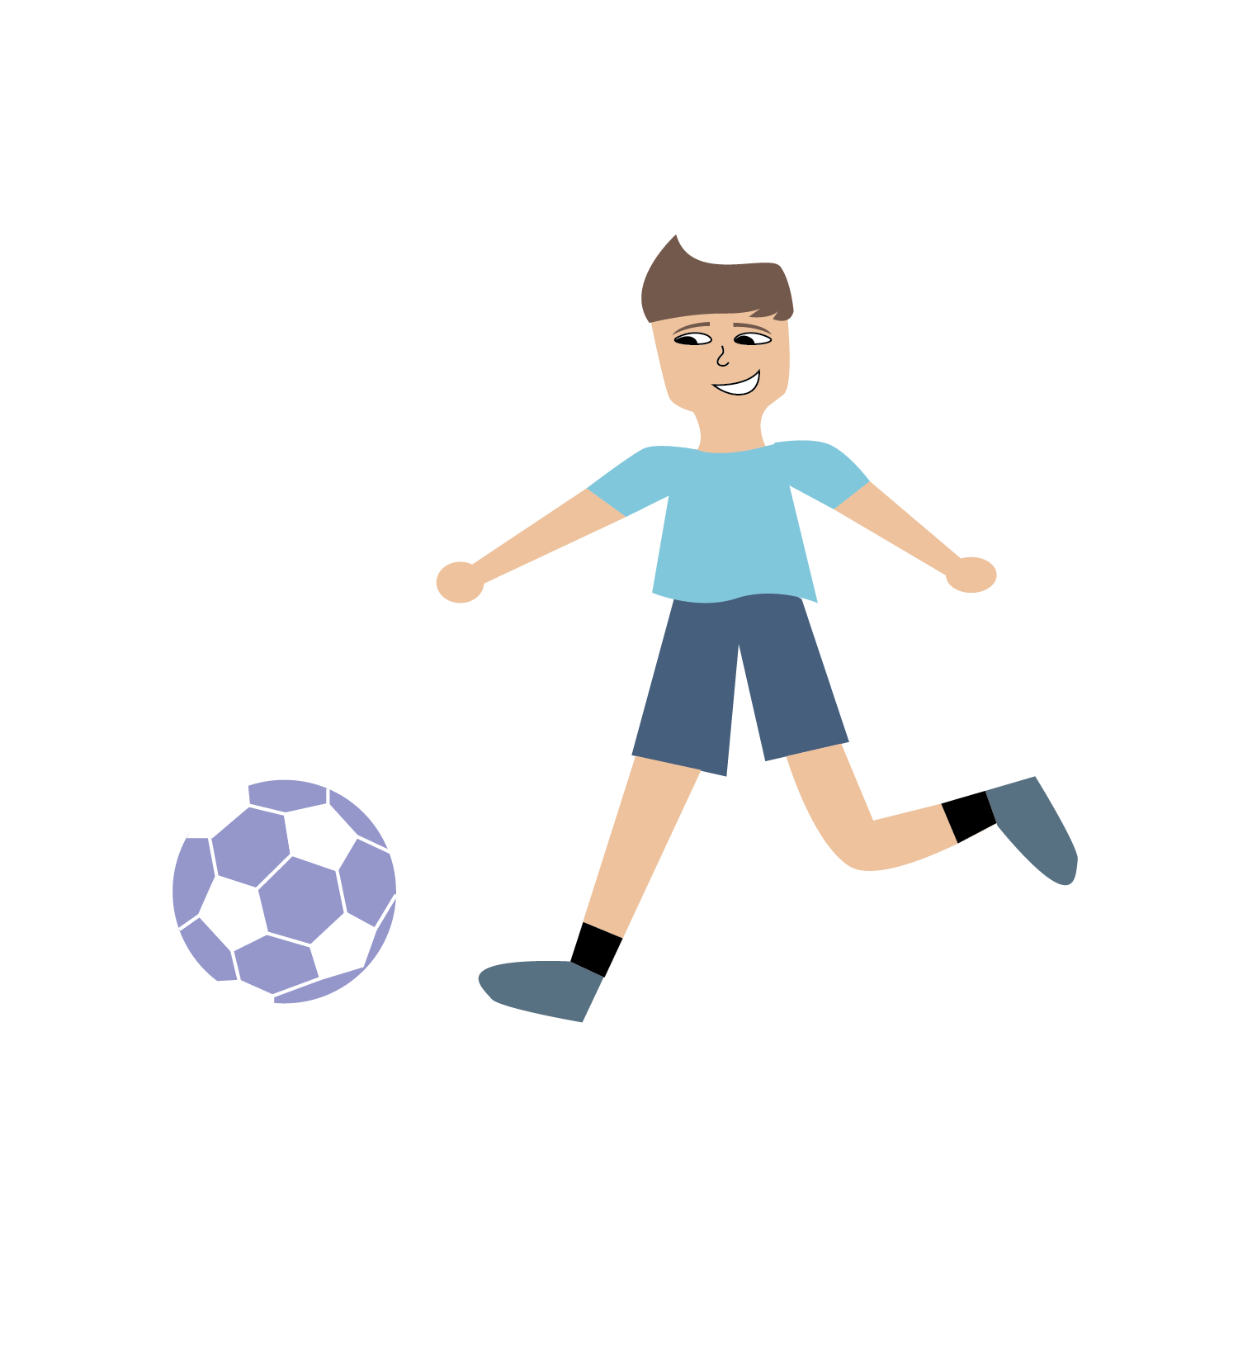
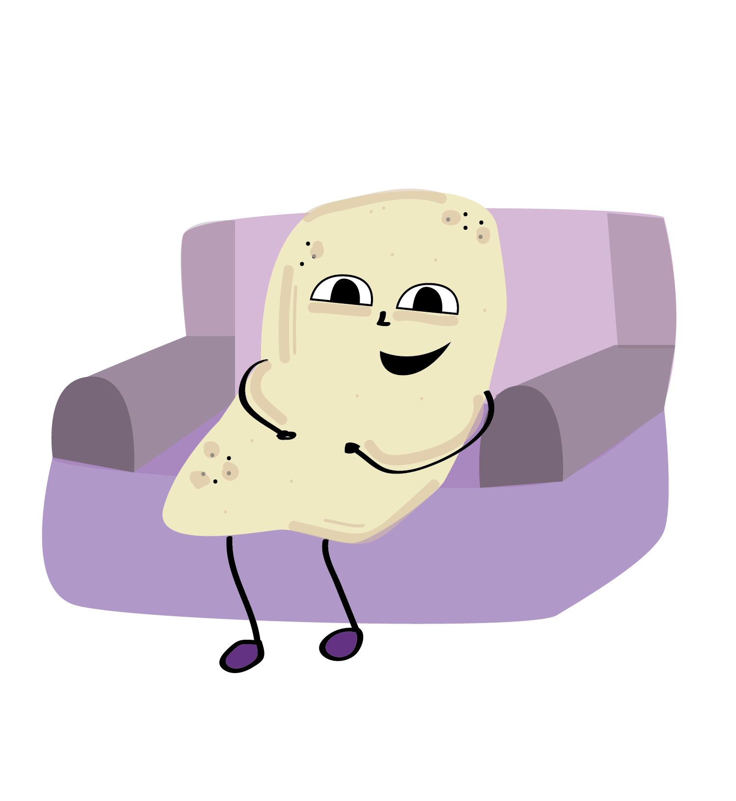
Warm up!
6. Exercise has no real impact on your testosterone.
TRUE or FALSE
© FEMM
Notes:
Exercise has no real impact on your testosterone.
False! Research shows that testosterone levels rise after exercise. Younger men get a bigger boost post-exercise.

Slide 9
Warm up!
7. Alcohol and smoking or vaping (marijuana or tobacco products) lowers your testosterone.
🚬🤯
TRUE or FALSE
© FEMM
Notes:
Alcohol and smoking/vaping (marijuana or tobacco products) lower your testosterone.
True. In the testes, alcohol adversely affects the Leydig cells, which produce and secrete the hormone testosterone. Smoking lowers testosterone levels and sperm numbers.

Slide 10
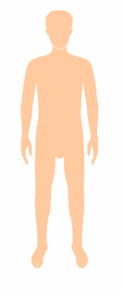

Warm up!
8. Only men have testosterone.
TRUE or FALSE
© FEMM
Notes:
Only men have testosterone.
False. Women also have testosterone, just as men have the main female hormone, estrogen. But where these hormones are made and the amount that is healthy for their bodies is different in men and women. But the male body makes about 15-20 times more testosterone than a woman’s body does.

Slide 11
Warm up!
9. Testosterone levels change slightly
over the course of a day.
TRUE or FALSE
© FEMM
Notes:
Testosterone levels change slightly over the course of the day.
True. Testosterone levels are highest in the morning and lowest in the evening, although they do not change much from day to day or year to year once you have started making adult amounts of testosterone.

Slide 12
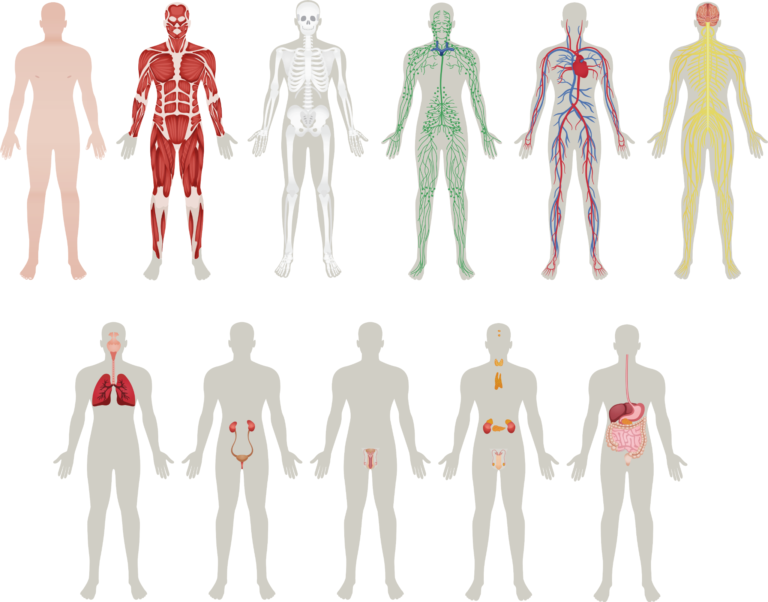
Warm up!
10. Testosterone plays a big role in overall health.
TRUE or FALSE
© FEMM
Notes:
Testosterone plays a big role in overall health.
True. You need your body to make the right amount of testosterone for your age, in order to support your energy levels, mood, growth, muscle tissue, etc. You can help your body make the right amount of testosterone by making healthy choices.

Slide 13
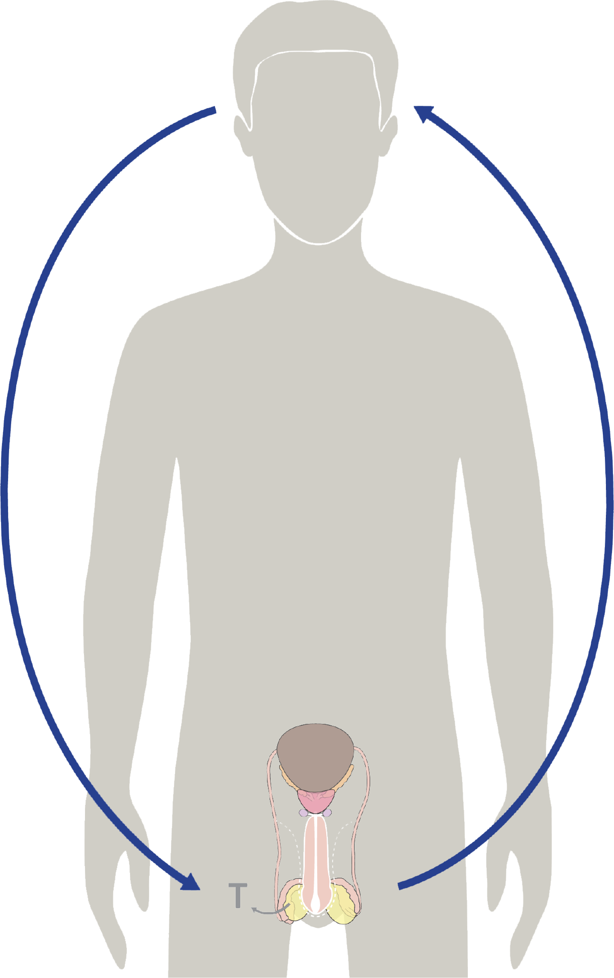
Your reproductive system & hormones
An amazing thing is that the brain helps to generate testosterone, and this hormone in turn helps to develop the brain!
The brain sends hormonal signals to your reproductive organs to help them mature and function. The testicles receive these hormonal signals and send signals back to the brain, developing new pathways in the brain.
© FEMM
Notes:
Ask: where do all of the physical and emotional changes of puberty start? In the brain!
An amazing thing is that the brain helps to generate testosterone, and this hormone in turn helps to develop the brain! Did you know that the male brain doesn’t fully mature until the age of 25?
13

Slide 14
Your brain & hormones
Your brain is still developing.
The changing hormone levels in the brain cause the physical and emotional changes you experience.
Because the brain is the organizing center for all this activity, things that affect your brain will affect your whole body.
© FEMM
Notes:
This means that right now, your brain is wide open and ready for knowledge! What are you doing to teach your brain each day? Changing hormone levels in the brain cause all of the physical and emotional changes that you experience in puberty. Because the brain is the organizing center for all this activity, things that affect your brain affect your physical and emotional health.
14

Slide 15
You body and testosterone
Hormones are
POWERFUL.
Small changes in hormone levels cause huge changes in your mood and in your body.
© FEMM
Notes:
Hormones are powerful. The smallest changes in hormone levels can cause huge changes in your body.

Slide 16
You body and testosterone
Text message testosterone
🩵you feel more sensitive and self-conscious
🧠improved mood and focus
you find you need to sleep more. 😴
😡😰 you get more easily upset or angry and you don’t know why
Increased muscle mass💪🏽
🦴increased bone density!
© FEMM
Notes:
Testosterone impacts your brain, your emotions, your sleep, your muscles, and more.
The increasing testosterone levels in your body cause the physical changes that you can see, like getting taller, but also the emotional changes you experience, from feeling sensitive and self-conscious to energetic and competitive.

Slide 17
You body and testosterone
Testosterone & your growth
 | testosterone
brain cells | increases ability to learn
bones | bone formation & density
muscle mass | builds
hair growth | promotes
fat metabolism | helps promote fat burning
blood sugar | helps keep at healthy level
well-being | normal levels promote confidence and motivation
© FEMM
Notes:
This chart shows only a few of the amazing things happening in your body during puberty, thanks to testosterone. Note that testosterone increases brain cells, which increases your ability to learn, for starters!

Slide 18
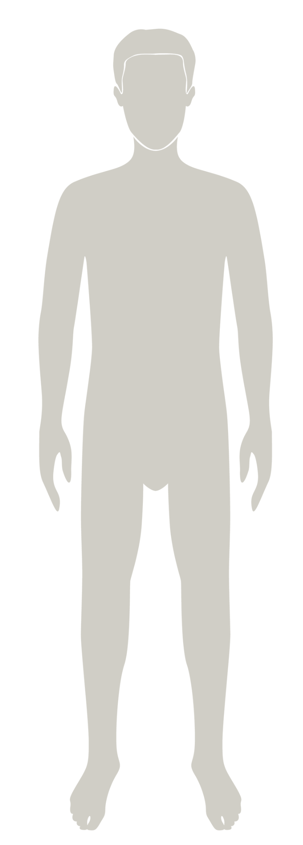
Your mood and testosterone
Changing hormone levels can make you feel a WHOLE LOT of things at once!
You have all this energy, but suddenly you’re angry and upset. You feel sensitive and insecure, but also want to show off...
🧠
😴
😡😰
🩵
💪
This is normal. There is a lot of growing and changing going on in your brain and your body!
YOUR JOB in this process, is to try and make the BEST choices possible, for you and your overall health, as you go through this time of rapid development in puberty.
© FEMM
Notes:
Changing hormone levels can make you feel a whole lot of things all at once. One minute you want to show off, the next minute you feel insecure. This is normal as your brain is changing. The most important thing for you to remember is that your job is to try to make excellent choices for yourself, for others and for your health as you develop through puberty.

Slide 19

You body and testosterone
Puberty can start in the brain around the age of 10, but you may not notice changes in your body until later.
Remember that every boy develops at a different rate.
© FEMM
Notes:
Puberty starts to happen around the age of 10, but for most boys they won’t notice any physical changes until much later. Things take time. Remember: everyone's body is different and when you start puberty will depend on your genetics as well as your health habits.
Let’s talk about some of the changes you will see and address some concerns guys have as they enter puberty.

Slide 20
Hormones & your height
Testosterone levels influence height during puberty.
Once you have reached your full height, based on your genetics and health choices, testosterone does not continue to make you grow taller.
🥕 Practicing excellent lifestyle habits during puberty is YOUR best bet to help your testosterone levels be at their healthiest!
© FEMM
Notes:
Testosterone levels influence height during puberty. Yet, many boys your age are shorter than the girls. This is normal, because girls get a head start on puberty (typically ages 9-14 for a girl, and ages 10-17 for a boy). Boys also go through puberty for a longer time, so making healthy choices as you go through puberty is the best way to grow as you should.

Slide 21
Hormones & your muscles
Testosterone is an important factor in muscle growth, but it is not the only one.
Remember that each guy starts developing more muscle at his own pace. For some boys, this starts around age 14.
💪
Exercise and playing sports is an excellent lifestyle habit during puberty to help YOUR testosterone levels be at their healthiest!
© FEMM
Notes:
You might be worried about how your body will develop. Guys can expect their shoulders to broaden and muscles to grow, but be patient - all guys grow differently and at different times. For most boys, this part of puberty starts around the age of 14. The best way to support muscle development is to exercise and play sports as it reduces stress, boosts your mood and helps keep your hormones healthy, too.

Slide 22
Hormones & your hair
Testosterone has a big impact on your hair: it gets thicker, more oily and coarser.
Testosterone also acts on different parts of your body to grow hair: armpits, chest, face, pubic area, legs, forearms, etc.
This continues throughout
puberty.
👨🏻
© FEMM
Notes:
In puberty, the hair all over your body begins to thicken. Boys begin to see hair growing on the chin and upper lip, chest, armpits, and in the pubic area (around the reproductive organs). This hair growth is a result of hormones, particularly testosterone, working hard to develop your body from the inside out.

Slide 23
Hormones & your voice
Testosterone has a big impact on your voice: it deepens it and lowers it.
👾 This is called voice mutation*.
*But it doesn’t make you a mutant.
This can start around age 12.
🗣️
© FEMM
Notes:
Testosterone acts on your vocal cords and larynx, causing your voice to become deeper and lower. This usually starts to happen around age 12.

Slide 24
Hormones & sweat
Testosterone promotes changes in your body that cause you to sweat more during puberty.
💧Sweating is a sign of health.
👍 You can help yourself (and those around you!) by taking regular showers and using deodorant.
💦
© FEMM
Notes:
Have you noticed that you’re sweating more? It’s because hormones are driving so much activity in your body! You sweat when your body gets warm, and then sweat evaporates, cooling you down. Sweat itself is not smelly, but in contact with the bacteria on your skin -- sweat + bacteria = smelly. Just shower more often and let your body do its normal thing. Also, you can wash your face with a warm washcloth when you wake up and before you go to bed, to help keep your face clean.
Remember, all of these changes in puberty are signs of health! It means your body is receiving the right hormonal signals and in the right amounts. Growing to maturity is a sign that you are becoming the teenage men you are supposed to be. If you have specific questions about what is happening to your body at any given time during puberty, it’s always best to ask a trusted adult: your dad, your mom, a family member or your doctor can help give you the best advice for you and your health.

Slide 25
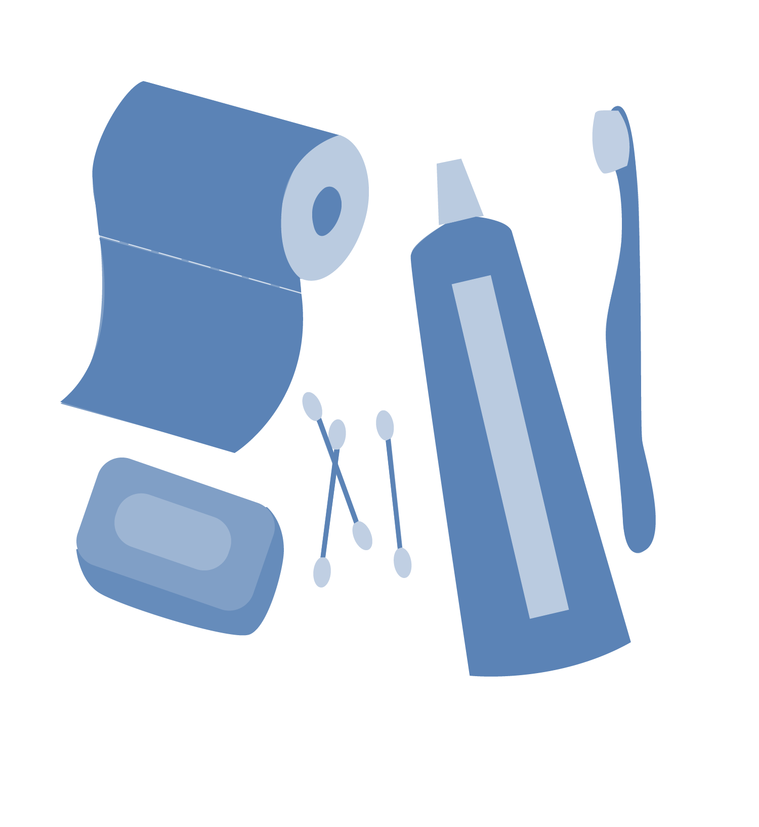
Hormones and you
Hygiene: habits that keep your body clean and contribute to your overall health
Bathe or shower daily, or as needed after exercise
Use deodorant to help eliminate body odor
Brush your teeth morning and night
Clean and trim your nails 1 a week
Wash your face morning and night
Wash your hands after using the
bathroom
© FEMM
Notes:
As you grow and mature, you become responsible for keeping your body clean and healthy.
The things you do to keep yourself clean are called hygiene habits.
It’s important to bathe or shower once a day or as needed, after exercise. You may need to start using a deodorant to help eliminate body odor.
Brush your teeth in the morning before school and at night, before bed.
Cut your nails once a week. Nails can hold bacteria underneath them, so it’s best to make sure they are clean. It’s also important to not bite your nails or the skin around them. Breaking the skin around your nails allows bacteria to enter into your body.
Washing your face in the morning when you wake up and at night, before you go to bed, will help your skin clear away excess bacteria and oil. You can just use a washcloth with warm water.
Maintaining healthy habits in each of these areas is important for your entire life, but especially in puberty. Getting in the habit of good hygiene will help you feel more confident in yourself as you go through puberty.
25

Slide 26
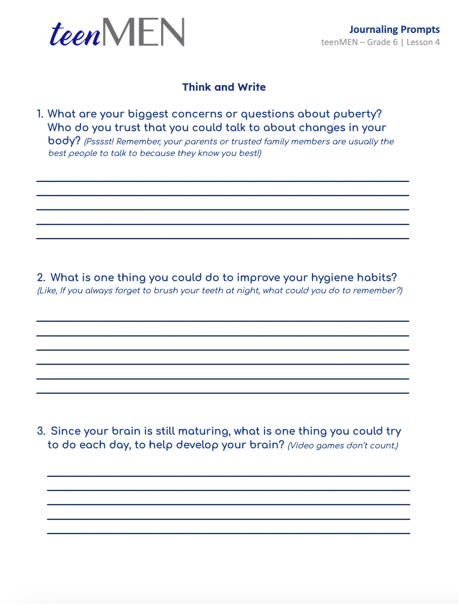
Think and Write
Write it all out.
© FEMM
Notes:
Step 5 (10 minutes): Think and Write: Journaling
Journal activity: Take the remaining class time and have each student respond to the questions on the Think and Write: Journaling page. Let them know they can keep this information to themselves if they wish.

Slide 27
Review
Hormones are responsible for puberty.
Puberty is normal and is a sign of health!
Puberty will have effects on your whole body, changing and maturing it. Some of these changes will be seen in your hair, voice, height, and muscles.
We can continue to help our bodies become as healthy as possible with how we treat our body and with the healthy choices we make.
© FEMM
Notes:
Testosterone and other hormones cause changes in our body during puberty. Puberty is a sign of health! Next lesson we’ll learn about the three pillars of health and how we can make excellent choices that will support our health and hormones!

Slide 28
Grade 6
LESSON 4
© FEMM

