Slide 1

Grade 7
LESSON 1
© FEMM

Slide 2
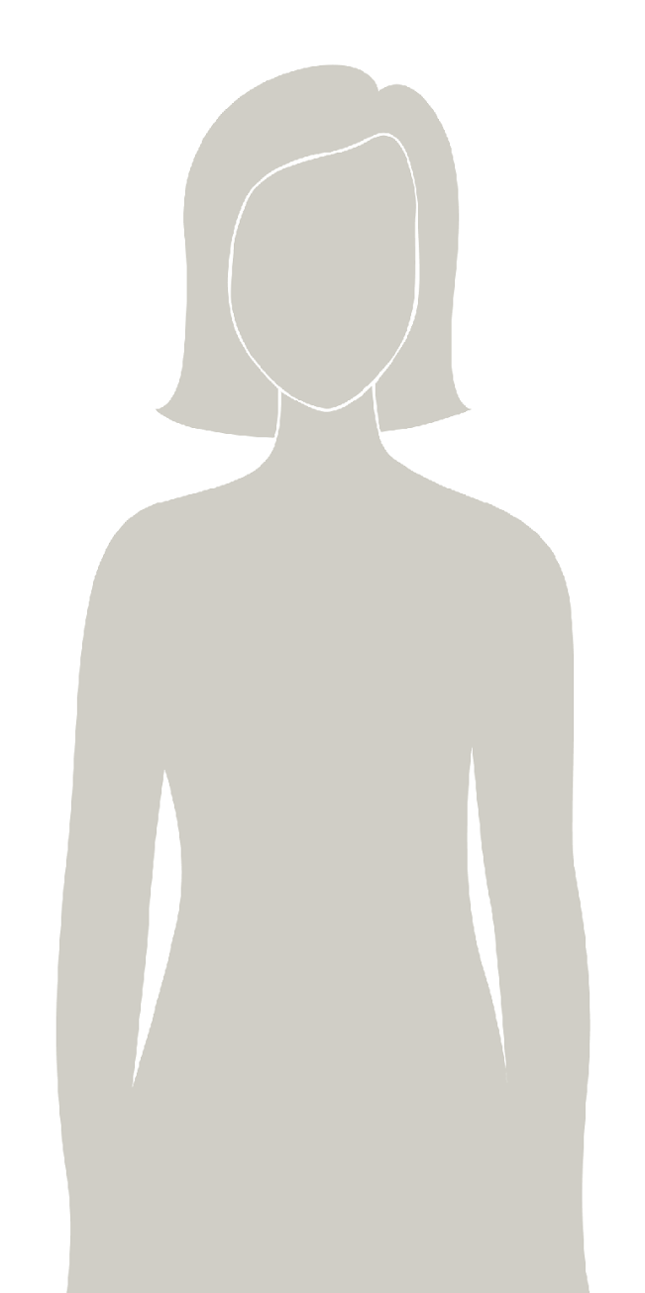
Introducing
a health program
that will help you understand your body & track your health.
You will learn about:
the reproductive system
why ovulation is a sign of health
how lifestyle choices affect your mood & wellbeing
how to track your health
© FEMM
Notes:
teenFEMM is a health program that will help you understand your body and track your health as you grow to full maturity. You will learn about the reproductive system, the physical and emotional changes of puberty, and how daily lifestyle choices affect health.
You will have 8 teenFEMM classes per year. teenFEMM classes will continue every year through grade 12. By then you will be a health expert!

Slide 3
Activity: Positive Post-it Notes
You work hard in class which inspires me to try more
You are always kind to everyone
You are so fun to be around
Notes:
In this class, over the course of eight lessons, you will learn about the reproductive system, the physical and emotional changes of puberty, how daily lifestyle choices affect your mood and wellbeing, and how to track your health.
Give each student two-post-it notes. Ask them to get out a pen.
To start, let’s do an icebreaker called Positive Post-it Notes, to focus on the good things about each person during this unique time of growth and change! On each sticky note, write one nice thing about the person sitting to either side of you. We will put all of these up on the wall in the classroom to remember our strengths and focus on seeing ourselves and one another in a positive light.

Slide 4
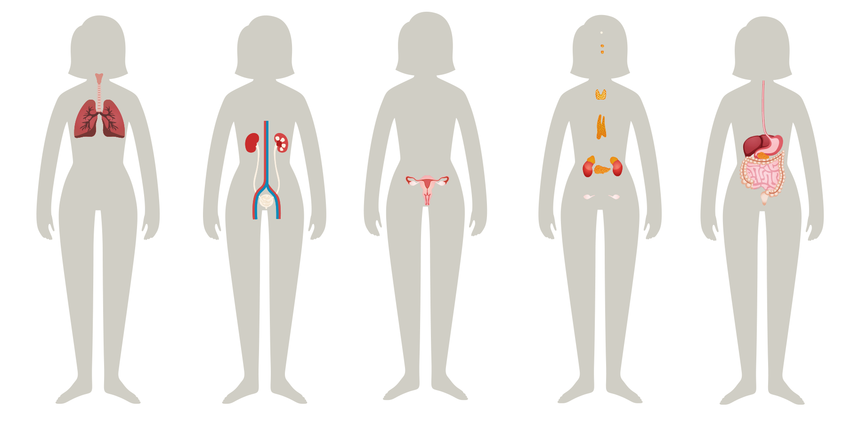
Your body
Your body has many organs.
Liver
Lungs
Heart
Kidneys
Stomach
Brain
Pancreas
Spleen
Large intestine
All of your organs need to work together
for your body to be as healthy as possible.
© FEMM
Notes:
Step 2 (20 minutes): Body Systems + Worksheet
Your body is made up of many organs. Each organ has a particular and important job to do, and all of your organs need to work together for your body to be healthy.

Slide 5
Your body
A group of organs that work together for a particular function, is a system.
Your body has many systems, all working together for your health.
© FEMM
Notes:
When certain parts of the body work together for a similar purpose, this is called a body system.
The human body is made up of many body systems; every system works together to ensure that you stay healthy. If one organ or body system is unhealthy, other body systems work overtime; thus, putting a strain on overall health. Every part of the body impacts the health of the whole body.

Slide 6
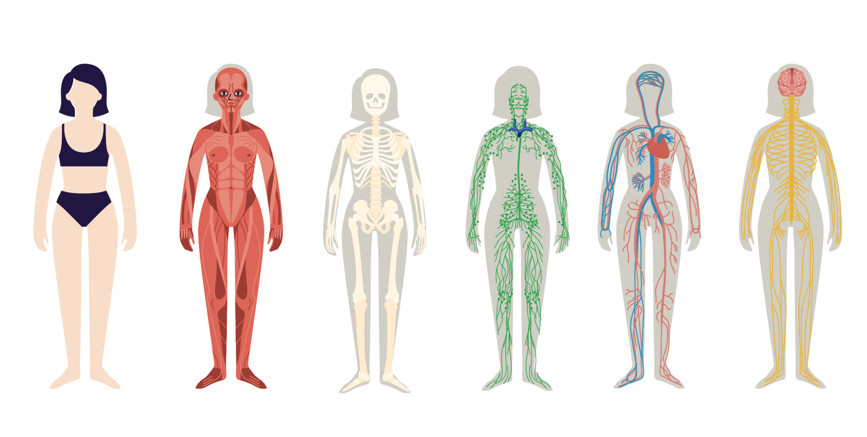
I’m just going to muscle my way in…
The Skeletal System
2. The Muscular System
© FEMM
Notes:
Let’s look at the names and functions of nine body systems:
The skeletal system: bones support our body so that we can stand and sit, and the rib cage protects our lungs and heart.
The muscular system: muscles support movement of our body.
Note: The skeletal and the muscular systems together form the musculoskeletal system. So, you can refer to these two systems separately or together.

Slide 7
You’ve got a lot of nerve!
Brain
You’ve got a lot of nerve!
Nervous S.
I know. Over 7 TRILLION
(nerves) in the whole body!
3. The Nervous System
© FEMM
Notes:
Don’t be nervous about the function of this system: it controls everything you do! When you are startled and you jump, that’s your nervous system working for you. It is made up of your brain, spinal cord, and all the nerves in your body. Guess how many nerves you have in your whole body? Over 7 trillion nerves! The brain is the control center and the spinal cord is the major highway to and from the brain.

Slide 8
I need to take a breather…
Brain
You know what’s BREATHTAKING?
Respiratory S.
You.
Brain
But seriously, YOU take
22 thousand breaths a day!
4. The Respiratory System
© FEMM
Notes:
4. The respiratory system includes the nose, mouth, throat, voice box, windpipe, and lungs.
Through our lungs, we breathe the air and oxygen we need for life. Here’s another crazy fact about our amazing bodies. Guess how many breaths you take every day? 22,000 breaths a day!

Slide 9
I’ll need time to digest this …
5. The Digestive System
© FEMM
Notes:
5. The digestive system breaks down the food you eat to make fuel for your body, which is absorbed as nutrients, then eliminates the waste it cannot use.

Slide 10
I gotta go
6. The Urinary System
© FEMM
Notes:
6. The urinary system is responsible for filtering, recycling, and getting rid of fluid.

Slide 11
I need to circulate
Brain
Listen to any good beats lately?
Circulatory S.
I drop around 10,000 beats per day and my surround Circulatory System pumps about five litres of blood.
7. The Circulatory System
(or the Cardiovascular System)
© FEMM
Notes:
7. The circulatory system: This system pumps blood from the heart through the blood vessels, carrying oxygen from the lungs and fuel from food, to all parts of the body.

Slide 12
I’m more vital than you think!
8. The Reproductive System
© FEMM
Notes:
8. The reproductive system is responsible for bringing about new life. In boys this system includes the testes, scrotum, penis, and tubes through which sperm travel. In girls, the reproductive system includes the ovaries, fallopian tubes, uterus, cervix and vagina. It is important to note that each system develops only one of the cells needed for creating a new human life; both one cell from the male system and one cell from the female system must join together for the creation of a new human life. Additionally, the reproductive system is vital to your overall health. As you go through puberty, the main female hormones are produced in your ovaries and travel through your bloodstream impacting mood, growth, skin, bone density and more!

Slide 13
I’ve just gotta get a message to you
9. The Endocrine System
© FEMM
Notes:
9. The endocrine system works intricately with the reproductive system. The endocrine system releases hormones. The system is composed of a group of ductless glands located throughout the body that produce hormones in response to the body’s needs. Once released, hormones may act on nearby structures, or they may travel in the blood to distant target organs. Hormones act like text messages in the body. So, your brain might send a text to your thyroid gland to let it know that it’s time to do its thing. “Hey, thyroid, can you get moving?” Hormones play a major role in puberty.

Slide 14
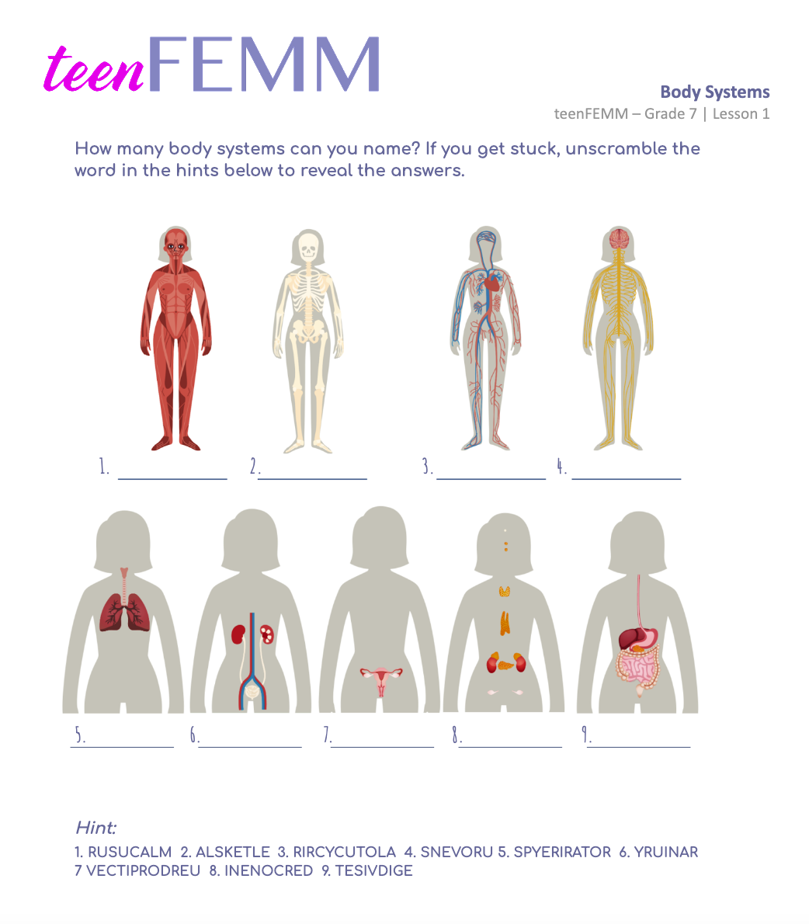
Body Systems Worksheet
Can you name 9 systems at work in your body?
Notes:
Each system in the body must function properly for the whole body to be healthy.
The health of one system impacts all of the other systems.
Hand out the Body Systems Worksheet for students to complete. Review the answers with the class using the Teacher’s Answer Key provided in the materials.

Slide 15

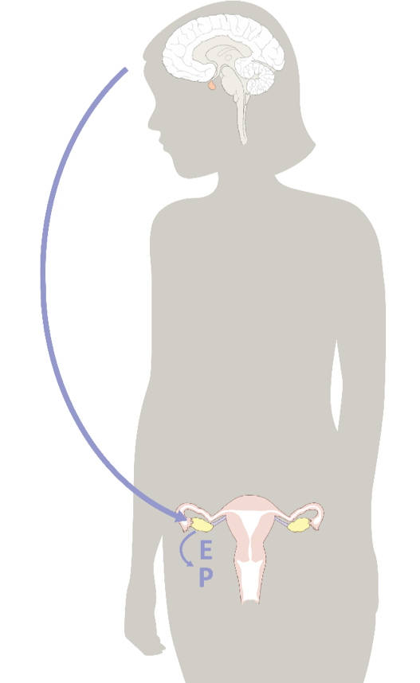
Hormones
Hormones are signals sent throughout the body to tell each system what to do.
Hormones are controlled by the brain.
© FEMM
Notes:
Step 3 (10 minutes): Hormones + Puberty
To function properly, each body system needs signals from the brain. These signals tell each body system what to do and when, etc.
Do you know what these signals are called? Hormones! Hormones are chemical signals that direct the activity of every system in the body. Hormones are controlled by the brain.

Slide 16
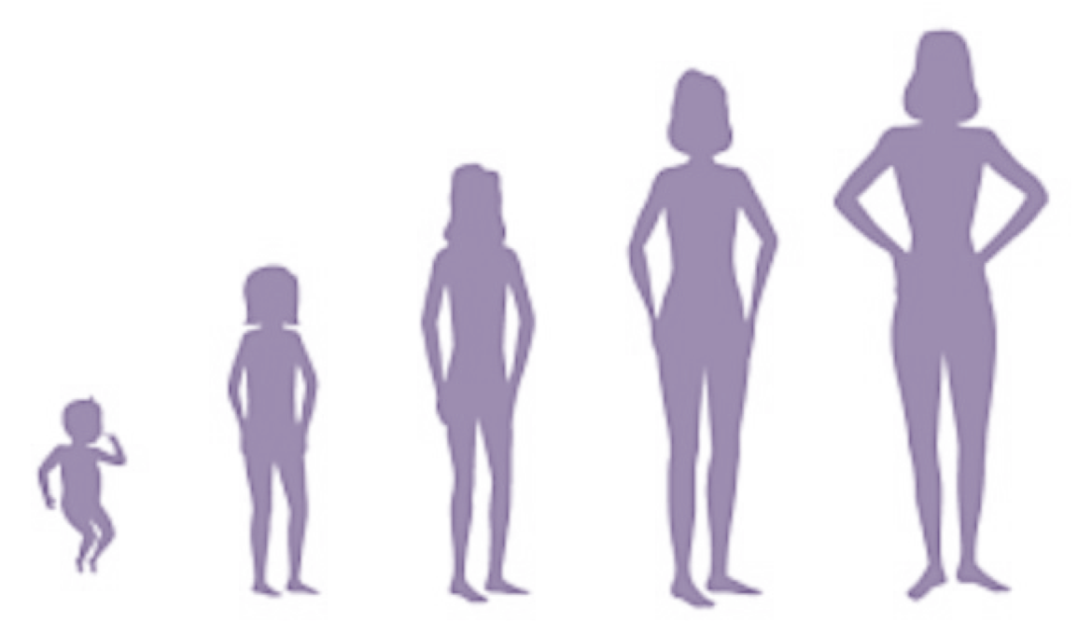
Puberty
Puberty is a time when your body matures from childhood towards adulthood.
Your body changes
You get taller
Your breasts and hips develop
Increased body hair
Hello teenFEMM student, you are here.
You can also experience more oily skin,
body odour, emotional changes, etc.
© FEMM
Notes:
In puberty, hormones sent from the brain tell your body to increase one of the female hormones, called Estrogen. This kickstarts the many hormonal changes that take place from around 9 to 14 years of age for a girl. For boys, the main hormone is testosterone and their puberty takes place between ages 10 and 17. Puberty is a time of rapid growth, when your brain and your body mature, develop and change.

Slide 17
Hormones: messages from your brain
Brain
Reproductive System, hello, come in, do you read me?
Repro S.
Roger that, Brian.
*BRAIN
Increase Estrogen, Ovary and out.
Lolz 🙄
© FEMM
Notes:
During this time, the communication between your brain and your reproductive system is developing. You can think of it like this: puberty increases the messages sent between the brain and the reproductive system. The brain tells the reproductive system to develop and mature, triggering changes that you see and feel throughout your body.
Some changes in puberty include the notice of body odor, hair growth, acne and mood/emotional changes. All of this is part of a normal, healthy, maturation process. Hormones and the healthy development of your brain and reproductive system have a huge impact on your overall health!

Slide 18
Review
All body systems are important for overall growth.
A healthy reproductive system is an important indicator of your body’s overall health.
Your brain and reproductive system are linked by chemical messengers called hormones.
Puberty is a time when your body grows to full maturity.
© FEMM
Notes:
CONCLUSION
Every body system is important to our overall health. Through teenFEMM, as we learn more about your growth and development during adolescence, we will focus on how a healthy reproductive system is an especially important sign of your overall health. In the next lesson, we will learn about the parts of the reproductive system.

Slide 19
Grade 7
LESSON 1
© FEMM

