Slide 1

Grade 8
LESSON 1
© FEMM

Slide 2
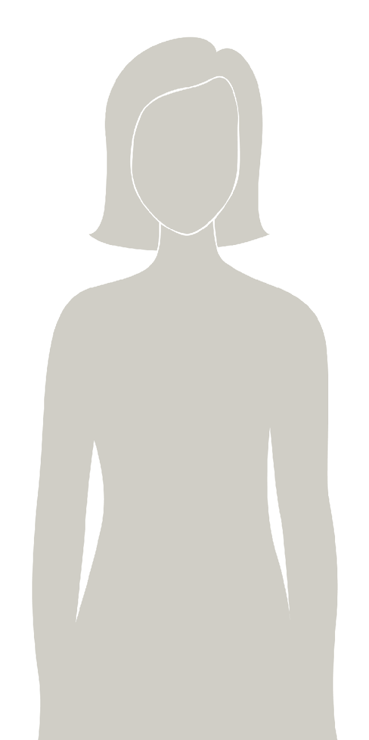
Introducing
a health program
that will help you understand your body & track your health.
You will learn about:
the reproductive system
why ovulation is a sign of health
how lifestyle choices affect your mood & wellbeing
how to track your health
© FEMM
Notes:
Step 1 (5 minutes): Introduce teenFEMM health program
teenFEMM is a health program that will help you understand your body and track your health as you grow and mature. Through this course, you will learn that ovulation is an important sign of health. You will also continue to learn about how important it is to chart and create a health record for yourself. Identifying your body’s ovulation within two years of the onset of your first menstruation is important, as ovulation is a sign of overall health and wellness.
This course will also teach you about the many fascinating things that hormones do. You probably already know about estrogen and progesterone, but there are two other extremely important reproductive hormones, called: Follicle Stimulating Hormone (FSH) and Luteinizing Hormone (LH). For women and men, hormones impact every system in the body. So, we have a lot to cover!
By the time this course is over, you will be a hormonal health expert!

Slide 3
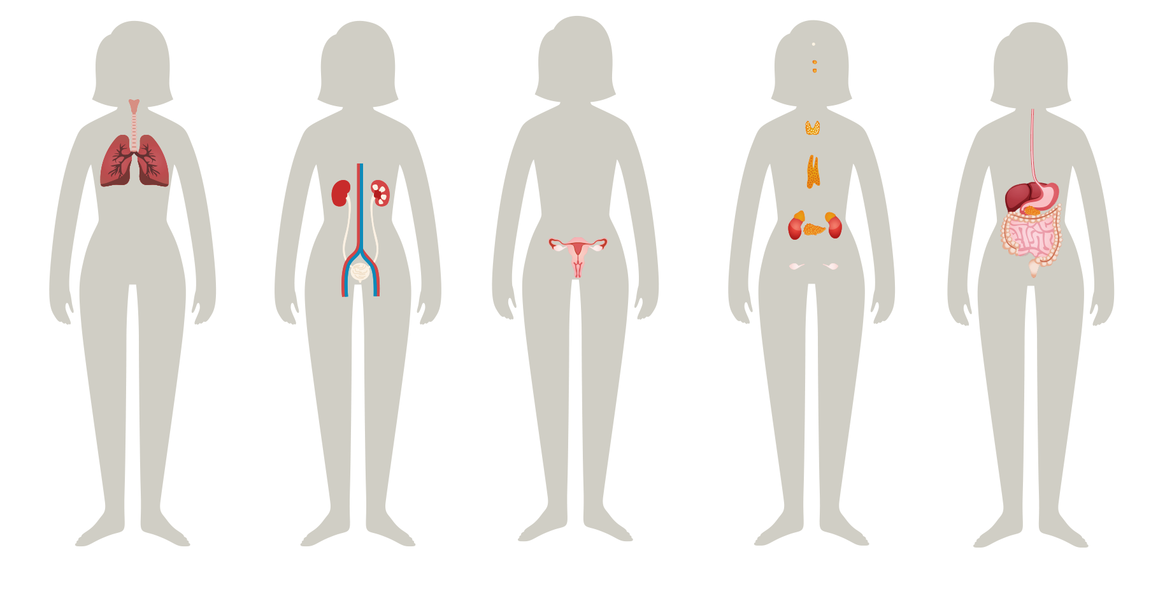
Your body is made up of systems
Your body has many systems, all working together for your health.
© FEMM
Notes:
Step 2 (5 minutes): Healthy Body
As you know, your body is made up of many organs. Each organ has a particular and important job to do, and all of your organs need to work together for your body to be as healthy as possible. When certain parts work together for a similar purpose, they are called a system. Your body has many systems, all working together to make sure you function well.

Slide 4

Healthy body systems
A few body systems you already know are:
musculoskeletal
nervous
respiratory
circulatory
digestive
urinary
endocrine
reproductive
© FEMM
Notes:
Step 3 (10 minutes): Review 9 systems covered in grade 7 + Introduce 2 new systems
We learned nine systems in class last year:
The muscular and skeletal systems (also known as the musculoskeletal system): Sometimes these two systems are listed as one because they are so interconnected. The muscles, bones, and joints are attached to each other by different tissues. Ligaments are found at your joints, and their job is to hold bones together. Tendons are found at the ends of muscles, and their job is to connect muscles to bones.
The nervous system: The nervous system controls everything you do, including breathing, walking, thinking, and feeling. This system is made up of your brain, spinal cord, and all the nerves of your body. The brain is the control center and the spinal cord is the major highway to and from the brain. The nerves carry the messages to and from the body, so the brain can interpret them and take action.
The respiratory system: The respiratory system consists of the airways, the lungs and the respiratory muscles that move air in and out of the body.
The circulatory system: The circulatory system is made up of blood vessels that carry blood, away from and towards the heart. Arteries carry blood away from the heart and veins carry blood back to the heart. The circulatory system carries oxygen, nutrients, and hormones to cells, and removes waste products, like carbon dioxide.
The digestive system: Digestion (your body using food for energy and growth) takes place in a series of organs that together are called the alimentary canal, or digestive tract. The digestive system consists of a group of connected organs—the mouth, pharynx, esophagus, stomach, small and large intestines, and anus. Through these structures, food is processed via mechanical and chemical action into usable nutrients and expendable waste. Although the liver, gallbladder, and pancreas play a critical role in digestion, they are not part of the digestive tract itself.
The urinary system: The various activities of the body create waste by-products that must be expelled in order to maintain health. To excrete fluid wastes, the body has a specialized filtering and recycling system, involving the kidneys, ureter tubes, bladder and urethra.
The endocrine system: controls and regulates body processes by means of chemical messengers called hormones. The system is composed of a group of ductless glands located throughout the body that produce hormones in response to the body’s needs. Once released, hormones may act on nearby structures, or they may travel in the blood to distant target organs.
The reproductive system is key to our overall health, as healthy hormone levels have an impact on our whole body. It is also responsible for bringing about a new life. In women, it includes the ovaries, fallopian tubes, the uterus, vagina, and breasts. In men, the reproductive system includes the testes, scrotum, penis, and all the tubes through which sperm travels.

Slide 5
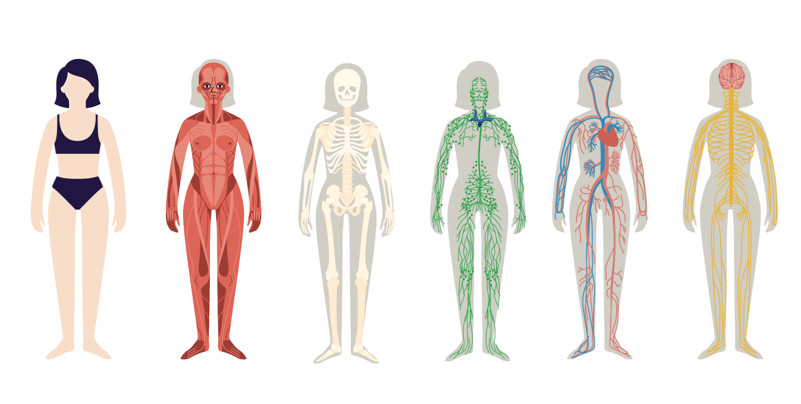
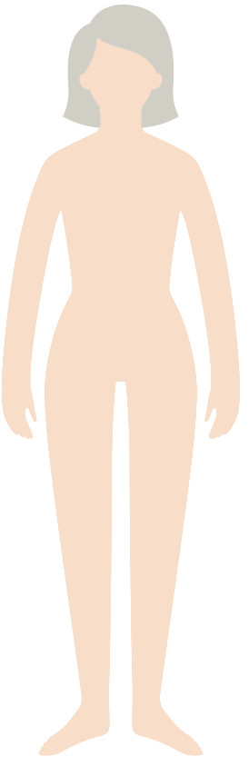
The 11 Body Systems
The body is made up of systems.
musculoskeletal
nervous
respiratory
circulatory
digestive
urinary
endocrine
reproductive
integumentary
lymphatic
Lymphatic
Integumentary
ORIGIN from Latin
lympha ‘water’
ORIGIN from Latin
tegere ‘to cover’
© FEMM
Notes:
There are two additional body systems to learn about, bringing us to a total of 11 systems:
The lymphatic system is a network of organs which works to balance body fluid and fight against infection. It is part of the immune system. It consists of lymph vessels which connect to all of the lymph nodes throughout the body.
The integumentary system is made up of the organs which form the outermost layer of our bodies. These organs are the skin, hair and nails. This system has many important functions which include providing protection to internal organs, sensing the world around us, regulating body temperature, preventing moisture loss, and synthesizing vitamin D. As you know by now, this system goes through some big changes during puberty. Increased oil production by glands in the skin during puberty due to hormonal changes is one of the more noticeable (and sometimes frustrating) things teenagers often face.

Slide 6
Body Systems Worksheet
Notes:
Now let’s look at all of the body systems and name them.
Hand out the Body Systems Worksheet for students.
Give students a few minutes to fill in the blanks and name as many systems as they can. Then, go over the answers together as a class using the next slide.

Slide 7
Answers
Integumentary
Muscular
Skeletal
Lymphatic
Circulatory
Nervous
Respiratory
Urinary
Reproductive
Endocrine
Digestive
Notes:
The body is made up of many systems. Every system of the body must function properly for the body to be healthy.

Slide 8
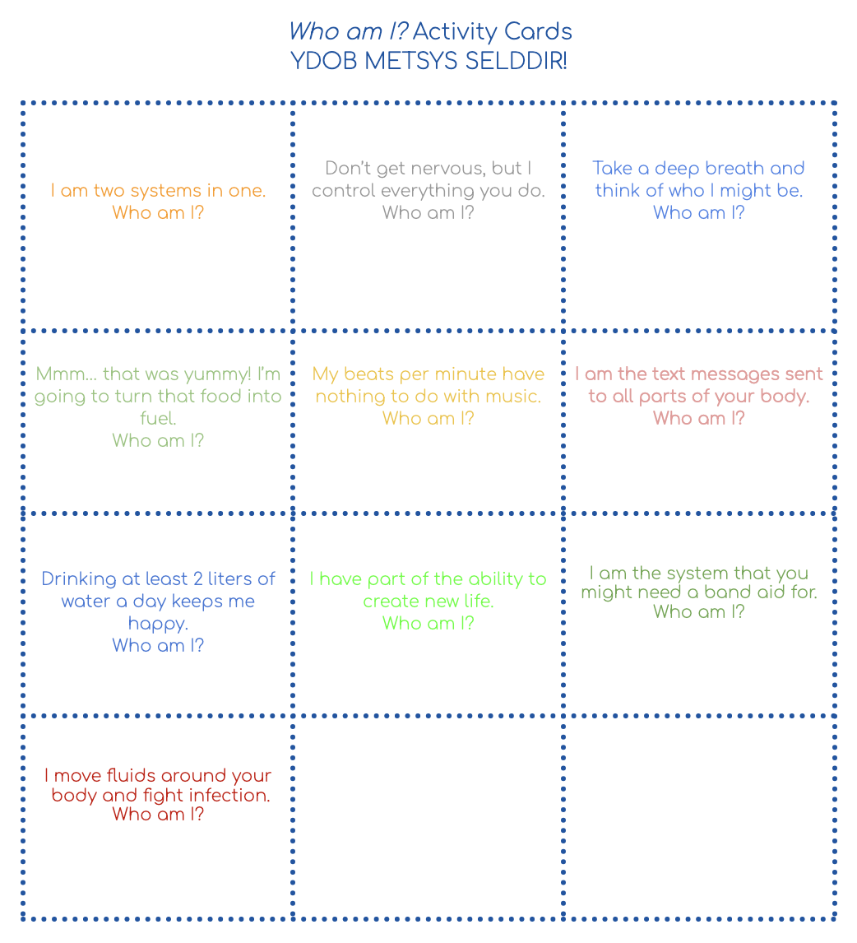
Who am I? Worksheet
?
?
?
?
?
?
YDOB METSYS SELDDIR!
*BODY SYSTEM RIDDLES
?
?
?
?
© FEMM
Notes:
Step 4 (5 minutes): “Who Am I?” Activity
Cut out the cards on the dotted line on the “Who Am I”? Worksheet
Ask for student volunteers for the activity
Provide each volunteer with one card containing a riddle
Have the volunteer read their card aloud to the class and ask the class to guess the system.
Answers are at the bottom of the worksheet page.

Slide 9
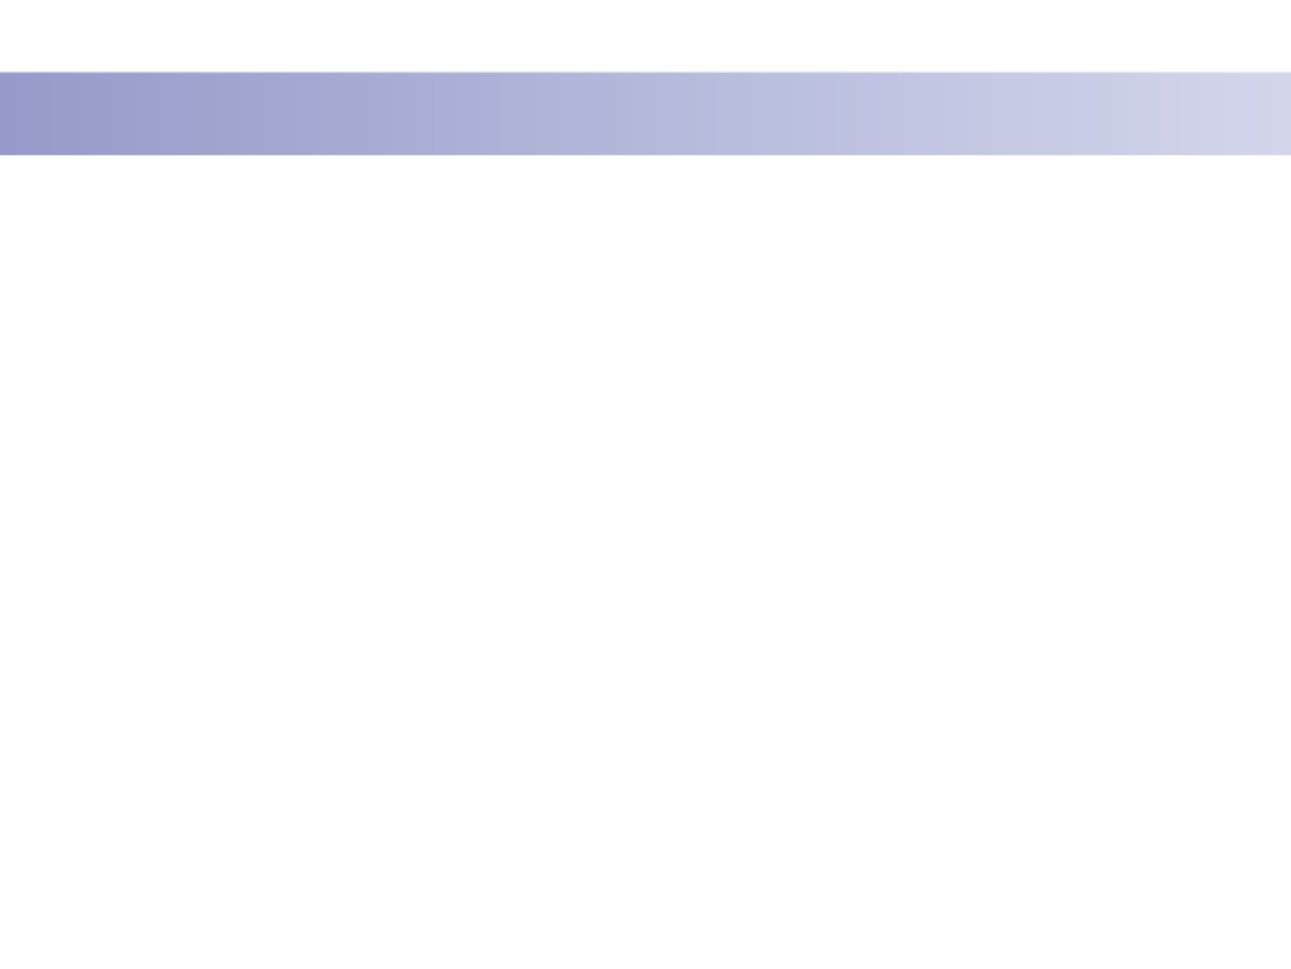
What is homeostasis?
Homeostasis
homeo = similar
stasis = stable
When all systems are working together, despite changes in our external world, our body is in a state of homeostasis.
© FEMM
Notes:
Step 5 (5 minutes): Introduce the concept of homeostasis.
When all of the body systems are functioning well, we feel really good and healthy! The maintenance of an organism’s internal environment (i.e. our body) is called homeostasis. When all systems are working together, despite changes in our external world, this is called homeostasis. (Homeo comes from the Greek for “similar” and stasis means “stable.”)

Slide 10
What is homeostasis?
🥵
Sweating is an important function of the integumentary system.
When the body gets too warm,
sweat glands (located all over
the body, but especially the
forehead, armpits and groin area) produce sweat.
When sweat evaporates off the skin’s surface, the body is
cooled.
💦
If we didn’t sweat,
our body would overheat,
causing other systems to malfunction!
💦
Integumentary
© FEMM
Notes:
Let’s say we go outside after school on a really hot day for a sports practice; eventually we will start to sweat. Sweating is controlled by which system? Our integumentary system! The fact that we start to sweat is a healthy sign!
Sweating is an important function of the integumentary system as if we didn’t sweat, our body would overheat, causing other systems to start to malfunction. When the body gets too warm, sweat glands (located all over the body, but in particular the forehead, armpits and groin area) produce sweat. Sweat is mostly water and salt. When the sweat evaporates from the skin’s surface, the body is cooled as body heat is dissipated.

Slide 11
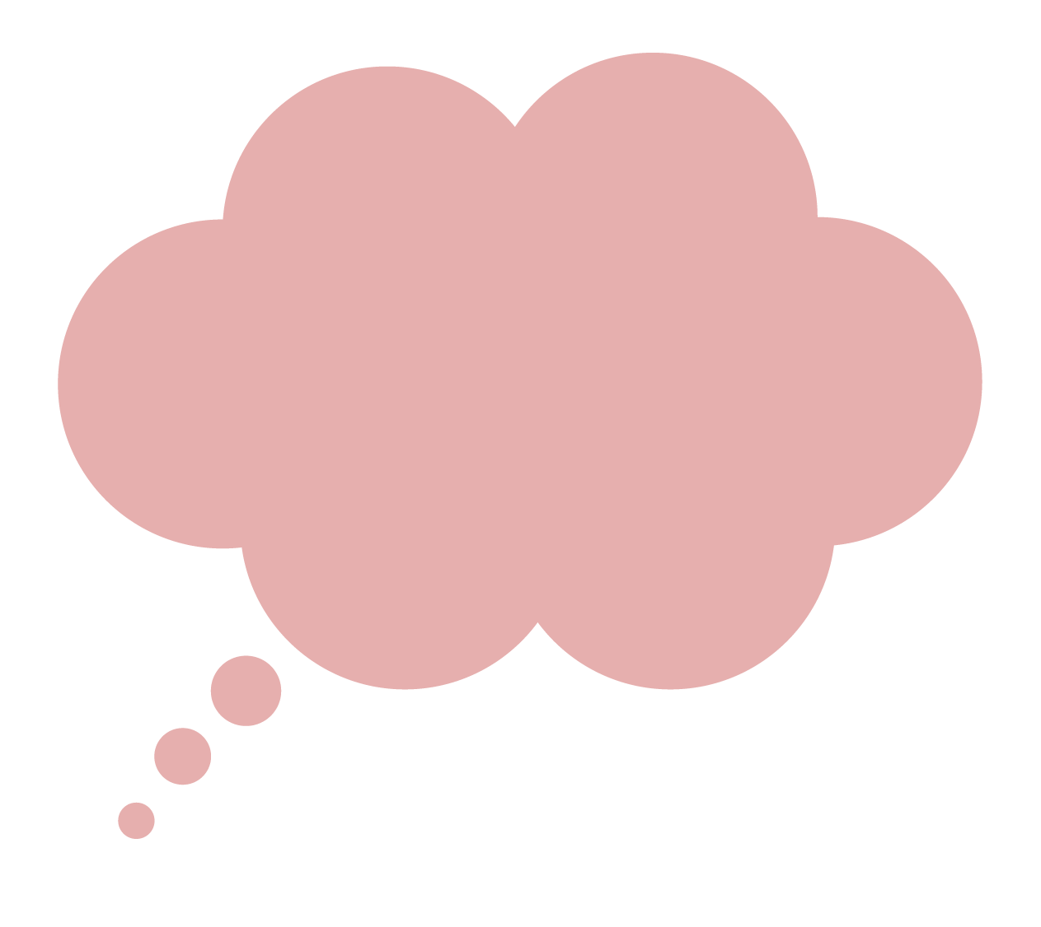
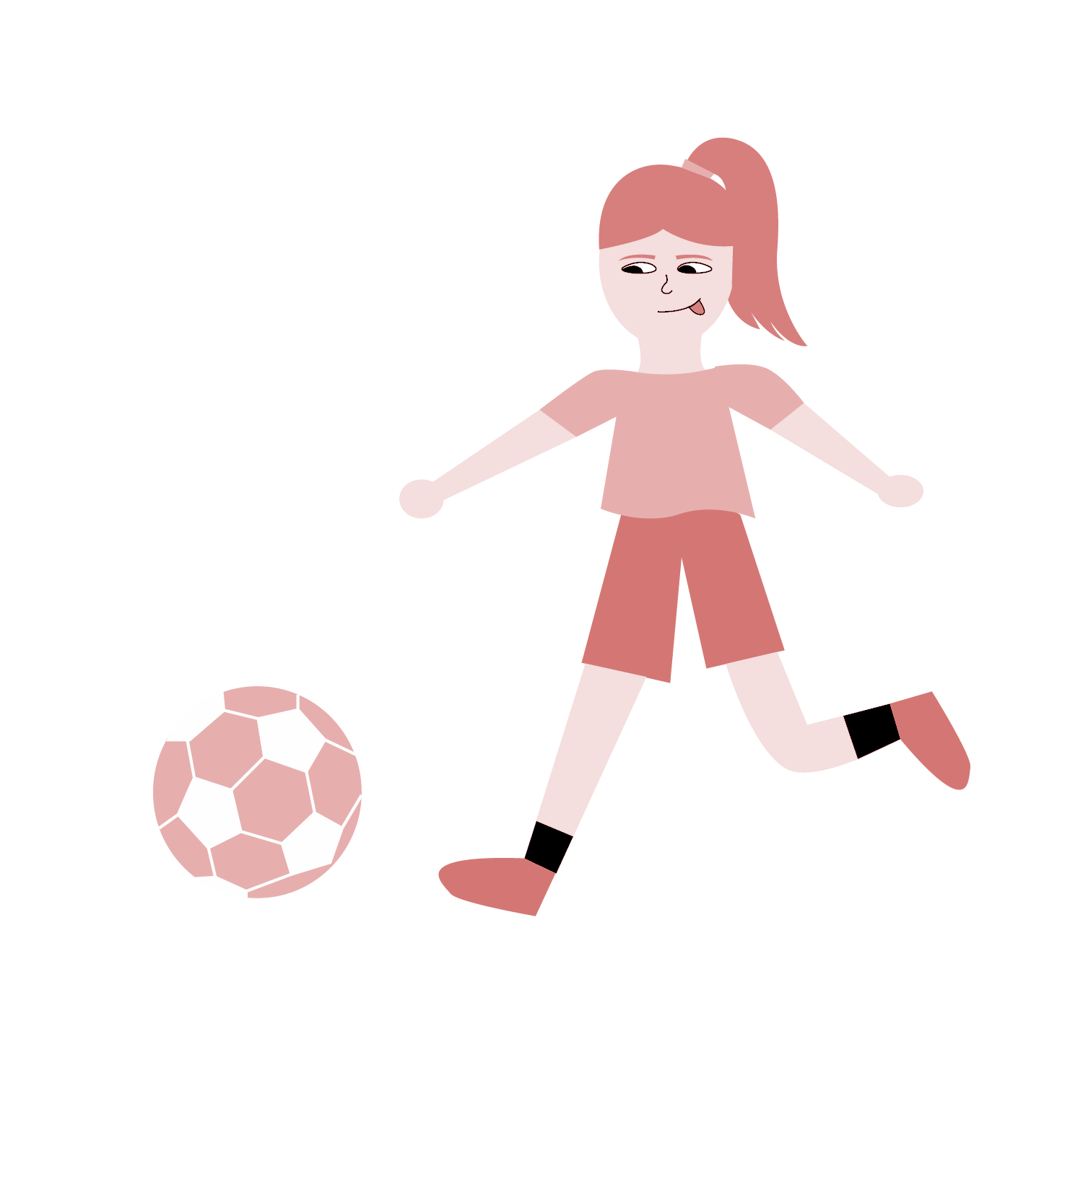

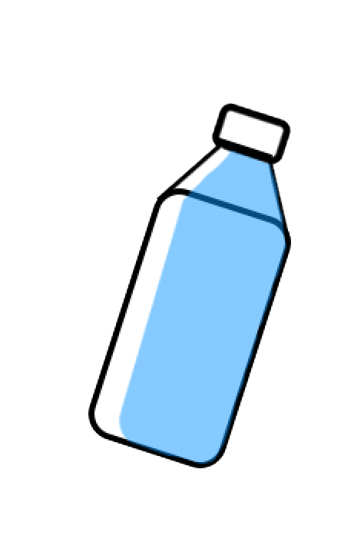
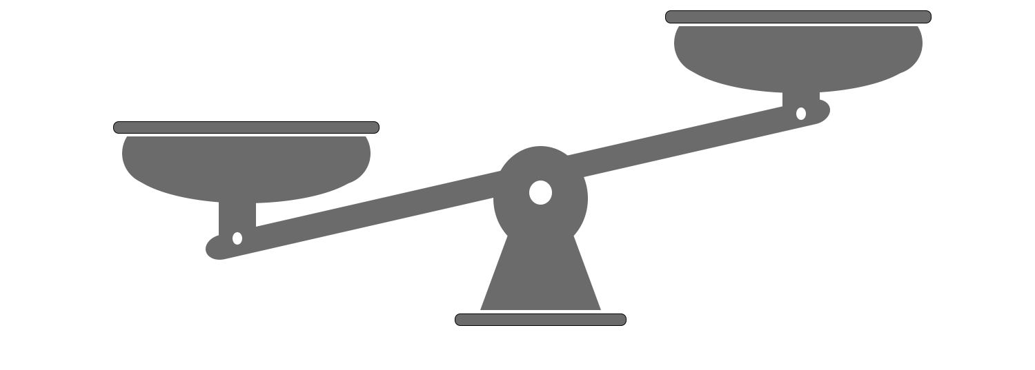
What is homeostasis?
This heat is killing me!
© FEMM
Notes:
However, maybe you have noticed that when you’re hot, you get a bit red in the face. Why? It’s an amazing reason, actually. When our body temperature increases, our blood vessels expand towards the skin's surface to release excess heat. This is why someone looks “flushed”. It’s a way that the integumentary and the circulatory system work together to bring our body temperature back to a normal range to achieve… homeostasis!
The reaction of our integumentary system to produce sweat, is a way of cooling off the body in order to maintain its ideal temperature. This internal balance that our body maintains (thanks to our 11 body systems), is homeostasis.

Slide 12
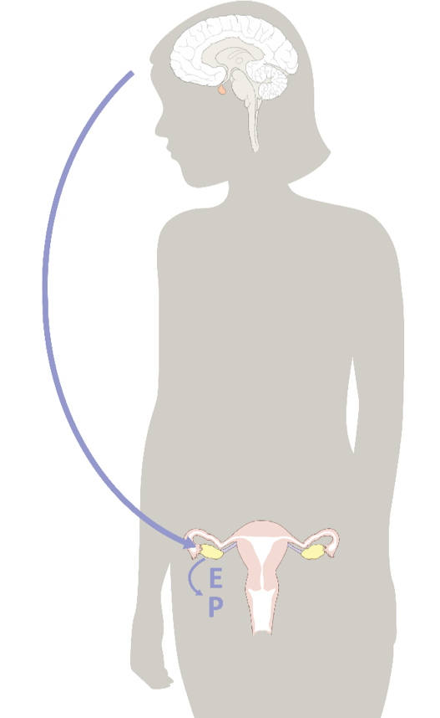
Homeostasis & the Hormonal Axis
Big Brain
Reproductive System. Hello, do you read me?
Repro S.
Roger that, brian.
*brain
Increase Estrogen. Ovary and out.
Lolz 🙄
© FEMM
Notes:
Step 6 (5 minutes): Connect homeostasis and the hormonal axis.
It’s important to remember that our reproductive system is an integral part of our overall health, too. The reproductive system is not just for some far-off day in the future when we want to reproduce. It’s an important system of our body that affects every other body system, today and now. So, just as the example of sweating is a necessary function of the integumentary system, the process of the ovulatory cycle every month in a woman’s body is an indicator of the health and balance of hormones in the reproductive system.
Our endocrine system (which controls our hormones) affects our nervous system. And our nervous system controls almost all of the body’s processes! So, if all of these messages between the brain and reproductive system are not being sent or properly received, it will affect our mental and physical health, as well as our growth and development!
The special link between the brain and the reproductive system is called the hormonal axis.

Slide 13
Homeostasis & the Hormonal Axis
Hormonal Axis
the system of communication between the
brain and the reproductive organs
If we disrupt the homeostasis
of our reproductive and endocrine systems, we will affect the communication between our brain and our organs.
© FEMM
Notes:
The hormonal axis is a way of describing this invisible arc (as shown on the slide) linking the brain and the ovaries in particular communication throughout a woman’s life, from puberty and beyond.
Write the following vocabulary definition on the board:
Hormonal Axis: The system of communication between a woman’s brain and ovaries; it regulates female hormones that affect the reproductive system and overall health.

Slide 14
Review
The 11 body systems work together to keep your body in a state of homeostasis.
A healthy reproductive system is an important indicator of your body’s overall health.
Your brain and reproductive system are linked by chemical messengers. We call this system of communication the hormonal axis.
When the hormonal axis is fully functioning, you can grow to full maturity.
© FEMM
Notes:
CONCLUSION
Every human person has the eleven body systems we’ve discussed in this class. The health of every individual depends on all of these systems properly working together in the state called homeostasis. This is why a healthy reproductive system is an important indicator of the health for the rest of the body’s systems (as one system impacts all of the others). The way that the brain and the reproductive system are linked is called the hormonal axis. When the hormonal axis works properly, all of its components are able to do their jobs and help adolescents grow to full maturity. In the next lesson, we will review female reproductive system anatomy and male reproductive anatomy.

Slide 15
Grade 8
LESSON 1
© FEMM

