Slide 1

Grade 8
LESSON 1
© FEMM

Slide 2
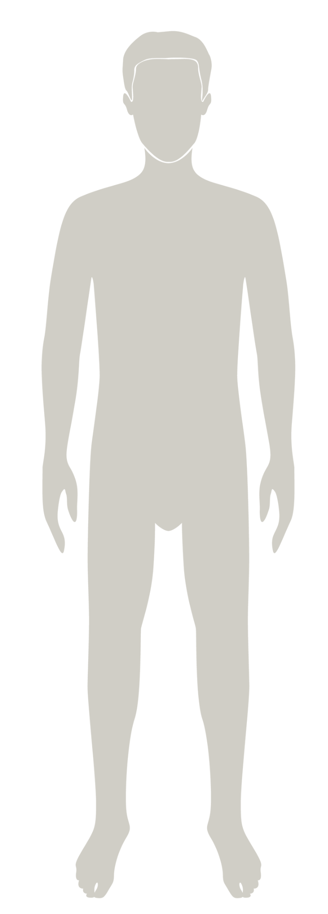

Introducing teenMEN
is a health program that will help you understand your body & your health as you grow to full maturity.
You will learn about:
✔️the reproductive system
✔️the physical and emotional changes
of puberty
✔️ how your daily lifestyle choices affect your health
© FEMM
Notes:
Step 1 (1 minute): Introduce teenMEN health program
teenMEN is a health program that will help you understand your body and track your health as you grow to full maturity.
Maturity means the growth and full development of the body, brain, and emotions. In other words, it’s a time when your life takes off and you start to mature towards adulthood. We are going to learn in this class what this looks like for your body and for your health. Most of the growth and development that happens in your brain and body you don’t control. But maturity also means taking responsibility for the things you can control: your choices and how you respond to situations in your life.
In this class you will learn about your hormones, your reproductive system, the physical and emotional changes of puberty, and how the choices you make now will impact your life as you grow to full maturity. This year, you will also begin to learn about the female anatomy, reproductive system, and hormones. Through this course, you will learn about the many fascinating things that hormones do. Hormones impact every system in the body. So, we have a lot to cover!

Slide 3
Healthy body
The body is made up of systems.
A few you may already know:
musculoskeletal
nervous
respiratory
digestive
circulatory
endocrine
urinary
reproductive
© FEMM
Notes:
Step 2 (10 minutes): Review the body systems; introduce integumentary and lymphatic.
As you know, your body is made up of many organs. Each organ has a particular and important job to do, and all of your organs need to work together for your body to be as healthy as possible. When certain organs work together for a similar purpose, they are called a system.
Your body has many systems all working together to make sure you function well.
Let’s review the job of the different body systems that make up our body as a whole:
The muscular and skeletal systems (also known as the musculoskeletal system): Sometimes these two systems are listed as one because they are so interconnected. The muscles, bones, and joints are attached to each other by different tissues. Ligaments are found at your joints, and their job is to hold bones together. Tendons are found at the ends of muscles, and their job is to connect muscles to bones.
The nervous system: The nervous system controls everything you do, including breathing, walking, thinking, and feeling. This system is made up of your brain, spinal cord, and all the nerves of your body. The brain is the control center and the spinal cord is the major highway to and from the brain. The nerves carry the messages to and from the body, so the brain can interpret them and take action.
The respiratory system: The respiratory system consists of the airways, the lungs and the respiratory muscles that move air in and out of the body.
The cardiovascular (or circulatory) system: The circulatory system is made up of blood vessels that carry blood, away from and towards the heart. Arteries carry blood away from the heart and veins carry blood back to the heart. The circulatory system carries oxygen, nutrients, and hormones to cells, and removes waste products, like carbon dioxide.
The digestive system: Digestion (your body using food for energy and growth) takes place in a series of organs that together are called the alimentary canal, or digestive tract. The digestive system consists of a group of connected organs—the mouth, pharynx, esophagus, stomach, small and large intestines, and anus. Through these structures, food is processed via mechanical and chemical action into usable nutrients and expendable waste. Although the liver, gallbladder, and pancreas play a critical role in digestion, they are not part of the digestive tract.
The urinary system: The various activities of the body create waste by-products that must be expelled in order to maintain health. To excrete fluid wastes, the body has a specialized filtering and recycling system which includes the kidneys, bladder, and urethra - a tube that transports urine to the outside of the body.
The endocrine system: controls and regulates body processes by means of chemical messengers called hormones. The system is composed of a group of ductless glands located throughout the body that produce hormones in response to the body’s needs. Once released, hormones may act on nearby structures, or they may travel in the blood to distant target organs.
The reproductive system is key to our overall health, as healthy hormone levels have an impact on our whole body. It is also responsible for bringing about a new life. In men, the reproductive system includes the testes, scrotum, penis, and all the tubes through which sperm travels. In women, it includes the ovaries, fallopian tubes, the uterus, vagina, and breasts.

Slide 4
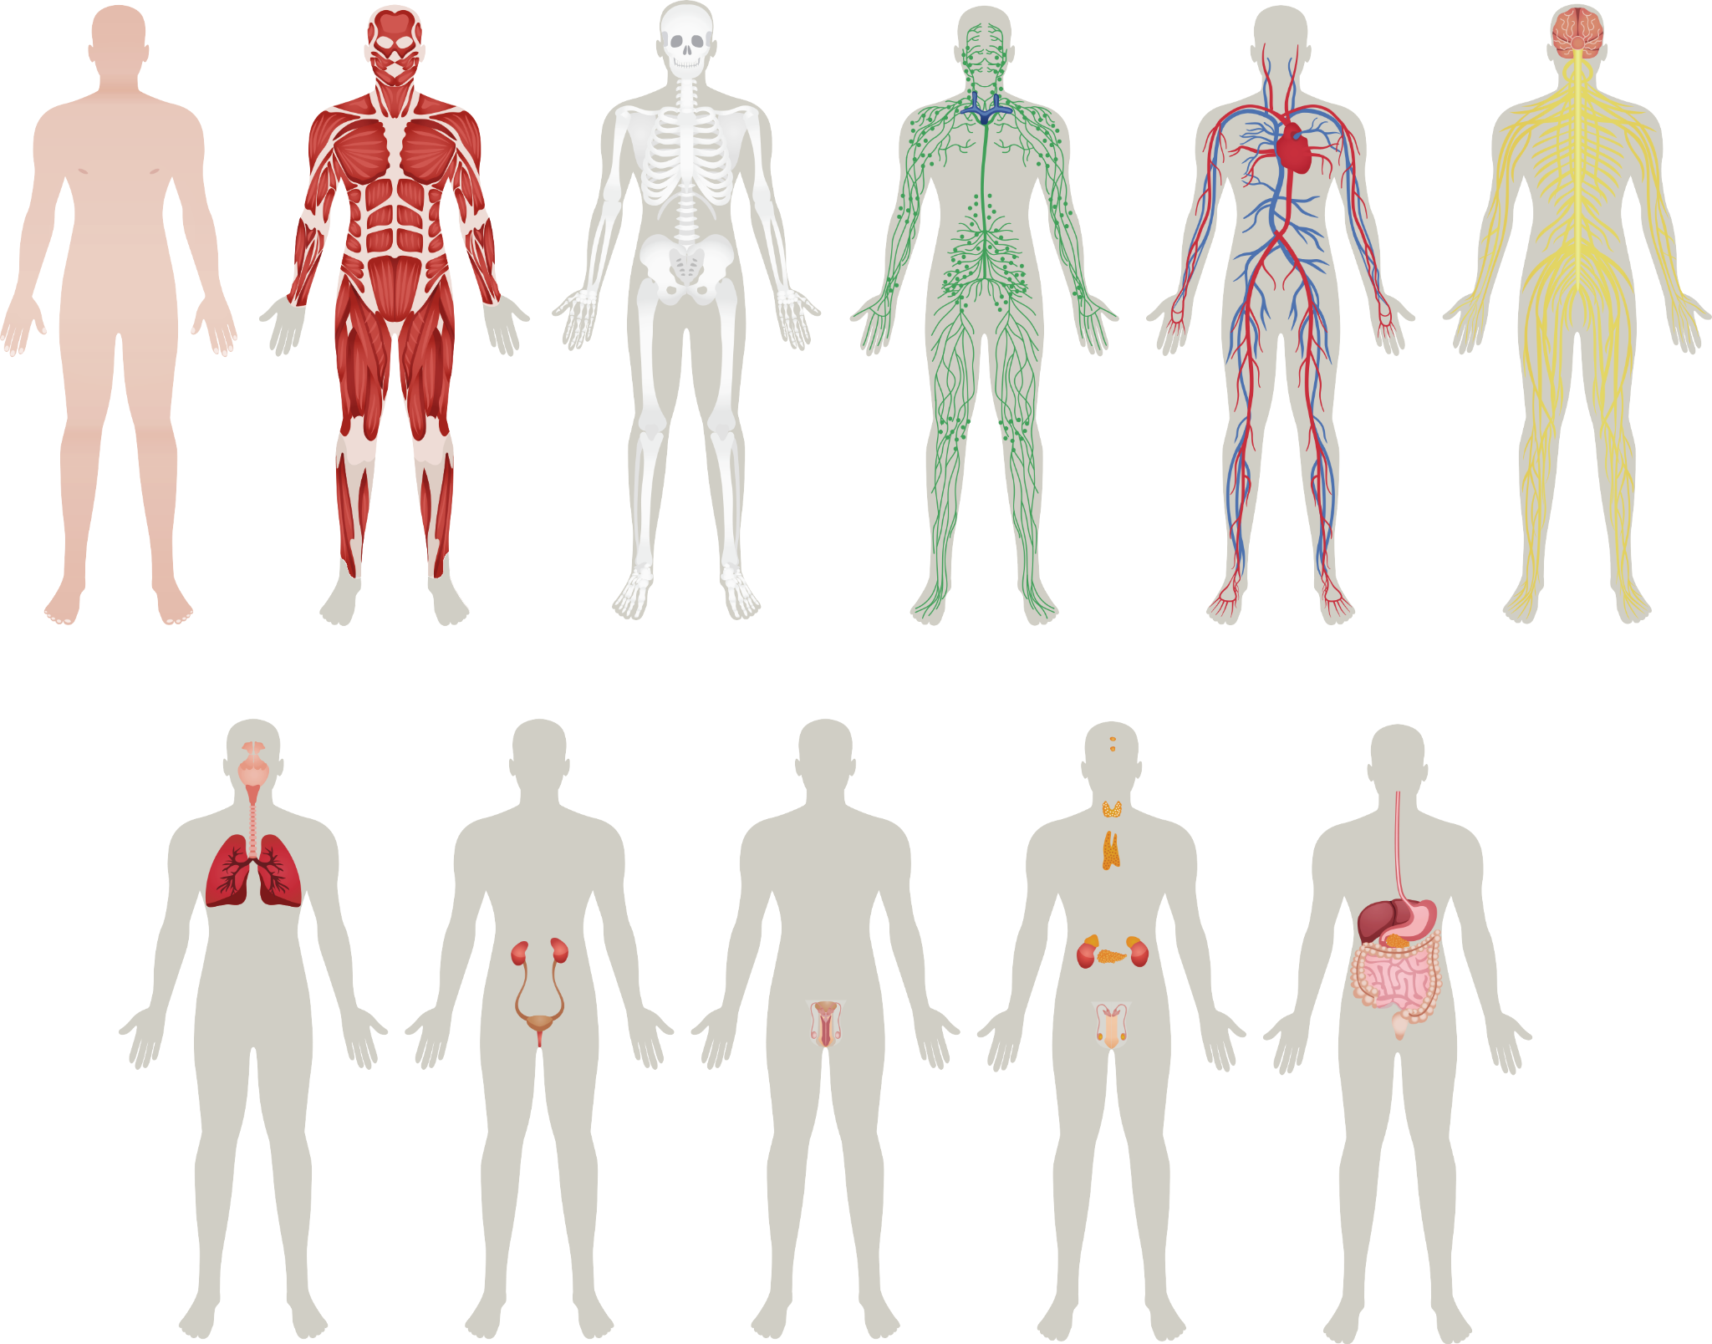
Healthy body systems
musculoskeletal
nervous
respiratory
digestive
circulatory
endocrine
urinary
reproductive
lymphatic
integumentary
Lymphatic
Integumentary
Origin: from Latin
lympha, limpa ‘water’
Origin: from Latin
tegere ‘to cover’
© FEMM
Notes:
There are two additional body systems, bringing us to the total of 11 systems:
The lymphatic System is a network of organs which works to balance body fluid and fight against infection. It is part of the immune system. It produces and releases cells that monitor for and then destroy any foreign invaders, like viruses, bacteria, or parasites. It consists of lymph vessels which connect to all of the lymph nodes throughout the body.
The integumentary system is made up of the parts which form the outermost layer of our bodies. These parts are the skin, hair, and nails. This system has many important functions which include providing protection, sensing the world around us, regulating body temperature, preventing moisture loss, and synthesizing vitamin D. As you know by now, this system goes through some big changes during puberty. Increased oil production by glands in the skin during puberty due to hormonal changes is one of the more noticeable (and sometimes frustrating) things boys and girls often notice.

Slide 5
Healthy body
Healthy body
The body is made up of systems.
The health of every system impacts
the health of the whole body.
© FEMM
Notes:
The body is made up of systems. Every system in the body must function properly for the whole body to be healthy!

Slide 6
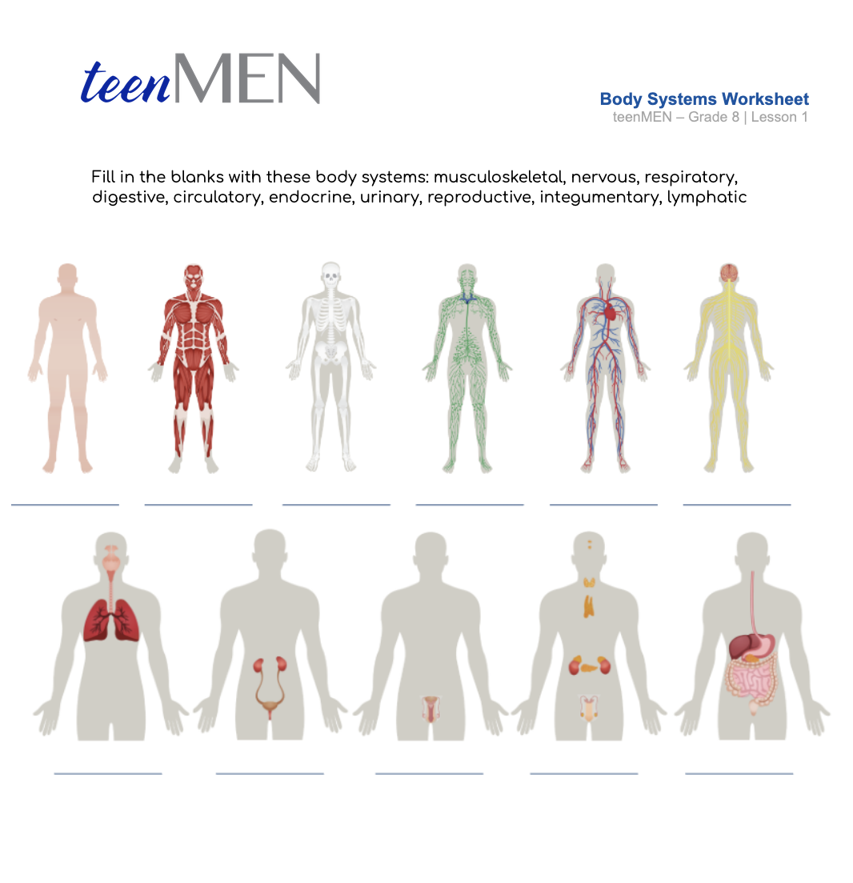
Body Systems Worksheet
Name that System!
© FEMM
Notes:
Step 3 (5 minutes): Body Systems Worksheet
Now let’s see if we can identify all 11 of the body’s systems. Hand out the Body Systems Worksheet for students, face down. Set a timer for two minutes. The first person to get all 11 systems correct, wins!

Slide 7
Answers | Body Systems Worksheet
Integumentary
Muscular
Skeletal
Lymphatic
Circulatory
Nervous
Respiratory
Urinary
Reproductive
Endocrine
Digestive
© FEMM
Notes:
Review the answers as a class using the slide.

Slide 8
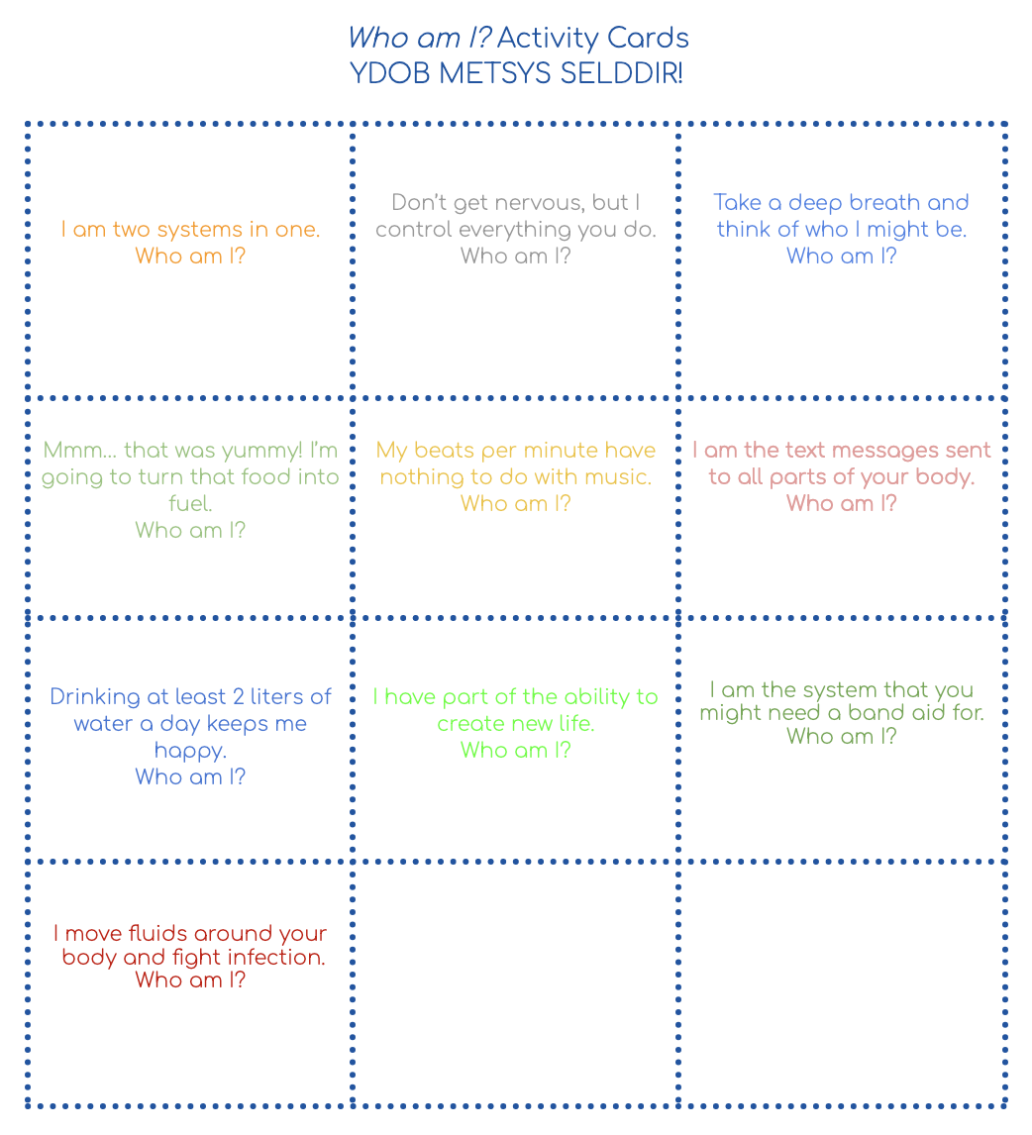
Activity: ydob metsys selddir
?
?
?
musculo-skeletal
system
nervous system
respiratory system
?
?
?
YDOB METSYS SELDDIR!
*BODY SYSTEM RIDDLES
digestive system
circulatory system
endocrine system
?
?
?
urinary system
reproductive system
integumentary system
?
lymphatic system
© FEMM
Notes:
Step 4 (5 minutes): Who Am I? Activity Cards
Ask for student volunteers for the activity.
Provide each volunteer with one of the cards containing a riddle.
Have volunteers read their card aloud to the class and ask the class to guess the system.
Once all riddles have been guessed, click on the slide to reveal all answers at once.

Slide 9
What is homeostasis?
Homeostasis
homeo = similar
stasis = steady
When all systems are working together,
despite changes in our external world,
our body is in a state of homeostasis.
© FEMM
Notes:
Step 5 (10 minutes): Introduce Homeostasis
When all of the body systems are functioning well, we feel good and healthy. But as soon as one of them stops functioning properly, all of the other systems are affected. We might not notice this right away, but over time this can have an impact on our health.
When all systems are working properly, our body is in a state called homeostasis. Homeo is Greek for ‘similar’ and stasis means ‘steady’.

Slide 10
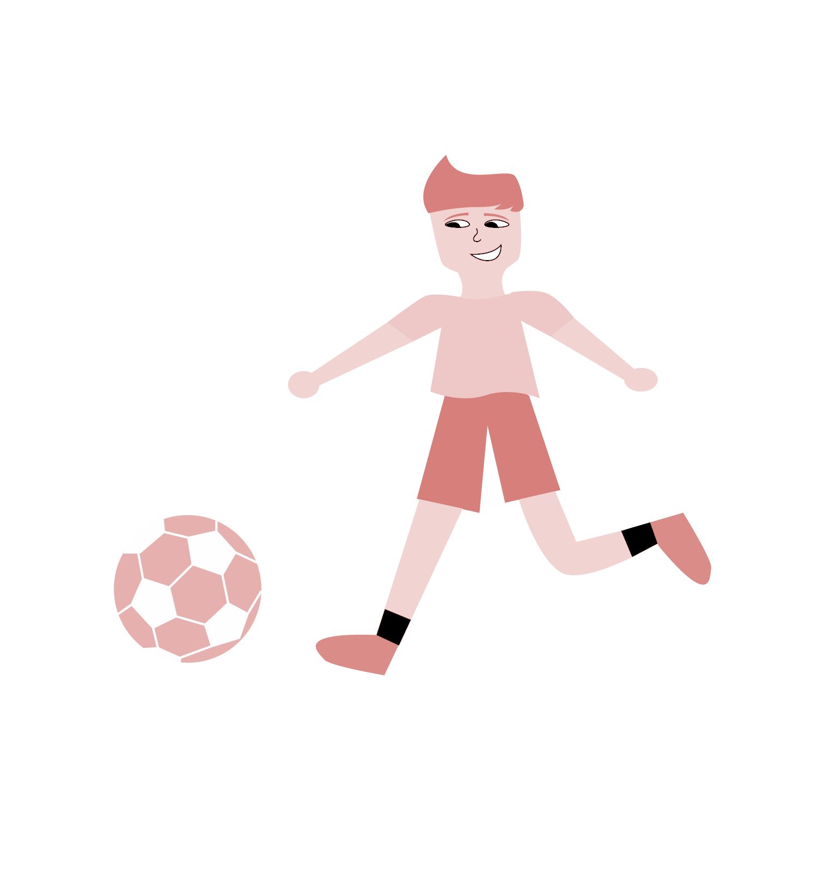
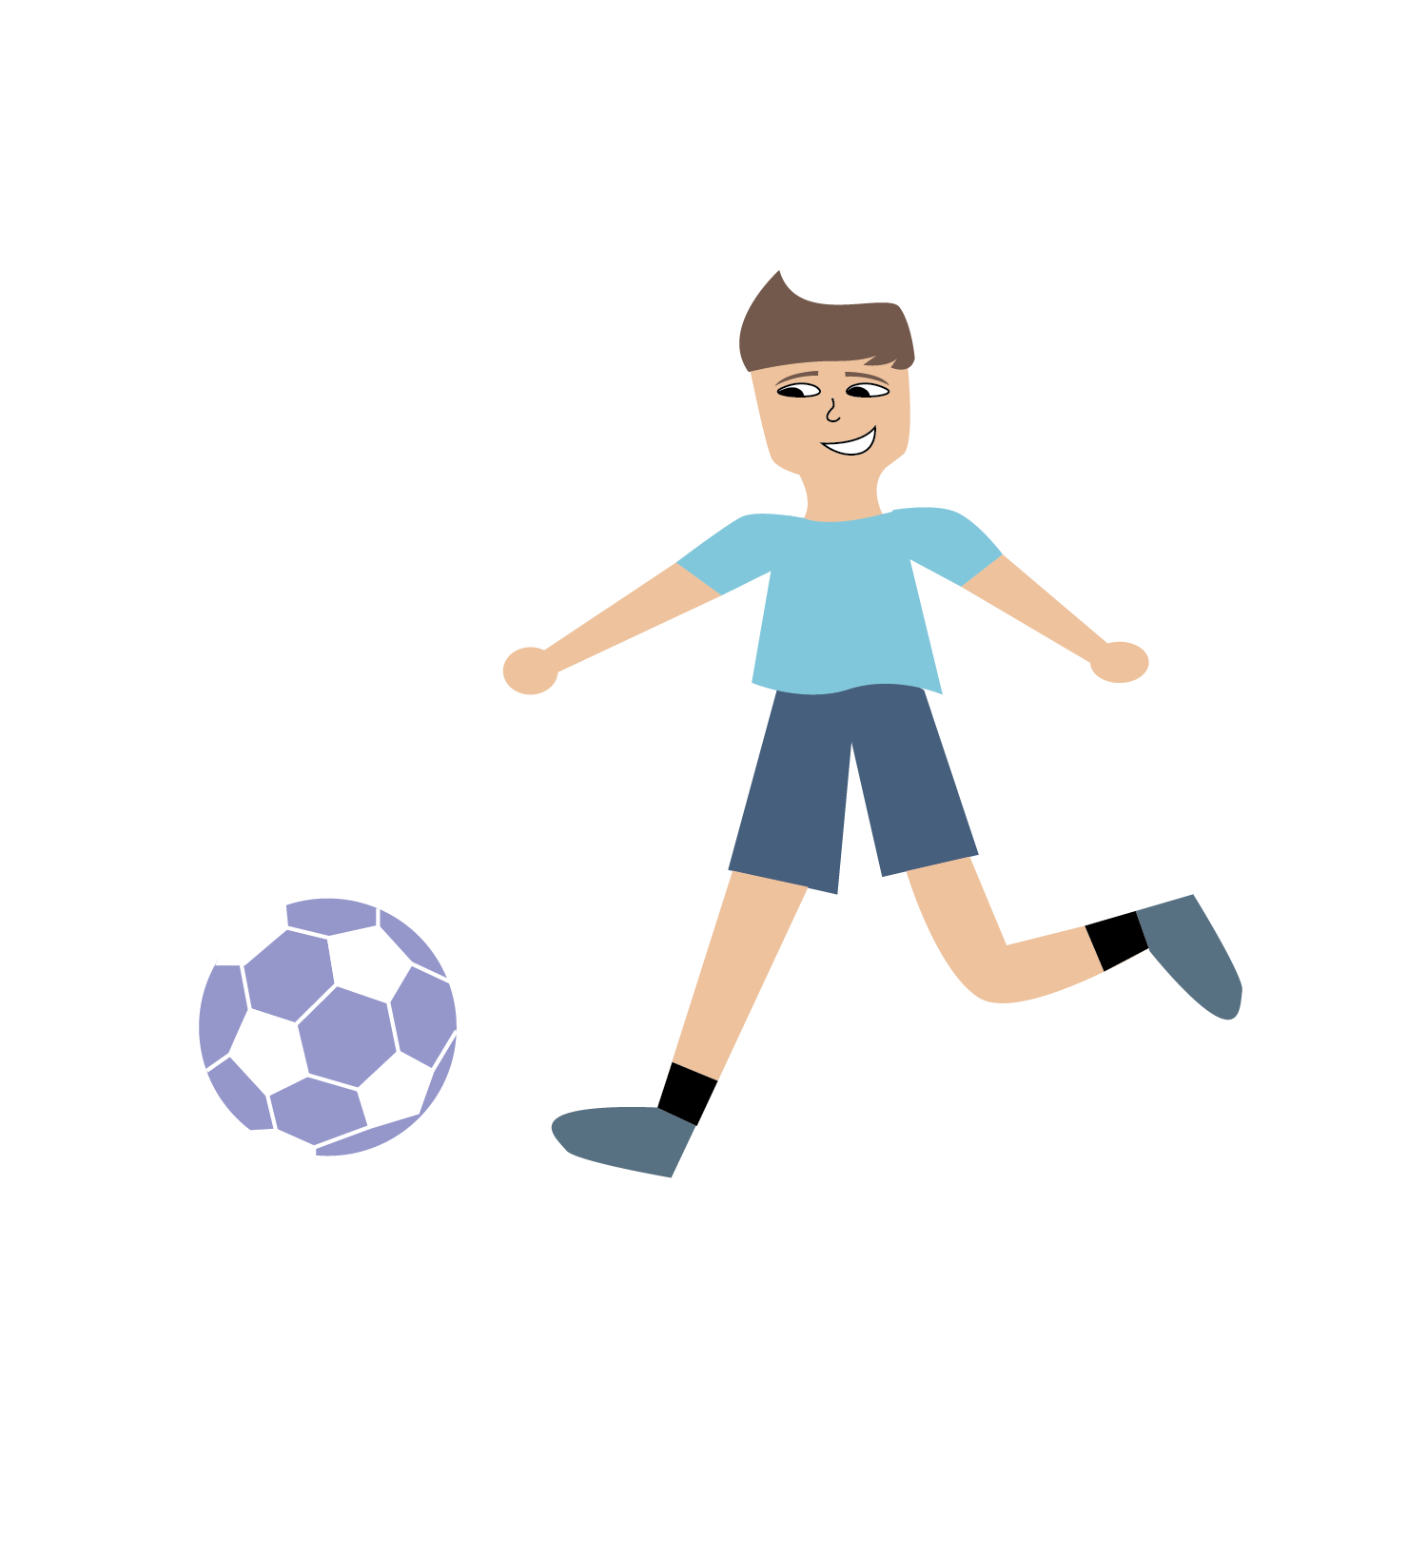
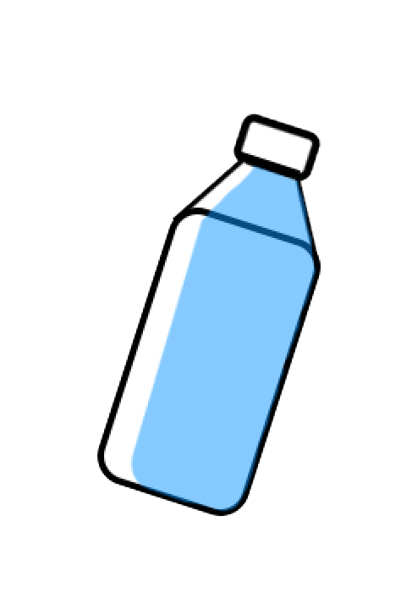
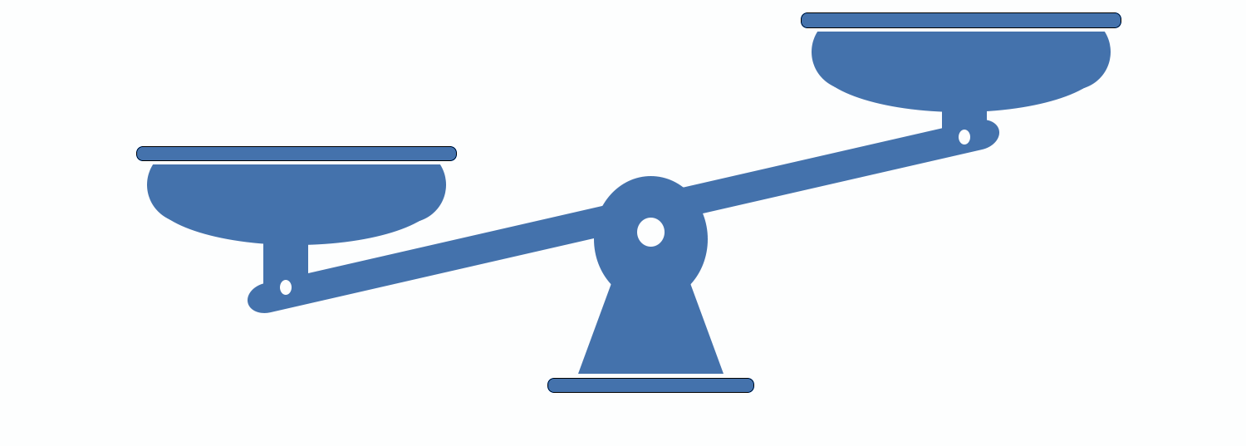
Homeostasis in Action
© FEMM
Notes:
For example, when we go outside on a really hot day for a soccer practice, eventually we start to sweat. Sweating is controlled by which of the 11 body systems? That’s right, the integumentary system.

Slide 11
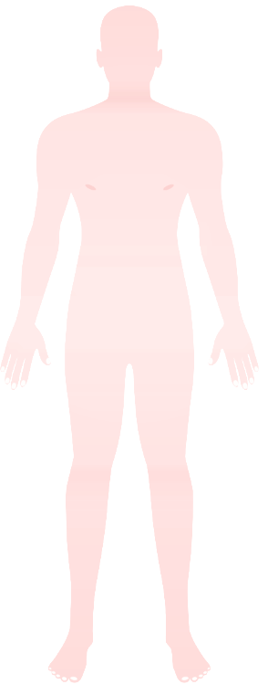
Homeostasis in Action
in·​teg·​u·​men·​ta·​ry
a tough outer protective layer; an external covering
cir·cu·la·to·ry
system is made up of blood vessels that carry blood away from and towards the heart
© FEMM
Notes:
When the body gets too warm, sweat glands (located all over our body, but in particular the forehead, armpits and groin areas) produce sweat. Sweat is mostly water and salt.
When the sweat evaporates from the skin’s surface, the body is cooled as body heat is dissipated. However, maybe you have noticed that when you’re hot, you get a bit red in the face? When our body temperature increases, our blood vessels expand towards the skin's surface to release excess heat. This is why someone looks “flushed”. It’s a way that the integumentary and the circulatory system work together to bring our body temperature back to a normal range. This internal balance that our body maintains (thanks to our 11 body systems), is homeostasis.
Click on slide to show the integumentary system, as well as the circulatory system turning the body “flush” from the blood vessels expanding towards the surface of the skin.

Slide 12
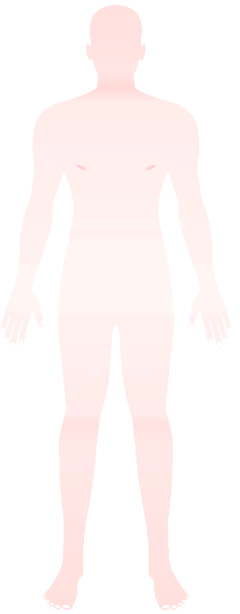

Homeostasis
so this guy
needs this guy
2L
cir·c
© FEMM
Notes:
We still need to do our part to help our body rehydrate after sweat is lost. One important habit is to drink enough water each day to support our body. For teenagers, this means about 2L a day.

Slide 13
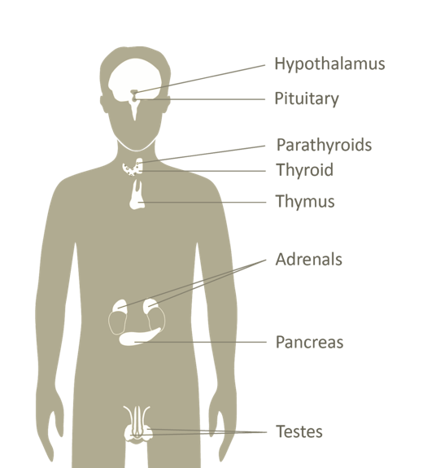
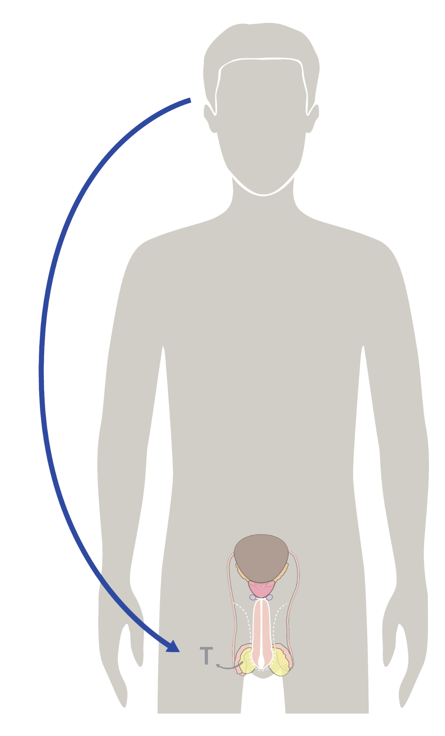
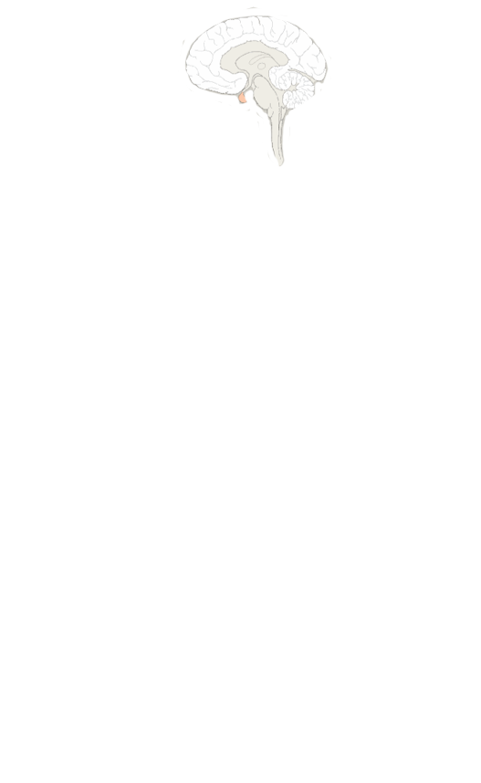
Homeostasis & the Hormonal Axis
Hormones are signals released in the blood to regulate different organs.
Hormones direct:
growth & development
mood
reproduction
© FEMM
Notes:
Step 6 (5 minutes): Homeostasis and the Hormonal Axis
Did you know? Even when it comes to something as basic as sweating on a hot day, your hormones are involved? The endocrine system is known as the messenger system, because hormones are chemical signals, released into the blood (circulatory system) to direct different organs.
The system of communication between the brain and the reproductive organs is called the Hormonal Axis. In men, the hormonal axis is the communication between the brain and the testes; it regulates male hormones that affect the reproductive system and overall health.
13

Slide 14
The Hormonal Axis
Brain H.
Reproductive System.
Hello, come in, do you read me?
Repro S.
Hello, Bran.
* Brian
🤦‍♂️
BRAIN
Increase Testosterone.
Roger that!
© FEMM
Notes:
An axis is just a way of illustrating this invisible line of communication. You can also think of hormones like text messages sent from the brain to different parts of the body to direct your growth, development, mood and more!

Slide 15
Hormonal Axis & the Body Systems
Brain
Reproductive System.
Hello, come in, do you read me?
Increase Testosterone.
Hormones direct all of the body systems.
© FEMM
Notes:
Hormones direct all of our body systems. The main male hormone is testosterone, produced in the testicles. The hormone testosterone affects every single cell in your entire body! It changes your brain, your bones, your optic nerve (eye sight), everything! If we disrupt the homeostasis of our reproductive and endocrine systems, this will impact physical and mental health, as well as our growth and development. But, when we practice healthy habits, which we’ll learn more about in later lessons, the hormonal axis is able to work properly and help you grow to full maturity.

Slide 16
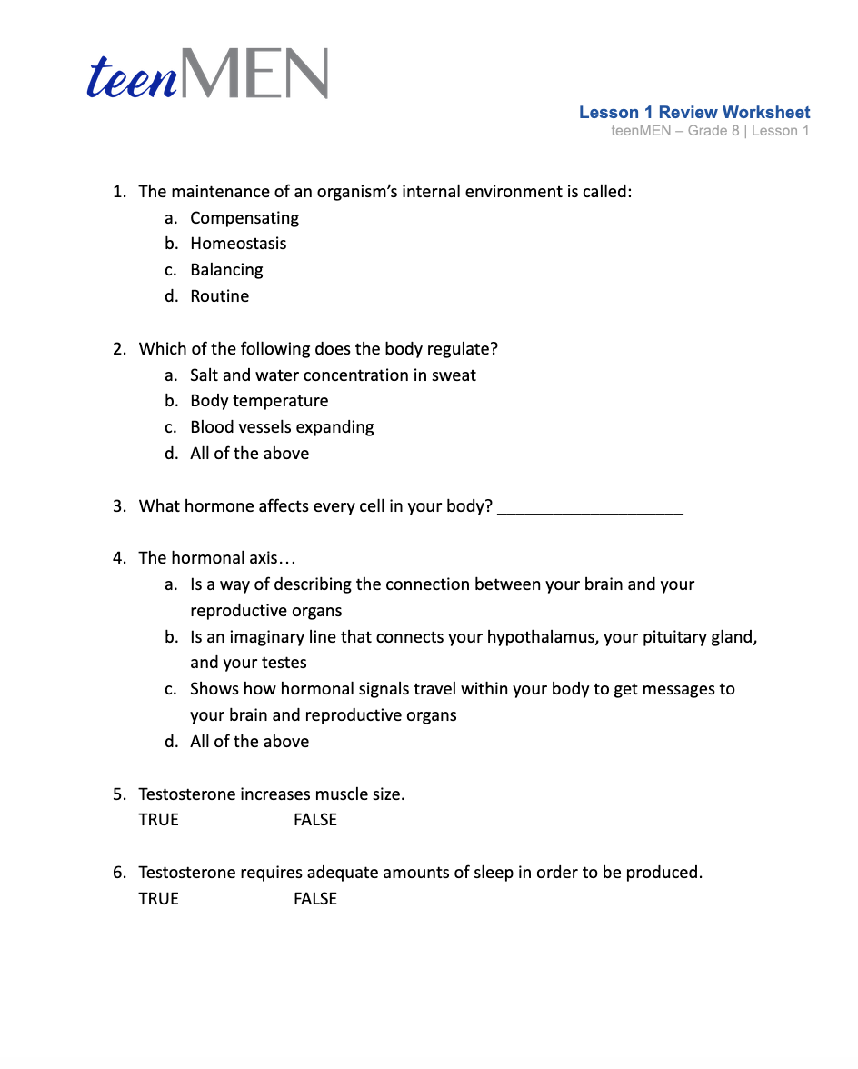
Worksheet
© FEMM
Notes:
Step 7 (5 min): Lesson 1 Review Worksheet + Answer Key
Provide students with a short review, by handing out the Lesson 1 Review Worksheet. If time permits, have students fill out the worksheet in class and review the answers using the Answer Key provided in the materials. Or, the worksheet may be given out as homework and reviewed in class at the beginning of the next lesson.

Slide 17
Review
The 11 body systems work together to keep your body in a state of homeostasis.
A healthy reproductive system is a good indicator of your body’s overall health.
Your brain and reproductive system are linked by chemical messengers. We call this the hormonal axis.
When the hormonal axis is fully functioning, you can grow to full maturity.
© FEMM
Notes:
CONCLUSION
Each body system contributes to the homeostasis of other systems and of the entire organism. No system of the body works in isolation and the well-being of the person depends upon the well-being of all the interacting body systems. A disruption within one system generally has consequences for several additional body systems.

Slide 18
Grade 8
LESSON 1
© FEMM

