Slide 1
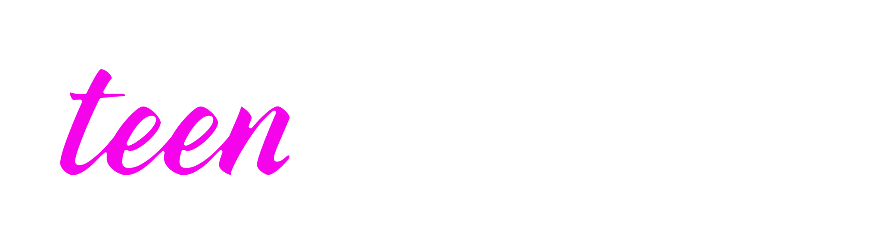
Grade 8
LESSON 2
© FEMM

Slide 2
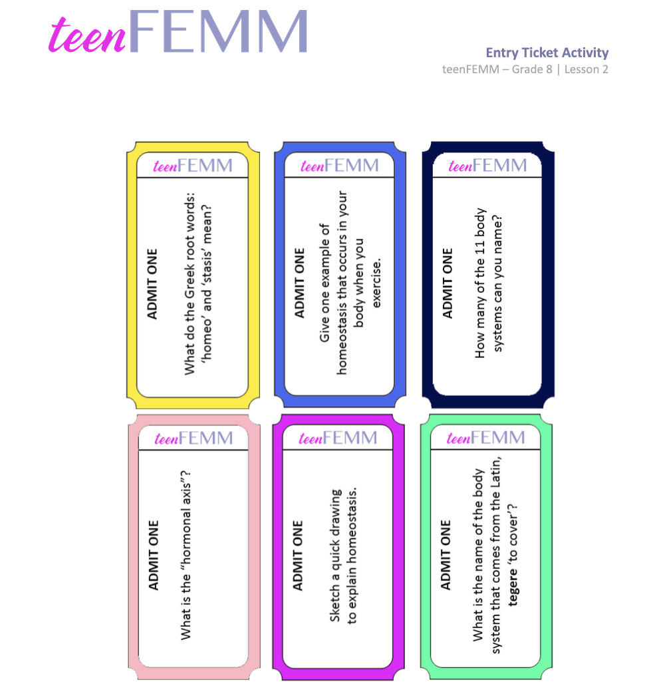
Entry Ticket Activity
Notes:
Step 1 (10 minutes): “Entry Ticket” Activity
Print and cut out an “Entry Ticket” per student.
Greet students at the door as they enter the classroom and give each student an “Entry Ticket”
Have students write their answers down on the back of the ticket and review questions and answers as a class:
What do the Greek words ‘homeo’ and ‘stasis’ mean?
(Homeo means ‘same’, stasis means ‘stable’.)
Give one example of homeostasis that occurs in your body when you do sports? (E.g., You get hot and your body starts to sweat to cool off. You get thirsty from sweating, you want to drink water to replace the lost water from sweating.)
Sketch a quick illustration of homeostasis. (E.g., Can be an image of a scale, of an activity, etc.)
How many of the 11 body systems can you name?
(Muscular, Skeletal, Nervous, Respiratory, Cardiovascular, Digestive, Urinary, Endocrine, Reproductive, Lymphatic, Integumentary)
What is the hormonal axis?
(The hormonal axis is the system of communication between the brain and the reproductive organs.)
What is the name of the body system that comes from the latin tagere ‘to cover’.
The integumentary system - as the skin is like a covering over the body.

Slide 3
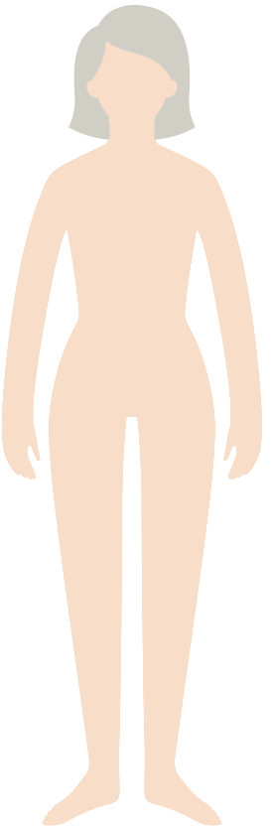
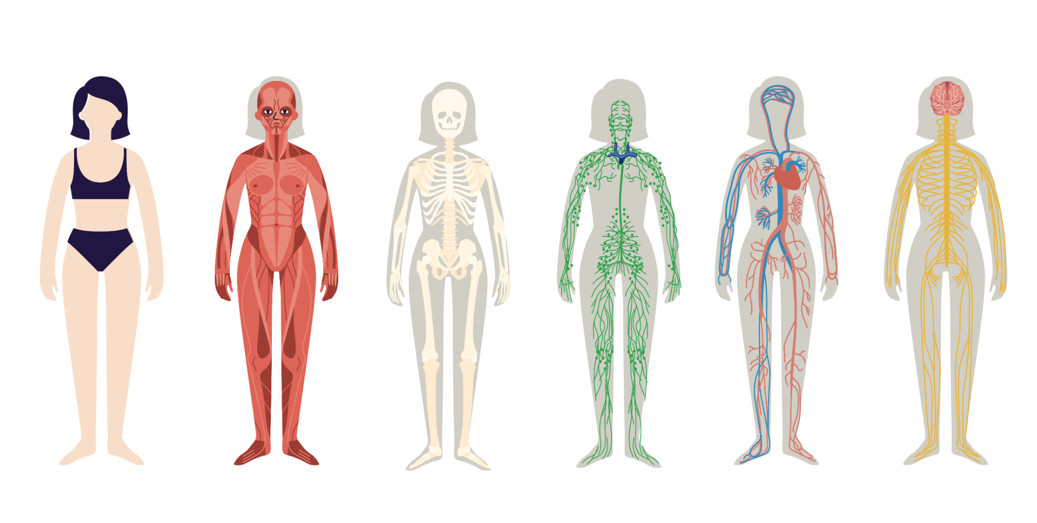
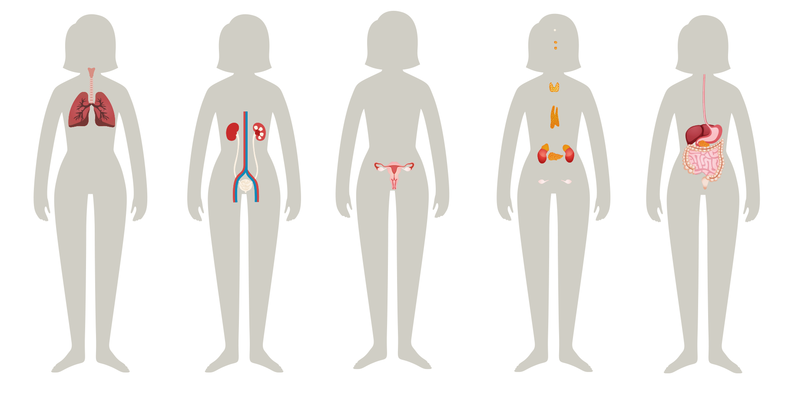
Can you remember the 11 body systems?
Notes:
Step 2 (5 minutes): Review body systems, hormones, and puberty
In the last lesson, the class learned about the 11 body systems. Can you name the 11 body systems? See if students can name all 11 body systems and then review the answers on the next slide.

Slide 4
Answers
Integumentary
Muscular
Skeletal
Lymphatic
Circulatory
Nervous
Respiratory
Urinary
Reproductive
Endocrine
Digestive
Notes:
Review answers together.

Slide 5
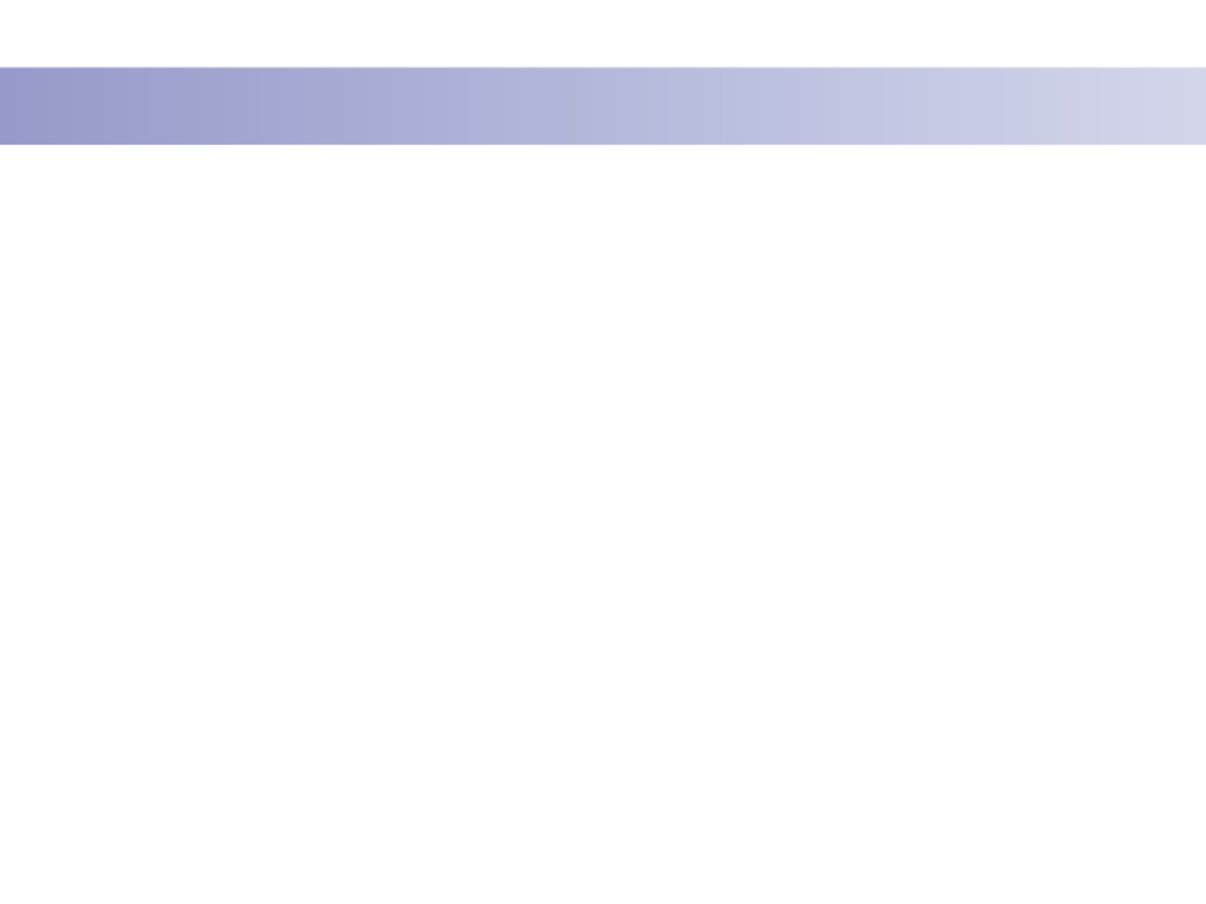
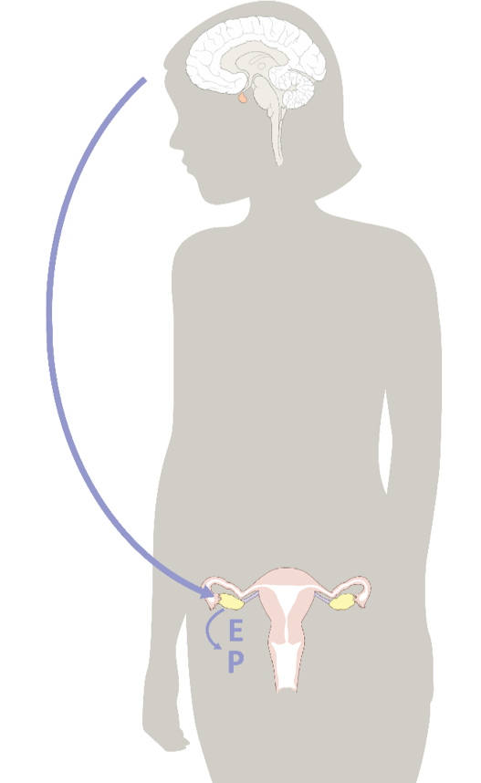
What do all of the body’s systems need?
Pituitary Gland
LH
FSH
Estrogen
Progesterone
Signals from the brain
Hormones!
© FEMM
Notes:
Signals from the brain or “text messages” are sent throughout your body to direct all of the growth and changes that you are going through now, in puberty. What are these signals or “text messages” called? Hormones!
In this lesson we are going to learn more about the male and female reproductive systems and how hormones impact health.

Slide 6
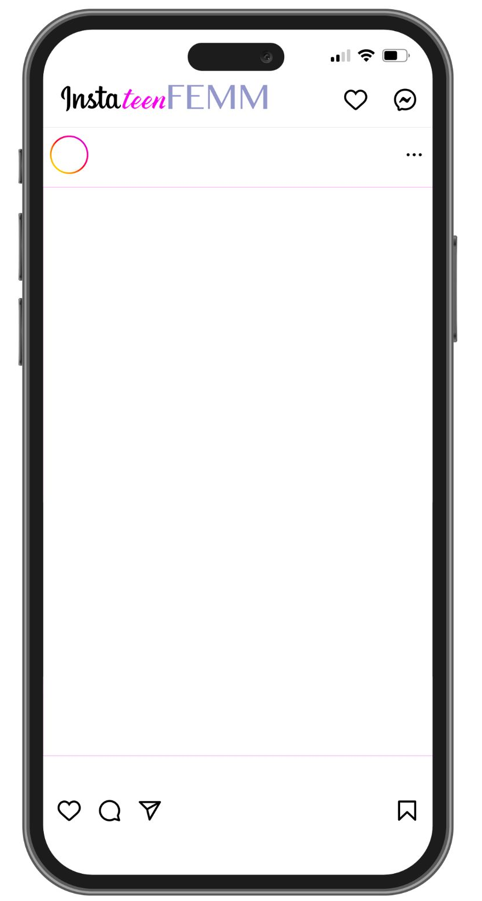
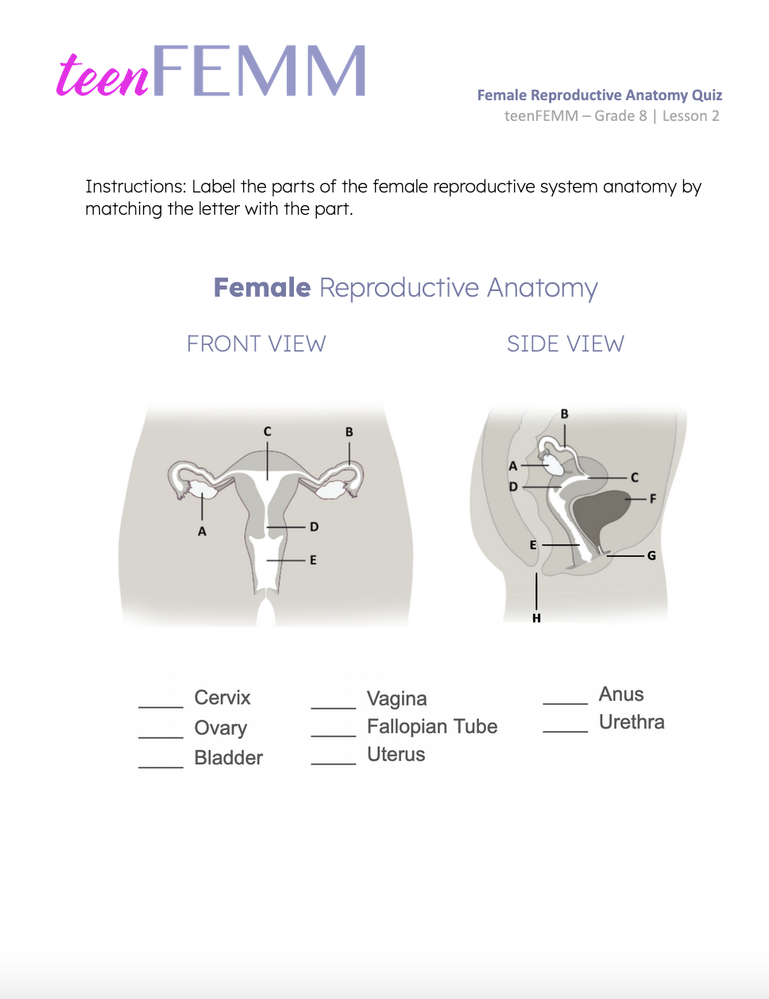
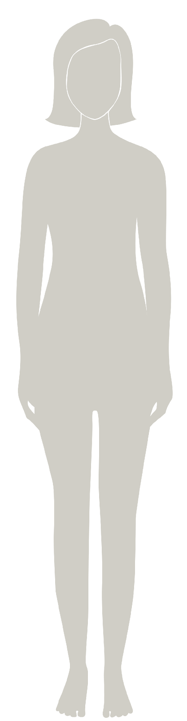
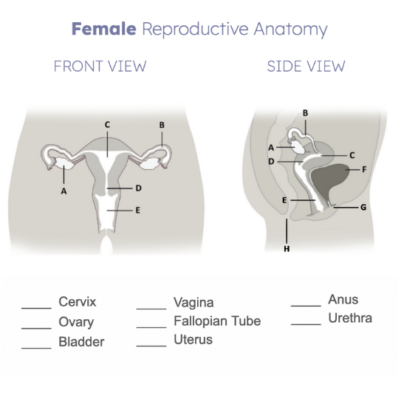
Female Reproductive Anatomy | Quiz
How well do you really know your selfie?
© FEMM
Notes:
Step 3 (10 minutes): Overview of the female reproductive system anatomy.
Hand out the Female Anatomy Worksheet and see if students can label the parts.

Slide 7
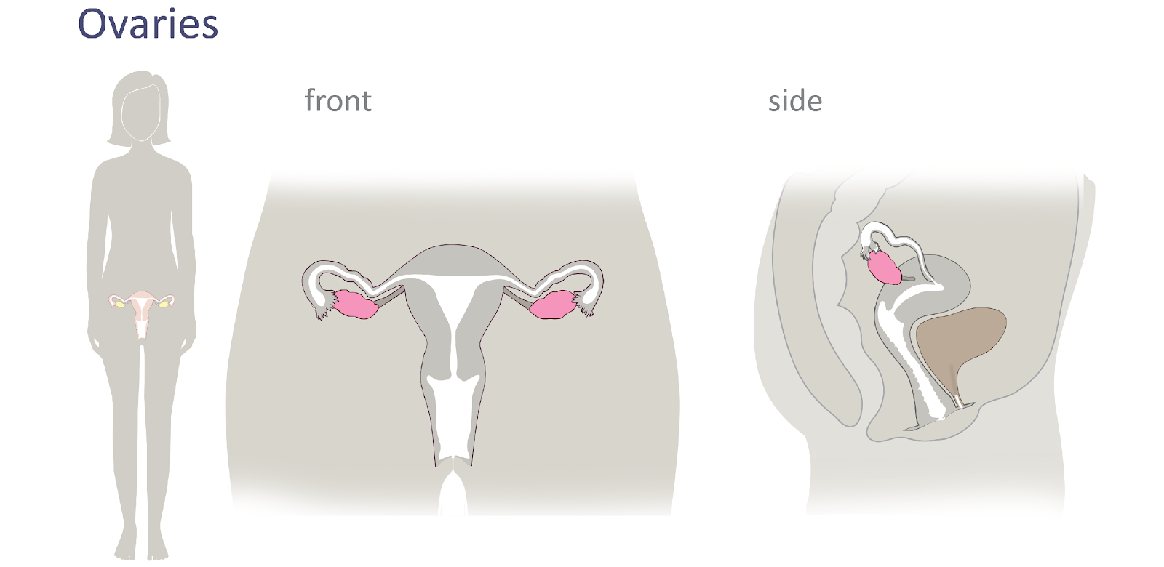
Female Reproductive Anatomy
© FEMM
Notes:
The Ovaries are two small organs/glands that sit on either side of the uterus. The ovaries take turns; each month one is responsible for developing and releasing an egg. The egg is the female cell of reproduction. The woman’s ovaries store all her eggs from the time of birth. When an egg is released from the ovary, this is called ovulation. Ovulation is a very important event that should occur each month in a healthy woman who has already gone through puberty, regardless of whether a woman is ready to have a child or not. Why? One reason is that the egg, as it develops, produces estrogen, which your body needs.

Slide 8
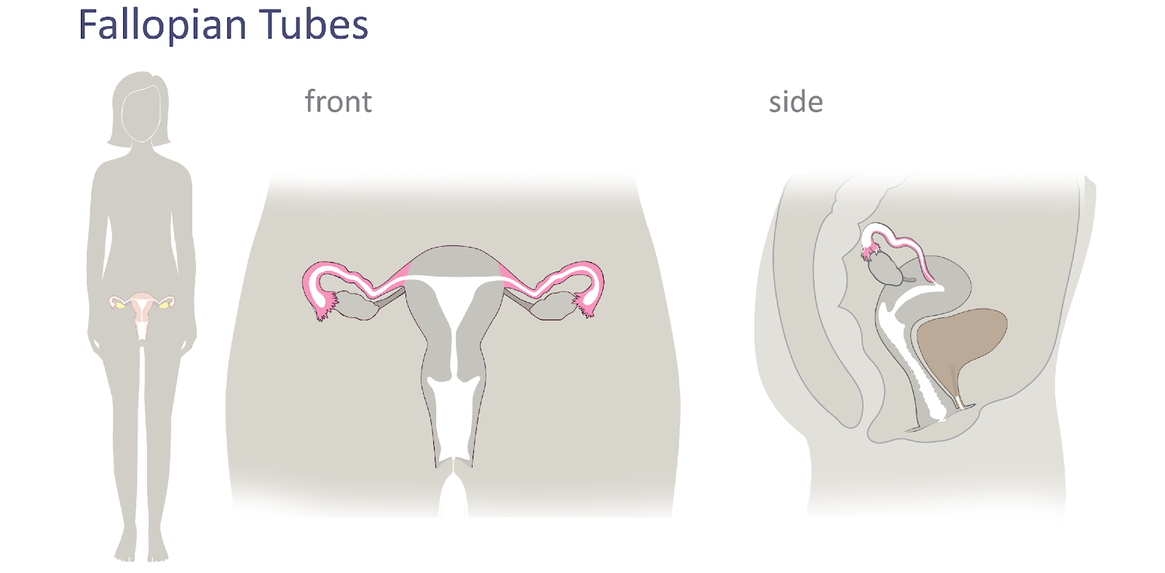
Female Reproductive Anatomy
© FEMM
Notes:
The Fallopian Tubes are two long thin tubes situated on either side of the uterus, providing a way for the egg to travel from the ovary to the uterus. The tubes are not actually connected to the uterus, but contain fingerlike projections called fimbriae that grab the egg and move it into the tubes. They are about the width of a spaghetti noodle.

Slide 9
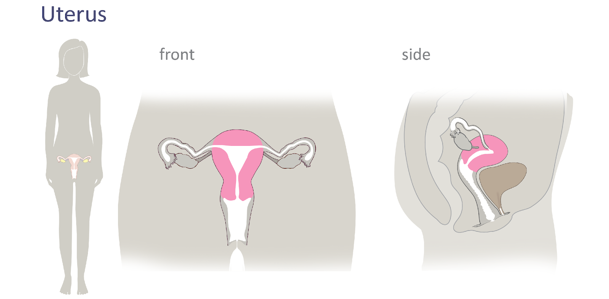
Female Reproductive Anatomy
© FEMM
Notes:
The Uterus is the hollow, pear-shaped organ in which a baby can grow and develop. The lining of the uterus is shown in light pink. The lining of the uterus is called the endometrium. This mucus membrane lining responds to an increase in hormones each month to thicken in preparation to someday support a possible pregnancy. The uterus is very strong and stretchy and can grow up to 1,000 times its size as the baby grows. When a woman becomes pregnant, the baby attaches to this lining to receive the nourishment it needs to grow. But if a woman does not become pregnant, then this lining sheds at the end of her ovulatory cycle, in what we know as menstruation and her hormonal levels decrease once again.

Slide 10
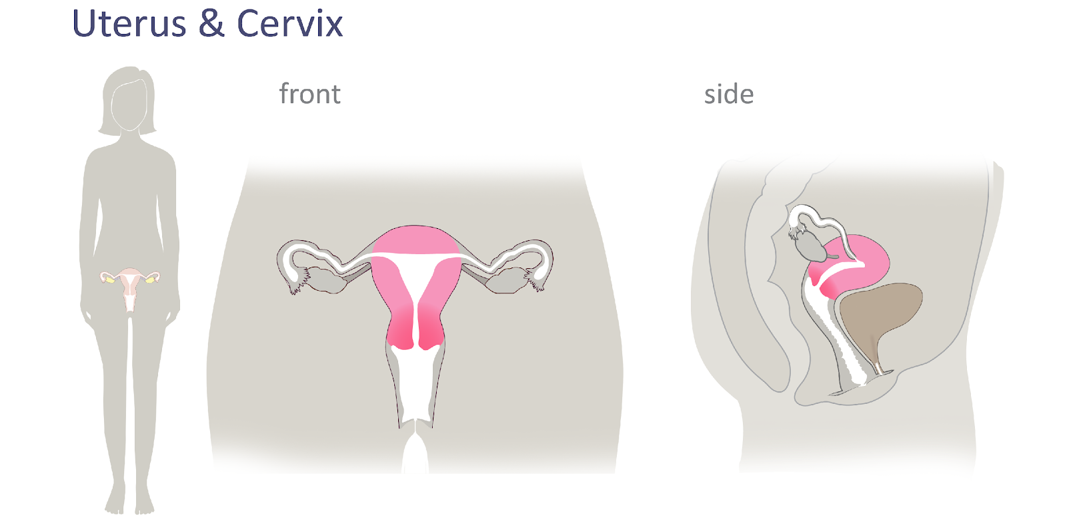
Female Reproductive Anatomy
© FEMM
Notes:
The Cervix is the opening at the base of the uterus; a narrow canal that opens into the vagina. Cervical mucus is a fluid produced by the cervix. Your cervical mucus changes throughout your menstrual cycle.

Slide 11
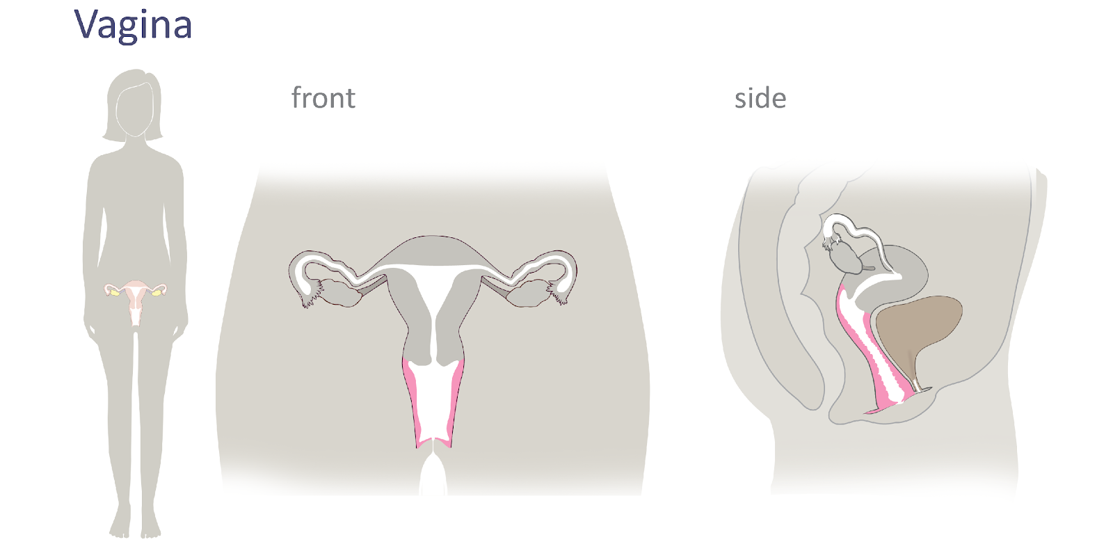
Female Reproductive Anatomy
© FEMM
Notes:
The Vagina is the canal that connects the uterus to the outside of the body. It is the entrance to the reproductive organs in sexual intercourse. It is also the exit for menstrual blood each cycle. It is the exit when a baby is delivered - and for this reason, It is sometimes also referred to as the birth canal.
The organ in brown on the right hand side of the slide is the bladder. The bladder is not part of the reproductive system, but rather part of the urinary system.

Slide 12
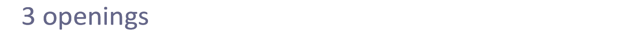
Female Reproductive Anatomy
Urethra
Vagina
Anus
Vagina
© FEMM
Notes:
The Urethra is the tube that carries the urine (pee) from the bladder to the outside of the body. The opening behind the vagina is the anus. The anus is part of the digestive system. It is the opening for waste to exit the digestive tract.
Women have three openings: the vagina, the urethra and the anus.

Slide 13
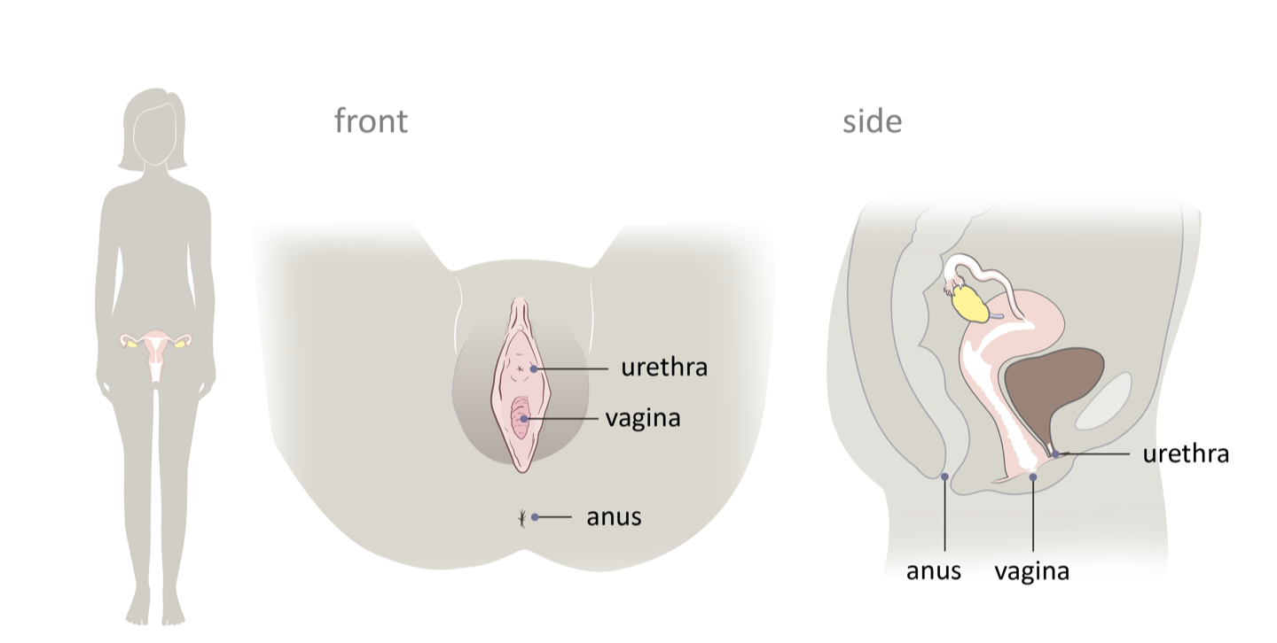
Female Reproductive Anatomy
Urethra
Vagina
Anus
Vagina
© FEMM
Notes:
The proximity of these three openings can increase the risk of bacteria transfer. This means that when using the bathroom, it is important to always wipe from front to back to avoid introducing bacteria from the digestive system towards the vagina and/or urethra. The top and front part of this area is called the pubic area. This is also where hair will grow on the skin and this is completely normal. Men also grow pubic hair in their pubic area.
Women have three openings: the vagina, the urethra and the anus.
The proximity of these three openings can increase the risk of bacteria transfer. This means that when using the bathroom, it is important to always wipe from front to back to avoid introducing bacteria from the digestive system towards the vagina and/or urethra. The top and front part of this area is called the pubic area. This is also where hair will grow on the skin and this is completely normal. Men also grow pubic hair in their pubic area.

Slide 14
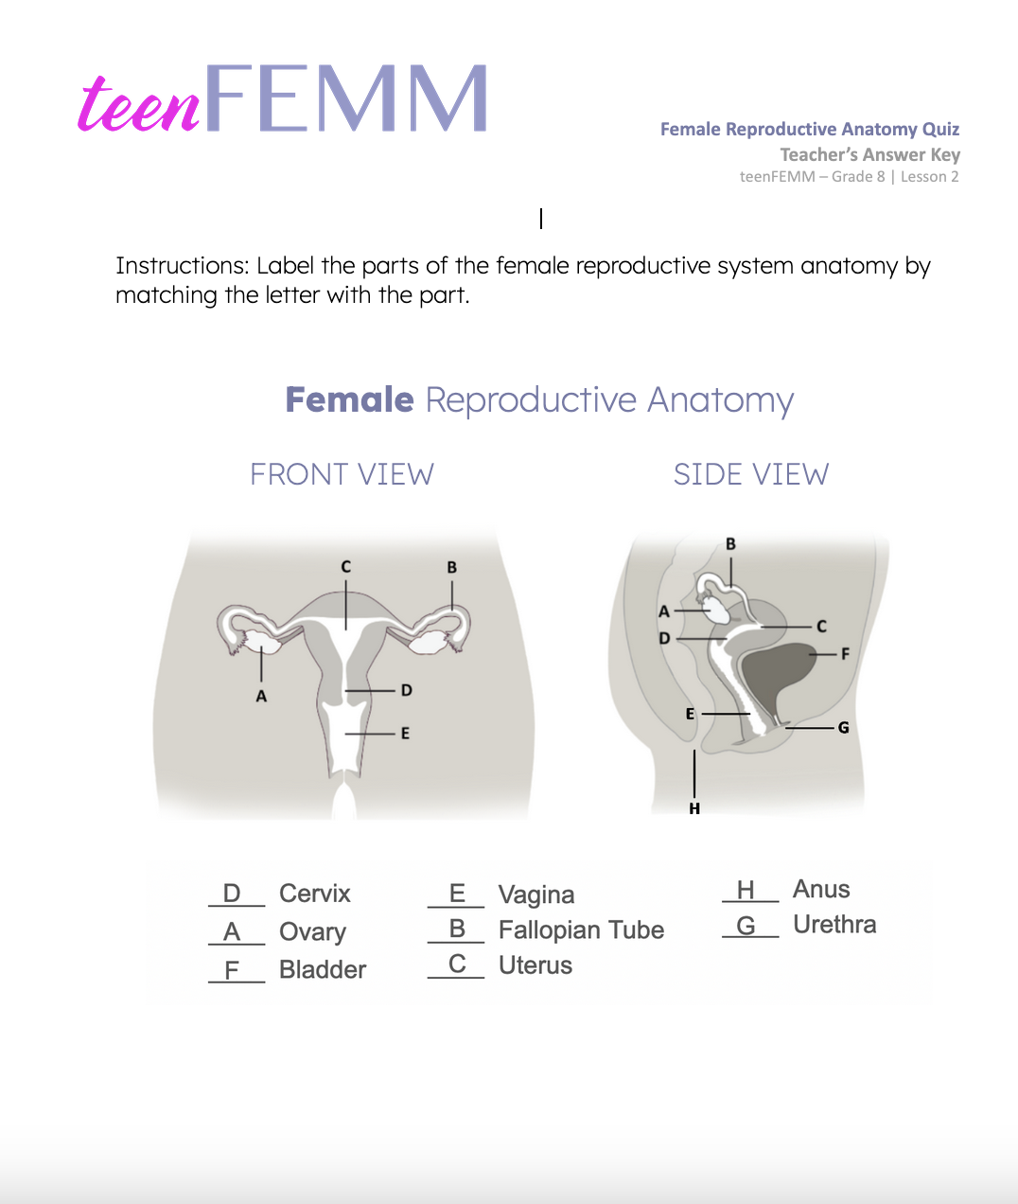
Answers | Female Reproductive Anatomy Quiz
Bravo! Nice work, teenFEMM student!
© FEMM
Notes:
How did you do on the Female Reproductive Anatomy Quiz? Ask students to tally their score.

Slide 15
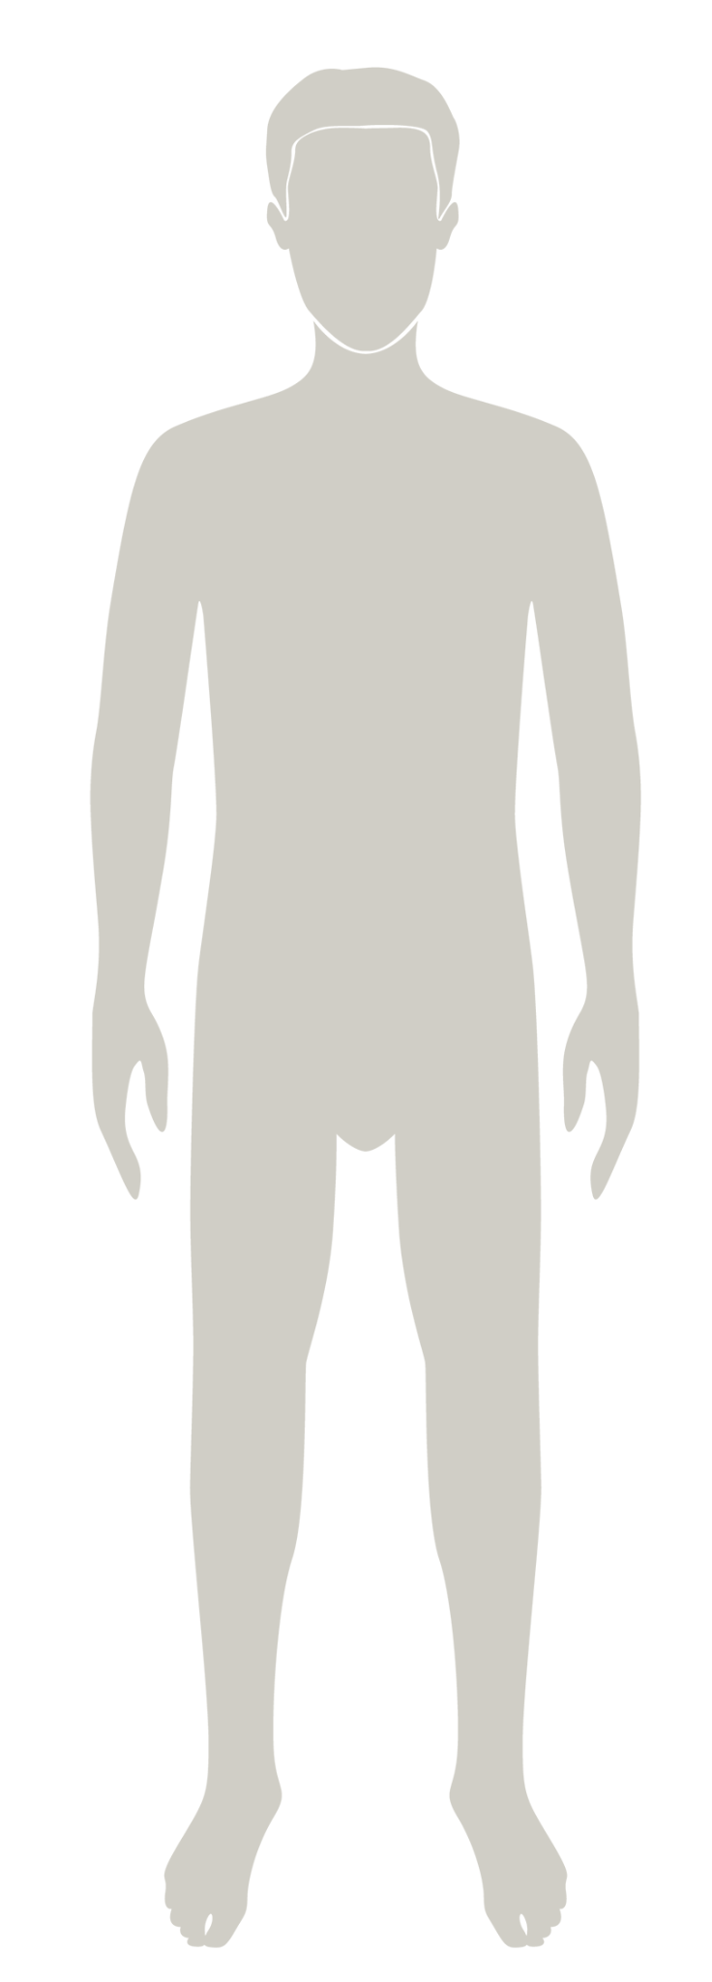
Male Reproductive Anatomy
Male
Reproductive Anatomy
© FEMM
Notes:
Step 4 (10 min): Introduce the Male Reproductive Anatomy.
As we know, the reproductive system is responsible for bringing about a new life. But a healthy reproductive system is also vital to the overall, everyday health of a person - for both women and men.
Testosterone is the dominant male hormone, and is very important as boys go through puberty; it helps to direct the bodily changes that boys go through: wiring their brains, strengthening their bones, and influencing their mood. Let’s learn the names of the different organs that make up the male reproductive system and how they work together to support health.

Slide 16
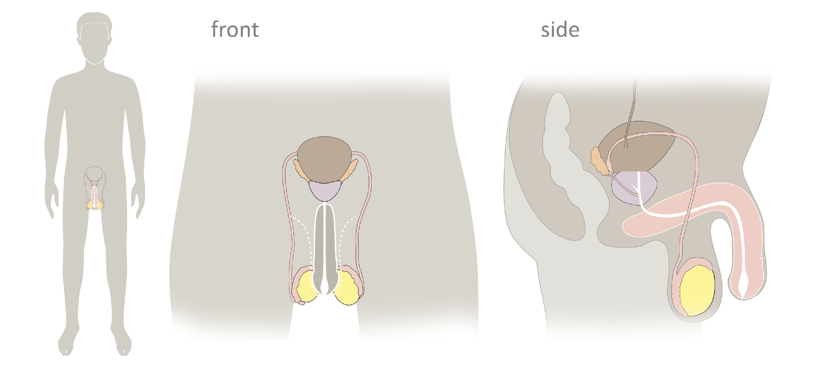
Male Reproductive Anatomy
© FEMM
Notes:
Reference the slides below to define and describe the anatomy of the male reproductive system. There will be a quiz on the Male Reproductive Anatomy, too!
Male Reproductive Anatomy: Here you see the whole male reproductive system.
The testicles are highlighted in yellow. The scrotum is presented in gray, the skin that encloses the testes. The bladder is brown, but just like we reviewed in the female reproductive system it is actually part of the urinary system. The urethra is the tube shown in white that travels through the penis.
Let’s learn about at each of these body system parts more in-depth:

Slide 17
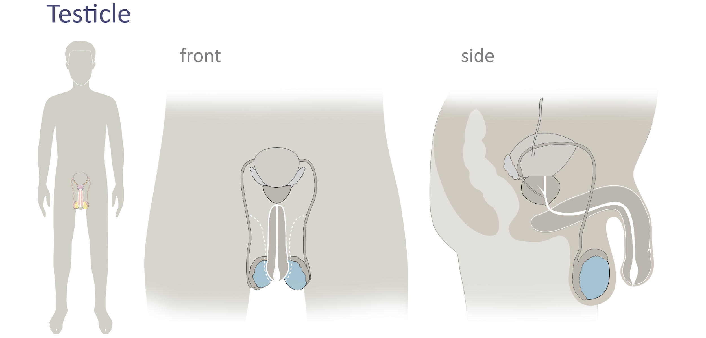
Male Reproductive Anatomy
Testicles
© FEMM
Notes:
The Testicles are 2 organs that produce sperm, the male cell of reproduction and the main male reproductive hormone, testosterone.
Did You Know? The testicles are located outside the body in order to maintain the ideal temperature for sperm production. Sperm production occurs at around 93.2ºF (34ºC). This is 5.4ºF (3ºC) below our normal body temperature of 98.6ºF (37ºC ). Just those few degrees make all the difference!

Slide 18
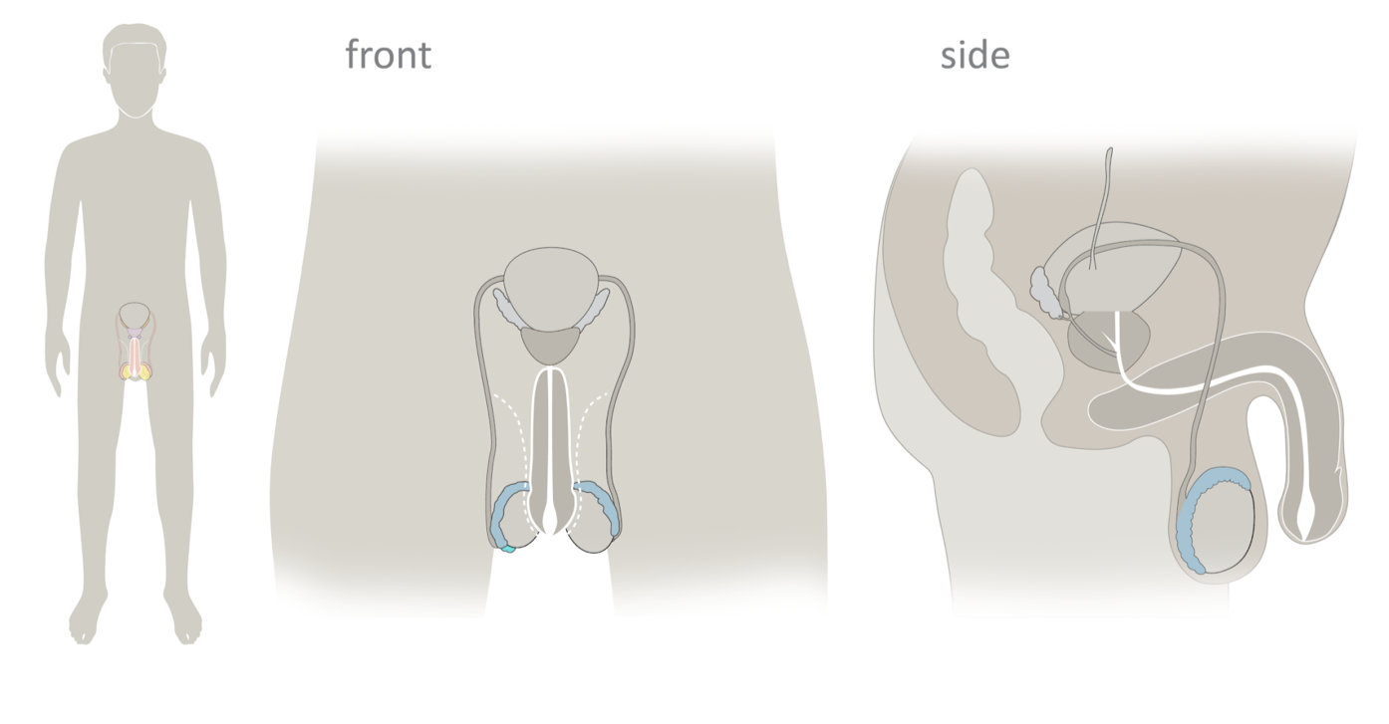
Male Reproductive Anatomy
Epididymis
© FEMM
Notes:
Attached to each testicle is the Epididymis, a coiled tube or passageway. Sperm is made in the testicles and then travels to the epididymis. In adult males, the length of the epididymis (if it was uncoiled and stretched out) is between 20 to 23 feet long! It takes sperm around 4 to 6 weeks just to travel through the epididymis. The human body is amazing!

Slide 19
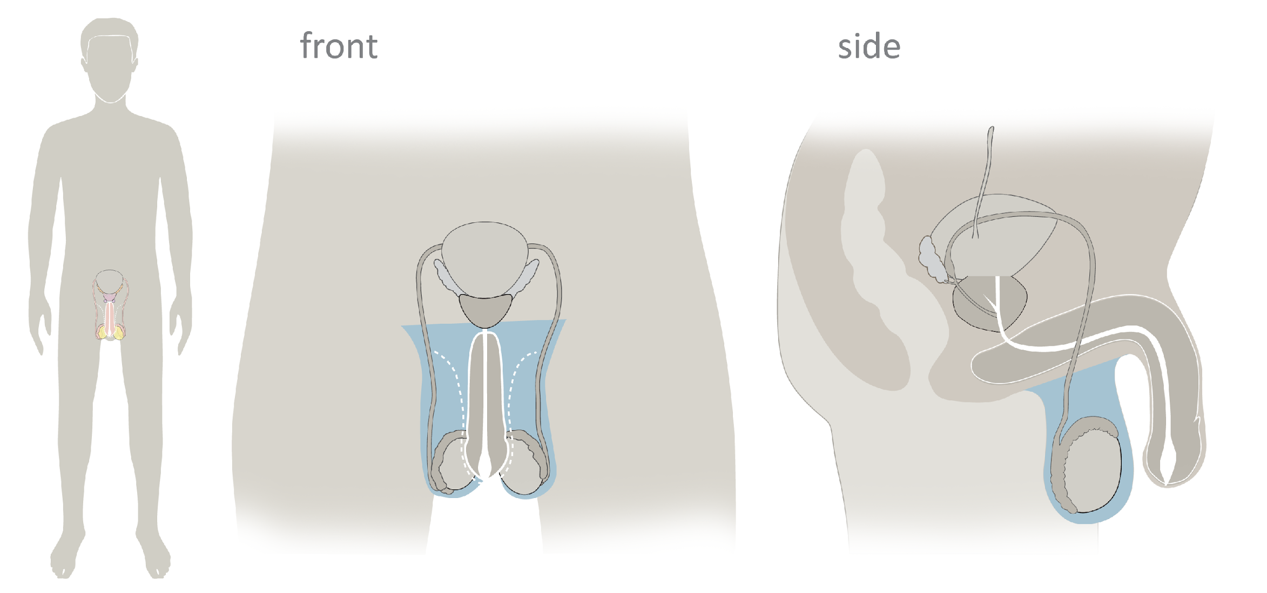
Male Reproductive Anatomy
Scrotum
© FEMM
Notes:
The Scrotum is the protective sac that encloses the testes and epididymis and draws them toward or away from the body in order to regulate temperature.

Slide 20
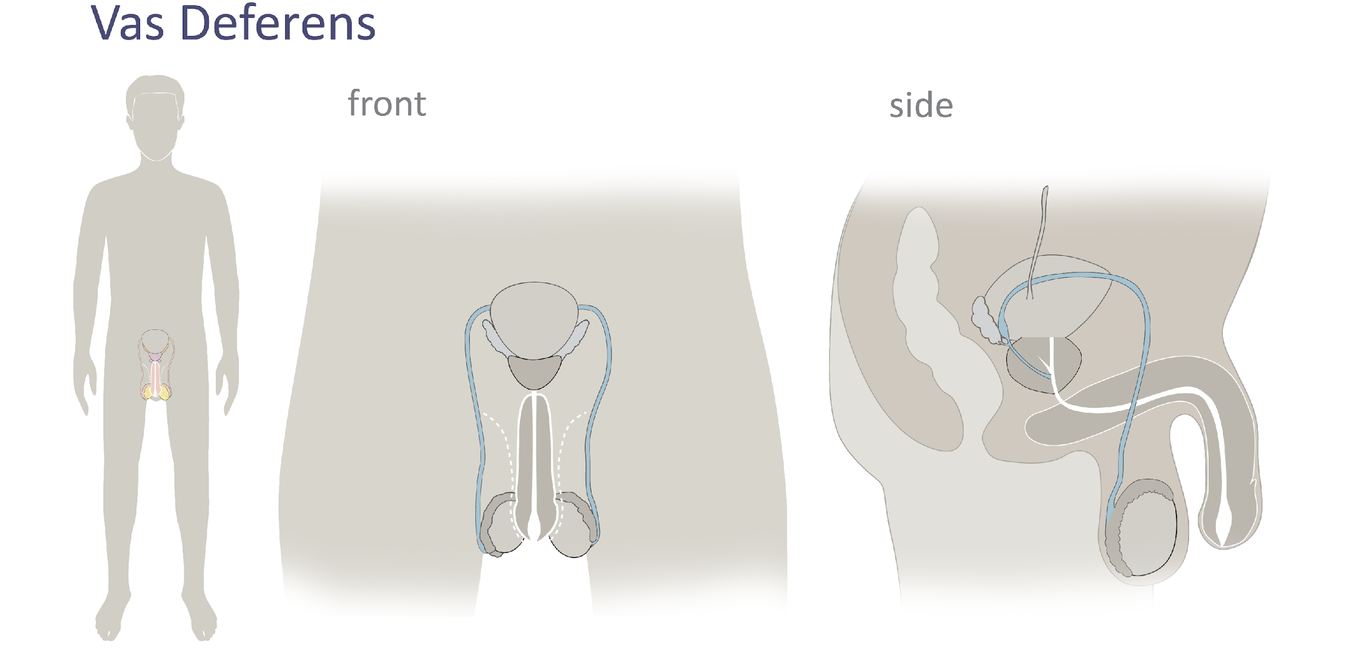
Male Reproductive Anatomy
Vas Deferens
© FEMM
Notes:
Vas deferens: A tube that transports sperm out of the testicles. There are two vas deferens, one for each testicle. They are about the width of a spaghetti noodle.
Compare: the fallopian tubes are long thin tubes that are situated on either side of the uterus, providing a way for the egg to travel from the ovary to the uterus. They are about the width of a spaghetti noodle.

Slide 21
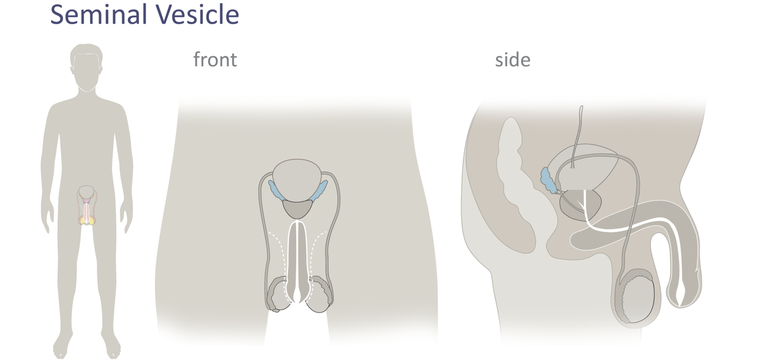
Male Reproductive Anatomy
Seminal vesicles
© FEMM
Notes:
Seminal vesicles: a pair of glands on either side of the bladder that contribute fluid to semen, to help nourish and transport sperm.

Slide 22
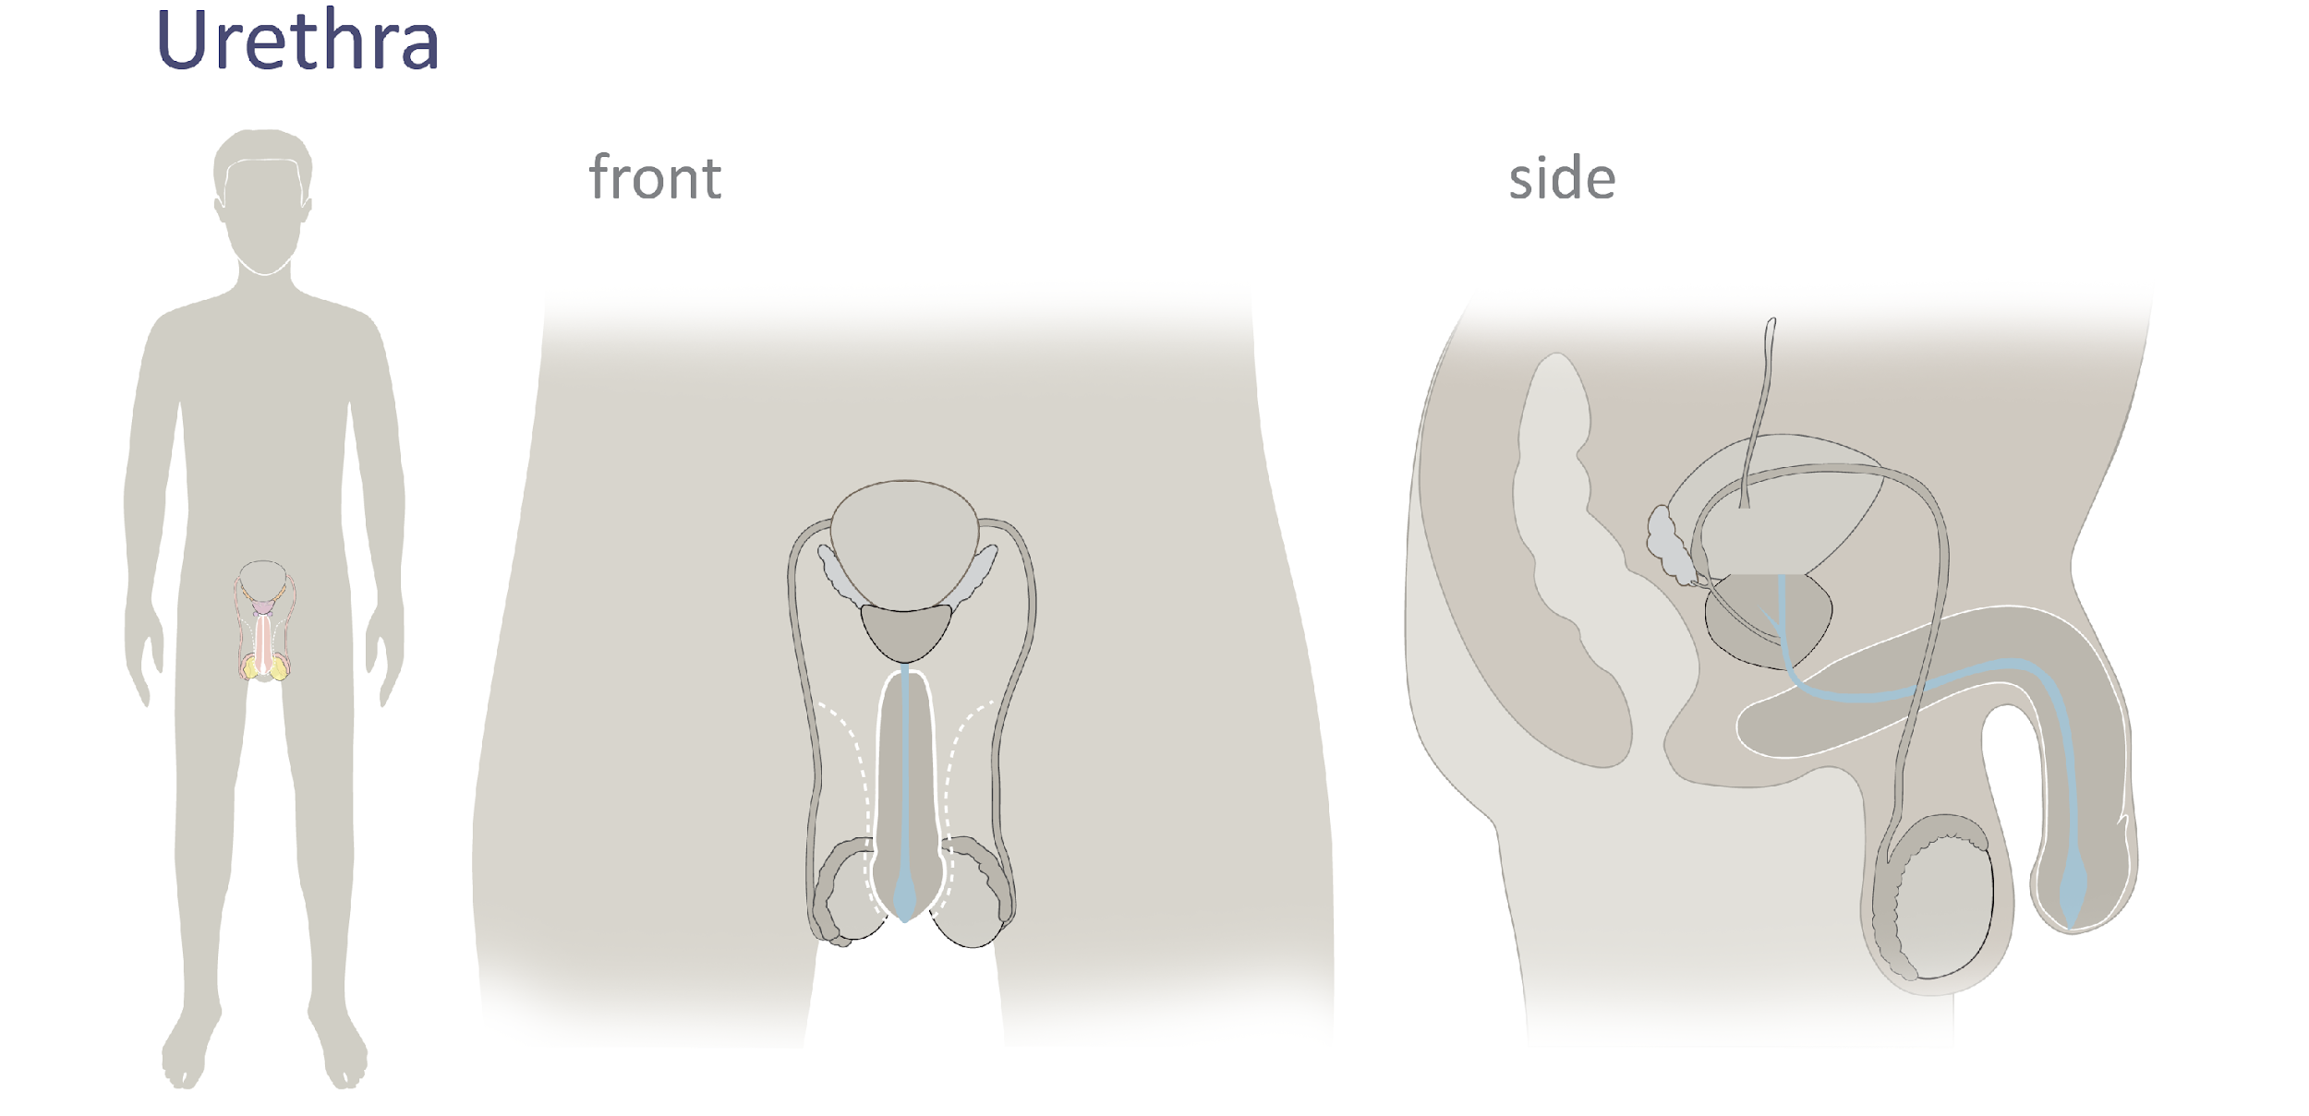
Male Reproductive Anatomy
Urethra
© FEMM
Notes:
Urethra: The urethra is the tube that travels out the penis and allows either urine or seminal fluid to escape (though never at the same time).

Slide 23
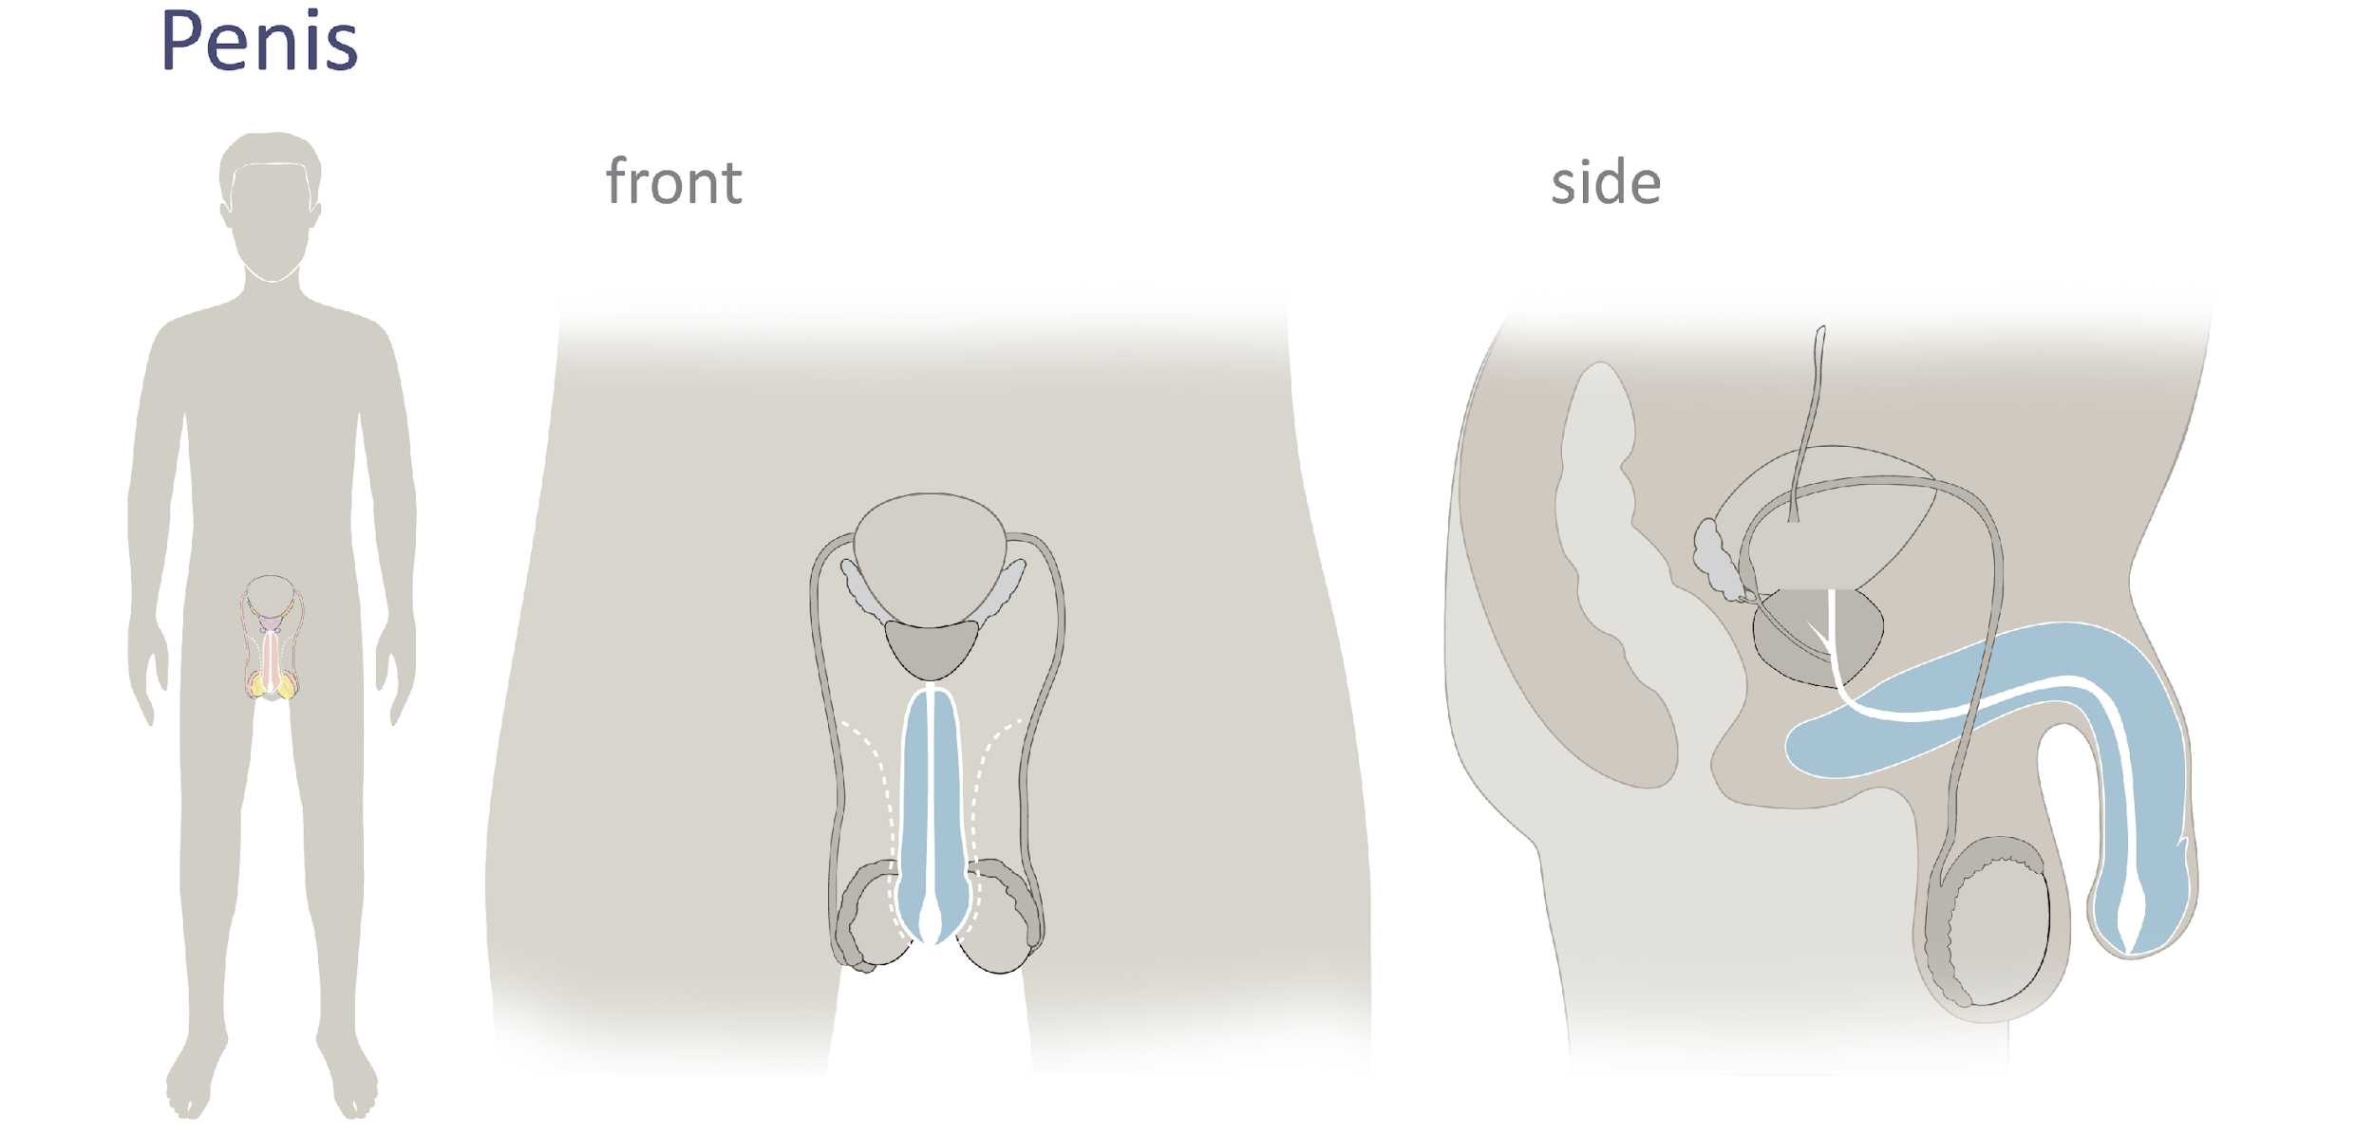
Male Reproductive Anatomy
Penis
© FEMM
Notes:
Penis: The penis is actually made up of two parts: the shaft and the glans. The shaft is the main part of the penis and the glans is the tip. At the end of the glans is a small slit or opening, which is where semen and urine exit the body through the urethra (either one or the other, never at the same time).

Slide 24
Male Reproductive Anatomy
2 openings
Urethra
Anus
© FEMM
Notes:
In this final anatomy slide, point out the two openings to the body that men have, as opposed to the three that women have, shown in the side image:
urethra: tube that travels through the penis, carrying either: 1. urine from the bladder OR 2. semen from the reproductive system.
anus: opening for waste to exit from the digestive system

Slide 25
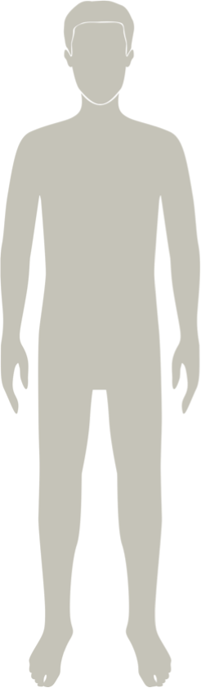
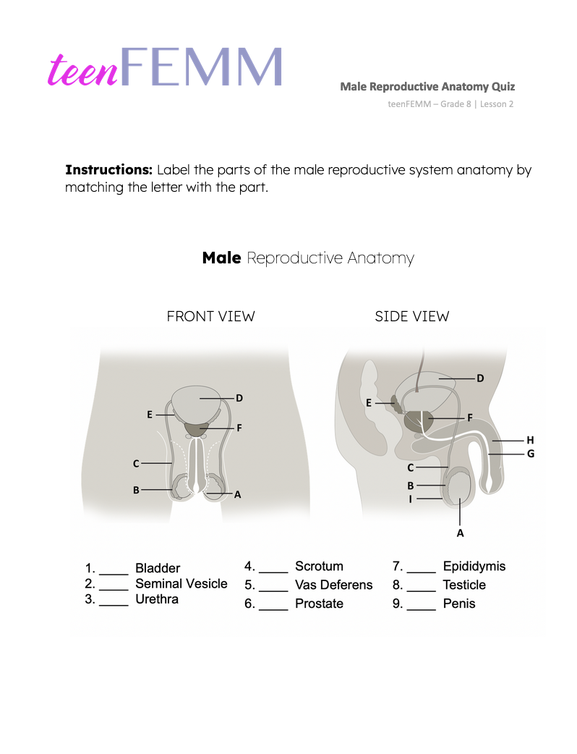
Quiz | Male Reproductive Anatomy Quiz
© FEMM
Notes:
Step 5 (5 min): Male Anatomy Quiz Worksheet & slides
Provide students with the Male Reproductive Anatomy Worksheet and ask them to label the male reproductive anatomy.

Slide 26
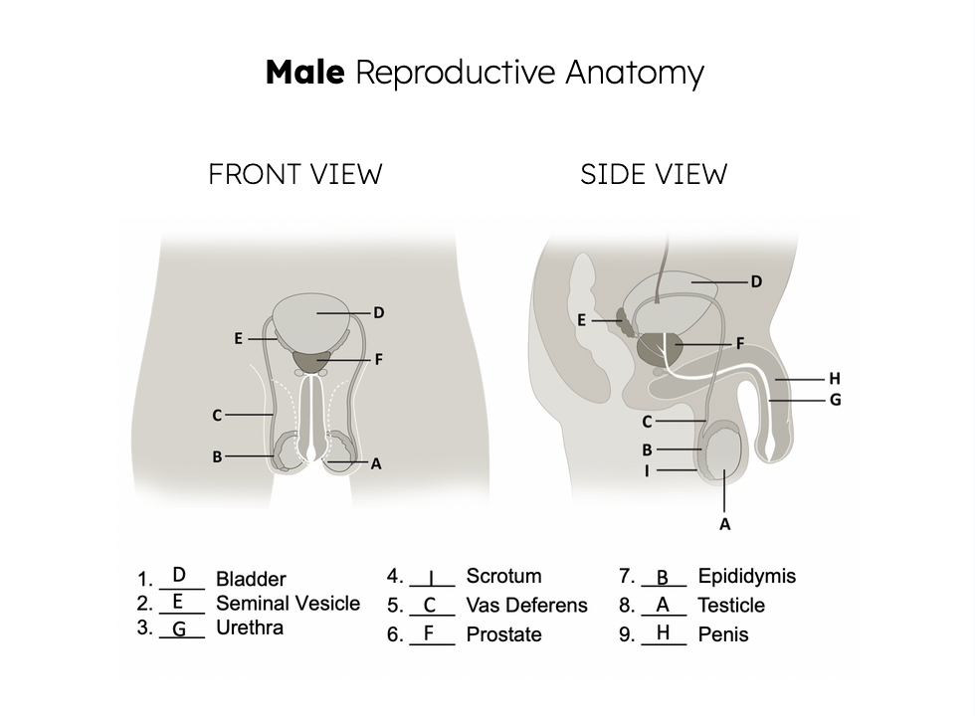
Answers | Male Reproductive Anatomy Quiz
Notes:
Review their answers using the Male Anatomy Quiz slide (first with blank spaces and once they’ve made their guesses, show the slide with answers).

Slide 27
Review
The male reproductive system is responsible for developing the male cell of reproduction: sperm and the hormone testosterone.
The female reproductive system is responsible for developing the female cell of reproduction: the egg
and the hormones estrogen and progesterone.
The development of the cells of reproduction indicate that hormone levels are healthy: this is important for the general health of men and women!
© FEMM
Notes:
Now you have a good understanding of the parts that make up both the male and female reproductive systems. The male reproductive system is responsible for developing the male cell of reproduction: the sperm and the hormone testosterone. The female reproductive system is responsible for developing the female cell of reproduction: the egg and the hormones estrogen and progesterone. For both boys and girls, the most important thing to remember right now is that the development of the cells of reproduction is an indicator of healthy hormone levels in your body as you continue through puberty. In the next lesson, we will focus on ovulation and hormones, paying attention to what this means for your brain, body, mood, energy and overall health.

Slide 28
Grade 8
LESSON 2
© FEMM

