Slide 1

Grade 8
LESSON 2
© FEMM

Slide 2
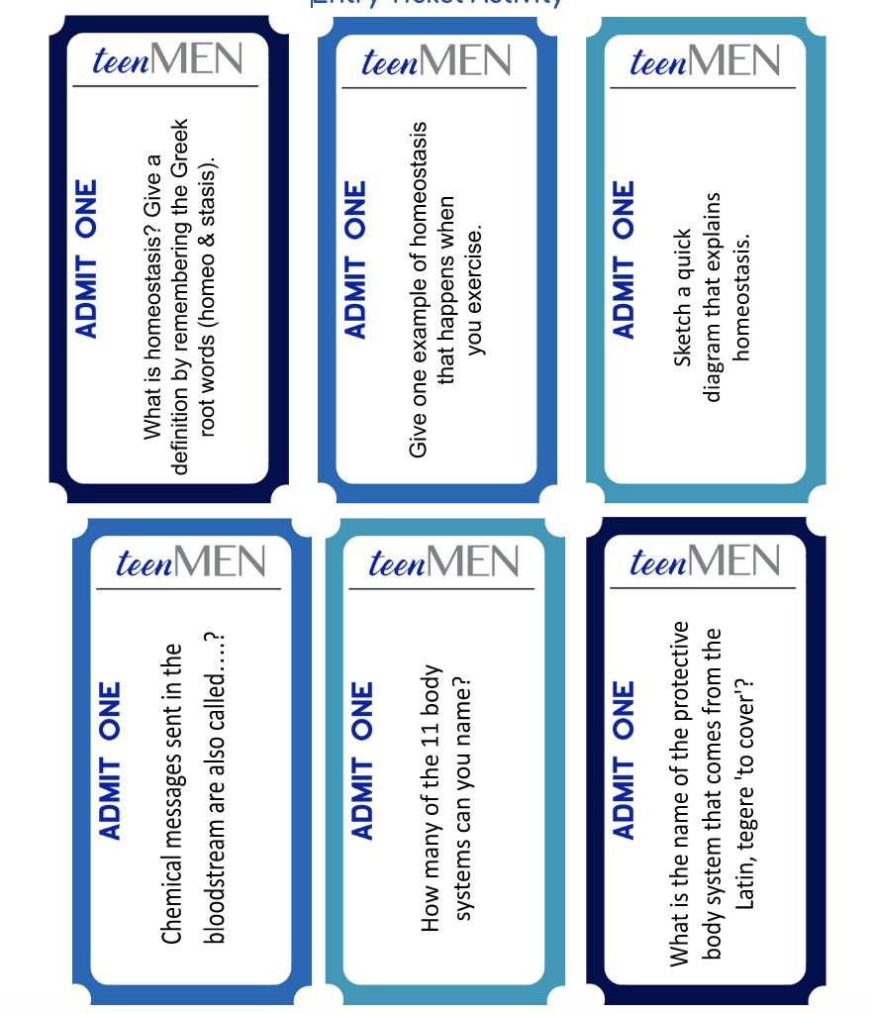
Entry Ticket
© FEMM
Notes:
PROCEDURE
Step 1 (10 minutes): Entry Ticket Activity
Hand out one Ticket per student to fill in at their desk. Have students write their answer on the back of the ticket or on a separate piece of paper if they need more space.
Give students two minutes and then review answers together on the next slide.

Slide 3
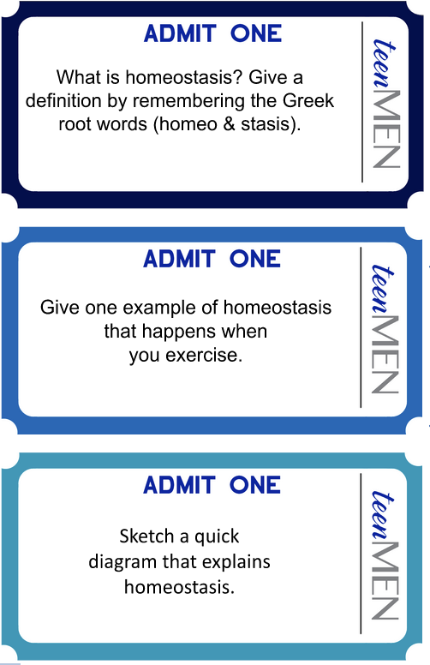
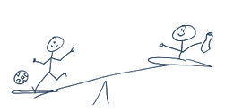
Answers
Homeo means “same” and stasis, “steady” so homeostasis is how the body balances itself internally despite external changes.
Hormones!
1. Integumentary
2. lymphatic
3. Respiratory
4. Urinary
5. Reproductive
6. Endocrine
7. Digestive
8. Muscular
9. Skeletal
10. Nervous
11. Circulatory
Sweat! As your temperature increases, your body cools itself down by sweating.
water
sweat
Integumentary
Latin: ‘tegere’ to cover’.
© FEMM
Notes:
Answers:
1. Chemical messages sent in the bloodstream are also called…? Hormones!
2. What is homeostasis? Homeo means ‘same’ and stasis means ‘steady’, so homeostasis is how the body balances itself internally despite external changes.
3. How many of the 11 body systems can you name?
Integumentary Endocrine
Digestive Muscular
Skeletal Nervous
Circulatory Lymphatic
Respiratory Urinary
Reproductive
4. Give one example of homeostasis that happens when you exercise. Sweat! As your temperature increases, your body cools itself down by sweating.
5. What is the name of the protective body system that comes from the Latin tegere ‘to cover’? Integumentary.
6. Sketch a quick diagram that explains homeostasis. (See slide).

Slide 4
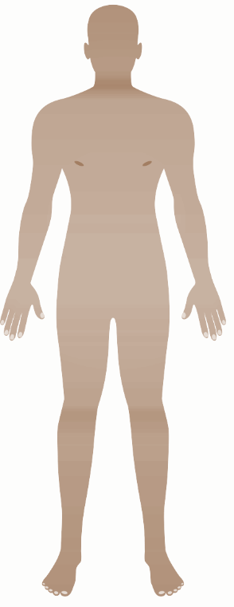
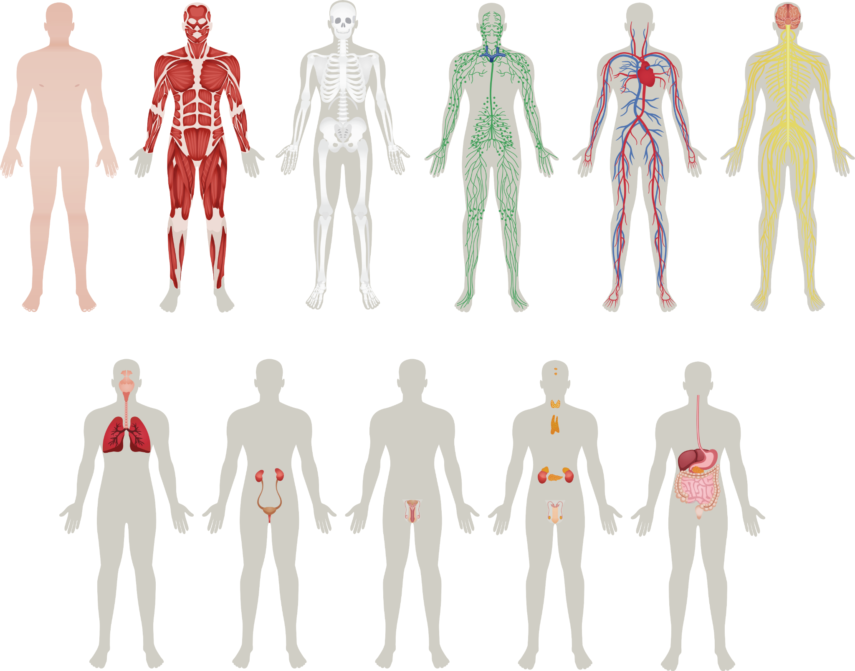
Can you name the 11 body systems?
© FEMM
Notes:
Step 2 (2 minutes): Review 11 Body Systems
In our last class, we learned about the 11 systems of the body and how they all work together to make sure we grow to full maturity.
Can you remember the names of the different body systems? Ask students to raise their hand to name the 11 body systems shown on the slide.
Review answers on the following slide.

Slide 5
Answers
Integumentary
Muscular
Skeletal
Lymphatic
Circulatory
Nervous
Respiratory
Urinary
Reproductive
Endocrine
Digestive
© FEMM
Notes:
Step 3 (5 minutes): The Brain Controls Your Hormones
What does every body system need? Clear signals from the brain. What are these signals or “text messages” sent by the brain to every organ and tissue called? Hormones!

Slide 6
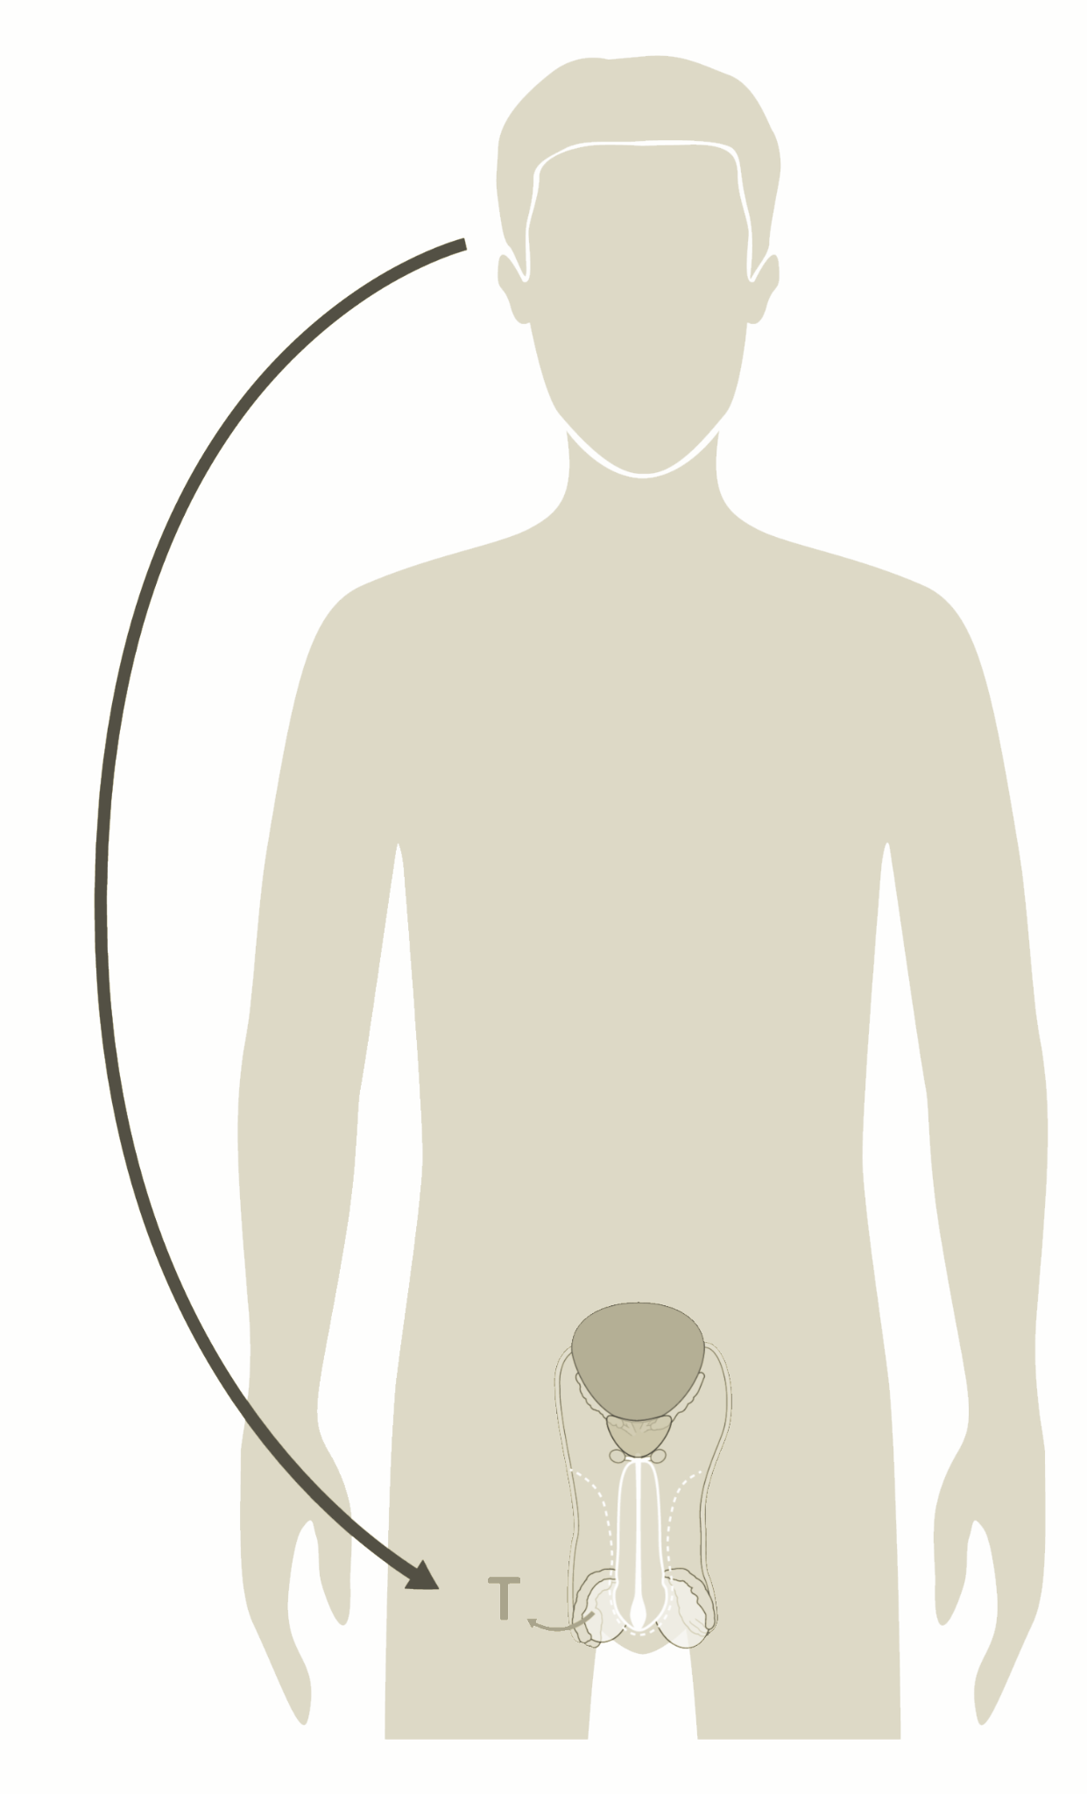
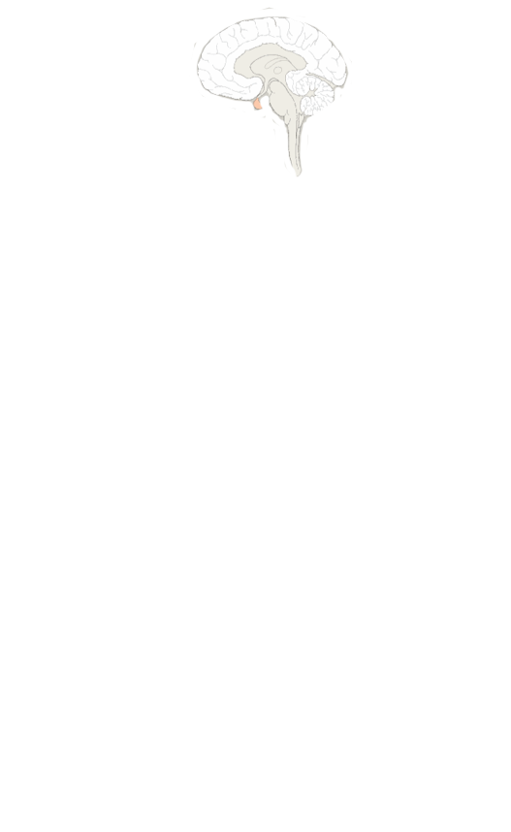
The Brain Controls your Hormones
Brain
Reproductive System.
Hello, come in, do you read me?
Increase Testosterone.
Hormones direct all of the body systems.
© FEMM
Notes:
Hormones direct all of the growth and change in your body, through puberty and beyond. The Hormonal Axis, the system of communication between your brain and your reproductive system, regulates hormones, including testosterone. Testosterone is the main male hormone, and is important to your overall health as you go through puberty! Testosterone wires your brain, strengthens your bones and muscles and influences your mood. Let’s take a closer look.

Slide 7
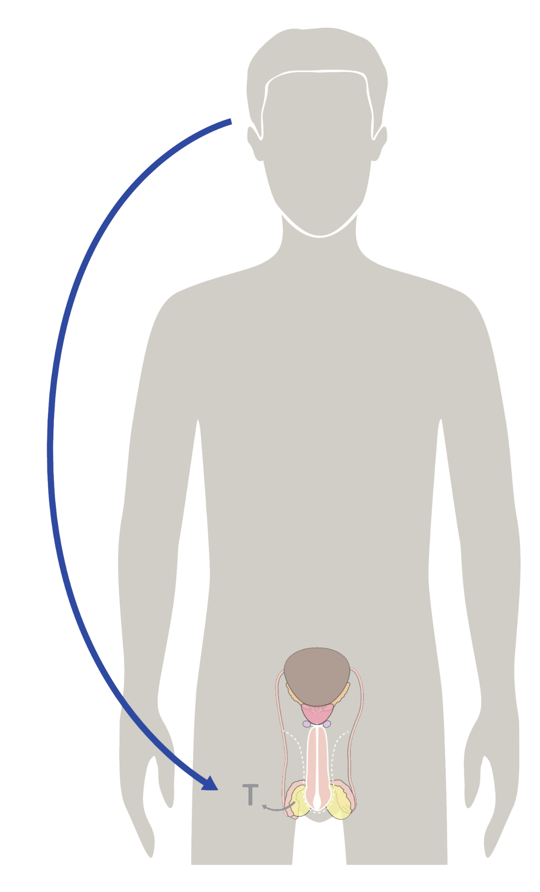
The Brain & Reproductive Hormones
The powerful Pituitary Gland!
FSH
Follicle-Stimulating Hormone
brain
LH Luteinizing Hormone
brain
1
2
testicles
Testosterone
rises + feeds back to brain
3
© FEMM
Notes:
In the brain is the Pituitary Gland (circled in orange). The powerful pituitary gland is called the “master gland” as it controls the secretion of most hormones in the body.
The pituitary gland produces a hormone called Luteinizing Hormone (LH). LH launches the production of testosterone in the testicles. The pituitary gland also produces Follicle Stimulating Hormone (FSH), which helps produce sperm.
When testosterone levels increase, this feeds back to the brain to inhibit the release of LH and FSH. The brain is constantly sending hormonal messages back and forth to control this process.

Slide 8
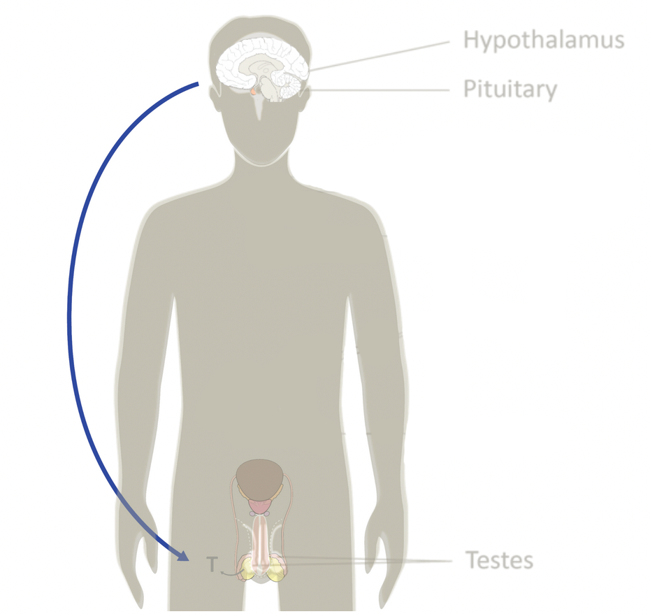

The Brain Controls your Hormones
Brain aka “Mister P”
Hey, Reproductive System. I’m sending LH to you.
Alr so Testosterone actually getting lower so send that LH again.
Brain
👍
Repro S.
Got it: increase testosterone!
OK we’re good. No more LH. Thx!
© FEMM
Notes:
If we think of hormones like text messages, it’s an ongoing conversation between the brain and your reproductive system.

Slide 9
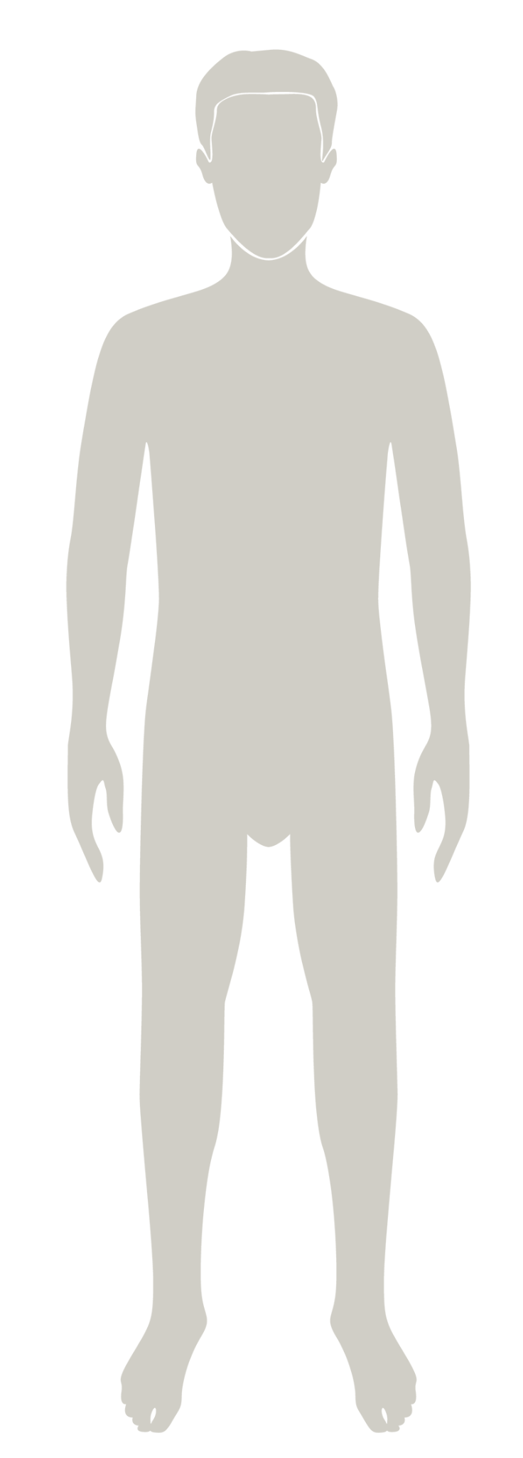
Anatomy
Male
Reproductive Anatomy
© FEMM
Notes:
Let’s review the different parts of the male reproductive system to better understand your body and your health.
Reference the slides below to define and describe the anatomy of the male reproductive system.

Slide 10
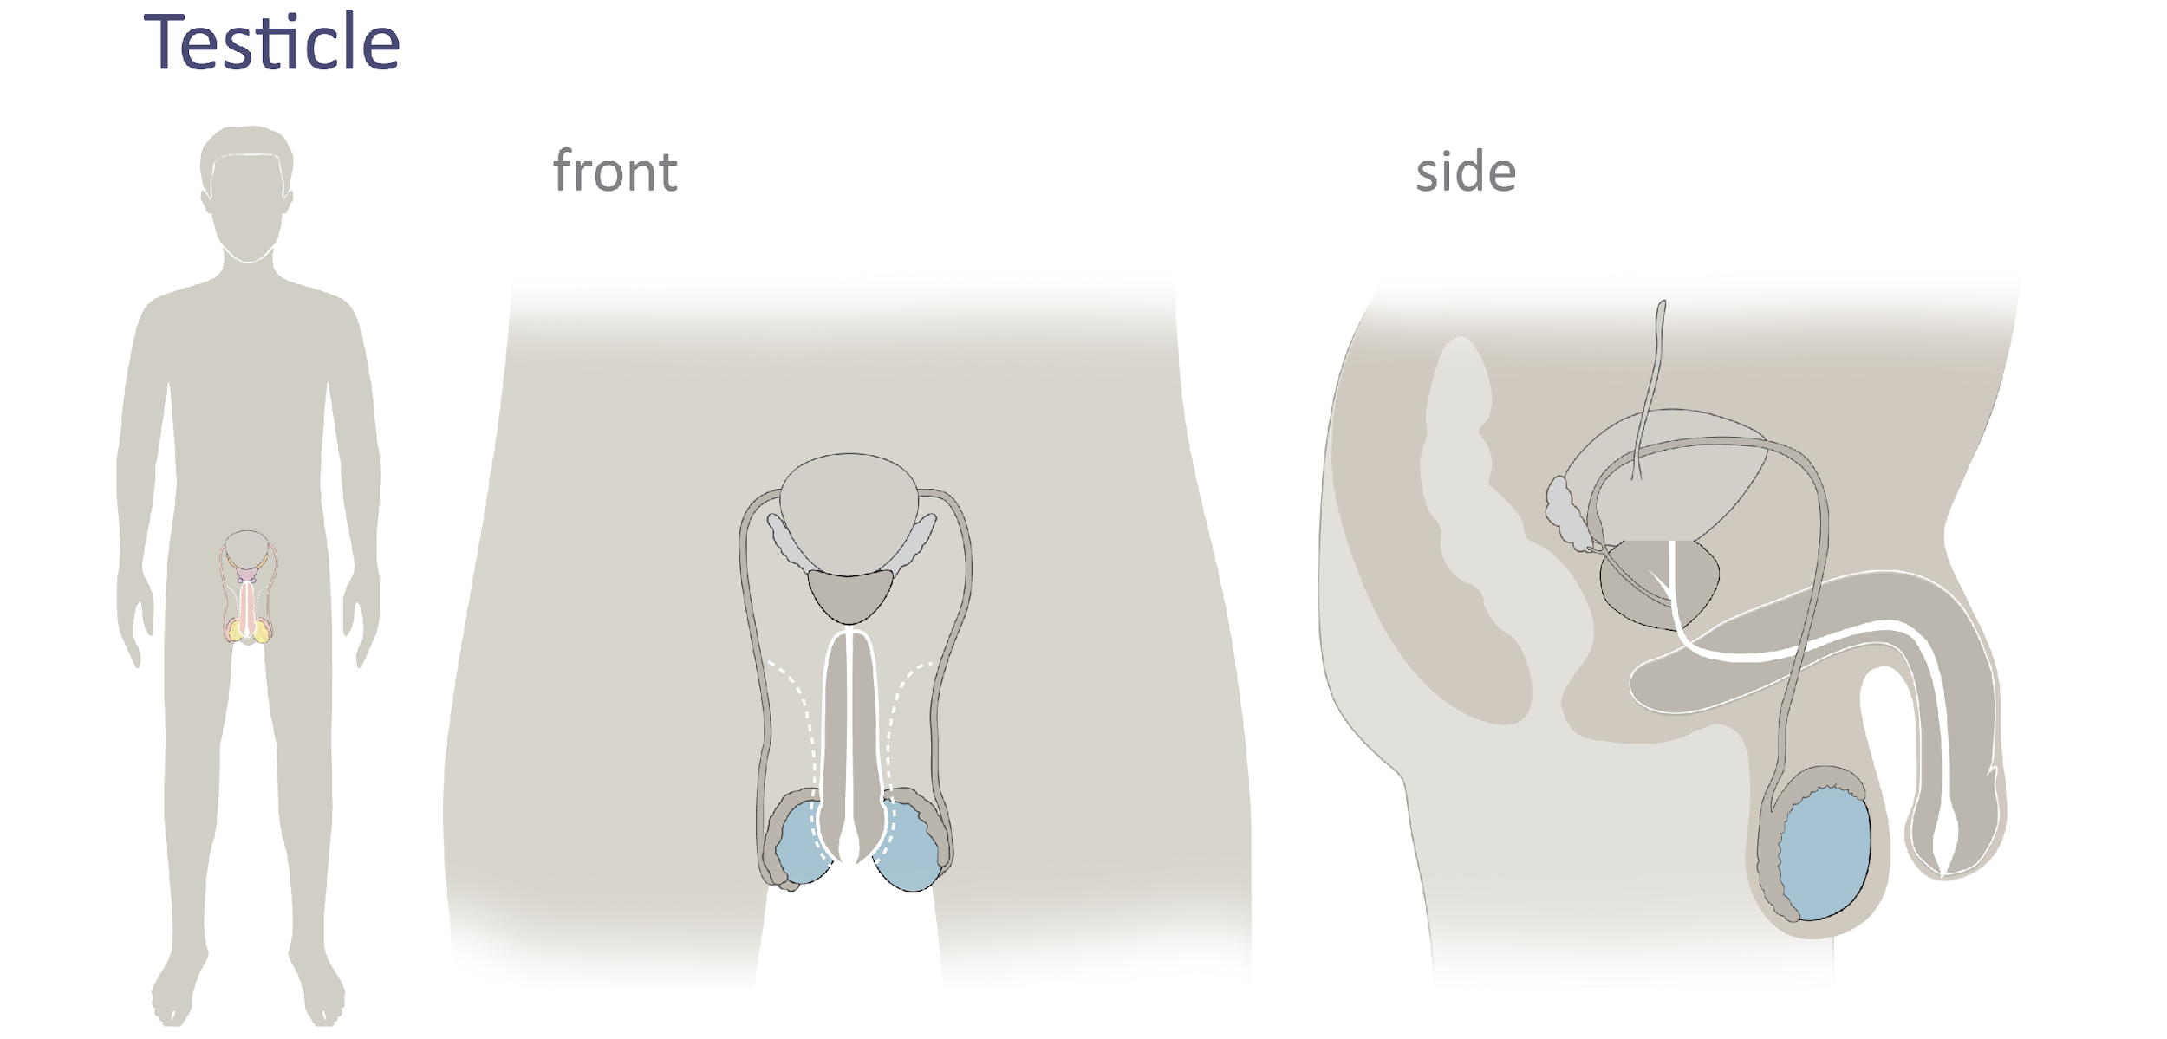
Male Reproductive Anatomy
testicles
© FEMM
Notes:
The testicles (or testes) are the pair of organs, highlighted on the slide in light blue, that produce sperm, the male cell of reproduction. The testicles are also where the main male hormone, testosterone, is produced.

Slide 11
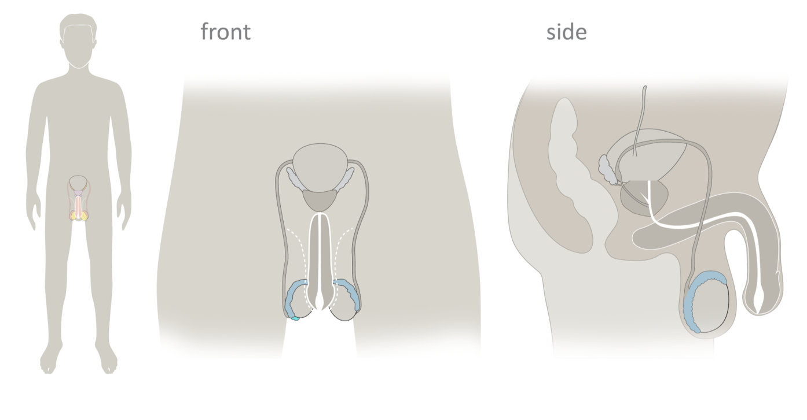
Male Reproductive Anatomy
epididymis
© FEMM
Notes:
Attached to each testicle is the epididymis, a coiled tube or passageway. Sperm is made in the testicles and travels through the epididymis. Here’s an amazing fact: in adult males, the length of the epididymis (if it was uncoiled) is about 20 feet long! It takes sperm about 4 to 6 weeks to travel through the complex of the epididymis. Given how long it takes sperm to travel through the epididymis, it makes sense that a main function of the epididymis is to mature sperm as well as connect the testicles to the vas deferens.

Slide 12
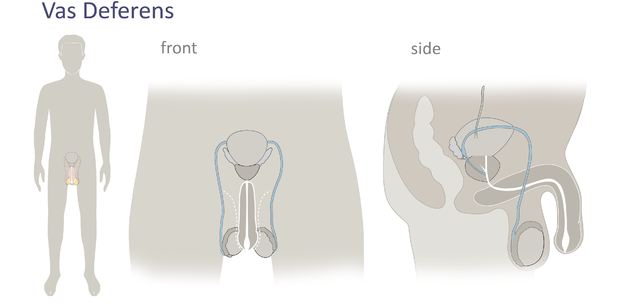
Male Reproductive Anatomy
vas deferens
© FEMM
Notes:
Vas deferens: A tube that transports sperm from the testicles and out the penis through the urethra. There are two vas deferens tubes, one for each testicle. The vas deferens begins at the epididymis and stretches upwards, crossing over the urethra behind the bladder, to the prostate. Here, the vas deferens joins with the seminal vesicles to form the ejaculatory duct, which passes through the prostate and empties into the urethra.

Slide 13
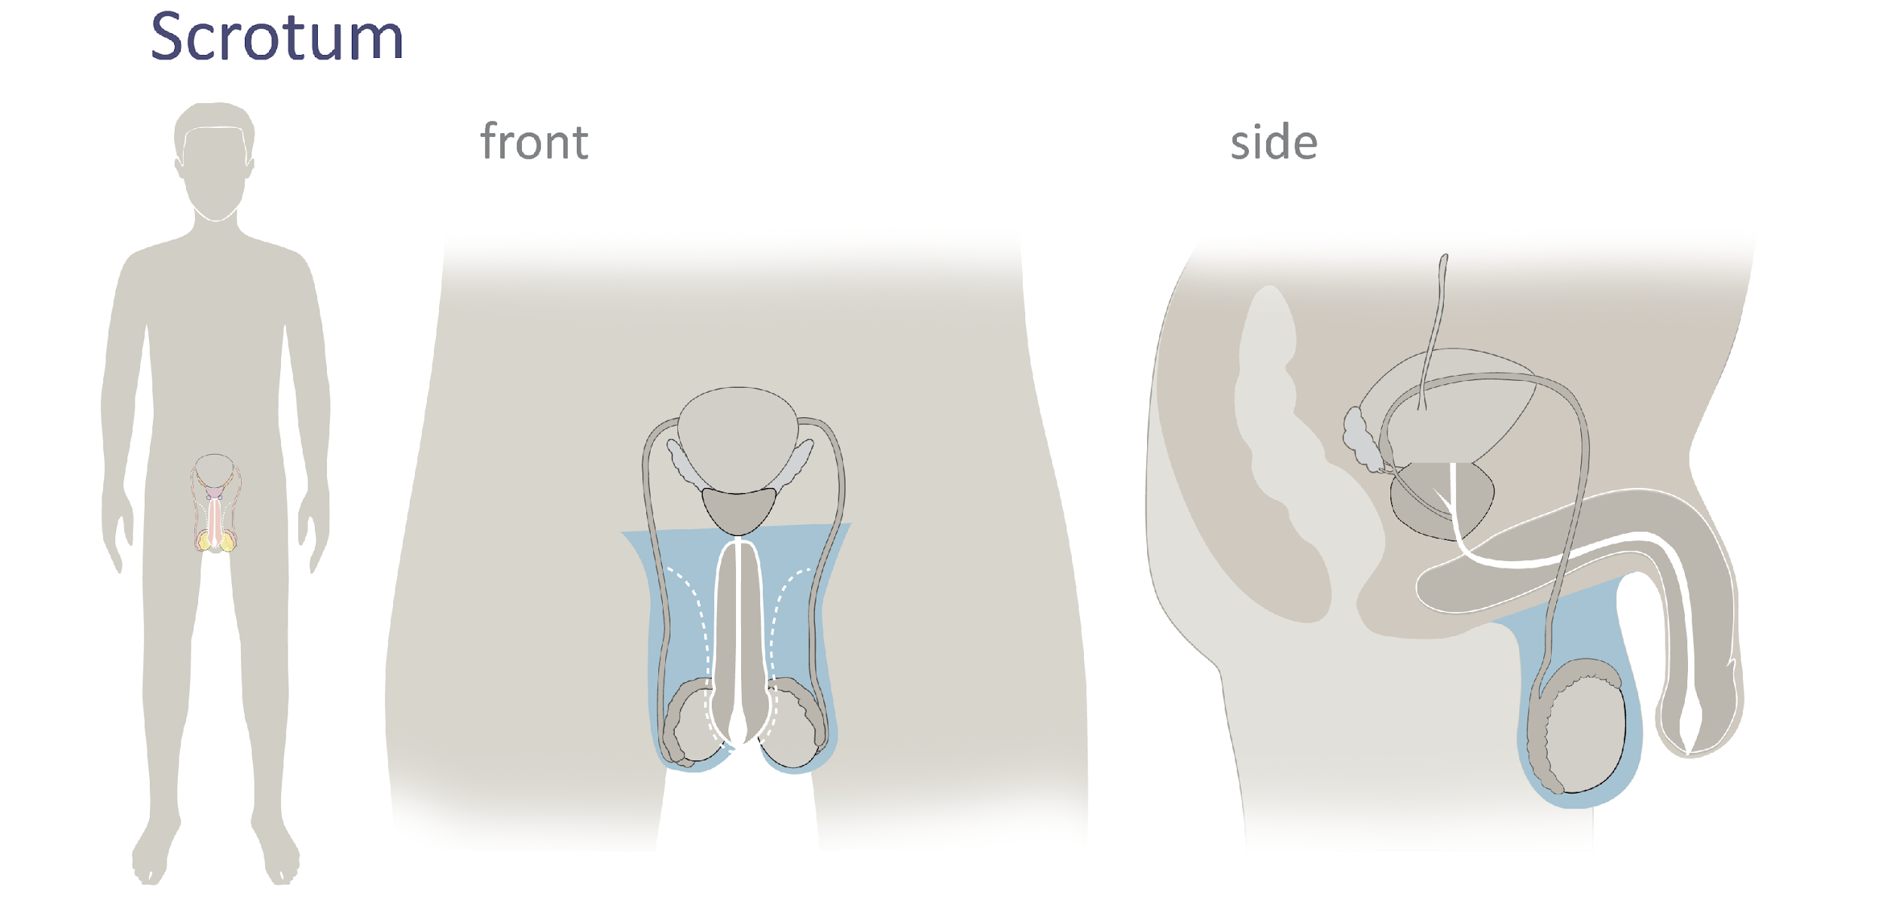
Male Reproductive Anatomy
scrotum
© FEMM
Notes:
The scrotum is the protective sac that encloses the testes, epididymis and part of the vas deferens. The scrotum works to draw all of these parts toward or away from the body to regulate temperature. For example, when it’s very hot out, the scrotum will actually detect this and regulate the position of the testes so that they are kept at an ideal temperature. The ideal temperature for the scrotum is around 93.2ºF (34ºC). This is 5.4ºF (3ºC) below our normal body temperature of 98.6ºF (37ºC ). Isn’t it crazy what the body can do!?

Slide 14
Male Reproductive Anatomy
seminal vesicles
© FEMM
Notes:
Seminal vesicles: a pair of glands on either side of the bladder that contribute fluid to semen, to help nourish and transport sperm.

Slide 15
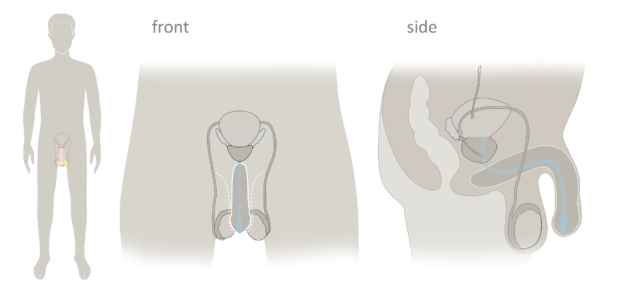
Male Reproductive Anatomy
urethra
© FEMM
Notes:
The urethra is a tube that begins at the bladder (organ that holds urine) and ends at the tip of the penis. The urethra is the tube that allows either urine or seminal fluid to pass out of the body. *Note that urine and seminal fluid are not released at the same time.

Slide 16
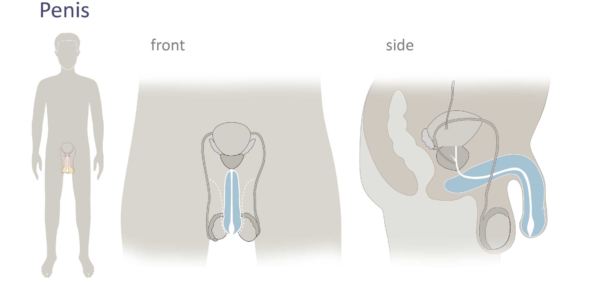
Male Reproductive Anatomy
penis
© FEMM
Notes:
Penis: The organ that allows for the passage of urine out of the body. It is also the organ used for sexual intercourse.
Semen: The fluid containing sperm; semen is transported and released from the body through the urethra during ejaculation.

Slide 17
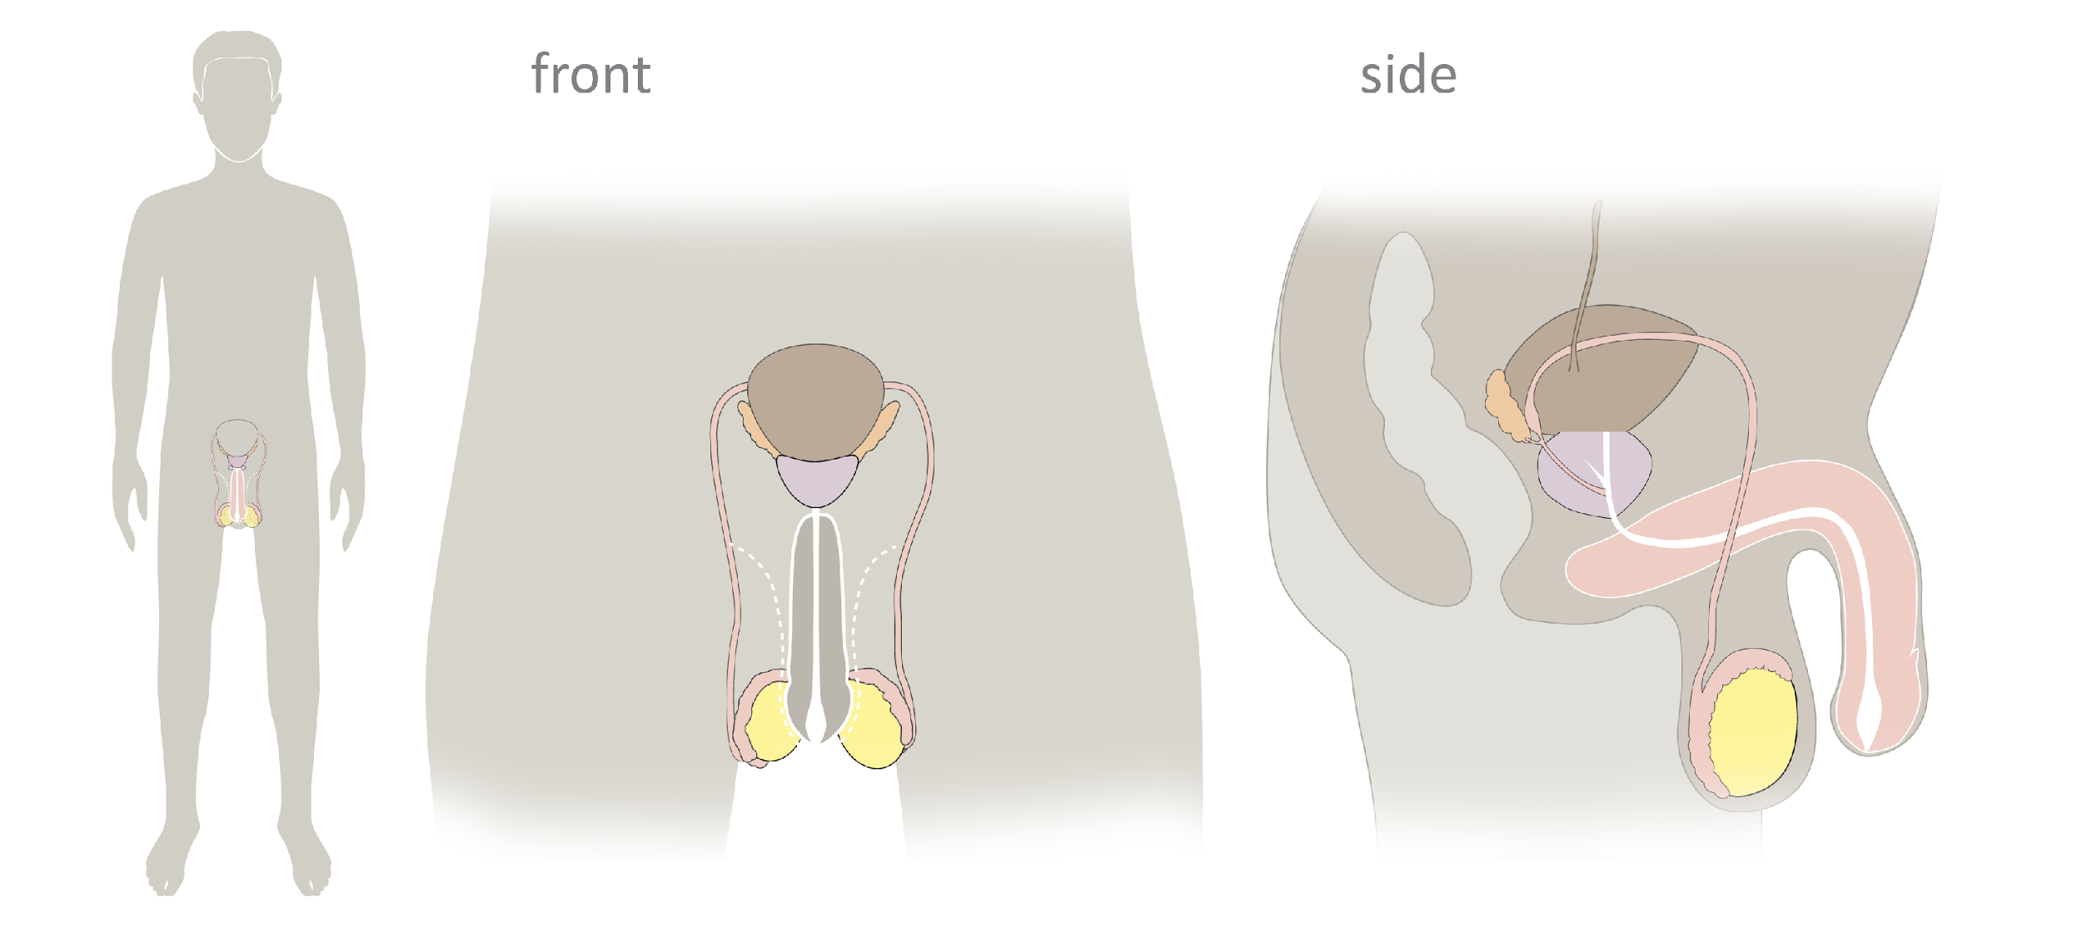
Overview | Male Reproductive Anatomy
© FEMM
Notes:
Let’s review.
Sperm is made in the ______ (testes or testicles) which are enclosed by the ________ (scrotum). Sperm is stored and matured in the __________ (epididymis) and travels through the _______ (vas deferens). The seminal vesicles are two glands that secrete fluid, to help nourish and transport sperm. The ______ (urethra) is the tube through which urine exits the body; it is also the tube through which semen exits the body.
The testicles are highlighted in yellow. The epididymis are attached to the testes, differentiated in pink. The scrotum is presented in gray, around the testicles. The vas deferens, two tubes, are also in pink. The bladder is the brown organ, but it is not part of the reproductive system, even though it is very close by; it is actually part of the urinary system. The urethra is the tube shown in white that travels through the penis, which is also presented in pink on the slide.

Slide 18
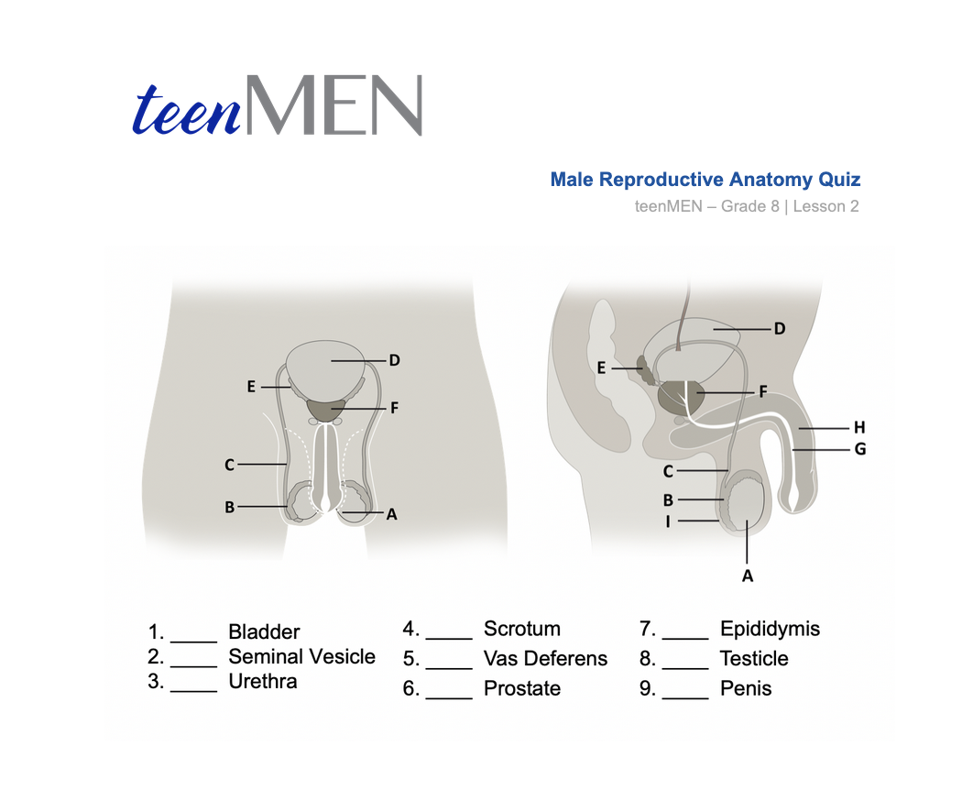
Male Reproductive Anatomy
© FEMM
Notes:
Step 5 (5 minutes): Male Anatomy Quiz: Worksheet
Hand out the Male Anatomy Quiz Worksheet. Have students label the reproductive anatomy by filling in the blanks. Give students a couple of minutes and then review the answers together as a class, using the next slide.

Slide 19
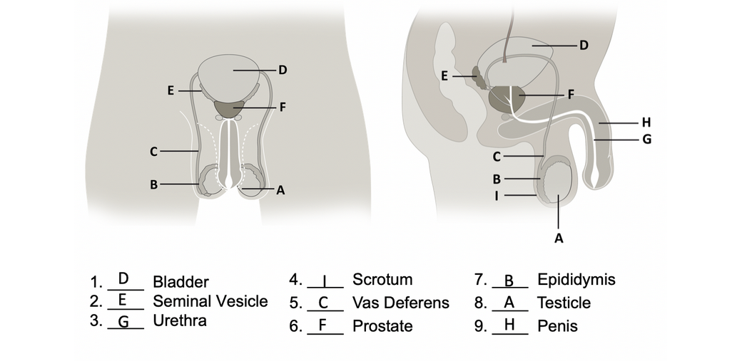
Answers | Male Reproductive Anatomy
© FEMM

Slide 20
Review
The male reproductive system is responsible for developing the male cell of reproduction, sperm, and the main male hormone, testosterone.
The development of the cells of reproduction indicate that hormone levels are healthy.
We can continue to help our bodies become as healthy as possible with how we treat our body and the healthy choices we make.
© FEMM
Notes:
The male reproductive system is an important body system that is vital to our overall health. The male reproductive system is responsible for developing the male cell of reproduction, sperm; and the hormone testosterone. As your body matures through puberty, the development of the cells of reproduction indicate that your hormone levels are healthy. The way that our reproductive systems are growing right now is a sign of health that our hormones are working well. We can continue to help our bodies become as healthy as possible with how we treat our body and the healthy choices we make. We’ll learn more about how to make healthy choices in the upcoming lessons.

Slide 21
Grade 8
LESSON 2
© FEMM

