Slide 1

Grade 8
LESSON 3
© FEMM

Slide 2

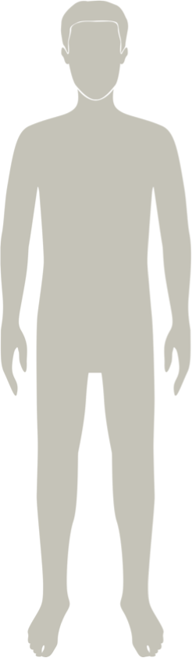
Review
© FEMM
Notes:
Step 1 (2 minutes): Review answers from “Do you still have any questions about the female or male reproductive anatomy?” gathered during last class.

Slide 3
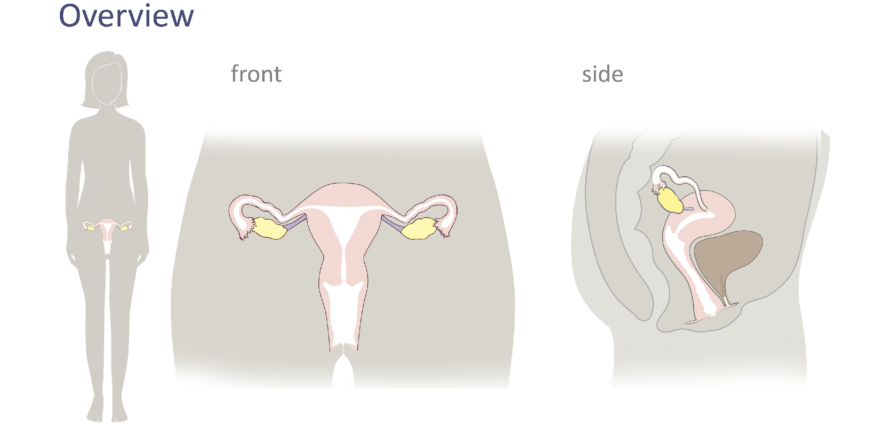
Female Reproductive Anatomy
© FEMM
Notes:
Step 2 (5 minutes): Review the anatomy parts and how they all work together.
Slides: Healthy body; Female Reproductive Anatomy
Let’s briefly review the anatomy of the female reproductive system. On this slide, we can see the basic parts, the uterus, ovaries, fallopian tubes, cervix, and vagina. In the side view, we can see all of these same parts, as well as the anus, bladder, and urethra. Let’s see if we can label these parts as a class.

Slide 4
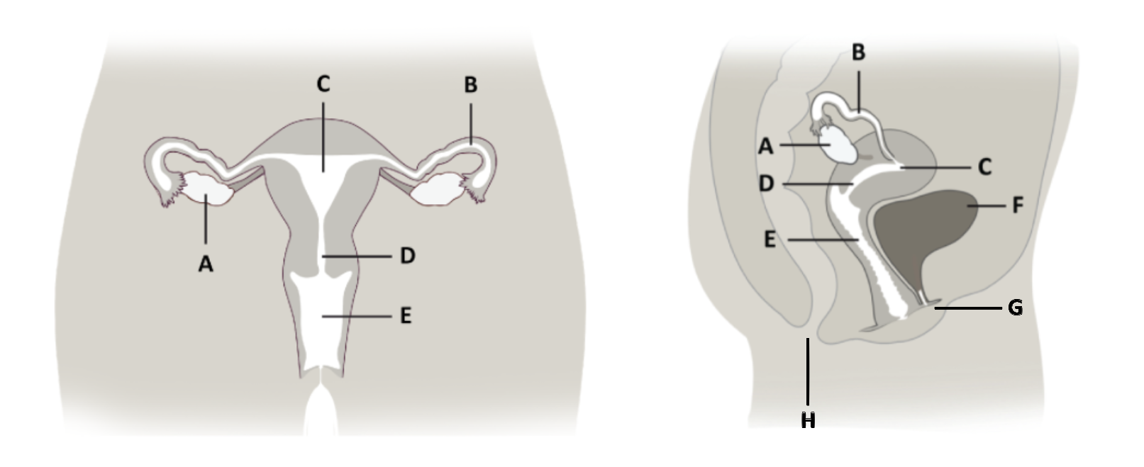
Female Anatomy Quiz
____ Cervix
____ Ovary
____ Bladder
____ Vagina
____ Fallopian Tube
____ Uterus
____ Anus
____ Urethra
Notes:
Have students identify the labeled anatomy. When finished, check student answers using the following slide.

Slide 5
Answers | Female Anatomy Quiz
____ Cervix
____ Ovary
____ Bladder
____ Anus
____ Urethra
D
A
F
E
B
C
H
G
____ Vagina
____ Fallopian Tube
____ Uterus
Notes:
Ovary: 2 small organs on either side of the uterus that contain a woman’s eggs - develop and release an egg, each month.
Fallopian Tube: 2 tubes, on either side of the uterus, where the egg travels after ovulation.
Uterus: also called the ‘womb’, is where babies begin to grow.
Cervix: canal at the base of the uterus, that opens into the vagina.
Teacher: point out the 3 openings/exits from the body: vagina, urethra, anus.
Vagina: canal that connects the uterus to the outside of the body. entrance to the reproductive organs and exit for the delivery of a baby.
Urethra: tube that carries urine from the bladder to the outside of the body.
Anus: opening for waste matter from the digestive system to exit the body.

Slide 6
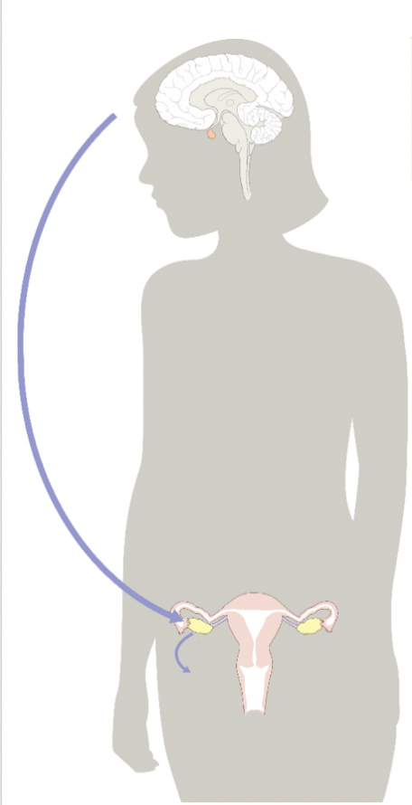
The Fab Four Main Female Hormones
FSH
Follicle-Stimulating Hormone
brain
LH Luteinizing Hormone
brain
1
3
ovary
Progesterone
rises + feeds back to brain
ovary
Estrogen
rises + feeds back to brain
2
4
E
P
Notes:
Step 3 (15 minutes): Introduce the four main female hormones
Before we take a closer look at the process of ovulation, it’s important to remember the four main female reproductive hormones: FSH, estrogen, LH, and progesterone.
1. Follicle stimulating hormone (FSH) is a hormone in the brain in the pituitary gland. It does exactly what its name suggests: it sends a message from the brain to the ovaries to select and begin to develop an egg inside of a follicle in the ovary.

Slide 7
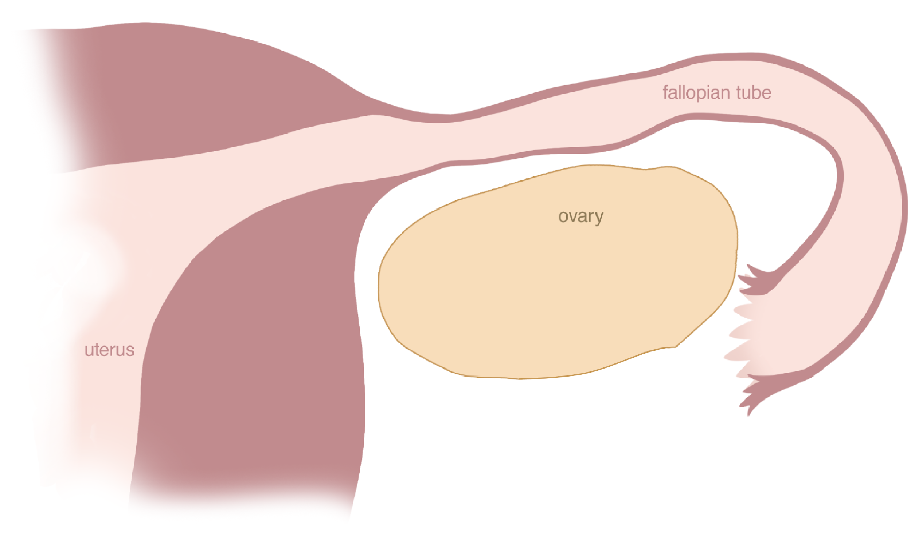
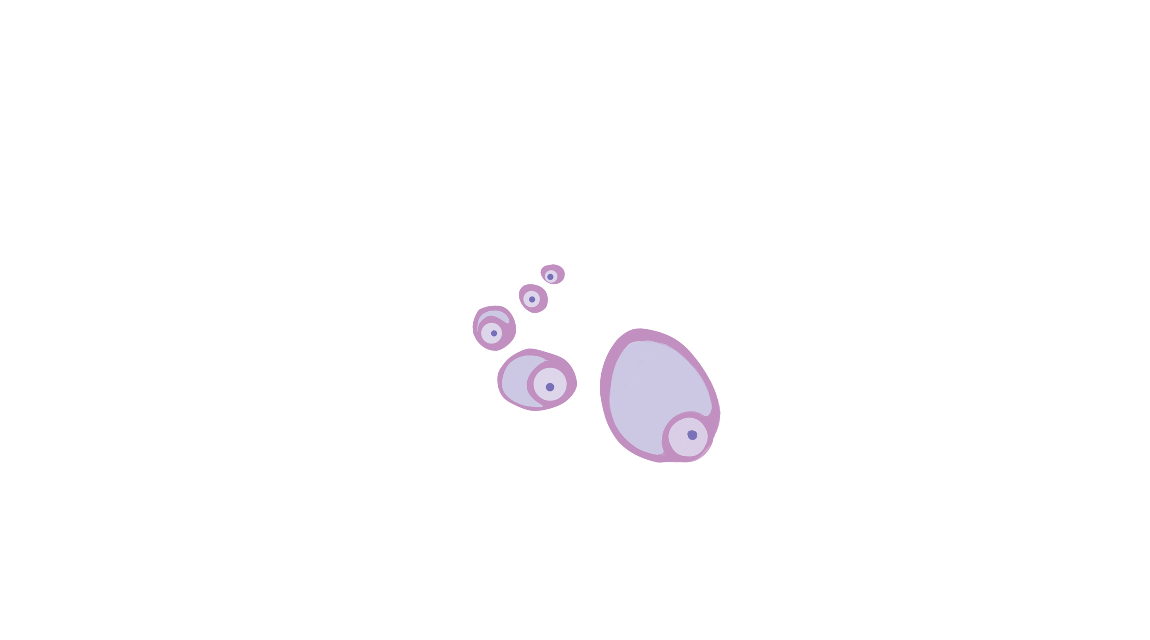
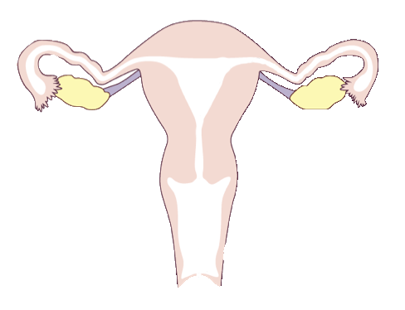
Ovulation: FSH + Estrogen
FSH
E
© FEMM
Notes:
1. Follicle stimulating hormone (FSH) is a hormone produced in the brain, by the pituitary gland.
It does exactly what its name suggests; Follicle Stimulating Hormone sends a message to the ovaries to stimulate the growth and development of an egg and follicle in the ovary.
2. The egg and follicle grow in the ovary, producing more and more estrogen. When the level of estrogen is sufficiently high, this acts like a feedback loop sending a message back to the brain.

Slide 8
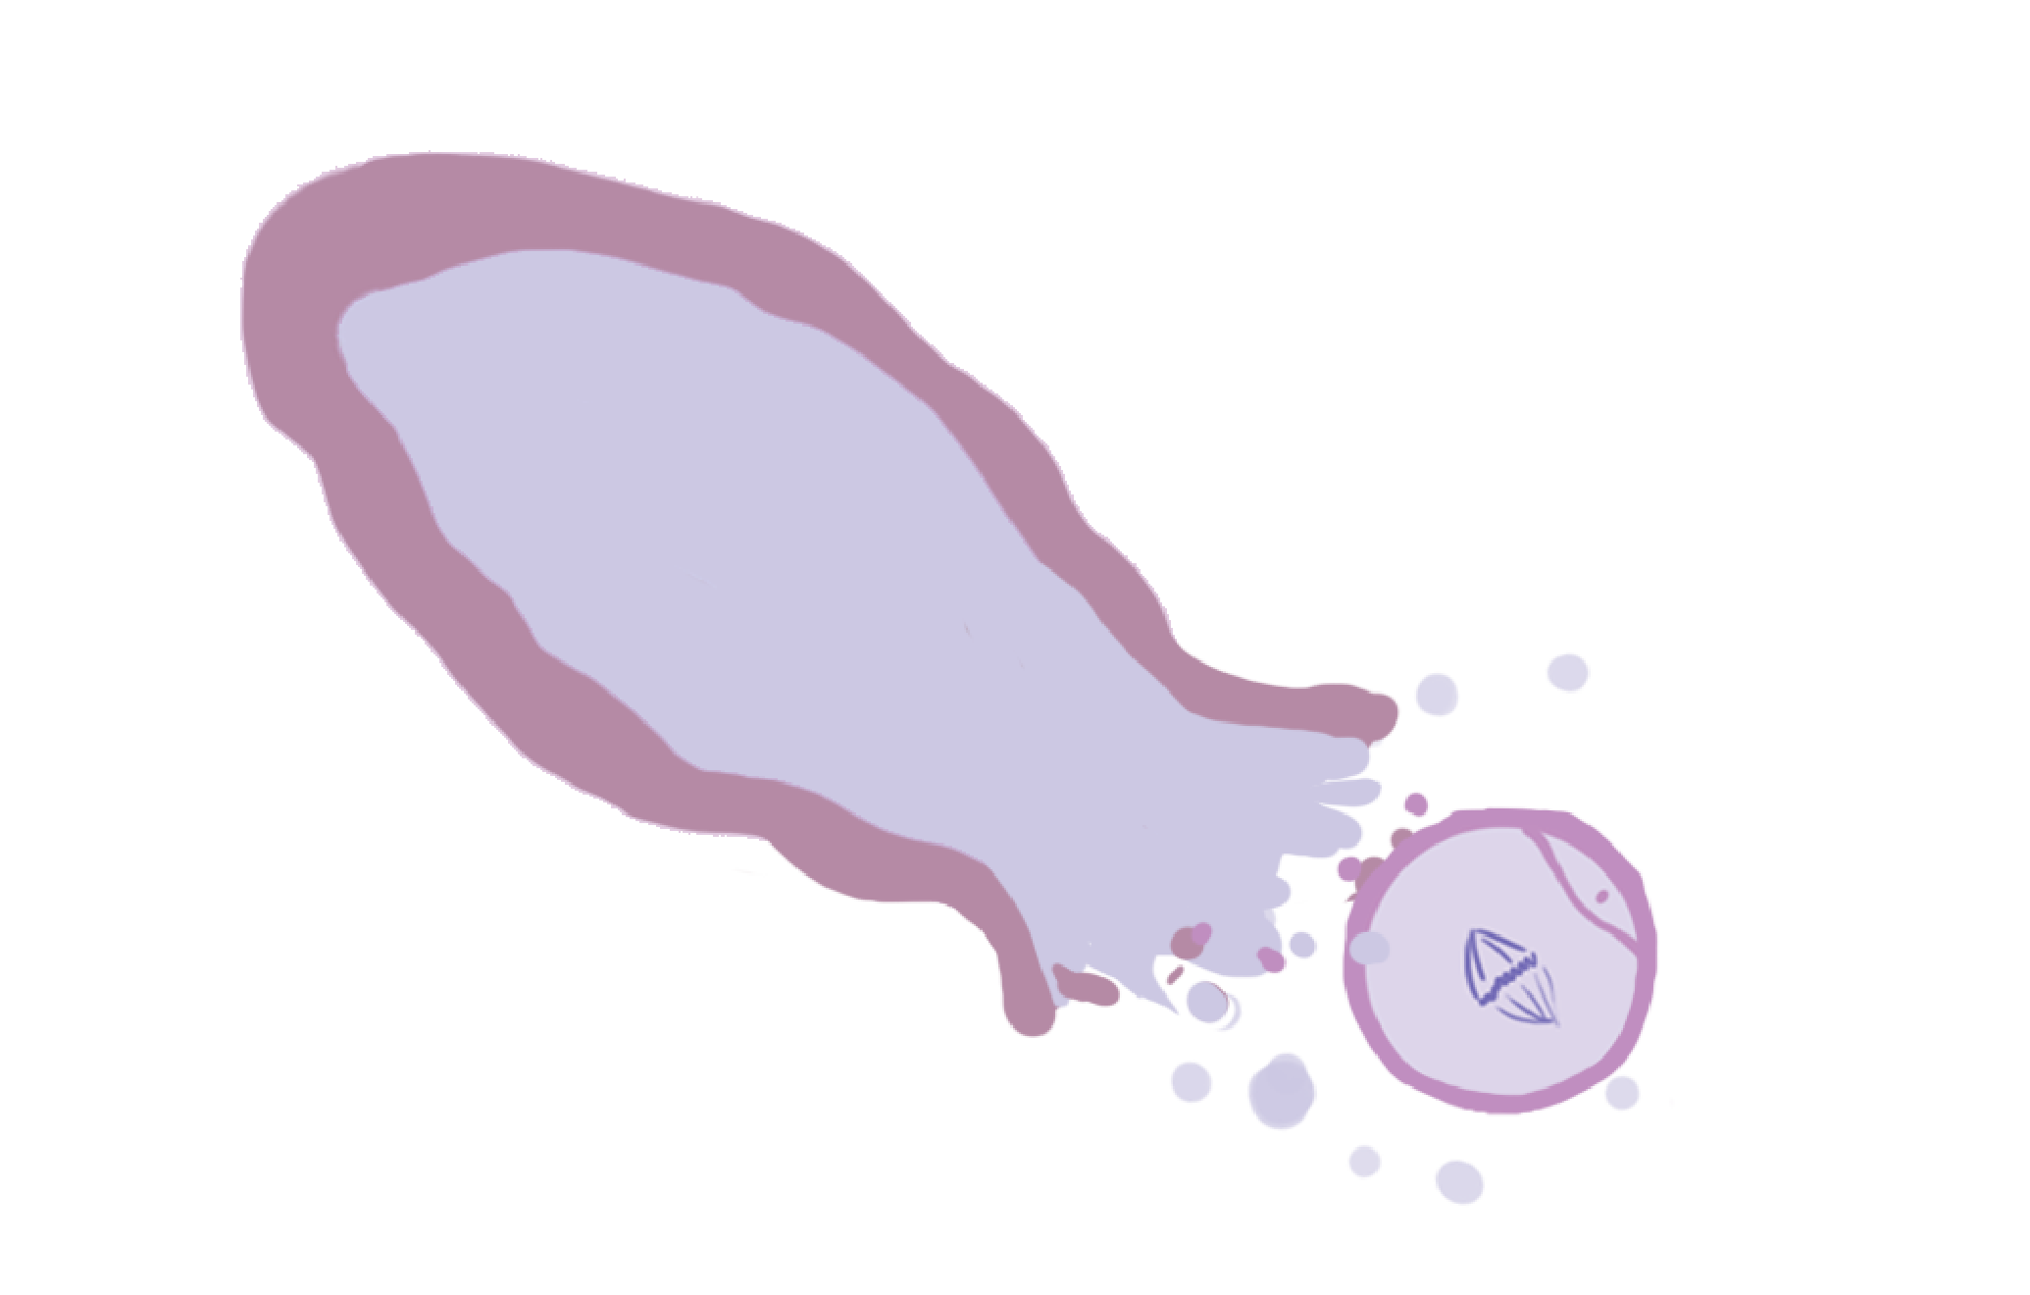
Ovulation: LH
LH
© FEMM
Notes:
3. The hormone estrogen signals the brain to stop the release of FSH and to release Luteinizing Hormone (LH).
This usually happens around day thirteen of the cycle. LH triggers the release of the egg from the follicle and ovulation occurs.
In ovulation, the egg is released into the fallopian tube. As you can see, there are two ovaries, and they usually alternate - one month the left ovary releases an egg and the next month the right ovary does.

Slide 9

Ovulation: Progesterone
P
© FEMM
Notes:
4. After ovulation, the empty follicle is recycled into a new tissue called the corpus luteum, which produces the hormone progesterone.
Corpus luteum is Latin for ‘yellow body’ as it is yellowish in color under a microscope.
Now, what happens to the egg? Cycle after cycle, the egg simply dissolves in the fallopian tubes, the corpus luteum breaks down and menstruation happens about two weeks later.
However, if the egg joins together with sperm (the male cell of reproduction), the fertilized egg, the beginning of a new human life, will travel through the fallopian tube to implant in the lining of the uterus. Progesterone levels will continue to rise to support a pregnancy.
All of this activity happening in our reproductive system month to month isn’t just necessary for reproduction. Ovulation and the fab four hormones have a major impact on our overall health!

Slide 10
Your turn!
© FEMM
Notes:
Step 3 (5 minutes): Now it’s the students’ turn to describe what happens in the ovary each month.
Ask: What’s the name of the hormone that sends a message from the brain to the ovaries to select and begin to develop an egg?
Follicle Stimulating Hormone FSH.

Slide 11
Your turn!
© FEMM
Notes:
Ask: What happens to the egg and the follicle? Which hormone do they produce?
As the egg and follicle grow inside the ovary, the growing and maturing egg and follicle produce more and more estrogen.
Ask: What happens when the level of estrogen is sufficiently high?
When estrogen is sufficiently high and the egg and follicle have grown and matured, this triggers the release of another hormone called Luteinizing Hormone (LH). LH causes the egg to be released from the follicle in ovulation.

Slide 12
Your turn!
© FEMM
Notes:
Ask: Where does the egg “travel to” after ovulation?
Once ovulation takes place, the egg travels to the fallopian tube. It’s in the fallopian tube that the egg meets sperm, in the case of intercourse. If fertilization occurs, the sperm joins with the egg and together a new life is formed that will implant in the uterus to continue to grow. If fertilization does not take place, the egg simply dissolves in the fallopian tube 12-24 hrs after ovulation.
Ask: Does ovulation mean that pregnancy has occurred?
No. Ovulation is simply what happens in your body, every cycle, as a healthy sign that the proper level of hormones are being produced. Pregnancy can only occur if sperm are present around the time of ovulation.
Ask: What happens in the ovary after ovulation?
After the egg has been released from the follicle in ovulation, and has been swept into the fallopian tube….the empty follicle produces progesterone.

Slide 13
Your turn!
© FEMM
Notes:
Great job explaining that!
So, let’s review. Ovulation is the bursting of the mature egg from the follicle; it happens in the ovary.
The two main jobs of the ovary are to develop and ovulate an egg, and to produce estrogen and progesterone.

Slide 14
The Fab Four Female Hormones
P
FSH
LH
E
© FEMM
Notes:
The hormone FSH (Follicle Stimulating Hormone) initiates this process, which starts in the brain. When FSH signals the ovaries, an egg and follicle in the ovary start to develop. As they grow and develop, they produce estrogen. Once estrogen reaches a certain level, it triggers LH (Luteinizing Hormone) from the brain. This causes ovulation to happen! After the egg leaves the follicle in ovulation, the left-over follicle is recycled into the corpus luteum and produces the hormone progesterone.
Ovulation happens once a month. This is why in teenFEMM, the monthly cycle is referred to as the ovulation cycle.
This is a good moment to acknowledge that the ovulation cycle is often referred to as the menstrual cycle. This isn’t incorrect, but ‘ovulation cycle’ is more accurate. Using this terminology helps girls and women develop a more positive view of their cycle and begin to recognize why ovulation is considered a vital sign of health.

Slide 15
The Fab Four: Hormones and Your Development
Your brain and your ovaries talk.
FSH
LH
Sending hormonal messages throughout the body.
The health of your hormones during puberty shapes your body and your brain for the rest of your life! 😮
*Ovulation is a sign of health* as it indicates that all your reproductive hormones are working properly!
E
P
Notes:
Step 5 (5 minutes): Revisit the hormonal axis in the context of ovulation and overall health.
What does it mean to have healthy hormones during puberty? Why is it important to make healthy choices now, and to begin to understand the ovulation cycle before it may even be actually happening every month?
As you go through puberty, the hormonal axis is still developing. The brain is the command center, communicating with the reproductive system to send hormonal messages throughout the body. These hormones are vital to growth and development! Did you know that the overall health of your hormones during puberty shapes your body and your brain for life?

Slide 16
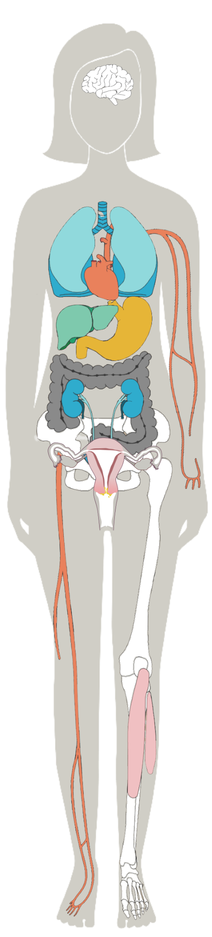
Effects of Estrogen & Progesterone on your body
 | Estrogen | Progesterone
uterus | tones, contracts | relaxes
uterine lining | grows | maintains
breasts | grows | normalizes
bones | forms | maintains
blood vessels | dilates, increases flow | relaxes, normalizes clotting
brain cells | stimulates | maintains and heals
well-being | normal levels promote well-being; high levels increase anxiety | promotes sleep and relaxation; decreases anxiety
Notes:
Ovulation is a sign of hormonal health because ovulation indicates that your brain and your ovaries are communicating well, and that all four main female hormones are firing! This slide shows some of the important things that estrogen and progesterone do for our bodies during the ovulatory cycle. A tiny thing like ovulation has a number of amazing benefits on a woman’s body, like helping you develop strong bones, build muscle, sleep well and stimulate brain cells.

Slide 17
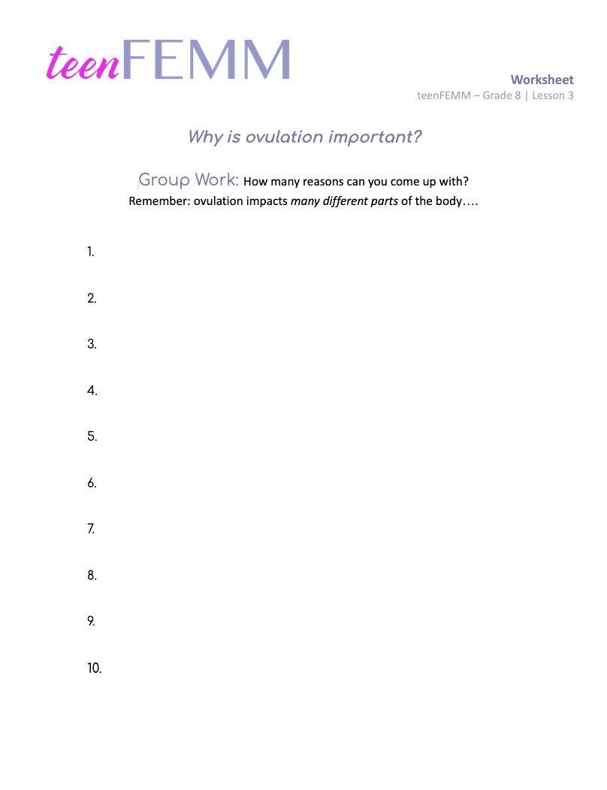
Worksheet
really
^
Why is ovulation important?
© FEMM
Notes:
Step 5: (10 minutes) Worksheet: Why is ovulation important? (Previous slide can be left on screen/referred to if needed.)
Divide students into small groups. Hand out the “Why is Ovulation Important?” Worksheet to each group. Explain that you will show the previous slide (“Effects of Estrogen & Progesterone on your body”) for ten seconds, to allow groups to study and try to retain everything they can from the slide. At “go”, groups will turn over their worksheet and write down as many effects they can recall from the previous slide or from the lesson. After four minutes, the group with the most correct answers, wins!
Possible combined answers:
1. For human reproduction to take place, ovulation must occur.
2. Bone growth and development
3. Breast growth and development
4. Skin balancing
5. Hair growth
6. Optic nerve development
7. Brain pathway development
8. Regulating mood
Estrogen has the effects of:
Toning and contracting the uterus
Growing the uterine lining
Developing the breasts
Forming the bones
Dilating the blood vessels
Stimulating brain cell growth
Promoting well being
Progesterone has the effects of:
Relaxing the uterus
Maintaining the uterine lining
Normalizing breast tissue
Maintaining bone growth
Relaxing the blood vessels
Maintaining and healing brain cells
Promoting sleep and relaxation

Slide 18
Review
Ovulation is a marker for health and hormone levels.
There are four main reproductive hormones involved in ovulation: FSH, estrogen, LH, and progesterone.
We need the right amounts of estrogen and progesterone in our bodies to be at our best, physically and mentally.
Notes:
CONCLUSION
As you can see, ovulation is an extremely fascinating and important event! It is essential for bringing new life into the world, but what we don’t often hear is how essential it is as a marker for basic health and hormone levels.
We need the right amounts of estrogen and progesterone in our bodies to feel our best, physically and mentally. In the next lesson, we will begin to learn how to chart or track the physical signs your body gives you that will help you to create a health record for yourself, and to learn more about your body.

Slide 19
Grade 8
LESSON 3
© FEMM

