Slide 1

Grade 8
LESSON 3
© FEMM

Slide 2
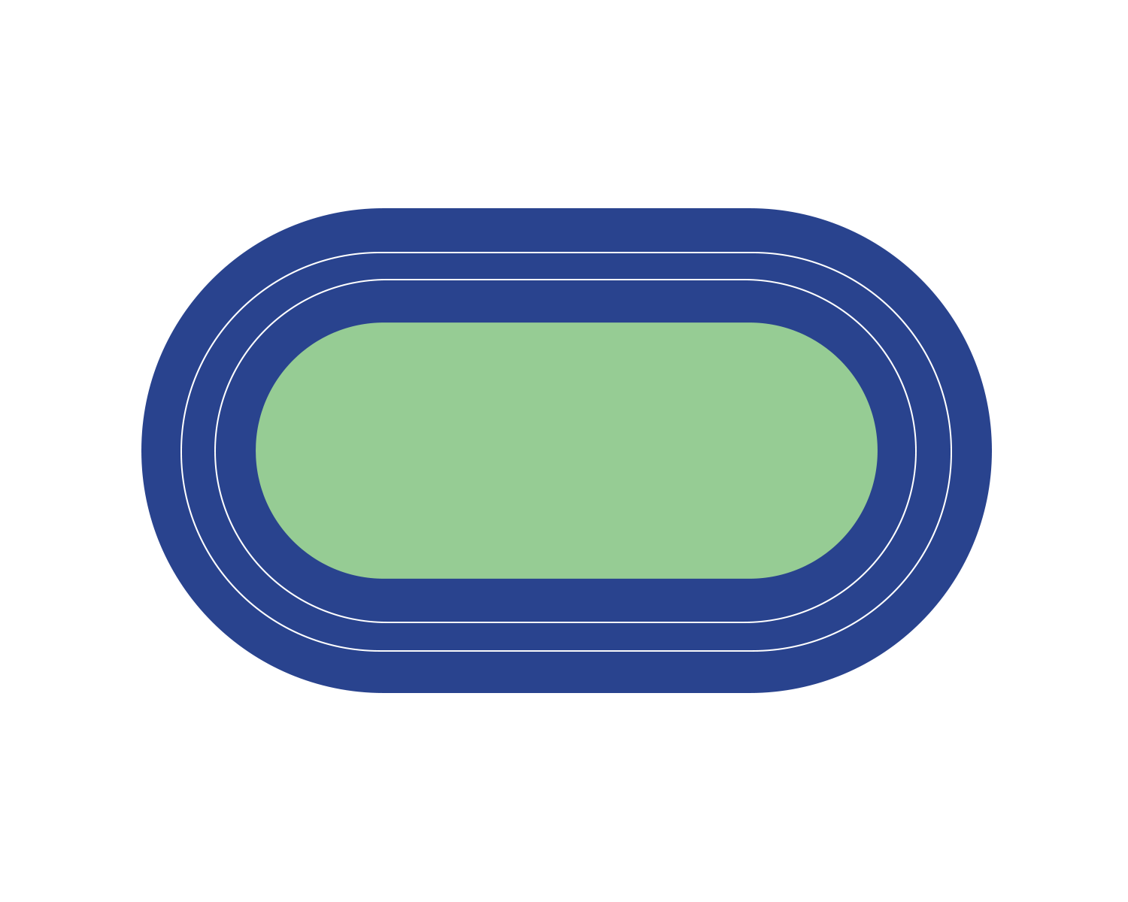
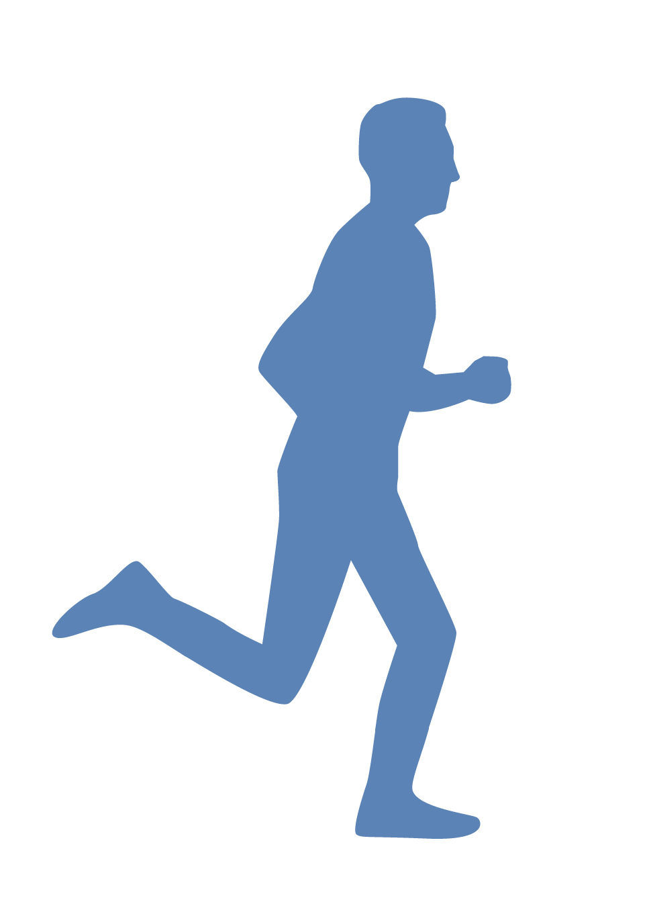
Male Reproductive System
RELAY RACE REVIEW
© FEMM
Notes:
PROCEDURE
Step 1 (10 minutes): Male Reproductive System Relay
Divide students into two teams. Depending on class size, each team will need to consist of at least three students but can be three pairs, three small groups per team, etc. Have the questions for each team printed, cut and ready. Pen or pencils needed.
In this teenMEN Relay Race, each team will need to correctly complete three legs of the race to finish. To start, the first group from each team will come forward and receive their questions. Each group will complete their questions at the front of the class. When they have completed the questions (or as many as they can answer), they will submit their page to the teacher and return to tag the next group to come forward, etc. The first team to finish with the most number of questions answered correctly, wins!
Review answers using the following slides.

Slide 3
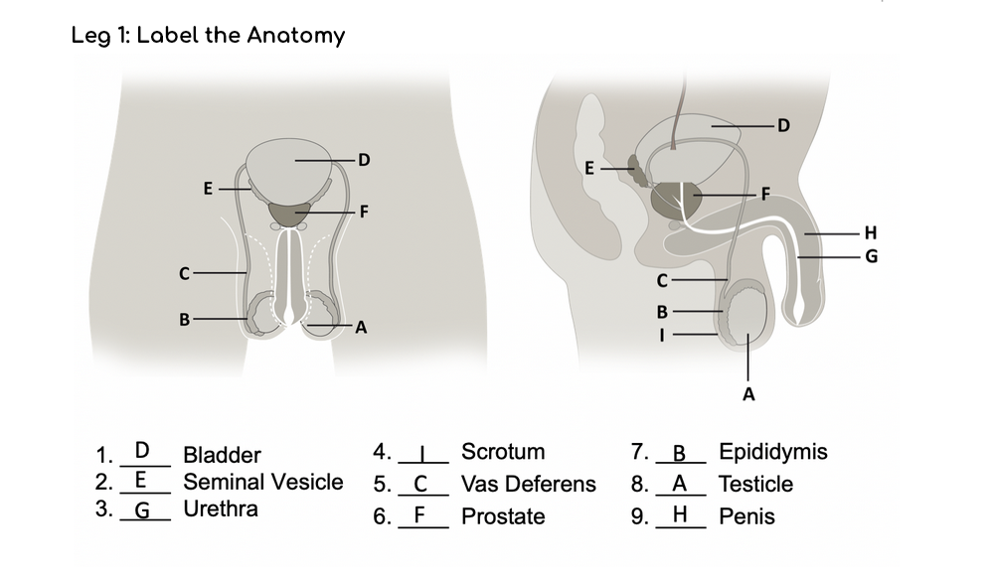
Answers | Male Reproductive Anatomy
© FEMM

Slide 4
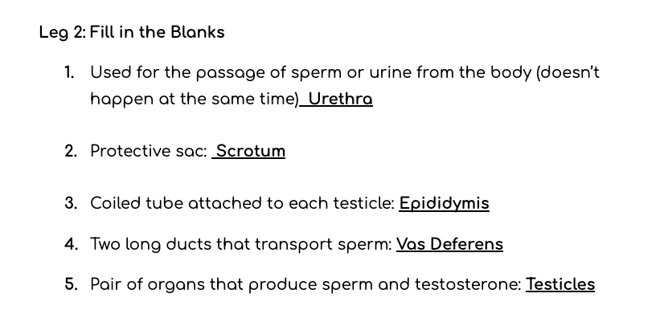
Answers | Fill in the Blanks
© FEMM

Slide 5
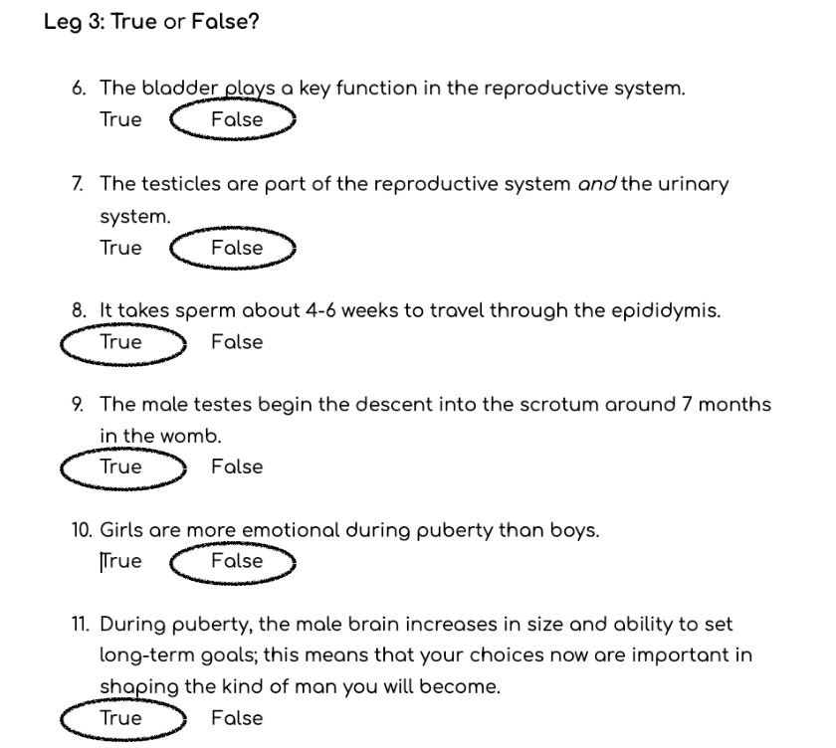
Answers | True or False
Leg 3: True or False?
© FEMM
Notes:
6. The bladder plays a key function in the reproductive system.
False. The bladder is not technically part of the reproductive system, though it is close to the reproductive organs; it is part of the urinary system.
7. The testicles are part of the reproductive system and the urinary system.
False. The testicles are part of the reproductive system and the endocrine system, as they produce the hormone testosterone.
8. It takes sperm about 4-6 weeks to travel through the epididymis.
True!
9. The male testes begin the descent into the scrotum around 7 months in the womb.
True! The testes begin the descent into the scrotum around 7 months gestation, when the testes begin secreting reasonable quantities of testosterone.
10. Girls are more emotional during puberty than boys.
False. Even before physical changes are noticeable, boys can feel overly sensitive, angry or anxious, during puberty.
11. During puberty, the male brain increases in size and ability to set long-term goals; this means that your choices now are important in shaping the kind of man you will become.
True! During puberty, the male brain reaches its largest physical size and is reshaped! The part of the brain behind the forehead, called the prefrontal cortex, is one of the last parts to mature. This area is responsible for skills like planning, prioritizing, and making good decisions.

Slide 6
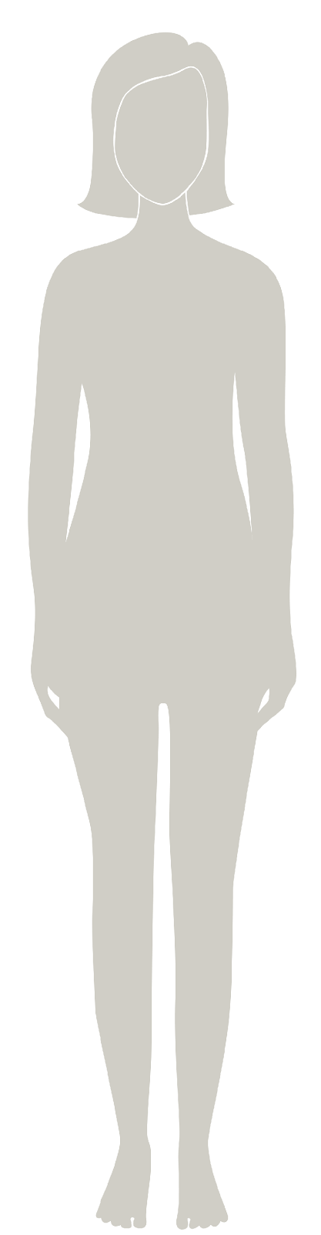
Female Reproductive Anatomy
Female
Reproductive Anatomy
© FEMM
Notes:
Step 2 (10 minutes): Introduce the Female Reproductive Anatomy
Today we’re going to learn about the female reproductive system. The female reproductive system is also located in the pelvic area and is vital to overall health and wellbeing.

Slide 7
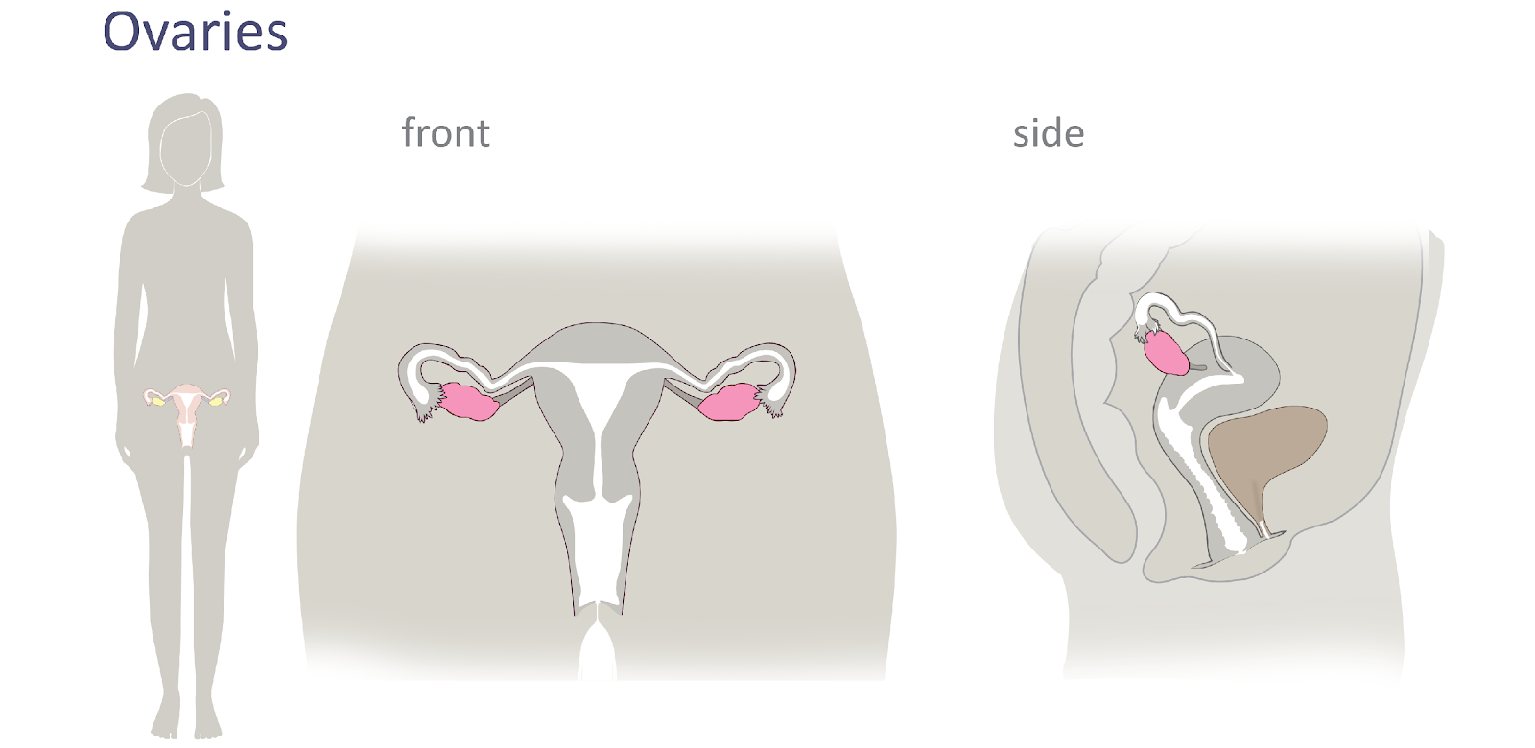
Female Reproductive Anatomy
© FEMM
Notes:
The ovaries are the two small organs that sit on either side of the uterus, highlighted in pink on the slide. The job of the ovaries is to:
1. Develop and mature an egg, the female cell of reproduction.
2. Produce the two main female hormones, estrogen and progesterone.
The female body starts making eggs at nine weeks in the womb! Inside the ovary, eggs are contained in small sacs, called follicles. As of puberty, inside the ovary each month, an egg matures (to about the size of a pinhead or a grain of sand) and bursts from its follicle in a process called ovulation. For girls, ovulation is a sign of health, not for reproduction but because it indicates that all of her hormones are rising to the right levels for this process to occur.
Compare: The testes are the two male organs of reproduction. The job of the testicles is to:
1. Produce sperm, the male cell of reproduction.
2. Produce the main male hormone, testosterone.
Just as sperm production is a vital sign of hormonal health in men, ovulation is a vital sign of hormonal health for women.

Slide 8
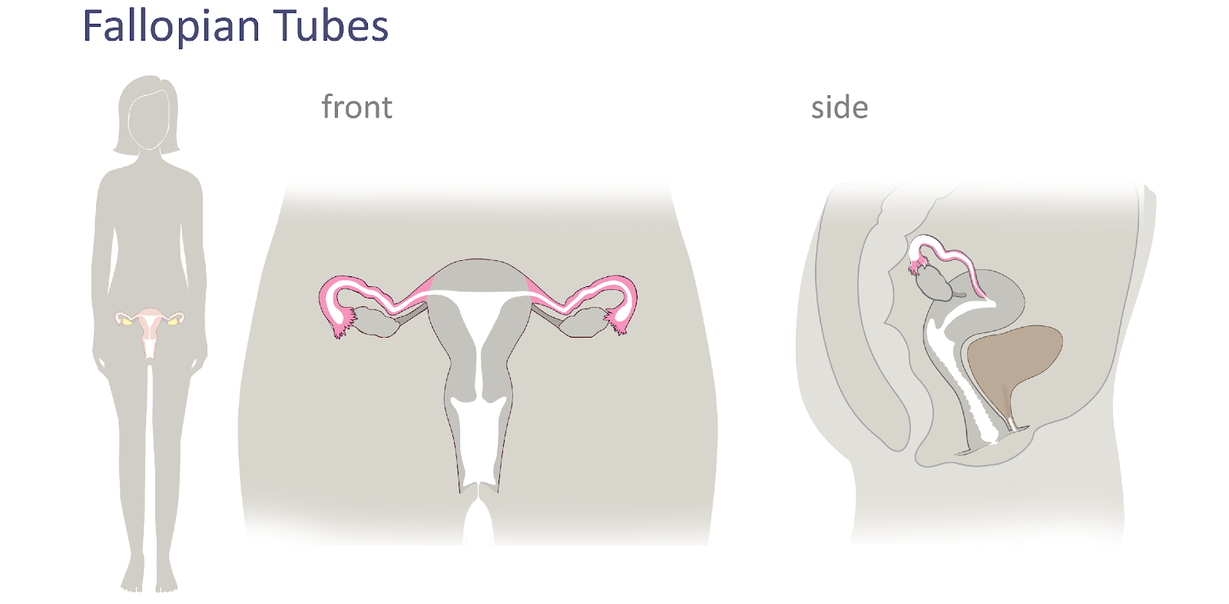
Female Reproductive Anatomy
© FEMM
Notes:
The fallopian tubes are the long thin tubes that are connected to either side of the ovary. They are about the width of a spaghetti noodle. When the egg is released from the ovary (called ovulation), it travels to the fallopian tube. On its own, the egg will simply dissolve in the fallopian tube in about 24-48 hours.
Compare: The Vas Deferens are two tubes that transport sperm, the male cell of reproduction, from the testicles. They are also about the width of a spaghetti noodle.

Slide 9
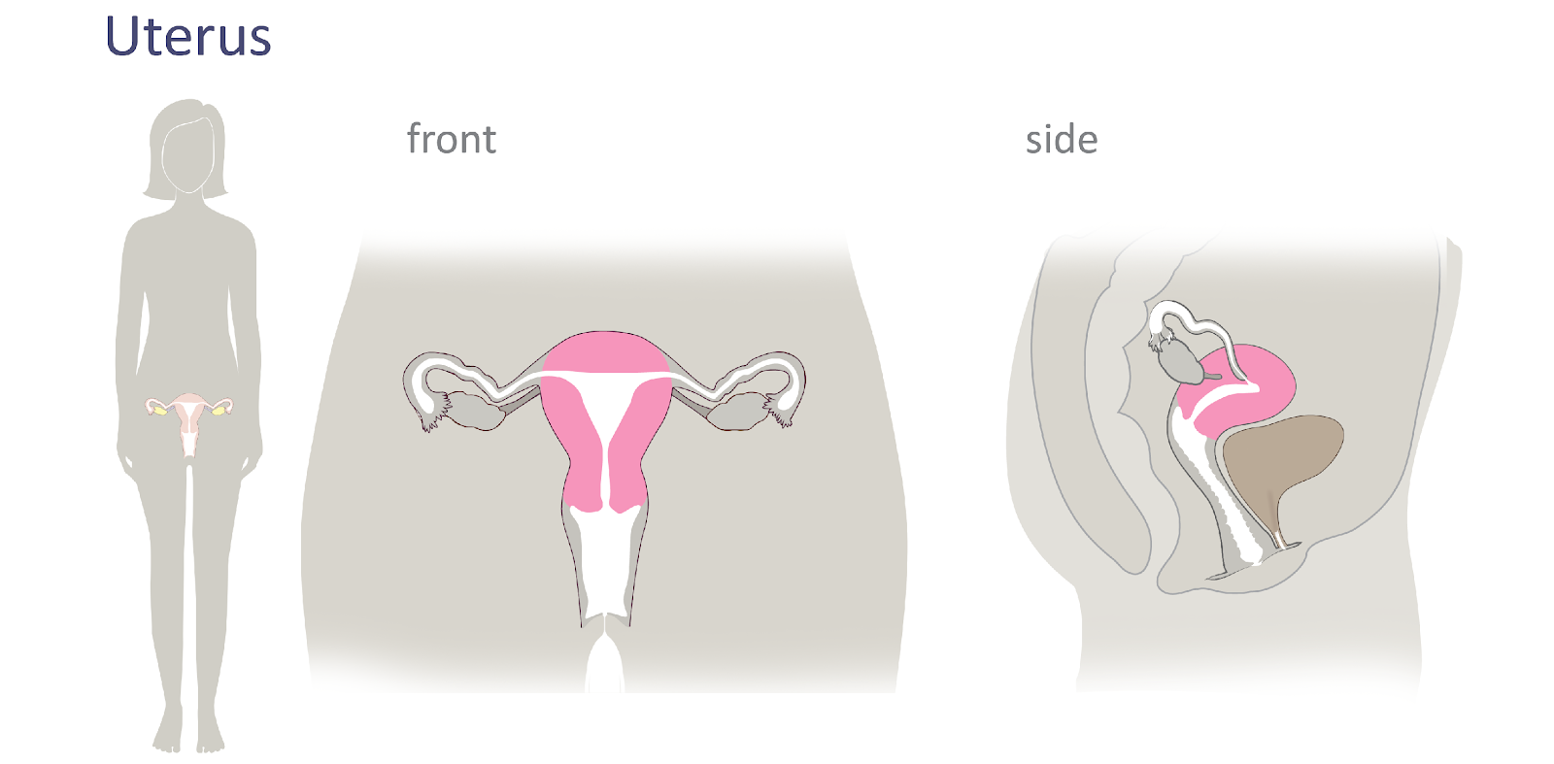
Female Reproductive Anatomy
© FEMM
Notes:
In the front view on the slide, you see the uterus in the center. Without the uterus, none of us would be here! The uterus is a hollow, pear shaped organ where a baby grows and develops. It is sometimes called the womb. Get this: the uterus is the strongest muscle per square inch in the human body, with the propulsion force/size ratio of a crossbow!
The lining of the uterus is called the endometrium. This lining responds to hormones each month, thickening and then shedding in menstruation. This process is the body’s preparation for a possible pregnancy someday, as the fertilized egg implants in the uterine lining wall to receive the nourishment it needs to grow for 9 months.

Slide 10
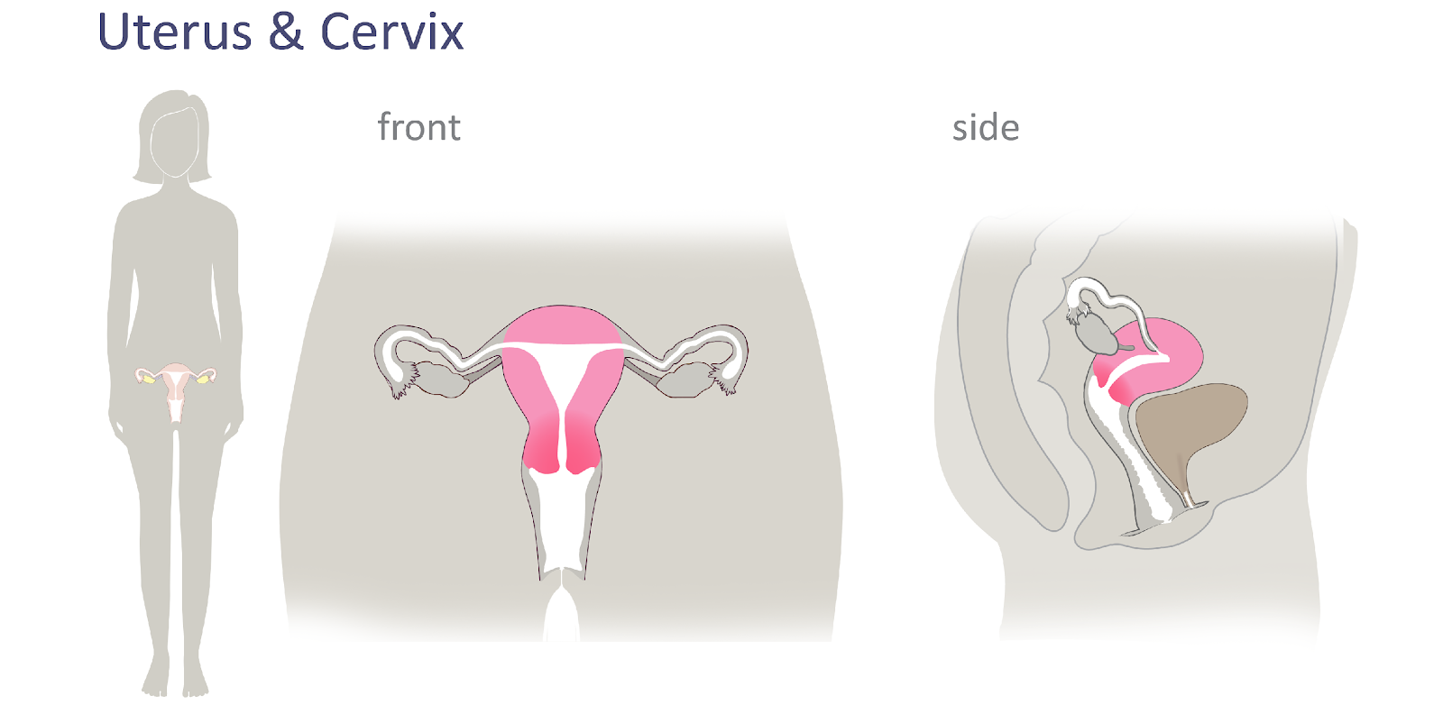
Female Reproductive Anatomy
© FEMM
Notes:
The cervix is the canal or opening at the base of the uterus that connects to the vagina.

Slide 11
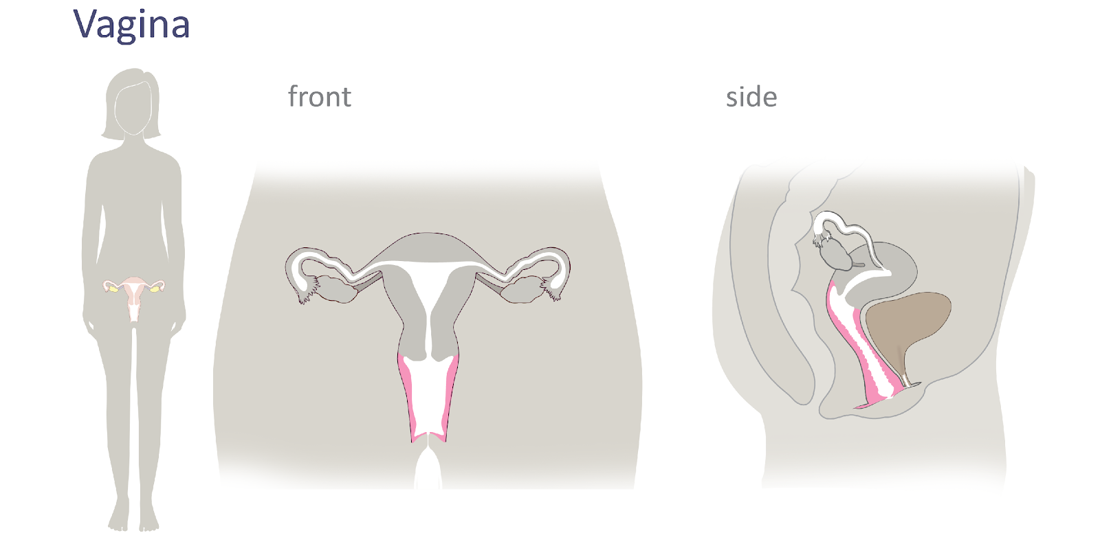
Female Reproductive Anatomy
© FEMM
Notes:
The vagina is the canal that connects the uterus to the outside of the body. It is the entrance to the reproductive organs and the exit for the delivery of a baby. It is the exit for menstrual bleeding each month.

Slide 12
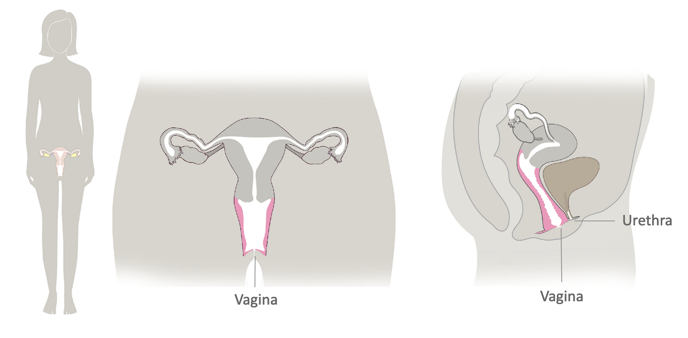
Female Reproductive Anatomy
© FEMM
Notes:
The urethra is a separate opening from the vagina and carries urine from the bladder to the outside of the body. The urethra is not part of the female reproductive system; it is part of the urinary system but it is shown due to its proximity to the reproductive system.

Slide 13
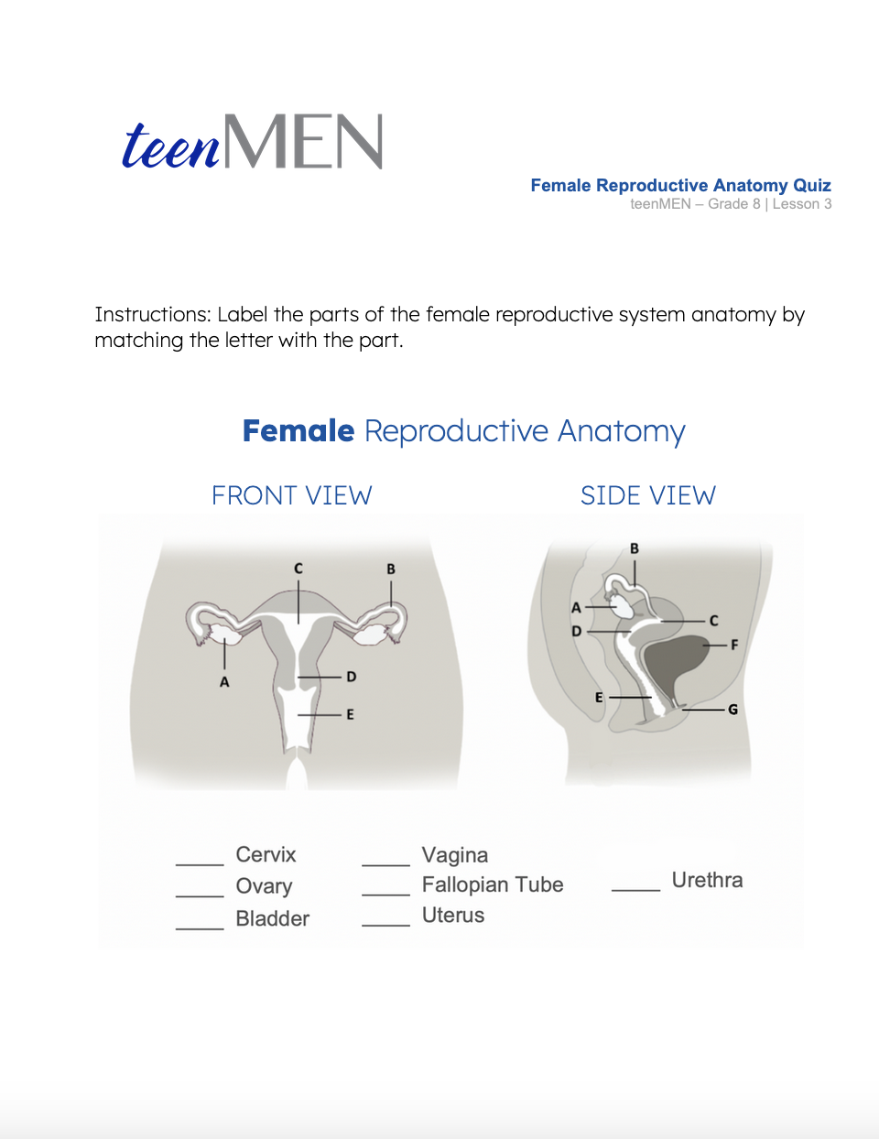
Female Reproductive Anatomy
It’s time for the… Quiz!
© FEMM
Notes:
Step 3 (5 minutes): Female Reproductive Anatomy Quiz
Provide students with the worksheet: Female Reproductive Anatomy Quiz.
Then, review the answers using the following slide, or the Answer Key provided in the lesson materials.

Slide 14
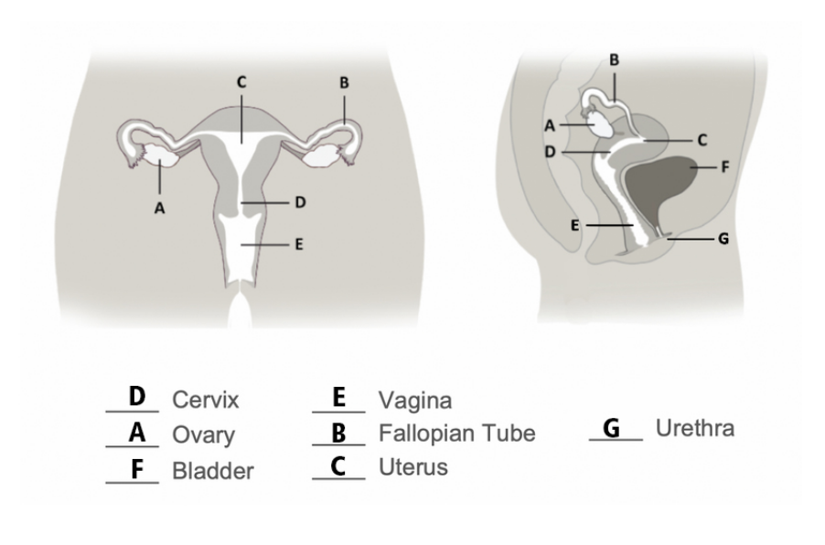
Answers | Female Reproductive Anatomy
Answers
Quiz Answers!
© FEMM
Notes:
Then, review the answers using the following slide, or the Answer Key provided in the lesson materials.

Slide 15
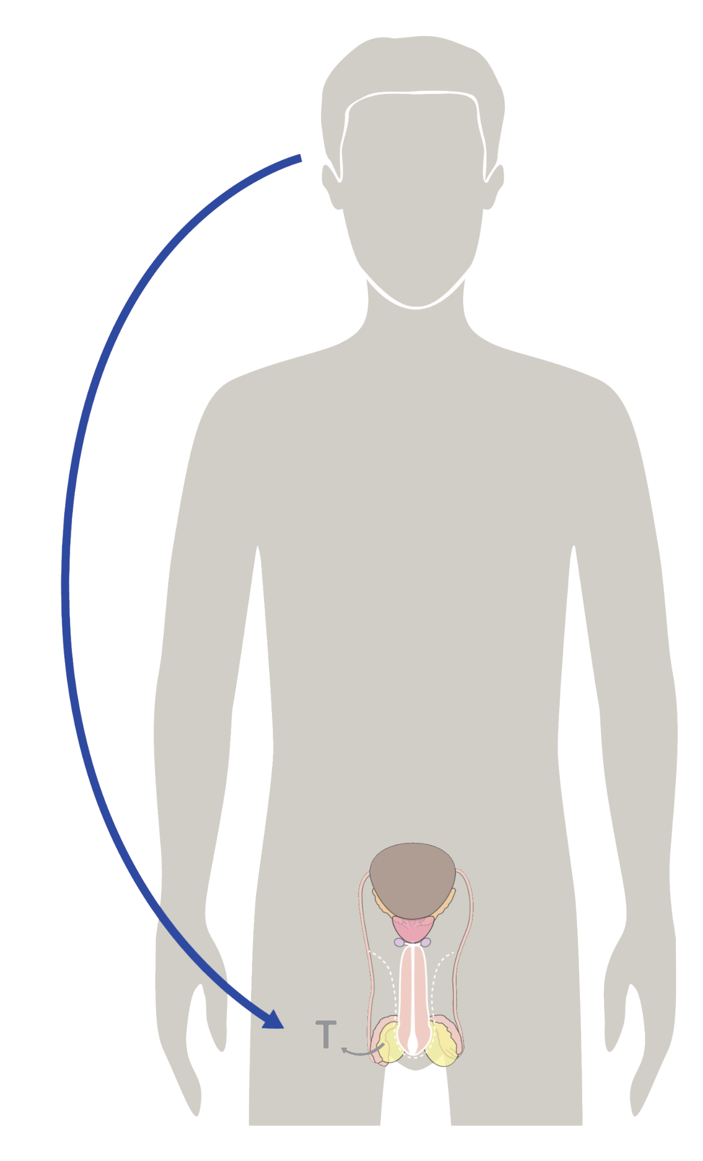
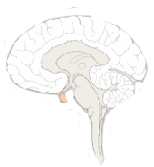
The Brain & Reproductive Hormones
The powerful Pituitary Gland!
LH
Luteinizing Hormone
brain
FSH
Follicle-Stimulating Hormone
brain
1
2
testicles
Testosterone
+ sperm production
3
© FEMM
Notes:
Step 4 (8 minutes): The Brain & Reproductive Hormones
The healthy function of the reproductive system and its hormones is controlled by the brain. This is why reproductive health has a big impact on our mental and physical health.
In the brain is the Pituitary Gland (circled in orange). Fun fact: the pituitary gland weighs only about as much as a raisin and is about the size of a kidney bean! However, the pituitary gland is called the “master gland” as it controls the secretion of most hormones in the body.
Last lesson, we learned that the pituitary gland in the brain produces Follicle Stimulating Hormone (FSH) and Luteinizing Hormone (LH). In men, FSH and LH drive the production of sperm and testosterone. When testosterone levels increase, the pituitary gland inhibits the release of FSH and LH. The brain is constantly sending hormonal messages back and forth with the reproductive system to control this process.

Slide 16
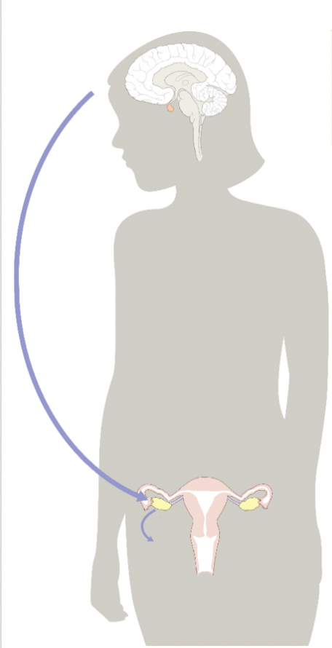
The Brain & Reproductive Hormones
The powerful Pituitary Gland!
LH
Luteinizing Hormone
brain
FSH
Follicle-Stimulating Hormone
brain
1
3
ovary
Progesterone
rises + feeds back to brain
ovary
Estrogen
rises + feeds back to brain
2
4
E
P
© FEMM
Notes:
In women, FSH (Follicle Stimulating Hormone) starts the maturation of the egg and follicle in the ovary. As the egg and follicle grows, this produces estrogen. Once the egg is mature, this feeds back to the brain to release a surge of LH (Luteinizing Hormone) triggering ovulation. After ovulation, the empty follicle produces progesterone.

Slide 17

The Brain & Reproductive Hormones
Pituitary Gland
FSH
LH
Testosterone
Brain aka “Mister P”
Hey, sending FSH and LH
Reproductive System
Got it. Testosterone increasing!
© FEMM
Notes:
For both men and women, the brain is the control center, sending hormones, like text messages, throughout the body for it to mature and function at its best.

Slide 18
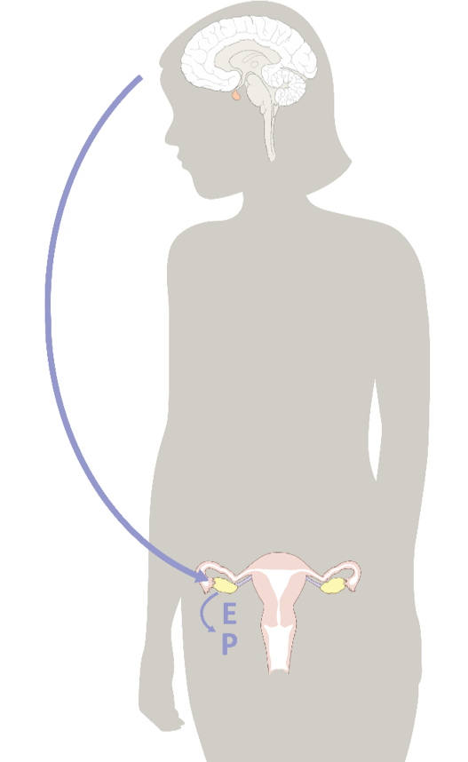
The Brain & Reproductive Hormones
Pituitary Gland
FSH
LH
Estrogen
Progesterone
Brain
Hey, sending FSH!
Reproductive System
Got it! Estrogen rising!
© FEMM
Notes:
The healthy function of every body system, including the reproductive system, is important to physical and emotional health. The growing and changing that is happening as a result of hormones during puberty is a sign that the brain and the reproductive system are communicating well.

Slide 19
Review
The male reproductive system is responsible for developing the male cell of reproduction: sperm, and the hormone testosterone.
The female reproductive system is responsible for developing the female cell of reproduction: the egg, and the hormones estrogen and progesterone.
The development of the cells of reproduction indicate that hormone levels are healthy; this is important for men and women!
Part of growing in maturity is making healthy choices for our bodies and always treating others with the respect they deserve.
© FEMM
Notes:
CONCLUSION: (2 minutes)
Now that we have looked at both the male and female reproductive anatomy, we can see that the male and female reproductive systems have distinct differences. As you can see, hormones are extremely fascinating and important! The reproductive system is essential for bringing new life into the world, but what we don’t often hear is how essential it is as a marker of basic health and hormones. There is a lot going on inside of teens during puberty! Part of growing in maturity is learning to make healthy choices for our bodies and always treating others with the respect they deserve.

Slide 20
Grade 8
LESSON 3
© FEMM

