Slide 1

Grade 8
LESSON 4
© FEMM

Slide 2
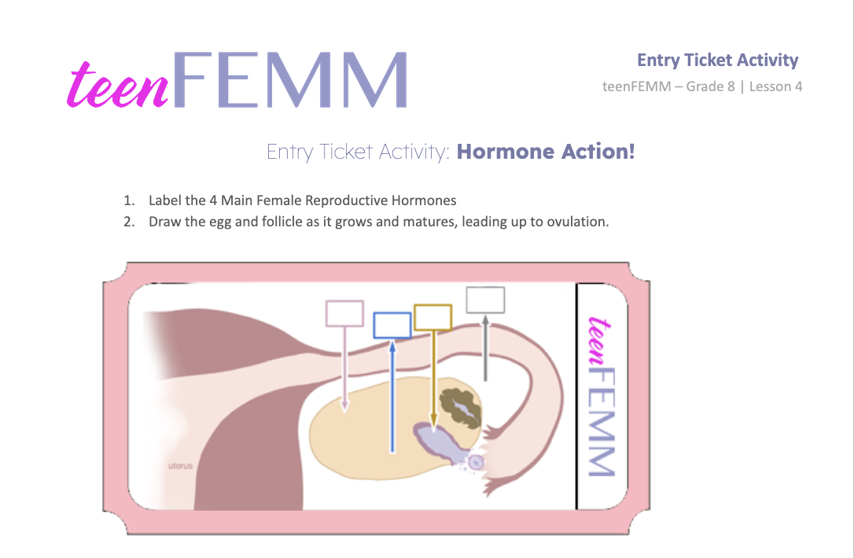
Entry Ticket | Hormone Action!
© FEMM
Notes:
Step 1: (5 min) Hormone Action! “Entry Ticket” activity.
Ask students to label the 4 Main Female Reproductive Hormones.
Ask students to draw the egg and follicle as it grows and matures, leading up to ovulation.
When students are finished, show the following slide for the answers: the 4 hormones and illustration of maturing egg and follicle.

Slide 3

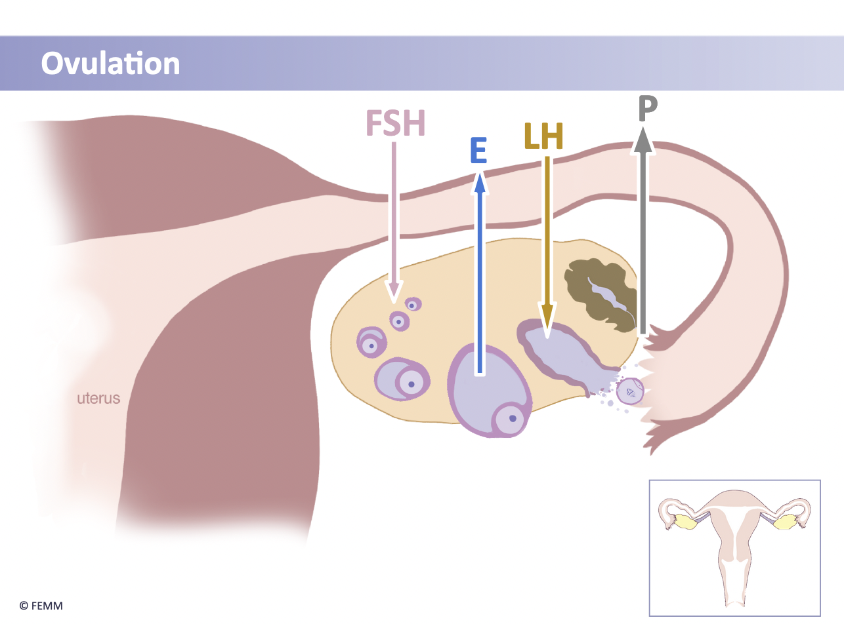
Answers | Hormone Action!
© FEMM
Notes:
When students are finished, show this slide for the answers: the 4 hormones and illustration of maturing egg and follicle.

Slide 4
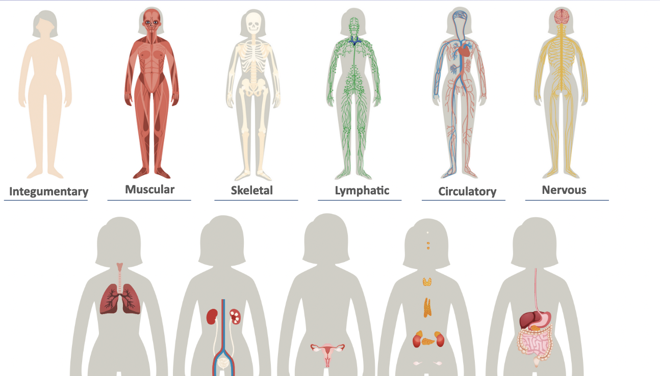
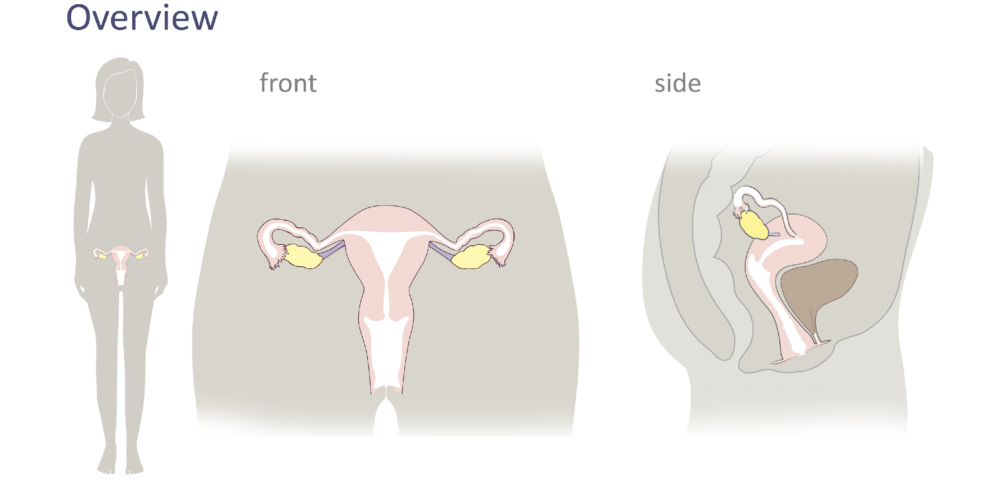
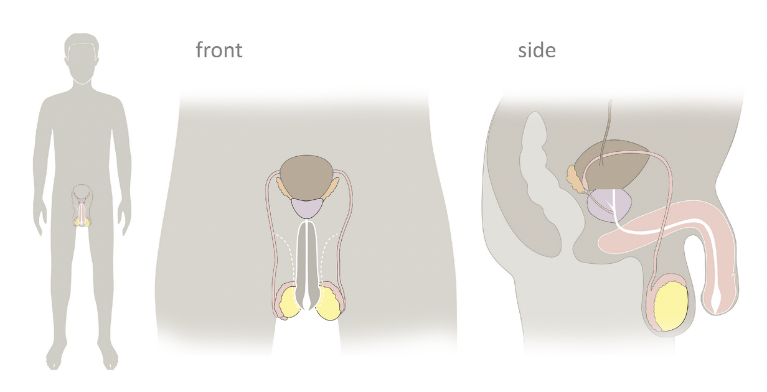
Review
Lesson 1
Lesson 2
Lesson 3
Lesson 4
You are here.
Notes:
In teenFEMM, we began Lesson 1 by learning about the body systems and how they work together. In Lesson 2, we zoomed in on the female reproductive system and the female and male anatomy. In Lesson 3, we looked at the process of ovulation, and the four main female reproductive hormones produced through the ovulatory cycle: Follicle Stimulating Hormone (FSH), Estrogen, Luteinizing Hormone (LH), and Progesterone.
Today, in Lesson 4, we will talk more about why the ovulatory cycle is so important to your overall health and the specific impacts of estrogen and progesterone in the body.

Slide 5

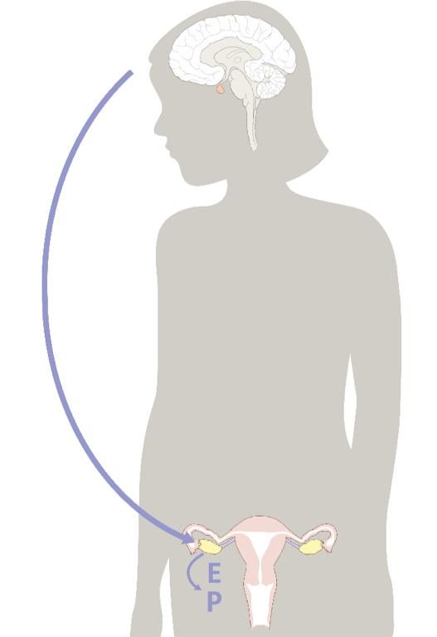
The brain is the command center
© FEMM
Notes:
The brain is the command center for your body, directing hormones that impact your overall health. Ask: Which two of the four main female hormones are produced in the brain? That’s right: FSH and LH.
As we know, the hormonal axis (the purple arc on the slide) is a visual representation of the hormonal communication between the brain and your reproductive system. This communication is constant and produces the ovulatory cycle.

Slide 6
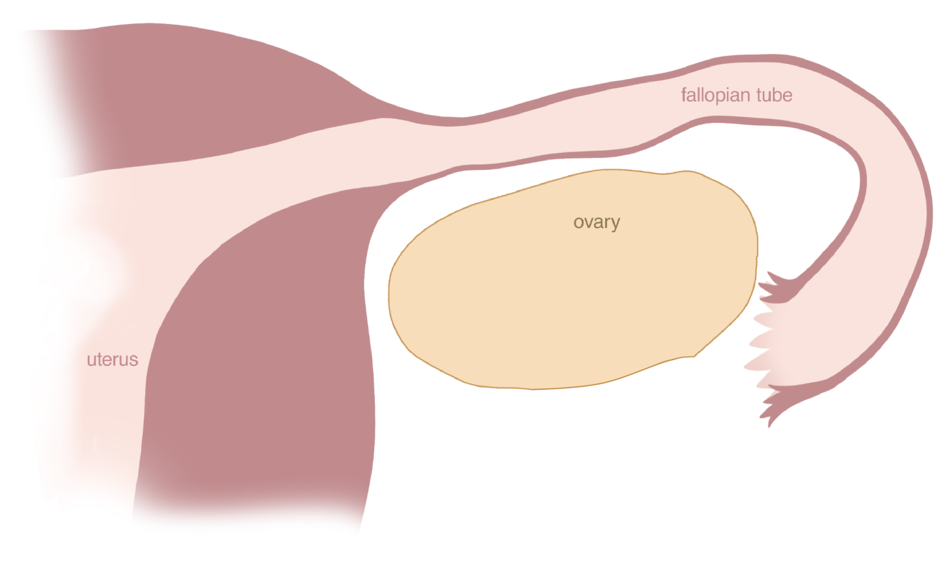
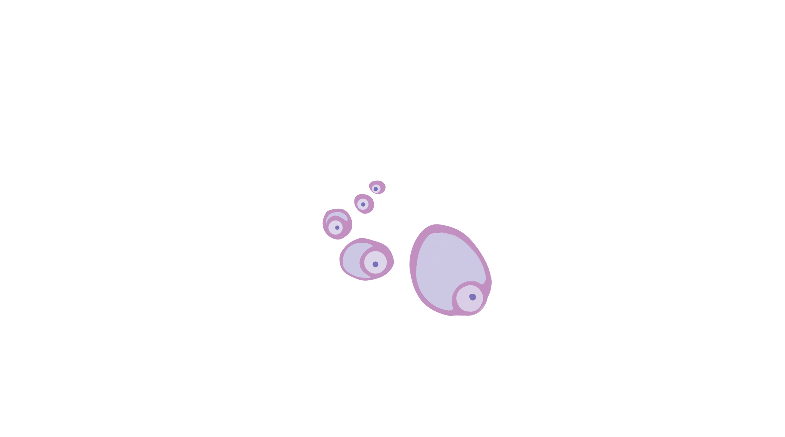
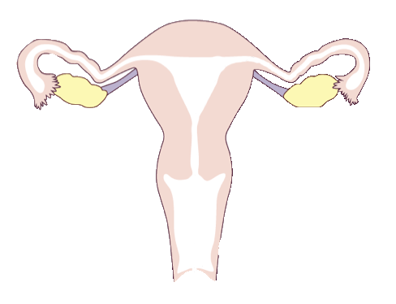
The ovulatory cycle
FSH
© FEMM
Notes:
Step 3 (10 minutes): Describe what happens in ovulation + menstruation.
Let’s review the full cycle, looking at ovulation and menstruation.
Ask: In the first part of the cycle, which hormone, produced in the brain, sends a message to the ovaries to stimulate an egg to grow and develop?
Click on the slide to reveal the answer: Follicle Stimulating Hormone (FSH).
Ask: In the ovary, the egg is surrounded by a special, protective tissue, called?
A follicle. Hence the name, Follicle Stimulating Hormone.

Slide 7
The ovulatory cycle
Estrogen
© FEMM
Notes:
The egg and follicle grow together.
Ask: As the egg and follicle grow in the ovary, they make which hormone? Click on the slide to reveal the answer: Estrogen.
The bigger and more mature the egg and follicle get, the more estrogen they make.
When the egg has grown to full maturity, it produces peak levels of estrogen. This high level of estrogen in the ovary feeds back to the brain to say: “stop producing Follicle Stimulating Hormone!”

Slide 8
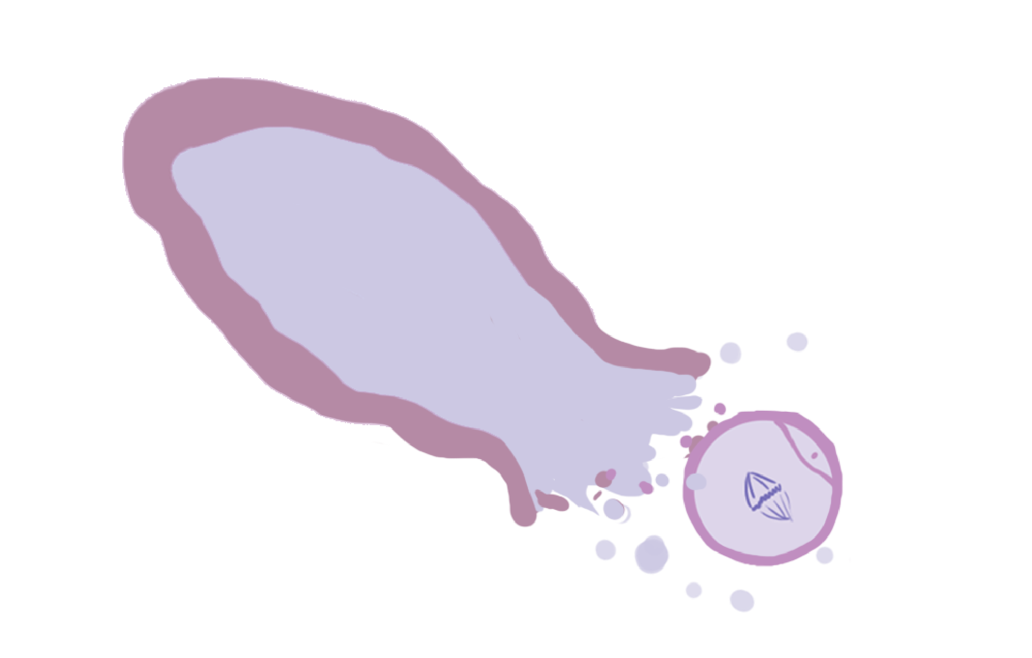
The ovulatory cycle
LH
© FEMM
Notes:
Ask: Which hormone, sent from the brain, triggers ovulation? Click on the slide to reveal the answer: Luteinizing Hormone (LH).
LH causes the egg to burst from its follicle. The egg then travels into the fallopian tube.

Slide 9

The ovulatory cycle
Progesterone
© FEMM
Notes:
In the ovary, the now-empty follicle becomes a new tissue called the corpus luteum. The word comes from the Latin ‘corpus’ for ‘body’ and ‘luteus’ for ‘yellow’ as the cells lining the follicle (under a microscope) are yellow in color.
Ask: The corpus luteum secretes (makes) which hormone? Click on the slide to reveal the answer: Progesterone. Progesterone is a super awesome hormone that every strong female body needs! Progesterone promotes mental well-being, sleep, and relaxation!
Now, maybe you’re thinking: wait, what happens to the egg after ovulation, again? On its own, the egg simply dissolves in the fallopian tube after 12-24 hours. Progesterone levels peak and then after 10-14 days the corpus luteum becomes inactive and the lining of the uterus sheds.
Ask: What’s the shedding of the uterine lining called ? Menstruation.

Slide 10
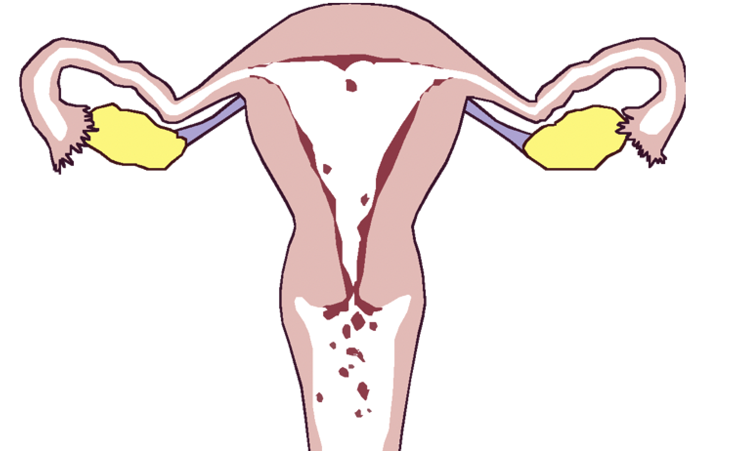
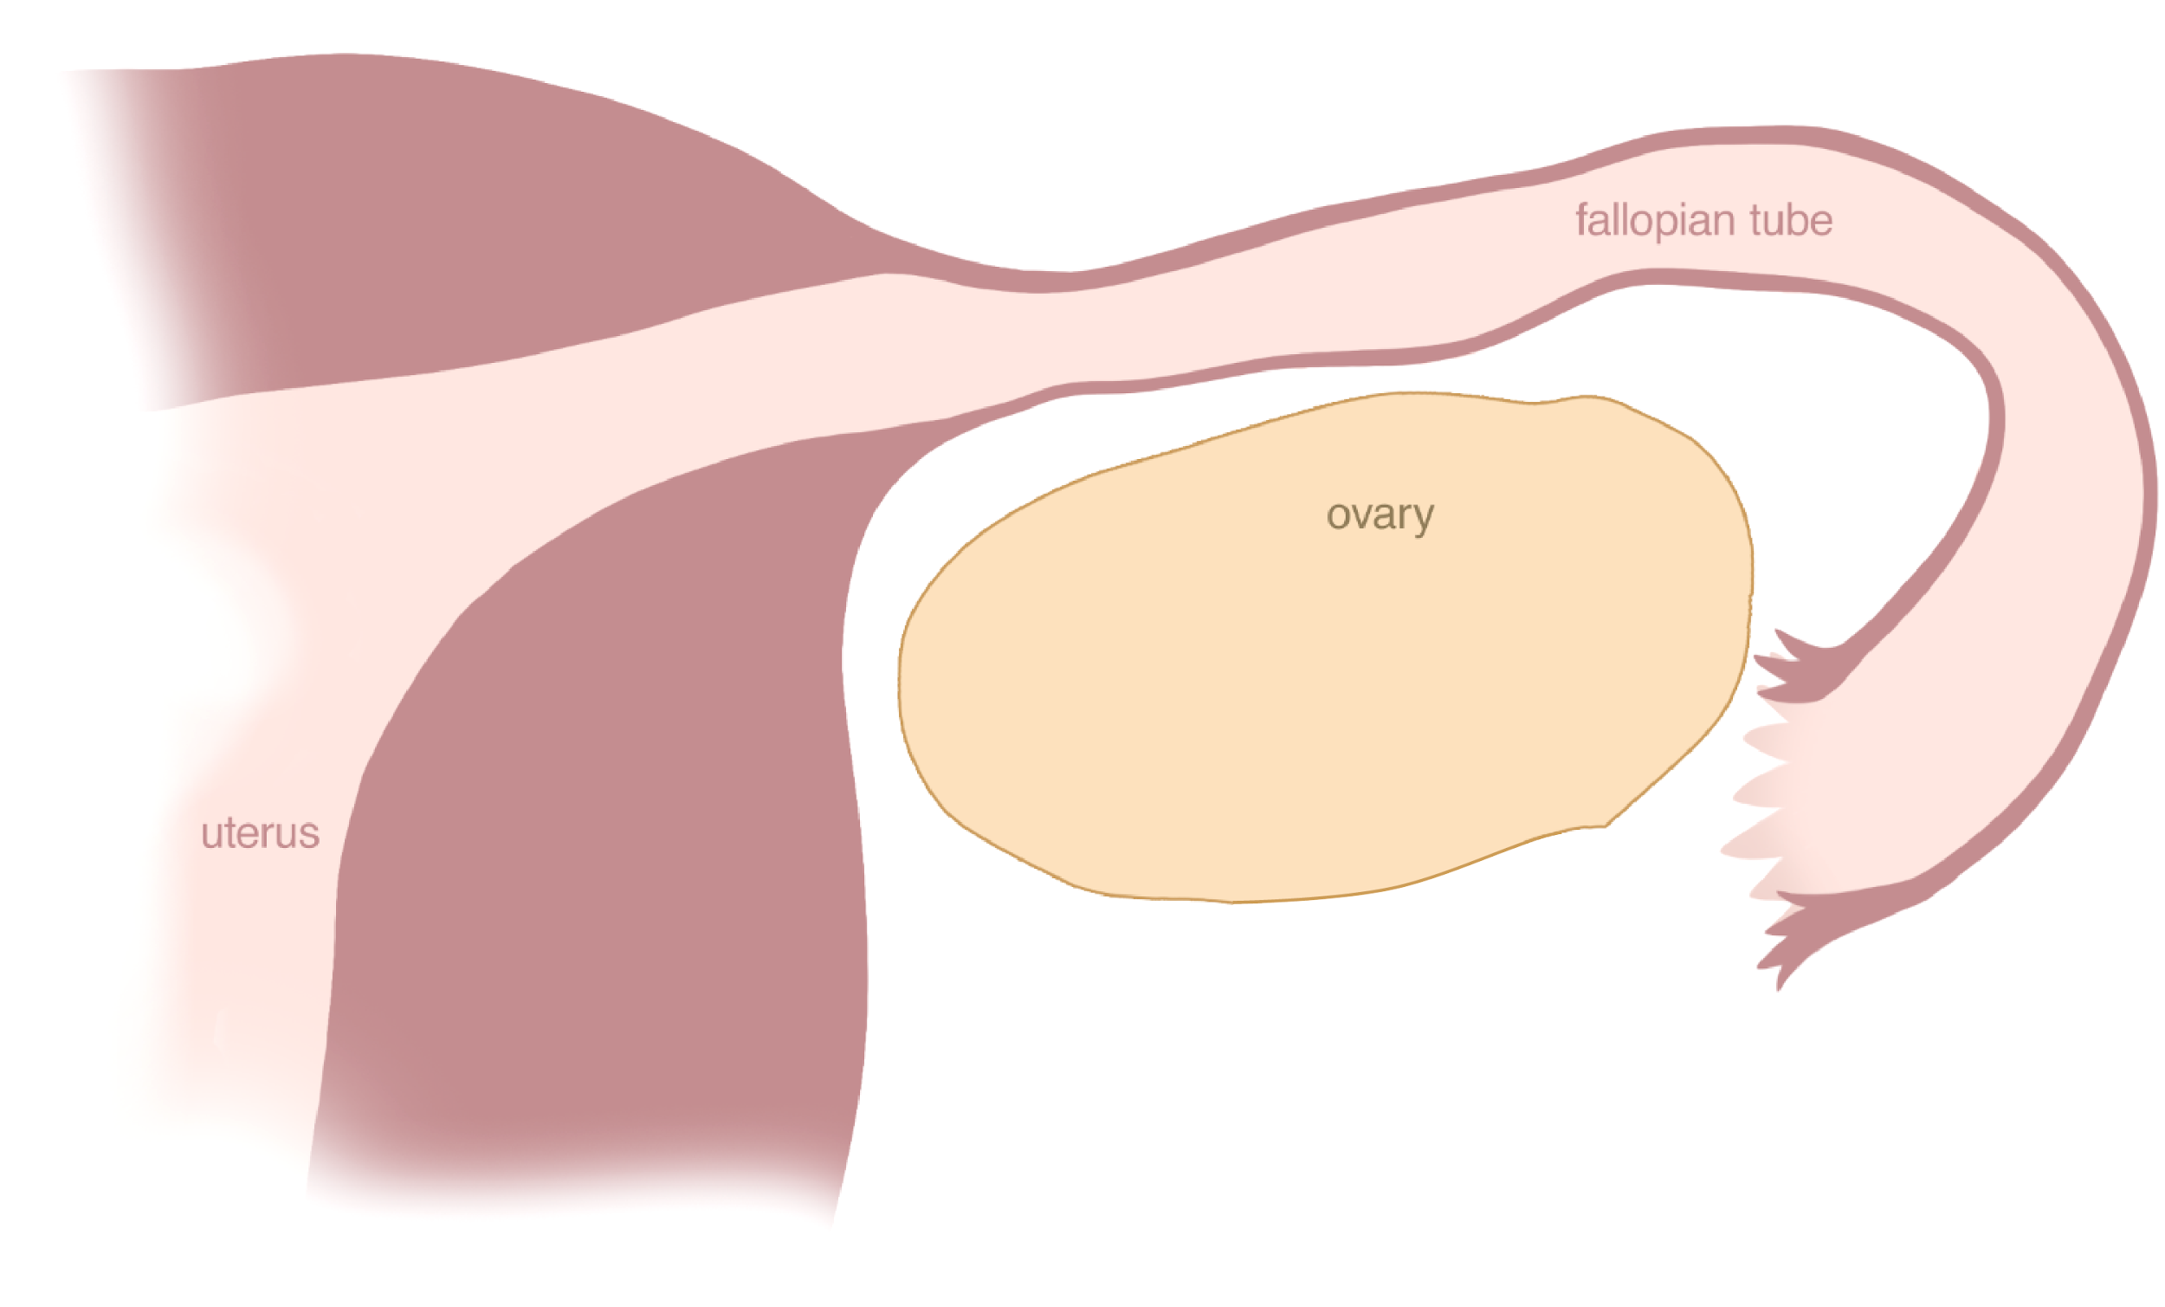
Menstruation
Notes:
Menstruation typically lasts from 3-7 days in a normal and healthy cycle. This shedding of the uterine lining is what is happening inside of you when you get your period.
Debilitating pain or heavy bleeding is not normal or healthy and you can talk to your parents about reaching out to a FEMM doctor to receive care.
The whole ovulatory cycle: from growing and releasing an egg, producing the hormone estrogen and then progesterone, to menstruation, repeats every 24-36 days. This cycle is a normal and important process that tells us a lot about a woman’s health and the health of her hormones.

Slide 11
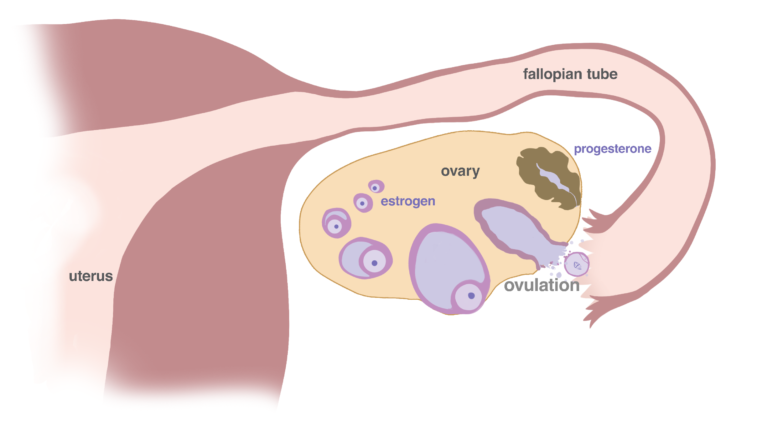

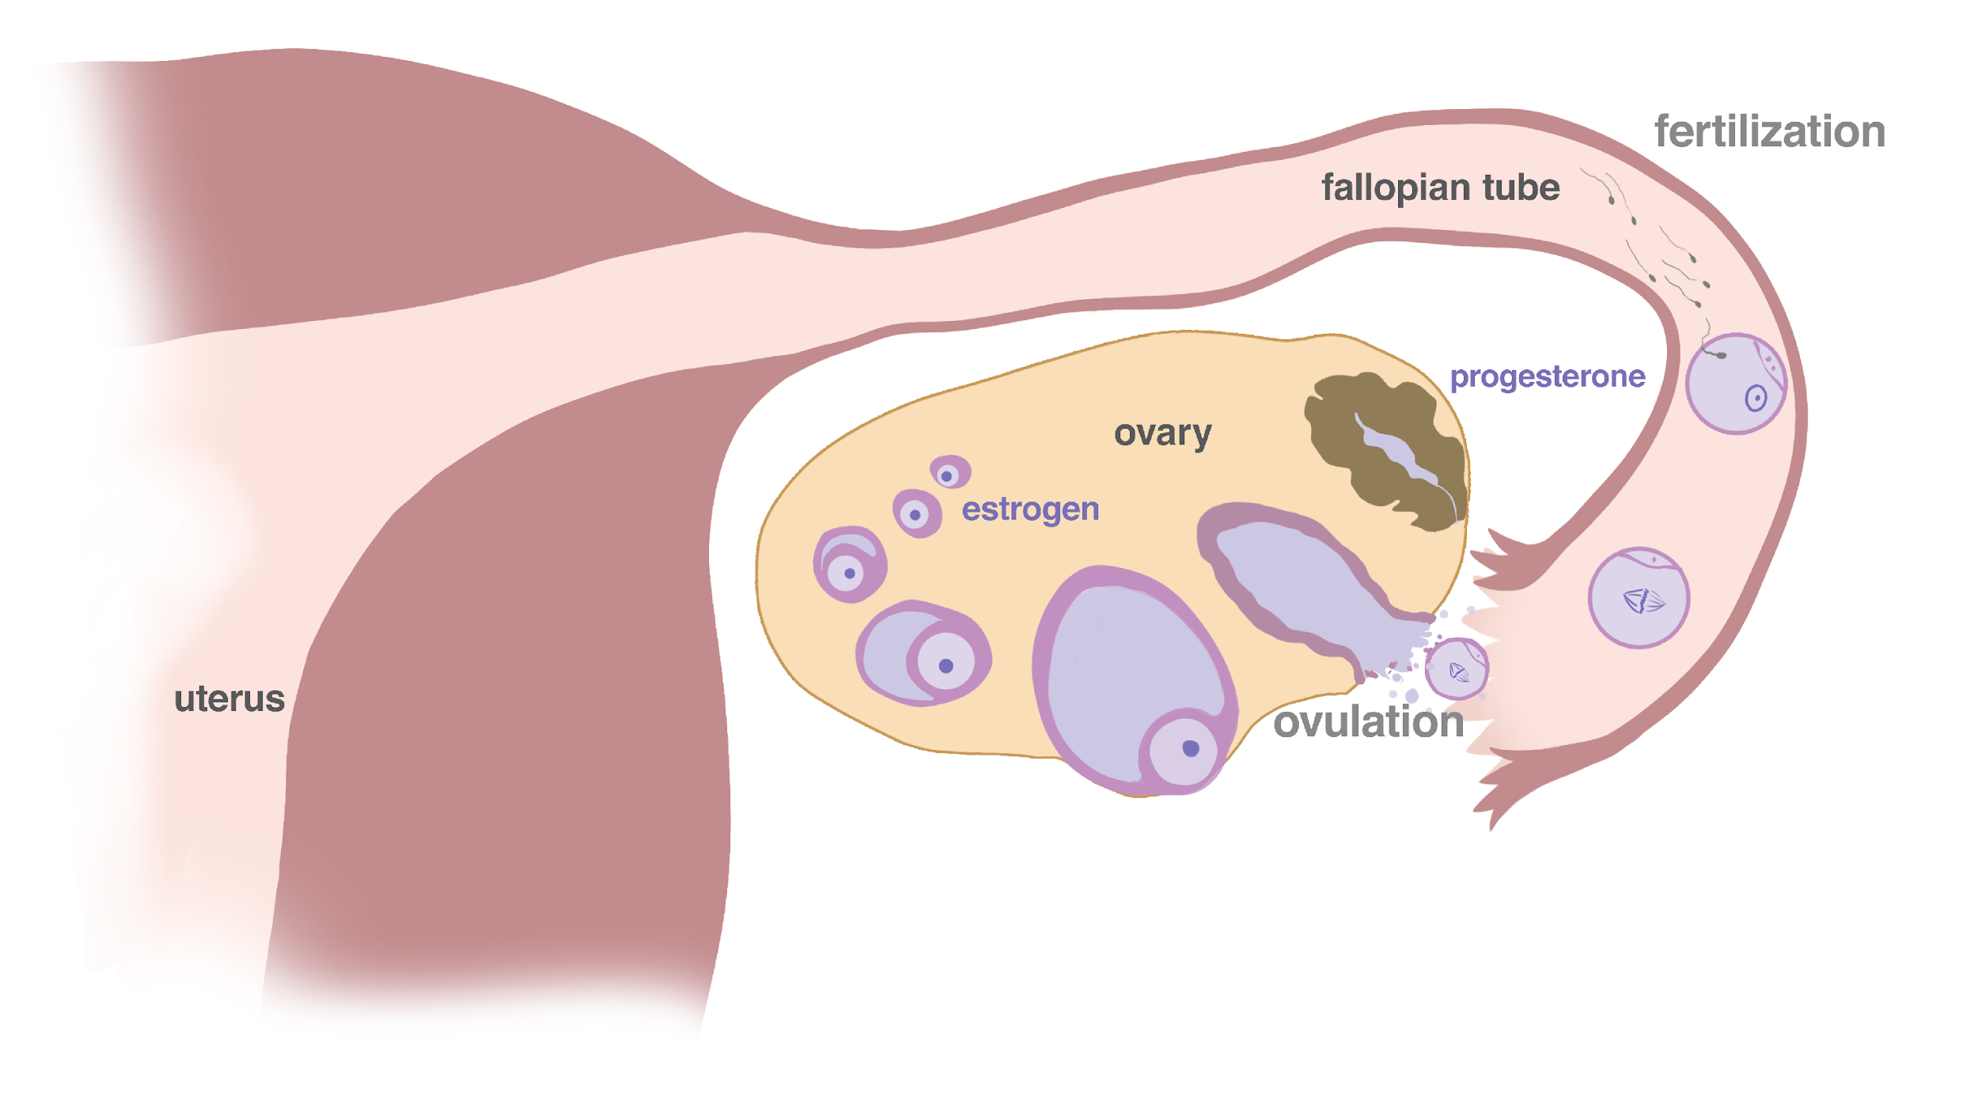
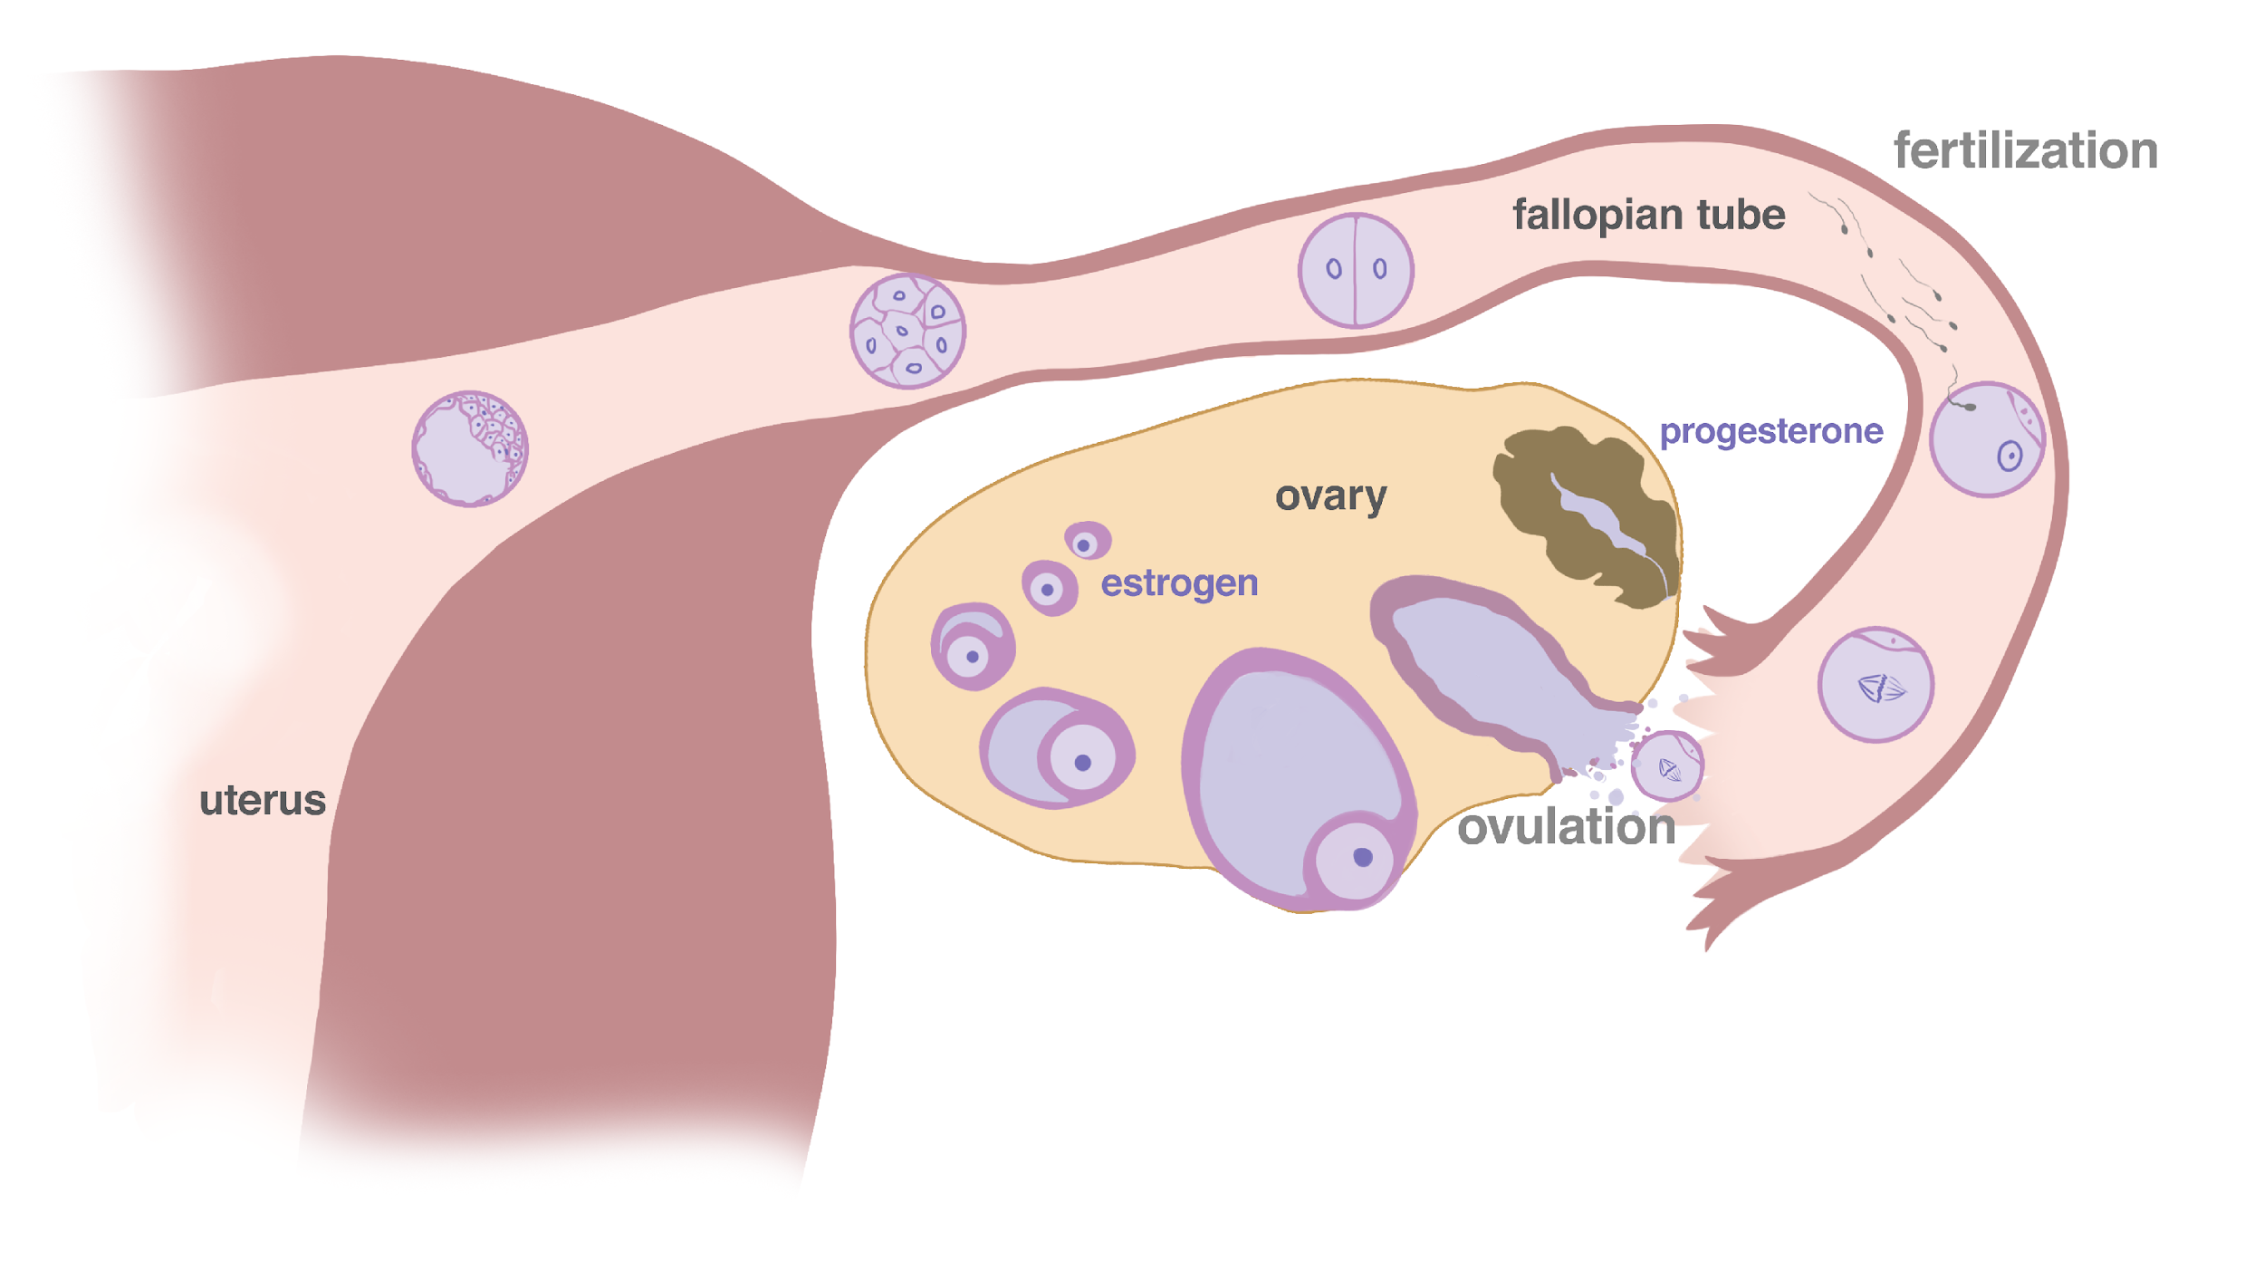
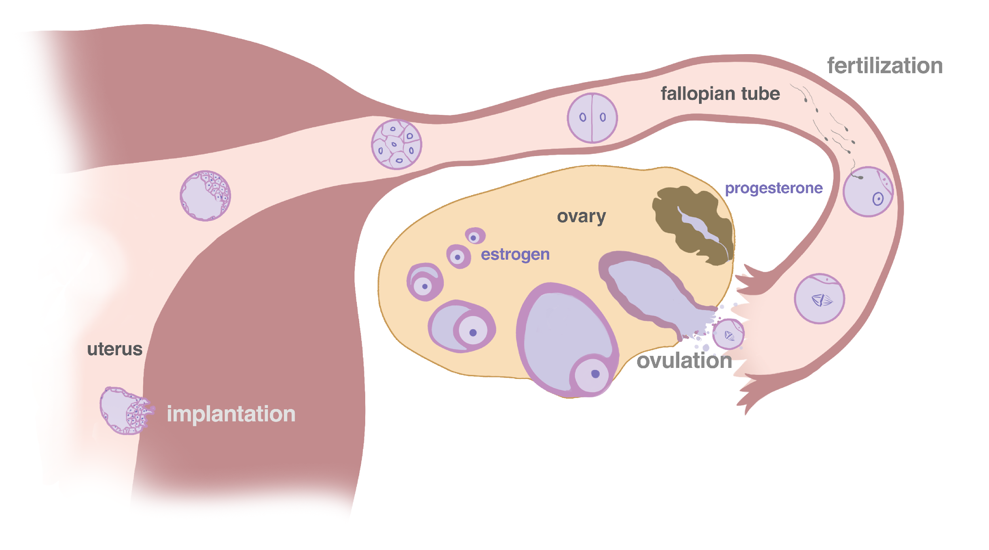
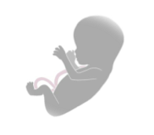
The beginning of life
© FEMM
Notes:
Now, if the egg joins with the male cell of reproduction (sperm) through sexual intercourse, it becomes a fertilized egg, also known as a zygote. This newly formed life travels to the uterus, where it embeds in the uterine lining.
If pregnancy occurs, progesterone will continue to rise, maintaining the lining of the uterus, in order to make it a nourishing place for a baby to grow for the next 9 months.

Slide 12
Pop Quiz
What are the ✌🏻 main jobs
of the ovaries?
To grow and release an egg
1
2
Produce estrogen + progesterone
Notes:
But back to right now. It’s important to remember that the ovulatory cycle is not just relevant to a far-away reproductive goal. Ovulation is a general indicator of your body’s health. Estrogen and progesterone work together to build and strengthen bones, ensure breast development, impact skin and hair, and influence your brain and emotions.
Step 4 (10 minutes): Expand upon the term “cycle.”
What are the 2 main jobs of the ovaries?
To grow and release an egg (ovulation) each cycle.
To make the hormones estrogen and progesterone.

Slide 13
Every woman has a cycle
Every woman has a cycle
from puberty until around age 50
It is called the ovulation cycle
since ovulation is the most important event
It is often called the menstrual cycle
since menstruation is the most obvious sign
Notes:
Every woman has a cycle, beginning in puberty until around age 50. We call it the ovulation cycle rather than the menstrual cycle, because ovulation is the main event.
The word ovulation comes from the latin word “ova” which means egg. Ovulation means the process by which the egg is released.
As you learn more about your hormones, and their patterns and effects, you will see how helpful it is to recognize this cyclical pattern. There may be times in your cycle that you’re really energetic and other times when you want to rest. This repeating, monthly pattern will become so important to creating a health record, knowing yourself, and recognizing what makes you unique.
Did you know? Men have hormonal cycles, too? However, in men, the hormone pattern repeats daily, as opposed to monthly. Typically, testosterone levels are higher in the morning and lower at night. So, the next time someone says women are “hormonal”, you can remind them that the male hormone testosterone can also lead to outbursts, irritability, and fluctuations in mood too;)
For both males and females, lifestyle impacts hormones and their effects. In addition to managing symptoms as they come, finding ways to relieve stress is important as the body matures through these hormonal changes.

Slide 14
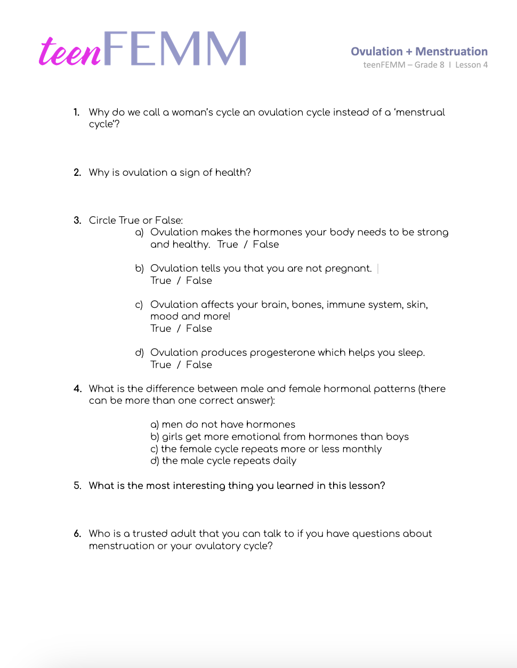
Worksheet
Notes:
Step 5 (5 min): Worksheet: Ovulation + Menstruation
Hand out the Worksheet to students and give them a few minutes to complete. Review the correct answers by using the Worksheet: Answer Key provided in the lesson folder.

Slide 15
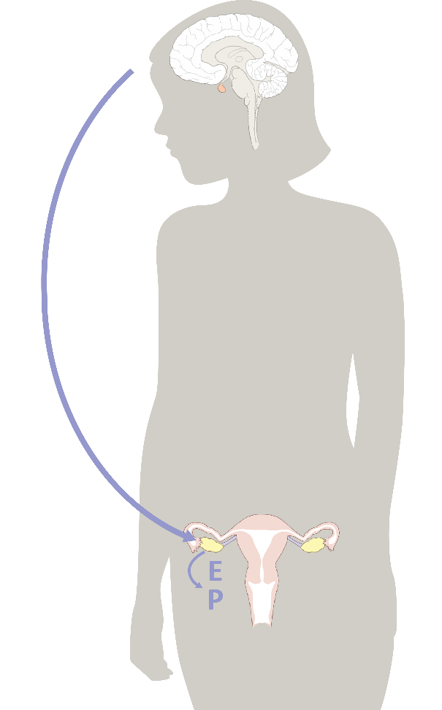
Estrogen & progesterone for your health
 | estrogen | progesterone
uterus | tones, contracts | relaxes
uterine lining | grows | maintains
breasts | grows | normalizes
bones | forms | maintains
blood vessels | dilates, increases flow | relaxes, normalizes clotting
brain cells | stimulates | maintains and heals
well-being | normal levels promote well-being; high levels increase anxiety | promotes sleep and relaxation; decreases anxiety
Have you ever noticed that you feel different at different times in your cycle?
That makes sense, since different hormones are at work!
© FEMM
Notes:
Step 6 (10 min): Expand on the importance of estrogen and progesterone to health.
Have you ever noticed that you feel different at different times in your cycle? Let’s look at this chart, to examine the specific effects of estrogen and progesterone on the body.

Slide 16
Hormones help your mood!
Estrogen + Progesterone
are so important for our mental health.
When hormones drop before our period, we can feel more irritable and anxious.
😣
Notes:
Mood
Do you feel the same when you have your period as when you don’t? Right before your period, do you feel a bit more worried or anxious than usual? That’s because progesterone is dropping. And what does Progesterone do? Progesterone promotes sleep, relaxation and decreases anxiety!
It’s important to make a note of these emotional and mental health changes, so that you can remember to be gentle with yourself during these times. These are patterns that will help you understand your cycle and yourself better. Hormones have a big influence on your brain. It is very common to experience mood changes as you go through puberty.

Slide 17
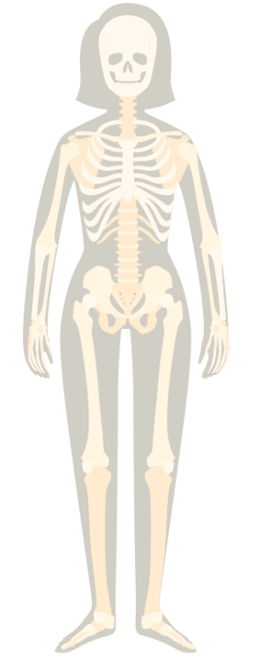
Hormones help your bones!
Estrogen + Progesterone
are really important for bone health and strength!
Too much or too little estrogen or progesterone can contribute to osteoporosis. (Scary! Like me, right?)
Notes:
Bones (height/size and density)
As you go through puberty, your bones are growing rapidly. Your bone and mineral density is increasing. By the time you are cycling regularly, you most likely will not grow any taller. Proper hormone levels are necessary to achieve optimum bone mass so your bones stay strong and are not as susceptible to breaks.

Slide 18

Hormones help your hair!
Estrogen + Progesterone
stimulate hair growth. They can even help your hair grow faster!
💁🏻‍♀️
Too little estrogen and progesterone can cause hair thinning or hair loss.
Notes:
Hair
Healthy estrogen and progesterone levels improve hair thickness and prevent loss and thinning. As estrogen rises during puberty, girls will also notice pubic and underarm hair growth. This is totally normal and healthy.

Slide 19

Hormones help your breasts!
Estrogen + Progesterone
are necessary for normal breast development through puberty.
Progesterone balances estrogen-ic growth which is especially important with regards to preventing cancer.
Notes:
Breasts
Both estrogen and progesterone are necessary for normal and healthy breast development in puberty. Increasing hormones promote breast growth, and it takes several years for breasts to fully mature. In the first stage of development, the nipple and area surrounding the nipple (called the areola) begin to expand. Then, the breasts continue to enlarge until they reach their full size. It is normal for one breast to grow faster than the other, or to experience soreness as they grow.

Slide 20
Hormones help your skin!
Estrogen
increases skin hydration, and supports increased skin thickness.
Progesterone balances estrogen and contributes to sebaceous gland (oil production) activity.
Notes:
Skin
Hormones are working hard in your body throughout puberty. Sometimes when they work a little too hard, you can end up with acne, which is when there is an overproduction of oil in the glands in your skin. Making healthy choices with diet and exercise can support overall hormonal health to keep your skin healthy and clear into the future. We will talk more about making healthy choices in the next lessons.
For underarm sweat, deodorant can be used, applied once in the morning; you can reapply if you have a sporting event or another activity that might cause more sweating later in the day. Is there a trusted adult you can talk to about your personal care routine? The timing, products, and methods can be different for each girl.

Slide 21
Hormones help your brain!
Proper amounts of Estrogen + Progesterone facilitate higher order cognitive functioning such as memory, attention, and language!
🧠
Can I get a fist bump,
you brainiac, you?!
Notes:
The brain is not fully developed until about age 25, for both boys and girls, and hormones play a key role in developing all of the essential brain pathways and processes.

Slide 22
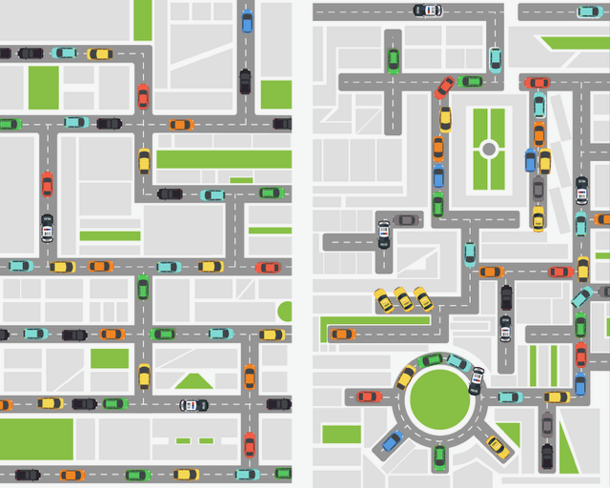
Hormones organize your brain!
Did you know that proper amounts of Estrogen + Progesterone produced through ovulation help to
ORGANIZE the developing teen brain?
That means that your brain looks like this…
Instead of this…
Notes:
The activity of your whole body is directed by your brain. The hormones produced naturally by your body, month to month, are necessary to the proper organization of your brain. Like a good city planner, your body’s natural hormonal processes are mapping out your brain so that you have clear thinking and creative pathways for years to come.

Slide 23
Review
Having an ovulation cycle is important for our overall health.
Estrogen and progesterone have specific effects on different parts of our body.
During the next lesson, we will learn how to chart the cycle.
© FEMM
Notes:
CONCLUSION
The ovulatory cycle is not just an isolated event happening somewhere “down there” and relevant when you want to have a baby. The ovulatory cycle and all of the hormones it produces are vital to the proper development of every part of your body. Now that we’ve looked at what the hormones progesterone and estrogen do to balance and develop our body and brain, next lesson we will learn how we can track the specific characteristics of our cycle. Tracking this information is called “charting” and it’s helpful information to know about our bodies and our health.

Slide 24
Grade 8
LESSON 4
© FEMM

