Slide 1

Grade 8
LESSON 4
© FEMM

Slide 2
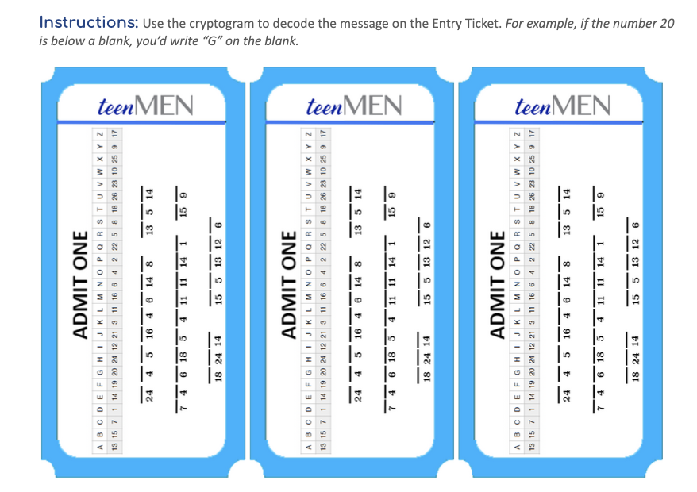
D E C O D E the message
© FEMM
Notes:
PROCEDURE
Step 1 (5 minutes): Entry Ticket Activity: Decode your Hormones
Hand out one ticket per student and see who can decode the cryptogram message first!
Answer: HORMONES ARE CONTROLLED BY THE BRAIN

Slide 3

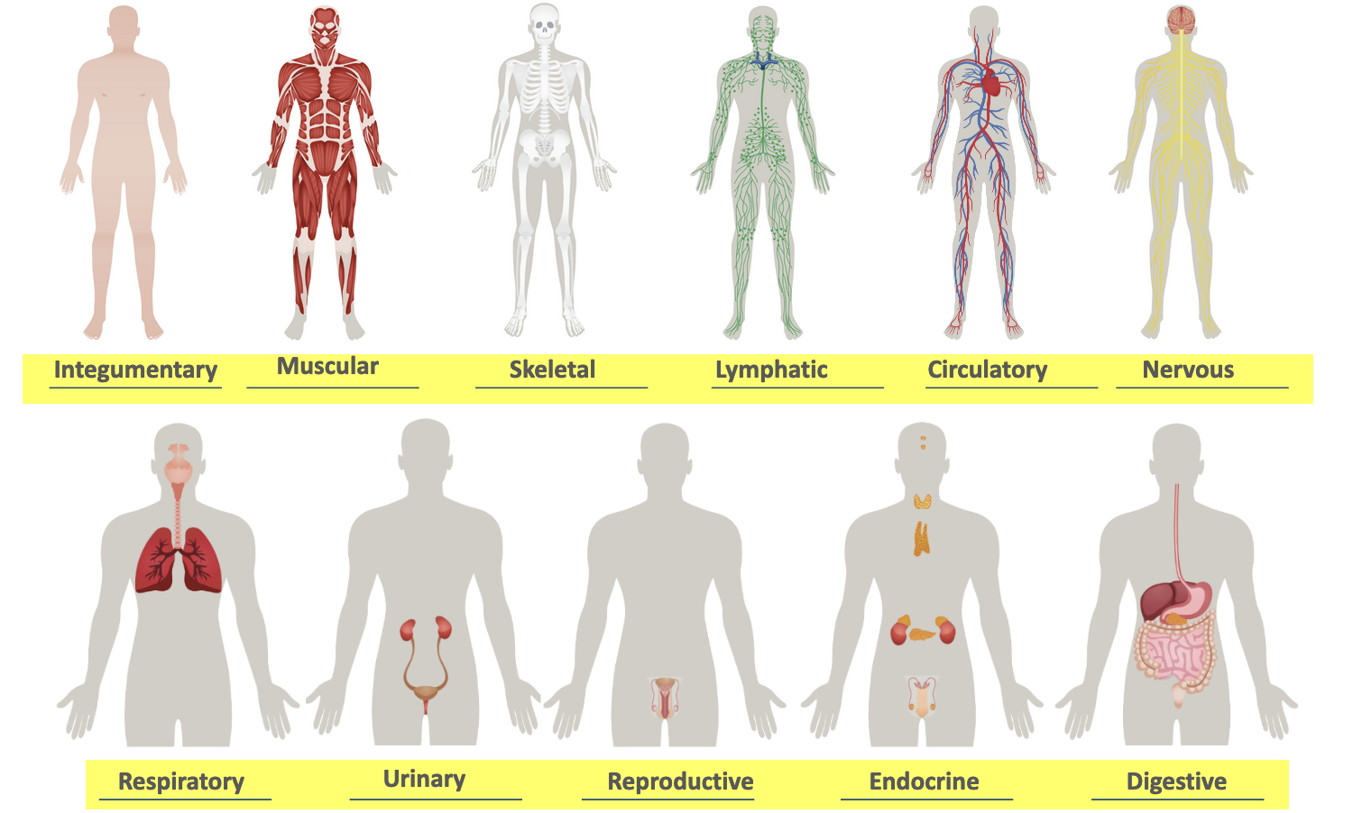
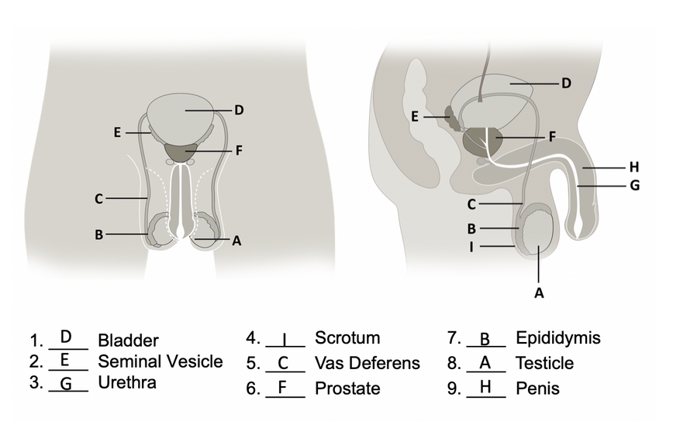
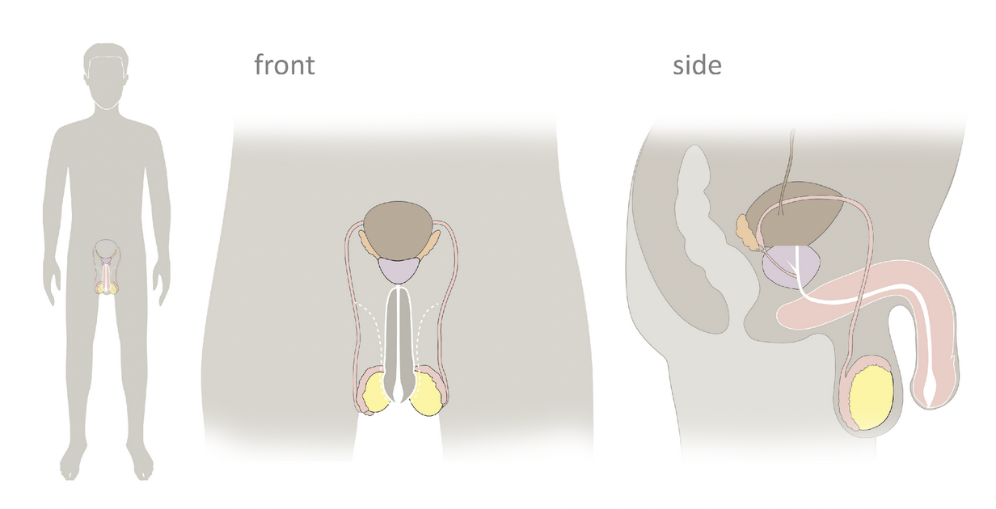
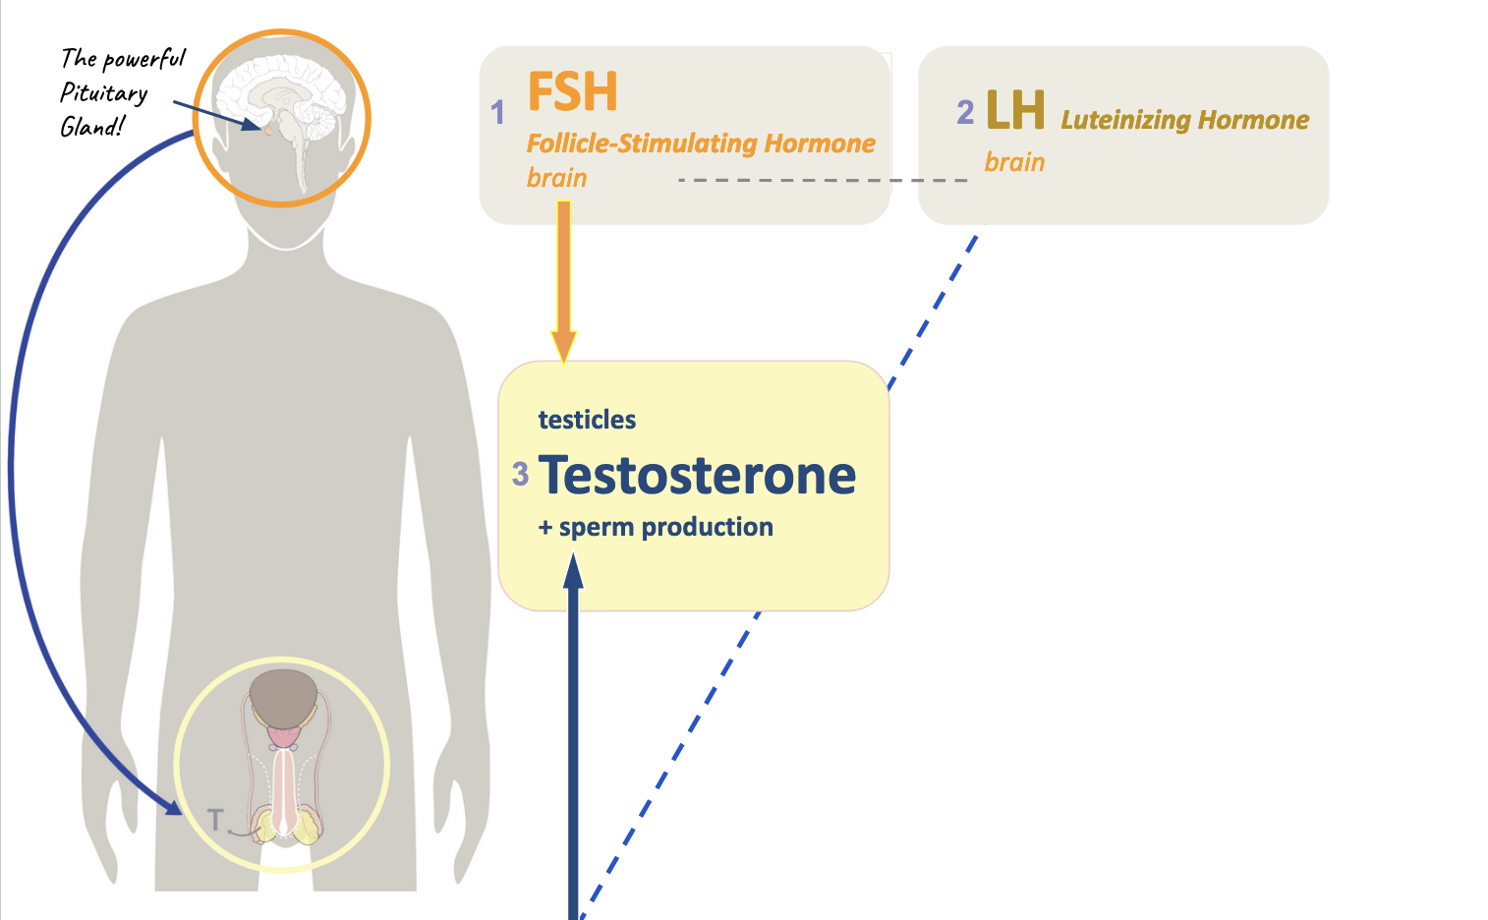
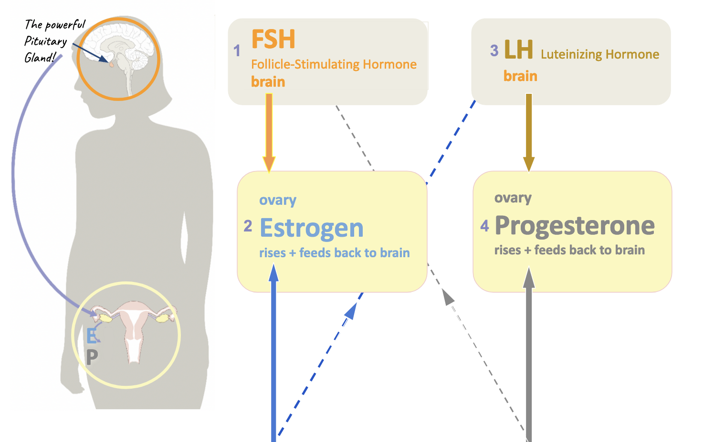
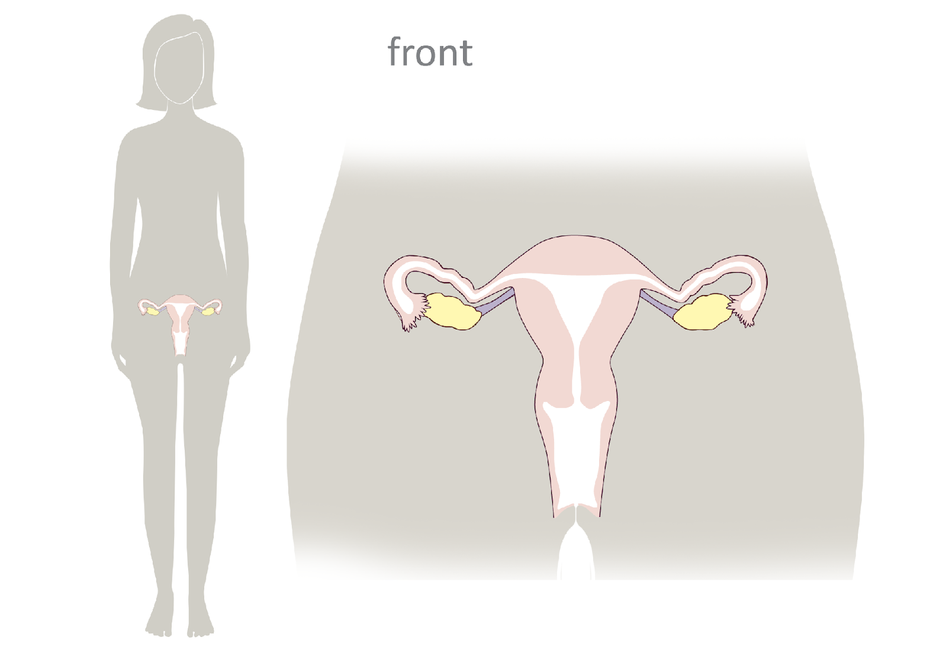
Review
Lesson 1
Lesson 2
Lesson 3
Lesson 4
You are here.
© FEMM
Notes:
Step 2 (5 minutes): Review
In the first lesson of teenMEN, we learned about all the 11 systems of the body and homeostasis. In the second lesson, we learned about the parts of the male reproductive system and how the brain and the reproductive system are linked through a hormonal axis. In lesson three we learned about the male and female reproductive anatomy and how hormones, controlled by the brain, are vital to the healthy function of both systems.

Slide 4
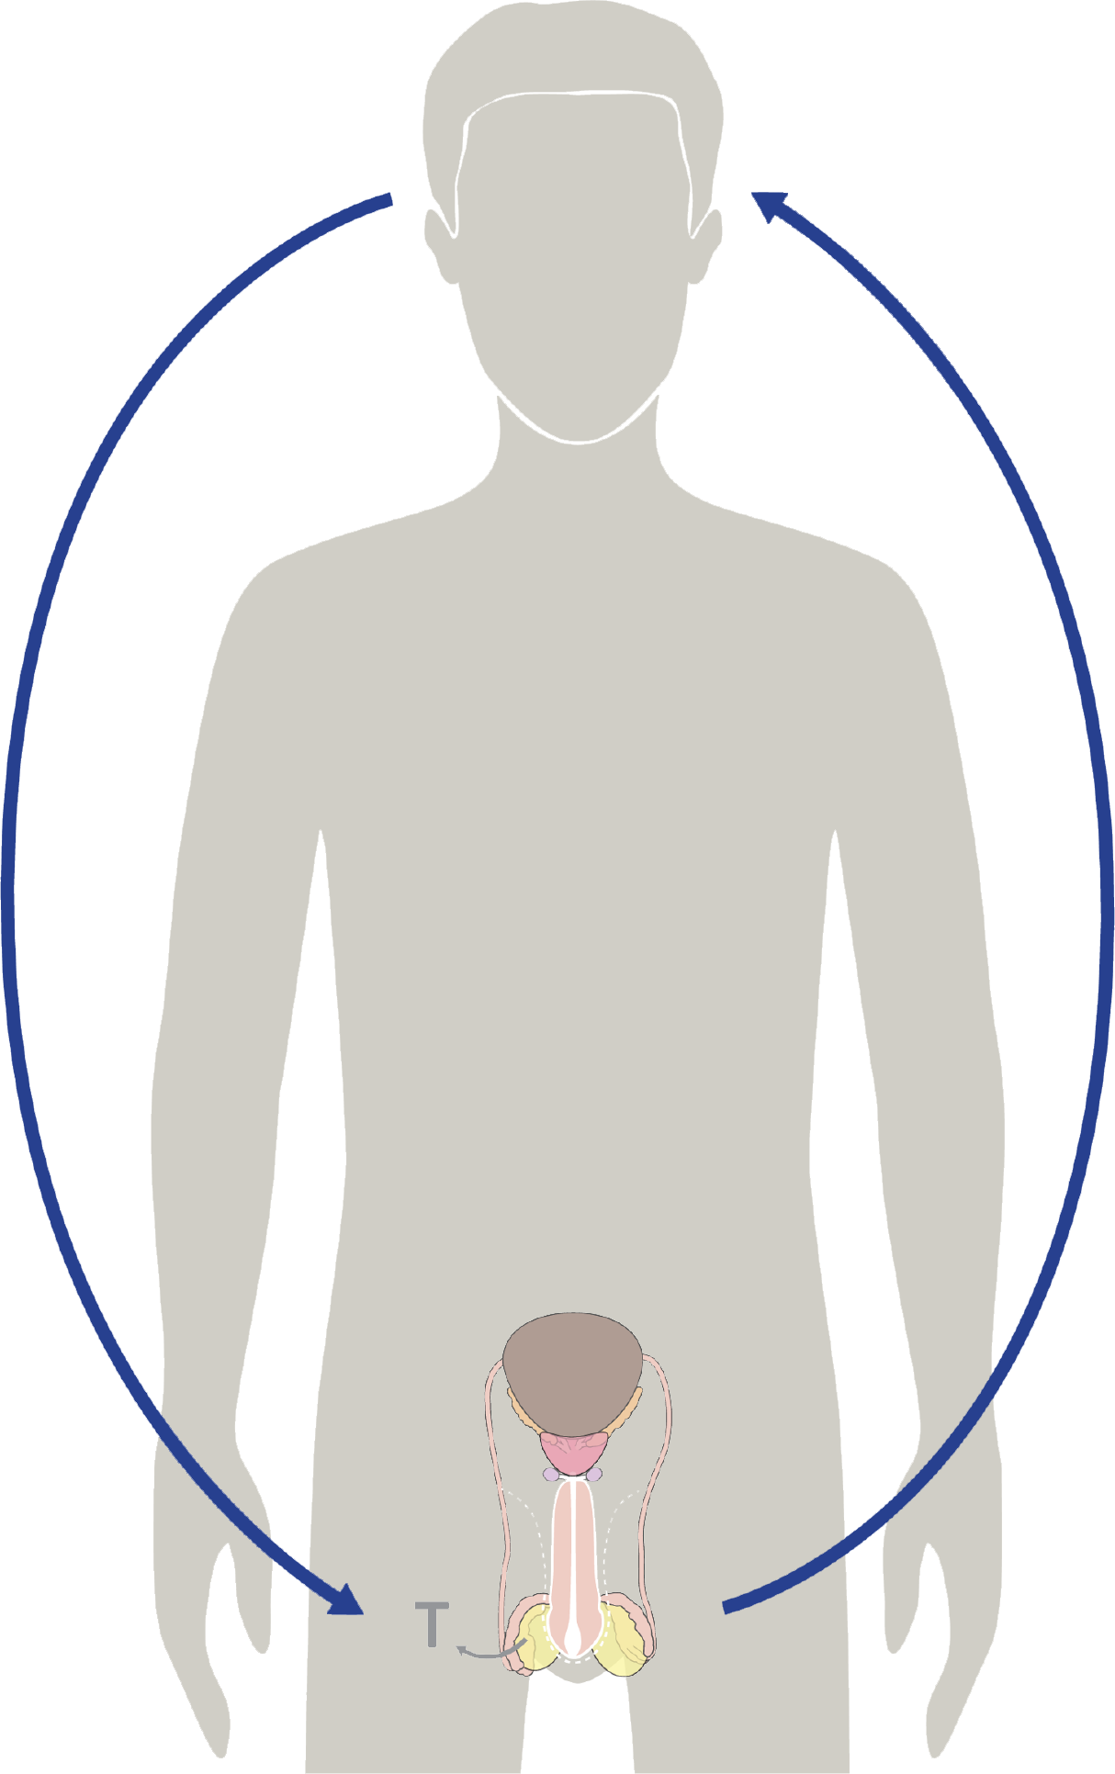
Hormonal feedback
The brain sends
FSH + LH
to the testes
4. Testosterone develops
the body and the brain.
3. The increase in testosterone impacts every part of your body.
2. The cells in the testicles
produce sperm
and testosterone
© FEMM
Notes:
Hormonal feedback is another way of thinking about the communication between the brain and the reproductive system. In men, the brain communicates with the testes to produce testosterone and this in turns feeds back to the brain, like a loop. As we learned last lesson, the pituitary gland sends Follicle Stimulating Hormone and Luteinizing Hormone to the testes. The cells in the testes respond by producing sperm and testosterone. The increase in testosterone impacts every part of your body. An amazing thing is that the brain helps to generate testosterone, and this hormone in turn develops the different parts of your brain. This is hormonal feedback.

Slide 5
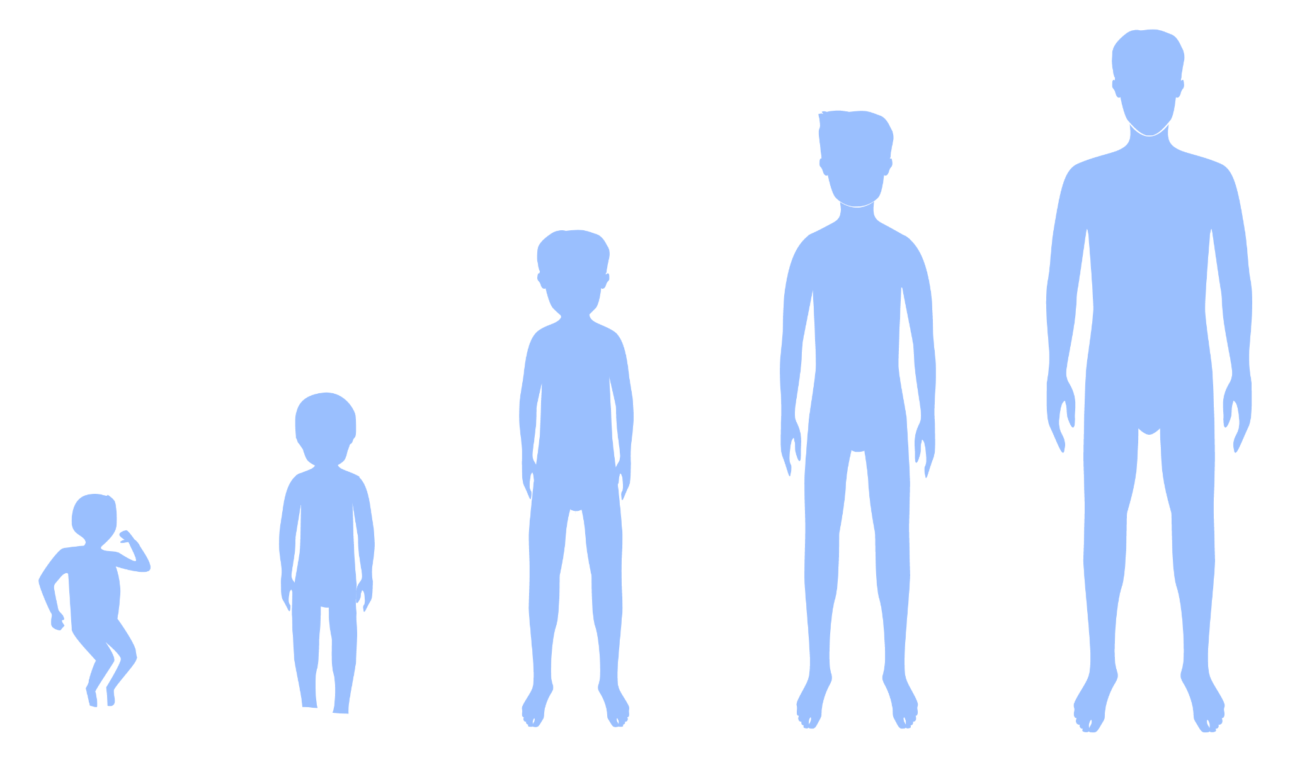
Testosterone & development
Age 17-18
300 to 1,200 ng/dL
Puberty
Age 15-16
100-1,200 ng/dL.
Age 10
7-130 ng/dL
Newborn baby boy
75-400 ng/dL
© FEMM
Notes:
Step 2 (10 minutes): Testosterone & sperm development
When does hormonal feedback begin? At just nine weeks after conception, the male fetus in the womb is already beginning to secrete testosterone, developing the brain and male genitalia.
As a newborn baby, there is a second surge of testosterone, accelerating growth and impacting brain development around 1-3 months. Testosterone levels then drop again, until around age 10. During puberty, the male body produces about 30 times more testosterone than it did before puberty. This slide shows the normal range of testosterone measured in the blood. The numbers are measured in ng/dL which stands for nanograms per deciliter, but you don’t have to know that. The main thing is just to show that there is a mini-testosterone surge after birth and then a major surge during puberty, which happens between the ages of 10-17. This surge in testosterone at the onset of puberty causes the cells in your testes to mature and begin the production of sperm.

Slide 6

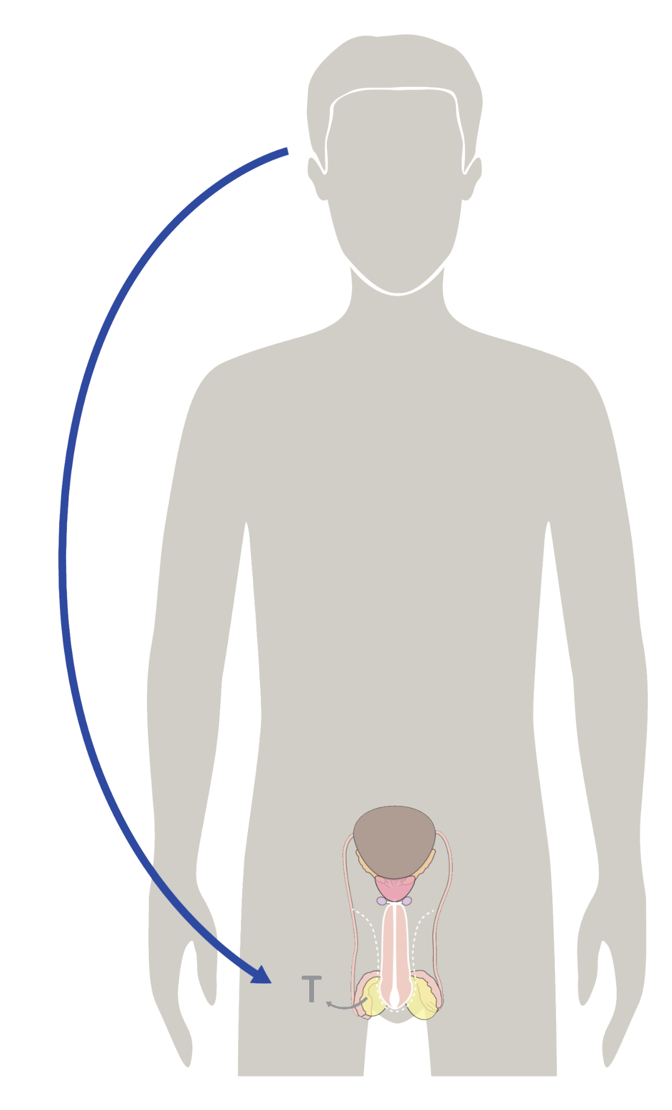
Sperm production & your body
Sperm production & your body
This starts in puberty, when the brain signals the testes to start producing:
Testosterone & Sperm
Sperm:
male cell of reproduction
Testosterone:
main male hormone
© FEMM
Notes:
From before you were born, your body produced testosterone and had the capacity to produce sperm. But during puberty, thanks to testosterone and other hormones, the body activates the sperm-producing cells in the testicles.

Slide 7
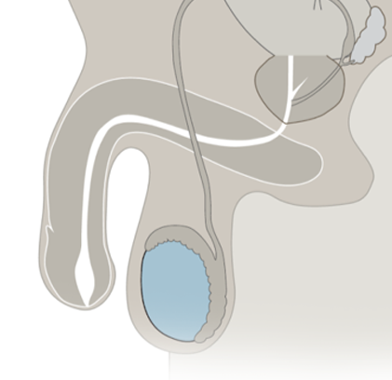


Male cell of reproduction
Sperm cells grow and develop a head, midpiece and tail inside complex tubes in the testicles, called the seminiferous tubules.
Sperm cell
© FEMM
Notes:
Sperm develop within a system of tiny tubes in the testes called the seminiferous tubules. Sperm cells divide and grow in these tubes until they have a head, midpiece and short tail.

Slide 8
Male cell of reproduction
The epididymis is even more tightly coiled and complex than the seminiferous tubules!
The epididymis is so tightly coiled that this tiny part of the body if uncoiled would actually be about 20 feet!
You can think of the epididymis like a difficult maze for sperm to complete!
Epididymis
Epididymis
© FEMM
Notes:
From there, sperm move into the epididymis. The epididymis is even more tightly coiled than the seminiferous tubules in the testes. The epididymis is a highly complex tissue. If uncoiled, the tiny epididymis would measure about 20 feet! The epididymis is like a difficult maze for sperm to go through, ensuring that sperm properly mature and that only the healthiest survive the journey.
From the epididymis, sperm travels up the vas deferens, joins with fluid from the seminal vesicle, passes through the prostate and empties into the urethra. This fluid is called semen. Semen is propelled out of the urethra in a process called ejaculation. When sperm isn't ejaculated, the sperm cells simply break down in the epididymis. This is a normal part of the male reproductive cycle.

Slide 9

Sperm production in the testicles
Sperm production in the testicles
Sperm have a head, a midpiece, and a tail.
It takes about 75 days for sperm
to mature.
Sperm must be made at a temperature that is lower than the body’s temperature.
The head is where
genetic material
is carried
The midpiece supplies
the energy the tail
needs to move
The tail propels the
sperm and helps
breach the
egg
© FEMM
Notes:
Under a microscope you can see that sperm have a few distinct parts. Sperm have a head, a midpiece, and a tail. Each part of the sperm serves a special function in human reproduction, to enter the female egg and join together to create a new life. It takes about 75 days for your body to mature new sperm, but as of puberty, this process is happening every day in your body, so sperm are constantly being generated. Sperm must be made at a temperature that is lower than the body’s temperature. This is why the testicles are located outside the body to maintain a separate temperature.

Slide 10
Sperm production in the testicles
Sperm are the male cell of reproduction.
They are made in the testicles.
They are one of the smallest cells in your body.
Each sperm (0.05 millimeters!) contains all of your DNA! (Incredible!)
© FEMM
Notes:
Sperm is the male cell of reproduction. The sperm cell is approximately 0.05 millimeters long, which is very tiny. In contrast to the egg cell, the female cell of reproduction, the male sperm cell is one of the smallest cells of the human body! The egg cell is roughly ten times bigger than sperm. Each sperm (0.05 millimeters long) contains all of your DNA. Isn’t that incredible?!

Slide 11
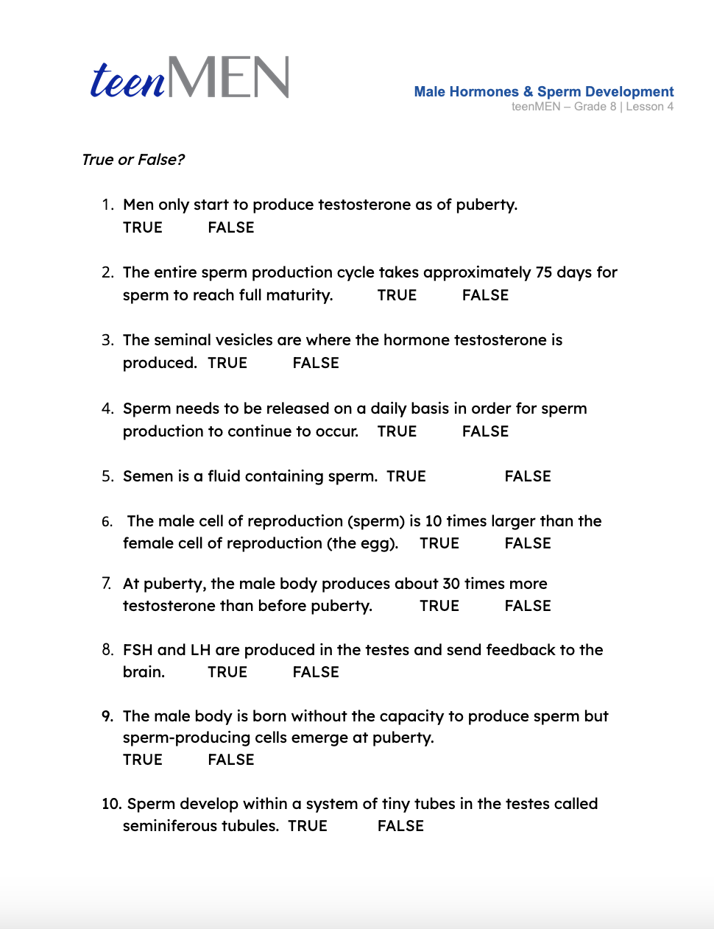
How much do you really know about…
Male Hormones?
© FEMM
Notes:
Hand out the Worksheet: Male Hormones & Sperm for students to complete. When students are finished, review the answers together using the Answer Key provided.

Slide 12
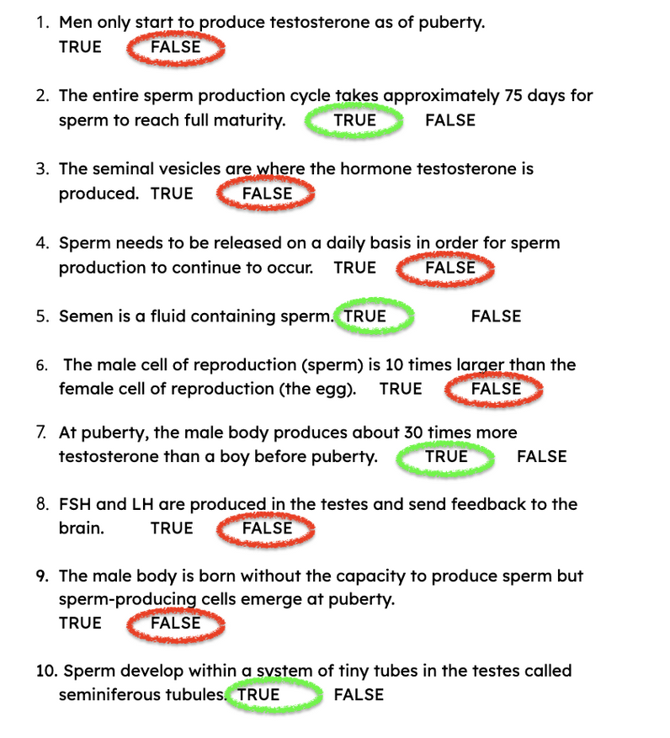
Answers | How did you do?
© FEMM
Notes:
Answers + Explanations
FALSE. At just nine weeks after conception, the male fetus produces testosterone. But during puberty, testosterone increases by a lot!
TRUE. Remember the complex maze of the epididymis that sperm have to travel through?
FALSE. Testosterone and Sperm are produced in the testicles.
FALSE. Sperm cells dissolve and will be reabsorbed by the body. The body is continually making and maturing sperm.
TRUE. Many parts of the male reproductive system contribute to this fluid in order to nourish and transport sperm.
FALSE. The female cell of reproduction, the egg, is roughly 10 times larger than sperm.
TRUE. Testosterone reaches its peak in males in their late teens.
FALSE. FSH and LH are produced in the pituitary gland, located in the brain, and signal the testes to produce testosterone and sperm.
FALSE. The male body is born with sperm cells in the testicles, they’re just inactive. At puberty, the body activates the sperm-producing cells in the testes.
TRUE.

Slide 13
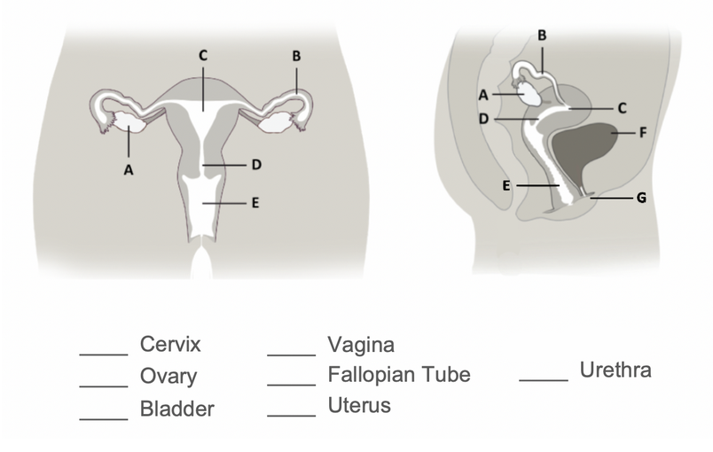
Female Reproductive Anatomy
D
E
A
B
G
F
C
© FEMM
Notes:
Step 3 (10 minutes): Female Anatomy & Ovulation Cycle
Now that we’ve tested your knowledge and dispelled a few myths regarding the male reproductive system, let’s see if you can remember the female anatomy.
Use Female Reproductive Anatomy slide and label together as a class, having students provide the answers aloud. Click on the slide to reveal one answer at a time.

Slide 14

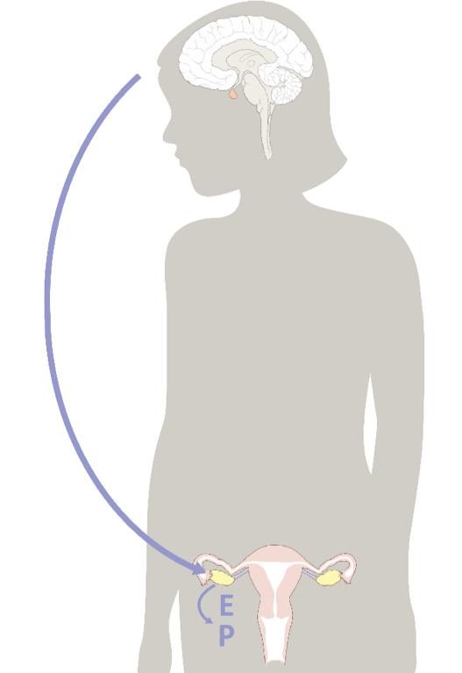
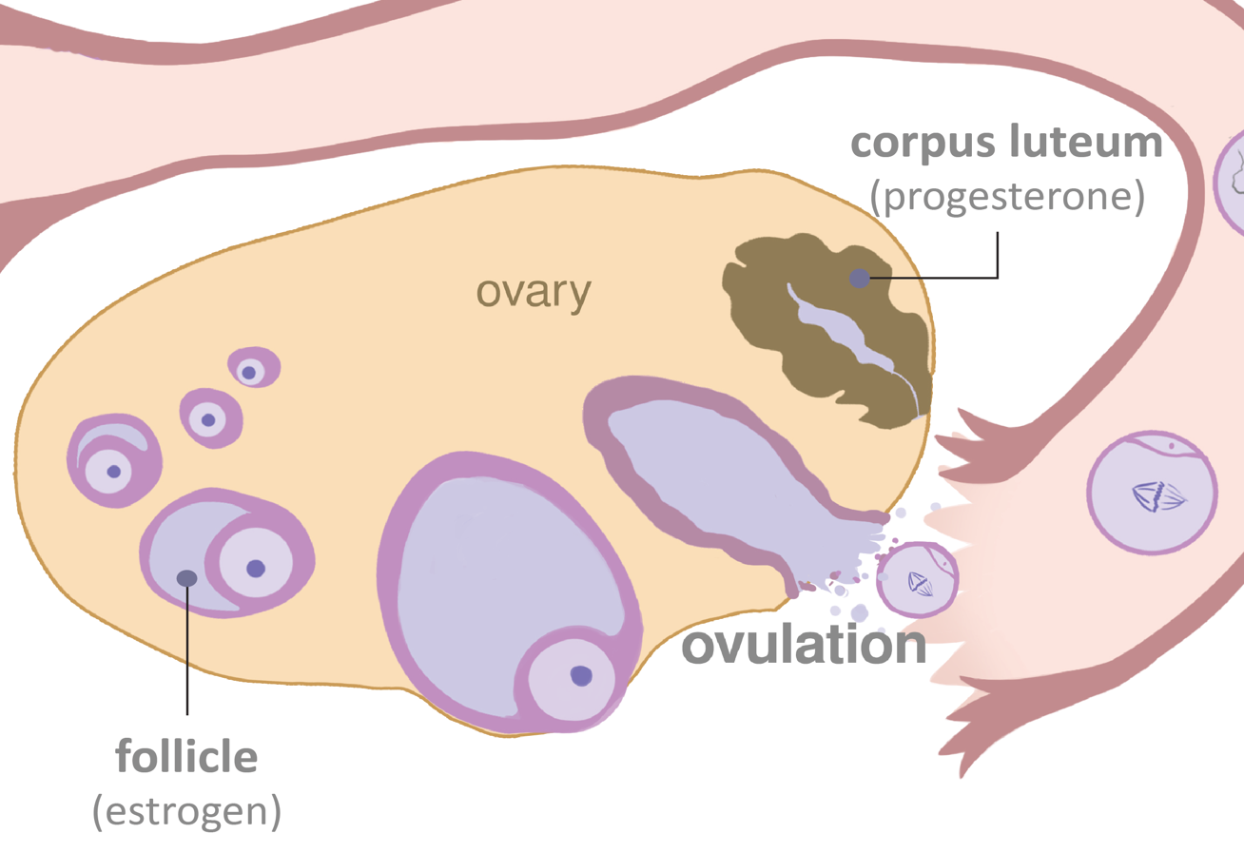
Command center
The brain controls hormones
hormonal
axis
© FEMM
Notes:
Women’s bodies also use hormones to produce the female cell of reproduction, the egg. At the onset of puberty for girls, the brain signals the ovary to develop an egg each month. The main female hormones are estrogen and progesterone, represented on the slide as E and P.
You may have generally heard a female cycle referred to as the “menstrual cycle” or a “period”. But it’s actually more correct to call it the ovulatory cycle, as ovulation is the main event of the cycle each month. The human body is complex. Understanding the intricacy of each person’s reproductive system gives us greater respect for one another. Let’s look at the fascinating hormonal feedback in the female ovulatory cycle.

Slide 15
Hormonal feedback: the ovulatory cycle
The brain sends
FSH to the ovary
5. Estrogen and progesterone drop causing the uterus lining to shed in menstruation.
4. After ovulation, the empty follicle in the ovary produces progesterone.
2. This causes an egg + follicle to grow in the ovary. The growing egg + follicle produce estrogen.
3. Increased estrogen tells
the brain to release LH to trigger ovulation.
© FEMM
Notes:
1. The brain sends the hormone, FSH (Follicle Stimulating Hormone), to one of the ovaries each month, to kickstart the growth and development of an egg and follicle inside the ovary. The egg is surrounded by a special, protective tissue, called a follicle. (Hence, the name: follicle stimulating hormone.)
2. FSH causes an egg and follicle to grow. The growing egg and follicle in the ovary produce estrogen.
3. The increased levels of estrogen in the body produced by the egg and follicle, feed back to the brain to release the hormone LH (Luteinizing Hormone). LH triggers ovulation and the egg is released from the ovary.
4. The empty follicle in the ovary now produces the hormone progesterone.
5. Estrogen and progesterone levels drop, causing the lining of the uterus to shed in menstruation, in preparation for the next cycle.

Slide 16

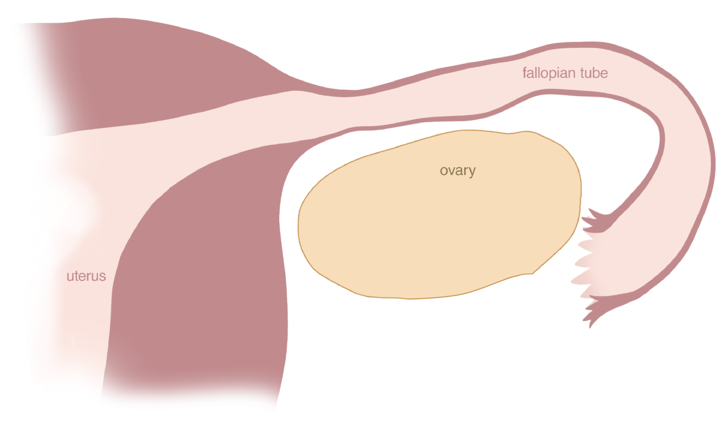
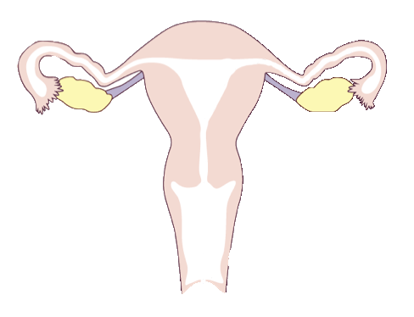
Ovulatory cycle: Follicle Stimulating Hormone
The ovulatory cycle: Follicle Stimulating Hormone
FSH
© FEMM
Notes:
This is a lot of new information, so let’s look at this process in the ovary, step by step. The brain sends FSH to the ovary to stimulate the egg and follicle to grow. As the egg and follicle grow together, (you can see it on the slide) they increase in size.

Slide 17
Ovulatory cycle: Estrogen
The ovulatory cycle: Estrogen
Estrogen
© FEMM
Notes:
As the egg and follicle continue to increase in size, day to day, they produce more and more estrogen. When the egg and follicle are fully developed, estrogen reaches its peak and feeds back to the brain to send Luteinizing Hormone (LH).

Slide 18
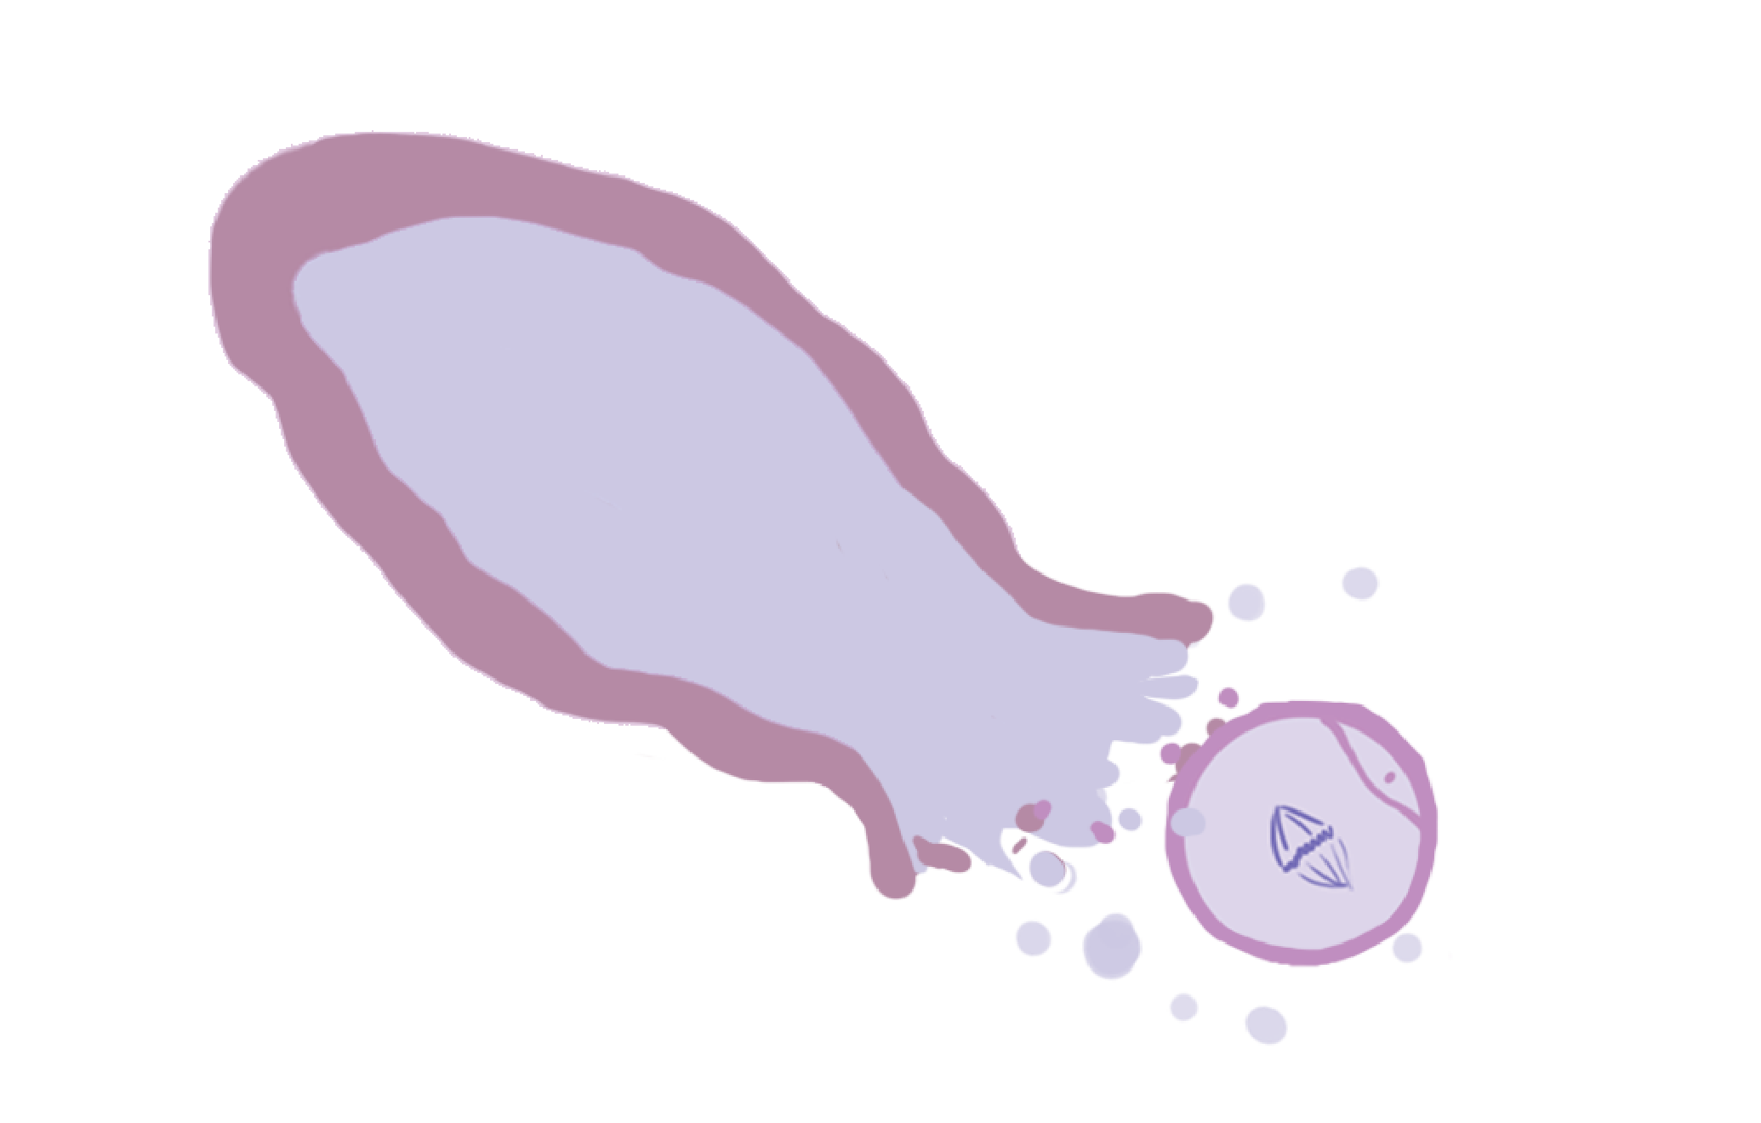
Ovulatory cycle: Luteinizing Hormone
The ovulatory cycle: Luteinizing Hormone
LH
© FEMM
Notes:
LH is sent from the brain to the ovary and causes the egg to be released from the follicle into the fallopian tube. This is called ovulation.

Slide 19

Ovulatory Cycle: Progesterone
The ovulatory cycle: Progesterone
Progesterone
© FEMM
Notes:
After ovulation, the egg’s empty follicle stays in the ovary and the body does an amazing thing: it “recycles” the follicle. The body changes the follicle so that it becomes a new tissue called the corpus luteum, which makes the hormone progesterone.
But what happens to the egg after it is released from the ovary into the fallopian tube? In a typical cycle for adolescents, if there is no sexual contact and no sperm present, the egg simply dissolves in about 12-24 hours. And eventually, the uterus lining, which has been thickening during the process of the cycle, sheds in menstruation. Menstruation or “a period” is the end of one ovulatory cycle.

Slide 20
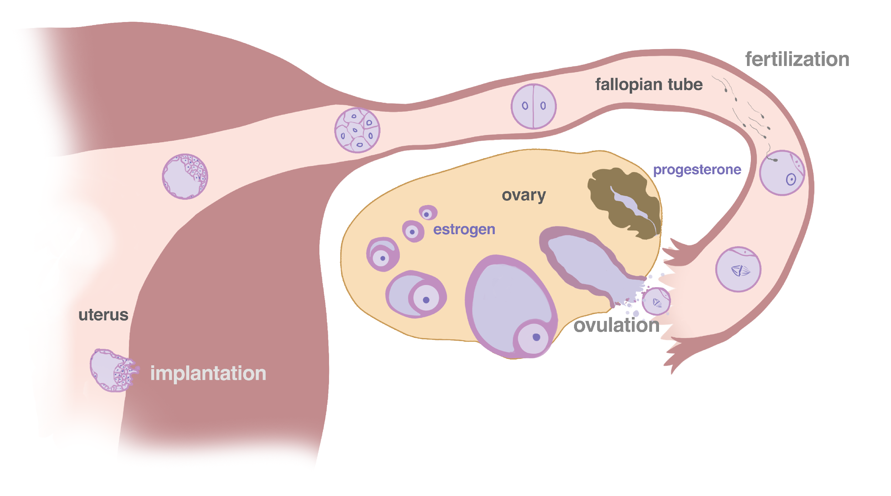
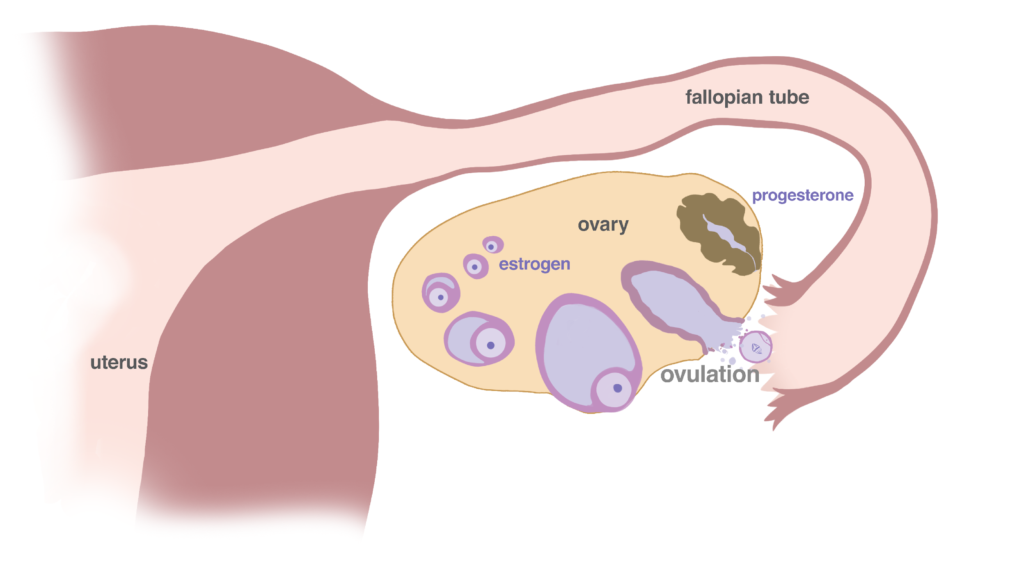

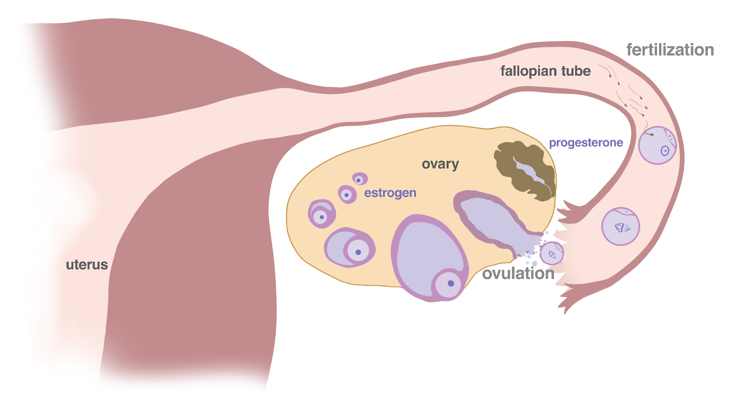
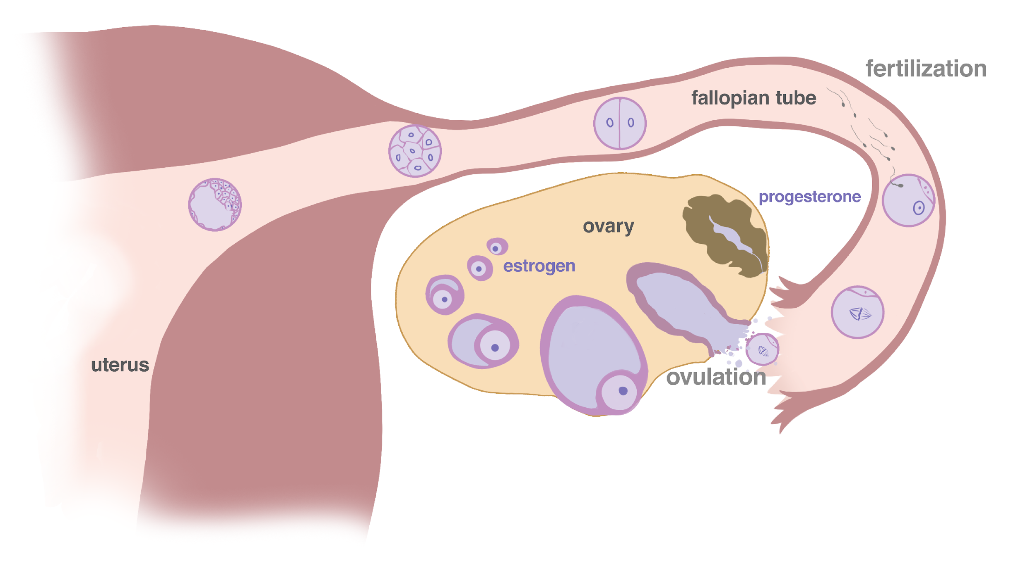
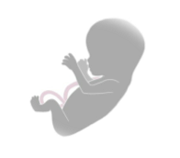
The beginning of life
Reproduction: New Life
© FEMM
Notes:
In the case of reproduction, through intercourse, the sperm present in ejaculatory fluid travel from the vagina up to the uterus and join with the egg in the fallopian tube to fertilize the egg.
A fertilized egg is also known as a zygote: the beginning of a new human life. This newly formed life contains the genetic material of both parents. The zygote travels into the uterus, where it embeds into the uterus wall; there it continues to grow with the expanding uterus until a baby is born approximately nine months later.

Slide 21

What’s so great about hormones?
Effects of estrogen & progesterone on your body
 | Estrogen | Progesterone
uterus | tones, contracts | relaxes
uterine lining | grows | maintains
bones | forms | strengthens
muscles | helps maintain muscle mass and strength | muscle relaxation
blood vessels | dilates, increases flow | relaxes, normalizes clotting
brain cells | higher cognitive function | maintains and heals
well-being | normal levels promote well-being; high levels increase anxiety | promotes relaxation; decreases anxiety
© FEMM
Notes:
Did you know? Just as sperm production is a sign of hormonal health in men, the process of ovulation is important for hormonal health in women. Ovulation isn’t just relevant when you want to become a parent; without ovulation, the female body doesn’t make all of the female hormones that a woman’s body needs to be healthy.
Here are some of the amazing things these two hormones do together, to support women’s health. For example, estrogen increases cognitive function in women. Progesterone heals the brain and helps with sleep! Estrogen builds women’s bone mass. Progesterone strengthens women’s bones.

Slide 22

What’s so great about hormones?
Effects of estrogen & progesterone on your body
 | Testosterone
testicles | initiates and maintains sperm production
bones | strengthens bones
muscles | builds
fat metabolism | helps promote fat burning
blood vessels | promotes blood flow and good circulation
brain cells | crucial for brain development; increases ability to learn and retain new information
well-being | normal levels promote confidence and motivation
© FEMM
Notes:
Men’s bodies also produce progesterone and estrogen - just in very small amounts. And women’s bodies also produce small amounts of testosterone. Look at how vital testosterone is to the healthy function of every part of your body! From your bones to your blood and well-being, hormones are at work!

Slide 23
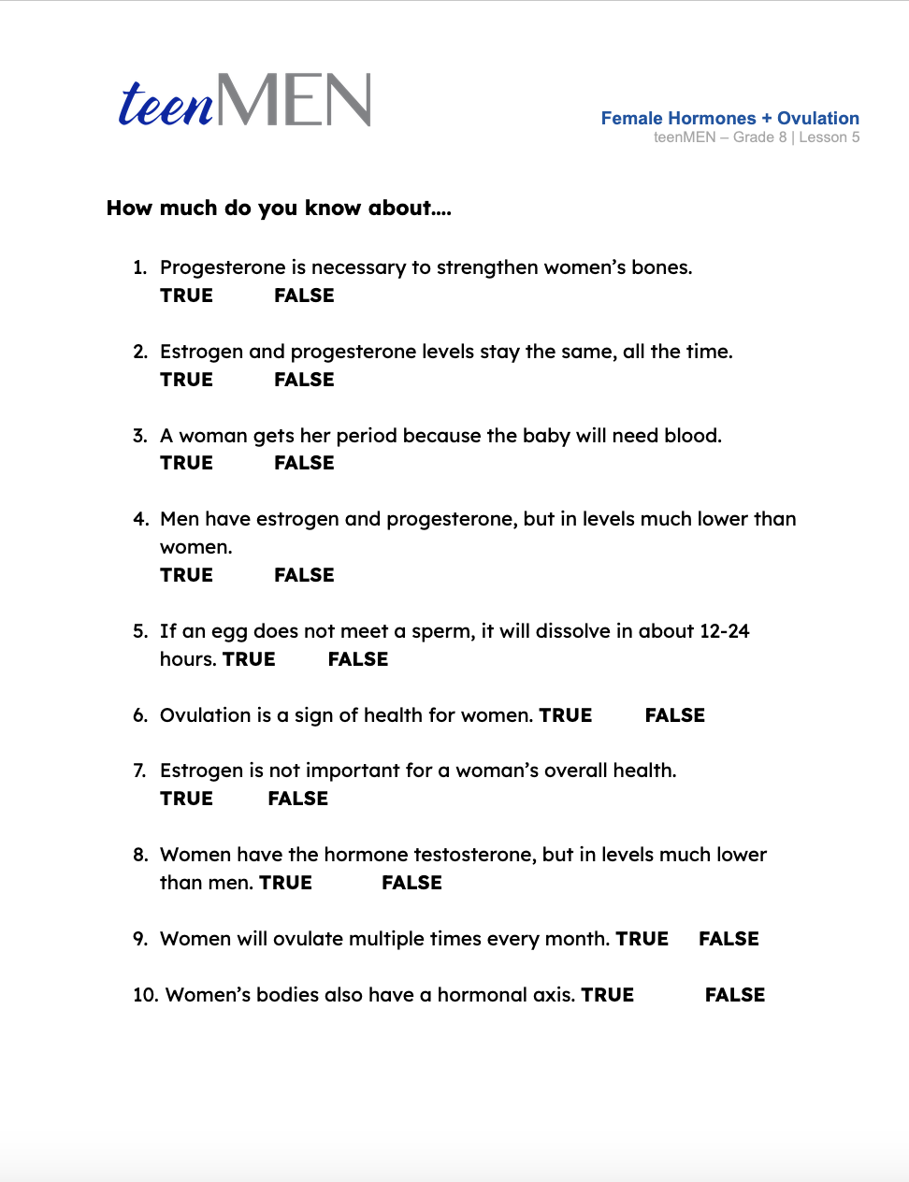
How much do you really know about…
Female Hormones?
© FEMM
Notes:
Step 5 (5 minutes): Worksheet: Female Hormones & Ovulation Quiz
Hand out the Female Hormones & Ovulation Quiz for students to complete.
When students are finished, review the answers together using the Answer Key on the next slide or in the materials provided.

Slide 24
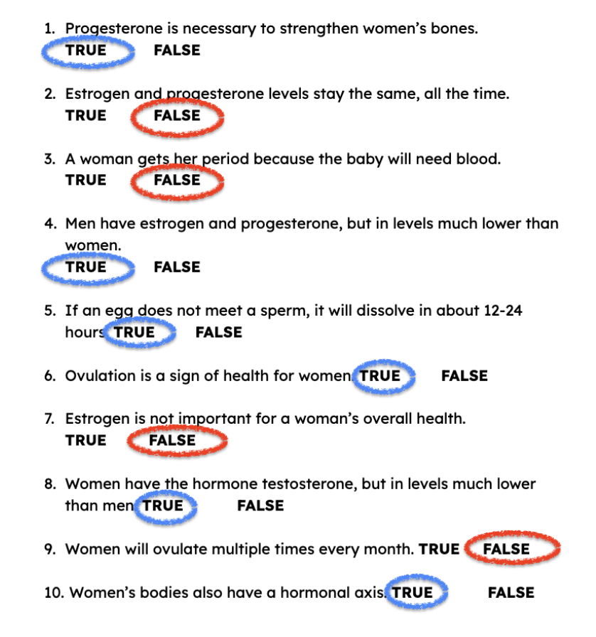
Answers!
© FEMM

Slide 25
Grade 8
LESSON 4
© FEMM

