Slide 1

Grade 8
LESSON 5
© FEMM

Slide 2
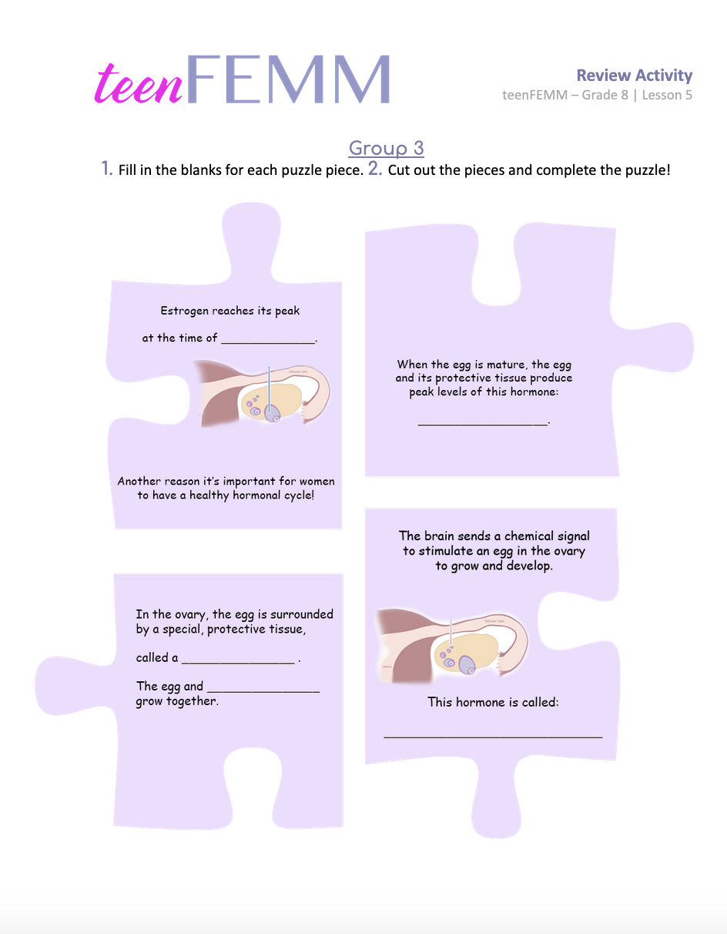
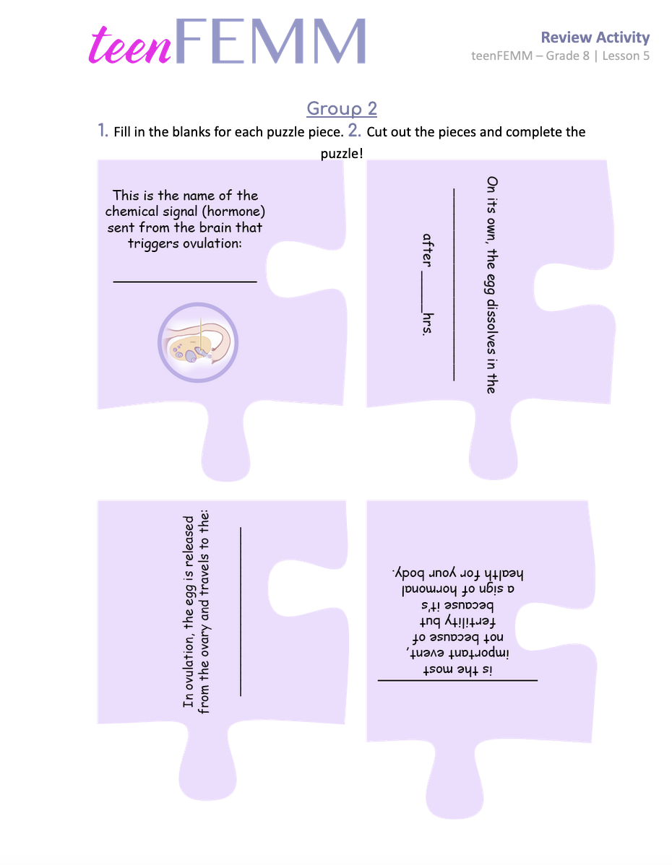
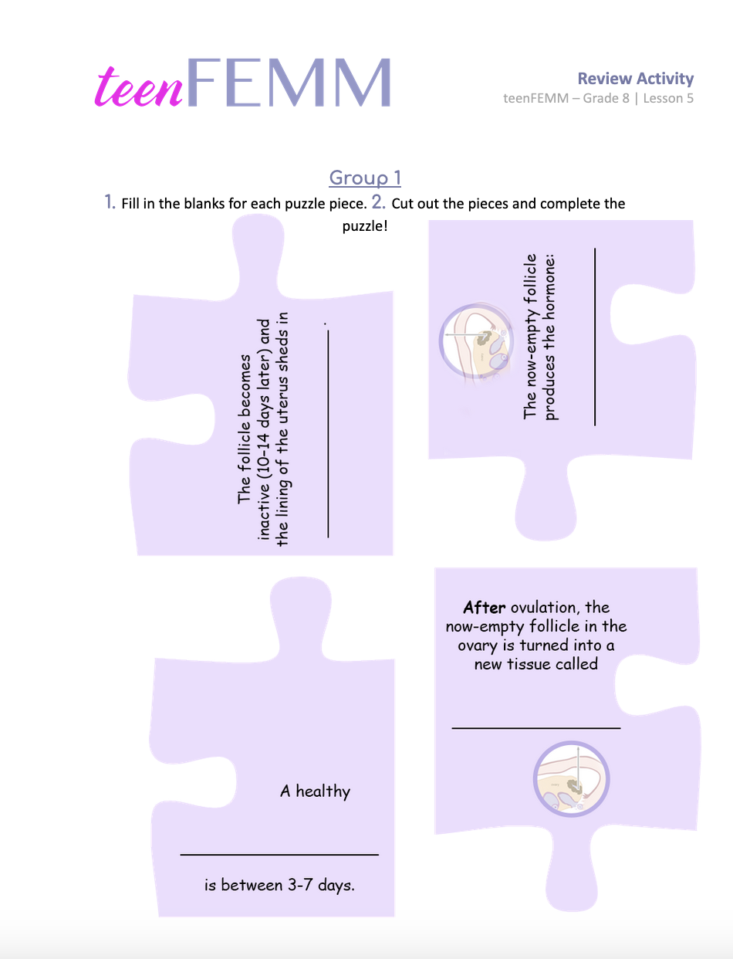
Puzzled about the _________cycle?
© FEMM
Notes:
Step 1 (10 minutes): Review Activity: Puzzles
Divide the class into three groups. Give each group one of the puzzles.
Instructions:
1. Fill in the blank to answer the question on each puzzle piece.
2. Cut out the pieces and complete the puzzle.
3. Once groups have completed their puzzle, have the whole class arrange the three puzzles in the correct order of the cycle events.

Slide 3

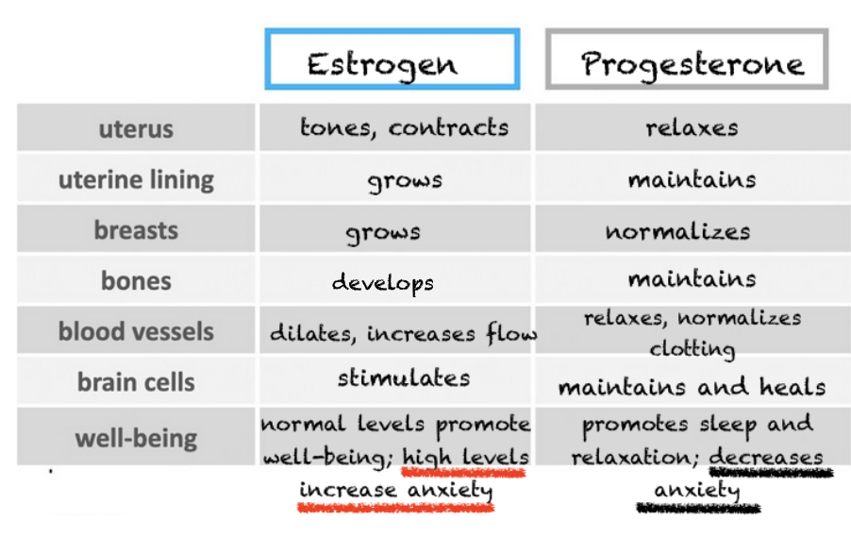
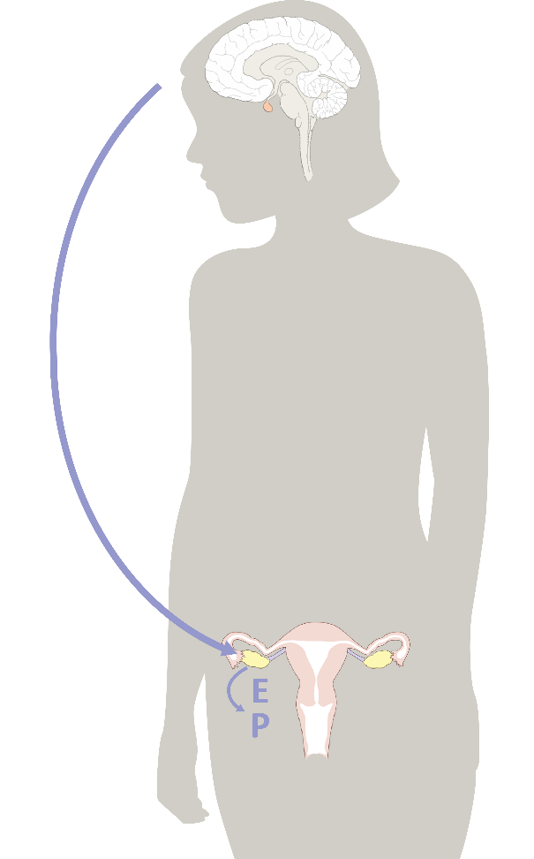
Estrogen & Progesterone for your body
© FEMM
© FEMM
Notes:
Step 2 (5 min): Introduce Lesson
As you are learning, hormones direct all of the physical changes of puberty. Hormones impact every part of the body. From the development of the pathways in the brain, to emotional wellbeing, blood vessels, breasts, bones and more; the hormones produced through the ovulatory cycle are vital to overall physical and mental health.
Right now, during puberty, some of you will see signs of estrogen and progesterone before other girls do. You may have lower levels of hormones, but they will continue to develop as you mature through your teen years.

Slide 4
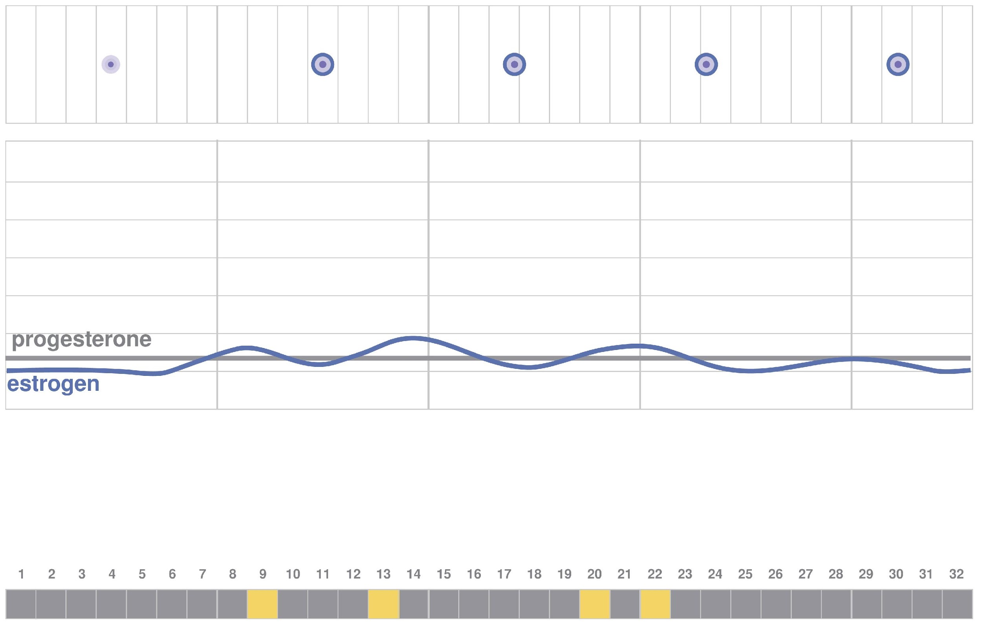
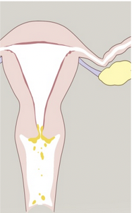
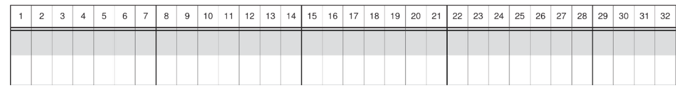
Hormones → Biomarkers in Puberty
At the level of the ovary
egg+follicle grow slightly
Egg+follicle growing produces slight rises in estrogen (blue line)
Slight estrogen on cervix produces slight cervical fluid.
These Biomarkers charted as yellow.
Notes:
The amazing thing is that all of these hormonal changes are happening inside of us - directed by the brain and happening in the ovaries - and we don’t even have to think about them!
This slide shows an example of how what is happening with hormones inside our body during puberty impacts what we observe on the outside.
1. The first image (yellow frame) shows what is happening in the ovary. The egg and follicle grow only a little at this stage of puberty.
2. The second image (purple frame) shows the slight rise in estrogen, based on the growth of the egg in the ovary.
3. The third image (pink frame) shows the effects of this slight rise in estrogen in the body, at the level of the cervix. The rise in estrogen produces a pasty or sticky type of cervical mucus.
4. The fourth image (gray frame) shows a chart, with the body’s cervical mucus observations or biomarkers, written down.

Slide 5
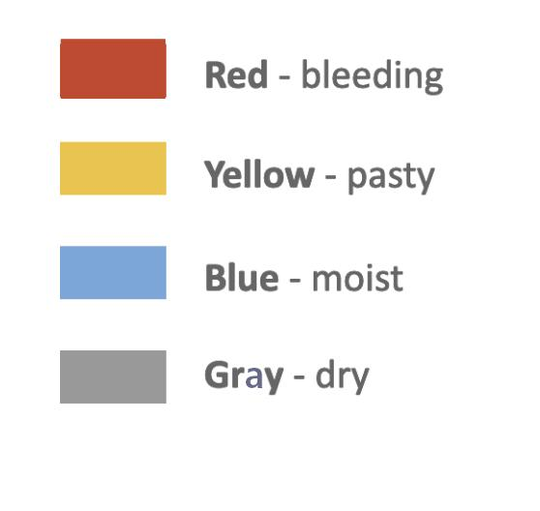
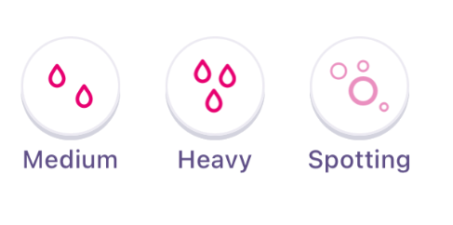
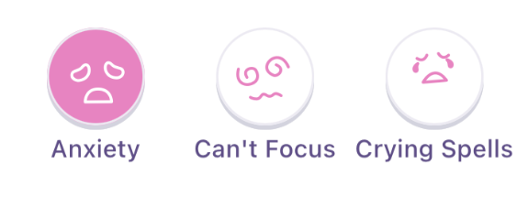
Hormonal health | Biomarkers
Your period is a biomarker to chart
‘Bio’ = life
‘Marker’ = sign
2. Feeling like this
is also a biomarker you can chart
© FEMM
Notes:
What are Biomarkers? Bio means ‘life’ and marker means ‘sign’. Biomarkers are signs of what’s going on with the hormones inside of our body. Biomarkers include fluids such as menstruation (bleeding) and cervical fluid, and also emotional and physical symptoms. Cervical fluid is the fluid secreted by the cervix which changes in consistency (from dry to moist) based on the changing hormone levels in the body.
Charting is a way to record these biomarkers by writing them down on paper.
As your hormonal axis (the communication between your brain and your ovaries) is still developing through your teen years, charting is a great way to be able to see and understand when this process begins for you and make sure it develops as it should. (This is important to note. In grade 8, most of the girls will be menstruating, but there may be a few who are not.) It’s pretty amazing that as women we can track these signs and have a window into the health of our body!

Slide 6
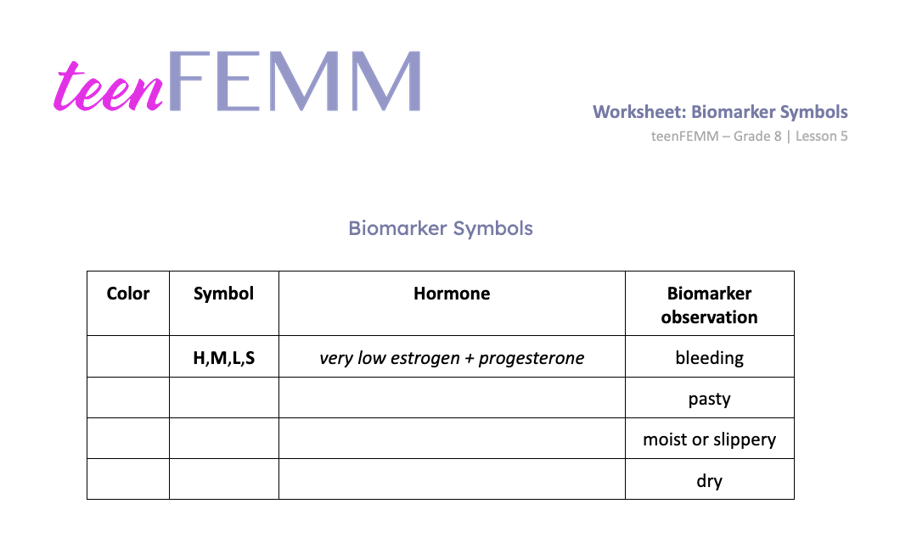
Worksheet | Biomarker Symbols
© FEMM
Notes:
Step 3 (10 minutes): Worksheet: Biomarker Symbols Chart
Hand out the Worksheet: Biomarker Symbols Chart to students, along with pencil crayons to fill in the chart.
Today we are going to look at charting (to record on paper) the biomarkers (signs) of hormones that you can observe in your body. Let’s fill in the Biomarker Symbols chart together.
Probably the most obvious biomarker is menstruation or getting your period. Bleeding is a sign that the lining of your uterus, called the endometrium, is shedding. This is a normal and vital sign of hormonal health. To chart this, we use the color red. Students should color in the appropriate box “red” on their Biomarker Symbols Worksheet.
There are additional symbols you can chart when it comes to your period:
H for heavy
M for moderate
L for light
S for spotting
Spotting is when you have bleeding that is very light or happens outside the time of your menstruation.
A healthy period should last from 3-7 days with at least one day of H or M bleeding if you have had your period for two years or more. During your period (menstruation) both estrogen and progesterone are very low. Why? Remember that the period comes at the end of the ovulatory cycle, and so estrogen is falling and progesterone is dropping after the corpus luteum stops producing progesterone.
Next, after your period, estrogen is once again beginning to rise (triggered by FSH in the brain) starting a new cycle. This rise in estrogen in the body acts on the cervix (the small canal at the base of the uterus), producing cervical mucus. Low levels of estrogen produce low levels of cervical mucus. As this fluid travels down the vaginal canal, you might observe a pasty or crumbly observation on the inside of your underwear, or on a tissue when you wipe. Totally normal. What color do you chart for this type of cervical mucus? “Yellow”. Students should color in the box yellow and write down “low estrogen” under Hormone.
As estrogen continues to rise, this changes the cervical mucus to a more fluid/wet sensation outside of the vagina. High levels of estrogen in the body produce high levels of cervical mucus. You may feel some wetness or notice a slippery sensation when you use the bathroom or after playing sports. This type of cervical mucus is normal and a sign of your hormonal health. Tracking your cycle can help you to recognize this and feel confident about your body.
To chart this fluid sensation, which indicates high levels of the hormone estrogen, we use the color “Blue”. Students should color in the corresponding box blue and write “high estrogen” under Hormone.
When estrogen is high, this sends feedback to the brain to produce LH (luteinizing hormone) to trigger ovulation. After ovulation, the empty follicle becomes the corpus luteum and produces the hormone Progesterone. This changes the cervical mucus once again to a thick mucus. Because this type of mucus is thick, not like estrogen-type mucus, it doesn’t travel towards the vaginal canal and instead of “moist or slippery”, the hormone progesterone is experienced as “dry” at the level of the vagina. Gray is the color we use to chart the observation/experience of “dry” and the hormone to write is Progesterone.

Slide 7
Biomarker Symbols: Answer Key
Color | Symbol | Hormone | Biomarker observation
 | H,M,L,S | very low estrogen + progesterone | bleeding
 |  | low estrogen | pasty
 |  | high estrogen | moist or slippery
 |  | progesterone | dry
© FEMM
Notes:
Have students check their Biomarker Symbol Chart against this slide to ensure it is correct.
Now that you have this handy Biomarker Symbol Chart filled in, you have a great reference for charting the different hormones as they change in your body during the ovulatory cycle.

Slide 8
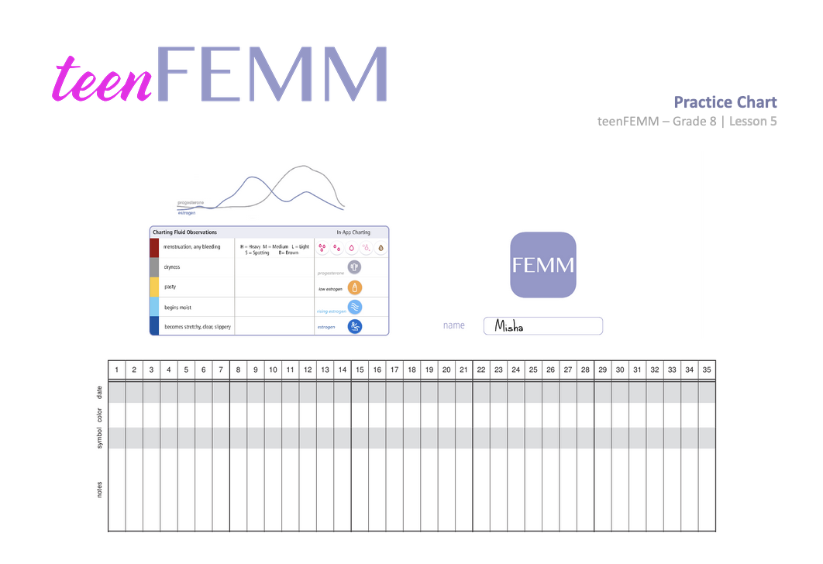
Practice | Learn to chart hormonal health!
© FEMM
Notes:
Step 4 (10 minutes): Practice Charting
Hand out a FEMM Practice Chart: Misha for each student.
(For students who took the teenFEMM course in 7th grade: Does anyone remember learning to chart the cycle from last year?) Did you know that FEMM has a free app for Apple and Android phones to support you in your charting? Allow students to participate by simply raising hands or sharing anything they might remember from last year.
Let’s practice charting the signs of hormonal health!

Slide 9
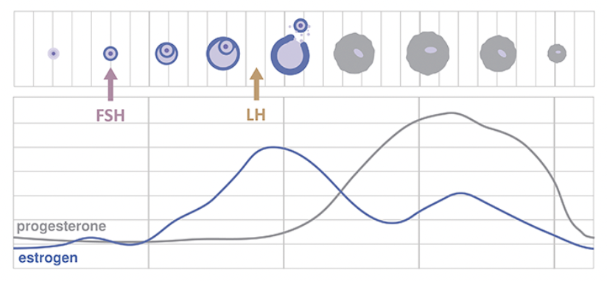
Hormonal health looks like:
Practice | Learn to chart hormonal health!
This is what a mature ovulatory cycle looks like if the hormones estrogen and progesterone were graphed.
Notes:
This slide shows what a mature ovulatory cycle looks like, when estrogen and progesterone are produced in the proper amounts through ovulation. You can see Estrogen in blue and Progesterone in gray.
For now, let’s look at charting the signs of hormonal health with Misha, as her cycle is still maturing.

Slide 10
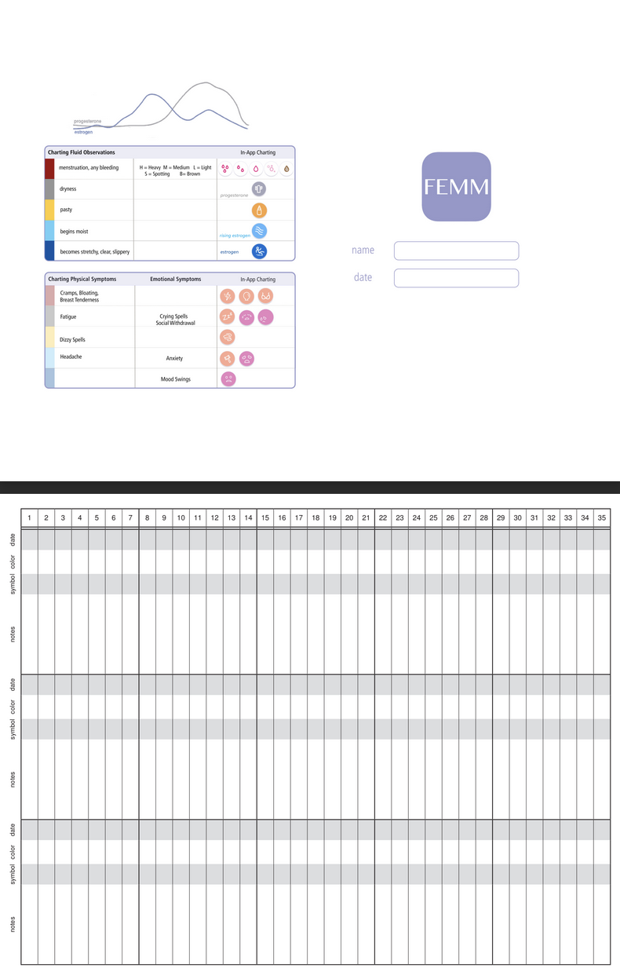

Charting the signs of hormonal health | Misha
Misha, Grade 8
Days 1-8 she doesn’t notice anything. Just feels dry.
What color should she use to chart this?
© FEMM
Notes:
Misha is in Grade 8. On days 1-8 of her cycle, she doesn’t notice anything and feels dry. What color should she use to chart this?
Click on the slide to reveal the answer. (Gray.)

Slide 11

Charting the signs of hormonal health
Day 9 she notices a slight change to sticky. Or, maybe it’s pasty.
What color should she use to chart this biomarker?
© FEMM
Notes:
On Day 9, she notices a slight change to sticky or pasty. What color should she use to chart this biomarker? Click on the slide to reveal the answer. (Yellow.)

Slide 12
Charting the signs of hormonal health
Days 10, 11, and 12 she feels dry again. What color does she use to chart this?
© FEMM
Notes:
On Days 10, 11, and 12, she feels dry again. What color does she chart with? Click on the slide to reveal the answer. (Gray.)

Slide 13
Charting the signs of hormonal health
Day 13 she notices similar mucus to what she experienced on day 9.
What color does she use to chart this?
© FEMM
Notes:
On Day 13 she notices similar mucus to what she experienced on day 9. What color does she use to chart? Click on the slide to reveal the answer. (Yellow.)

Slide 14
Charting the signs of hormonal health
Days 14-19 she doesn’t notice anything. Dry. What does she chart?
© FEMM
Notes:
Days 14-19, she doesn’t notice anything. Dry. What color does she use to chart? Click on the slide to reveal the answer. (Gray.)
Day 20, she notices a crumbly mucus again. (Yellow.)
Day 21 she feels dry again. (Gray.)
Day 22 she notices a slight something (Yellow.)
Day 23-31 she experienced dryness. (Gray.)
Show the next slide with the completed chart and go over answers to clarify as needed.

Slide 15
Charting the signs of hormonal health
© FEMM
Notes:
For this cycle, we see that estrogen levels are still low for Misha. She doesn’t observe any slippery or high estrogen type mucus. Why is this? Because Misha is not yet ovulating, her estrogen levels are low and her progesterone levels are staying at the same level. This is a normal looking chart for a girl in puberty. Her brain is learning to communicate with her ovaries and her hormones are “waking up” and preparing for a full ovulatory cycle. For now, she is producing a very small amount of mucus that she notices as a pasty or crumbly mucus.
What happened on day 32? Any guesses?

Slide 16

Charting the signs of hormonal health
© FEMM
Notes:
She got her period (menses). She would chart this by starting a new line, counting the first day of her period as Day 1 on the next row on her chart.

Slide 17
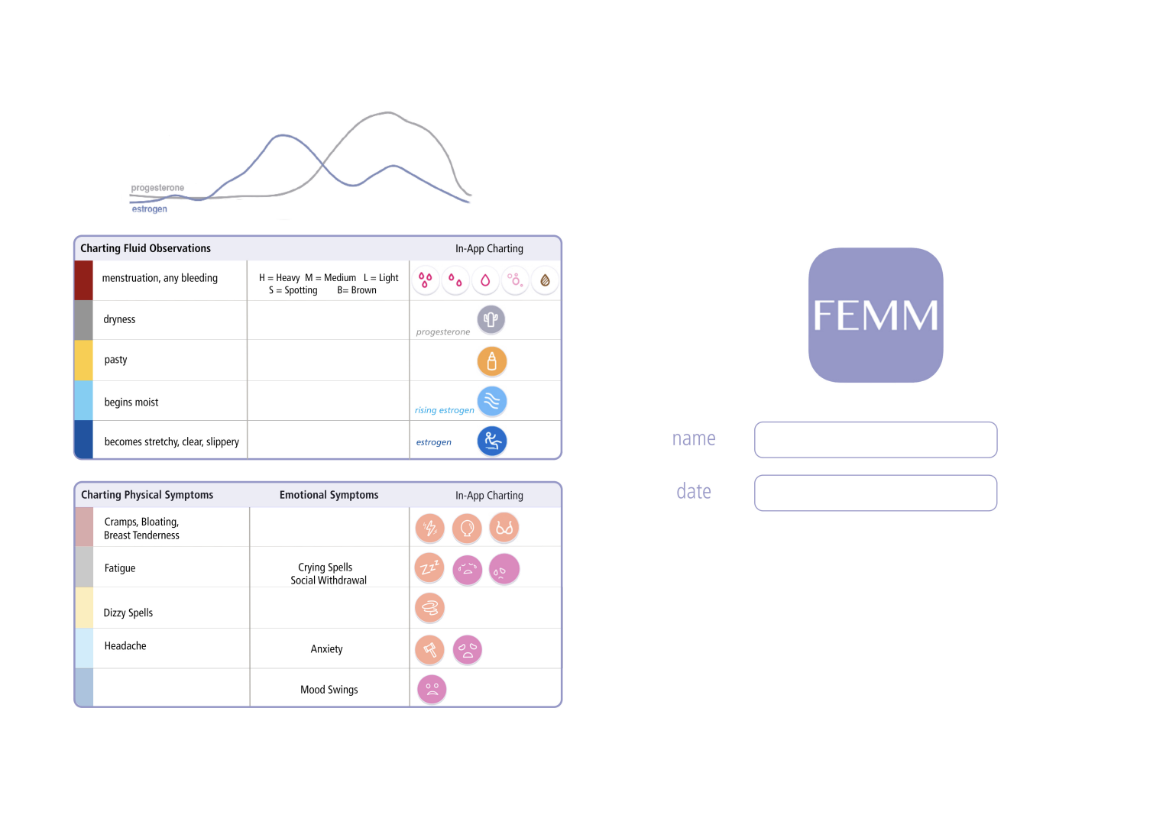
Review | Chart Your Health
Charting helps YOU to create
your very own health record.
  This helps you see
  what your hormones are doing
  inside of your body!
Taking time to learn to track your biomarkers helps you to understand your body, feel confident in your body and support your emotional and physical health.
© FEMM
Notes:
Step 5: CONCLUSION
You did a great job today! Provide each student with a FEMM Chart for their use.
You can take a FEMM chart home with you and try to chart your own cycle. There are charting symbols and cervical mucus biomarkers on the back, for reference. Everyone will be at different stages of their cycle, so it’s important to remember that charting is about your very own private health record. Charting helps you monitor what’s happening with your hormones and your health. Throughout the next few lessons, we will be able to talk about what we can do to help keep our hormones and bodies healthy.

Slide 18
Grade 8
LESSON 5
© FEMM
© 2023 FEMM Foundation, Inc. All rights reserved.

