Slide 1

Grade 8
LESSON 5
© FEMM

Slide 2
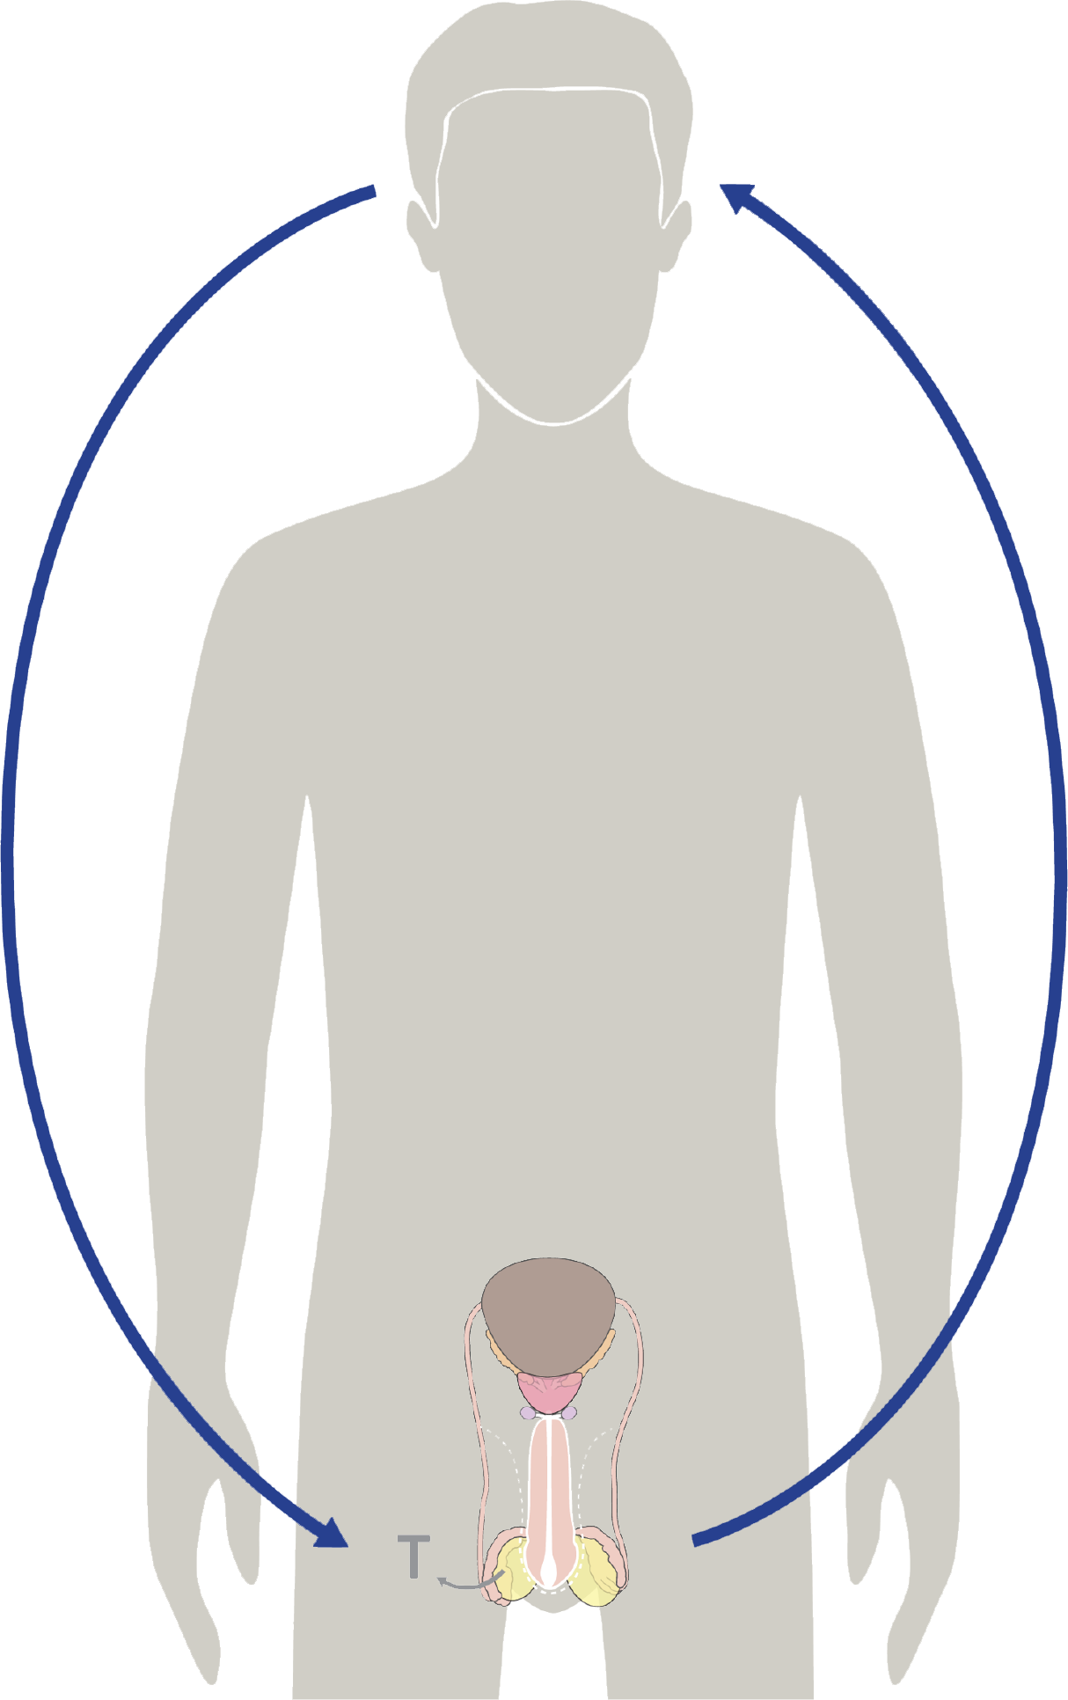
Review: Hormonal feedback
The brain sends
FSH + LH
to the testes
4. Testosterone develops
the body and the brain.
3. The increase in testosterone signals to different parts of your body to grow.
2. The cells in the testicles
produce sperm
and testosterone
© FEMM
Notes:
PROCEDURE
Step 1 (5 minutes): Review hormonal feedback
Today, we’re going to learn more about the changes of puberty and your brain. But first, let’s review.
What is the hormonal axis? Ask a student to describe the hormonal axis in their own words. This is the way that the brain and the reproductive system are linked.
Hormonal feedback is another way of understanding this process as a circuit or loop. On the slide we see this process of hormonal feedback broken down into four steps:
1. In the brain, the pituitary gland sends Follicle Stimulating Hormone and Luteinizing Hormone to the testes. 2. The cells in the testes respond by producing sperm and testosterone. 3. This increase in testosterone in the body tells all of the other parts of the body to grow. 4. An amazing thing is that the brain helps to generate the production of testosterone, and testosterone in turn helps to develop the brain.

Slide 3
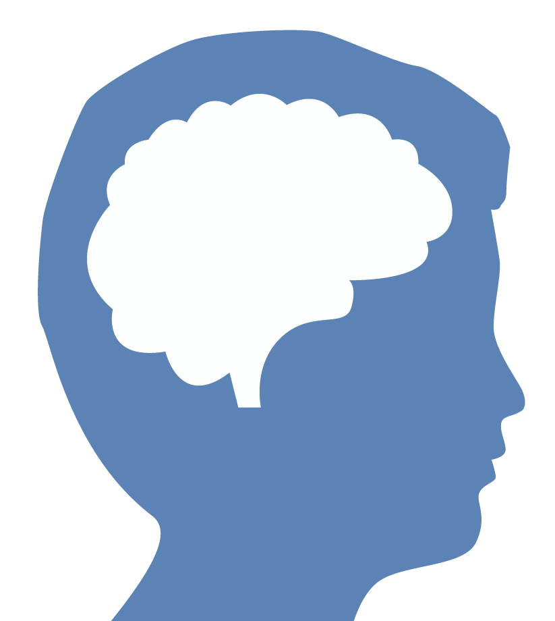
Did you know?
prefrontal cortex
amygdala
25
© FEMM
Notes:
Step 2 (5 minutes): Puberty and the brain
Play this short video on the development of the brain.
Your brain is amazing! At just 5 weeks old a human fetus is the size of an apple seed but the brain has already begun to grow. Incredible. The “pruning” that the video describes is actually what’s happening now, during puberty, and will continue after puberty.
Did you know: the human brain isn’t fully mature and developed until around age 25? During puberty your brain is undergoing its own massive growth spurt and remodel. The last parts of the brain to fully mature are the prefrontal cortex, where judgment and long-term decision making takes place, and the amygdala, which is the emotional center. Click on the slide to show where the prefrontal cortex and the amygdala are located in the brain.
These parts of the brain are particularly critical for emotional awareness and self-control. As a result, the teen brain is highly sensitive. For example, studies show that adolescents become addicted to nicotine faster and at lower doses. Most addictions begin in adolescence. So, now is the most important time to say no to things that are unhealthy for you and practice making excellent choices.

Slide 4
You have the power to shape your brain
Your choices wire
your brain
The brain is constantly forming new neurons and connections, based on your experiences, thoughts, actions, and environment.
The brain is designed to recognize habits. These habits can be wired into the brain.
© FEMM
Notes:
Your brain is constantly forming new neurons (nerve cells, the fundamental units of the brain) and connections. The brain is designed to recognize habits. These habits become hard-wired into the brain. Every time you make an excellent choice for yourself and your health, like choosing to play a new sport or do your homework after school, these choices shape your brain, hard-wiring it for success, for life.

Slide 5
Activity
Think of a skill or goal in your life that you would like to work on…
What are some steps you could take to work towards this goal?
© FEMM
Notes:
Step 3 (10 minutes): Brain Connections Activity
Have students stand up and form a circle. Ask the class to think of and name an example of a skill or a goal in their life that they’d like to work on. For example: “I want to get better at soccer.” Then, brainstorm suggestions with the class about what choices to make to improve in this area: “...I could attend every practice, go for a run on the days that I don’t have practice, etc.”
Show the ball of yarn and explain that the ball of yarn represents the brain and the string represents neural pathways (the connections that develop in the brain).
To start, hold on to the beginning/end of the string and then toss the ball to a student in the circle.
As the student receives the ball of yarn, they are to give one suggestion for how to improve at the skill/goal agreed upon by the class. i.e. “I won’t talk when the coach is talking” and then, hanging on to their corner of the yarn, toss the ball to the next student.
After many examples, note how thick the connections and brain pathways are getting! Every choice you are making is strengthening the neural connections, forming habits in your brain to achieve your goals.
Then, have each student give an excuse for not going to soccer practice. For example: “friends came over and I lost track of the time”, “I didn’t feel like it,” “I didn’t ask for a ride,” etc. With each excuse given, have the students toss the ball of yarn back to the person who threw it to them, undoing or taking away the line of yarn and the neural pathway created (leaving only a few connections between neurons in the end). Note how thin and weak the neural connections are now.
Your choices are shaping your brain now and for your future. Whether it’s learning a new skill at soccer practice or learning to say no to something that’s unhealthy for you, you are wiring your brain. Puberty is a hugely important time for your brain’s growth and development. Your choices begin as a single action, but if repeated long enough, these patterns become hardwired, neural pathways carved deep into the brain.
Did you know: the human brain is considered to be one of the most powerful computers. Your brain has 100,000 miles worth of blood vessels - that’s enough “circuitry” to go around the earth approximately four times! So if you ever think you don’t have what it takes, you’re not good enough or you can’t break a bad habit, just remember that you have a powerful brain that can change and adapt, one choice and one step at a time.

Slide 6
Your brain and testosterone
Hormones are
POWERFUL.
The smallest changes in hormone levels cause big changes in your brain and body.
© FEMM
Notes:
Step 4 (5 minutes): Testosterone and Puberty
As we know, hormones are controlled by the brain and hormones are powerful!
Have you ever heard about Olympic athletes who were caught using substances to make them go faster or jump higher or run longer? The substances they take are often a kind of testosterone. Even things found in muscle-building supplements can be very unhealthy for your body, especially as you are still growing and your hormonal axis is maturing. Supplements and drugs to increase muscle and testosterone cause damage to the heart, increase the risk of cancer and they actually decrease or even stop your body’s own production of testosterone.
In puberty, testosterone will help your body to develop and mature. It will help you grow taller and build strong bones and muscles. It will also cause your voice to change, eventually deepening. You will also notice that your body will start to produce more odor and sweat and become more hairy. All of these things will happen when your body is ready. You do not want to interfere with your brain and body development.

Slide 7
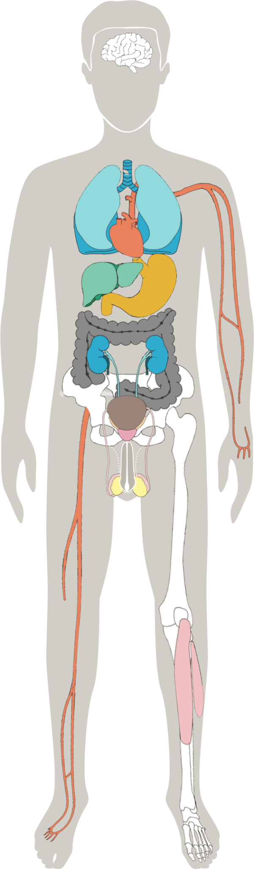
Your body and testosterone
 | testosterone
brain cells | increases ability to learn
bones | strengthens bone formation & density
muscles | increases muscle mass
hair | promotes growth
fat metabolism | promotes fat burning
blood sugar | keeps at a healthy level
overall well-being | normal levels promote confidence and motivation
© FEMM
Notes:
Testosterone increases muscle mass and bone density, affecting the muscular and skeletal systems. Testosterone also increases oxygen in the blood, which increases energy and endurance. This impacts the cardiovascular and respiratory systems. This chart shows how testosterone impacts your whole body.
Remember, for some guys, puberty starts early and for other guys, puberty starts a little later, because every guy’s body is unique.

Slide 8
Your body and testosterone
Testosterone & growth
Testosterone has these effects:
strengthens bones, muscles, heart
deepens voice
sharpens mind
increases hair growth
increases oil & sweat production
These changes typically happen between the ages of 10-17.
© FEMM
Notes:
Your body’s production of testosterone will:
Help you grow taller
Strengthen bones, muscles and heart
Cause your voice to change and become deeper
Sharpen your mind
Make you more hairy
Cause your body to produce more odor and sweat

Slide 9

Frequently Asked Questions
Frequently Asked Questions
“How tall will I be?”
Tamir, age 14
© FEMM
Notes:
Step 5 (10 minutes): Questions about Puberty
Let’s talk about some of the changes you might be seeing or questions you might have. Go through slides with frequently asked questions from teenage boys.
How tall will I be? There’s no way to know how tall you’ll get exactly (until you stop growing!). Many boys your age are shorter than the girls. This can be normal, because girls get a head start on puberty (typically ages 9-14 for a girl, and guys go through puberty a little later). Boys often are still growing after the girls have stopped, so you’ll likely catch up and be taller than some of the girls eventually. Some boys stop growing when they’re 16, but some boys keep growing until they’re 18!

Slide 10
Frequently Asked Questions
“What does testosterone
do to my brain?”
Will, age 13
© FEMM
Notes:
What does testosterone do to my brain?
Testosterone changes how your brain is organized. It can make certain structures of your brain bigger. Also, testosterone influences how your brain gets activated when it responds to a situation or environment. Testosterone has been shown to have a good impact on mood, lessening both anxiety and depression. Testosterone also improves your spatial memory abilities. Testosterone could help you stand up to a bully. It can also give you the brain power to focus on what you’re doing! The main thing to know is that testosterone is good for your brain; you just have to make sure you are developing the right habits!

Slide 11
Frequently Asked Questions
“How can I get
bigger muscles?”
Marc, age 14
© FEMM
Notes:
How can I get bigger muscles?
Guys can expect their shoulders to broaden and muscles to grow, but remember - all guys grow differently and at different paces. Testosterone acts directly on your muscles and also helps keep your bones strong. The best thing you can do to support your muscular system is to play sports and exercise each day. We’ll discuss this health habit more next lesson.

Slide 12
Frequently Asked Questions
“Why am I getting more hair?”
Nick, age 14
© FEMM
Notes:
Why am I getting more hair on my body?
Testosterone travels to the hair cells, leading to darker and thicker hair, and hair growth on the underarms or face. Boys can begin to see hair growing on the chin and upper lip, chest, armpits, and in the pubic area (around the reproductive organs). In puberty, the hair all over your body begins to thicken.

Slide 13
Frequently Asked Questions
“Do I need deodorant now?”
Chris, age 13
© FEMM
Notes:
Do I need deodorant now?
Sweat is not smelly… until it comes into contact with your skin. Sweat and bacteria are what make you smell. Using deodorants can cover up the smell, but… Sweat pushes out dirt and grime in the skin. So, letting your sweat dry allows it to settle back into your pores, complete with whatever toxins it was trying to push out in the first place. This is why it’s important to shower after exercise.

Slide 14
Frequently Asked Questions
“I’m washing my face, but
I’m still getting pimples!”
Cole, age 13
© FEMM
Notes:
Acne
Testosterone and other hormones are working hard in your body and sometimes they work a little too hard and produce oil that clogs your pores and you end up with pimples. This is normal, but you can ask a parent to help you select a product that could help clear your skin.

Slide 15
Frequently Asked Questions
“Why does a guy’s voice change during puberty?”
Daniel, age 13
© FEMM
Notes:
Voice
Testosterone is responsible for the voice deepening during puberty. Testosterone causes the vocal cords to thicken and the larynx or voice box to grow larger in men during puberty. The voice may "crack" or "break" as the body adjusts to the changes in the larynx. Most guy’s voices don’t fully mature until their twenties.

Slide 16
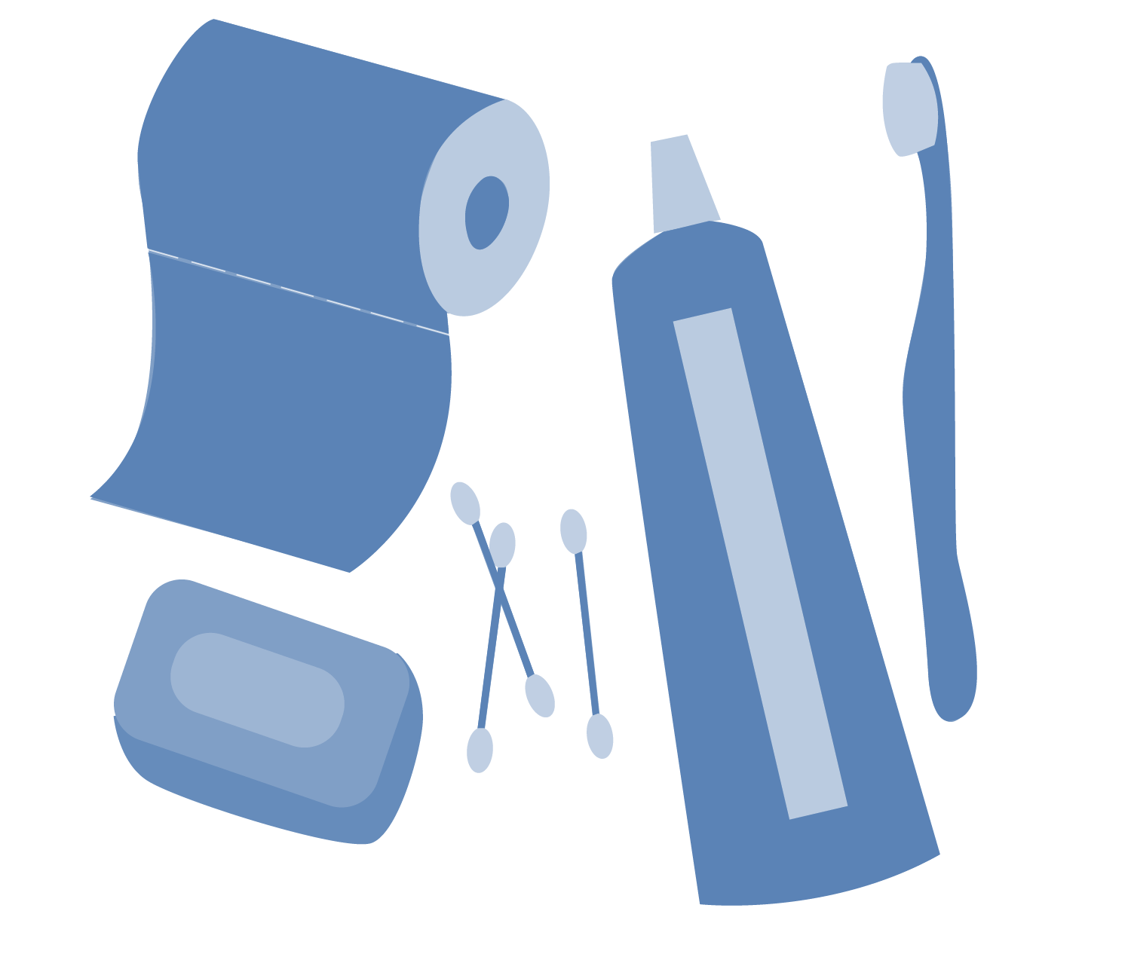
Healthy Habits
Healthy habits: Hygiene
Hygiene: the habits that help keep you clean and healthy.
Bathe or shower daily.
Use deodorant, as needed, to help eliminate body odor.
Wash your face in the morning and at night.
Trim your nails once a week.
Brush your teeth every morning and before bed at night.
Wash your hands frequently.
Wear clean clothes every day.
© FEMM
Notes:
Because of all the changes in your body, it’s important that you take care of your body. Your hygiene habits are important for your health. Here are some of the hygiene habits you should be practicing:
Bathe or shower daily. This is really important for the health of your skin and for getting rid of body odor as well as to clear away sweat, dirt and bacteria.
Use deodorant, as needed, to help eliminate body odor.
Wash your face in the morning and at night to help keep your skin clear.
Trim your nails once a week. Keeping your nails short helps to protect against bacteria getting under our nails and ingrown toenails which are painful.
Brush your teeth every morning and at night. Don’t forget to brush your tongue and to floss to get rid of plaque in between teeth.
Some boys will need to start shaving soon. You might not be in this category yet, but eventually you will need to start shaving. It can be fun to pick out shaving cream and a razor at the store. Ask a parent if you need help or advice.
16

Slide 17
Puberty and testosterone
Changes in hormones can make you feel more self-conscious
during puberty.
Testosterone plays a big role in mood and mental health.
🧠
❤️
Testosterone increases
muscle mass.
🩸 Testosterone increases oxygen in the blood. This increases energy and endurance.
💪
Hormones have a big role to play in the changes you will experience over the next several years.
It’s normal to feel more sensitive or self-conscious as your brain and your body are going through
a lot of changes!
Testosterone increases bone density!
💀
© FEMM
Notes:
The growth that you see and experience during the next several years should give you confidence that you are developing as you should. Changes in testosterone can impact your mood, making you feel more sensitive or self-conscious at times. This is normal as the brain is growing, developing and changing. It’s important to remember that emotions will come and go, but we always have the power to choose how we respond.

Slide 18

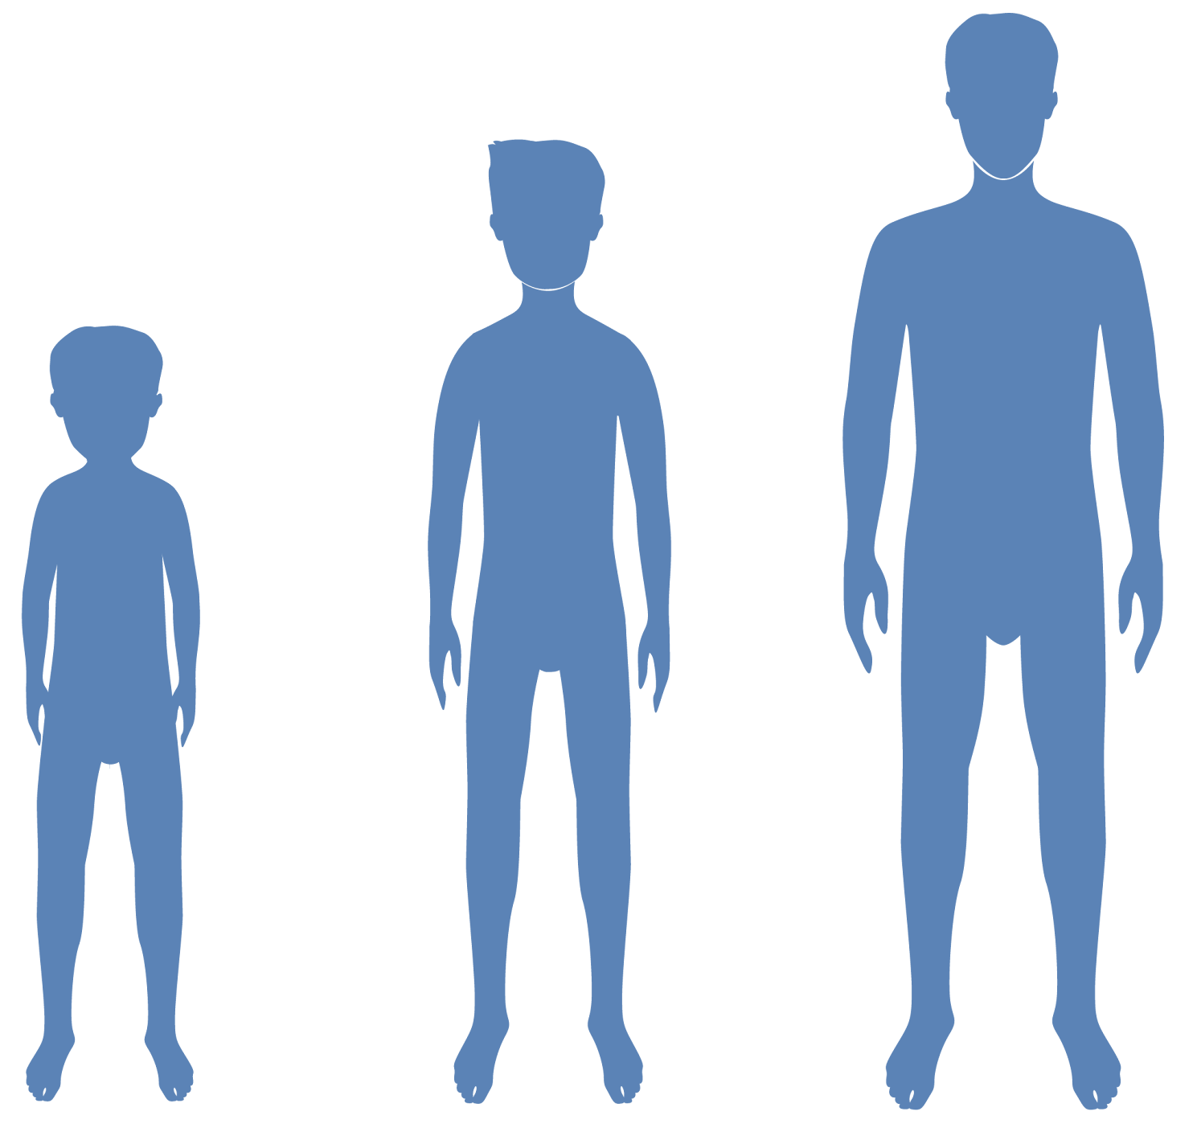
Rapid Fire Five
Name 5 things that will change in a young man’s body because of the effects of testosterone:
___________ _____________
___________ _____________
___________
Height
Increased muscle
More body hair
Voice deepening
Increased sweat
© FEMM
Notes:
1. Name 5 things that will change in a young man’s body because of the effects of testosterone:
Possible Answers (others can also be accepted if they were covered in class)
Make you more hairy
Help you grow taller
Build stronger bones and muscles
Cause your voice to change and become deeper
Cause your body to produce more sweat and odor.
Increase oxygen in the blood
Sharpen the brain, improve memory
Mood changes: more self-conscious and self-confident

Slide 19
Rapid Fire Five
2. At 5 weeks old the human fetus is the size of an appleseed; the brain develops at five months.
TRUE or FALSE
© FEMM
Notes:
2. At 5 weeks old the human fetus is the size of an appleseed; the brain develops at five months.
False. At just 5 weeks old a human fetus is the size of an apple seed but the brain has already begun to grow.

Slide 20
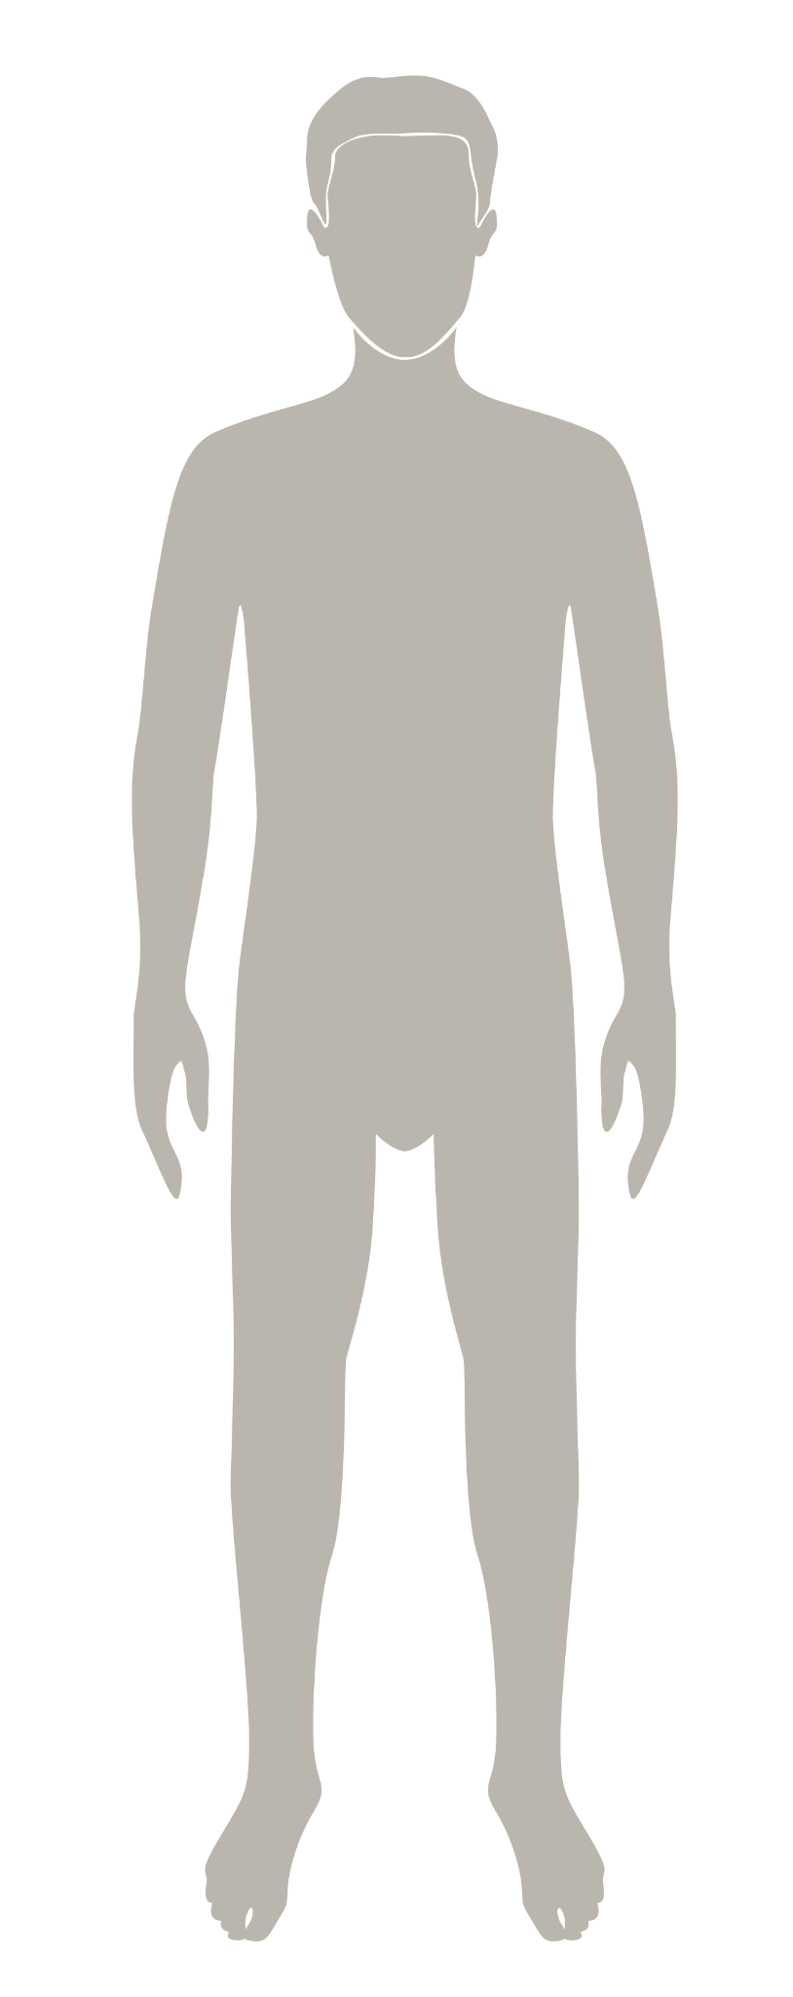
Rapid Fire Five
3. In puberty, the male body produces 5 times more testosterone than it did before the onset of puberty.
TRUE or FALSE
© FEMM
Notes:
3. In puberty, the male body produces 5 times more testosterone than it did before the onset of puberty.
False. More like 5x6… or, 30 times the amount.

Slide 21
Rapid Fire Five
4. The brain isn’t fully mature until what age?
?
25
© FEMM
Notes:
4. The brain isn’t fully mature until what age? 25

Slide 22
Rapid Fire Five
5. Of these five parts of the brain, which two are the last to mature:
Corpus Callosum
Amygdala
Pituitary gland
Prefrontal cortex
Cerebellum
© FEMM
Notes:
5. Of these five parts of the brain, which two are the last to mature:
Amygdala Pituitary gland Prefrontal cortex
Cerebellum Corpus Callosum

Slide 23
Grade 8
LESSON 5
© FEMM

