Slide 1

Grade 8
LESSON 6
© FEMM

Slide 2
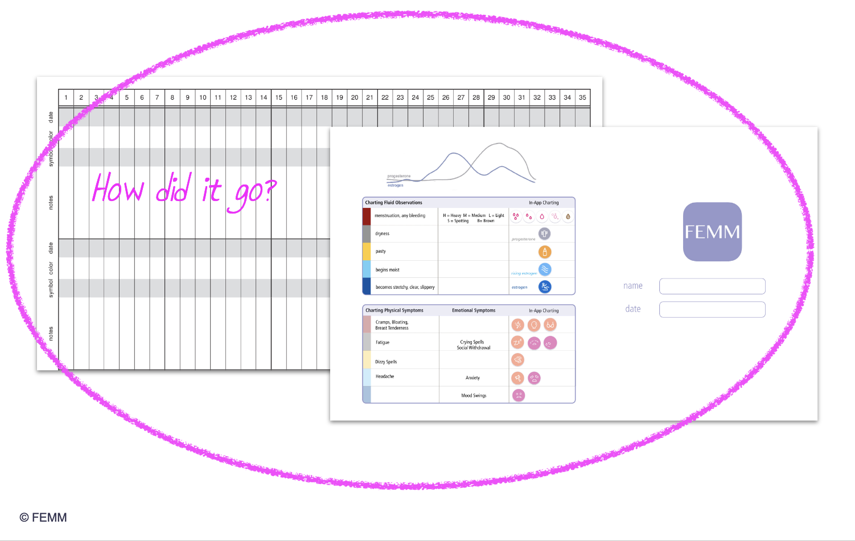
Review | Did you try to Chart Your Health?
nothing?
Moist
Moist
Moist
© FEMM
Notes:
Step 1 (5 minutes): Introduce the lesson.
Did you try to chart your cycle this past week? Did it help you to understand yourself or what’s going on in your body? Give students a minute to volunteer to share any of their responses to these questions.
If you haven’t started charting yet, or did but forgot for a few days and then had trouble getting back to it, that’s OK! The great thing is that you can always start at any point. If you’ve never paid attention to your biomarkers before, it can seem a little bit overwhelming. But maybe, if you start to chart, recognizing your own biomarkers will give you confidence in your body, realizing that what you had maybe previously thought was weird, random, or even something bad, is actually a normal and healthy sign of what your hormones are doing.

Slide 3

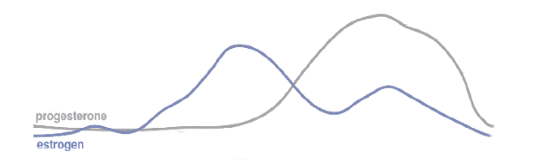
Meet Addison!
👩🏻‍🦰
She’s 13.
She just started 8th grade.
She’s been charting for about 6 months.
She didn’t notice much at first…
Now she is recognizing more of her biomarkers.
📚
🧐
© FEMM
Notes:
Step 2 (10 minutes): Introduce the case study for the day.
Addison is 13 years old and just started 8th grade. She has been charting for about 6 months. At first, her charts were much like the one we saw last lesson: some off and on cervical mucus that she charted with the symbol yellow and gray. There were times when she wondered if it was even worth charting! She felt like getting her period might be the only obvious biomarker she could confidently identify!
Then, about 2 months ago she started to notice a little bit more cervical fluid and began to chart some blue days. She remembered from her teenFEMM course that this indicated that her brain and ovaries must be communicating more and her hormonal axis was maturing. From her chart, we can actually get a picture of what is going on in her ovaries and how these hormones are acting on her cervix, producing different types of cervical mucus that she can observe. Let’s take a look.
Hand out the Worksheet: Addison’s Chart to the class.

Slide 4
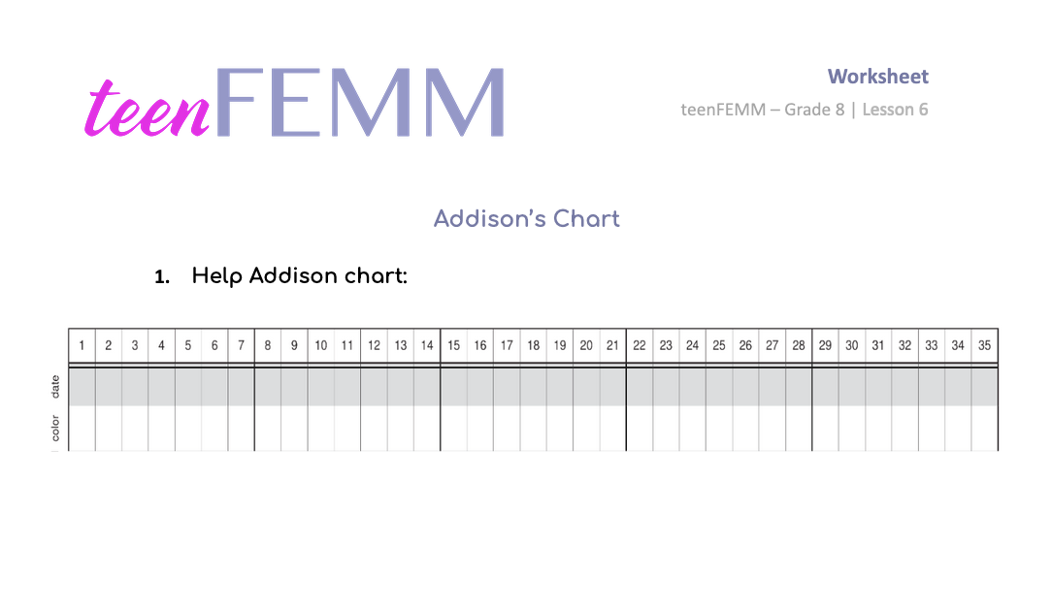
Worksheet | Addison
Notes:
Let’s help Addison fill in her chart, based on her charting notes. But first, let’s review the colors we use to chart the biomarkers.

Slide 5
Charting Symbols
Color | Symbol | Hormone | Biomarker observation
 | H,M,L,S | very low estrogen + progesterone | bleeding
 |  | low estrogen | pasty
 |  | rising estrogen | moist sensation
 |  | high estrogen | slippery sensation, clear, stretchy
 |  | progesterone | dry
Notes:
What is red for? Bleeding. How about yellow? Yellow is for low estrogen. What about gray? Gray is for the hormone progesterone and the sensation that accompanies this is dryness. Now, we’re getting a little more specific about blue today. Light blue is for rising estrogen and it has a moist sensation. Dark blue is for high estrogen and it has a slippery sensation. You might even see clear or stretchy looking mucus on the paper when estrogen is high. Alright, now let’s get back to Addison.

Slide 6
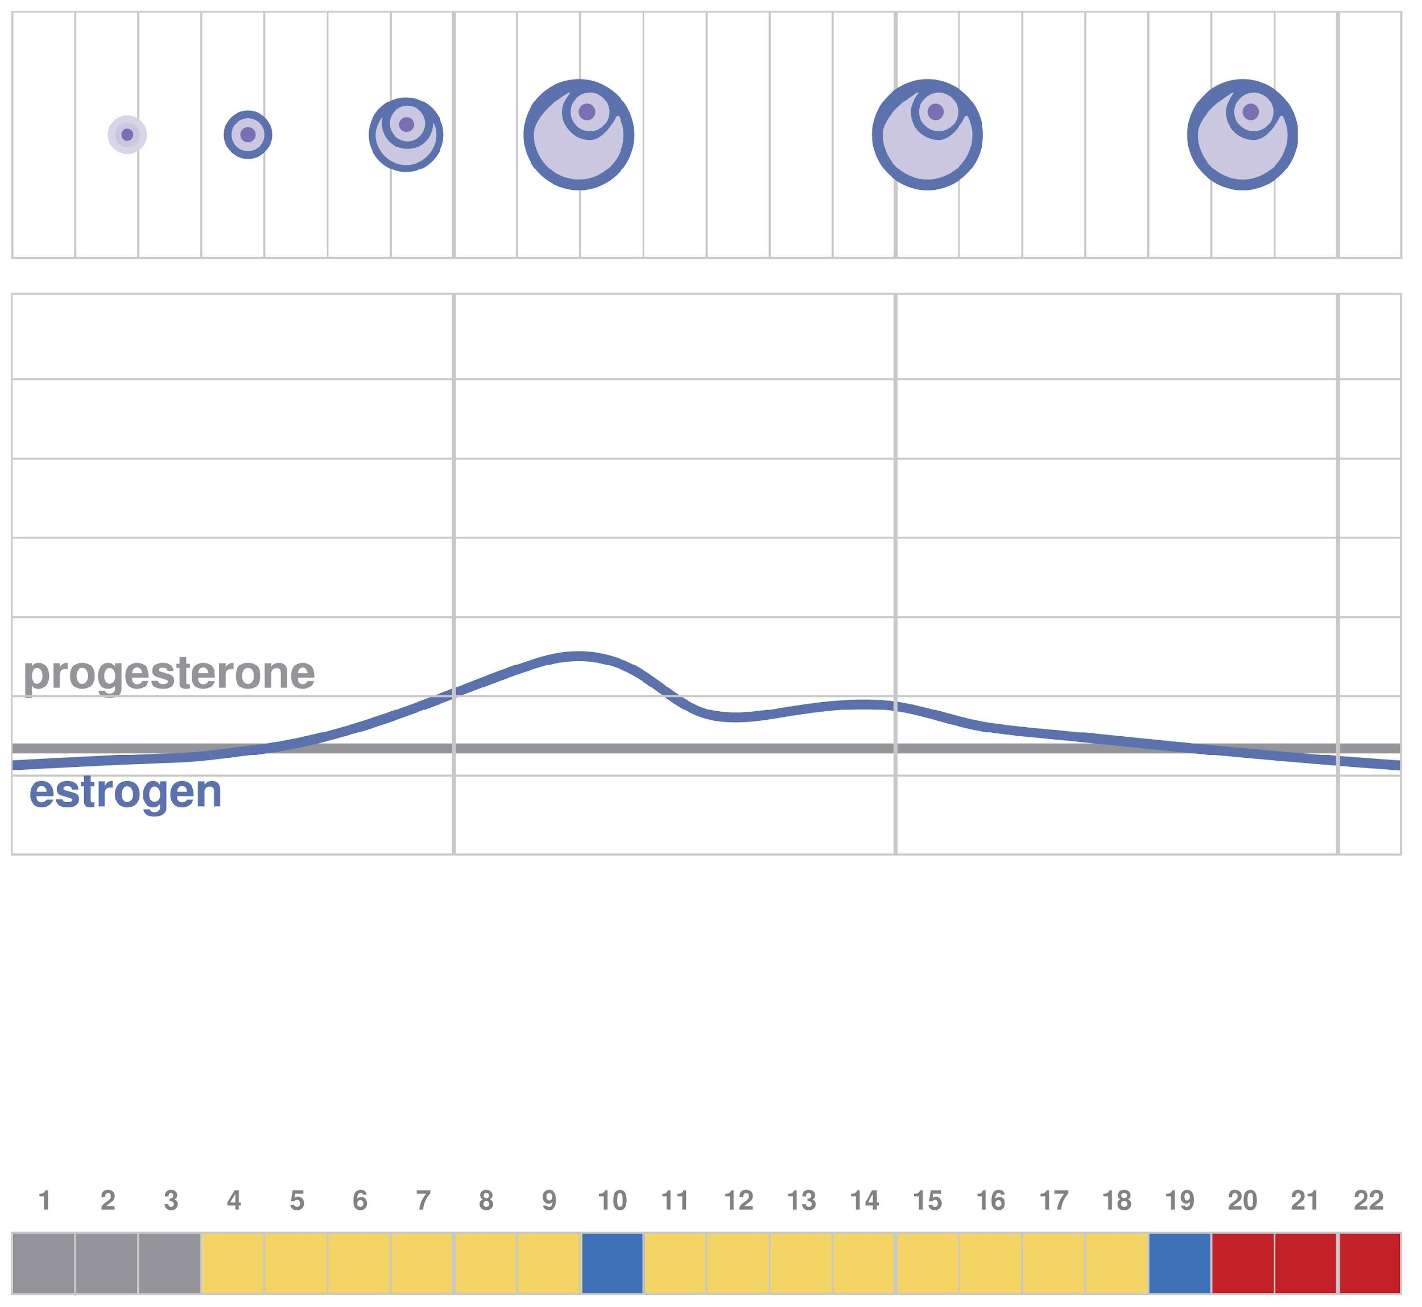
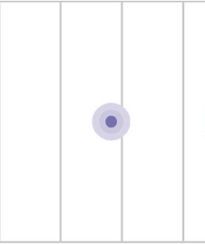

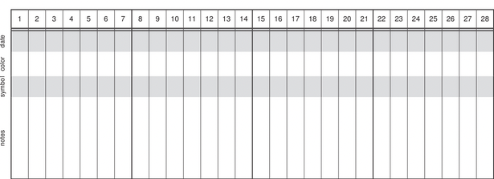
Addison’s Chart
Actually kind of cool that I can see the effects of hormones working inside my body!!
Spotting
Felt dry
Woop! Definitely slippery feeling
Bleeding
Moist?
Moist
Moist
Moist
dry
Moist
dry
dry
dry
moist
moist
moist
dry
dry
dry
dry
dry
Notes:
On the first 6 days of her charting, Addison didn’t “feel” any moisture when wiping and so she made a note that said, “felt dry”. Looking at the egg and follicle in the ovary (top row) and also her hormonal chart (second row), does it make sense that Addison didn’t feel or notice any cervical mucus? Yes! The egg and follicle aren’t growing much and the hormone graph shows us that estrogen is lower than progesterone for the first few days. So, progesterone acts on the cervix to produce a dense mucus that seals the cervix and causes a sensation of dryness. Have students fill in the first six days of the chart with the color gray.
On day 7, Addison noticed a change to moisture. She said this felt different and looked different from the crumbly, pasty substance she noticed before, in earlier cycles. She had this for 3 days. What should she chart? Light blue for rising estrogen.
On day 10, Addison feels something very different. “Woop! Definitely slippery feeling,” she wrote in her notes. “Actually kind of cool that I can see the effects of the hormones inside of my body,” she wrote on the side. It’s more than moisture, so she charts this as dark blue, for high estrogen.
Then, the next day she feels dry. It’s a very different feeling when wiping, compared to the day before. She charts gray. She has this again the next day. She charts gray.
Then she feels some moisture again on days 13 and 14. It’s not like it was on day 10, so she charts Light blue.
Then she goes back to dry on 15 and 16. Gray.
Some moisture again on days 17-19. Light blue.
On day 20 it’s dry. Gray.
On days 21-24 it feels the same. Dry. Gray.
Day 25 she notices some very light spotting. She charts this with Red. On Day 26 she notices that her bleeding is heavier than the day before. She charts Red again.
Have students compare their chart answers against the answers on the following slide:

Slide 7
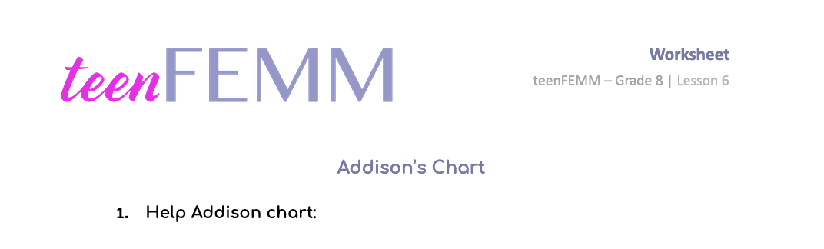
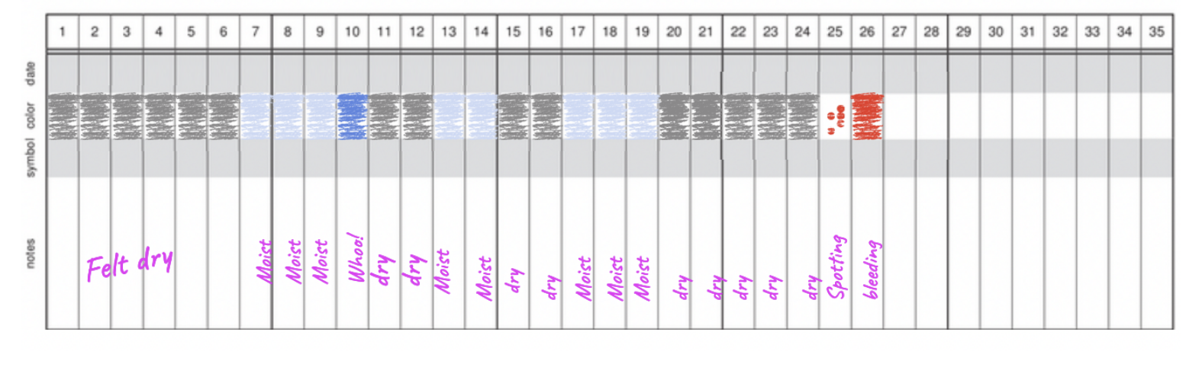
Check your work
dry
Moist
dry
Moist
Moist
Felt dry
Whoo!
Moist
dry
Moist
dry
Moist
Moist
Moist
dry
dry
dry
dry
dry
Spotting
bleeding
© FEMM
Notes:
Ask students if this is what they charted for Addison.
Step 3 (5 minutes): Phases of the Cycle
Based on this chart, do you think ovulation occurred? No, not this cycle, but this is ok. Her brain is sending messages to her ovaries to start to develop an egg, and as the egg grows, it is producing estrogen. These increased levels of hormones are contributing to Addison’s growth and development.
In Addison’s first few cycles, dry days indicated that she was experiencing very little hormonal activity (low progesterone AND estrogen) - remember the chart in the previous lesson that was just yellow and gray?

Slide 8
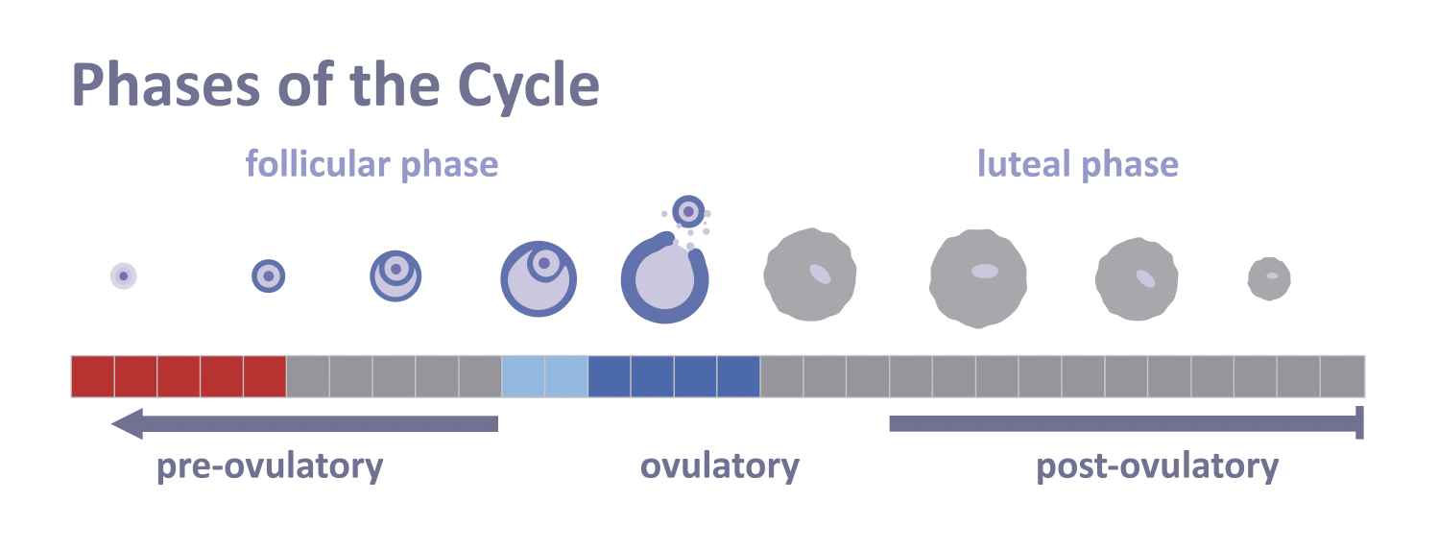
A Mature Ovulatory Cycle
© FEMM
Notes:
In a mature cycle, the dry phase after ovulation is called the “luteal phase” as progesterone is the dominant hormone, produced by the corpus luteum.
In the case of Addison’s chart, she had estrogen biomarkers, but no ovulation occurred, as she had only five days of dryness before her period. Remember: no ovulation, no corpus luteum. For Addison’s age, her chart is still healthy. But when she begins to ovulate, a normal and healthy luteal phase will produce lots of healthy progesterone in her body for 9-18 before the uterine lining sheds as she gets her period.
Now, we know it’s so important to have both estrogen and progesterone balance each other out. So, is there anything Addison can do as she grows and mature to help balance her hormones? Yes!

Slide 9




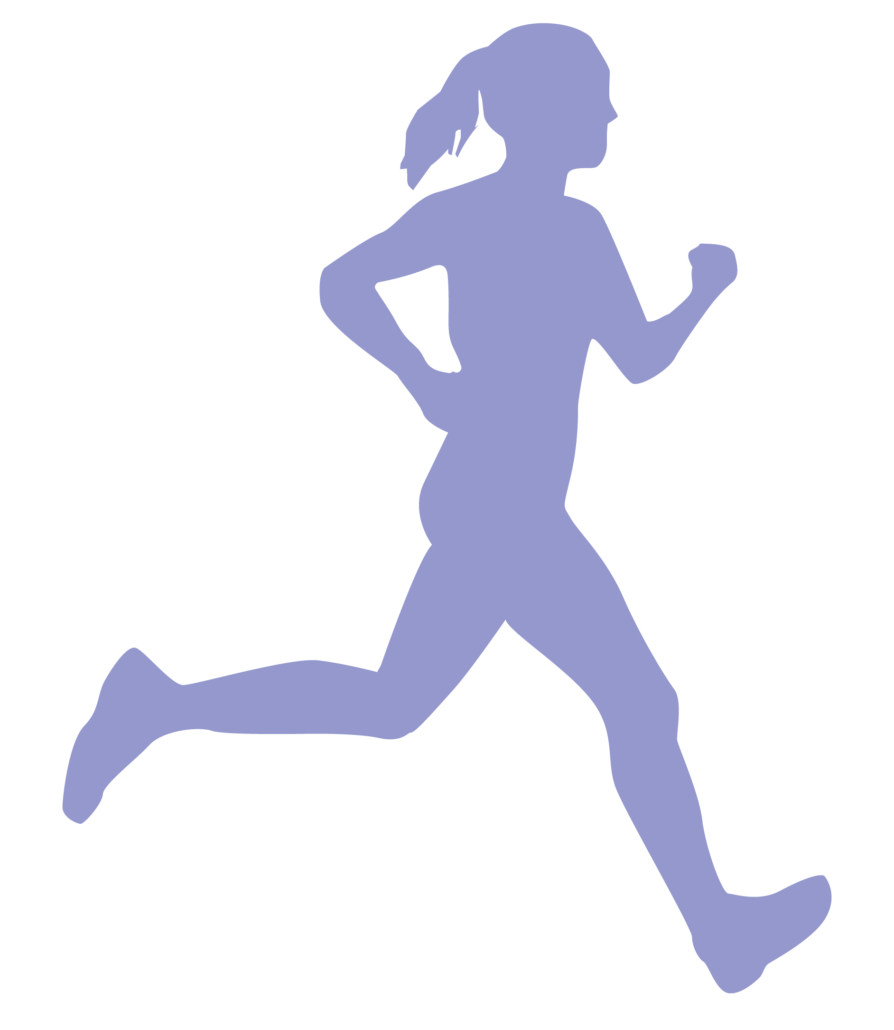
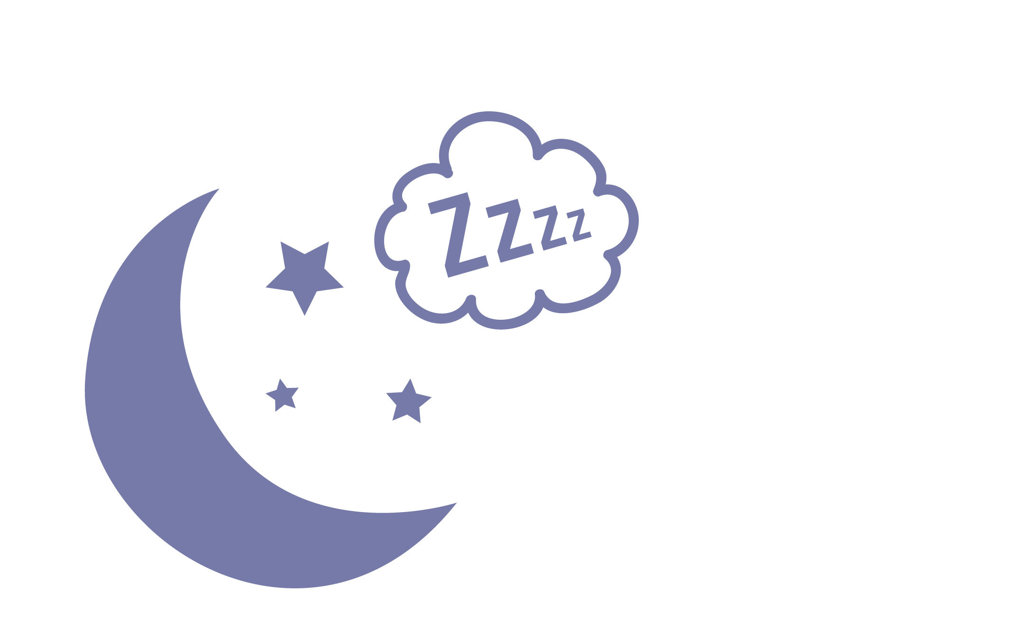

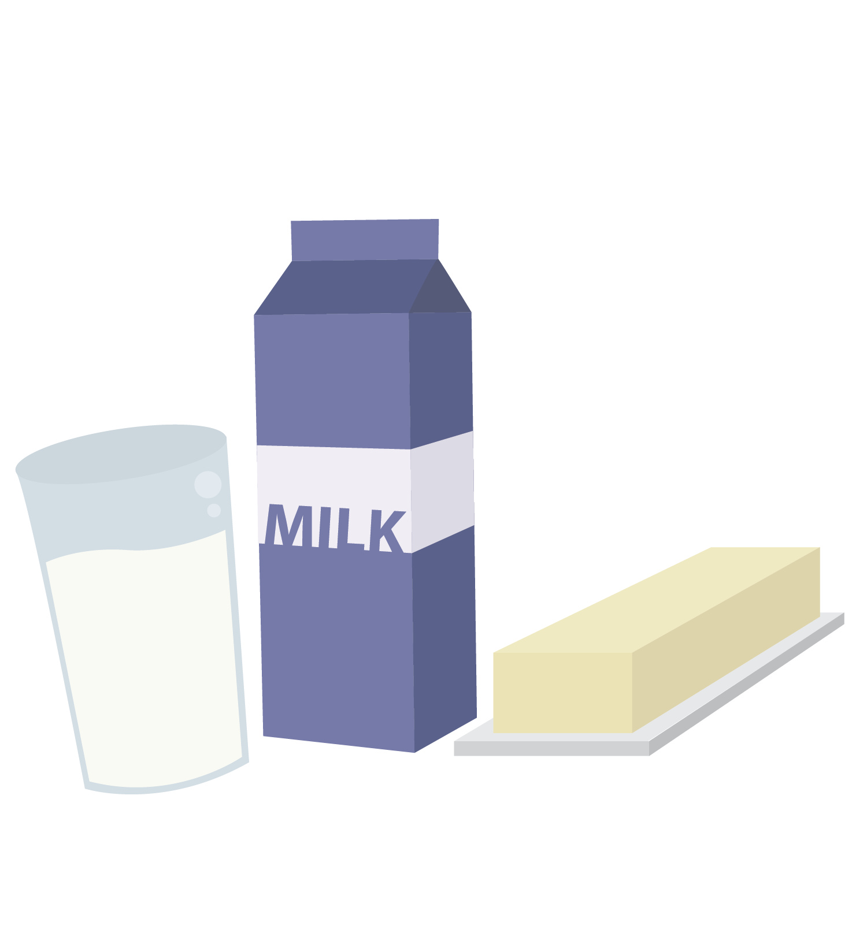
The Three Pillars of Health
The Three Pillars Supporting Your Health
1
2
3
Nutrition
Exercise
Sleep
© FEMM
Notes:
Step 4 (10 minutes): The 3 Health Pillars
Addison needs to practice the three pillars of health: adequate nutrition, exercise and sleep. These three pillars will help her brain and her body mature in the best way through puberty.
The first pillar of health is Nutrition. Good nutrition fuels the body, which is especially important now, as your brain and hormones are still changing and developing. Everything we eat, our body breaks down and uses to nourish our bones, muscles and cells. So it’s important to give our body what it needs.

Slide 10
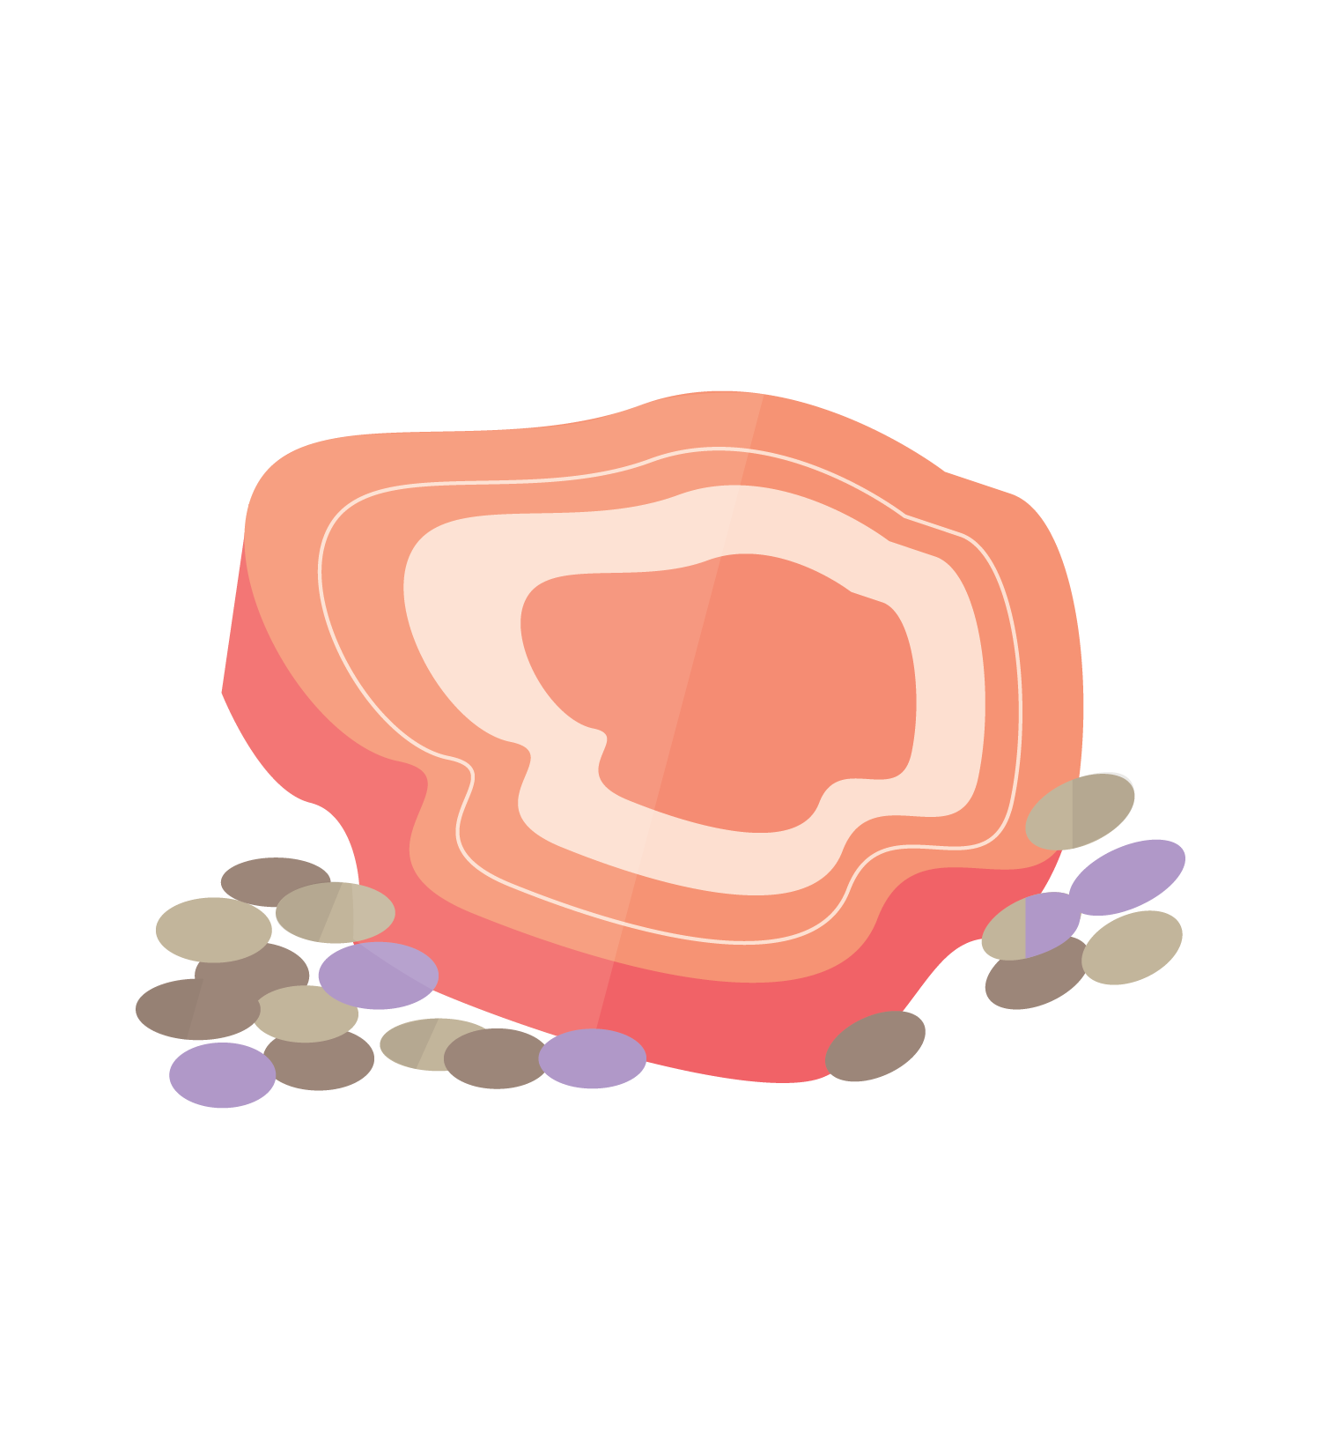

The Three Pillars of Health
Proteins: build and maintain cells, help make hormones.
Red meat, chicken, fish, eggs, beans, etc.
Carbohydrates & Fats: provide energy, balance hormones.
Whole grains, pasta, potatoes, oats, etc
Avocados, olive oil, nuts and seeds
Vitamins & minerals: build+maintain cells, balance hormones.
Green leafy vegetables, carrots, beets, oranges, bananas, blueberries, blackberries, etc.
Water: carries nutrients, energizes muscle, clears waste.
Your Body Needs:
1
Nutrition
Teens are supposed to drink 1L to 2L of water a day to stay hydrated!
© FEMM
Notes:
Your body needs:
Proteins: build and maintain cells, help make hormones.
Sources: red meat, chicken, fish, eggs, beans, yogurt, etc.
Carbohydrates & fats: provide energy, balance hormones.
Sources: whole grains, pasta, potatoes, oats, etc.
Healthy fats: avocado, olive oil, nuts and seeds, as well as peanut or other nut butters.
Vitamins & minerals: build and maintain cells, balance hormones.
Sources: green leafy vegetables, carrots, beets, oranges, bananas, blueberries, blackberries, beets, etc.
Water: carries nutrients, energizes muscle, clears waste. Note: Teens are supposed to drink 1L to 2L of water a day to stay hydrated and flush out toxins.

Slide 11
The Three Pillars of Health
Physical activity: boosts hormones, strengthens your heart, increases lung capacity, improves your mood and reduces anxiety.
Strength: squats, pushups, situps, holding a plank
Improves bone density (so you break fewer bones when you’re old!)
Increases longevity (people with strong bodies live longer!)
Cardio: walking, running, playing sports, dance, biking, swimming
Improves sleep
Regulates blood sugar
Improves mood
60 minutes of any physical activity a day will make you feel:
Better
More confident
Less stressed
Your Body Needs:
2
Exercise
© FEMM
Notes:
Your body was made to move! Physical exercise is not for the benefit of instagram or social media, it’s not just for athletes and it’s not about being a certain body type or weight.
Exercise increases your energy, improves your mood and reduces anxiety. How does exercise improve your mood? Exercise releases hormones called endorphins, which are chemical signals from the brain (in the pituitary gland) that increase feelings of wellbeing. As we know, hormones are all chemical messengers. The job of these hormones is to make you feel happier, more confident, and less stressed! So physical activity literally exercises the hormones in your brain! 60 minutes of activity every day is recommended to all teens.
Exercise can be “you” time, simply going for a jog as you listen to music. Or, grab a friend and power-walk together. Whether you like playing sports, dancing, swimming or even jumping rope, the important thing is to find an exercise you enjoy.

Slide 12
The Three Pillars of Health
Sleep: when the body repairs tissues, muscles, cells, produces hormones, removes toxins and restores energy.
Hormones produced during sleep:
Melatonin
Cortisol (regulates stress response)
Growth hormone
Leptin and Ghrelin (regulate appetite)
Time to “clean house”:
Sleep is when the brain initiates a cleaning process to flush out waste and toxins in the brain.
Sleep is when you form and maintain the pathways in your brain that let you learn new things and create new memories.
8-10 hours a night:
9 hours of sleep is best for peak mental health.
Insufficient sleep is linked to lower academic and athletic achievement.
Your Body Needs:
3
Sleep
© FEMM
Notes:
The third pillar of health is Sleep. Sleep is absolutely essential to health. Did you know that every part of your body is renewed faster during sleep than when awake? Most of your reproductive hormones are produced while you sleep!
In order for your body to repair itself at the end of each day, you need 8-10 hours of sleep at night! 9 hours of sleep is recommended for optimal mental health (reduces anxiety and depression). Getting 8-10 hrs of sleep a night regulates your growth hormones, maintains a healthy weight and improves your brain’s ability to learn new things.

Slide 13
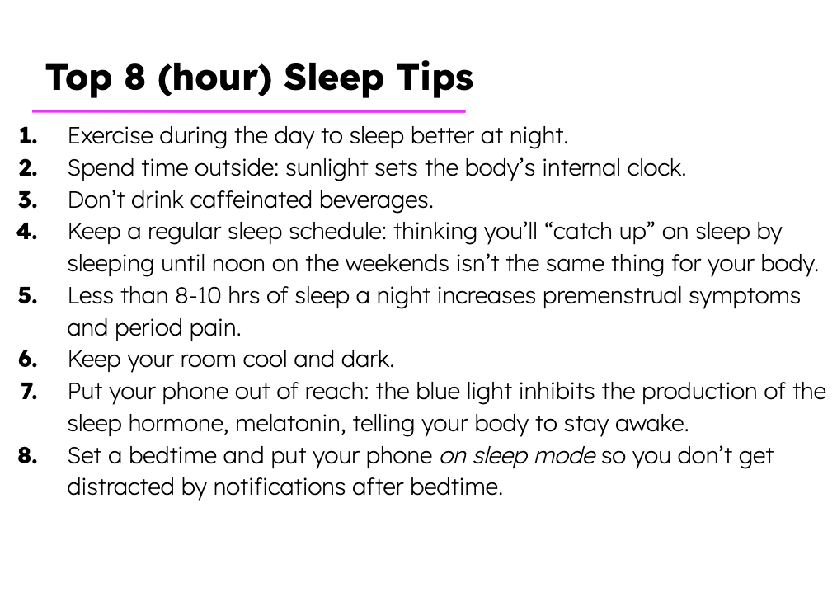
My Top 3 to Try
#1
#2
#3
Notes:
The third pillar of health is Sleep. Sleep is absolutely essential to health. Did you know that every part of your body is renewed faster during sleep than when awake? Most of your reproductive hormones are produced while you sleep!
In order for your body to repair itself at the end of each day, you need 8-10 hours of sleep at night! 9 hours of sleep is recommended for optimal mental health (reduces anxiety and depression). Getting 8-10 hrs of sleep a night regulates your growth hormones, maintains a healthy weight and improves your brain’s ability to learn new things.

Slide 14
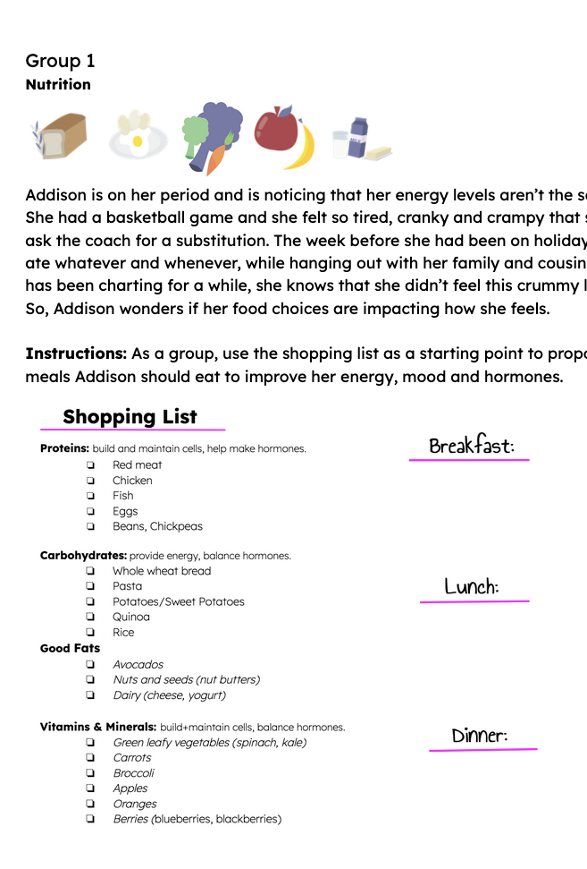
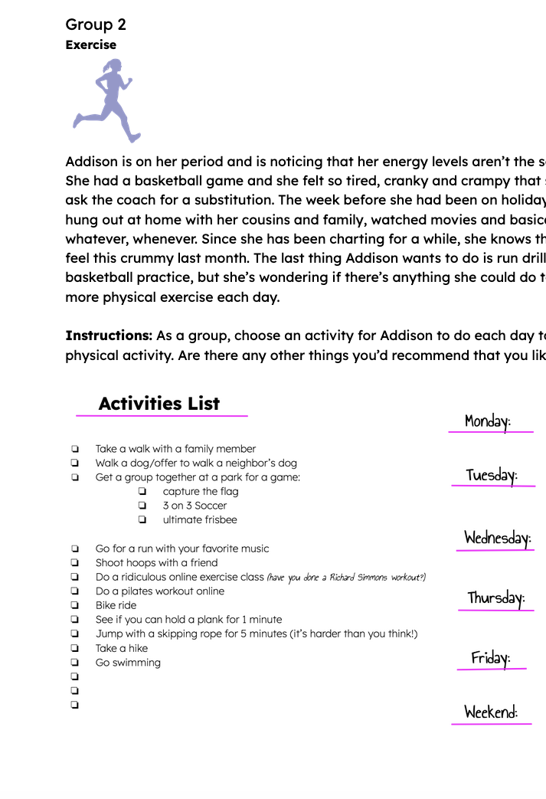
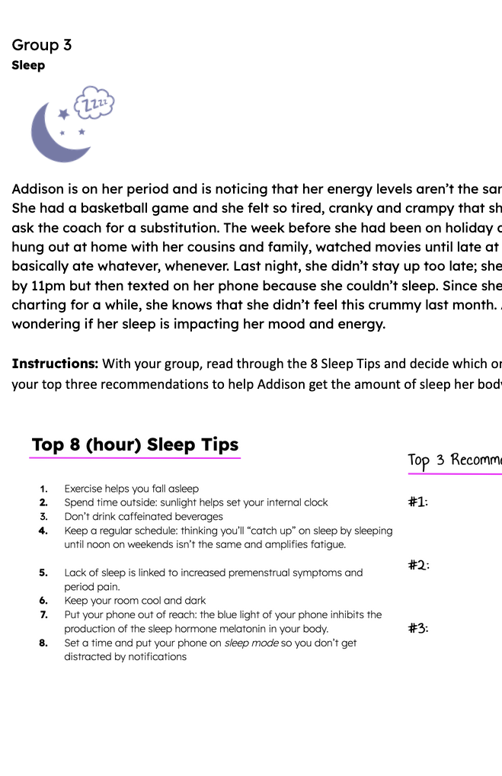
Case Study | The Three Pillars of Health
1
2
3
Nutrition
Exercise
Sleep
© FEMM
Notes:
Step 5 (5 minutes): Case Study Worksheet
Divide students into 3 groups and give each group a Health Pillar Case Study to work on.

Slide 15
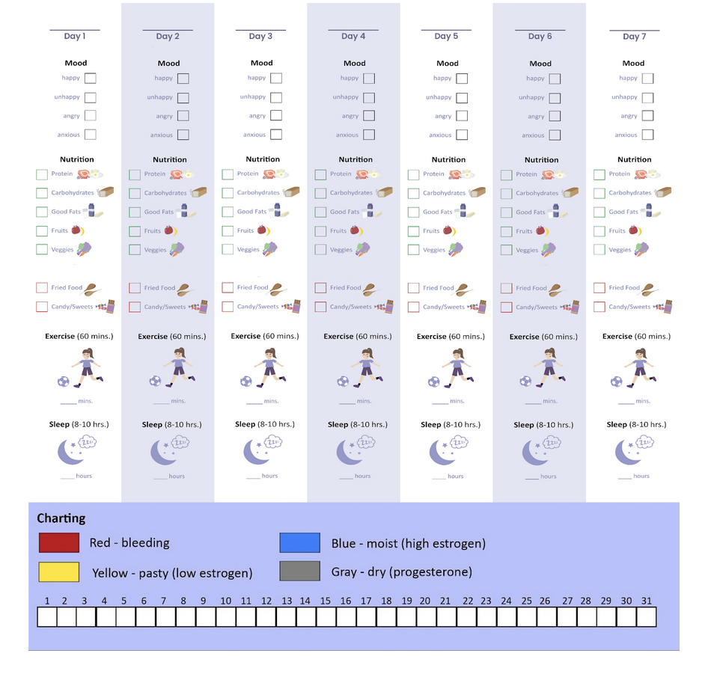
Healthy Habits Challenge
Notes:
CONCLUSION
Hand out the Healthy Habits Challenge to students.
In this lesson, we learned more about charting and how your charting will change as a healthy cycle matures. We also learned that we can take charge of our health by practicing the 3 health pillars: nutrition, sleep and exercise. This week, we’re going to take the Healthy Habits Challenge and try to see how many days in a row you can eat healthy, exercise and get 8-10 hrs of sleep at night. Tips and ideas are on the back of the page!
Students may be more motivated if there is a reward, or, if it’s a students versus teachers challenge.

Slide 16
Grade 8
LESSON 6
© FEMM

