Slide 1

Grade 8
LESSON 6
© FEMM

Slide 2


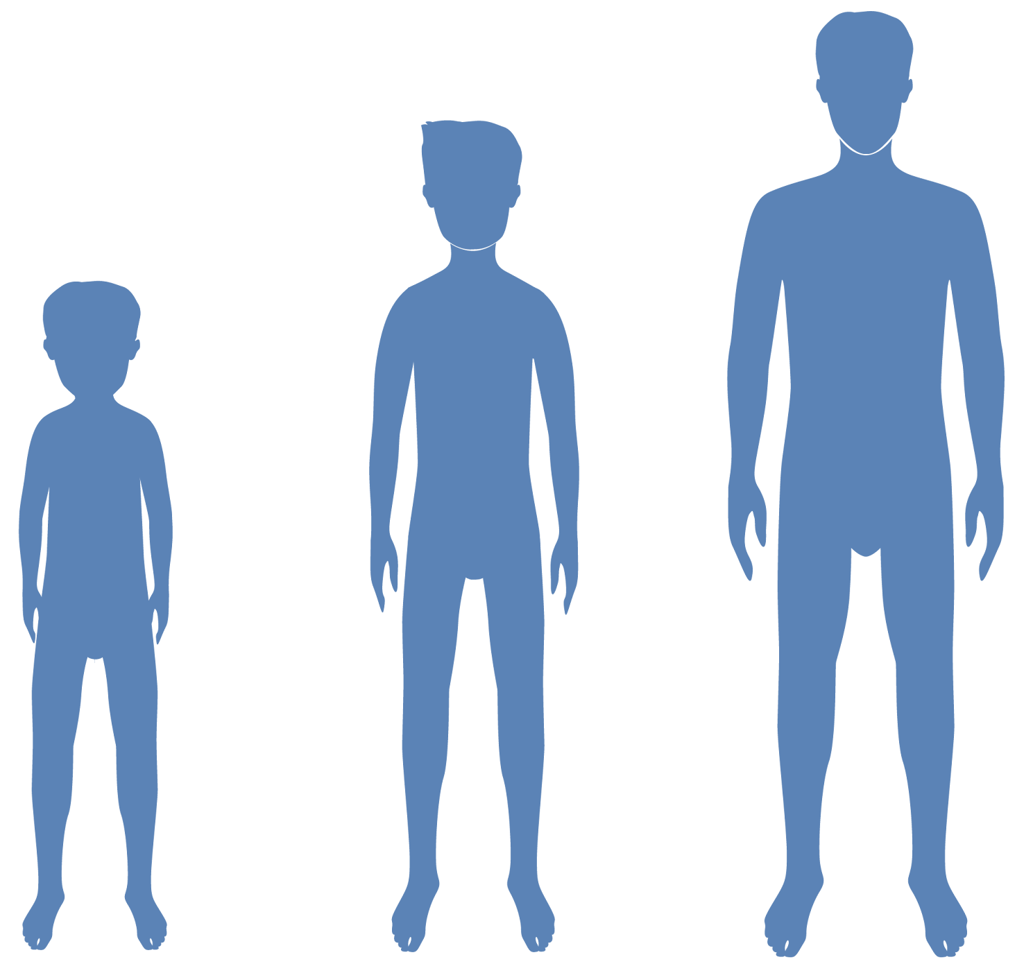
Rapid Fire Five Review
Name 5 things that will change in a young man’s body because of the effects of testosterone:
___________ _____________
___________ _____________
___________
Height
Increased muscle
More body hair
Voice deepening
Increased sweat
© FEMM
Notes:
PROCEDURE
Step 1 (5 minutes): Rapid Review
We learned the last lesson that puberty is a hugely important time not only for your body, but for your brain. Let’s do a rapid review!
Name 5 things that will change in a young man’s body because of the effects of testosterone.
Possible Answers:
1. Make you more hairy
2. Help you grow taller
3. Build stronger bones and muscles
4. Cause your voice to change and become deeper
5. Cause your body to produce more sweat and odor
6. Sharpen the brain and improve memory
7. Mood changes

Slide 3
Review
2. At 5 weeks old the human fetus is the size of an appleseed; the brain develops at five months.
TRUE or FALSE
© FEMM
Notes:
At 5 weeks old the human fetus is the size of an appleseed; the brain develops at five months.
False. At just 5 weeks old a human fetus is the size of an apple seed but the brain has already begun to grow.

Slide 4
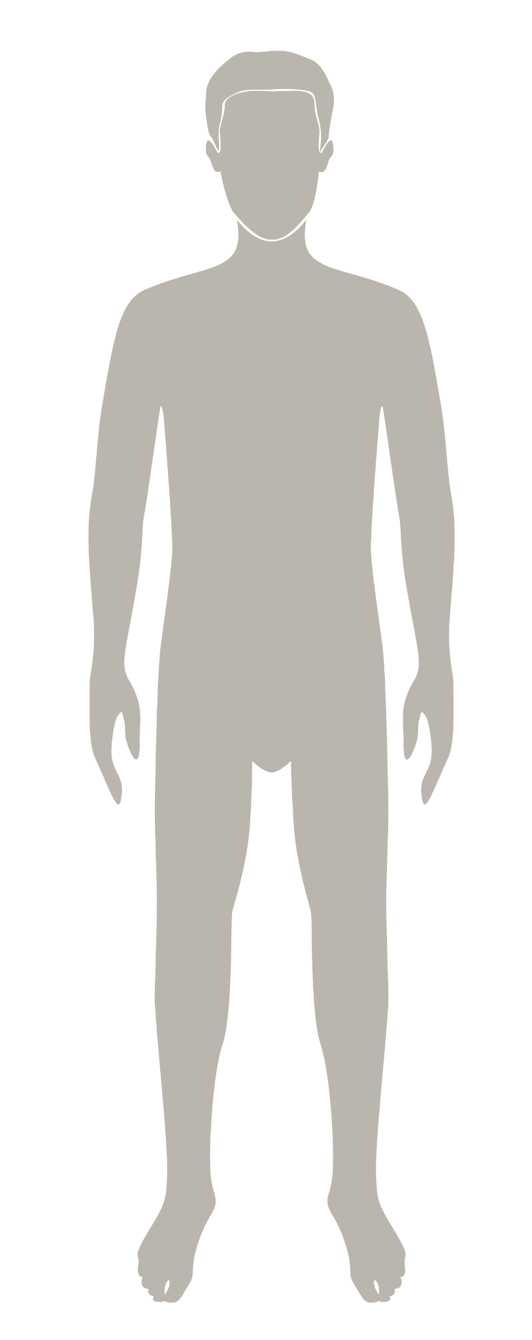
Review
3. In puberty, the male body produces 5 times more testosterone than it did before the onset of puberty.
TRUE or FALSE
© FEMM
Notes:
In puberty, the male body produces 5 times more testosterone than it did before the onset of puberty.
False. More like 5x6… or, 30 times the amount.

Slide 5
Review
4. The brain isn’t fully mature until what age?
?
25
© FEMM
Notes:
The brain isn’t fully mature until what age?
Answer: 25

Slide 6
Review
5. Of these five parts of the brain, which two are the last to mature:
Corpus Callosum
Amygdala
Pituitary gland
Prefrontal cortex
Cerebellum
© FEMM
Notes:
Of these five parts of the brain, which two are the last to mature:
Answers: Amygdala and Prefrontal cortex

Slide 7
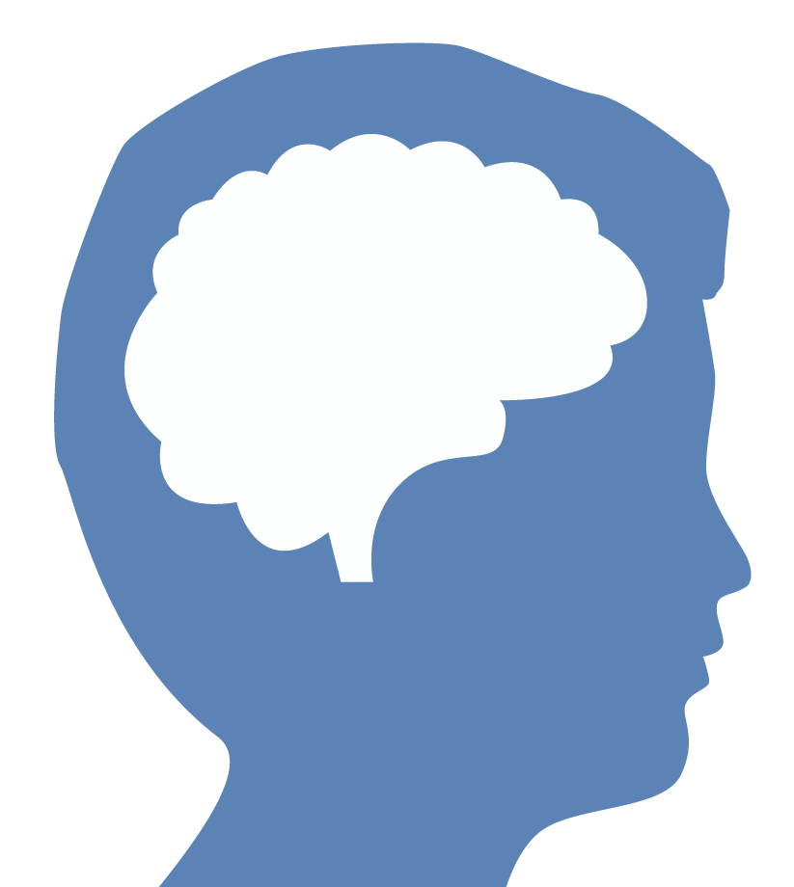
Brain development & testosterone
Your choices in puberty shape your brain
Your choices shape
your brain
The brain is constantly forming new connections, based on your choices.
The brain is designed to recognize habits. When choices become habits, these habits get wired in to the brain.
© FEMM
Notes:
Your choices shape your brain. The brain is constantly forming new connections, based on your choices. When choices become habits, these habits get hard-wired into the brain.
Step 2 (10 minutes): Health Pillars and the Brain
Since your brain is still developing and maturing, your choices now are shaping your brain, for life! We know that for men, testosterone is vital for the proper development and maturation of the brain and body. So, is there anything you can do to support your hormonal health? Yes!

Slide 8

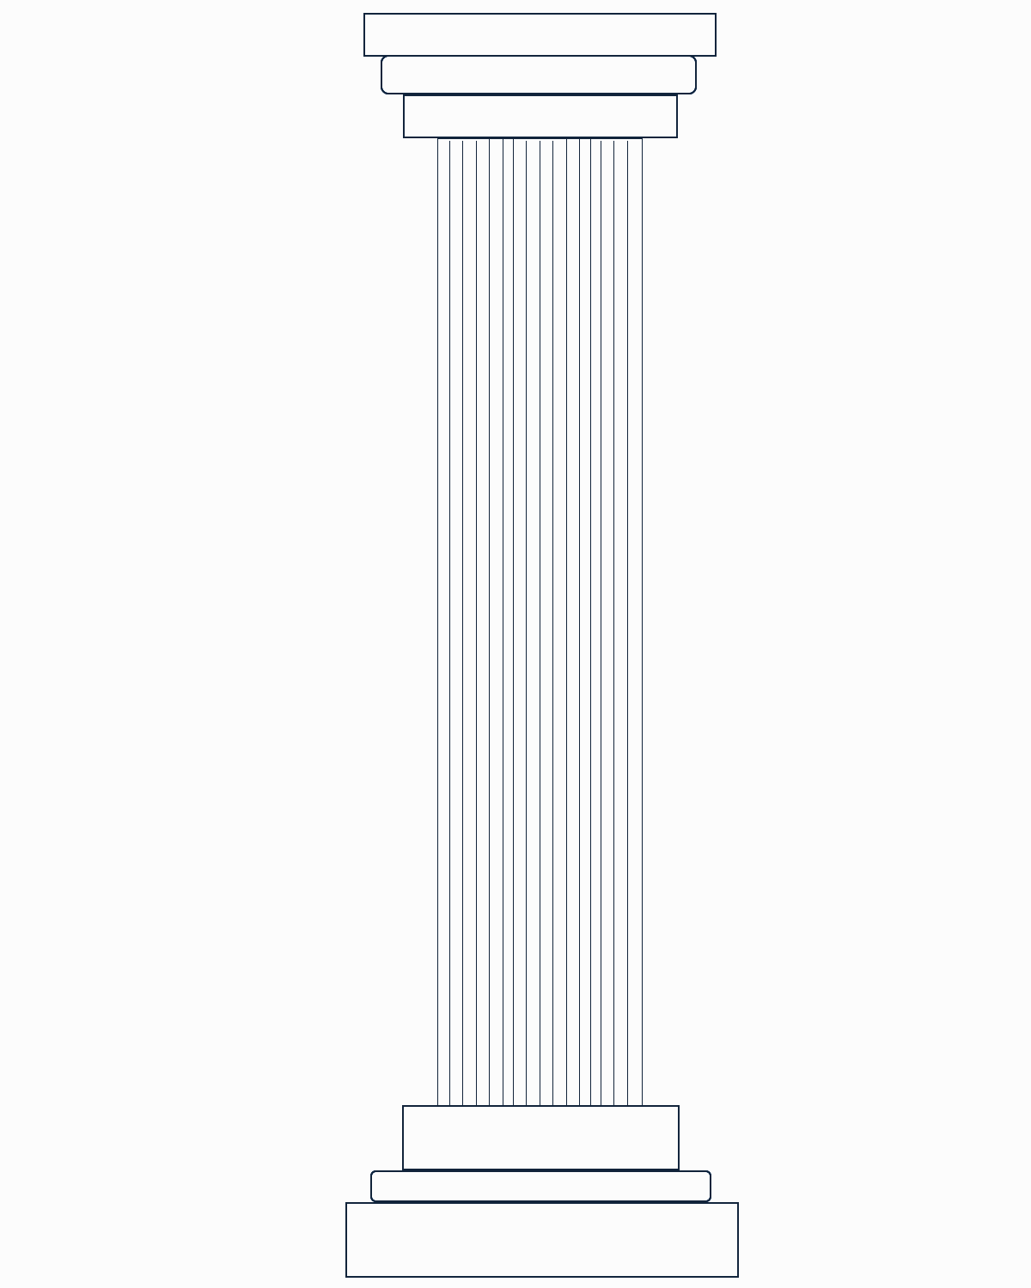

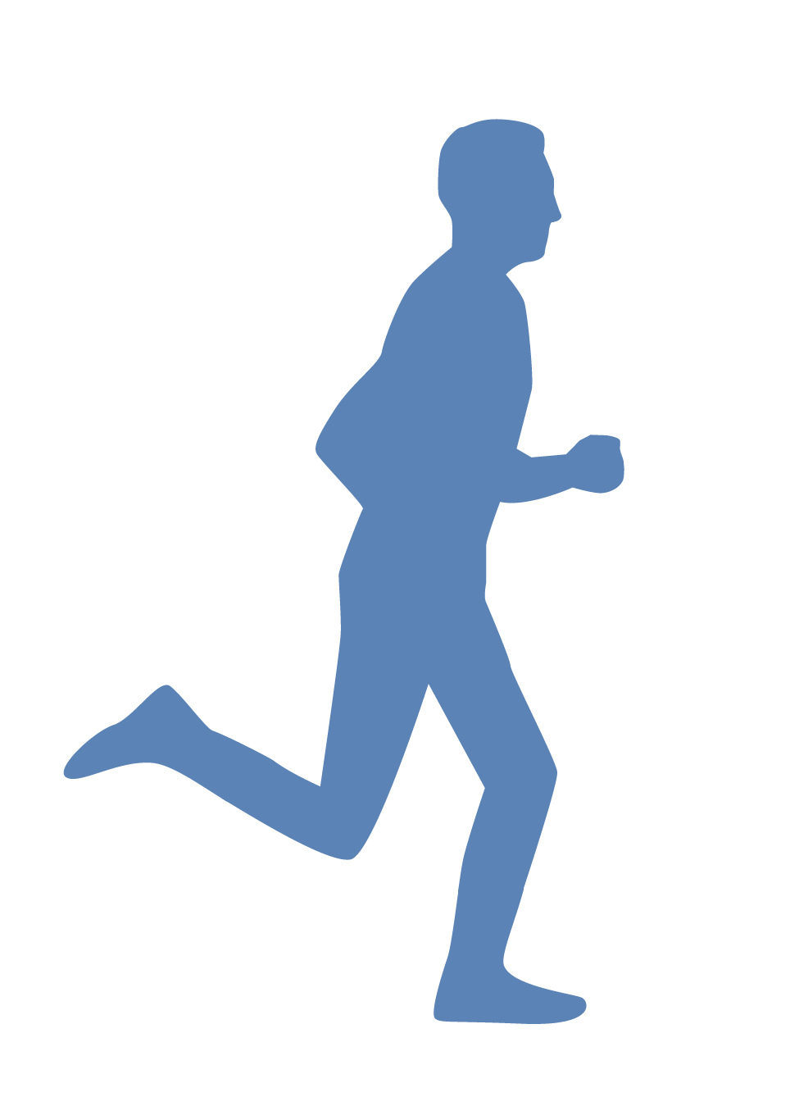
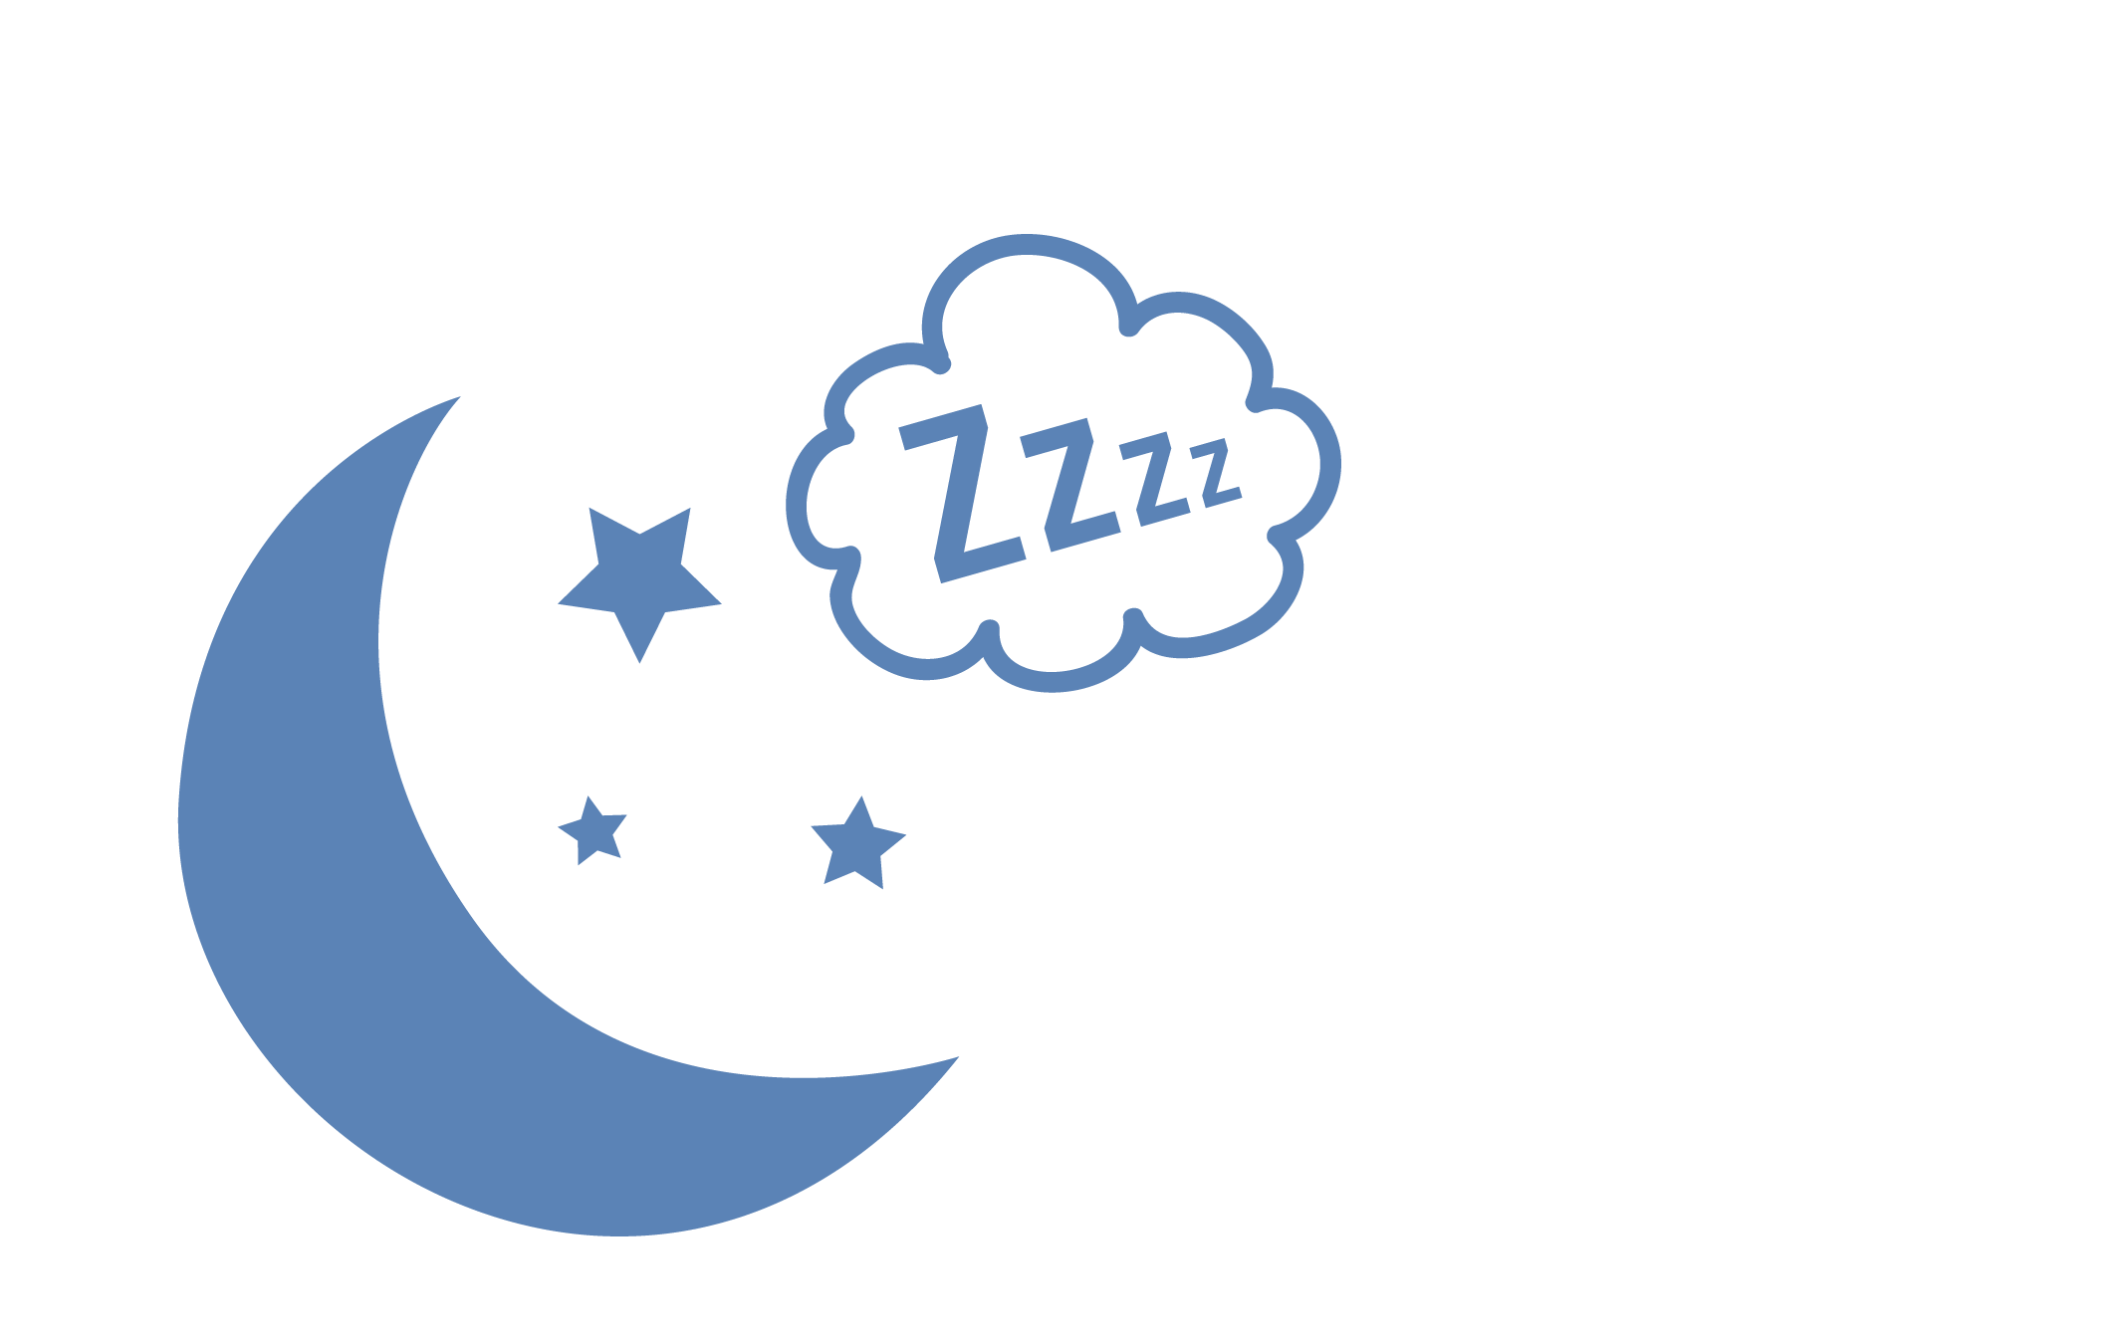


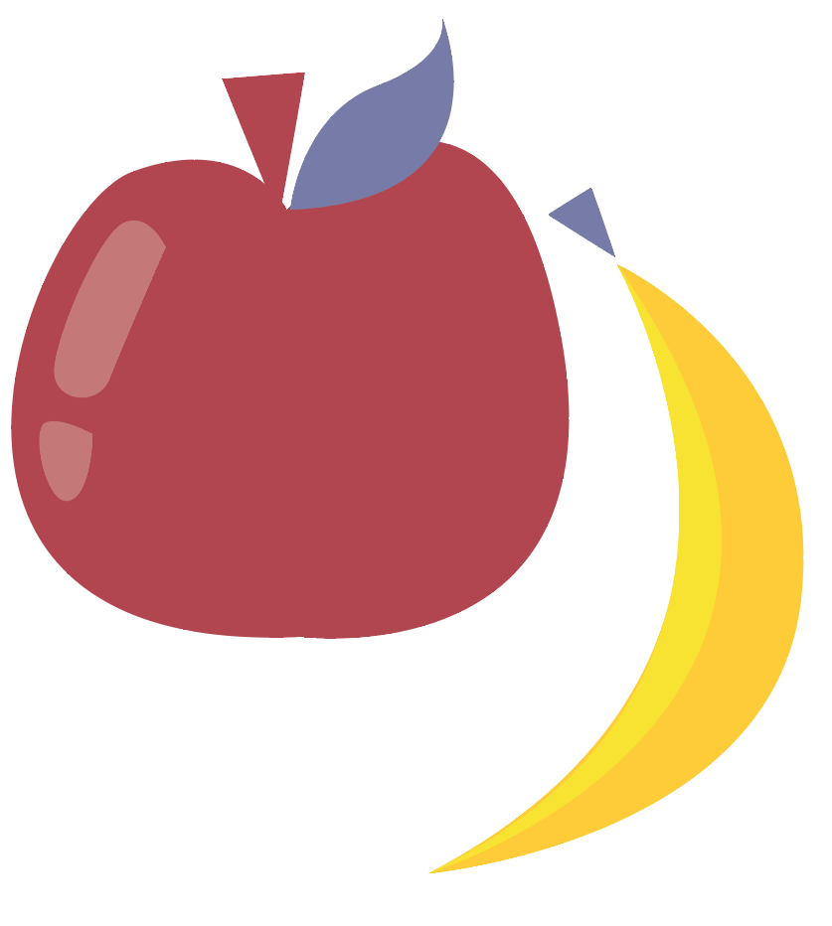
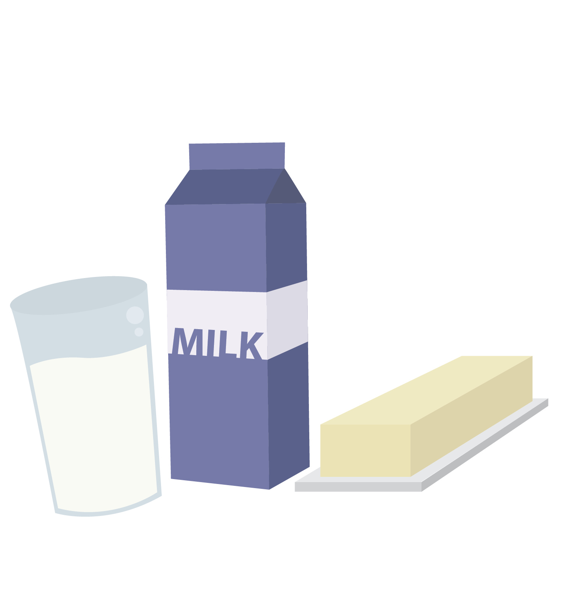
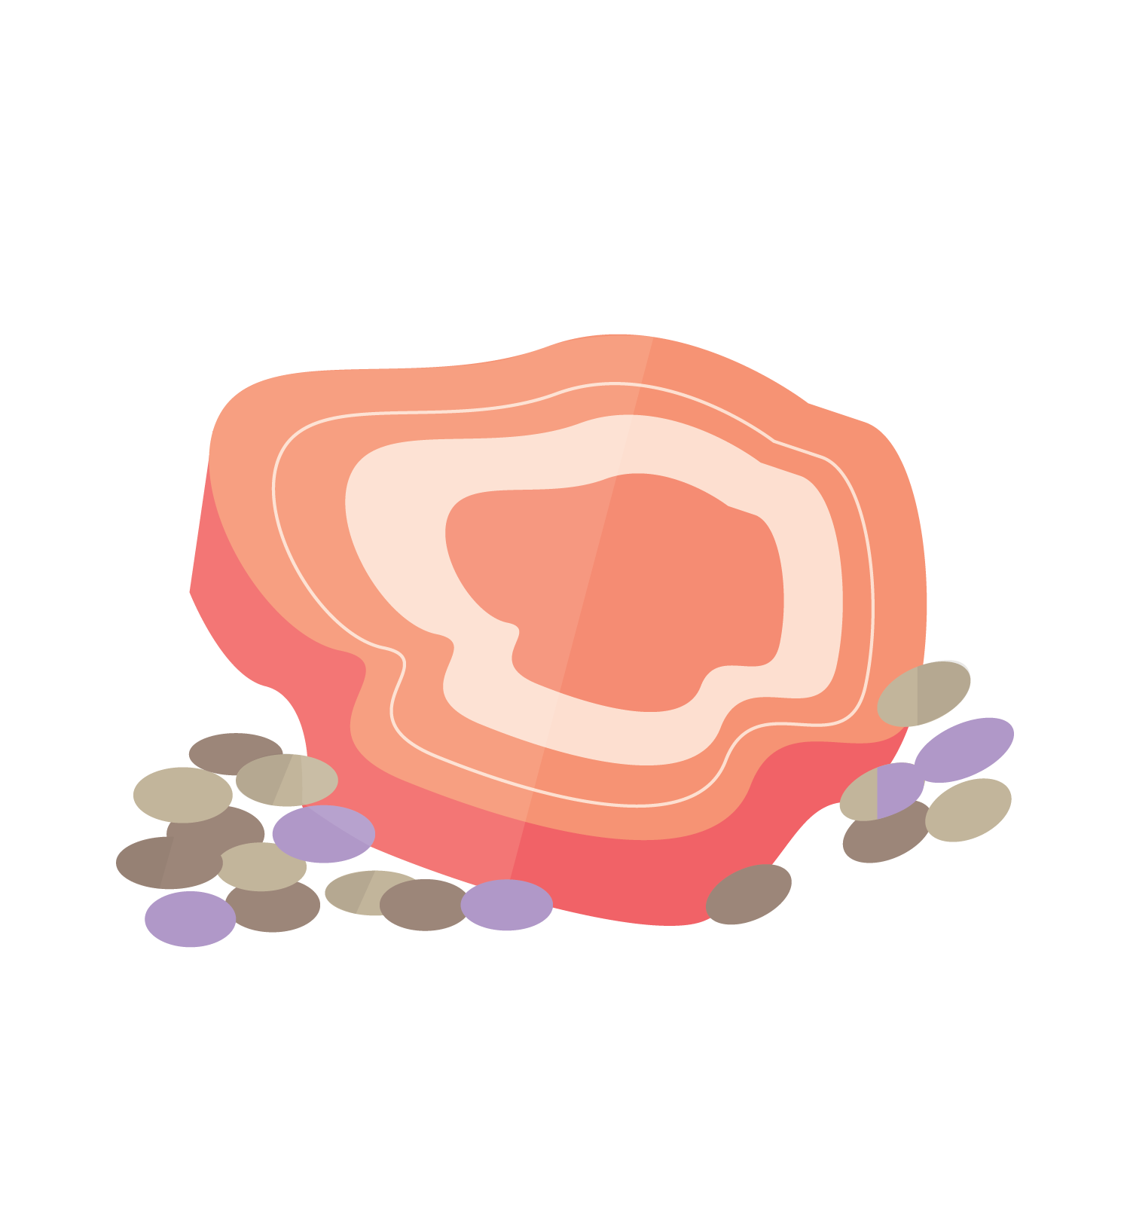
The Three Pillars Supporting Your Health
1
2
3
Nutrition
Exercise
Sleep
© FEMM
Notes:
This lesson, we’re going to focus on the three pillars of health: nutrition, exercise and sleep. These three things are called the “pillars” of health because they are the foundation of health. These three pillars are necessary to the proper development of the brain, our hormones and every system in the body. When we don’t do these things, we make it hard for our body to function at its best.

Slide 9
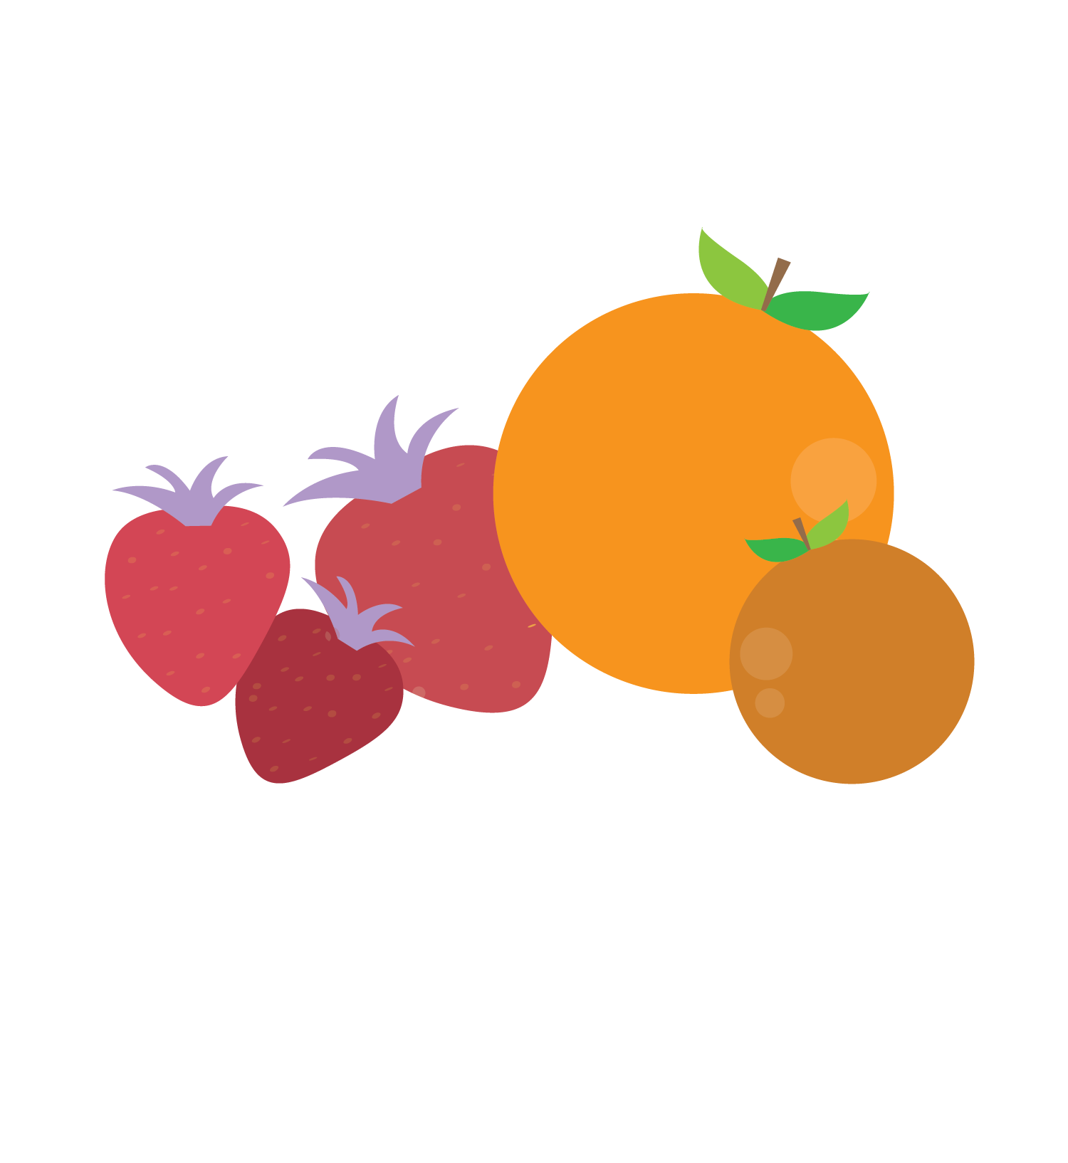
The Three Pillars of Health
Your Body Needs:
Proteins: build and maintain cells, help make hormones.
Red meat, chicken, fish, eggs, beans, etc.
Carbohydrates & Fats: provide energy, balance hormones.
Whole grains, pasta, potatoes, oats, etc
Avocados, olive oil, nuts and seeds
Vitamins & minerals: build+maintain cells, balance hormones.
Green leafy vegetables, carrots, beets, oranges, bananas, blueberries, blackberries, etc.
Water: carries nutrients, energizes muscle, clears waste.
1
Nutrition
Teens are supposed to drink 1L to 2L of water a day to stay hydrated!
© FEMM
Notes:
Nutrition is the first health pillar. Good nutrition fuels every cell in your body. You’ve probably heard the phrase: “you are what you eat”? Of course, you are much more - and much more important - than simply what you eat, but there’s also some truth in that phrase. Here’s why…
Let’s say Blake buys french fries from the cafeteria most days for lunch. This means that Blake’s brain maturation, his eleven body systems, and all of his hormonal development during puberty are running on potatoes, salt and oil… Blake is tired after lunch and finds it hard to focus in class. After school, he just wants to chill and play video games. Is Blake getting the nutrition his brain and body needs? No.
Our everyday choices create habits. A habit is something you do so often that it becomes natural for you. Remember: habits shape our brain. So, Blake needs to practice better nutrition habits. Let’s look at the basic types of nutrition your body needs to grow and be strong each day.
Proteins: build and maintain cells, help make hormones.
Examples: Beef, chicken, fish, eggs.
Carbohydrates: provide energy, balance hormones.
Examples: whole grain bread, quinoa, potatoes, pasta, oats
Healthy Fats: avocado, nuts and seeds, etc.
Vitamins & minerals: build and maintain cells, balance hormones.
Examples: oranges, apples, blueberries, green leafy spinach, red tomatoes, carrots, yellow squash, etc.
Water: carries nutrients, energizes muscle, clears waste. Most adolescents don’t drink enough water! Teenagers should drink 1L to 2L of water every day.

Slide 10
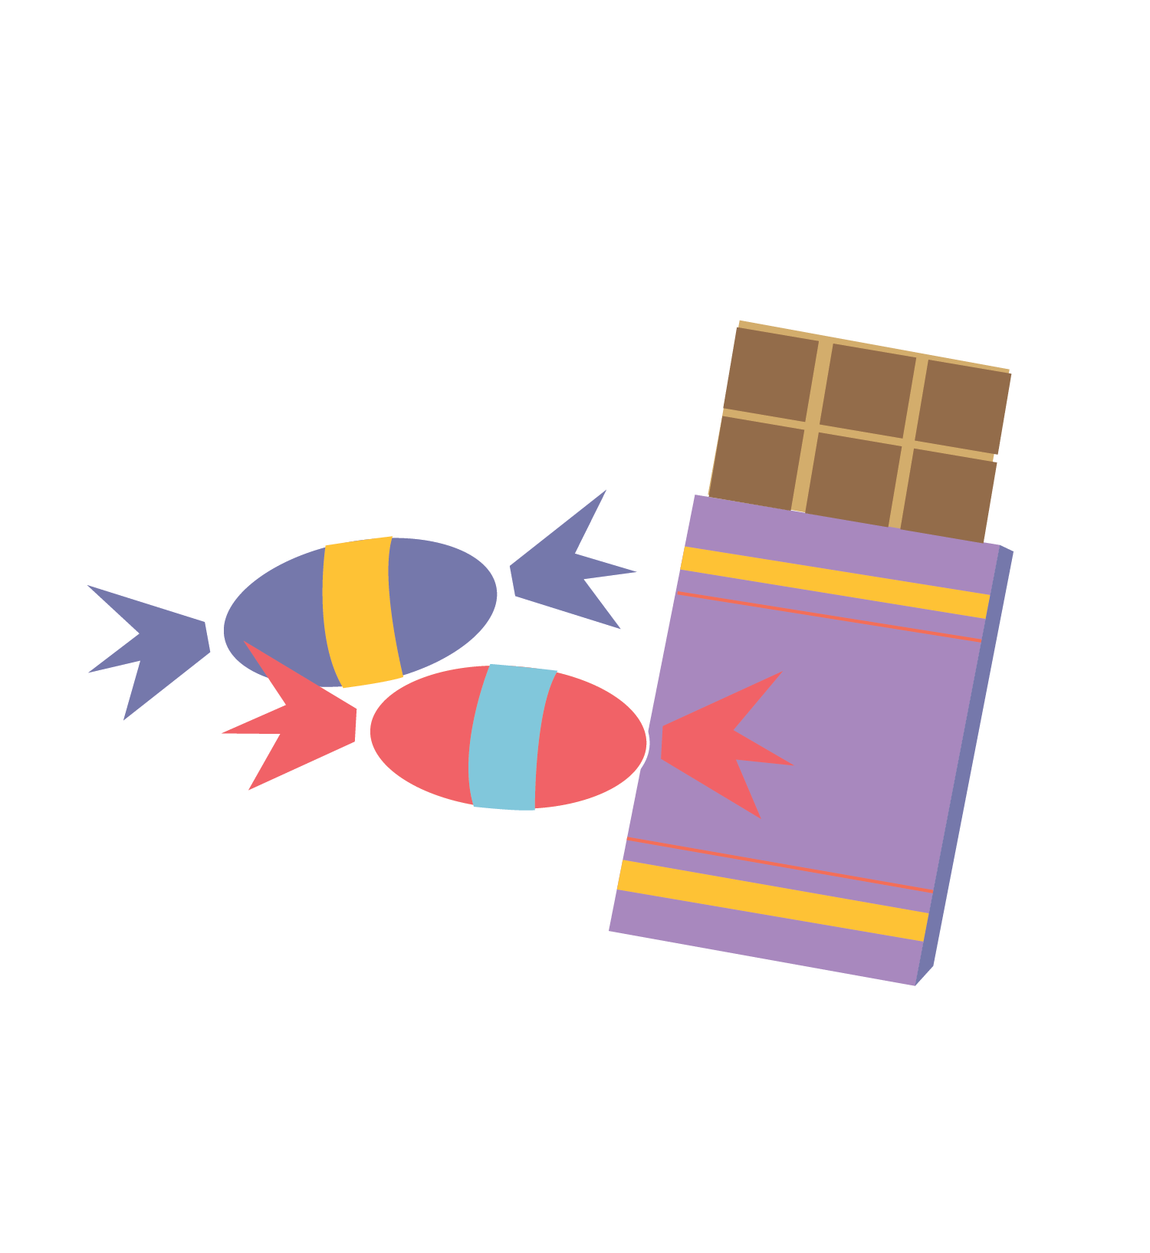
The Three Pillars of Health: Nutrition
Brain development & testosterone
Your food choices
impact your brain!
Eating fast foods and refined sugars (chocolate bars, soda, sports drinks, etc.) not only leads to weight gain but slows learning and memory.
These foods also disrupt communication between nerves in the brain, impacting maturation.
© FEMM
Notes:
Your food choices have a major impact on your brain. A balanced diet is linked to better mental health, superior cognitive functioning and even higher intelligence! Junk food interrupts adolescent maturation and brain development. Eating a lot of saturated fat (fast foods) and refined sugars (chocolate bars, soda, sports drinks, energy drinks, sweets, etc.) slows learning and memory and disrupts the connections between nerve cells in the brain.

Slide 11
The Three Pillars of Health
Exercise: supports testosterone production, strengthens your heart, increases lung capacity, improves your mood and reduces anxiety.
Aerobic: running, soccer, basketball, hockey, swimming, etc.
Increases blood flow to the brain, improving attention and memory
Regulates blood sugar
Improves sleep
Improves mood
Strength: squats, pushups, pull ups, holding a plank, etc.
Increases bone and muscle density
Improves focus and muscle control; contributes to the development of the prefrontal cortex
Your Body Needs:
2
Exercise
© FEMM
Notes:
Exercise is the second pillar of health. Exercise strengthens your heart, lungs, muscles and bones. Exercise also supports testosterone production.
Aerobic exercises are activities like playing basketball, soccer, hockey, swimming, etc. Aerobic basically means “air”, as it relates to exercises that improve the body's ability to take in and transport oxygen.
Strength-building exercises like squats, push ups, and pull ups, are also important as they build muscle and develop your brain. These exercises build focus and balance, developing the prefrontal cortex.

Slide 12
The Three Pillars of Health: Exercise
Positive side-effects of 60 minutes of daily exercise:
2
An organized brain. Exercise organizes the brain, supporting clearer thinking, improved attention, memory and more.
Better grades. Exercise can improve your grades as it increases cognitive function.
Feeling better. Exercise reduces stress and helps lower the chances of depression and anxiety. Exercise can also give you a sense of pride and accomplishment.
Sleeping better.
Exercise
60
minutes a day
© FEMM
Notes:
60 minutes of exercise every day is recommended for all teens. There are lots of positive side-effects of exercise, such as: clearer thinking, improved attention, better academic performance, better athletic performance and increased self-confidence. Exercise releases hormones called endorphins, which are chemical signals from the brain (in the pituitary gland) that increase feelings of wellbeing. As we know, hormones are all chemical messengers. The job of these hormones is to make you feel happier, more confident, and less stressed! So physical activity also exercises the hormones in your brain!

Slide 13
The Three Pillars of Health
Hormones produced during sleep:
Melatonin
Cortisol (regulate stress response)
Growth hormone
Leptin and Ghrelin (regulate appetite)
Testosterone
Time to “clean house”:
Sleep is when the brain initiates a cleaning process to flush out waste and toxins in the brain.
Sleep is when you form and maintain the pathways in your brain that let you learn new things and create new memories.
8-10 hours a night:
Insufficient sleep is linked to lower academic and athletic achievement.
Your Body Needs:
3
Sleep
© FEMM
Notes:
Sleep is the third pillar of health.
Sleep is absolutely essential for your body! Every part of your body is renewed faster during sleep than when awake. Testosterone levels increase in sleep. This is why testosterone is higher in the morning.

Slide 14
The Three Pillars Supporting Your Health
The Three Pillars of Health: Sleep
The Three Pillars Supporting Your Health
Lack of regular sleep has real consequences:
3
Difficulty concentrating: lack of sleep impacts your mental ability. This can lead to poor academic achievement.
Moodiness, aggression and risk-taking: lack of sleep impacts the emotional development in our brain. This leads to an increase in moodiness, aggressive behavior and risk-taking.
Poorer athletic performance: lack of sleep impacts reaction time, accuracy and endurance. Lack of sleep also slows your body’s ability to recover from injury.
Sleep
© FEMM
Notes:
Lack of sleep makes it more difficult to concentrate. This impacts academic achievement in school. Lack of sleep also impacts emotional development in your brain, causing moodiness, aggressive behavior, increased risk-taking and poor decision-making.

Slide 15
Want to be better at sports? Go to bed early!
Sleep-deprived
10 Hours of Sleep
Athletes were slower.
Exhausted faster.
Delayed reaction time in male athletes.
Difficulty learning new skills and slower decision making.
Research of middle and high school athletes revealed that a lack of sleep is associated with increased injury.
A study of men’s basketball players who extended their sleep to 10 hours a night found several positive outcomes:
The players ran faster in both half-court and full-court sprints.
Their shooting improved by at least 10%.
The athletes reported feeling better physically and mentally.
© FEMM
Notes:
When it comes to sports, lack of sleep also slows your reaction time, accuracy and endurance in a game. If you want to be better at sports, the simplest thing you could do to improve in this area is focus on getting to sleep by 10pm.

Slide 16
The Three Pillars Supporting Your Health
The Three Pillars of Health: Sleep
The Three Pillars Supporting Your Health
Lack of regular sleep has real consequences:
3
Sleep
Lack of sleep can significantly reduce testosterone production.
One study found that participants who got only 5.5 hours per night for eight days experienced a 10-15% decrease in testosterone production.
© FEMM
Notes:
Not getting enough sleep also impacts your body’s testosterone production. One study found that participants who got only 5.5 hours of sleep for eight days experienced a 10-15% decrease in testosterone production.

Slide 17

The Three Pillars of Health: Sleep
The Three Pillars of Health
Exercise during the day to sleep better at night.
Spend time outside: sunlight sets the body’s internal clock.
Don’t drink caffeinated beverages.
Keep a regular sleep schedule. Thinking you’ll “catch up” on sleep by sleeping until noon on the weekends isn’t the same thing for your body.
Keep your room cool and dark.
Take time away from screens before bedtime: the blue light inhibits the production of the sleep hormone, melatonin, telling your body to stay awake.
Set a bedtime and alarm on your phone and stick to it.
Put your phone on sleep mode so you don’t get notifications as you’re trying to fall asleep.
8 Tips for Better Sleep!
3
Sleep
© FEMM
Notes:
Here are 8 tips for getting better sleep:
Exercise during the day to sleep better at night.
Spend time outside: sunlight sets the body’s internal clock.
Don’t drink caffeinated beverages.
Keep a regular sleep schedule. Thinking you’ll “catch up” on sleep by sleeping until noon on the weekends isn’t the same thing for your body.
Keep your room cool and dark.
Take time away from screens before bedtime: the blue light inhibits the production of the sleep hormone, melatonin, telling your body to stay awake.
Set a bedtime and alarm on your phone and stick to it.
Put your phone on sleep mode so you don’t get notifications as you’re trying to fall asleep.
During sleep, your body builds and repairs your bones and muscles, regulates your growth hormones and keeps your immune system healthy. Getting 8-10 hours of sleep also helps keep your weight balanced as you crave less sugar and salt when your body is well rested. All of these things… and you don’t even have to do anything but sleep!

Slide 18
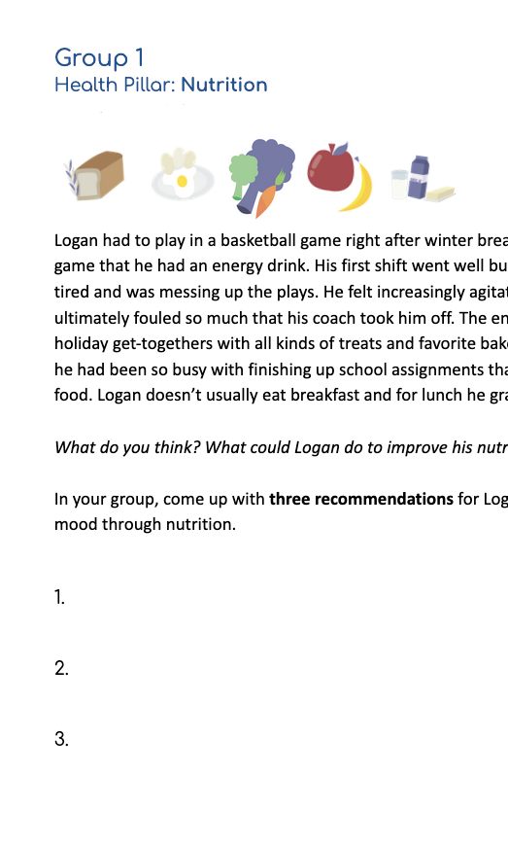
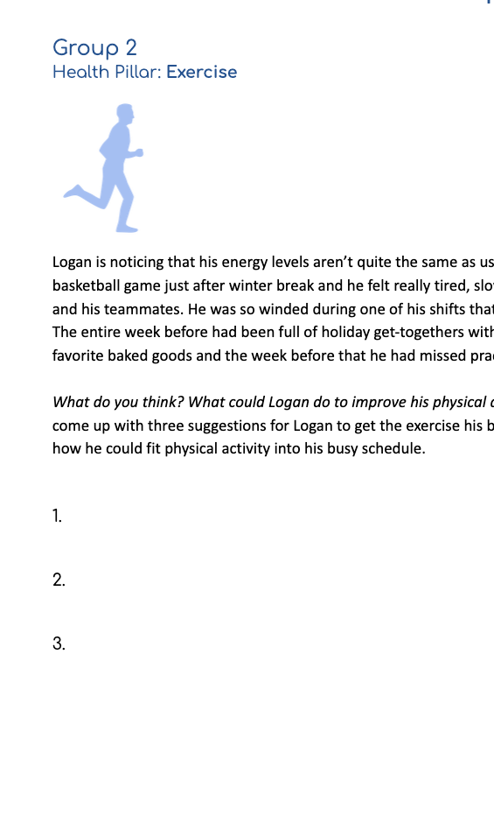
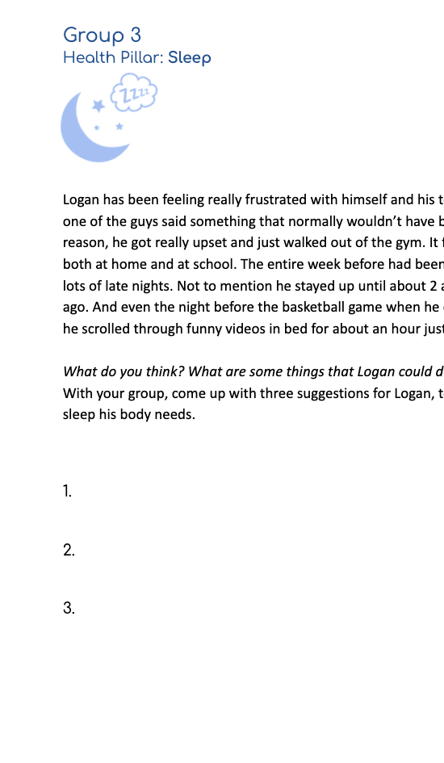
Case Study | The Three Pillars of Health
1
2
3
Nutrition
Exercise
Sleep
© FEMM
Notes:
Step 3 (10 minutes): Health Pillars Case Studies
Divide students into groups of three. Give each group one of the Pillars of Health: Case Study. Have students read their case study and come up with three ways to help Logan improve his nutrition, exercise and sleep habits. When groups are finished, discuss the case studies together with the class, using the Answer Key provided in the materials.

Slide 19
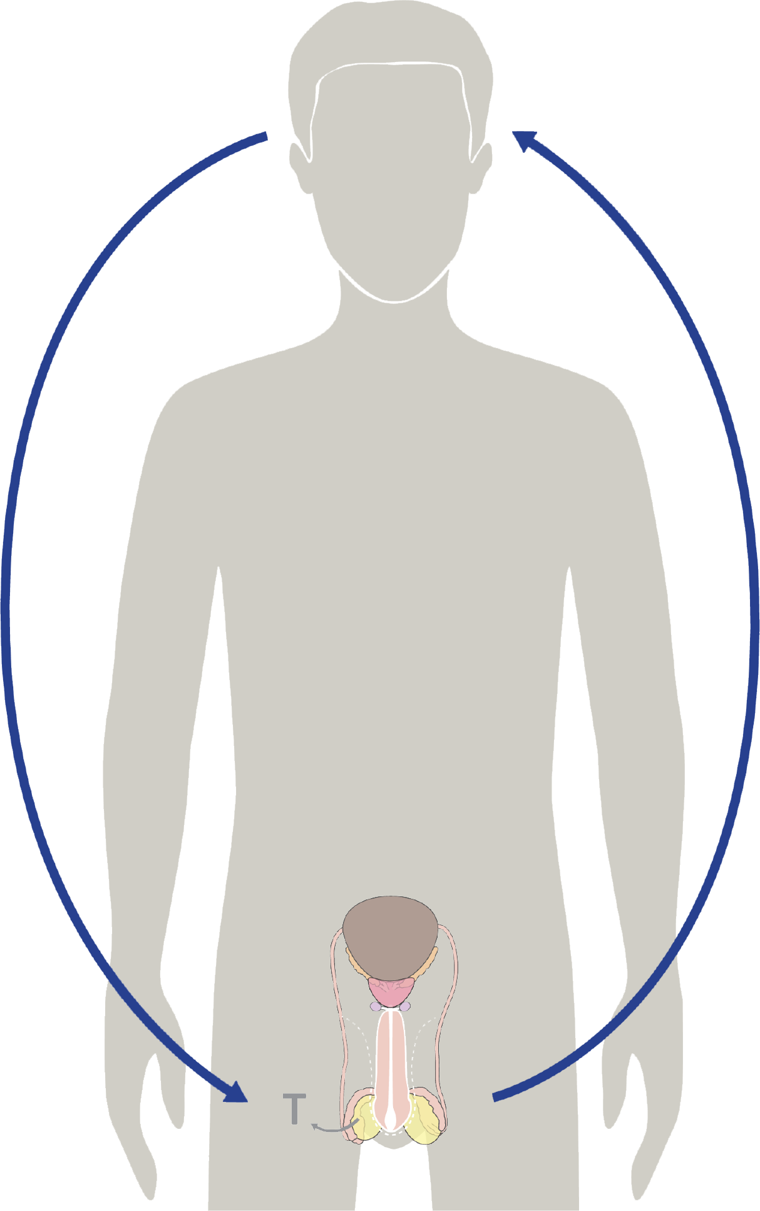
Does technology influence the brain?
YES! Because the brain directs all hormonal activity…
Things that affect your brain affect your physical & emotional health!
© FEMM
Notes:
Step 3 (10 min): Media, Technology and Health
Because the brain is the organizing center for your body, things that affect your brain also affect your physical and emotional health. One of the things that can affect your brain is technology use.

Slide 20

Technology use
What are the positive and negative aspects of media and technology use?
© FEMM
Notes:
Do you own a smartphone? They are pretty easy to get your hands on. Maybe you or your friends have had phones for a while. Phones and other screens and devices have both positive and negative aspects.

Slide 21
Positives 👍
Allows us to connect with friends and family.
Allows us to have fun together.
Allows us to reach out for help.
Allows us to learn in a way we wouldn’t have been able to do before.
© FEMM
Notes:
Maybe your grandparents live far away and you FaceTime them from your family’s iPad or your phone. It’s great to be able to do this! Technology can also help us learn many new things or see things in a way that we would never have been able to do 50 years ago.

Slide 22
Negatives 👎
Distracts
Lowers our attention span (the ability to focus on one task)
Technology/gaming addiction
Skipping meals/loss of sleep
Watching porn
© FEMM
Notes:
Technology also carries risks. Adolescence is a critical time for brain development. While watching videos or texting with friends is fun, it’s crucial to limit screen time. Here’s why.
Have you ever heard of technology addiction? Sometimes, when you’re having a really good time doing something on a screen, it can be hard to notice how much time is being used. Eventually, you might even start to feel like you “need” the device to feel good and that when it isn’t in your hand, you are looking for it all the time. Technology is also sometimes used as an escape from things you do not want to do (e.g., homework, piano practice, chores, or other hard things you need to do). It’s easy to be distracted from focused work when you have a million messages and sounds going off on your phone as every new snap or alert comes in. Phone use can even get in the way of your pillars of health.
You might skip a meal to keep gaming. Do you know that when you skip a meal, your body sees this as a mini-emergency? It starts to produce stress hormones. This might not be such a big deal once in a while, but if we do it a lot, it affects our blood sugar levels, which means that we can get cranky and irritable. Regularly skipping meals also affects your metabolism, making you gain or lose weight.
You might stay up really late at night to watch YouTube when you should have been asleep three hours ago! These can have very real effects on our body and brain. When tech usage affects sleep, this can have negative effects on our ability to pay attention, learn, and remember things in school the next day. It can also make you feel more worried, frustrated or sad. Excessive screen time disrupts your sleep. You may stay up later interacting with your device. Your body releases a chemical called melatonin at night, in response to darkness. It helps your body fall asleep and stay asleep. Bright screen lights reduce melatonin production, keeping you awake.
You might start to watch pornography and find it hard to stop. Pornography is material that is designed to arouse sexual feelings by depicting nudity, sexual behavior, or any type of sexual information. Pornography is easier to get than ever, but that doesn’t mean it’s good for us. Pornography use is correlated to concentration problems, low motivation, depression, social anxiety, negative self-perception and lack of sensitivity towards others. Watching porn causes erosion to the prefrontal cortex, the region of the brain that controls major functions like impulse and willpower. Instead of normal and healthy development and maturation of this part of the brain, porn rewires the brain to a more juvenile state.
Porn can have serious effects on your ability to have healthy relationships. Over time, with increased usage, it can also have negative physical effects on your body. Porn objectifies both men and women; it trains your brain to view human beings only as objects of pleasure, or use, rather than human beings with special value.
If you or someone you know is struggling in any of these areas (gaming, Youtube, porn), it’s best to bring it up with a trusted adult and get some help. Know that you’re not alone and that shame, lying about it or hiding the issue will only make the issue worse. As hard as it might be to talk about, it’s a rising problem among teens and you’ll be taking the responsible step to tell a trusted parent or mentor about what you’re going through.

Slide 23
Negatives 👎
Be Aware!
Skipping meals to keep scrolling
Did you know that when you skip a meal, your body sees this as a mini-emergency?
It starts to produce the stress hormone, cortisol.
This causes irritability, emotional changes and fatigue.
!
© FEMM
Notes:
Skipping meals to keep scrolling
When you skip a meal, your body sees this as a mini-emergency and produces the stress hormone cortisol. This causes irritability (hangry, anyone?) emotional changes and fatigue. This isn’t good for your brain, mood or body.

Slide 24
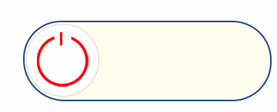
iHealth Tips: You have the power
Turn off notifications, put your phone on airplane mode or turn off your phone when doing homework.
Put your phone on sleep mode 30 to 60 minutes before bed.
Schedule time to do things without phones or other screens.
Exercise - you’ll feel a natural boost of your brain’s feel-good chemicals.
Practice doing one thing at a time. When you’re watching a movie, don’t check your phone. This helps to develop mental focus.
slide to power
© FEMM
Notes:
Given what you now know about how your brain responds to social media, computer games, online videos, and other forms of digital media, remember that you have the power to make choices about how you structure your device use.
Here are the top iHealth tips:
Turn off notifications, put your phone on airplane mode or turn off your phone when doing homework. Distraction is easy. Create a distraction-free zone.
Put your phone on sleep mode 30-60 minutes before bed.
Schedule time to do things without phones or other screens: go outside, try a new hobby, hang out with friends (without phones).
Exercise—you’ll feel a natural boost of your brain’s feel-good chemicals.
Practice doing one thing at a time. When you’re doing homework: just do your homework. When you’re watching a movie: watch the movie, don’t check your phone. These small habits build mental focus and train the brain. Learning these habits now will serve you in relationships, school and your future career.

Slide 25
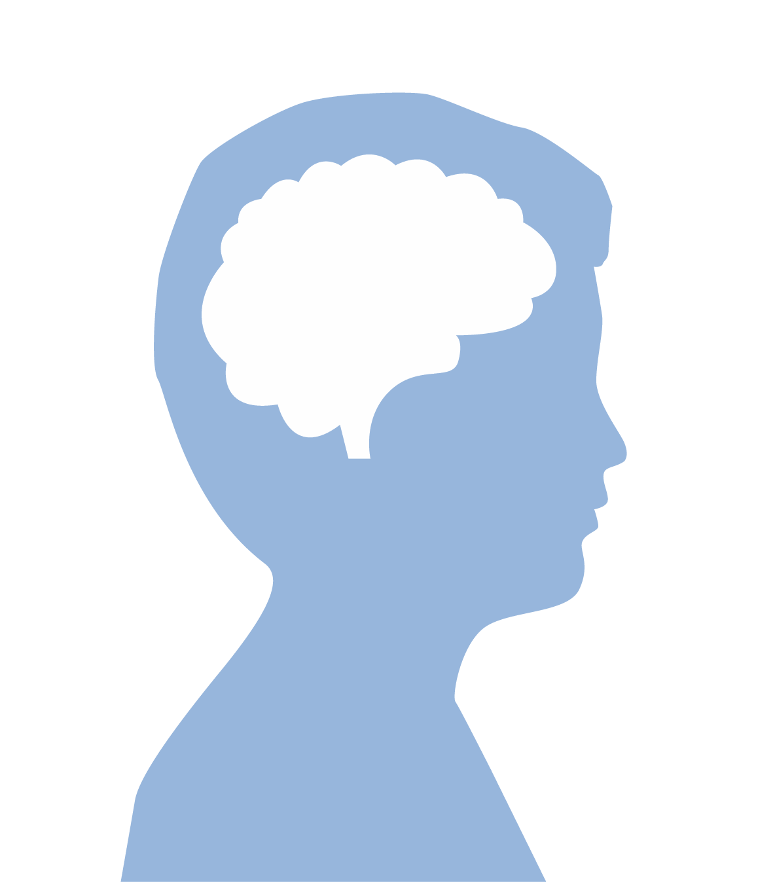

Technology and the brain: think it’s no big deal?
This is the cerebral cortex.
It’s made up of tissue, called ‘gray matter’.
It has a wrinkled appearance from its many folds
and grooves. It plays a key role in memory, thinking,
learning, problem-solving, emotions and more.
It develops in puberty.
It thickens as we learn new ideas,
play sports, learn an instrument, etc.
Teens who spend 7 hours on screens have
a thinner cerebral cortex than their peers.
?
© FEMM
Notes:
This is the cerebral cortex, the outer layer of the brain. The prefrontal cortex, which we learned about in a previous lesson, is one part of the cerebral cortex. The cerebral cortex is made up of tissue, called “gray matter”. Gray matter is wrinkled in appearance, from its many folds and grooves.
The gray matter of the cortex thickens as neural connections are made. In adulthood, higher intellectual ability is associated with a thicker brain cortex.
A study called the Adolescent Brain Cognitive Development (ABCD) study revealed that adolescents who use screens more than seven hours a day had a thinner cortex than those who used screens less. This thinning of the cortex can lead to subtle, cognitive problems and places people at risk for developing depression. Lots more studies are needed to understand this but one thing is for sure: you have the power to take charge of your devices.

Slide 26
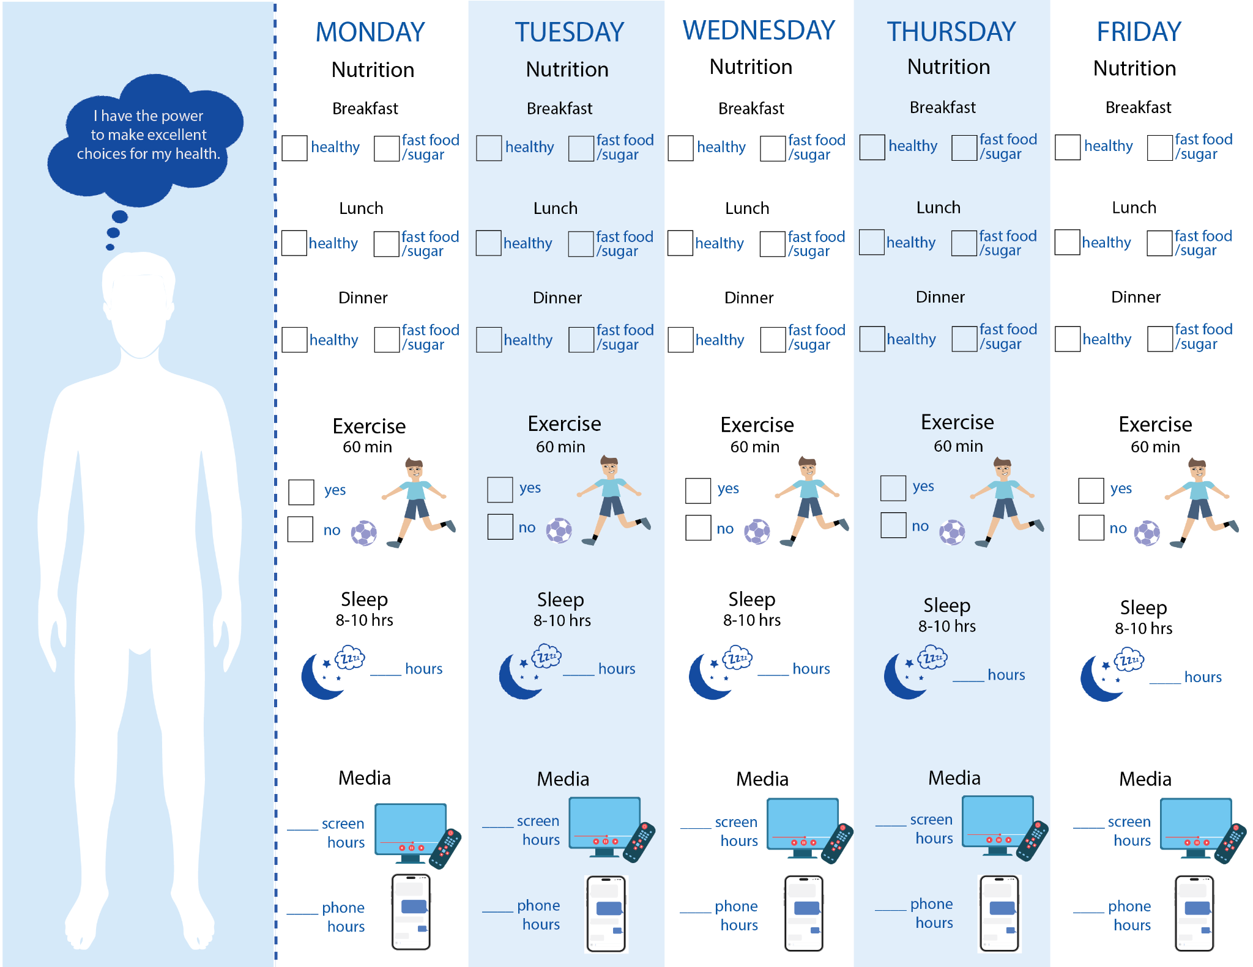
Health Challenge!
© FEMM
Notes:
CONCLUSION
Hand out the Health Habits Challenge to students.
Today we learned more about how nutrition, exercise and sleep affect our body and mind. We also learned that what we consume, including the media, images and content through technology, needs to support the health of our body and mind. This week, we’re going to help our bodies become as healthy as possible by taking a health habits challenge! For nutrition, check whether your breakfast, lunch and dinner was healthy or whether it consisted of fast food, fried food or processed sugar. For exercise, your goal is 60 minutes of activity each day. For sleep, the goal is at least 8 hours a night. For media use, check your phone at the end of day to see how many hours of screen time you average and then add in any additional time spent watching TV, playing video games, etc. Fill in your checklist each day and we’ll count up your points next class! Offer a prize for the winner, or, make it a teacher versus students challenge to incentivize students.

Slide 27
Grade 8
LESSON 6
© FEMM

