Slide 1

Grade 8
LESSON 7
© FEMM

Slide 2
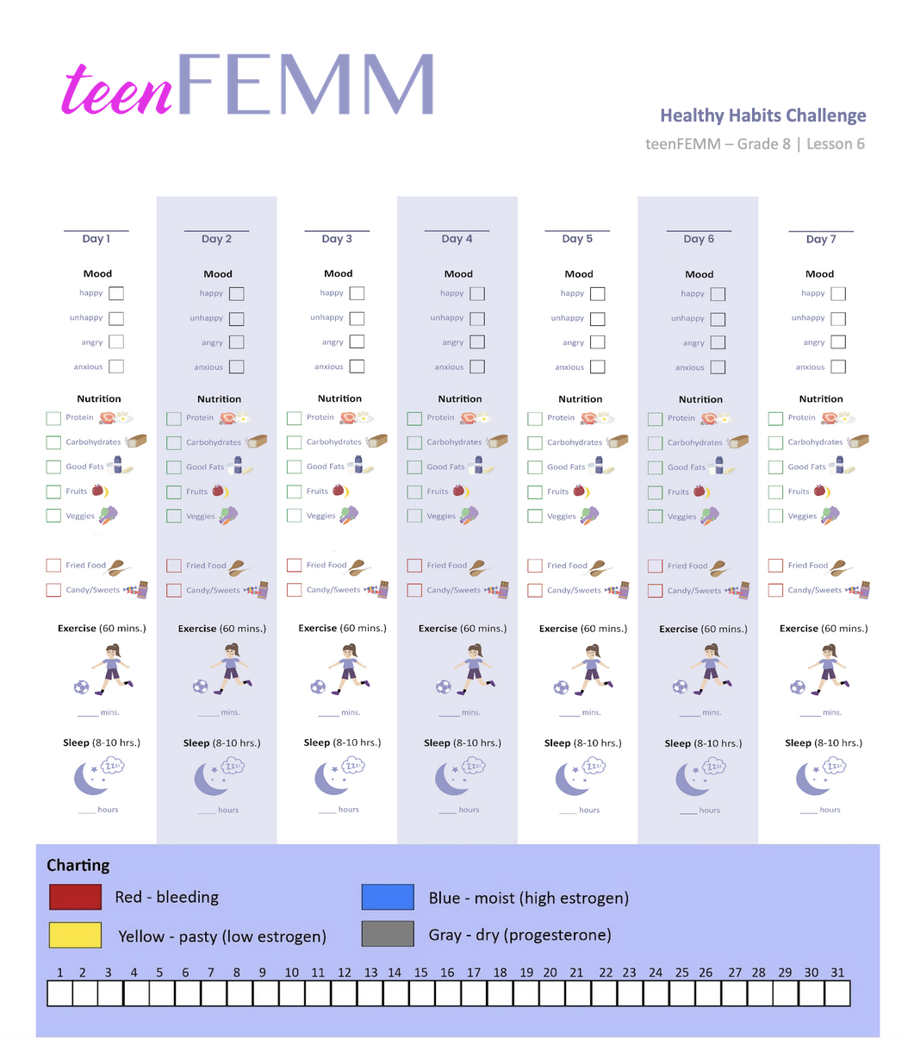
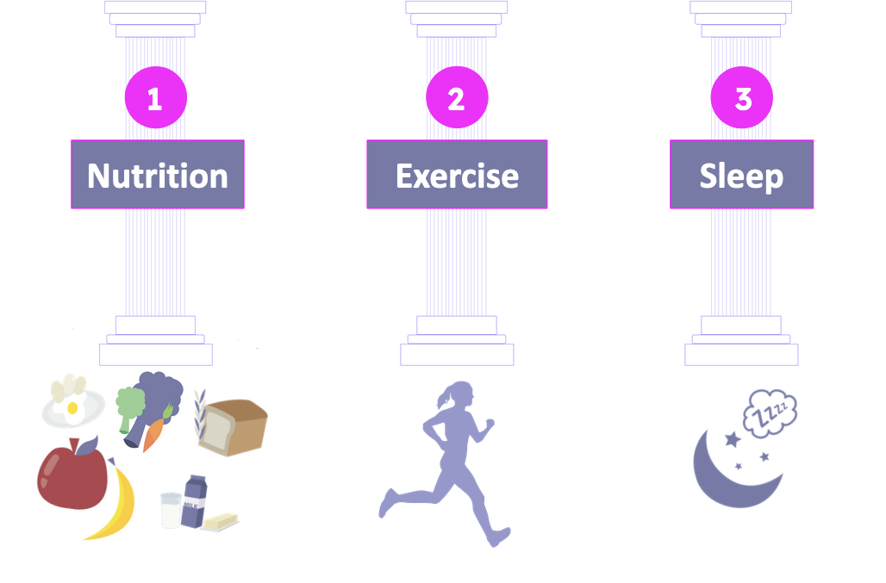
Healthy Habits Challenge
How did it go?
© FEMM
Notes:
Last lesson, we talked about how charting can help you to “see” on paper what is going on with your hormones inside your body. We also assigned the Healthy Habits Challenge! How did it go? Did you notice any connections between your nutrition, exercise, sleep and how you felt emotionally or physically?
Discuss the Healthy Habits Challenge from the previous week. If there was a prize associated with the assignment, award the winner. Otherwise, help students to reflect on the challenge. Possible prompts:
Was it difficult or easy? Which part was the most difficult for you? What were some of the obstacles you faced in trying to complete the challenge? What is something you learned from the activity?

Slide 3
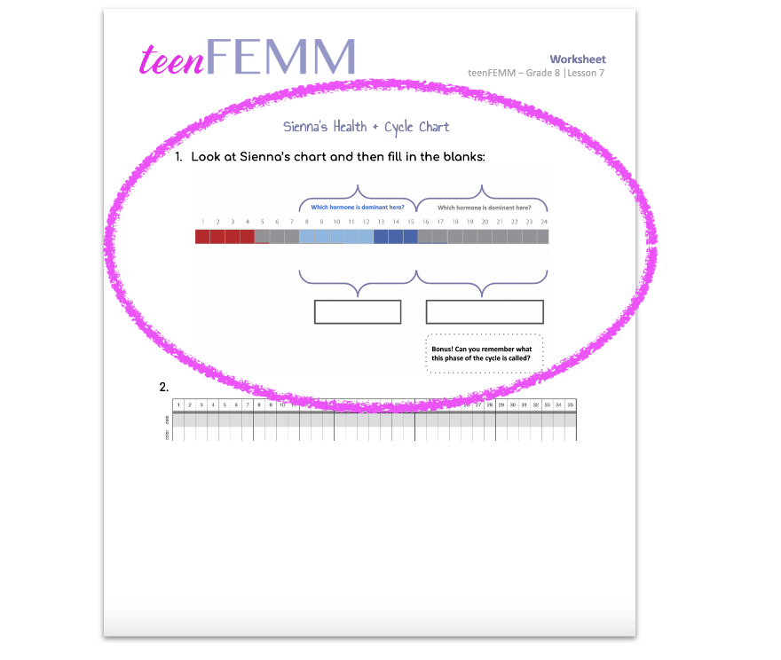
Worksheet | Sienna
© FEMM
Notes:
Step 2 (10 minutes): Worksheet: Sienna’s Health + Cycle Chart
Let’s look at the cycle of another 8th grade girl named Sienna who is friends with Addison.
Hand out the Worksheet: Sienna’s Health + Cycle Chart to each student in the class. Answers to the Worksheet are on the following slides or can be found in the materials.

Slide 4

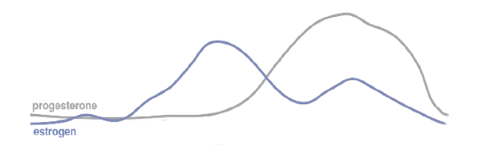
Meet Sienna!
👩🏽
She’s also 13.
She is in 8th grade.
She has been charting for about 6 months
(she started at the same time as Addison).
She is not ovulating yet.
She runs on the cross-country team.
She has a dog named Riley.
📚
🏃🏽‍♀️‍
🐕‍🦺
© FEMM
Notes:
Sienna is on the cross country team and her family has a dog, a black lab named Riley. She is not ovulating yet, but she has been charting for 6 months. As you can see from her chart, Sienna’s hormonal axis is continuing to wake up and she is, like Addison, getting closer to having an ovulatory cycle. Let’s take a couple of minutes to fill in the answers to Question 1. on your worksheet.

Slide 5
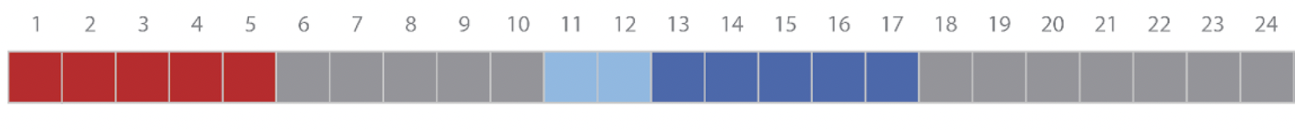


Worksheet | Sienna
Which hormone is dominant here?
Which hormone is dominant here?
Bonus! Can you remember what this phase of the cycle is called?
© FEMM
Notes:
Questions can be displayed and read aloud from the following slide. Once students have answered the questions individually on their worksheet, go through the following answers together.
Sienna’s period lasted four days. Then her brain sent Follicle Stimulating Hormone to the ovaries to begin to develop an egg. As that egg started to develop, it produced which hormone….? That’s right, estrogen. This is where we see the light blue on day 8 on Sienna’s chart. Light blue for rising estrogen and blue for high estrogen. “Which hormone is dominant during this part of the cycle?” Estrogen!
Even though the egg grew, and produced estrogen which is great for Sienna’s growth and development, it didn’t mature enough to trigger LH and Sienna didn’t ovulate. Progesterone took over after the egg stopped progressing towards ovulation (this is why she experienced dryness). “Which hormone is dominant during this part of the cycle?” Progesterone!
Bonus: this phase of the cycle is called the luteal phase. Show the next slide to reveal the answers.

Slide 6
Worksheet Answers | Sienna
Which hormone is dominant here?
Which hormone is dominant here?
Estrogen
Progesterone
Bonus! Can you remember what this phase of the cycle is called?
The Luteal Phase!
© FEMM
Notes:
Answers.

Slide 7
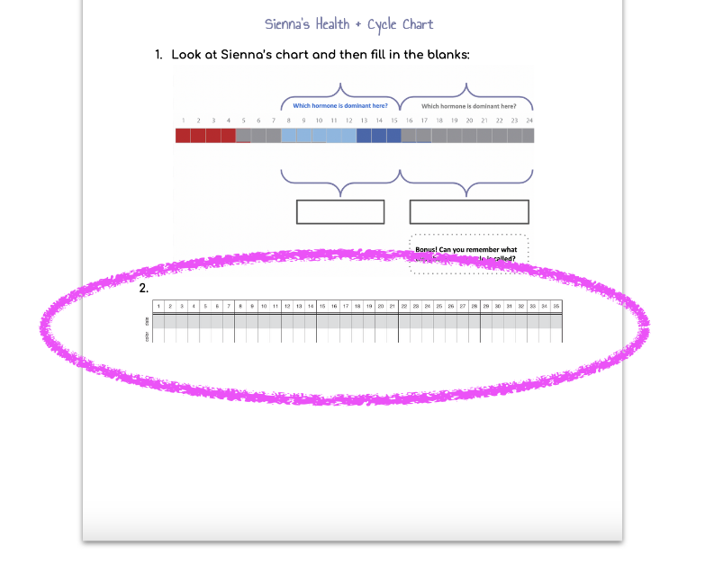
Worksheet | Sienna
© FEMM
Notes:
Step 3 (10 minutes): Mature Ovulatory Cycles
A few months later, Sienna began to take notice of the link between the types of food she was eating and how she felt during her period. She tried to eat less candy, especially before her period. From this, she noticed less cramping and overall tiredness during her period. The next cycle, Sienna also noticed that if she prioritized getting 9 hours of sleep each night, she was less worn out during her period and her cramps weren’t as bad. It was exciting for her to notice these correlations and be able to see how changing her habits really helped her to be more self-aware and feel better about herself.
About 6 months later, Sienna noticed her cycles getting longer and longer. Question number two on your worksheet is a blank chart, so we’ll help Sienna fill in her chart. Have students use their pencil crayons to fill in the chart for Sienna’s cycle.
Day 1- Sienna had moderate bleeding, day 2- heavy bleeding, day 3- moderate bleeding, day 4- light bleeding, day 5- light bleeding. Days 6-10- dry, day 11- she felt a change to moisture, day 12- that moisture continued, day 13 she felt wetness and noticed some clear mucus, days 14-15 same, day 16- she saw more of the clear mucus, day 17- she noticed clear, stretchy, slippery mucus, days 18-31- she felt dry. Have students check their charting with the following slide.

Slide 8
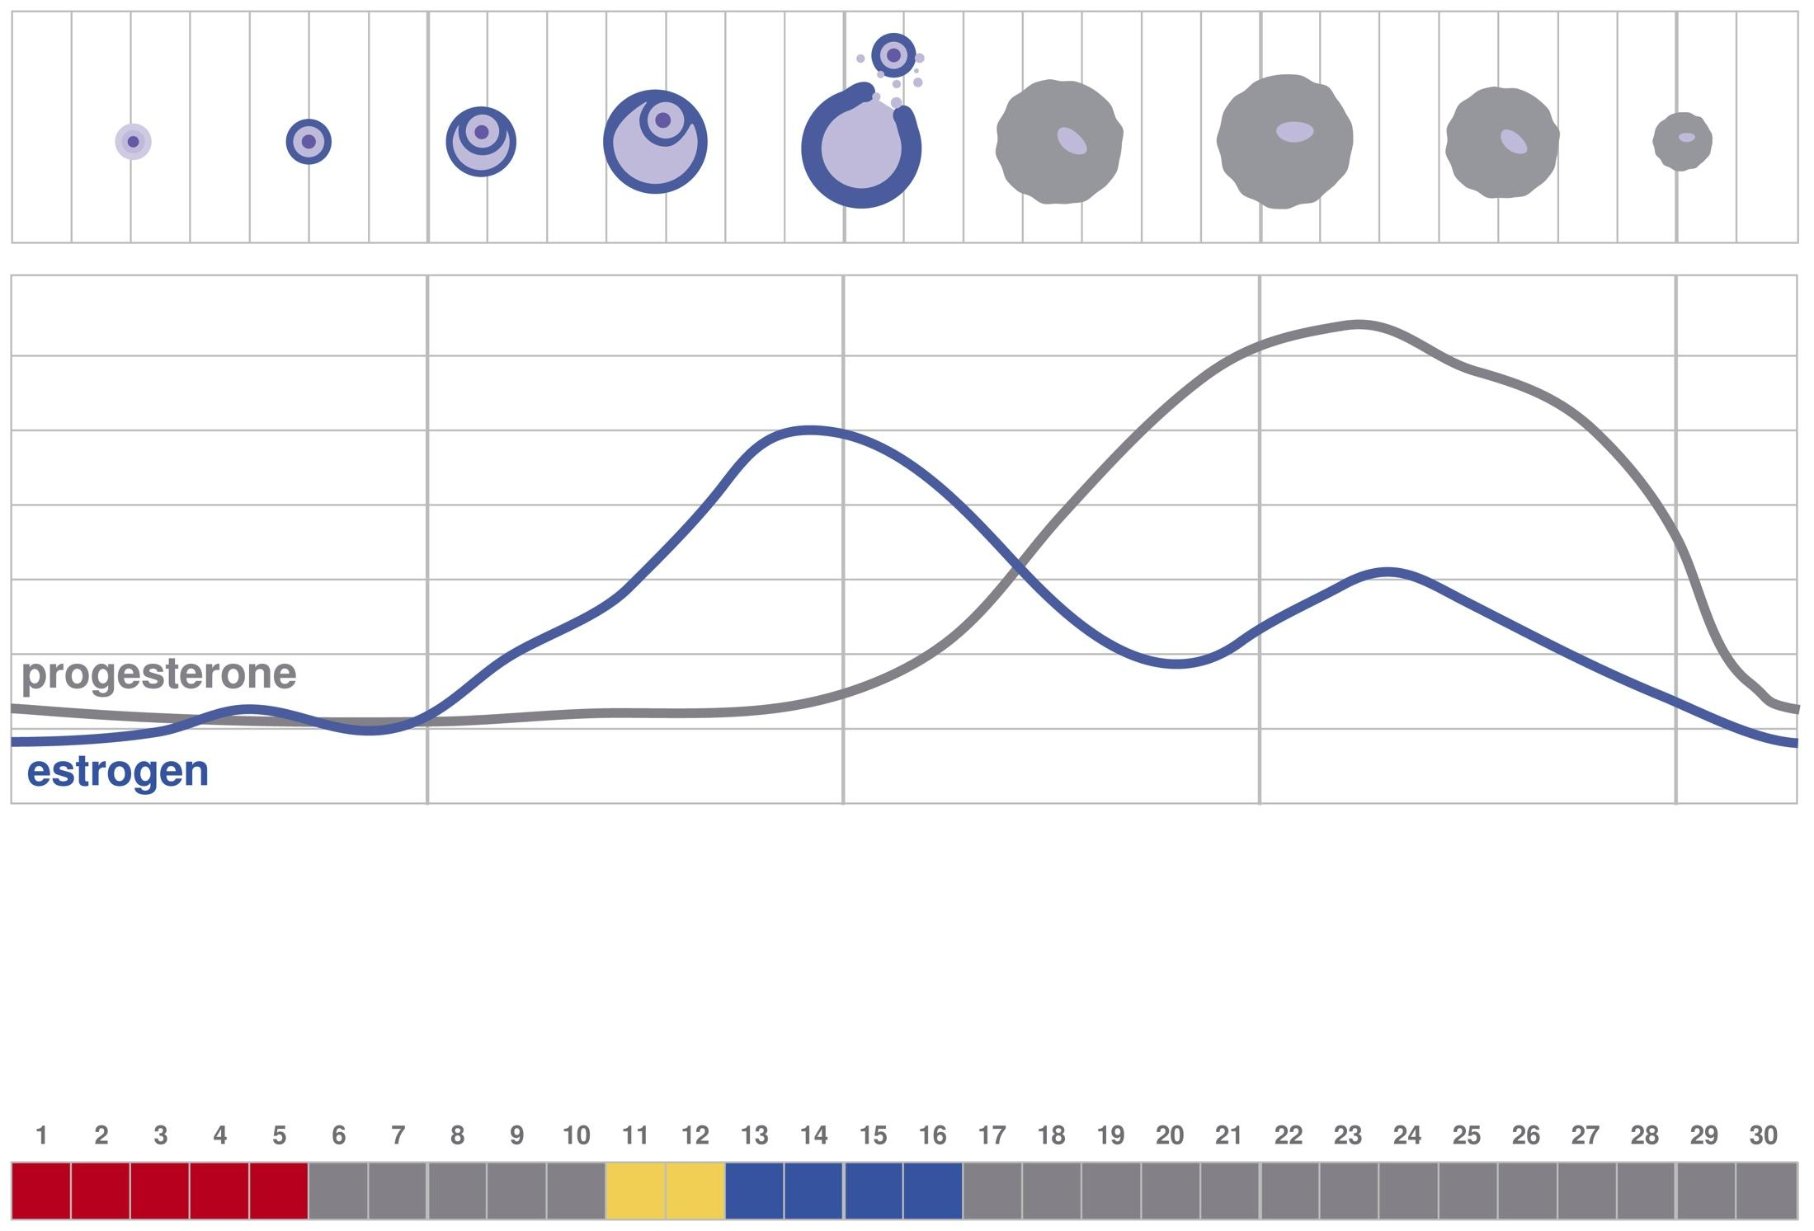
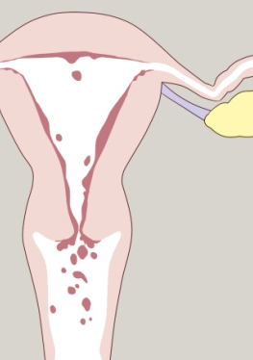
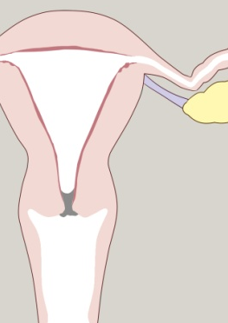
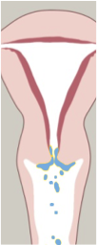
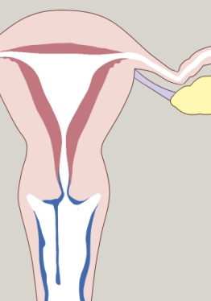
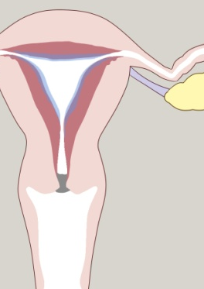
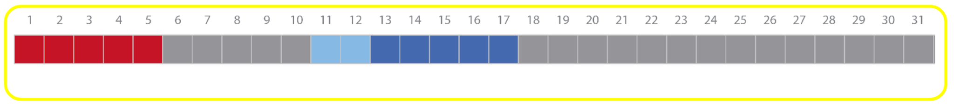
Worksheet Answers | Sienna
Notes:
Do you remember how long the luteal phase should be in a healthy and mature ovulatory cycle? 9-18 days. How long is Sienna’s luteal phase? 14 days. Sienna’s chart shows a very normal and healthy ovulatory cycle!

Slide 9
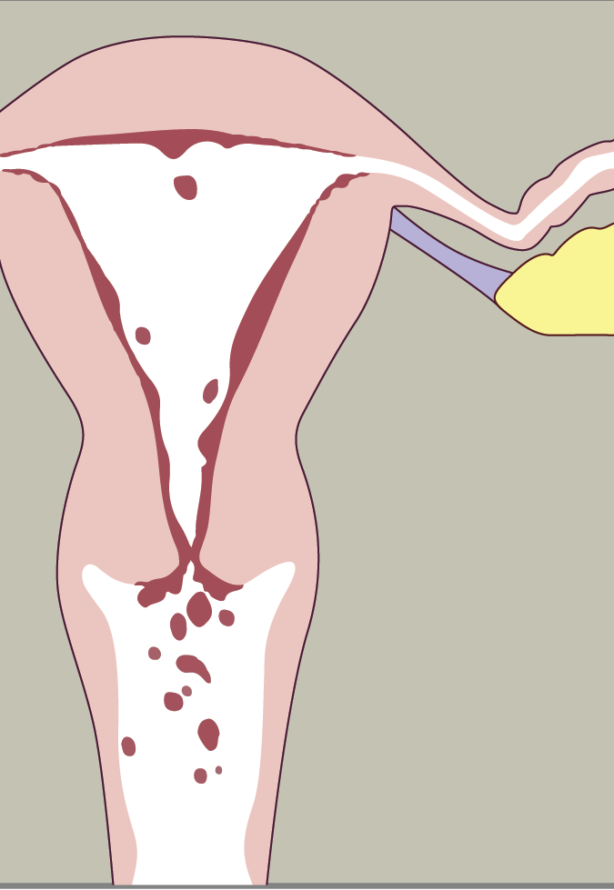
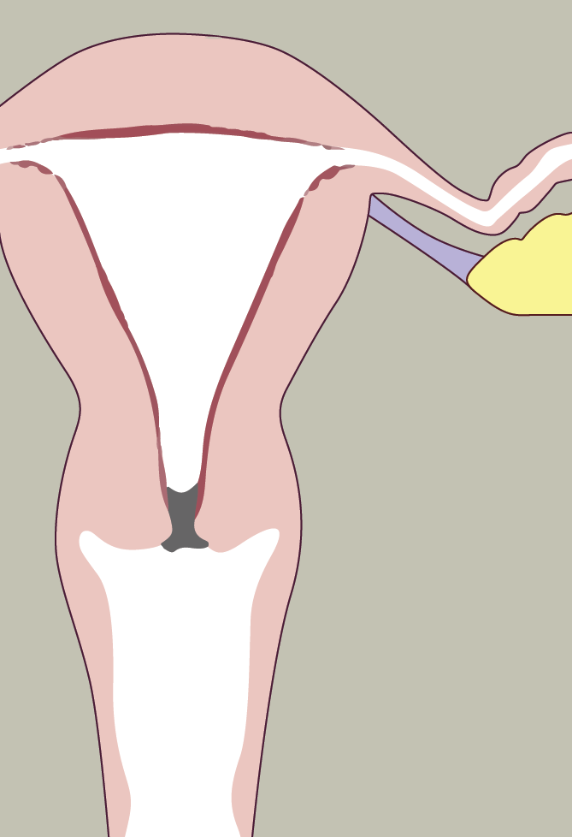
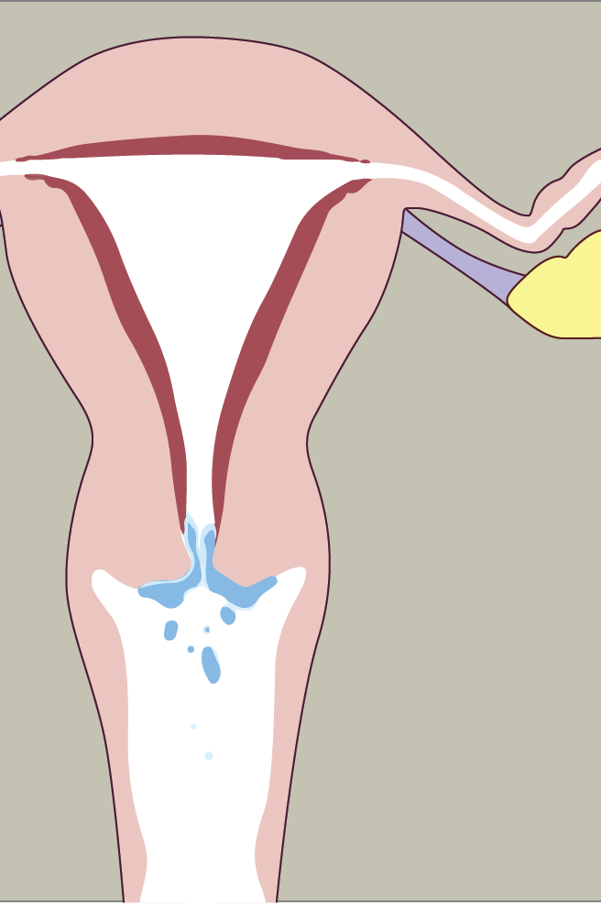
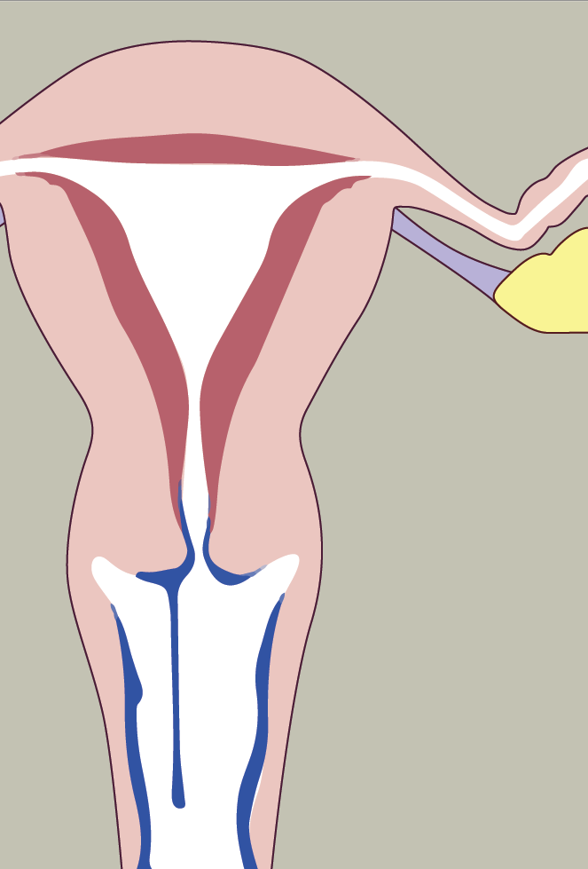
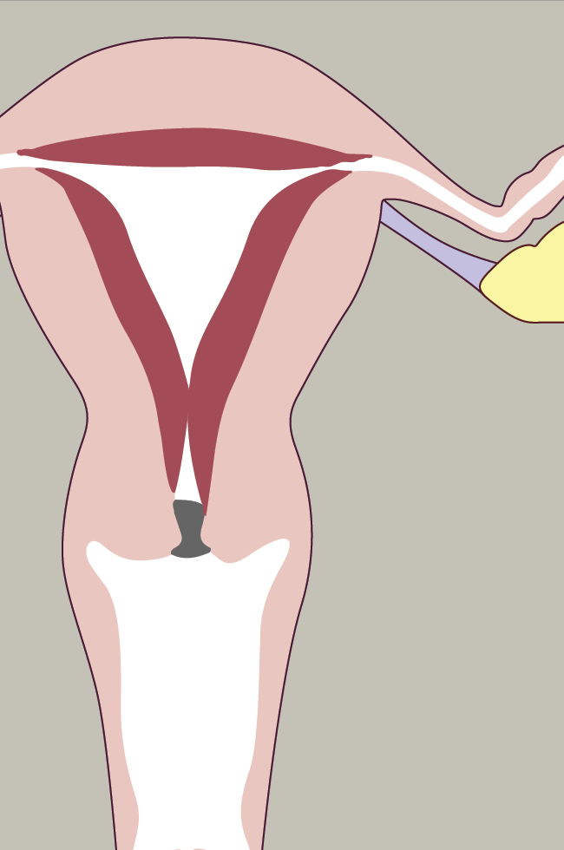
A healthy cycle looks like this…
Menstruation
Healthy menstruation is 3-7 days
© FEMM
Notes:
Step 4 (5 minutes): Normal + Healthy Cycles
Now that we have journeyed first with Addison and now Sienna as they charted the healthy progression of their cycle, you might be wondering how to know if a cycle is healthy, and if every girl’s chart will look the same? There is a healthy range of normal for mature cycles. A healthy cycle looks like this…
Day 1 of each cycle starts on the first day of your period or menstruation; this will be lighter now, but last a little bit longer and be a little bit heavier as you begin to ovulate. A healthy menstruation should be 3-7 days.

Slide 10
A healthy cycle looks like this…
Dryness
Dryness after your period means hormones are low because your ovary is not yet developing an egg
You may see days of dryness after your period.
© FEMM
Notes:
Then, some girls experience dryness before the onset of mucus. The number of days of dryness can be different for each woman. Some might have a day or two, others might notice mucus right away after bleeding slows. Totally normal.

Slide 11
A healthy cycle looks like this…
Days of mucus: signs of ovulation
Egg is developing & estrogen is rising
Mucus should increase in quality and quantity.
© FEMM
Notes:
If you are ovulating and your cycles become regular, you will notice the first day that you see and/or sense mucus that will increase in quantity and quality (become more stretchy, clear, and slippery). Then, ovulation will occur.

Slide 12
A healthy cycle looks like this…
Dryness
Dryness reflects progesterone.
The “luteal phase” after ovulation should last from 10-14 days.
© FEMM
Notes:
After ovulation, it is normal to experience dryness, because the empty follicle (which contained the egg as it developed) turns into the corpus luteum and produces progesterone.
Now you’ve seen an example of a healthy, ovulatory cycle. As you continue to chart, you can pay attention to your nutrition, the type of physical movement and exercise you do, how much sleep you get, and try to notice how these relate to how you feel, both emotionally and physically, at different parts of your cycle.

Slide 13

A healthy cycle looks like this…
notice:
If your cycle isn’t regulating by the age 14 OR you are already experiencing pain, irregular bleeding, or mood issues like anxiety & depression, you should talk to your parents about seeing a FEMM doctor.
A FEMM medical doctor will look at your chart and work to treat the underlying hormonal health issues.
Appointments can be made online at femmhealth.org
© FEMM
Notes:
Maintaining a healthy lifestyle and forming positive habits will support your health, but if you don’t see your cycle regulating by the age of 14 or you are already experiencing pain, irregular bleeding, or mood-related issues like anxiety or depression, you can talk to your parents about seeing a FEMM doctor. A FEMM medical doctor will look at your charting and help treat the underlying hormonal health issue. Appointments can be made online by visiting femmhealth.org

Slide 14
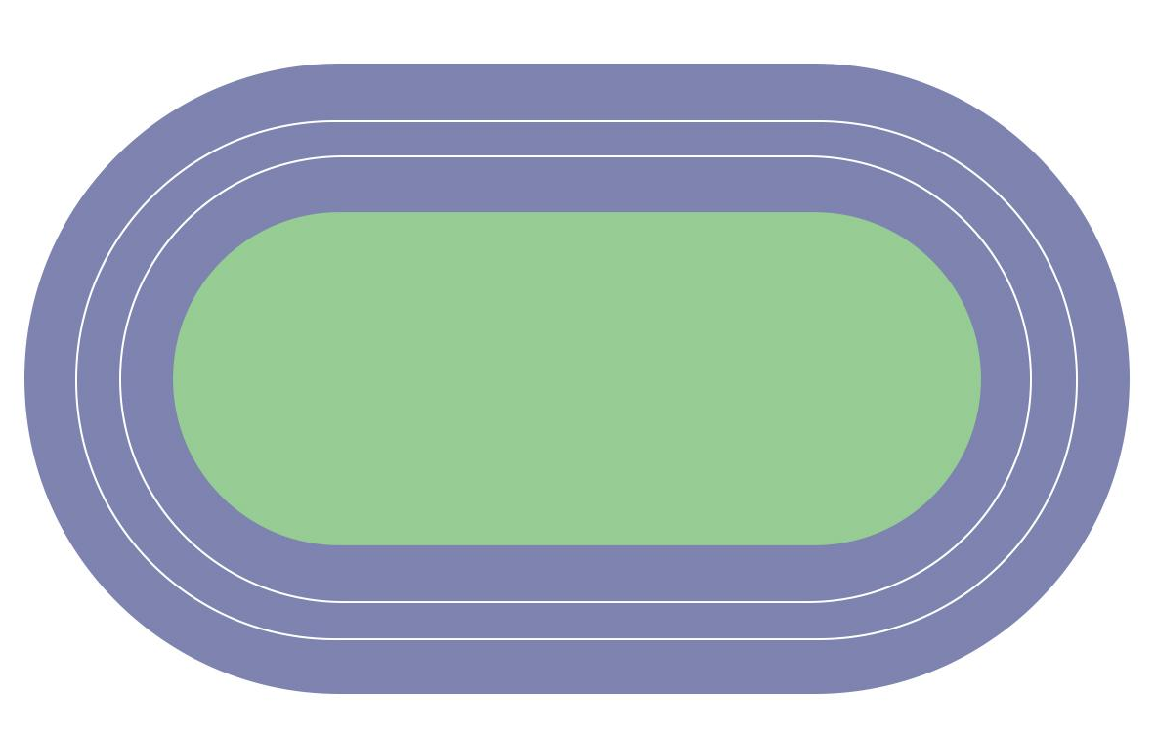

Review Rush Relay Race!
© FEMM
Notes:
Step 5 (5 minutes): Review Rush Relay Race
Divide students into two teams. Depending on the class size, teams can consist of three students, three pairs, three small groups, etc. Have the questions for each team printed, cut and ready to hand each group. Pen or pencils will be needed.
In this teenFEMM Relay Race, each team will need to correctly complete six questions to finish the race. There are three legs of the race, with two questions each. To start, the first group from each team will come forward and receive their questions. When they have answered the questions, each team will need to have me check their answers. If they are correct, they will return to their team and tag the next group to come forward. However, if both answers are not correct, they have to stay until they get the answers correct before they can tag the next group on their team. The first team to finish with all of their questions correct, wins!

Slide 15
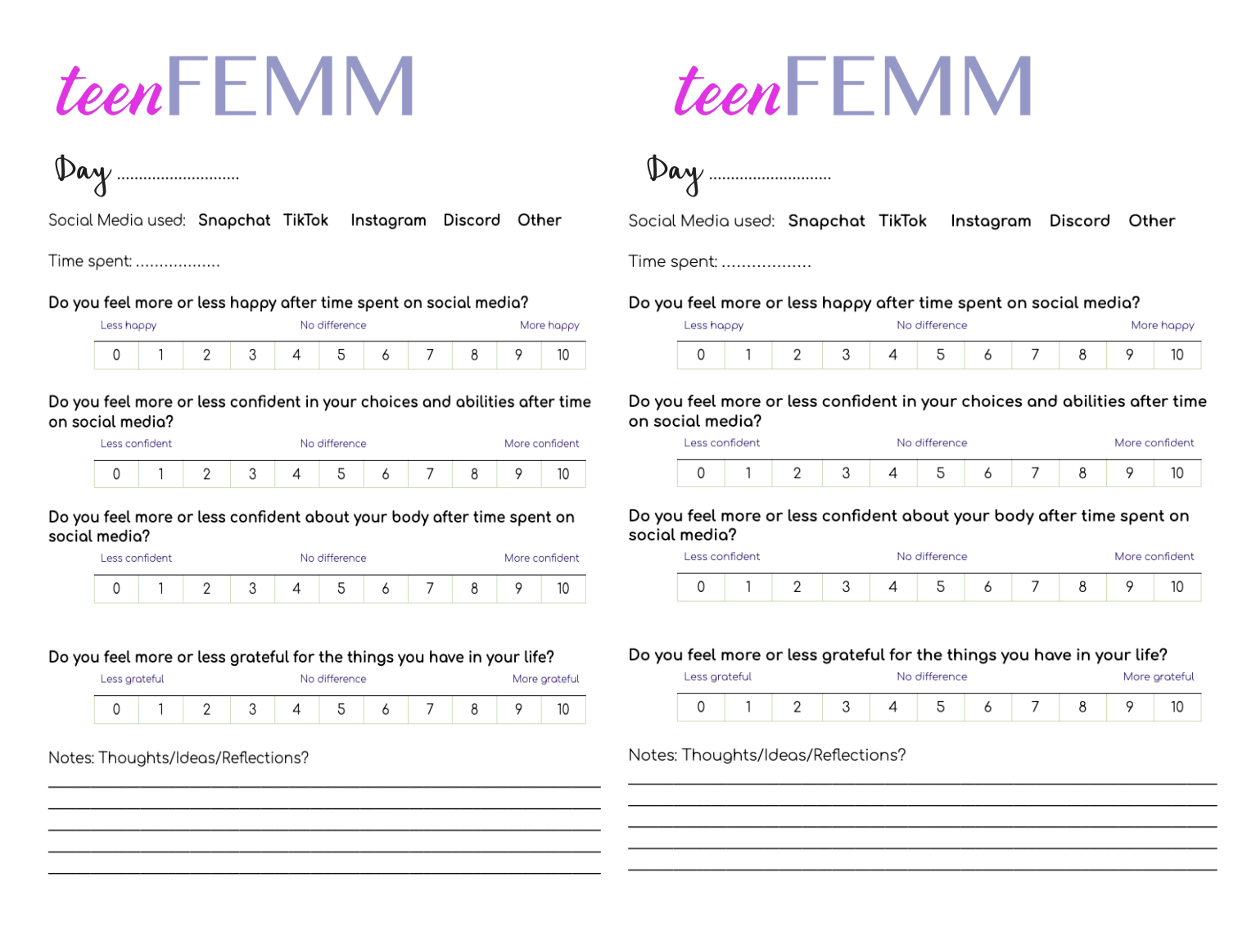
This Week: Take the Social Media Challenge
Notes:
CONCLUSION
Hand out a Social Media Journal booklet for each student.
This week, we’re going to take on a different kind of health challenge: we’re going to pay attention to our social media use. At the end of each day, check your phone settings to see how much time you were on your phone and fill in the journaling prompts. We’ll discuss this next class!

Slide 16
Grade 8
LESSON 6
© FEMM

