Slide 1

Grade 8
LESSON 7
© FEMM

Slide 2
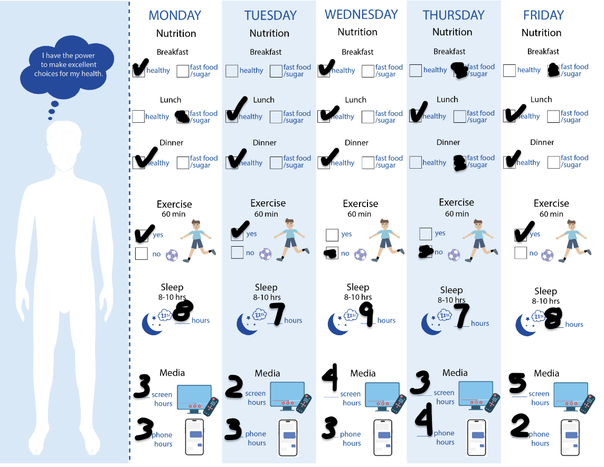
Health Habits Challenge!
For every healthy meal, give yourself 1 point.
Nutrition: 10pts
For every 60 min. of exercise, give yourself 1 point.
Exercise: 3pts
For each night of 8+ hours of sleep, award yourself 1 point.
Sleep: 3pts.
If TOTAL Media use each day is less than 6 hrs, give yourself 1 point.
Media: 1pt
Health Habits Total = 14 points
© FEMM
Notes:
Step 1 (5 minutes): Health Habits Challenge!
Have students get out their Health Habits Challenge worksheet from the previous class. Let’s see how you all did with the Health Habits Challenge and tally the points! For every meal that's healthy, give yourself one point. For every day that you achieve 60 minutes of exercise, give yourself one point. For every night of 8 hours of sleep, award yourself one point. For media, add up your total time (phone and/or tablet, computer, screen) and for every day that is fewer than 6 hours, give yourself one point. See slide for example of adding up the points. Offer a prize to the winner(s).

Slide 3
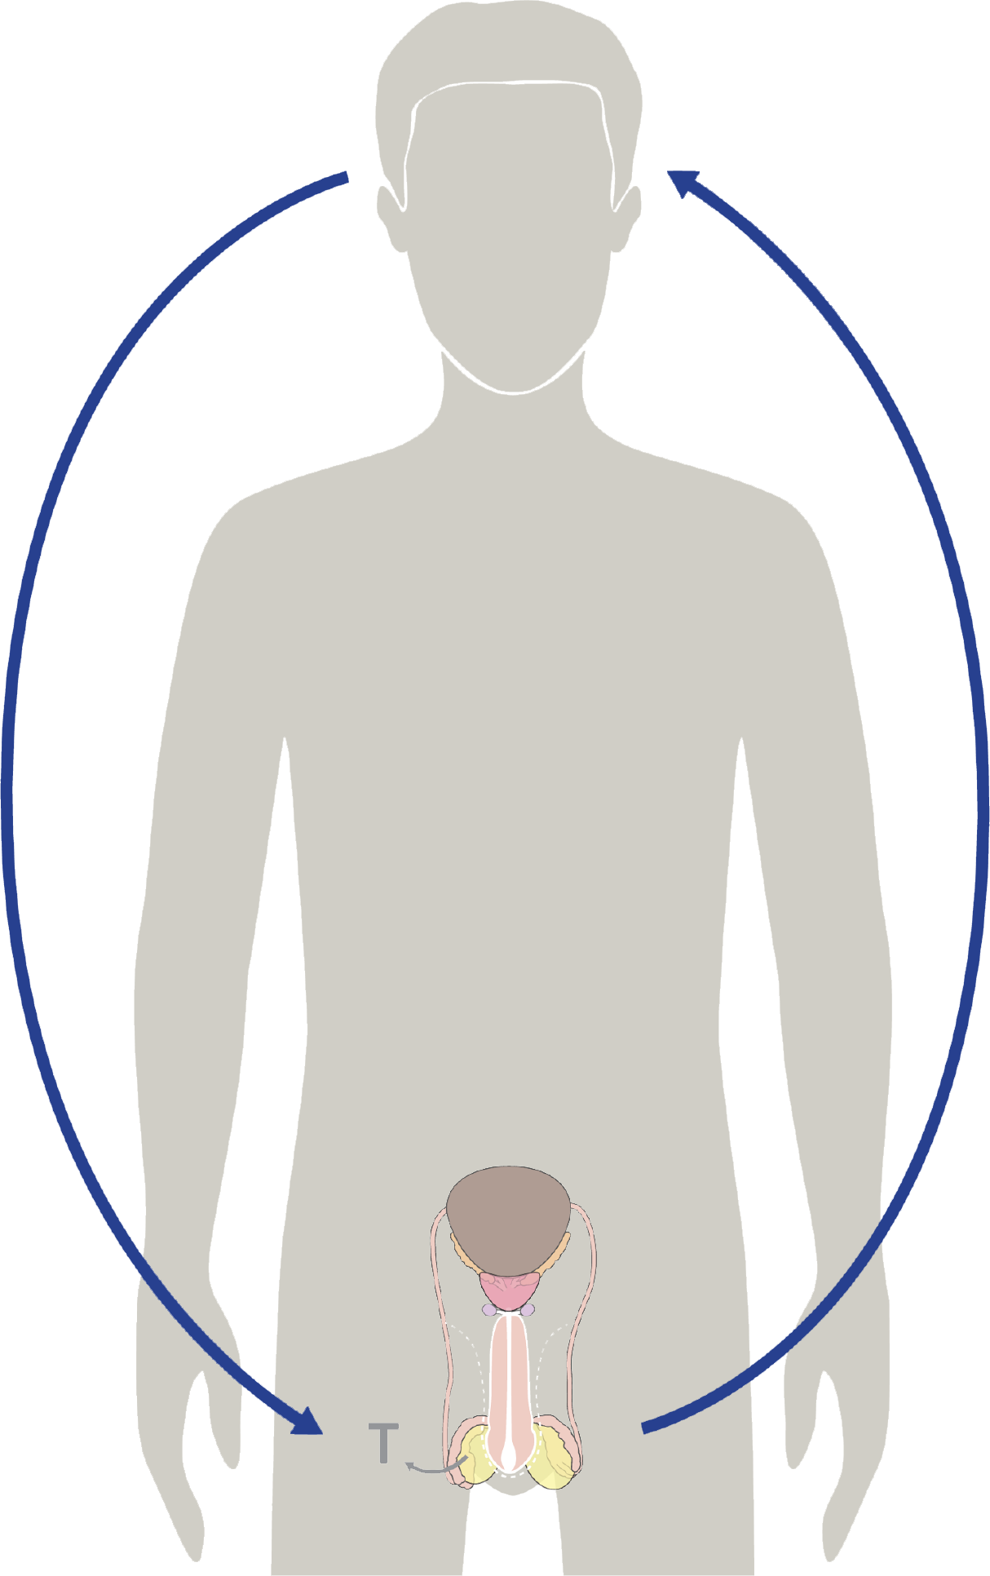
The Brain & Health Habits
Hormones cause all the growing & changing that your body does during puberty.
Testosterone is the main male hormone. After testosterone is produced, it acts as a messenger back to your brain.
Things that affect your brain affect your physical & emotional health!
© FEMM
Notes:
Step 2 (5 minutes): The Brain: Health Habits Matter
As we have learned, hormones cause all of the growing and changing that the body does during puberty. Testosterone is the main male hormone. After testosterone is produced, it acts as a messenger back to the brain. This is called hormonal feedback. The brain and the body are in constant communication. This is why things that affect your brain affect your physical and emotional health. And the reverse is true, too!

Slide 4

Brain development & testosterone
Your choices affect your gray matter
Your choices matter.
The cerebral cortex is the outer layer of the brain. It is made up of tissue called “gray matter”. Gray matter is wrinkled in appearance, from its many folds and grooves.
Choices that increase
gray matter:
Getting enough sleep
Exercising
Good nutrition
Reading, learning new skills and hobbies that challenge yourself
© FEMM
Notes:
Your choices matter. To be precise: your choices are not only important but they increase or decrease your brain’s gray matter. The outer layer of the brain is called the cerebral cortex; it is made up of tissue, called “gray matter”. Gray matter is wrinkled in appearance, as the more you learn new things, the more folds and wrinkles you put in your brain. Gray matter increases rapidly during adolescence until around age 25.
Lifestyle choices that build or increase gray matter, include: getting enough sleep, exercising, eating healthy food, reading, learning new skills and practicing hobbies that challenge your brain.

Slide 5
Brain development & testosterone
Your choices affect your gray matter
Your choices matter.
The cerebral cortex is the outer layer of the brain. It is made up of tissue called “gray matter”. Gray matter is wrinkled in appearance, from its many folds and grooves.
Choices that decrease gray matter:
Lack of sleep
Drinking alcohol
Drugs
Pornography
Too much screen time
© FEMM
Notes:
Lifestyle choices that decrease gray matter and can even do damage to a healthy brain, are: lack of sleep, alcohol, drugs, smoking, pornography and too much screen time.

Slide 6

Under Construction
!
impulse control
predict consequences of action
regulates thoughts and emotions
25
still maturing until mid-twenties
© FEMM
Notes:
The adolescent brain is still “under construction”, growing and developing. The choices you make now will shape your brain for the rest of your life. Alcohol and marijuana use decrease memory and mental performance, damaging brain cells. Getting in the habit of the three pillars of health: nutrition, exercise and sleep, increase mental performance, build brain cells and support your hormonal and overall health.

Slide 7
VOCABULARY
Self-awareness
Self-Awareness
self-a·ware·ness
Noun
Having a strong sense of who you are, how you feel and think, and the reasons for your actions.
© FEMM
Notes:
Step 3 (10 minutes): Self-Awareness and Excellent Habits of Thinking; Feel. Think. Act.
Part of becoming a mature person is becoming more self-aware. Self Awareness means having a strong understanding of who you are, how you feel and think, and the reasons for your actions.

Slide 8

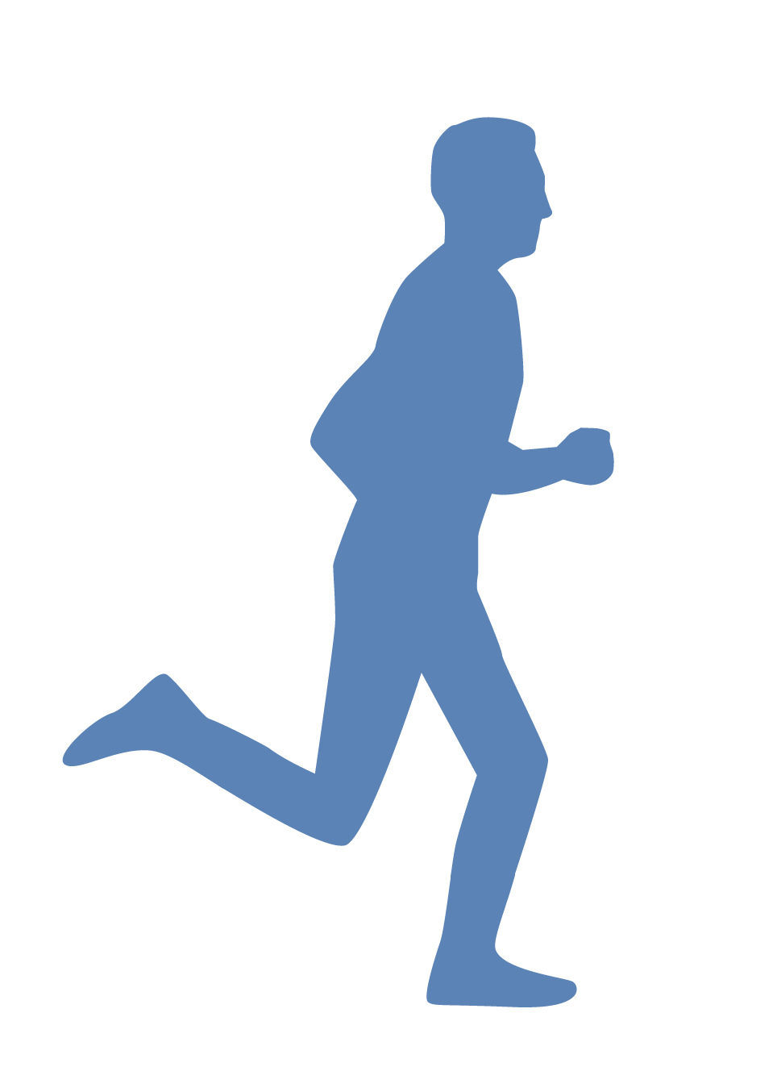
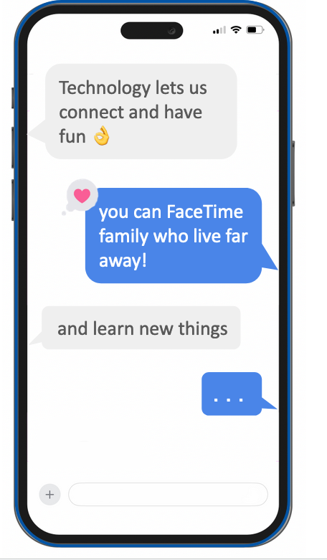
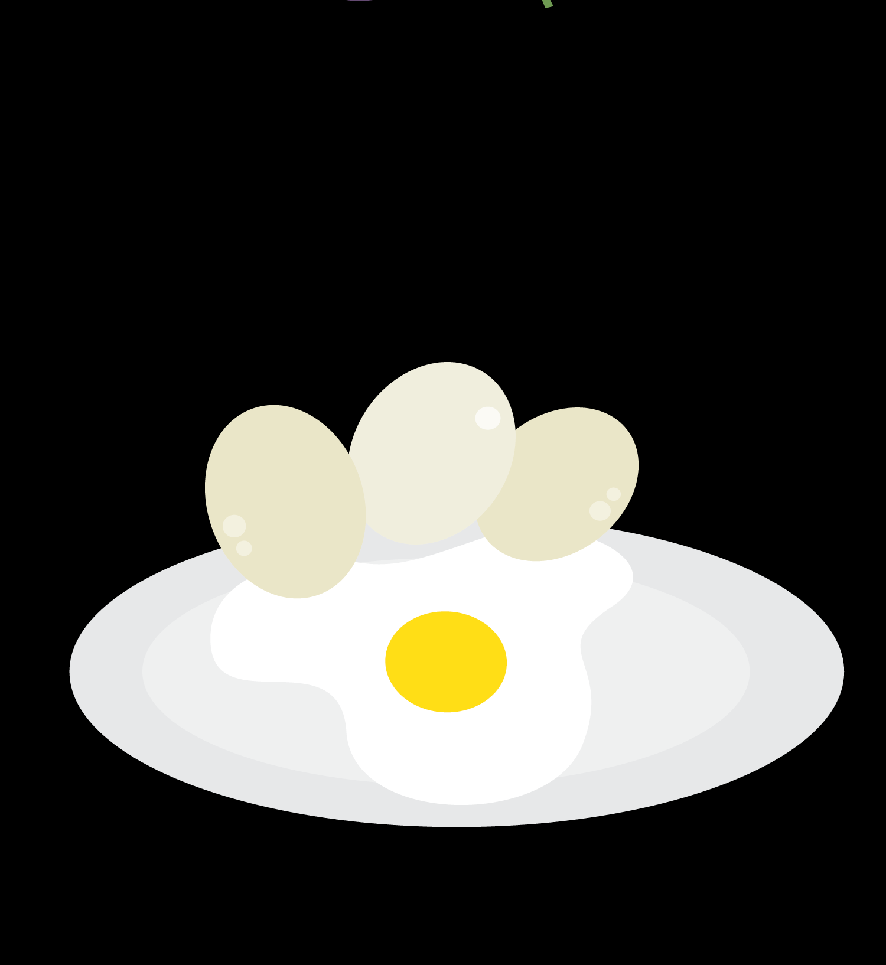


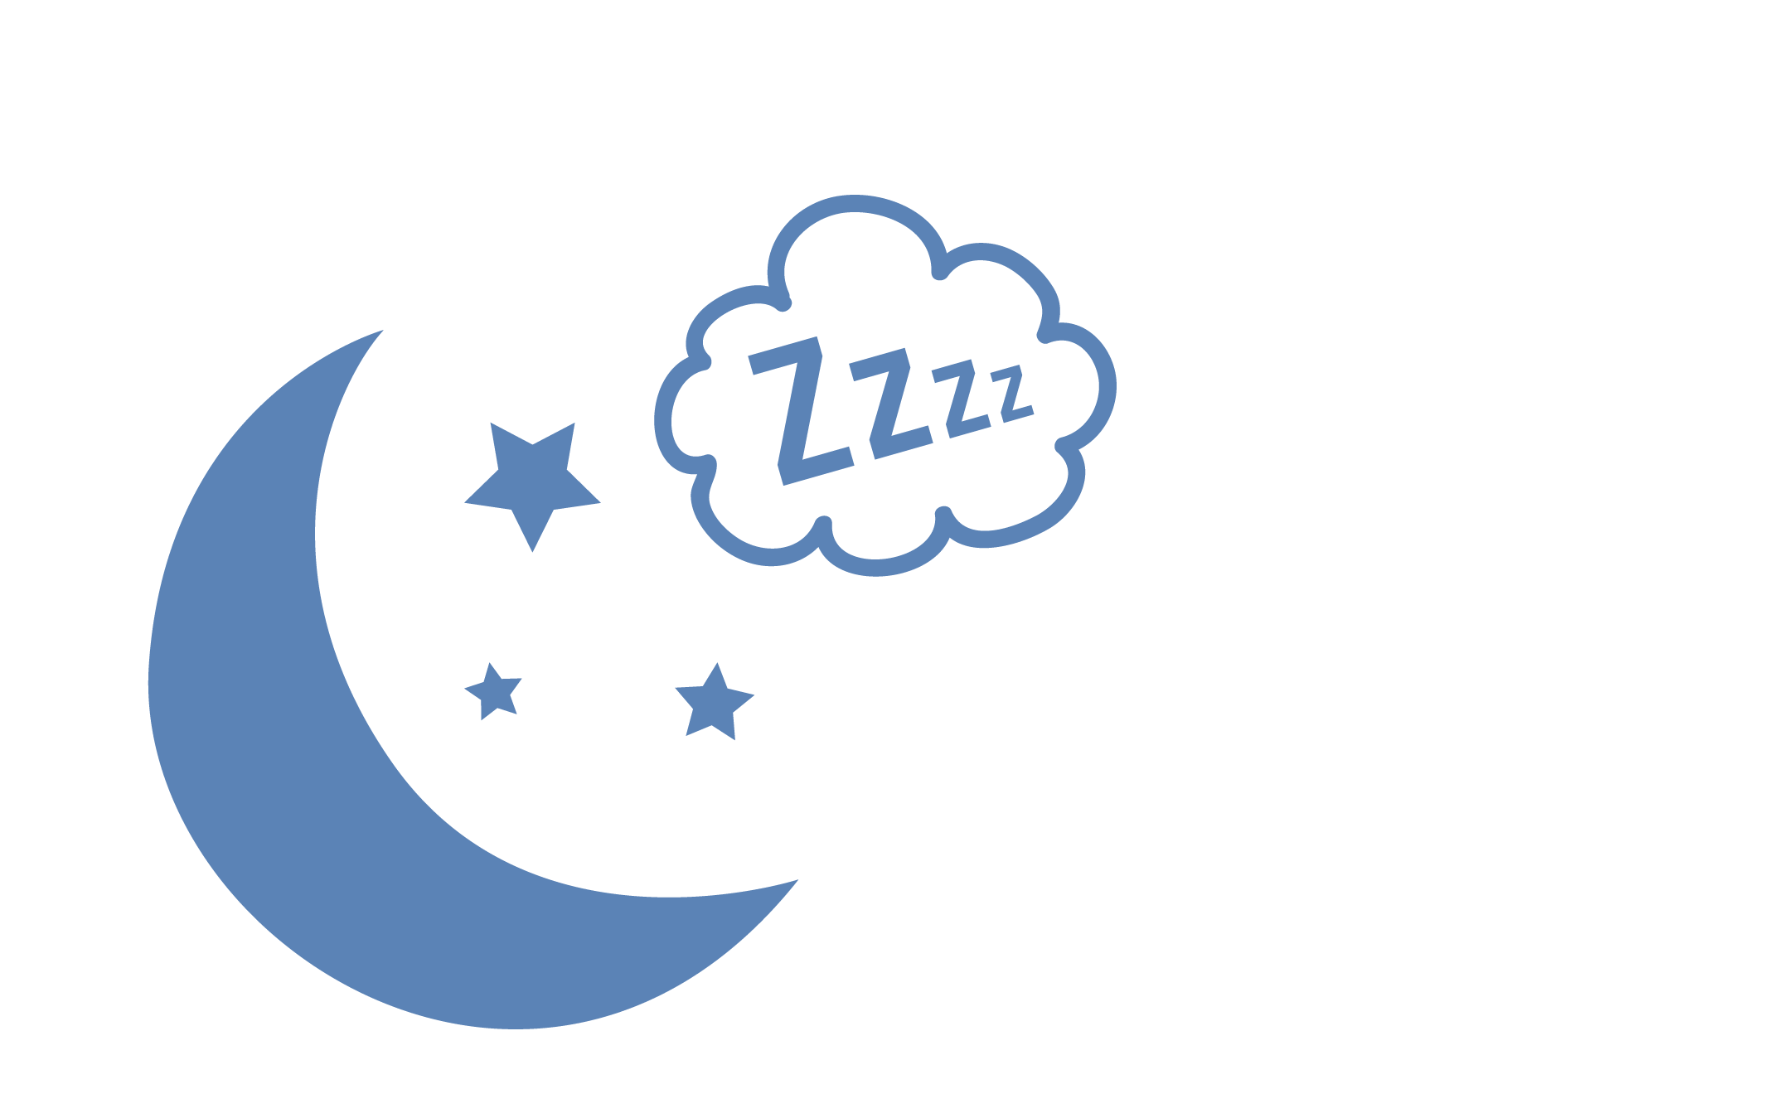

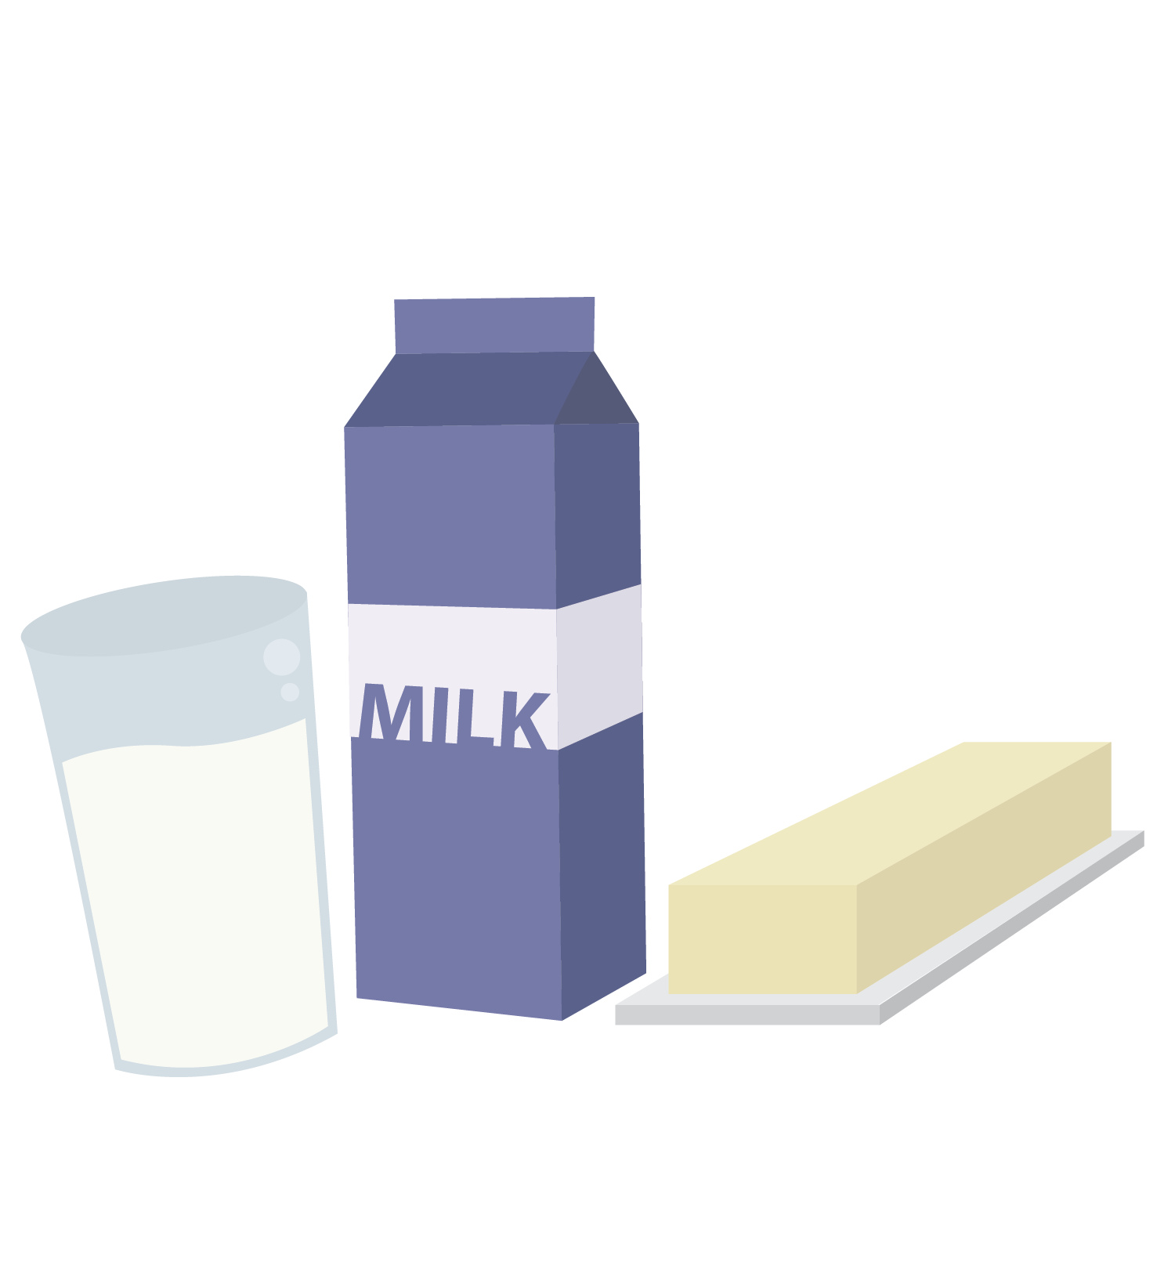
Self-Awareness
Stress
Exercise
self-awareness
Time Online
Peers
Nutrition
Hormones
Sleep
Notes:
Self-awareness is understanding how our nutrition choices, exercise and sleep (or lack of) all contribute to our mood, ability to think and make good decisions. There are other factors, too, like who you spend your time with (peers) and how much time you spend online. All of these things play a big role in our emotional and physical health. Having the self-awareness to check-in with ourselves about how we are feeling and why we are behaving in a certain way, is a sign of maturity in a person.

Slide 9
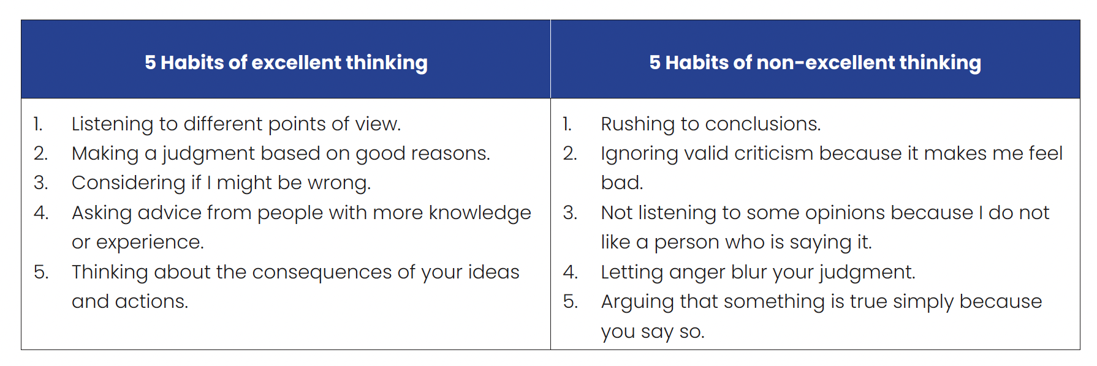
Develop your prefrontal cortex? Excellent thinking!
5 Habits of Excellent Thinking
5 Habits of Non-Excellent Thinking
?
© FEMM
Notes:
Want to develop and mature your prefrontal cortex? Excellent thinking! Here are five excellent habits of thinking:
1. Listening to different points of view.
2. Making a judgment based on good reasons.
3. Considering if you might be wrong.
4. Asking advice from people with more knowledge or experience than you have.
5. Thinking about the consequences of your ideas and actions.
Here are five non-excellent habits of thinking:
1. Rushing to conclusions.
2. Ignoring valid criticism just because it makes you feel bad.
3. Not listening to different opinions because you don’t like the person saying it.
4. Letting anger blur your judgment.
5. Arguing that something is true simply because you say so.

Slide 10
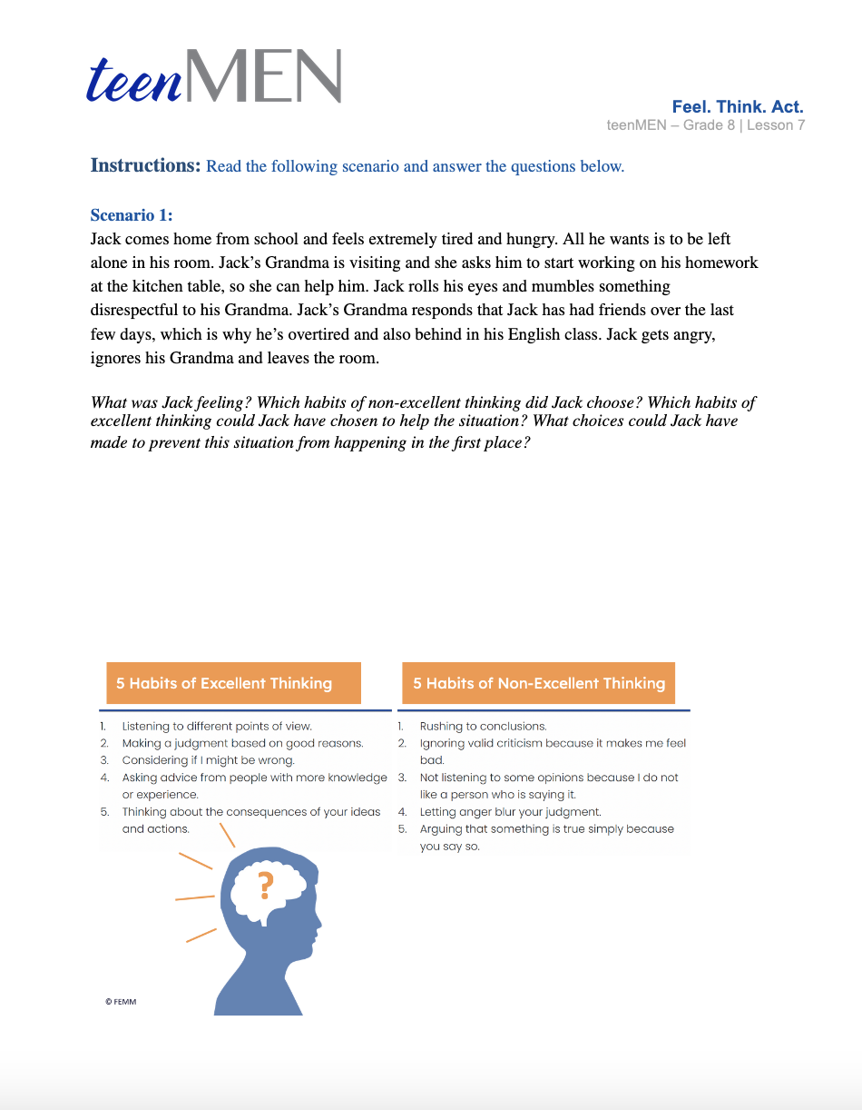
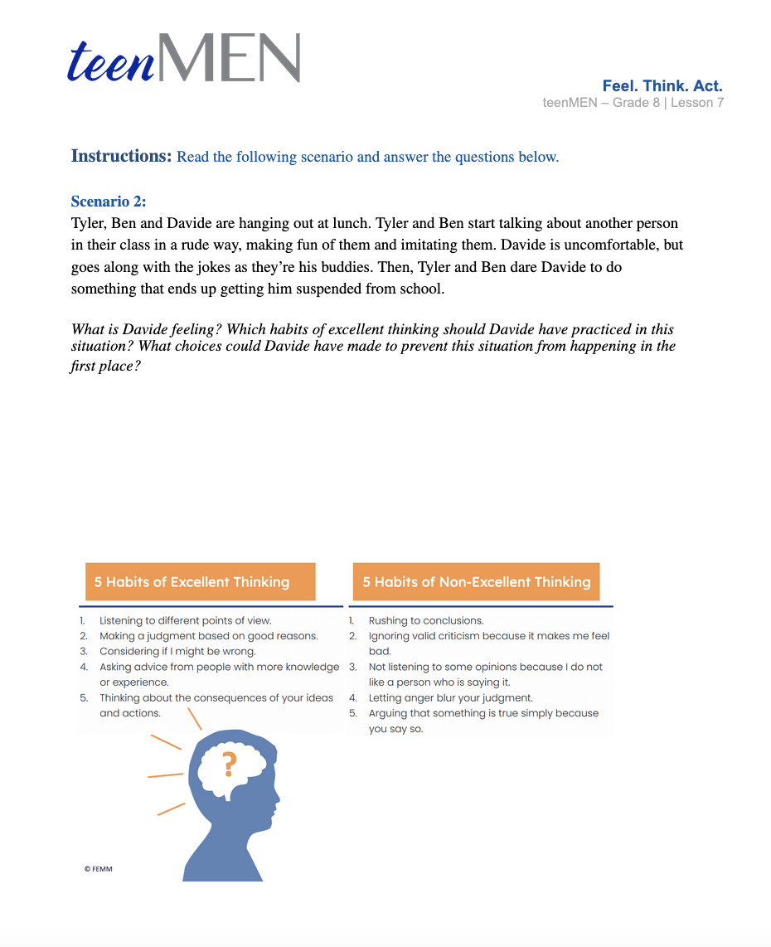
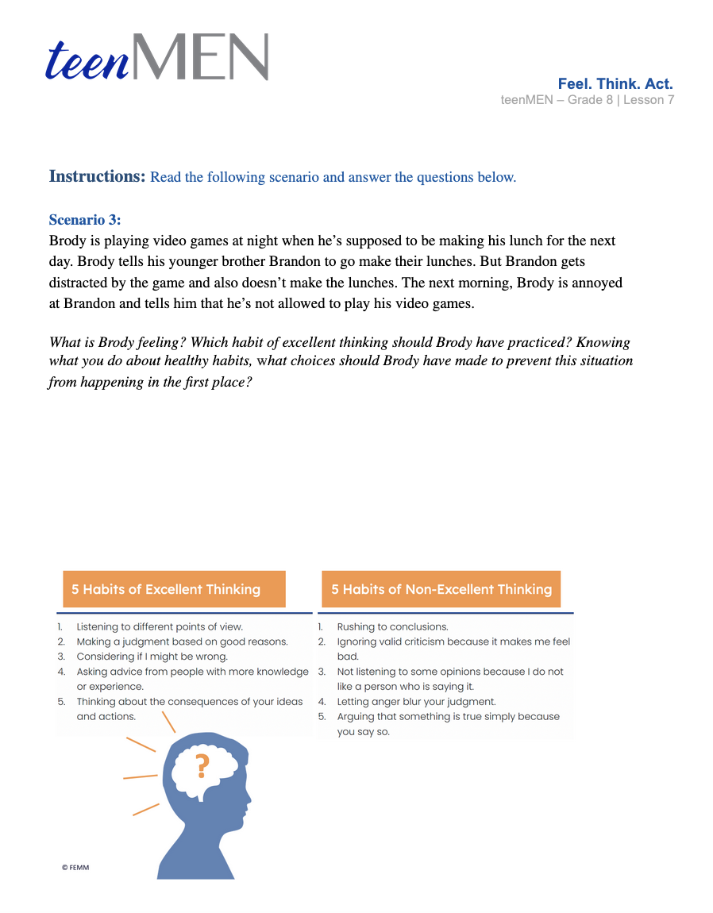
Self-Awareness | Feel. Think. Act.
Having a strong sense of who you are,
how you feel and think, and the reasons for your actions.
Notes:
Divide students into three groups and give each group one of the Feel. Think. Act. scenarios.
Give groups a few minutes to read, discuss and write down their responses to the questions. Then, discuss the answers with the class using the Answer Key provided in the materials.

Slide 11

Choose good sources of information online
Ask a parent or trusted family member.
Make sure you’re getting all the facts.
Watch out for ads that don’t look like ads.
Avoid clickbait!
Protect your privacy!
!
© FEMM
Notes:
Step 4 (5 minutes): Self-Awareness and Online Information
Self-awareness is vital when it comes to navigating the many different kinds of influences we are bombarded with online. In seeking out reliable sources of information online, here are some key things to consider:
Ask for help. Ask a parent, trusted family member, teacher or librarian which resources they would recommend. For school work, make sure the internet isn’t your only research tool! There are great books, encyclopedias, and more.
Get all the facts. If you’re reading an article from a news site, check the original source that the news article mentions; sometimes the original source is entirely different from the headline!
Watch out for ads. Sometimes it says “Ad” beside an ad, but other times paid advertising fits seamlessly into a web page. Getting your information from Instagram or Tiktok can also be problematic, since anything can be posted on social media.

Slide 12
You’ll never believe… how to avoid clickbait!
“Clickbait” is just what it sounds like: a link with a sensationalized headline to make people click on them. It’s usually a link to a weird page trying to sell you something.
“Achieve Results With This One Trick!”
Sometimes it can also infect your computer with viruses.
“He Didn’t Know… Then This Happened.”
!
© FEMM
Notes:
Avoid clickbait! Clickbait are links that sensationalize article headlines to make people click on them. Most are trying to sell you something and sometimes, they can infect your computer with viruses.

Slide 13
Protect yourself online!
It is not safe to send photos of yourself to someone you don’t know. It is also not appropriate to share photos of someone else.
Don’t let yourself be scammed.
  Sites that are poorly made, have spelling mistakes, or ask for a lot of information. Don’t trust a website asking for:
    Age/Birthday
    Address
    Phone number
    Credit card or bank info
!
Always ask a parent or trusted adult if you are unsure.
© FEMM
Notes:
Last but not least, protect yourself online!
It is not safe to send photos of yourself to someone you don’t know online. It is also not appropriate to share photos of anyone else online, in a group chat, etc. It can even lead to legal charges. Don’t trust a website or a person online asking you to provide a lot of personal information. If a site looks poorly made, has spelling mistakes or asks for a lot of information, it’s probably a scam and you should check with a parent before continuing.

Slide 14
4 Ad types to look for:
Clickbait: sensationalized headlines you can’t resist:
“The money making secret that banks don’t want you to know!”
Bandwagon Effect: everyone else is doing it:
“Eight out of ten homes use our security system. Don’t let your home be a target.”
Pseudo-science: invented or exaggerated scientific claims:
“With Phyto-Dorphine™ Skin Booster.”
Endorsement: a celebrity uses this product, so you should too.
“Be like Mike” was a Gatorade campaign featuring Michael Jordan.
© FEMM
Notes:
Step 5 (10 minutes): Advertising Types; Case Studies: teenMEN Advertising Agency
There are lots of messages out there, telling us: “Do this!” “Be this!” “Try this!” Let’s look at four common types of advertising:
Clickbait: these are sensationalized headlines containing a “hack” or “secret” to make people want to check them out. “The money making secret that banks don’t want you to know!”
Bandwagon Effect: this type of advertising may play up the fear of missing out. Or, the message may claim that you should try something because everyone else is! “Eight out of ten homes are equipped with Eyespy Home Security system. Don’t let your house be the target.”
Pseudo-science: this is when advertisers exaggerate claims or make up scientific names to sell a product. “Phyto-Dorphine™ Skin Booster by L'Oréal.”
Endorsement: this type of ad usually shows a celebrity using the product, so that consumers will want to buy the product: “Be like Mike” was a Gatorade campaign featuring Michael Jordan.

Slide 15

Case Studies
Presentations by groups from:
Media and Advertising Agency©
© FEMM
Notes:
Divide students into four groups. Give each group one of the teenMEN Advertising Agency case studies. Give groups a few minutes to come up with their ad to present. Then, have each group present their ad to the class. If groups run out of time to present, they can present their ad at the beginning of the next class.

Slide 16
Review
Maturity means taking responsibility for our choices.
Practicing excellent habits of thinking can help us mature.
Making good choices online is part of growing in maturity.
© FEMM
Notes:
CONCLUSION
Growing up and becoming a mature person means taking responsibility for our choices. As we discussed today, practicing excellent habits of thinking and being self-aware when it comes to what you’re seeing and doing online is an important step to growing in maturity. Excellent, healthy choices, not only shape and develop your prefrontal cortex, but they shape your life!

Slide 17
Grade 8
LESSON 7
© FEMM

