Slide 1

Grade 8
LESSON 8
© FEMM

Slide 2
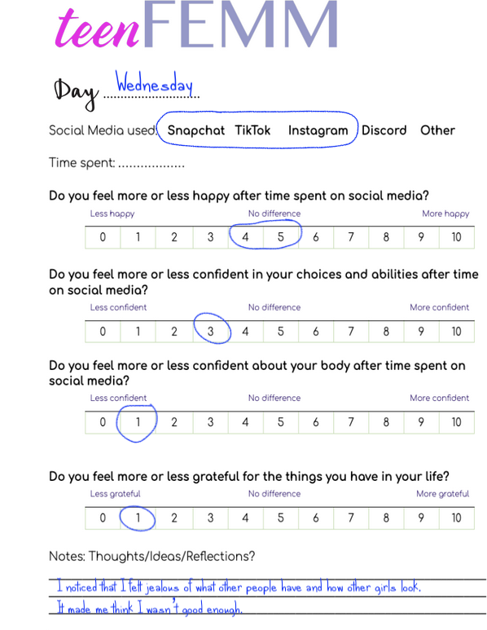
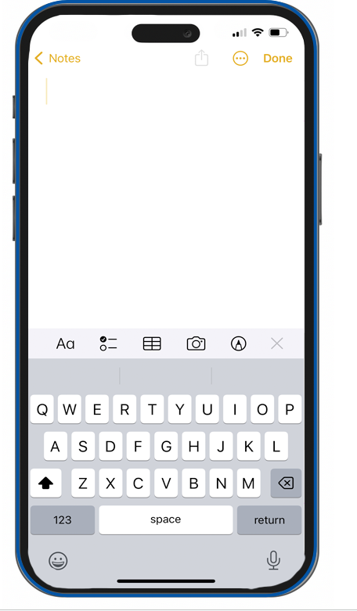
How does social media make me feel?
Do I feel 👍 or 👎 positive
after time on social media?
Do I feel 👍 or 👎 confident
after time on social media?
Do I feel 👍 or 👎 grateful
for the things that I have in my life after time on social media?
© FEMM
Notes:
Step 1 (5 minutes): Review Social Media Journal + Self-Awareness
Discuss with students the Social Media Journal from the previous class.
Did you fill in your Social Media Journal last week? How did it go? What did you notice about your mood after spending time on social media? Did you feel more or less confident after spending time on social media? Did you have more positive or negative thoughts about your appearance or body? Did you feel more or less grateful for the things in your life?

Slide 3
VOCABULARY
Self-awareness
self-a·ware·ness
Noun
Having a strong sense of who you are, how you feel and think, and the reasons for your actions.
© FEMM
Notes:
What is self awareness? Self awareness means to have a strong understanding of who you are, how you feel and think, and the reasons for your actions.

Slide 4
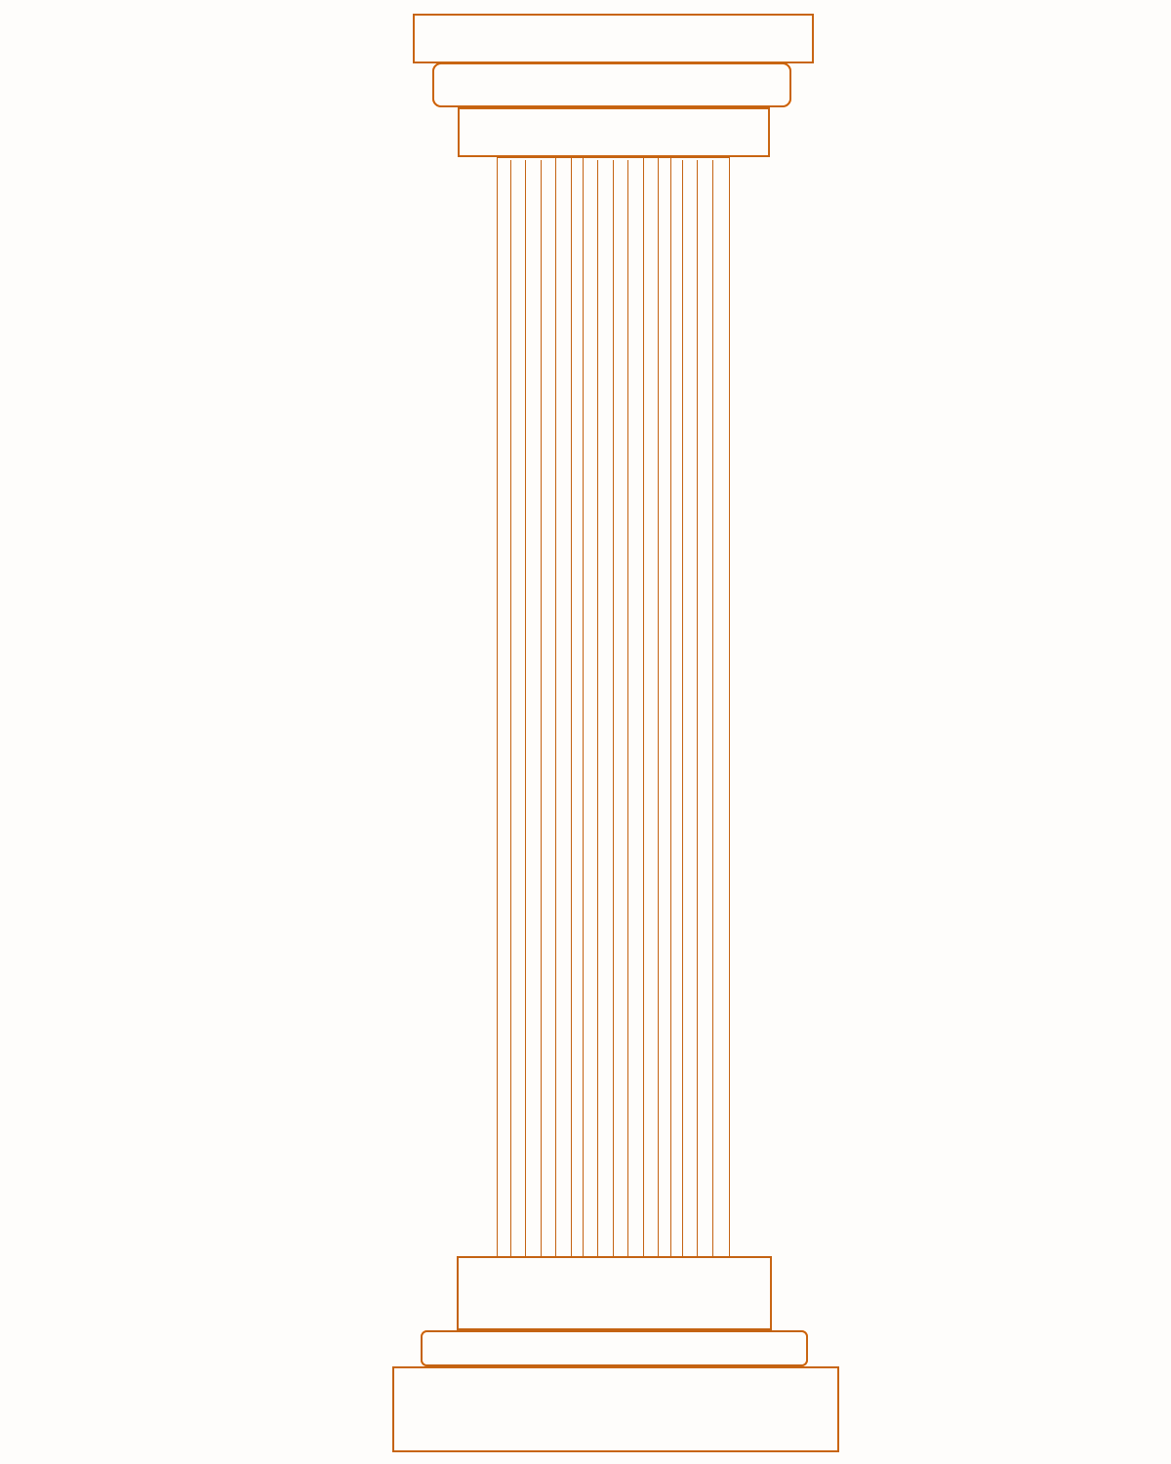
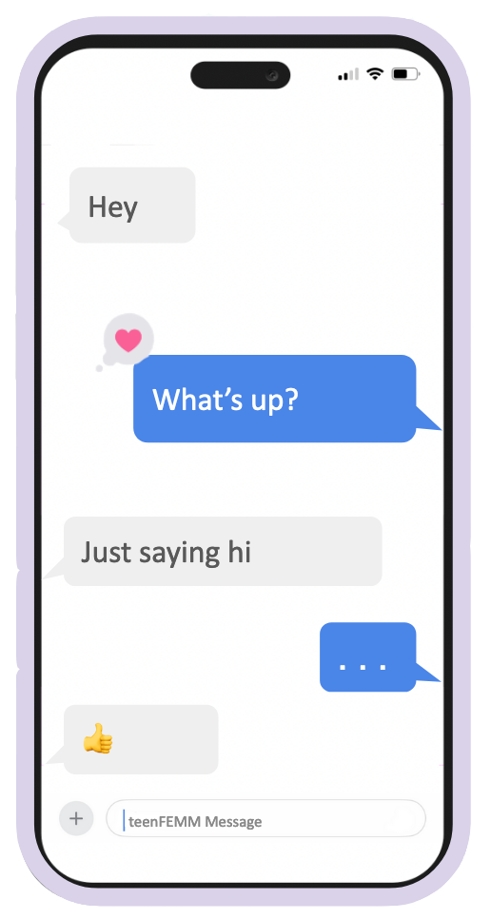
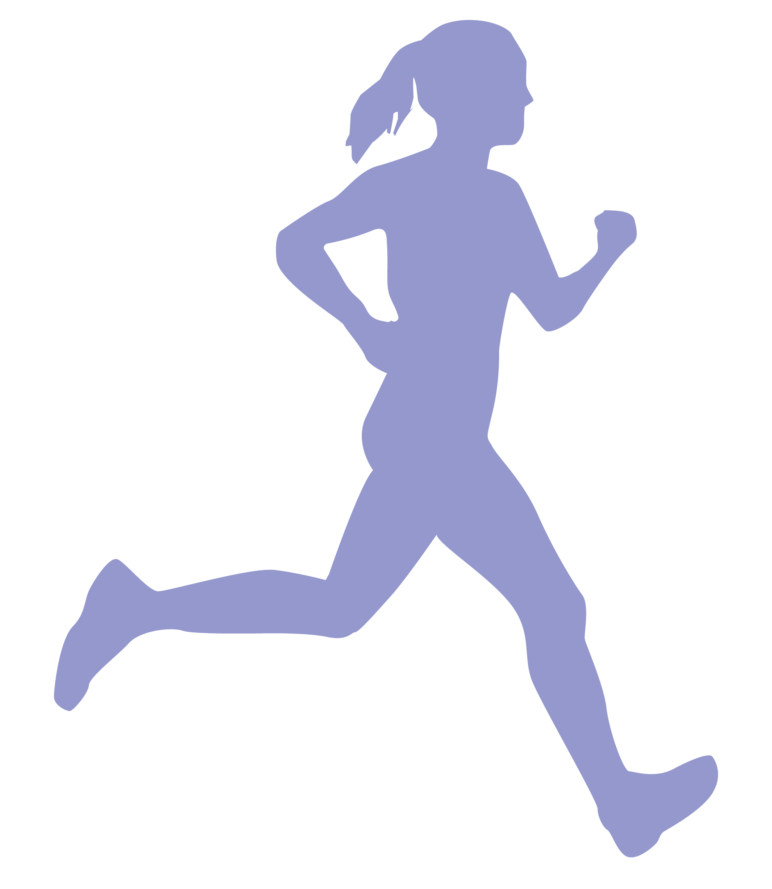
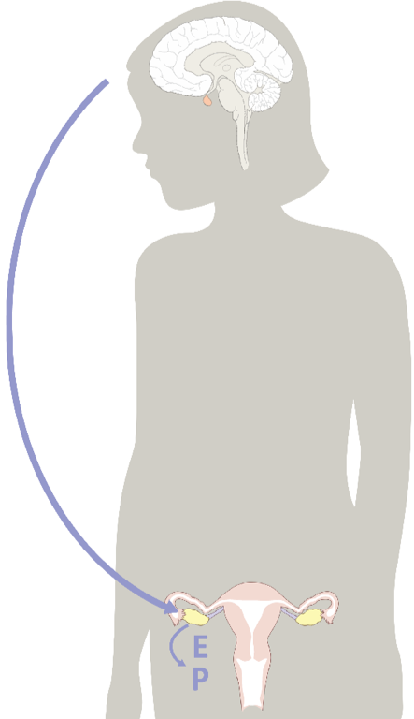
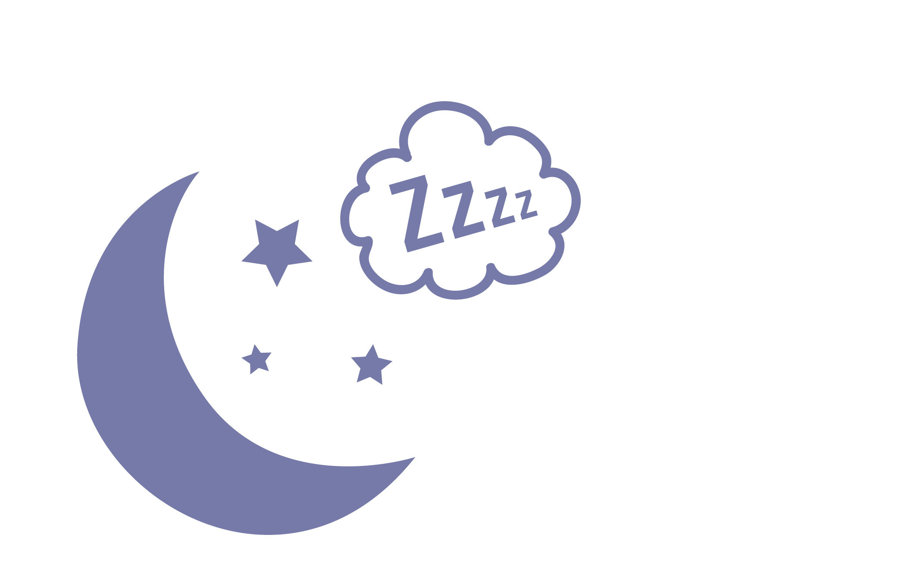
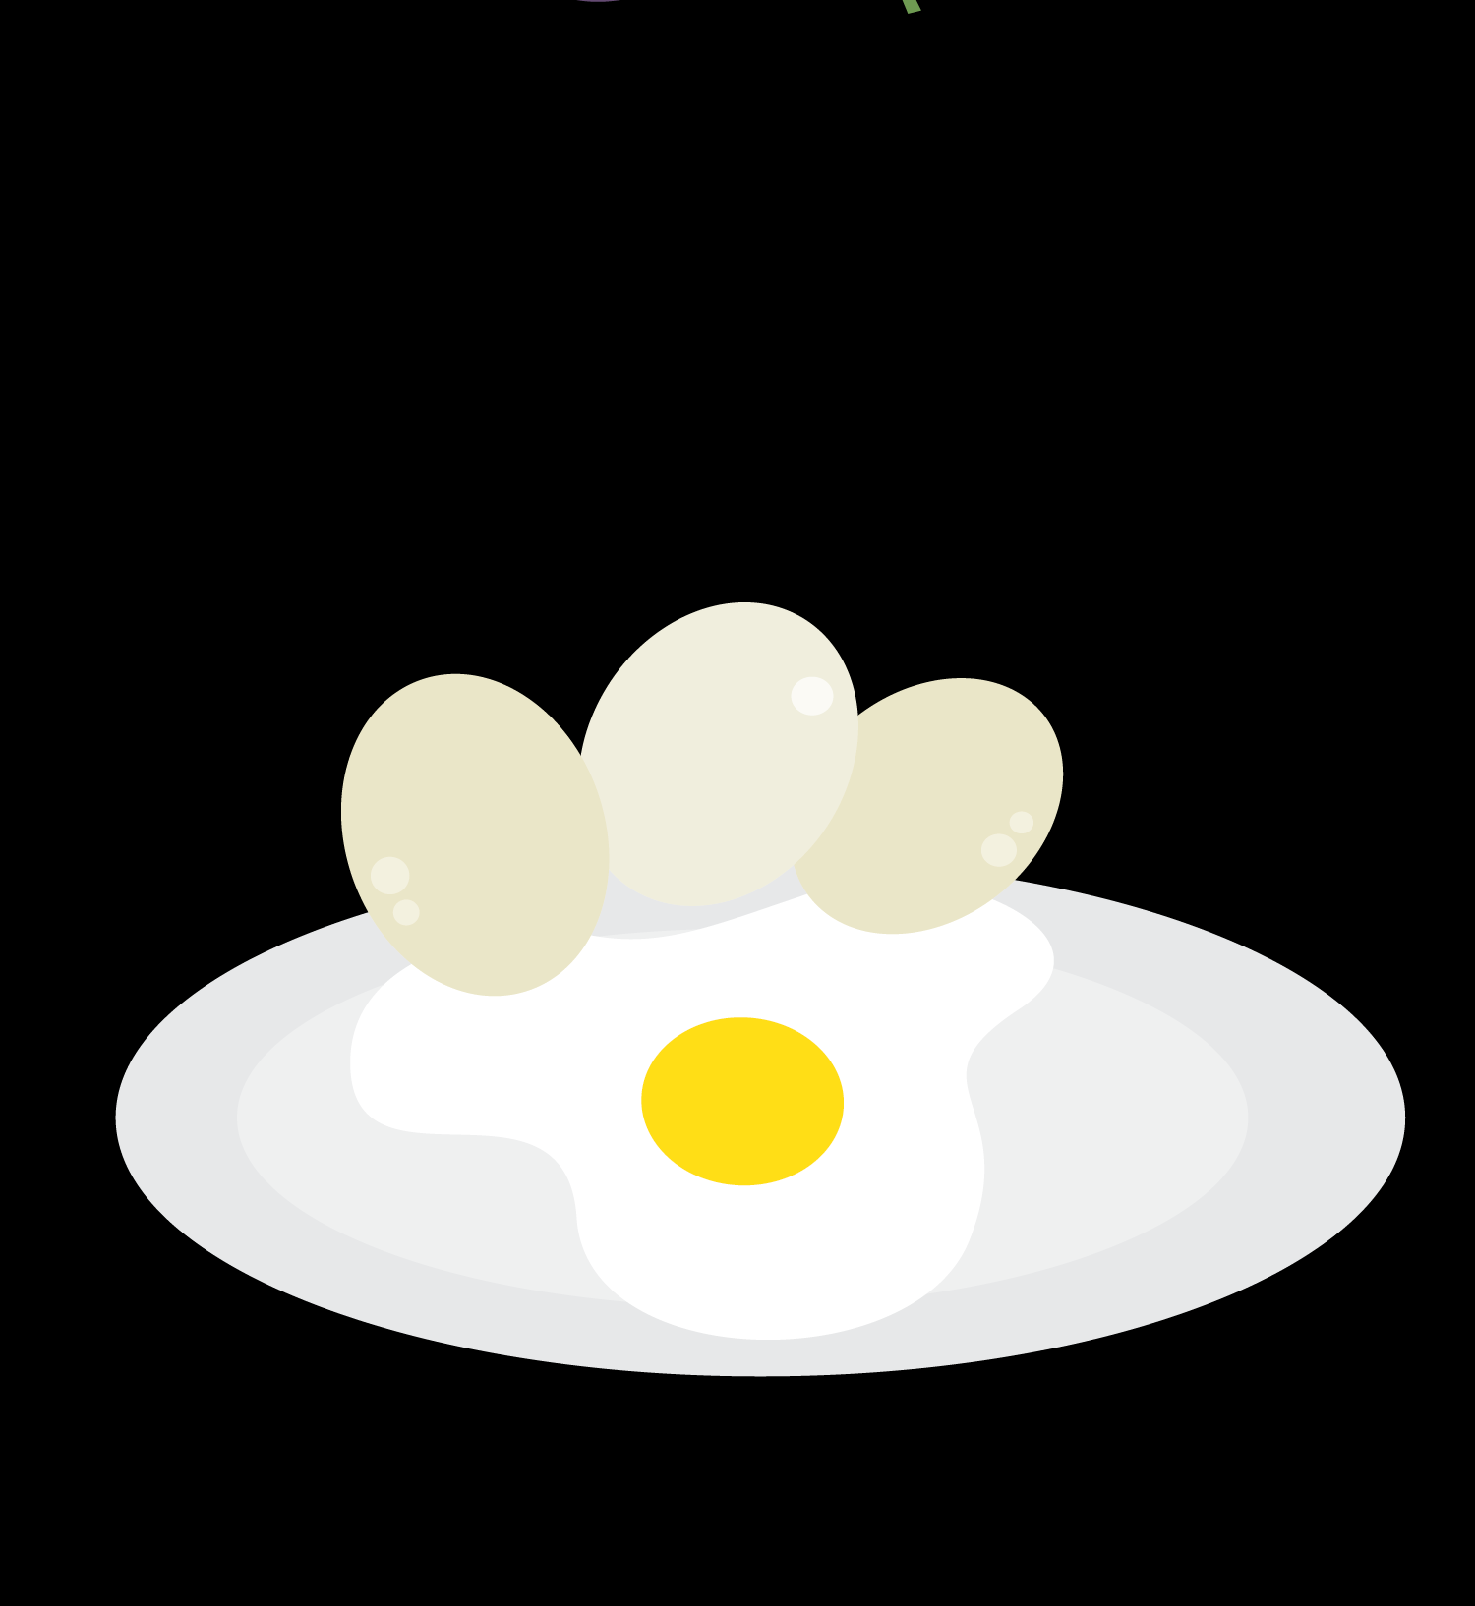



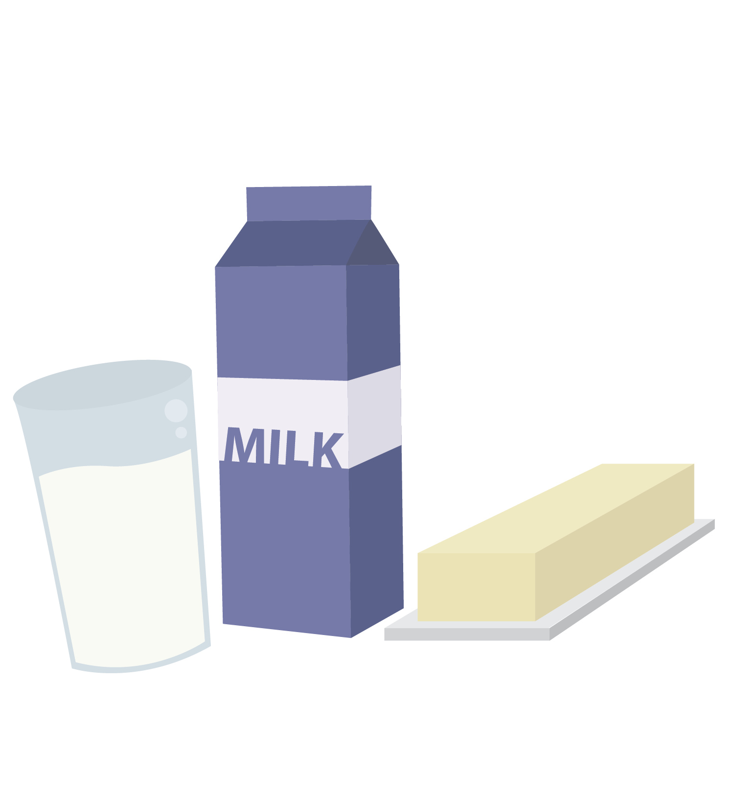
Self-awareness
Stress
Exercise
self-awareness
Technology
Peers
Nutrition
Hormones
Sleep
© FEMM
Notes:
Part of self-awareness is understanding how our hormones, nutrition, exercise, sleep (or lack of) can all contribute to our mood. There are other factors, too, like who you spend your time with and how much time you spend online. All of these things play a big role in your emotional and physical health. Having the self-awareness to check-in with ourselves about how we are feeling or why we are behaving in a certain way, is a sign of maturity in a person.

Slide 5
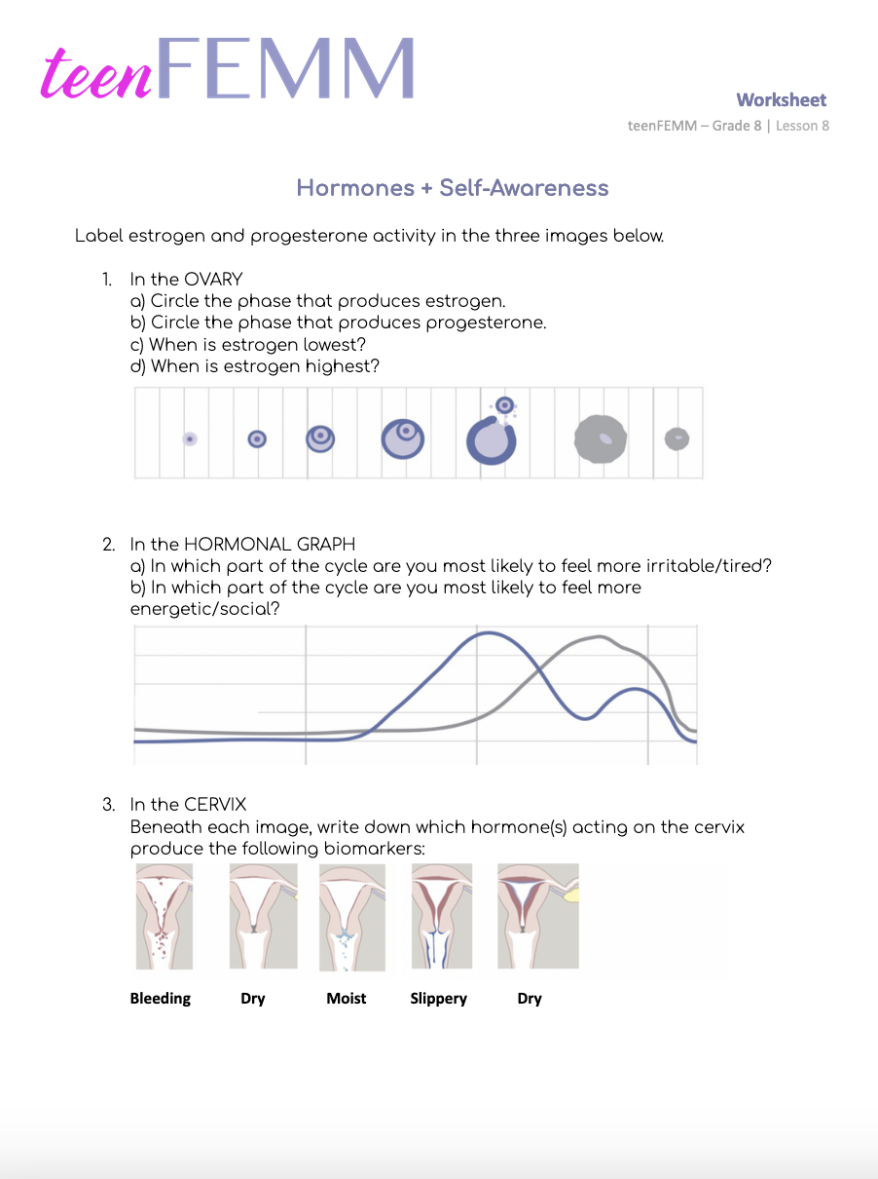
Worksheet
Hormones + Self-Awareness = Charting!
Notes:
Step 2 (5 minutes): Worksheet: Hormones + Self Awareness
Hand out the Worksheet: Hormones + Self Awareness. Give students a couple of minutes to answer the questions. Review the answers together as a class, using the following slide or with the Answer Key provided in the materials.

Slide 6
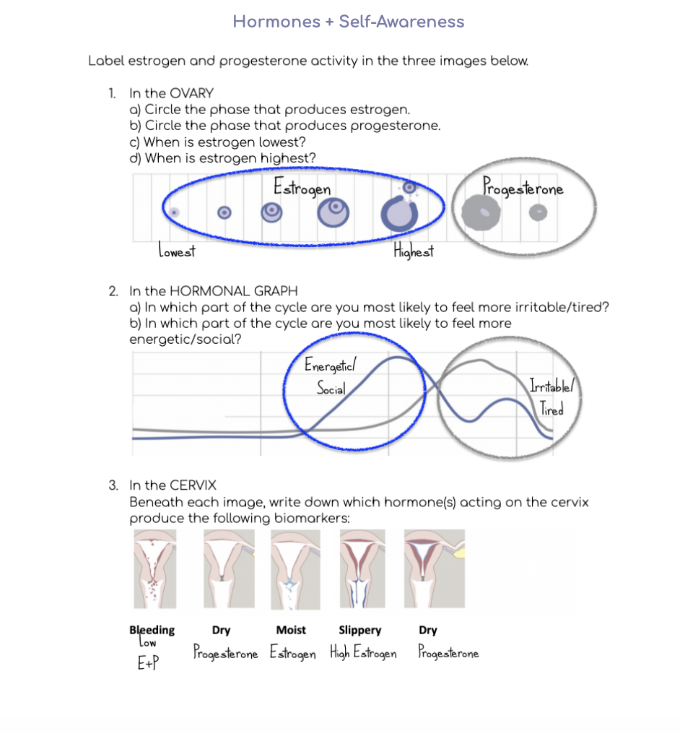
Answers | Hormones + Self-awareness
When estrogen is rising, you may find that you have more energy and feel more social.
At the end of a cycle, when both Estrogen and Progesterone are falling, it can be normal to have slightly less energy or feel more anxious/irritable.
Notes:
Answers
1. In the OVARY
a) The growing egg and follicle produce estrogen. This phase is circled in blue.
b) After ovulation, the now empty follicle, the corpus luteum, produces progesterone. This phase is circled in gray.
c) Estrogen is lowest (after menstruation) before the egg+follicle start to grow.
d) Estrogen is highest around the time of ovulation.
2. In the HORMONAL GRAPH
a) You are most likely to feel more irritable when both estrogen and progesterone are dropping at the end of the cycle. Circled on the slide. It is normal to feel a little bit more emotional and tired since hormones impact every part of your body.
b) You are most likely to feel more energetic and social when estrogen is rising. Circled on the slide.
3). In the CERVIX
During menstruation, hormones are low. Both estrogen and progesterone.
Dry indicates progesterone (low, but still higher than estrogen).
Moist is estrogen.
Slippery is high estrogen.
Dry is progesterone.
Charting is a great habit to build self-awareness. A habit is something you do so often that it becomes natural to you. For example, after charting for multiple months, you may know about yourself that in the middle of the cycle, when estrogen is high, you have a lot of energy and want to make plans. Then, at the end of your cycle, when both estrogen and progesterone are dropping, you may know that you have less energy and are more sensitive emotionally and so you need to get 8-10 hours of sleep to support your emotional health. This won’t be the same for everyone, so charting helps you become self-aware of your unique patterns.
Can you think of something else that impacts your health? Technology.

Slide 7
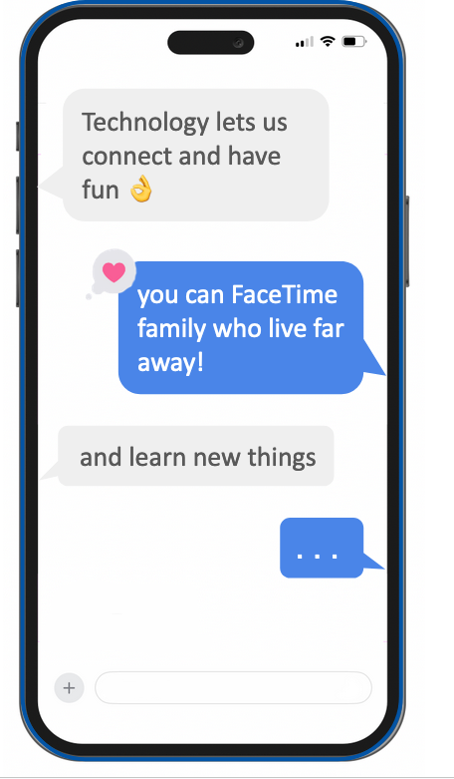
Self-awareness and Technology
Pros ✔️
Cons X
- distraction
- stay up late on phone
- social media/peer pressure
- increases anxiety
- fun
- lets you connect
- learn new things
© FEMM
Notes:
Step 3 (5 minutes): Self awareness and Technology
Technology gives us lots of opportunities to have fun and connect. Technology can help us learn new things about the world around us. These are some of the “pros” when it comes to technology. But technology also has its downside, or “cons”, too. Technology often has the effect of making us disconnect. It can distract us from things we need to do (maybe homework?) and it can negatively impact our relationships if we’re not really giving our full attention to the people in front of us.
There are other health risks when it comes to technology, too.

Slide 8

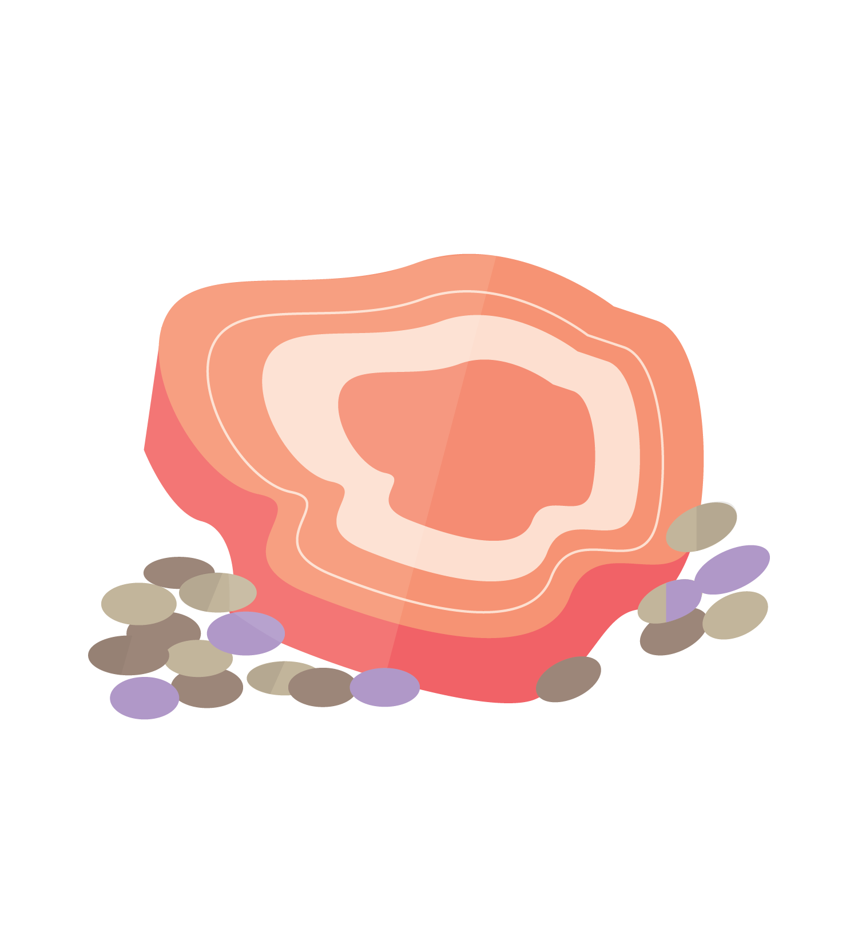
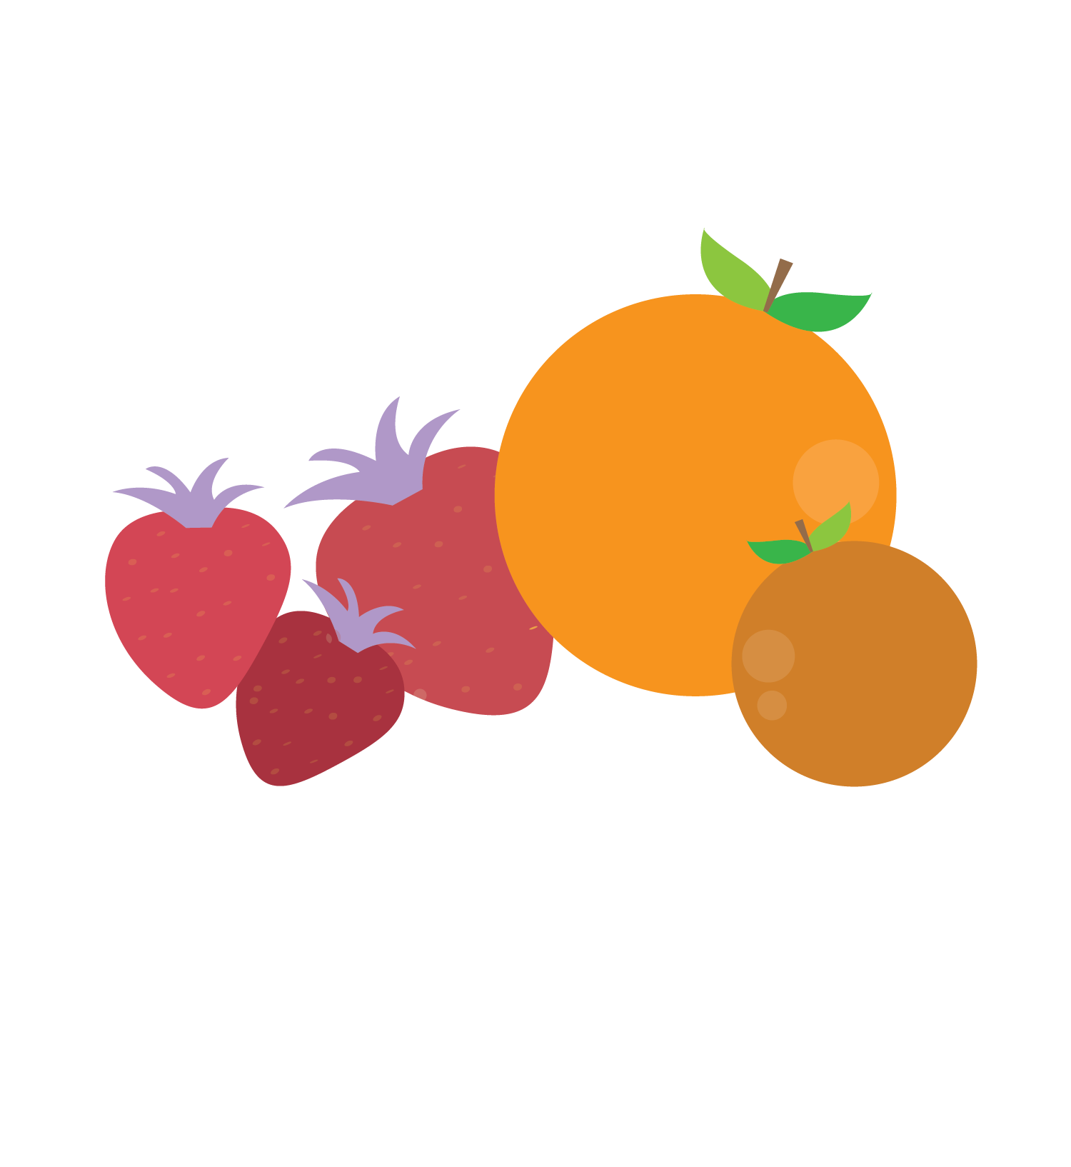
Self-awareness and Technology
Be Aware!
Skipping meals to keep scrolling
Did you know that when you skip a meal, your body sees this as a mini-emergency?
It starts to produce the stress hormone, cortisol.
This causes irritability, emotional changes and fatigue.
!
© FEMM
Notes:
1. Skipping meals to keep scrolling
When you skip a meal, your body sees this as a mini-emergency and produces the stress hormone cortisol. This causes irritability (hangry, anyone?) emotional changes and fatigue. This isn’t good for your brain, mood or body.

Slide 9
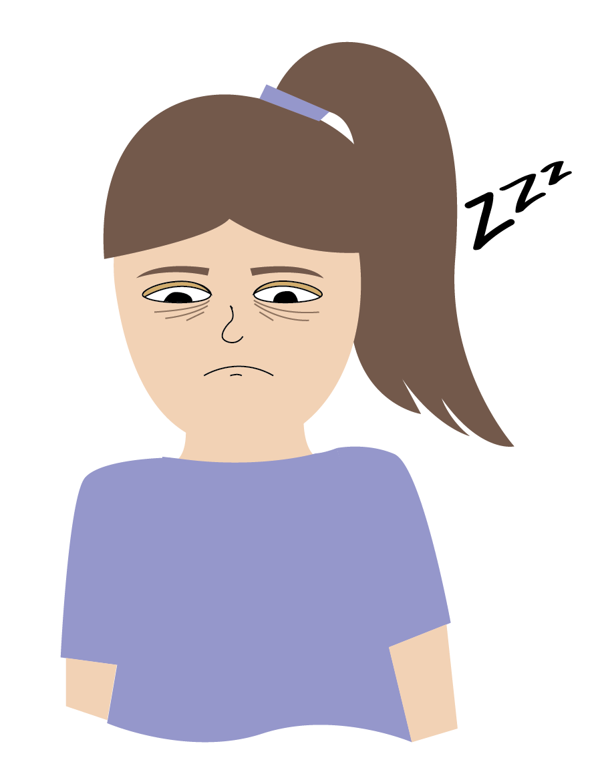
Self-awareness and Technology
Be Aware!
Staying up late on your phone when you should have been asleep three hours ago!
This has very real effects on your body and brain. Lack of sleep affects your ability to pay attention, learn, and remember things.
Not getting enough sleep can also make you feel more anxious, overwhelmed and sad.
!
For best results, turn off screens 1hr before bed.
© FEMM
Notes:
2. Staying up late on your phone when you should have been asleep three hours ago!
Lack of sleep affects your ability to pay attention, learn, and remember things in school. This can have very real effects on your body and brain. It can also make you feel more anxious and overwhelmed.
Turn off auto-scroll in advance, in your settings on TikTok, Instagram, etc.

Slide 10
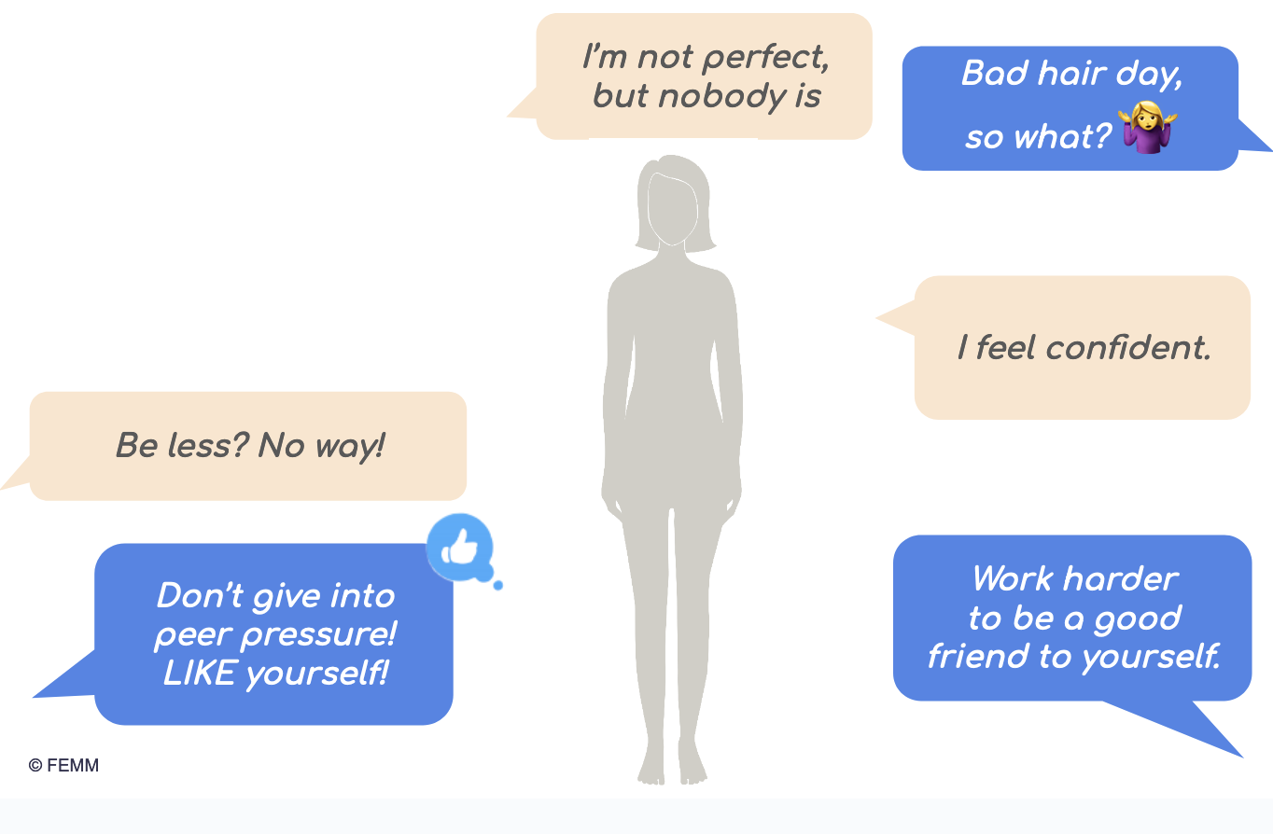
Self-awareness and Technology
Be Aware!
Spending time on Instagram, Tik Tok, etc. can make you feel like your body doesn’t measure up.
Have you ever felt this before? Did you know that 1 out of 3 girls feel worse about their bodies after time online? Fight back!
Leave the screen and make things, do things, play sports, enjoy quality time with people who love you.
You are valuable, just as you are.
!
© FEMM
Notes:
3. Screen time impacts your body image
Spending time on a screen, whether it’s Instagram, Tik Tok or watching shows, impacts your body image. Body image is how an individual person sees their own body and the feelings that go along with this perception, both positive and negative. Did you know that 1 out of 3 girls feels worse about themselves after time online? Spend time offline: make things, play sports, enjoy music, get out in nature and be with people who love you. You are valuable just as you are.

Slide 11
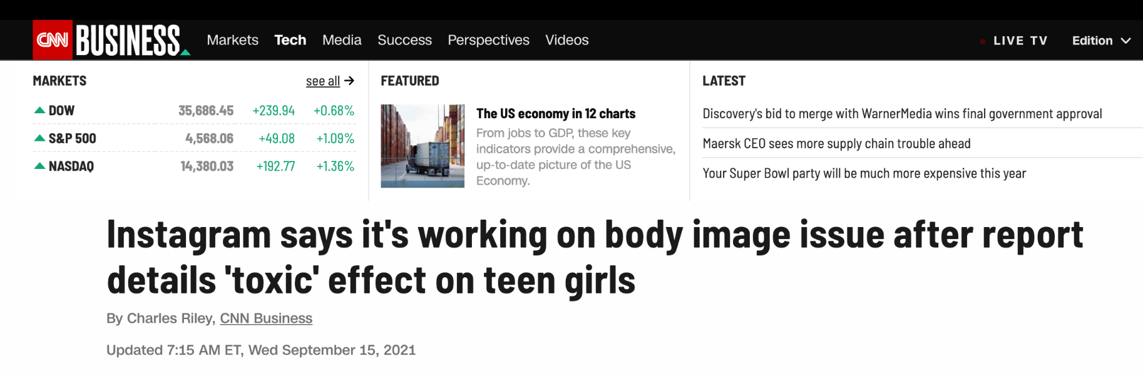
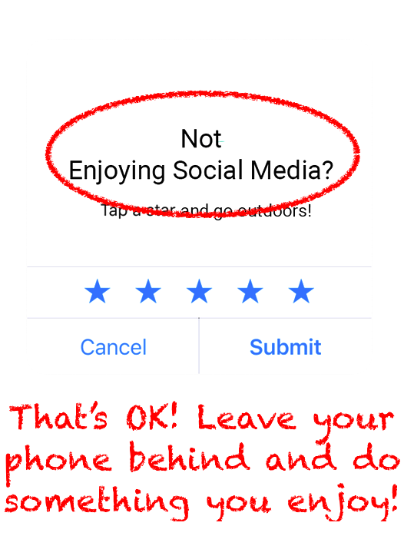
Time online can be toxic for body image
© FEMM
Notes:
This is a very normal time in your life to be thinking more about your body as it grows and changes. But, each person grows at her own pace, depending on genetics and healthy choices. What does body image have to do with mood and your health? Stress.

Slide 12
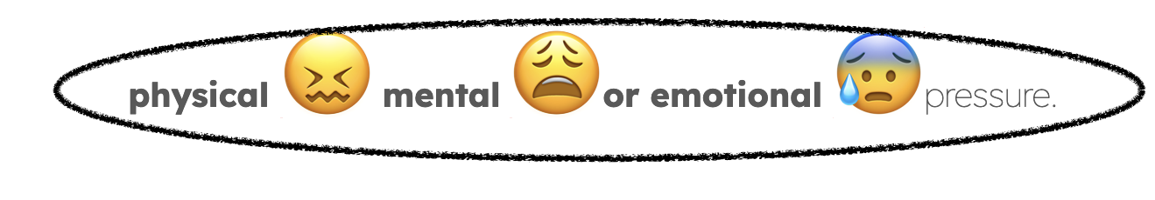
VOCABULARY
Self-awareness and Stress
stress
Noun
The body’s response to
© FEMM
Notes:
Step 4 (10): Stress: Internal and External; Positive and Negative Responses
Stress is the body’s response to physical, mental or emotional pressure. As a teenager, stress can be as a result of grades, sports, siblings, peers, etc. As adults, stress might be about finances, a job, taking care of family things, etc. Stress is something that happens to everyone at all stages of life.
Also, not all stress is bad! If there’s a test coming up and we feel stressed about it, that can spur us to study for the test. However, if we get too overwhelmed by our stress, we can put off studying for the test until the night before, which ends up negatively impacting our sleep and performance on the test the next day. This, in turn, tells our brain to stress out about tests even more!! In this scenario, we make the stress worse with avoidance. So, what do we do when we are feeling stressed?
The first thing is to identify the stress. Let’s look at two kinds of stress.

Slide 13
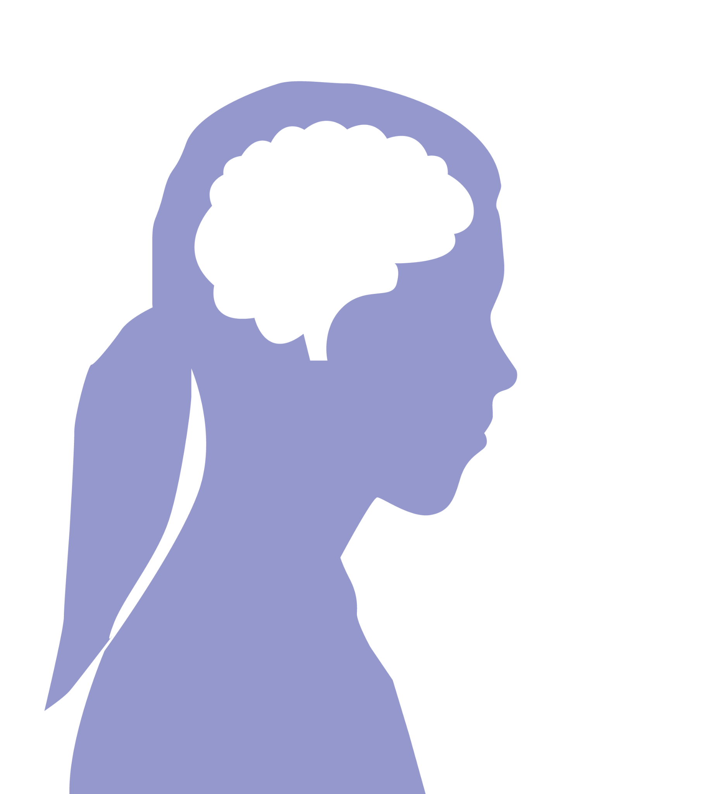

Self-awareness and Stress
There are two kinds of Stress.
I’m a failure. Because I’m not good at this I’ll never be good
at ANYTHING !
INTERNAL STRESSORS
Thoughts or behaviors that create stress.
When our mindset or expectation is “all or nothing,” this can cause us stress.
© FEMM
Notes:
1. Internal stressors are thoughts or behaviors that create stress. For example, when our mindset or expectation is “all or nothing,” this can cause us stress. If we think we either have to be perfect at public speaking or else we’re a failure at public speaking, we are going to feel stressed when the teacher announces that everyone in the class has to give a presentation.

Slide 14
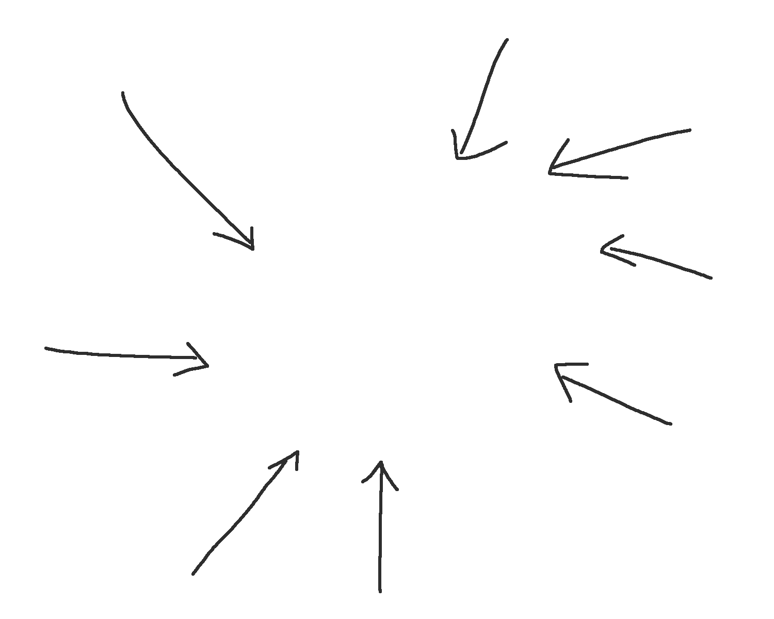
Self-awareness and Stress
There are two kinds of Stress.
2.
EXTERNAL STRESSORS
Stress that comes from external factors you can’t control.
When major life events happen,
like the death of a grandparent
or a parent loses their job,
this can cause us stress.
© FEMM
Notes:
2. External stressors: stress that comes from external factors you can’t control.
This could be the death of a grandparent or a parent losing their job. These kinds of stressors come from outside of ourselves. We can’t control the external stressor; but we CAN choose how we respond to it.
There are negative and positive ways to respond to stress.

Slide 15

Self-awareness and Stress
NEGATIVE ➖
Self-Talk
POSITIVE ✔️
I failed and embarrassed myself.
I’m proud of myself. It takes courage to try to be excellent!
I’m overweight and out of shape. I might as well not bother.
I am capable and strong and I want to get healthier for me.
I’ve never done this before and I’m sure I’ll be bad at it.
I’ve never done this before so this is an opportunity to develop myself.
© FEMM
Notes:
Negative self-talk and self-criticism can come easily when we’re down. However, it doesn’t actually help. Talk to yourself like you would talk to a friend. If a friend ran for student council and lost, you wouldn’t think or say to them: “You shouldn’t even have tried.” You’d say, “I heard it was really close! You should try again next year as you’d be so good at it!” Why don’t we talk that way to ourselves?

Slide 16
Self-awareness and Stress
NEGATIVE responses to Stress seek temporary distraction
EXAMPLES
Criticizing yourself (negative self-talk)
Becoming aggressive or even violent (yelling at someone, throwing or kicking something)
Eating too much or too little
Smoking
Drinking alcohol
Avoiding the family members or friends who actually
want what’s best for you
© FEMM
© FEMM
Notes:
Negative coping responses to stress seek temporary distraction but actually make the stress and the situation worse. For example, both alcohol and smoking increase stress hormones in the body. So if you think they take the edge off - think again as, in reality, once the drugs wear off, your stress levels will be even higher than they were before. If you are going through a stressful time, talk to a trusted family member or adult in your life.

Slide 17
Self-awareness and Stress
POSITIVE responses to Stress build long-term resiliency
EXAMPLES
Getting enough sleep
Eating healthy foods
Exercising or getting outdoors to enjoy nature
Spending time with family members and friends who want
what’s best for you
Singing, playing music or dancing
Playing with a pet
Making and following through with an action plan
This mood will pass.
What I can control
is how I respond.
Notes:
Positive coping responses to stress build long-term resiliency. The situation may be difficult, but by practicing healthy ways of dealing with stress, you are actually teaching your brain and your body how to stay calm despite the storm; practicing habits of resiliency will support your mental and physical health for your whole life. Positive ways to deal with stress include finding an outlet like making things, art, listening to music, going outdoors or exercising, talking to family and friends who want what’s best for you. All of these activities produce endorphins in the brain, which are mood-lifting and stress-reducing hormones.

Slide 18
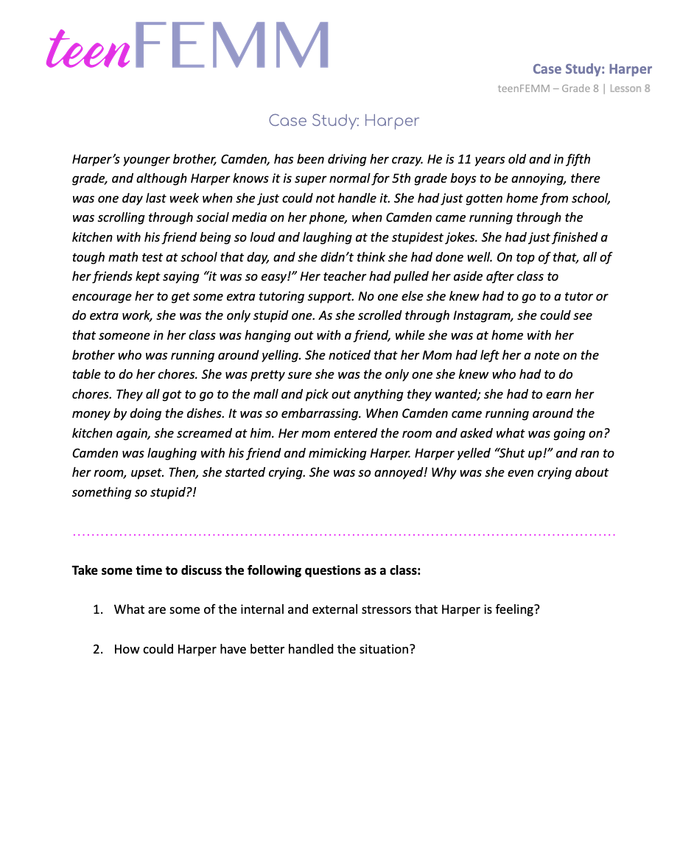
Case Study
Notes:
Step 5 (5 minutes): Case Study: Harper
Let’s read about a situation that happened this week with Harper. Read the Case Study aloud to the class and then discuss the following two questions:
What are some of the external and internal stressors that Harper was feeling?
Possible answers:
External stressor: She had a tough math test at school that day… all of her friends thought it was easy… the teacher told her she should consider getting some extra tutoring support… Camden started running through the kitchen with his friend being so loud and telling the stupidest jokes! These are all examples of external stressors that Harper is experiencing.
Internal stressor: ...no one else she knew seemed to have to go to a tutor or do extra work. She was the only stupid one… Nobody else had to do chores…
These are all examples of Harper’s internal stressors: her thoughts and behaviors that are causing stress. These thoughts are untrue (other people do have to do chores… everyone needs help with something… it’s mature to accept support and do extra work to get good grades). Additionally, as she continues to compare her life to an idealized representation of the lives of others on social media, she feeds her internal stressors which causes her to feel worse about her life.
How could Harper have better handled the situation?
Possible answers:
Harper could have recognized her brother was being extra silly with a friend over and therefore chosen to leave them alone. She could have talked to her Mom. Even talking through her emotions and thoughts would have made her feel better and calmed her down after a stressful day. She could have gone for a walk or done an activity that was mood-lifting and stress-reducing.

Slide 19
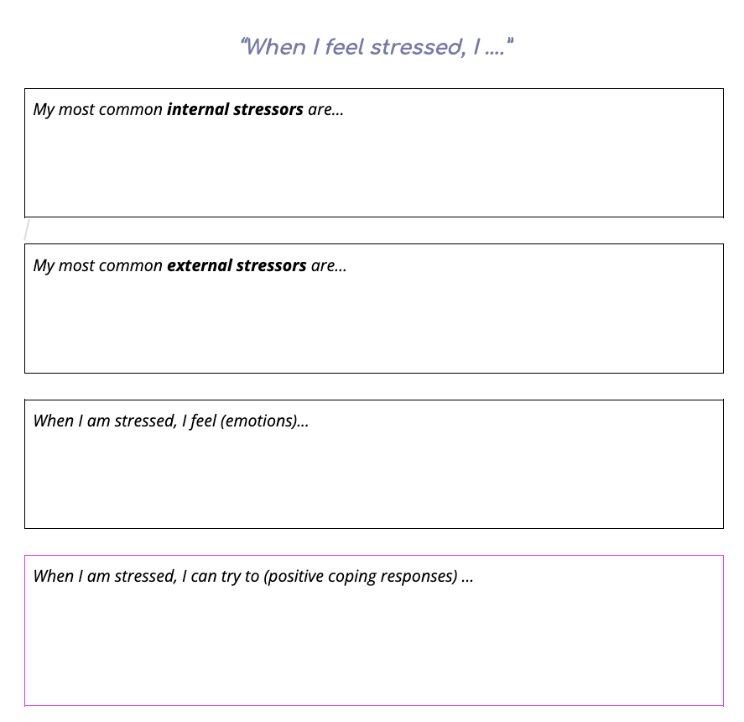
Worksheet
Notes:
Hand out the Worksheet: When I Feel Stressed. Give students a few minutes to reflect and write down their responses. Ask students if they’d like to share any responses.

Slide 20

Conclusion
Keep charting!
Remember that nutrition, exercise, and sleep, have a big impact on your mood and health!
Healthy Choices help beat stress
🙂 🫀 🧠
Nutrition
Exercise
Sleep
Notes:
If you are charting your cycle, making good choices when it comes to nutrition, exercise, and sleep, then you will grow and develop at the pace that is right for you! If you have questions or want to talk about your experience, ask a trusted parent or family member in your life about their experiences instead of comparing yourself to what you see online.
Course Summary
The boys in your grade have completed their grade 8 teenMEN course as you have been working through this course. Although their changes are different from yours, hormones are also playing a major role in the boys’ body and brain development during puberty. It is important to remember that everyone goes through puberty. It’s helpful to have a little bit more understanding for each other as you navigate these changes.
This brings us to the end of our teenFEMM grade 8 course. I hope that you have learned some new things about your cycle and your health, and are feeling more confident about yourself as you go through this amazing stage of growth in your lives. It is a great idea to keep charting- on paper or in the free FEMM App online if your parents are ok with it - so that you have a unique health record for yourself as you become the woman you are meant to be. Remember the impacts of sleep, nutrition, and exercise on your developing mind and body, and that your ovulatory cycle is an important window into your own health and strength as a young woman! As you become more aware of these hormonal changes and how they impact how you think and feel, you will be better equipped to face all of the exciting new adventures life has in store for you.

Slide 21
Grade 8
LESSON 8
© FEMM

