Slide 1

Grade 8
LESSON 8
© FEMM

Slide 2
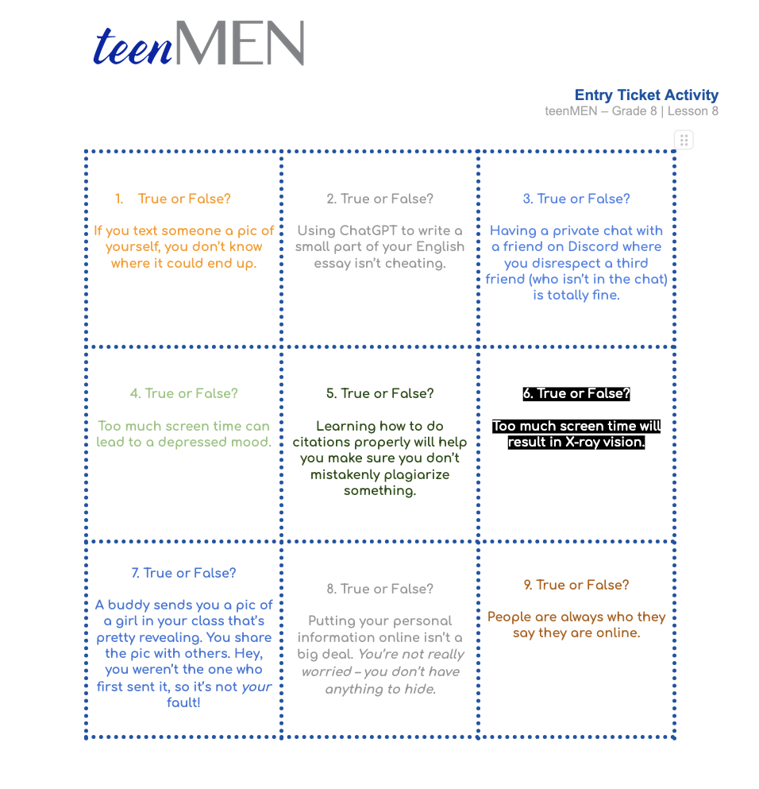

Entry Ticket Activity
!
Entry Ticket Activity
True or False
© FEMM
Notes:
Step 1 (5 minutes): Entry Ticket Activity: True or False Cards
Have students read their questions aloud and answer whether the statement is True or False. Review answers together, using the Answer Key provided in the materials.

Slide 3
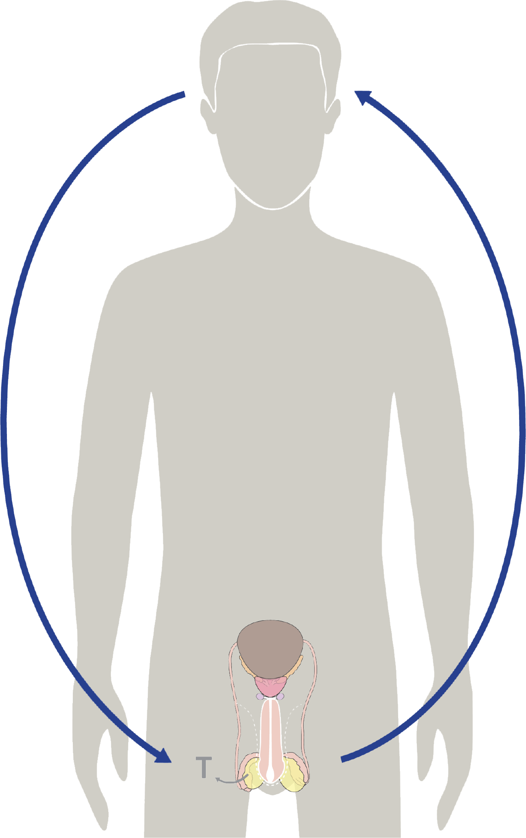
The Brain & Health Habits
Hormones cause all the growing & changing that your body does during puberty.
Testosterone is the main male hormone. After testosterone is produced, it acts as a messenger back to your brain.
This is why things that affect your brain affect your physical & emotional health!
© FEMM
Notes:
Step 2 (5 minutes): Stress & Hormones
Do you remember what controls the activity of every system in the body?
Yes, hormones! Hormones are directed by your brain and, as we have learned, hormones send feedback to the brain to make it want to act in certain ways.

Slide 4

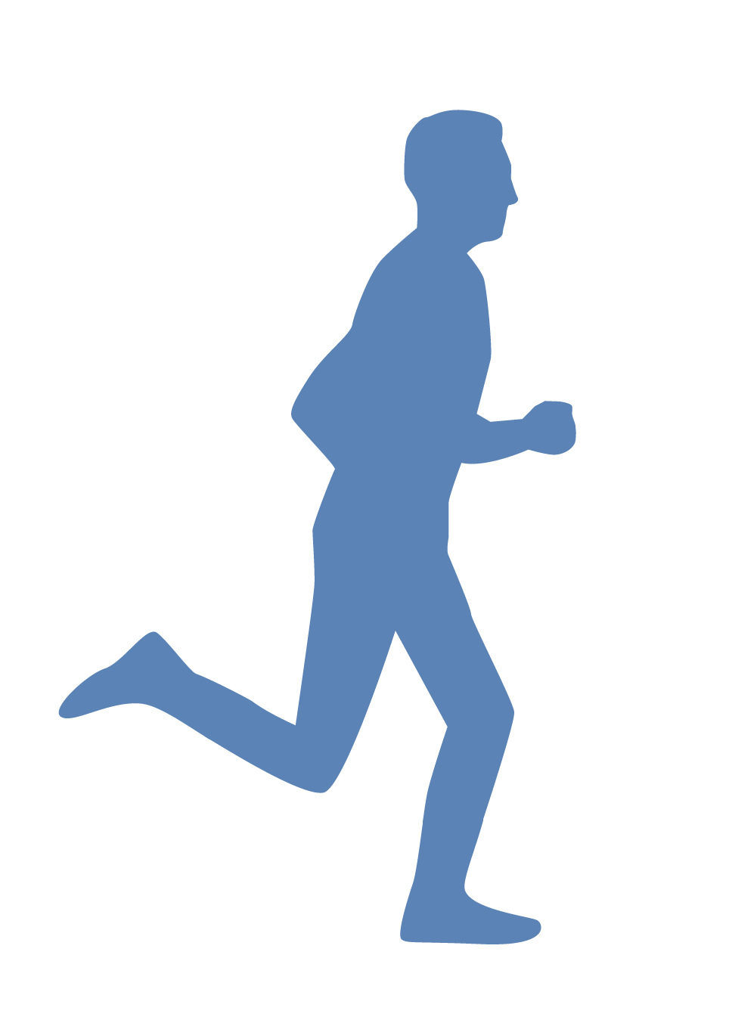
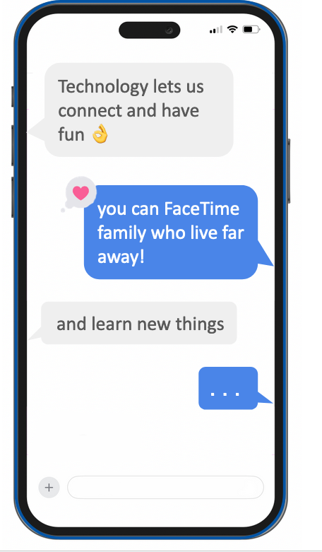


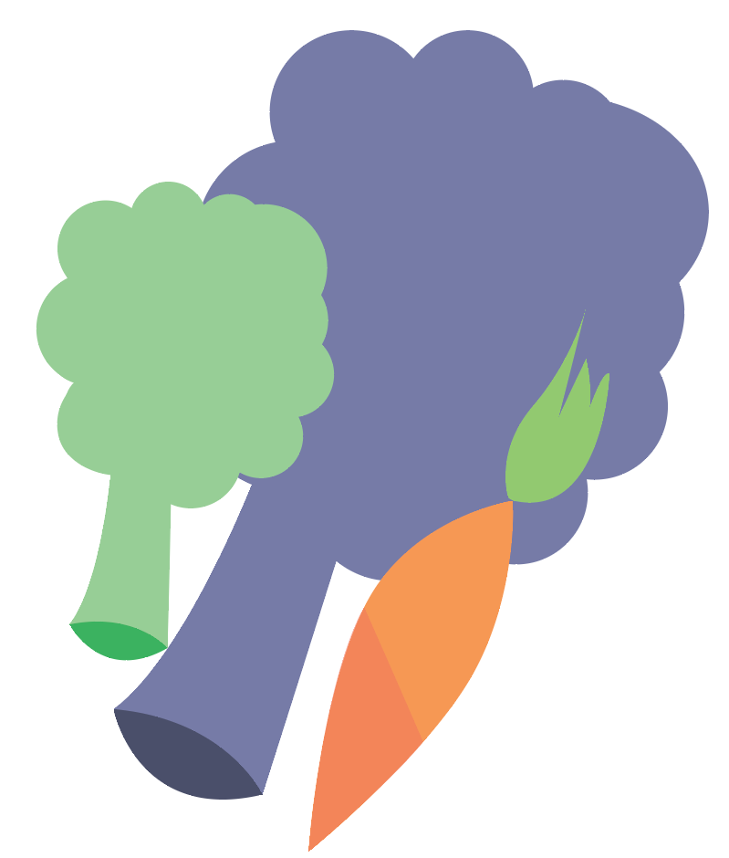
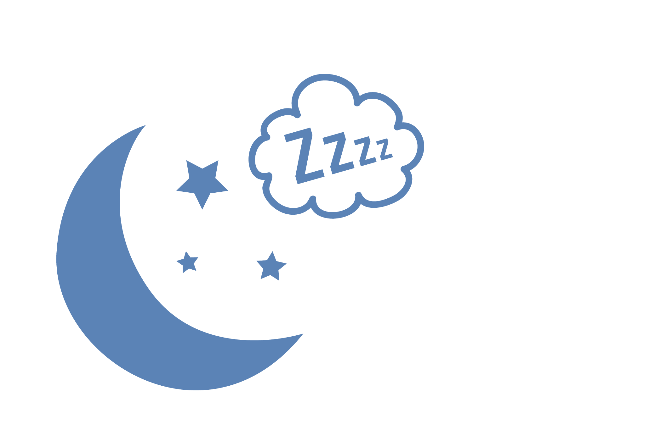

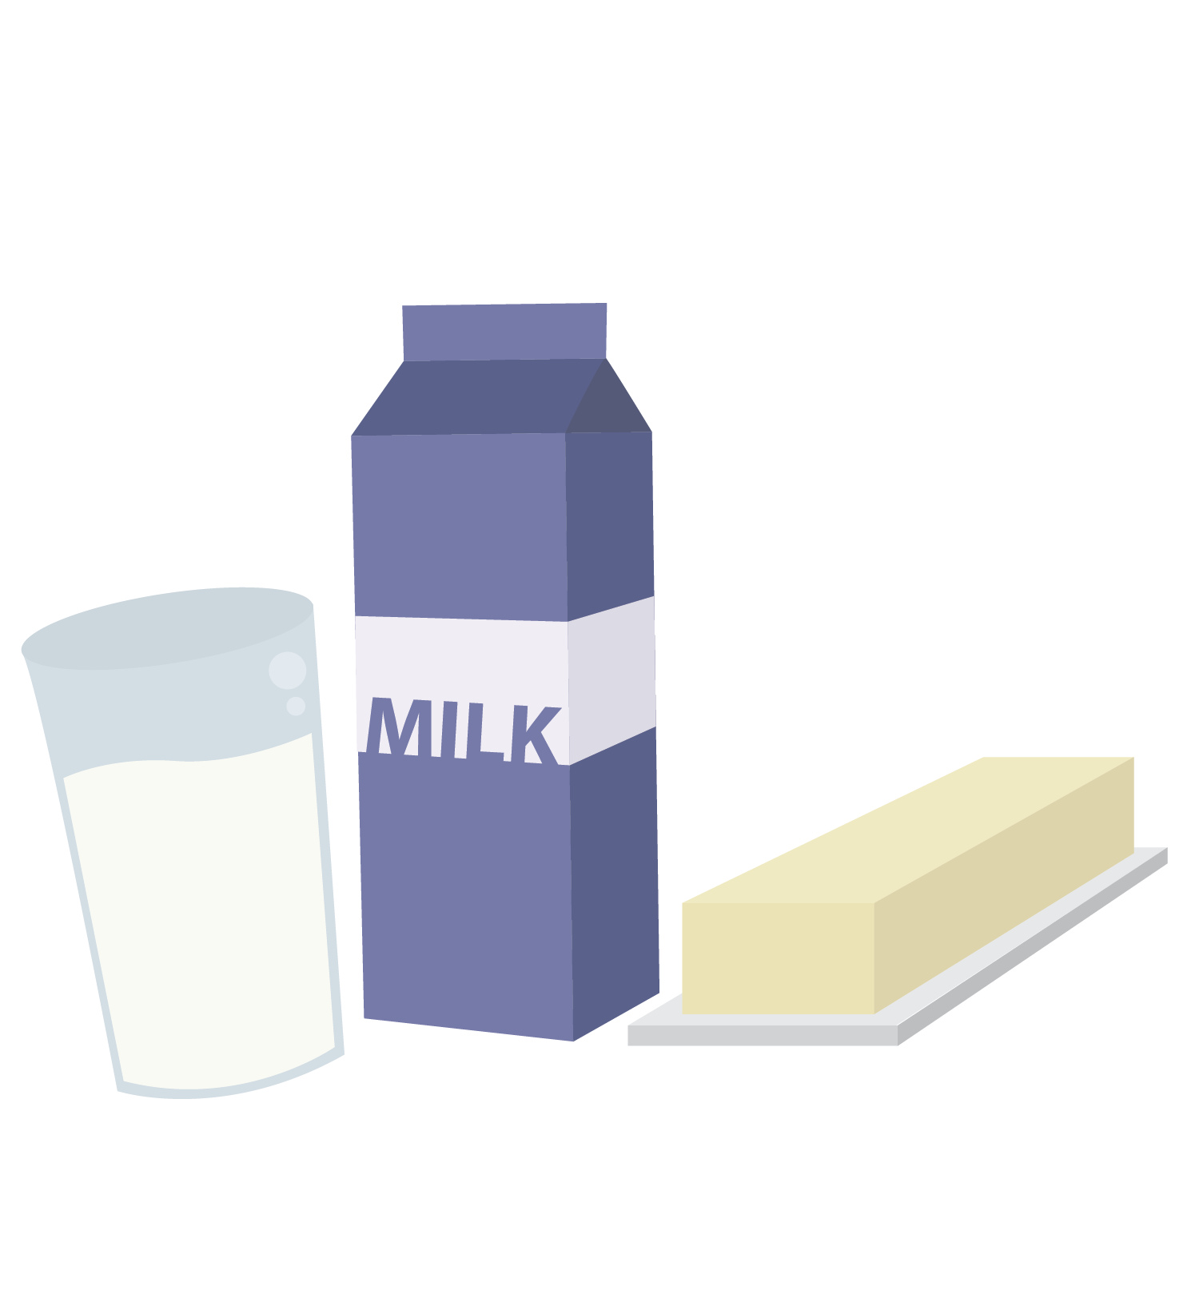
Self-awareness | things that affect your hormones
Stress
Exercise
self-awareness
Time Online
Peers
Nutrition
Hormones
Sleep
Notes:
Hormones are affected by what you eat, how much sleep you get, whether you exercise, etc. In the previous class, we learned that self-awareness means recognizing how all of these things: nutrition, exercise, sleep (and lack of), peers and time online all play a big role in our emotional and physical health. The other thing that impacts hormones? Click on the slide to circle the answer. Stress.

Slide 5
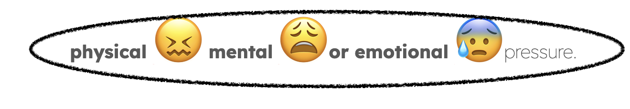
VOCABULARY
Self-Awareness and Stress
stress | stres |
Noun
The body’s response to
© FEMM
Notes:
It’s important to know that stress is something that happens to everyone and at all stages of life. Also, not all stress is bad! If there’s a test coming up and we feel stressed about it, that can motivate us to study for the test. However, if we get too overwhelmed by our stress, we might put off studying for the test and then stay up way too late studying only the night before, which negatively impacts our sleep and performance on the test the next day. In this scenario, we made our stress worse, with avoidance. So, it’s not necessarily stress that is the problem: it’s what we do when we are feeling stressed.

Slide 6
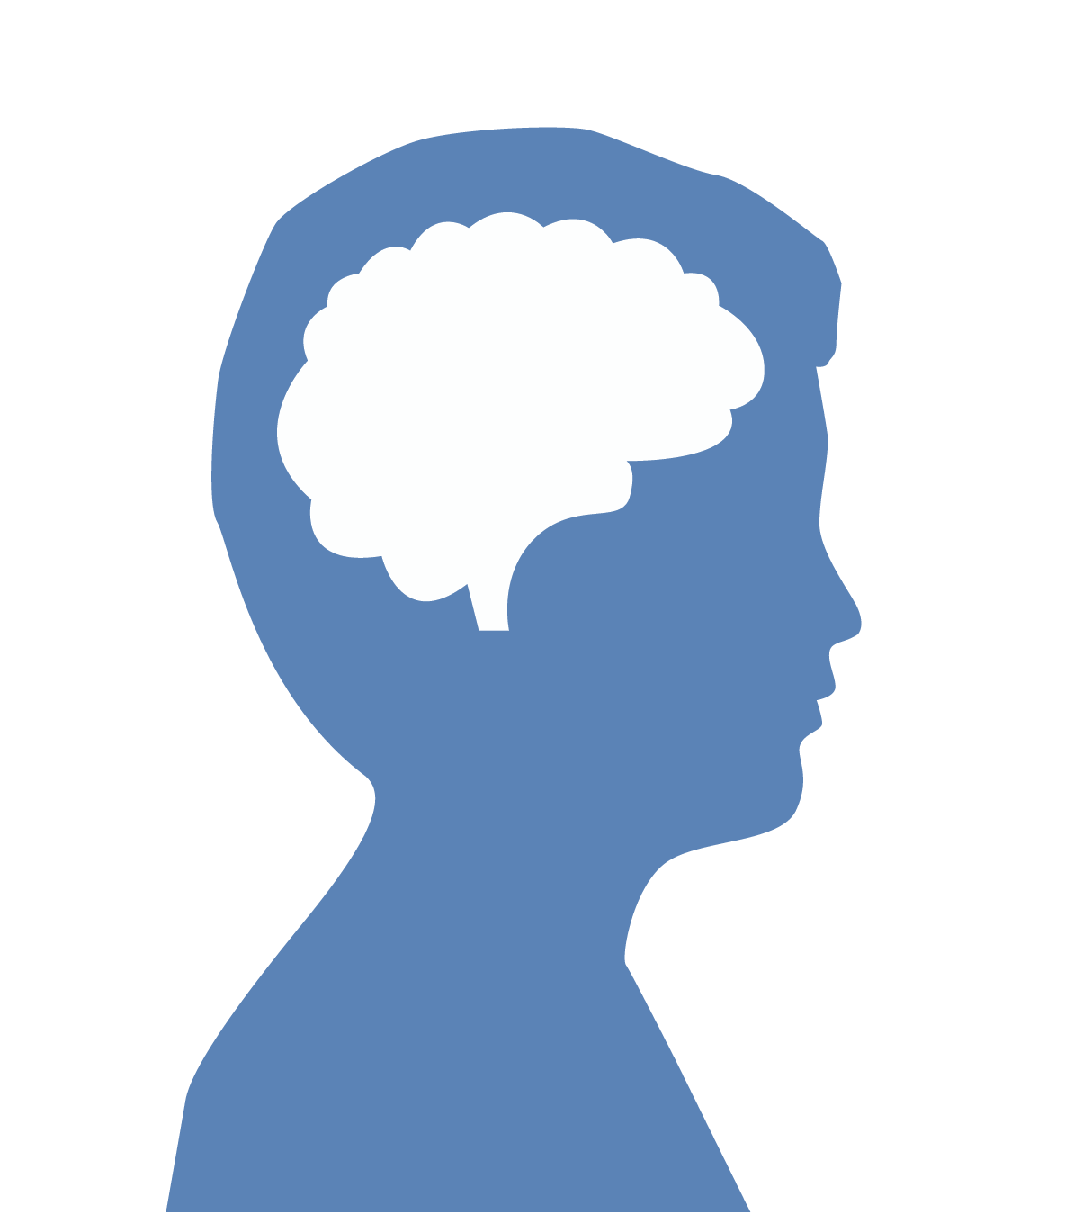

Self-awareness and Stress
Self-Awareness and Stress
There are two kinds of Stress.
I’m a failure. Because I’m not good at this I’ll never be good
at ANYTHING !
INTERNAL STRESSORS
Thoughts or behaviors that create stress.
When our mindset or expectation is “all or nothing,” this can cause us stress.
© FEMM
Notes:
Step 3 (5 minutes): Internal and External Stressors
How can we manage stress? The first thing to do is recognize the type of stress.
Internal stressors are thoughts or behaviors that create stress. For example, when our mindset or expectation is “all or nothing,” this can cause us stress. If we think we either have to be perfect at public speaking or else we’re a failure at public speaking, we are going to feel stressed when the teacher announces theveryone in the class has to give a presentation.

Slide 7
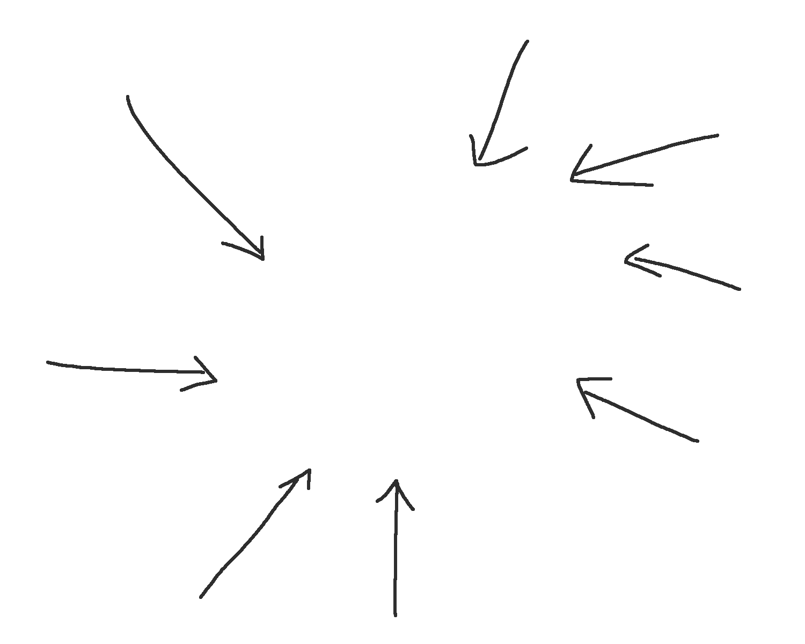
Self-awareness and Stress
Self-Awareness and Stress
There are two kinds of Stress.
2.
EXTERNAL STRESSORS
Stress that comes from external factors you can’t control.
When major life events happen,
like the death of a grandparent
or a parent loses their job,
this can cause us stress.
© FEMM
Notes:
External stressors are stressors that we have little or no control over. These can include major life events, like the death of a grandparent or a parent losing their job. These kinds of stressors come from outside of ourselves, which is why they are called external. We can’t control external stressors; but we CAN choose how we respond.

Slide 8
Self-awareness and Stress
Self-awareness and Stress
Self-Awareness and Stress
NEGATIVE responses to Stress avoid challenges and seek distraction
EXAMPLES
Criticizing yourself (negative self-talk)
Becoming aggressive or violent (yelling at someone or throwing something)
Eating too much or too little
Smoking
Drinking alcohol
Avoiding the family members or friends who actually
want what’s best for you
© FEMM
© FEMM
Notes:
Step 4 (10 minutes): Negative and Positive Ways of Dealing with Stress + Worksheet
There are negative and positive ways to respond to stress.
Negative coping responses to stress seek temporary distraction but actually make the stress and the situation worse. For example, both alcohol and smoking increase stress hormones in the body. So if you think they take the edge off - think again as, in reality, once the drugs wear off, your stress levels will be even higher than they were before. If you are going through a stressful time, talk to a trusted family member or adult.

Slide 9
Self-awareness and Stress
Self-awareness and Stress
Self-Awareness and Stress
NEGATIVE ➖
Self-Talk
POSITIVE ✔️
I failed and embarrassed myself.
I’m proud of myself. It takes courage to try to be excellent and I am trying.
I’m a failure so I will just pretend I don’t care.
I am capable of changing my habits and I want to get healthier for me.
I’ve never done this before so I don’t want to try and fail.
I’ve never done this before so this is an opportunity to challenge myself.
© FEMM
Notes:
Negative self-talk can come easily when we’re feeling down. However, it doesn’t actually help. If a friend tried out for a team and didn’t make it, you wouldn’t say to them: “It just shows that you shouldn’t have even tried.” You’d say, “Yeah, but I heard the tryouts were really hard this year! I’ll practice with you and then you should try out next year.” Try to practice talking to yourself like you would talk to a friend.

Slide 10

Self-awareness and Stress
Self-awareness and Stress
Self-Awareness and Stress
POSITIVE responses to Stress build long-term resiliency
EXAMPLES
Exercising or getting outdoors to enjoy nature
Getting enough sleep
Eating healthy foods
Spending time with family members and friends who want
what’s best for you
Playing music
Volunteering
Making and following through with an action plan
{
This mood will pass.
What I can control
is how I respond.
Notes:
Positive coping responses to stress build long-term resiliency.
The situation may be difficult, but by practicing healthy ways of dealing with stress, you are actually teaching your brain and your body how to stay calm despite the storm; practicing habits of resiliency will support your mental and physical health for your whole life. The top three positive ways to deal with stress are the three pillars of health! Exercise, nutrition and adequate sleep. Exercising, eating regularly and getting 8-10 hours of sleep helps keep our body more resilient to stress. Also, listening to or playing music, making something (art, learning a hobby) and being in nature are all activities that produce endorphins in the brain, which are mood-lifting and stress-reducing hormones.
We CAN help our body deal with stress.
Look out for that negative self-talk and try to replace it with more positive statements. This helps us work on our mindset and those internal stressors.
Make an action plan/to-do list. Whether it’s chores at home or a big assignment coming up at school, break the project down into small steps. Write each step down on a piece of paper. Do one thing and then cross it off your list. This will calm your brain and give you the confidence that you can do it, one step at a time.
Remember: NOBODY gets there alone. EVERYBODY needs support, encouragement and help. Talk to a trusted family member about what you’re thinking or feeling. Stress is a normal part of life. We are all going to have times in our lives where we are very stressed. It’s important to remember when we are going through a difficult time that it won’t last forever.

Slide 11
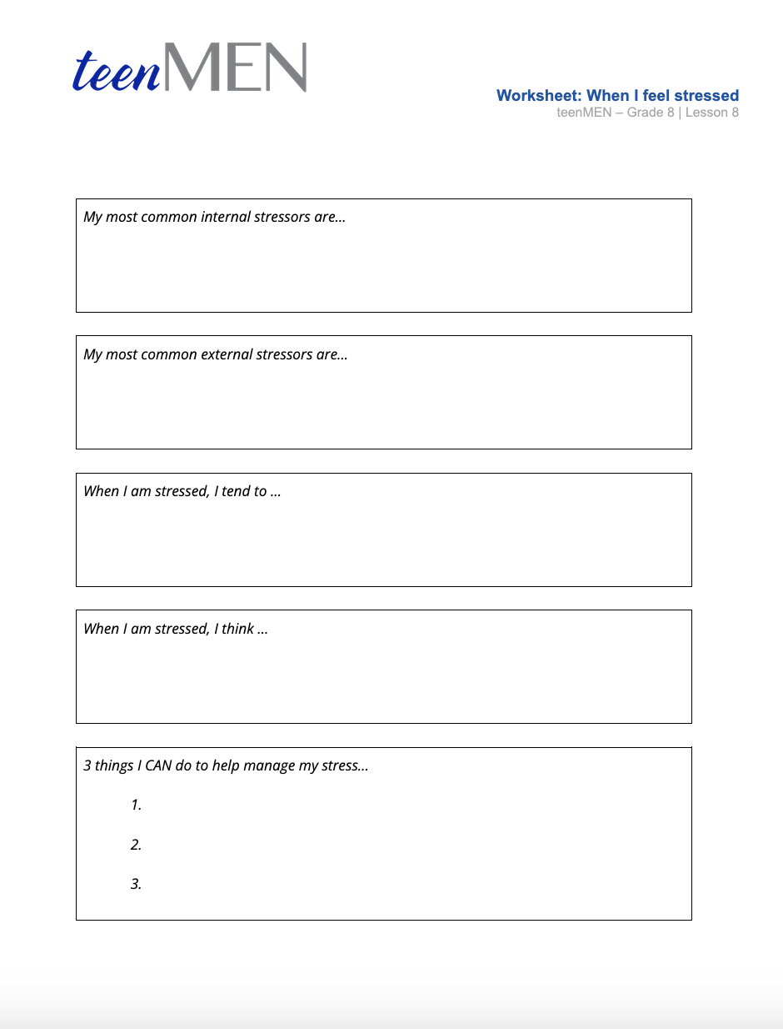
Worksheet
Self-awareness and Stress
Self-awareness and Stress
Worksheet
This mood will pass.
What I can control
is how I respond.
Notes:
Hand out the Worksheet: When I Feel Stressed to each student. Give students time to write down their responses and then ask students if they’d like to share their responses.

Slide 12
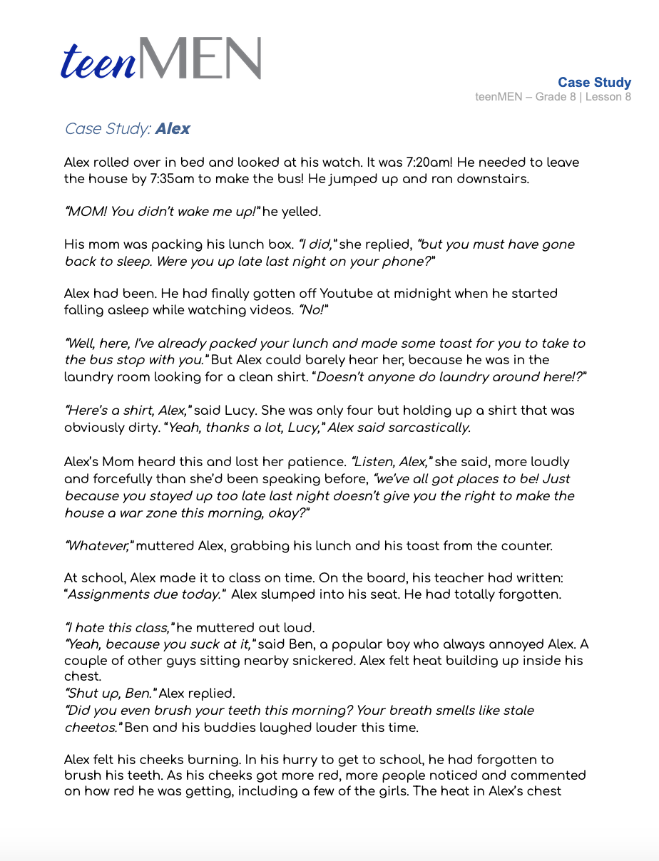
Worksheet
Self-awareness and Stress
Self-awareness and Stress
Case Study: Alex
This mood will pass.
What I can control
is how I respond.
Notes:
Step 5 (10 minutes): Case Study + Conflict Resolution
Let’s read a Case Study to look at how stress can lead to conflict if we don’t manage our stress in a healthy way.
Read the Case Study: Alex with students. Discuss the questions at the end of the text, using the Teacher’s Answer Key provided in the lesson materials.
Alex didn’t take any small steps to manage his stress in a healthy way. This led to conflicts at home and escalating at school. Whether it’s with parents, siblings, teachers or even our friends, it’s a sign of maturity to be able to resolve conflicts positively.

Slide 13
Conflict resolution
Recognize your emotions.
Stick to the facts!
Listen well.
© FEMM
Notes:
1. Recognize your emotions. Try to name how you are feeling: are you sad, angry, disappointed, fearful or anxious? Naming your emotion is a better option than just ignoring it or saying it doesn’t matter. Feel. Think. Act. When you can identify your emotions, you can communicate your needs without threatening or punishing others.
2. Stick to the facts! Don’t bring up old problems that are not relevant to what is going on right now. Remain calm and be respectful when addressing the person with whom you are in conflict. Be specific about what is bothering you or about what you need.
3. Listen well. Ask questions to the other person if you need to clarify what they are saying. Try to use your power of imagination to understand things from their view.

Slide 14
Scripts for: conflicts with peers
You see two guys at school starting to shout and swear at each other, but they haven’t started physically fighting yet.
“Hey, guys, don’t do this right now. Let’s handle this later.
You see a couple of guys at school teasing a classmate, Evan, who doesn’t have as many friends and struggles socially.
Hey, Evan. Can you help me? Mr. X asked me to carry
these boxes to the cafeteria.
“
© FEMM
Notes:
-You see two guys at school starting to shout and swear at each other, but they haven’t started physically fighting yet. Possible script: “Hey guys, don’t do this right now. Let’s handle this later.” Sometimes delaying a conflict is enough for everyone to cool down and talk things through when everyone is feeling less emotional and upset.
- You see a couple of guys at school teasing another guy, Evan, who doesn’t have as many friends and struggles socially. Possible script: “Hey Evan. Can you help me? Mr. X asked me to carry these boxes over to the cafeteria.” This can be a mature way to step up and get Evan out of the situation, without escalating things for Evan or yourself.

Slide 15
Script for: conflict with parents
You find yourself getting in an argument with a parent about the same thing, again.
“ Mom, could I talk to you about how many minutes I’m allowed on screens every day? I feel like we always fight about it.
© FEMM
Notes:
- You find yourself getting into an argument with a parent about the same thing, again.
Possible script: “Mom, could I talk to you about how many minutes I’m allowed on screens every day? I feel like we always fight about it.” You’ll probably be surprised at how impressed a parent will be, if you maturely try to communicate and problem-solve this issue, together.

Slide 16
Review
Our emotions are affected by our hormones.
Stress + conflict are a normal part of life.
We can learn skills to make us better at conflict resolution.
It is the way that we choose to manage stress and deal with conflict that makes us mature individuals.
© FEMM
Notes:
CONCLUSION - Summary of teenMEN & teenFEMM
Stress and conflict is a normal part of life. It is the way that we choose to manage stress and deal with conflict that makes us mature individuals.
The girls in your grade have completed their Grade 8 teenFEMM course as you have been working through this course. Although their changes are different from yours, their hormones are also playing a major role in their body and brain development during puberty. It is important to remember that everyone goes through puberty and just as you may have difficult days, the mature and thoughtful thing to do is recognize that your peers are also learning to navigate physical and emotional changes. With a little bit of focus on making good choices to support your bodies and minds through this process, you will all grow into amazing young leaders in your family, school and community!

Slide 17
Grade 8
SUMMARY
© FEMM

Slide 18
Review
Both boys’ and girls’ hormones play a huge role in development during adolescence.
Remember: everyone goes through puberty!
Focus on making good choices to support your body and mind.
© FEMM
Notes:
CONCLUSION - Summary of teenMEN & teenFEMM
The girls in your grade have completed their grade 8 teenFEMM course as you have been working through this course. Although their changes are different from yours, their hormones are also playing a major role in their body and brain development during puberty. It is important to remember that everyone goes through puberty and just as you may have difficult days, the mature and thoughtful thing to do is recognize that your peers are also learning to navigate physical and emotional changes. With a little bit of focus on making good choices to support your bodies and minds through this process, you will all grow into amazing young leaders in your family, school and community!

Slide 19
Grade 8
LESSON 8
© FEMM

